Slide 1
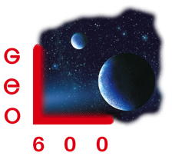
The road to 10 dB
Kate Dooley, Emil Schreiber
GWADW, Girdwood, May 19 2015
LIGO-G1500668

Slide 2
Motivation
ET-0106C-10
also, all LIGO strawman designs assume around 10 dB observed squeezing

Slide 3
The main challenges
1. losses
2. phase noise
S. Dwyer et al., 2013

Slide 4
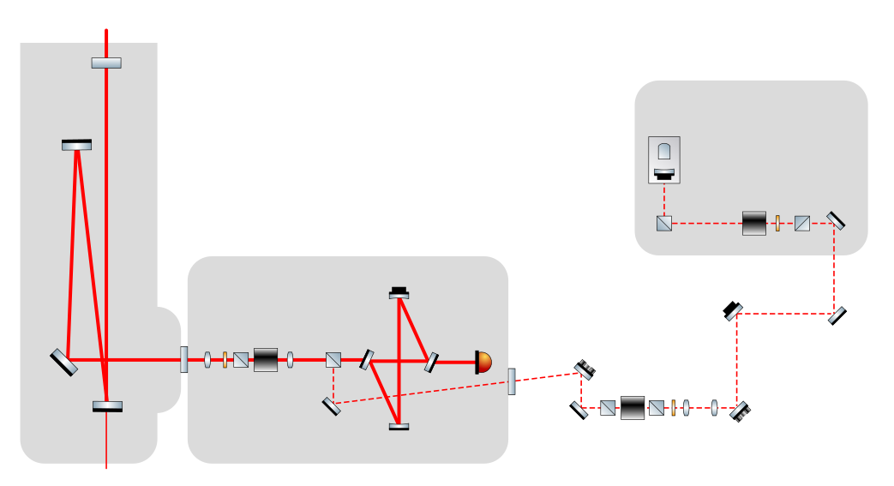
The injection path
from IFO
MSR
OPA
Faraday isolator
OMC
Faraday
isolator
PD
1% tap-off
Faraday
isolator

Slide 5
Loss budget
component | achieved at GEO (at some point) | goal (numbers from Strawman Team Red)
OPA internal loss | 5% | 3%
Faraday isolator (rotator + 2 PBS’) | 4 · 2% | 3 · 0.8%
loss on IFO reflection | 1% (estimated) | 1%
mode matching to OMC | 4% | 1%
OMC internal loss | 2% | 0.5%
PD quantum efficiency | 1% | 0.5%
filter cavity | – | 1%
tap off | 2 · 1% | –
total | 21% (40% observed) | 9%
source:
LIGO-T1200046-v1

Slide 6
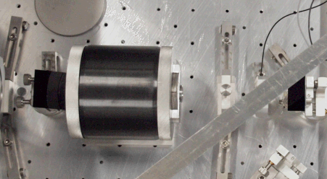
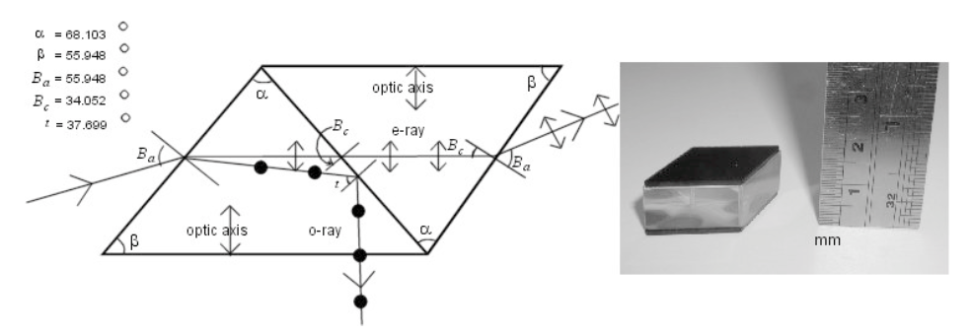
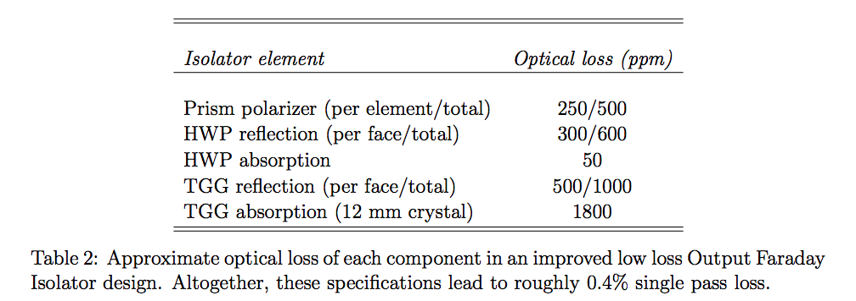
Low loss Faraday isolators
current GEO Faraday rotators have 0.6% single pass loss
PBS cubes show up to 1% loss
Glasgow PBS design: 220 ppm
need redesign if we care for both polarizations
isolator design at the University of Florida based on optimized IFI design: 0.4% loss
K. D. Skeldon et al., 2000
R. Goetz, LIGO-T1500187

Slide 7
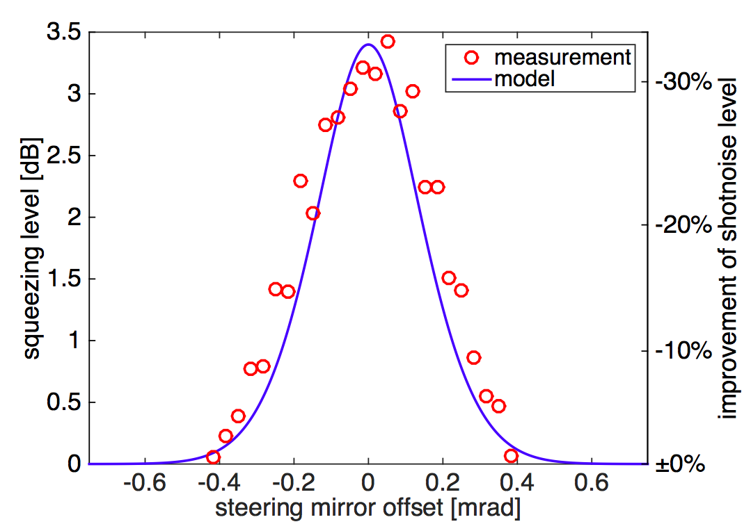
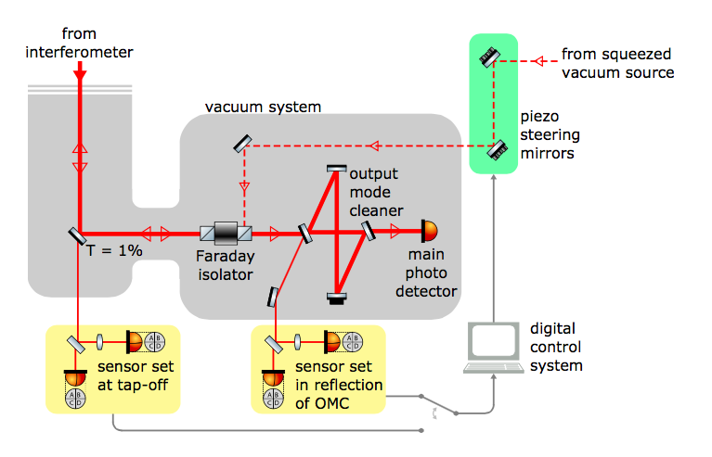
Alignment control
E. Schreiber et al., LIGO-P1500056

Slide 8
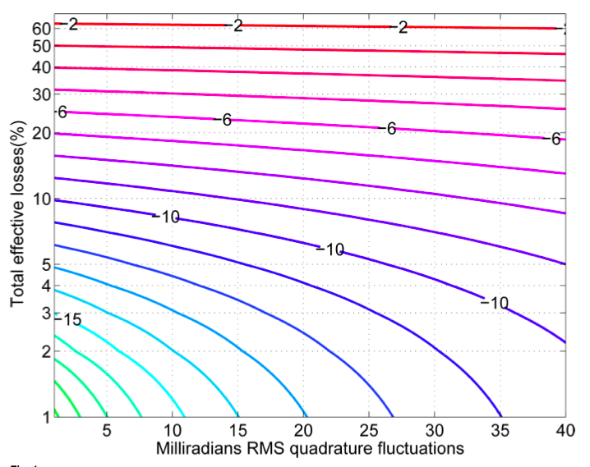
The phase noise roadmap
Dwyer et al. Optics Express, Vol. 21, Issue 16 (2012)

Slide 9
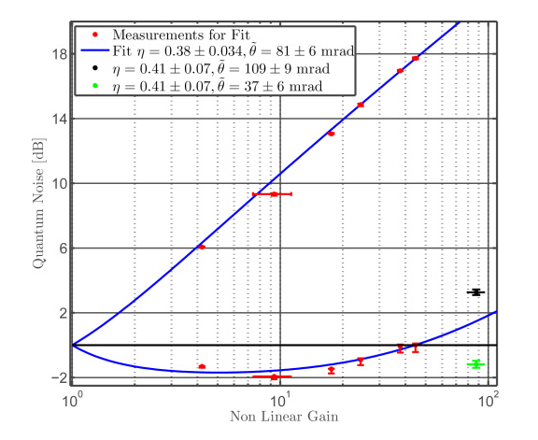
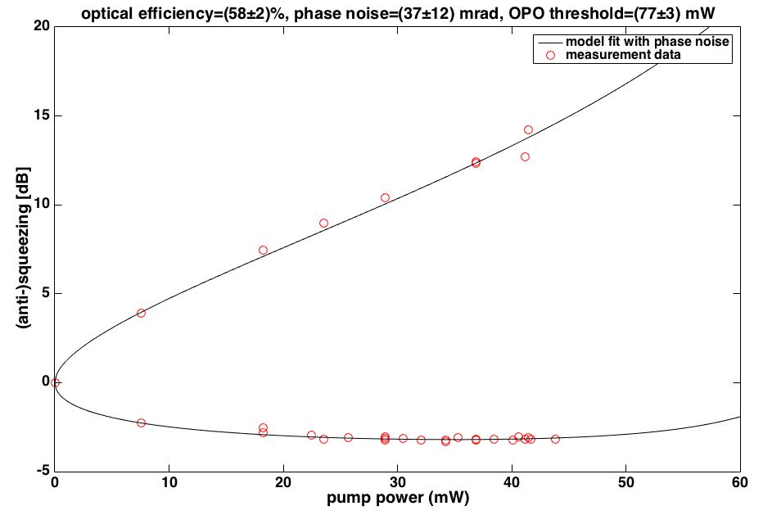
Total phase noise (current detectors)
Out-of-loop measurements of total phase noise
GEO:
LIGO:
Both sites: ~37 mrad rms (!)
Dwyer, PhD thesis (2013)

Slide 10
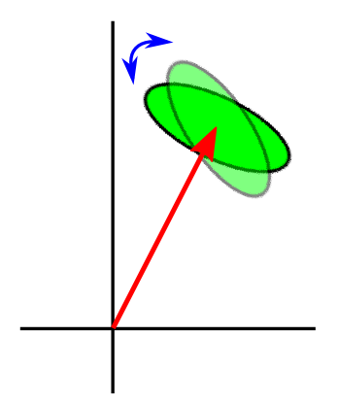
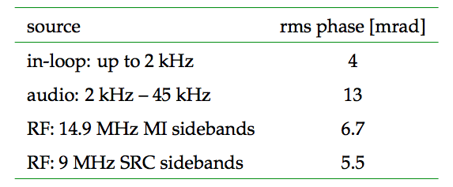
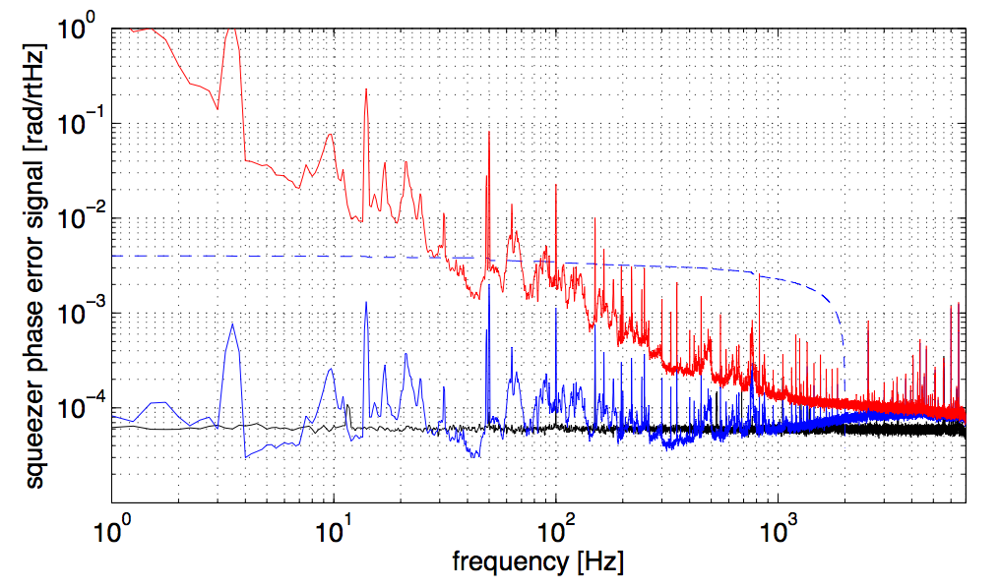
Phase noise budget
Total accounted-for phase noise = 16 mrad rms
(LIGO accounted-for phase noise = ~ 25 mrad rms)
Free-running
In-loop
Both interferometers observe excess phase noise.
Sensor noise

Slide 11
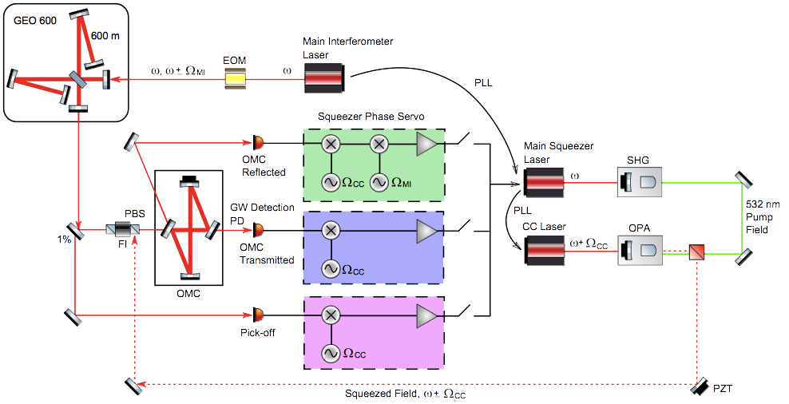
Squeezing phase error signal: 3 choices

Slide 12
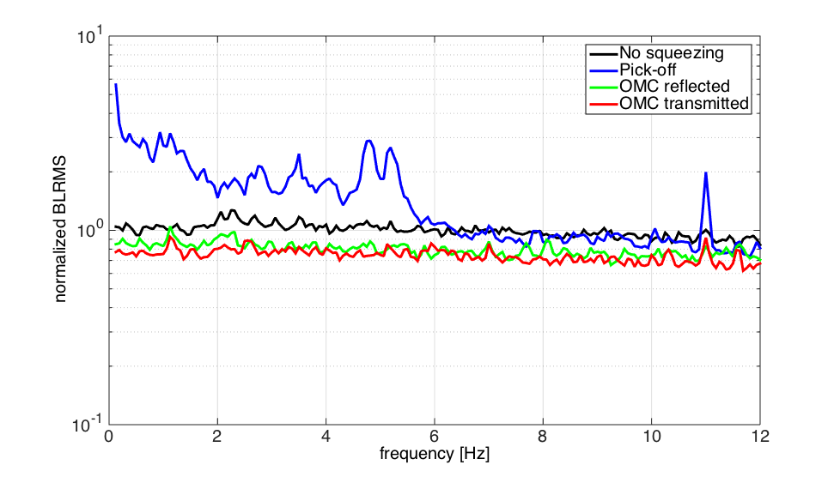
New signals = stable squeezing
Stability of h(t) from 4 kHz – 5 kHz (a shot-noise-limited region)
Squeezing level fluctuates when phase error signal derived from pre-OMC pick- off field

Slide 13
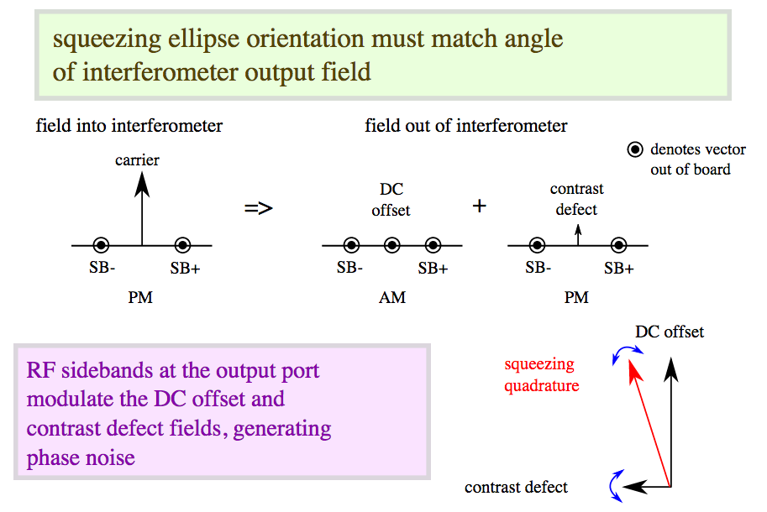
Phase noise from RF sidebands

Slide 14
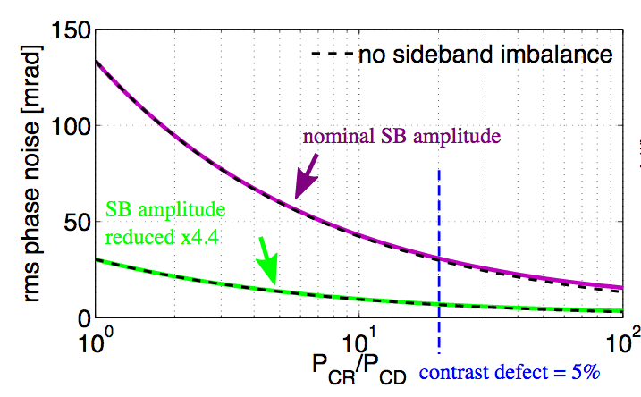
Phase noise from RF sidebands
Example: GEO 14.9 MHz Michelson sidebands

Slide 15
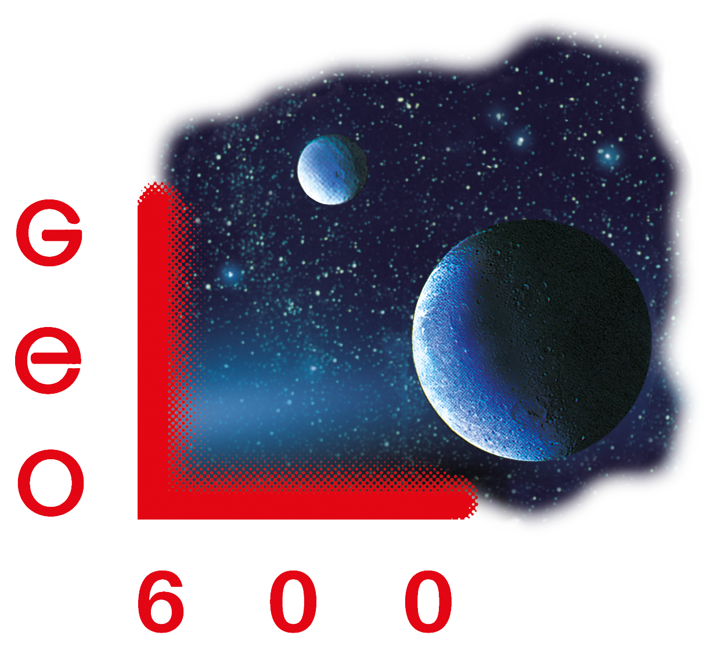
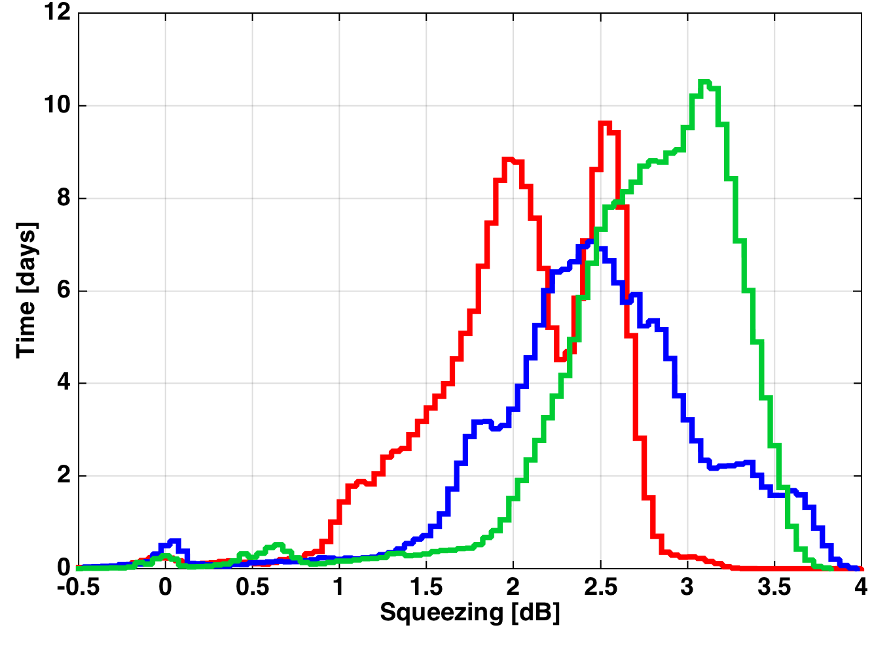
3 years of squeezing
2014
2013
2012

Slide 16
Adapt the interferometer design

Slide 17
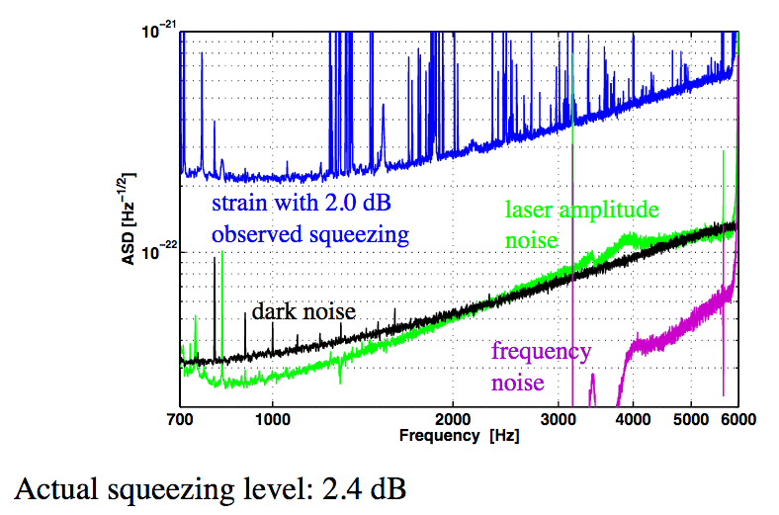
Don’t forget about other noise sources

Slide 18
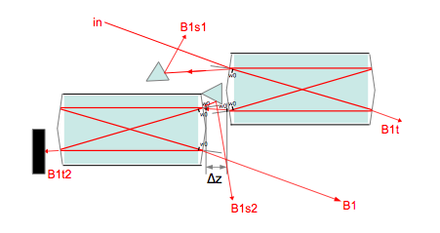
2 OMCs a la Virgo?
Reduce losses and phase noise from RF sidebands
– 2 OMCs in series
-- low finesse → low losses
-- double pole → sufficient filtering of RF sidebands
Virgo has already demonstrated 96% transmission through both OMCs
Advanced Virgo TDR
VIR–0128A–12

Slide 19
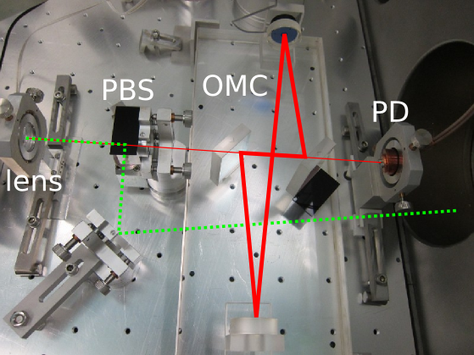
Summary and open questions
For 10 dB of squeezing:
– Phase noise must be reduced from ~35 mrad to ~10 mrad
– Optical losses must be reduced from ~40% to ~8%

Slide 20
Summary and open questions
For 10 dB of squeezing:
– Phase noise must be reduced from ~35 mrad to ~10 mrad
– Optical losses must be reduced from ~40% to ~8%
In what other ways can we adapt the interferometer to be compatible with 10 dB squeezing?
2 OMCs?
can we minimize pick-offs for other control beams?
can we make use of OMC reflection for ifo alignment?
?

