Slide 1
Post-facto Noise Subtraction Pipeline, Bilinear Coupling
Keita KAWABE, LHO

Slide 2
Disclaimer
This is about noise subtraction (FF)
but nothing modern , nothing new, no controls topic per se, not about serious problems we face now
(but they’re going to be more interesting once we start producing science data)

Slide 3
Topics
Post-facto noise subtraction pipeline originally developed for S6.
Possibility of subtracting bi-linear (and potentially tri-and higher order) coupling.

Slide 4
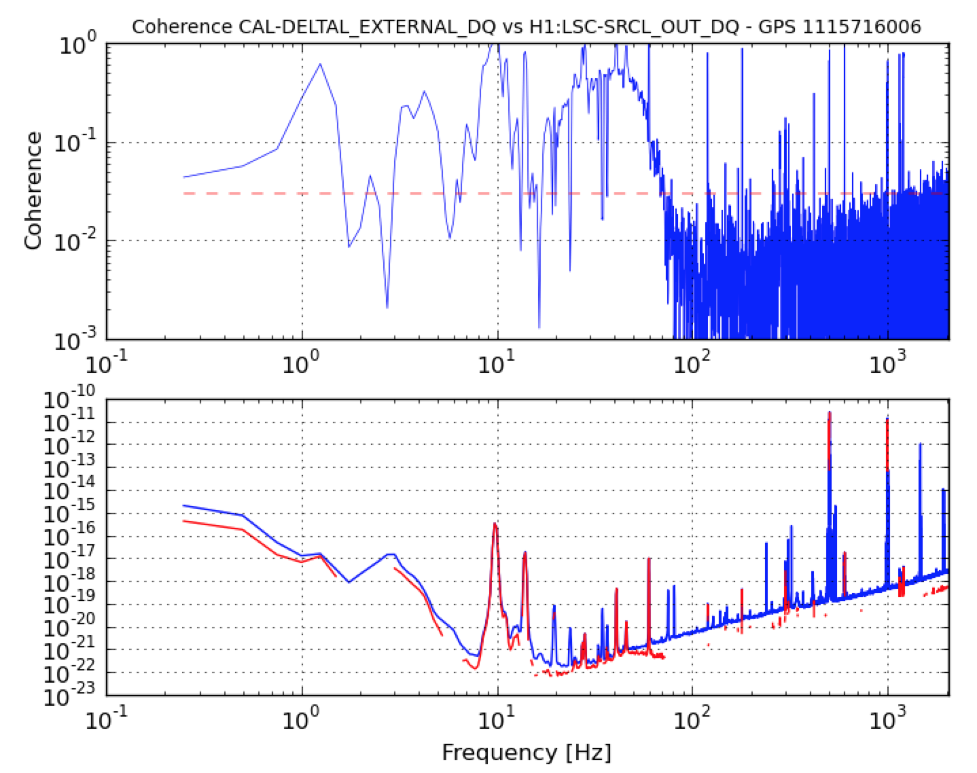
Noise that could couple linearly
Auxiliary control
(MICH , PRCL, SRCL)
Ground motion
PSL/IMC (ISS, FSS)
There could be many more.

Slide 5
Attacking a known linear noise coupling
Reduce the noise if you can,
And/or reduce the coupling if you can,
And then feed forward in real time to subtract the residual and life should be good.
(In LIGO, FF paths can be and are built into the control system, e.g. MICH, SRCL, PRCL, tilt meter)

Slide 6
But what if…
your FF is not as awesome as it should be?
Your TF might not be good at sub-% level.

Slide 7
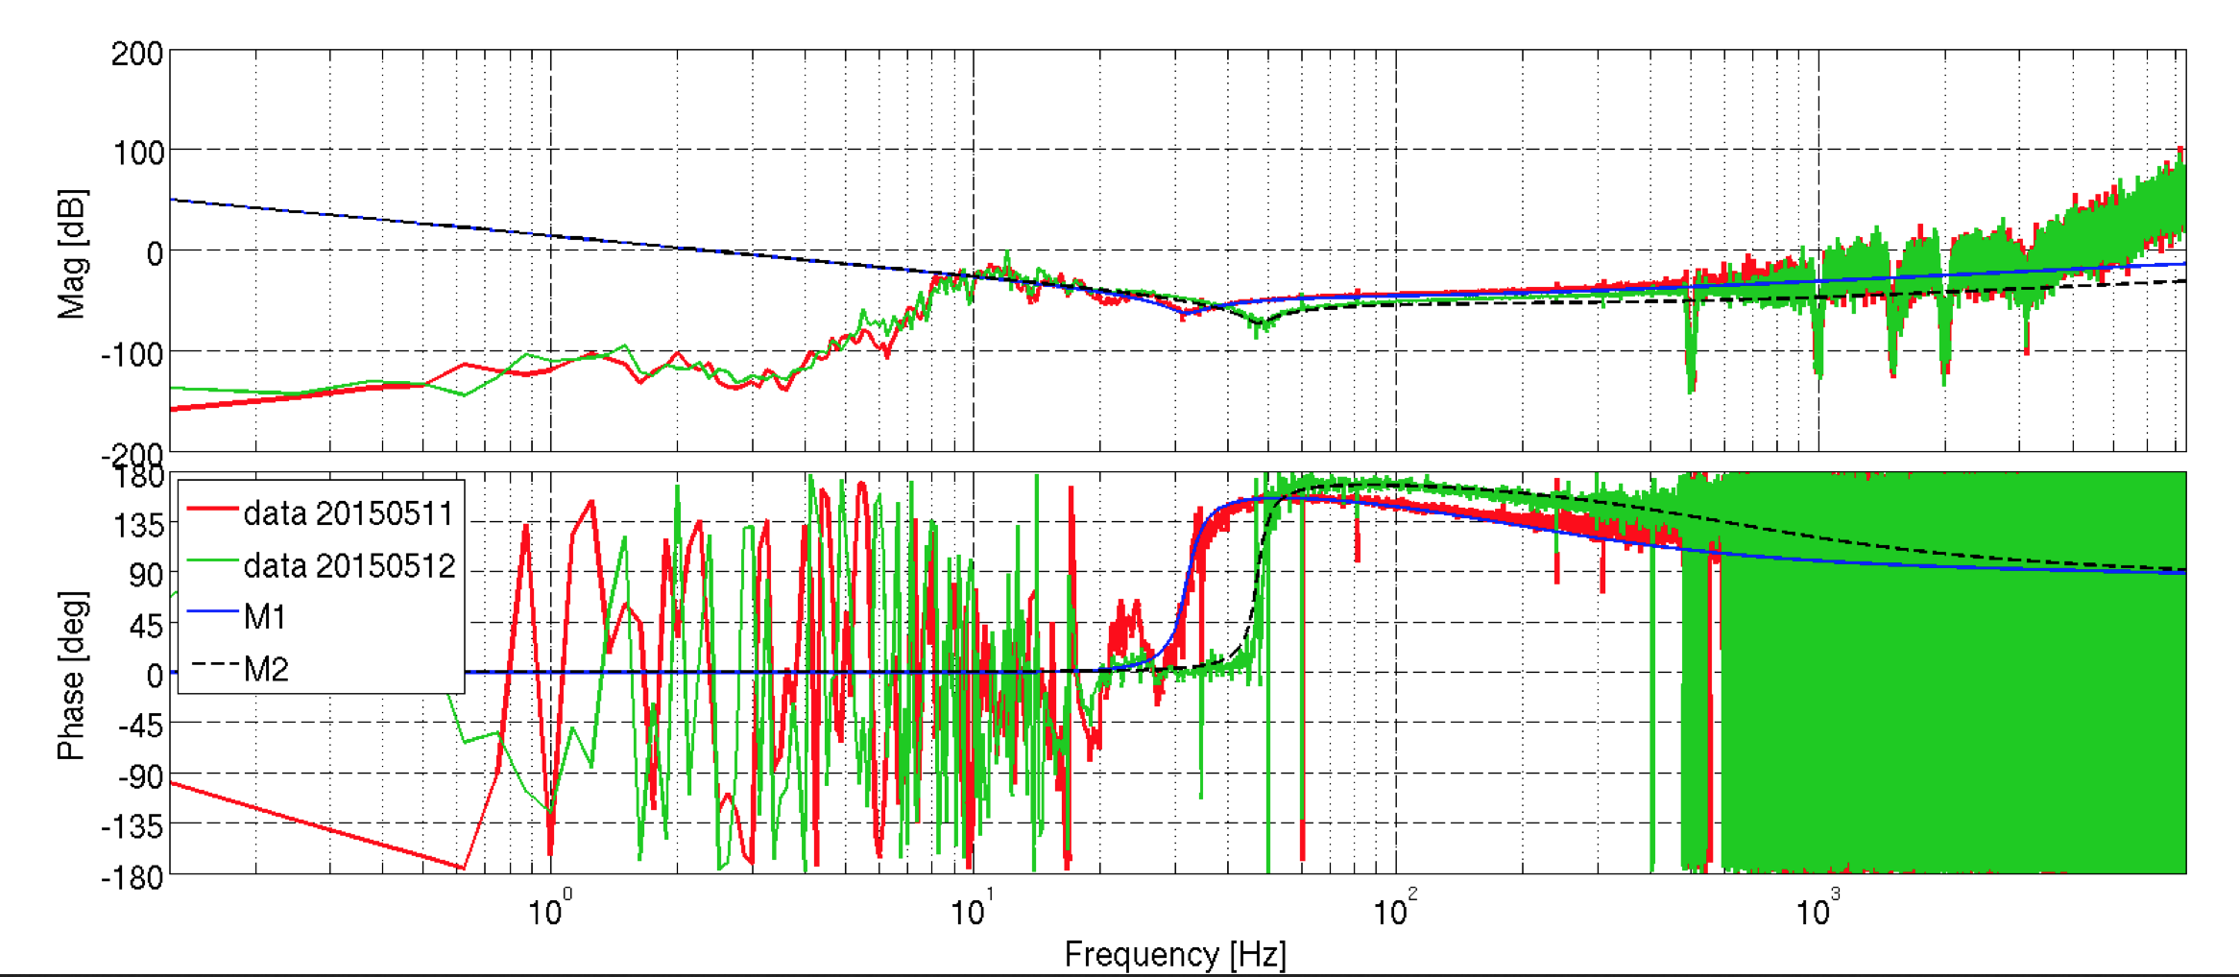
But what if…
the coupling changes over time for some reason?
Alignment drift,
Thermal drift,
Charge accumulation/loss affecting ESD strength
Etc.

Slide 8
But what if…
the noise or the coupling becomes momentarily larger and pollutes your science data?
you find a new coupling after the science data is taken?

Slide 9
It’s OK
You can still retroactively subtract these guys as far as the data is on the disk.

Slide 10
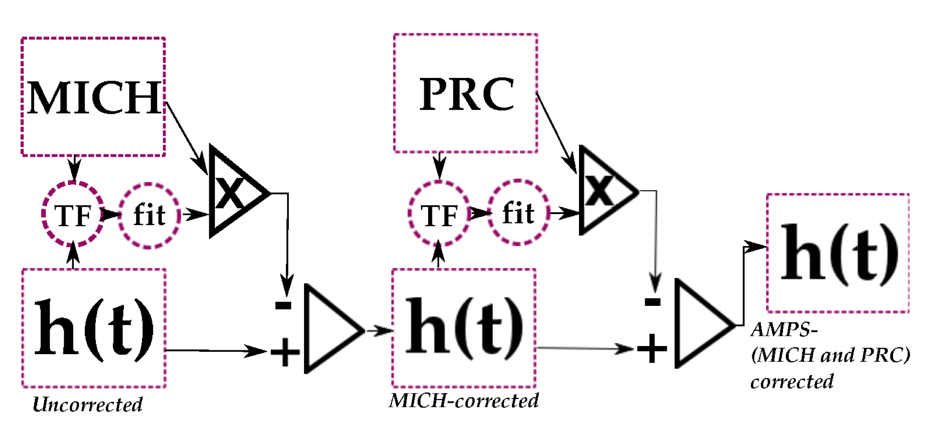
Example: Grant Meadors’ AMPS pipeline
eLIGO S6 off-line subtraction of MICH and PRCL
Adaptive t-domain filter automatically updated
This is not only about S6 nor MICH/PRCL! Could be adapted to other noise/IFO

Slide 11
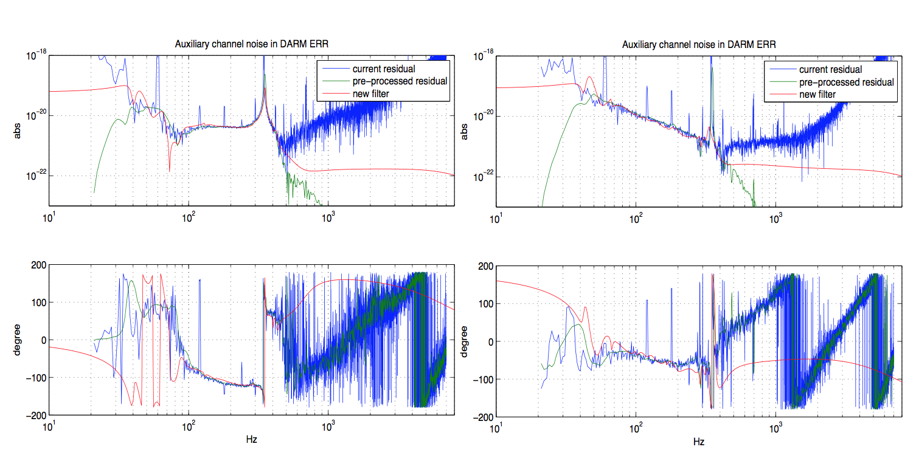
High quality noise TF
Uses long science data to generate noise TF (as opposed to short injection TF)

Slide 12
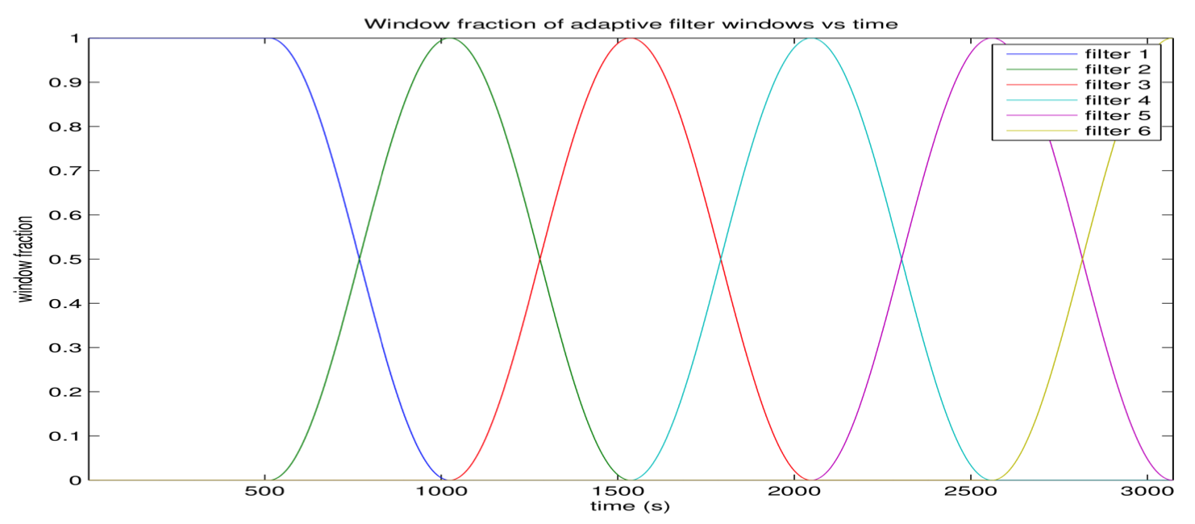
Adaptive filter generation
Hands-free (according to Grant)
Filters automatically updated and smoothly ramped/merged.

Slide 13
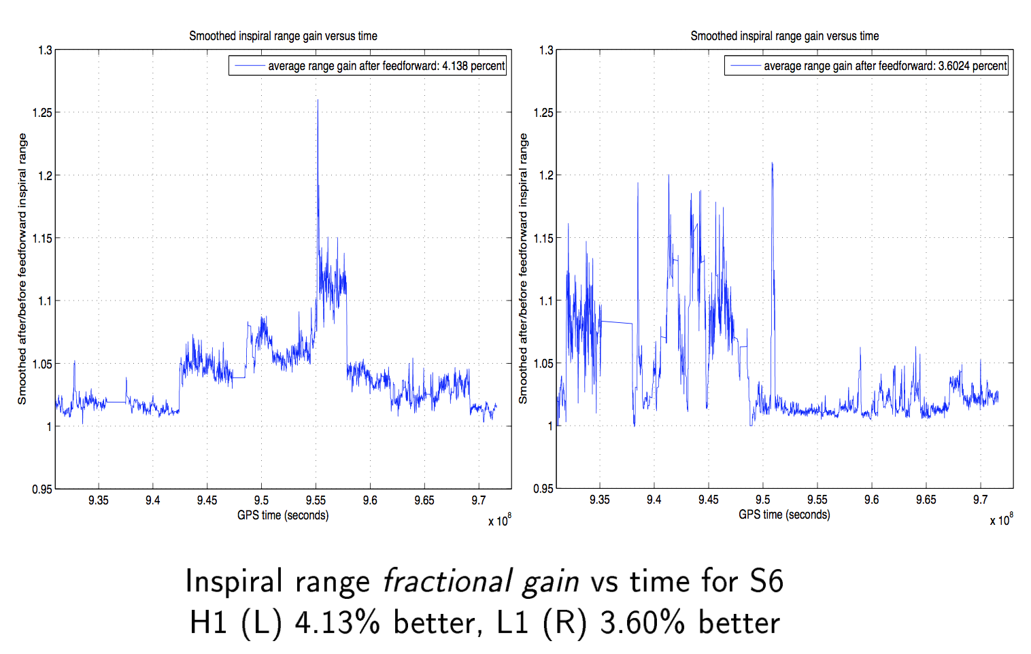
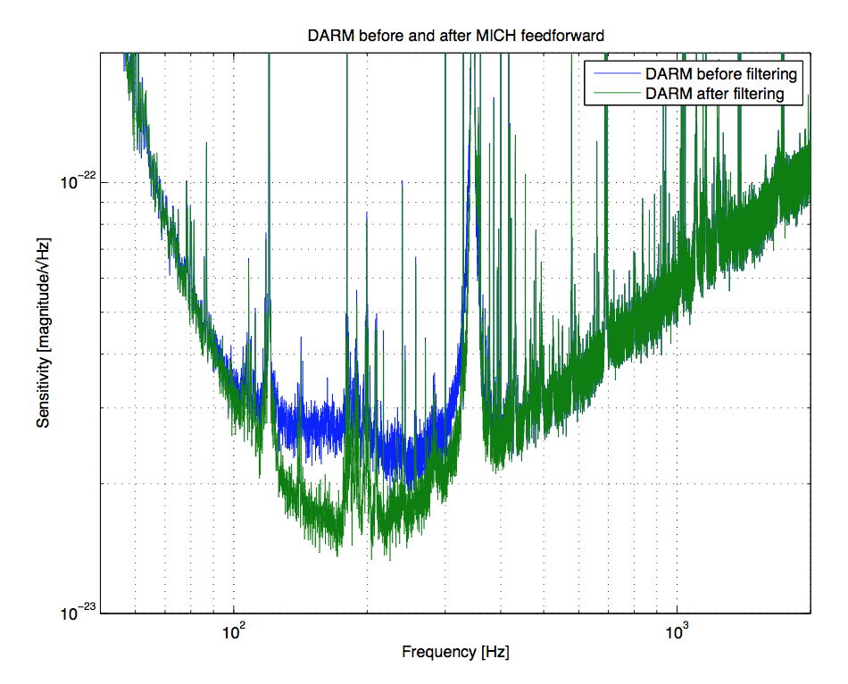
Entire S6 results: Very good

Slide 14
The code is there, mostly ready yet unused.
Resurrect. Use. (There might be some bureaucracy regarding calibration and data analyses but it’s worth it.)
Adapt to some other noise sources. Use.

Slide 15
Bilinear coupling
Noise = x(t) * y(t), e.g. A2L
Many, many examples of these in IFO noise.
(and of course there should be trilinear(??) and higher order coupling like x*y*z etc.)

Slide 16
Ex) Low frequency noise upconverted by a line
Around various lines (angle dither, length dither, mirror resonances, sus resonances etc.)

Slide 17
example

Slide 18
(example of self-inflicted damage which was already fixed: OMC dither and LF OMCL)

Slide 19
Is bilinear (and higher order) coupling a major problem as of now for aLIGO?
No, there are more serious offenders than these at the moment (e.g. scattering)
Maybe yes, if e.g. high frequency srcl coupling is x*y^2 type
Are these worth tackling?
Immediately: Depends (see above)
For improving science data quality: Yes

Slide 20
Tackle how?
Look at easier ones first, i.e. line*LF
Simple convolution should (and does) allow you to see coherence between DARM and line*LF.

Slide 21
eLIGO Example: coh[DARM(60Hz peak)*ASC(XHz), DARM(60+-XHz)]

Slide 22
Bilinear coupling Non-conclusion
We can measure the coherence of bi-linear coupling noise and DARM.
Coherence = the noise could be subtracted
Off-line or in real time
I’ll see (in the future) if I can make a reasonable subtraction of easy targets around aLIGO lines.

