Slide 1
GWADW
Controls Sessions
we make it look easy, but …

Slide 2
Opening Comments
Controls are fundamentally different from the other session topics
Difficult to discuss controls for a system/interferometer which has not been designed (barely conceptualized)
While control considerations are integral to system design trade-offs, these considerations are generally simple & fundamental (observability/controllability, sensor/actuator locations, bandwidth, …)
We assume (correctly, I think) that “if you build it, they will control it”
control system design must be integral in the detailed design phase
Our control synthesis has been (generally) based on classical control theory
Can we benefit from “Modern” controls?
Can we benefit from the recent AI successes (e.g. deep learning)?

Slide 3
Controls Sessions
A | Tue | 9:00-10:30 | System identification and modern Control
B | Tue | 11:00 – 12:30 | Optimal feedback
C | Tue | 4:00 – 6:00 | Noise feedforward and subtraction
D | Wed | 9:00 – 10:30 | Lock acquisition problems and improvements
E | Wed | 4:00 – 5:30 | Interferometer stability (Keeping the IFO Lock)
F | Wed | 6:00 – 7:00 | Next Generation Control System Architecture
Hopefully not too much scope
Other topics, and sub-topics, are possible, depending upon the interests of workshop participants (e.g. robust controls, fault-tolerant controls, ....). Participants can help us shape the direction of the workshop

Slide 4
Session A: System Identification
Data and models for the controller design
Transfer functions for SISO controller
Matrices of transfer function for MIMO calculations
Matrices of transfer functions for Diagonalization
State Space model for optimal control (fitting, phase loss, right half plan zeros, high order model…)
Problems
Can be time consuming
Tune parameters (Amplitude, frequency band, averages…)
Usually not optimized (Schroeder…)
- SNR, Dynamic range, Saturations… multiple sensors
Accuracy, coherence (fitting, model reduction, phase loss, right half plan zeros…)
Goals:
Compare techniques
Exchange tools and ideas
Define goals (state of the art, explore new tools…)
Could help upgrades, next generations (early stages of testing and commissioning)

Slide 5
A | Tues | 9:00 | 10:30 | 1:30 | System identification and modern Control | Coordinating/Leading discussion | Brett Shapiro
 |  | 9:00 | 9:15 | 0:15 |  | Overview of System ID techniques & setting the session goals | Dennis
 |  | 9:15 | 9:35 | 0:20 |  | System ID for Suspensions & Seismic Isolation Systems | Brett Shapiro
 |  | 9:35 | 9:55 | 0:20 |  | System ID at VIRGO | Bas Swinkels
 |  | 9:55 | 10:15 | 0:20 |  | Cross couplings in suspensions and seismic platforms | Anamaria Effler
 |  | 10:15 | 10:30 | 0:15 |  | Sys ID for Modern Control | Brett, Jo, Giancarlo, Manuel

Slide 6
Session B: Optimal Control
SISO filtering versus Optimal Control
We have a very good knowledge of our systems,
Designed to be diagonal
Extremely well instrumented, all dofs, states measured
SISO is easy to debug (phase margin, gain margin…)
Pole placement, high order controller
(i) Optimal controllers (ii) Observers, SNR (iii) Modal control
LQR: Cost function, weight…
Kalman filter
Goals:
Already investigated, good outcome, still not used, why
Prospects, application
Working groups, collaboration
Partial step done…

Slide 7
B | Tues | 11:00 | 12:30 | 1:30 | Optimal feedback | Coordinating/Leading discussion | Dennis/Fabrice
 |  | 11:00 | 11:20 | 0:20 |  | Introduction talk (review of modern control tools, state space methods, their pros and cons) | Den Martynov
 |  | 11:20 | 11:40 | 0:20 |  | Discussion and comparison of classical and modern control techniques | Christophe Collette
 |  | 11:40 | 11:55 | 0:15 |  | Summary of the Caltech Workshop | Gabriele
 |  | 11:55 | 12:15 | 0:20 |  | Kalman filtering for vibration isolation | Jo van den Brand
 |  | 12:15 | 12:30 | 0:15 |  | Suspension Controls, including thoughts on applicability of modern controls | Brett Shapiro

Slide 8
Session C: Feedforward and noise subtraction
Already made the step…
The standard way (rely on intuition, identify the sensor path, identify the correction path, implement)
The optimal way (array of sensors, linear regression, least square minimization, Wiener…)
Results already obtained
Goals:
Where do we stand (Past results, current work)
Prospects, applications
Instrumentalist and DetChar
Automating
Adaptive

Slide 9
C | Tues | 4:00 | 6:00 | 2:00 | Noise feedforward and subtraction | Coordinating/Leading discussion | Gabriele Vajente
 |  | 4:00 | 4:10 | 0:10 |  | Introduction and setting the stage | Gabriele Vajente
 |  | 4:55 | 5:15 | 0:20 |  | Sensor correction in seismic and suspensions | Fabrice
 |  | 4:10 | 4:35 | 0:25 |  | Feed forward of auxilairy degrees of freedom | Bas Swinkels
 |  | 5:15 | 5:30 | 0:15 |  | Online subtraction pipeline, and bilinear noise coupling | Keita Kawabe
 |  | 4:35 | 4:55 | 0:20 |  | Feedforward at LLO and 40m, adaptive feed forward | Denis Martynov
 |  | 5:30 | 6:00 | 0:30 |  | Data mining tools: hot to find channels that can be used for subtraction; how to tackle non stationary noises and couplings? | Gabriele Vajente

Slide 10
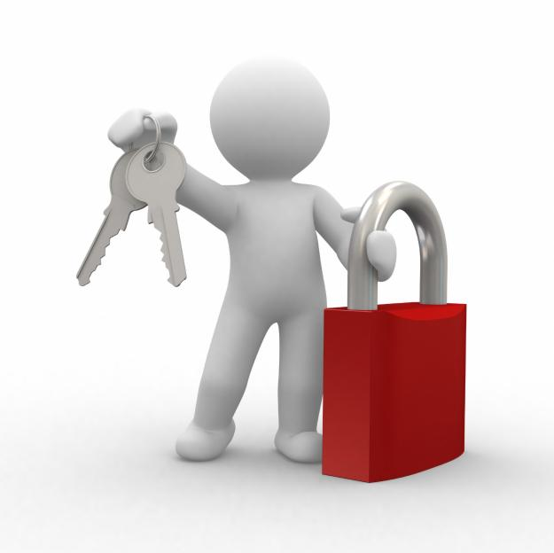
D: Lock Acquisition Problems & Improvements: description
Significant time is expended in the initial stages of commissioning to discover an approach for (robust) lock acquisition
Perhaps one of the biggest payoffs for control systems is in improving the nonlinear lock acquisition strategies
Can learning methods be used to speed up our discovery of faster or more robust lock acquisition strategies?
Can simulation, or emulation with sub-scale optical plants, be used to provide sufficient fidelity and examples for learning strategies?

Slide 11
D: Lock Acquisition Problems & Improvements: program – Wed 9:00a – 10:30a
Session to be led/coordinated by Keita Kawabe
Acquisition overview/problems & discussions
LHO (Sheila Dwyer) LLO (TBD)
VIRGO (TBD) GEO (TBD)
KAGRA (TBD) 40m Lab (TBD)
Group discussion on common themes
“Mode hoping in low finesse cavities” (Paul Faulda)
one potential lock acquisition problem
“Bayesian approach to the locking problem for high finesse suspended optical cavities” (Manuel Marchiò and Giancarlo Cella)
“Noise modeling for interferometer control” (Chris Wipf)
focused on how noise budget modeling can be useful for locking and lock loss studies

Slide 12
D: Lock Acquisition Problems & Improvements: goals/questions
From each interferometer, gather a compendium of
lock acquisition problems
Locking metrics & statistics
Discuss approaches to address each lock acquisition problem and their relative merits and success to date
Are the pre-lock auxiliary systems (OptLev, ALS, TCS, …) adequate, or are improvements necessary?
Shouldn’t future interferometers be designed to observe and control all DOF (bounce, roll, violin modes)?
Would we benefit from embedding independent sensing/actuation into the interferometers for routine diagnostic measurements & characterization?
Which lock acquisition problems can & should be pursued on small scale research interferometers?

Slide 13
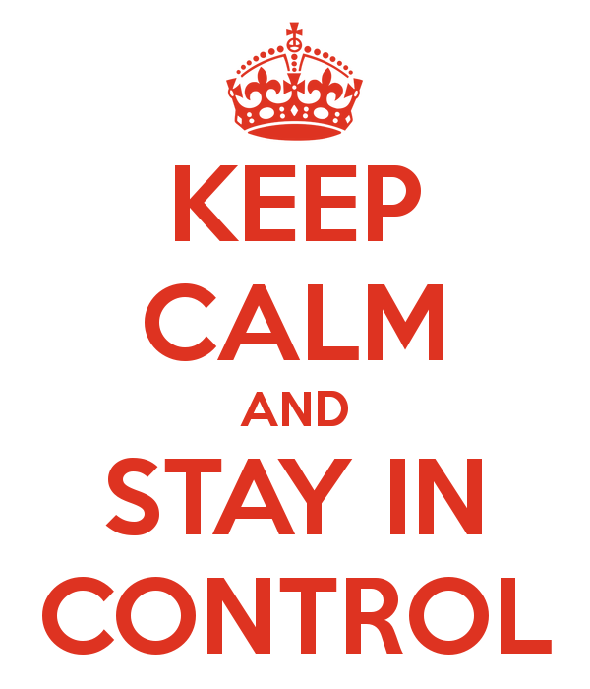
E: Interferometer stability (maintaining lock) description
Much of an interferometer’s down-time may be a result of cavity lock loss and subsequent lock re-acquisition
Methods to prevent lock loss (whether due to environmental disturbance or machine 'glitches') could be very beneficial
Potential causes: wind, earthquake, thermal stability, parametric instability, ...

Slide 14
E: Interferometer stability (maintaining lock) program – Wed 4:00p – 5:30p
Session to be led/coordinated by Sheila Dwyer
Overview of lock loss events/causes (Geo/Virgo/LHO/LLO) Bas Swinkles, Anamaria Effler, Keita Kawabe, Hartmut or Kate ?)
Mitigation of disturbances caused by wind on the detectors (Krishna)
TCS controls approaches to prevent lock loss, or mitigate the effects of lock loss (Alastair Heptonstall)
LIGO/Virgo earthquake studies and controls configuration (Sebastien Biscans, in collaboration with Michael Coughlin and Paolo Ruggi)

Slide 15
E: Interferometer stability (maintaining lock) goals/questions
Gather a compendium of lock loss event causes
Do we have detchar infrastructure for automatic detection, logging, and calculation of statistical metrics?
Discuss approaches to address each lock loss cause and their relative merits and success to date
Are the lock loss prevention auxiliary systems adequate, or are improvements necessary?
Would we benefit from embedding independent sensing/actuation into the interferometers for environment sensing?
Which lock loss problems can & should be pursued on small scale research interferometers?

Slide 16
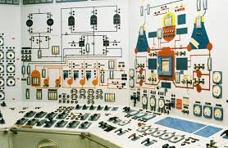
F: Next Generation Control System *Architecture description
Explore the requirements and features of a next-generation, control system architecture
supervisory controls,
slow controls
fast, real-time controls
We need participation from real-time control system experts and commissioners
*by architecture we mean “everything”: hardware, software, interfaces, comm. protocols, DB mgmnt …

Slide 17
F: Next Generation Control System Architecture program – Wed 6:00p – 7:00p
Session to be led/coordinated by Jamie Rollins
Requirements and features of a next generation control system (Jamie Rollins)
With hoped-for participation by many control system users
Pros & Cons of Current Gravitational Observatory Control Systems (Rolf Bork)
With hoped-for participation by many control system users

Slide 18
F: Next Generation Control System Architecture goals/questions
Requirements and desired features of next generation control systems
In what ways can we the GW community better collaborate/share and (possibly) migrate to a common platform, or at least common elements?
What systems and technologies are emerging which show promise for future detectors?
Develop a plan to explore the applicability of industrial control systems and the experience of other physics projects with modern and next-generation control systems

Slide 19
Final Comments
How can we as a community share and sustain a growing expertise in the application of advanced/modern controls to GW interferometer systems?
We lost the momentum from the 2014 winter workshop on advanced controls at CIT
LVC working group on controls techniques?
Bi-yearly (virtual) meetings?

