Slide 1
Sensing and control problems in low finesse cavities, or “how (not) to hop” Paul Fulda University of Florida 05.20.2015 GWADW 2015 Alaska
This doc: LIGO-G1500645, see also note LIGO-T1500230

Slide 2
Outline
ALS control of aLIGO ARM cavities.
Low finesse – Alignment sensitivity.
Control of SRCL in aLIGO Dual Recycled Michelson.
Mode hopping in H1 DRMI.
Alignment dependence.
Mode matching / Gouy phase dependence.
Cross couplings.
Why no hopping in L1 DRMI?
Beyond the second zero crossing.
How does mode hopping occur?
How can it be mitigated?

Slide 3
ALS control of aLIGO ARMs
Transmissivity of ETM for green light was much higher than expected: ~37% compared to requested <4% (LHO aLOG 9520).
Length control was difficult at first, operation seemed very alignment dependent.
Mode hopping was observed: cavity was seen to resonate alternatively HG₀₀ mode or HG_{10/01} modes (e.g. LHO aLOG 9653).

Slide 4
ALS mode hopping simulation
Very simple setup: look at PDH signal in reflection.
Tilt ITM (or ETM, or soft or hard) and observe changes in error signal.

Slide 5
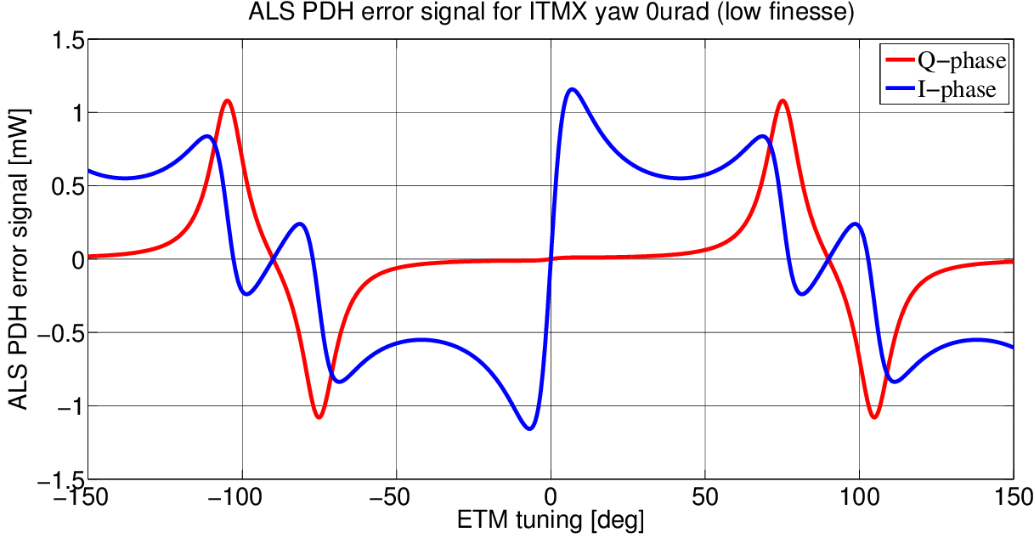
ALS PDH error signal
With measured ETM transmission 37% (Finesse ~17)

Slide 6
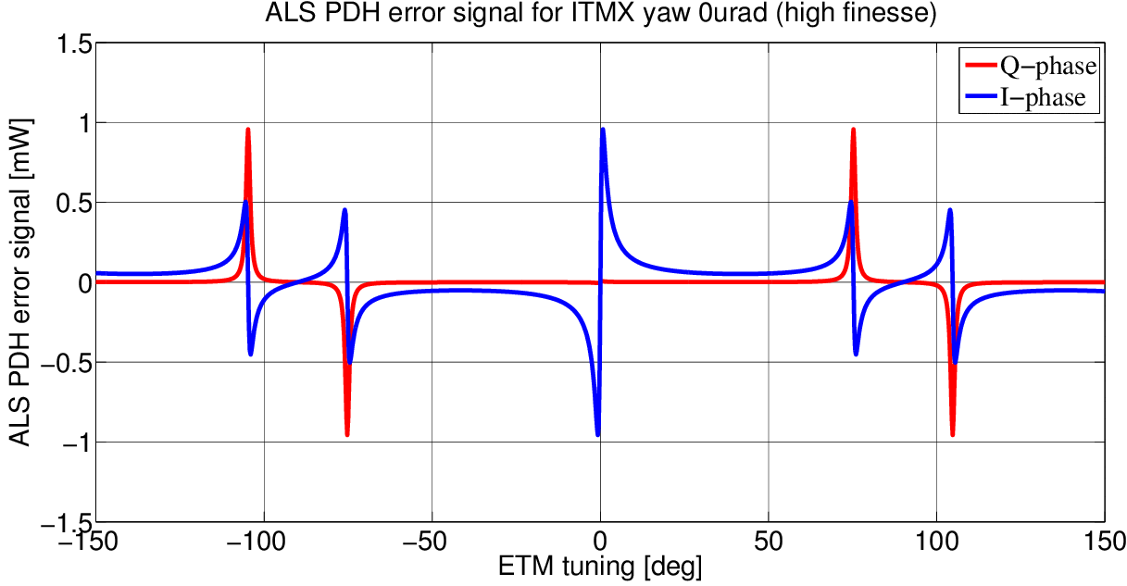
ALS PDH error signal
With nominal ETM transmission 4% (Finesse ~125)

Slide 7
ALS PDH error signal
HG_{10/01} mode resonances “blend” into the HG₀₀ mode resonance, distorting error signal.
Multiple zero crossings, plus some RMS length/frequency noise can lead to hops.
At large enough misalignment, only the HG_{10/01} zero crossing exists.
Higher finesse case looks less likely to hop.
Second zero crossing more isolated.
Higher sensing gain, better length/freq RMS(?)
Wavefront sensors for the ALS beam were the solution, stabilizing the alignment of the green cavity.

Slide 8
SRCL control in DRMI
Mode hopping observed during H1 DRMI commissioning (LHO aLOG 14002).
Also recognised alignment dependence of hoppiness (e.g. LHO aLOG 14027).
More complicated situation than ALS:
3 length degrees of freedom: PRCL, MICH, SRCL
Cross coupling from PRCL to SRCL
Low finesse SRC with Michelson as input mirror
Misaligned Michelson converts HG₀₀ to HG_{10/01}

Slide 9
Simulation of H1 DRMI
DRMI with 9MHz and 45MHz sidebands resonant in PRC (carrier anti-resonant), 45MHz sidebands resonant in SRC.
Known PRCL-> SRCL coupling evident.

Slide 10
Observed mode hopping in H1 DRMI: alignment dependence
Alignment dependence of SRCL error signal – similar story to ALS ARMs: HG₁₀ mode distorts HG₀₀ error signal

Slide 11
Comparison with required misalignment for hopping
Compared tilt required to make second zero crossing in simulation with measurements for core optics.
Divergence angle of beam at BS in DRMI ~ 40µrad
Good agreement for BS and ITMX.
[LHO aLOG 15362]

Slide 12
So why does H1 DRMI hop but L1 doesn’t?
H1 starts mode hopping for BS yaw 2µrad
L1 DRMI unlocks already with BS yaw 2µrad!
Other things that can affect sensitivity of SRCL error signals to alignment:
Mode matching.
Common (SRC Gouy phase).
Differential (contrast defect).
Schnupp asymmetry.
What else?
RMS length noise.
Cross coupling PRCL to SRCL.
SRC length.

Slide 13
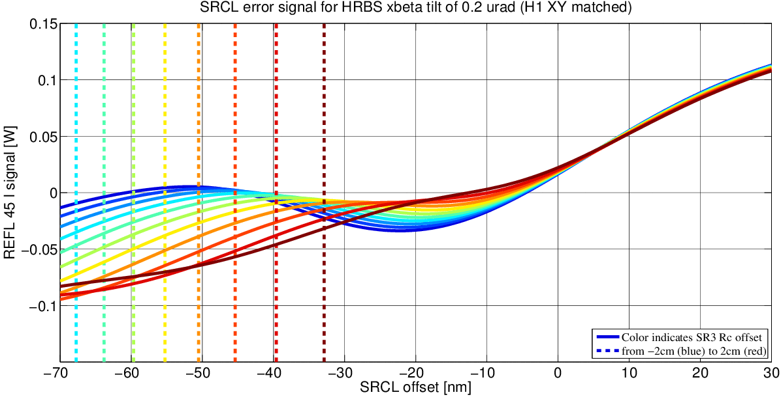
Effect of common mode mismatch (SRC Gouy phase)
Look at SRCL error signal with BS tilt for a range of SR3 RoC values.
SRC Gouy phase is strongly dependent on SR3 RoC relative to SR2-SR3 separation. Relatively large uncertainties on these values.

Slide 14
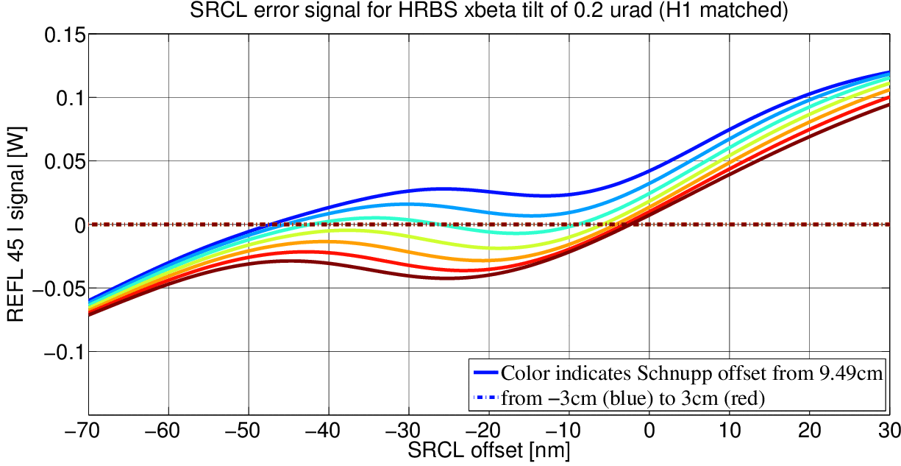
Effect of Schnupp asymmetry length
Look at SRCL error signal with BS tilt for a range of Schnupp offsets from 9.49cm
Schnupp asym. determines Michelson reflectivity for 45MHz sidebands.
Measured values at H1 and L1 only differ by <1cm though.

Slide 15
L1 DRMI lock loss
Why is lock lost when tilt BS by > 0.2µrad?
Error signal gain could go very small:
Might not cause hopping, but could cause lock loss.
L1 SRC Gouy phase smaller than H1 SRC Gouy phase?

Slide 16
Beyond the second zero crossing
Can we define some “hoppiness parameter”…IBU?
Height of the hill between zero crossings.
Longitudinal separation of zero crossings.
Required misalignment.
PRCL to SRCL coupling
If not well cancelled with feedforward, PRCL motion creates offset on SRCL error signal.
Are two concurrent zero crossings even required for hopping?
Probably not if there is some large alignment fluctuation.

Slide 17
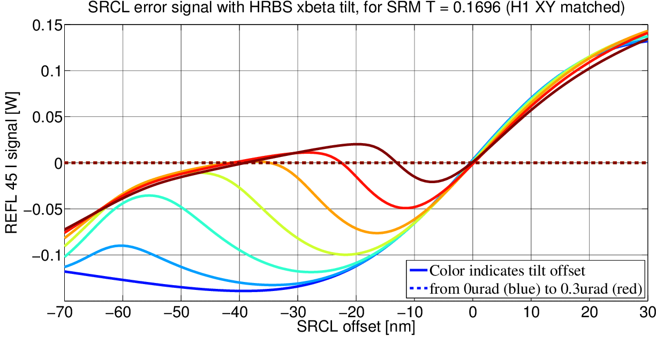
Mitigating mode hopping
Improve alignment control (easy to say…)
Increase cavity finesse (ALS / SRM reflectivity, Schnupp).
Increase HOM separation (Gouy phase).
Caveat: not changing Schnupp asymmetry with T_{SRM}

Slide 18
Summary
Mode hopping in both low finesse cavities at H1.
Both alignment related: HG_{10/01} resonance distorts the HG₀₀ error signal.
Other factors also impact hopping behaviour:
Cavity Gouy phase (separation of HOMs)
Schnupp asymmetry (cavity finesse/coupling)
H1 and L1 DRMI hopping disparity
Possibly due to different SRC Gouy phase.
Would be nice to check if we can measure!
Can be mitigated by:
Suppressing HOM injection (mismatch, alignment).
Adding an error signal offset (only a temporary solution).
Increasing cavity finesse, or HOM separation.

Slide 19
Acknowledgments
Thanks to the following for their collaboration and help on this:
Lisa Barsotti
Andreas Freise
Daniel Brown
Sheila Dwyer
Yuta Michimura
Kiwamu Izumi

Slide 20
Extra slides…

Slide 21
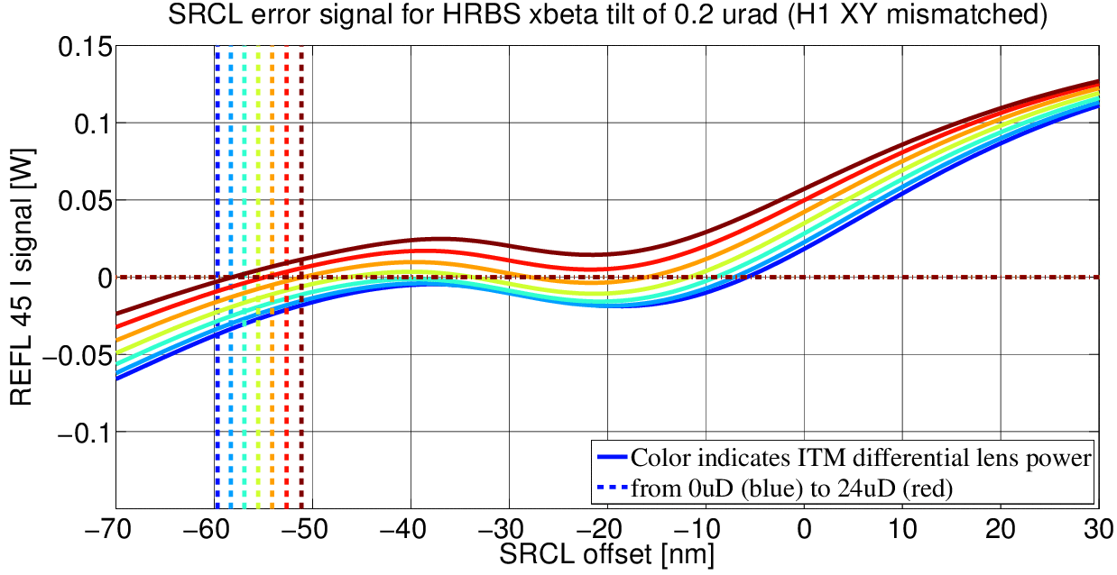
Effect of differential mode mismatch (contrast defect)
Look at SRCL error signal with BS tilt for a range of differential ITM lens values.
+
-
Unlikely to explain difference in H1 and L1, because CO₂ laser used to minimize CD in both.

Slide 22
Schnupp asymmetry length
Affects reflectivity of Michelson for 45MHz sidebands.

