Slide 1
System Identification for LIGO Seismic Isolation
Brett Shapiro
GWADW – 19 May 2015

Slide 2


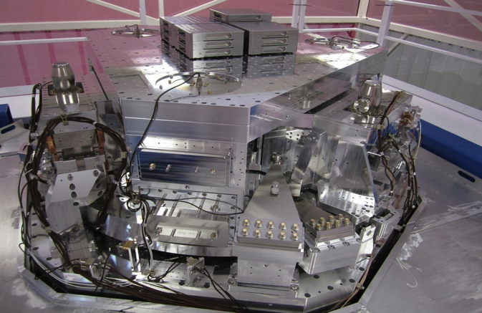
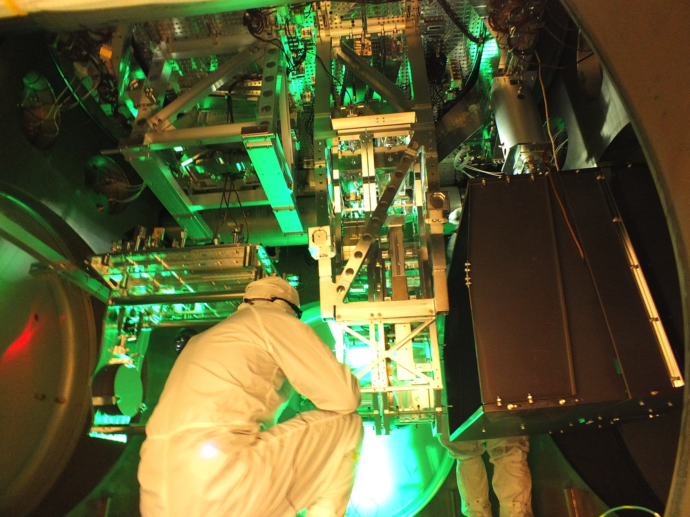
Contents
Internal Seismic Isolation (ISI)
  Measurements
  Modeling
Suspensions
  Measurements
  Modeling
Notes:
I’m going to talk about how we measure and model the active and passive seismic isolation systems in aLIGO. These include the ISI, and the suspensions.

Slide 3
Internal Seismic Isolation (ISI)
Notes:
The ISI is the active platform.

Slide 4
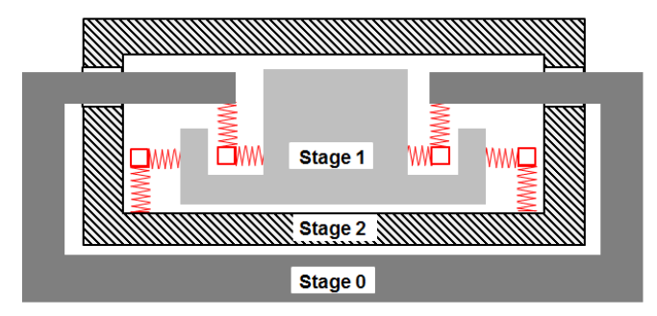
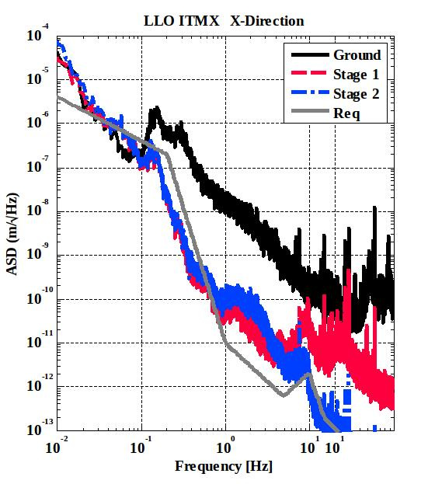

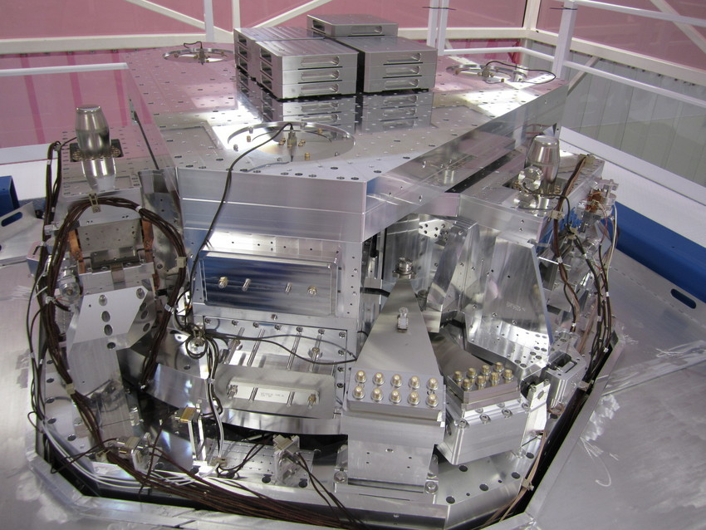
BSC chamber (core optics) configuration and performance
Pier
Pier
Ground
From G1401207
Notes:
Which supports the suspended optics. The ISI for the core optics is a 2 stage actively controlled platform. The test mass suspension hangs off the bottom of it. Don’t be confused be this rather ISI-centric sketch here. It’s approximating the quadruple pendulum as a single pendulum. Which we’ll talk about that more later.

Slide 5
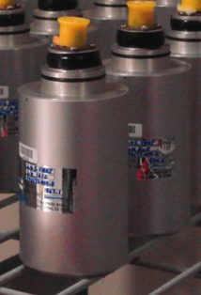
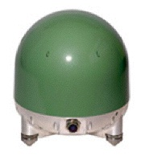
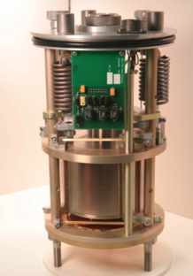
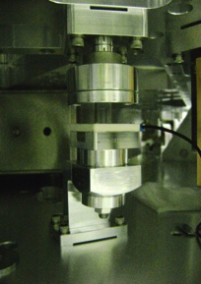
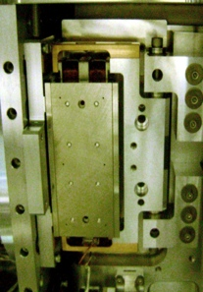
Where stuff is on a BSC-ISI
STAGE 2 (ST2)
STAGE 1 (ST1)
STAGE 0 (ST0)
L4C
T240
GS13
f = ~1 Hz
f = ~5 mHz
f = ~1 Hz
Inertial Sensors
Inertial Sensor
CPS
ACT
Displacement
One corner’s ST0-1 and ST1-2
position sensors and actuators
Electromagnetic
Sensor
Actuators
Notes:
The ISI has an extensive array of displacement sensors, inertial sensors, and actuators acting on all 12 DOFs.

Slide 6
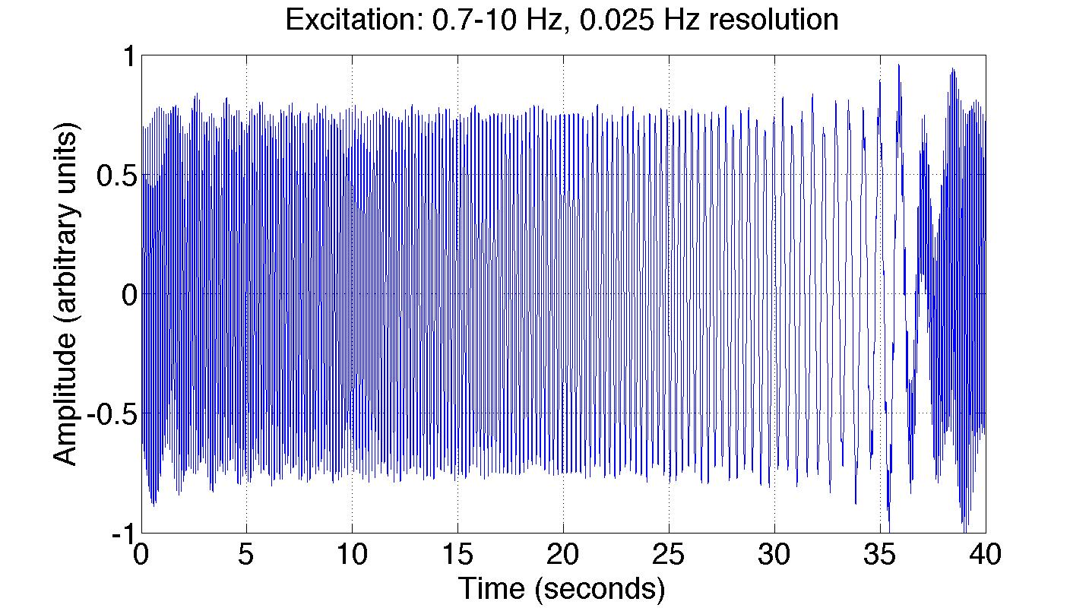
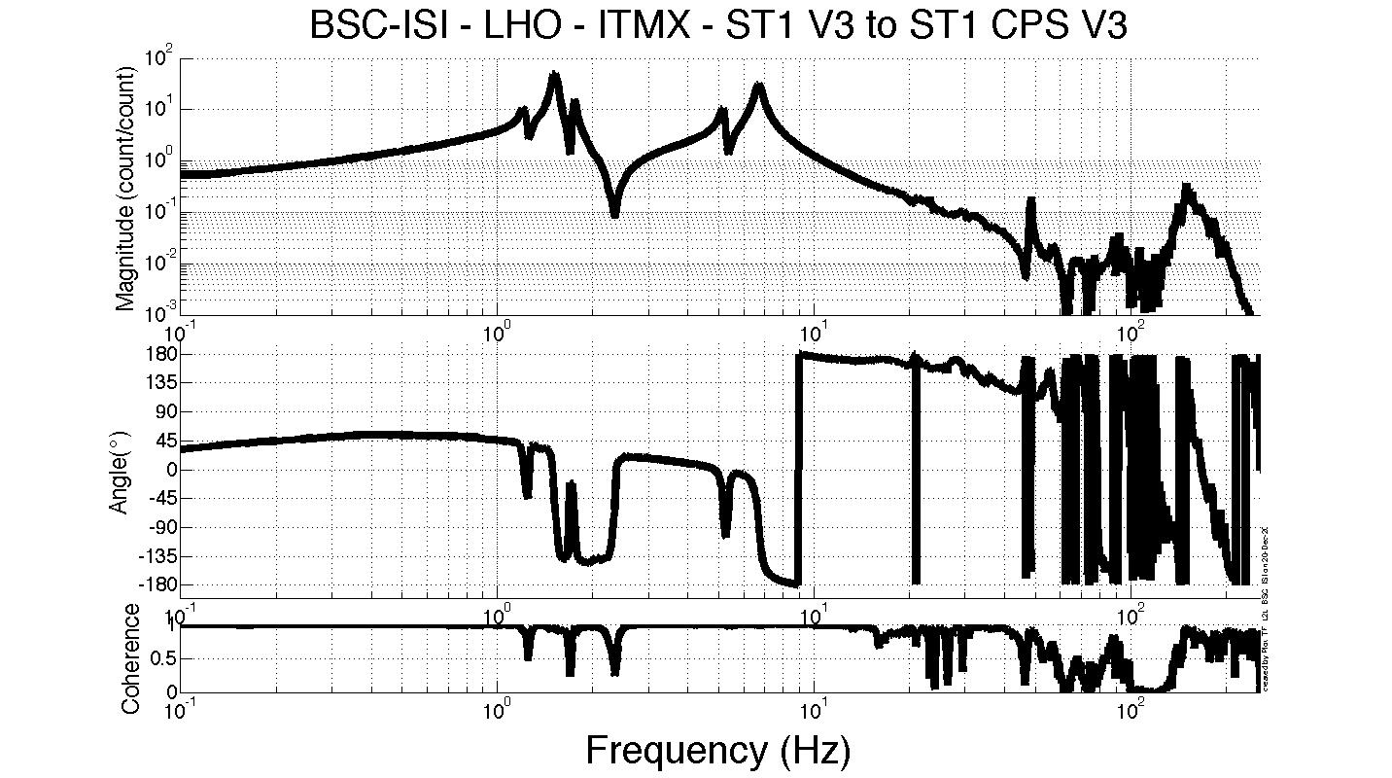
Schroeder Phase TFs
Excitation spectrum
The excitation consists of a frequency comb with a spacing of Δf
The phase of each sine wave is set to minimize the largest excitation value
All within MATLAB
Δf
Amplitude
Frequency
Notes:
We use this array to measure transfer functions with the so called Schroeder Phase technique.
This works through a set of MATLAB scripts that inject a frequency comb through the actuators to measure many frequencies simultaneously.
So it is kind of like a swept sine measurement, but with all the frequencies injected at the same time, making the measurement a lot faster.
The phase of the sine waves are adjusted so that they don’t add in some bad way that creates large periodic spike in the drive. This is where the name Schroeder phase comes from.
And you can see in this example the drive amplitude remains pretty constant with time. This technique is also often better than white noise excitations because the drive is concentrated at specific frequencies. In some sense it combines the best of both swept sine and white noise.

Slide 7
Example TF from BSC-ISI
Notes:
Here is an example of a transfer function measured with this technique.

Slide 8
Example TF from BSC-ISI
10 Hz – 100 Hz
measurement
100 Hz – 500 Hz
measurement
0.1 Hz - 0.7 Hz
measurement
0.7 Hz – 10 Hz
measurement
Notes:
In practice, the measurement is split up into multiple frequency bands in order to maximize the coherence.
The MATLAB interface has the advantages that it is easy to automate these measurements to run over night, and that all our analysis is done in MATLAB so there is no need to import the data.

Slide 9
Example TF from BSC-ISI
The measured transfer functions are also useful as models
Notes:
So that’s the measurement side of things for the ISIs. For the modeling, typically we just use the measurement itself as the model since it already has the magnitude and phase information we need to design the controllers.

Slide 10
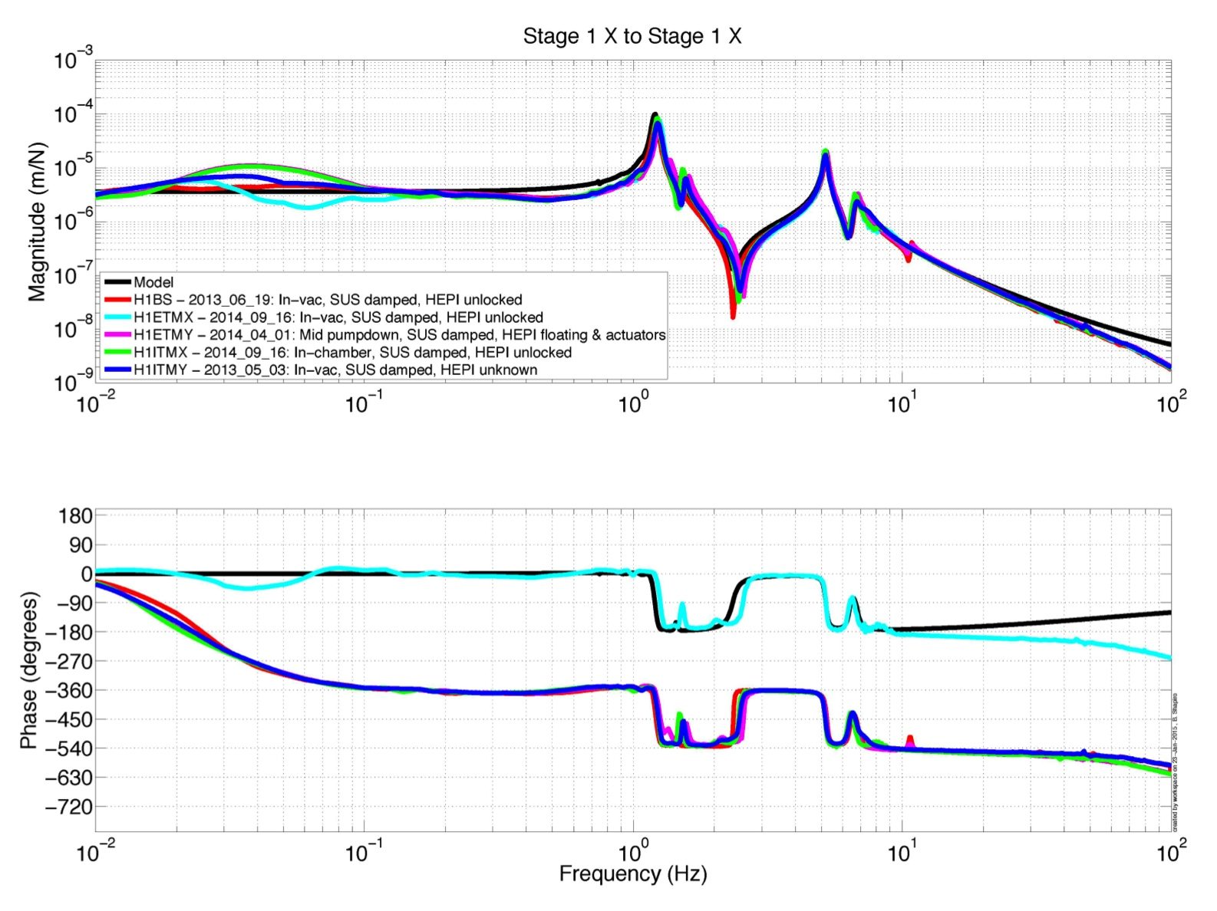
Model fit to Measurements
Fit using MATLAB’s N4SID – frequency domain or time domain. Generates state space model.
Notes:
However, we know that it is useful to have state space models as well. So this plot shows an example fit to measured data using MATLAB’s N4SID function, which spits out a state space system and can take either frequency domain or time domain data.
(Reasons for good models: to make predictions on noise; design changes; temperature sensitivities; all the controls analysis and design tools in MATLAB; and others I’m not thinking of.)

Slide 11
Suspensions
Notes:
So that was the ISI. The second half of the talk is on the suspensions.

Slide 12
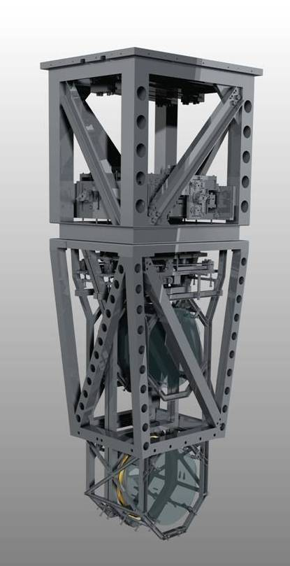
Quadruple Suspension (Quad)
Reaction Chain
Main (test) Chain
Purpose
Input Test Mass (ITM, TCP)
End Test Mass (ETM, ERM)
Location
End Test Masses, Input Test Masses
R0, M0
Control
Local – damping at M0, R0
Global – LSC & ASC at all 4
Sensors/Actuators
BOSEMs at M0, R0, L1
AOSEMs at L2
Optical levers and interf. sigs. at L3
Electrostatic drive (ESD) at L3
Documentation
Final design review - T1000286
Controls arrang. – E1000617
L1
L2
L3
Notes:
This is the test mass suspension. It has 4 stages, with the test mass at the bottom. It also has a reaction chain that supports the cavity locking actuators at the 3 lower stages.
Each chain only has its own independent set of sensors and actuators at the top mass, where we use Birmingham OSEMs. This is an important limitation.

Slide 13
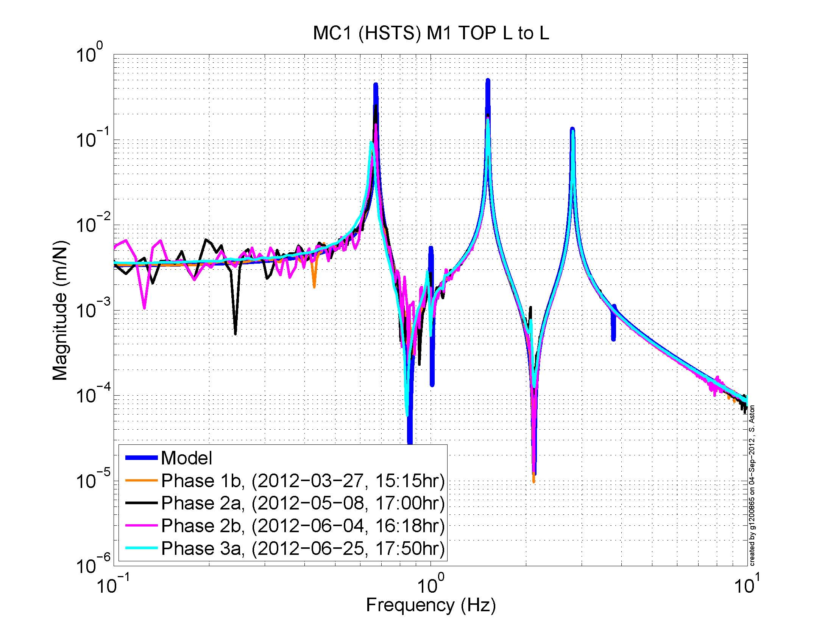
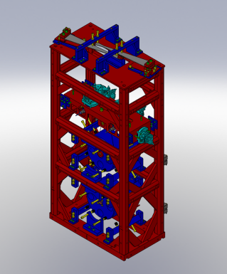
SUS Schroeder Phase Transfer Functions
Consistent performance for suspensions between testing phases and sites
Allows comparison of the “as-built” suspension resonances against an analytical model of the mechanics
To give us confidence that the suspension works as designed
Aiming for repeatability for suspensions throughout all Phases of testing
Also want to maintain repeatability from site to site
HSTS
Ref - G1300132
Notes:
So we use those OSEMs to measure transfer functions at the top mass.
This is a transfer function measured using the Schroeder phase technique. Generally, the long detailed measurements are done in this way.
Note: Noise is due to bad coherence at low frequencies, mostly due to environmental factors (n.b. Phase 2, chamber-side is most noisy of all).

Slide 14
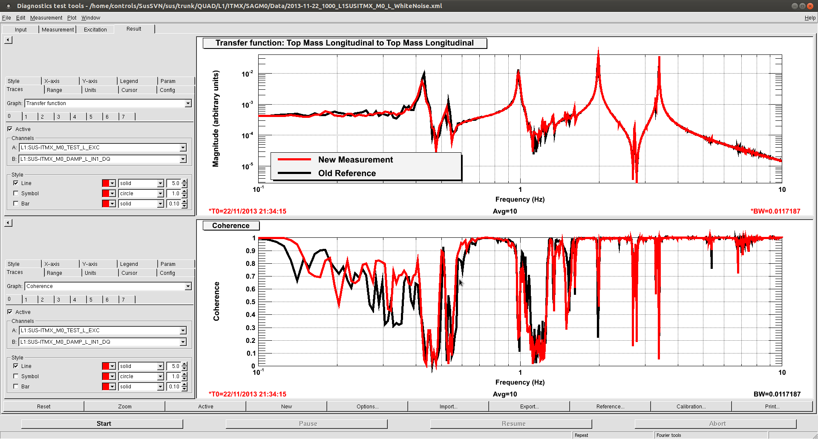
SUS DTT White Noise Measurement
Notes:
But we also do faster diagnostics with white noise measurements in DTT, which is a custom LIGO measurement software. For fast diagnostics this is useful because it has a really nice GUI and user interface.
This example shows a measurement that took only about 3 minutes.

Slide 15
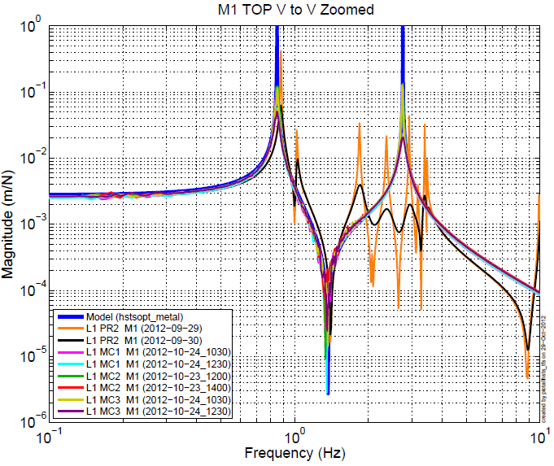
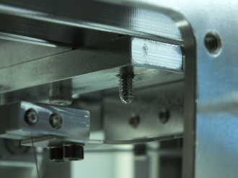
Testing - Transfer Functions Find Bugs
Help diagnose when something has gone wrong e.g. identify rubbing source
PR2 showed no signs of rubbing during Phase 3a (free-air)
But following pump-down, Phase 3b, only PR2 shows severe rubbing (orange)
After venting, still exhibited identical vertical rubbing, suggesting no t buoyancy related (T1100616)
Visual inspection identified it to be a lower blade stop interfering
HSTS
Lower blade-stop
Ref - G1300132
Notes:
If the TF can tell you the suspension is OK, it can also tell you that its not OK. This example shows something rubbing in the suspension.
The transfer function will tell you if something is wrong with the suspension, and sometimes they will even tell you what is wrong, especially if you have a good model of the system.

Slide 16
Suspension Model Parameter Estimation
Notes:
In suspension we do happen to have very good mechanical state space models.

Slide 17
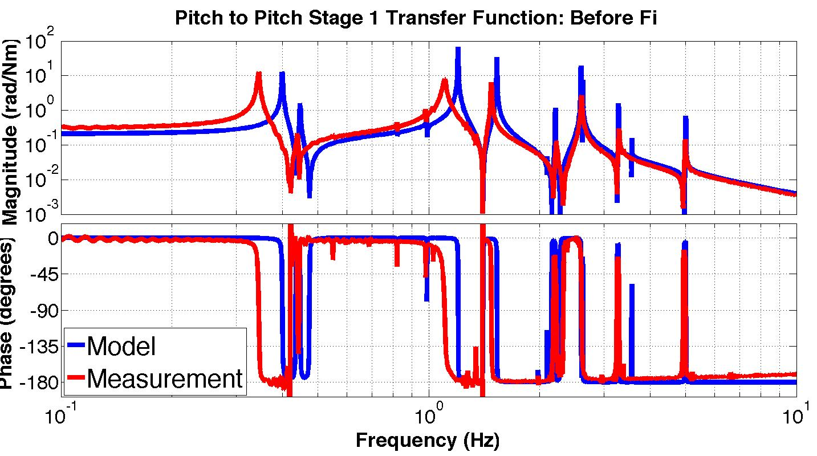
Model vs Measurement
Top Mass Pitch to Pitch Transfer Function: Before fit
Notes:
These models are capable of predicting nearly all the dynamics that are important to us.
However, these models start out not matching the measurements so well, as you can see in this pitch transfer function.
So we use a parameter estimation algorithm to make the model a more accurate representation of what we have.

Slide 18
Error Measurement
Top Mass Pitch to Pitch Transfer Function: Before fit
Error = difference
in mode freq
High Q resonant frequency measurements are not subject to calibration errors or noise.
The measurement ‘noise’ is the data resolution, which only depends on time.
Notes:
To do this, we start by quantifying the error between the model and the measurements. We do this using difference in the resonant frequencies.
Resonant frequencies are really useful because they are not subject to calibration errors. Also, for high Q sharp peaks you can decrease the uncertainty in the frequency simply by measuring for longer.

Slide 19
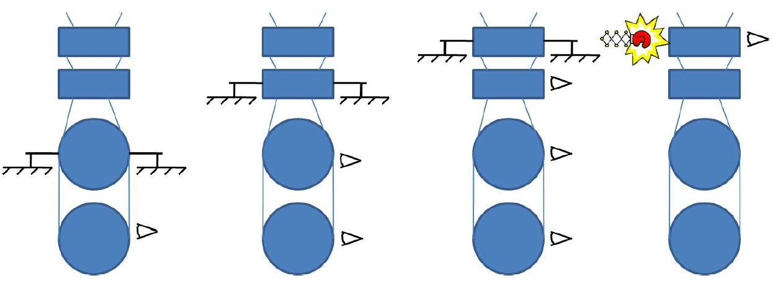
Maximizing the Measurements
2nd lowest
stage locked
2nd highest
stage locked
Top locked
All free
6 resonances
12 resonances
18 resonances
24 resonances
6 + 12 + 18 + 24 = 60 resonant frequencies
Notes:
It turns out though, that the suspensions don’t have enough resonance frequencies to identify all the uncertain parameters in the models. So we simply increase the number of resonances by locking the suspension down in some funny configurations. This cartoon illustrates locking the 2nd to last stage, which gives us 6 more. Then, the next one up is locked, and so forth. This increases the number of frequencies from 24 to 60.

Slide 20
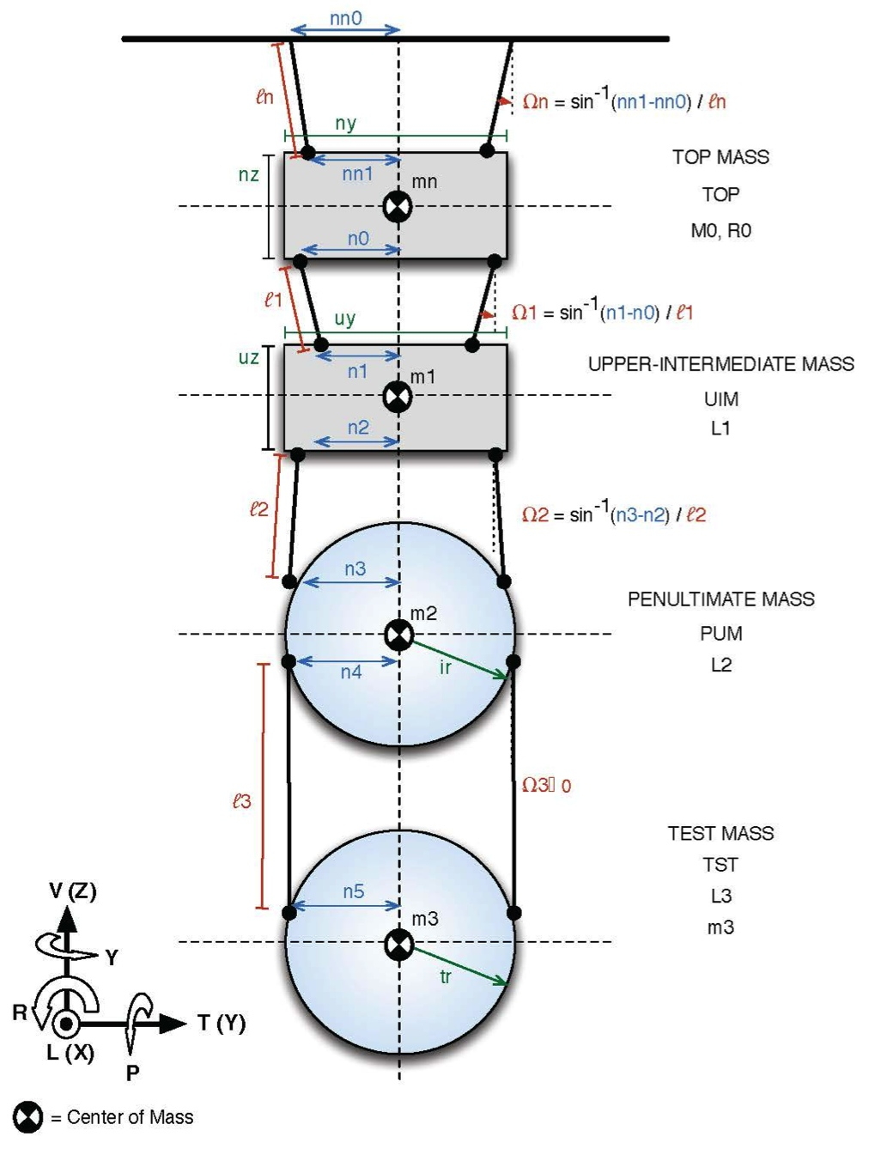
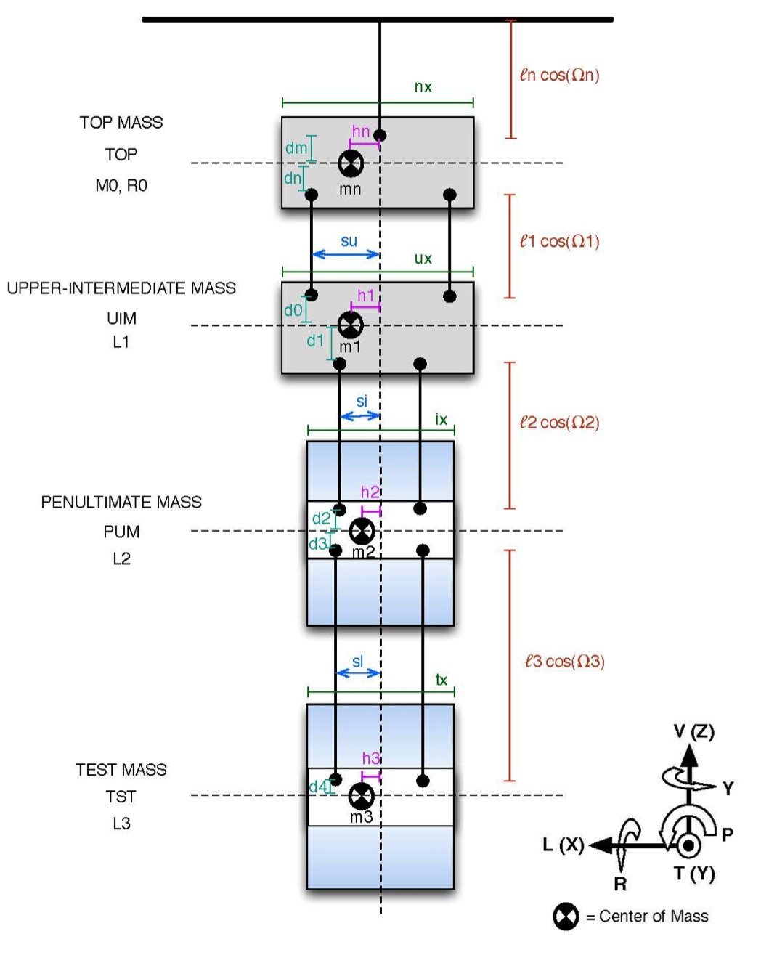
Quad Model – 67 unique parameters
Front
Side
Notes:
The model itself is a state space system that is parameterized in terms of all the physical values of the suspension.

Slide 21

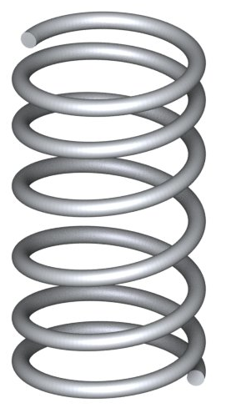
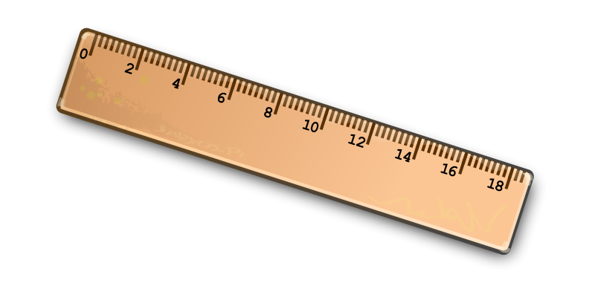
Quad Model – 67 unique parameters
Physical parameters include:
Inertia
Spring stiffness
Wire dimensions
…
Etc…
Front
Side
Notes:
These include things like, inertia, spring stiffness, wire dimensions, and many others.

Slide 22
Before Parameter Estimation
Top Mass Pitch to Pitch Transfer Function: Before fit
Notes:
The algorithm itself I’ll speak more about in my next talk, but it’s a basic Gauss-Newton algorithm, which is just a standard version of Newton’s method.
So this slide shows again a comparison of the model before running the algorithm.

Slide 23
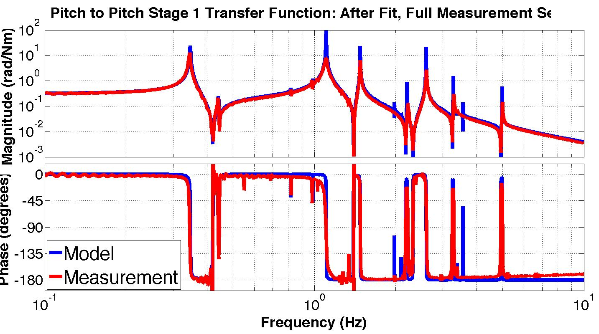
After Parameter Estimation
Top Mass Pitch to Pitch Transfer Function: After fit
References: T1000458 and “Selection of Important Parameters Using Uncertainty and Sensitivity Analysis”, Shapiro et al.
Notes:
And this is after. You see the model now matches quite well.

Slide 24
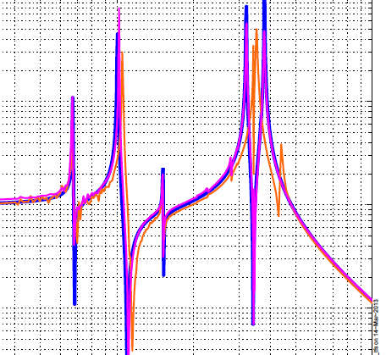
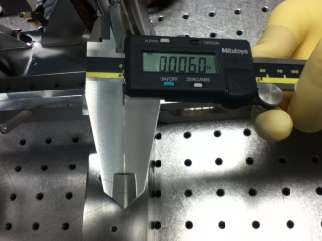
Parameter Estimation Can Diagnose Errors
Wrong optic wire diameter
All DOFs for SRM (HSTS) looked good, except for an ugly feature in Pitch (orange)
Modeling suggested that most likely the incorrect diameter lower wire could be the culprit (see LLO aLOG 4766 i.e ø = 152 μm instead of ø = 120 μm
This was later confirmed, and replaced with the correct wire diameter (magenta)
HSTS
Measuring lower wire diameter
Ref - G1300132
Notes:
In addition to making good models, this is also useful for finding errors in the suspension. The orange curve here is a measurement from a suspension where we unknowingly installed the wrong wire diameter around the optic.
And we really had no idea what was wrong with this suspension until the algorithm suggested that it was probably the optic’s wire and if so, it would be about 150 microns instead of 120.
Sure enough, when we put some calipers on the wire, this proved to be true. So that was a big win for our modeling.

Slide 25
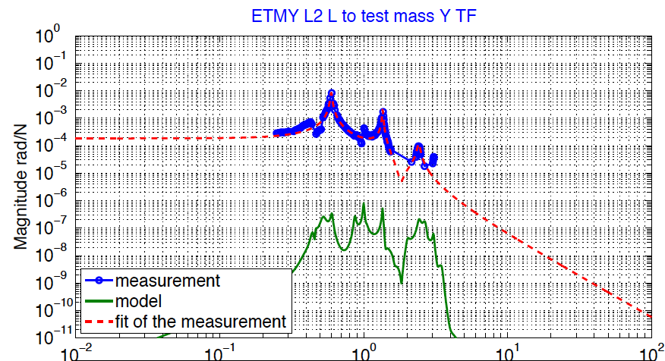
Model Misses Cross-Couplings
Frequency (Hz)
Notes:
However, the models aren’t perfect and the main area where they lack is in the cross couplings.
The model in green here says there should basically be no coupling between these DOFs. But of course of the measurement in blue says there is. So far our sys-id has not been sufficient to predict this, so we need more work here.
Anamaria is going to talk about these cross coupling issues more later.

Slide 26

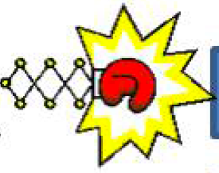
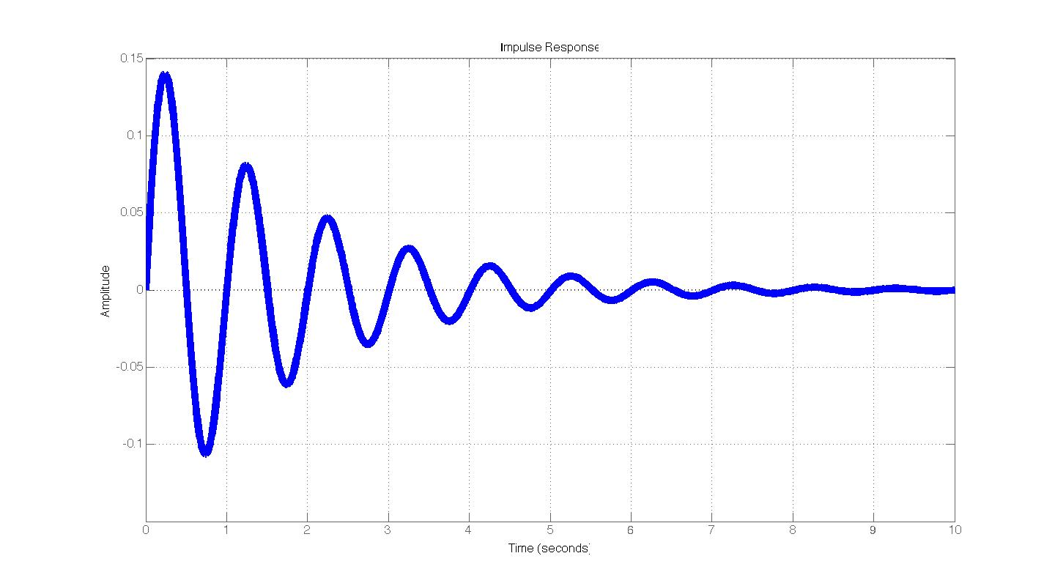
Homework: find ways to improve measurements of future suspensions
Examples
  More sensors
    & actuators
  Different dynamics
    e.g. lower bounce mode frequency
  Many solutions will help both sys-id and control
Notes:
I’ll conclude by giving you some homework. That is to think of ways to improve the measurements of future suspensions.
It is likely that many of the solutions will also benefit the control of the suspension, so this will be a really useful exercise.

Slide 27
Back Ups

Slide 28
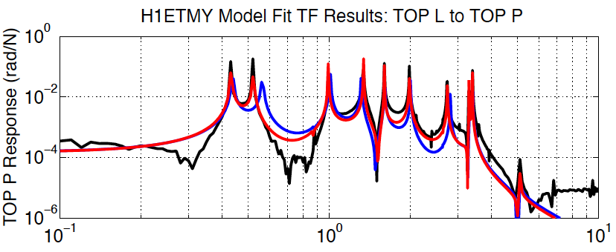
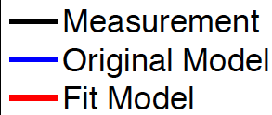
Model Misses Cross-Couplings
Frequency (Hz)

Slide 29
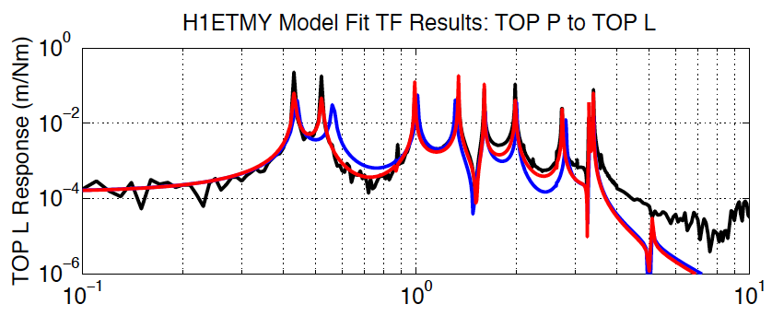
Model Misses Cross-Couplings
Frequency (Hz)

Slide 30
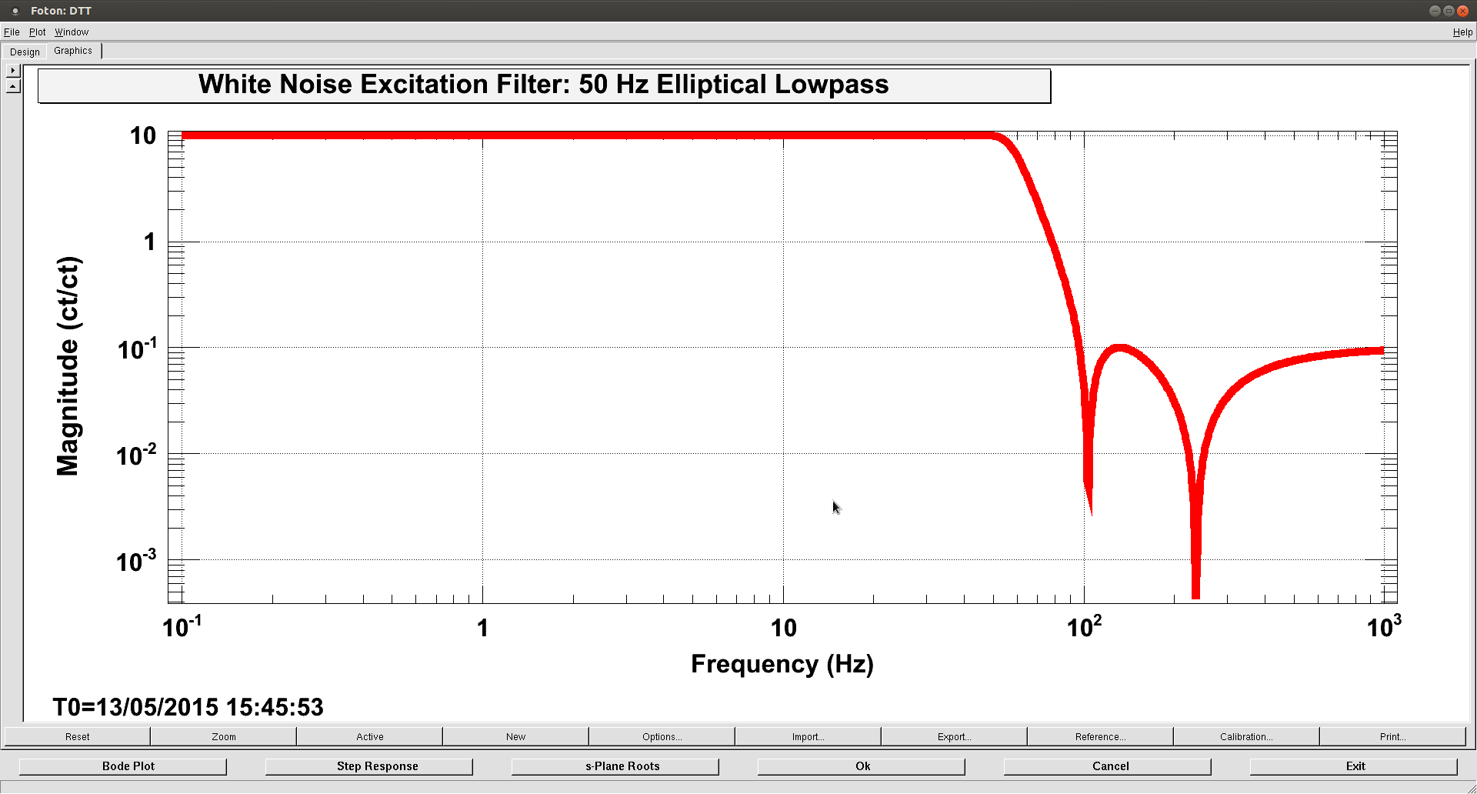
SUS DTT White Noise Filter

Slide 31

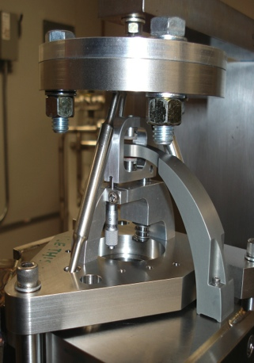
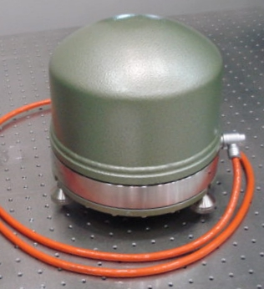

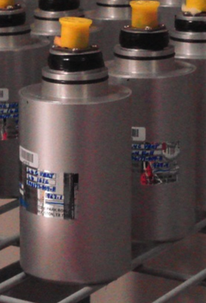
SEI Sensors and Their Noise
“Low” Frequency
IPS
Kaman’s Inductive Position Sensors
Used On: HEPIs
Used For: ≤ 0.5 Hz Control, Static Alignment
Used ‘cause: Reasonable Noise, Long Range
CPS
MicroSense’s Capacitive Displacement Sensors
Used On: HAM-ISIs and BSC-ISIs
Used For: ≤ 0.5 Hz Control, Static Alignment
Used ‘cause: Good Noise, UHV compatible
DC
10 mHz
STS2
Strekheisen’s STS-2
Used On: HEPIs
Used For: 0.01 ≤ f ≤ 1Hz Control
Used ‘cause: Best in the ‘Biz below 1 Hz, Triaxial
T240
Nanometric’s Trillium 240
Used On: BSC-ISIs
Used For: 0.01 ≤ f ≤ 1Hz Control
Used ‘cause: Like STS-2s, Triaxial, no locking mechasim -> podded
GS13
GeoTech’s GS-13
Used On: HAM-ISIs and BSC-ISIs
Used For: ≥ 0.5 Hz Control
Used ‘cause: awesome noise above 1Hz,
no locking mechanism -> podded
1 Hz
L4C
Sercel’s L4-C
Used On: All Systems
Used For: ≥ 0.5 Hz Control
Used ’cause: Good Noise, Cheap,
no locking mechanism -> podded
800 Hz
“High” Frequency

Slide 32
SEI Sensors and Their Noise

Slide 33
What is System Identification?
“System Identification deals with the problem of building mathematical models of dynamical systems based on observed data from the system.”
- Lennart Ljung, System Identification: Theory for the User, 2nd Ed, page 1.

Slide 34
References
Lennart Ljung, System Identification: Theory for the User, 2nd Ed
Dariusz Ucinski, Optimal Measurement Methods for Distributed Parameter System Identification

