Slide 1
Lessons Learned from Commissioning of Advanced Detectors
May 18, 2015
Daniel Sigg LIGO Hanford Observatory

Slide 2
Lessons
Good QA & experience lead to quick progress
Locking
Arm Length Stabilization (ALS) is working
Dual Recycled Michelson Locking (DRMI) is working (3f technique)
Alignment stability is important with low frequency seismic systems
Low frequency seismic isolation systems at Virgo
Squeezing at GEO
Underground and cryogenic at KAGRA
Low finesse cavities causes alignment offset problems
High Q resonances and uncontrolled DOFs
Thermal adjustments not needed at 20W input
ESD charging Issues
Parametric Instabilities

Slide 3
Progress

Slide 4
Sensitivity
Preliminary

Slide 5
Preliminary

Slide 6
L1 Noise Model

Slide 7
Locking
Full Lock
Switching to Nominal Sensors &
Adjusting operating point
DRMI 3f
Intensity Power [W]
Arm Length Stabilization
Refl.
Power [W]
Refl.
Locking
Time [s]

Slide 8
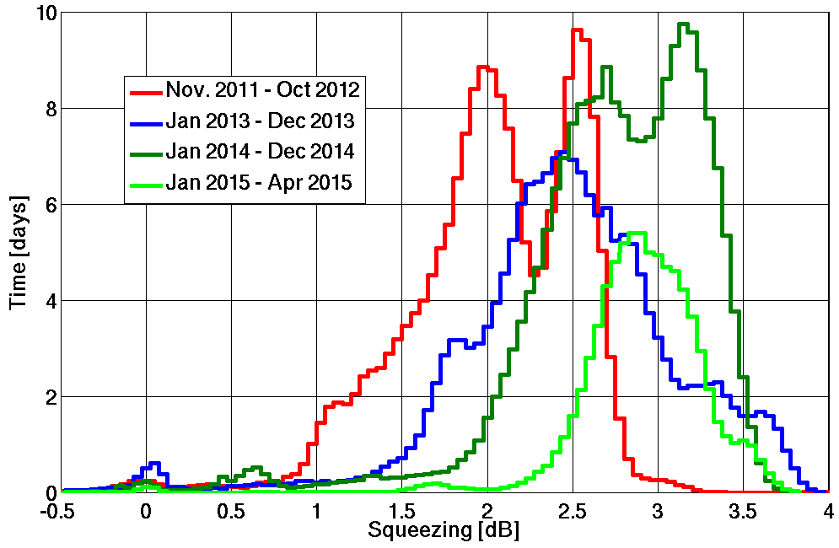
Squeezing at GEO
Squeezing long term stable around 3dB
After researching phase control and auto-alignment now focus on losses
Data taking runs well, fully automated locking

Slide 9
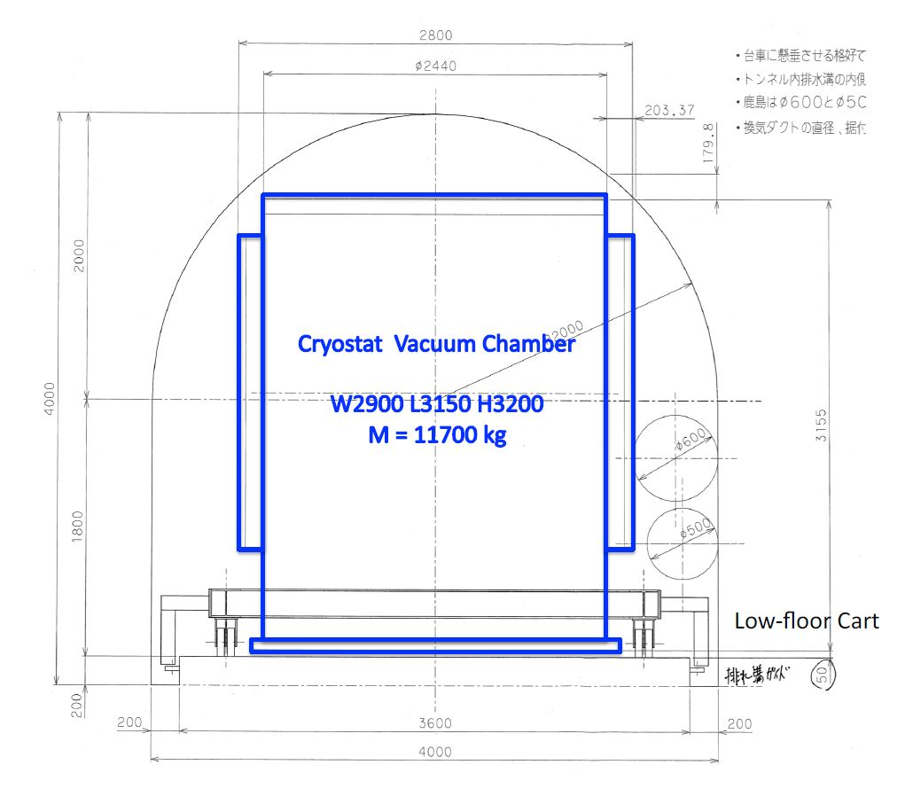
Underground & Cryogenic at KAGRA

Slide 10
Parametric Instabilities
Evans et al., Phys. Rev. Lett. 114, 161102 (2015)

Slide 11
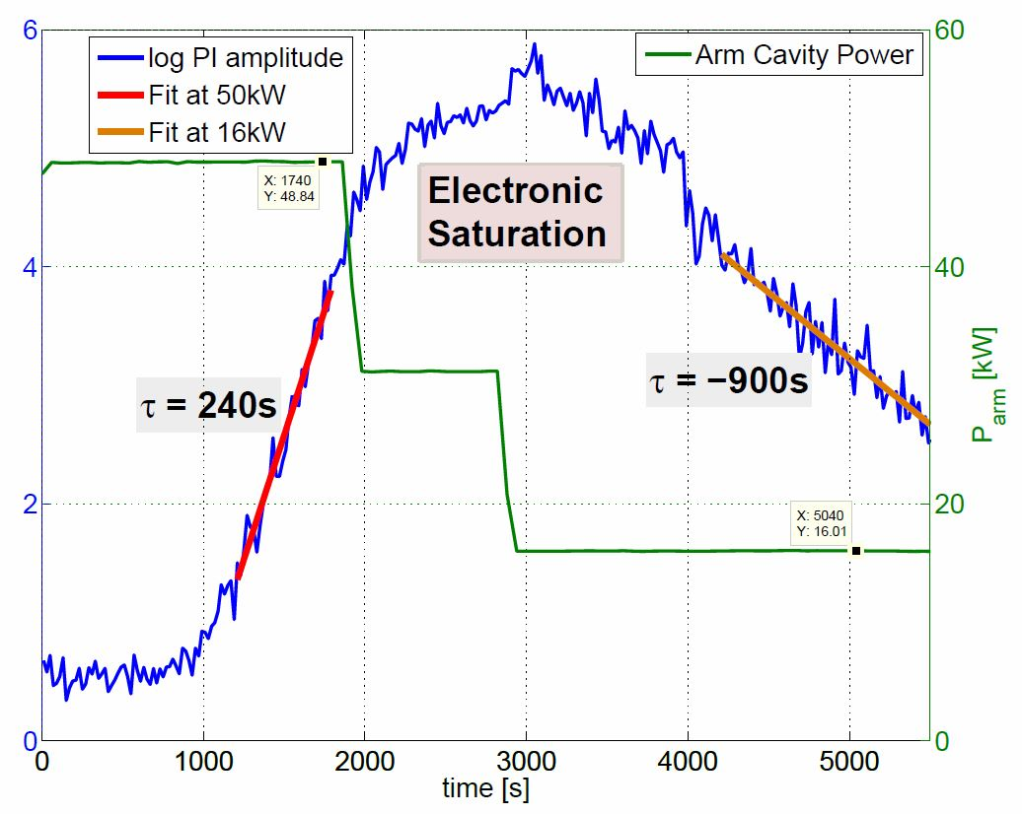
Parametric Instabilities (3)
Mechanical Optical

Slide 12
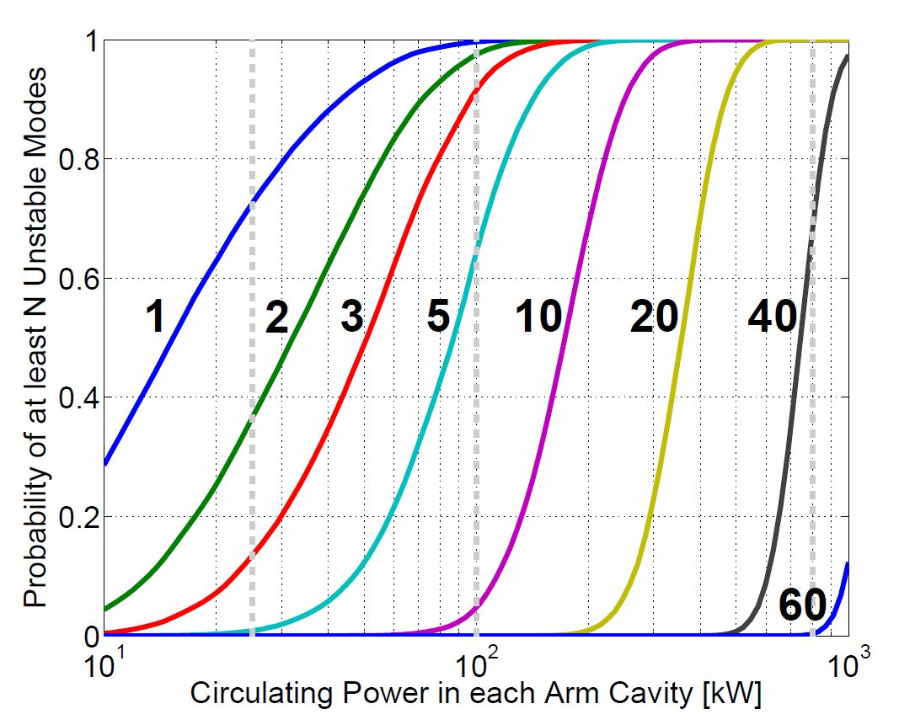
Parametric Instabilities (2)
Number of Unstable Modes Depends on ROC
Thermal control of ROC can work for small N

Slide 13
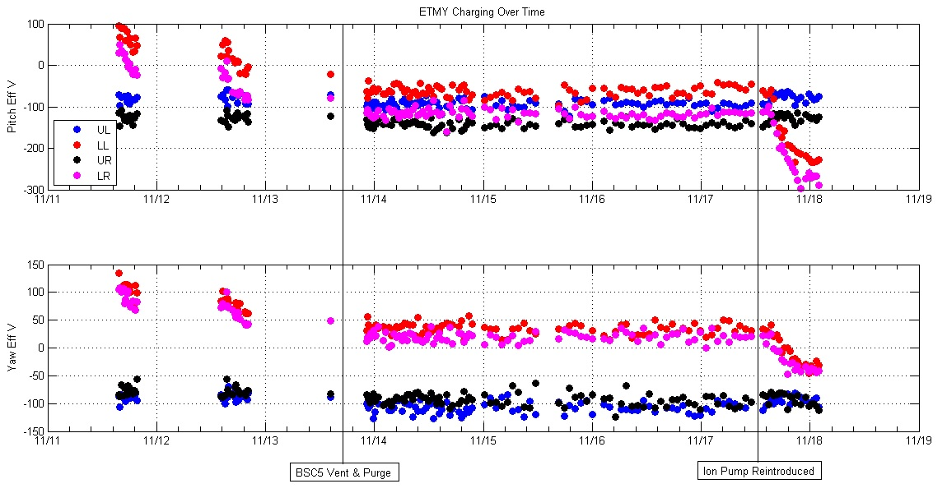
Electro Static Drive
250V
Recharging

Slide 14
Electro Static Drive (2)
Charge is a problem, can be 10s (even >100) of Volts
First contact leaves a charge behind
Field lines must terminate somewhere (e.g. ring heater)
Drive strength depends on charge, adds a linear term
Charge is not uniform
Injecting ions into the vacuum did not fix the problem
Hard to reach the back surface
Recharging does occur
Ion pump main culprit, needs to be shielded or removed
Test masses need to be discharged before pumping
Seems to stay discharged without an ion pump

Slide 15
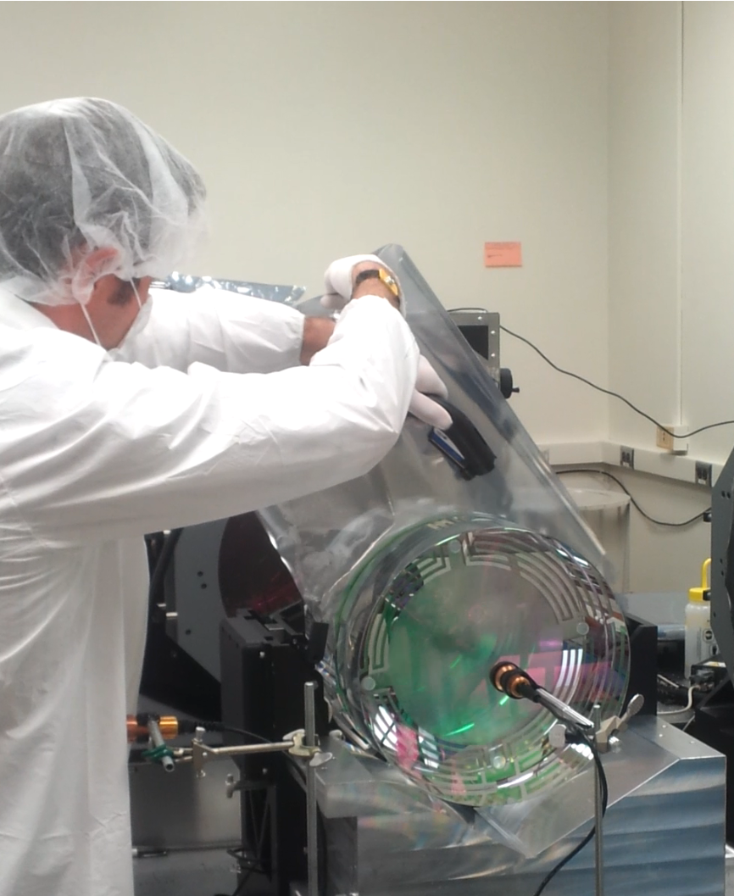
Electro Static Drive (4)

Slide 16
Summary
Sensitivity of initial detectors surpassed quickly
Robust locking achieved
Squeezing is now ready and robust (GEO)
Parametric instabilities are real; need to be dealt with
Test mass charge is a problem
Discharging effort underway
What’s left?
High power operations: thermal control, PI, alignment instability
Low frequency noise hunting & controls optimization
Make the seismic system work during bad weather
Damping of high Q modes
Backscatter mitigation

