Slide 1
Beam Splitter in aLIGO
Hiro Yamamoto LIGO/Caltech
BS02 to BS05? larger BS?
BS in aLIGO IFO for near future upgrade
  All COC optics of L1 as is except for BS
  TCS can correct power terms in ITM substrate
    ITM power terms are nullified, to be realized by re-polished CP
Performance degradation by geometrical hierarchy
Effect of RM3 aperture on the beam beyond BS
Effect of ITM inhomogeneity, mixing with BS inhomogeneity
Effect of ESD, visible for larger BS
Summary

Slide 2

Geometry related to performance
ESD on CP
(modeled by a simple with hole with 266mm aperture)
266mm
BS
230x260mm
262mm

Slide 3
Performance degradation of aLIGO IFO
T1400055
1) no loss at all, with large mirrors. A finite HOM (3.7ppm) looks a nice gaussian so probably the base mode parameter is slightly off.
2) 1) + ETM transmittance 3.7ppm
3) 2) + test mass aperture 326mm, round trip loss by the aperture is 1.94ppm (with 340mm, RTL is 0.6ppm)
4) 3) + 266mm ESD aperture, placed using BS baffle (266mmx266mm) in front of BS
5) 4) + 35ppm arm loss
6) 5) + power recycling mirror and beam splitter loss and transmission. Sum of losses + RM2 transmission is 583ppm
7) 5) + ITM AR side loss, (ITMX loss 206ppm, ITMY loss 330ppm)
8) 5) + 6) and 7), i.e., losses and transmission in the PRC, BS and ITM AR
9) 8) + finite opening angles in PRC (0.79° for PRM2 and 0.615° for PRM3). Among the total HOM of 240ppm, major ones are HG(1,0) of 12ppm and HG(0,2) of 210ppm.
10) 9) + PRM3 aperture 262mm
11) 10) + BS 367.1mm/60mm no baffle
12) 11) + BS baffle (210mmx260mm). Total HOM goes up to 540ppm from 260ppm by clipping using BF baffle. The major is HG(4,0) of 170ppm.
13) 12) with BS baffle facing to X arm offset by 1mm in horizontal direction
14) 12) with BS baffle facing to X arm offset by 2mm in horizontal direction
15) 10) + BS 410mm/67mm with BS baffle (237mmx260mm)
16) 15) with BS baffle facing to X arm offset by 2mm in horizontal direction
17) 10) + BS 450mm/73.5mm with BS baffle (260mmx260mm) : no performance impact by the BS baffle
18) 17) with BS baffle facing to X arm offset by 2mm in horizontal direction
19) 10) + BS 490mm/80mm with BS baffle (260mmx260mm)
20) 19) with BS baffle facing to X arm offset by 2mm in horizontal direction
Arm loss
simple lossless
realistic lossy
37cm BS w/o baffle
Finite incident angles on PRM2 and PRM3

Slide 4
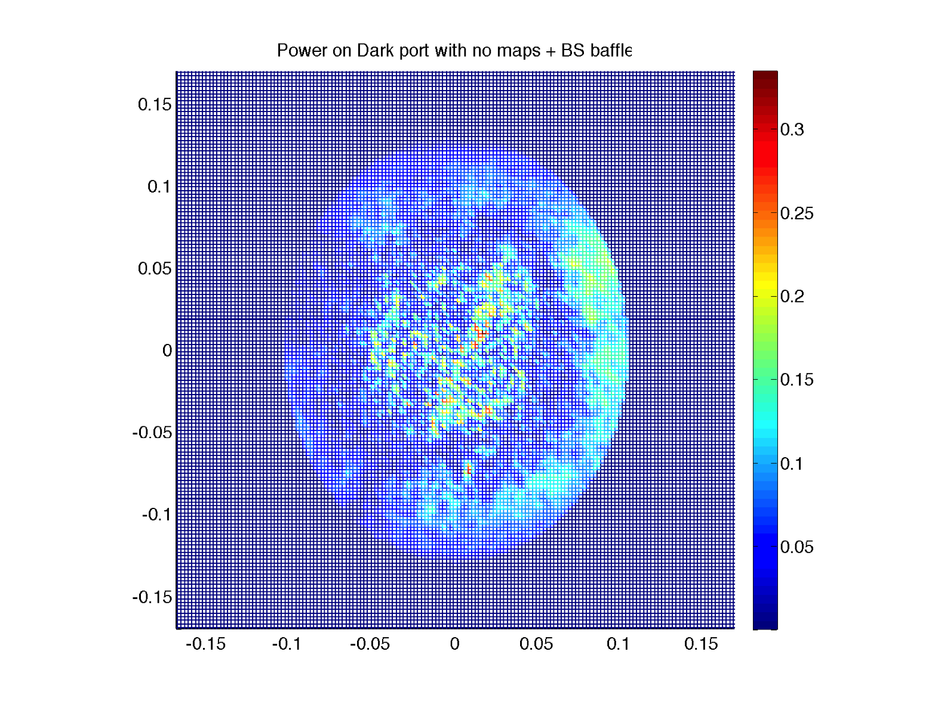
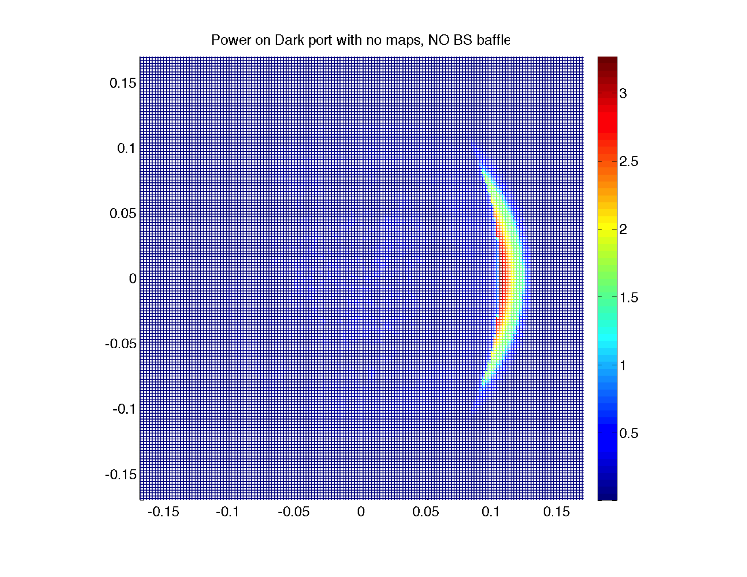
BS baffle designed to suppress CD
With BS baffle : 7ppm
Without BS baffle : 210ppm
(d) – (b)

Slide 5
BS size
CD nullified by BS baffle
Sensitivity on positioning :
Baffle aperture(11.5cm) =
2.1 x beam size(5.3cm)
T1400055
1) no loss at all, with large mirrors. A finite HOM (3.7ppm) looks a nice gaussian so probably the base mode parameter is slightly off.
2) 1) + ETM transmittance 3.7ppm
3) 2) + test mass aperture 326mm, round trip loss by the aperture is 1.94ppm (with 340mm, RTL is 0.6ppm)
4) 3) + 266mm ESD aperture, placed using BS baffle (266mmx266mm) in front of BS
5) 4) + 35ppm arm loss
6) 5) + power recycling mirror and beam splitter loss and transmission. Sum of losses + RM2 transmission is 583ppm
7) 5) + ITM AR side loss, (ITMX loss 206ppm, ITMY loss 330ppm)
8) 5) + 6) and 7), i.e., losses and transmission in the PRC, BS and ITM AR
9) 8) + finite opening angles in PRC (0.79° for PRM2 and 0.615° for PRM3). Among the total HOM of 240ppm, major ones are HG(1,0) of 12ppm and HG(0,2) of 210ppm.
10) 9) + PRM3 aperture 262mm
11) 10) + BS 367.1mm/60mm no baffle
12) 11) + BS baffle (210mmx260mm). Total HOM goes up to 540ppm from 260ppm by clipping using BF baffle. The major is HG(4,0) of 170ppm.
13) 12) with BS baffle facing to X arm offset by 1mm in horizontal direction
14) 12) with BS baffle facing to X arm offset by 2mm in horizontal direction
15) 10) + BS 410mm/67mm with BS baffle (237mmx260mm)
16) 15) with BS baffle facing to X arm offset by 2mm in horizontal direction
17) 10) + BS 450mm/73.5mm with BS baffle (260mmx260mm) : no performance impact by the BS baffle
18) 17) with BS baffle facing to X arm offset by 2mm in horizontal direction
19) 10) + BS 490mm/80mm with BS baffle (260mmx260mm)
20) 19) with BS baffle facing to X arm offset by 2mm in horizontal direction
simple lossless
realistic lossy
Loss: 37cm BS w/ baffle = 600ppm
45cm BS = 100ppm
RM3
BS
ITM
45cm BS
26cm
45cm BS keeps the signature of PRM3 aperture

Slide 6
ITM / BS aberrations : some sees, some not
Sign flip on resonance
CR
SB
BS /
Reflected field by arm
CR (Eout) : don’t see
SB (Eref) : see
Signal SB (Eleak) : see
BS /
Mode in recycling cavity
CR : insensitive
SB, Signal : sensitive

Slide 7
PRG and CD with TCS corrections
LLO PRMI
TCS
L1 data
Simulation
log11140 CD~400ppm, PRG~45

Slide 8
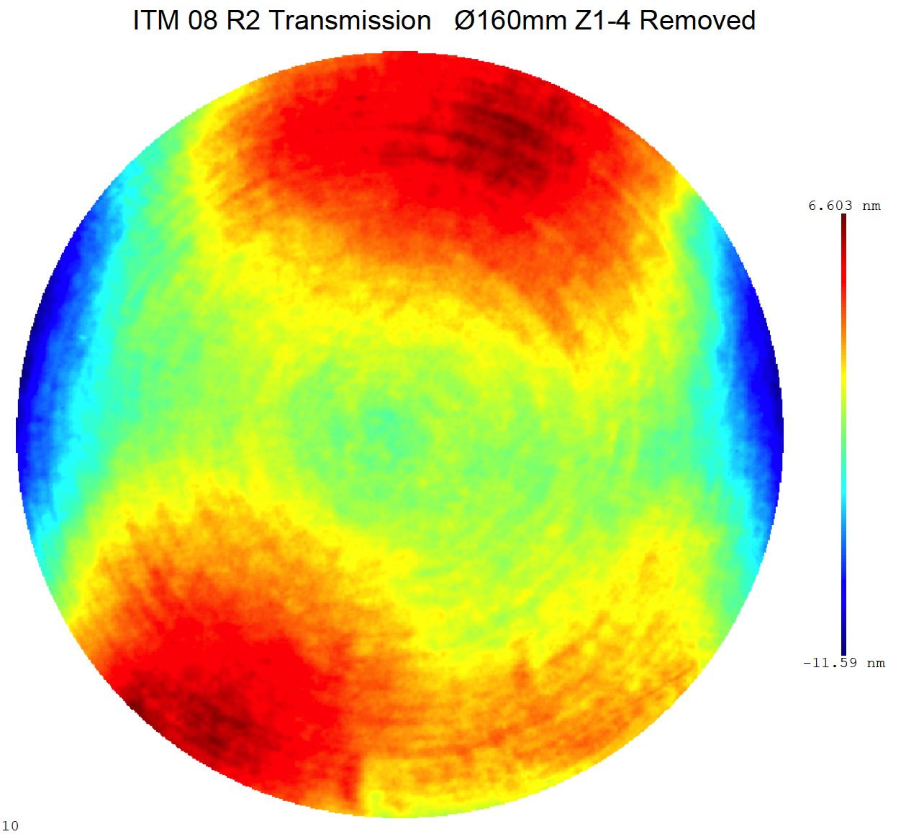
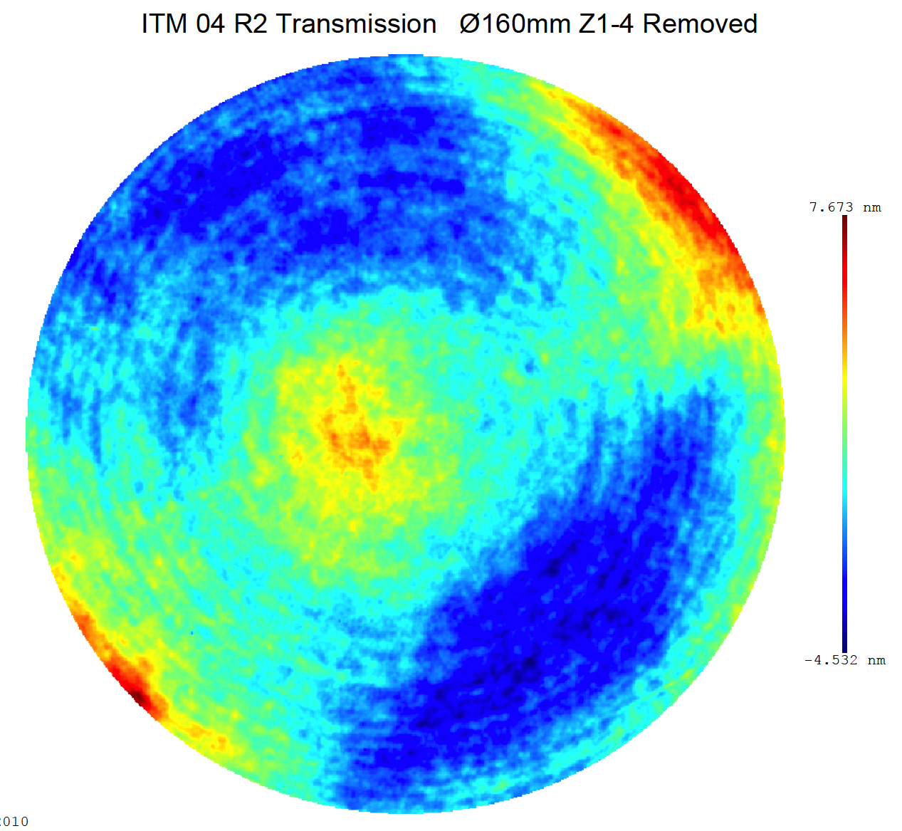
Effect of BS/ITM aberration on CD
Through near field propagation:
Power distribution does not change
Phase can change on reflection/transmission
ITM transmission map after power term removed
ITM08 / ITMY
ITM04 / ITMX
200mm
BS uniformity needs to be good only in
280mm x 200mm
6.6nm
7.7nm
ϕ=160mm
-11.6nm
-4.5nm

Slide 9
BS : Three maps and
Thermal distortion
BS Reflections
BS Transmissions
ITM Transmissions

Slide 10
Effects of BS on CR and SB simulation
L1 with all known COC data
including reflection and
transmission maps of ITM
Lock by CR
MICH to make dark port darkest
9MHz RF SB within this locked PRFPM
Two ITM thermal states
  Cold : ITMs have no power in the transmission maps
  Optimal : ITMs have 50km lens in the transmission maps
Mode is defined by arm, with 50km static lens in ITMs

Slide 11
Effects of BS on CR and SB quantitative view
 |  |  | No BS (37cm) | BS02 (37cm) | BS05 (37cm) | No BS (45cm) | Beam on ITM
Cold | CR | PRG | 39 | 39 | 40 | 41 | 5.33cm
 |  | CD (ppm) | 66 | 225 | 114 | 76
 |  | HOM (ppm) | 790 | 780 | 690 | 470
 | SB | PRG | 55 | 50 | 40 | 48 | 5.95cm
 |  | HOM (%) | 2.3% | 2.5% | 3.0% | 2.2%
optimal | CR | PRG | 39 | 39 | 40 | 40 | 5.30cm
 |  | CD (ppm) | 82 | 210 | 136 | 108
 |  | HOM (ppm) | 2100 | 2300 | 2400 | 1450
 | SB | PRG | 108 | 108 | 108 | 114 | 5.35cm
 |  | HOM (ppm) | 580 | 780 | 1200 | 340

Slide 12
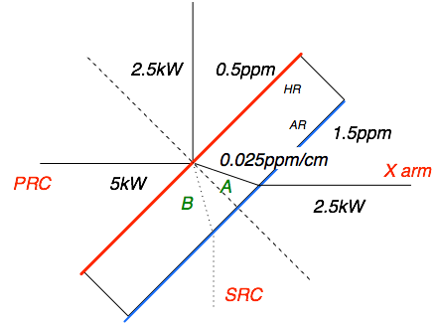
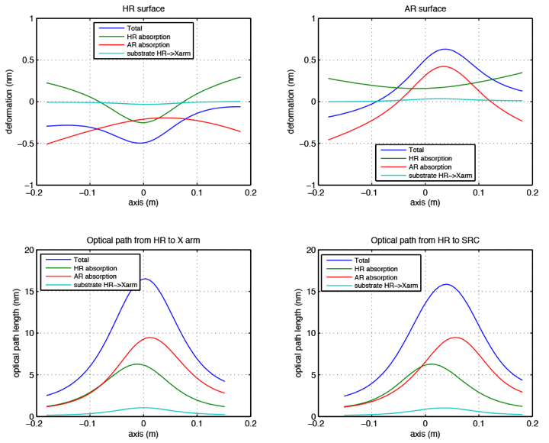
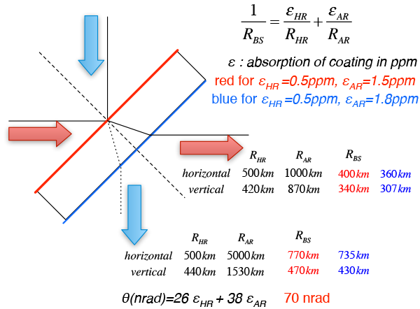
BS Thermal distortion
heated
no heating
12

Slide 13
Noises by BS baffle and ESD motions
BS baffle motion for 37cm BS
  h(f) = 4 x 10⁻¹¹ δ_{ISI}(f)
ESD motion for 45cm BS
  h(f) = 2 x 10⁻⁹ δ_{CP-ITM}(f)
Both are smaller by 100 than the requirements

Slide 14
Summary
BS02 vs BS05
  If it ain’t broken, don’t fit it.
  Some may improve, but will see some new issue
Aperture change from 37cm to 45cm
  Improve total loss around BS
  Less critical to positioning of beams and mechanical structure
Noises due to BS baffle or ESD motions are negligible

