Slide 1
Suspension Control with Thoughts on Modern Control
Brett Shapiro
19 May 2015

Slide 2

Can modern control be useful for the suspension systems?
Notes:
My goal is to convince you, in the next 15 minutes, that modern control is just one more tool to add to our controls toolbox. And like any tool, there are places to use it and places not to use it.
I think it’s also worth pointing out that there is a larger world of optimal control techniques out there. So while I’m focusing on the small subset of modern control, it is worth keeping in mind that there are other tools out there as well. (Note: in the control theory literature modern control refers to state space methods, e.g. like LQG, LQR, Hinfinity.)

Slide 3


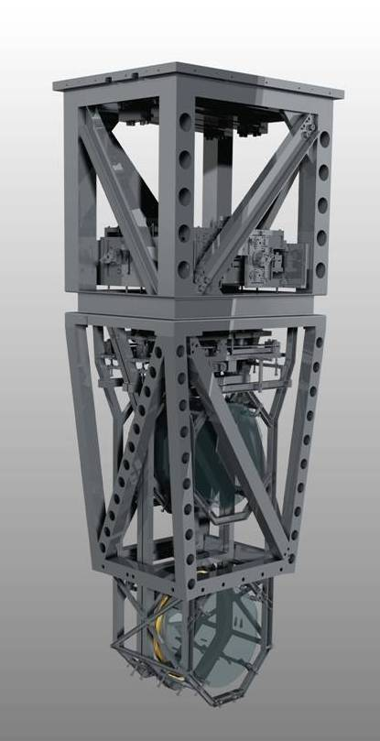
Quadruple Suspension (Quad)
Reaction Chain
Main (test) Chain
Purpose
Input Test Mass (ITM, TCP)
End Test Mass (ETM, ERM)
Location
End Test Masses, Input Test Masses
R0, M0
Control
Local – damping at M0, R0
Global – LSC & ASC at all 4
Sensors/Actuators
BOSEMs at M0, R0, L1
AOSEMs at L2
Optical levers and interf. sigs. at L3
Electrostatic drive (ESD) at L3
Documentation
Final design review - T1000286
Controls arrang. – E1000617
L1
L2
L3
Notes:
But first I’ll remind you what the LIGO test mass suspension and its 3 distinct controllers look like.
The suspension has 4 stages, with the test mass at the bottom. It also has a reaction chain that supports the cavity control actuators.
The top stage is in charge of the damping control…

Slide 4
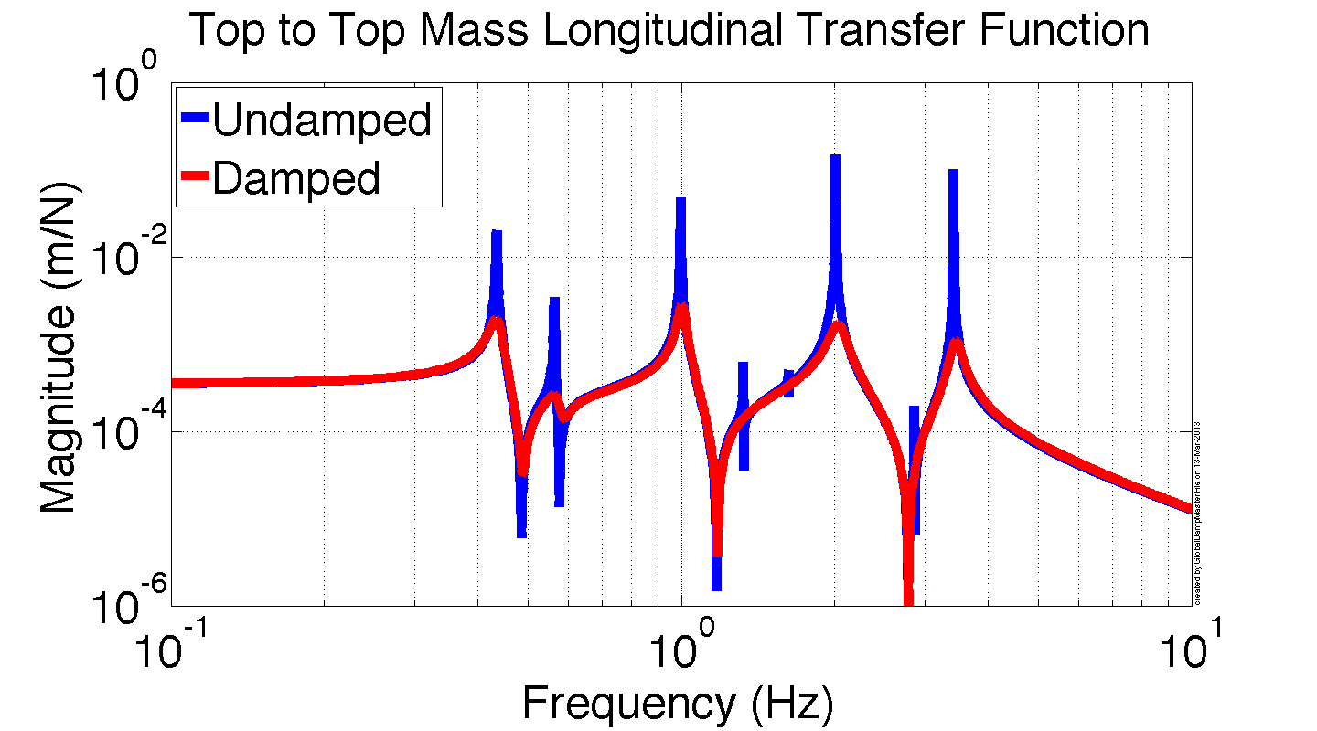
Suspension damping feedback
sensor noise
Used to reduce the Qs of the suspension modes
Good candidate for modern control
[m]
Damping feedback filter
[N]
+
Notes:
…as illustrated here. The damping exists entirely at the top mass so that the re-injected sensor noise is well isolated from the test mass.
I think this damping is a good candidate for modern control, which I’ll talk more about in a couple of slides.

Slide 5
Suspension cavity control
Controls the length of the cavity
Probably not a good candidate for modern control
Maybe other
optimal methods
Reaction Chain
Main (test) Chain
Drift control
Low frequency control
Medium frequency control
High frequency control
Cavity length
Cavity control filters
Notes:
The second type of control is the cavity length control. The sensor here is the cavity signal itself. The actuation is split into different frequency bands at the four different stages.
This is probably not a good candidate for MC because the limiting factor is not noise, rather saturating actuators. Actuator saturation limits are non-linear and MC methods are designed for purely linear systems.
Also, while technically being a MIMO controller, the fact that there is only a single output, the cavity signal, means we can design the loops using familiar SISO concepts, like phase margin.
Probably beyond the scope of this talk:
MC is not designed to handle nonlinear things like saturating actuators.
That being said, this might be a good candidate for the so called ‘generalized cost function method’ that is currently being developed by a few different people. I unfortunately don’t have time to talk about it, but it is interesting because it basically involves replacing people with computer algorithms in the design of our loops. Not at all clear to me this is a good thing do (which I fell comfortable saying because I’m one of the people working on it but definitely very interesting.
References: G1400853, SWG 11297

Slide 6
Suspension angular control
Control the pointing of the test mass
Might be a good candidate for modern control
Reaction Chain
Main (test) Chain
Optical levers or wavefront sensors
Alignment control filters
Notes:
The final type of control is the angular control. It sets the pointing of the test mass by acting on the 2nd to last stage. Though in principal you can use any of the higher stages as well.
The main limiting factor in this loop is sensor noise. I’ve never designed one of these loops myself, so I can’t say from experience, but I think MC is worth considering here, simply because the sensor noise is so limiting. My guess is we would do just as well with loop shaping, unless there is a way to combine more sensor information (like the OSEMs).

Slide 7
Modern Control Example - Damping
sensor noise
[m]
Modal Damping
[N]
+
Notes:
For the next few slides I’ll show an example of how modern control has benefited the damping of the suspensions.

Slide 8
Modal Damping with State Estimation
top mass
drive
Suspension
Displacements
of every stage
pendulum
eigenvector matrix
Modal damping filters
modal displacements
of all stages
modal forces
Notes:
We call this particular type of control modal damping. The idea is to…

Slide 9
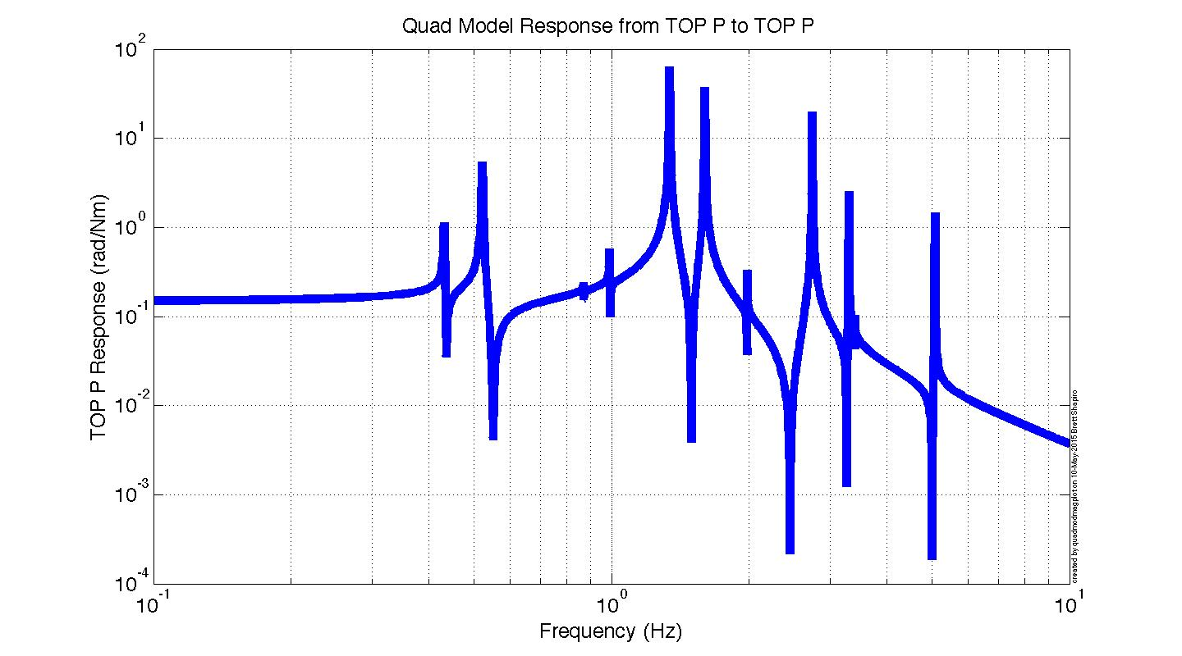
Modal Damping with State Estimation
top mass
drive
Pendulum
Displacements
of every stage
pendulum
eigenvector matrix
N mode plant
Modal damping filters
modal displacements
of all stages
modal forces
Notes:
…take a very complicated system with many modal resonant frequencies and use a matrix transformation to…

Slide 10
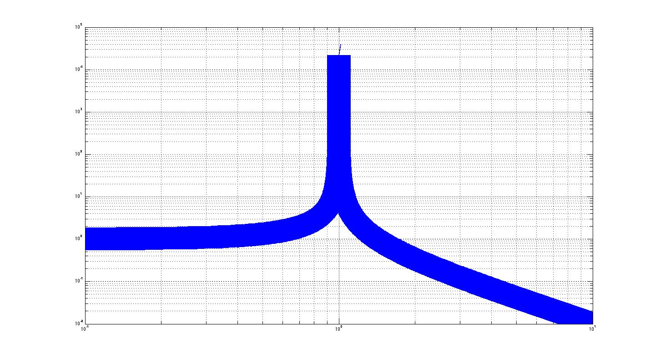
Modal Damping with State Estimation
top mass
drive
Pendulum
Displacements
of every stage
pendulum
eigenvector matrix
N mode plant
Modal damping filters
modal displacements
of all stages
modal forces
N, 1 mode plants
Notes:
…break it up into a series of simple, independent, single resonant frequency systems. The matrix transformation is no different from the matrices we use now except that the matrix happens to an eigenvector matrix.
Then we can design a very simple damping filter for each mode (in fact its usually the same filter but scaled in frequency), and use another matrix transformation to sum the damping signals back together.
Tuning becomes really easy in this way. For example you just increase the gain on the modes that need more damping, and decrease it on those that don’t to improve the noise performance. In fact, it’s easy to do this tuning in real time, which you can’t do with regular SISO control. For my thesis I even automated this tuning so the damping could respond in an optimal way to evolving seismic noise.

Slide 11
Modal Damping with State Estimation
top mass
drive
Pendulum
top mass
displacement
pendulum
eigenvector matrix
N mode plant
Modal damping filters
modal displacements
of all stages
modal forces
N, 1 mode plants
Notes:
So at this point I haven’t actually shown any modern control yet. The problem modern control solves is that to do the modal decomposition we need sensors at every stage, but we only have sensors at the top mass.

Slide 12
Modal Damping with State Estimation
top mass
drive
Pendulum
top mass
displacement
pendulum
eigenvector matrix
N mode plant
Estimator uses LQR to optimize the noisy sensor(s) for good estimation
Estimator
Modal damping filters
estimated
modal displacements
of all stages
modal forces
N, 1 mode plants
Notes:
So instead we use an estimator that reconstructs the missing information using our state space model of the suspension. The model in the estimator tracks the real suspension with the sensor signal we do have. The estimator is designed using the LQR method to optimize the problem of using a noisy sensor to estimate the missing information.

Slide 13
Modal Damping with State Estimation
top mass
drive
Pendulum
top mass
displacement
pendulum
eigenvector matrix
N mode plant
Estimator design is independent from damping design
Estimator
Modal damping filters
estimated
modal displacements
of all stages
modal forces
N, 1 mode plants
Notes:
A really useful feature of estimators is that the stability of the estimator has nothing to with the stability of the damping. So the estimator’s design is largely independent from the damping filters, assuming the model is good enough. But notably, our suspension models are good enough that this assumption has yet to be broken.
Another useful feature is that, since this an inherently MIMO technique, it very easy to include additional information to improve the modal estimates. That’s why you see the actuator signal coming into the estimator as well. We may as well use that information if we have it.

Slide 14
Modal Damping with State Estimation
top mass
drive
Suspension
top mass
displacement
pendulum
eigenvector matrix
easy to add in
other sensors with almost no impact on stability
Oplevs or WFS
Estimator
Modal damping filters
estimated
modal displacements
of all stages
modal forces
N, 1 mode plants
Notes:
Similarly, we could also include the optical lever or WFS information. This actually helps the damping of the lowest frequency modes quite a bit, because they couple more to the test mass than the top mass.

Slide 15
Modal Damping Loop Gain – This is Stable!?
unity gain
-180
+180
-180
+180
-180
Notes:
So I have here an example modal damping loop gain. This isn’t something you usually bother to look at with MC designs, but I think here it is informative to look at it just to make a point. (For the MIMO case the concept of loop gain breaks down. This example is applied to a SISO case to make the point.)
Because everyone knows that for stable control the phase must stay within +-180 degrees. This is one of the first things you learn when learning to design loops. But look at this thing, it crosses 180 like 4 times, yet it is still stable! Actually, what we learned isn’t completely true. Modern control algorithms know better because the physics of stability are built into them.

Slide 16
Modal Damping Loop Gain – This is Stable!?
unity gain
-180
+180
-180
+180
-180
Notes:
It turns out you can cross 180 as many times as you want, provided that the magnitude is less than 1 each time. Actually, there are more subtleties than that, but that just reinforces my point.
So modern control, and optimal control in general, is one way of avoiding artificial constraints that we might impose on our systems. Sometimes we aren’t aware we are doing so as in this case, and sometimes we are, just because we need to simplify them so that we can get our heads around the problem. An example is the ISI control. I don’t want to suggest we should use MC on the ISI, I don’t know the answer to that. I am just using it as an example of a system where we use a bunch of SISO loops loop to control a 12X12 MIMO system, just so it is tractable. In doing so we’re missing out on taking advantage of the couplings between the DOFs that comes naturally to MC algorithms. Another example is the suspension damping, which is why modal damping has the potential to damp more efficiently.

Slide 17

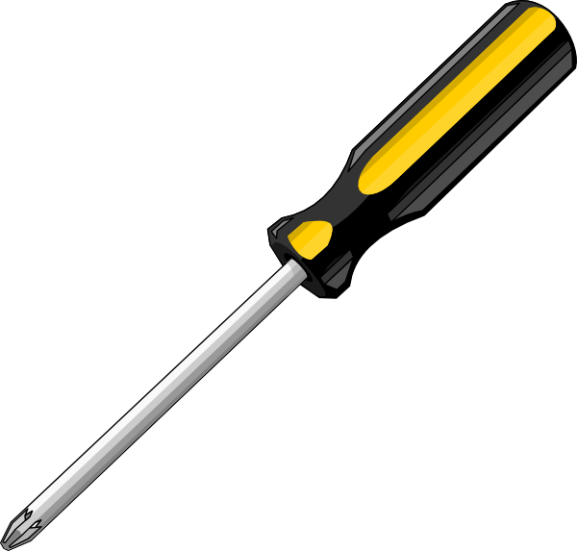


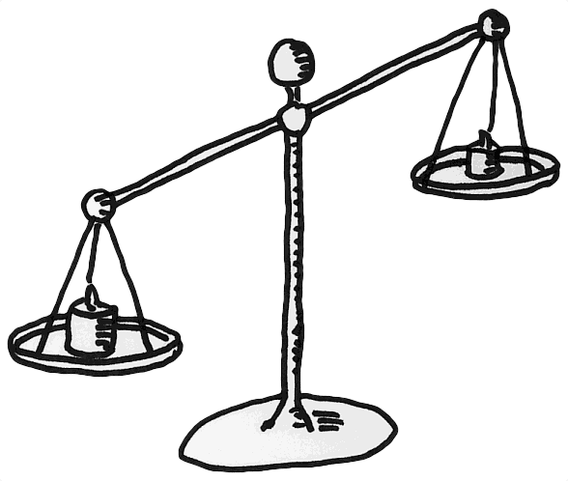


Humans (loop shaping)
Modern controls
Distinguishing good and bad results
Adjusting to the unexpected
‘human readable’ designs
MIMO systems
Not subject to human biases and strategies
Quantitatively ‘optimal’ solutions
‘Optimal’ only in the context of the cost function
Unmodeled dynamics
‘human readable’ designs
MIMO systems with many coupled loops
Have individual biases and strategies
Notes:
To conclude, I made a non-exhaustive comparison of what I think people are good and bad at and what MC is good and bad at. You’ll see that, in general, the areas where people are good are the areas where MC is bad, and where people are bad, MC is good.

Slide 18
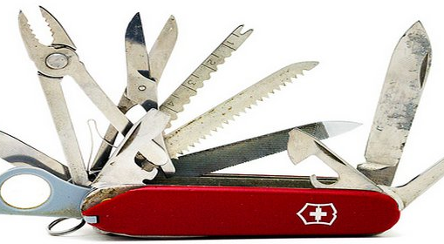
Conclusion – every job has its tool
Notes:
We should use the right tool to solve the right problem.

Slide 19
Back Ups

Slide 20
Concerns I often hear about Modern control, and my responses to those concerns
This is just a first attempt to answer these concerns. I think we should agree on the responses as a group, citing examples. By doing so we’ll be well on our way to exploiting the best each technique has to offer.

Slide 21
Concerns often heard about Modern Control (MC)
We’re just moving the complexity of the design to the cost function.
It is hard to predict how a change in the cost will impact the loop.
The cost function does not permit the designer to include as much intuition as classical techniques like loop shaping.
We don’t know what optimal really means so we end up just turning the knobs of the cost function to get a result the seems OK.
Stability is not guaranteed in practice.
Only a few people know how to use it.
We’ll lose understanding of our own control systems. Too much complexity is buried in algorithms.

Slide 22
My responses to those concerns
“We’re just moving the complexity of the design to the cost function.”
In some cases yes. But there are cases where MC simplifies the problem. Modal damping is an example, which is actually a mix of MC and traditional loop shaping. The MC decouples the system into independent modes, which are then controlled using traditional loop shaping. In other cases, MC might be no more or less complex, yet provide better results. In general, keeping the cost function simple helps a lot.
“It is hard to predict how a change in the cost will impact the loop.”
Can be yes. Using simple cost functions makes it easier to predict what will happen. If the cost function needs to be so complicated that it is disconnected from the result, then MC may not be the right tool for the problem.
“The cost function does not permit the designer to include as much intuition as classical techniques like loop shaping.”
Adding some frequency dependence helps here. Keeping it simple also helps preserve intuition. If the frequency domain shape needs to very complicated, or frequency weighting is required for more than 2 or 3 loops, MC might not be the best choice (at least on its own).

Slide 23
My responses to those concerns
“We don’t know what optimal really means so we end up just turning the knobs of the cost function to get a result the seems OK.”
As before, keeping it simple helps preserve intuition. Also, sometimes it works well simply to scan through the space of cost function values and pick the ones that work best. Modal damping was implemented in this way, by writing an ‘outer’ cost function that optimized the MC cost function with things we actually care about like DARM noise and Q values. Might it seem silly to have a cost function for a cost function, but it does work very well in this case.
“Stability is not guaranteed in practice.”
Stability is an issue with any feedback method (even feedforward sometimes). If you start with a good model in the modern controller, any adjustments needed to ensure stability will be minor.

Slide 24
My responses to those concerns
“Only a few people know how to use it.”
I think this and the next points are the most serious concerns. My response for this one is that if we want our systems to work at peak performance, we need to make all the tools available to us. People who work on high performance systems should make the effort to become familiar with MC methods. In most cases MATLAB makes them pretty easy to use. A deep understanding of the (usually difficult) math behind them isn’t necessary for effective use.
“We’ll lose understanding of our own control systems. Too much complexity is buried in algorithms.”
This is legitimately something too watch out for. In some cases MC can simplify the control without losing much understanding of what’s going on, as in modal damping. In other cases MC can obscure the physics of what’s going on. In those cases we should use loop shaping methods, unless MC solves some essential problem loop shaping can’t. Thus, the point made earlier in these slides to use the right tool in the right place.

Slide 25
Summarizing what Modern Control is good and bad at and when it is useful for us

Slide 26
Summarizing what is modern control good at
MIMO systems
  Will utilize many signals seamlessly and take advantage of built in couplings
Generating theoretically stable solutions
  Even for unstable systems (Para. Inst. perhaps?)
Very simple to use software, e.g. MATLAB
Not being subject to human biases

Slide 27
Summarizing what is modern control bad at?
‘Optimal’ is only in the context of the cost function (inputs vs outputs).
  Loss of human intuition
  No nonlinear effects like actuation limits
Stability requires very good models
  Will not handle unmodeled dynamics at all, e.g. bounce and violin modes
The controller is no more complex than the plant
  Though you can augment the plant with any frequency dependence in the cost functions

Slide 28
So when is modern control useful?
When the usual methods aren’t meeting the requirements
  and /or
When MC can simplify a MIMO system
  and (in all cases)
When the cost functions are simple

Slide 29
Modal Damping Notes

Slide 30
Modal Damping with State Estimation
= pendulum
eigenvector matrix
= Cartesian coordinates
= sensor sig.
= estimated modal coord.
= Cartesian damping forces
= modal damping forces
mode damping filter
mode damping gain
Cartesian
Coordinates
(coupled
dynamics)
Pendulum
Estimator
Modal
Coordinates
(decoupled
dynamics)

Slide 31
Modal Feedback Design
approximate damping ratio
,
,
,

Slide 32
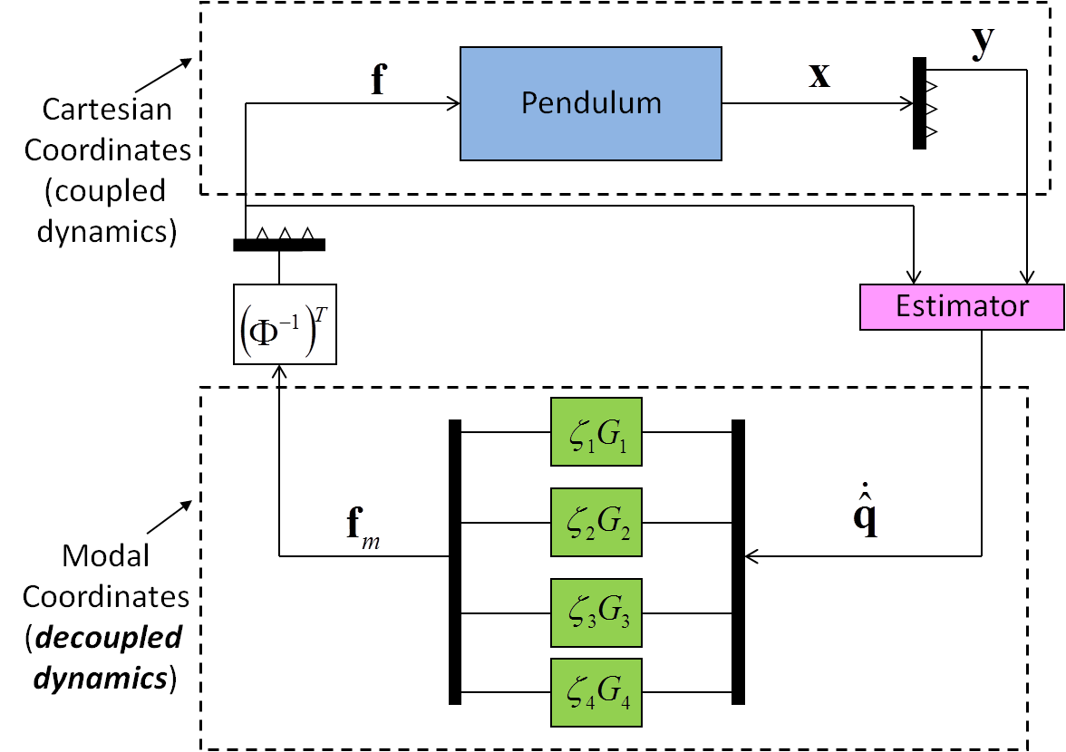
Estimator Design
Linear Quadratic Regulator (LQR) design
?
Weight cost of using noisy sensor
Weight cost of estimation error

Slide 33
Choosing Q and R: Not Unique
R is still to be determined

Slide 34
Solving the R matrix for MIMO Modal Damping
Try a bunch of R matrices and see what works best
Measure ‘best’ with an auxiliary cost function.
z
DOFs i are: x, y, z, yaw, pitch, roll
x

Slide 35
Modal Estimation Cost
(x is the laser axis)

Slide 36
Optimal Noise Amplification
simulation
Noise requirement

Slide 37
Comparison of MD Noise Performance
simulation
B Shapiro, Modal control with state estimation for advanced LIGO quadruple suspension, MSc Thesis, 2007

Slide 38
Generalized Cost Functions for Cavity Length Control
References: G1400853, G1400567, SWG log 11297

Slide 39
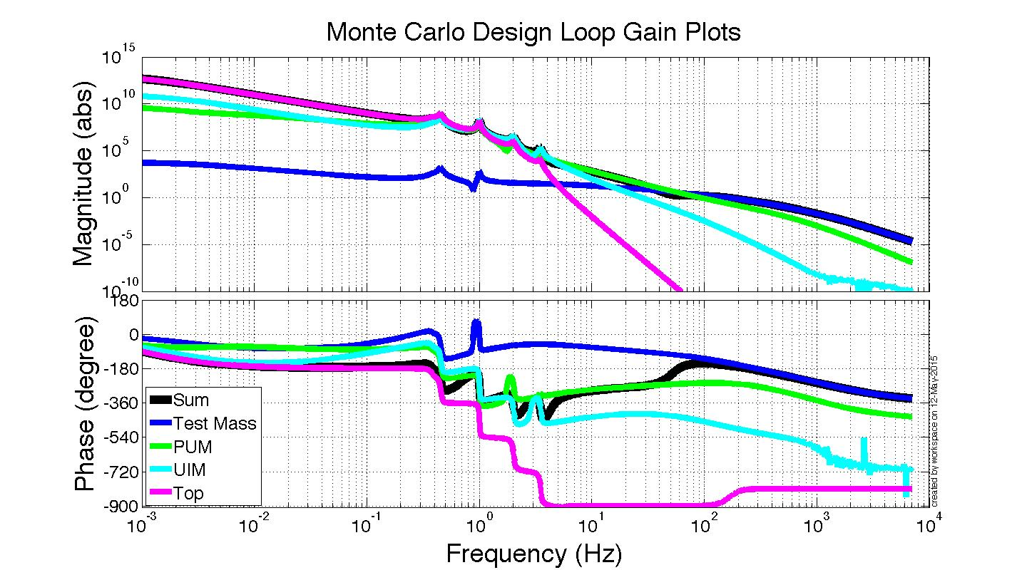
Monte Carlo Design
12 million iterations – about 1 day of computation time in MATLAB

Slide 40
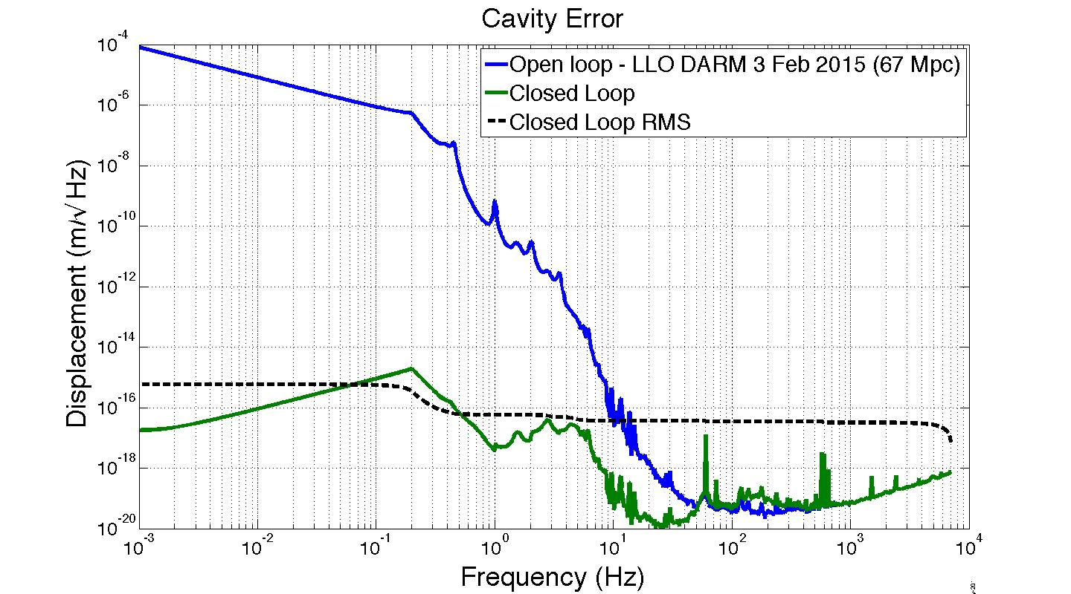
Cavity Performance (simulation)
RMS error = 5.8e-16 m
Requirement < 1e-15 m
DAC RMS voltages:
Top = 0.21 V
UIM = 0.29 V
PUM = 0.99 V
TM = 0.06 V
DAC saturates at 10 V

Slide 41
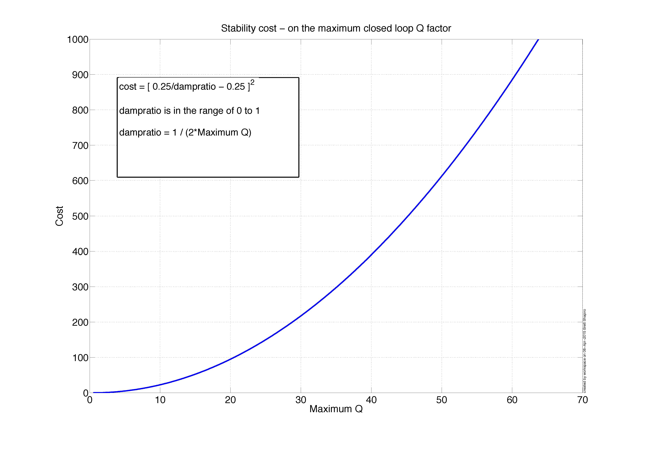

Slide 42
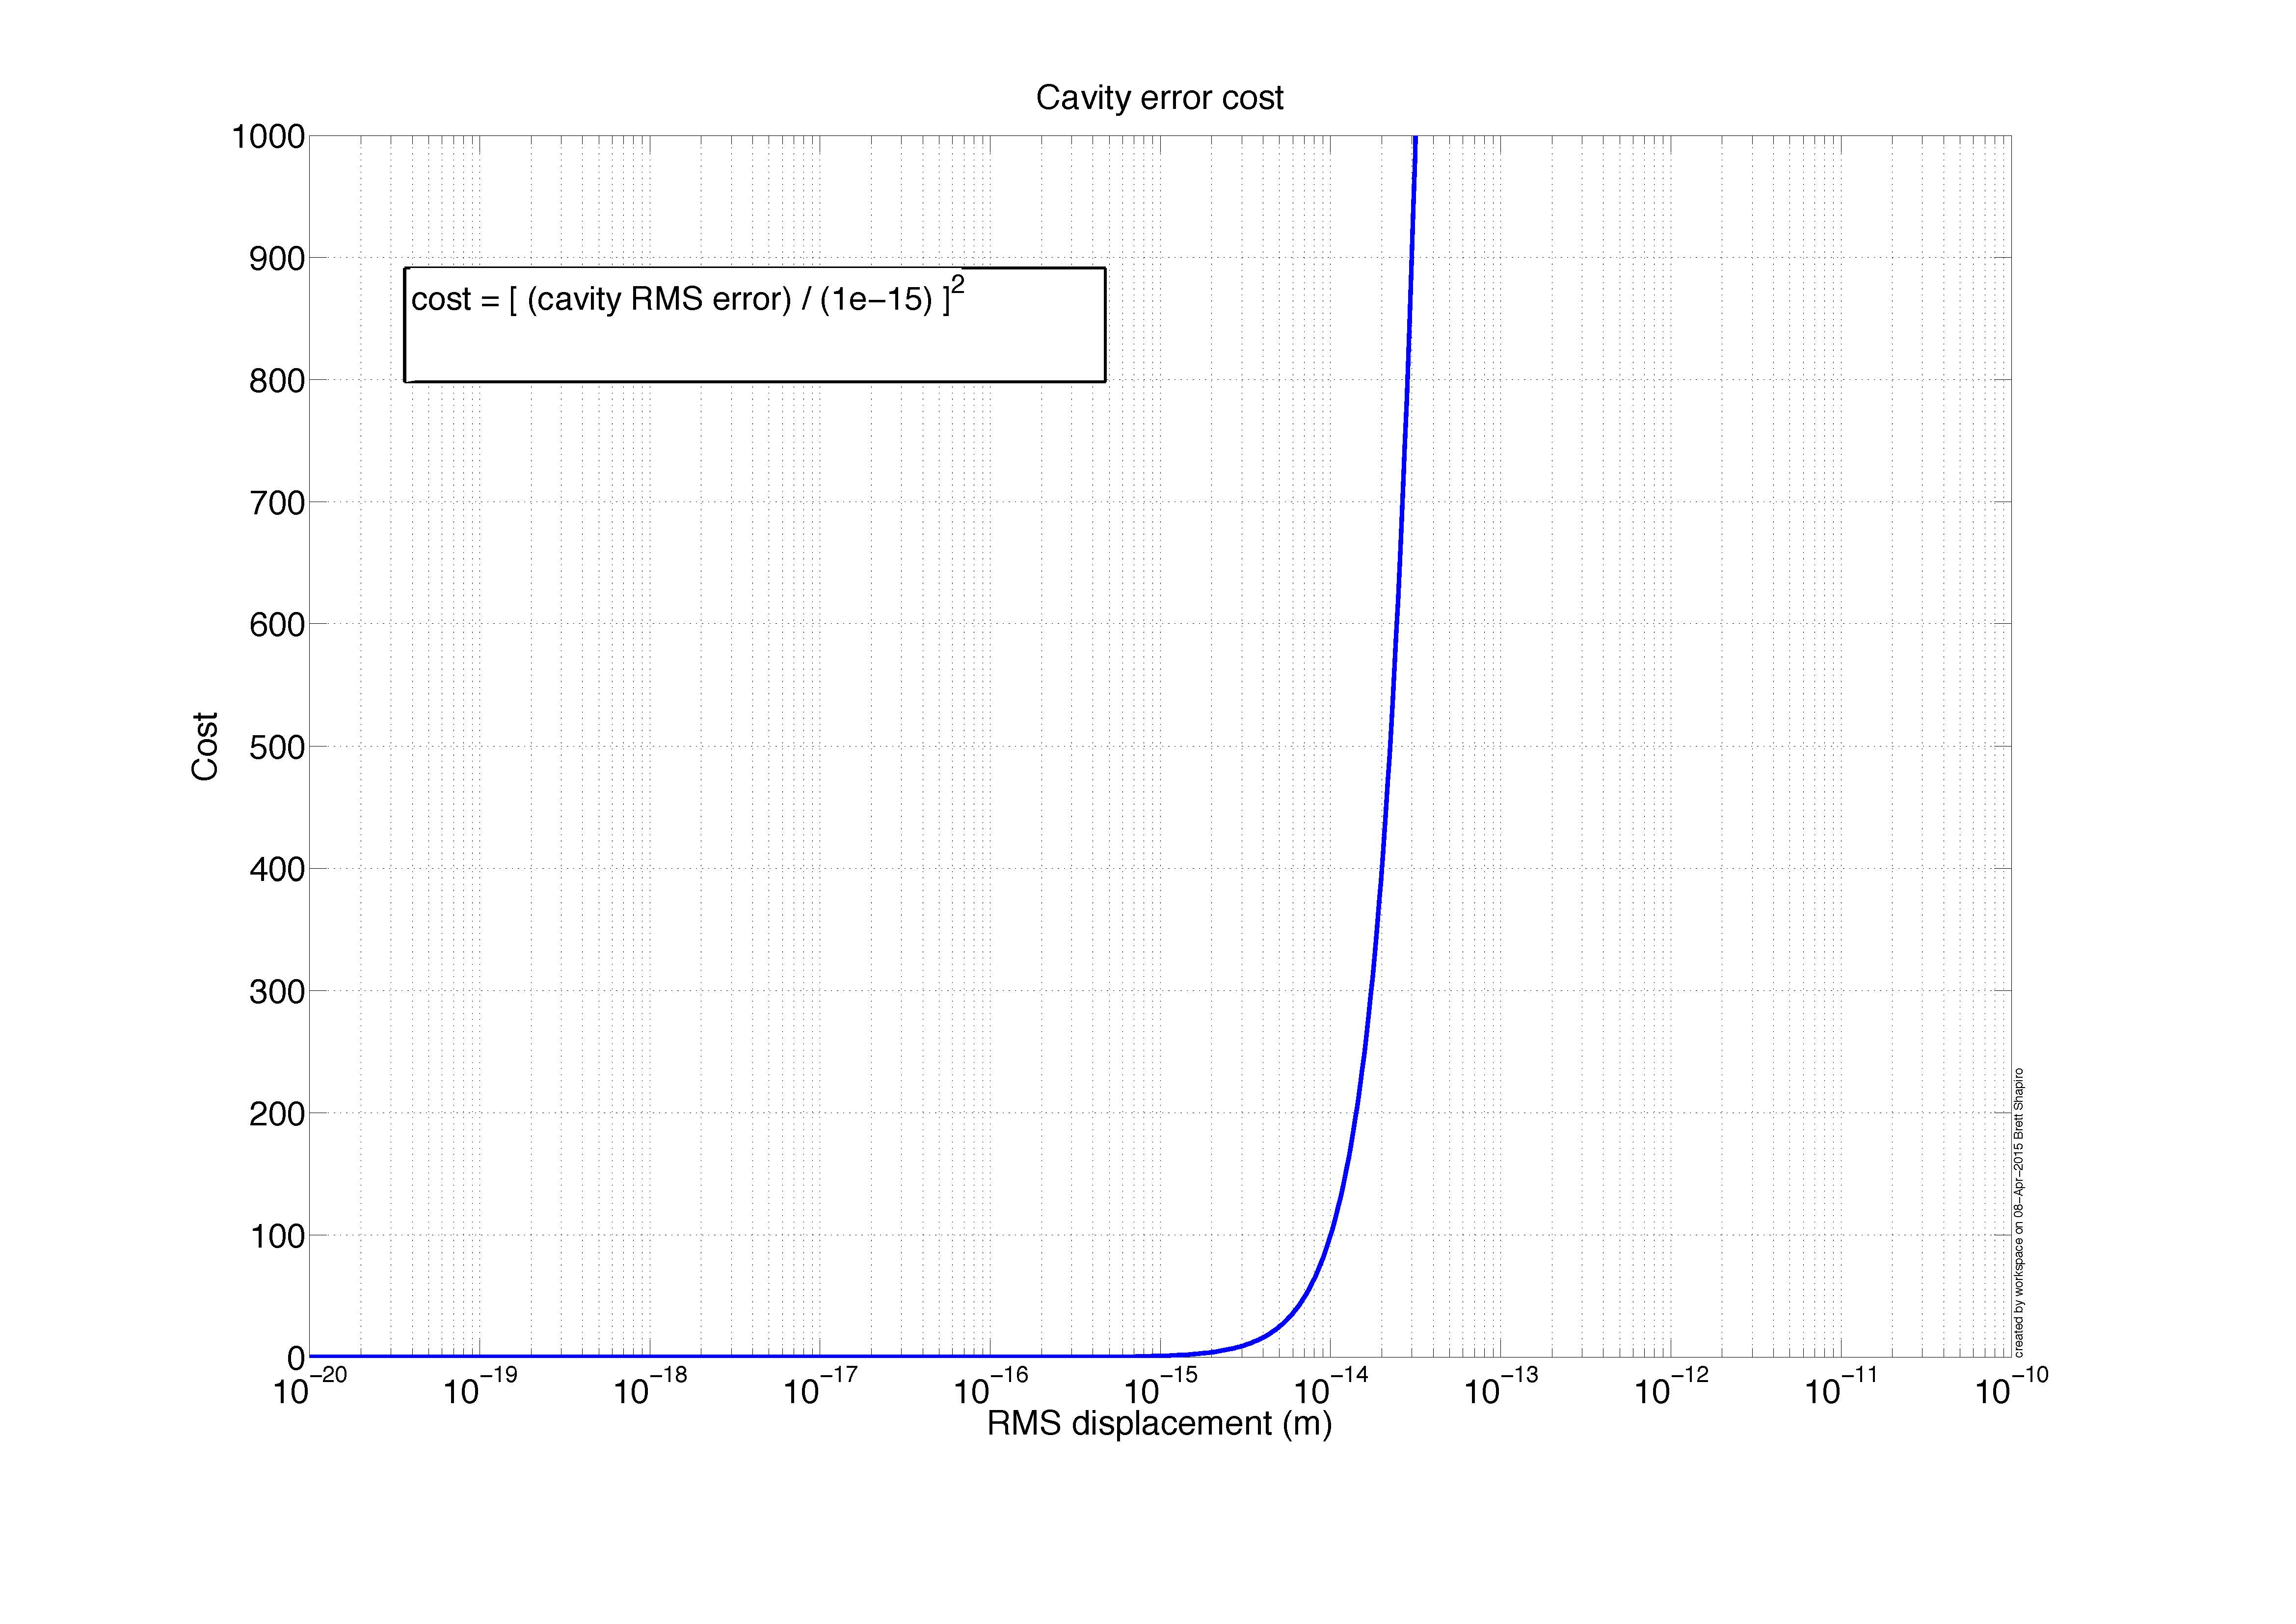

Slide 43
