Slide 1
Thermal Noise in Thin Silicon Structures
Matthew Winchester
Mentors: Nicolas Smith, Zach Korth, and Rana Adhikari
August 20, 2015

Slide 2
Overview
Motivation
Thermal noise
Damped oscillator review
Fluctuation-Dissipation Theorem
Experimental design
Measurements
Conclusions

Slide 3
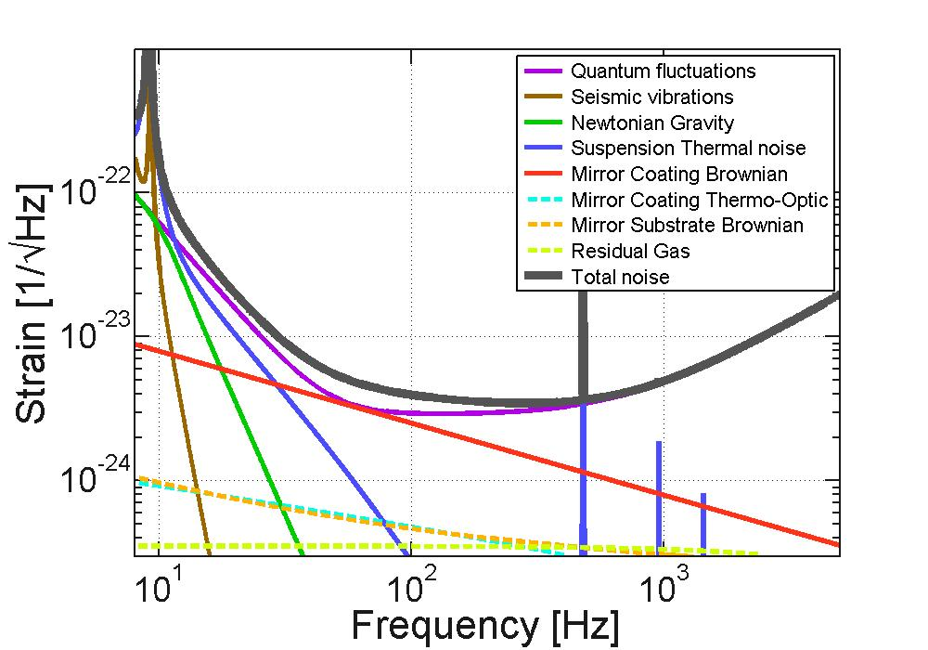
Motivation – Increase Future Detector Sensitivity
Reduce thermal noise in suspensions and test masses
Current detectors use fused silica
Crystalline silicon is being considered for future detectors
Favorable material properties (more on this later)

Slide 4
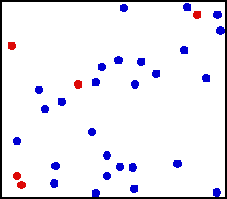
Thermal Noise in LIGO
Temperature is a measure of average kinetic energy
Random thermal fluctuations couple to displacement noise in detector
How do we reduce the shaking in our test masses? (without cooling everything to 0K)

Slide 5
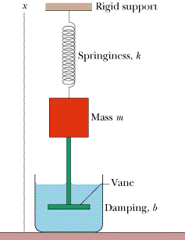
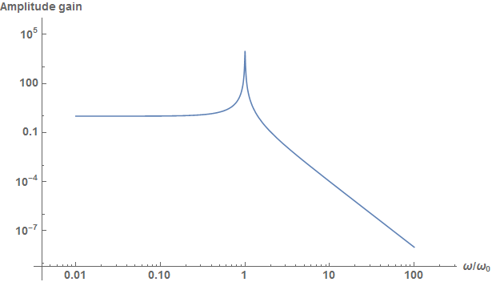
Underdamped Oscillator Review
Equation of motion:
Frequency response:
Underdamped:

Slide 6
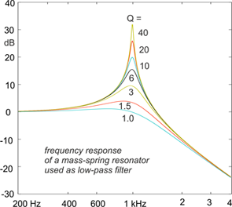
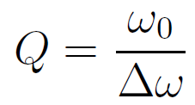
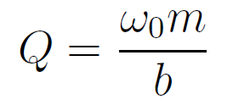
Quality Factor Q

Slide 7
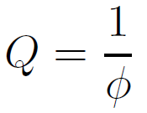
Internal Damping
Restorative force leads displacement by loss angle ϕ

Slide 8
How are losses in oscillators related to thermal noise?

Slide 9
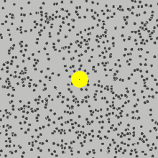
Fluctuation-Dissipation Theorem
FDT relates thermal fluctuations (noise) to dissipation (damping/resistance/loss)
Brownian motion
Johnson noise

Slide 10
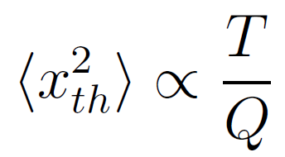
Thermal Noise in Damped Oscillators
Thermal noise power spectrum:
Away from resonance:
We want to design high Q, low loss silicon resonators

Slide 11
Our Resonators – Silicon Cantilevers

Slide 12
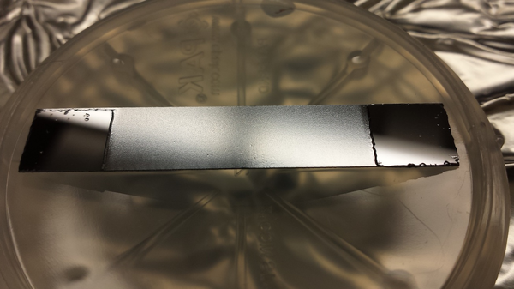
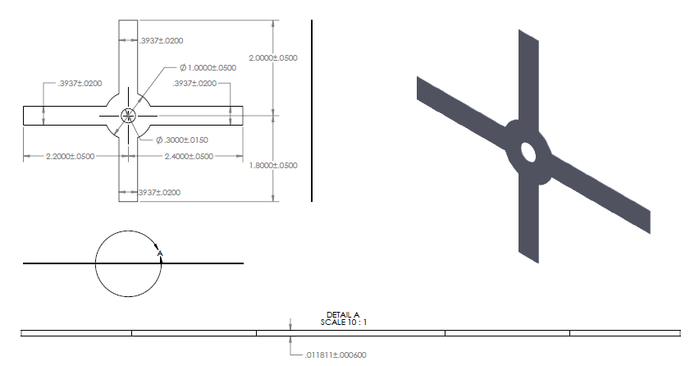
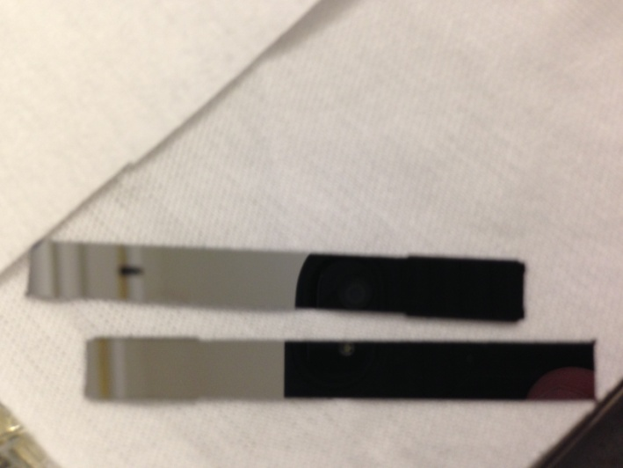
Silicon Cantilever Design
RIP

Slide 13
Experimental Design

Slide 14
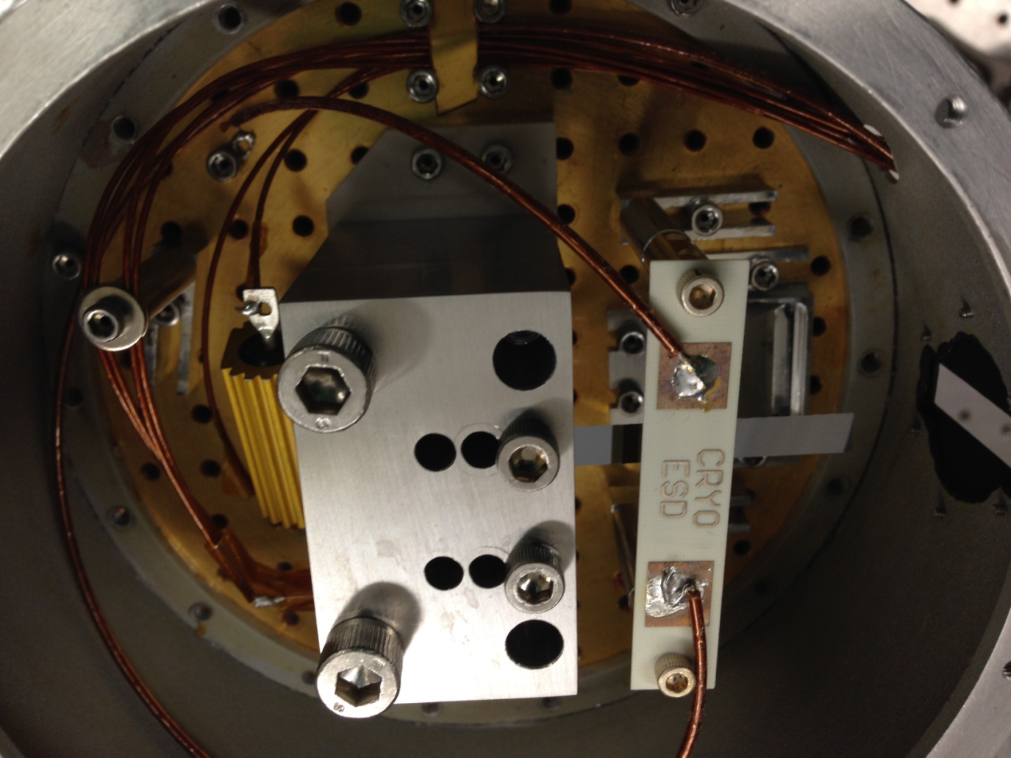
Experimental Design

Slide 15
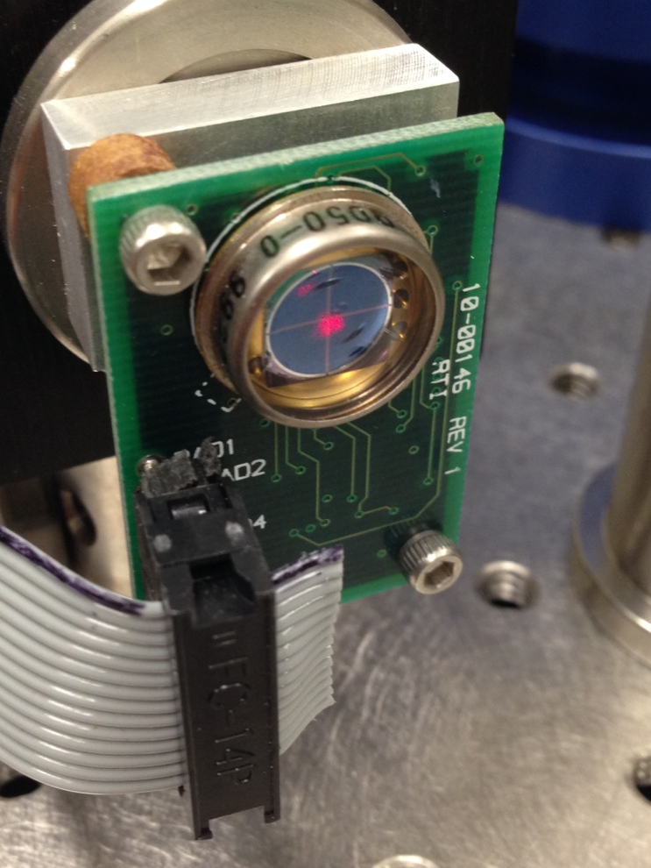
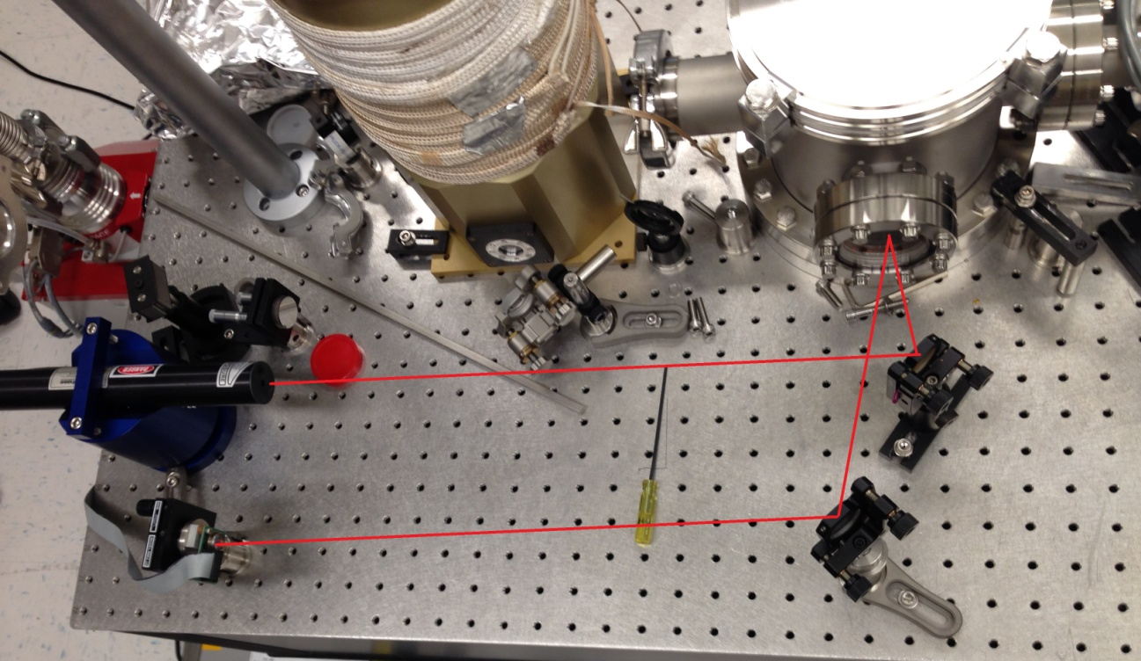
Experimental Design - Optics

Slide 16
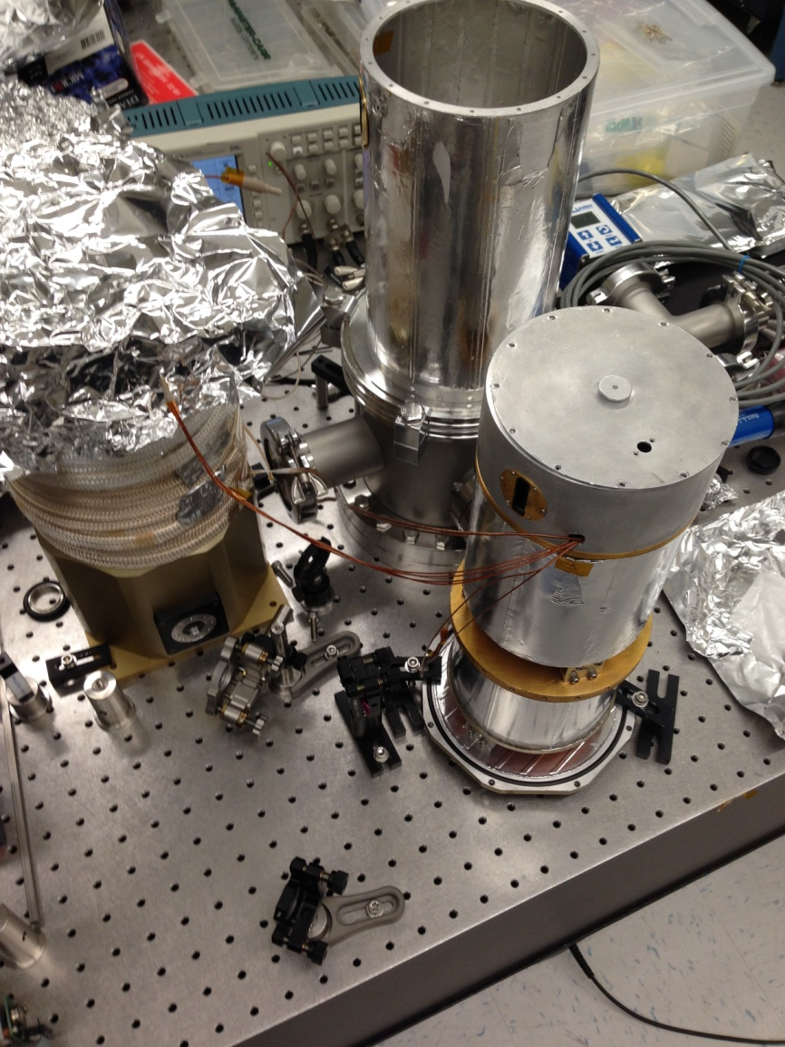
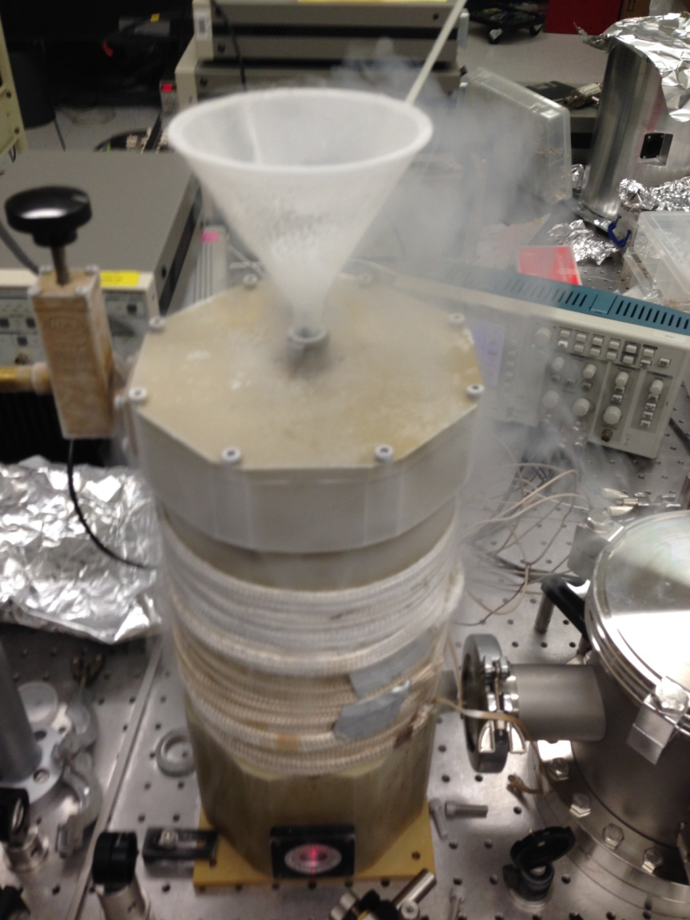
Experimental Design – Insulation

Slide 17
Ringdown Measurement
Excite cantilever with impulse and watch free decay

Slide 18
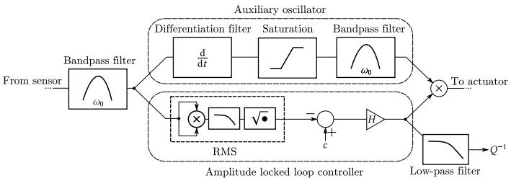
Continuous Measurement
Cantilever is continuously driven at constant amplitude
Less sensitive to background excitations
Measures Q over temperature sweeps, etc.

Slide 19
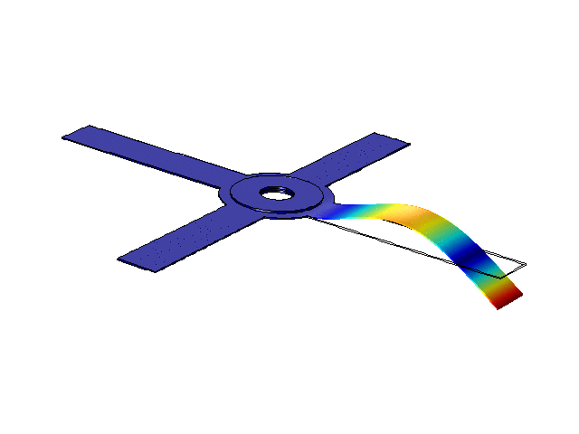
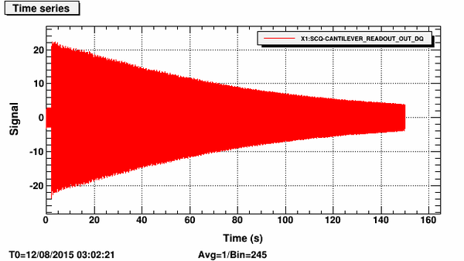
Making Conclusions about Losses
Theory
Simulation
Experiment

Slide 20
Sources of Loss
Thermoelastic loss
Clamp loss
Surface loss
Phonon-phonon loss
Gas damping
Bulk loss
Excess losses

Slide 21
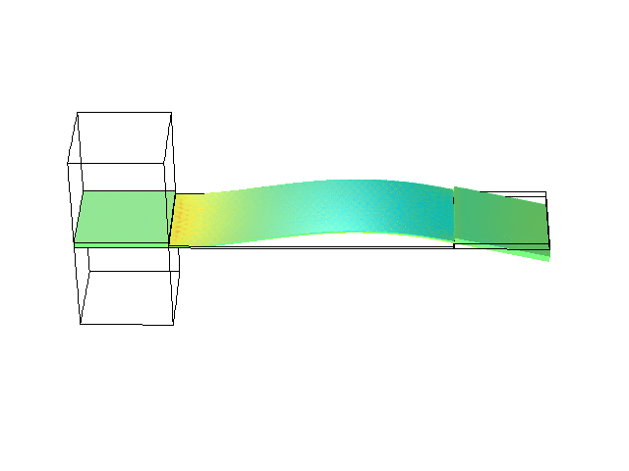
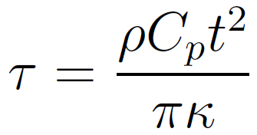
Thermoelastic Loss
Coefficient of thermal expansion couples strain to temp.
Heat fluxes driven by temp. gradient dissipate energy

Slide 22
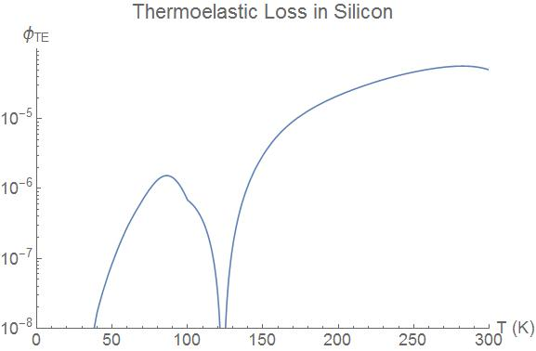
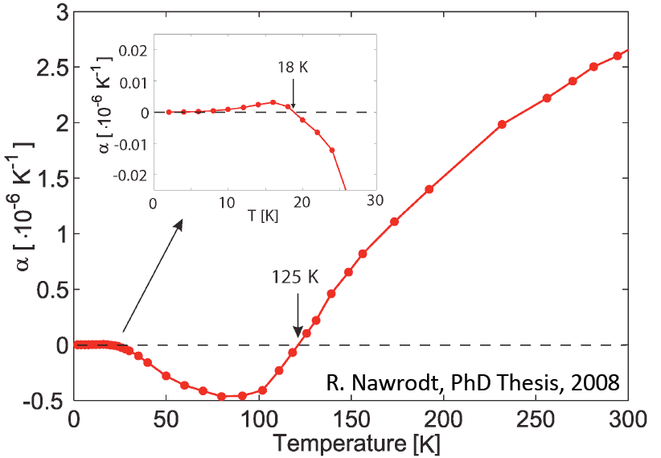
Thermoelastic Loss cont.
Silicon has a vanishing α at T=125K

Slide 23
TE Loss Conclusions
Don’t see dramatic increase in Q at 125K
Q is ~2 orders of magnitude lower than TE loss limited prediction
Not TE loss limited

Slide 24
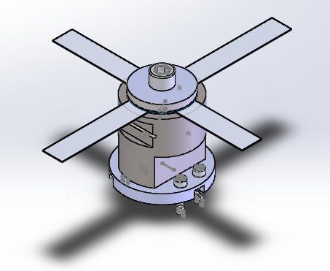
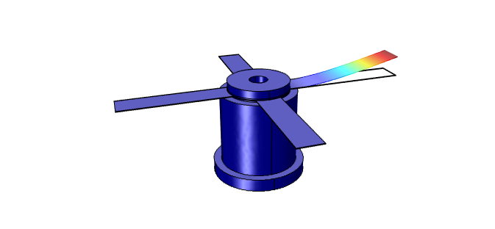
Clamp Loss
Energy is transferred from cantilever and stored in clamp, base, etc. as strain energy

Slide 25
Clamp Loss Conclusions
Simulations predict that very little strain energy is stored in clamp, washers, base, etc.
New clamp designs don’t significantly improve Q
Reclamping doesn’t change Q
Not clamp loss limited

Slide 26
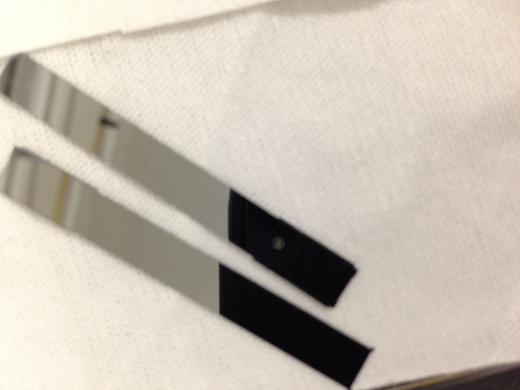
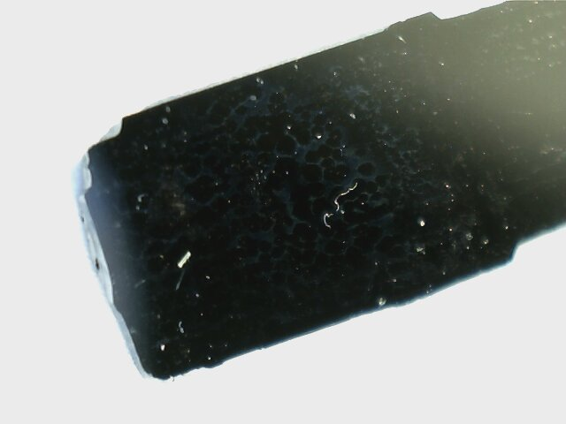
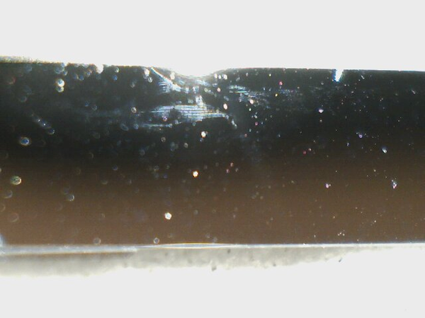
Surface Loss
Surface roughness, lattice imperfections, adsorbed surface materials, etc. contribute to a lossy surface

Slide 27
Surface Loss Conclusions
Cantilever surfaces clearly show surface defects
Cleaning doesn’t improve Q (?)
Lossy surface layers in simulation accurately predict experimental results
Much more work to be done investigating different etching techniques
Candidate for dominant loss source

Slide 28
Summary
No quality factor peak at 125K – not TE limited
Simulation shows low strain energy ratios – not clamp loss limited
Most likely surface loss limited – lossy surfaces in simulation match experiment
Developed technique for continuous measurements of several resonant modes simultaneously – speed up future Q measurements

Slide 29
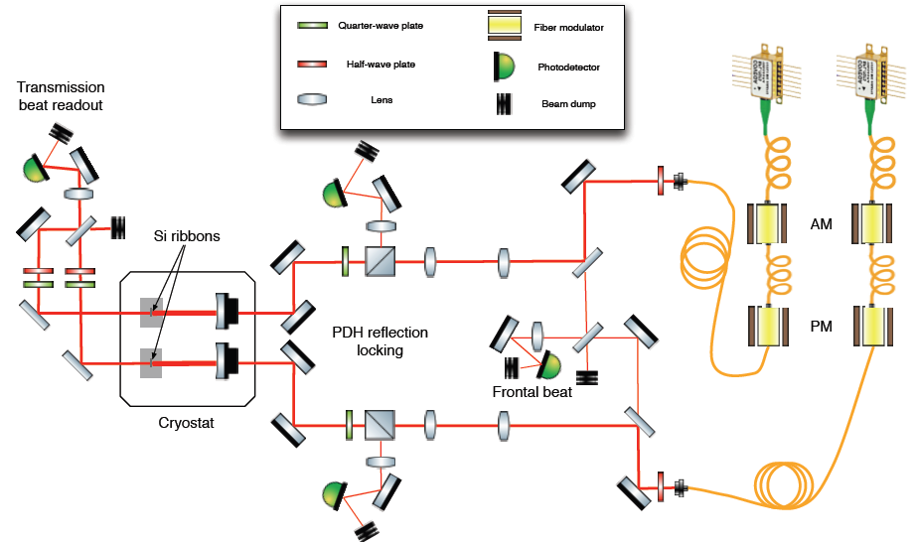
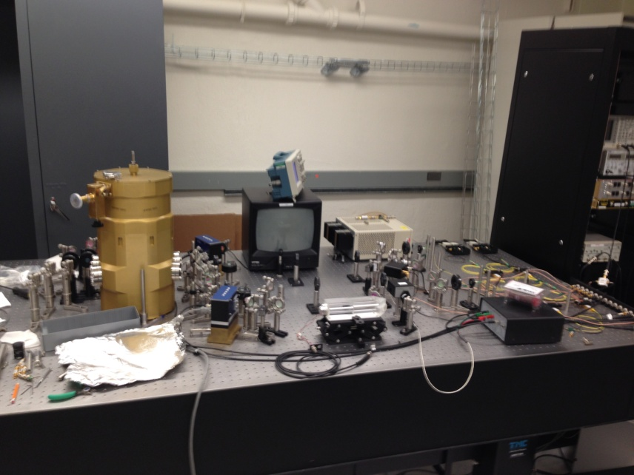
Future Work
Experiment with different etching techniques
Investigate loss in thin films and optical coatings
Direct thermal noise measurements

Slide 30
Acknowledgements
My mentors: Zach, Nic, and Rana
Fellow SURF students
LIGO Scientific Collaboration faculty
NSF and Caltech
Thanks for a great summer!

Slide 31
Questions?

Slide 32
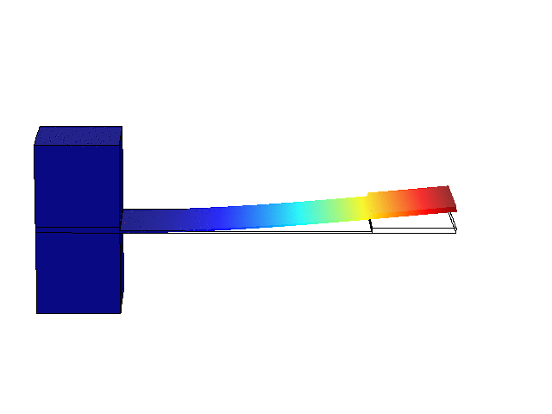
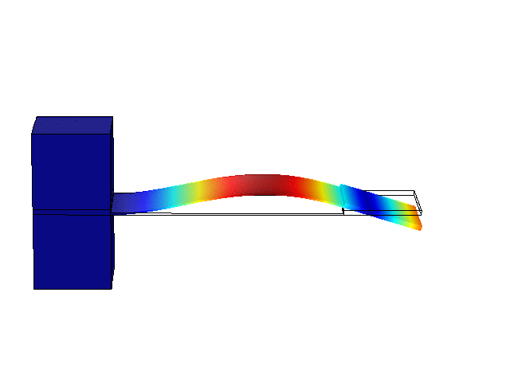
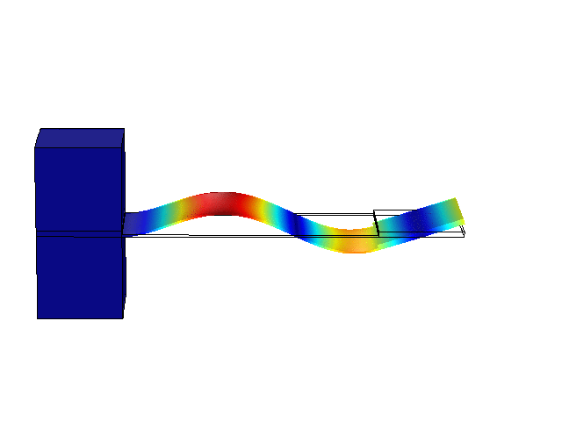
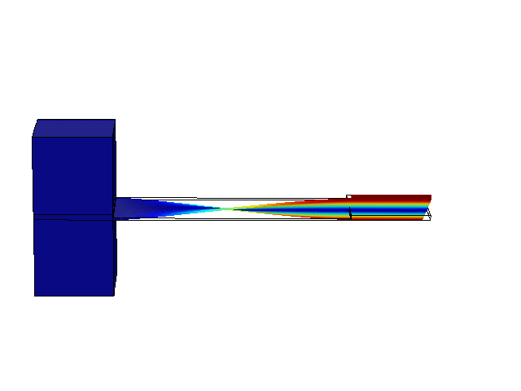
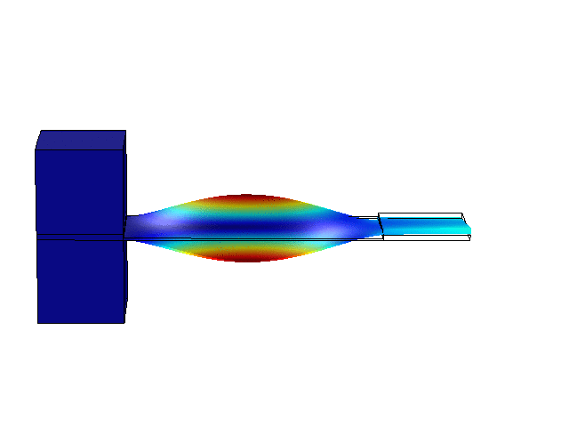
COMSOL Mode Simulations
Normal Modes
Fundamental mode
2nd mode
3rd mode
Torsional Modes
Fundamental mode
2nd mode

