Slide 1
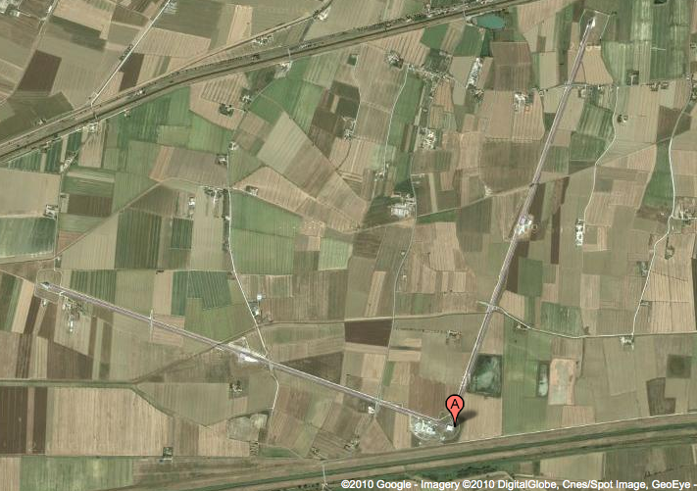
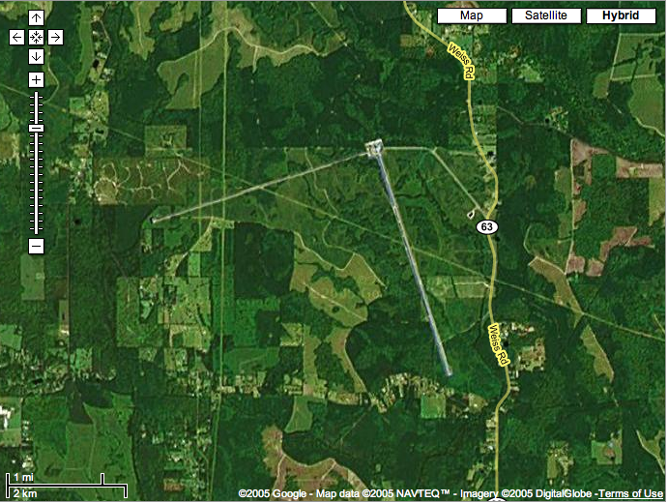
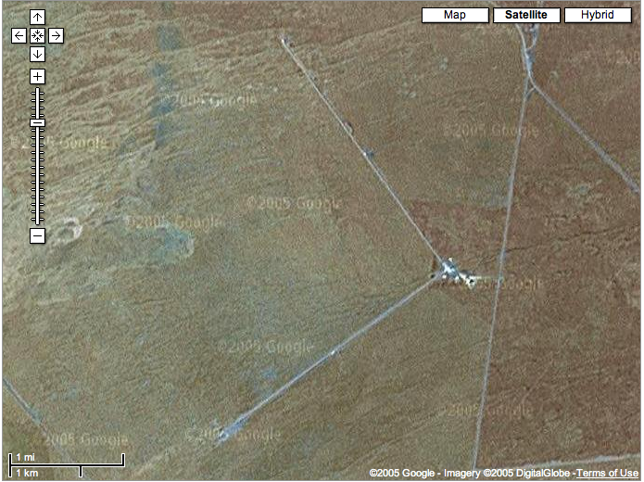
Status of Advanced LIGO detectors
Gabriela González
Louisiana State University
For the LIGO Scientific Collaboration and the Virgo Collaboration
Virgo detector, Cascina, Italy
LIGO Livingston Observatory, Louisiana, USA
LIGO Hanford Observatory Washington, USA

Slide 2
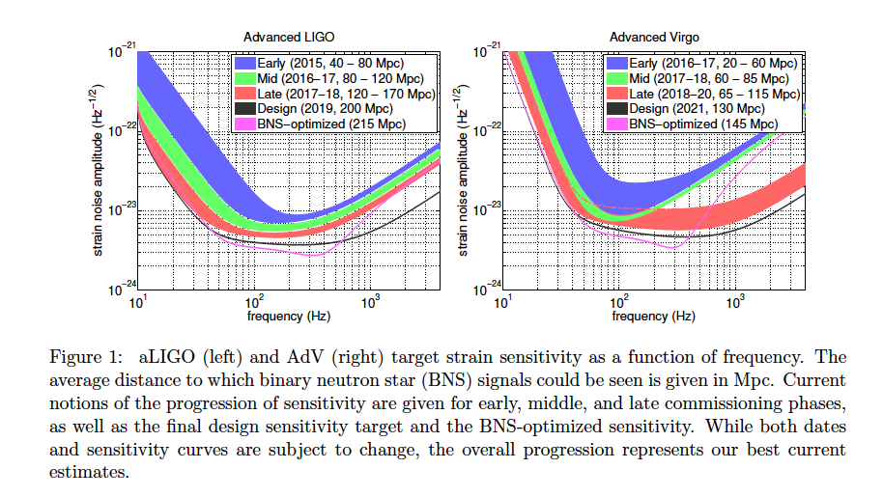
A reminder: Observing Scenario
Prospects for Localization of Gravitational Wave Transients by the Advanced LIGO and Advanced Virgo Observatories, The LIGO Scientific Collaboration and The Virgo Collaboration, arXiv:1304.0670

Slide 3
A reminder: Observing Scenario
Updated news on localization for O1 – talk by F. Marion

Slide 4
Very rapid commissioning progress
Latest calibrated spectra in https://dcc.ligo.org/LIGO-G1401390/public

Slide 5
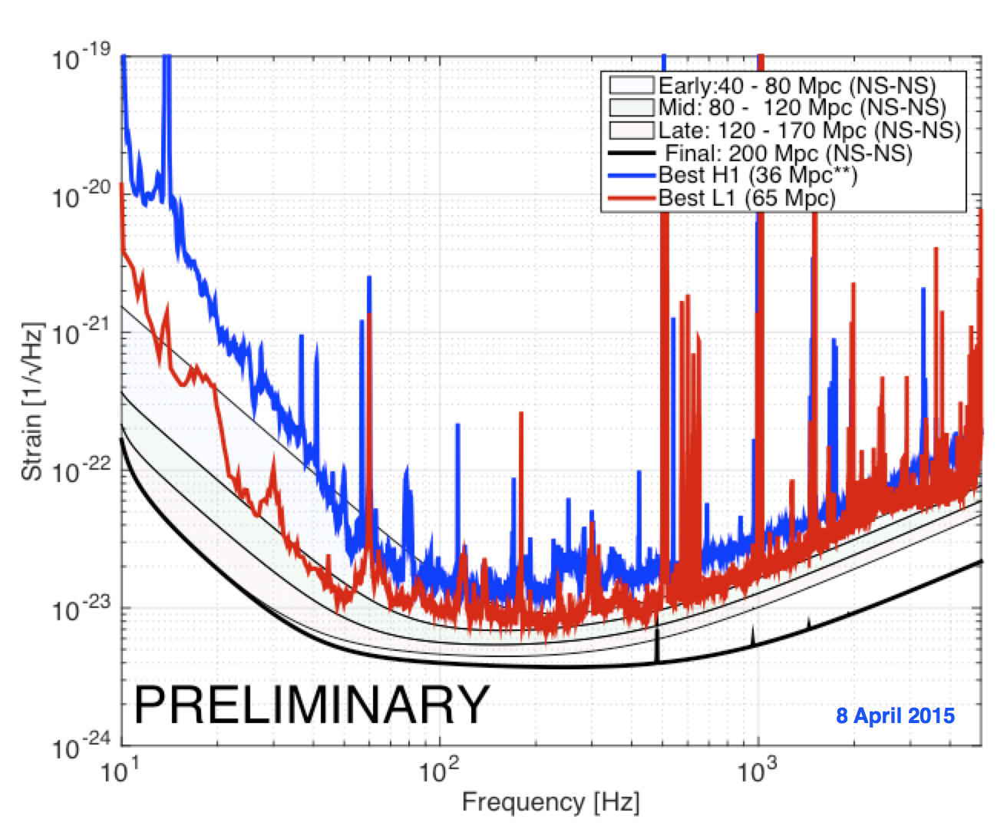
Current sensitivity acceptable for O1

Slide 6
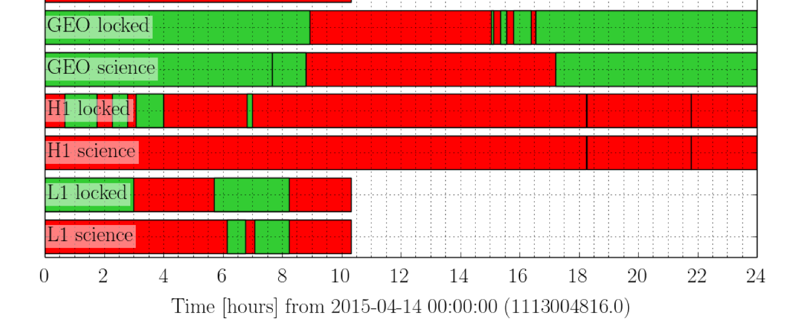
Detectors in operation

Slide 7
… and stable

Slide 8
Timeline for Engineering Runs and O1
Precise dates will depend on status of detectors, operations and analysis.

Slide 9
Future runs’ dates (with Virgo)
Again - will depend on progress on detectors’ sensitivities.
There will likely be short engineering runs in between observing runs.

