Slide 1
Plans for the First Observing Run (O1)
Peter Shawhan for the LSC and Virgo
Workshop on the LIGO-Virgo EM Follow-up Program Cascina — April 23, 2015
LIGO-G1500517-v2
GOES-8 image produced by M. Jentoft-Nilsen, F. Hasler, D. Chesters (NASA/Goddard) and T. Nielsen (Univ. of Hawaii)

Slide 2
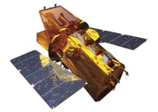
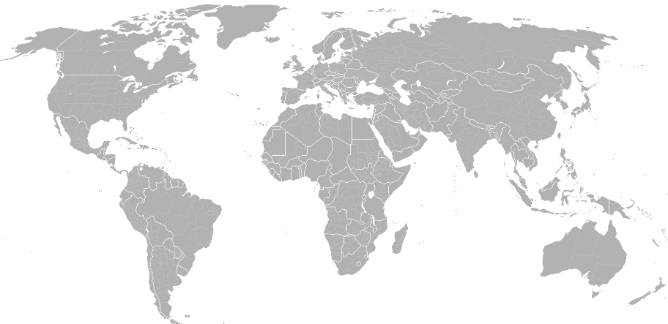
The Big Picture
LIGO Hanford
GEO 600
KAGRA
Virgo
LIGO Livingston
LIGO-India
Send info to observers
Transfer data
Data quality validation
Analyze data, identify triggers, infer sky position
Trigger database
GW data
Select event candidates
Estimate background
Swift: NASA E/PO, Sonoma State U., Aurore Simonnet

Slide 3
Event Candidate Selection and Validation
Software component: “Approval Processor”
Preliminary identification
Trigger found by low-latency CBC or Burst search
Estimated FAR below some threshold
Not a (non-blind) hardware injection
Not already vetoed for data quality reasons
Data quality validation
More sophisticated data quality checks (iDQ)
Operators at observatories confirm there were no anomalous conditions
Skymap file has been generated
Elapsed time goal:
“Preliminary” VOEvent alert
3-5 min
“Initial” VOEvent alert
or
Retraction VOEvent notice
5-10 min

Slide 4
How to Interpret a “Preliminary” Alert
The “Preliminary” alert type is intended to help observers prepare to possibly follow up an event candidate
May be useful to wake up a human or a scheduling computer
For some instruments, could initiate buffering of data
It should not be considered a validated GW candidate
We don’t know yet what fraction of Preliminary alerts will pass the validation checks and produce “Initial” alerts
[During the LIGO/Virgo science run in 2009-10, about 1/3 were rejected at this stage]

Slide 5
Updated Information
“Initial” VOEvent alert
Identifying an event candidate will also launch software to do more sophisticated parameter estimation
Sky position and physical parameters of the source
Can require many hours (MCMC)
Produces updated skymap
Potentially could refine FAR estimate too
→ One or more “Update” alerts
It’s possible that further examination of an event candidate could discover an issue with data quality or estimation of the FAR (significance)
“Update” VOEvent alert
Retraction VOEvent notice

Slide 6
FAR Threshold / Alert Rate for O1
We will generate alerts from CBC and Burst low-latency searches
We propose to set the FAR threshold so that we expect ~1 CBC alert and ~1 Burst alert per calendar month during O1
Total of about 6 alerts expected during O1
Note: the event type and FAR is included in the alert, so you could apply a tighter cut on the alerts you receive, if you want
Caveats:
Estimated corrections for livetime and rate of surviving data quality checks
Poisson statistics
Low-latency FAR estimation could have some systematic issues
Position reconstruction is a bit worse for weaker events
We’re saying we will generate alerts for ~6 false event candidates, plus however many real event candidates are loud enough to pass the FAR threshold too (which could be zero during O1)

Slide 7
Real Events vs. FAR Threshold
In O1, assuming 60 Mpc ranges, “realistic” BNS merger rate is exact, and background model in “Prospects” paper (arXiv:1304.0670):
1 per 100 years $ρ_{c}≥12$ 0.10 events selected
1 per year $ρ_{c}≥11$ 0.13 events selected
1 per month $ρ_{c}≥10.46$ 0.15 events selected
➔ Very small additive gain of real events in O1
(Despite large difference in number of false events!)
Fractional gain will be more valuable in later runs
Note: any 1-per-100-years event will be selected with any of these thresholds; and even with the loose 1-per-month threshold, 2/3 of real events selected will have FARs of 1-per-100-years or better
With full range of possible BNS merger rates:
0.001 to 1
0.0013 to 1.3
0.0015 to 1.5
Probably

Slide 8
Rationale for the Loose FAR Threshold
Practice!
We (LIGO/Virgo) and you (EM observers) need practice
Observing strategies
Data analysis
Really confronting the statistical issues
Best to do this during the course of O1, rather than concentrating it in a short test period
Time for us to make adjustments to procedures
Spacing to do multi-night follow-up observing
The purity will probably be very low, but at least these are the best GW event candidates we’ll have so far – and hey, we could get lucky
You can always be more selective by making a tighter cut on FAR
~6 alerts seems like enough for every group to probably be able to follow up one or more

Slide 9
Pre-O1 Testing
We will provide test alerts, generated at programmed times to simulate the approval process, distributed through GCN/TAN
Including during our ER7 engineering run (first ~2 weeks of June)
A few example VOEvents are now posted in the LV_EM wiki* at https://gw-astronomy.org/wiki/LV_EM/VOEventExamples
Maybe not quite the final formatting
* Anyone not yet registered for the LV-EM Forum & wiki: see https://gw-astronomy.org/wiki/LV_EM/RegistrationInstructions
(this page is viewable even if you haven’t yet registered)
Be sure to select your “project” at the bottom of the web form

Slide 10
Blind Injections
From the MOU: “… a small number (up to 3 blind injections per run) of simulated signals may be injected into the GW interferometer data, and may lead to GW candidate alerts. No LIGO and VIRGO members (aside from the few people entrusted to carry out the program in secrecy) or <partner group> members will know that those events are not of astrophysical origin until after they have been fully vetted by LIGO and VIRGO.”
Won’t be un-blinded until the result/preprint is ready to be made public
The LIGO-Virgo blind injection committee has stated that they intend to do this at a rate “comparable to astrophysical expectations”. For O1, that means:
There could very well be no detectable blind injection
Chance of having >1 detectable blind injection is probably extremely small
In any case, the blind injection program will end when the first GW event is published

Slide 11
General LIGO/Virgo Criteria for Interpreting and Publishing Events
1. Above ~5 sigma (false prob $≲10^{−6}$): “detection” paper
Unlikely (but possible!) that we will get a golden event like this in O1
2. Above 3 sigma (false prob $≲0.003$): “evidence” paper
For O1, corresponds to FAR ~ 1 in 100 years
3. Above 2 sigma: describe as outlier in end-of-run upper limits paper, but inconclusive evidence
In this case, a reasonably significant EM counterpart (false coinc prob $≲0.05$) could make this scientifically more interesting, and worth publishing a joint paper
4. Loudest trigger is consistent with background: just describe briefly in upper-limit paper
Unlikely that an apparent EM counterpart could make this interesting, unless it’s a short GRB or otherwise exceptionally distinctive (would need convincing demonstration)
EM counterpart too? Hooray!

Slide 12
Reminder of Publication Constraints
From the MOU: “Any apparent counterpart to the GW event candidate, that was identified due to the GW candidate alert, is strictly embargoed: it may not be published or presented prior to the public announcement or publication of the GW event candidate by LIGO and VIRGO. LIGO and VIRGO will share detailed information with all partners who observed the counterpart prior to publishing or presenting the GW event results.”
The embargo is important to LIGO/Virgo
We need to be the ones to present the GW data, after careful vetting
We will keep you updated on any findings as we check a candidate
Baseline plan is that LIGO/Virgo will publish GW event candidates according to their significance based on the GW data alone
Follow-up observations will then add to the story
Frees us from trying to write huge joint papers unless it’s really necessary to establish the reality of an event in the first place
We’ll be happy to share drafts and coordinate with companion papers
Normal co-authorship/acknowledgment etiquette if any unpublished proprietary information is used in a paper

Slide 13
More About Publications
LIGO+Virgo intend to publish something routinely reporting all alerts sent out during O1, even if consistent with background
Lifts the embargo, so you can refer to that information and write concretely about your follow-up observing attempts, if you want
Timeline: aiming (optimistically?) for 3 months after the run ends
We urge due caution when considering whether an EM transient is really likely to be a true counterpart
Statistical significance of any apparent counterpart needs to be carefully evaluated in light of the large GW sky regions and background population of EM transients
Especially for the first detection of GW signals, observation of a new signature calls for convincing evidence
Recall that no restrictions are intended on the publication of EM transients which were not triggered by a GW alert
But you can’t hint that there was a GW counterpart (even if we know there is one!!!), if the embargo is still in effect

Slide 14
Any questions or comments?

Slide 15
Some Questions for Discussion
Does follow-up strategy need something more than FAR and sky map?
Will your observing strategy depend on CBC vs Burst? Other parameters?
Could/should we skip the human validation step before issuing “Initial” alerts?
Would still have the ability to retract later if humans find some anomaly
Do you expect to coordinate with other observers? If so, how?
Are other EM observations useful (or essential) for planning yours?
How will you evaluate the significance (i.e., low chance of false coincidence) if you find an apparent counterpart?
And how low of a false coincidence probability could to demonstrate with your specific instrument(s) and analysis?
Any specific suggestions or requests for testing?

