Slide 2
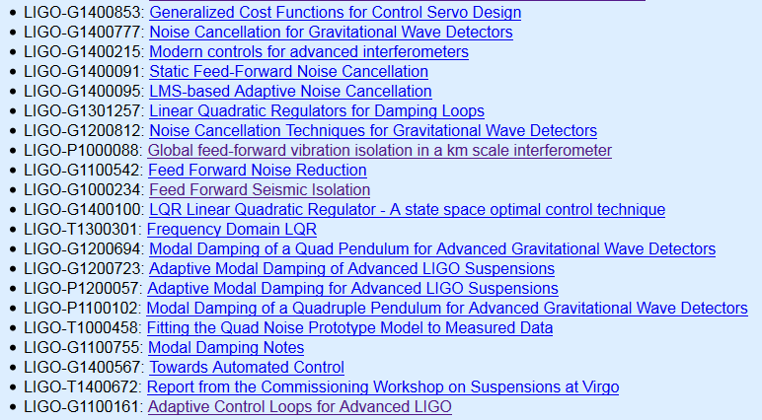
List of useful documentation
Tags: Sys IS, Optimal, Subtraction, Adaptive….

Slide 3
Session B: Optimal Control
SISO filtering versus Optimal Control
(i) Optimal controllers (ii) Observers, SNR (iii) Modal control
LQR: Cost function, weight…
Kalman filter
Goals:
Already investigated, good outcome, still not used, why
Prospects, application
Working groups, collaboration
Half step done…

Slide 4
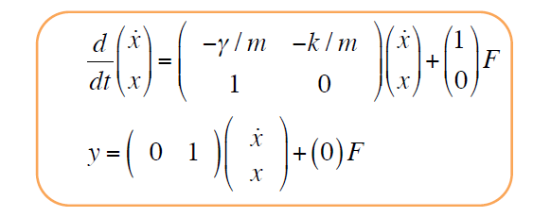
Introduction talk (review of modern control tools, state space methods, their pros and cons) | Den Martynov
G1400557-v1 State-Space Methods for Feedback Control
Very detailed introduction:
State Space methods
Linear quadratic
Weighting
Augmenting the state
Kalman
H Infinity
Went other one hour, great interaction.

Slide 5
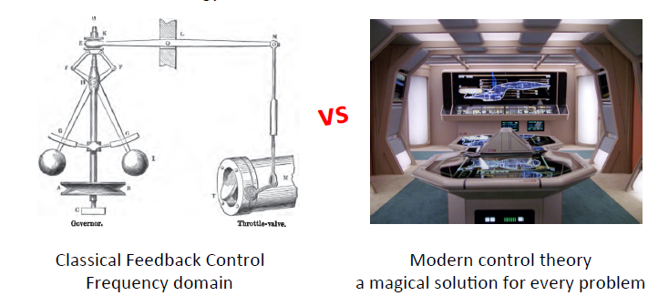
Summary of the Caltech Workshop | Gabriele
T1400302-v3 | Report from the Commissioning Workshop of Winter 2014
G1500679 A summary of the Modern Controls workshop @ Caltech

Slide 6
Summary of the Caltech Workshop | Gabriele
Time domain versus frequency domain tools
Open question on minimizing signals with optimal feedback tools

Slide 7
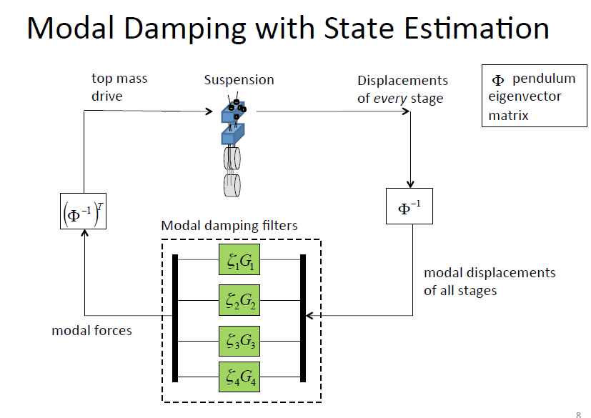
Suspension Controls, including thoughts on applicability of modern controls | Brett Shapiro
G1500626-v2 | Suspension Control with Thoughts on Modern Control

Slide 8
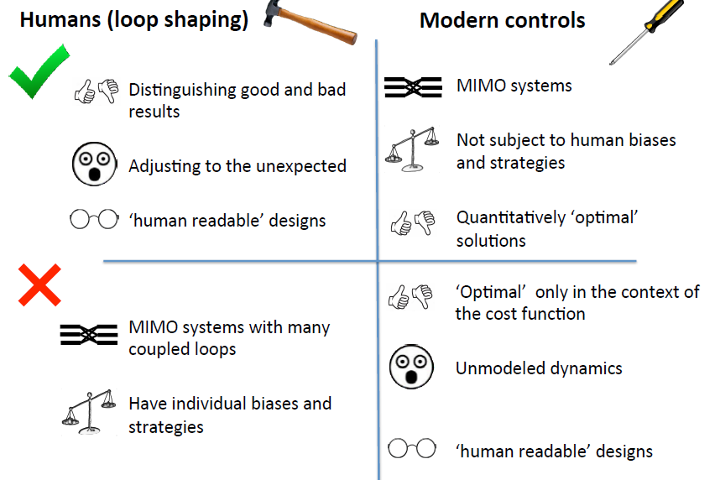
G1500626-v2 | Suspension Control with Thoughts on Modern Control

Slide 9
G1500626-v2 | Suspension Control with Thoughts on Modern Control

Slide 10
Kalman filtering for vibration isolation | Jo van den Brand

Slide 11
Discussion and comparison of classical and modern control techniques | Christophe Collette
LIGO-G1500689: Discussion and comparison of classical and modern control techniques

Slide 12
Modern control, general outcome:
Understanding the tools
Their pros and cons
It’s not a magic solution
But we can see the potentials:
Filter blends
Handling cross couplings
Keeping the momentum

Slide 13
Session C: Feedforward and noise subtraction
Already made the step…
The standard way (rely on intuition, identify the sensor path, identify the correction path, implement)
The optimal way (array of sensors, linear regression, least square minimization, Wiener…)
Results already obtained
Goals:
Where do we stand (Past results, current work)
Prospects, applications
Instrumentalist and DetChar
Automating
Adaptive

Slide 14
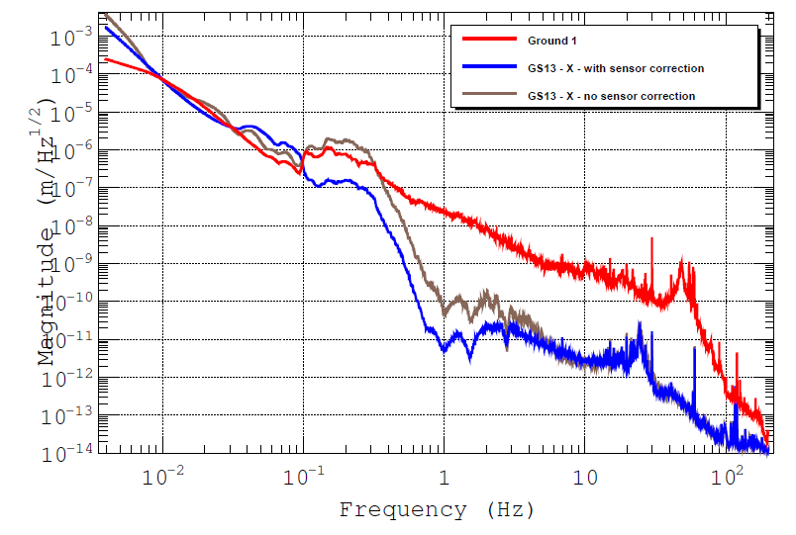
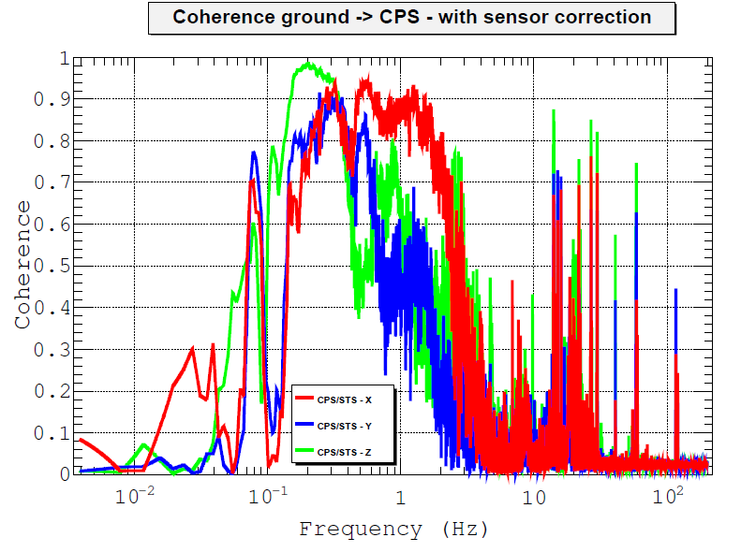
Sensor correction in seismic and suspensions | Fabrice
Some questions:
1) How to make the best use of our array of sensors?
2) How do make used of our array of witness sensors, vertical axis as rotation sensors, tilt sensors?
3) Are we using the good target sensors?
4) How do we search for coherence?
5) Toolbox for the linear regression, Wiener implementation?
6) Going adaptive for non stationary processes?

Slide 15
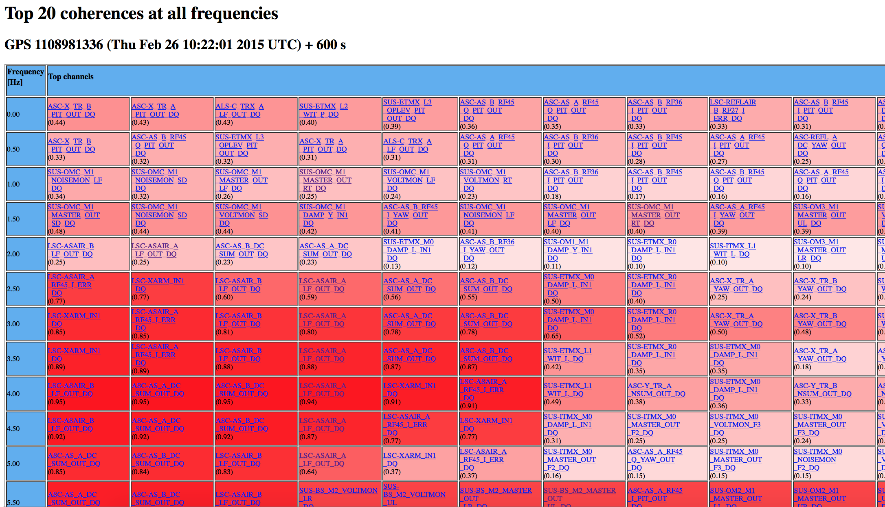
Data mining tools: hot to find channels that can be used for subtraction; how to tackle non stationary noises and couplings? | Gabriele Vajente
G1500682-v1 | Data mining: how to find channels to feed-forward
BruCo: Brute Force Coherence (LIGO-G1500230)

Slide 16
Feed forward of auxilairy degrees of freedom | Bas Swinkels

Slide 17
Online subtraction pipeline, and bilinear noise coupling | Keita Kawabe

Slide 18
Feedforward at LLO and 40m, adaptive feed forward | Denis Martynov

Slide 19
DetChar & Commissioning Tools
Ryan Fisher
Goal: Collect a set of vetted tools in one place so they get used
Plan: Create an Approved/Complete Tools wiki
Organized by Category
Organizers: Ryan Fisher, Fabrice Matichard, Gabriele Vajented, Dennis Coyne, Bas Swinkels

Slide 20
“Vetting” Requirements
Ryan Fisher
SVN or GIT checkout of code available
A set of instructions that allows a user to start from nothing and end up with an expected output
A set of instructions on how to change the inputs or configurations to get different desired outputs
Description of what the tool is useful for and what you get out of it
Any limitations (location, software) or package requirements on running it
The tool should be vetted by a volunteer from DetChar or elsewhere

Slide 21
What Kinds of Tools?
Ryan Fisher
First set:
BruCo - Brute force correlation code
Excavator - correlate auxiliary channels with glitches
wDQ - used to simplify generating Omega Scans for glitch follow-up
Desired:
Non-stationary noise
Bi-Linear and Non-Linear coupling analysis
Weiner statistic/adaptive analysis calculation
Spectral tools

Slide 22
Feedforward/Subtration, general outcome
Need to generalize the search for coherence
Auxiliary degrees of feedom (using similar tools…)
Solving non stationarity
Search for non linearity, bi-linear couplings
Adaptive tools
Making the tools available
Wonderful collaborative effort
To do list
Things are in motion

