Slide 1
Low Vibration Cryogenics for LIGO Voyager
Brett Shapiro
Stanford University
Notes:
I’m going to talk to you about some new directions for the cryogenics that we’ve been discussing recently at Stanford.
So I am going to propose a number of changes, and not just from a cryogenics point of view.
So I really want to encourage you to interrupt me with questions, comments, throughout the talk.

Slide 2
LIGO III Cryosystem
ISI Stage 2
…
124 K Silicon test mass
Notes:
First, here is the way we have been thinking about the cryogenics for the passed couple of years with the 124 K test mass

Slide 3
LIGO III Cryosystem
ISI Stage 2
…
Heat shield at 80 K
124 K Silicon test mass
Notes:
cooled with a radiative heat shield mounted to ISI

Slide 4
LIGO III Cryosystem
ISI Stage 2
…
Room temperature
Heat shield at 80 K
124 K Silicon test mass
Notes:
Everything else is kept at room temperature

Slide 5
LIGO III Cryosystem
ISI Stage 2
…
Room temperature
Vacuum flange
Cold link
Heat shield at 80 K
124 K Silicon test mass
Notes:
The shield is cooled with a long cold link that weaves through the stages of the ISI on its way to the vacuum flange

Slide 6
LIGO III Cryosystem
ISI Stage 2
…
Room temperature
Vacuum flange
Cold link
Heat shield at 80 K
Beam tube shield at 80 K
10 m
124 K Silicon test mass
Notes:
The laser beam passes through a 10 m long beam tube heat shield that is rigidly attached to the main shield.

Slide 7
LIGO III Cryosystem
ISI Stage 2
…
Room temperature
Vacuum flange
Cold link
Heat shield at 80 K
Beam tube shield at 80 K
Challenge – integrating cryo and seismic
Seismic shorts
cold link modes
Long heat path
Thermal drifts
10 m
124 K Silicon test mass
Notes:
There are a number of challenges to overcome to make this work.
Such as integrating the cryogenic and seismic systems. For example the cold link will introduce seismic shorts and vibrational modes….

Slide 8
LIGO III Cryosystem
ISI Stage 2
…
Room temperature
Vacuum flange
Cold link
Heat shield at 80 K
Beam tube shield at 80 K
Challenge – integrating cryo and seismic
Seismic shorts
cold link modes
Long heat path
Thermal drifts
10 m
Challenge – balance 10 m shield from suspended platform
124 K Silicon test mass
Notes:
Also, there is the challenge of balancing a 10 m beam tube shield from a suspended platform.
So I am going to propose a different approach, where we solve these issues by separating the overall system into dedicated pieces.

Slide 9
Actively controlled shield (ETM)
Stage 2
St0
St0
Gate Valve
Gate Valve
z
Cryo pump
124 K test mass
Notes:
And here is a sketch of that approach showing the End station vacuum envelope.
Here’s the test mass inside the BSC.
By the way, I plan to spend at least half this talk on just this figure. I’ll point out the various features 1 by 1.

Slide 10
Actively controlled shield (ETM)
Stage 2
St0
St0
Gate Valve
Gate Valve
z
80 K heat shield and lower structure
Cryo pump
124 K test mass
Notes:
Here’s the heat shield surrounding the lower suspension as before.

Slide 11
Actively controlled shield (ETM)
Blade springs
Stage 2
St0
St0
Gate Valve
Gate Valve
z
80 K heat shield and lower structure
Cryo pump
124 K test mass
Notes:
However, you’ll note that the shield is attached to stage 0, rather than stage 2, and it is suspended from springs.
This means the issue of integrating the cryo and seismic systems is solved by physically decoupling them.

Slide 12
Actively controlled shield (ETM)
Blade springs
Cold link
Stage 2
St0
St0
Gate Valve
Gate Valve
z
80 K heat shield and lower structure
Cryo pump
124 K test mass
Notes:
One immediate benefit of this, the heat transfer can be done with a short and simple cold link that goes right to the vacuum wall.

Slide 13
Actively controlled shield (ETM)
Sensors between heat shield and stage 2
Blade springs
Cold link
Stage 2
St0
St0
Gate Valve
Gate Valve
z
80 K heat shield and lower structure
Cryo pump
124 K test mass
Notes:
However, a complication of hanging the heat shield from stage 0, is that it may not be isolated enough for scattered light. So it will need active control.
To do this, you would put sensors between the shield and stage 2, which is well isolated.

Slide 14
Actively controlled shield (ETM)
Sensors between heat shield and stage 2
Actuators between stage 0 and heat shield
Blade springs
Cold link
Stage 2
St0
St0
Gate Valve
Gate Valve
z
80 K heat shield and lower structure
Cryo pump
124 K test mass
Notes:
You’d then have actuators between stage 0 and the heat shield.
The control would then lock the heat shield to stage 2, without actually touching it.

Slide 15
Actively controlled shield (ETM)
Sensors between heat shield and stage 2
Actuators between stage 0 and heat shield
Blade springs
Cold link
Stage 2
80 K baffled beam tube shield
St0
St0
≈ 900 mm dia
Gate Valve
Gate Valve
z
10 m
80 K heat shield and lower structure
Cryo pump
124 K test mass
Notes:
Another feature of this approach is that the issue of balancing a long beam tube shield from a suspended platform, is avoided again, by physical decoupling.
Here the beam tube shield is not connected to the main shield at all, it’s physically separated with some gap and supported by the beam tube instead.
We can get away with this by maximizing the its diameter and length. Here it is basically making use of all the available space.
You’ll also note, that this beam tube shield incorporated angled baffles along its length. These serve both to block scattered laser light, as well as scattered warm radiation leaking through the opening.
These baffles by the way, are very similar to those used by KAGRA, which is not a coincidence.

Slide 16
Actively controlled shield (ETM)
Sensors between heat shield and stage 2
Actuators between stage 0 and heat shield
Blade springs
Cold link
Stage 2
80 K baffled beam tube shield
St0
St0
≈ 900 mm dia
Gate Valve
Gate Valve
z
10 m
80 K heat shield and lower structure
Cryo pump
ACB in suspended HS
124 K test mass
Notes:
Speaking of baffles, thing we can actually simplify from aLIGO is the removal of the ACB suspension. Here the ACB is simply integrated into the suspended heat shield.

Slide 17
Actively controlled shield (ETM)
Sensors between heat shield and stage 2
Room temp upper structure, disconnected from cold lower
Actuators between stage 0 and heat shield
Blade springs
Cold link
Stage 2
80 K baffled beam tube shield
St0
St0
≈ 900 mm dia
Gate Valve
Gate Valve
z
10 m
80 K heat shield and lower structure
Cryo pump
ACB in suspended HS
124 K test mass
Notes:
The last feature in this figure is the warm upper structure of the quad, which is physically disconnected from the lower structure. It’s not clear here, but the lower quad structure is meant to be a part of the heat shield.
Now, it may seem scary at first to suspend the lower structure. But keep in mind that the aLIGO structure is also suspended because its on the ISI. If you ever get the chance to work on a suspension when the ISI is free this immediately becomes obvious as soon as you touch it.
The only difference here is that the 2 structures are suspended from different places.
I’ll speak about a bit more about this later.

Slide 18
Pros/cons of separate cryo and seismic
Pros
No seismic isolation impact
Shorter heat transfer path
Much greater choice of heat transfer methods
Allows more science payload (bigger test masses)
Cons
Requires another active control system with many additional sensors and actuators per BSC
Notes:
…
We can put more mass into our suspensions.
Because the ISI has a finite payload, and because it no longer has to support the cryogenics, more payload is available for the suspension system.
Of course we do pay for all this by having yet another active control system with a full compliment of sensors and actuators.

Slide 19
To make 1 structure or 2?
- in the case of a suspended heat shield
 | Temperature of cold part | Thermal stress + alignment of warm part | Vibrational mode frequencies | Damping of vibrational modes | Relative complexity of construction
1 structure
2 structures: warm & cold
Note:
For 1 structure, the heat shield is not integrated. It cools the lower structure radiatively, along with the suspension.
For 2 structures, the heat shield is fully integrated into the lower structure as 1 unit.
Good
Fair
Risky
Show stopper
Notes:
So now I’d like to address the question of separating the cold lower structure from the upper.
…
So what you see is that in the first case, these challenges become difficult because they are all competing with each other.
As has become the theme of this talk, the second case simplifies these challenges by physically decoupling them.

Slide 20
To make 1 structure or 2?
- in the case of a suspended heat shield
 | Temperature of cold part | Thermal stress + alignment of warm part | Vibrational mode frequencies | Damping of vibrational modes | Relative complexity of construction
1 structure
2 structures: warm & cold
?
?
Note:
For 1 structure, the heat shield is not integrated. It cools the lower structure radiatively, along with the suspension.
For 2 structures, the heat shield is fully integrated into the lower structure as 1 unit.
Good
Fair
Risky
Show stopper

Slide 21
Conceptual LIGO III SolidWorks Sketches

Slide 22
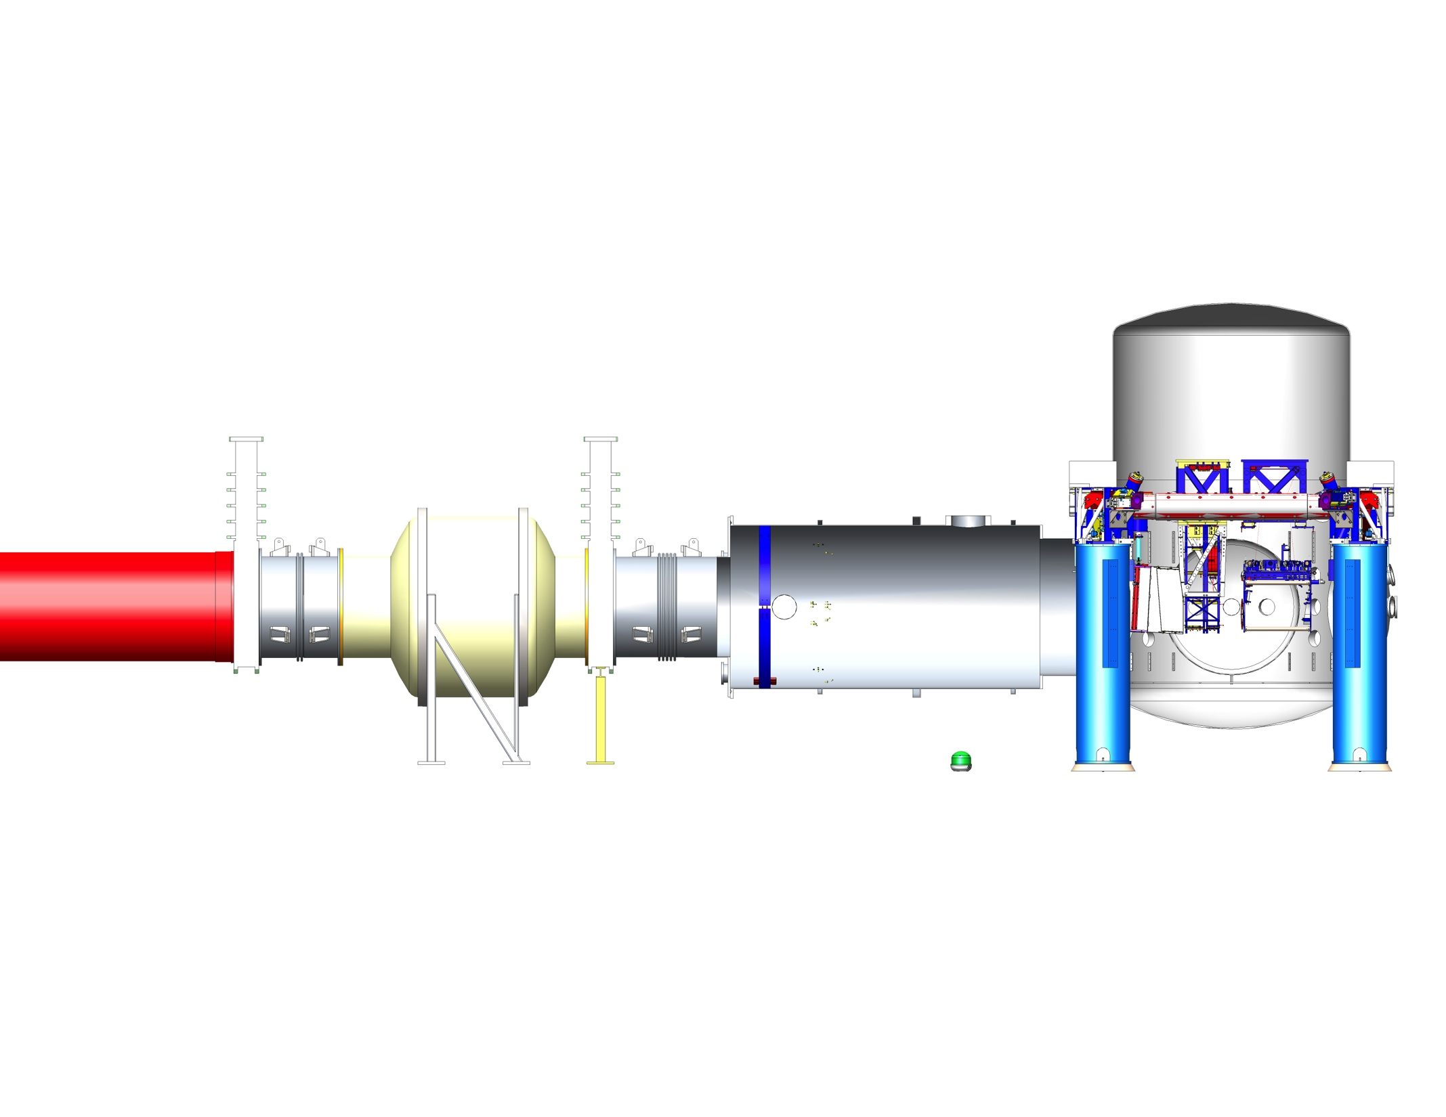
aLIGO LLO Y End SolidWorks Model
5 m
5 m
10 m

Slide 23
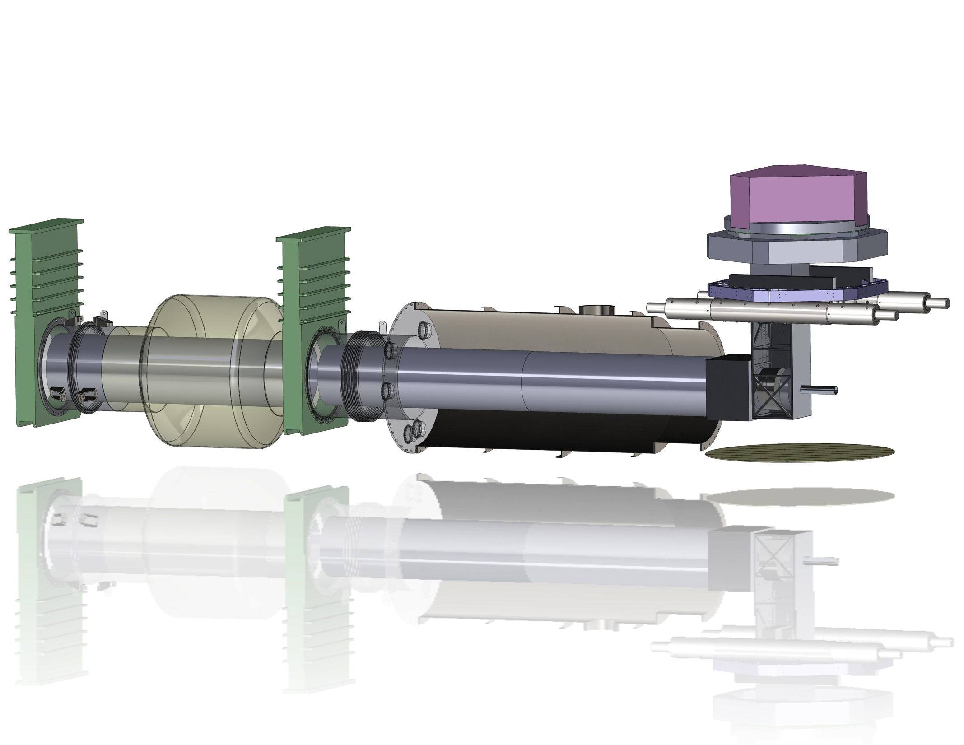
LIGO III End Station Conceptual Model
Gate valve
Gate valve
ISI

Slide 24
LIGO III End Station Conceptual Model
Gate valve
Gate valve
ISI
Stage 0

Slide 25
LIGO III End Station Conceptual Model
Gate valve
Gate valve
ISI
Stage 0
Suspended heat shield / lower quad structure 80 K

Slide 26
LIGO III End Station Conceptual Model
Gate valve
Gate valve
ISI
Stage 0
Transmitted
beam shield
Suspended heat shield / lower quad structure 80 K

Slide 27
LIGO III End Station Conceptual Model
Gate valve
Gate valve
ISI
Stage 0
Transmitted
beam shield
Arm Cavity Baffle integrated
with suspended heat shield, 80 K
Suspended heat shield / lower quad structure 80 K

Slide 28
LIGO III End Station Conceptual Model
Gate valve
Gate valve
ISI
Stage 0
Transmitted
beam shield
Arm Cavity Baffle integrated
with suspended heat shield, 80 K
Beam tube shield mounted to beam tube, 80 K
Suspended heat shield / lower quad structure 80 K

Slide 29
LIGO III End Station Conceptual Model
Gate valve
Gate valve
ISI
Stage 0
Transmitted
beam shield
Cryo pump, cools this
section of shield,
and maybe everything else
Arm Cavity Baffle integrated
with suspended heat shield, 80 K
Beam tube shield mounted to beam tube, 80 K
Suspended heat shield / lower quad structure 80 K

Slide 30
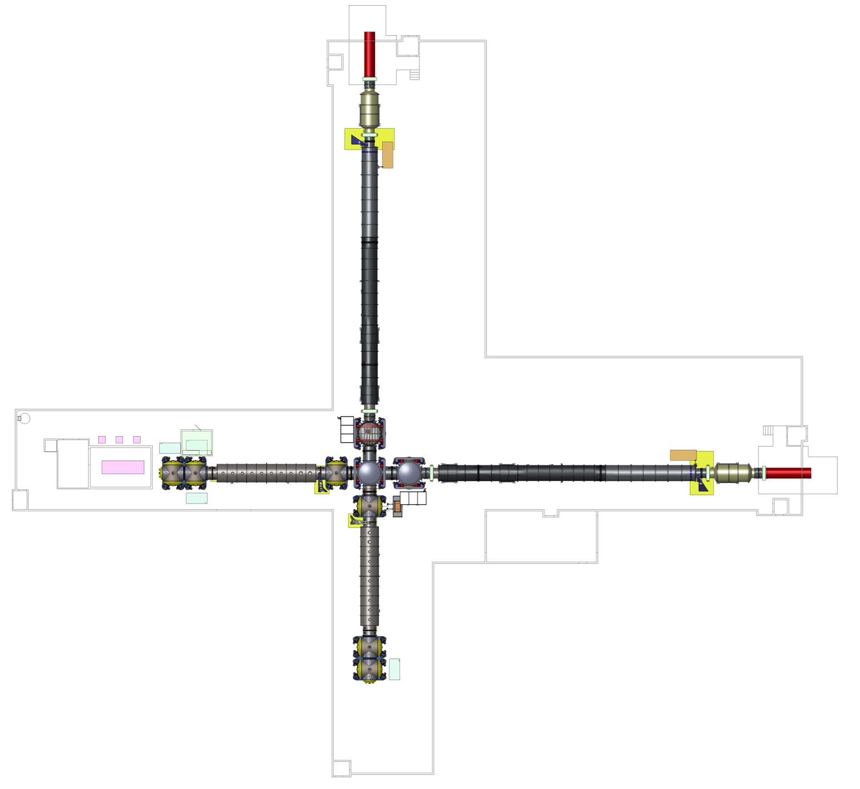
aLIGO LLO corner station SolidWorks model
34 m
2 m

Slide 31
Conclusions: Work/info needed for a low vibration cryo system
Stage 2
St0
St0
Gate Valve
Gate Valve
z

Slide 32
Conclusions: Work/info needed for a low vibration cryo system
Beam tube shield
Backscatter of coatings (BRDF)
Heat leak simulation with ray tracing.
Stage 2
St0
St0
Gate Valve
Gate Valve
z

Slide 33
Conclusions: Work/info needed for a low vibration cryo system
Beam tube shield
Backscatter of coatings (BRDF)
Heat leak simulation with ray tracing.
Stage 2
St0
St0
Gate Valve
Gate Valve
z
Optical coating emissivity

Slide 34
Conclusions: Work/info needed for a low vibration cryo system
Transmitted beam?
Beam tube shield
Backscatter of coatings (BRDF)
Heat leak simulation with ray tracing.
Stage 2
St0
St0
Gate Valve
Gate Valve
z
Optical coating emissivity

Slide 35
Conclusions: Work/info needed for a low vibration cryo system
Transmitted beam?
Beam tube shield
Backscatter of coatings (BRDF)
Heat leak simulation with ray tracing.
Stage 2
Getting optical levers through shield?
St0
St0
Gate Valve
Gate Valve
z
Optical coating emissivity

Slide 36
Conclusions: Work/info needed for a low vibration cryo system
How to handle thermal drifts of
Stops
Sensors
fibers
Transmitted beam?
Beam tube shield
Backscatter of coatings (BRDF)
Heat leak simulation with ray tracing.
Stage 2
Getting optical levers through shield?
St0
St0
Gate Valve
Gate Valve
z
Optical coating emissivity

Slide 37
Conclusions: Work/info needed for a low vibration cryo system
How to handle thermal drifts of
Stops
Sensors
fibers
Demonstrate an active cryo shield will work
Transmitted beam?
Beam tube shield
Backscatter of coatings (BRDF)
Heat leak simulation with ray tracing.
Stage 2
Getting optical levers through shield?
St0
St0
Gate Valve
Gate Valve
z
Optical coating emissivity

Slide 38
Stanford Active Heat Shield Experiment

Slide 39
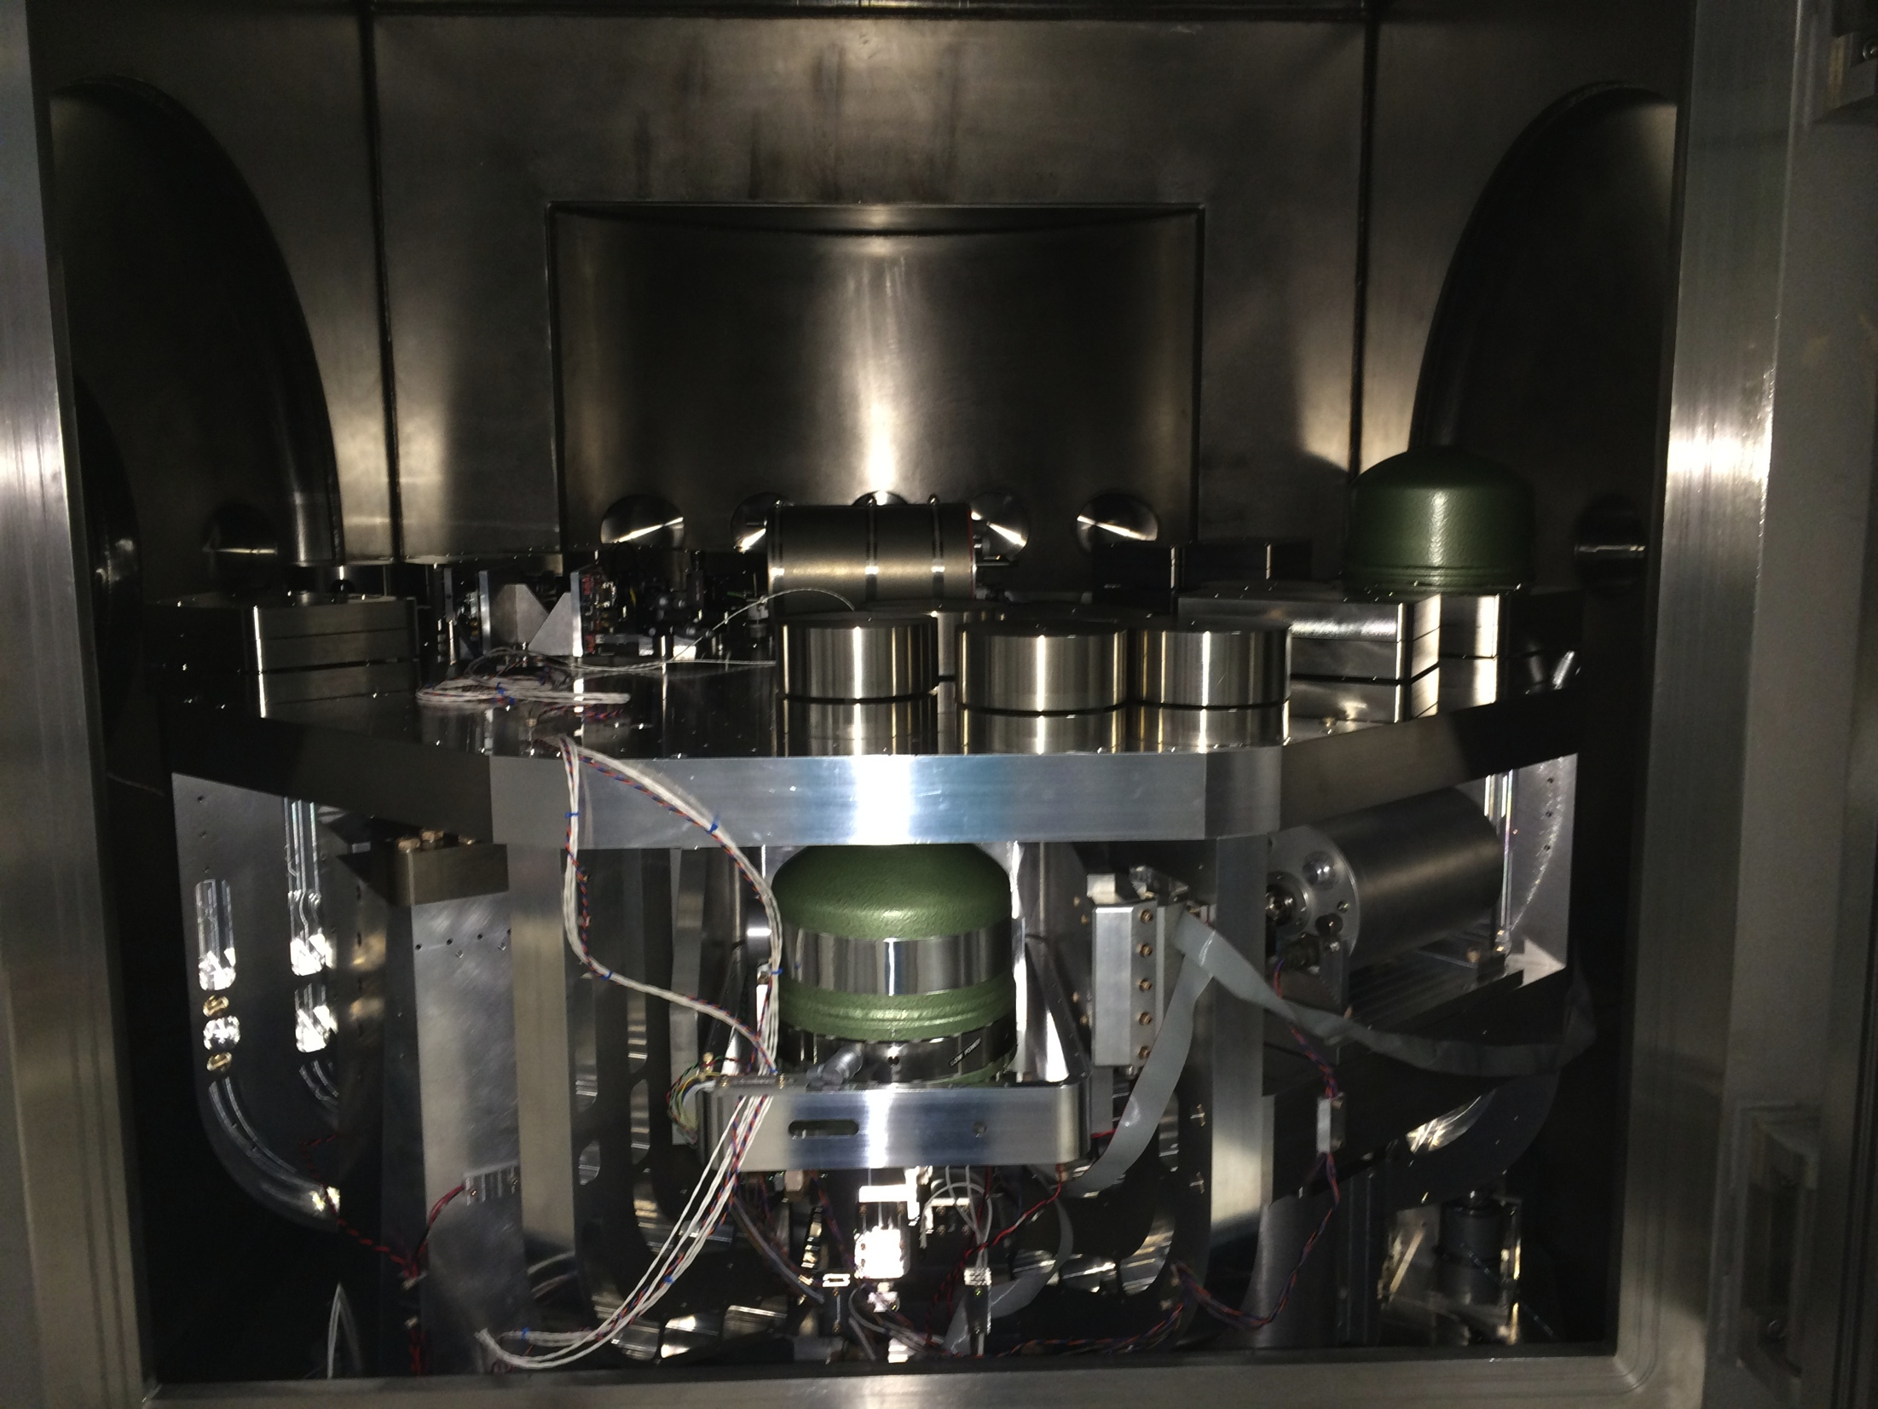

Slide 40
Stage 0 spring post
Stage 2
Stage 1

Slide 41
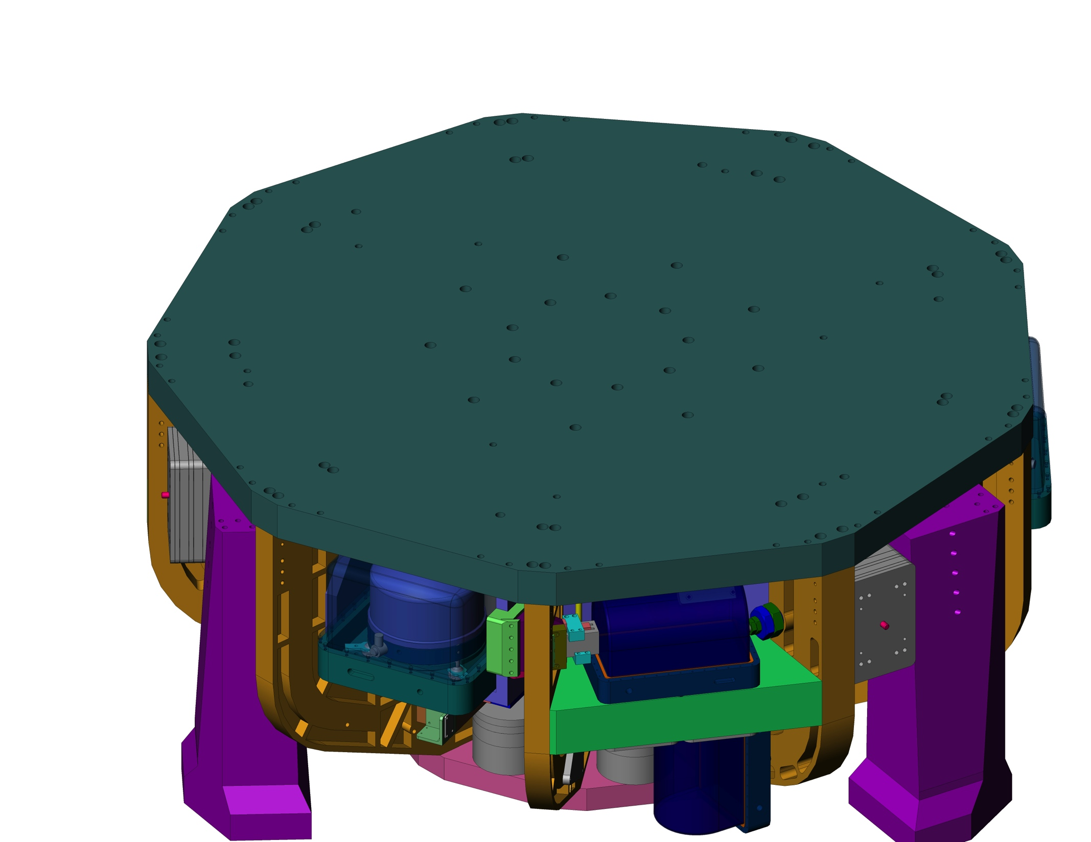

Slide 42
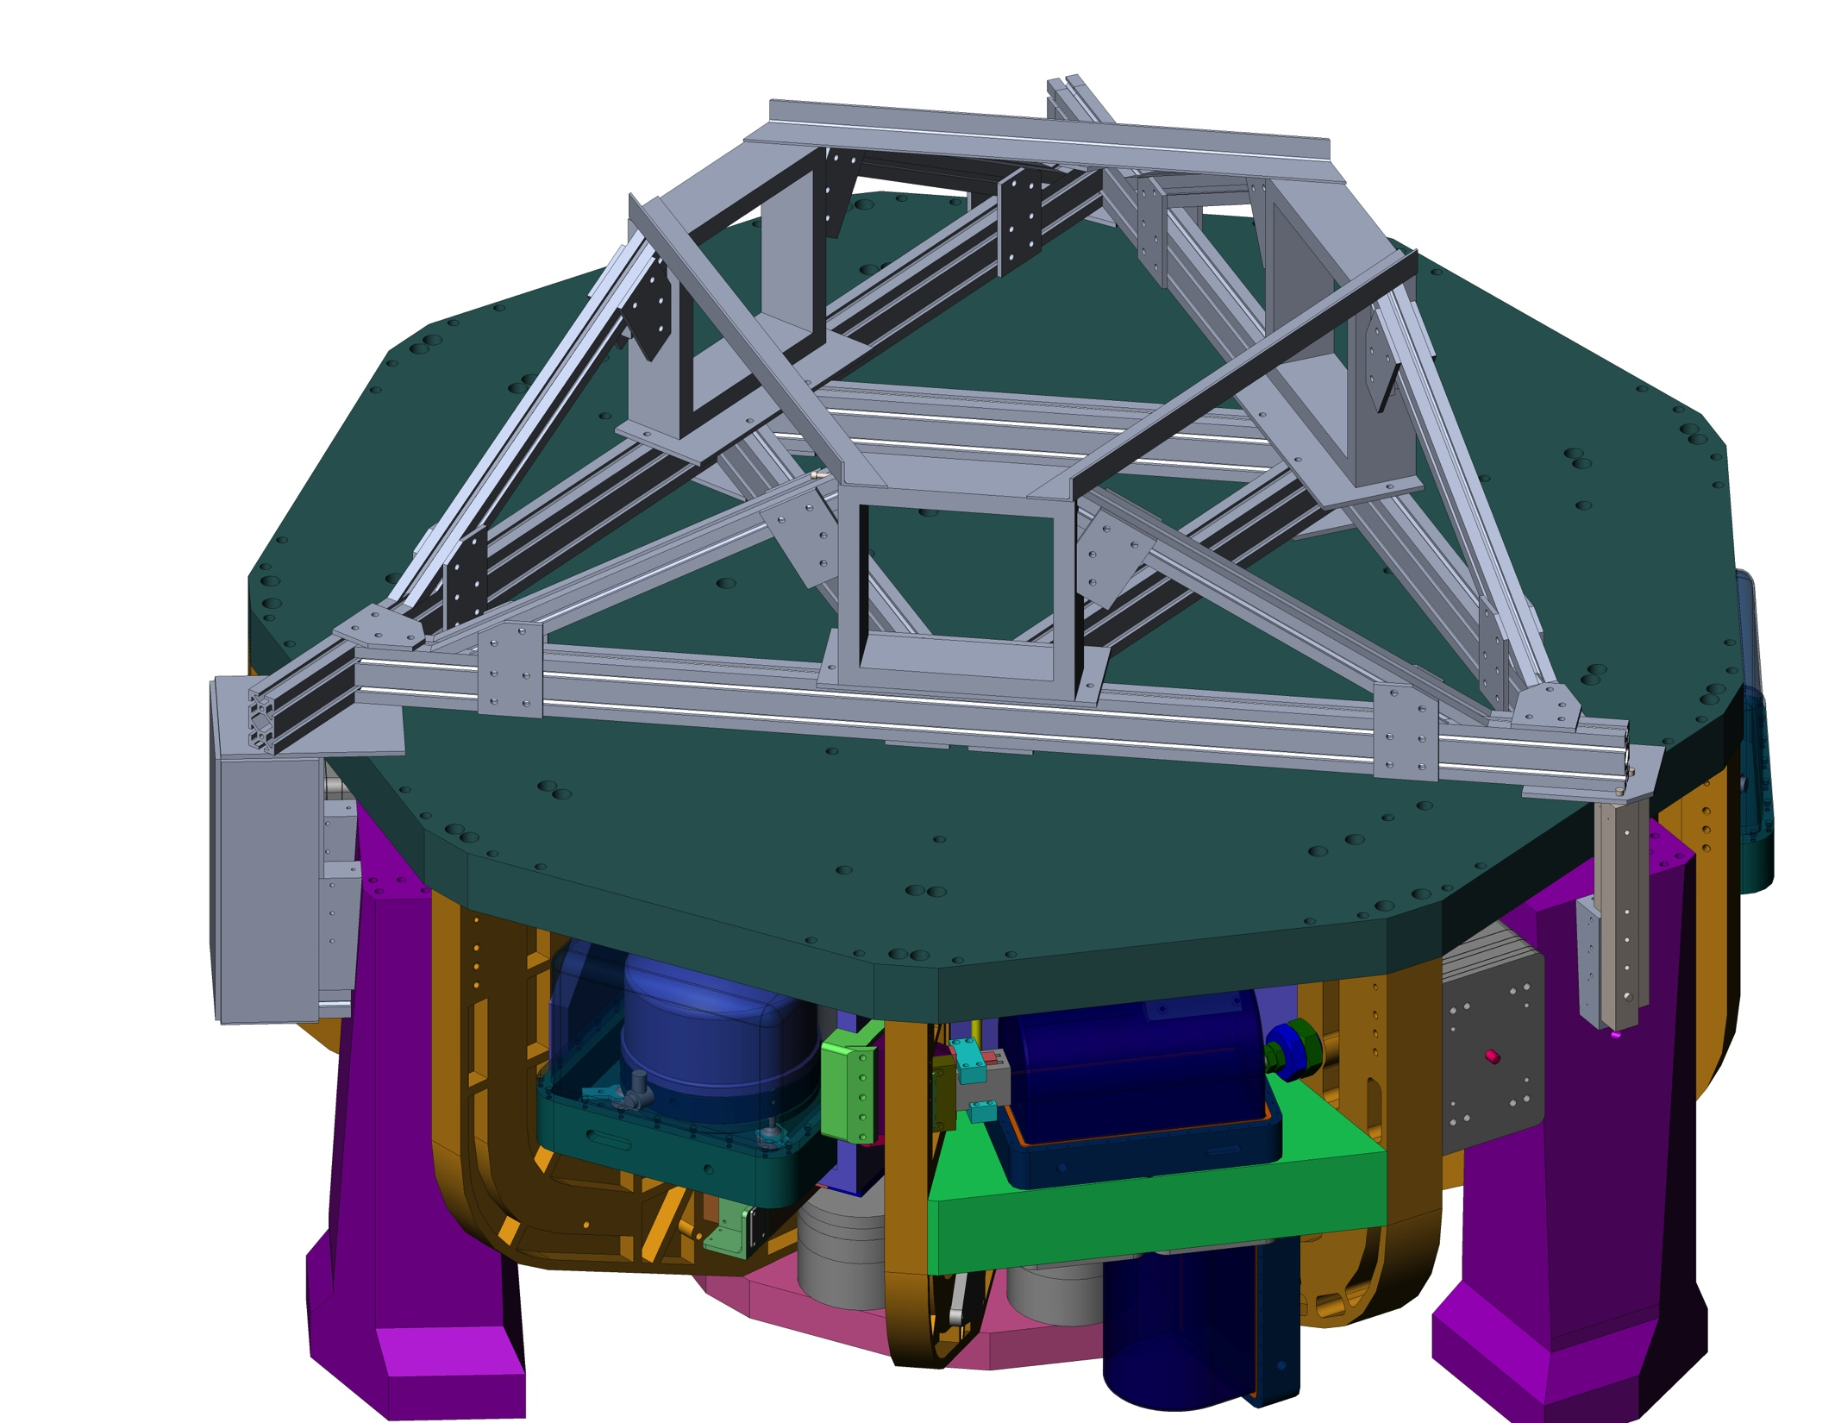

Slide 43
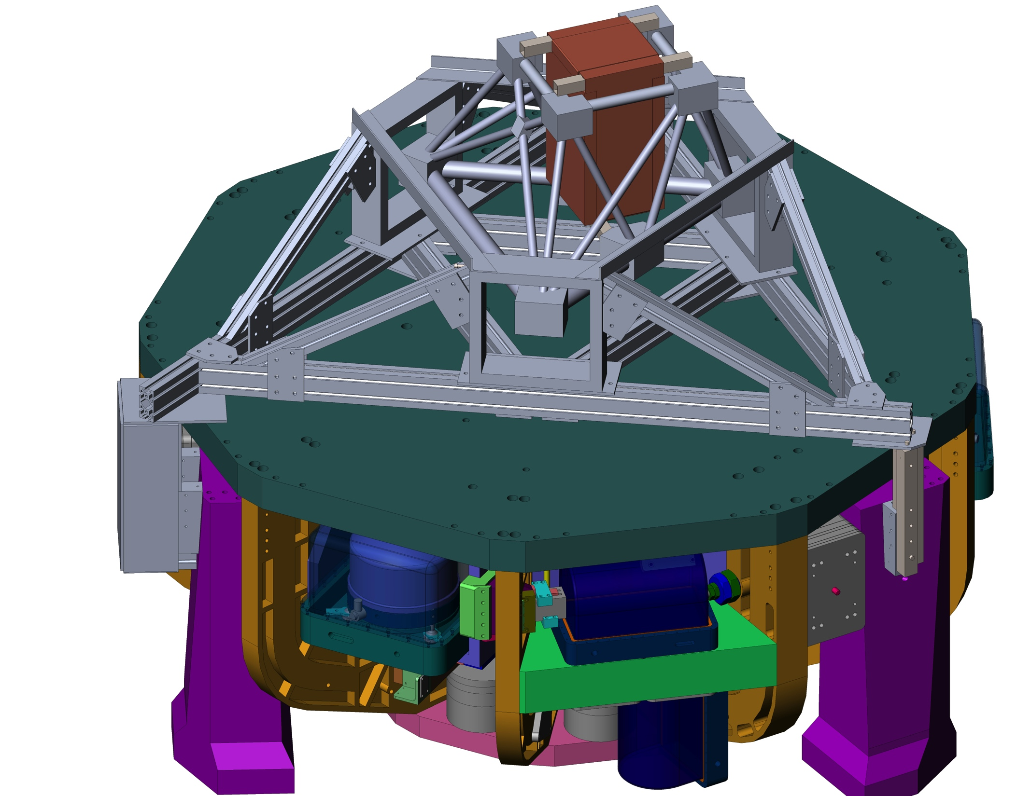

Slide 45
6 OSEMs between shield and table

Slide 46
6 OSEMs between shield and table
2 coil actuators and 2 witness geophones in each of the 3 corners

Slide 47
Optic suspended from stage 2 with a warm blade spring
6 OSEMs between shield and table
2 coil actuators and 2 witness geophones in each of the 3 corners

Slide 48
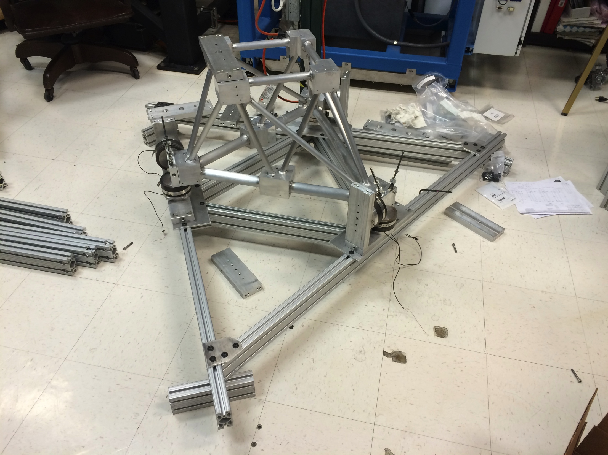
Construction well underway!
Photo taken 12 March 2015

Slide 49
BackUps

Slide 50
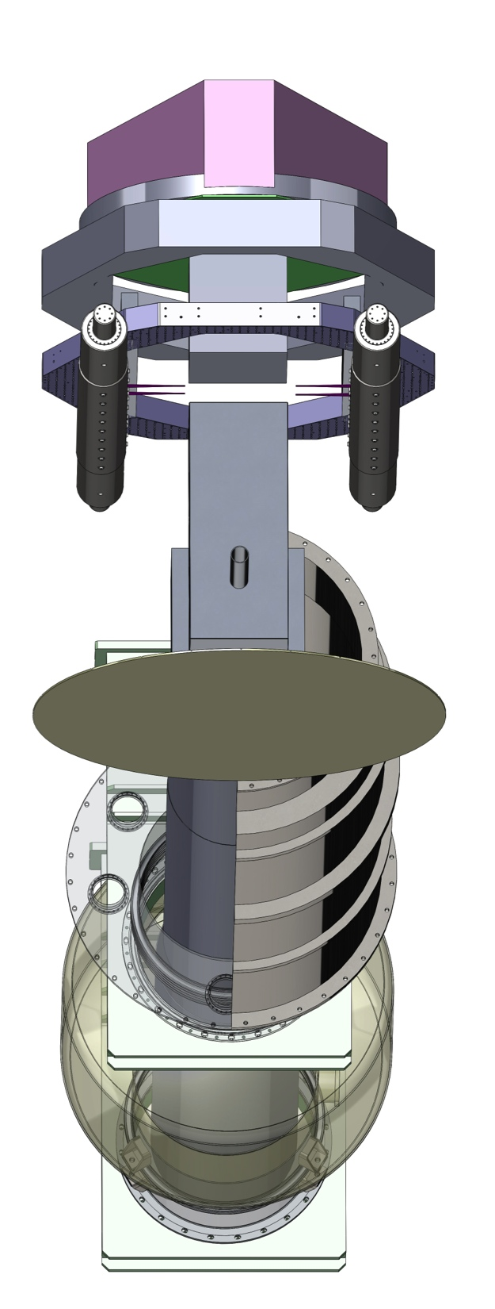
LIGO III end station back view model
ISI
Upper quad structure, room temp
Stage 0, room temp
Heat shield blade springs, room temp
Suspended heat shield / lower quad structure, 80 k
Transmitted
beam shield, 80 K
BSC floor, room temp
Beam tube shield mounted to beam tube, 80 K

Slide 51
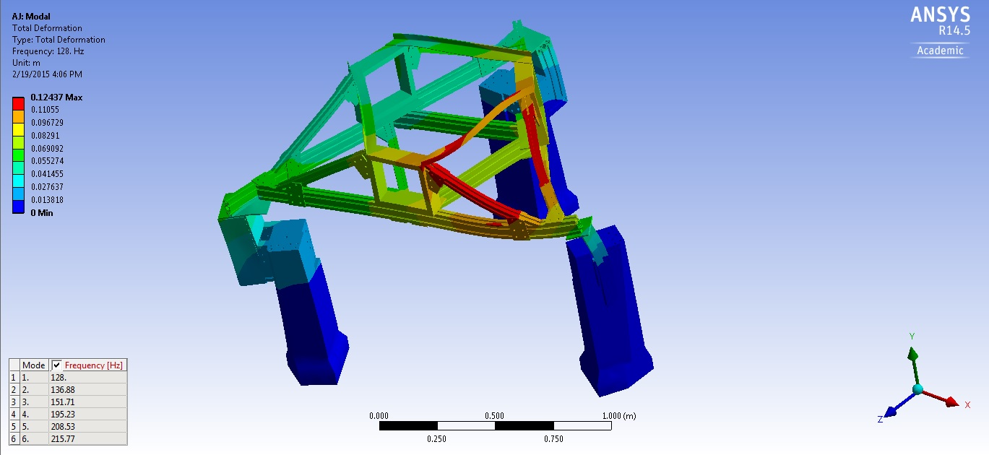
Vibrational modes of support structure

Slide 52
Heat Shield Requirements
Beam tube length
Scattered light (much uncertainty to overcome)

Slide 53
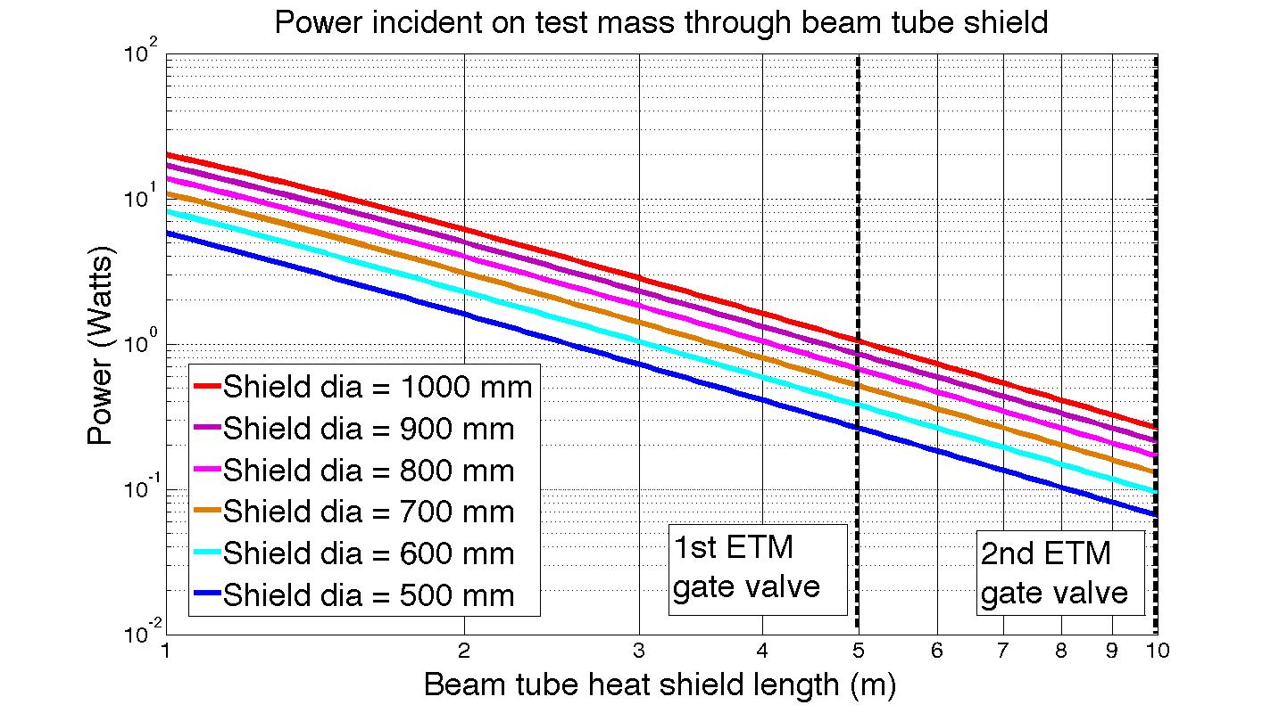
Radiation leak from Beam Tube

Slide 54
Light scattering noise estimates

Slide 55
Scattered light modeling for shield
Linear regime – differential displacement between cavity and scattering surface much less than light wavelength. Only worry about > 10 Hz
Nonlinear regime – differential displacement comparable to or greater than a wavelength. Upconversion is an issue, must worry about large amplitude low frequency motion.

Slide 56
Linear regime scattered light References
T940063 - Noise due to backscatter off baffles, the nearby wall, and objects at the far end of the beam tube; and recommended actions – Flanagan and Thorne.
This is a useful reference for the basic theory and derivations.
T1300354 - Scattered light noise due to the ETM coating ripple – Fritschel and Yamamoto
Good example of applying the equations in T940063
T1300332 - Noise from baffle motion with the current ETM coating – Rai
Complements the example of T1300354

Slide 57
Nonlinear regime scattered light References
P1100117 - The impact of upconverted scattered light on aLIGO – Ottaway, Fritschel, and Waldman

Slide 58
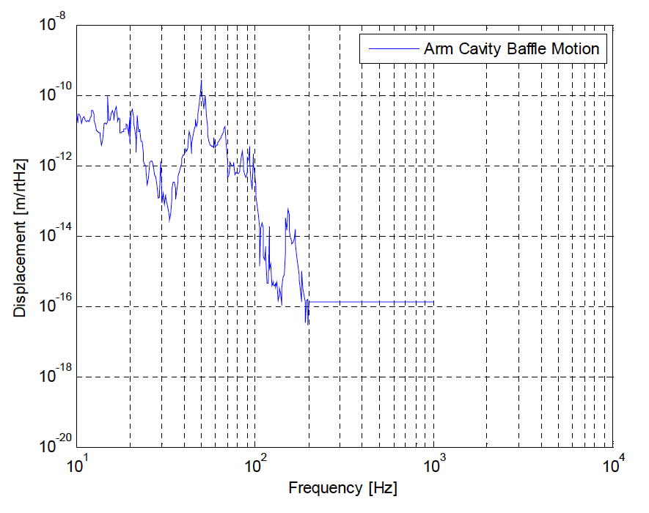
in aLIGO
Ref T1000747-v4, pg 41

Slide 59
Linear scattered light noise estimates
Small angle scatter across beam tube length – beam tube parameters in E940002 and P990007
Parameters of calculation following notation in T1300354
Calculated heat shield displacement requirement from small angle scatter

Slide 60
Linear scattered light noise estimates
Large angle scatter in local heat shield – assuming 150 W of local scatter out of 3 MW cavity
Parameters of calculation following notation in T1300354
Calculated heat shield displacement requirement from large angle scatter

Slide 61
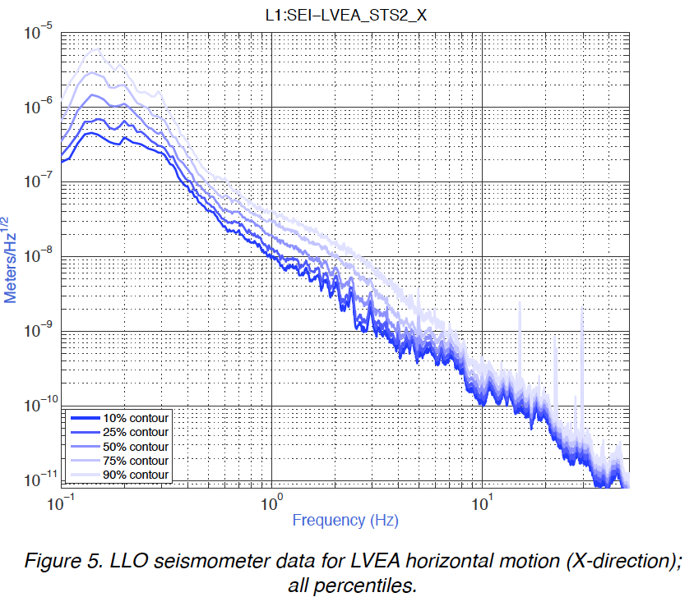
T0900312

Slide 62
10 Hz heat shield scattered light requirement
T0900312

Slide 63
10 Hz heat shield scattered light requirement
10 Hz motion with 3 Hz suspension
T0900312

Slide 64
10 Hz heat shield scattered light requirement
OSEM noise
10 Hz motion with 3 Hz suspension
T0900312

Slide 65
KAGRA Cryo System

Slide 66
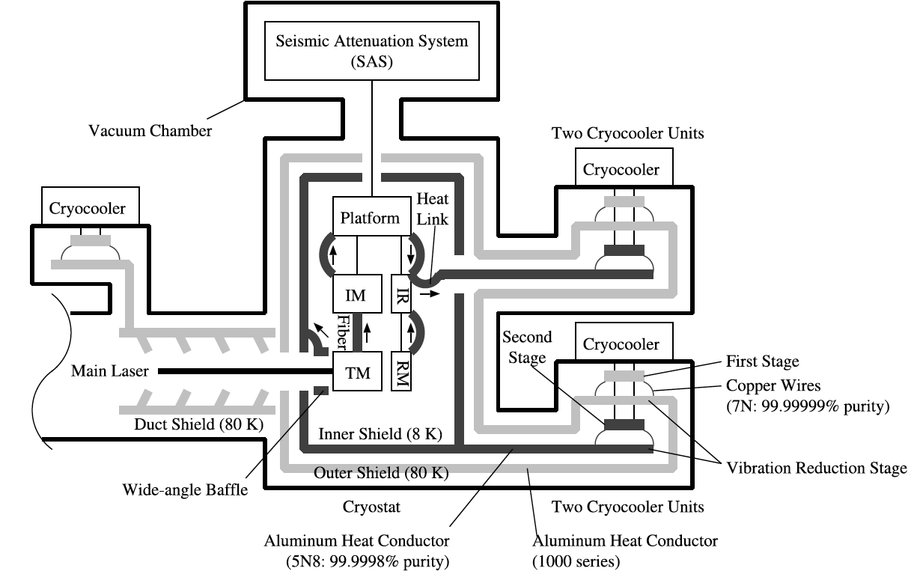
KAGRA’s cryogenic system
(pulse tube)
Yusuke Sakakibara et al 2014 Class. Quantum Grav. 31 224003
http://iopscience.iop.org/0264-9381/31/22/224003/

Slide 67
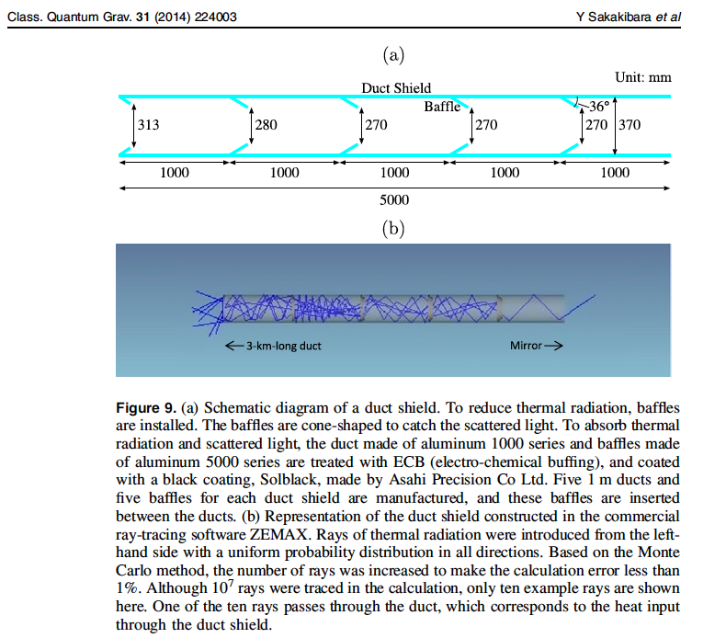
KAGRA beam tube heat shield
Quote from text pages 2-3: “In CLIO, thermal radiation through the duct shield (described in section 4 ) was 1000 times larger than our expectation because we had neglected reflections from the duct shield. To
reduce this heat load, donut-shaped structures (called baffles) were introduced.”

Slide 68
Annealed Pyrolitic Graphite (APG)
K core technology from thermacore
~ 3 times the conductivity of copper, in plane, but magnetic

Slide 69
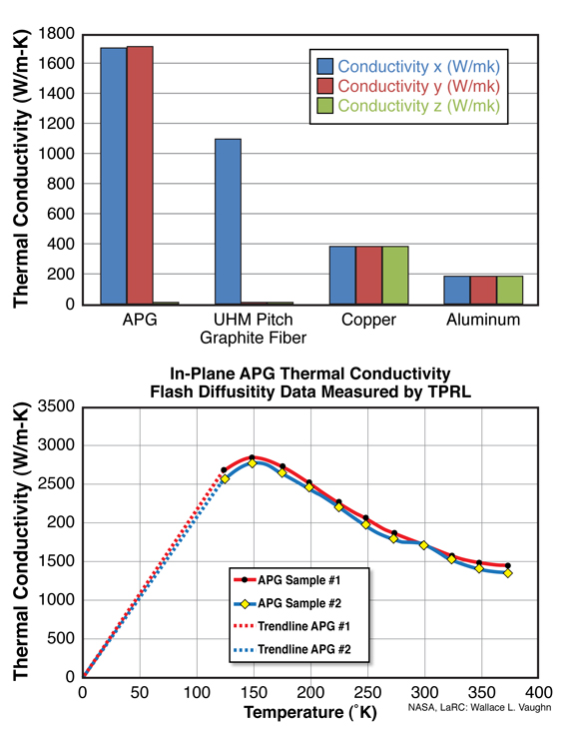
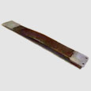
Annealed Pyrolitic Graphite (APG)
See a brief video introhttps://www.youtube.com/watch?v=kMD0GUZmoy0
The graphite can be made flexible by making it into thin strips
Vacuum compatible, at least to NASA specs for outgassing
Conductive peak around 120-150 K
The graphite is highly diamagnetic
Cu 99.999%
http://www.thermacore.com/thermal-basics/advanced-solid-conduction.aspx

Slide 70
Shorter shield with cryo baffle
Actuators between stage 0 and heat shield
Room temp upper structure, disconnected from cold lower
Sensors between heat shield and stage 2
Cold link
Oplevs: require steering mirrors or openings to enter shield
Stage 2
80 K suspended cryo baffle
St0
St0
Gate Valve
80 K, non suspended beam tube shield
80 K heat shield and lower structure
Arm cavity baffle part of suspended HS
124 K test mass

Slide 71
Cold SUS structure configurations
 | Temperature of cold part | Thermal stress + alignment of warm part | Vibrational mode frequencies | Damping of vibrational modes | Relative complexity of construction
1 structure
2 structures: warm & cold
Cold suspended from warm
Low freq sus modes
Good
Fair
Risky
Show stopper

Slide 72
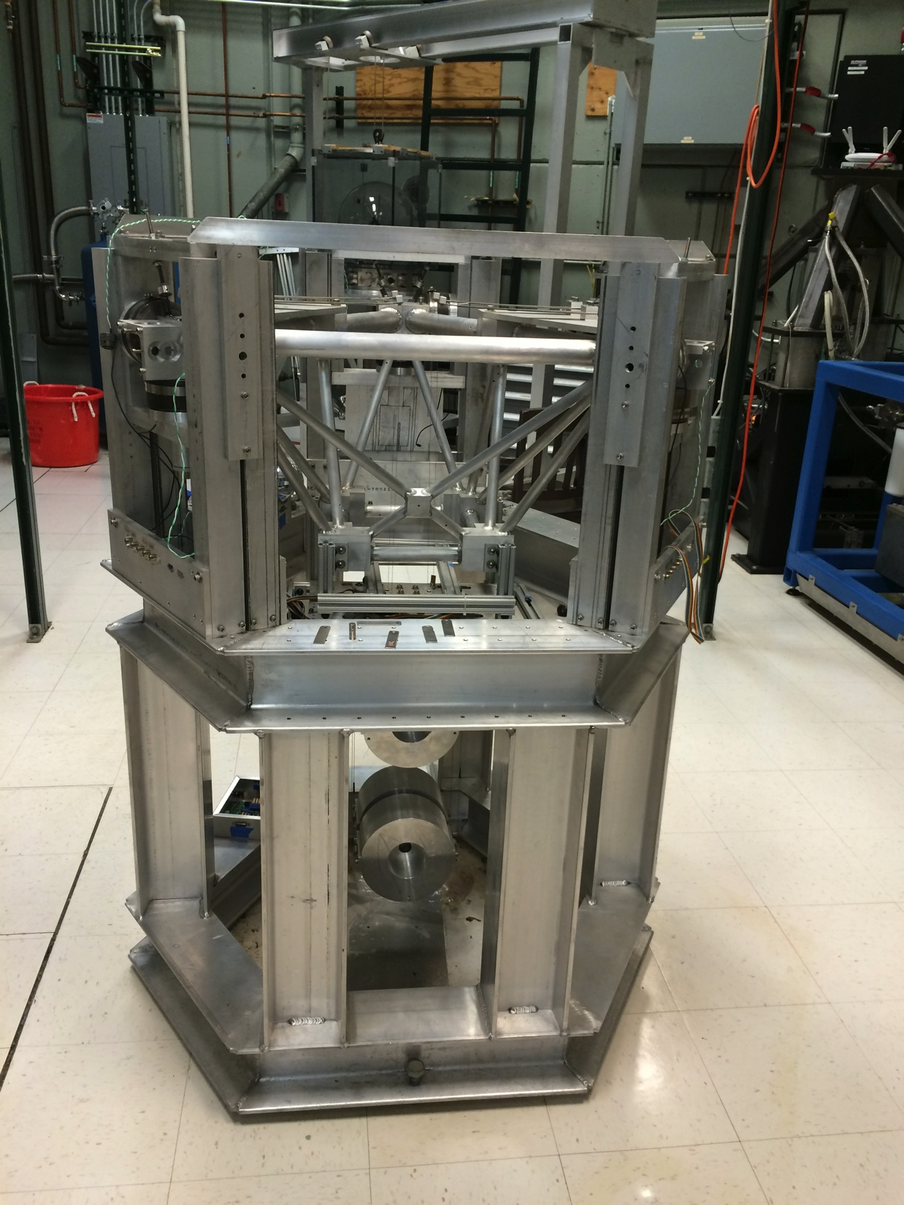

Slide 73
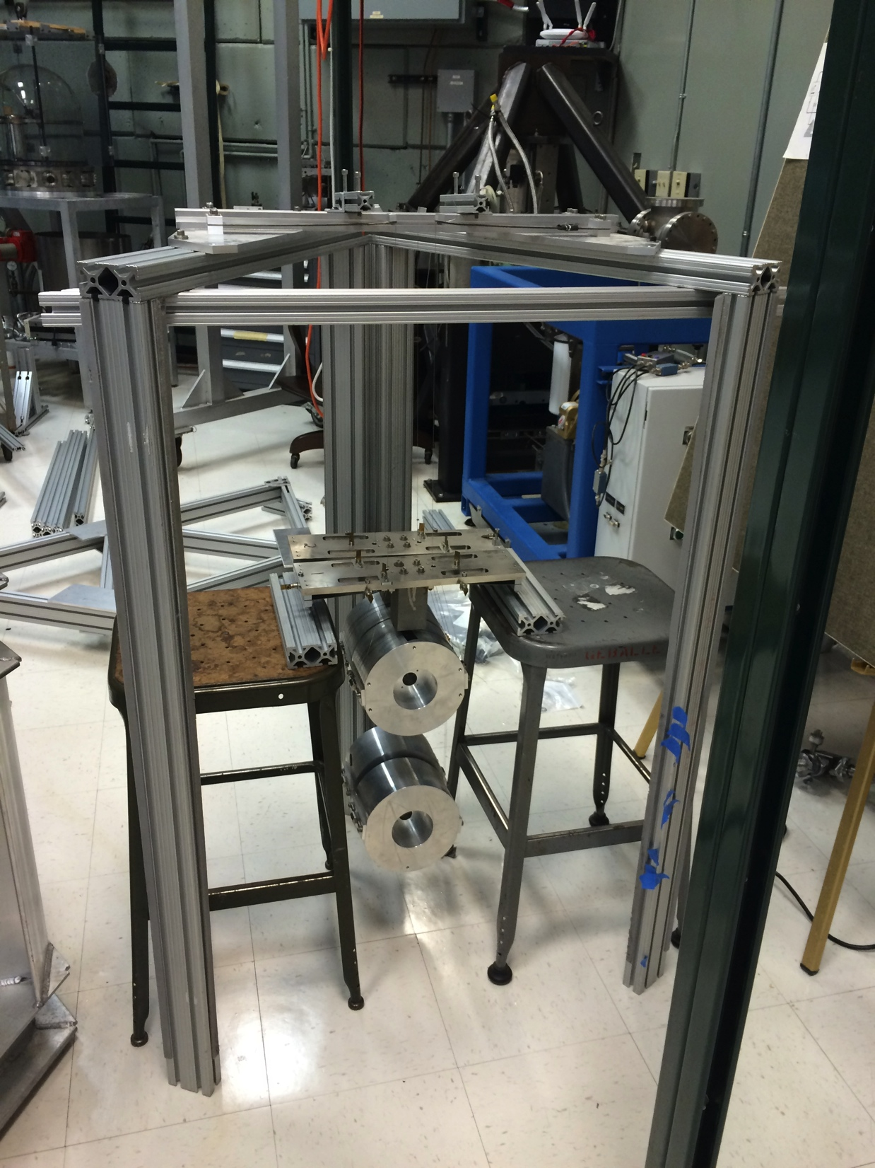

Slide 74
BSC ISI Stage 0-1 lockers - D1000854
Something like this could be used to limit the suspended heat shield / lower quad structure range of motion. The design makes it impossible for the suspension to fall in the event of a wire or spring failure.
Stage 1
Stage 0

Slide 75
Possible arrangement of lower-structure-to-upper-structure lockers considering thermal contraction
Warm dimensions
Cold dimensions
Top view of lower structure (square cross-section). Thermal contraction occurs along an unconstrained DOF of the lockers, for a spatially uniform lower structure temperature. The clearance in the lockers will set a requirement on the maximum thermal gradient in the structure.

Slide 76
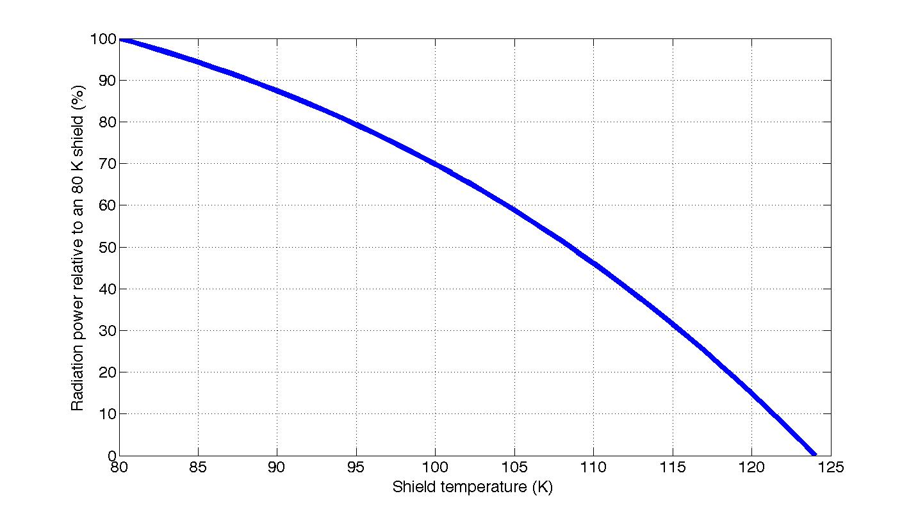
How much cooling is lost if the shield is warmer than 80 K?

