Slide 1
OMC Black Glass Assembly Procedure
Kate Gushwa
Calum Torrie
E15000214-v6

Slide 2
DOCUMENT OUTLINE
The Basics
Glass Inspection & Cleaning
Prep:
Non-Glass Parts
Glass
In Chamber
Assembly Procedure

Slide 3
THE BASICS

Slide 4
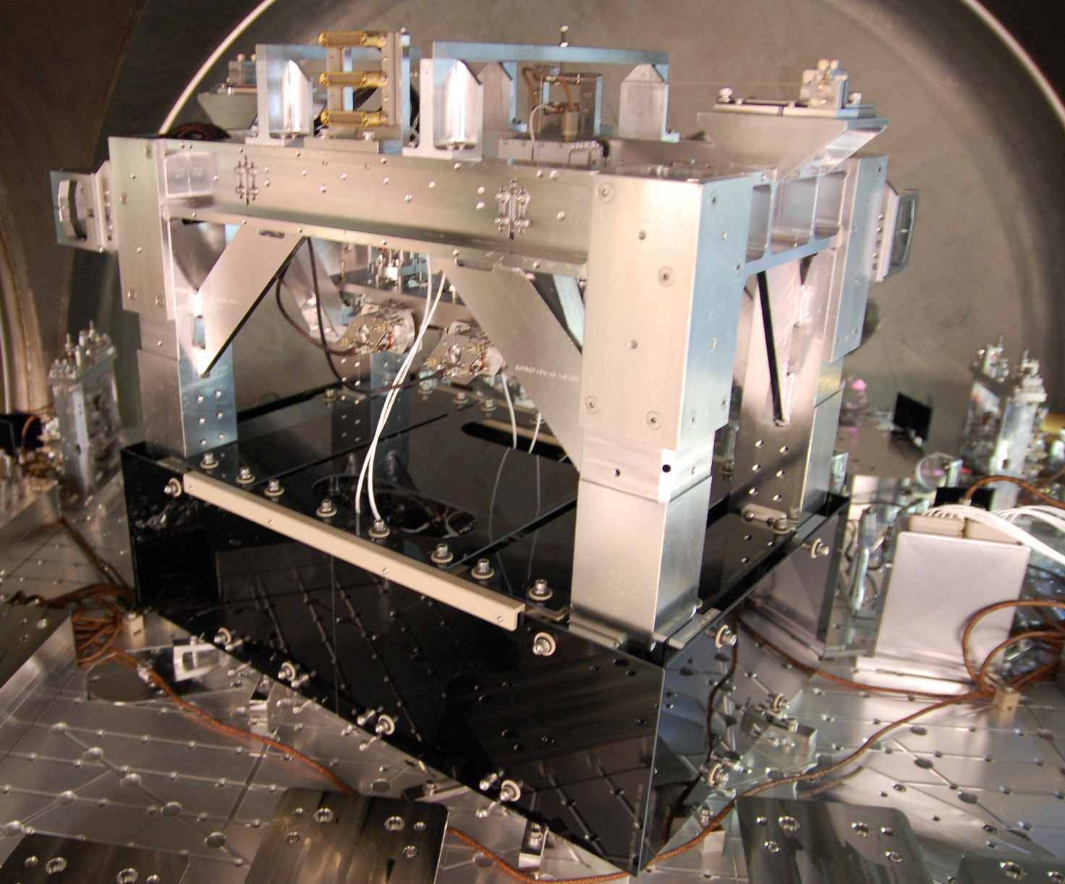
THE BASICS
Overview
This document summarizes the prep work and installation procedure for the OMC Black Glass Shroud.
Black Glass
Total panels: 26
Each panel has a coated side labeled “S1”
Glass Bolt Assy (D1500105) used on all panels
Inner vertical panels (6 total) have C-Clamp Assy, aka brackets
Refer to E1500213 for a collection of associated documents
EQ Stop Assy (D1201441)
Installed assy (v3) will be replaced with an updated version (v5)
EQ Stop Temporary Stabilizer Assy (D1500156) used during the replacement
New, compact EQ Stop Knobs (D1201474) require threaded bumper (D1201440) from old stops

Slide 5
THE BASICS
Black Glass BOM*
 |  |  |  |  |  |  |  |  |  |  | QTY - C-CLAMP ASSY (BRACKETS)
 |  |  |  |  |  | QTY - BOLT ASSY (D1500105) |  |  |  |  | C-CLAMPS (D1500058) |  | STIFFENERS (D1500147) |  |  |  | C-Clamp Jaw (D1500148) (68) | C-Clamp Screw (D1500144) (58) | Screw, SHC 4-40 X 0.5 (67)
 | ITEM NO. | PART NUMBER | DESCRIPTION | QTY | S1 | Basic (36) | -1 (37) | -2 (38) | -3 (39) | -4 (No #) | -101 (LH) (34) | -102 (RH) (35) | -3495 (63) | -3620 (64) | -5370 (65) | -4620 (66)
1 | 10 | D1500042-101 | Outer Panel (-X Side) RH | 1 | Shoulder | 3 | - | - | - | -
2 | 11 | D1500042-102 | Outer Panel (-X Side) LH | 1 | Shoulder | 3 | - | - | - | -
3 | 12 | D1500043-101 | Outer Panel (REFL AIR) RH | 1 | Shoulder | 3 | - | - | - | -
4 | 13 | D1500043-102 | Outer Panel (REFL AIR) LH | 1 | Shoulder | 3 | - | - | - | -
5 | 14 | D1500044 | Outer Panel (TRANS AIR) | 1 | Shoulder | 4 | - | - | - | -
6 | 15 | D1500045 | Outer Panel (-Y Side) | 1 | Shoulder | 4 | - | - | - | -
7 | 16 | D1500046-101 | Outer Panel (TOP) | 1 | Shoulder | 4 | - | - | - | -
8 | 17 | D1500046-102 | Outer Panel (TOP) | 1 | Shoulder | 4 | - | - | - | -
9 | 18 | D1500046-103 | Outer Panel (TOP) | 1 | Shoulder | 4 | - | - | - | -
10 | 19 | D1500046-104 | Outer Panel (TOP) | 1 | Shoulder | 4 | - | - | - | -
11 | 20 | D1500047-101 | Inner Panel (BOT) | 1 | Head | - | 3 | - | - | -
12 | 21 | D1500047-102 | Inner Panel (BOT) | 1 | Head | - | 3 | - | - | -
13 | 22 | D1500048 | Horz Panel (-X Side) | 1 | Head | 2 | - | - | 2 | -
14 | 23 | D1500049 | Horz Panel (REFL AIR) | 1 | Head | 2 | - | - | 2 | -
15 | 24 | D1500050 | Horz Panel (-Y Side) | 1 | Head | - | - | 2 | - | -
16 | 25 | D1500051 | Horz Panel (TRANS AIR) | 1 | Head | - | - | 2 | - | -
17 | 26 | D1500052 | Vert Panel (TRANS AIR) | 1 | Head | - | - | 2 | - | - | 2 | - | - | - | - | 1 | 1 | 4 | 6
18 | 27 | D1500053 | Vert Panel (-Y Side) | 1 | Head | - | - | 2 | - | - | 1 | 1 | 1 | - | - | - | 1 | 4 | 6
19 | 28 | D1500054-101 | Vert Panel (REFL AIR) | 1 | Head | - | - | 2 | - | - | 2 | - | - | - | 1 | - | 1 | 4 | 6
20 | 29 | D1500054-102 | Vert Panel (REFL AIR) | 1 | Head | - | - | 2 | - | - | - | 2 | - | 1 | - | - | 1 | 4 | 6
21 | 30 | D1500055-101 | Vert Panel (-X Side) | 1 | Head | - | - | 2 | - | - | - | 2 | - | - | 1 | - | 1 | 4 | 6
22 | 31 | D1500055-102 | Vert Panel (-X Side) | 1 | Head | - | - | 2 | - | - | 2 | - | - | 1 | - | - | 1 | 4 | 6
23 | 40 | D1500116 | Top Horz Panel (Inner) | 2 | Head | - | - | - | - | 6
24 | 57 | D1500143 | Top Panel Extn | 2 | Shoulder | 4 | - | - | - | -
 |  |  |  |  |  | 44 | 6 | 16 | 4 | 6 | 7 | 5 | 1 | 2 | 2 | 1 | 6 | 24 | 36
* Qty for final assy, not prep work
(#) denotes the item no. per the top level OMC assy drawing (D0900295)

Slide 6
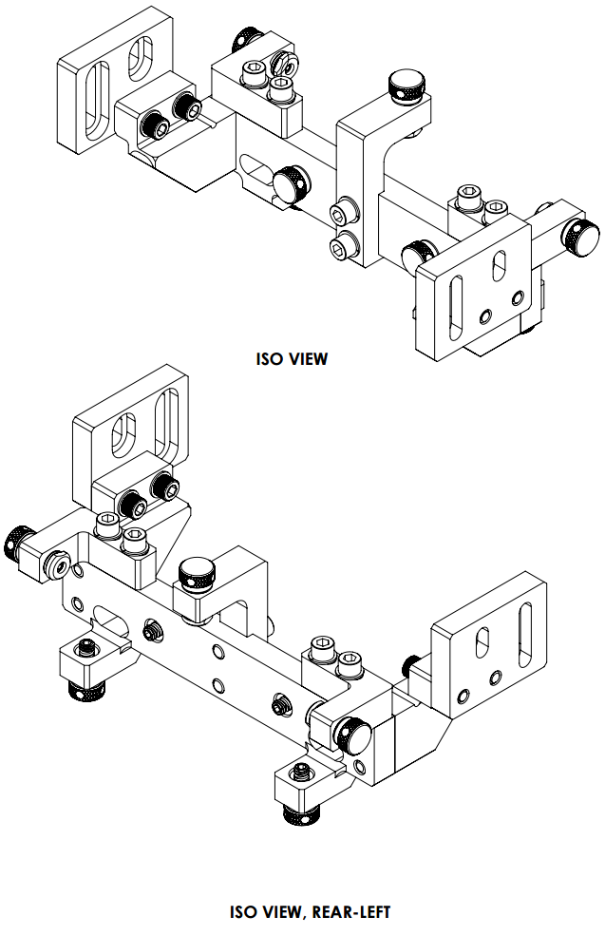
THE BASICS
EQ Stop Assy BOM*
ITEM NO. | PART NUMBER | DESCRIPTION | MATERIAL | QTY
7 | D1201441 | EQ Stop Assy | - | 2
7.1 | D1201471 | Main Bar | 6061-T6 Al | 2
7.2 | D1201472 | Left Support (Bracket) | 6061-T6 Al | 2
7.3 | D1201473 | Right Support (Bracket) | 6061-T6 Al | 2
7.4 | D1201474 | EQ Stop Knob | - | 14
7.4.1 | D1201440 | Threaded Bumper, EQ Stop | Semitron ESD 480 | 14
7.4.2 | D1500149 | Thumb Screw, EQ Stop | 18-8 SSTL | 14
7.4.3 | 91318A410 | Hollow-Lock Set Screw, 1/4"-20 X 1/8" LG | 18-8 SSTL | 14
7.5 | D1201475 | Top Bracket | 6061-T6 Al | 2
7.6 | D1201476 | Side Bracket | 6061-T6 Al | 4
7.7 | D1201478-101 | Horizontal Adjust (LH) | 6061-T6 Al | 2
7.8 | D1201478-102 | Horizontal Adjust (RH) | 6061-T6 Al | 2
7.9 | Thread Insert | Helicoil 1/4"-20 x 1Dia | Nitronic 60 | 28
7.10 | Holokrome_78060 | SHCS, 1/4-20 X .875 LG. | 18-8 SSTL | 4
7.11 | Holokrome_78062 | Screw, SHC, 1/4-20 x 1.0 LG. | 18-8 SSTL | 8
7.12 | WFV-25 | Vented Washer, .255 ID X .468 OD X .032 THK #1/4 | 18-8 SSTL | 20
7.13 | 95966A529 | Screw, SHC, 1/4-20 X 1.0 LG. (Captive) | 18-8 SSTL | 8
7.14 | 93615A422 | Screw, LSHC, 1/4"-20 x 1.25" LG. | 18-8 SSTL | 8
* Qty for final assy, not prep work

Slide 7
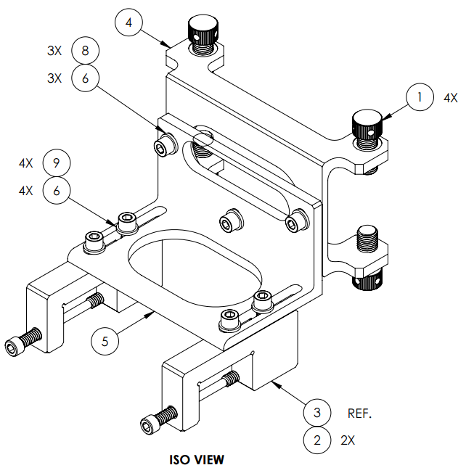
THE BASICS
Temp EQ Stop Stabilizer Assy BOM
ITEM NO. | PART NUMBER | DESCRIPTION | MATERIAL | QTY
69 | D1500156 | EQ Stop Temp Stabilizer Assy | - | 2
69.1 | Q104-222-15 | Thumbscrew, 7/16-20 X 1.0 LG. | PEEK | 8
69.2 | D1500144 | C-Clamp Screw | 316 SSTL | 4
69.3 | D1500150 | C-Clamp | 6061-T6 Al | 4
69.4 | D1500151 | U-Channel | 6061-T6 Al | 2
69.5 | D1500154 | L-Bracket | 6061-T6 Al | 2
69.6 | NAS620-C416 | Washer, Flat, 1/4 | 300 SSTL | 14
69.7 | 95630A470 | Washer, Flat, 1/4 | PTFE (general) | 8
69.8 | MS16995-48 | Screw, SHC, 1/4-20 X .50 LG. | 300 SSTL | 6
69.9 | MS16995-49 | Screw, SHC, 1/4-20 X .63 LG. | 300 SSTL | 8
69.10 | Thread Insert | Helicoil 1/4"-20 x 1Dia | Nitronic 60 | 8

Slide 8
GLASS INSPECTION & CLEANING

Slide 9
GLASS INSPECTION & CLEANING
TOOLS & MATERIALS
Safety eyewear
Vectra Alpha 10 wipes
Berkshire wipes
Large metal pans
Methanol
Glass funnel
Glass bottle
Methanol squeeze bottle
Flashlight array
A lot of table space

Slide 10
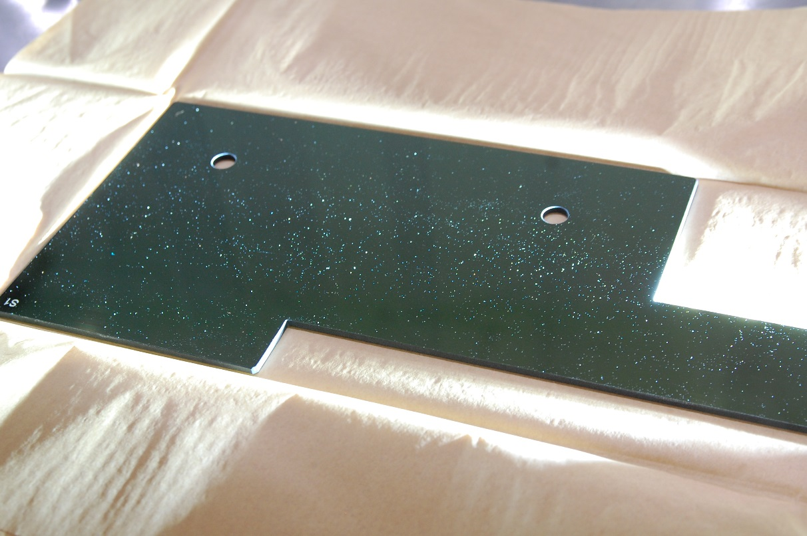
GLASS INSPECTION & CLEANING
PROCEDURE
Per L1500091:
Pour methanol into a clean squeeze bottle and into a small glass bottle.
Do not use an old batch or bottle of methanol.
Line the bottom and sides of the clean metal pans with Vectra Alpha 10 wipes.
Panels will be rinsed in the pan, so ensure there is enough padding to protect the glass.
Carefully unpack the glass.
Immediately after unpacking, inspect 100% of panels with a high intensity white light at incident angle.

Slide 11
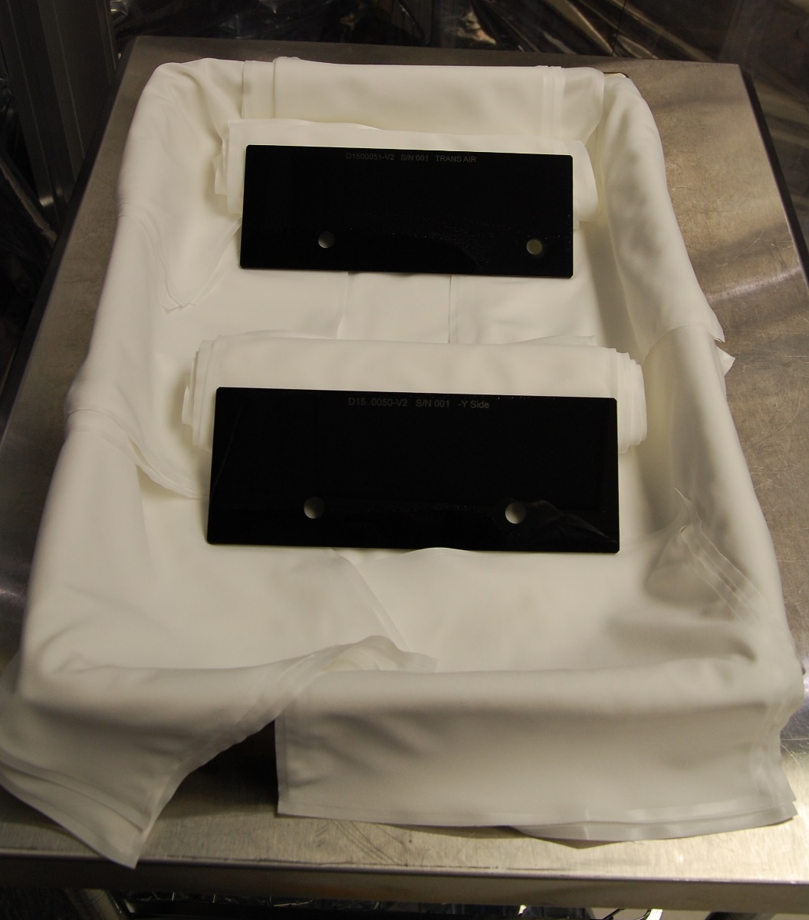
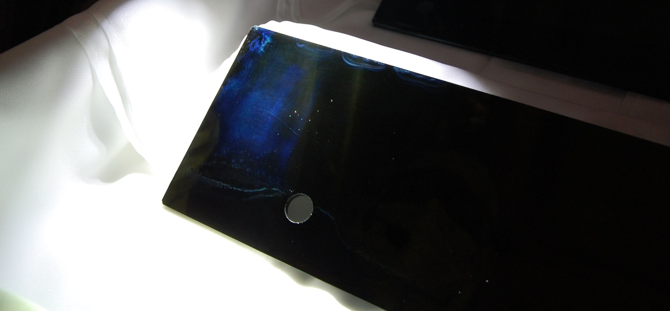
GLASS INSPECTION & CLEANING
PROCEDURE
Lean panel(s) against padded wall of a metal pan or prop up with wipes.
Wipe edges with a methanol saturated Berkshire wipe.
Rinse each side 2x with methanol from the squeeze bottle. Allow to dry between rinses.
Immediately replace gloves if they come into contact with methanol. Inspection revealed a blue residue on a panel that was handled with gloved hands while it was wet.

Slide 12
GLASS INSPECTION & CLEANING
PROCEDURE
Inspect both sides.
If particles or other contaminants are still visible, repeat Step 7.
Lay out 2 sets of clean Vectra Alpha 10 wipes in an area away from the methanol rinsing.
Place the panel on the first set of clean wipes with the uncoated side facing up.
Drag wipe the uncoated side 2x with a methanol saturated Berkshire wipe.
Inspect the uncoated side.
If the surface does not appear clean, repeat Step 11.
Turn the panel over to the coated side, and place it on the second set of clean wipes.
Discard the first set of wipes.
Drag wipe the coated side 2x with a methanol saturated Berkshire wipe.
Inspect the coated side.
If the surface does not appear clean, repeat Step 14.
Line clean pans or aluminum foil boats (for storing glass) with Vectra Alpha 10 wipes.

Slide 13
GLASS INSPECTION & CLEANING
PROCEDURE
Place the now clean panel in the pan/boat with the coated side facing up.
Cover class with Vectra Alpha 10 wipes to keep clean.

Slide 14
PREP – NON-GLASS PARTS Pre-Assembly
Note – BOM quantities in this section are for prep work only, and may not reflect the top level total.

Slide 15
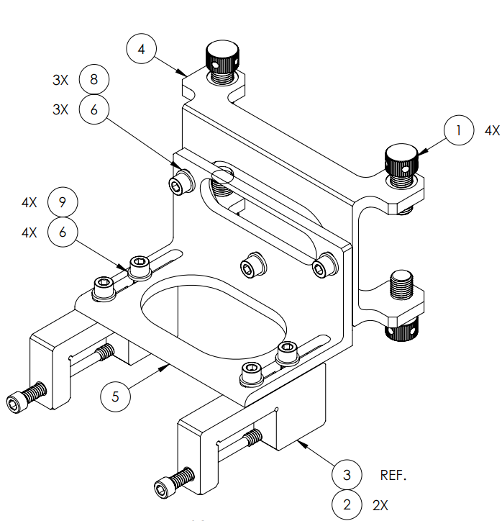
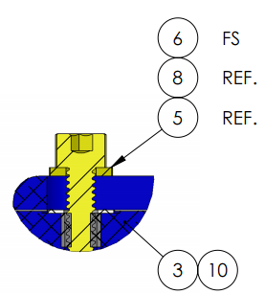
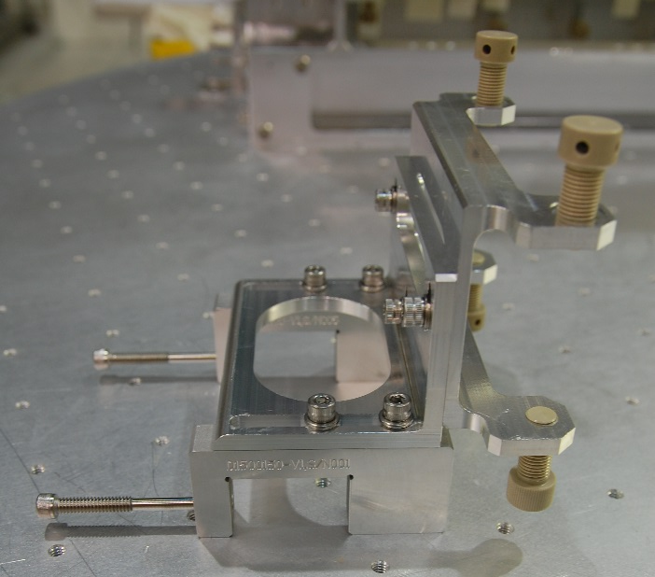
PREP – TEMP STABILIZER ASSY
D1500156
Have enough parts to make 2 assy but only 1 was required during practice at Caltech and install at LHO.
BOM (table below)
Item no. are for assy, not top level OMC
Qty for 1 assy
Position:
EQ Stops (1) – retracted
C-Clamp screws (2) – retracted
U-Channel (4) – slide all the way down
L-Bracket (5) – retracted
C-Clamps must be aligned to U-Channel
ITEM NO. | PART NUMBER | DESCRIPTION | MATERIAL | QTY
1 | Q104-222-15 | Thumbscrew, 7/16-20 X 1.0 LG. | PEEK | 4
2 | D1500144 | C-Clamp Screw | 316 SSTL | 2
3 | D1500150 | C-Clamp | 6061-T6 Al | 2
4 | D1500151 | U-Channel | 6061-T6 Al | 1
5 | D1500154 | L-Bracket | 6061-T6 Al | 1
6 | NAS620-C416 | Washer, Flat, 1/4 | 300 SSTL | 7
7 | 95630A470 | Washer, Flat, 1/4 | PTFE (general) | 4
8 | MS16995-48 | Screw, SHC, 1/4-20 X .50 LG. | 300 SSTL | 3
9 | MS16995-49 | Screw, SHC, 1/4-20 X .63 LG. | 300 SSTL | 4
10 | Thread Insert | Helicoil 1/4"-20 x 1Dia | Nitronic 60 | 4

Slide 16
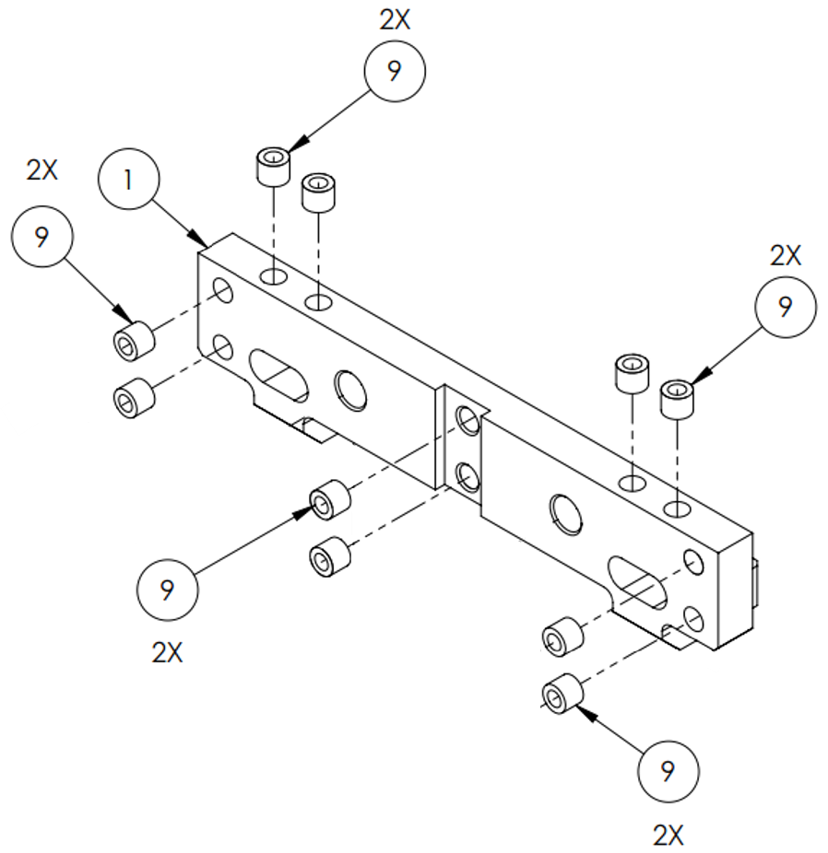
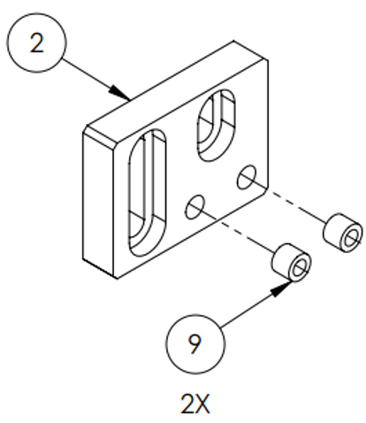
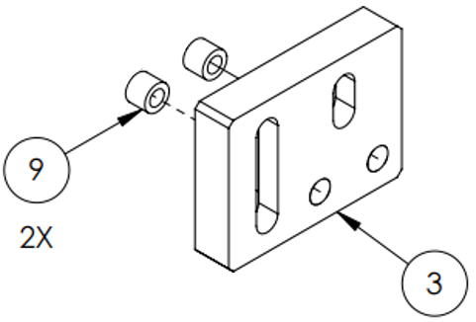
PREP – EQ STOP ASSY
Overview
D1201441
Total: 2
Partially assembled
BOM (table below):
Item no are for assy, not top level OMC
Qty for 1 assy
Helicoil:
Main Bar (1)
Left & Right Supports (2 & 3)
ITEM NO. | PART NUMBER | DESCRIPTION | MATERIAL | QTY
1 | D1201471 | Main Bar | 6061-T6 Al | 1
2 | D1201472 | Left Support (Bracket) | 6061-T6 Al | 1
3 | D1201473 | Right Support (Bracket) | 6061-T6 Al | 1
7 | D1201478-101 | Horizontal Adjust (LH) | 6061-T6 Al | 1
8 | D1201478-102 | Horizontal Adjust (RH) | 6061-T6 Al | 1
9 | Thread Insert | Helicoil 1/4"-20 x 1Dia | Nitronic 60 | 14
12 | WFV-25 | Vented Washer, .255 ID X .468 OD X .032 THK #1/4 | 18-8 SSTL | 4
13 | 95966A529 | Screw, SHC, 1/4-20 X 1.0 LG. (Captive) | 18-8 SSTL | 4
14 | 93615A422 | Screw, LSHC, 1/4"-20 x 1.25" LG. | 18-8 SSTL | 4

Slide 17
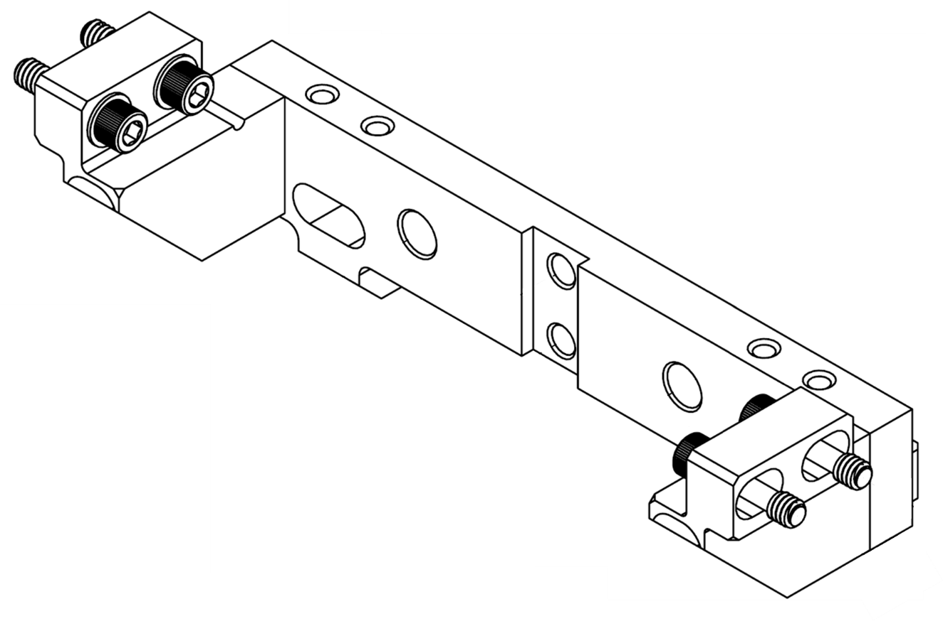
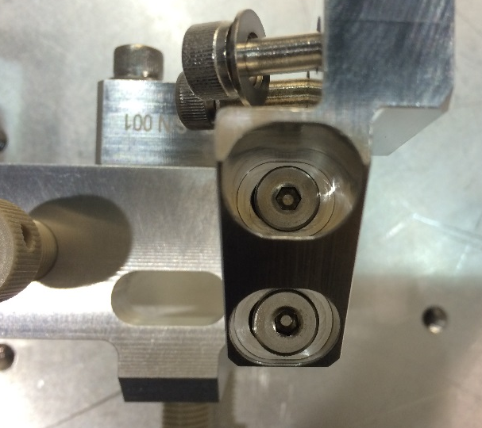
PREP – EQ STOP ASSY
Partially Assembled
EQ Stops will be taken from old EQ Assy (later step)
Position:
Horizontal Adjust LH (7) & RH (8) – retracted (as far inward as possible)

Slide 18
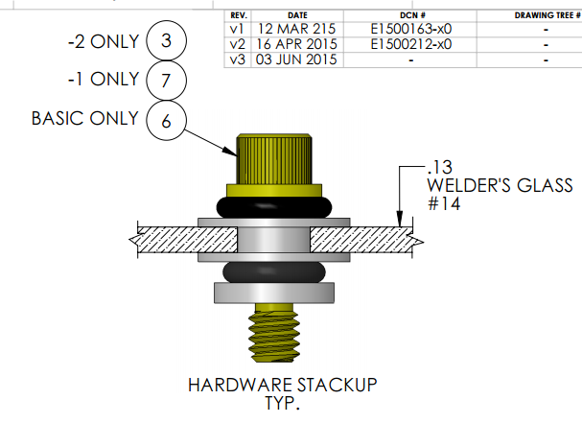
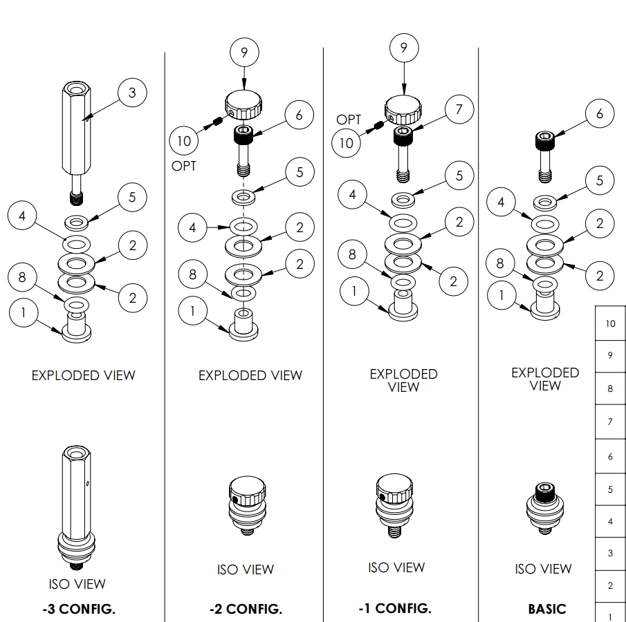
PREP – BOLT ASSY
Overview
D1500105
Multiple configurations
Drawing (v3) doesn’t show the -4 config.
Item no. in table below are for bolt assy, not top level OMC.
 |  |  |  | QTY (EA)
ITEM NO. | PART NUMBER | DESCRIPTION | MATERIAL | Basic (36) | -1 (37) | -2 (38) | -3 (39) | -4 (No #)
1 | D1500059 | C'Bore Shoulder Washer | PEEK | 1 | 1 | 1 | 1 | 1
2 | D1500104 | 1/4 Washer | PEEK | 2 | 2 | 2 | 2 | -
3 | D1500118 | Male/Female Standoff, 1/4-20 (Captive) | 6061-T6 Al | - | - | - | 1 | -
4 | 2-110 Parker | O-Ring, 3/32 X 3/8 ID X 9/16 OD | Viton | 1 | 1 | 1 | 1 | 1
5 | NAS620-C416 | Washer, Flat, 1/4 | 300 SSTL | 1 | 1 | 1 | 1 | 1
6 | 95966A523 | Screw, SHC, 1/4-20 X .88 LG. (Captive) | 18-8 SSTL | 1 | - | 1 | - | 1
7 | 95966A529 | Screw, SHC, 1/4-20 X 1.0 LG. (Captive) | 18-8 SSTL | - | 1 | - | - | -
8 | 2-109 Parker | O-Ring, 3/32W X 5/16 ID X 1/2 OD | Viton | 1 | 1 | 1 | 1 | 1
9 | D1500146 | Screw Cap | PEEK | - | 1 | 1 | - | -
10 | 94355A135 | Set Screw, 4-40 X 3/16 LG. | 18-8 SSTL | - | 1 | 1 | - | -
11 | D1500104-1 | Larger 1/4 Washer | PEEK | - | - | - | - | 2
 |  |  |  | Basic (36) | -1 (37) | -2 (38) | -3 (39) | -4 (No #)
 |  |  | TOTAL | 44 | 6 | 16 | 4 | 6

Slide 19
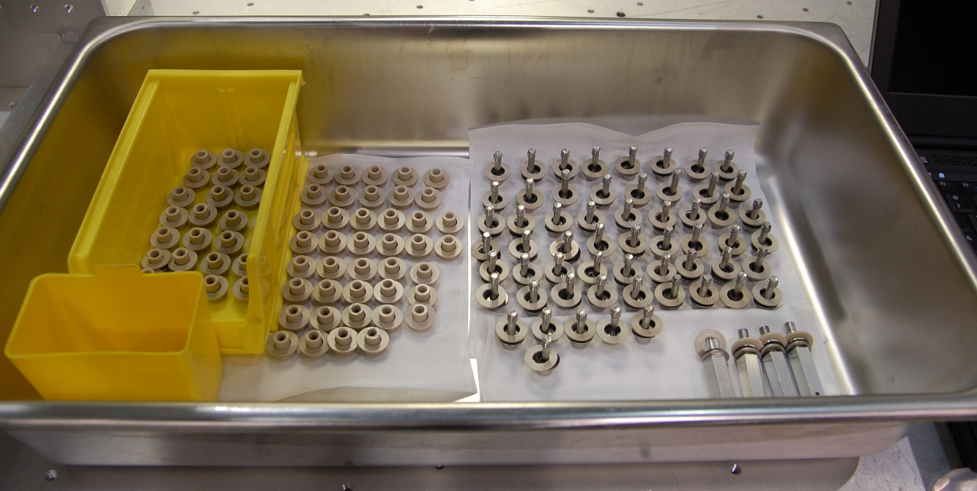
PREP – BOLT ASSY
Optional
Save time – put together ALL the top & bottom halves of the bolt assy
Bottom Half
Same parts used for all configurations except -4 (which has a larger PEEK washer).
 |  |  |  | QTY (EA)
ITEM NO. | PART NUMBER | DESCRIPTION | MATERIAL | All Except -4 (36-39) | -4 (No #)
1 | D1500059 | C'Bore Shoulder Washer | PEEK | 1 | 1
2 | D1500104 | 1/4 Washer | PEEK | 2 | -
8 | 2-109 Parker | O-Ring, 3/32W X 5/16 ID X 1/2 OD | Viton | 1 | 1
11 | D1500104-1 | Larger 1/4 Washer | PEEK | - | 2
 |  |  |  | All Except -4 (36-39) | -4 (No #)
 |  |  | TOTAL | 70 | 6

Slide 20
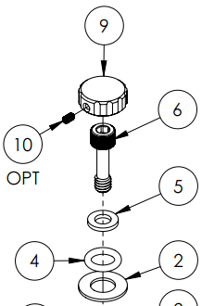
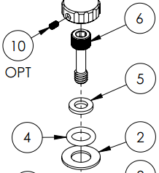
PREP – BOLT ASSY
Optional
Top Half
Most commonly used configurations:
Basic
-2
-2 is the Basic config. plus a screw cap
 |  |  |  | QTY (EA)
ITEM NO. | PART NUMBER | DESCRIPTION | MATERIAL | Basic (36) | -2 (38)
2 | D1500104 | 1/4 Washer | PEEK | 1 | 1
4 | 2-110 Parker | O-Ring, 3/32 X 3/8 ID X 9/16 OD | Viton | 1 | 1
5 | NAS620-C416 | Washer, Flat, 1/4 | 300 SSTL | 1 | 1
6 | 95966A523 | Screw, SHC, 1/4-20 X .88 LG. (Captive) | 18-8 SSTL | 1 | 1
9 | D1500146 | Screw Cap | PEEK | - | 1
10 | 94355A135 | Set Screw, 4-40 X 3/16 LG. | 18-8 SSTL | - | 1
 |  |  |  | Basic (36) | -2 (38)
 |  |  | TOTAL | 44 | 16

Slide 21
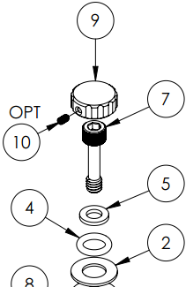
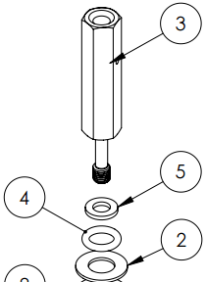
PREP – BOLT ASSY
Optional
Top Half
Less commonly used configurations:
-1
-3
-4
 |  |  |  | QTY EA
ITEM NO. | PART NUMBER | DESCRIPTION | MATERIAL | -1 (37) | -3 (39) | -4 (No #)
2 | D1500104 | 1/4 Washer | PEEK | 1 | 1 | -
3 | D1500118 | Male/Female Standoff, 1/4-20 (Captive) | 6061-T6 Al | - | 1 | -
4 | 2-110 Parker | O-Ring, 3/32 X 3/8 ID X 9/16 OD | Viton | 1 | 1 | 1
5 | NAS620-C416 | Washer, Flat, 1/4 | 300 SSTL | 1 | 1 | 1
6 | 95966A523 | Screw, SHC, 1/4-20 X .88 LG. (Captive) | 18-8 SSTL | - | - | 1
7 | 95966A529 | Screw, SHC, 1/4-20 X 1.0 LG. (Captive) | 18-8 SSTL | 1 | - | -
9 | D1500146 | Screw Cap | PEEK | 1 | - | -
10 | 94355A135 | Set Screw, 4-40 X 3/16 LG. | 18-8 SSTL | 1 | - | -
11 | D1500104-1 | Larger 1/4 Washer | PEEK | - | - | 1
 |  |  |  | -1 (37) | -3 (39) | -4 (No #)
 |  |  | TOTAL | 6 | 4 | 6

Slide 22
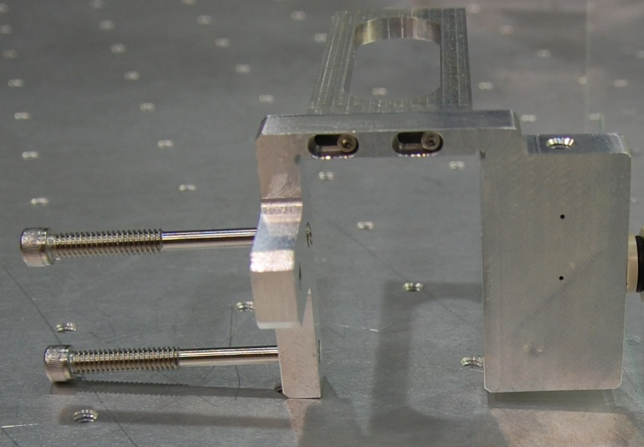
PREP – BRACKETS
Overview
Either fully assembled (2 total) or partially assembled (4 total).
“Fully” = prepped with both C-Clamps & Stiffener
“Partially” = prepped with 1 C-Clamp & Stiffener
C-Clamp Jaw & 2 SHCS always added after glass is positioned in chamber.
Position (for all):
C-Clamp Screws (58) – retracted
Stiffener (63-64)
Forward (i.e. toward glass, away from C-Clamp screws)
Holes are offset on some of the parts, so note the orientation. D# should be on side near the glass panel (i.e. away from the C-Clamp screws).
Align Stiffener & C-Clamps (or the bracket & glass won’t sit flat when installed).
Scribed D#
 |  |  |  |  | C-CLAMPS |  | STIFFENERS |  |  |  | C-CLAMP SCREW (D1500144) (58) | SCREW, SHC 4-40 X 0.5 (67)
 | ITEM NO. | PART NUMBER | DESCRIPTION | QTY | -101 (LH) (34) | -102 (RH) (35) | -3495 (63) | -3620 (64) | -5370 (65) | -4620 (66)
FULLY ASSEMBLED | 26 | D1500052 | Vert Panel (TRANS AIR) | 1 | 2 | - | - | - | - | 1 | 4 | 4
 | 27 | D1500053 | Vert Panel (-Y Side) | 1 | 1 | 1 | 1 | - | - | - | 4 | 4
PARTIALLY ASSEMBLED | 28 | D1500054-101 | Vert Panel (REFL AIR) | 1 | 1 | - | - | - | 1 | - | 2 | 2
 | 29 | D1500054-102 | Vert Panel (REFL AIR) | 1 | - | 1 | - | 1 | - | - | 2 | 2
 | 30 | D1500055-101 | Vert Panel (-X Side) | 1 | - | 1 | - | - | 1 | - | 2 | 2
 | 31 | D1500055-102 | Vert Panel (-X Side) | 1 | 1 | - | - | 1 | - | - | 2 | 2
 |  |  |  |  | 5 | 3 | 1 | 2 | 2 | 1 | 16 | 16

Slide 23
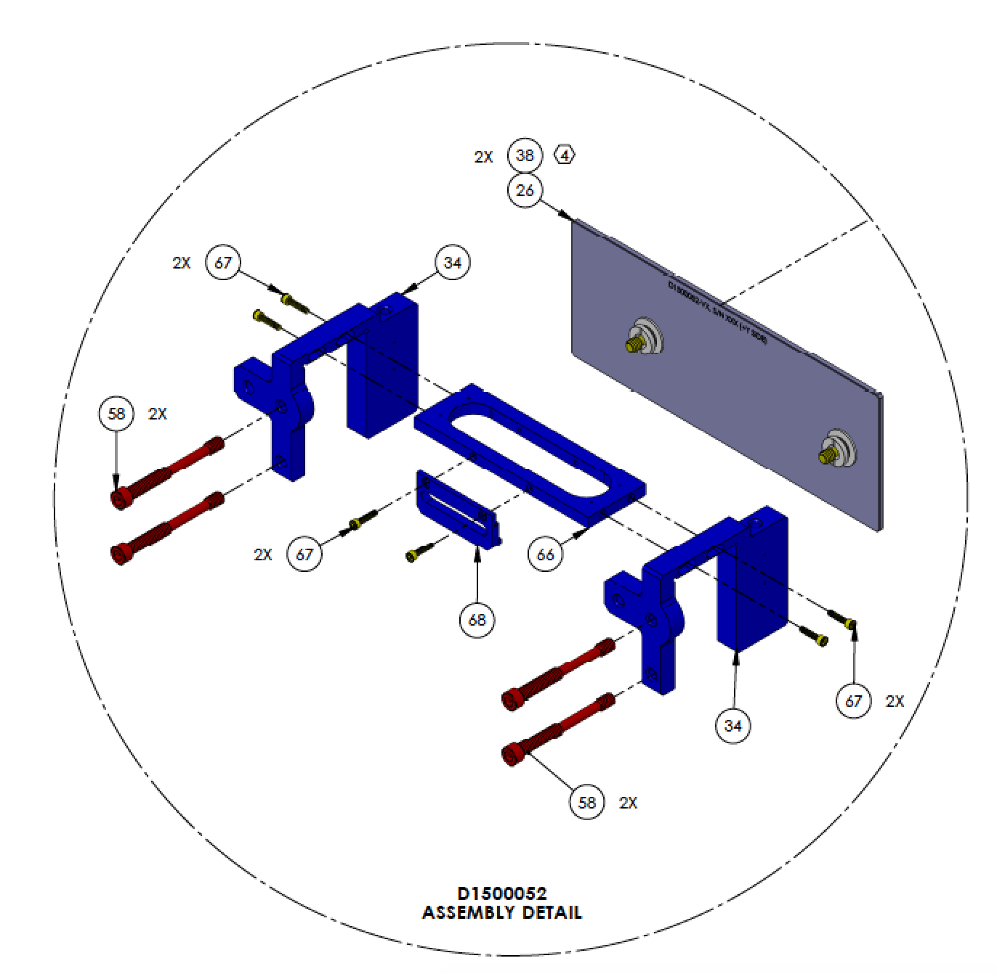
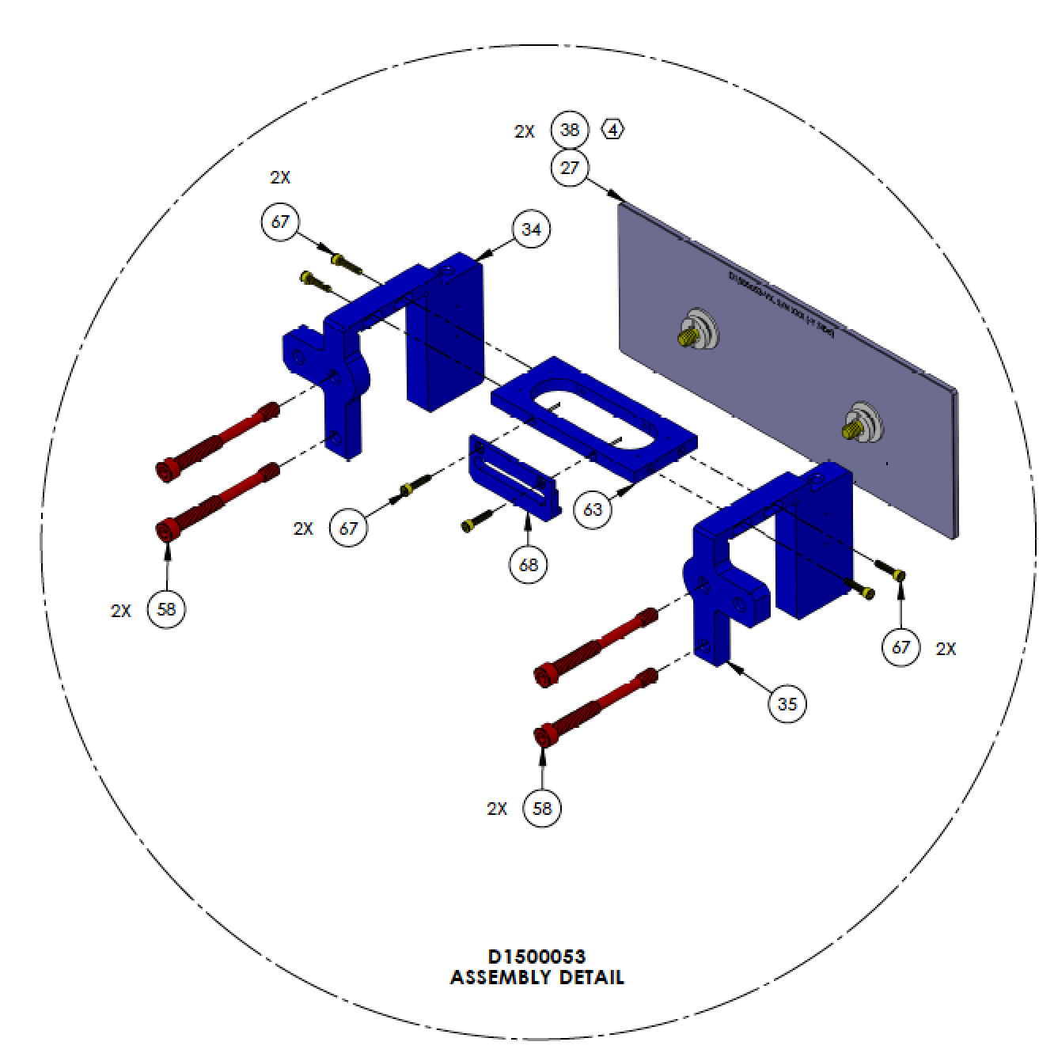
PREP – BRACKETS
Fully Assembled
Scribed D#
Bracket for D1500052
Bracket for D1500053
 |  |  |  | C-CLAMPS |  | STIFFENERS |  | C-CLAMP SCREW (D1500144) (58) | SCREW, SHC 4-40 X 0.5 (67)
ITEM NO. | PART NUMBER | DESCRIPTION | QTY | -101 (LH) (34) | -102 (RH) (35) | -3495 (63) | -4620 (66)
26 | D1500052 | Vert Panel (TRANS AIR) | 1 | 2 | - | - | 1 | 4 | 4
27 | D1500053 | Vert Panel (-Y Side) | 1 | 1 | 1 | 1 | - | 4 | 4

Slide 24
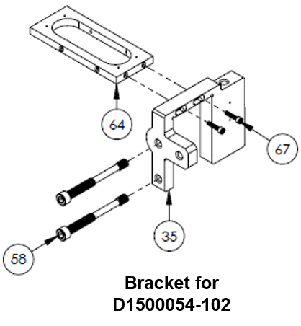
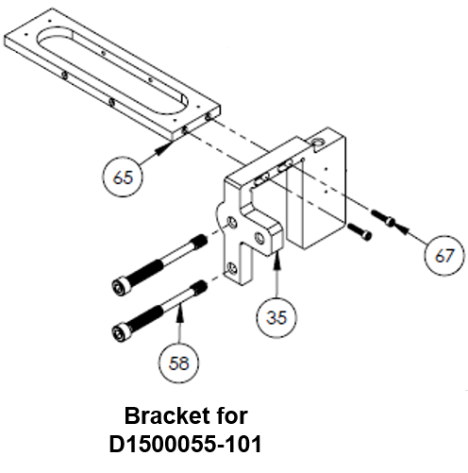
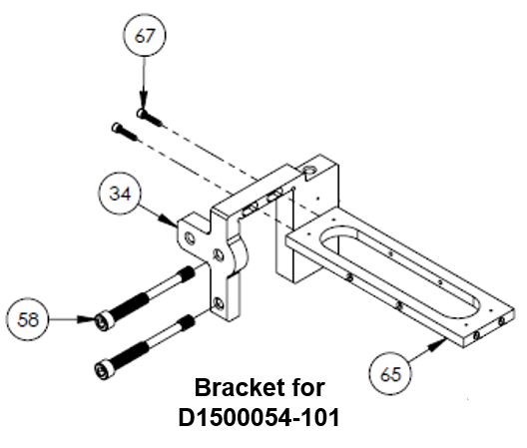
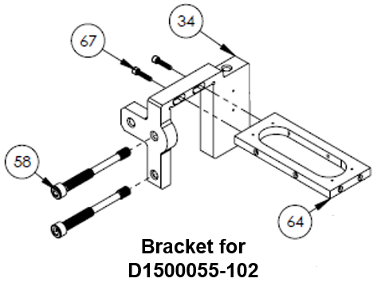
PREP – BRACKETS
Partially Assembled
Scribed D#
 |  |  |  | C-CLAMPS |  | STIFFENER |  | C-CLAMP SCREW (D1500144) (58) | SCREW, SHC 4-40 X 0.5 (67)
ITEM NO. | PART NUMBER | DESCRIPTION | QTY | -101 (LH) (34) | -102 (RH) (35) | -3620 (64) | -5370 (65)
28 | D1500054-101 | Vert Panel (REFL AIR) | 1 | 1 | - | - | 1 | 2 | 2
29 | D1500054-102 | Vert Panel (REFL AIR) | 1 | - | 1 | 1 | - | 2 | 2
30 | D1500055-101 | Vert Panel (-X Side) | 1 | - | 1 | - | 1 | 2 | 2
31 | D1500055-102 | Vert Panel (-X Side) | 1 | 1 | - | 1 | - | 2 | 2

Slide 25
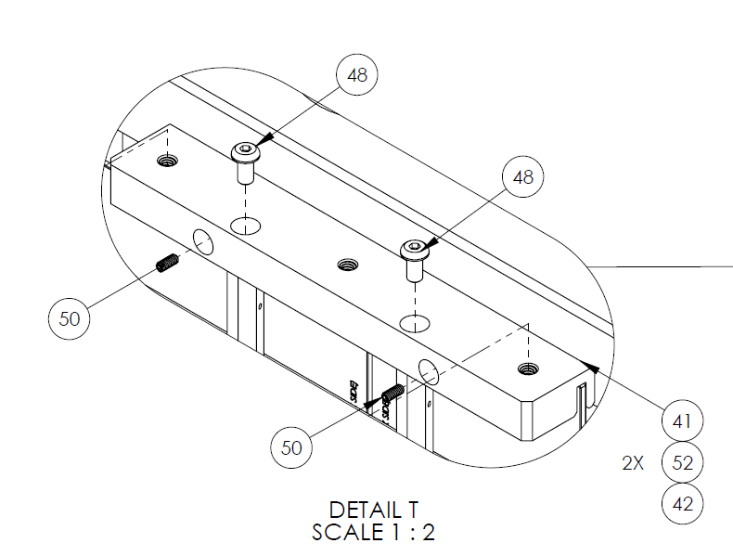
PREP – PEEK PARTS
Only need set screws & helicoils
Retract set screws
 |  |  |  | HARDWARE (TOTAL)
ITEM NO. | PART NUMBER | DESCRIPTION | QTY | Set Screw, 8-32 x .38 (50) | Helicoil, 1/4-20 x .25 (52)
33 | D1500057 | Midspan Support | 2 | 4 | 6
41 | D1500117 | Midspan Support (Inner) | 2 | 8 | 16
 |  |  |  | 12 | 22

Slide 26
PREP – GLASS Pre-Assembly
Note – BOM quantities in this section are for prep work only, and may not reflect the top level total.

Slide 27
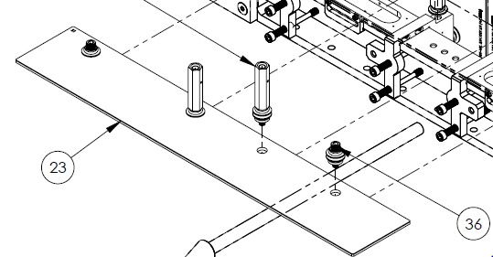
PREP – GLASS
Bolt Assy Only
 | PART NUMBER | QTY | S1 | QTY - BA | TOTAL
BASIC CONFIG. | D1500042-101 | 1 | Shoulder | 3 | 40
 | D1500042-102 | 1 | Shoulder | 3
 | D1500043-101 | 1 | Shoulder | 3
 | D1500043-102 | 1 | Shoulder | 3
 | D1500044 | 1 | Shoulder | 4
 | D1500045 | 1 | Shoulder | 4
 | D1500046-101 | 1 | Shoulder | 4
 | D1500046-102 | 1 | Shoulder | 4
 | D1500046-103 | 1 | Shoulder | 4
 | D1500046-104 | 1 | Shoulder | 4
 | D1500048* | 1 | Head | 2
 | D1500049* | 1 | Head | 2
-1 CONFIG. | D1500047-101 | 1 | Head | 3 | 6
 | D1500047-102 | 1 | Head | 3
-2 CONFIG. | D1500050 | 1 | Head | 2 | 4
 | D1500051 | 1 | Head | 2
-3 CONFIG. | D1500048* | 1 | Head | 2 | 4
 | D1500049* | 1 | Head | 2
-4 CONFIG. | D1500116 | 2 | Head | 6 | 6
* D1500048 & 49: outer holes = -2/basic config., inner = -3 config.
D1500049

Slide 28
PREP – GLASS
Assemblies with Brackets
OVERVIEW
All use Bolt Assy -2 config.
 |  |  |  | QTY - BA | QTY - C-CLAMPS |  | QTY - STIFFENERS
 | PART NUMBER | QTY | S1 | -2 Config. | -101 (LH) (34) | -102 (RH) (35) | -3495 (63) | -3620 (64) | -5370 (65) | -4620 (66)
FULLY ASSEMBLED* | D1500052 | 1 | Head | 2 | 2 |  |  |  |  | 1
 | D1500053 | 1 | Head | 2 | 1 | 1 | 1
PARTIALLY ASSEMBLED | D1500054-101 | 1 | Head | 1 | 1 |  |  |  | 1
 | D1500054-102 | 1 | Head | 1 |  | 1 |  | 1
 | D1500055-101 | 1 | Head | 1 |  | 1 |  |  | 1
 | D1500055-102 | 1 | Head | 1 | 1 |  |  | 1
 |  |  |  | 8 | 5 | 3 | 1 | 2 | 2 | 1

Slide 29
PREP – IN CHAMBER

Slide 30
PREP – IN CHAMBER
Count the number of EQ Stops currently installed (on old EQ Stop Assy).
Total = 14: Go to next step.
Total <14: For every missing EQ stop on the OMC, remove 1 EQ stop from the Temp Stabilizer Assy. Replace with PEEK stops.
Lock all EQ Stops.
Pinch/lock upper and lower blade stops.
Move/remove items per HAM6 Table Balance.pdf (D0900295 Other Files).

Slide 31
ASSEMBLY PROCEDURE
Notes:
2 person job.
Item numbers are given per the top level OMC drawing for reference.

Slide 32
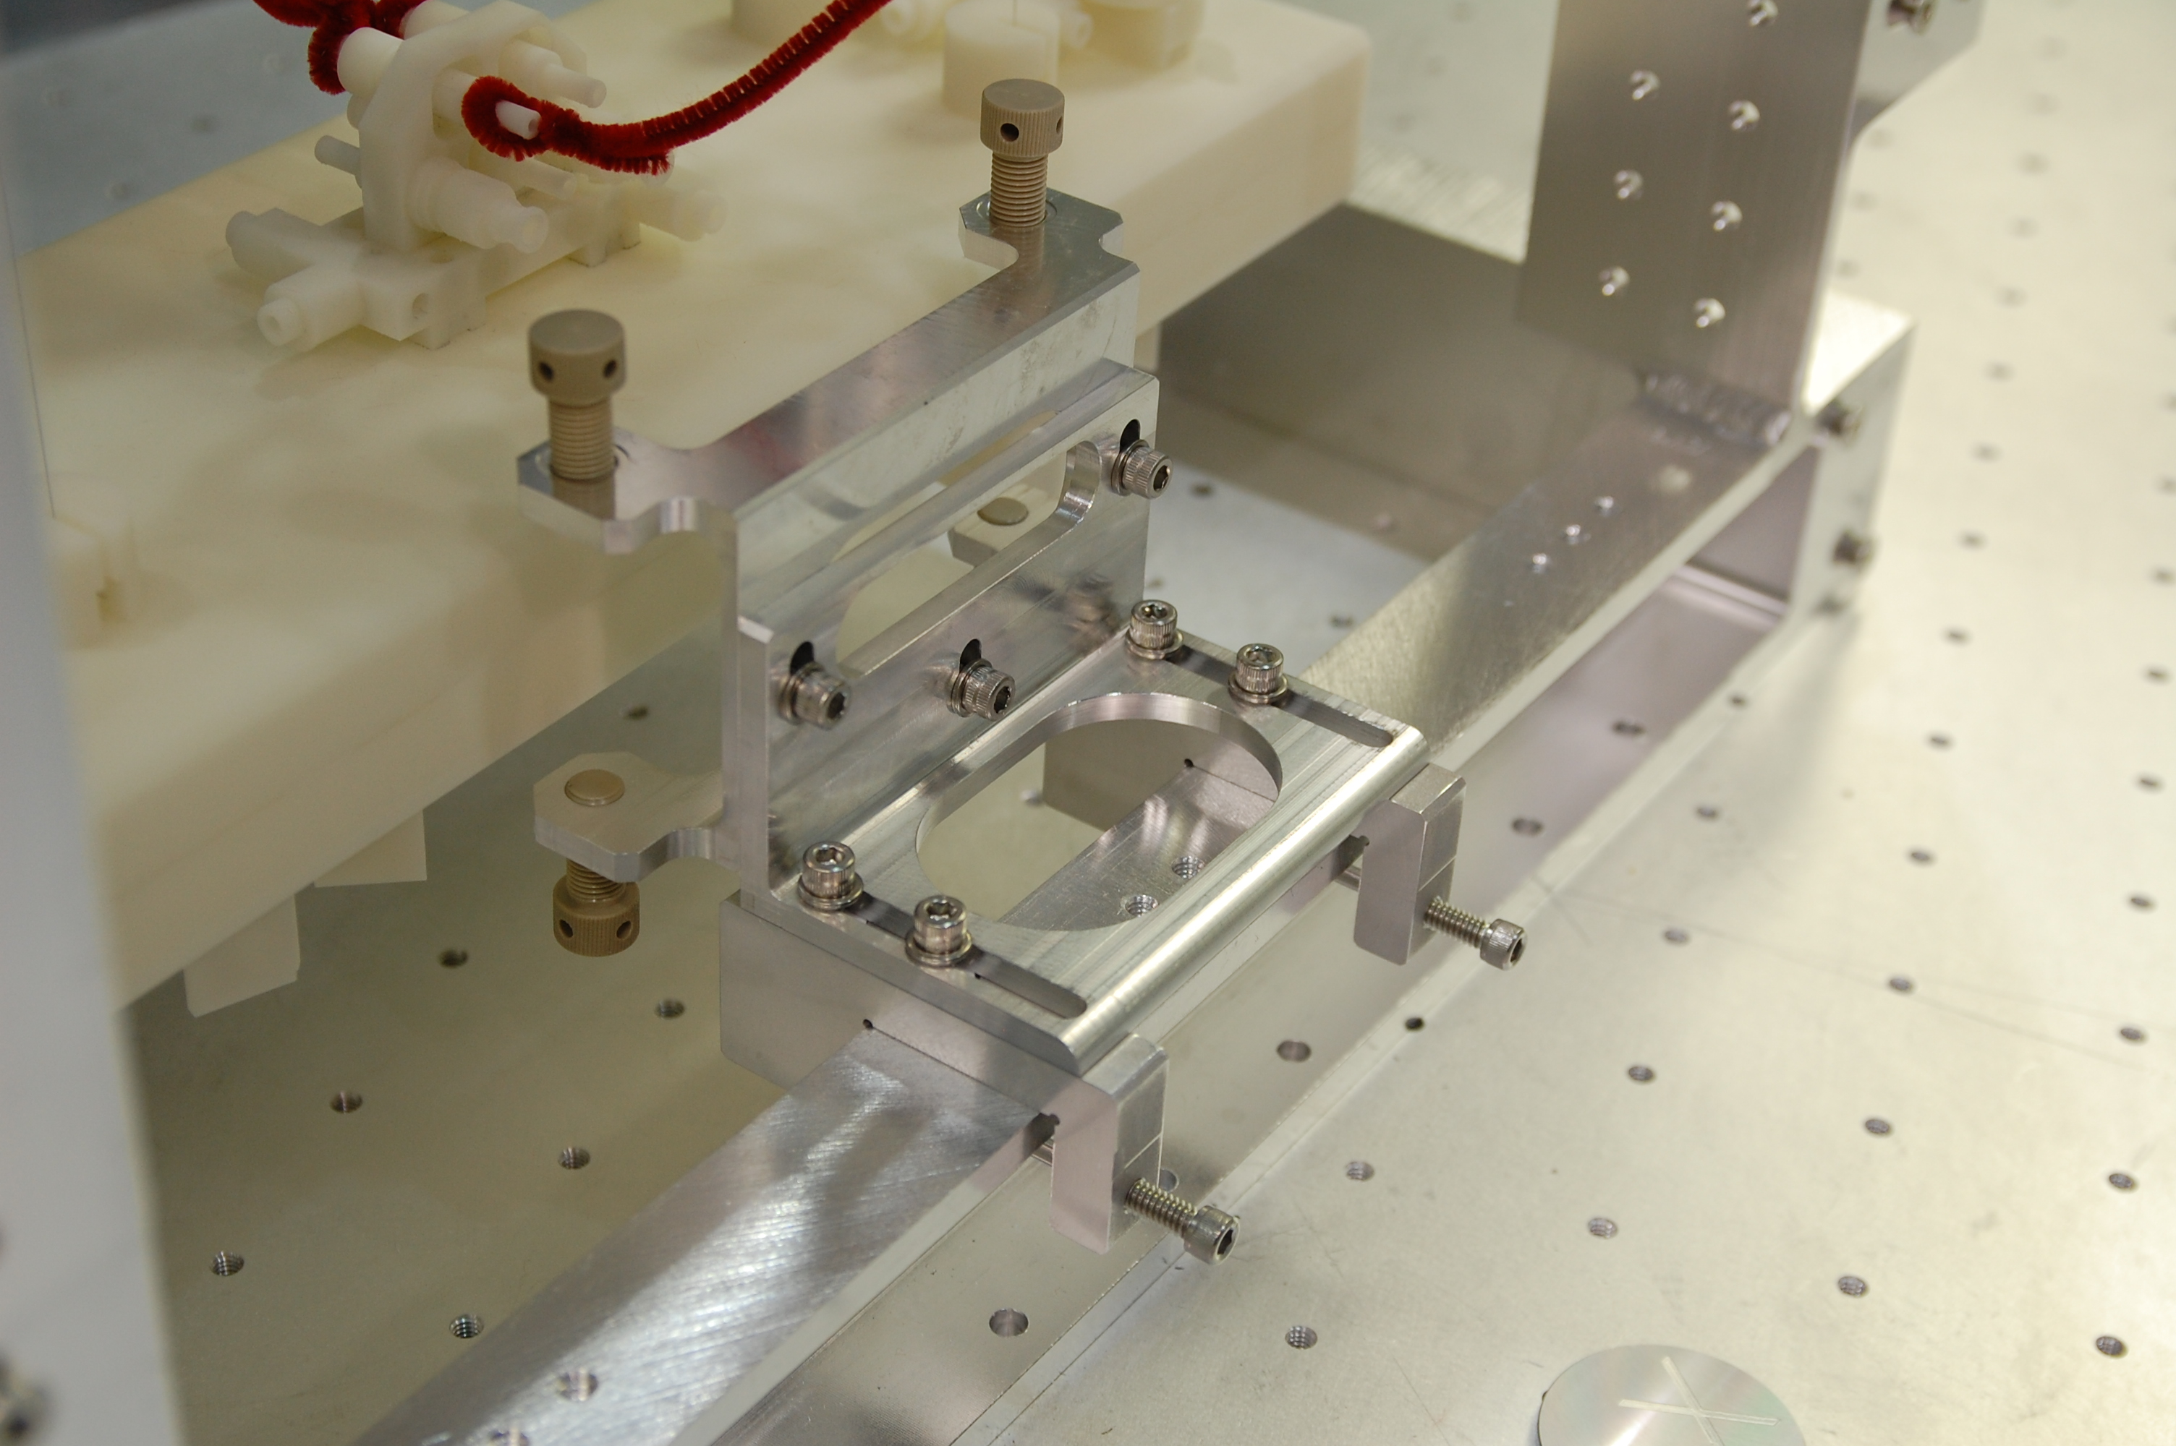
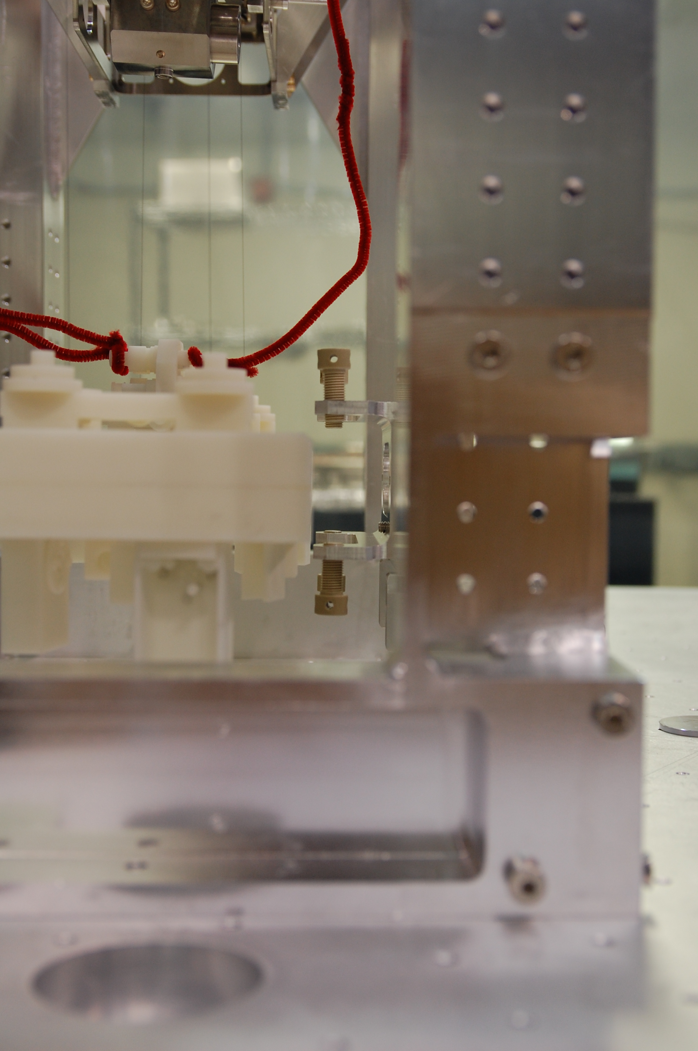
+X Side
Install EQ Stop Temp Stabilizer Assy (69) in its retracted position.
Tighten C-Clamp Screws (69.2)
Mind the parts on the bottom of the bench.
The assy pitches forward when the C-Clamps Screws are retracted. Once tightened, the assy is stable.

Slide 33
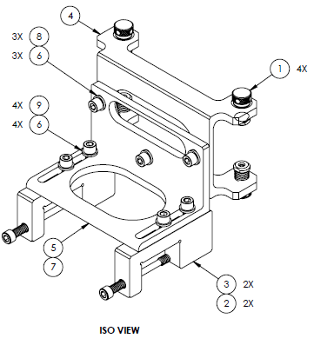
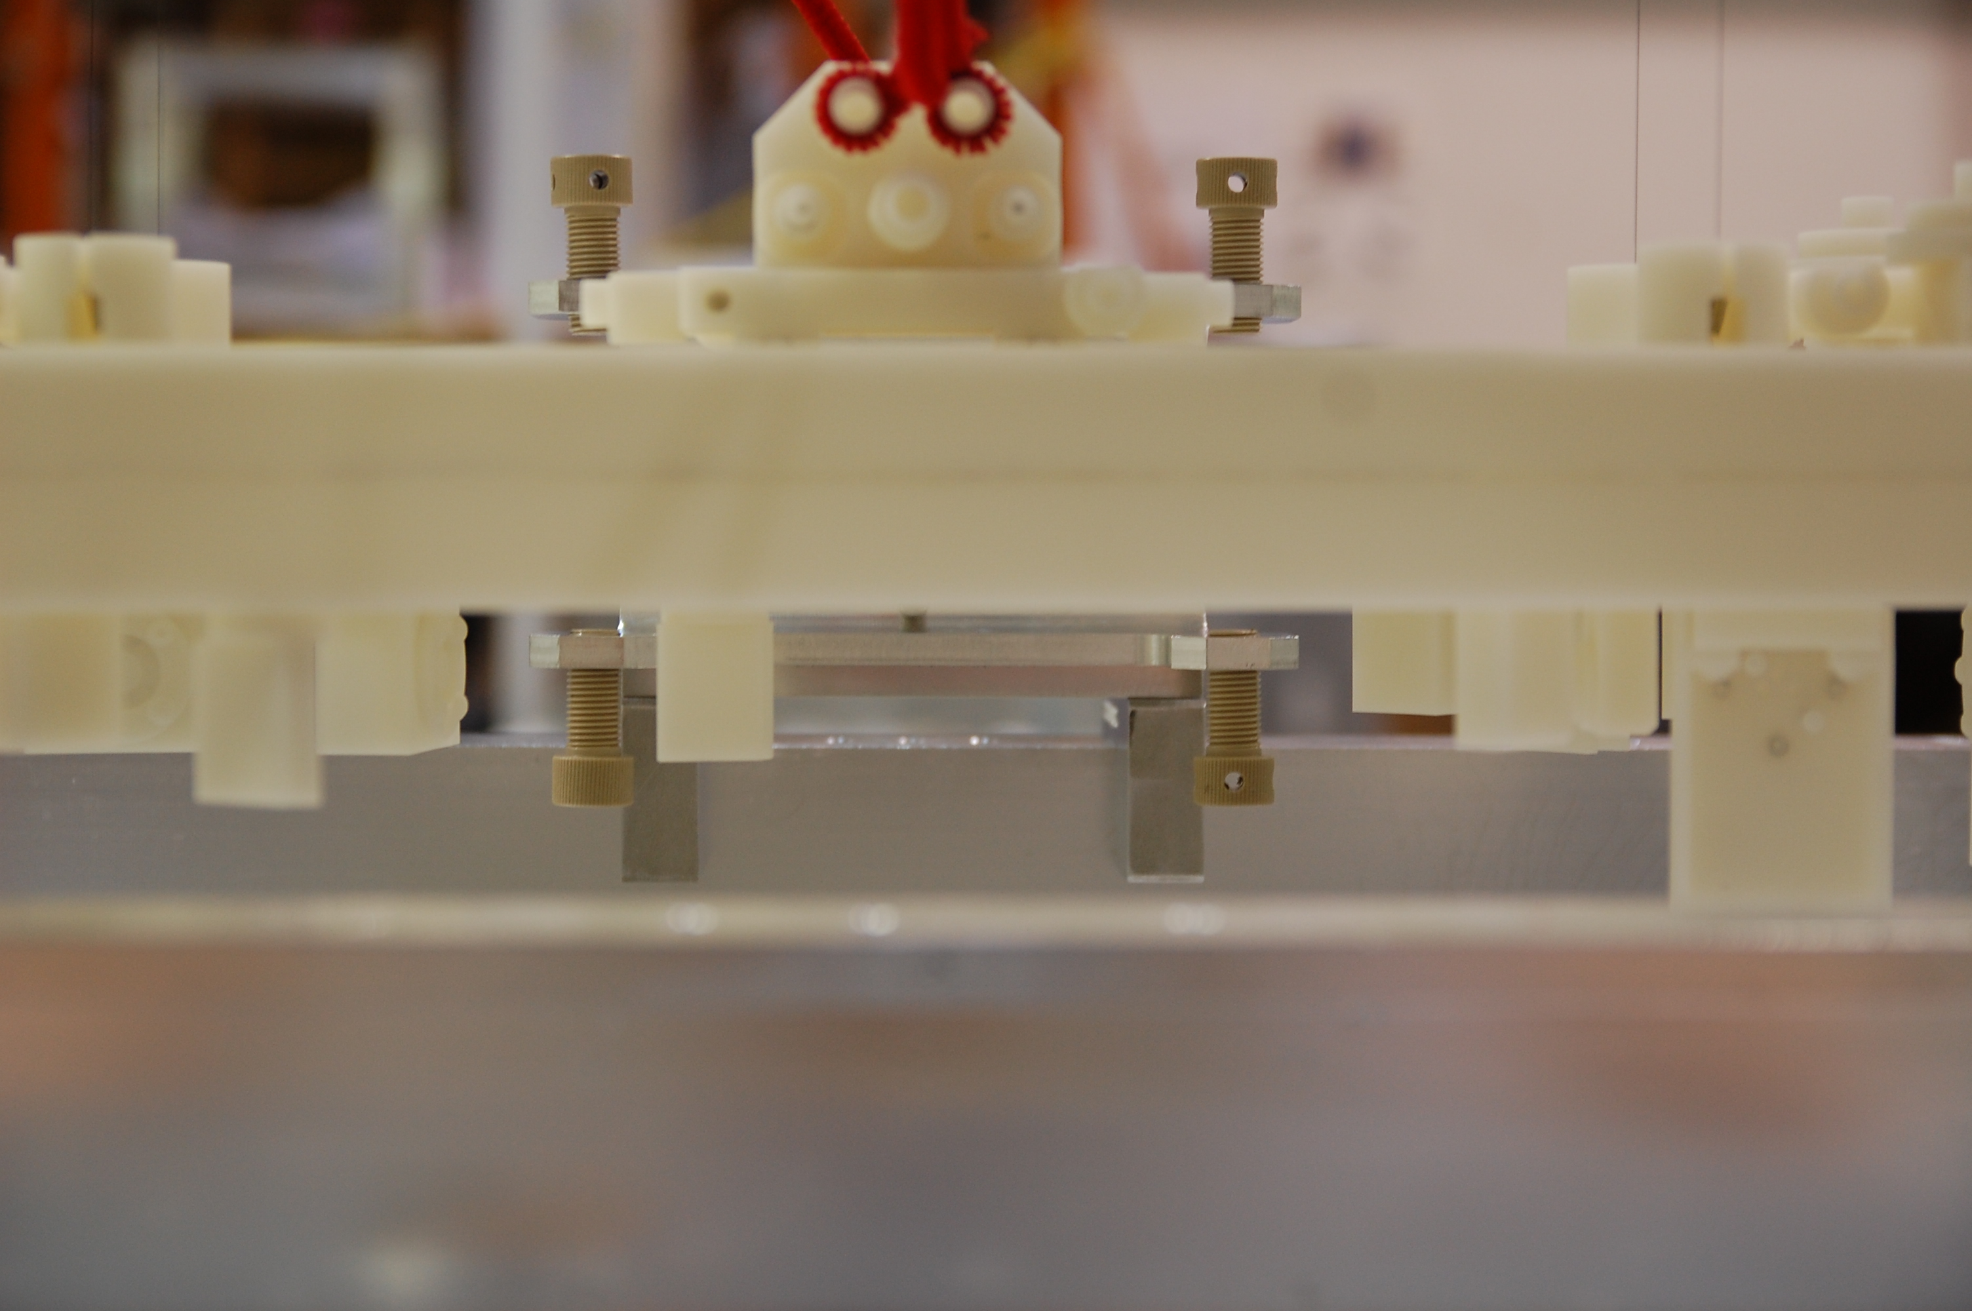
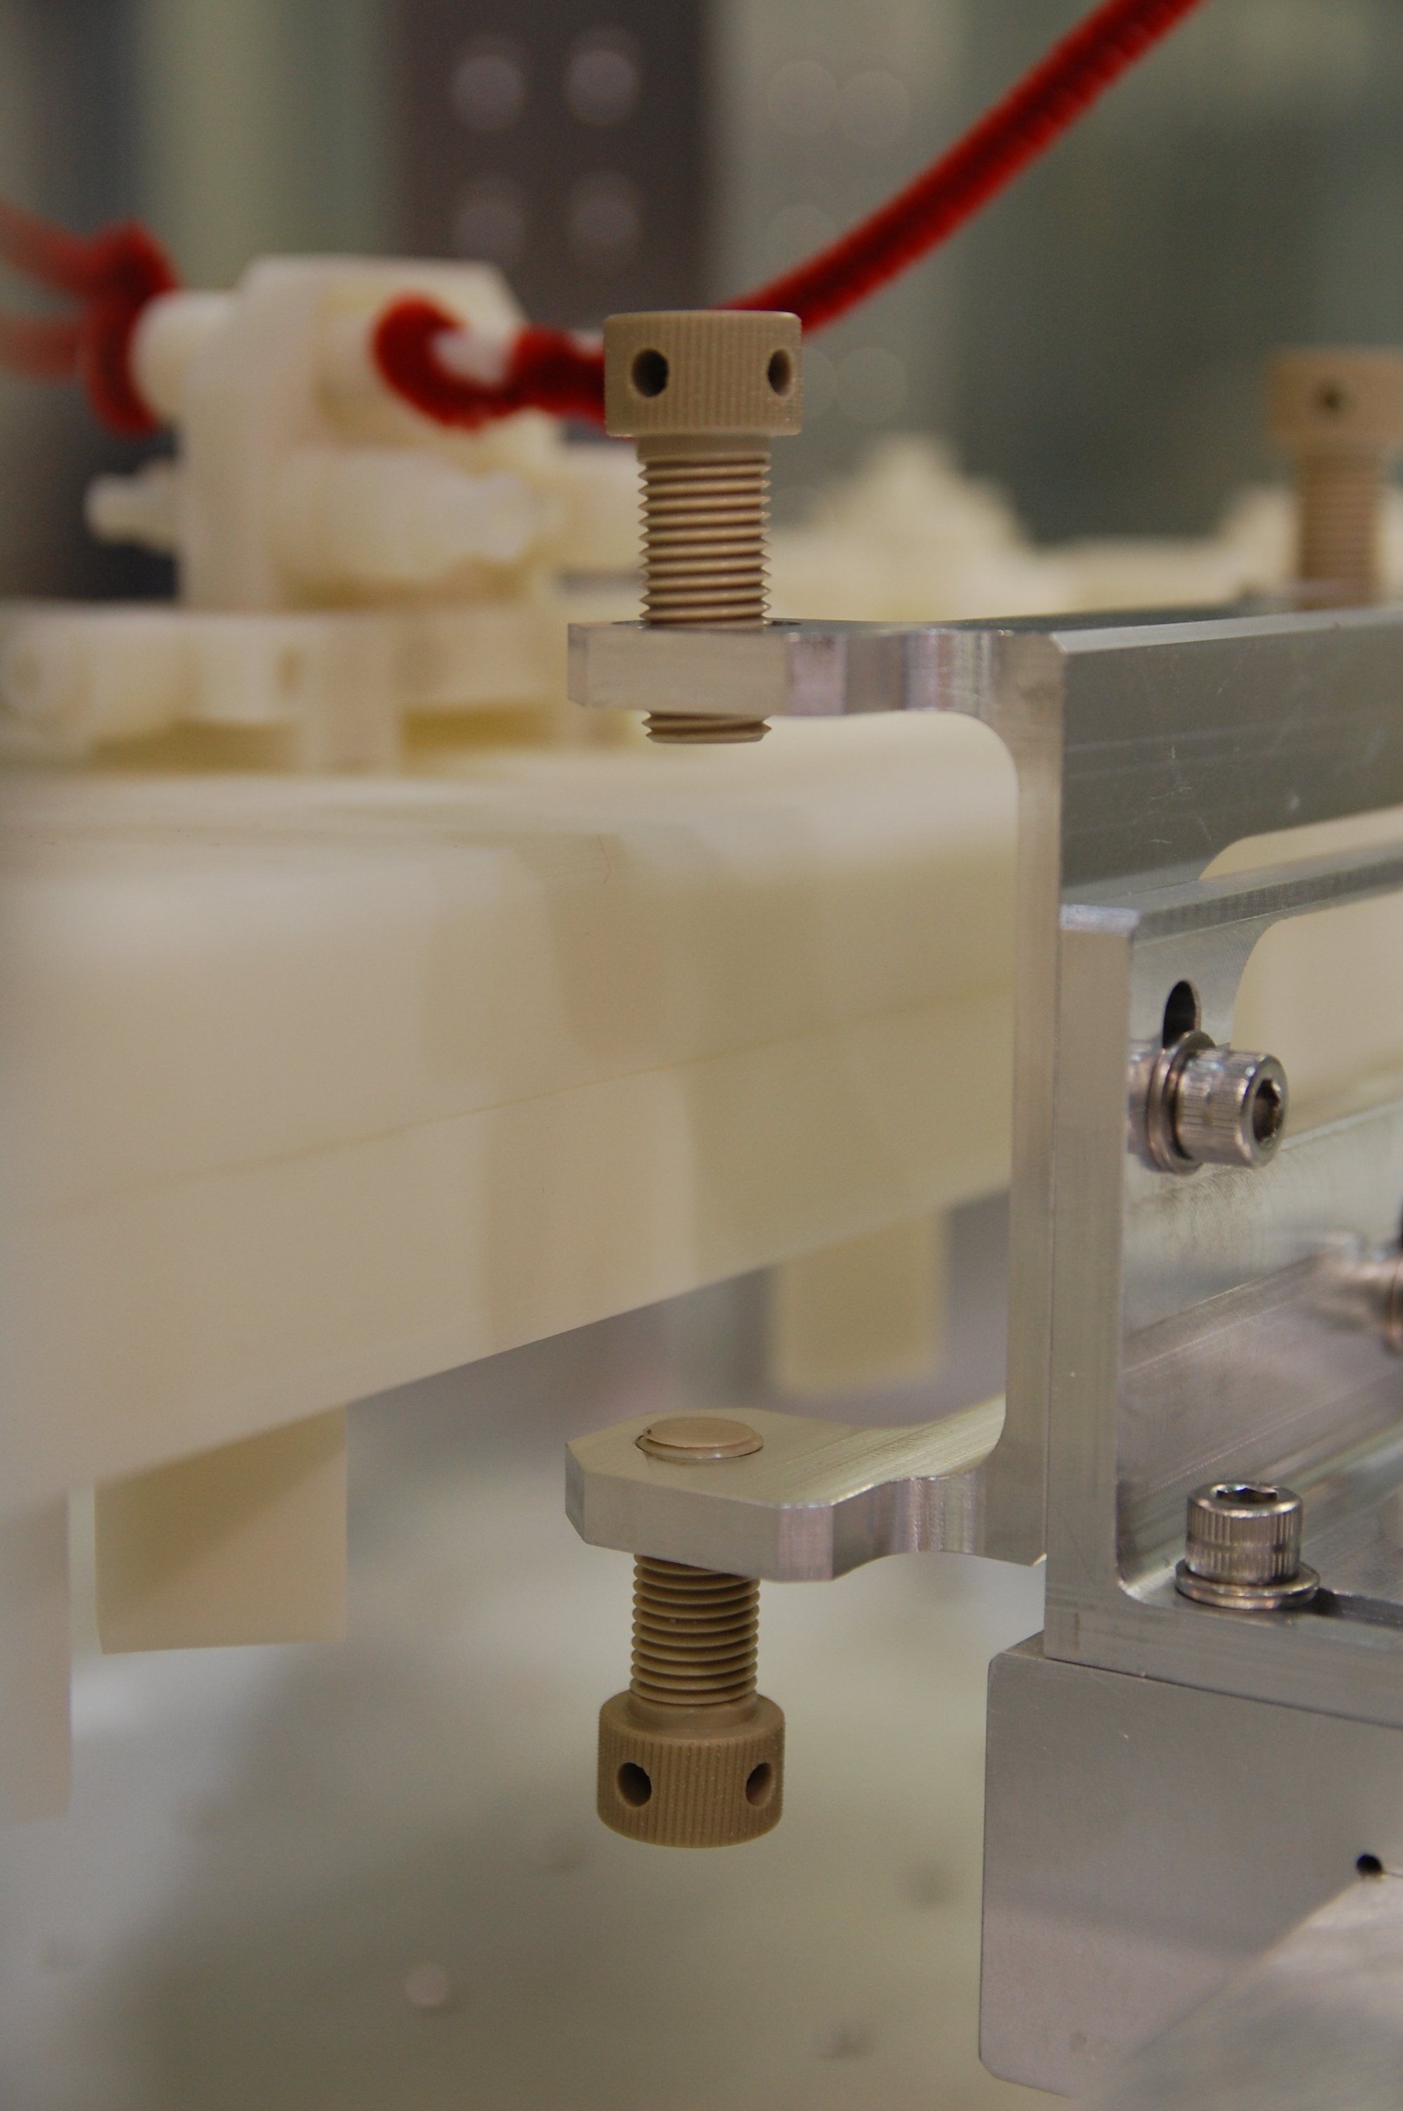
+X Side
Adjust EQ Stop Temp Stabilizer Assy position.
Loosen screws (69.8 & 69.9).
Center U-Channel (69.4) wrt bench, and lock in place.
Extend the L-Bracket (69.5) toward the bench as far as safely possible, and lock in place.

Slide 34
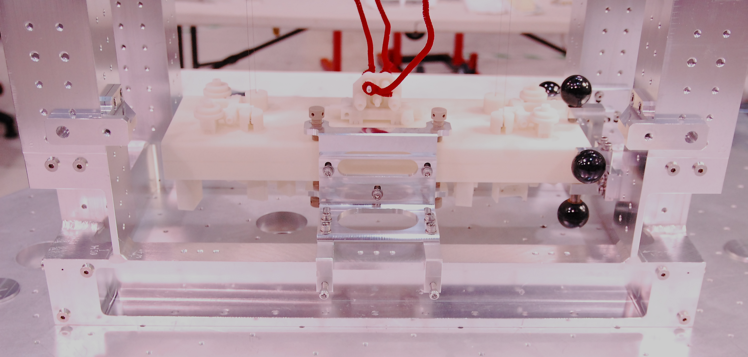
+X Side
Lock 4X PEEK EQ Stops (69.1).
Install 2X Panel Mounting Brackets (32).
Required hardware: 10X Screws, BHSC 1/4-20 x 0.5 (48)
Leave screws loose enough to adjust the position of the brackets.
Note – at LHO, 1X screw had to be removed from each bracket (position circled in red) to keep it flush with the structure.
32
2X
48
10X

Slide 35
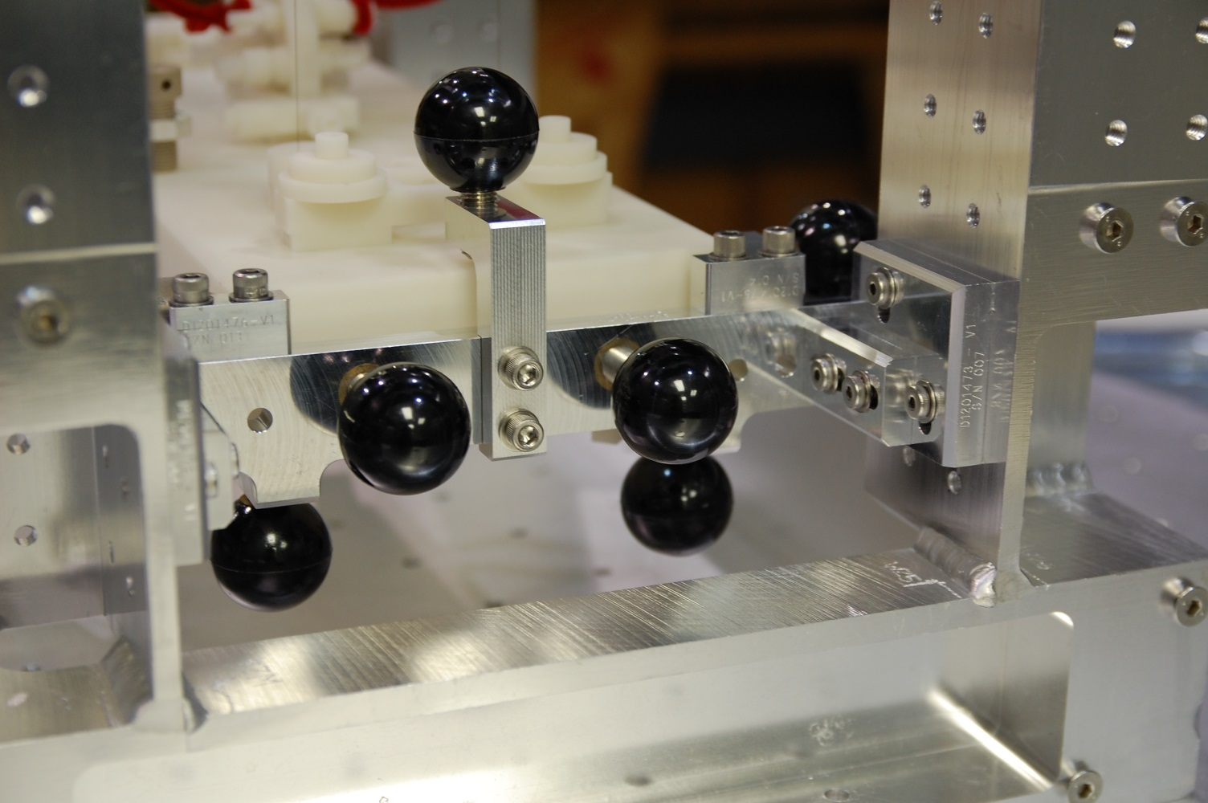
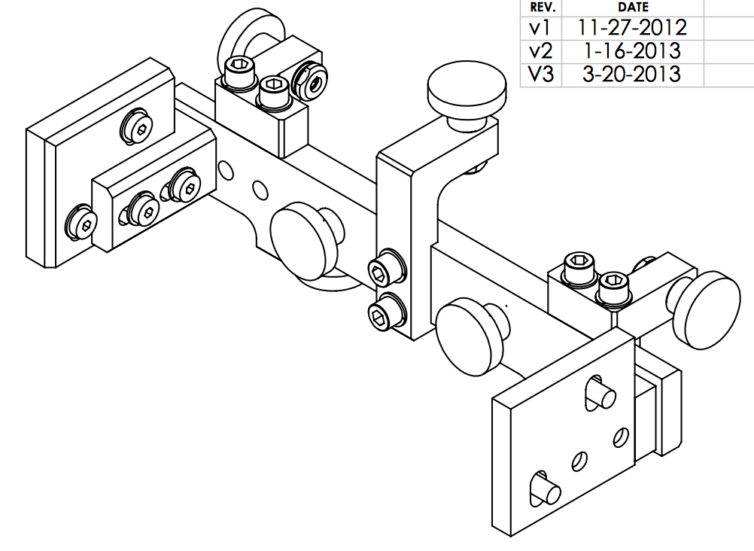
+Y Side
Fully retract 7X old EQ Stop Knobs.
Move old EQ Stop Assy as far back from the bench as possible.
Loosen 2X screws (circled) on 2X Horizontal Adjust parts.
Retract both Horiz. Adjust & tighten screws.
Hardware is not captive.

Slide 36
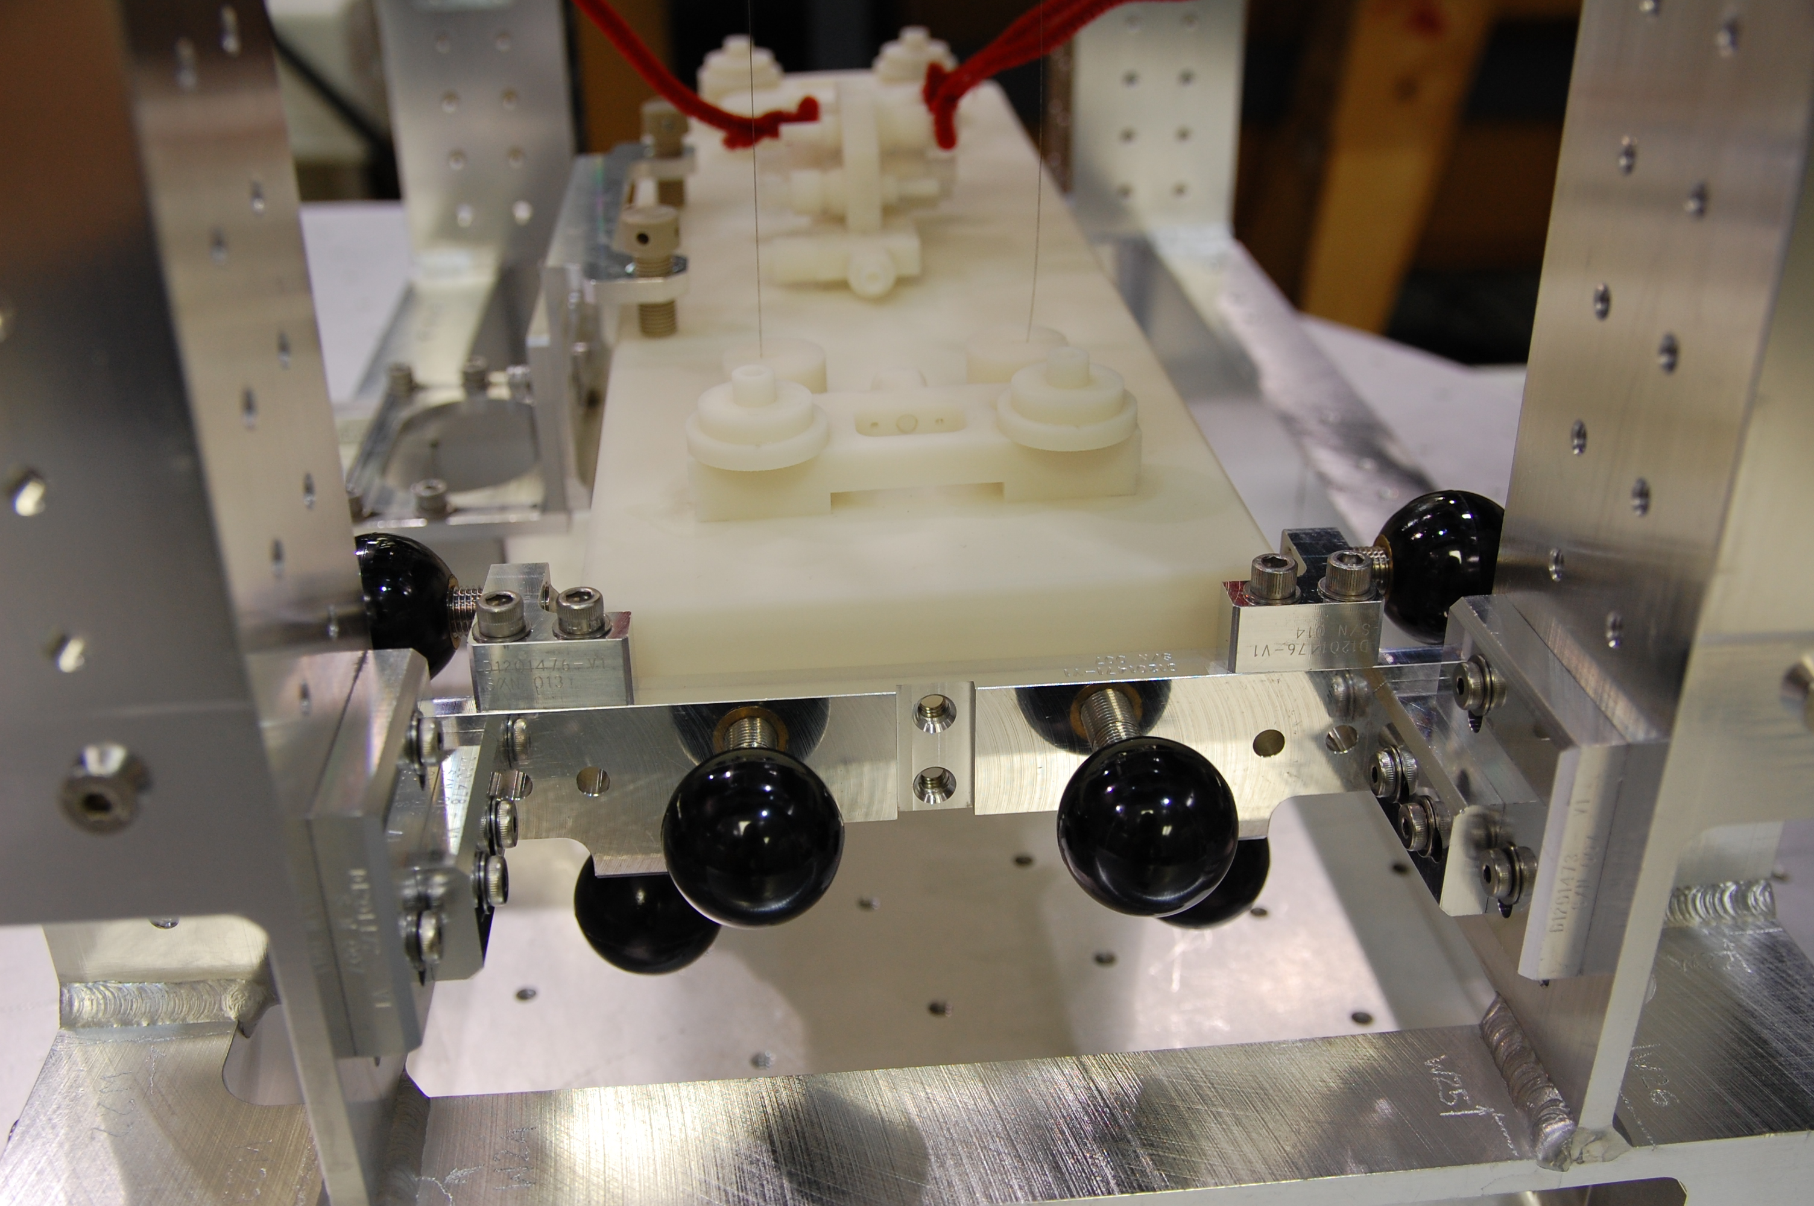
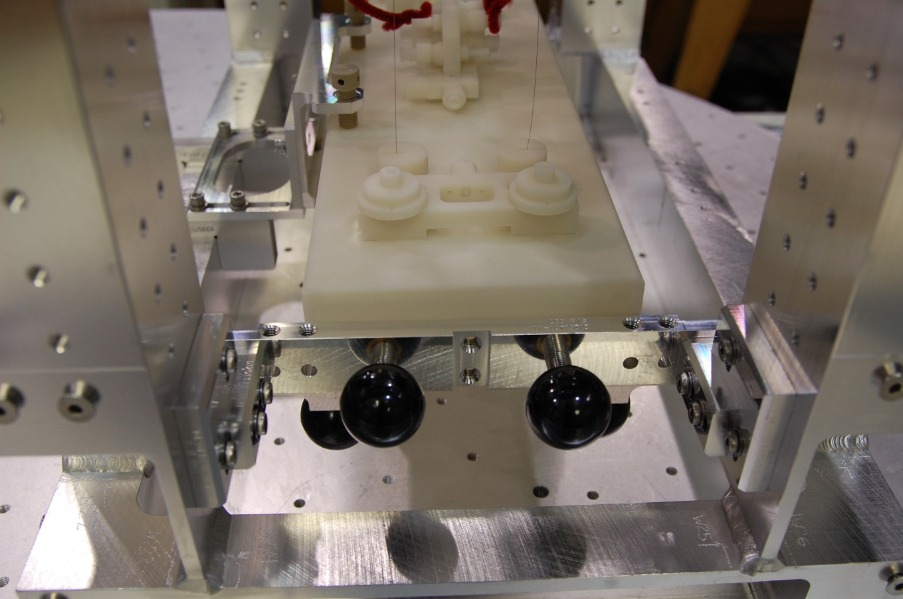
+Y Side
Remove Top Bracket.
Hardware: 2X SHCS (1/4-20), 2X washers
Remove 2X Side Brackets.
Hardware: 4X SHCS (1/4-20), 4X washers

Slide 37
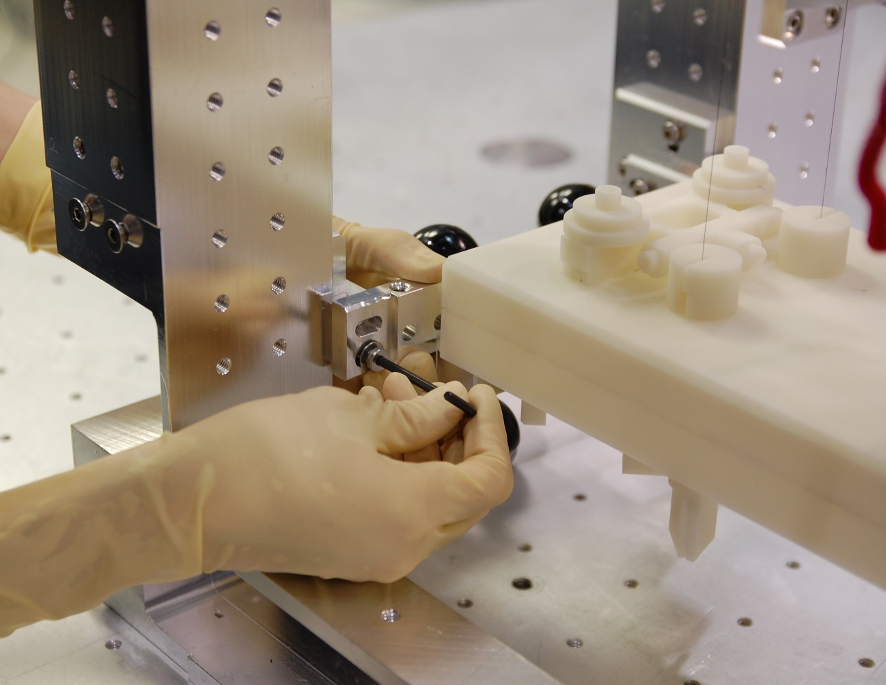
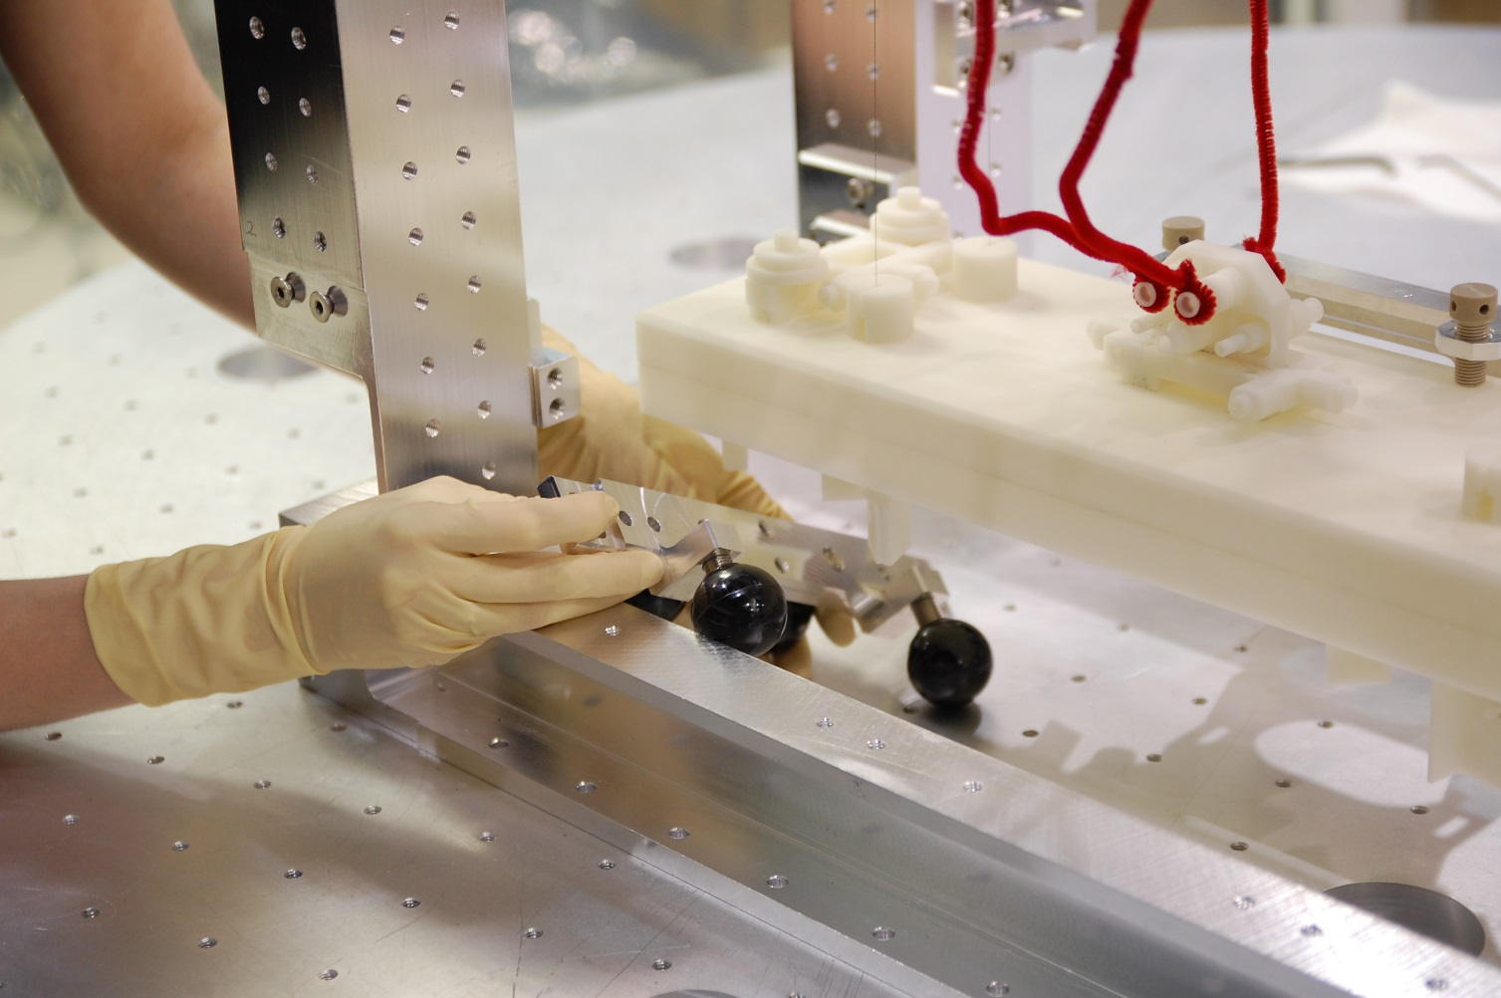
+Y Side
Remove 4X LSHC screws & 4X washers from Main Bar.
Hold to prevent from dropping.
Carefully lower Main Bar toward the table, and remove through the –X Side.

Slide 38
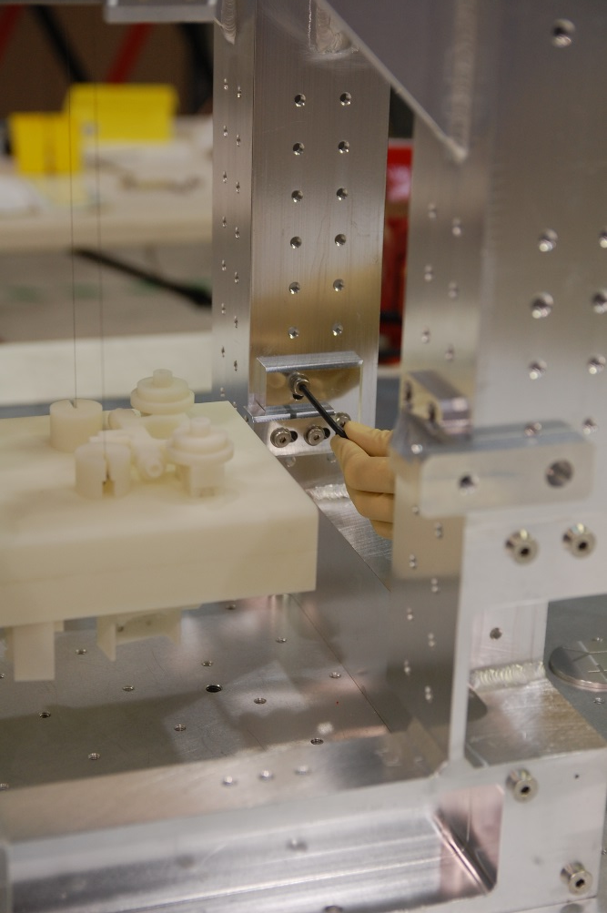
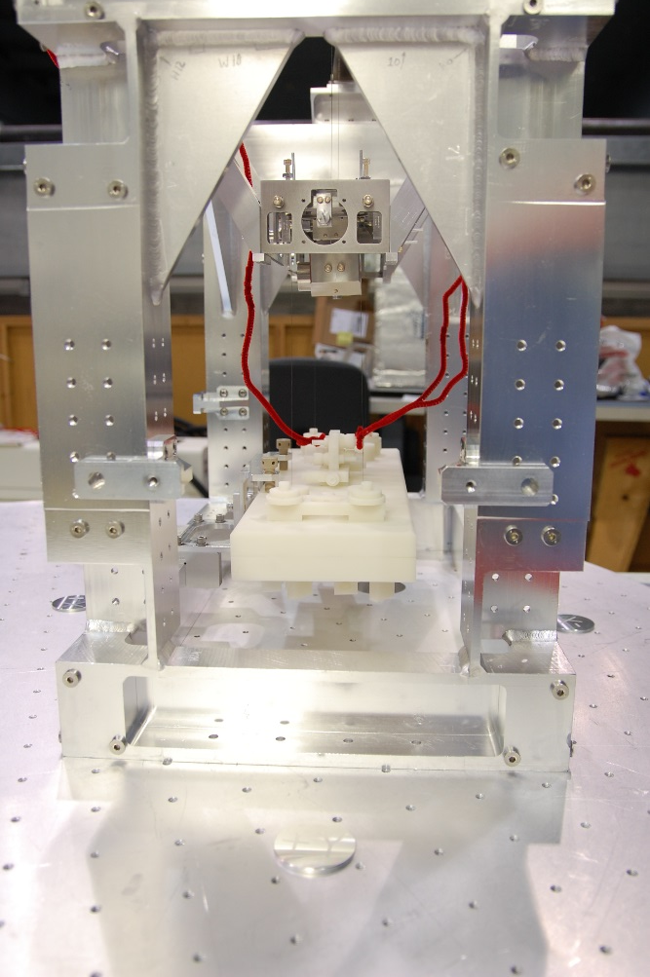
+Y Side
Remove Left & Right Supports.
Hardware: 4X LSHC screws, 4X washers
Install 2x Panel Mounting Brackets (32).
Req. hardware: 10X BHSC, 1/4-20 x 0.5 (48)
Leave screws loose

Slide 39
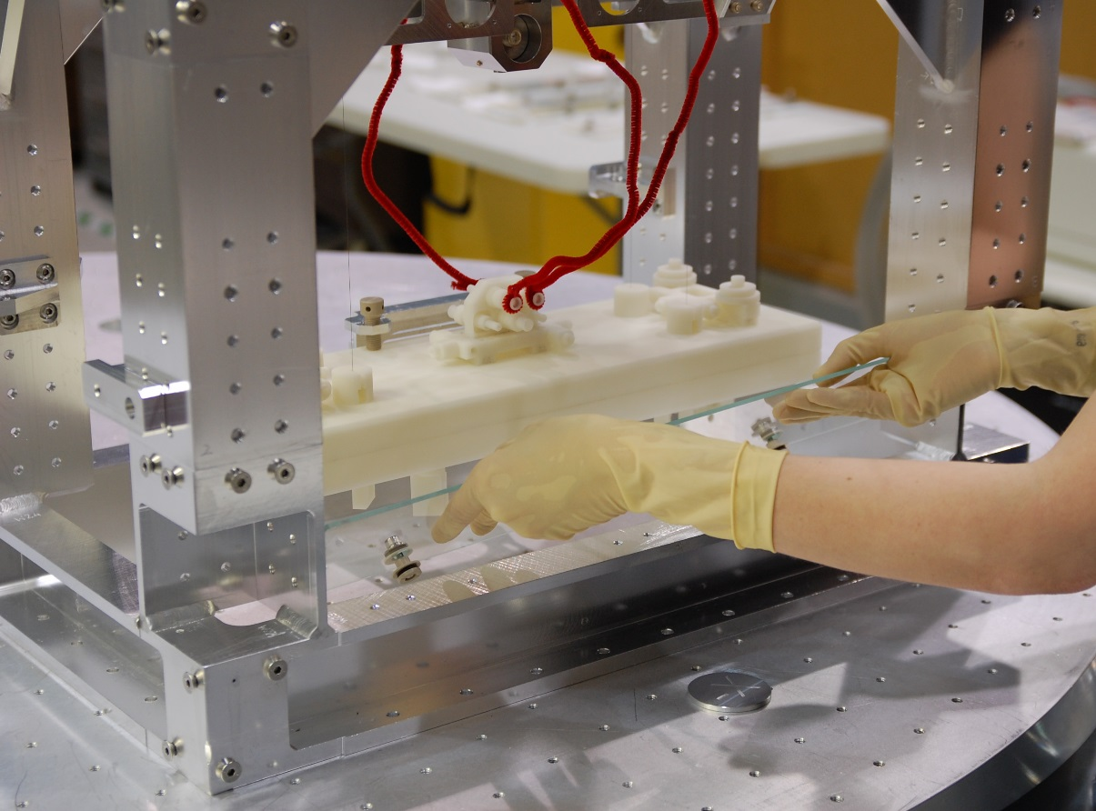
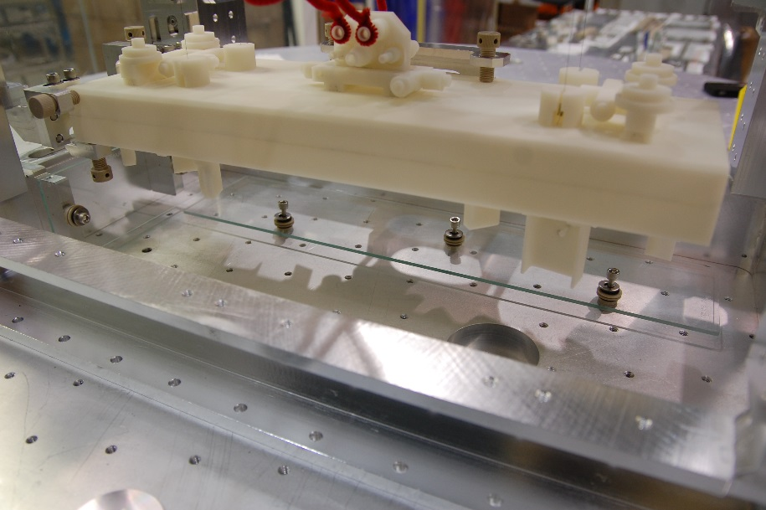
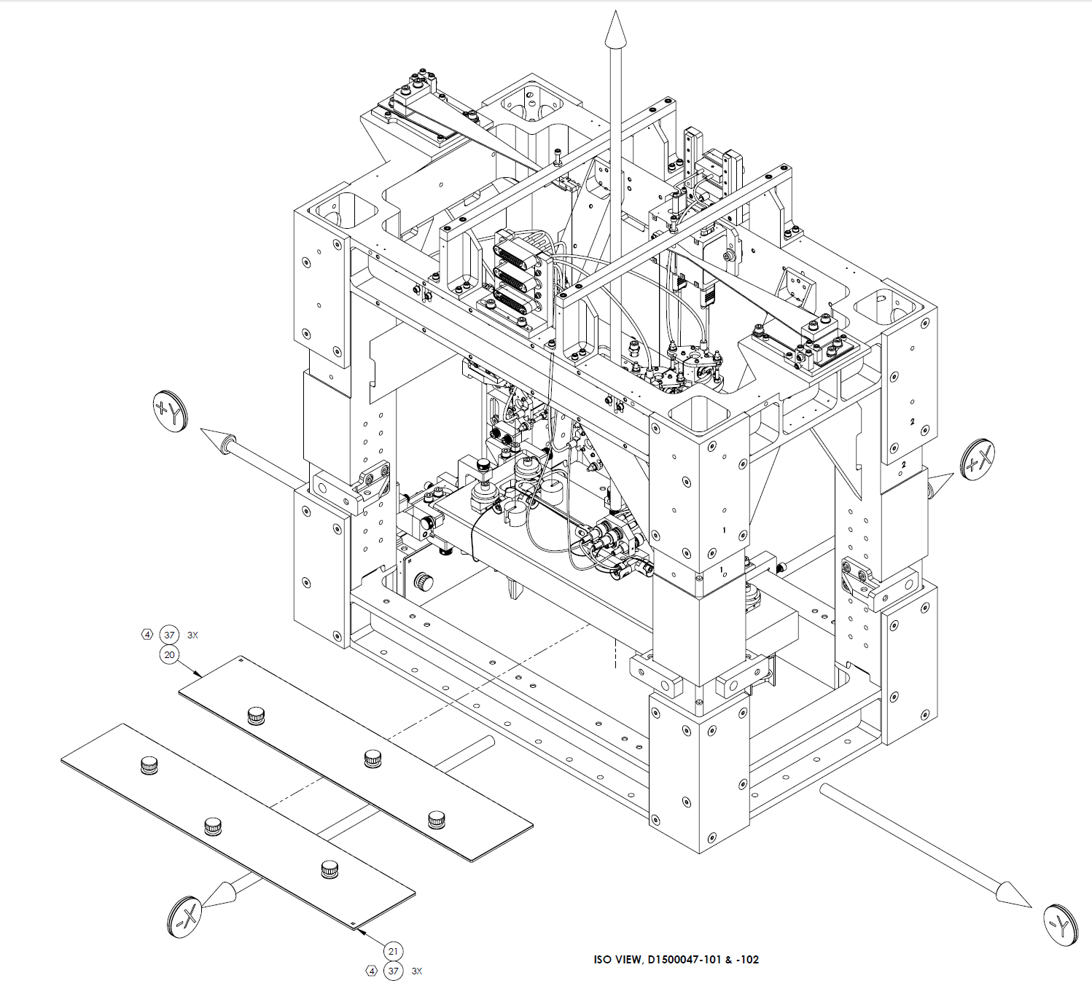
-X Side
Carefully position bottom panel D1500047-101 (20) under the bench, and slide toward +X side.
Assistance from a 2nd person on the –Y side may be required.
If all the pieces of the bolt assemblies are in place (see diagram), the glass will rest stably on the shoulder washers. If not, the glass may drop/pitch suddenly when handled as the hardware moves around.
Check the bolt assemblies, and help settle the hardware in place if needed.
Should be -1 config.
Note orientation

Slide 40
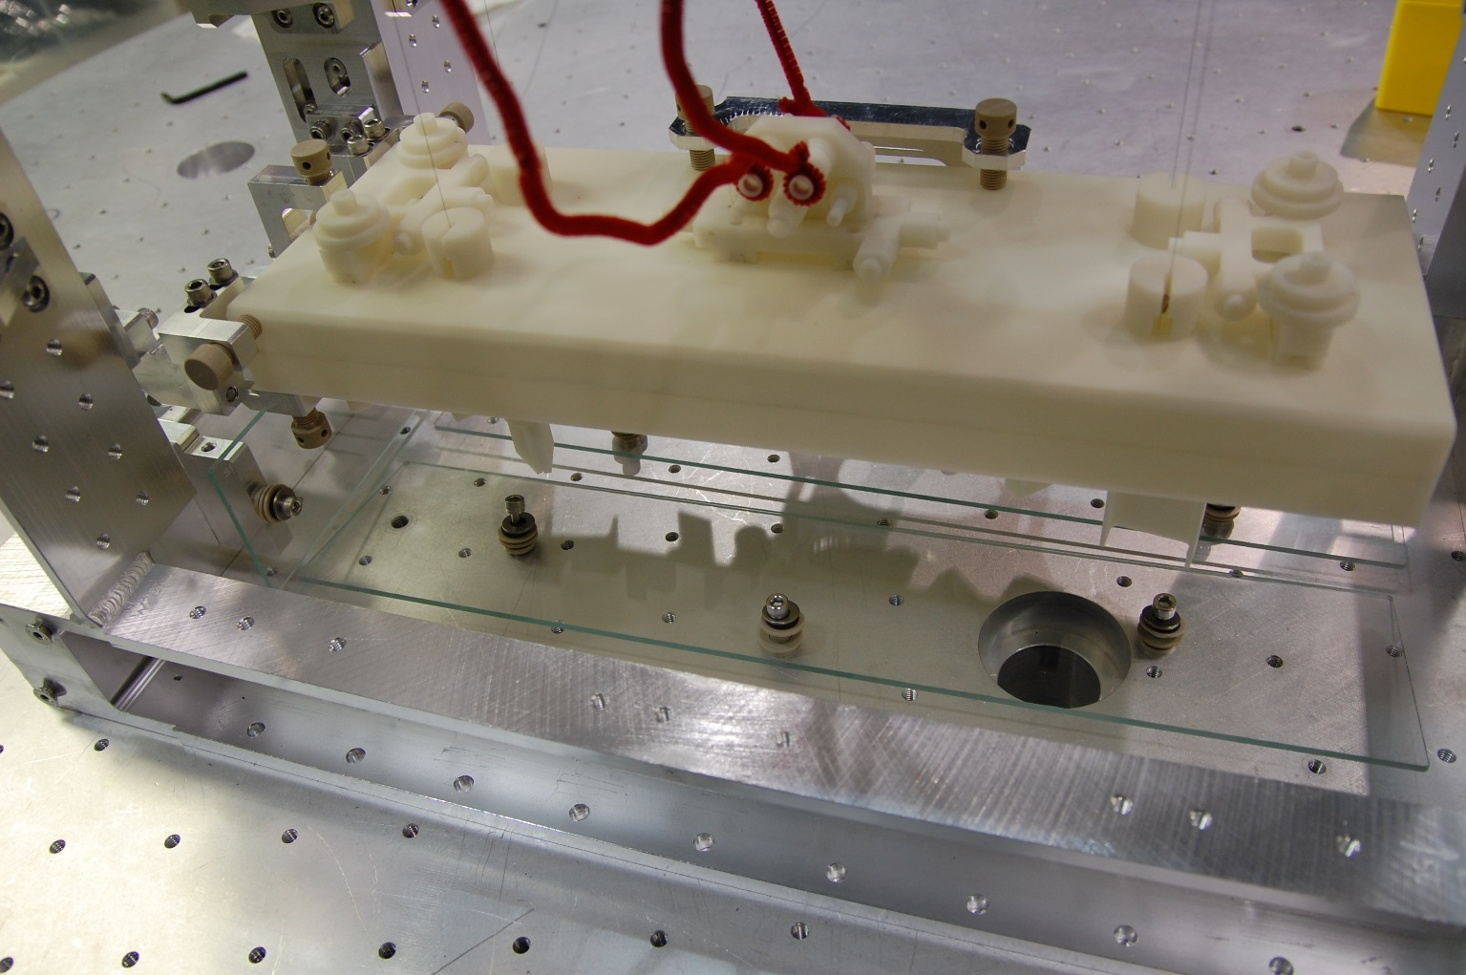
-X Side
Place bottom panel D1500047-102 (21) under the bench next to -101 (20).
Panels should be roughly centered below the bench.
Loosely bolt both panels to the table.

Slide 41
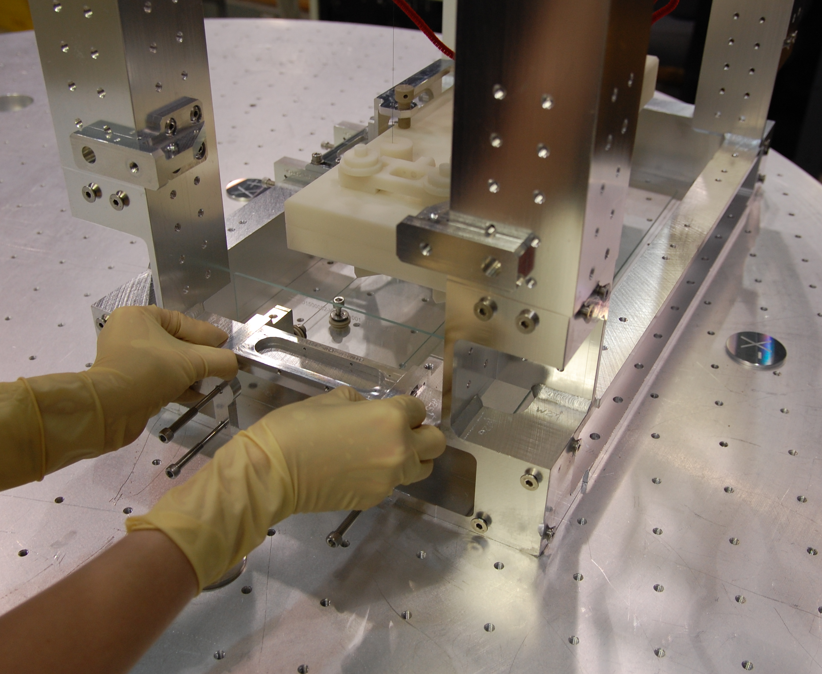
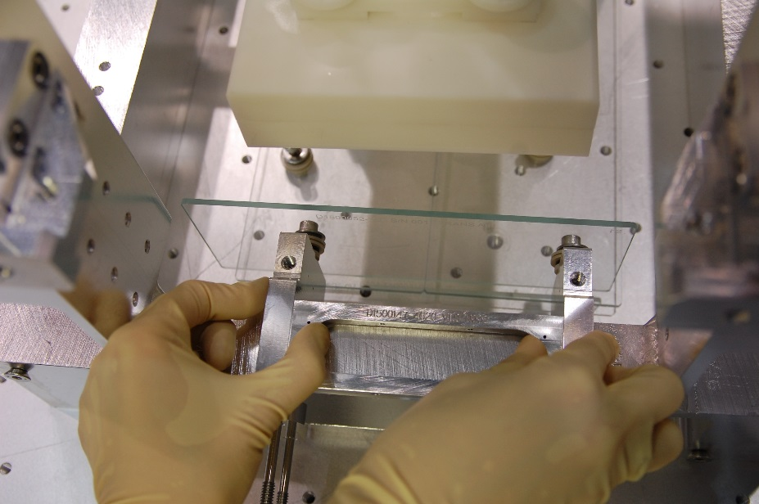
INTERFERENCE TEST
+Y Side
With a 2nd person monitoring the bottom panels, very carefully place vertical panel D1500052 (26).
If D1500052 touches the bottom panels (interference), remove it immediately.
Continue to the next step regardless of whether or not there is interference.
Note orientation (D#)

Slide 42
INTERFERENCE TEST
-X Side
Using the same glass panel (D1500052), check the entire –X side for interference.

Slide 43
INTERFERENCE TEST
+X Side
Repeat for +X Side.
This was possible at Caltech, but not at LHO.

Slide 44
INTERFERENCE TEST
NO INTERFERENCE:
Continue to Step 19.
INTERFERENCE:
Note the location of the 6X holes used to bolt the bottom panels to the table.
Remove both bottom panels.
Remove the bolt assemblies from the panels.

Slide 45
INTERFERENCE TEST
INTERFERENCE (continued):
Place an O-ring (37.8) on the table over each hole used to secure panel D1500047-101 (20).
Move panel -101 back into positon under the bench.
Loosely secure the panel using the upper half of the bolt assy.
Req. hardware circled in green.
Gain more play/sop and reduce the height of the panel by removing the shoulder washer and a PEEK washer (circled in red).
Place an O-ring over holes on the table for D1500047-102 (21).
Position -102 as before.
Loosely secure -102 in place with upper half of bolt assy.
For each side that can be accessed (±X& ±Y):
Check for interference between vertical and bottom glass panels.
Try to re-position bottom panels to prevent interference.
Top half
(above glass)
Bottom half
(below glass)
Removed

Slide 46
INTERFERENCE TEST
IF THERE’S STILL INTERFERENCE:
When positioning inner vertical panels (described in upcoming steps), use a washer(s) to raise the height of the brackets for the side that has interference. Do the same for the opposite side (i.e. do same for +Y & -Y or for +X & -X).
Contact Systems (Calum Torrie).

Slide 47
+Y Side
Protect bottom panels with wipes.
Position panel D1500052 (26) using gauge block D1500120-2140 (54) in +Y, +X corner.
Did not fit on OMC at LHO, so block was set on its side.
Tighten D1500052’s C-Clamp screws.
Watch for lifting of the C-Clamps & Stiffener (from over-tightening).
54

Slide 48
+Y Side
Add C-Clamp Jaw (68) once panel D1500052 is in its final position.
Req. hardware: 2X SHCS 4-40 x 0.5 (67)
Remove gauge block.
Place wipes over vertical glass panel.
67
2X
68

Slide 49
+Y Side
Install new Left & Right Supports (7.2 & 7.3) for the new EQ Stop Assy.
Req. hardware (relevant item numbers on D0900295 pg 7 are incorrect):
4X LSHC, 1/4-20 x 5/8 (51)
4X Vented Washer, .255 ID X .468 OD X .032 THK #1/4 (53)
Position by installing screws in upper holes. Must be level.
Then move outer screw to lower hole.
7.2
LH
7.3
RH
4X
51
4X
53

Slide 50
+Y Side
Remove 7X EQ Stop Knobs from the old EQ Stop Assy.
Add 4X new EQ Stop Knobs (7.4) to the new EQ Stop Assy Main Bar (7.1).
See BOM & diagram.
Threaded bumper & set screw are taken from old Stops.
Ignore – side brackets, they get added later
ITEM NO. | PART NUMBER | DESCRIPTION | MATERIAL | QTY
7.4 | D1201441 | EQ Stop Assy | - | 7
7.4.1 | D1201440 | Threaded Bumper, EQ Stop | Semitron ESD 480 | 7
7.4.2 | D1500149 | Thumb Screw, EQ Stop | 18-8 SSTL | 7
7.4.3 | 91318A410 | Hollow-Lock Set Screw, 1/4"-20 X 1/8" LG | 18-8 SSTL | 7

Slide 51
+Y Side
Slide new EQ Stop Assy (7) under bench.
In retracted position.
Will have to angle to avoid hitting glass or bench.

Slide 52
+Y Side
Stabilize by starting 4X captive screws (7.13) on the Horizontal Adjust parts (7.7 & 7.8).
Hold Main Bar to keep it from hitting bench.
Loosen 4X hidden screws (7.14) to move the Horiz. Adjusts closer to L & R Supports (7.2 & 7.3).
Finish locking in position with 4X captive screws (7.13).
Horiz. Adjusts must be level with L & R Supports, and Main Bar should be roughly centered wrt the bench.
7.7
LH
7.13
4X
7.8
RH
7.14
4X

Slide 53
+Y Side
Add a new EQ Stop Knob to the new Top Bracket (7.5) and both Side Brackets (7.6).
Install 2X Side Brackets (7.6).
Req. hardware:
4X SHCS 1/4-20 x 1.0 (7.11)
4X vented washer #1/4 (7.12)
Keep stops and the brackets themselves retracted (away from bench). Will adjust position later.
Install Top Bracket (7.5).
Req. hardware:
2X SHCS, 1/4-20 x .875 (7.10)
2X vented washer #1/4 (7.12)
7.6
2X
7.5
7.11
4X
7.10
2X
7.12
4X
7.12
4X
Hardware is not captive.

Slide 54
+Y Side
Lock 7X EQ Stops.
Remove wipes from vertical glass panel.
Place wipes on bottom panels for protection.
Remove old EQ Stop Assy using the same procedure as before (refer to Steps 5 – 11).
Install 2X Panel Mounting Brackets (32).
Req. hardware: 10X BHSC 1/4 X 0.5 (48), leave screws loose
With a 2nd person monitoring the bottom panels, very carefully place vertical panel D1500053 (27).
If there’s interference, immediately remove the vertical panel and follow instructions on page 44.
Continue to the next step if there’s no interference.
INTERFERENCE TEST
-Y Side

Slide 55
-Y Side
Position vertical panel D1500053 (27) using gauge block D1500120-2140 (54) in the -Y, -X corner.
Add C-Clamp Jaw (68) and tighten C-Clamp Screws.
Req. hardware: 2X SHCS, 4-40 x 0.5 (67)
Note orientation (D#)

Slide 56
-Y Side
Place wipes over vertical glass.
Install new EQ Stop Assy using the same procedure as before (refer to Steps 25 – 34).
Lock 7X EQ Stops.
Remove wipes from vertical glass.

Slide 57
+X Side
Unlock all 4X EQ Stop Knobs in the Temp Stabilizer Assy.
Move the Temp Stabilizer Assy into its retracted position.
Remove the Temp Stabilizer Assy.

Slide 58
+Y Side
-Y Side
Steps 50 & 51 can be done 1 side at a time by 1 person, or simultaneously by 2 people (recommended):
Fully retract all 14X EQ Stop Knobs.
Make final adjustments to the position of the EQ Stop Assy (i.e. set Stop Knobs).
X-axis: Center the Main Bar (7.1) wrt the bench
Loosen 4X hidden screws (7.14) in the Horiz. Adjust (7.7 & 7.8) to free the Main Bar only along the X-axis..
7.7
7.1
7.8

Slide 59
+Y Side
-Y Side
Z-axis: Center assy wrt the bench, so the distance to the Top & 2X Bottom EQ Stop Knobs is roughly the same.
Loosen 4X LSHC screws (51) in the Left & Right Supports (7.2 & 7.3) to slide assy up/down.
Confirm the Top & 2X Bottom Stops can be locked, then retract again.
At LHO, had to rotate the L & R Supports on the +Y Side EQ Stop Assy to get the Stops close enough to the bench.
7.2
7.3

Slide 60
+Y Side
-Y Side
Y-axis: Move the assy close enough to the bench to lock the 2X Middle Stops in the Main Body.
Loosen 4X captive screws (7.13) in the Horiz. Adjusts (7.7 & 7.8).
Mind the parts on the bottom side of the bench.
Confirm the 2X Middle Stops can be locked, then retract again.
X-axis: Move the 2X Side Brackets (7.6) close enough to the bench to lock the 2X Side Stops.
4X SHCS (7.11) in the Side Brackets.
Confirm the 2X Side Stops can be locked then retract again.

Slide 61
+Y Side
-Y Side
For each assy, confirm final position by locking all 7X EQ Stop Knobs.
May need to repeat some of the previous steps.
Once all the positions are set, re-lock all but the bottom 4X EQ Stop Knobs.
Set the bottom 4X Stops 1 – 2 mm from the bench.

Slide 62
+X Side
Double check and prep the vertical panels D1500054-101 & -102 (28 & 29) that are about to be installed. Confirm:
Correct type of Stiffeners & C-Clamps (refer to pg 24)
Stiffener orientation
Partially assembled bracket is on the side with the arm, and the other hole is empty.
Position:
C-Clamp screws – retracted
Stiffener – forward (toward glass)
Remaining parts are nearby (refer to pg 5)
Installed bolt assy is tight
HANDLING – Do not pick up panels using only the partial bracket. If holding partial bracket, other hand must be supporting the glass itself (main body, not the arm).
INCORRECT
CORRECT

Slide 63
+X Side
Preferable to have a 2nd person in chamber on the +Y side to assist with +X Side install.
Lay down wipes to protect the bottom panels and to cushion the incoming vertical panels.
Carefully place D1500054-102 (29) as shown below.
Check for interference with bottom panels.
Tightening the C-Clamp Screws a bit (not all the way) helps balance the partial assy.

Slide 64
+X Side
Slowly & gently move the -102 panel as far as it can safely go in the +Y direction.
Arm should stick out past the structure.
Possible obstructions/interference:
Installed +Y vertical panel D1500052 (26) – If this occurs mark/scribe the position, loosen C-Clamp screws, and slide it out of the way temporarily. Will not be able to use the gauge block once the +X vertical panel is installed.
Dog Clamps – Mark, note, photograph, move.

Slide 65
+X Side
Lay a single wipe over -102 as shown to protect it from scratches.
Position vertical panel D1500054-101 (28) per photo (overlaps -102).
Gently slide -101 as far as safely possible in the –Y direction.
This leaves a little gap between the 2 vertical panels.
Potential interference with -Y panel D1500053 (27) and dog clamps – mark/scribe position, note, move.

Slide 66
+X Side
Remove wipes.
Install 2X bolt assy (-2 config) in the empty holes.
Add missing C-Clamp to each partial assy.
Req. hardware: 4X SHCS, 4-40 x .5
Position vertical panels using gauge blocks D1500120-3250 (56) in +X, +Y corner and -3545 (55) between the panels.
Tighten C-Clamp Screws and add C-Clamp Jaw (68).
Req. hardware: 4X SHCS, 4-40 x .5
Use provided metal shim to help space glass. Want ~1/16” gap between the panels.
If dog clamps were moved, put them back.

Slide 67
+X Side
Install horizontal panel D1500049 (23).
Place PEEK Midspan Support (Inner) (41) on vertical glass and secure on standoffs.
Req. hardware: 2X BHSC 1/40-20 x.5 (48)
Slip PEEK Shim (42) behind the standoffs, and slide upward to position it between the set screws and glass.

Slide 68
+X Side
Tighten set screws.
Install D1500116 (40) in retracted position, then slide toward bench if possible.

Slide 69
+X Side
Position vertical outer panel D1500043-101 (2) as shown.
The installed inner vertical panel’s upper 2X C-Clamp screws fit through the holes in -101.
Screw the upper bolt assy into the Panel Mt Bracket (32) first, but leave loose.
Screw the lower 2X bolt assy into the installed C-Clamps, but leave loose.
May have to slide Panel Mt Bracket up/down to reach holes in C-Clamps.

Slide 70
+X Side
Repeat Steps 71 – 73 for the other vertical outer panel, D1500043-102 (13).

Slide 71
+X Side
Place PEEK Midspan Support (33) on outer panels and loosely secure to 2X Panel Mt Brackets.
Req. hardware: 2X BHSC 1/40-20 x.5 (48)
Hardware on Panel Mt Brackets and outer vertical panels was left loose to make this step easier. Will probably have the position of the Panel Mt Brackets to screw the Midspan Support in.
Align outer vertical panels using the provided metal shim, then lock everything in place.
1/16” gap between glass.
Tighten 6X glass bolt assy, 10X BHSC (8X on Panel Mt Brackets and 2X on Midspan Support).
Slide 2X support shims (42) between set screws and glass, then tighten set screws.

Slide 72
-X Side
Double check and prep the vertical panels D1500055-101 & -102 (30 & 31) that are about to be installed. Confirm:
Correct type of Stiffeners & C-Clamps (refer to pg 24)
Stiffener orientation
Partially assembled bracket is on the side with the arm, and the other hole is empty.
Position: C-Clamp screws – retracted & Stiffener – forward (toward glass)
Remaining parts are nearby (refer to pg 5)
Installed bolt assy is tight
Lay down wipes to protect the bottom panels and to cushion the incoming vertical panels.
Install 2X Panel Mt Brackets (32).
Required hardware: 10X Screws, BHSC 1/4-20 x 0.5 (48), leave loose.
Carefully place D1500055-101 (30).
Check for interference with bottom panels.
Tighten 6X bolt assy on bottom panels (below bench).

Slide 73
-X Side
Slowly & gently move the -101 panel as far as it can safely go in the -Y direction.
Potential interference with -Y panel D1500053 (27) and dog clamps – mark/scribe position, note, move.
Place a single wipe over -101 to protect it from scratches.
Position vertical panel D1500055-102 (32), and slide over as far as safely possible in +Y direction.
This leaves a little gap between the 2 vertical panels.
Potential interference with +Y panel D1500052 (26) and dog clamps – mark/scribe position, note, move.

Slide 74
-X Side
Remove wipes.
Install 2X bolt assy (-2 config) in the empty holes.
Add missing C-Clamp to each partial assy.
Req. hardware: 4X SHCS, 4-40 x .5
Position vertical panels using gauge blocks D1500120-3250 (56) in -X, +Y corner and -3545 (55) between the panels.
Tighten C-Clamp Screws and add C-Clamp Jaw.
Req. hardware: 4X SHCS, 4-40 x .5
Use metal shim to space panels ~1/16” apart.
If dog clamps were moved, put them back.

Slide 75
-X Side
Install horizontal panel D1500048 (22).
Place PEEK Midspan Support (Inner) (41) on vertical glass and secure on standoffs.
Req. hardware: 2X BHSC 1/40-20 x.5 (48)
Slip PEEK Shim (42) behind the standoffs, and slide upward to position it between the set screws and glass. Tighten set screws.

Slide 76
-X Side
Install D1500116 (40) in retracted position, then slide toward bench if possible.
Position vertical outer panel D1500042-101 (10) & -102 (11) as shown.
Screw the upper bolt assy into the Panel Mt Brackets (32) first, and then the lower bolt assy into the installed C-Clamps. Leave loose.
May have to slide Panel Mt Bracket up/down to reach holes in C-Clamps

Slide 77
-X Side
Place PEEK Midspan Support (33) on outer panels and loosely secure to 2X Panel Mt Brackets.
Req. hardware: 2X BHSC 1/40-20 x.5 (48)
Hardware on Panel Mt Brackets and outer vertical panels was left loose to make this step easier. Will probably have the position of the Panel Mt Brackets to screw the Midspan Support in.
Align outer vertical panels using the provided metal shim, then lock everything in place.
1/16” gap between glass.
Tighten 6X glass bolt assy, 10X BHSC (8X on Panel Mt Brackets and 2X on Midspan Support).
Slide 2X support shims (42) between set screws and glass, then tighten set screws.

Slide 78
-X Side
+/-Y Side
Next steps require 2 people in chamber – 1 on the -X Side and the other on +/-Y Side .
Install top outer panel D1500046-102 (17) as shown.
Position as far inward (away from wires) as possible.
Tighten down bolt assy to avoid pushing the panel into wires while installing the other top panels.
Install top panel -103 (18).
Position -102 & -103 as close to each other and as far away from the wires as possible.

Slide 79
-X Side
+/-Y Side
Install the top outer panels D1500046-101 & -104 (16 & 19).
Note the asymmetry between the slots and edges of the glass.
The nearer slot (shorter distance) is adjacent to the other glass panels.
The farther slot (longer distance) & the D# are adjacent to the OMC’s legs.
Position panels as close to the structure (far away from wires) as possible.
Longer distance
(farther)
Shorter distance (nearer)

Slide 80
+Y Side
-Y Side
Steps 104 – 107 can be done 1 side at a time by 1 person, or simultaneously by 2 people (recommended):
Set (release) all 14 EQ Stop Knobs.
Adjust the position of the top outer panels if needed (to avoid touching wires).
If the inner vertical panels D1500052 & 53 (26 & 27) were moved due to interference, return them to their correct positions.
If dog clamps were moved, put them back.

Slide 81
-Y Side
Install inner horizontal panel D1500050 (24).
Position outer vertical panel D1500045 (15) as shown.
Screw the 2X upper bolt assy into the Panel Mt Brackets (32) first, and then the lower 2X bolt assy into the installed C-Clamps. Leave loose.
May have to slide Panel Mt Brackets up/down to reach holes in C-Clamps.
Roughly align D1500045 to the other outer vertical panels on the +/-X sides, then lock everything in place.
Tighten 4X bolt assy, 8X BHSC on Panel Mt Brackets.
Remove panel D1500045.
Needed the panel in place to determine the position the Mt Brackets, but need it out of the way for the next step.
Typo

Slide 82
-Y Side
Install the top panel extension D1500143 (57).
Req. hardware: 2X bolt assy (Basic config.) – not captive
2nd person should hold the panel until the bolt assy are tightened down.
Install D1500045.

Slide 83
+Y Side
Install inner horizontal panel D1500051 (25).
Position outer vertical panel D1500044 (14).
Screw the 2X upper bolt assy into the Panel Mt Brackets (32) first, and then the lower 2X bolt assy into the installed C-Clamps. Leave loose.
May have to slide Panel Mt Brackets up/down to reach holes in C-Clamps.
Roughly align D1500044 to the other outer vertical panels on the +/-X sides, then lock everything in place.
Tighten 4X bolt assy, 8X BHSC on Panel Mt Brackets.
Remove panel D1500044.
Needed the panel in place to determine the position the Mt Brackets, but need it out of the way for the next step.

Slide 84
+Y Side
Install the top panel extension D1500143 (57).
Req. hardware: 2X bolt assy (Basic config.) – not captive
2nd person should hold the panel until the bolt assy are tightened down.
Install D1500044.

Slide 85
-X Side
Check the top panels one last time to make sure they aren’t touching cables or wires.
CELEBRATE!

