Slide 1
Gravitational wave searches: an overview
Matthew Pitkin for the LVC
University of Glasgow
Astronomy group seminar,
University of Southampton, Jan 2015
LIGO-DCC G1500072

Slide 2
Gravitational wave (GW) background

Slide 3
What are gravitational waves?
Gravitational waves are a direct prediction of Einstein’s General Theory of Relativity
Solutions to (weak field) Einstein equations in vacuum are wave equations
“Ripples in space-time”
$$\left(−\frac{∂^{2}}{∂t^{2}}+∇^{2}\right)h^{μν}=−16πT^{μν}$$
Vacuum so stress-energy tensor $T^{μν}=0$
$$\left(−\frac{∂^{2}}{∂t^{2}}+∇^{2}\right)h^{μν}=0$$
$$h^{μν}=A^{μν}\exp\left(ik_{μ}^{}x^{μ}\right)$$

Slide 4
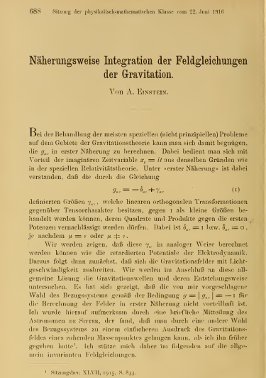
What are GWs?
Einstein first predicted GWs in 1916 paper
This had a major error – the waves carried no energy!
Einstein, “Näherungsweise Integration der Feldgleichungen der Gravitation“, Sitzungsberichte der Königlich Preußischen Akademie der Wissenschaften, 1916

Slide 5
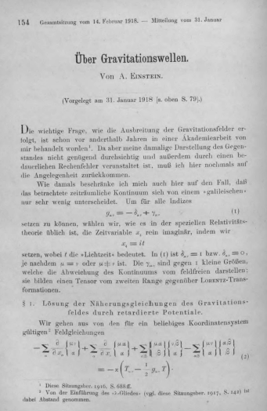
What are GWs?
Corrected in 1918 paper which introduced the now famous “quadrupole formula”
Einstein, “Über Gravitationswellen“, Sitzungsberichte der Königlich Preußischen Akademie der Wissenschaften, 1918

Slide 6
What are GWs
Source: Bulk Motion
Produces Changing Tidal Field
Oscillating Tidal Field
Propagates (Unobstructed)
to Observer
Observer Detects
Distortion Strain
$$l$$
$$l+Δl$$
Strain: $h=\frac{Δl}{l}$
Quadrupole formula:
$$h(t)= \frac{2}{r}\frac{G}{c^{4}}\ddot{I}(t)$$
mass quadruple
source distance (1/r - amplitude not power!)
~ 8x10⁻⁴⁵ small number!

Slide 7
What are GWs?
For two 1.4 M⊙ neutron stars near coalescence at a distance of 10 Mpc $h\sim 1.4×{10}^{−22}$
$$h(t)= \frac{2}{r}\frac{G}{c^{4}}\ddot{I}(t)$$
mass quadruple
Displacement measured by 4km long detector $\sim 5.6×{10}^{−19}\text{m}$ - about 1/10000th diameter of a proton, or measuring change in distance to α Centauri to ~1/10th diameter of a human hair!
~ 8x10⁻⁴⁵
source distance (1/r - amplitude not power!)
Detectable gravitational waves (GWs) will only come from the most massive and energetic systems in the universe e.g. black hole binaries, pulsars, supernova, GRBs, etc

Slide 8
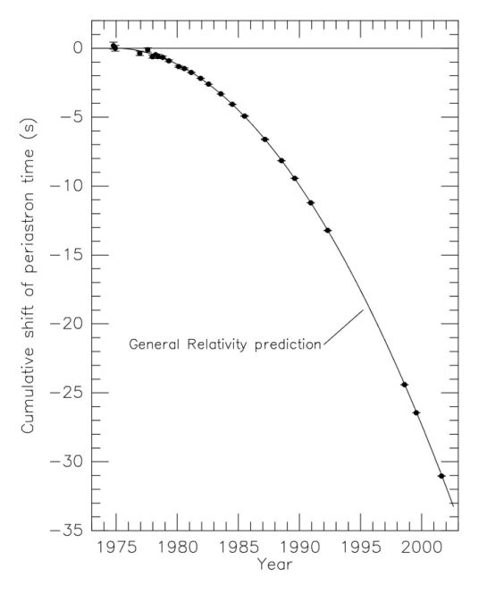
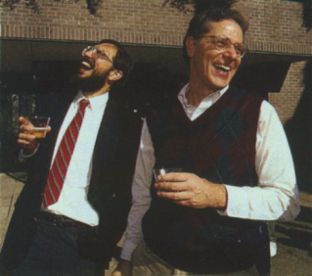
Evidence for GWs
GR works!
Gravitational lensing
Perihelion precession of Mercury
Shapiro delay
Gravitational time dilation
Frame dragging
Hulse-Taylor pulsar and other binary neutron star systems are losing energy exactly as predicted through GW emission
Notes:
BICEP2 polarisation patterns in CMB – probably not!

Slide 9
Detection and detectors

Slide 10
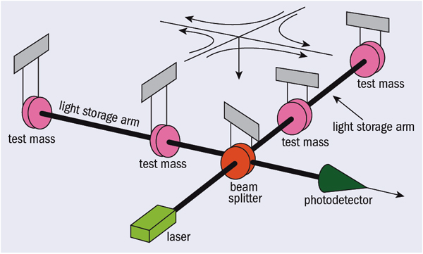
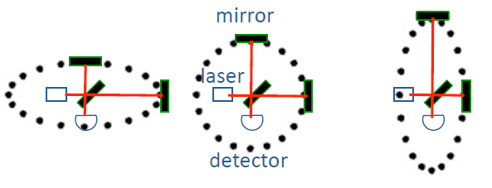
GW detection basics
Measure displacement between two freely falling test masses (i.e. the suspended mirrors at the end of an interferometer’s arms)
Detectors measure strain: larger arm length ➝ more sensitive
$$l+Δl$$
$$l$$
Strain: $h=\frac{Δl}{l}$

Slide 11
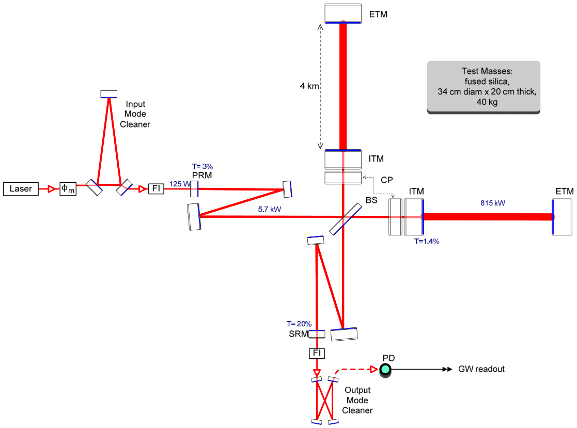
GW detection basics
Schematic of Advanced LIGO optical layout –in reality things are even more complicated!

Slide 12
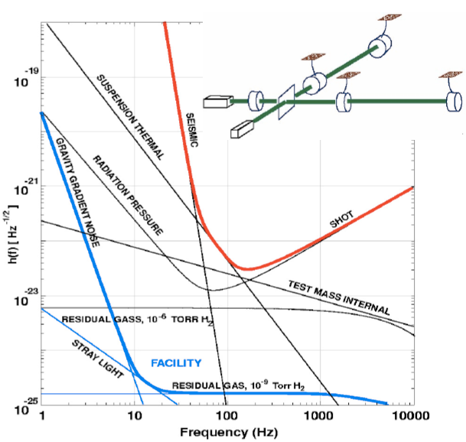
Noise sources
Many noise sources to overcome
Pendulum suspension isolates masses from seismic motion (low frequency <100Hz)
High quality factor masses, mirror coatings, suspensions reduces thermal noise in detection band (low-mid frequency 10s-100s Hz)
High laser power reduced laser shot noise (high frequencies > 100s Hz)
power recycling - keep as much light in interferometer arms as possible (few W input laser ➝ few kW in arms)

Slide 13
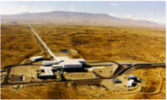
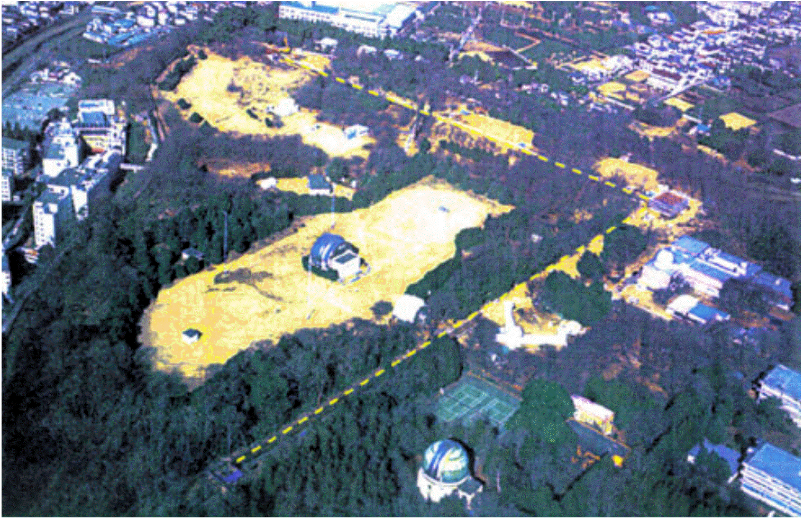
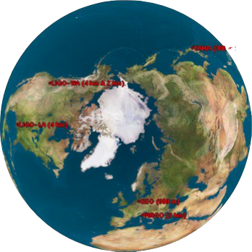
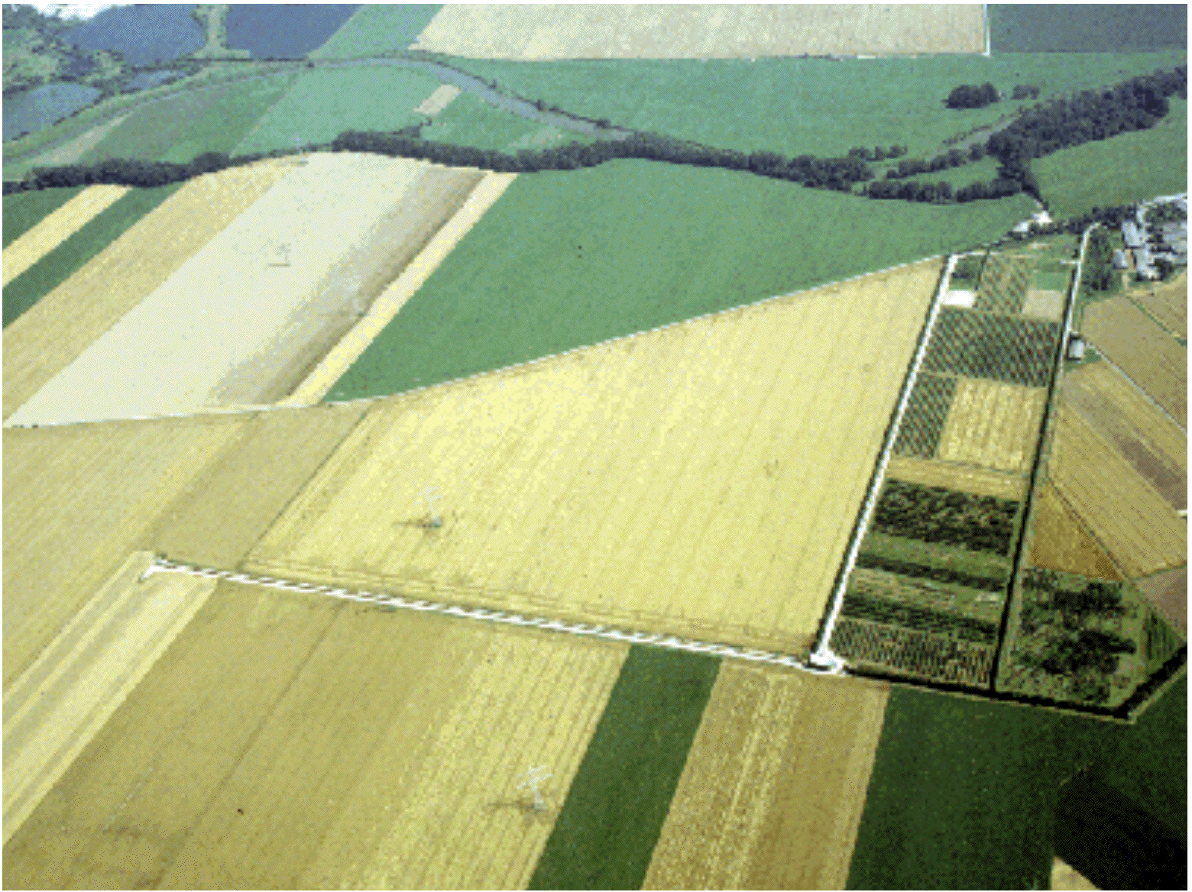
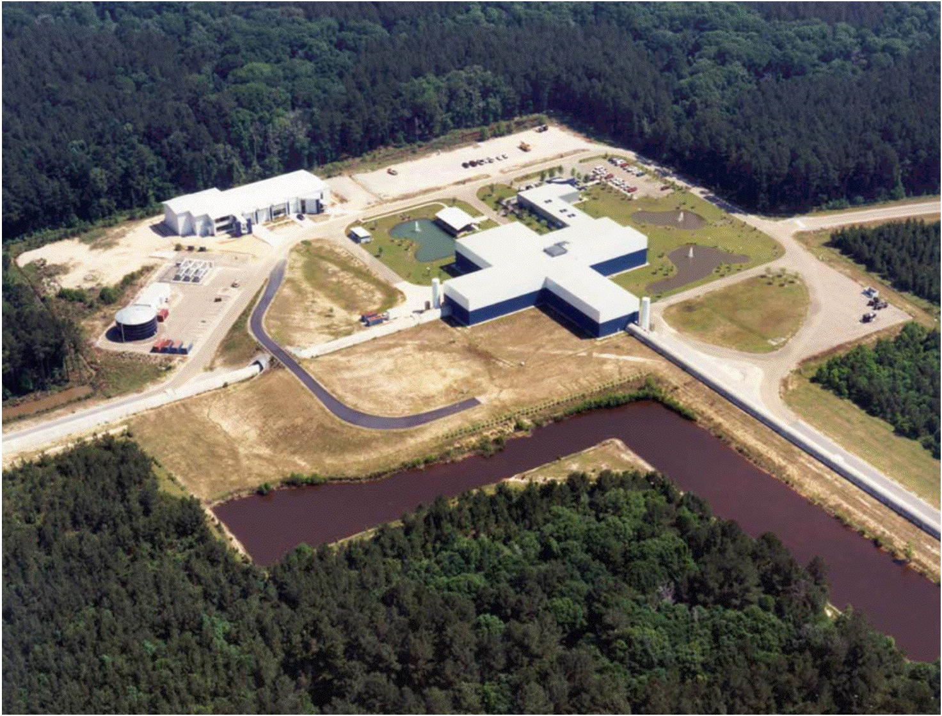
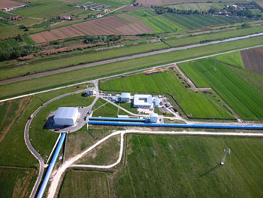
Worldwide detector network
TAMA (300m)
CLIO (100m)
KAGRA (3km)
GEO600/HF (600m)
LIGO Hanford WA
(4km)
LIGO Livingston LA
(4km)
Virgo (3km)

Slide 14
LIGO Scientific Collaboration

Slide 15
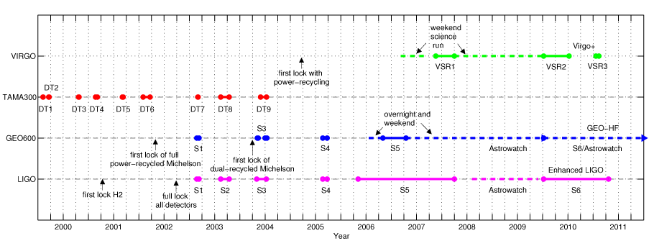
“Initial” and “Enhanced” detectors
Since 2001 the initial generation of interferometric detectors have been through periods of science data taking
6 major science runs producing astrophysical results up to 2011
Enhanced LIGO/Virgo+/GEO-HF tested some “Advanced” technology

Slide 16
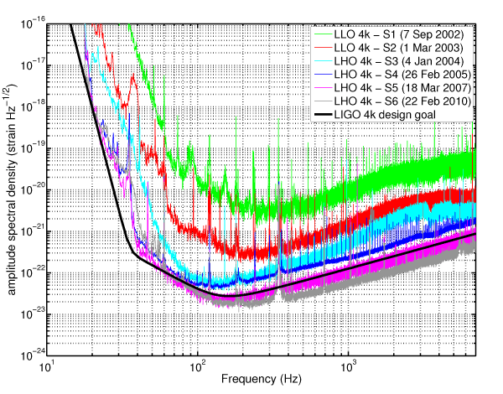
LIGO

Slide 17
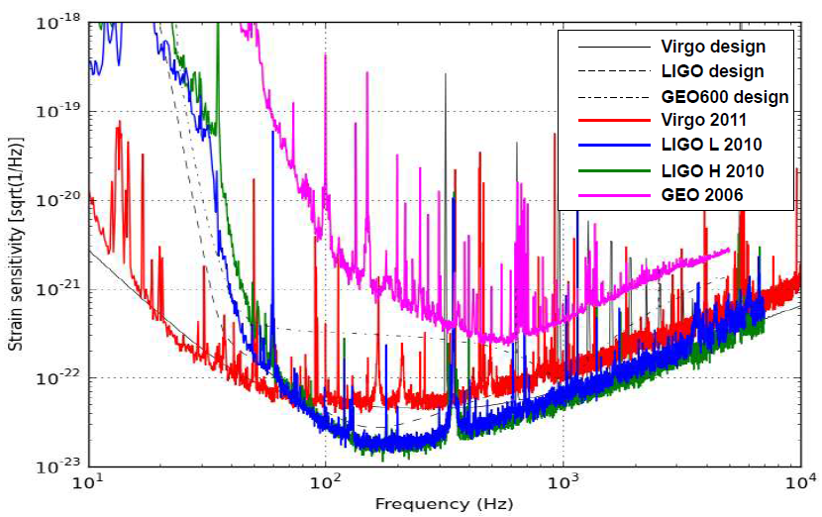
Detector network

Slide 18
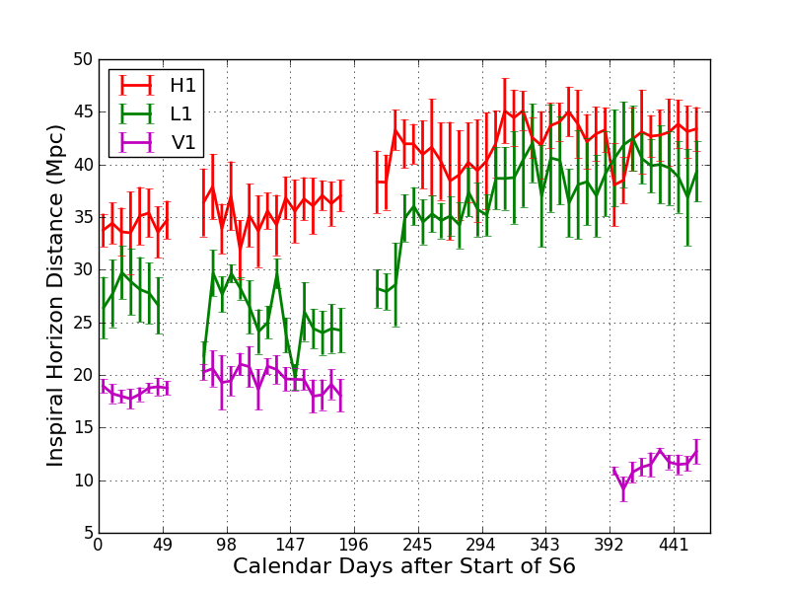
“Horizon distance” sensitivity
Often express detector sensitivity as the maximum distance to which we could observe the coalescence of two 1.4 solar mass neutron stars optimally oriented to the detector at an SNR of 8 (an angle averaged version can be obtained by dividing by ~2.3)
Figure for S6/VSR1,2,3 from LSC & Virgo, arXiv:1203.2674

Slide 19
GW searches and science

Slide 20
GW searches
Bursts
Any transient (e.g. < 1 sec) (potentially unmodelled) source of excess power
Compact binary coalescences (CBC)
late stage neutron star or black hole binary inspirals, mergers and ring-downs with well-modelled signal
Continuous [waves] (CW)
Any long duration quasi-monochromatic signal
Stochastic background
Coherent stochastic signals
Not broken down by the astrophysical source type (e.g. neutron stars can be CBC, burst, CW and stochastic emitters), but by waveform and the optimal search strategy

Slide 21
GW sources
Bursts
Core-collapse supernova, compact object coalescence, neutron star/black-hole vibrational modes, cosmic strings, …
Compact binary coalescences (CBC)
final stages of coalescence, merger and ring-down of binary neutron stars, binary black holes, or neutron star-black hole binaries
Continuous [waves] (CW)
deformed galactic neutron stars, …
Stochastic background
Cosmological background, astrophysical background of unresolved sources (e.g. binary systems)

Slide 22
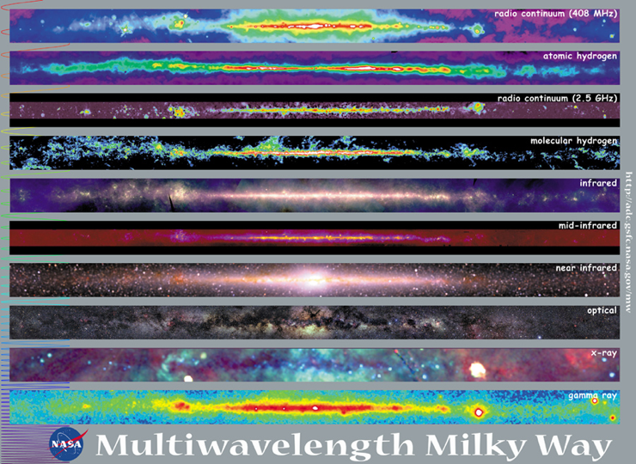
Why? Science with GWs
“New window on the universe”!
GWs
spanning 20 orders of magnitude in wavelength
+
Queen Mary, University of London
23rd Nov 2009

Slide 23
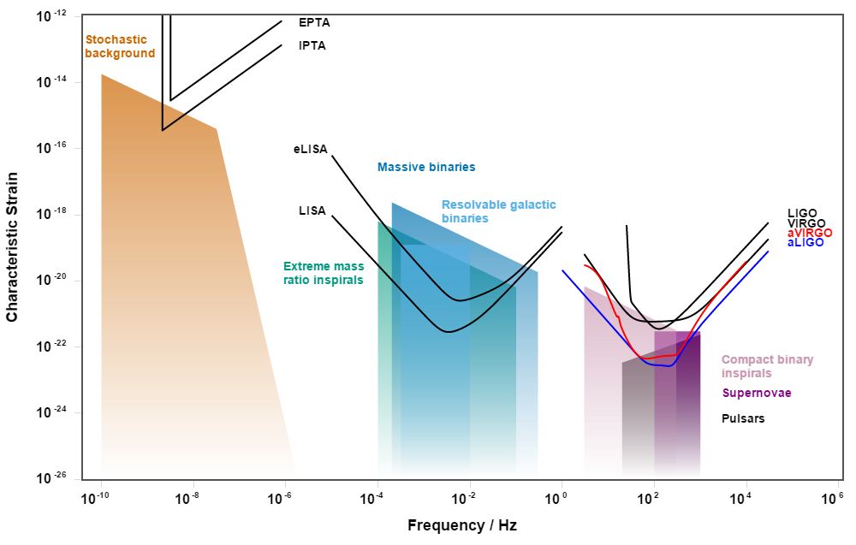
GW spectrum
Image credit: Moore, Cole & Berry, http://rhcole.com/apps/GWplotter/
Like EM astronomy we need different telescopes to see all parts of the spectrum, which show different sources/processes

Slide 24
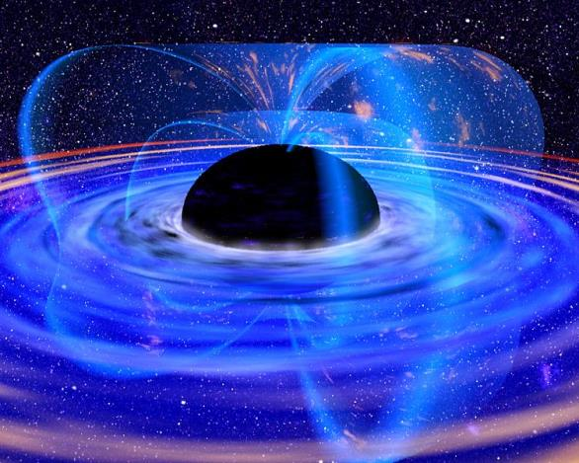
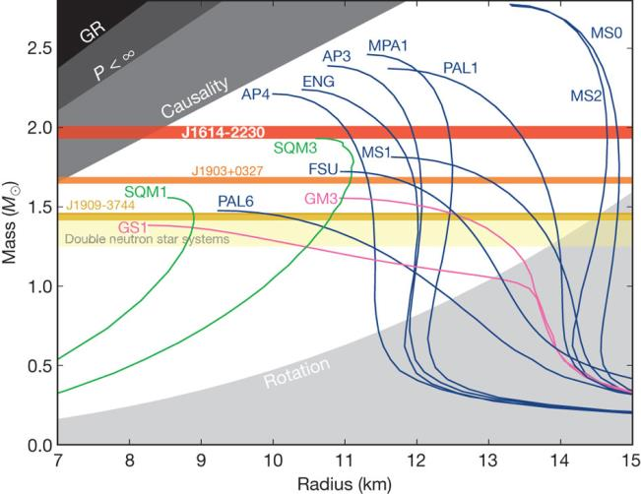
Science with GW
Fundamental physics:
What are the properties of GWs?
speed of GWs (massive gravitons?)
are there more than 2 polarisation states?
Is GR the correct description of gravity?
precision tests of correctness of GR in strong field regime
are black holes as GR predicts (“no-hair” theorem)?
Behavior of matter at nuclear densities and pressures
what is the composition of neutron star?
Neutron star EOS: Credit: Demorest et al, Nature 467, 1081-1083 (2010)

Slide 25
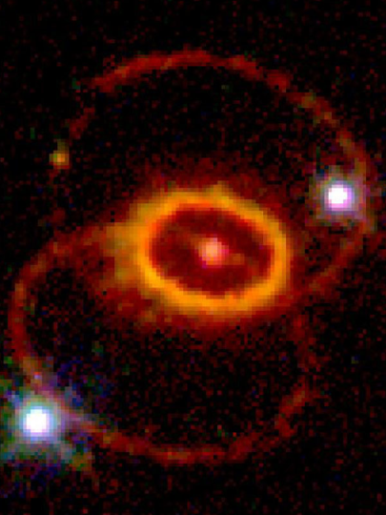
Science with GWs
Astronomy and astrophysics:
population studies (local and high redshift):
black holes (stellar mass, intermediate mass (do they exist?), supermassive) and neutron stars
massive star formation history
galaxy formation history
galactic white dwarf and neutron star binary numbers
Gamma-ray burst (GRB) central engine:
compact binary coalescence, hypernova?
Core collapse supernova:
what exactly happens during explosion?
Neutron stars and magnetars:
are they deformed?
why do they glitch?
Credit: (ESA/STScI), HST, NASA
See "Physics, Astrophysics and Cosmology
with Gravitational Waves"
B.S. Sathyaprakash and Bernard F. Schutz
http://www.livingreviews.org/lrr-2009-2

Slide 26
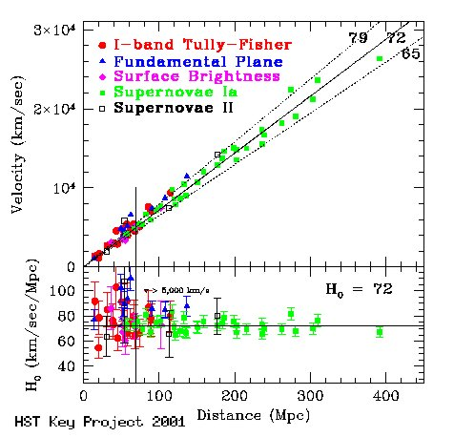
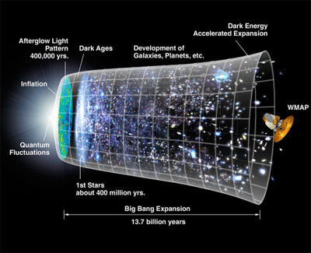
Science with GWs
Cosmology:
precise measurements of history of cosmic acceleration to z~10! without relying on “cosmic distance ladder” - standard sirens
cosmological stochastic background:
probe <10⁻¹⁴s after big bang!
inflation?
cosmic strings from phase transitions?
Credit: NASA

Slide 27
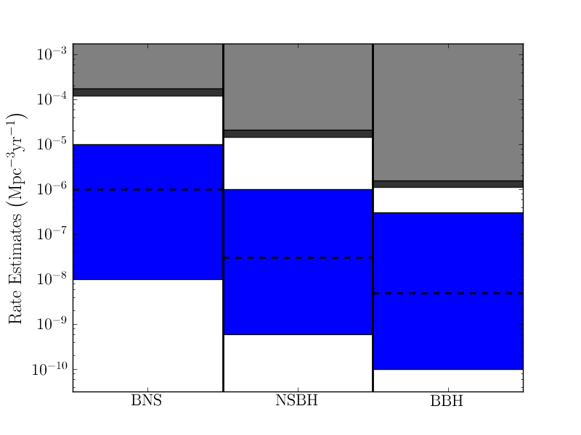
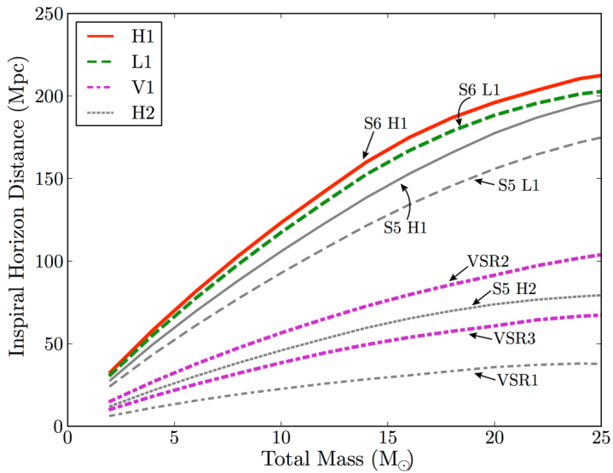
Results “highlights”
See http://www.ligo.org/science/outreach.php for a selection of summaries of LIGO/Virgo results
Low-mass (binaries with total mass between 2-25 solar masses) CBC search using LIGO S6 and Virgo VSR2 data
Horizon distance as a function of mass
Event rate limits for different systems
Abadie et al, PRD 85, 082002 (2012) arXiv:1111.7314

Slide 28
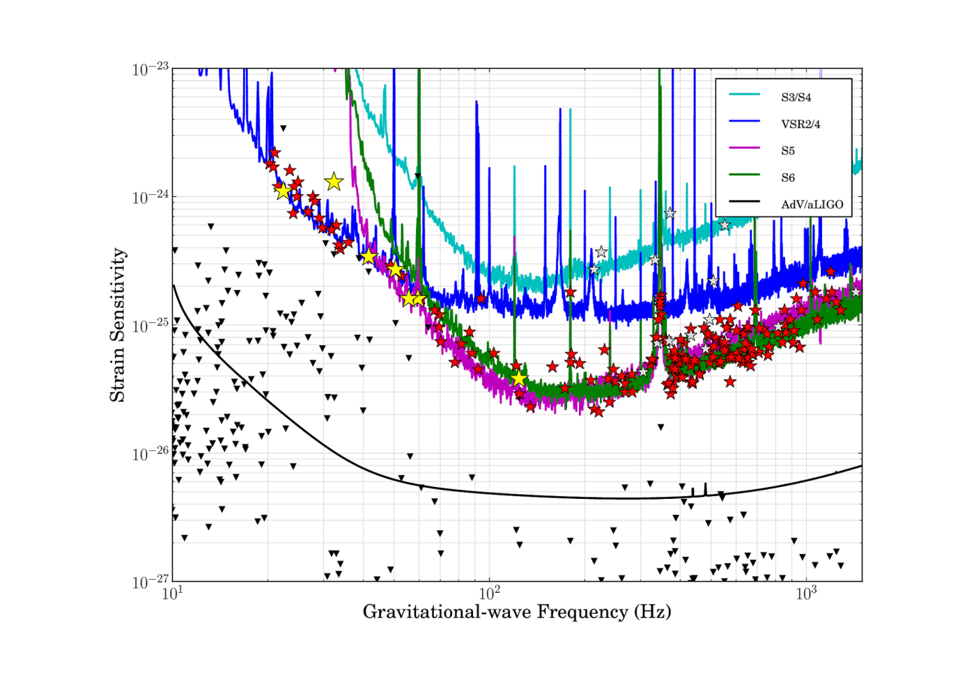
Results “highlights”
Aasi et al, ApJ 785, 2, 119 (2014) arXiv:1309.4027
Searching for GWs from known pulsars

Slide 29
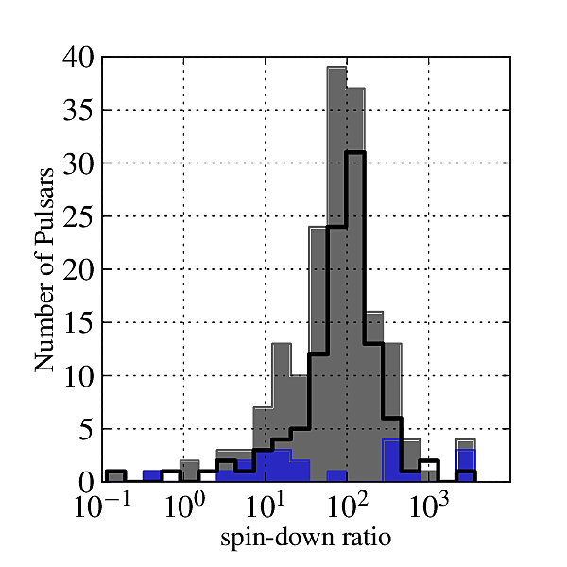
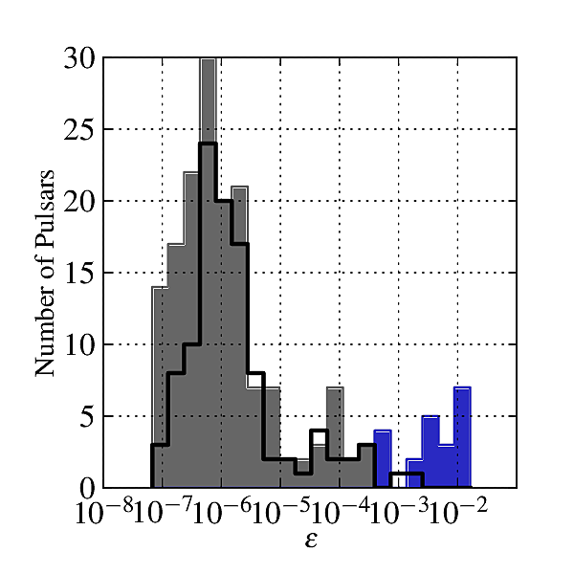
Results “highlights”
Aasi et al, ApJ 785, 2, 119 (2014) arXiv:1309.4027
Searching for GWs from known pulsars
Strain $h=4.2×{10}^{−26}ε_{−6}I_{38}f_{100}^{2}r_{\text{kpc}}^{−1}$
Spin-down limit: spin-down luminosity = GW luminosity
$$h_{sd}=2.5×{10}^{−25}I_{38}{\left|{\dot{f}}_{−11}\right|}^{1/2}f_{100}^{−1/2}r_{\text{kpc}}^{−1}$$
$ε_{−6}$: ellipticity (per ${10}^{−6}$)
$I_{38}$: principle mom. of inertia (per ${10}^{38}\text{kg}{\text{m}}^{2}$)
$f_{100}$: rotation freq. (per 100 Hz)
$r_{\text{kpc}}$: distance (kpc)
Ellipticity and mom. of inertia (or combined as mass quadrupole) are EOS dependent
Currently we expect $ε_{max}\sim {10}^{−4}$ for ‘exotic’ quark stars, $\sim {10}^{−5}$ for ‘normal’ NS, but more likely to be $<{10}^{−7}$

Slide 30
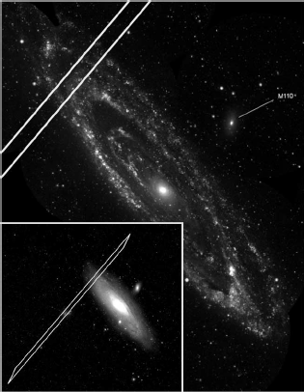
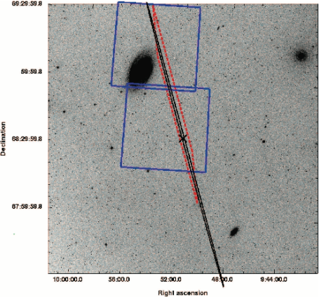
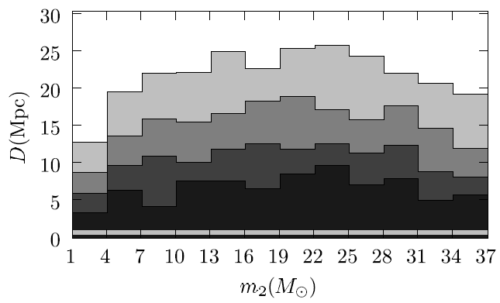
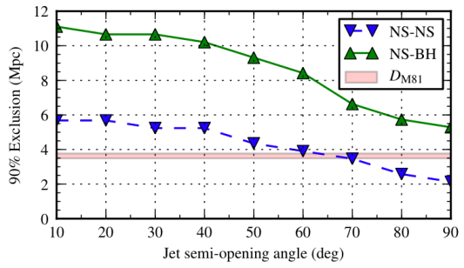
Results “highlights”
Abbott et al, ApJ 681, 2, (2008) arXiv:0711.1163
Abadi et al, ApJ 755, 1, 2 (2012) arXiv:1201.4413
Exclusion of compact binary mergers being sources of two short GRBs in M31 and M81 during S5
GRB 070201
M31 (0.78 Mpc)
GRB 051103
M81 (3.6 Mpc)
Darkest contour: 90% exclusion distance for CBC signal as a function companion mass
90% exclusion distance for CBC signal as a function of GRB jet opening angle
M31 distance

Slide 31
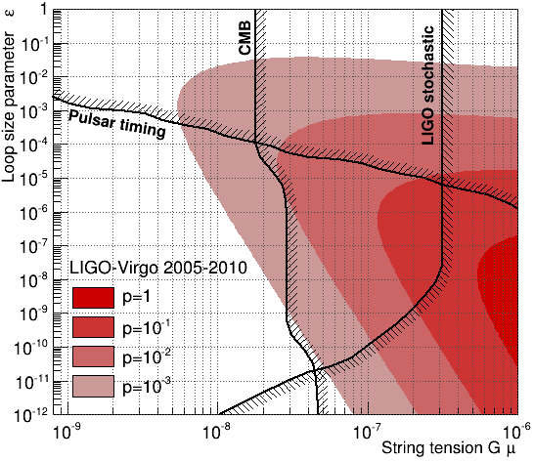
Results “highlights”
Aasi et al, PRL 112, 131101, (2014) arXiv:1310.2384
Do cosmic strings exist? Search for GW bursts from string cusps using LIGO & Virgo data constrained loop size parameter, string tension and probability of loop interation
Cusp GW waveform
0
sec
4

Slide 32
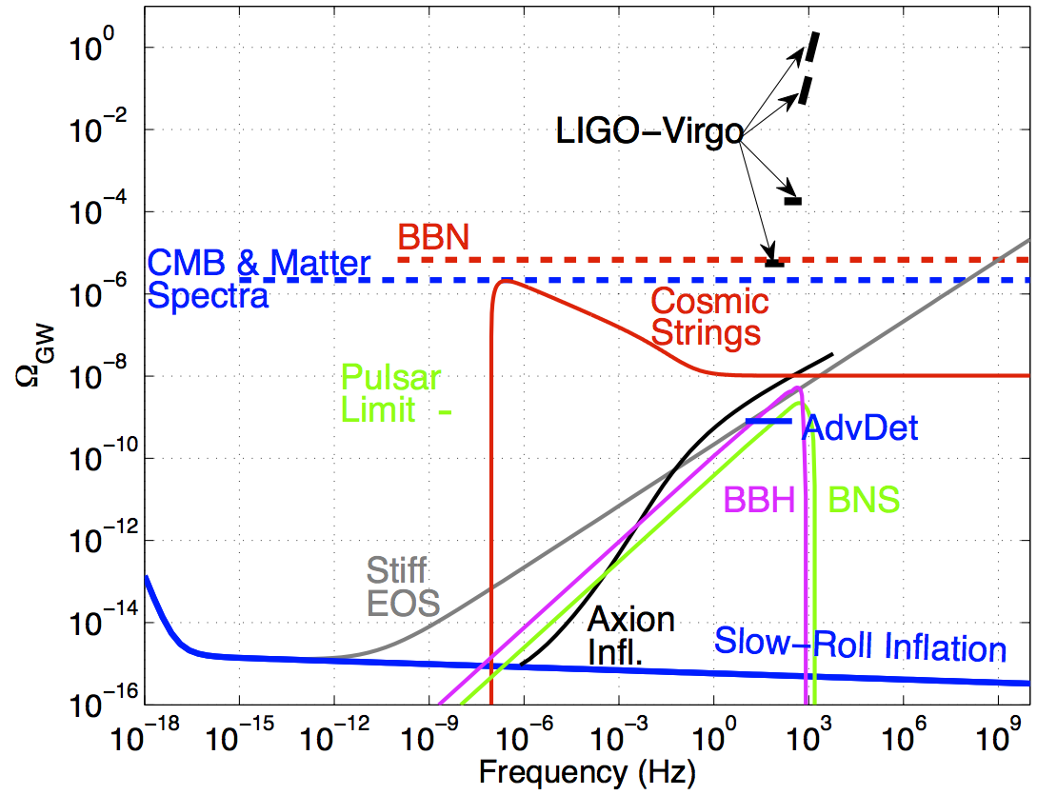
Results “highlights”
Search for cosmological stochastic background – results beat constraints from big bang nucleosynthesis
GW energy density (fraction of the critical density)

Slide 33
Some other searches…
GWs associated with 100s of long and short GRBs
Burst searches associated with neutrino observatories (e.g. IceCube)
Follow-up of GW triggers with optical telescopes
Searches for high mass (10s of solar mass) CBC signals
All-sky and directed (Cas A, galactic centre, Sco-X1) searches for CWs from neutron stars
[see http://www.ligo.org/science/outreach.php]

Slide 34
Advanced detectors

Slide 35
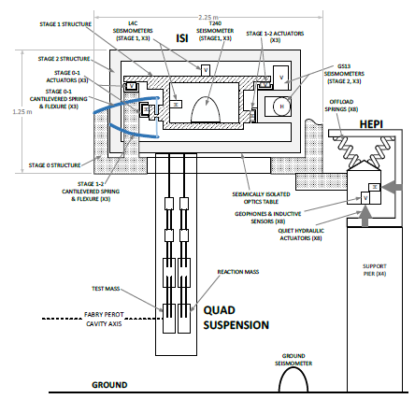
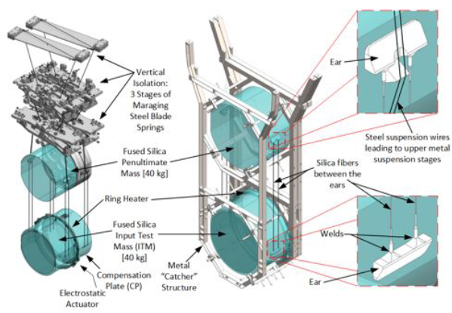
Advanced LIGO/Virgo
LIGO -> Advanced LIGO (aLIGO)
Virgo -> Advanced Virgo (AdV)
Aim to achieve order of magnitude sensitivity improvements over initial detectors and push sensitive band down to 10Hz
Main upgrades (aLIGO [similar for AdV]):
Higher laser power (~10W -> ~100W)
Larger test masses (10kg -> 40 kg)
Monolithic fused silica suspensions
Active seismic isolation
Improved mirror coatings
aLIGO see e.g. LSC, arXiv:1411.4547
AdV see e.g. Acernese et al, arXiv:1408.3978

Slide 36
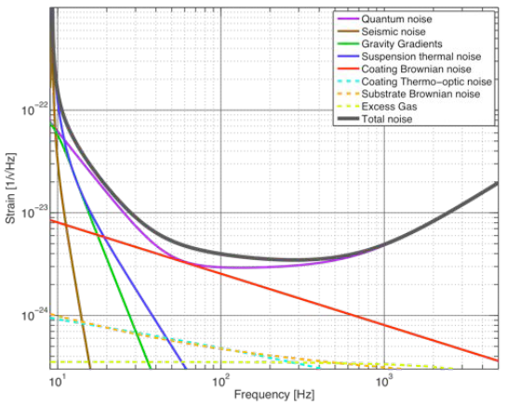
aLIGO noise budget
The LSC, arXiv:1411.4547

Slide 37
AdV noise budget
Acernese et al, arXiv:1408.3978

Slide 38
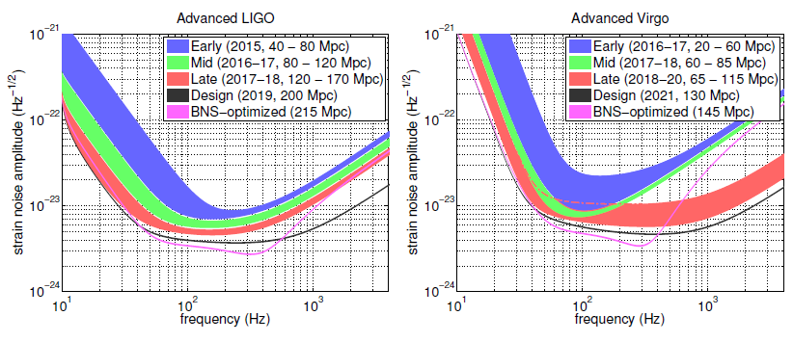
Observing schedule (estimate)
Aasi et al, arXiv:1304.0670
2015: 3 month run with two aLIGO detectors (potentially with AdV)
2016-2017: 6 month run with aLIGO and AdV
2017-2018: 9 month run with aLIGO and AdV
2019 onwards: 3 detector network at design sensitivity
2022: 4 detectors including LIGO India (or 5 with KAGRA)

Slide 39
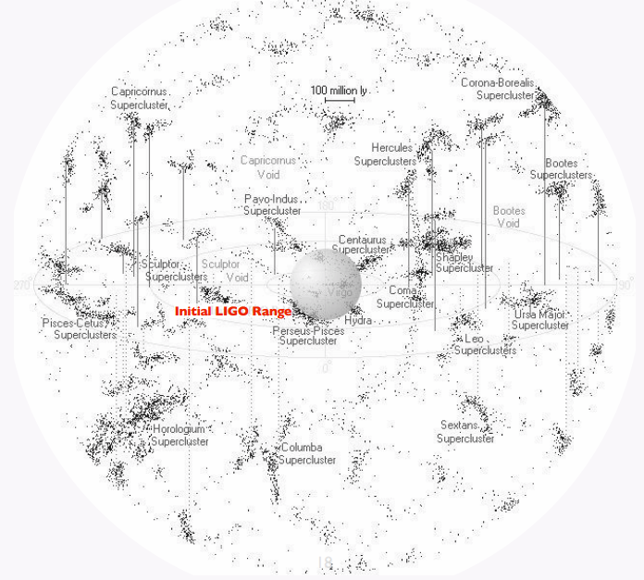
aLIGO search volume

Slide 40
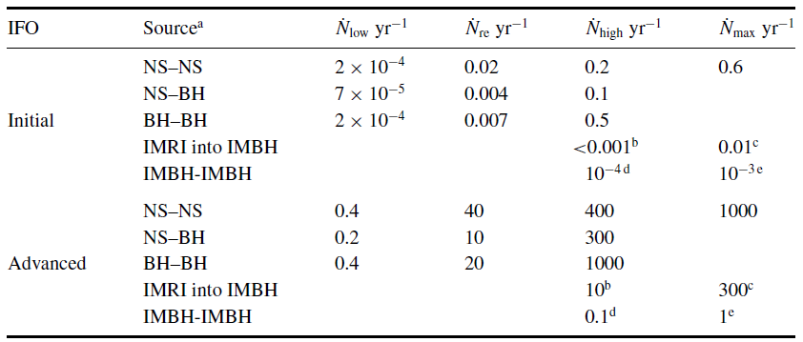
Rate estimates for CBCs
See Aasi et al, arXiv:1304.0670 & Abadie et al, CQG, 27, 173001 (2010) arXiv:1003.2480
Assuming design sensitivity and 3 aLIGO detectors

Slide 41
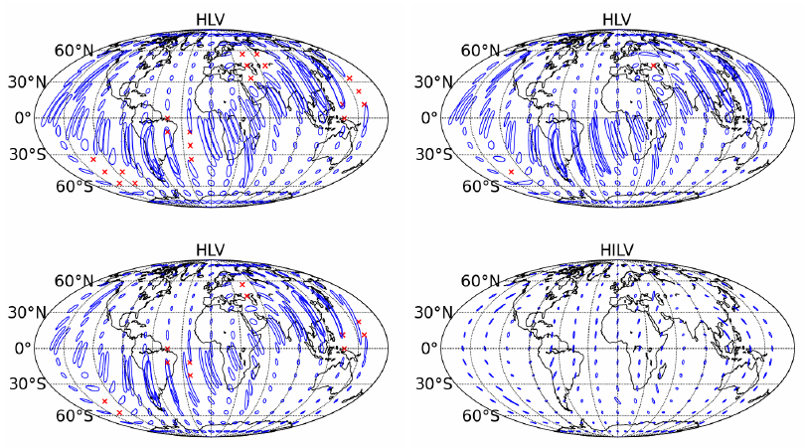
Sky localisation
For CBC and burst searches sky localisation is important to do EM follow-up (multi-messenger astronomy)
2016-17
2017-18
Sky localisation accuracy using triangulation (90% confidence regions) for face-on BNS – increase in sensitivity doesn’t make much difference, adding another detector does
2019+
2022+
Can do a bit better with full parameter estimation (see e.g. Singer et al, arXiv:1404.5623)
Aasi et al, arXiv:1304.0670

Slide 42
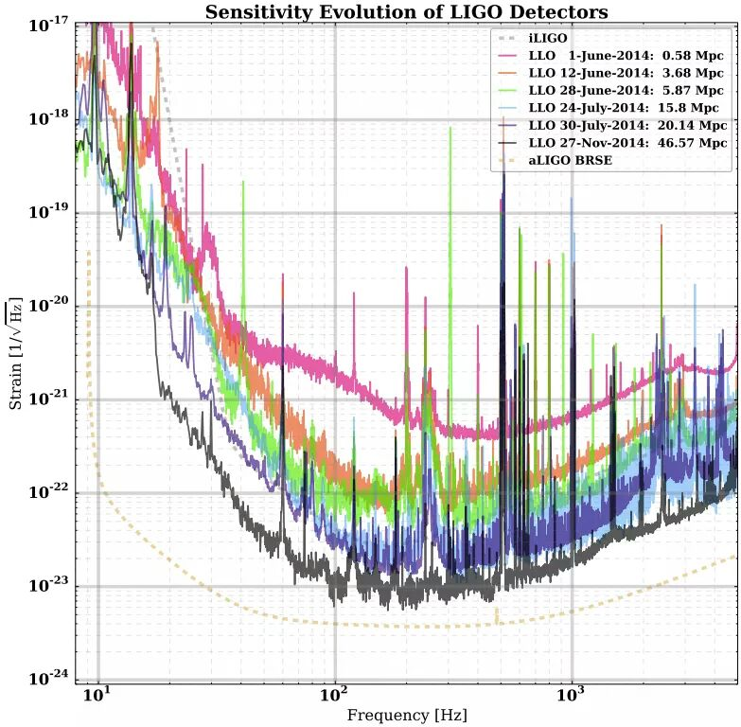
aLIGO progress
Looking good for observing run 1 (O1) in mid-to-late 2015

Slide 43
Summary
No direct detections of GWs yet
Lots of exciting science can be uncovered with GWs
Searches for many source types are well tested on initial GW detector data
Advanced detectors are on schedule to begin observations this year
Possible first detections by end of the decade

