Slide 1
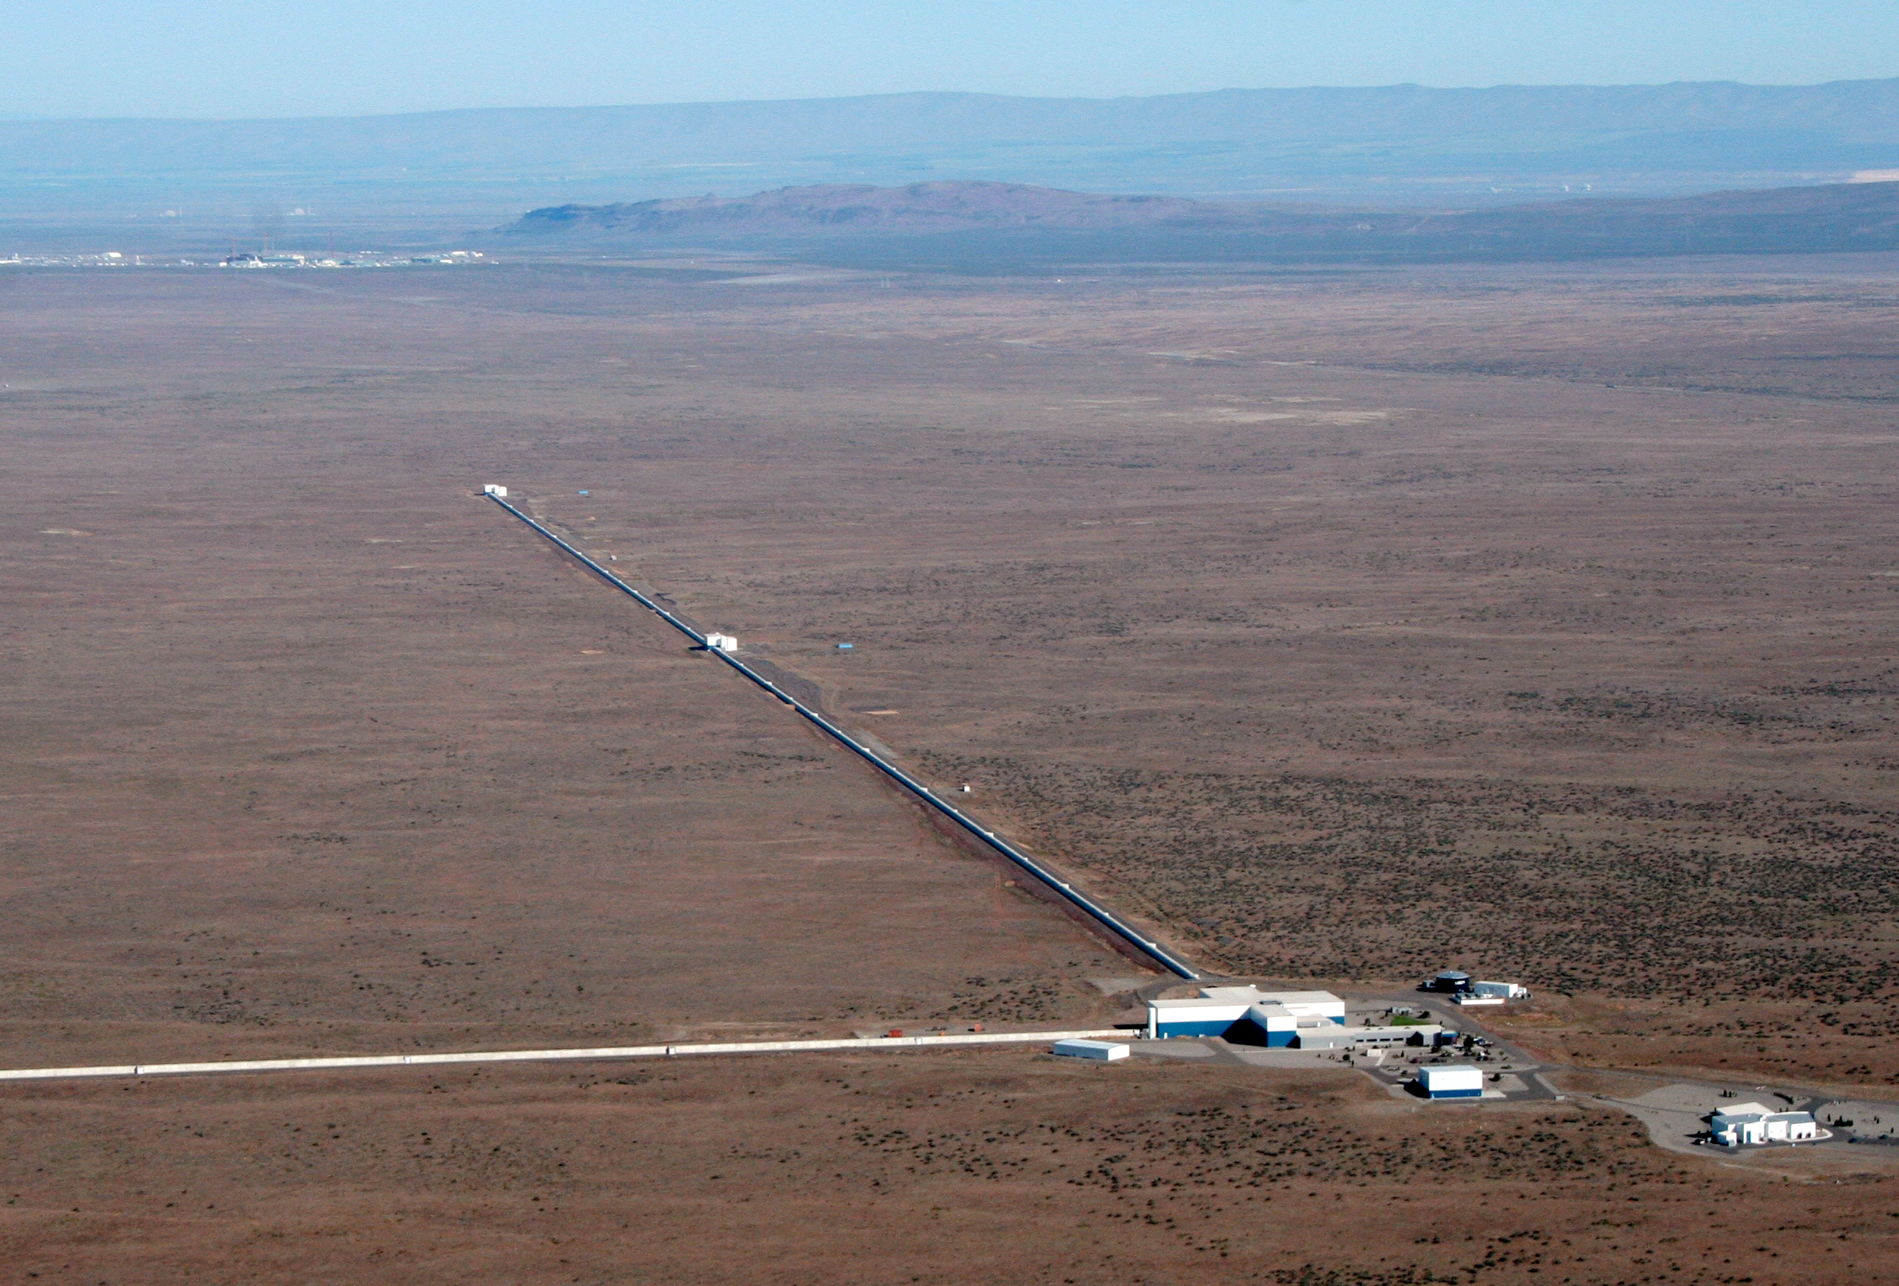
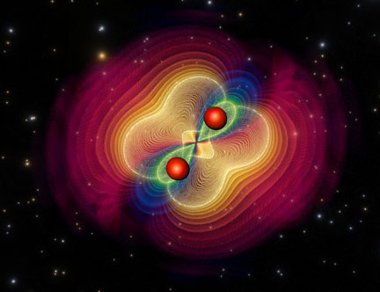


Laying a foundation for confident transient gravitational wave observations
Characterizing the Advanced LIGO instruments
Jess McIver for the
LIGO Detector Characterization Group
January 20, 2015

Slide 2
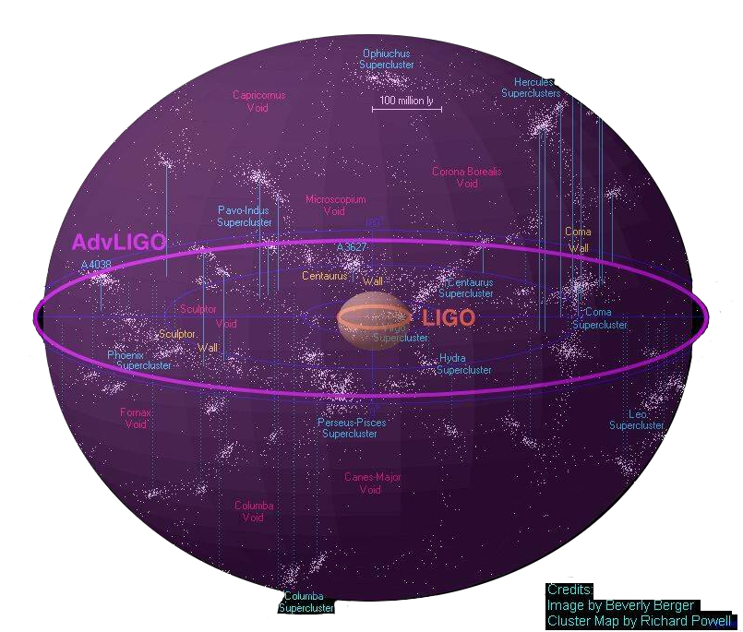
Advanced LIGO
Advanced LIGO
Livingston has
surpassed iLIGO
Notes:
– best achieved performance to date: ~59Mc

Slide 3
aLIGO instrumental improvements
Better
Seismic
Isolation
Reduced
Brownian
Noise
Increased
Laser Power
and Signal Recycling
Notes:
Three major frequency regimes improved by different technologies from initial to advanced LIGO
Low freq – introduction of active seismic isolation – actuating the platforms housing the optics to cancel the effects of ground motion – plus improved passive isolation suspensions
In our most sensitive frequency range on the order of hundreds of Hz we reduce the effects of thermal noise with improved optical coatings and the materials of our test mass suspensions
At higher frequencies we are dominated by shot noise, which scales inversely with circulating power, so we combat this by increasing input power and further recycling it

Slide 4
aLIGO installation and testing
Pre stabilized laser
Notes:
Test configurations of increasing complexity

Slide 5
aLIGO installation and testing
Input optics
Used for:
Input laser stabilization
Selecting for fundamental Gaussian beam mode

Slide 6
aLIGO installation and testing
Arm locking test
Arm Length Stabilization (ALS)
Tests:
Locking the interferometer arm cavities with green laser light
Notes:
Treat each arm as a distinct cavity and lock using GREEN laser light
Eventually this green light will be phase locked to the red light from the PSL and used to lock the arms when acquiring full ifo lock

Slide 7
aLIGO installation and testing
Power Recycled Michelson Interferometer (PRMI)
Vertex locking
Power Recycling Cavity:
Recycles the power that would exit via the power recycling mirror
Increases cycled power and reduces shot noise

Slide 8
aLIGO installation and testing
Vertex locking
Signal Recycling Cavity:
Tunable
Increases sensitivity in selected frequency band
Dual Recycled Michelson Interferometer (DRMI)

Slide 9
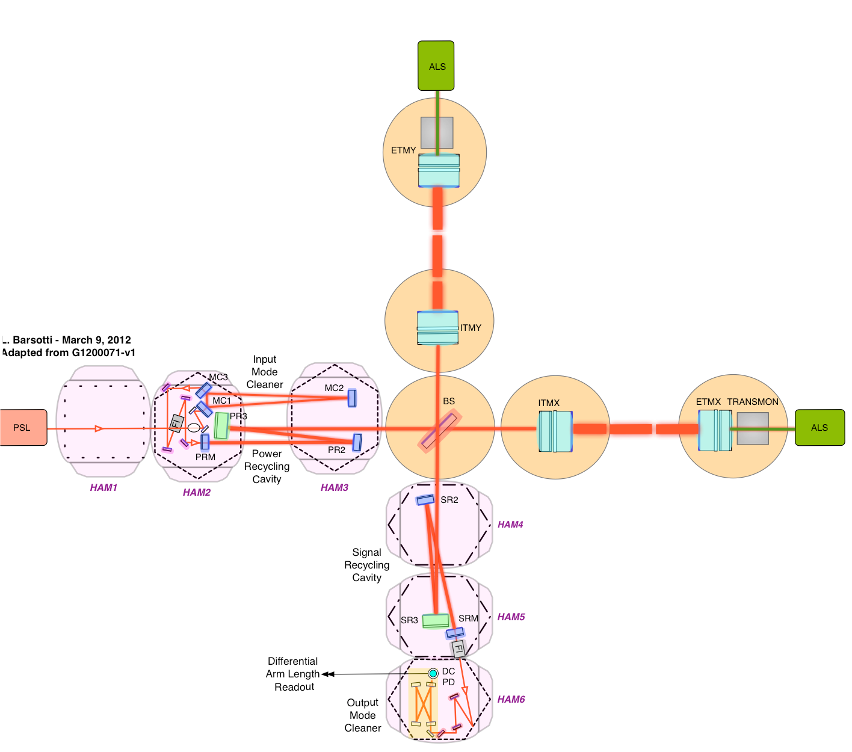
aLIGO installation and testing
Full interferometer!
Notes:
Appreciate all the different DOFs – IMC cavity, two arms, MICH, PRC, SRC, OMC

Slide 10
Timeline: from eLIGO to aLIGO
2010
2011
2012
2013
2014
2015
2016
S6
Hanford aLIGO installation, testing, commissioning
aLIGO observing run
S6
Livingston aLIGO installation, testing, commissioning
aLIGO observing run
Notes:
From S6 to O1

Slide 11
Timeline: from eLIGO to aLIGO
2010
2011
2012
2013
2014
2015
2016
S6
Hanford aLIGO installation, testing, commissioning
aLIGO observing run
Now
S6
Livingston aLIGO installation, testing, commissioning
aLIGO observing run

Slide 12
Timeline: installation and testing
2010
2011
2012
2013
2014
2015
2016
S6
Hanford aLIGO installation, testing, commissioning
aLIGO observing run
S6
Livingston aLIGO installation, testing, commissioning
aLIGO observing run
2010
2011
2012
2013
One arm
Input optics
Arms and vertex
Hanford Installation
Install
Input optics
Livingston Installation
Vertex
Arms
Full ifo

Slide 13
Timeline: the lead up to the first observing run
2010
2011
2012
2013
2014
2015
2016
S6
Hanford aLIGO installation, testing, commissioning
aLIGO observing run
S6
Livingston aLIGO installation, testing, commissioning
aLIGO observing run
2014
2015
Hanford Installation
Progress toward full ifo
Acceptance and sens. improve.
O1
Now
Livingston Full interferometer
Acceptance and sensitivity improvement
O1
Notes:
Progress toward full ifo – vertex and arms

Slide 14
The challenges of commissioning
Many effects cannot be tested prior to large scale implementation
Often noise sources stem from the interaction of different subsystems and cavities
Optic alignment
Laser power
Noise!
Seismic
Optic quality
Thermal effects
Scattering
Adapted from L. Barsotti
Notes:
A lot of these components have been tested rigorously before installing in the ifo – why all this noise?
Detector Characterization – looking at these noise sources from the perspective of the GW searches – is critical to help address these AS IFOS COME ONLINE. Looking at the data in each stage of ifo testing, running GW analysis pipelines, identifying what’s going to impact the searches.

Slide 15
Lessons from the past

Slide 16
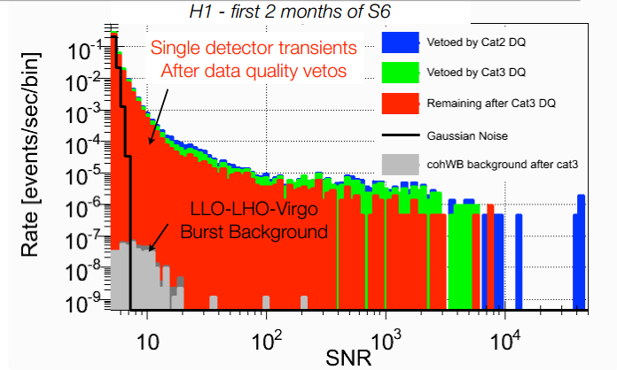
GW search pipelines are adversely affected by non-Gaussian data!
Long tails (outliers) in all-sky GW burst search background triggers greatly restrict achievable false alarm rate.
Non-Gaussian noise confuses parameter estimation for all transient searches.
  Slide: Josh Smith, 2014
Notes:
because of the loud tail, having a signal loud enough for detection is astrophysically unlikely.
GLITCHES BADLY LIMITED PAST SEARCHES!

Slide 17
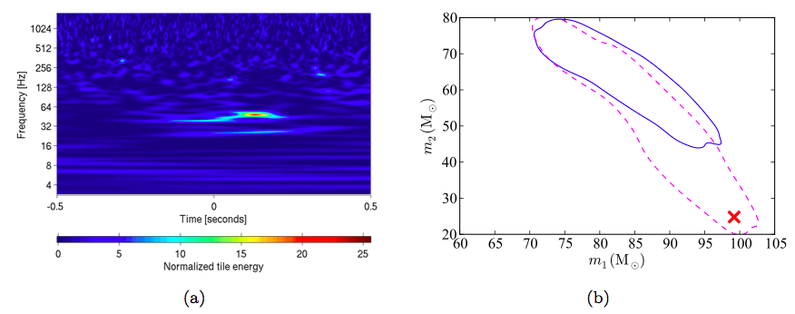
Example: NINJA2 search results
Actual injected masses
arvix 1401.0939
A normalized spectrogram of Hanford recolored noise only showing a transient event, or glitch, that happens to occur at the time of the injection.
Solid blue – the 95% credible region for mass estimation based on EOBNRv2 analysis using realistic recolored noise.
Dashed pink – in Gaussian noise.
  Slide: Josh Smith, 2014
Notes:
NINJA2 notes

Slide 18
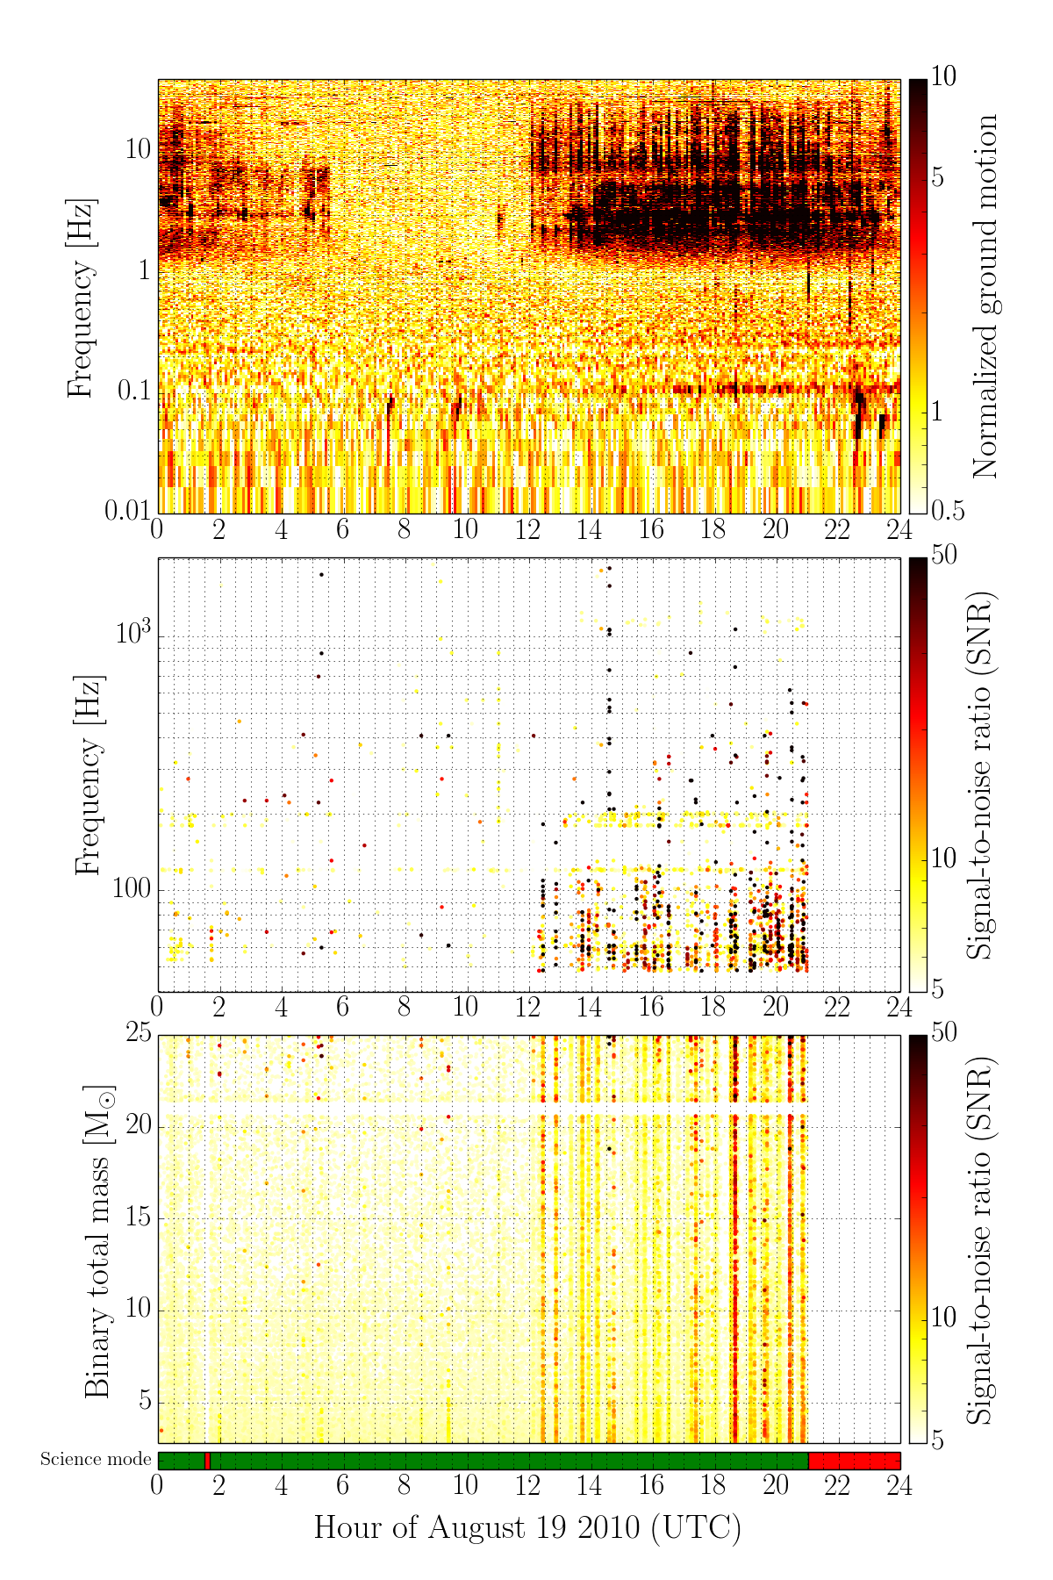
Example:
Transient seismic motion – a known and troublesome problem during S6.
arXiv preprint 1410.7764
Notes:
Noise that affected both major transient searches
(right) - this panel shows localised seismic noise events in time and frequency
coloured by their SNR. The lower left and right panels show transient events in
the gravitational-wave strain data as recorded by single-interferomter burst and CBC
inspiral searches respectively. Critically, during periods of high seismic noise, the
inspiral analysis ‘daily ihope’ [13] produced candidate event triggers across the full
range of signal templates, severely limiting the sensitivity of that search.

Slide 19
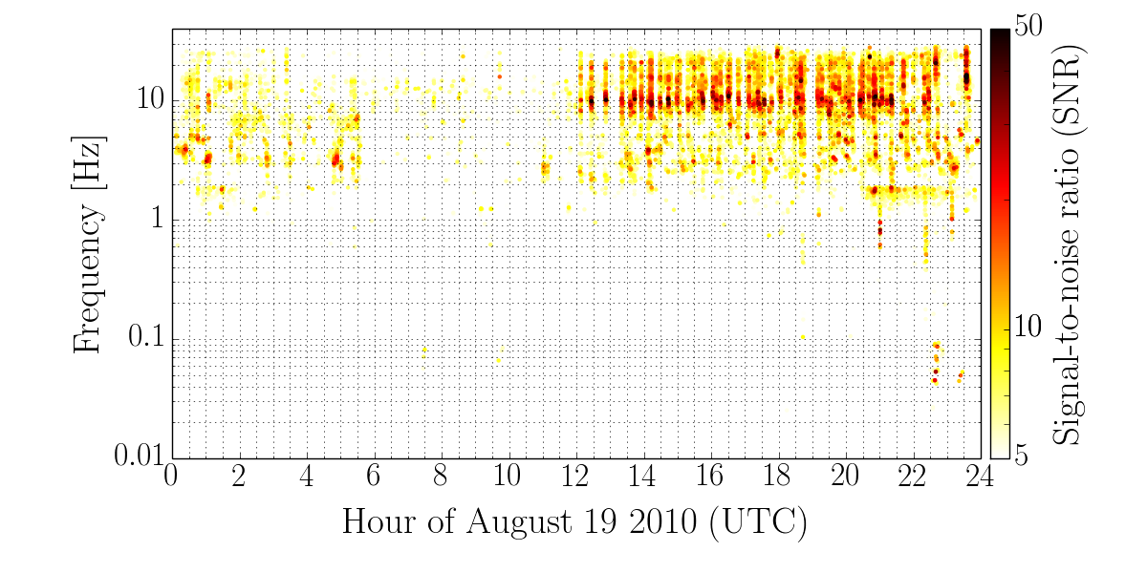
Transient ground motion as seen by single burst GW pipeline Omega
Transient seismic motion – a known and troublesome problem during S6.
arXiv preprint 1410.7764
Notes:
Low freq transients identified by well-tuned singlo ifo burst pipeline. BEST EFFICIENCY VETO IN S6 – model for future instrumental detchar
Seismic transient as identified by low-freq Omega on ground motion monitors associated with ~70% of glitches

Slide 20
Recent data from Advanced LIGO
Highlights of DQ features most troublesome for the transient searches
Notes:
Barely scratches the surface of noise hunting performed by the commissioners,
But these are highlights of noise features that MOST bother the transient GW searches

Slide 21
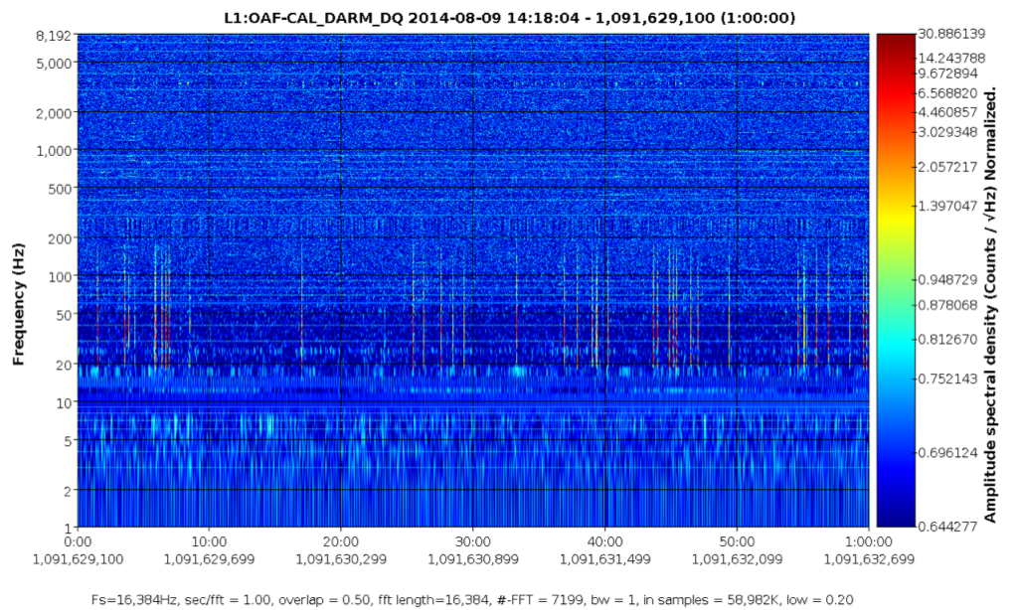
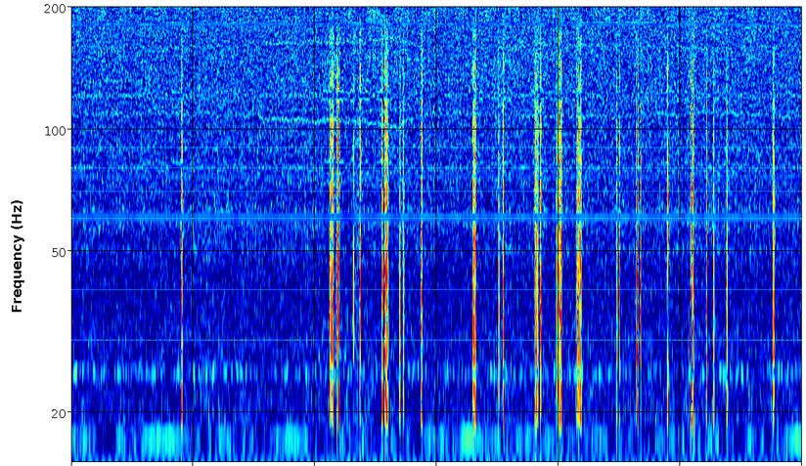
An early DQ issue diagnosis
Calibrated DARM - 1 hour on August 9th 2014
00:10
00:20
00:40
00:50
00:60
Time (minutes)
  Slide: Josh Smith, 2014

Slide 22
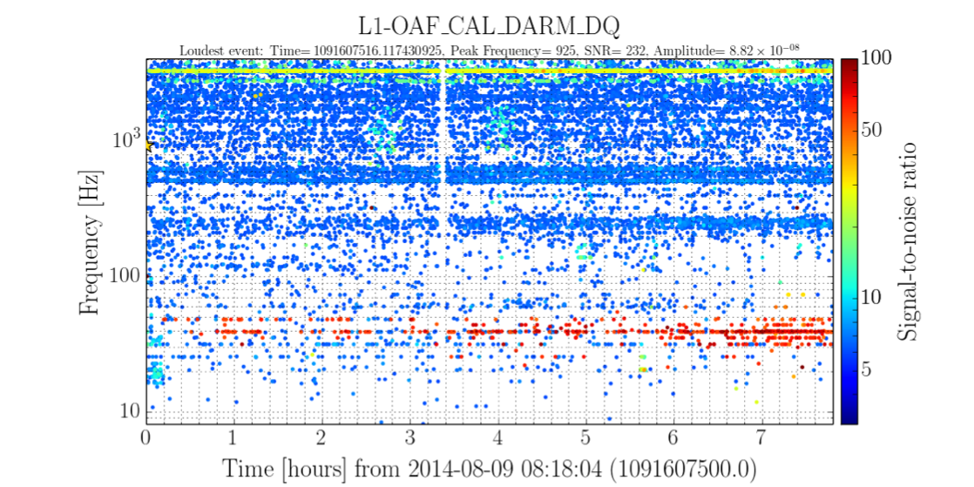
Through the lens of a single ifo burst GW pipeline
Calibrated DARM (differential arm length)
8 hours on August 9th 2014
  Slide: Josh Smith, 2014

Slide 23
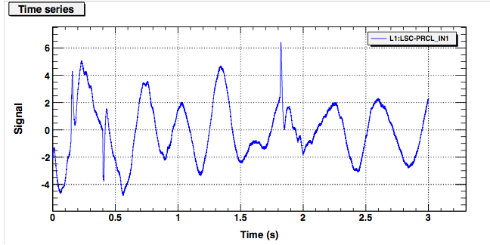
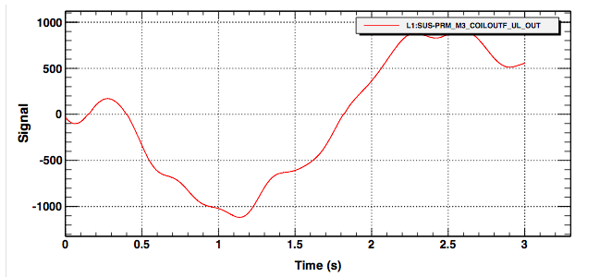
The mechanism : major carry transition DAC glitching
Power recycling cavity length
Power recycling mirror actuation
  Slide: Josh Smith, 2014
Notes:
LSC-PRCL_IN1_DQ is the power recycling cavity length error signal, so any misalignments in the PRC length will show up in this signal. Specifically this is the input to the control filters, so this signal is processed to make the PRC length control signal.

Slide 24
The mechanism : major carry transition DAC glitching
Power recycling cavity length
First dubbed “zero crossing” glitches – identified when vertex cavity actuation signals crossed zero.
Actually a subset of a broader known issue with these DACs.
Power recycling mirror actuation
  Slide: Josh Smith, 2014
Notes:
Think of it as an inversion of the majority of the switches. This is where glitch-ing is most common.
LLO commissioners reported Digital-to-Analog Converters (DACs) glitching on zero crossing (next slide) in ^{alog 13940}
This should occur for any other major carry transition (e.g.,+/- 2^16 for 18-bit DAC and +/- 2^14 for 16-bit DAC)

Slide 25
The mechanism : major carry transition DAC glitching
Major-carry transitions (MCTs): value transitions that cause a most significant bit(s) to change
Examples:
Power recycling cavity length
0111
1000
Power recycling mirror actuation
G1400823
1000
0111
  Slide: Josh Smith, 2014
Notes:
Think of it as an inversion of the majority of the switches. This is where glitch-ing is most common.
LLO commissioners reported Digital-to-Analog Converters (DACs) glitching on zero crossing (next slide) in ^{alog 13940}
This should occur for any other major carry transition (e.g.,+/- 2^16 for 18-bit DAC and +/- 2^14 for 16-bit DAC)
R-2R precision DACs

Slide 26
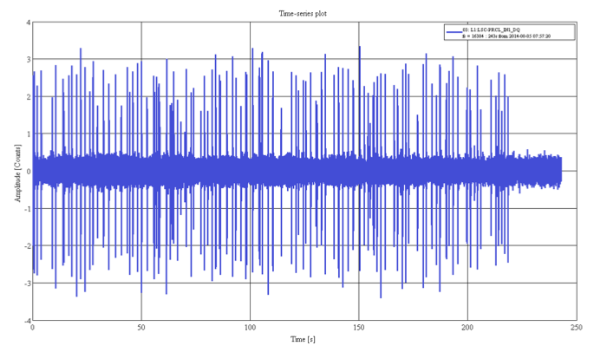
Offset applied to vertex cavity actuation
Time series of power recycling cavity length control signal
  Slide: Josh Smith, 2014

Slide 27
Offset applied to vertex cavity actuation
Time series of power recycling cavity length control signal
An offset is applied to the signal sent to the optic actuators in the vertex cavities
These signals no longer cross zero
The length signal glitching that couples to DARM is greatly reduced
  Slide: Josh Smith, 2014

Slide 28
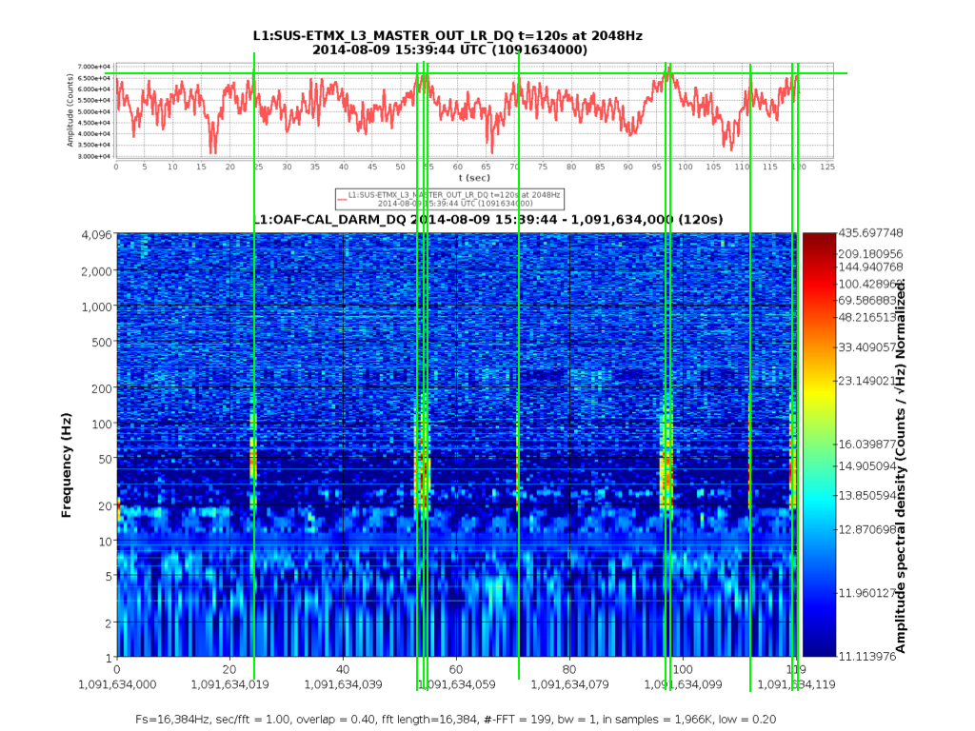
End station actuator glitches identified
End X optic suspension actuation signal
The Detector Characterization group also identified this behavior in one of the end stations at the 2^16 MCT
MCT glitching was later addressed with calibration of DACs – the offsets were removed in mid December
Calibrated DARM
Time – 2 hours
  Slide: Josh Smith, 2014
Notes:
DetChar can find these!
Some mitigation solutions proposed

Slide 29
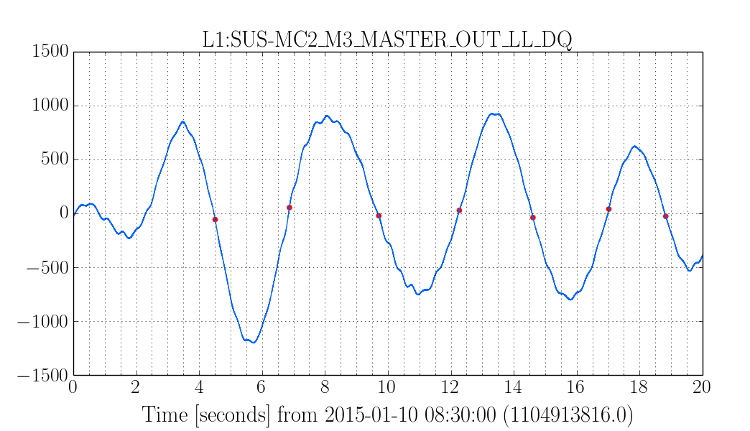
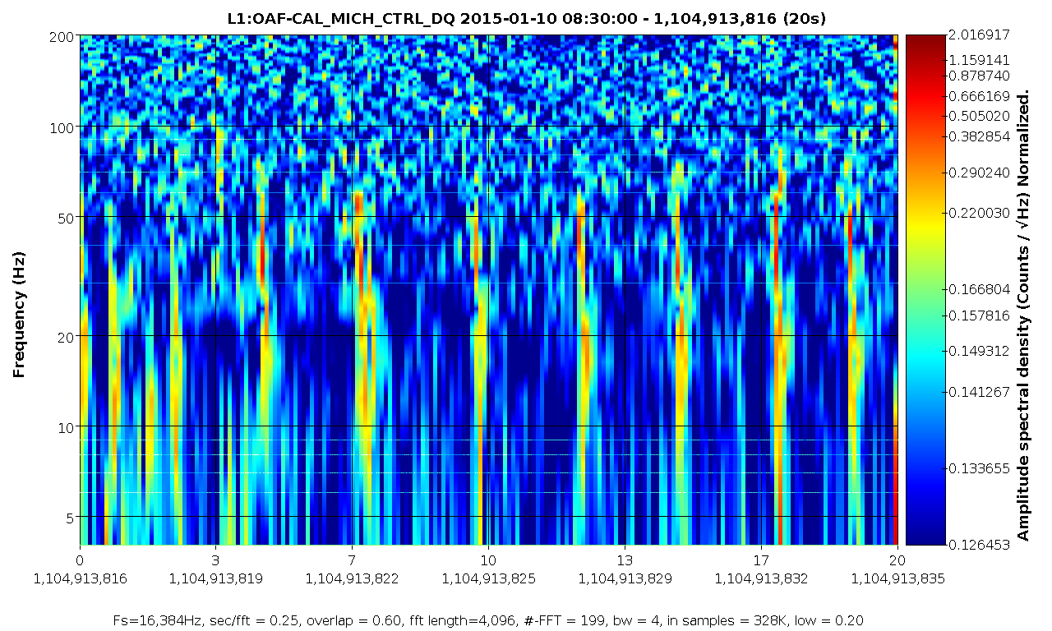
Return of DAC glitches
After ER6, loud glitches were observed in DARM
that coupled with the vertex cavities (SRCL, PRCL, MICH)
LLO alog 16354

Slide 30
Wasn’t DAC glitching fixed?

Slide 31
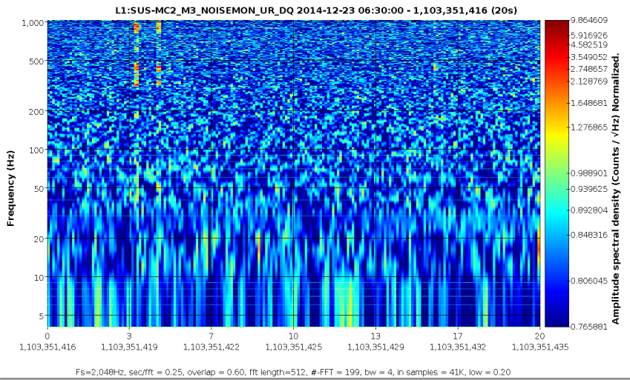
ER6 DAC calibration drift – week 1
LLO alog 16376

Slide 32
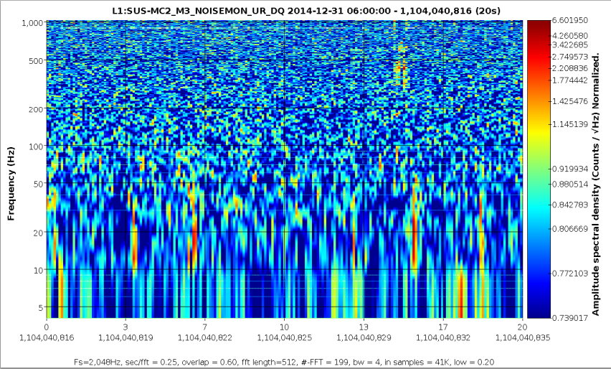
ER6 DAC calibration drift – week 2
LLO alog 16376

Slide 33
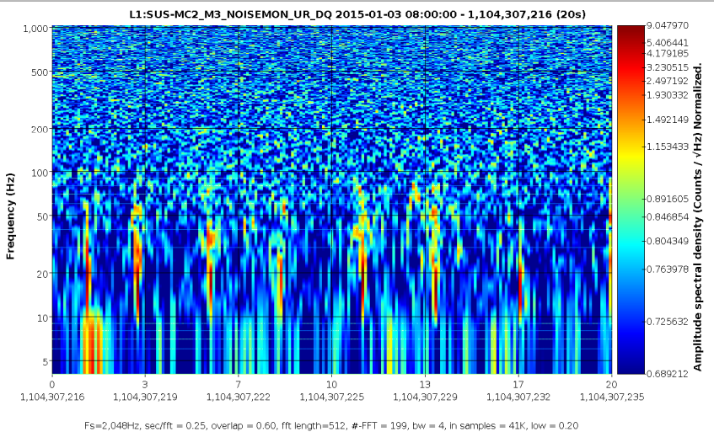
ER6 DAC calibration drift – week 3
LLO alog 16376
Notes:
Creeping back with greater prominence

Slide 34
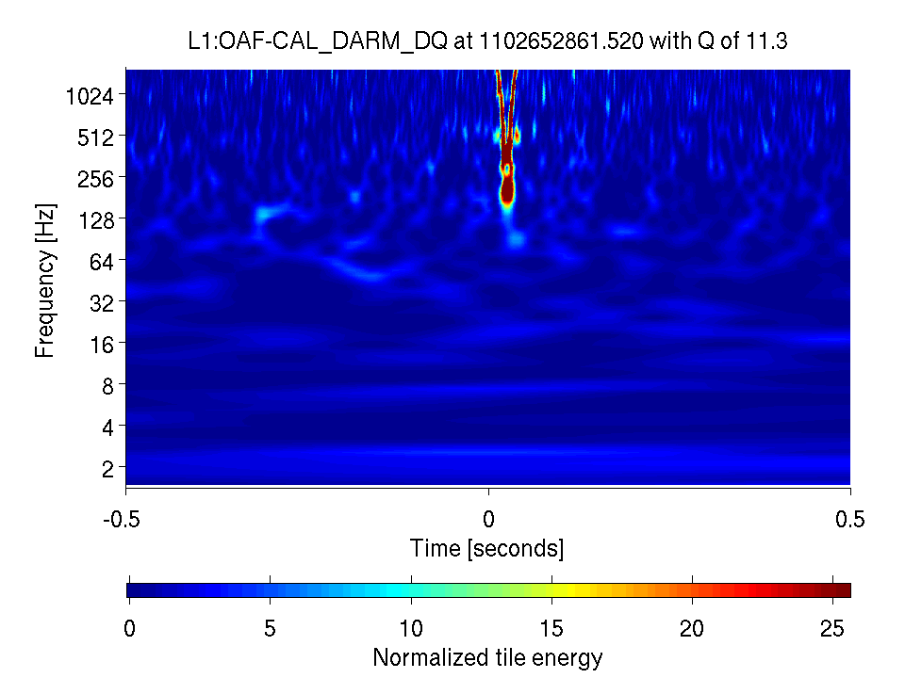
IMC beat frequency
Distinct “whistling” feature stemming from a beat frequency (WRT -817kHz) in the IMC that adversely affected the BBH search in ER6
Summary: LLO alog 16298

Slide 35
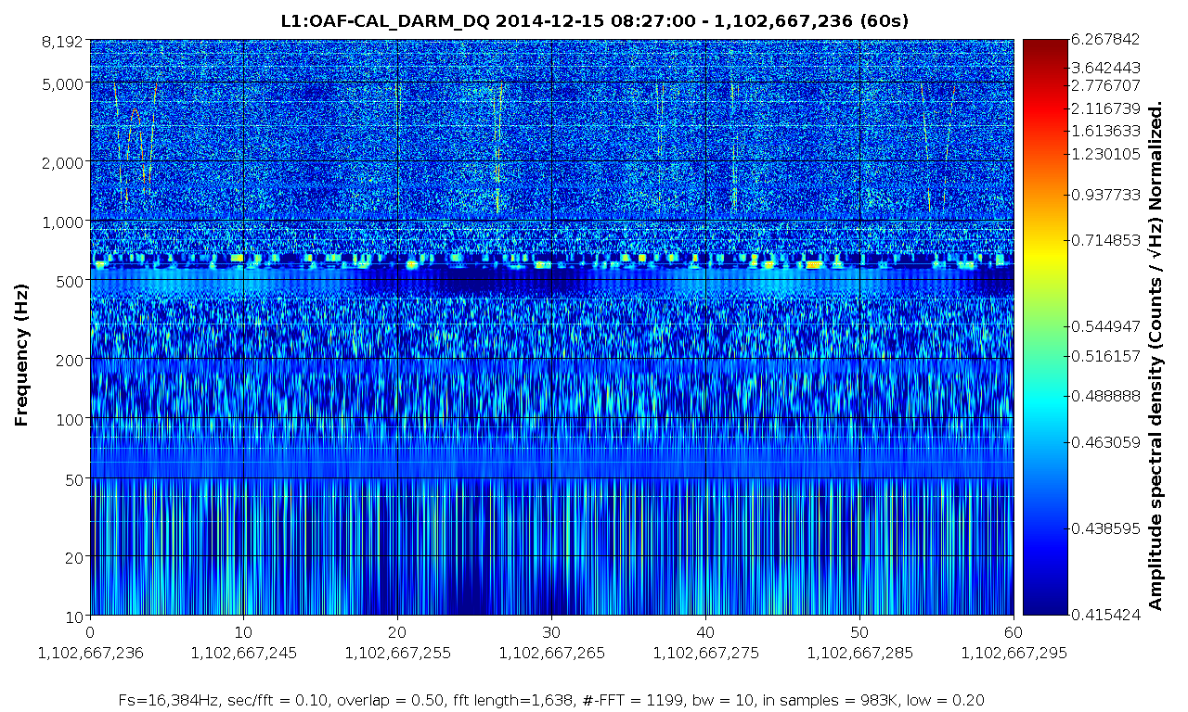
IMC beat frequency

Slide 36
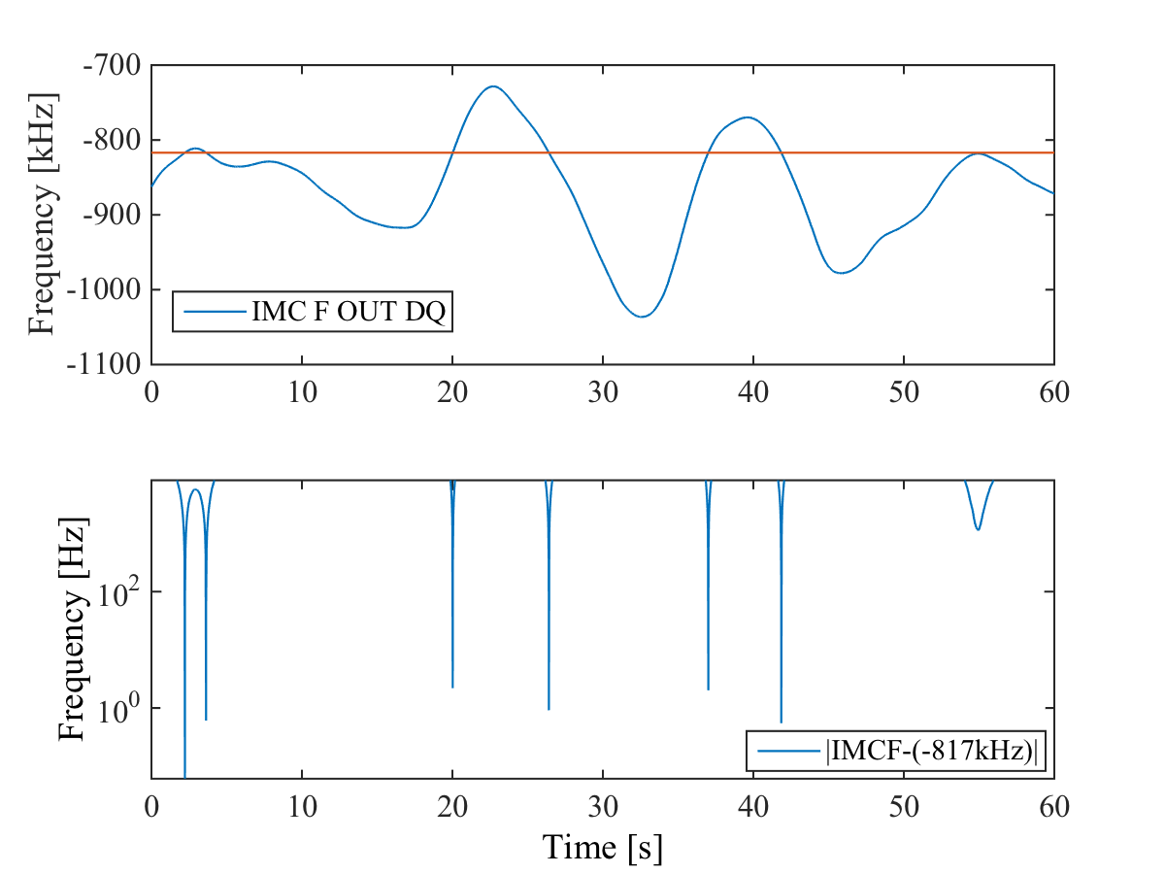
IMC beat frequency
Summary: LLO alog 16298

Slide 37
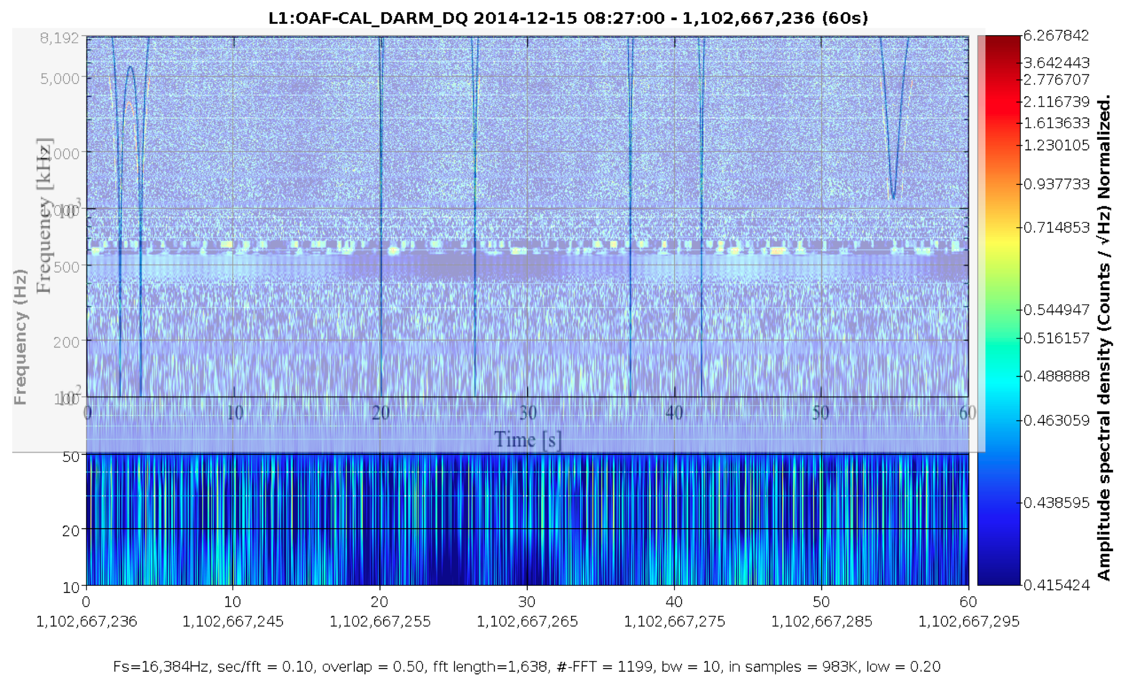
IMC beat frequency

Slide 38
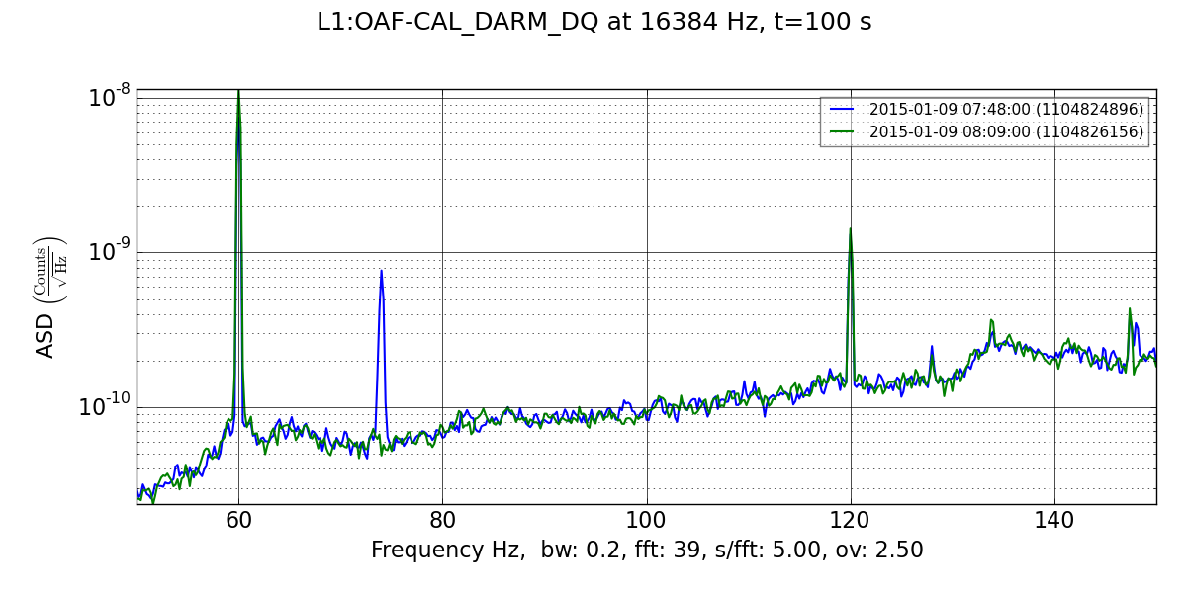
74 (72) Hz line – related to EY ring heater driver
LLO alogs 16316, 16291
Some coupling between the ring heater driver and DARM
Ring heater driver cable is moved (probably un-grounded)
Notes:
Biggest line under 100Hz aside from the power lines during ER6. Made a line of glitches around 74 Hz
Diagnosed with coherence tools

Slide 39
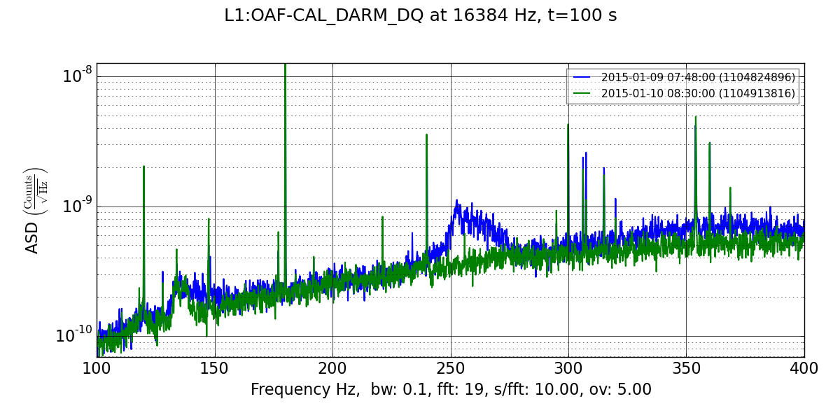
PZT-actuated mirror placement - 250Hz
LLO alog 16331
PZT-actuated mirror mounted on steering periscope
PZT-actuated mirror moved to optic bench
Notes:
Known problem for a long time. Tackled by commissioners during recent noise hunting.
Caused a swatch of glitches centered at 250Hz, especially

Slide 40
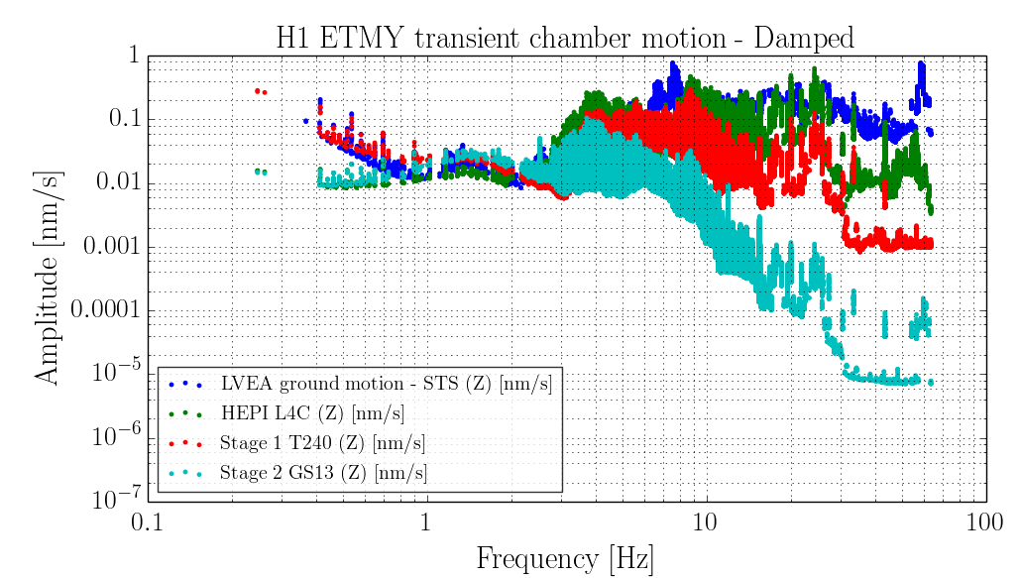
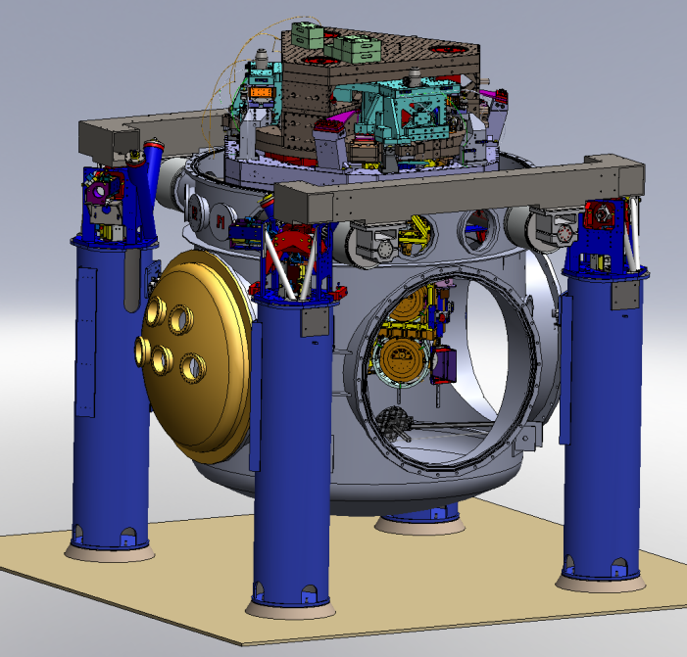
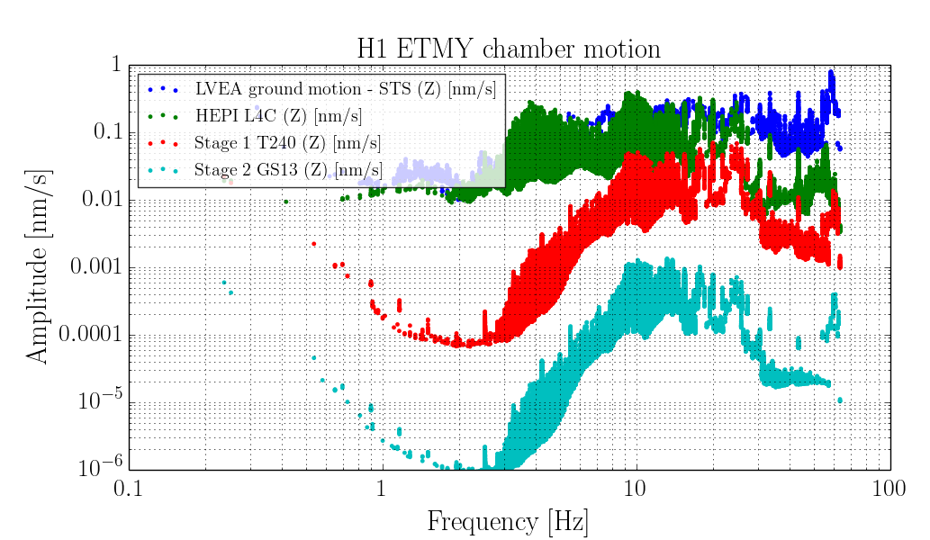
SEI transient propagation
H1 ETMY transient chamber motion – Fully isolated
Tracing the transient motion from the ground to the optic table in various states of isolation loop aggression.
More aggressive isolation mitigates transients well < ~15Hz
Notes:
Study focused on the core optic chambers, have 3 stages of active seismic isolation (4 passive). OPTIC TABLE
Many different isolation configurations were tested, least aggressive and most aggressive state shown

Slide 41
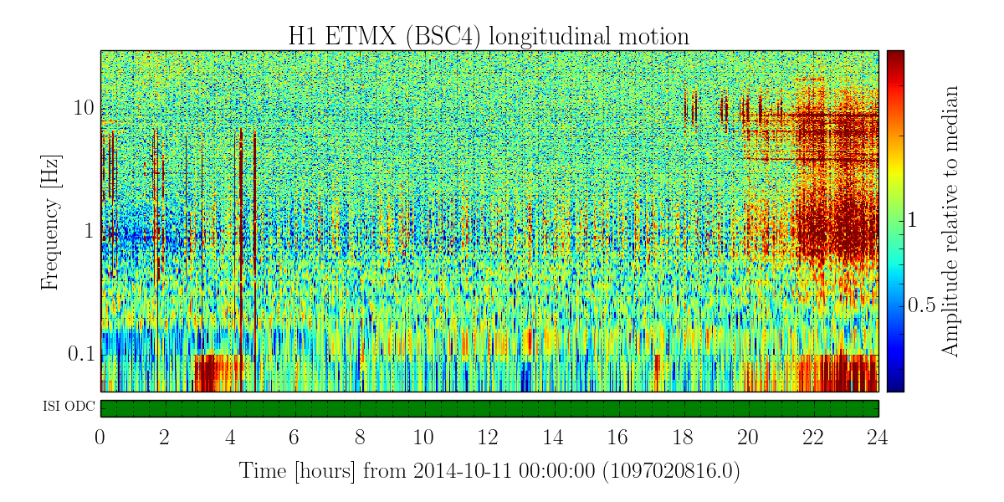
Windy vs. Quiet time transient SEI study at LHO
Most of the day, Oct 11, high microseism, low wind (~5MPH)
Notes:
Left isolation state constant at strongly isolated, and varied input ground motion

Slide 42
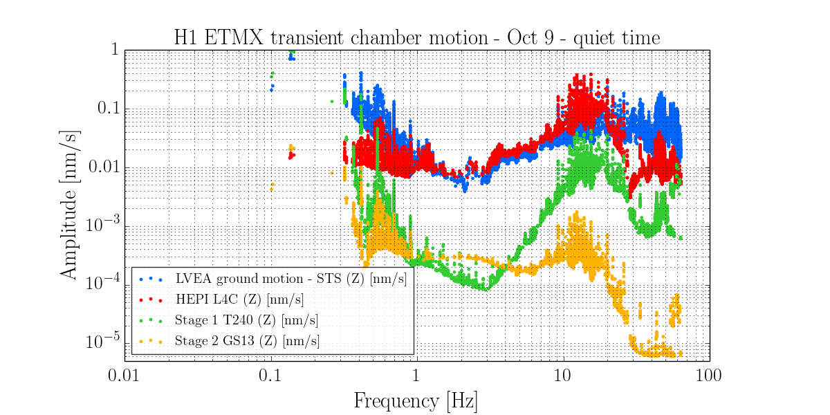
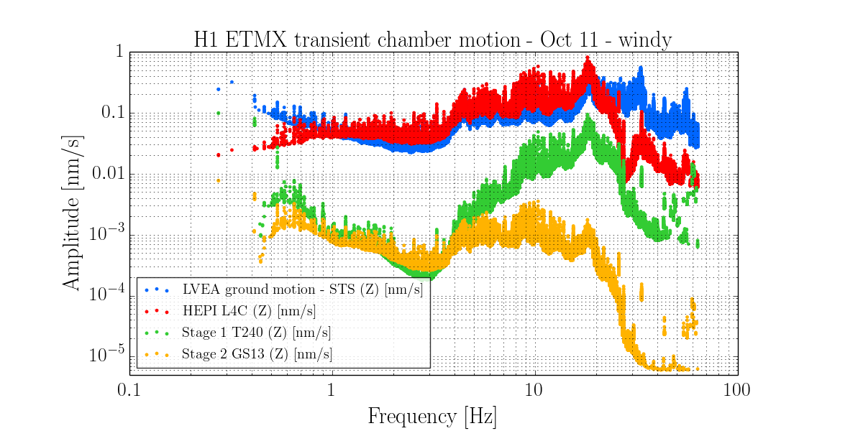
Windy vs. Quiet time transient SEI study at LHO
Most of the day, Oct 11, high microseism, low wind (~5MPH)
After~20:00 UTC, high wind (~30MPH)
Below are Omicron triggers of two hours of “quiet” time (left) and “windy” time (right). Each dot is a transient event. Transient motion amplitude is very elevated during high wind for events of freq < ~30Hz.
Note: these plots show ETMX local ground motion, not LVEA

Slide 43
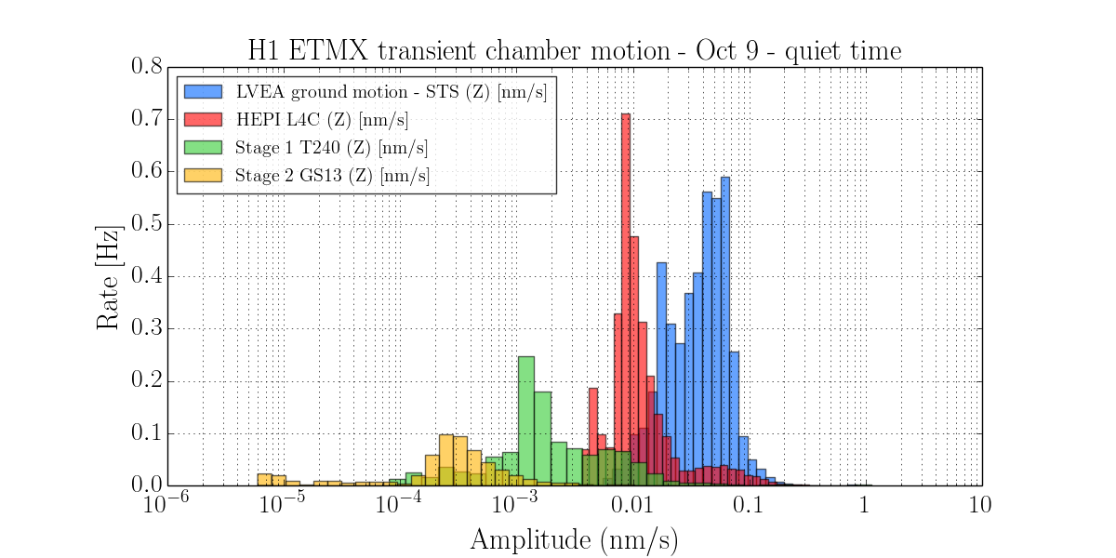
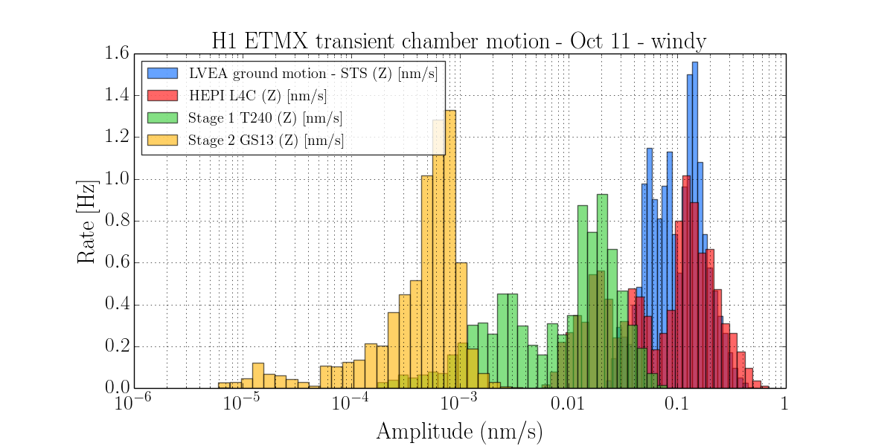
The rate of transient motion events also increases dramatically during windy time – by over a factor of 10 in optic table motion at end X.
Transient rate of 0.5Hz
Stage | Quiet* (# trigs) | Windy* (# trigs) | Factor increase
Ground motion | 30,755 | 116,601 | 3.8
HEPI (L4C) | 21,317 | 74,624 | 3.5
ISI ST1 (T240) | 7,791 | 57,948 | 7.4
ISI ST2 (GS13) | 3,924 | 49,562 | 12.6
* For a two hour period of relatively quiet or windy time
Isolated stages see a much greater increase in the rate of transients than ground motion during windy time.
Transient rate of 1Hz!!
Note: these plots show ETMX local ground motion, not LVEA

Slide 44
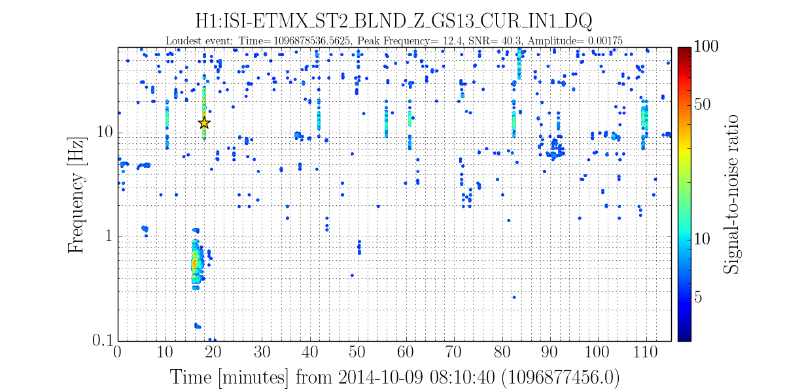
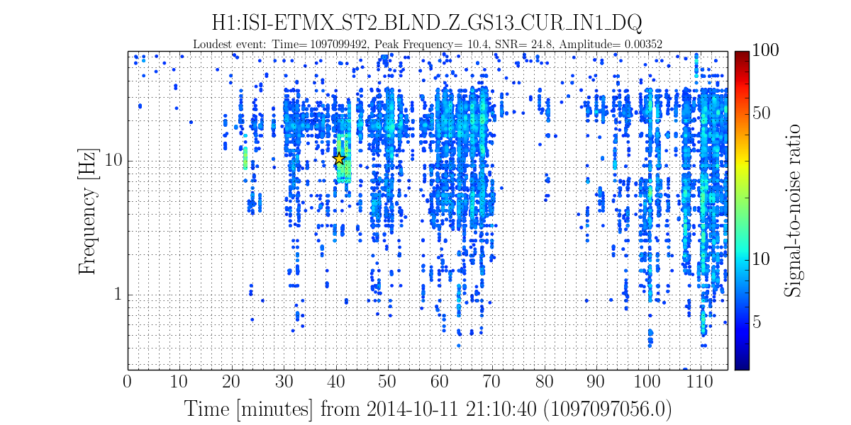
Conclusions for windy vs. quiet SEI transient study:
Ultimately, at the optic table the transient motion amplitude per event isn’t significantly increased above 10-15Hz, but the rate of transients is greatly increased
Oct 9 - Quiet
Oct 11 - Windy
Notes:
ITMY – rate much increased at high freq also

Slide 45
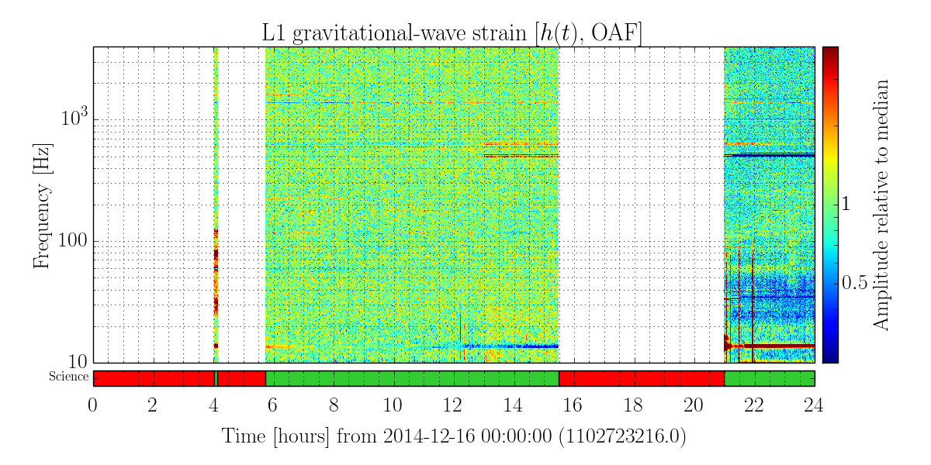
Livingston ER6 -Dec 16 lock
Notes:
Moving onto Livingston – results WITH DARM

Slide 46
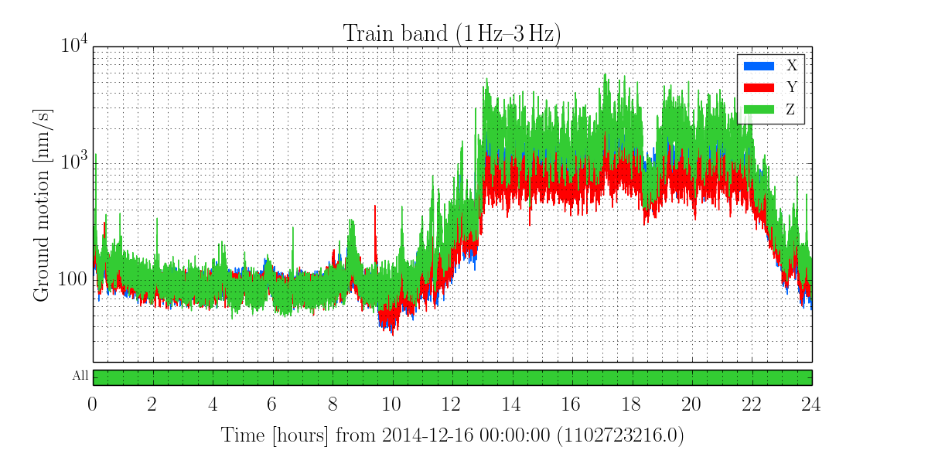
LLO alog 16101: “violin modes appear to be causing high trigger rate in CBC search” (also reported by cWB)

Slide 47
LLO alog 16101: “violin modes appear to be causing high trigger rate in CBC search” (also reported by cWB)
‘Seismically quiet’ time
‘Logging’ time

Slide 48
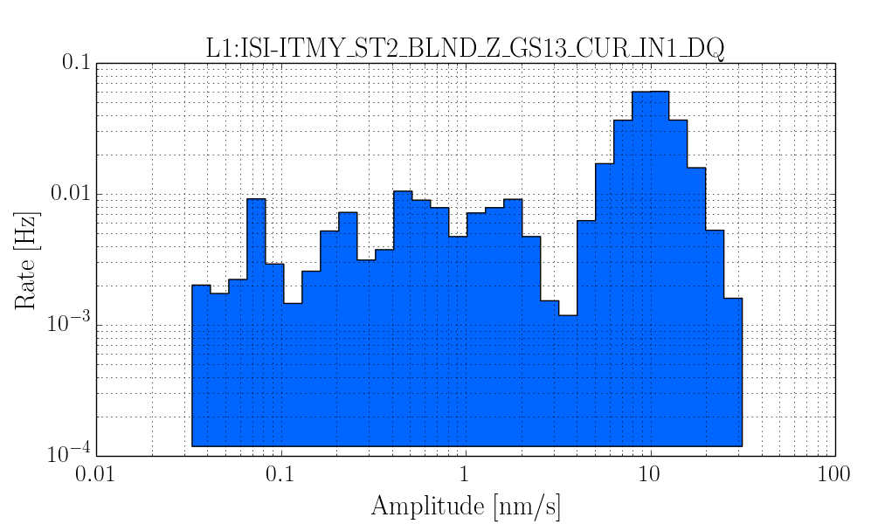
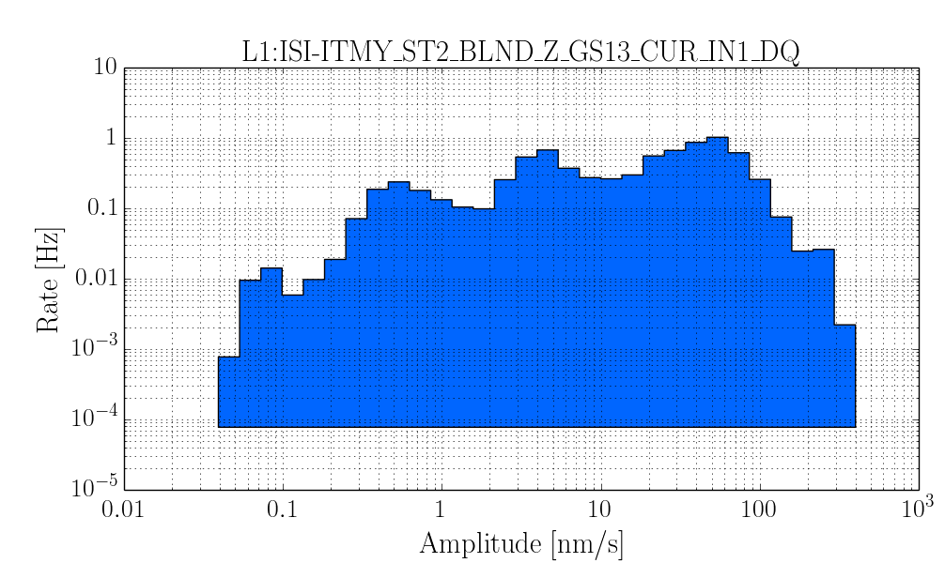
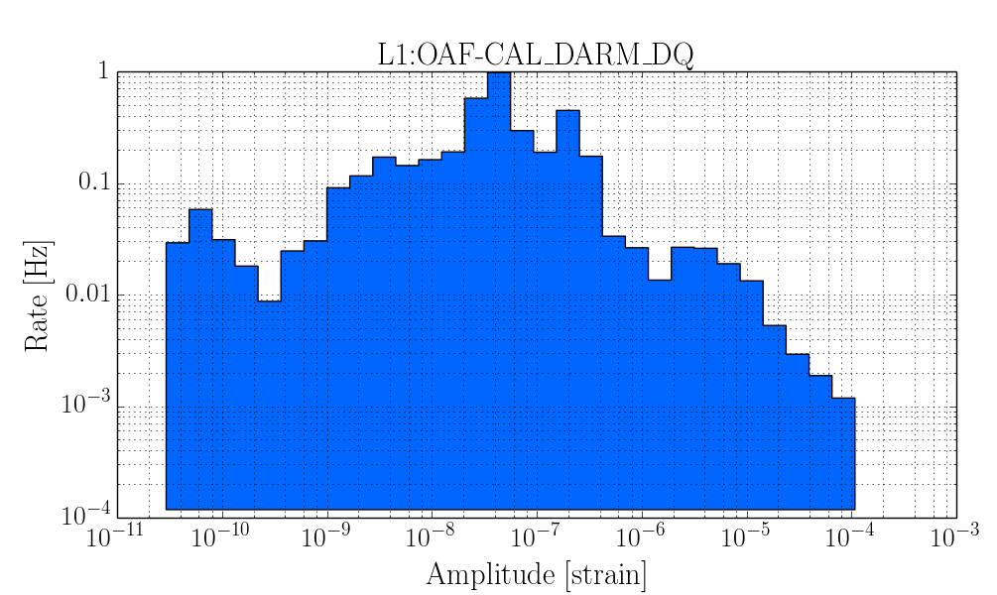
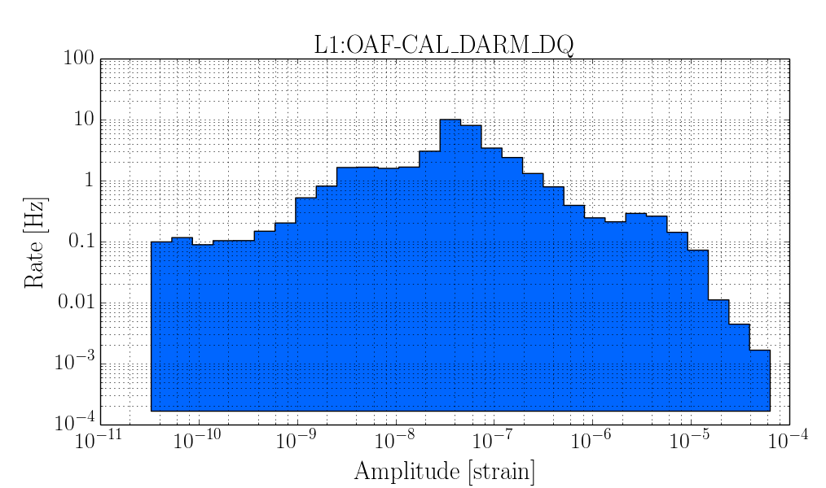
Seismically quiet part of lock
Logging stretch of lock

Slide 49
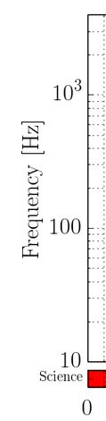
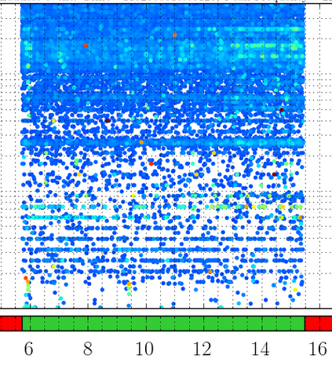
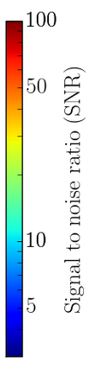
Summary - Dec 16 lock
ER6 glitch rate looked very clean on the whole!
Most features that would affect the transient searches are now understood/resolved

Slide 50
Summary - Dec 16 lock
250 Hz PZT on PSL periscope

Slide 51
Summary - Dec 16 lock
250 Hz PZT on PSL periscope
End Y ring heater driver

Slide 52
Summary - Dec 16 lock
250 Hz PZT on PSL periscope
End Y ring heater driver
MC2 DAC glitching

Slide 53
Summary - Dec 16 lock
IMC beat frequency
250 Hz PZT on PSL periscope
End Y ring heater driver
MC2 DAC glitching

Slide 54
Summary - Dec 16 lock
Seismic-related glitch rate increase

Slide 55
Conclusions
Thanks largely to commissioning efforts, LLO data looks GREAT! Greatly improved glitch rate compared to August.
Already characterizing Hanford at a subsystem level.
Other noise features that are troublesome to the transient searches will undoubtedly surface as the ifos evolve and commissioners dig into the noise floor.
Detchar has very good handle on potential DQ features that would most affect the search backgrounds.
Notes:
Dec 14 lock – 40Mpc had cleanest glitch rate, definitely better than S6, which which had clustered triggers of SNR 5 or greater at about 1Hz or a little more
This was down to almost half a Hz, some SNR > 20 outliers
Noise hunting lists for detchar (the searches) and commissioners are converging (list in control room)

