Slide 1
T1400698 - Vacuum Beam tube FEA notes:
Scope:
- Will the back scattering form the vacuum beam tube be a dominant noise at certain frequency?
- If yes, how to mitigate the problem?
To help answering these questions, a FEA model of the beam tube and its support structure has been made. Static analysis have been performed to see if the static compliance of the model is in agreement with expected values and measurements.
Modal analysis have been carried out to predict the shapes of the beam tube deformation.
Contents:
Page 2 summarize Robert’s preliminary analysis and gives key numbers (frequencies, stiffness, tube mass..)
Pages 2 to 6 present the finite element model
Pages 6 and 8 present a refined model
Pages 9 to 13 is on tubes modeling to assess the quality of the overall model
Pages 14 to 21 is on the modeling of the compliance of the electric insulators
Pages 21-22 is on the modeling of the bellows
Page 23 shows a static analysis of a full section
Page 24 gives conclusion

Slide 2
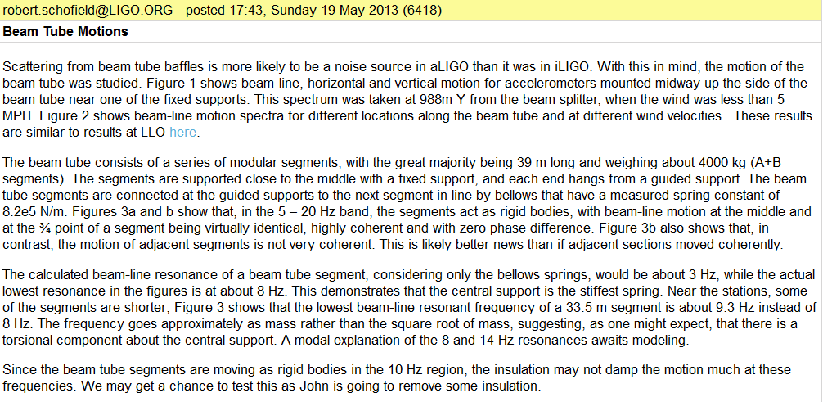
Robert’s analysis:

Slide 3
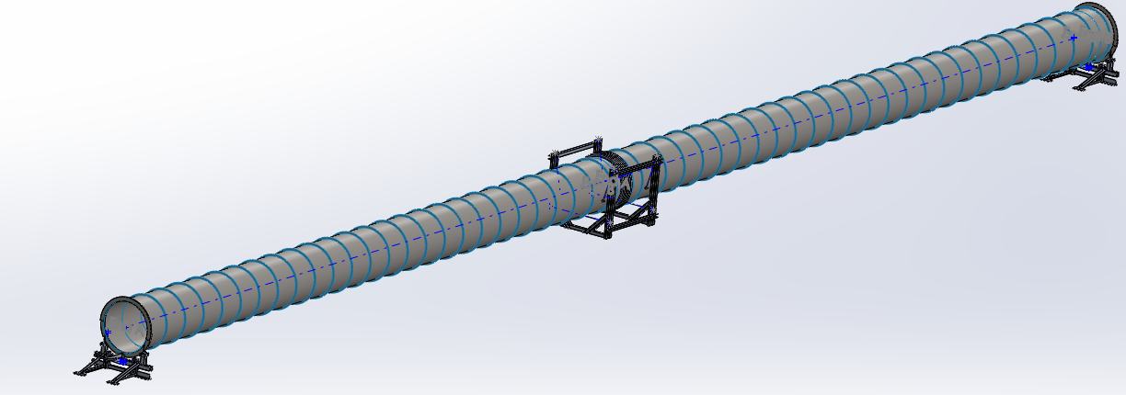
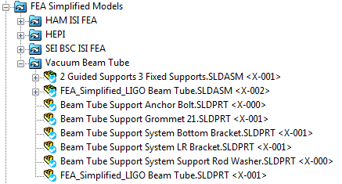
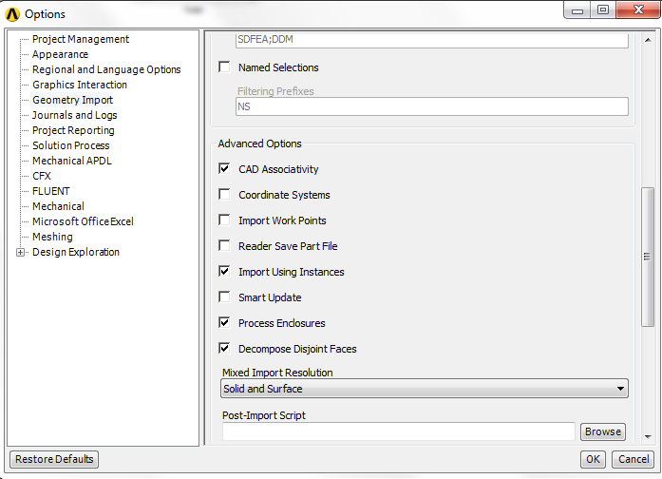
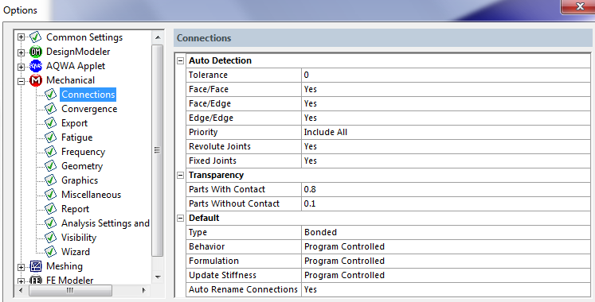
1. Model Overview
1.1 Model Description
CAD Model and import settings:

Slide 4
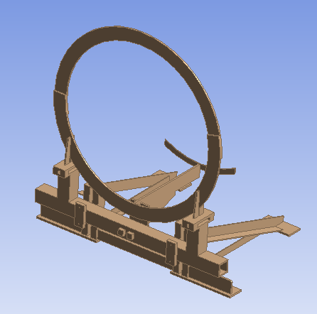
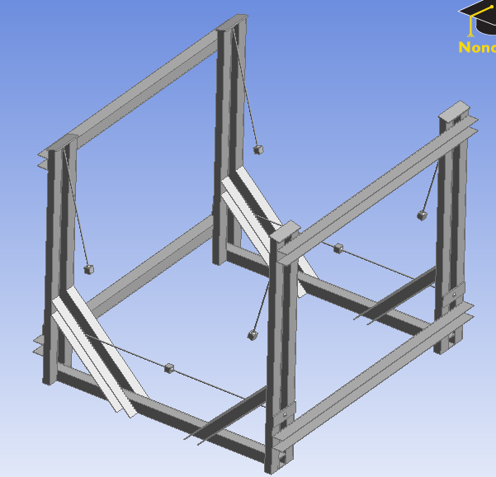
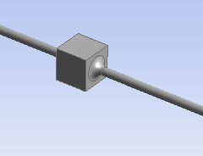
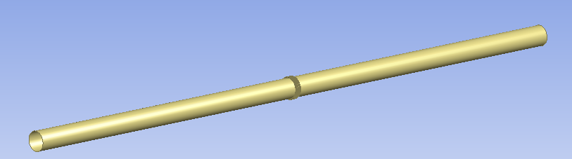
1.1 Model Description
Sub-assemblies:
Fixed and guided support: 3D elements
Beam tube, bellows and stiffening rings (not represented): shell elements

Slide 5
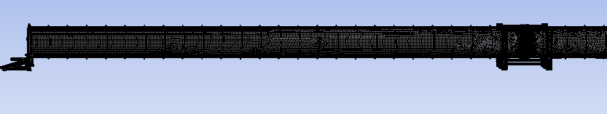
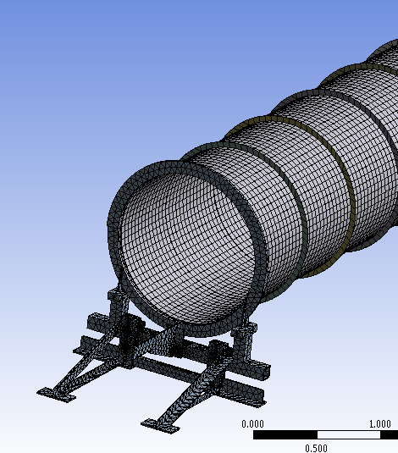
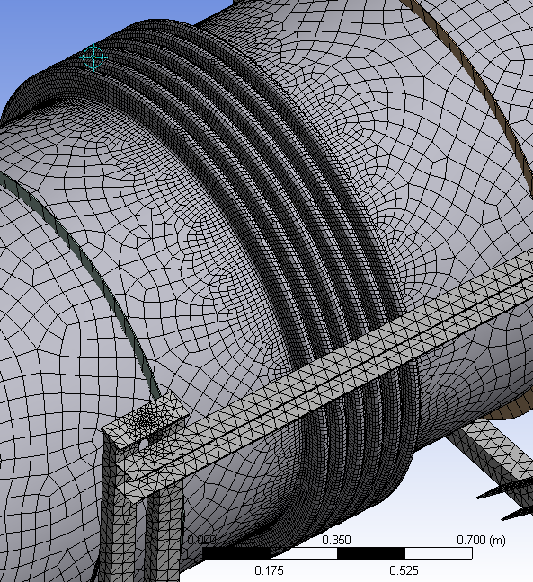

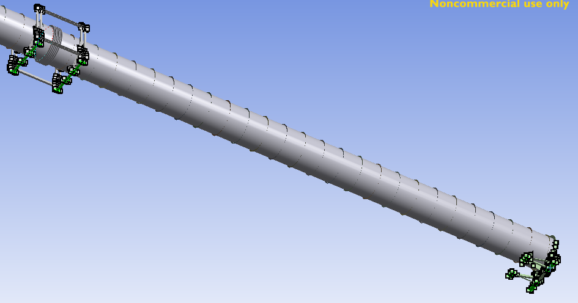

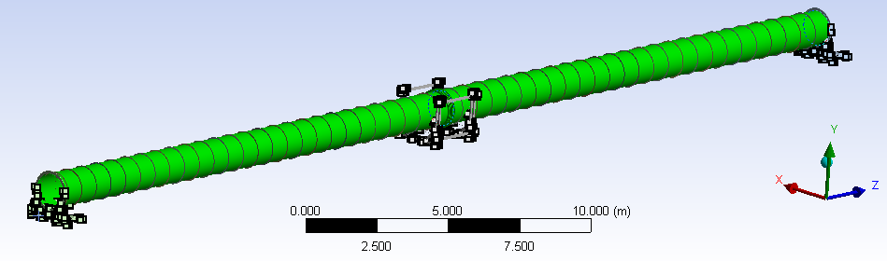
1.1 Model Description
Meshing:
Boundary conditions: bottom faces of clamped and guided support are clamped.
Properties check:

Slide 6
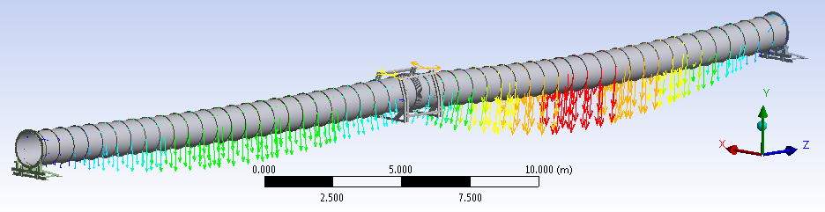
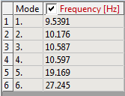
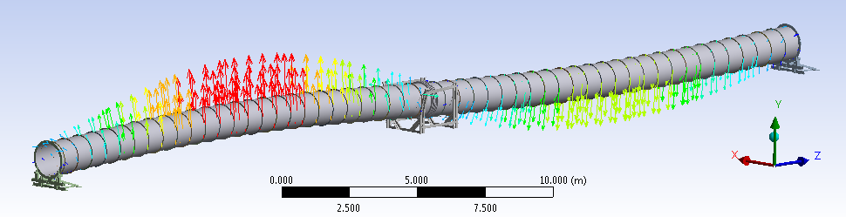
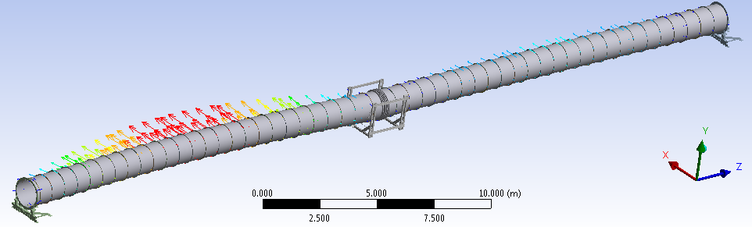
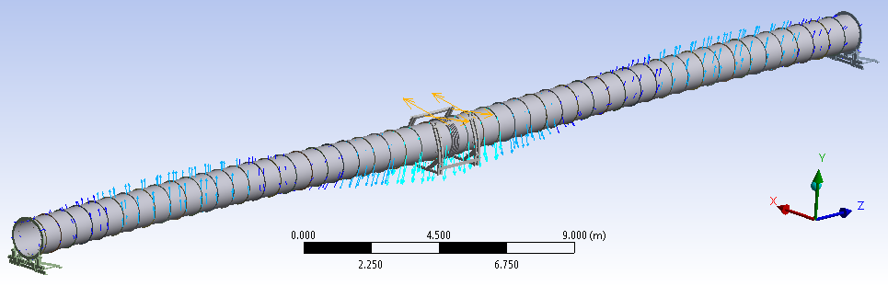
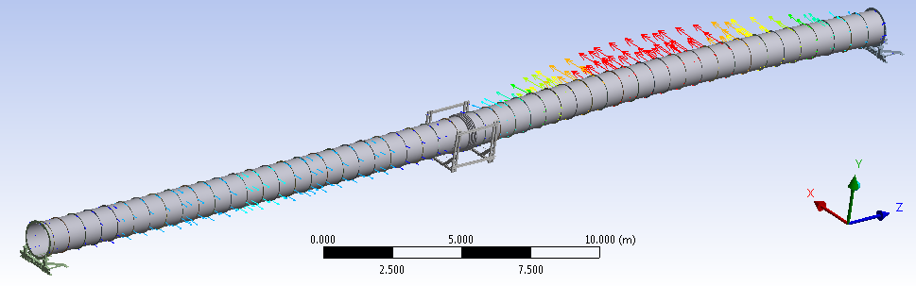
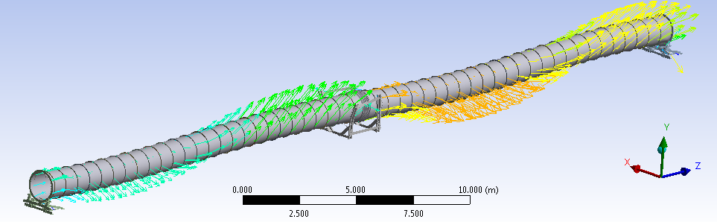
1.2 Modal Analysis Results
Mode 1
Mode 2
Mode 3
Mode 5
Mode 4
Mode 6

Slide 7
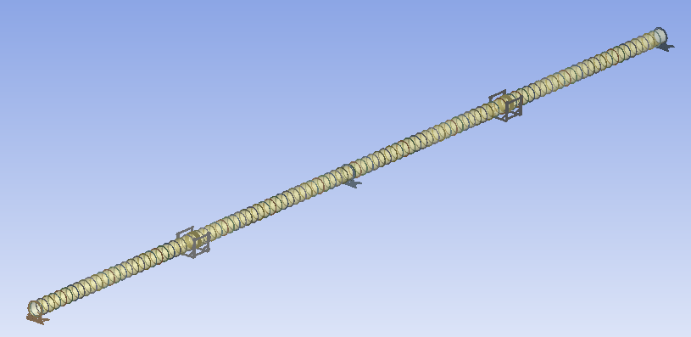
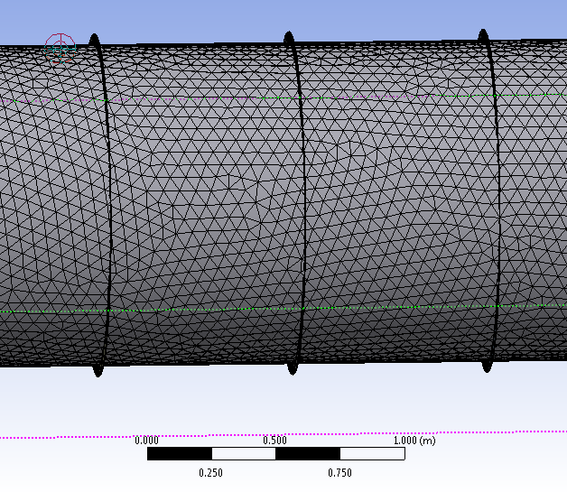
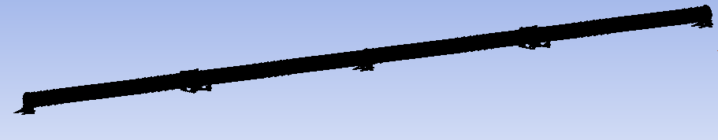
2. Refined Model
Questions about the first model / objectives for the refined model:
- Stiffening effect from contacts elements?
- Can we mesh it all solid?
- Gravity/pre-stress effects in cables?
- Longitudinal modes, bellows stiffness?
Two Sections:
Meshing…
Way longer to mesh/solve than a single section (had not completed after several hours)

Slide 8
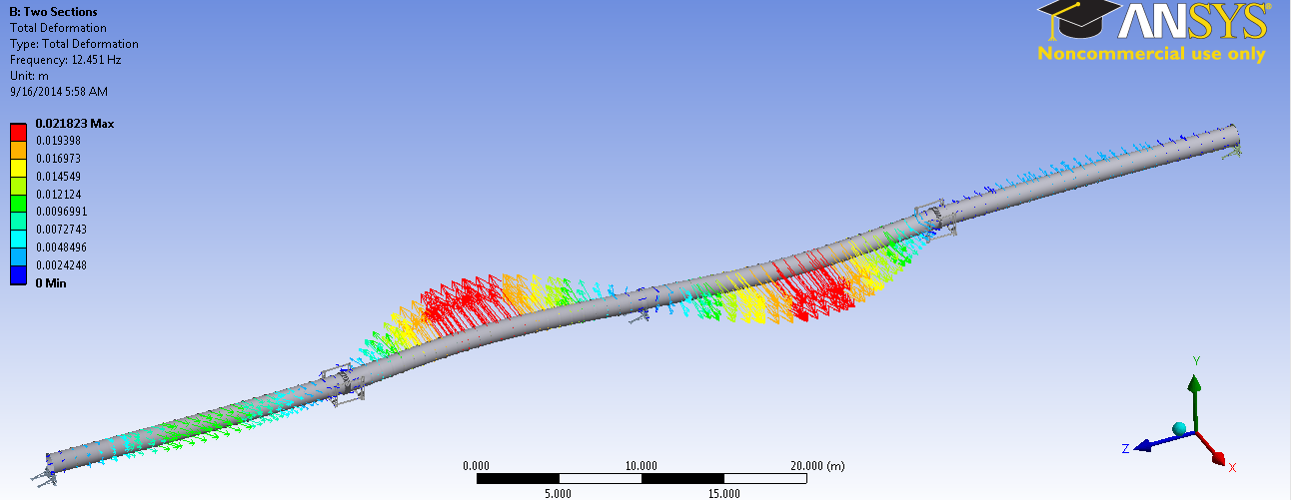
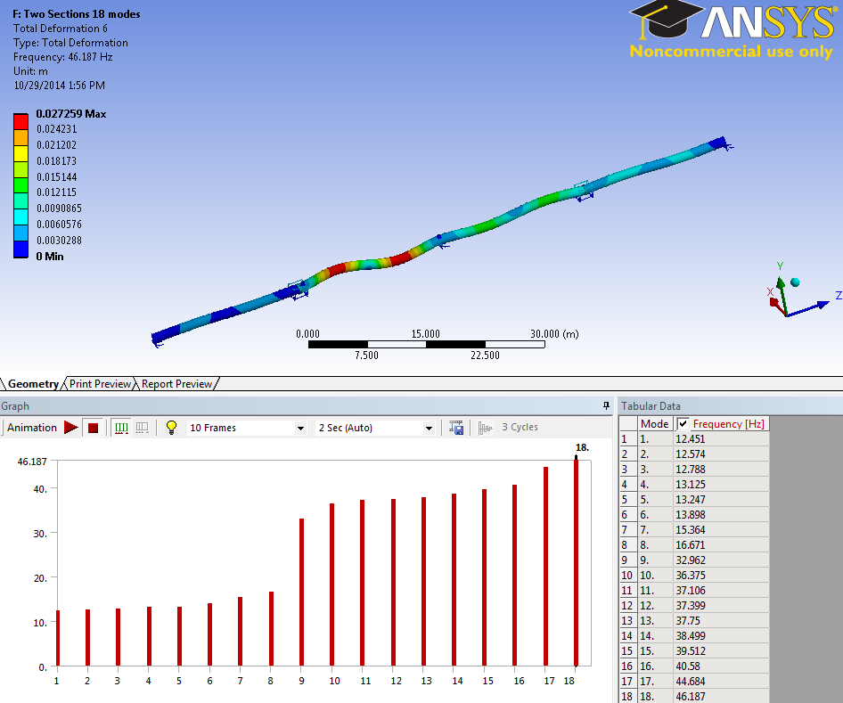
2. Refined model results
12.4 Hz
46.2 Hz

Slide 9
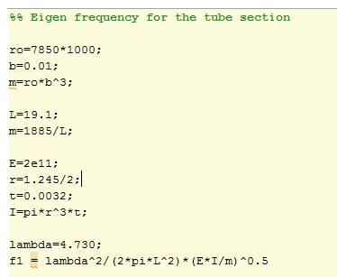

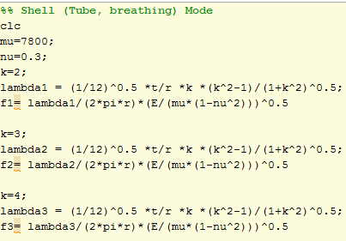
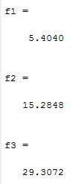
3. Tubes Modeling
3.1 Bending and breathing modes
Tube bending mode: analytical eigen frequency (Blevins)
Breathing mode
Cylindrical shells of infinite length (Blevins )

Slide 10
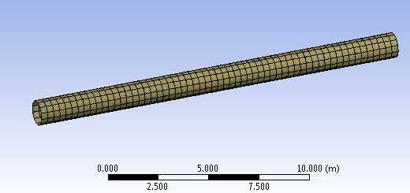
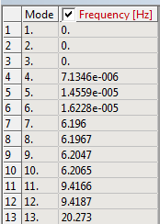
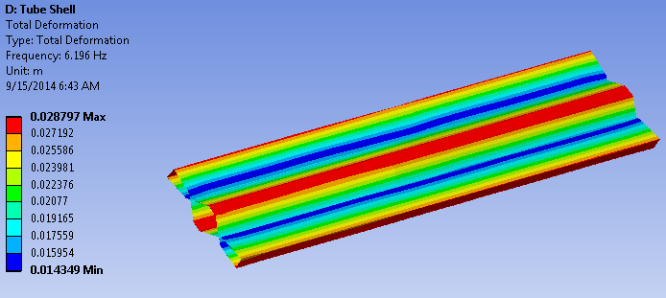
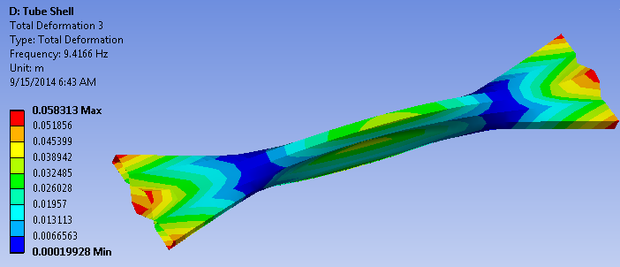
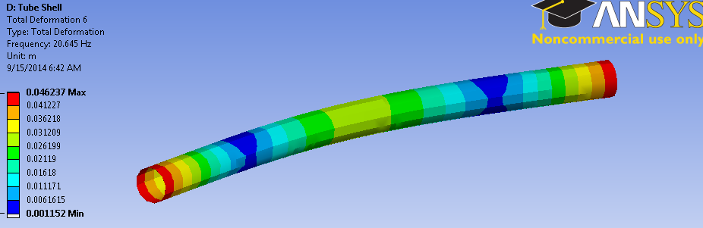
3.1 Bending and breathing modes
Using shell Elements

Slide 11
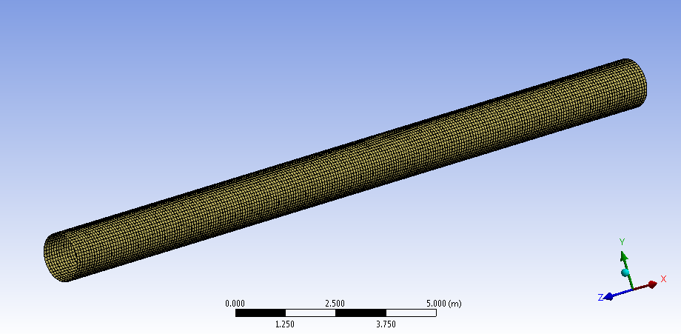

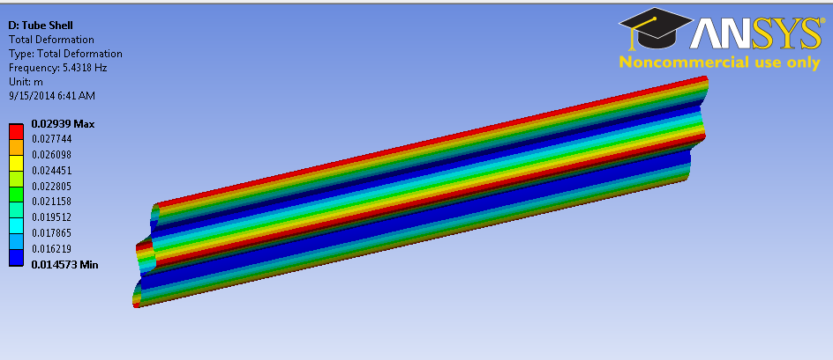
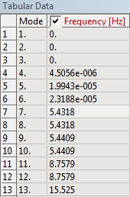
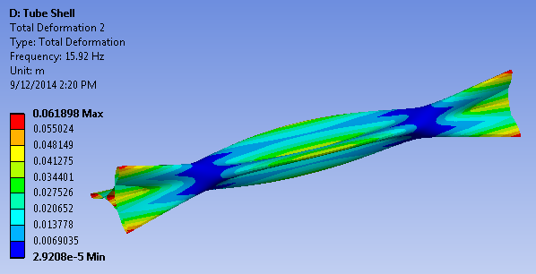
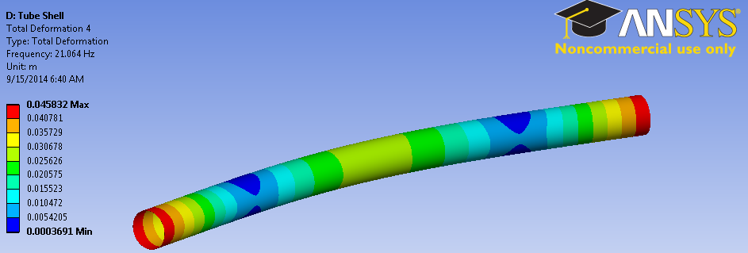
3.1 Bending and breathing modes
Thinner Meshing (Shell)

Slide 12
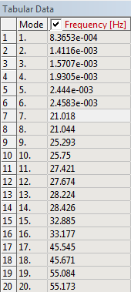
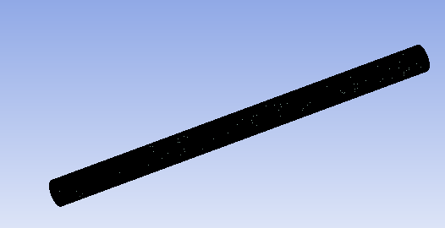
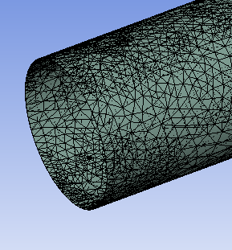
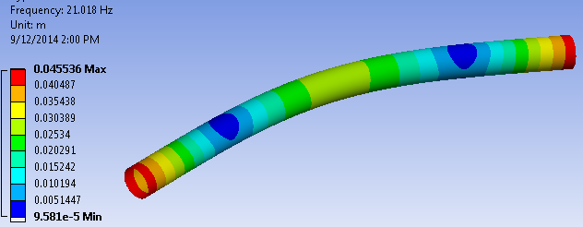
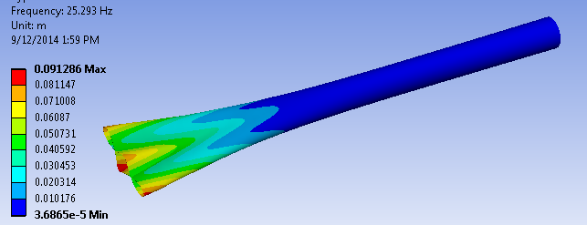
3.1 Bending and breathing modes
Solid Elements
Breathing mode not Predicted by the solid meshing

Slide 13
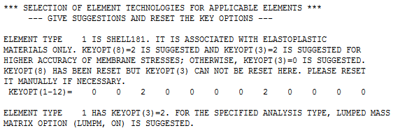
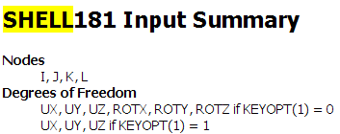
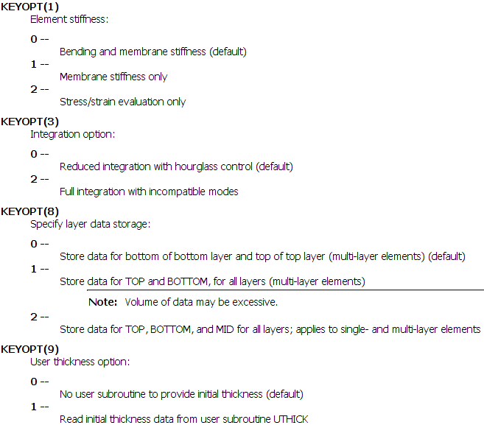
3.1 Bending and breathing modes
ANSYS Structural Analysis Guide:
http://orange.engr.ucdavis.edu/Documentation12.1/121/ans_str.pdf

Slide 14
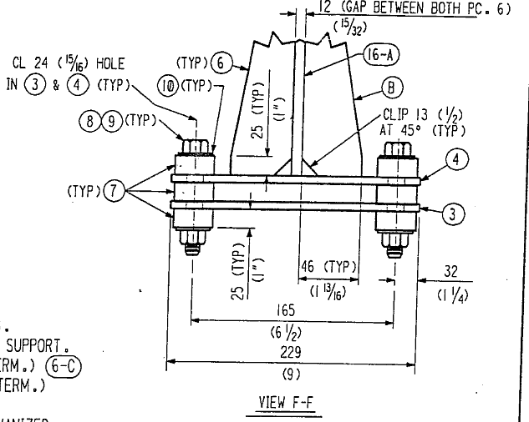
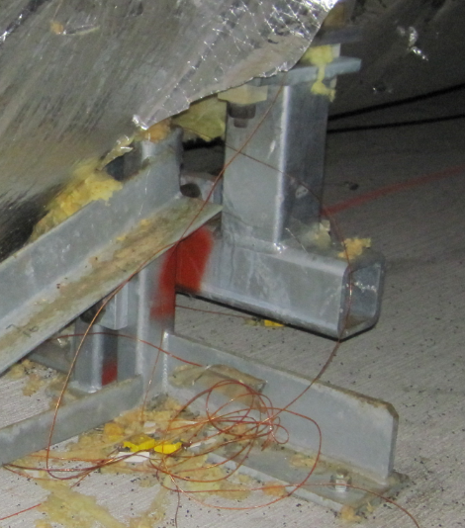
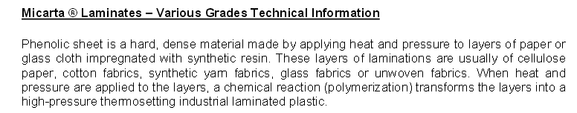
4. Including the “Micarta Block“
http://www.professionalplastics.com/professionalplastics/MicartaGrades-DataSheet.pdf

Slide 15


4. Including the “Micarta Block“

Slide 16

E = 3000 kpsi ~ 20,000 Mpa

Slide 17


Slide 18



Fixed Support Monolithic
k = F/x ~ 1e7 N/m

Slide 19



Shear Stiffness of a Micarta block (no holes first, to check with shear stress formula)
Analytical shear behavior:
Gamma=tau/G
G=E/2/(1+nu)
Tau =F/A
x= gamma * h
-> F = (A*G / h) * x
E = 20,000 Mpa
Nu=0.3
A=44mm*44mm
H=25 mm
k=5.96e8 N/m
k = F/x ~ 3.2e8 N/m
With hole
k = F/x ~ 1.56e8 N/m

Slide 20



Fixed Support with insulator still modeled with steels, but as independent parts. Contact elements between the insulators and the brackets. Check we get the same results as with the monolithic structure.
76 contacts…
9.02e-8m compared to 9.02e-8 for the monolithic steel structure -> similar result

Slide 21




5. Bellows stiffness
5.1 Using shell elements
k = F/x ~ 3.7e6 N/m
Got same results with twice many elements
(40,000 elements to 80,000 elements)

Slide 22





5. Bellows stiffness
5.2 Using solid elements
First Model:
k = F/x ~ 9.7e6 N/m
Meshing too coarse?
Thinner mesh:
300,000 elements
k = F/x ~ 3.7e6 N/m
Same results as with the shell meshing.

Slide 23



6. Static Model
Robert: “the pusher rod is attached to the bottom center of the 3rd stiffening ring from the fixed support. I had no load cells, only accelerometers, so no force measurements.”
Static FEA:
4.6e7 N/m

Slide 24
Conclusion / summary:
- The finite element models predict the bellow’s stiffness to be approximately 3.7e6 N/m.
Some stiffness measurements of the bellows are reported in LIGO document “E960123 Beam Tube Bakeout Design Requirements Document”. The document reports a mean value of 4677 lb/in (page 14). This translates into 8.2e5 N/m, which is about four times lower than the finite element results.
Robert had a look at the spare section of bellow that is seating on the LHO parking lot (mostly to check the thickness). He found an engraved value indicating a stiffness approximately twice higher than what is reported in E960123. That is still lower than what the FEA predicts.
The report E960123 states that “these spring constants have been corrected for the Hyspan calibration error in reporting the original data”, but it does not provide further details.
The finite element model predict the longitudinal stiffness of the assembly to be approximately 5e7 N/m. The analysis shows that electrical insulators (Micarta G10) should not contribute much to the overall compliance, assuming that they are perfectly bounded (enough preload in the joints).
- The finite element model (several sections of bean tubes, guided and fixed supports) does not predict any pure longitudinal mode. All the modes predicted involve a great amount of bending of the tubes. So either the full model over constrains the longitudinal motion, or the measurements underestimate the bending contribution of the tube.

