Slide 1
Higher order laser modes in gravitational wave detectors
LIGO-G1401391-v1
Koji Arai – LIGO Laboratory / Caltech

Slide 2
Higher order laser modes
Longitudinal sensing and control
  Plane wave calculation was sufficient
Alignment, mode matching, mode selection
  higher order modes need to be taken into account

Slide 3
Eigenmodes of the lasers
Solution of Maxwell’s equation for propagating electromagnetic wave under the paraxial approximation
=> Laser beams change their intensity distributions and wavefront shapes as they are propagated
=> Any laser beam can be decomposed and expressed
as a unique linear combination of eigenmodes
In this sense, a (given) set of eigenmodes are ortho-normal basis

Slide 4
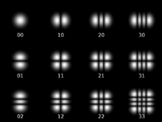
Hermite Gaussian modes
HG modes (TEM mods) : one example of the eigenmodes
A. E. Siegman, Lasers, University Science Books, Mill Valley, CA (1986)
H. Kogelnik and T. Li, Appl. Opt. 5 (1966) 1550-1567
Wikipedia http://en.wikipedia.org/wiki/Transverse_mode

Slide 5
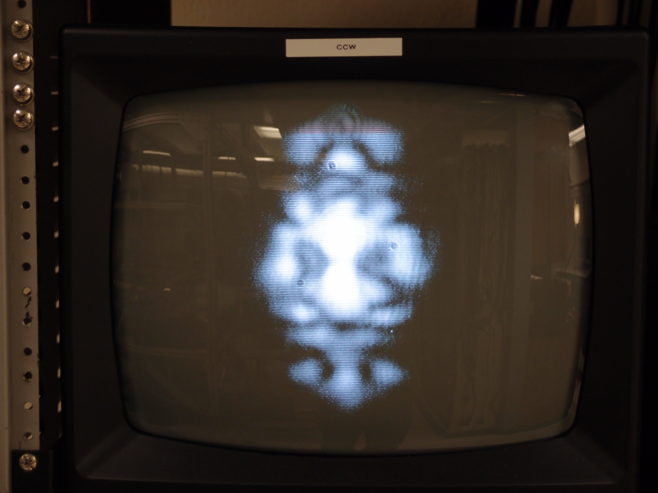
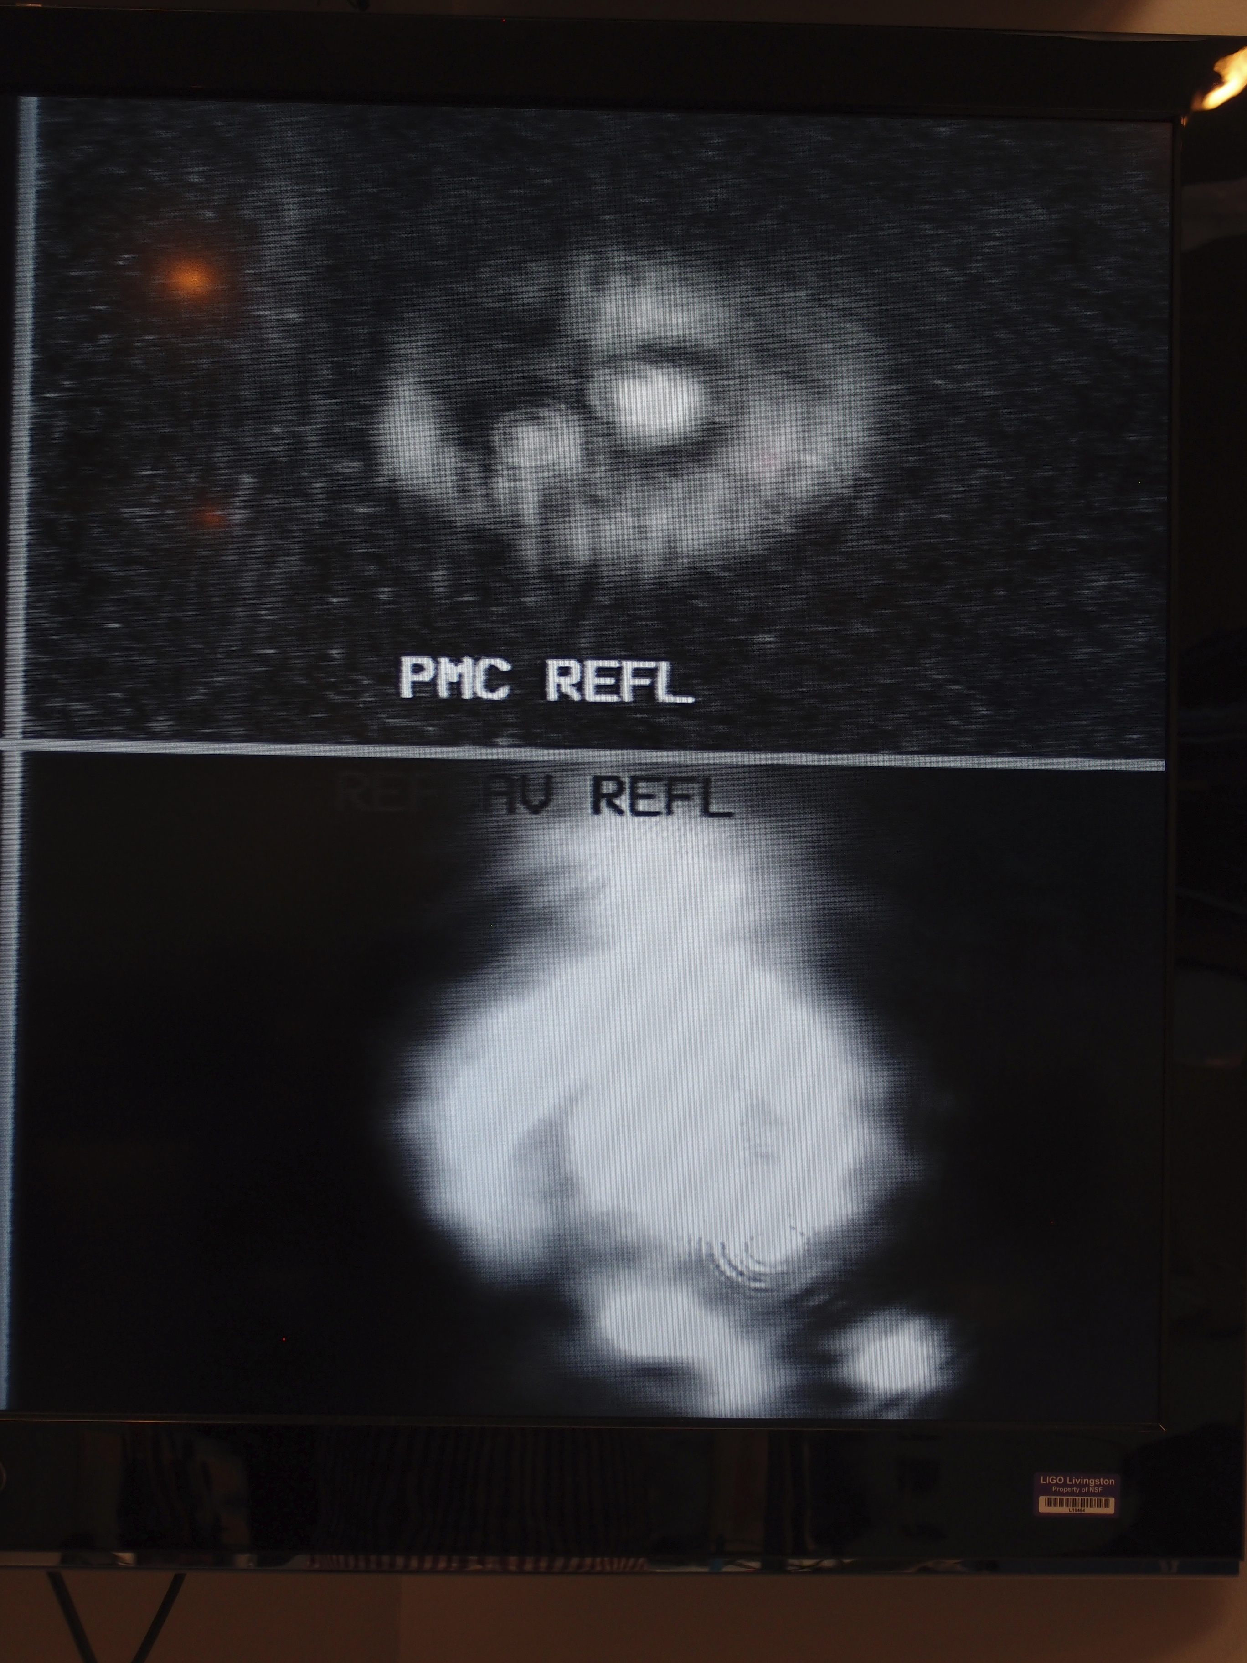
Any beam can be decomposed...
Astronaut
World cup football

Slide 6
Hermite Gaussian modes (TEM modes)
Trivia
There are infinite sets of HG modes
  A TEM00 mode for an HG modes can be decomposed into infinite modes
  for other HG modes
The complex coefficients of the mode decomposition is invariant
along the propagation axis
  Where ever the decomposition is calculated, the coefficients are unique.
No matter how a beam is decomposed, the laser frequency stays unchanged!
(sounds trivial but frequently misunderstood)

Slide 7
Useful to note
Beam size at z
Wavefront curvature at z
Gouy phase
Rayleigh range
cf. Huygens’ principle

Slide 8
Gouy phase shift
Gouy phase shift:
Relative Phase shift between the transverse modes
  Different optical phase of the modes for the same distance
  => Different resonant freq in a cavity (will see later)
  “Near field” and “Far field”

Slide 9
Decomposition of misaligned modes
Lateral shift:
Rotational shift:
K. Kawabe Ph.D thesis: http://t-munu.phys.s.u-tokyo.ac.jp/theses/kawabe_d.pdf

Slide 10
“Cavity” eigenmodes
TEM modes with matched wavefront RoC
A. E. Siegman, Lasers, University Science Books, Mill Valley, CA (1986)

Slide 11
“Cavity” eigenmodes
Due to different Gouy phase shifts between TEM modes,
their resonant frequencies are different
fFSR = c/2L
fTMS = fFSR x ζ/(2 pi)
ζ: cavity round trip Gouy phase shift
A. E. Siegman, Lasers, University Science Books, Mill Valley, CA (1986)

Slide 12
Optical resonator stability
g-factors
Stability criteria
A. E. Siegman, Lasers,
University Science Books,
Mill Valley, CA (1986)

Slide 13
Optical resonator stability
General case
The cavity is stable when this quantity ζ exists
T1300189 “On the accumulated round-trip Gouy phase shift for a general optical cavity” Koji Arai https://dcc.ligo.org/LIGO-T1300189

Slide 14
Cavity alignment
To match the input beam axis and the cavity axis
Corresponds to the suppression of TEM01/10 mode in the beam with regard to the cavity mode
4 d.o.f.: (Horizontal, Vertical) x (translation, rotation)
Note: it is most intuitive to define the trans/rot at the waist
To move the mirrors or to move the beam?

Slide 15
Cavity mode matching
To match the waist size and position of the input beam to these of the cavity
Corresponds to the suppression of TEM02/11/20 mode in the beam with regard to the cavity mode

Slide 16
Angular global control
Wave Front Sensing
  Misalignment between the incident beam and the cavity axis
  The carrier is resonant in the cavity
  The reflection port has
    Prompt reflection of the modulation sidebands
    Prompt reflection of the carrier
    Leakage field from the cavity internal mode
spatially distributed
amplitude
modulation
no signal
E Morrison et al Appl Optics 33 5041-5049 (1994)

Slide 17
Angular global control
Wave Front Sensing
  WFS becomes sensitive
  when there is an angle between
  the wave fronts of the CA and SB
  Can detect rotation and translation
  of the beam separately,
  depending on the “location” of the sensor
  Use lens systems to adjust the “location” of the sensors.
  i.e. Gouy phase telescope
Sensitive at the far field
Sensitive at the near field

Slide 18
Angular global control
Frequent mistake:
What we want to adjust is the accumulated Gouy phase shift!
Not the one for the final mode!

Slide 19
Angular global control
aLIGO implementation:
Separate Gouy phase of a set of two WFSs with 90 deg

Slide 20
aLIGO angular control
Combine WFS, DC QPD, digital CCD cameras

Slide 21
Other topics
PRC/SRC Degeneracy
Sigg-Sidles instability & alignment modes
  G0900594
Impact on the noise
  G0900278 / P0900258
Parametric Instability
  HOM in the arm cavity
  ->Rad Press.
  ->Mirror acoustic mode
  ->Scattering of TEM00->HOM

