Slide 1
Interferometer Length Sensing in Gravitational Wave Detectors
LIGO-G1401386-v1
Koji Arai – LIGO Laboratory / Caltech

Slide 2
Global control
Interferometer control using the main laser beam
  On the top of the local control,
  optical path lengths and the mirror alignment
  need to be kept at the most sensitive state of the interferometer

Slide 3
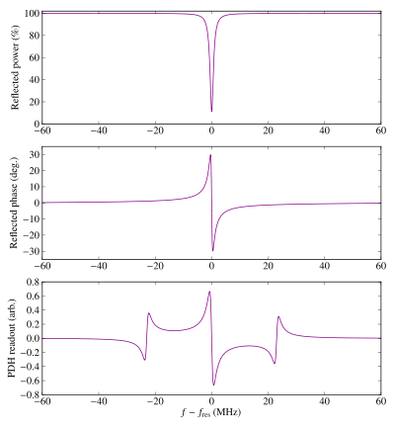
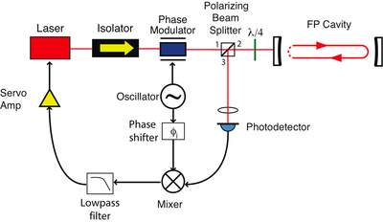
Cavity length control
Pound-Drever-Hall (PDH) technique
  We want to keep the cavity at the TOP of the resonance
  Phase of the cavity reflection is linear to the cavity detuning
  Use modulation / demodulation
  Cavity
  Ref Power
  Cavity
  Ref Phase
  PDH
  Error signal
  Detuning
Drever, R. W. P., et al Appl Phys B 31 97-105 (1983)
http://en.wikipedia.org/wiki/Pound%E2%80%93Drever%E2%80%93Hall_technique
http://www.sjsu.edu/faculty/beyersdorf/Archive/Phys208F07/Sideband%20generation%20in%20LIGO.pdf

Slide 4
Modulation
Phasor diagram

Slide 5
Modulation
Modulation sidebands
  Phase modulation Amplitude modulation

Slide 6
Modulation
Phasor diagram vs Sideband picture
2nd order? 3rd order?
sidebands rotate
at the rate of 𝜈_{m}
total field shows phase modulation at 𝜈_{m}

Slide 7
Modulation
Time dependent electric field vs Sideband picture
They are equivalent!

Slide 8
Modulation
Note: Photodetectors don’t feel phase modulation!

Slide 9
Modulation
Two quadratures of PM
Two quadratures of AM
Relationship between PM and FM (freq modulaition)

Slide 10
Demodulation
RF x LO & LPF
Two demodulation quadratures (I&Q)

Slide 11
RF detection ~ Interferemeter LSC
Use the interferometer as PM-AM converter

Slide 12
Pound Drever Hall technique
Sideband picture
  Carrier experiences “fast phase change” depending on the length of the interferometer

Slide 13
Pound Drever Hall technique
Phasor picture
  Reflected field on Resonance Detuned
carrier phase shift
total field only has
phase modulation at 𝜈_{m}
total field has
amplitude modulation at 𝜈_{m}
No power modulation
Power modulation at 𝜈_{m}
=> Photocurrent demodulated at 𝜈_{m}
shows the linear signal to the detuning!

Slide 14
Michelson length control
Michelson is operated at the dark fringe
for the shot noise and the power recycling
  At the dark fringe, DC signals can’t be a good error signal
  Schnupp asymmetry:
  Introduce small arm length asymmetry
  => RF sidebands leaks to the dark port

Slide 15
Michelson length control
Schnupp asymmetry ~ sideband picture
Because of the asymmetry, the dark port is no longer
dark for the sidebands even if the carrier is at dark.

Slide 16
Michelson length control
Schnupp asymmetry ~ phasor picture

Slide 17
aLIGO length control
Actual aLIGO Length control scheme

Slide 18
Resonant conditions
For signal extraction purpose we need to resonate
two sidebands (f1 and f2).
  f1 +1/-1 SBs should be resonant in the PRC
  f2 +1/-1 SBs should be resonant in both the PRC and SRC
The carrier, f1 SBs, and f2 SBs needs to go through the
resonances of the input mode cleaner.
(f1 = n fFSR_MC, f2 = m fFSR_MC)

Slide 19
Resonant conditions

Slide 20
Lock Acquisition: Real and Simulated
Transition from non-operational state to the final linear state
  Nonlinear process ~ Lock Acquisition
Before the lock, we can’t make a diagnosis of the control loops
Without diagnosis, the lock is difficult. (Chicken & egg problem)
  iLIGO Lock acquisition
  PRMI locked
  Yarm locked
  Xarm locked

Slide 21
Lock Acquisition: Real and Simulated
Mirror velocity vs Required actuator force
  Mirror momentum: p = m v
  Interaction time: dt = w / v
  Required force: F dt = m v
  => F = m v^2 / w
For single arm case:
  m: 40kg, v: 1um/s, w: 1nm => 0.04N
For common mode (double cavity) case:
  m: 40kg, v: 1um/s, w: 0.03nm => 1.3N
For DC control of a 1m pendulum for 1um displacement
  F = m g / l x = 0.4 mN
  3000 times smaller!
We want longer interaction time! (quieter mirror)

Slide 22
Lock acquisition strategy
Probabilistic lock & Deterministic lock
Arm Length Stabilization (aka green locking)
Transmission locking
3f locking
PDH linearization

Slide 23
Lock acquisition strategy
K. Izumi er al, ”Multicolor cavity metrology”, J. Opt. Soc. Am. A 29 (2012) 2092-2103

Slide 24
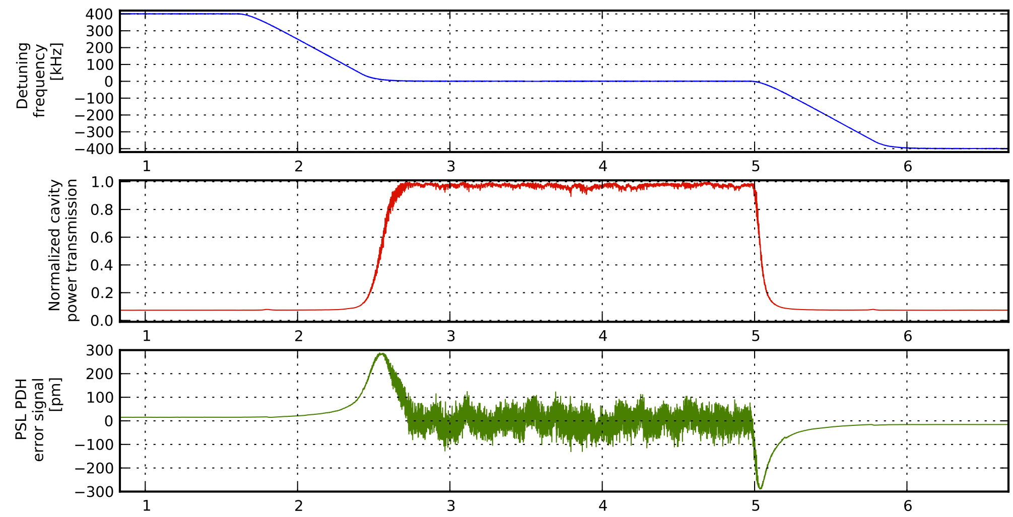
Lock acquisition strategy
Green Locking for one arm (40m prototype)

Slide 25
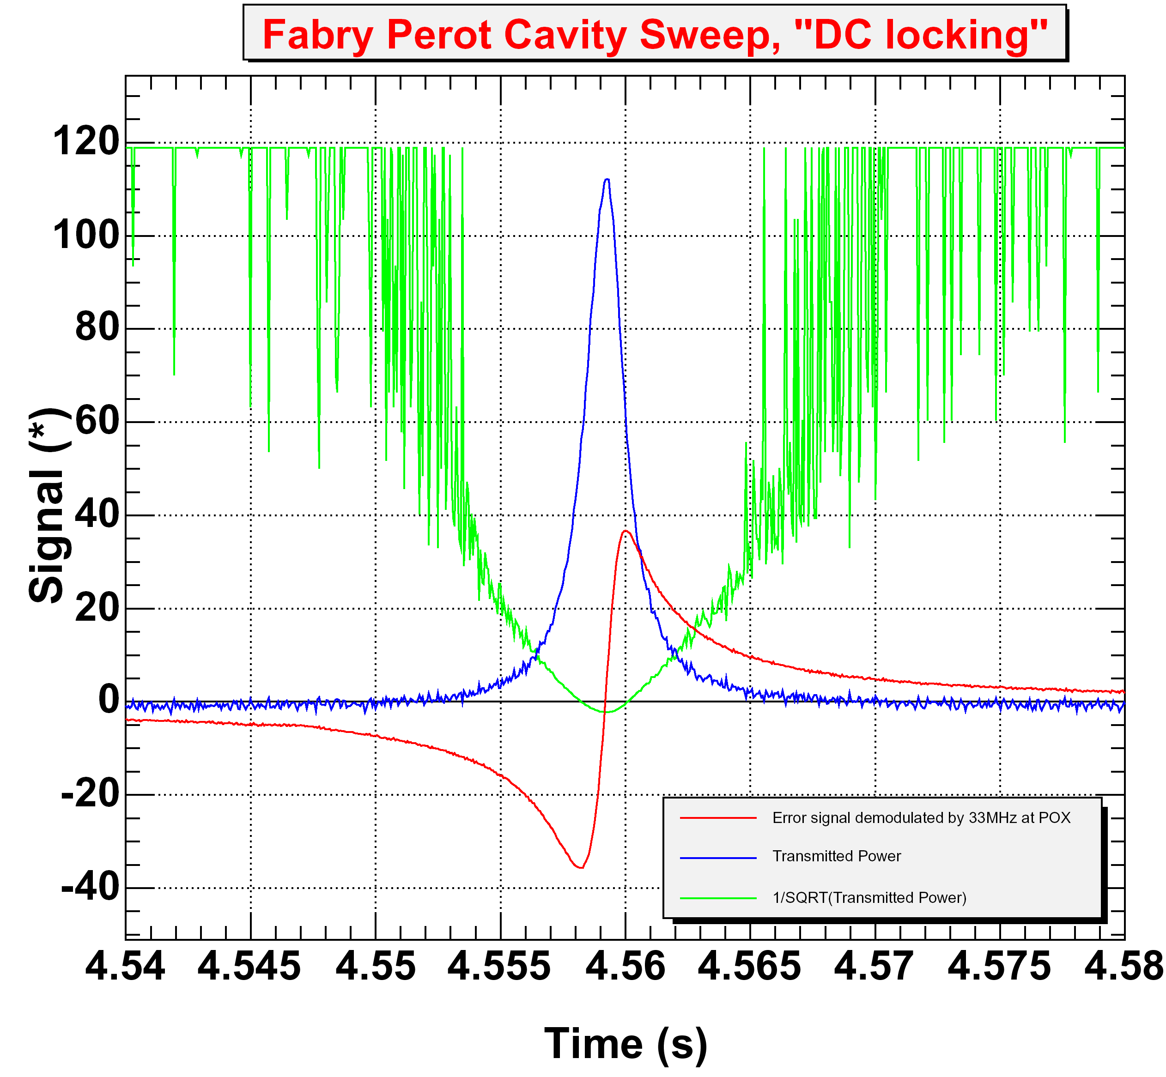
Lock acquisition strategy
Transmission locking
Resonant Lock
Off-resonant
Lock point
R. Ward PhD thesis (2009) California Institute of Technology
https://dcc.ligo.org/LIGO-P1400105

Slide 26
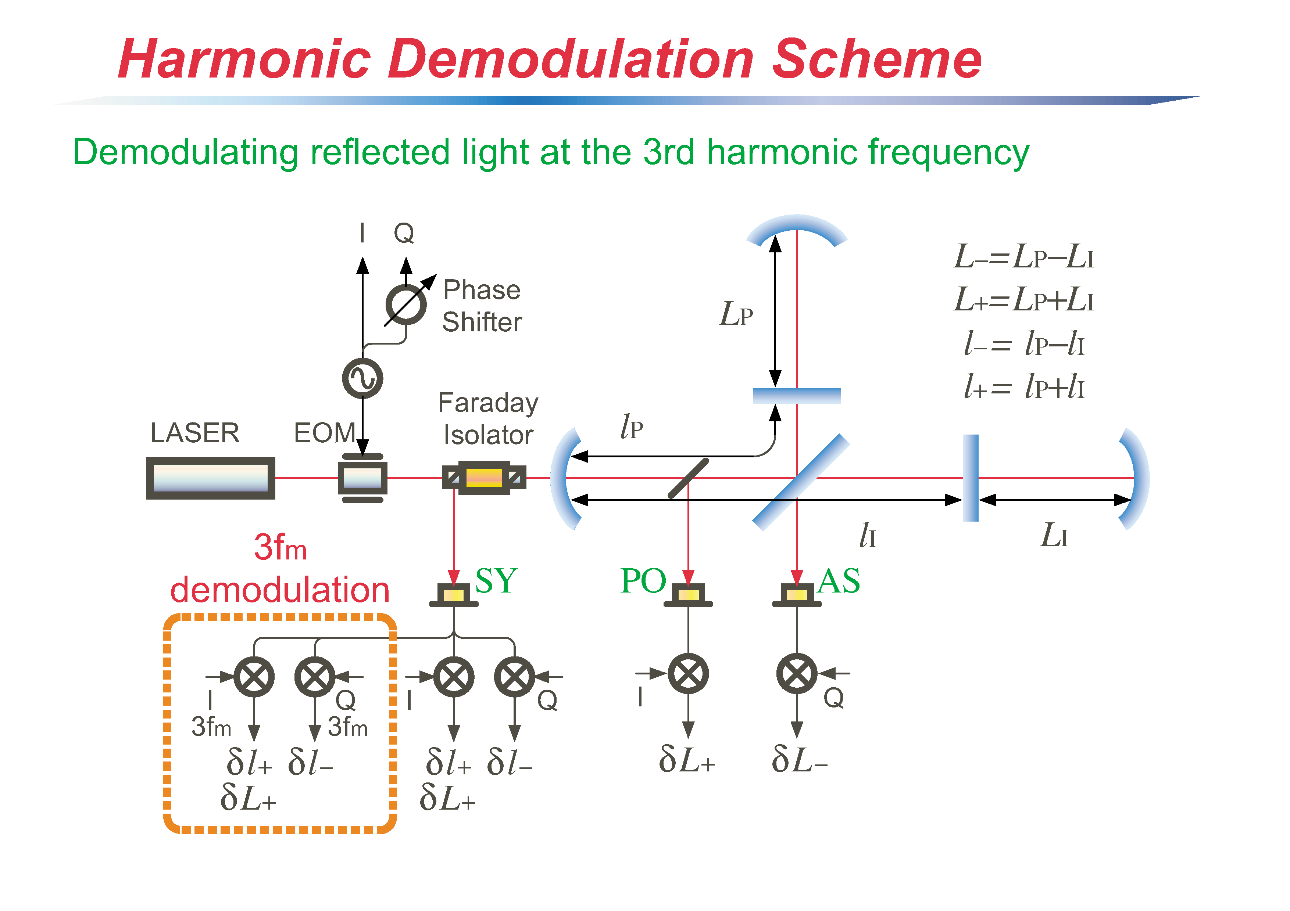
Lock acquisition strategy
3f locking (aka Arai technique!)
K. Arai PhD thesis (2001) Univ. of Tokyo
http://t-munu.phys.s.u-tokyo.ac.jp/theses/arai_d.pdf

Slide 27
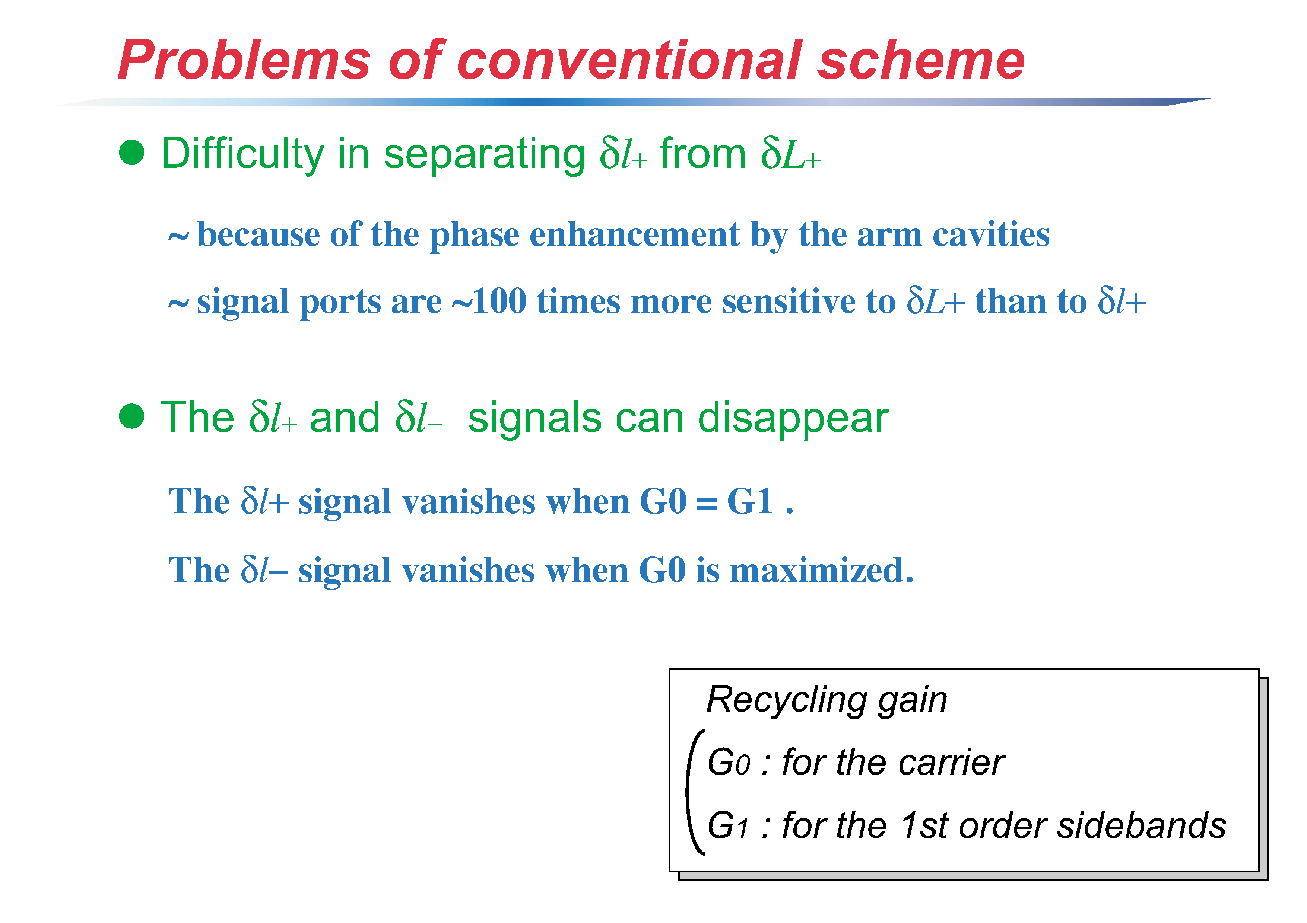
Lock acquisition strategy

Slide 28
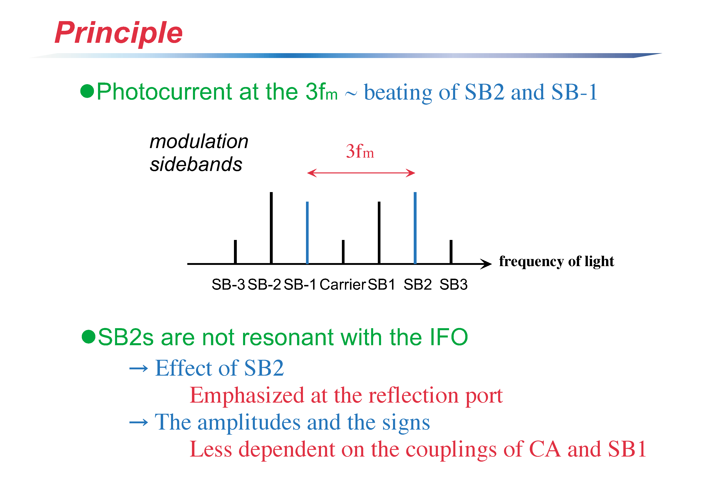
Lock acquisition strategy

Slide 29
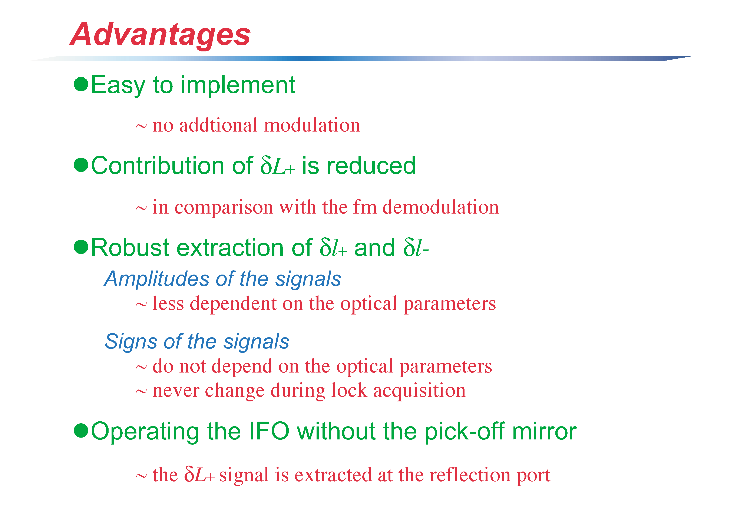
Lock acquisition strategy

Slide 30
Lock acquisition strategy
PDH linearization
M. Evans PhD thesis (2002) California Institute of Tech
http://www.ligo.caltech.edu/~mevans/lockAcq/thesis.pdf

Slide 31
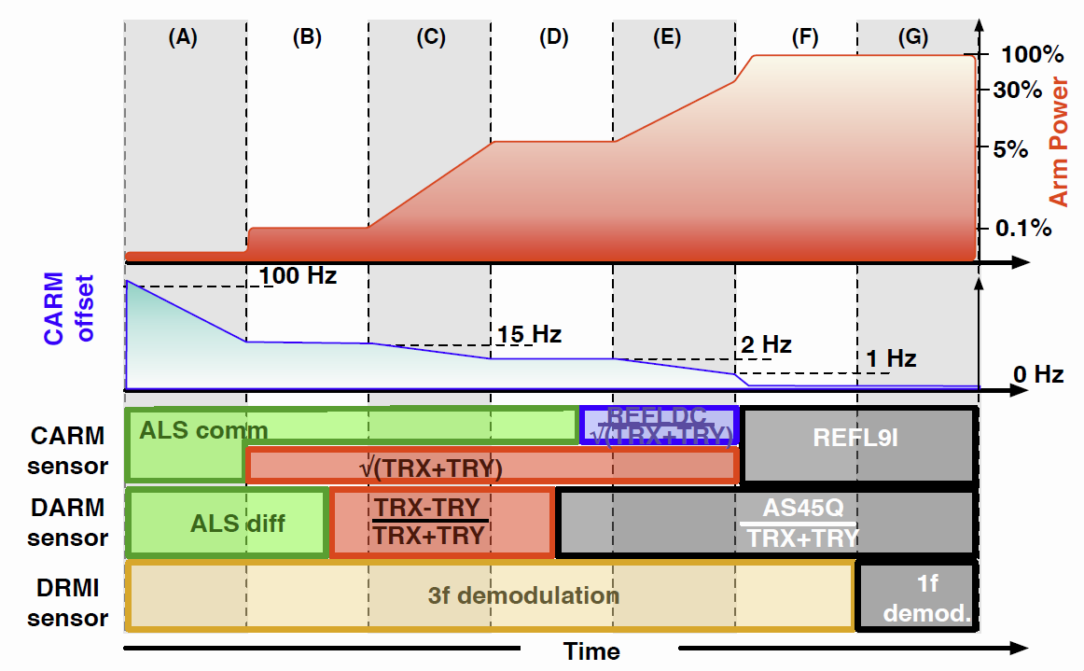
Design vs. realization
not needed
not needed

Slide 32
Locking Process: realized
Engage CM/AO
Reduce
CARM
offset
Transition
from ALS to
IR signals
Transition
DRMI 3f to 1f
Find arm
resonances
Offset
arms
Lock
DRMI
Align
recycling
mirrors
>95% coupled into IFO
Transition to reflection RF signal (REFL9I)

