Slide 1
LIGO-India Detector Master Class
Introduction
LIGO-G1401365-v1
Koji Arai – LIGO Laboratory / Caltech

Slide 2
Who is this guy!?
Ph.D at Univ of Tokyo (1995-1999)
  Design & build of TAMA300 double-pendulum suspensions
  Interferometer length sensing for power recycled Fabry-Perot Michelson Interferometer
Commissioning and science runs of TAMA300 interferometer (1999-2009)
@LIGO Caltech (2009-)
Output mode cleaner development
eLIGO/aLIGO commissioning

Slide 3
LIGO-India Detector Master Class: Overview
Mission:
To convey technical knowledge necessary for building and operating the LIGO India detector, or similar interferometer, including prototypes
by going through:
  the common technologies in laser interferometer GW detectors
  Detailed description / discussion about the interferometer sensing & control

Slide 4
LIGO-India Detector Master Class: Overview
Lecture plan
DAY1 General overview of laser interferometer GW detectors
Interferometer configurations
DAY2 Noises in GW detectors
DAY3 Control system & its modeling
DAY4 Interferometer length sensing and control
Feedforward noise cancellation
Quantum noise
DAY5 Higher-order laser modes

Slide 5
Interferometer GW detection

Slide 6
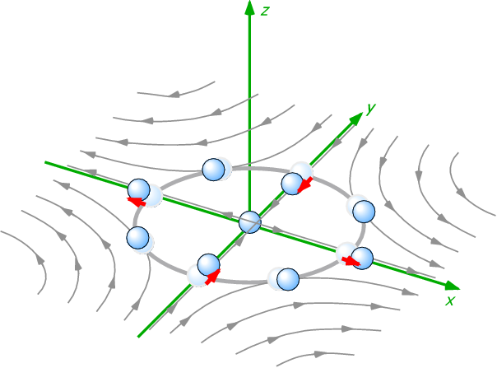
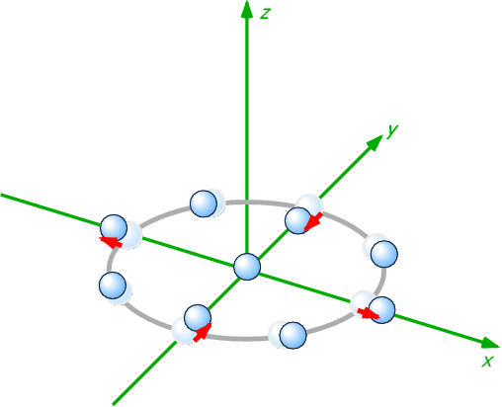
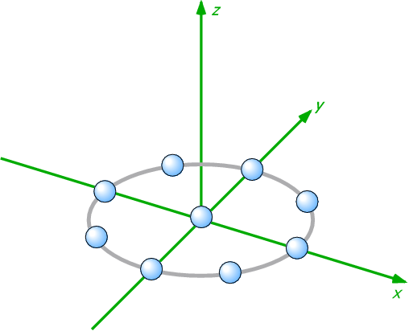
Gravitational wave
General Relativity
  Gravity = Spacetime curvature
  Gravitational Wave = Wave of spacetime curvature
GW
  Generated by motion of massive objects
  Propagates with speed of light
  Cause quadrupole deformation
  of the spacetime
GW
Free mass

Slide 7
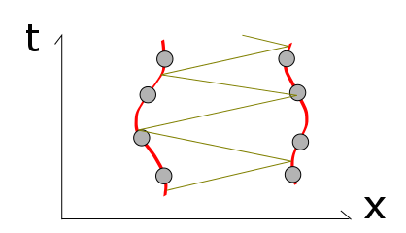
Gravitational wave
What does the balls feel?
  The balls are free mass (= free falling)
  ...Geodesic lines
Q. What happens
if the balls are connected
by bars
GW
Free mass

Slide 8
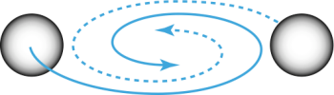
Interferometer GW detection
Michelson-type interferometers are used
Differential change of the arm path lengths
=>change interference
condition
Mirror
Mirror
Beamsplitter
Interference
Fringe
Laser

Slide 9
Antenna pattern
Antenna pattern (at low frequencies)
Rev. Mod. Phys. 86 (2014) 121-151
http://link.aps.org/doi/10.1103/RevModPhys.86.121
(http://arxiv.org/abs/1305.5188)

Slide 10
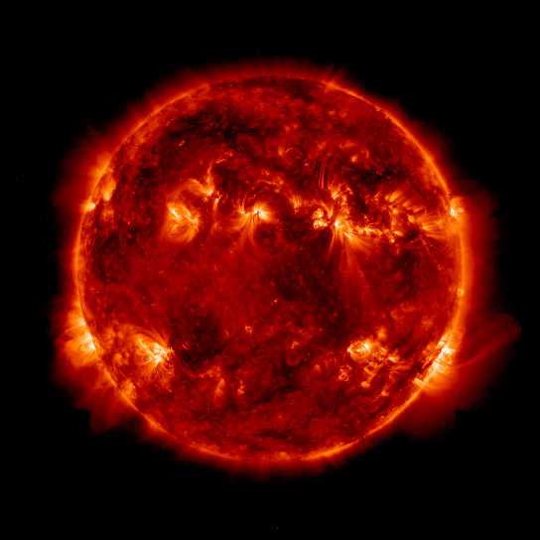
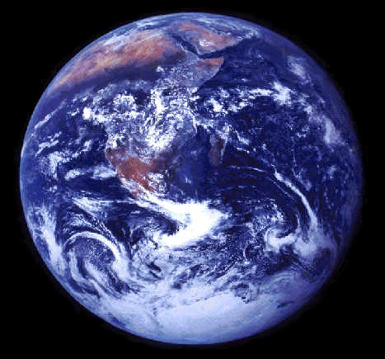
Amplitude of GWs
The effect of GW is very small
h ~ 10⁻²³ => distance of 1m changes 10⁻²³m
Corresponds to:
change by ~0.01 angstrom (or 1pm)
for distance between the sun and the earth
1.5 x 10¹¹ m
changes
by 1/100 of a H atom diameter!

Slide 11
Size of interferometer GW detectors
Mirror
GW Detection = Length measurement
The longer arms, the bigger the effect
  GW works as strain => dx = h_{GW} x L_{arm}
  Until cancellation of the signal happens
  in the arms
  Optimum arm length
Mirror
Mirror
Laser
Photodetector
Mirror
Laser
Photodetector

Slide 12
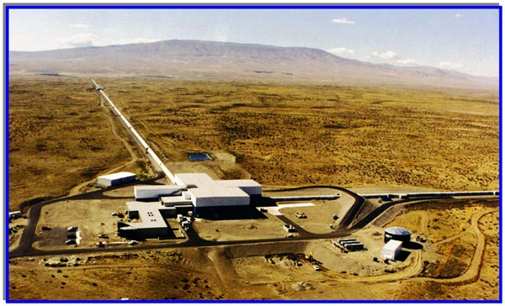
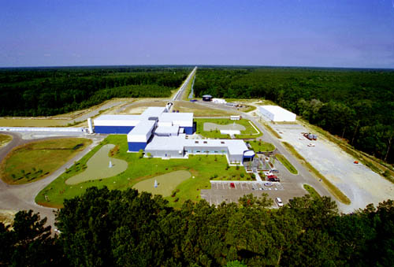
Size of interferometer GW detectors
LIGO Observatories
Hanford / Livingston 4km
\
c.f. Virgo (FRA/ITA) 3km, KAGRA (JPN) 3km, GEO (GER/GBR) 600m
Still shorter than the optimum length
=> Use optical cavity to increase life time of the photons in the arm

Slide 13
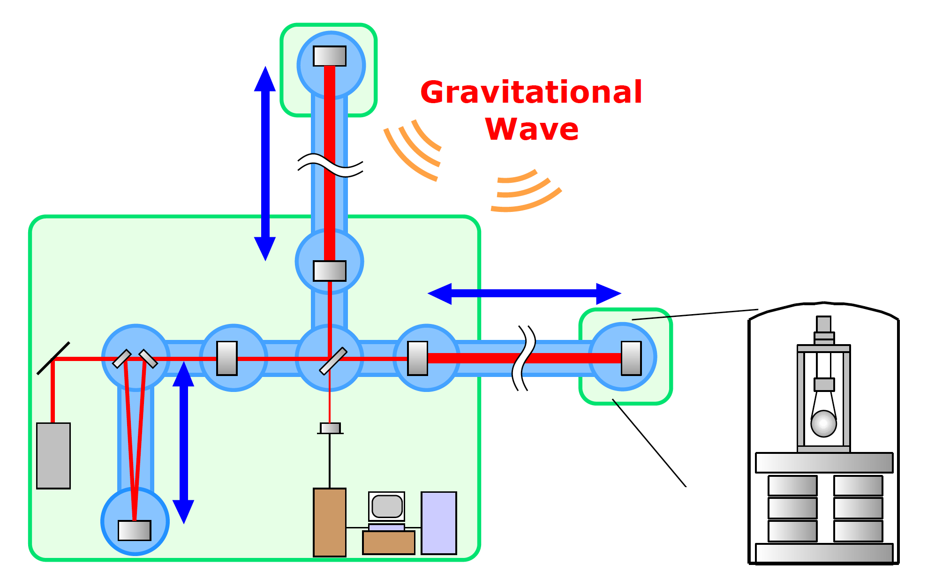
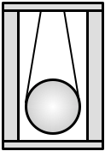
Components of the interferometer
“Still simplified” LIGO Interferometer
4km
Fabry-Perot
Cavity
Vacuum Chamber /
Beam tube
4km Fabry-Perot Cavity
Mirror Suspension
Beamsplitter
Recycling
Mirrors
Mirror
Photodetector
Vibration
Isolation
System
Digital Control System
Mode
Cleaner
L~16m
Laser
Data Acquisition
/Analysis System

Slide 14
Components of the interferometer
3 fundamentals of the GW detector
Mechanics
Optics
Electronics

Slide 15
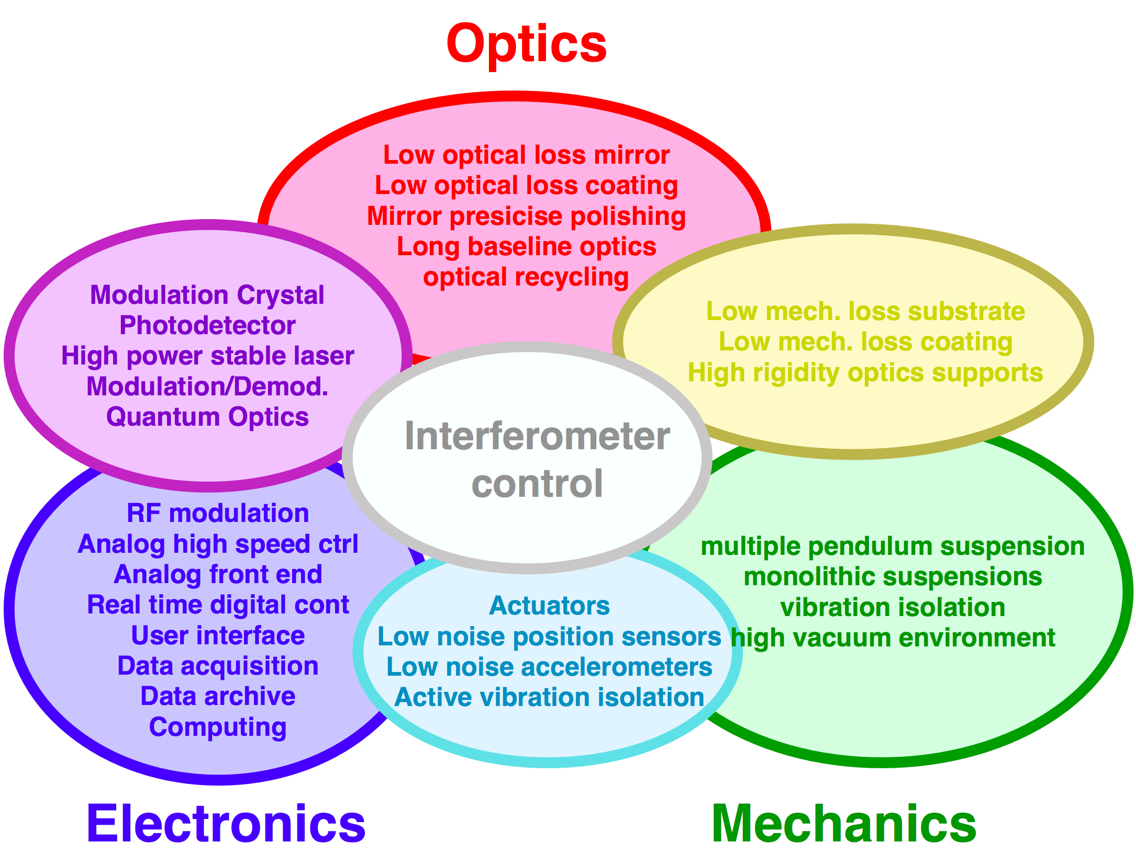
Components of the interferometer
3 fundamentals of the GW detector
Mechanics
Optics
Electronics

Slide 16
What can we do for the detection?
An IFO produces a continuous signal stream
in the GW channel
The detector is fixed on the ground
=> can not be directed to a specific angle
GWs and noises are, in principle, indistinguishable
=> Anything we detect is GW
Reduce noises!
Obs. distance is inv-proportional to noise level
x10 better => x10 farther => x1000 more galaxies

Slide 17
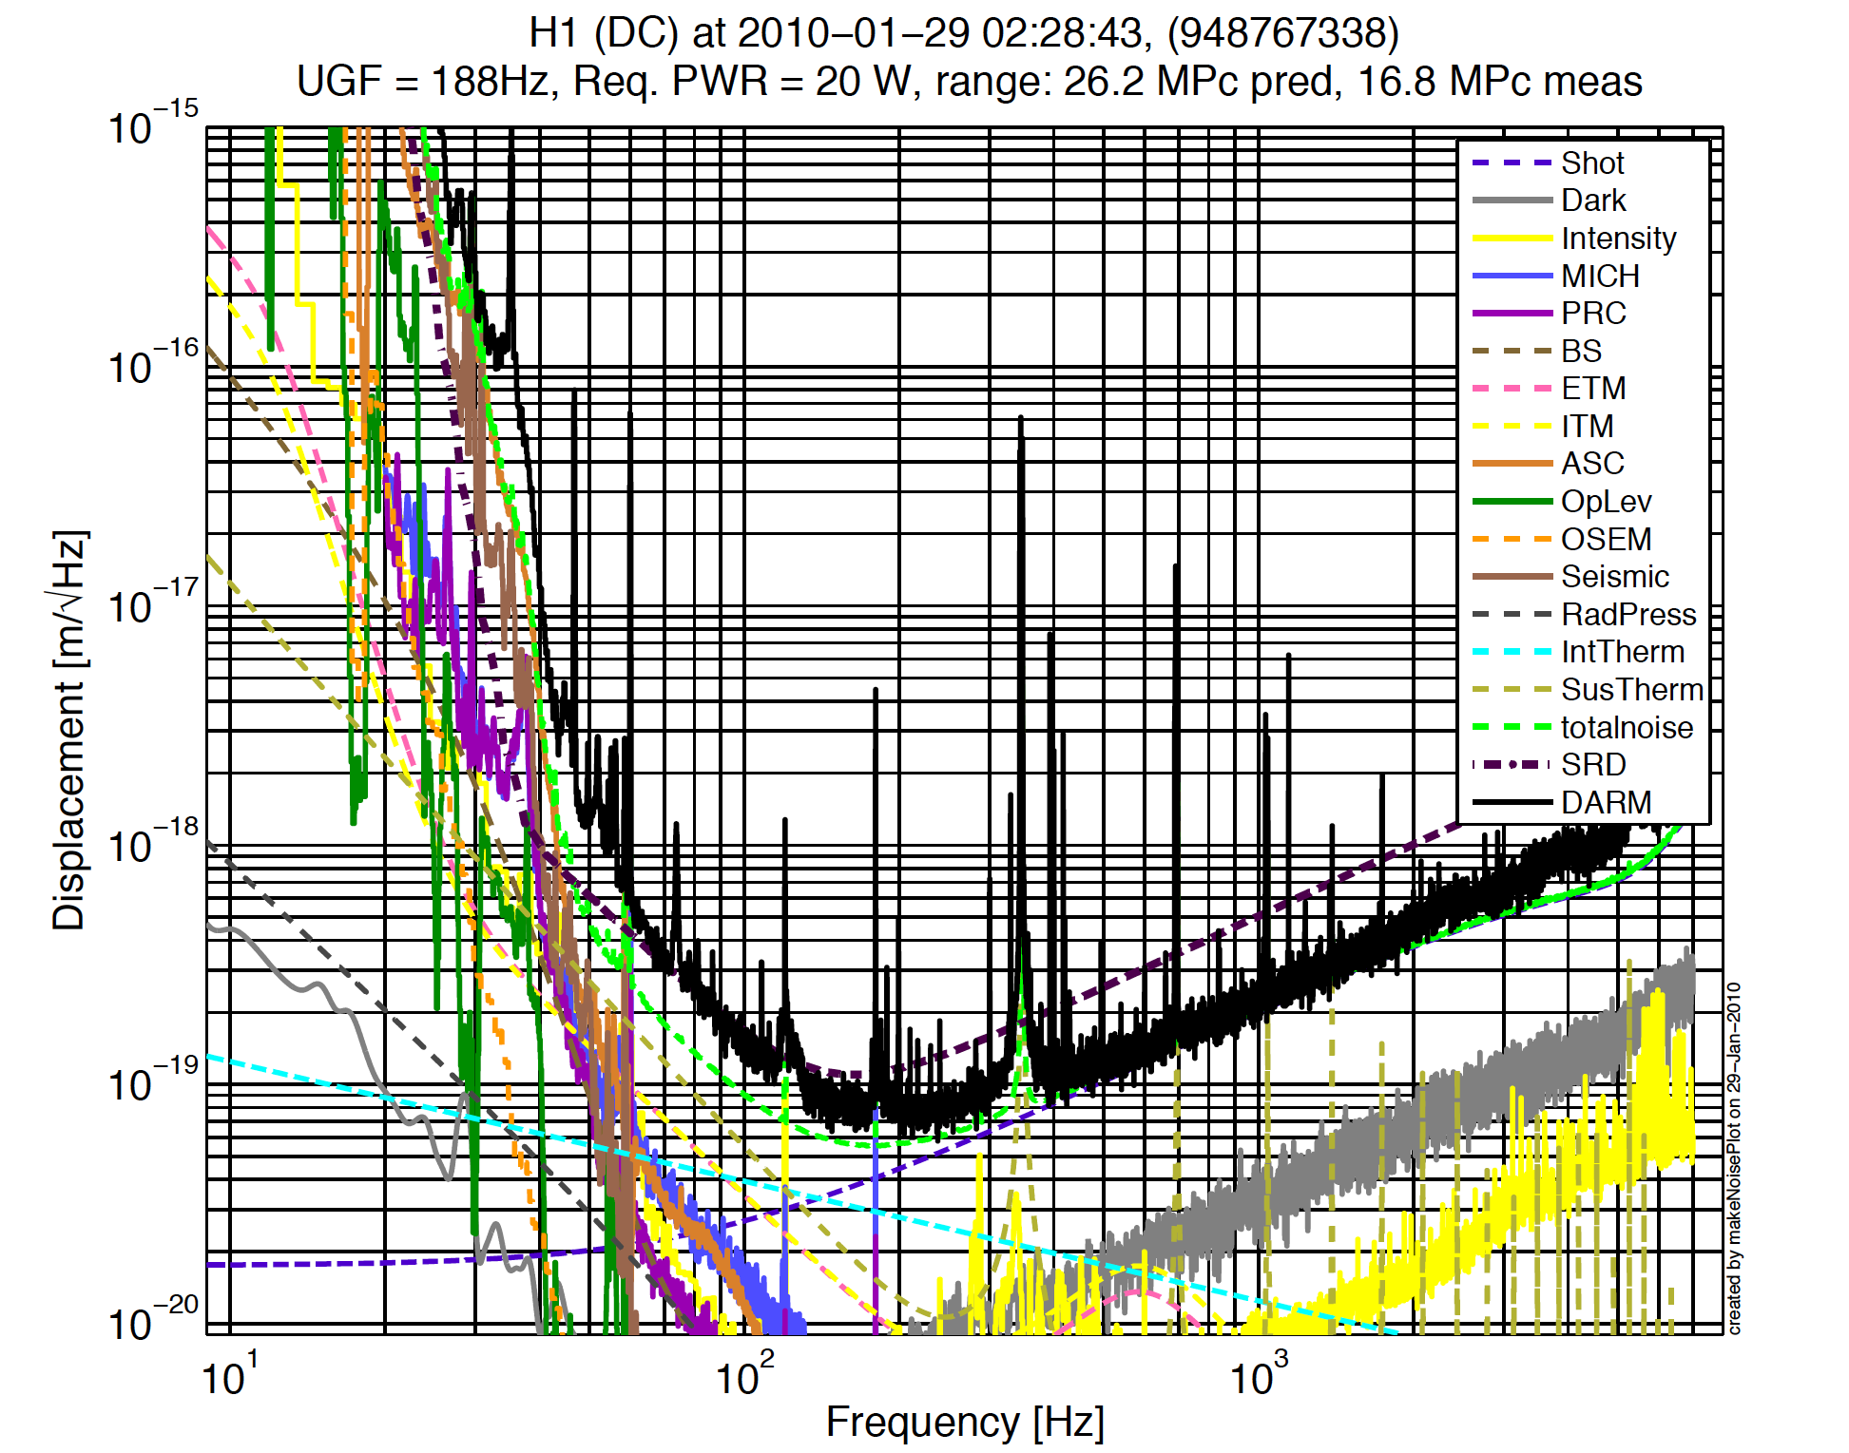
Sensitivity and noise
Sensitivity (=noise level) of Enhanced LIGO
Laser shot noise
Laser radiation
pressure noise
thermal noise
seismic noise
Laser intensity
/frequency noise
electronics noise
digitization noise
angular control noise
......
h= 2x10⁻²³ /rtHz

Slide 18
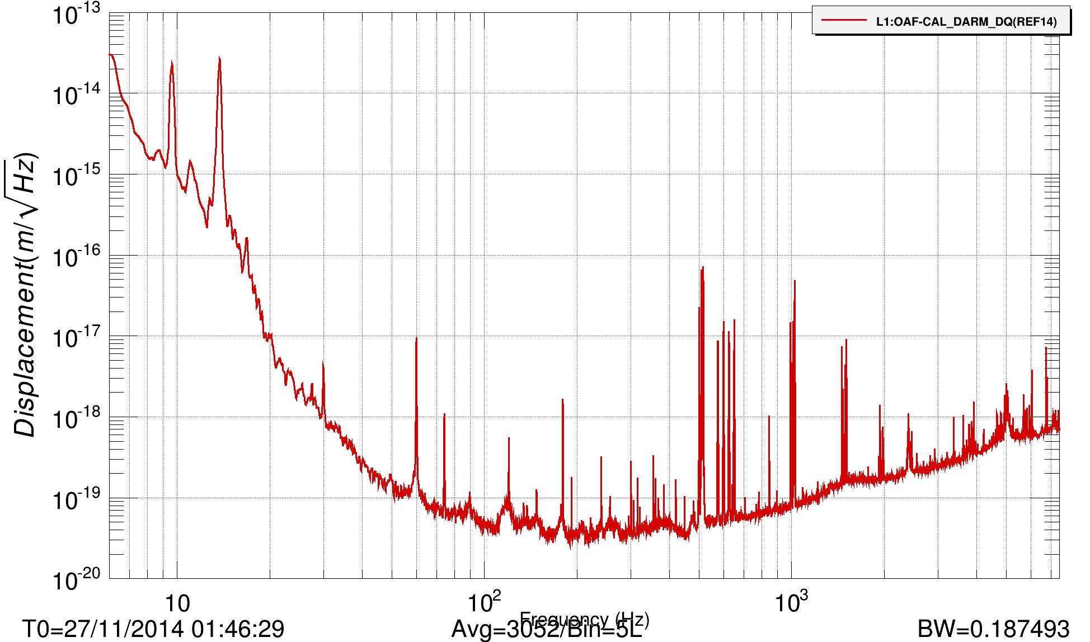
aLIGO sensitivity
aLIGO sensitivity
Preliminary
x= 4x10⁻²⁰ m/rtHz
h= 1x10⁻²³ /rtHz

Slide 19
Data Analysis
Compact Binary Coalescence
=> Chirp signal
  NS-NS binaries
  Accurate waveforms predictable
  (Post Newtonian approximation)
  => Template banks & Matched
  Filter analysis (amplitude & phase information)
  BH-BH binaries
  Similar waveforms,
  but more difficult to predict
  because of earlier merging
Mat]ched filtering analysis

Slide 20
Data Analysis
Msolar = 1.989*^30;
c = 2.9979*^8;
G = 6.67*^-11;
B. F. Schutz, “Gravitational wave astronomy”,
Class. Quantum Grav. 16 (1999) A131.
f_ISCO = 1/(pi (6 M)^3/2)
c = 299792458;
G = 6.67*^-11;
m1 = 1.4 Msolar;
m2 = 1.4 Msolar;
Msolar = 1.989*^30;
m = m1 + m2;
fISCO = c^3/(6^(3/2)*Pi*G*m)

Slide 21
Binary range
Binary inspiral range
  Chirp waveform PSD
  ISCO freq (HF cut off freq)
  Horizon range (Integrated SNR of 8)
  In the control room we use D/(2.26)
  taking all sky average
iLIGO 15Mpc
eLIGO 20Mpc
aLIGO 50Mpc
https://dcc.ligo.org/LIGO-T0900499/public

Slide 22
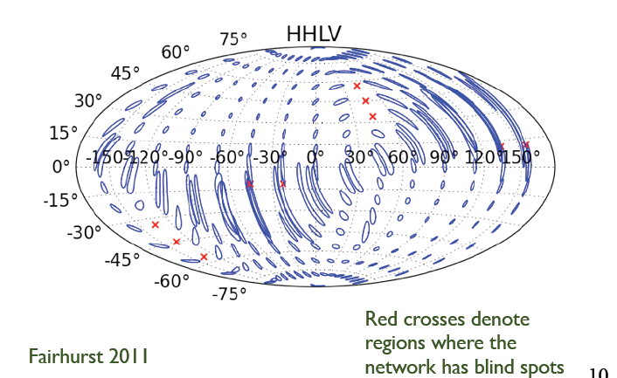
Localization capability:
LIGO-Virgo only

Slide 23
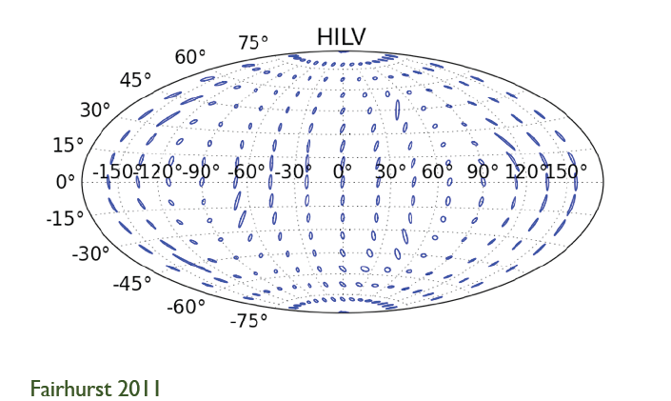
Localization capability:
LIGO-Virgo plus LIGO-India

Slide 24
Data Analysis
Burst gravitational waves
  Supernovae, binary merger phase, etc
  Accurate waveforms unpredictable
  => Find signals with an “unusual” amplitude
  => Important to distinguish from non-stationary noises
Continuous waves
  Pulsars
  Sinusoidal signal with some modulations
  => Longterm integration
  => Important to distinguish from line noises
  (Remark: power line freq. US 60Hz, India 50Hz)

Slide 25
Data Analysis
Stochastic gravitational wave background
  From early universe
  The waveforms are random
  => Correlation analysis of the detector network
  => The total GW flux can be estimated
  => Or, skymap of the flux is obtained from radiometric analysis
In all cases, it is highly desirable to have
the detectors to have comparable sensitivities

Slide 26
Summary
GWs ~ ripples of the spacetime
Not yet directly detected
~ the effect is so small (h<10⁻²¹)
Michelson-type interferometers are used
GW detection is a precise length (=displacement) measurement!
GW effect is very small

Slide 27
Summary
Basically, the larger, the better.
LIGO has two largest interferometers
in the world, and the third one will have
very important role in GW astronomy
IFO consists of many components
Optics / Mechanics / Electronics
and their combinations (e.g. Opto-Electronics)
Noises and signals are, in principle, indistinguishable.
Noise reduction is essential

