Slide 1
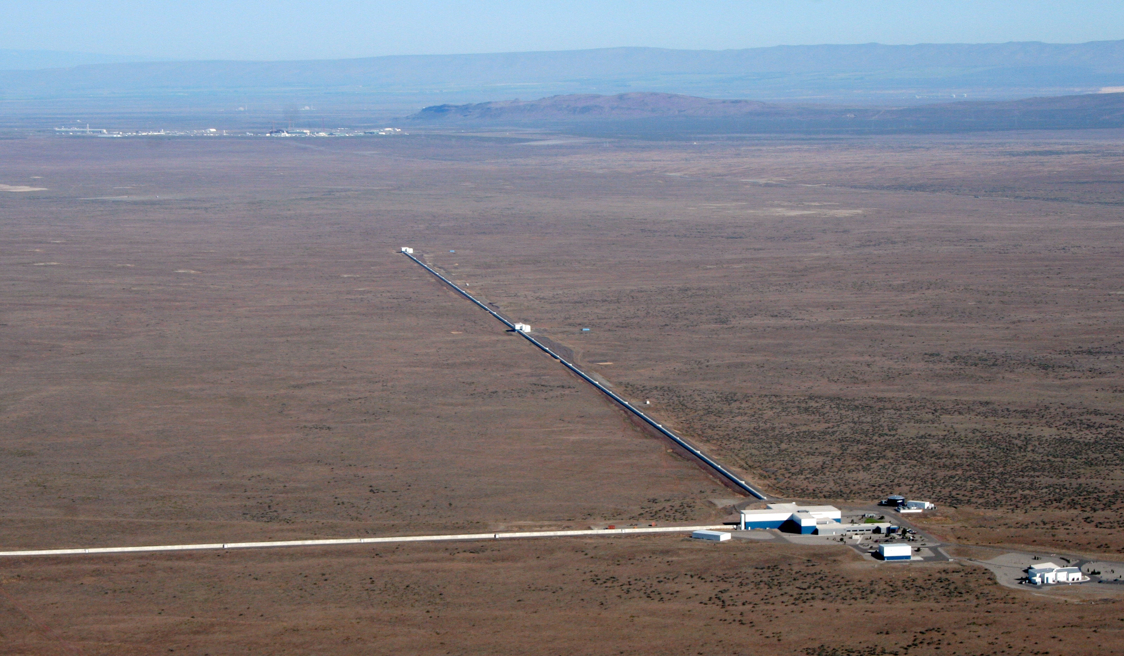
Parts of the path to today’s
Interferometric Gravitational-Wave detectors
David Shoemaker
For the LIGO Scientific Collaboration
GWA
LIGO-G1401350-v4

Slide 2
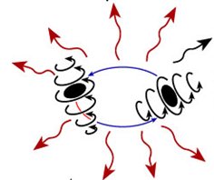
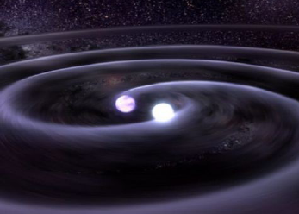
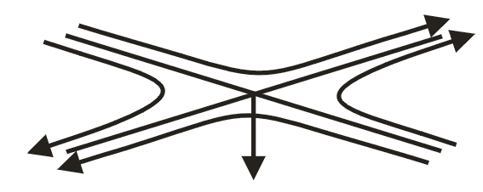
Gravitational waves
Gravitational waves are propagating dynamic fluctuations in the curvature of space-time (‘ripples’ in space-time)
Emissions from rapidly accelerating non-spherical mass distributions
  Practically, need massive objects moving at speeds
  approaching the speed of light
  According to GR, GWs propagate at the speed of light
  Quadrupolar radiation; two polarizations: h₊ and h_{x}
  Physically, GWs are strains
  GWs carry direct information about the dynamics of matter
  h is 10⁻²¹ for a ~monthly signal rate
Credit: T. Strohmayer and D. Berry

Slide 3
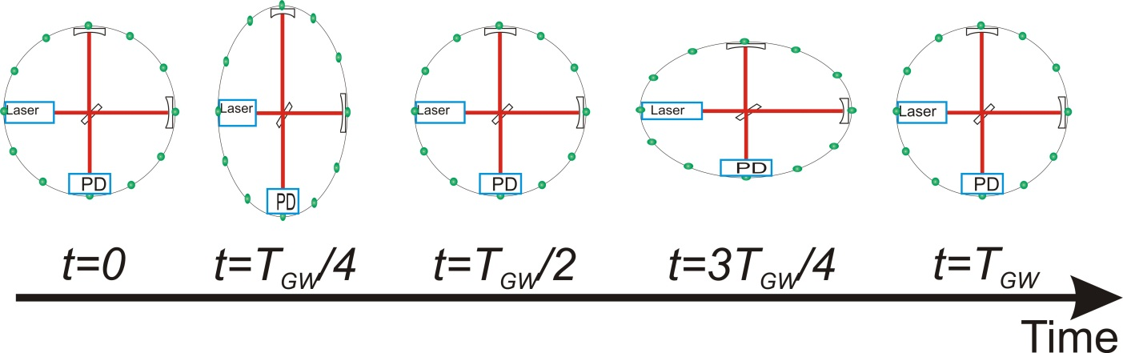
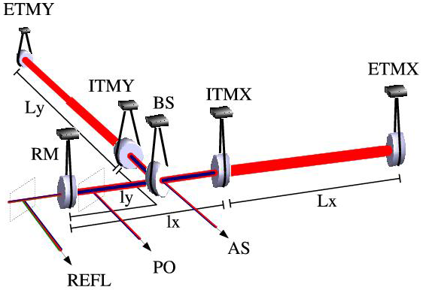
Interferometric Gravitational-wave Detectors
Enhanced Michelson interferometers
Passing GWs modulate the distance between the end test mass and the beam splitter
The interferometer acts as a transducer, turning GWs into photocurrent proportional to the strain amplitude
Arms are short compared to GW wavelengths, so longer arms make bigger signals
→ multi-km installations
Arm length limited by
taxpayer noise….
←4km→
←4km→
Laser →
Photo
diode

Slide 4
The concept
(At least one) early Gedanken experiment using interferometry to detect GWs:
  F.A.E. Pirani, Acta Phys. Polon. 15, 389 (1956)
  (predates invention of laser by 4 years!)
The proposal of using laser interferometry for gravitational-wave detection was first mentioned I believe by Gerstenstein and Pustovoit 1963 Sov. Phys.–JETP 16 433, from the standpoint of a theoretical possibility
Weber mentioned it in an unpublished laboratory notebook. Worked with Forward, which probably triggered early experiments by Forward – and the first actual interferometer
(a perfectly good place to apologize to people, places, and ideas that don’t show up in this rather narrow ‘history’)

Slide 5
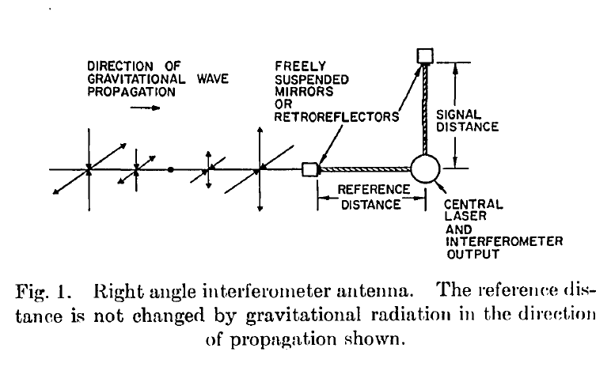
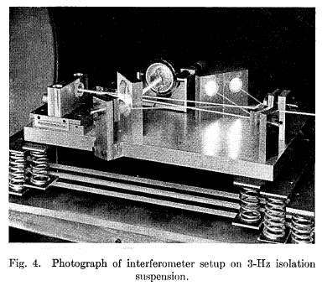
Forward Interferometer
Did not take advantage of the
Michelson differential arm sensitivity!
Data Analysis section:
“Calibration of the Ear”

Slide 6
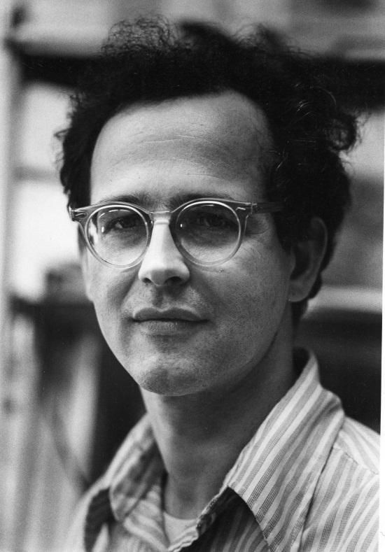
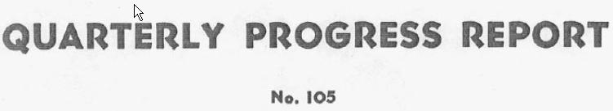
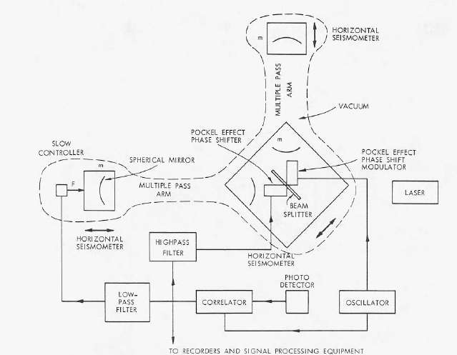

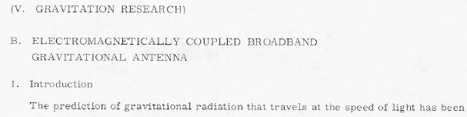
Substantial starting point for the field
Rai Weiss of MIT was teaching a course on GR
in the late ‘60s
Wanted a good homework problem for the students
Why not ask them to work out how to use
laser interferometry to detect gravitational waves?
Weiss wrote the instruction book we have been following
ever since

Slide 7
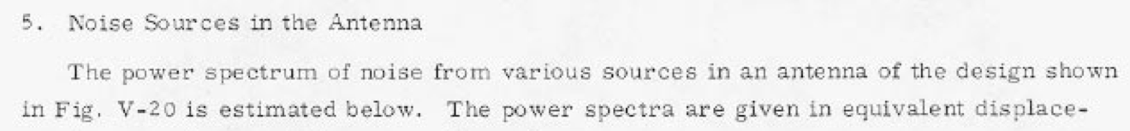
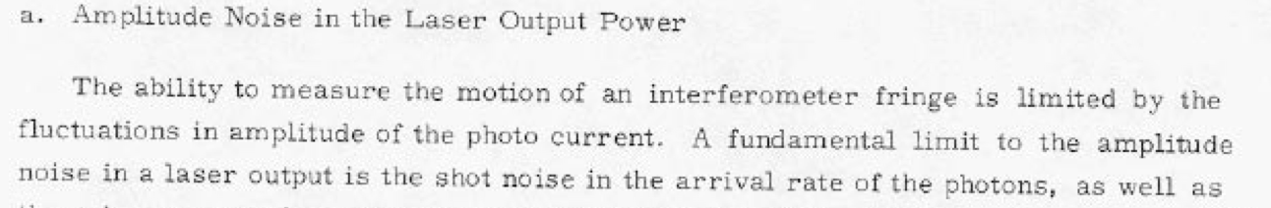
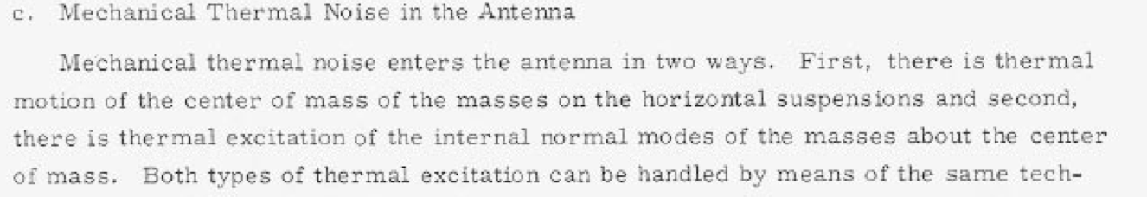
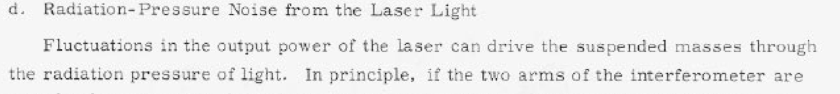
A few quotes from Weiss’ ‘72 Report

Slide 8
The epoch of city-states (‘70s, ‘80s)
Weber Bar groups, who both competed with us and developed needed technologies and cultured young scientists in the field
MIT/Weiss: 1.5m prototype with Delay Lines and electrostatic controls, early active systems, demonstrations of interferometry with FP arms
Glasgow/Drever/Hough: from Bars to Fabry-Perot cavities, then inspiration in configurations and multiple pendulums
Caltech/Drever/Whitcomb: the 40m Prototype and position sensing records
Orsay/Brillet: Diode-pumped Nd:Yag as the right laser
Pisa/Giazotto: first a high-gain active seismic isolation system, then an about face to the Super Attenuator concept
And one very special case:

Slide 9
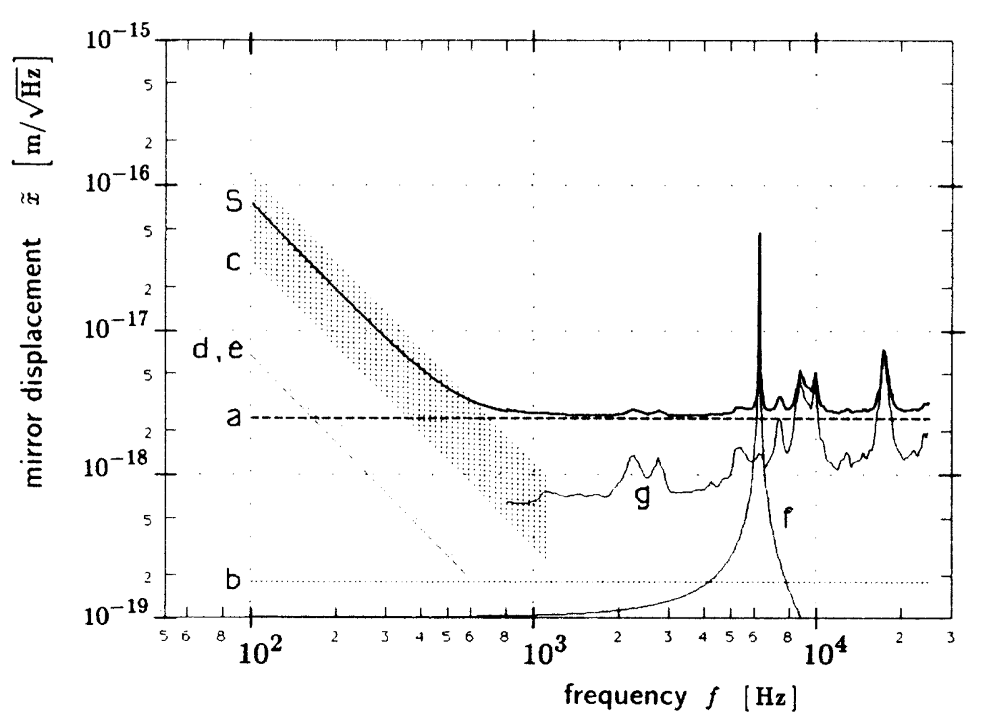
Garching Group
Early activity in computer automated analysis of Bubble chamber photographs and ‘large scale’ data magnetic storage; group led by Billing
  Custom hardware and software
A bold step: Billing Pursued GWs via Weber Bars – in Munich and in Frascati, Italy
Then, Interest in Interferometers perhaps piqued by Weiss’ proposal to NSF
Core group together for decades,
representing a broad range of
skills and interests
Built a series of ever more
sensitive prototypes,
culminating in the 30m
Delay Line system; best
understood and most sensitive
instrument for many years
First ‘noise budget’ that explained
observed performance

Slide 10
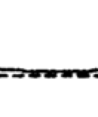
Garching Group
Many key discoveries/inventions made at Garching; a few examples…:
  Common mode interferometer stabilization – bringing reflected light back into interference with the incoming light – Almost power recycling
  OSEMs – simple combined shadow sensors and
  electromagnetic motors for suspended mirror control
  Shot noise and the non-stationary aspect of it in
  modulated systems
    Came to light due to the exquisite stability of the
    instrument, and the dogged determination and
    ‘housewife logic’ (her terminology!) of Lise Schnupp
  Scattering in delay lines, and means to mitigate through
  frequency modulation techniques
  Optical mode cleaners – cavities used in transmission
  Multiple pendulum suspensions
  Suspended bare optics to avoid mechanical damping and complexity
  Triangular arrangement for multiple interferometers (‘Vorschlag zum Bau…’)
Group migrated, mostly in spirit, to Hannover, and carries on!

Slide 11
Later Caltech and MIT activities
(and here my focus narrows to LIGO…)
The worldwide effort to establish a technical path to the required sensitivity gave some confidence that we knew what to build
Kip Thorne, Rai Weiss, and Ron Drever each had a vision that something great could happen in this field; Kip brought Drever to Caltech to found experimental group
Rai was certain that a unified proposal from both MIT and Caltech groups would be needed, and worked hard to make that happen
Caltech provided strong support to the (now named) LIGO Project, with Robbie Vogt as leader
A great deal of heat and just enough light followed, resulting in…

Slide 12
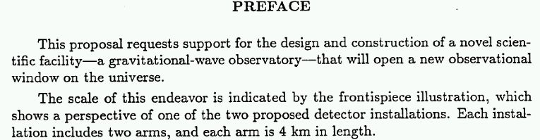
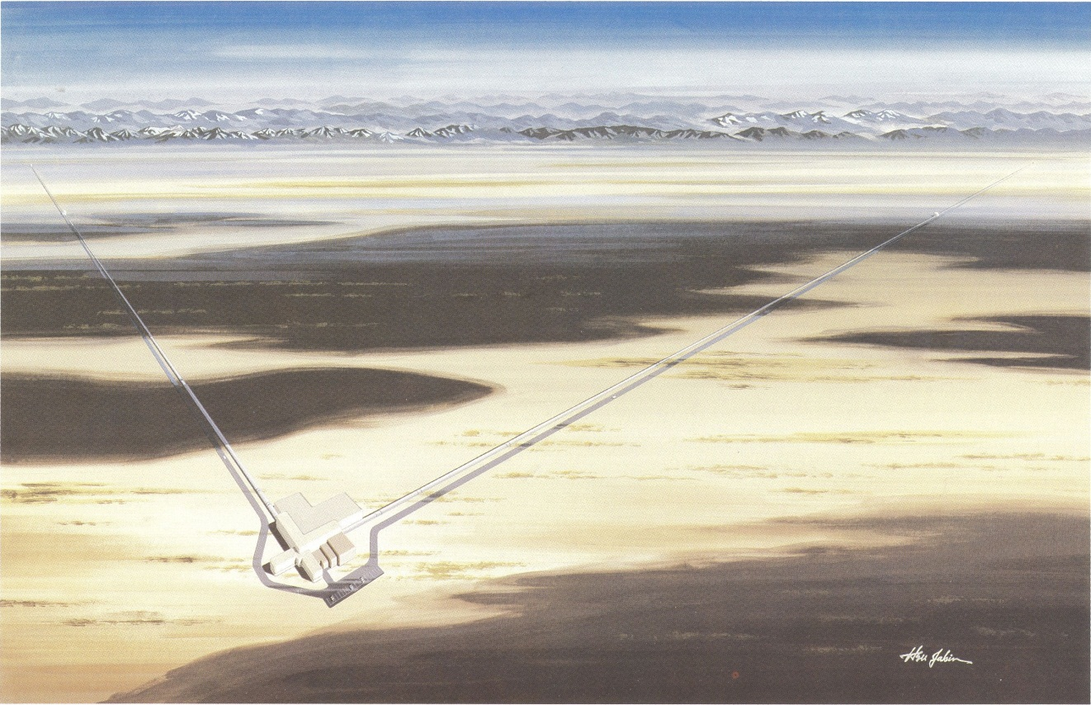
1989 Proposal to the US NSF

Slide 13
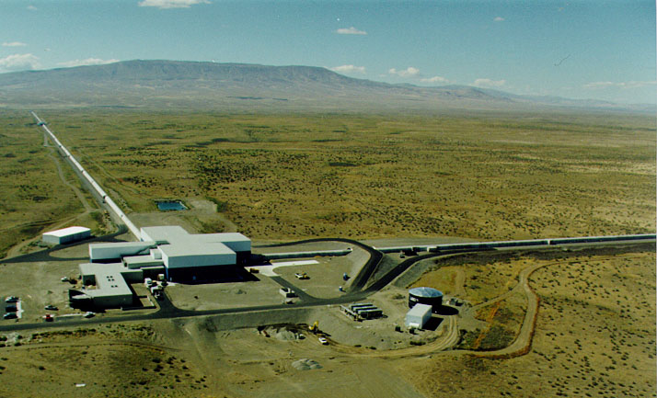
LIGO:
Today, Washington state…

Slide 14

…LIGO in Louisiana

Slide 15

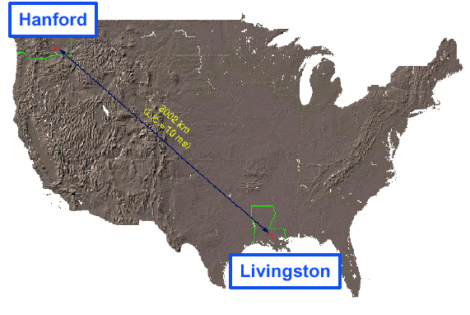
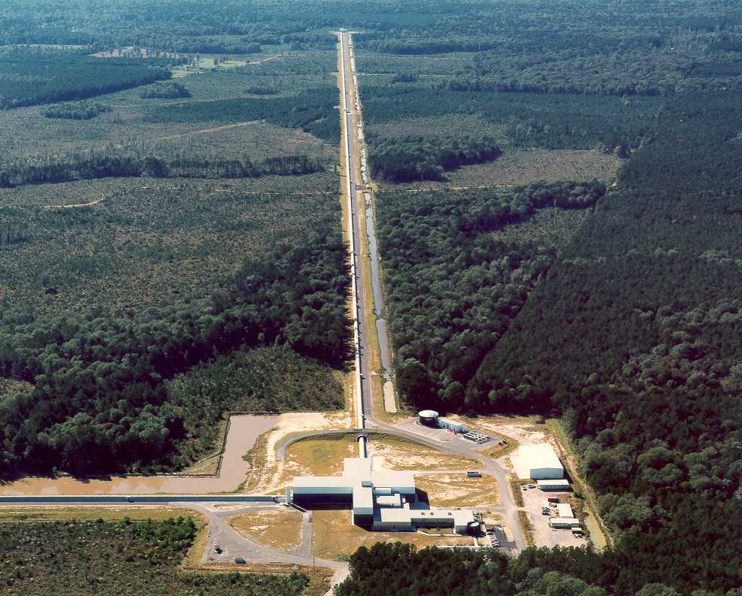
LIGO Laboratory: two Observatories and Caltech, MIT campuses
Mission: Develop gravitational-wave detectors; Operate them as astrophysical observatories
Jointly managed by Caltech and MIT
Two 4-km arm Observatories
MIT
Caltech
LIGO Livingston
Notes:
LIGO is actually two observatories.
Describe parameters
Emphasize that the arms are in ultra high vacuum. 8 km of steel 1.2 m dia beam tubes at each site
Separate observatories allow for coincidence detection – since the detectors see uncorrelated noise, only a true gravitational wave would appear on all the interferometers with the correct amplitude.
Emphasize that the LIGO Observatories were designed and are operated by Caltech and MIT

Slide 16
Initial LIGO Chronology
1985 (or so): Conceptual Design well formed
1989 : Construction proposal for LIGO submitted to the NSF
1992: NSF selects LIGO sites: Hanford, Wash., and Livingston, La.
1994: Groundbreaking at Hanford site
2000: Achieved “first lock” on Hanford 2-km interferometer
2002: First scientific operation of all three interferometers in S1 run
2005: Design sensitivity reached
…so about 20 years from a conceptual design to two Observatories, instruments, commissioning to design sensitivity
2007: Science run of one year integrated quality data at design sensitivity completed (“S5”)
  Upper limits and interesting non-detections; no detections
2010: Initial LIGO starts to be disassembled at Livingston, to enable…

Slide 17
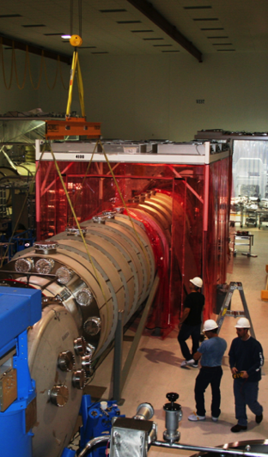
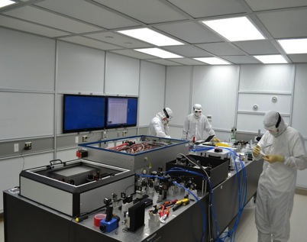
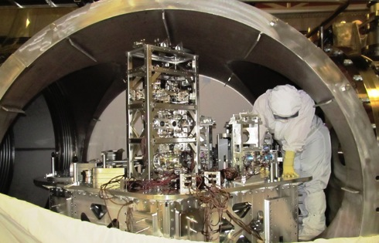
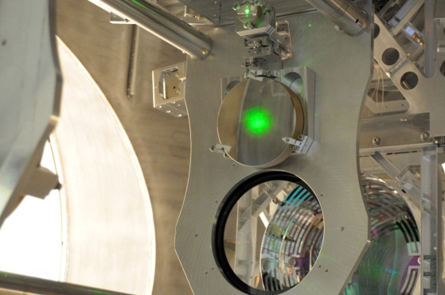
Advanced LIGO
Advanced LIGO is a complete redesign and rebuild of the LIGO interferometers
  10x more sensitive, 1000x more of the universe probed
Advanced LIGO funded April 2008
  $205.1M in funding from NSF; capital contributions from
  partners in UK, Germany, and Australia totaling $30M
Three 4 km long interferometers built
  One for Hanford, one for Livingston, one for future installation in India
Construction by LIGO Laboratory with participation by member groups of the LIGO Scientific Collaboration
On schedule and on budget to complete in March 2015

Slide 18
Chronology of aLIGO (as far as it goes…)
aLIGO’s path through the decades:
1990-2000: R&D, meetings like this one
1999: White Paper with conceptual design
2000-2004: Prototyping, modeling, applying (Note: this how where the LIGO Scientific Collaboration took form, to focus the community – City-States morph into Unions of LIGO, GEO, Virgo, KAGRA, ACIGA)
2006: Funding for 2008 start
2005-2008: Engineering, 1st articles, procurements
2008-2012: Building, de-installing, cleaning, installing
2013-2015: Installing, testing, documenting
2015→ Astrophysics
So, about 20 years from ripe R&D to fruition…
  (similar to Initial LIGO)
  Sobering for the next generation –
  need the conceptual design soon!

Slide 19
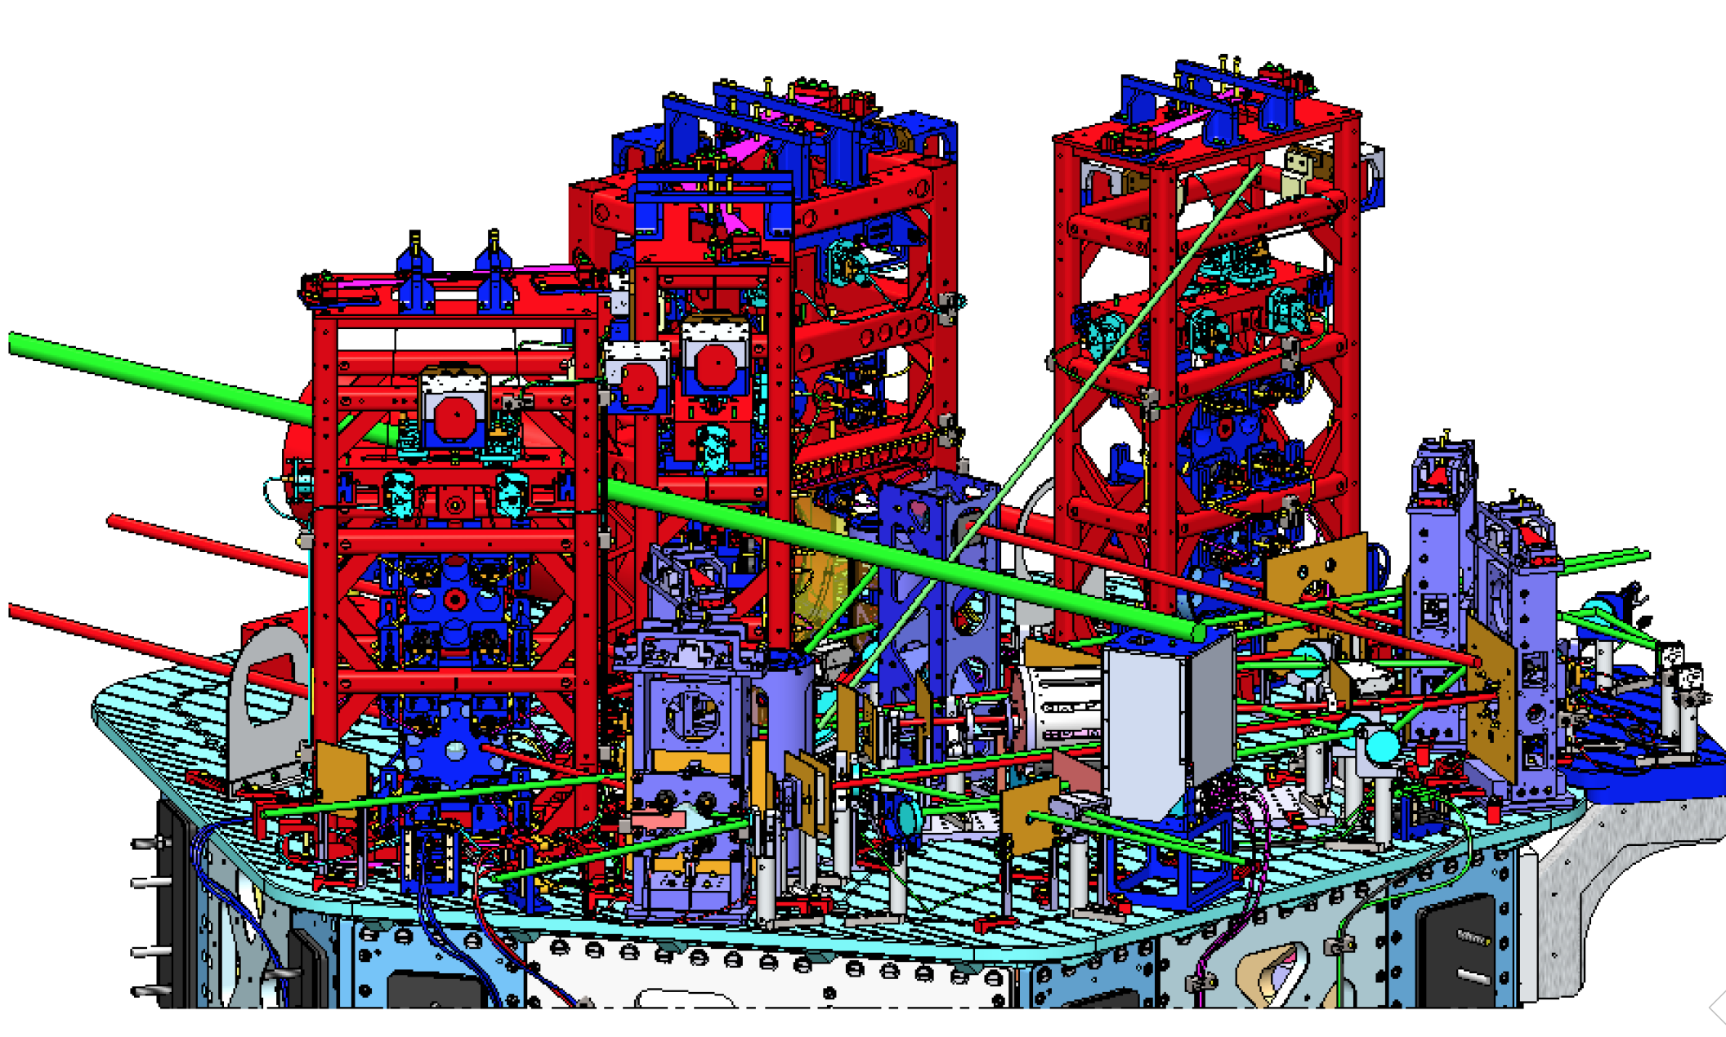

aLIGO is more complex than Initial LIGO…
Reality

Slide 20
aLIGO system layout

Slide 21

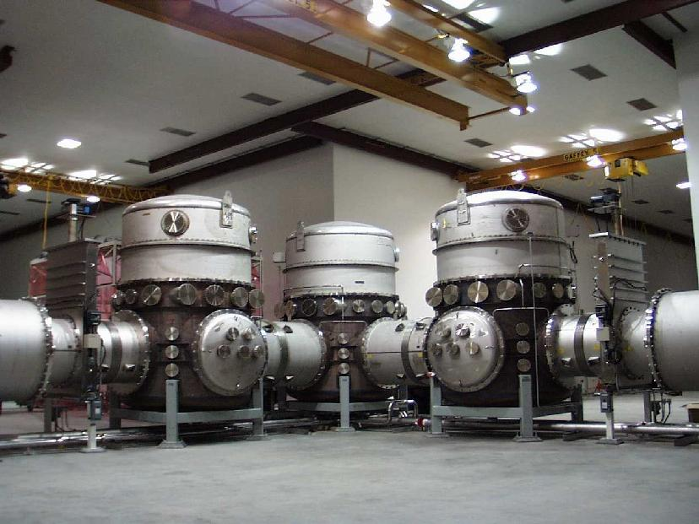
Design drivers
Long arms and extreme interferometry lead to many design impacts
World’s biggest UHV vacuum system, straighter than earth’s curvature
Optics size – 1064 nm over 4km requires beam spots of ~12 cm, 34cm optics
Readout requirements of one part in 10¹⁰ of a fringe requires 200W CW Nd:YAG lasers, stabilized in frequency, intensity, and pointing; boosted to ~1 MW with optical resonant cavities
Pointing and control requirements – hold 4km cavities on resonance to 10⁻¹⁵ m;
point optics with microradian RMS motion; 5 coupled cavities, 21 coupled DOF
Suppress seismic and anthropogenic noise input; another 18×5 + 12×5 MIMO DOF

Slide 22
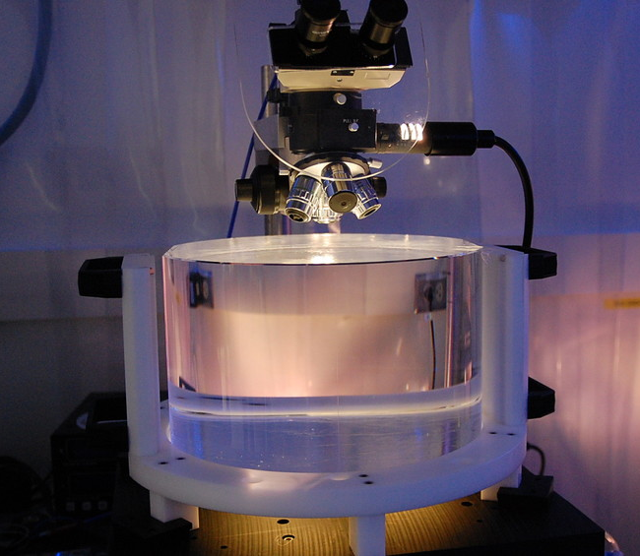
Test Masses
Both the physical test mass –
a free point in space-time – and a crucial optical element
Requires the state of the art in substrates, polishing, coating
Test Masses:
34cm φ x 20cm
40 kg
Round-trip optical loss: 75 ppm max
40 kg
Half-nm flatness over 300mm diameter
0.5 ppm absorption at 1064nm
Coating specs for 1064 and 532 nm
Mechanical requirements: bulk and coating thermal noise, high resonant frequency
Compensation plates:
34cm φ x 10cm
BS:
37cm φ x 6cm
ITM
T = 1.4%

Slide 23
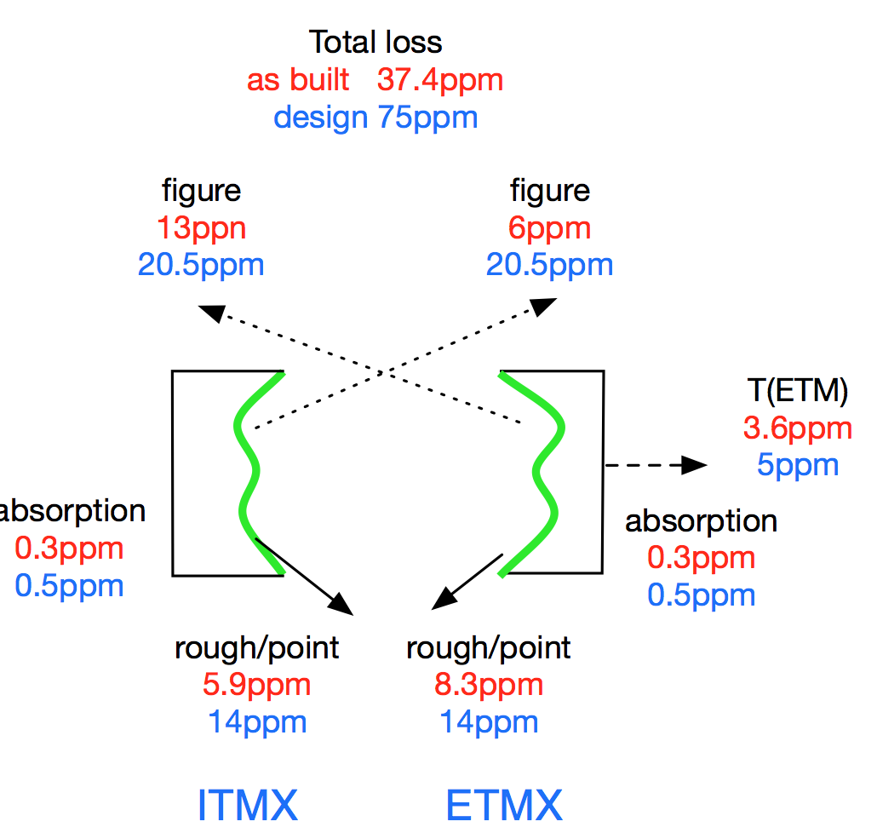
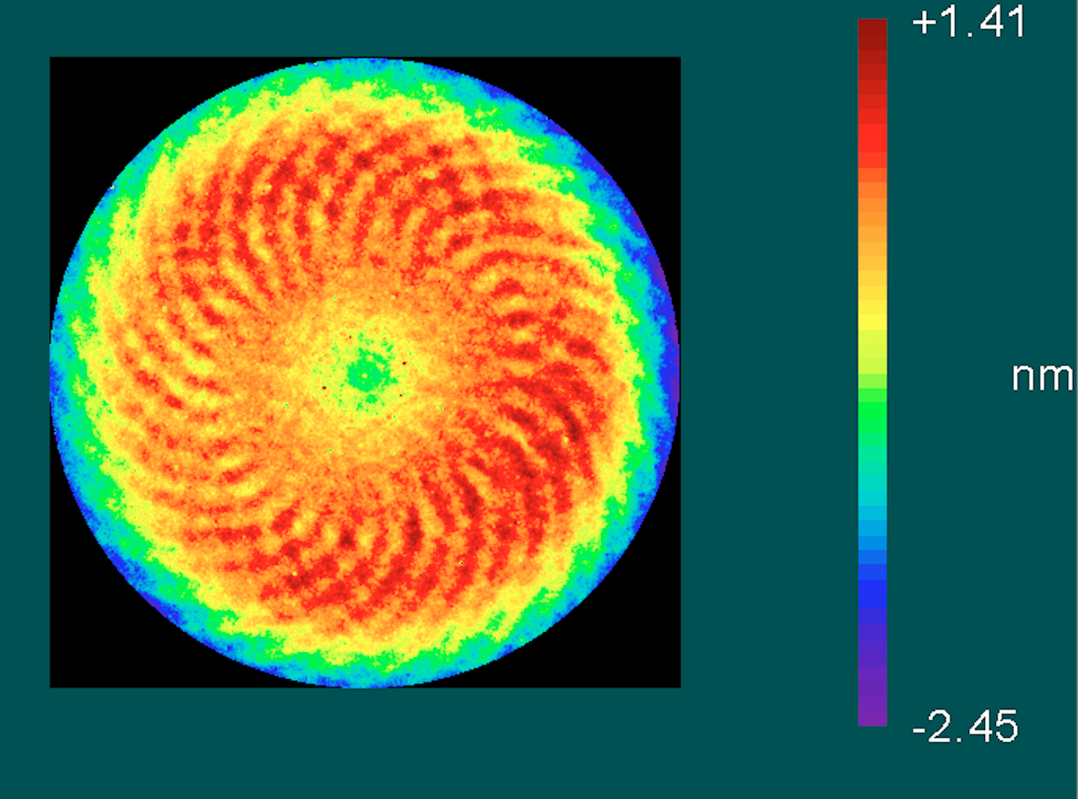
Coated Test mass Optics figure
In-house metrology on 300 mm diameter shows 0.66 nm RMS
  Substrate is <0.2 nm RMS – Ion Beam milling
  Note spiral from planetary system; about 0.2 nm pk-pk
Measurements of as-built mirrors show results are better than requirements! (but then dust pulls the complete cavity loss back up to 80 ppm…)

Slide 24
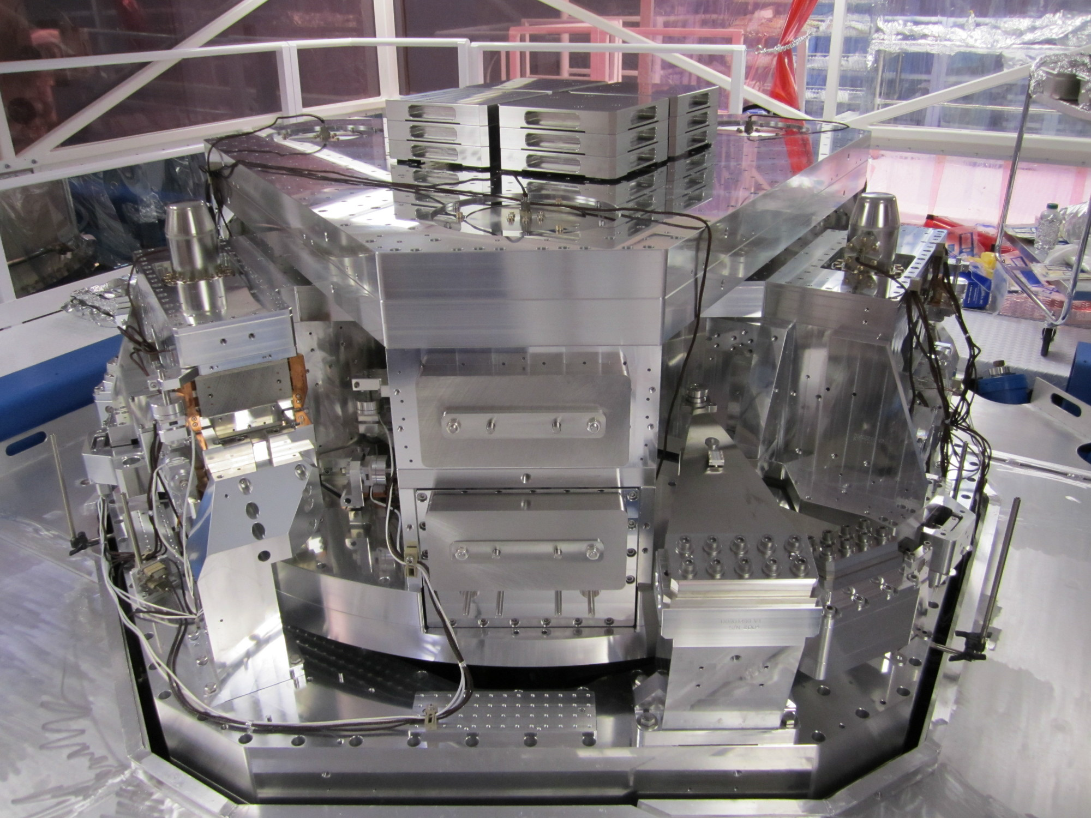
Seismic Isolation:
Multi-Stage Solution
Objectives:
  Render seismic noise a negligible limitation to GW searches
  Reduce actuation forces on test masses
Both suspension and seismic isolation systems contribute to attenuation
Choose an active isolation approach, 3 stages of 6 degrees-of-freedom :
  1) Hydraulic External Pre-Isolation
  2) Two Active Stages of Internal
  Seismic Isolation
Low noise sensors (position, velocity, acceleration) are combined, passed
through a servo amplifier, and delivered
to the optimal actuator as a function of
frequency to hold platform and 1-ton payload
still in inertial space
At 10Hz: 10⁻¹² m/rHz and -80 dB transmissibility
~2m

Slide 25
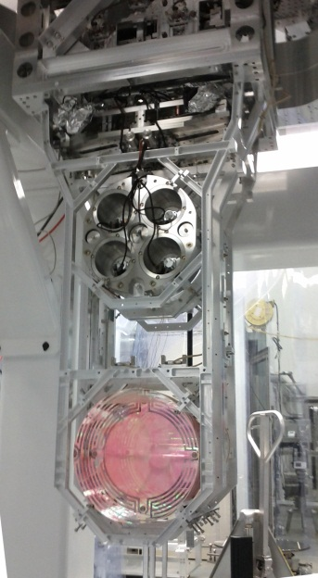

Test Mass Quadruple
Pendulum suspension (GEO)
Quadruple pendulum suspensions for the test masses; second ‘reaction’ mass to give quiet point from which to push
Create quasi-monolithic pendulums using
fused silica fibers to suspend 40 kg test mass
  VERY Low thermal noise! Q = 10⁹
Another element in hierarchical control system
Optics Table Interface
(Seismic Isolation System)
Damping Controls
Hierarchical Global
Controls
Final elements
All Fused silica
Electrostatic
Actuation

Slide 26
Advanced LIGO Project Status
The Project is 94% complete (earned value); H1 97%, L1 99.7% complete
All funds received from NSF, all in-kind contributions made; $12M remaining planned cost (mostly computing), plus $3.7M contingency for surprises
Project now extends to 2017 for Computing activities, but all else end-March 2015
$205M
Oct
‘14

Slide 27
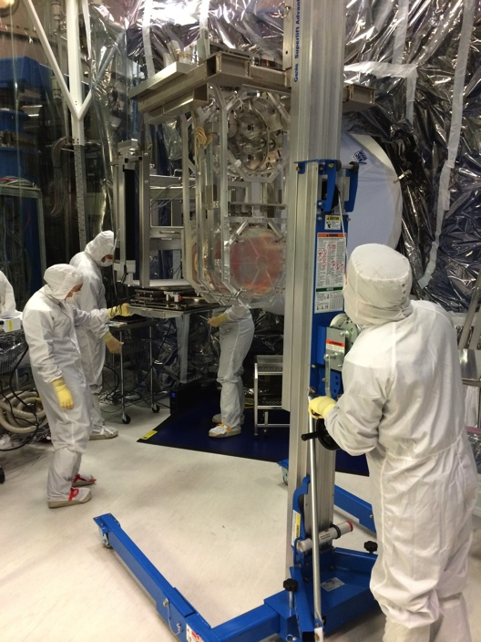
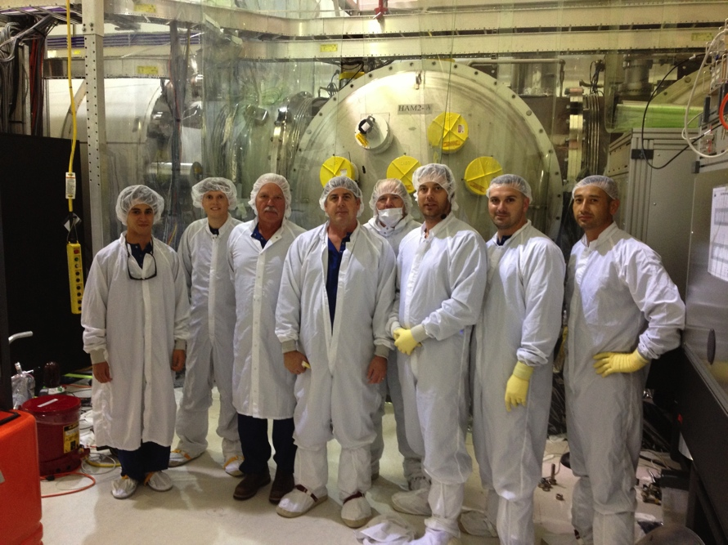
Hanford installation complete
Now under vacuum at all stations. Dual-recycled Michelson test underway; arms lockable with green Arm Length Stabilization, working toward full lock
Accomplished with huge help from LLO, CIT, MIT, LSC
Next: installation acceptance, and get to two-hour-lock milestone
Also, responsibility for 3rd ifo (India) is at Hanford – non-trivial task.

Slide 28
Livingston Project scope finished
The full interferometer lock was achieved on May 26, 2014
L1 formally met the aLIGO goal of a 2h stable lock
The IFO has been locked for as long as 7.5h
Initial alignment and the lock acquisition are mostly automated
Currently recovering from some in-vacuum work
(Need to complete System Acceptance/documentation)

Slide 29
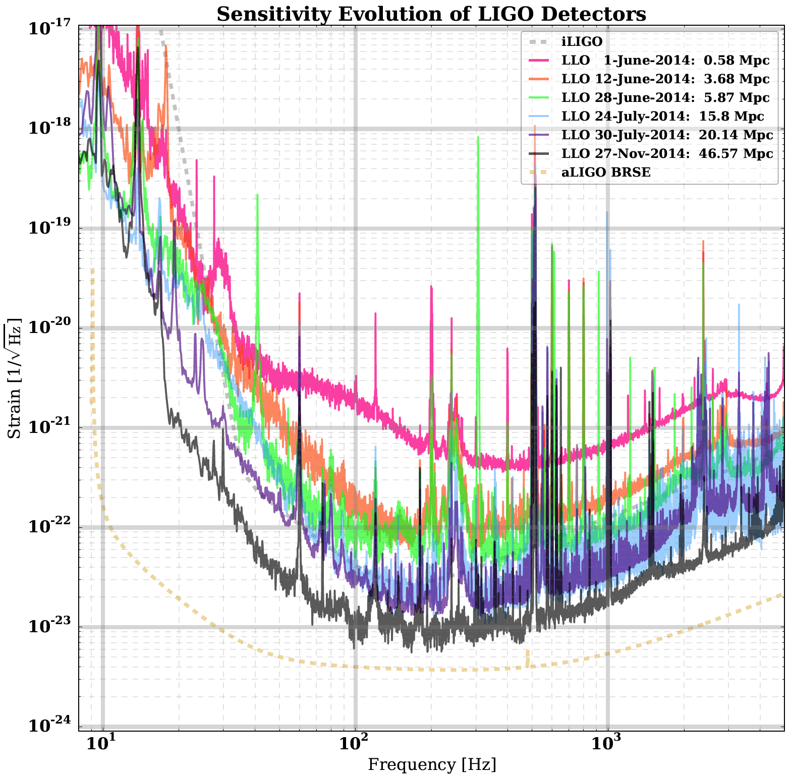
Progression of sensitivity through commissioning
Currently ~47 Mpc range for NS-NS inspiral, SNR 8
(2.6x better than iLIGO)
Goal at full power and completed commissioning
~50x
to go

Slide 30
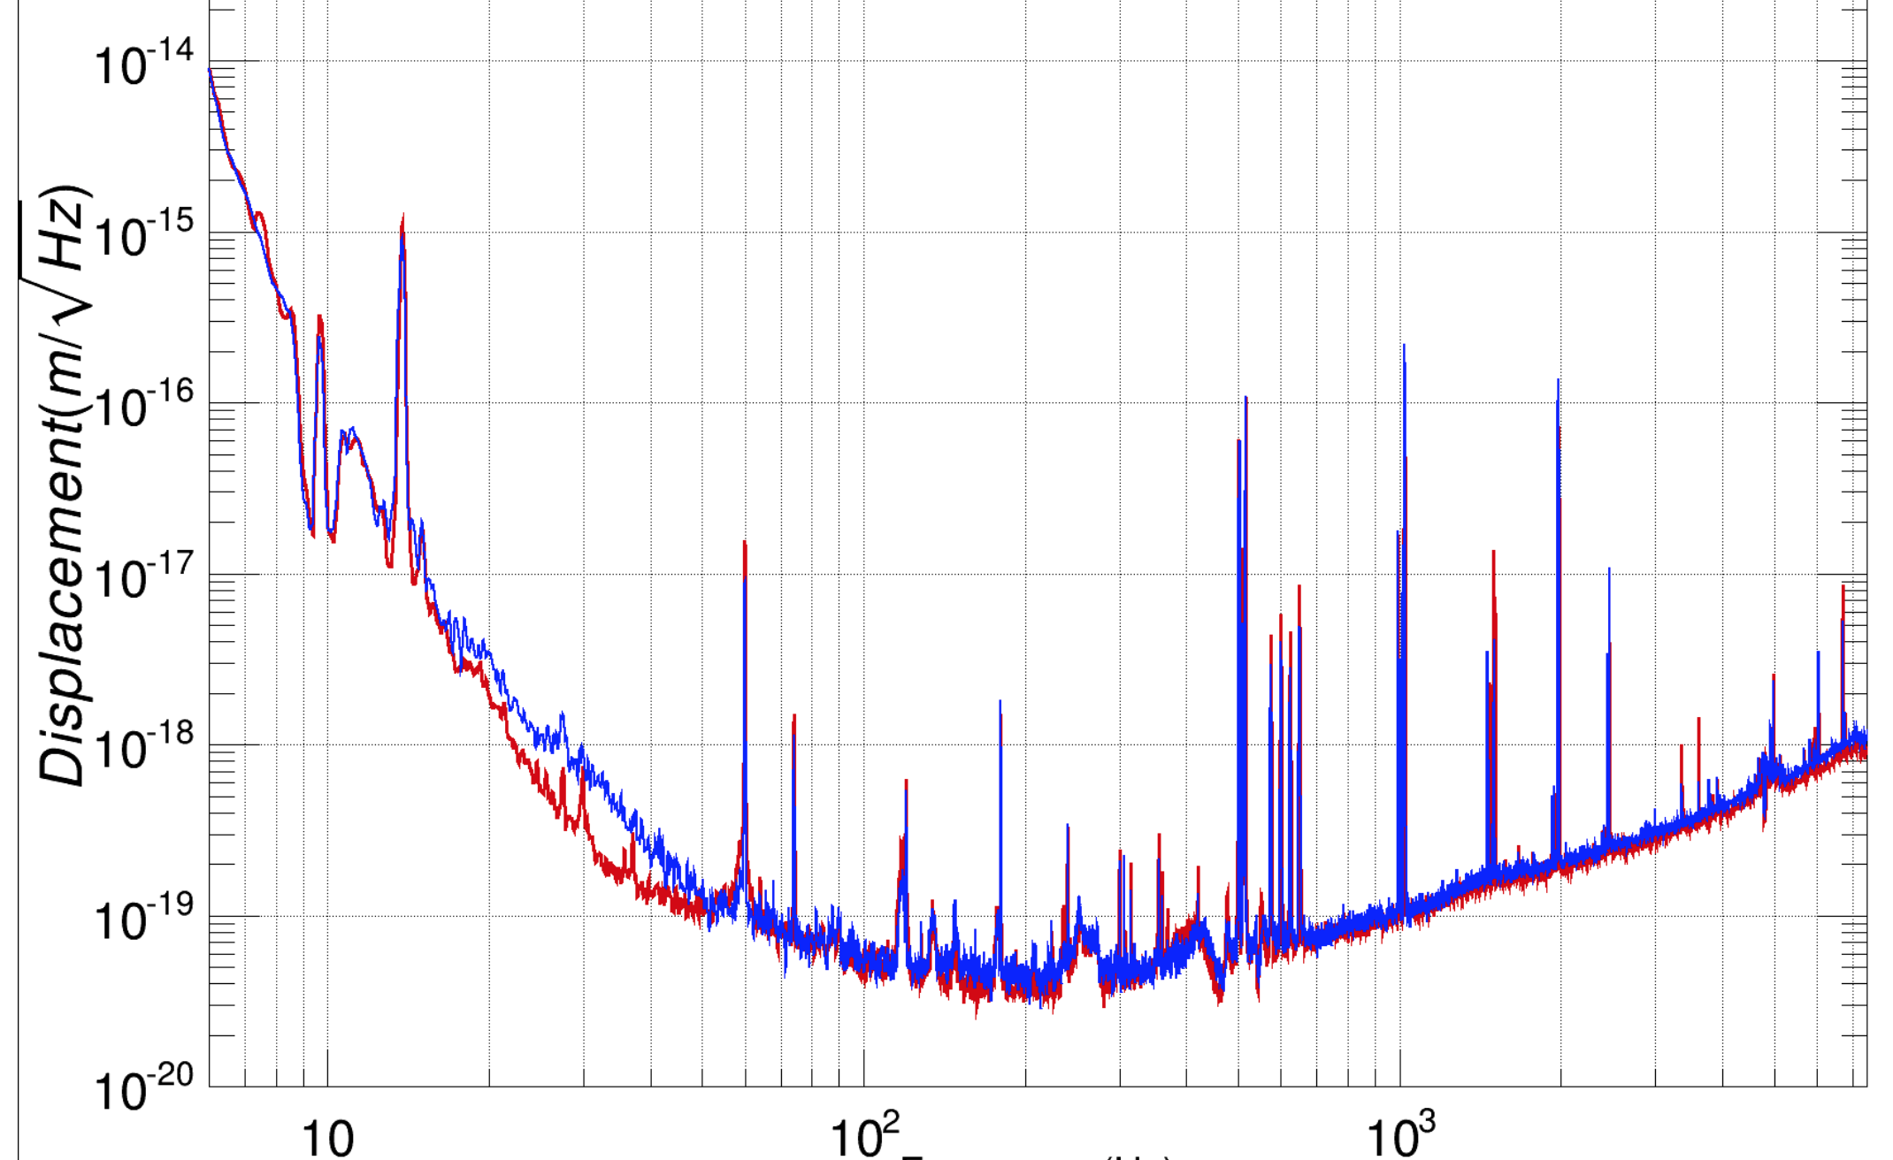
…and another factor of 2 improvement at low frequencies about 6 hours ago…
~25x
to go

Slide 31
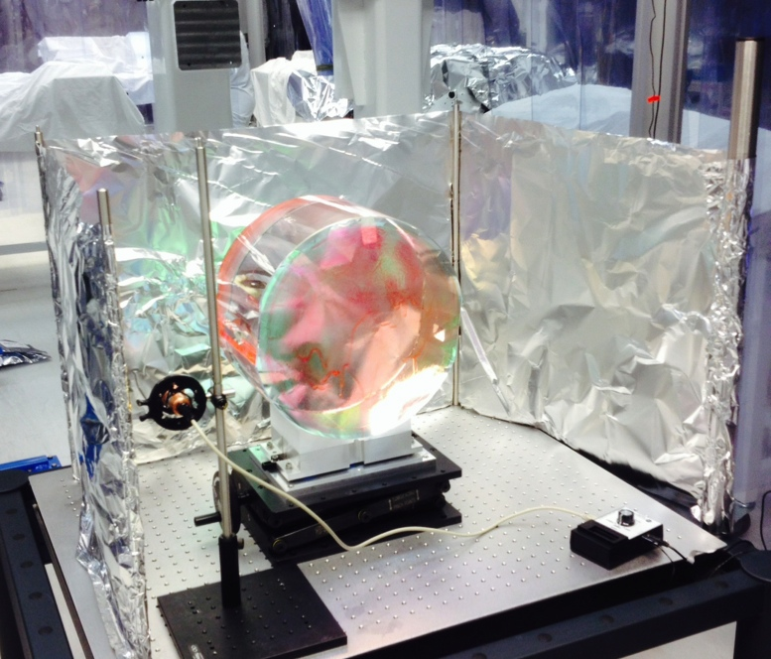
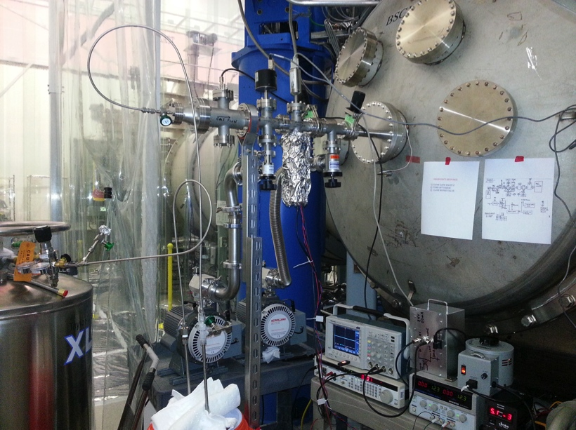
Scariest Technical Challenge of the moment:
Electrostatic Charging
Evidence at both sites of electrostatic (but time varying) charge on test masses
Creates problems for electrostatic actuation AND is a possible noise source
Investigating ion pumps as potential source – looking likely
  Looking at shielding from pumps – direct ion flow, x-ray produced remote ions; not easy
  …and considering getter pumps
Rai Weiss ionizer allows adjustment of charge; making enough for all test masses, but invasive – need to let in some gas, then pump again
Future interferometers must put this in the planning – problem more severe with lower frequency and better sensitivity
(and: it was mentioned in Weiss’ 1972 Report)

Slide 32
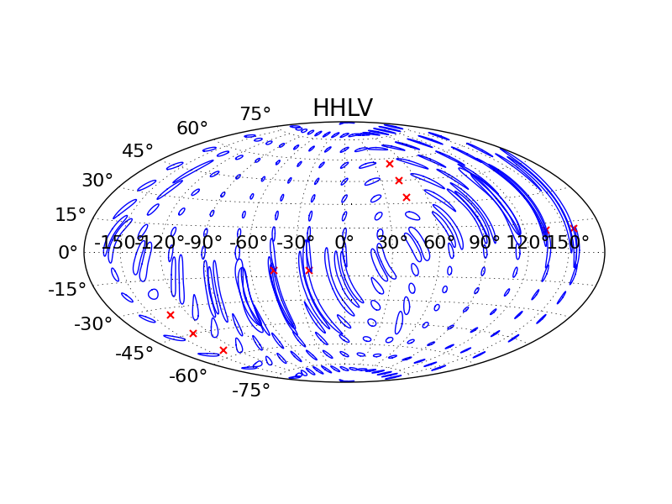
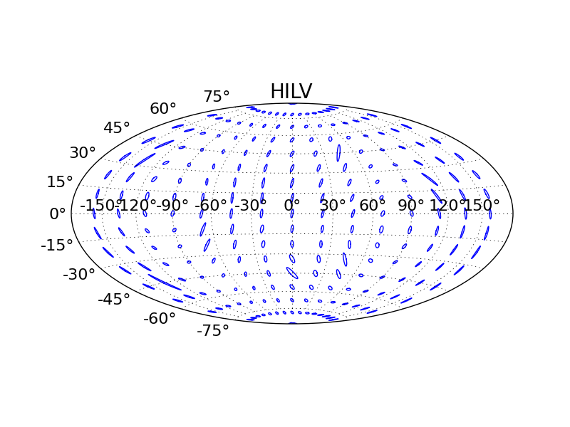
LIGO-India
Plan to take the 3rd aLIGO instrument – originally destined for Hanford as a 2nd instrument there – and install in India
Status
  LIGO-India identified by Indian Government as a Mega-science Project for 2012-2026 period
  Indian Cabinet level approval expected in November 2014 – signed note traveling to Cabinet as we speak
  Should have happened in late 2013, stalled for one year due to complications with data sharing and change of government in India
  Site selection process nearly complete
  Requires NSF approval of transfer of Ifo
  Current schedule has Observations beginning in 2022
Localizing GW events
Without
LIGO-India
Including
LIGO-India

Slide 33
What remains for the Project per se?
Internal Reviews: The Systems group spearheading a series of parallel/series reviews to accept subsystems, installations and ultimately the interferometers as whole devices
Subsystem Acceptance Reviews
Installation Acceptance Reviews
System Acceptance Reviews
Computing: In a change of plans, we will present yearly a plan to the NSF which will have in-house computing AND use of ‘shared resources’
Champagne: In March 2015.

Slide 34
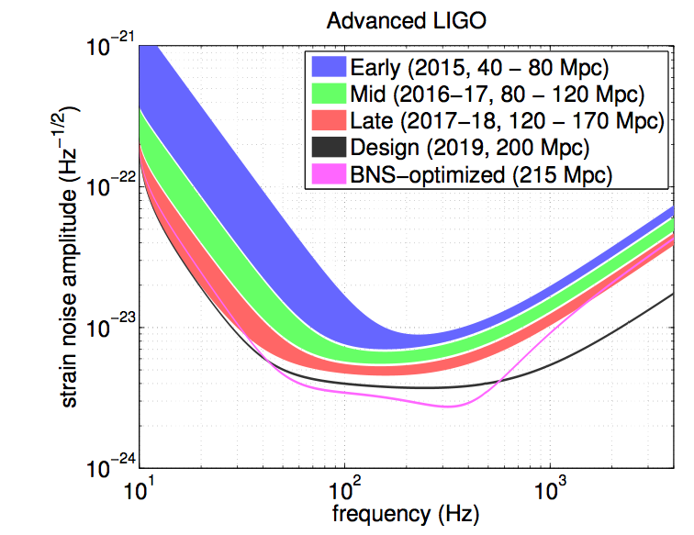
A look at the near future of Observations – when do we think we can see something?
Detections Possible
Detections Likely

Slide 35
What lessons learned?
Things we did well:
Full-scale mechanical and optics prototypes, installed and tested in exact copies of the infrastructure
Scaled interferometry testbeds, using acquisition, control, code of final system
Deep testing for both performance and robustness at all scales of integration
Documentation of designs, testing, and operations/maintenance
  (or will have done well once finished…)
Systems Engineering; flow-down of requirements, establishment of standards; pool of resources to solve subsystem problems (e.g., FEA)
Guardian sequencing system for locking/changing state – started late but caught up quickly; absolutely necessary for a device of this complexity

Slide 36
What lessons learned?
Things we did less well:
Overall Labor estimates (design, engineering, vendor oversight, cleaning, assembly, test, installation, documentation) – aLIGO underestimated the need by a factor 2
Drastically underestimated the technical scope of ‘Auxiliary Optics’ – thermal compensation, scattered light, optical levers, photon calibration
  All these worked (or will work!) out well in the end we believe
Drastically underestimated cost, labor, complexity, difficulty of contamination control, and still not happy with where we are and with our techniques
Some subsystems did not get the QA they should have
  Some in-house activities got less scrutiny
  Some vendors were delivering equipment too specialized for QA staff, so scientists stepped in as QA officers…not so good
  More QA staff, and more rigorous rules for QA activities

Slide 37
Incremental upgrades in planning
Frequency dependent Squeezing is an obvious option for aLIGO
Question will be if we try to use it instead of full power or after full power
Possible Upgrade to Advanced LIGO

Slide 38
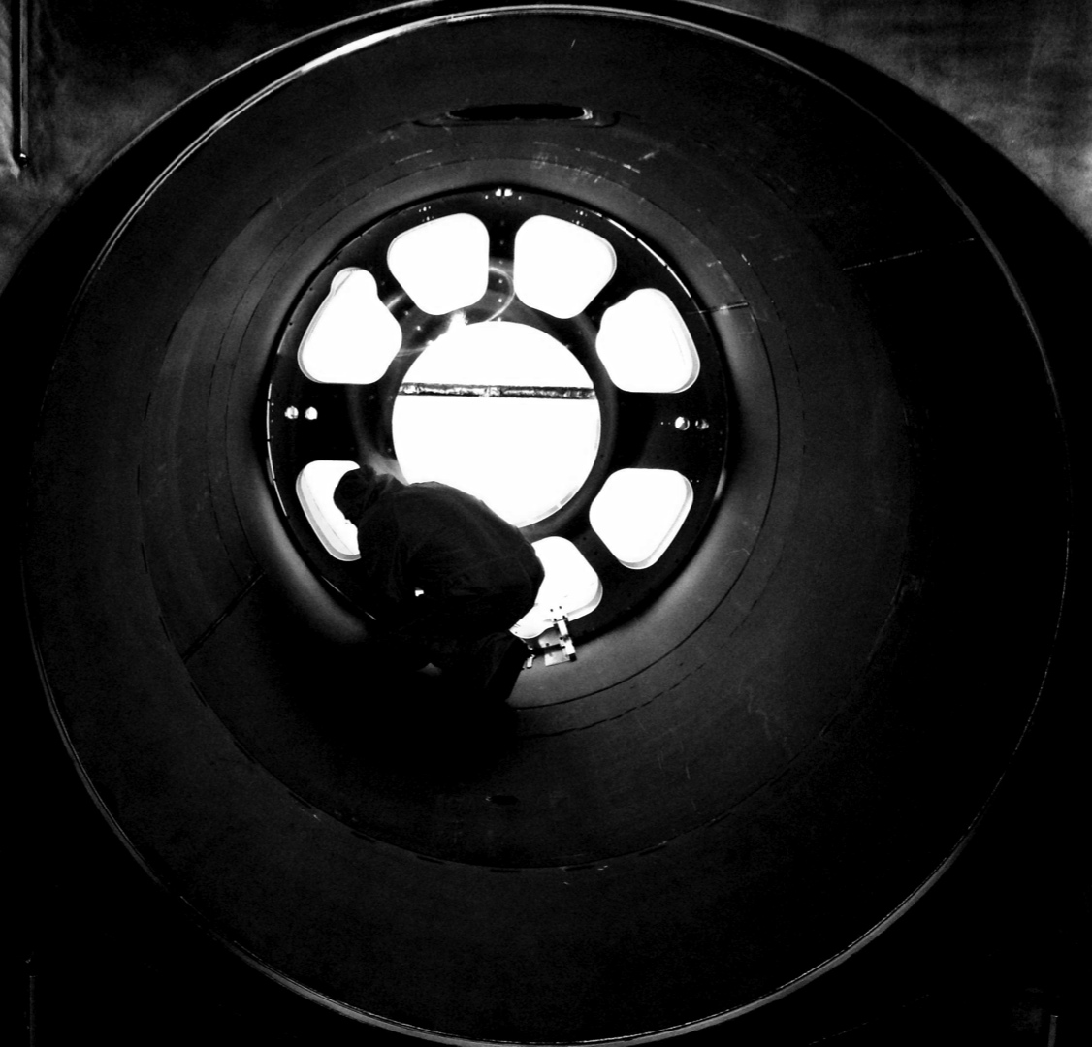
The Last Page
Significant milestones were recently obtained at both sites
  2h lock requirements fulfilled at LLO
  In-vacuum installation complete at LHO
At LLO, LSC participation in commissioning activities starting
At LHO, focus on integrated testing and 3IFO
Acceptance reviews in parallel
Work to do, but…
The light at the end of the
4km tunnel can be seen!
Goal: deliver detections for the 100th anniversary – 2016 – of Einstein’s paper on GWs

