Slide 1
Advanced LIGO status
Hiro Yamamoto LIGO lab/Caltech
Introduction
Initial LIGO and advanced LIGO
Sensitivities
Commissioning status
Targeting the first observations
Some slides are from “ET-aLIGO and beyond”, LIGO-G14001331, by David Shoemaker

Slide 2
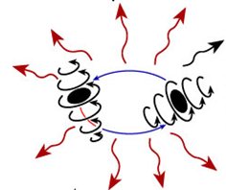
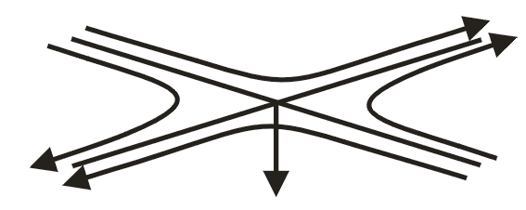
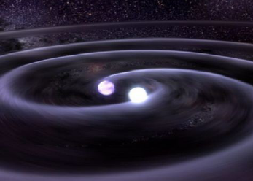
Gravitational waves
Gravitational waves are propagating dynamic fluctuations in the curvature of space-time (‘ripples’ in space-time)
Emissions from rapidly accelerating non-spherical mass distributions
  Quadrupolar radiation

Slide 3
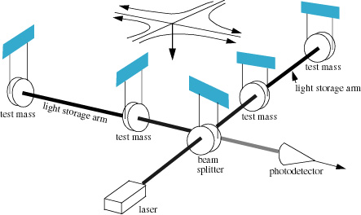
Interferometer for
Gravitational Wave detection
L₁
E₁
E₂
L₂
E₁- E₂ ∝ L₁-L₂
h~10⁻²³
L₁-L₂~10⁻¹⁹m

Slide 4
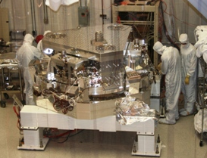
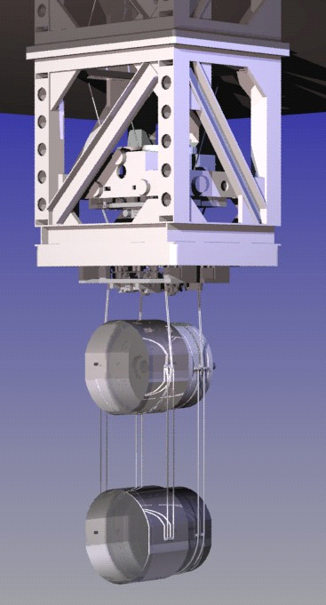
Design Overview
Signal- and Power-recycled Fabry-Perot interferometer
180 W 1064 nm laser
thermal compensation of
optics with CO₂ laser and
Ring-Heater
Arm-Length Stabilization to
aid locking
← 4km →
Active Seismic Isolation
← 4km →
Higher-mass, lower-loss, larger test mass optics
Mode-stable
Recycling Cavities
Quad
Fused-silica
suspension

Slide 5
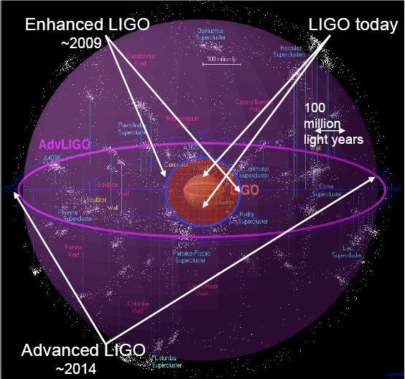
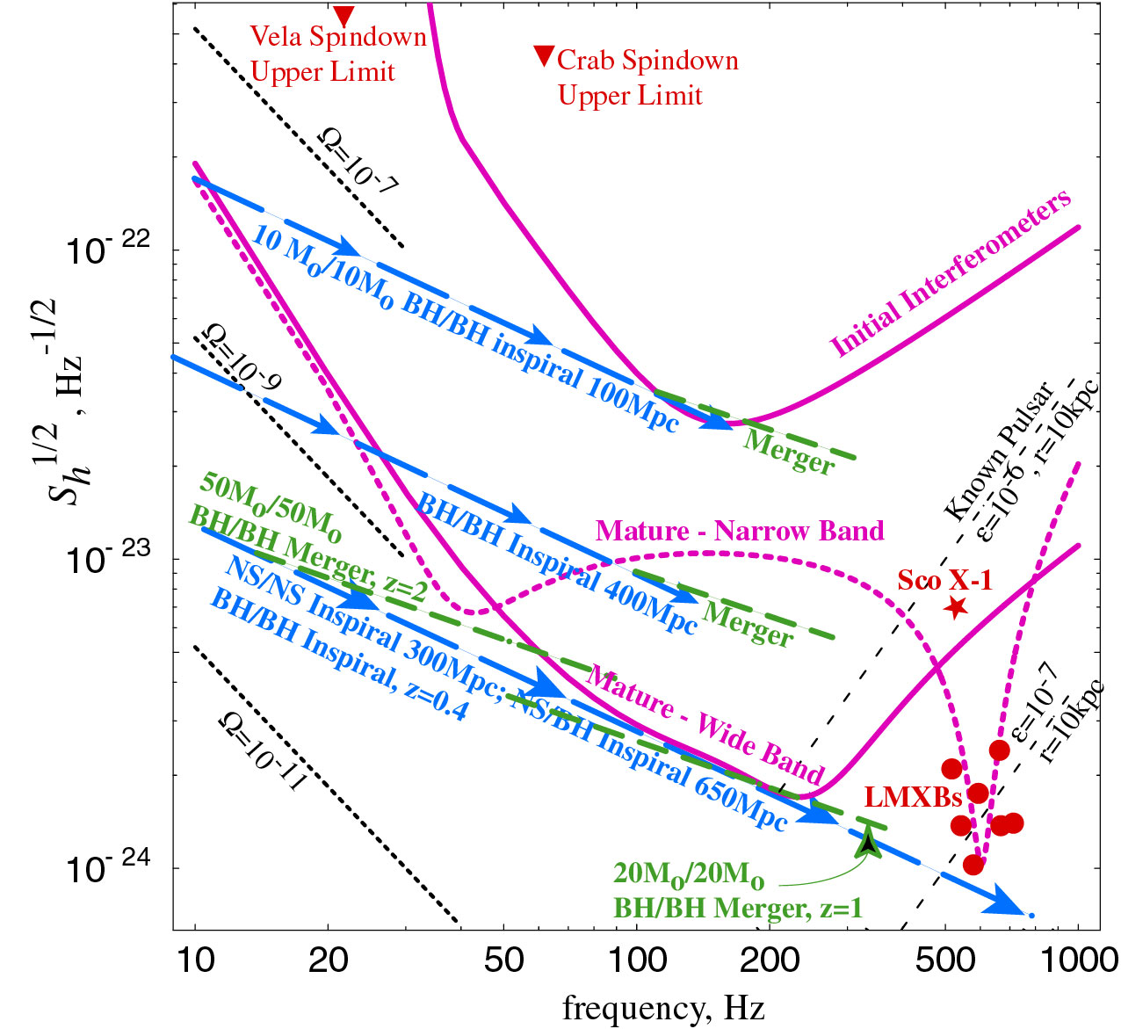
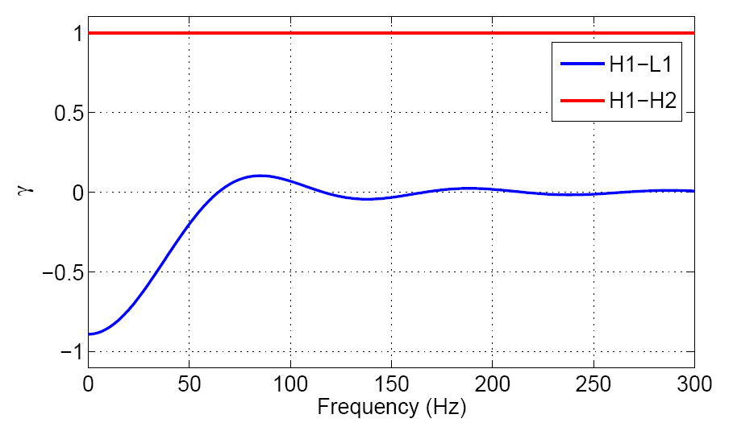
Initial LIGO
Advanced LIGO Scope
and Deliverables
Factor 10 better amplitude sensitivity
  (Reach)³ = rate
Factor 4 lower frequency bound
Tunable for various sources
NS Binaries: for three interferometers,
  Initial LIGO: ~20 Mpc
  Adv LIGO: ~300 Mpc, expect
  one event/week or so
BH Binaries:
  Initial LIGO: 10 M_{o}, 100 Mpc
  Adv LIGO : 50 M_{o}, z=2
Stochastic background:
  Initial LIGO: Ω~3e-6
  Adv LIGO ~3e-9
Image courtesy of Beverly Berger
Cluster map by Richard Powell
5

Slide 6
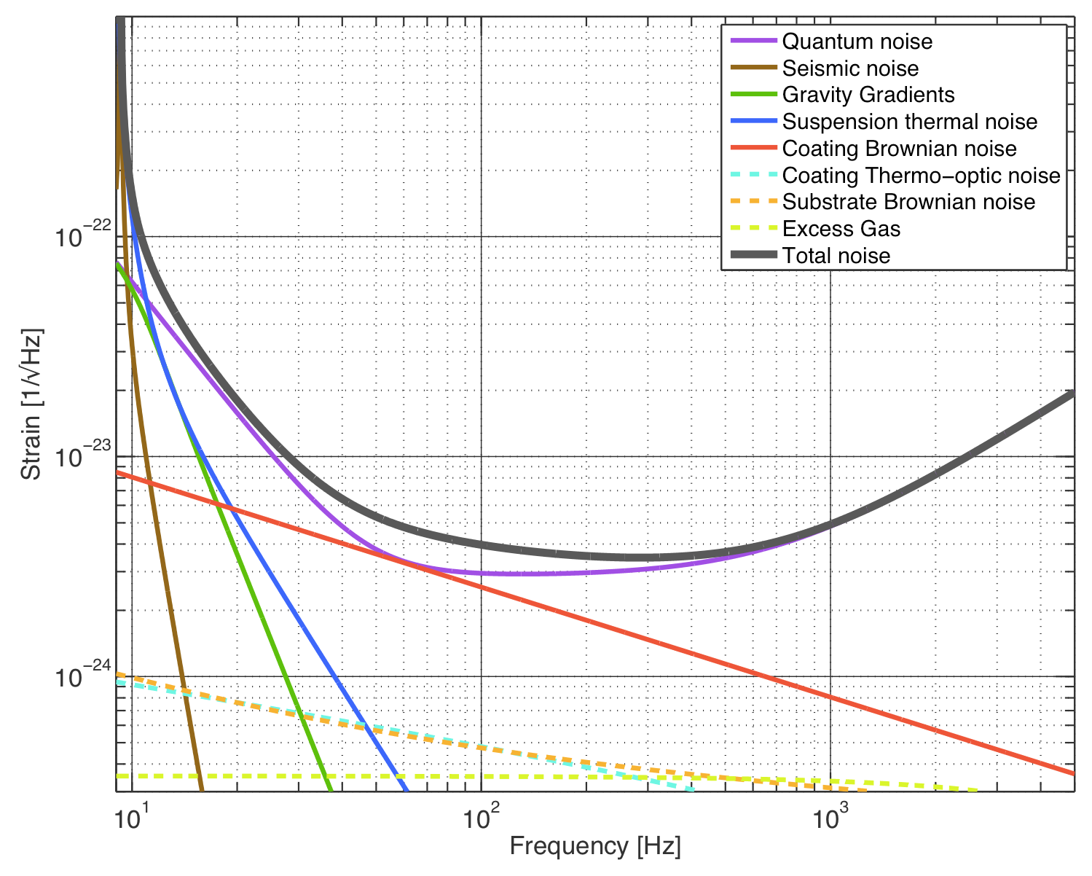
Noise components iLOGO = seismic + thermal + shot aLIGO = quantum noise + thermal

Slide 7
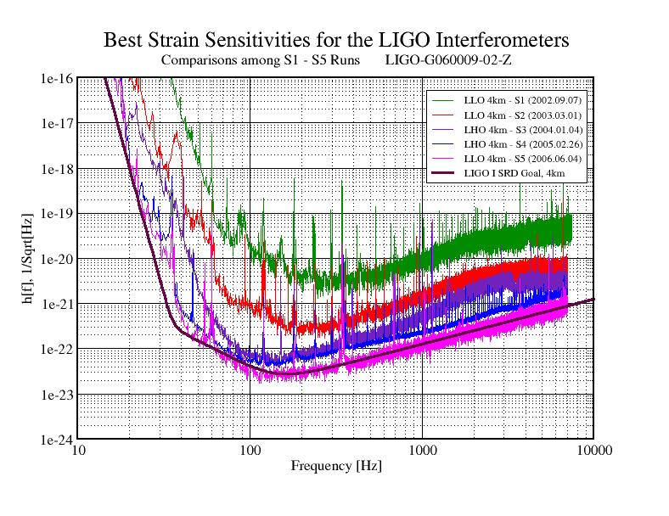
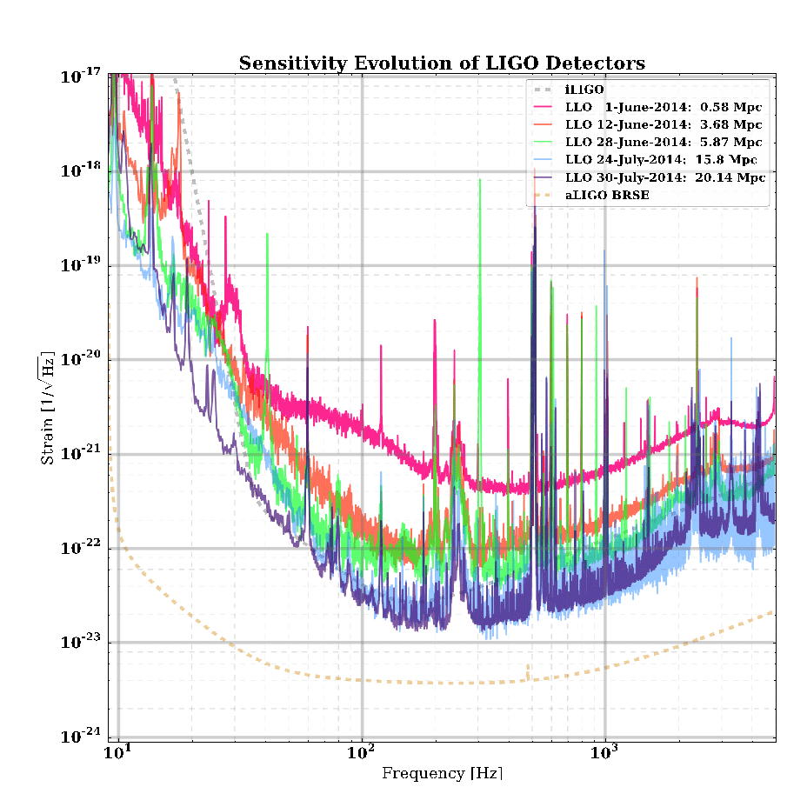
Improving sensitivities

Slide 8
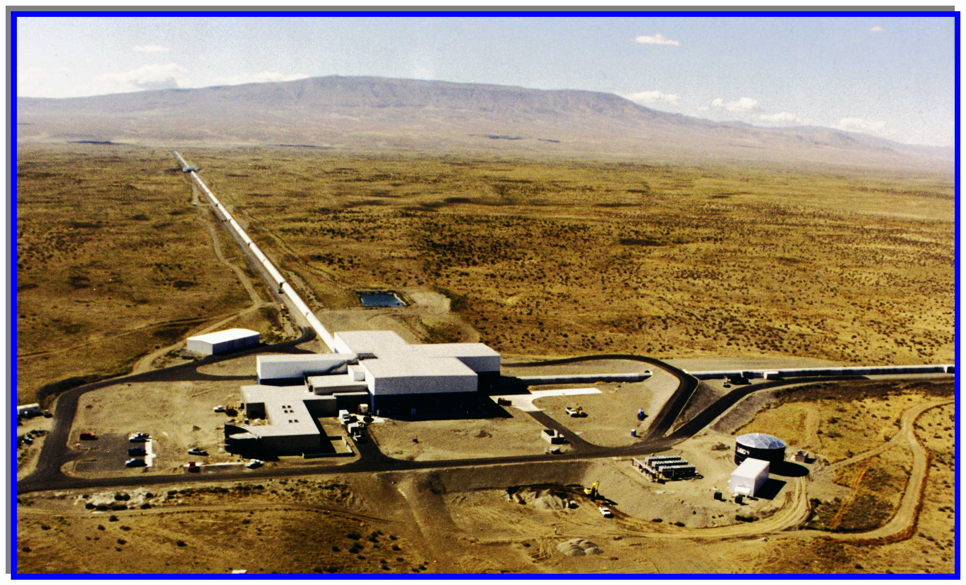
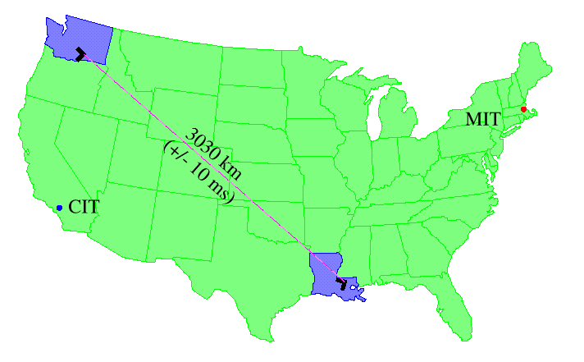
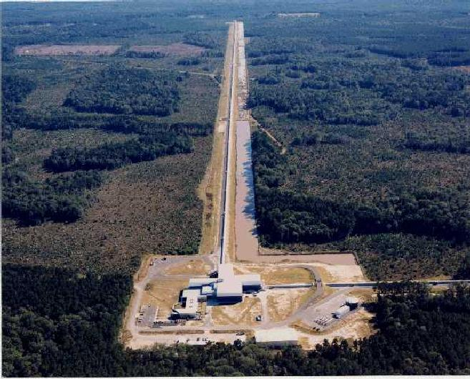
LIGO sites
Hanford
Observatory
(H2K and H4K)
4 km
+ 2 km
Hanford, WA (LHO)
located on DOE reservation
treeless, semi-arid high desert
25 km from Richland, WA
Two IFOs: H2K and H4K -> 4k LHO + 4k India
Livingston, LA (LLO)
located in forested, rural area
commercial logging, wet climate
50km from Baton Rouge, LA
One L4K IFO
Livingston
Observatory
(L4K)
4 km
Both sites are relatively seismically quiet, low human noise - NOT!!

Slide 9
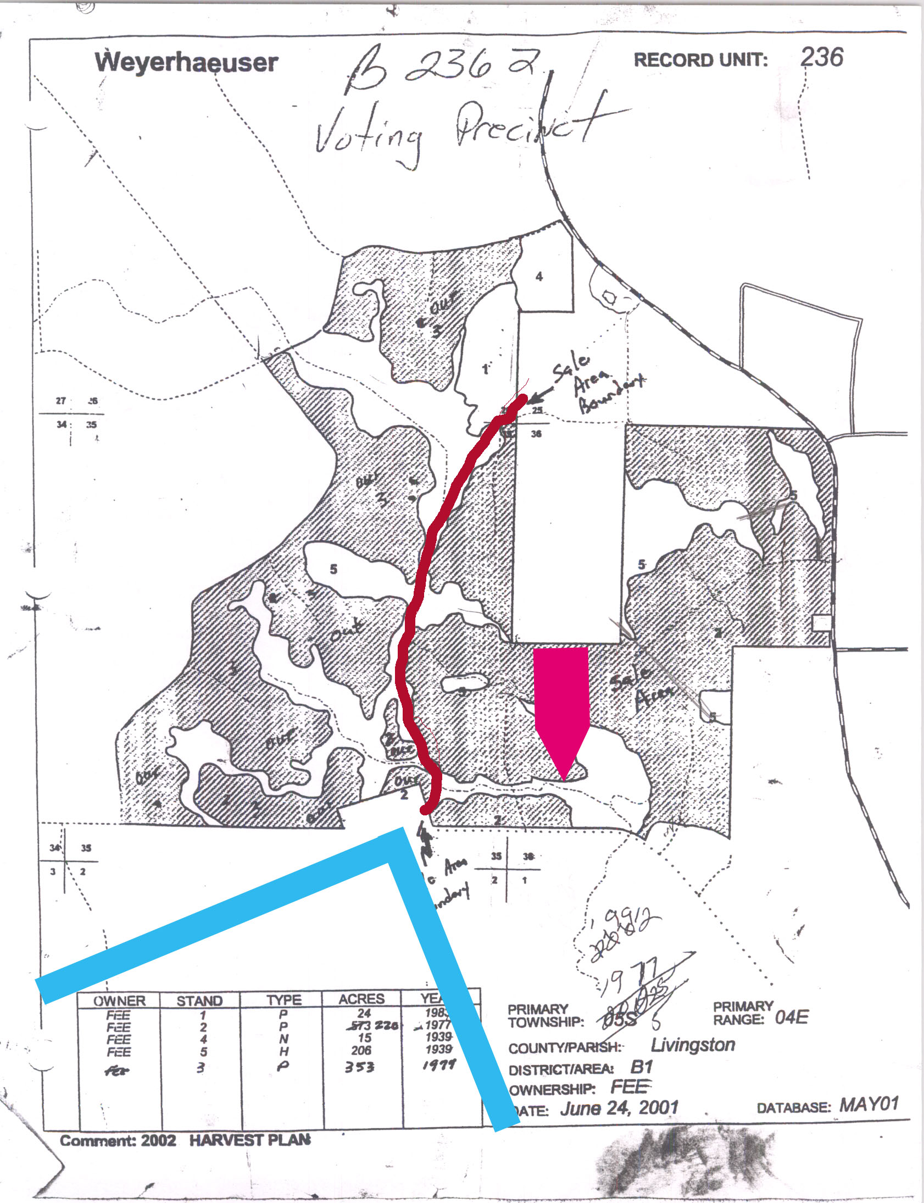
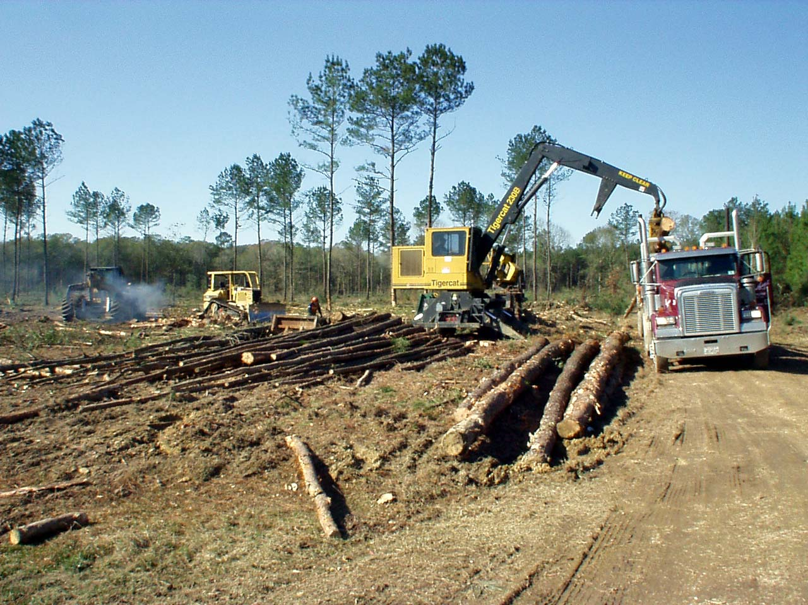
Logging at Livingston
Less than 3 km a few 100 meters away…
Dragging big logs …
Remedial measures at LIGO are in progress;
this will not be a problem in the future.

Slide 10
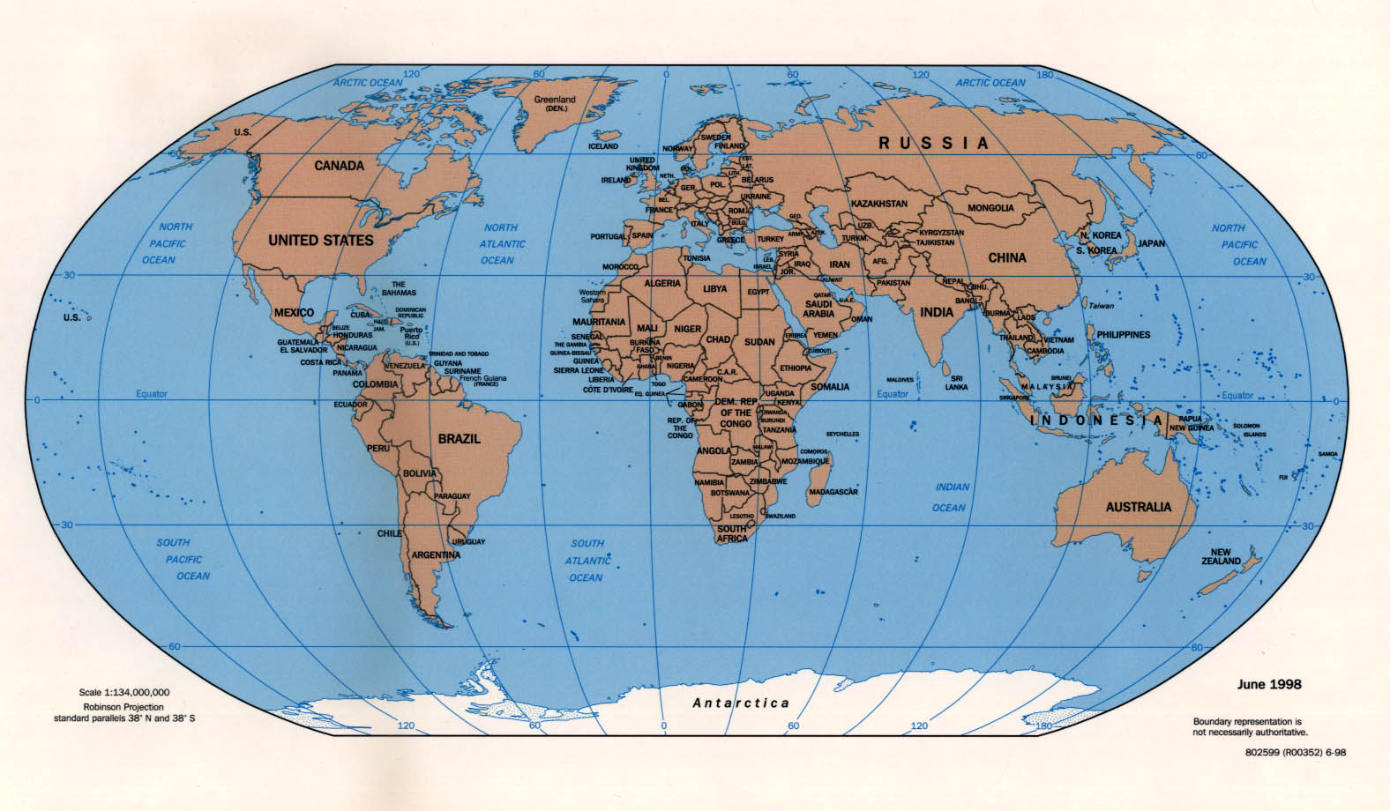
International network
Simultaneously detect signal (within msec)
GEO
Virgo
detection confidence
locate the sources
verify light speed propagation
decompose the polarization of gravitational waves
Open up a new field of astrophysics!
LIGO
KAGRA
LIGO-India

Slide 11

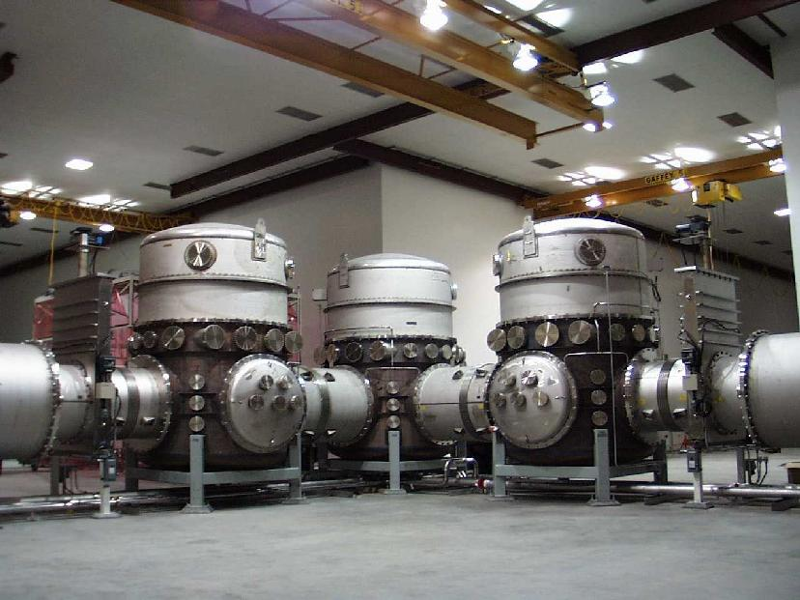
LIGO vacuums
Beam light path must be high vacuum, to minimize “phase noise”
All optical components must be in high vacuum, so mirrors are not “knocked around” by gas pressure

Slide 12
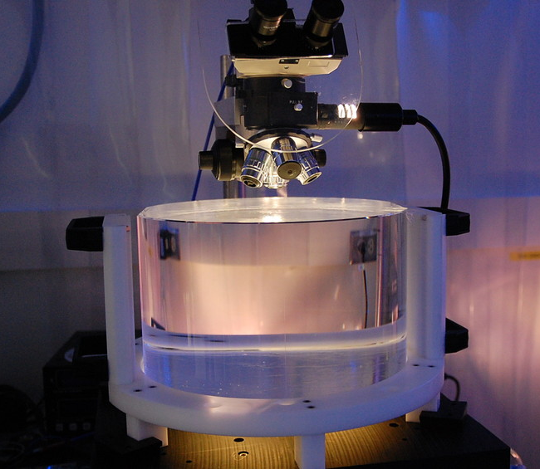
aLIGO Test Masses
Requires the state of the art in substrates, polishing, coating
Both the physical test mass –
a free point in space-time – and a crucial optical element
40 kg
Test Masses:
34cm ∅ x 20cm
Round-trip optical loss: 75 ppm max
Half-nm flatness over 300mm diameter
0.2 ppm absorption at 1064nm
Coating specs for 1064 and 532 nm
Mechanical requirements: bulk and coating thermal noise, high resonant frequency
40 kg
Compensation plates:
34cm ∅x 10cm
BS:
37cm ∅ x 6cm
ITM
T = 1.4%

Slide 13
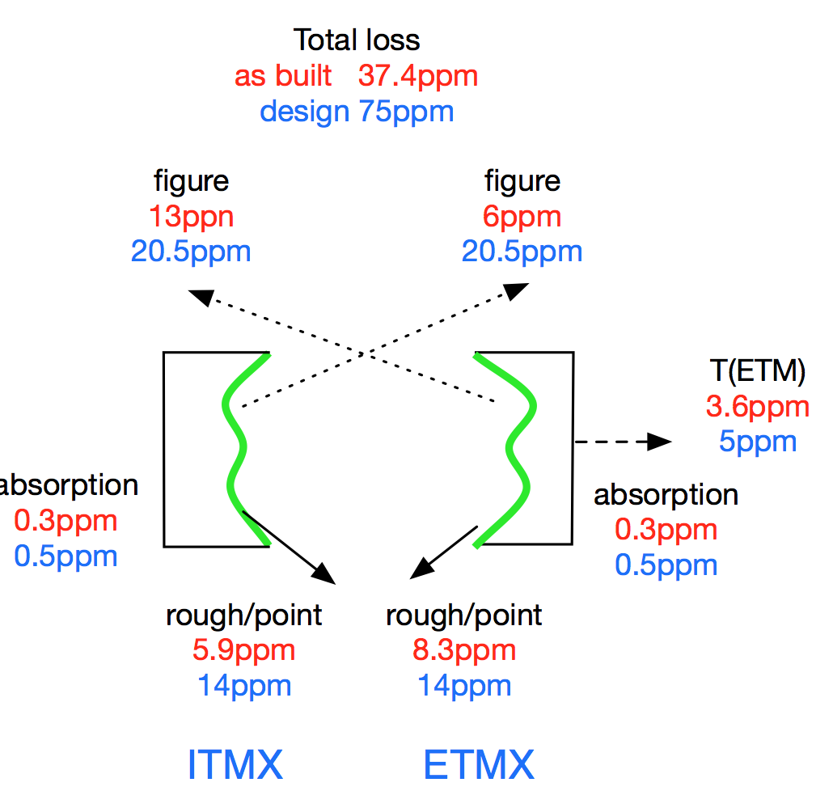
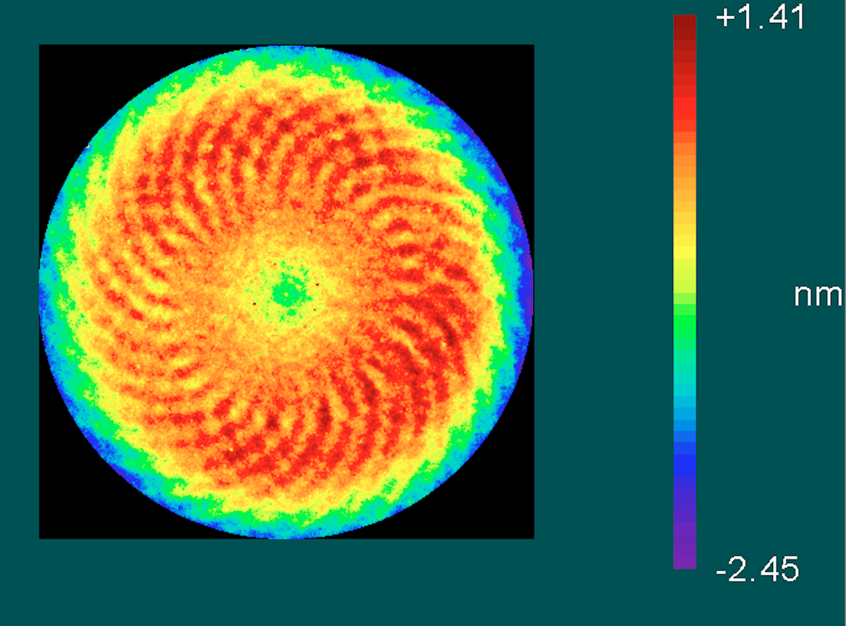
Test mass Optics figure
In-house metrology on 300 mm diameter shows 0.66 nm RMS
  Note spiral from planetary system; about 0.2 nm pk-pk
In-situ measurements of as-built 4km cavity show results are better than requirements!

Slide 14
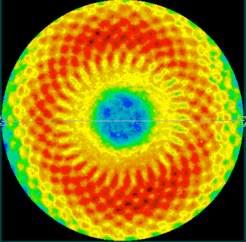
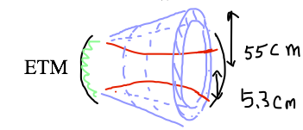
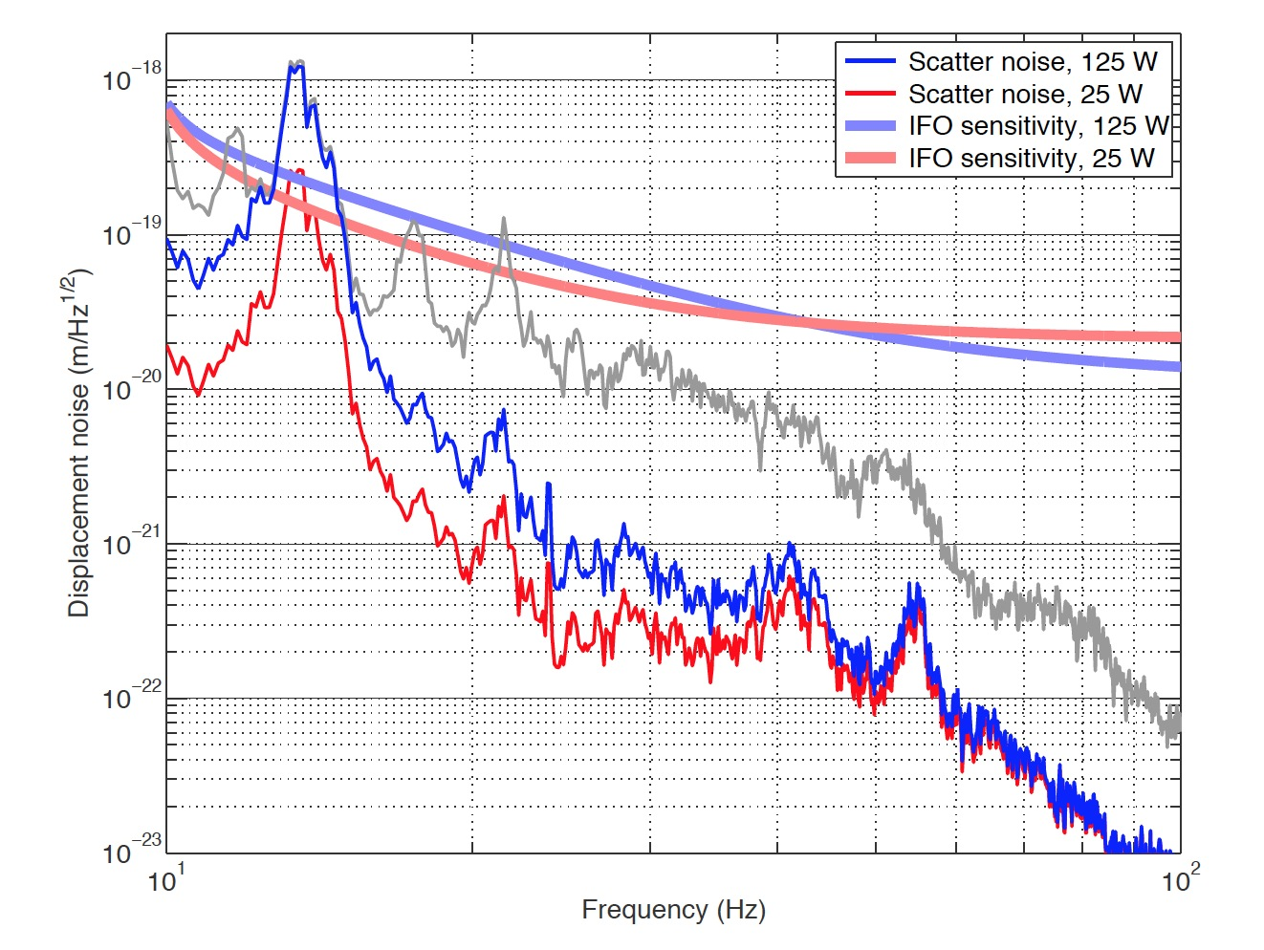
Noise injection by the spiral pattern on test mass coatings
Figure loss by two mirrors
~ 15-20ppm
ETM07 map
micro roughness, point scattering
~ 20 ppm
7.83mm
T1300354 by PF,HY
Phasemap resolution in simulation
main beam ⇒
ETM reflection ⇒
larger angle scattering into cone ⇒
reflected by beam tube baffles ⇒
back scattered into ETM ⇒
merged into the main beam

Slide 15
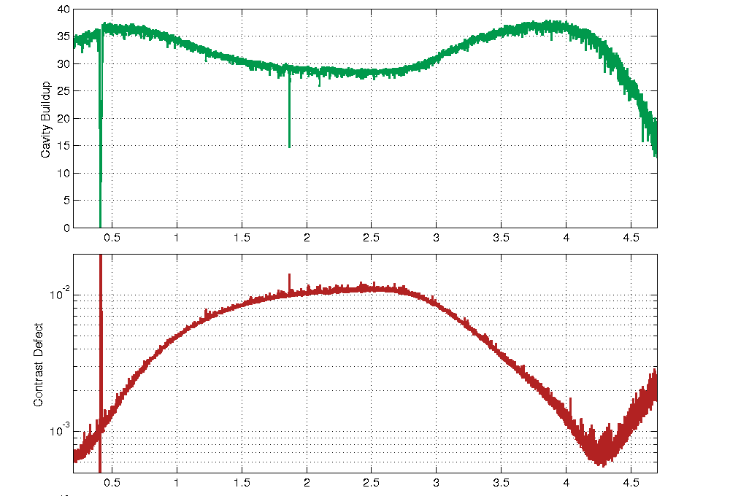
TCS corrections for LLO PRMI
RH optimal lens = n(SiO2) x 82km = 1/0.84 x10⁻⁵
CP optimal lens = 82km = 1/1.22 x10⁻⁵
log11140 CD~400ppm, PRG~45
log#9733 CD~600ppm, PRG~35

Slide 16
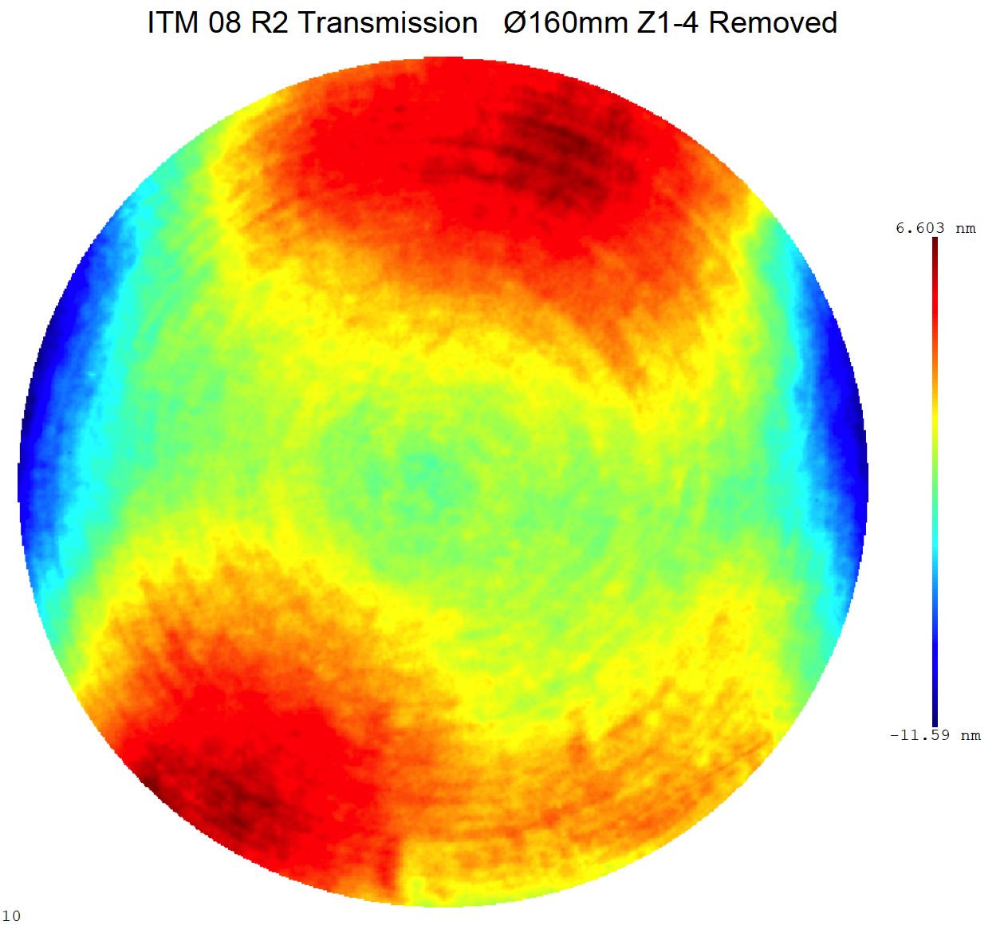
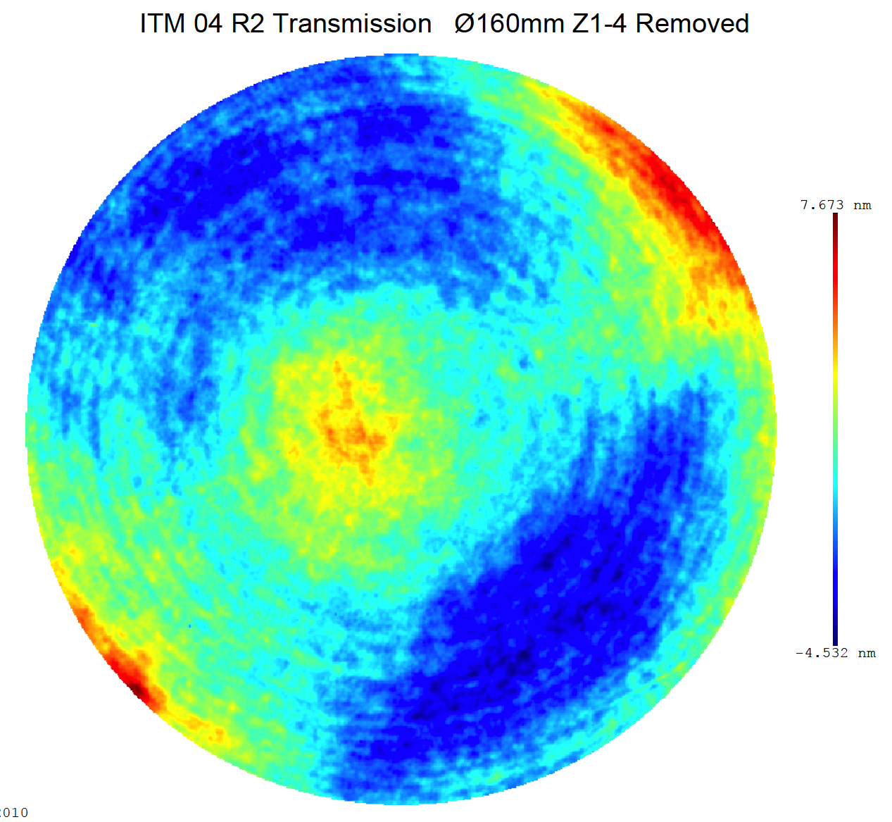
(In)Sensitivity on
ITM SPTWE + CP lens
ITM08 / ITMY
transmission map in 160mm w/o power
6.6nm
-11.6nm
ITM04 / ITMX
7.7nm
-4.5nm

Slide 17
Historical perspective:
Initial LIGO commissioning
1999
2000
2001
2002
2003
2004
2005
2006
2007
3
4
1
2
3
4
1
2
3
4
1
2
3
4
1
2
3
4
1
2
3
4
1
2
3
4
1
2
3
4
1
2
3
Inauguration
First Lock
Full Lock all IFO
Design sensitivity
4 km strain noise
10⁻¹⁷
10⁻¹⁹
10⁻²¹
10⁻²²
2.5x10⁻²³
10⁻¹⁸
10⁻²⁰
at 150 Hz [Hz^{-1/2}]
Engineering
E2
E3
E5
E7
E8
E9
E10
E11
Runs
Science
S1
S2
S3
S4
S5
First Science Data
Overall, 4-5 years from locking to design sensitivity

Slide 18
Project Integrated Testing Plan
Integrated testing phases interleaved with installation
Complementary division between LHO and LLO
  Designed to address biggest areas of risk as soon as possible
  H1 focused on long arm cavities; L1 worked outward from the vertex
July 2012
Oct 2012
Jan 2013
Apr 2013
July2013
Oct 2013
Jan 2014
Apr 2014
July2014
One Arm Test 1st arm cavity Green only
Input Mode Cleaner
HIFO-XY
Both arms + corner
No AS port
H1
HIFO-Y Y-arm + corner
Green + PSL IR
Build & test from the arms backward
L1
Input Mode Cleaner with high power test
Dual recycled Michelson
Full Interferometer
I
II
III
Build & test from the laser outward

Slide 20
LLO Project scope finished
The full interferometer lock was achieved on May 26, 2014
L1 formally met the aLIGO goal of a 2h stable lock
The IFO has been locked for as long as 7.5h
Initial alignment and the lock acquisition are mostly automated
Currently recovering from some in-vacuum work
(Need to complete System Acceptance/documentation)

Slide 21
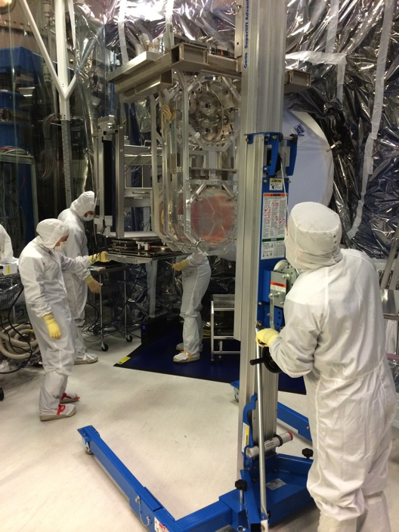
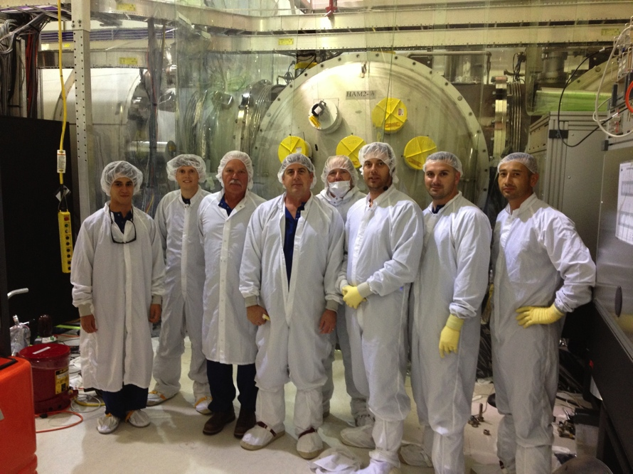
LHO installation complete
Now under vacuum at all stations. Dual-recycled Michelson test underway; arms lockable with green Arm Length Stabilization, working toward full lock
Accomplished with huge help from LLO, CIT and MIT
Next: installation acceptance, and get to two-hour-lock milestone
Also, responsibility for 3rd ifo (India) is at Hanford – non-trivial task.

Slide 22
Targeting the first observations
ER6 slated for start December 8th, 2014
  L1 expected to be locked for multiple-hour intervals, although not at peak sensitivity; H1 not locking yet
  Significant discussion in Joint Run Planning Committee on ER6 readiness (throughout the LSC), start date, calibration/freeze/run durations, and impact on commissioning
O1 observation run slated for as early as mid-July 2015; an evolving discussion as commissioning progress is understood
Important point: we want Both LIGO instruments working at comparable sensitivity for the first observing run
  Catch-up needed at LHO – integrated testing starting ~6 months later than LLO, and e.g., operator/detector support training just getting going; lessons learned will help, but only so much
  Still ‘all hands on deck’ from LLO, MIT, CIT and of course LHO to reach that goal, but with competing needs to complete aLIGO hardware and documentation, work on BeamTube leak repair

Slide 23
Advanced LIGO: anticipated science runs
3rd: 2017-2018
Full sensitivity (200 Mpc): end-2018
2nd run: 6 months @80-120 Mpc likely detection
2016-2017
1st run: 3 months @40-80 Mpc possible detection
2015

