Slide 1
Test Mass Discharging System (TMDS)
Design Review
20 Nov 2014
Rich Abbott, Dennis Coyne, Eddie Sanchez, Calum Torrie

Slide 2
References
T1400713: Test Mass Discharging System: Design Document
E1400447: BOM & Cost Estimate: Test Mass Discharging System
D1400331: Surface Charge Control Ionizer
  Plus linked part drawings
plus all of Rai's memos on the prototype which are collected as "related document" links under T1400713
  G1401265: ESD and Charging: LHO F2F, Oct 28, 2014
  G1401153: charging presentation to systems group
  T1400620: Additional notes on charging
  T1400647: Significant puzzle in explaining the charging mechanism of the test masses
  G1100364: ion neutralization
  T1100332: Surface charge control of the Advanced LIGO mirrors using externally introduced ions
  T1400477: Preparations for discharging the test mass at LHO ETMY and hypotheses about the charging
  T1400535: Experience with discharging the ETMY test mass at LHO in August 2014
  T1400497: Steps in operation of the ionizer
  T1400705: Ionizer research at LHO 1028-110314

Slide 3
Stipulations
We need a test mass discharging system - no debate.
The basic approach that Rai Weiss has prototyped will remain the concept
  i.e. a gas field ionization system GFIS and not for example a UV illumination system

Slide 4
Proposed Test Mass Discharging System (TMDS)

Slide 5
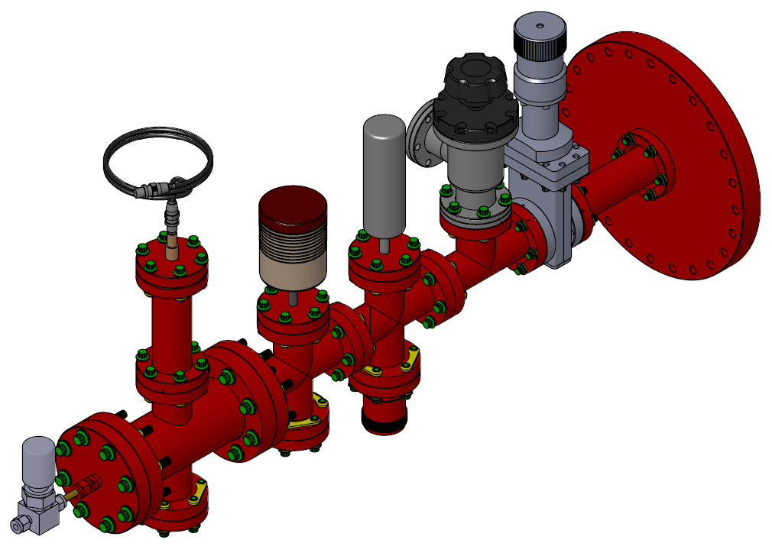
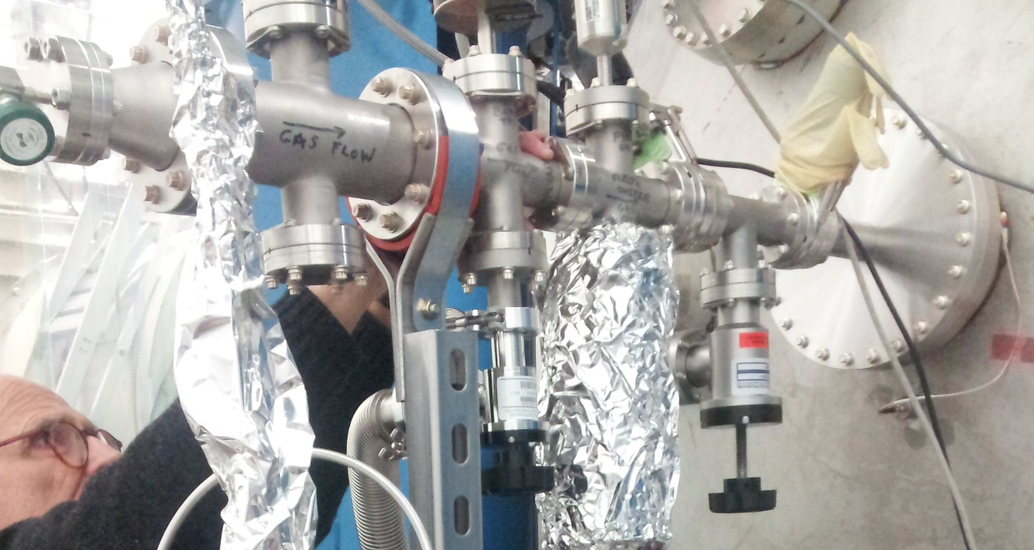
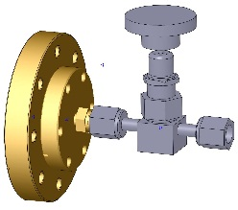
Pending Corrections
D1400331
EXTANT FLANGE HAS WELDED NIPPLE
ROTATE ANGLE VALVE 180°
(path to scroll pump)
FOR EASIER LEAK CHECKING: CHANGE FROM PIPE THREAD TO SWAGELOK FITTING TO ZERO-LENGTH CF FITTING TO VCR

Slide 6
Pending Corrections
Incorporate alignment marks/references to facilitate alignment of the emitter array to the aperture plate holes

Slide 7
Questions to Resolve
Quantities
  Planning to install an Ion Generator on every Test Mass chamber for all 3 Interferometers
  N = number of simultaneously operated TMDS
  Assuming each observatory can provide 1 LN2 Dewar, 1 Scroll Pump, N Oscilloscopes
  Vacuum ‘Tree’, Ionizers, Electronics & Gauges:
    17 = [4 TM chambers/IFO + 1 spare/IFO] x 3 IFOs + LASTI + 1 in-process spare
  Vacuum pumping, Gas Sources (GN2 boil-off & purge air)
    [3 vacuum volumes/Obs – {1 Dewer/Obs, 1 Scroll pump} avail] x 2 Obs = 4
    (Not providing for 3rd IFO or LASTI; Std equipment.)

Slide 8
Questions to Resolve
Gas Sources
  Planning to support both LN2 and purge air as options
    Optical absorption scans for coatings exposed to ions show no change (after cleaning off particulates) with either gas source
  Do we need to procure more LN2 dewars, or do the Observatories have enough?
  What is the appropriate piping and fittings for the GN2 line from the dewar to the flow meter?
  What is the appropriate piping and fittings for the purge air port to the flow meter?
  Do the observatories have sufficient piping & fittings to connect to the TMDS at the flow meter, or should this be part of the TMDS procurements?
  Planning to use neither a particulate filter nor a cold trap on the purge air line, unless measurements on the purge air indicate problems – OK?

Slide 9
Questions to Resolve
Electronics
  Ion Generator HV Power Supply: Use which approach?
    prototype sinusoid: Variac + Neo sign transformer, or
    proposed sq wave: HV Push/Pull Switch with DC-to-DC
  Incorporate custom Sq Wave generator into custom electrometer circuit bd, or continue to use a Lab Function Generator instrument (e.g. SRS DS335)? If the later, do the observatories have N units available?
  Still OK with oscilloscope display? (e.g. no custom digital readout)
  No need/desire to provide electrometer feedback to HV Supply to automatically keep below corona discharge, correct?

Slide 10
Questions to Resolve
Gas Field Ionization Source (GFIS)
  The prototype emitter/needle material was stainless steel
  Ti and Ta may have less particulate generation
  Planning to purchase a complete set of Ti needles plus a few sets of stainless steel, tungsten carbide (WC) and steel (M2 HSS) to experiment on particulate generation rates
  OK?

Slide 11
Request of the Review Committee
Authorization to proceed with procurement of:
  Vacuum equipment (trees, plumbing, gauges/controllers) – all commercial-off-the-shelf
  Gas Field Ionization System (GFIS) – custom design based on prototype
  Gas source components for both options (purge air and LN2 boil off)
Agreement to pursue detailed design and prototyping of the custom electronics
  Ion Generator Power Supply
  Electrometer

