Slide 1
Oplevs
What ails them:
1) glitchy laser
2) glitchy whitening boards
3) Oplev pier motion
4) Spot size and shape
5) QPD quadrant asymmetries

Slide 2
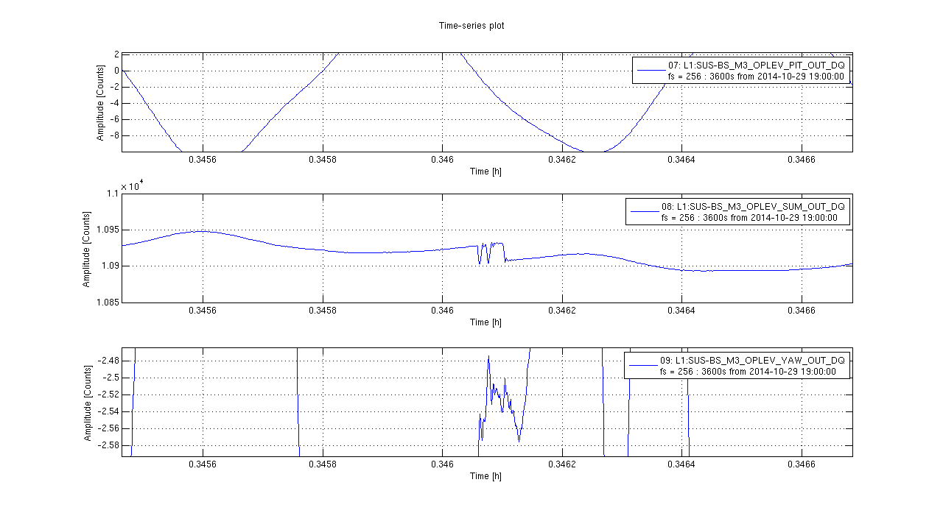
What do laser power glitches do?

Slide 3
Glitchy lasers
SR560
BP 3-1000 Hz

Slide 4
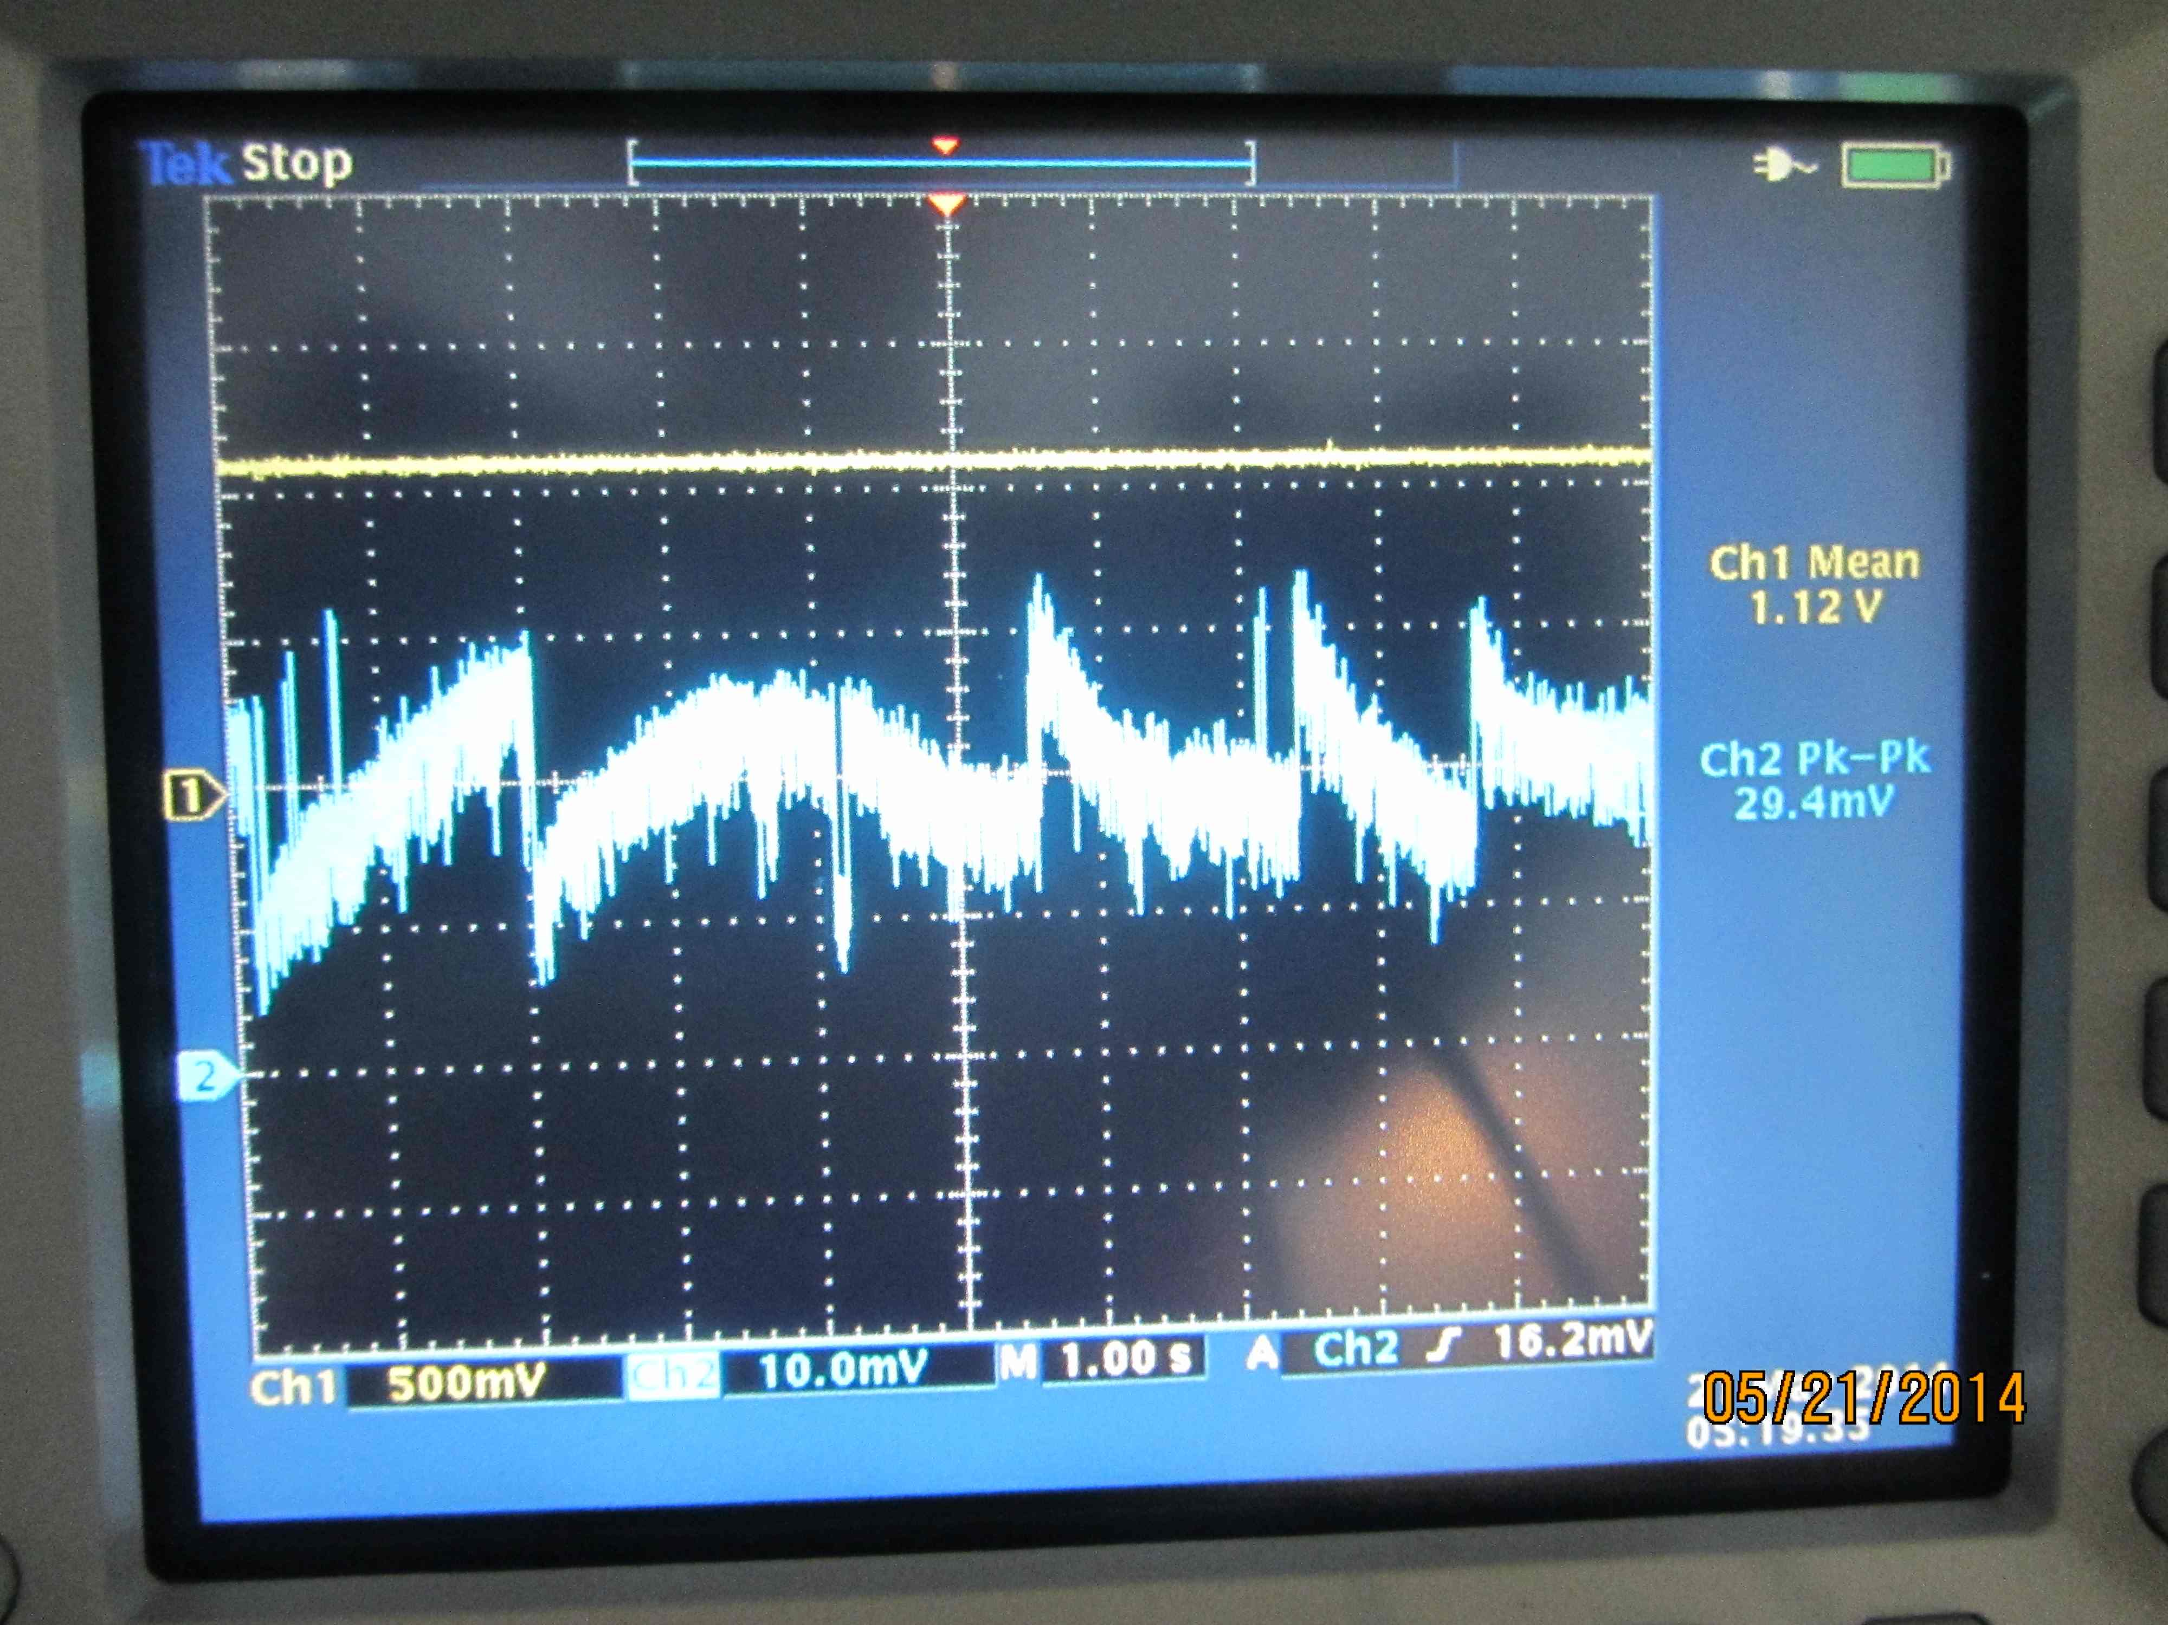
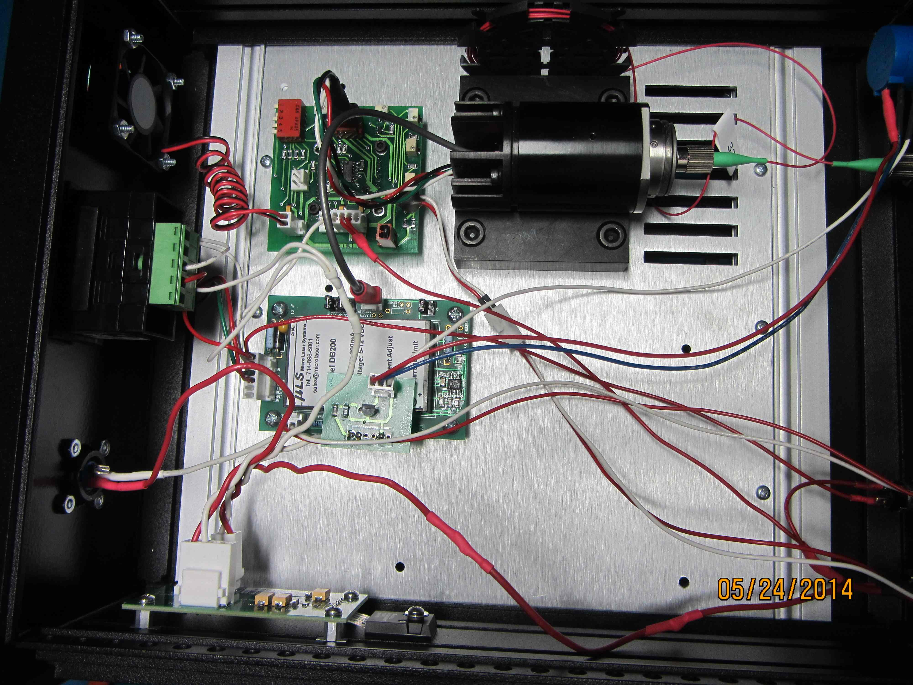
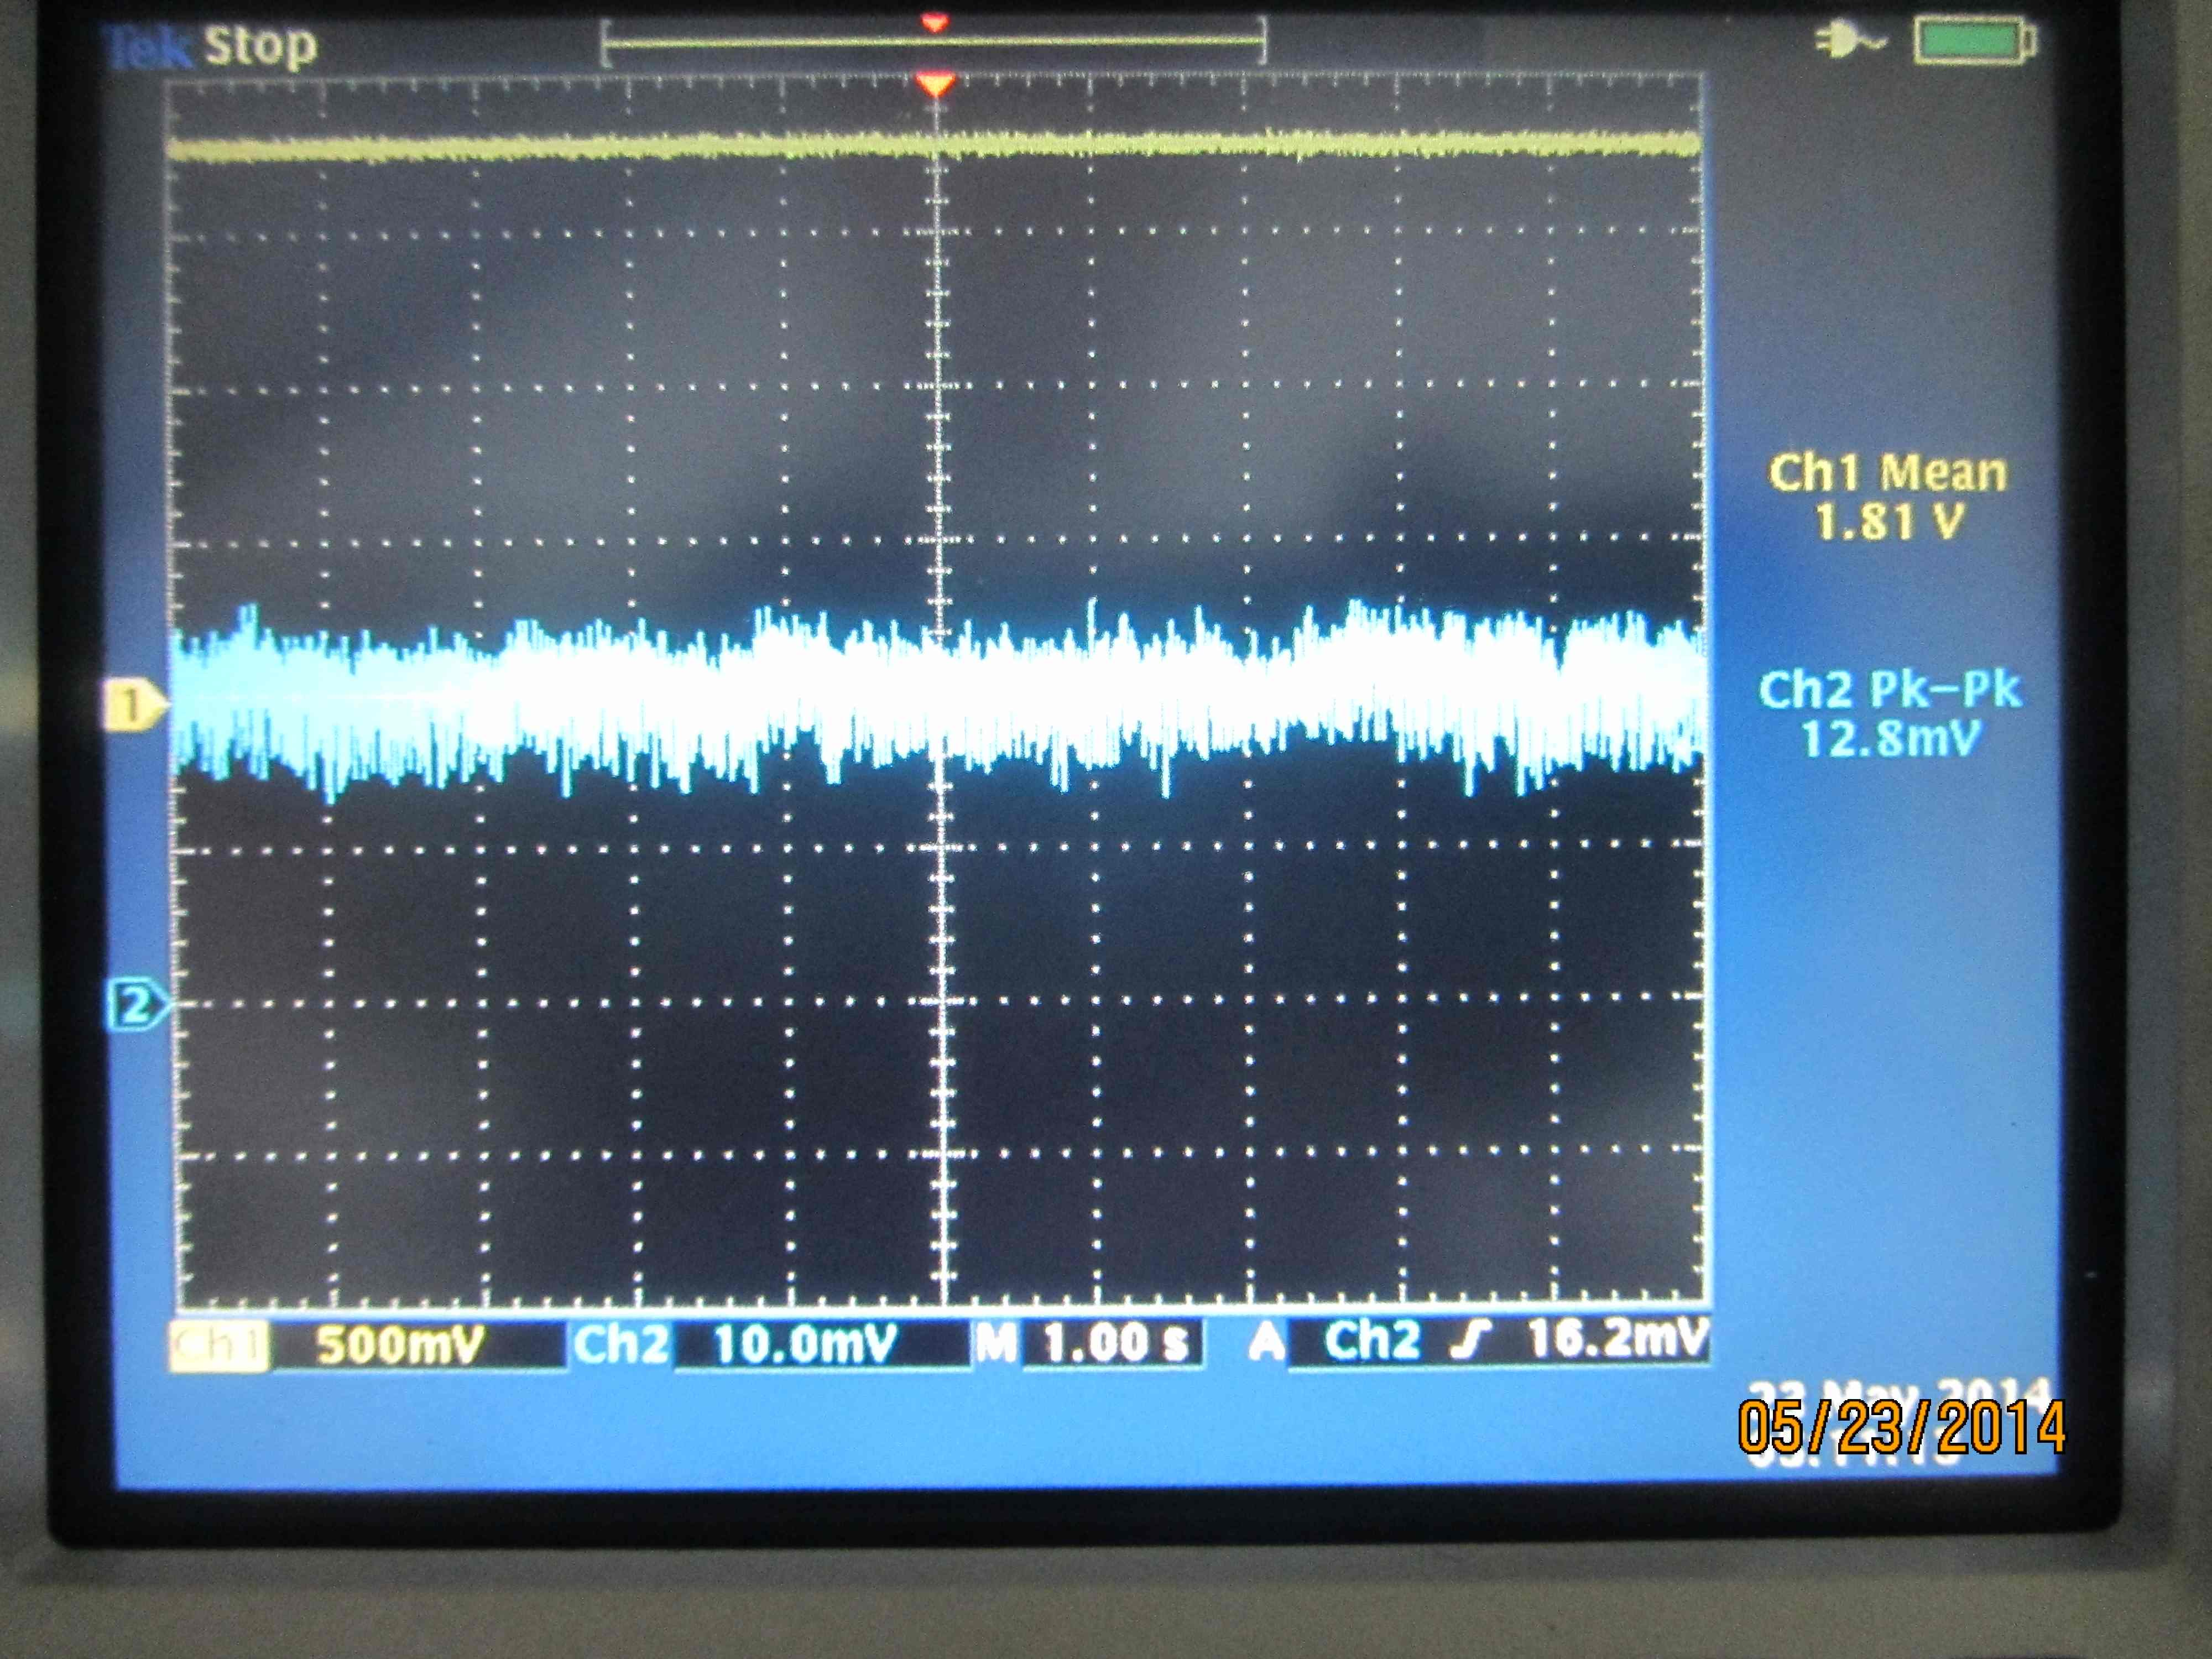
Early work on fixing the diode laser
Reduce optical feed back from the fiber tip ( stability over 100 s )
Choose an operating temperature / power ( 50% power loss stability ~ 1 hr )
Change the set-point of the T controller ( 20% power loss, stablility ~6 hrs )
Results in 23 May'14 : 12747

Slide 5
General response:
“who cares, we don’t use them anyway”
“If you can prove that they work we might consider using them”
“Oh! But they are not really fixed, they glitch after a while”
….. (silence)
“We cant use them unless they are glitch free over days”
“If we have one lock loss in day due to an oplev we are not going to use them”

Slide 6
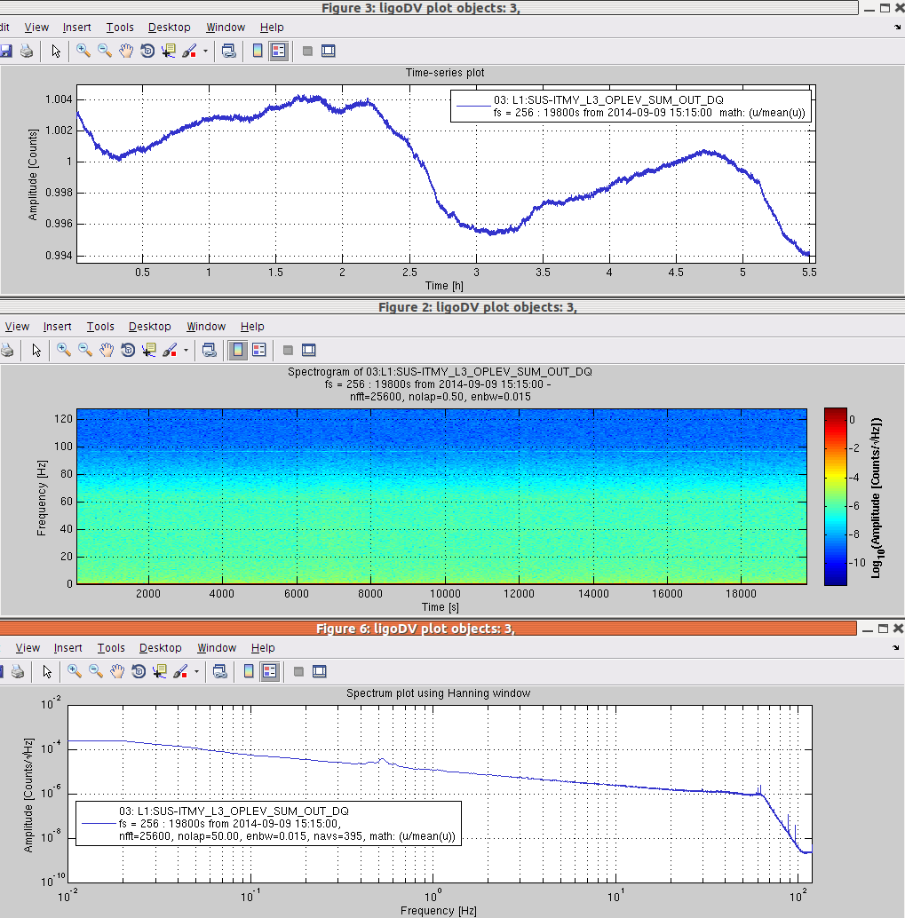
The stable LD fix
Reduce feedback from fiber tip
Adjust set-point of T control
Place the laser in a ice box
Remove the voltage stabilzer
Results in alog 14511

Slide 7
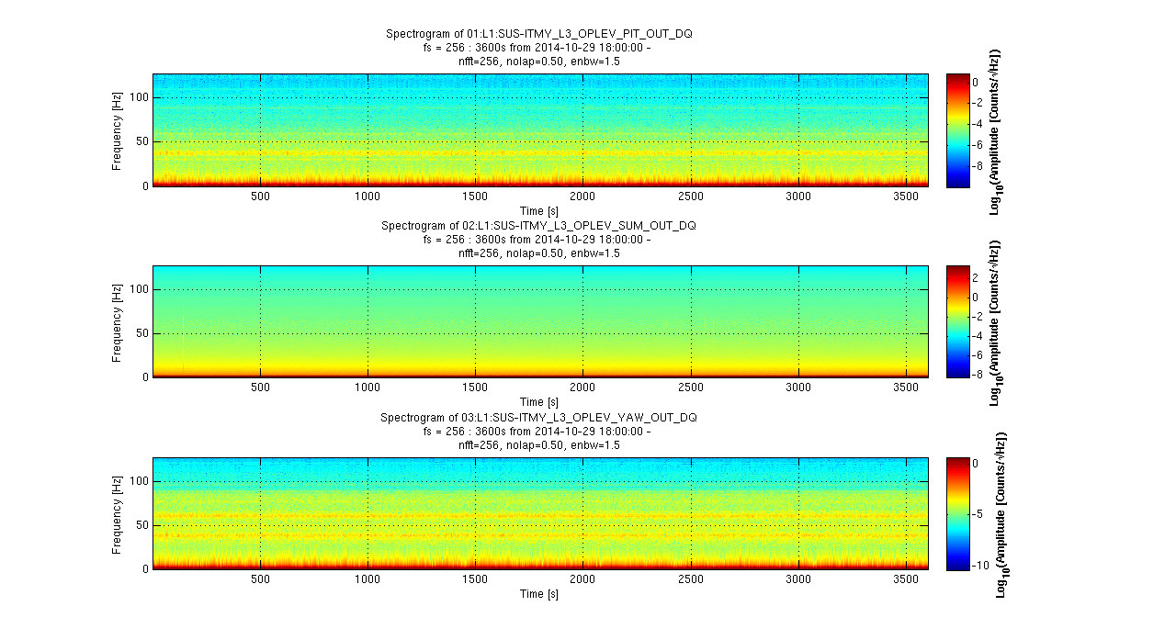
A fixed laser stays fixed: L1_ITMY oplev after 7 weeks

