Slide 1
H1 Locking Status
Commissioning Meeting 10/28/2014

Slide 2
DRMI Status
Downtime and locking duration have both improved dramatically.
The downtime has been reduced due to changes in the loop shape and gains, and adjusting the triggering thresholds (alog 14622)
The increased locking duration (~4 hrs) is probably due to several factors:
Better alignment
Less PRC clipping
Less BS oplev noise
ASC loops
There is still some SRCL mode hopping; however, the frequency of these hops occurring is much less, and it doesn’t always cause a lock loss.
Succeeded in transitioning from 1f to 3f

Slide 3
DRMI Signals
 | PRCL | SRCL | MICH
1F Signal | REFLAIR_A_RF9_I | REFLAIR_A_RF45_I & REFLAIR_A_RF9_I * | ASAIR_A_RF45_Q
3F Signal | REFLAIR_B_RF27_I | REFLAIR_B_RF135_I & REFLAIR_B_RF27_I * | REFLAIR_B_RF135_Q
Trigger | POPAIR_B_RF18_I | POPAIR_B_RF18_I | POPAIR_B_RF18_I
Optic | PRM | SRM | BS
UGF 1F | 60 Hz | 50 Hz | 10 Hz
UGF 3F | 60 Hz | 15 Hz | 10 Hz
* This is to decouple PRCL from SRCL.

Slide 4
ALS Status
ALS COMM and DIFF are robust.
ALS Guardians are in place.
Noise spectra are consistent with HIFO-XY days (alog 14324)
ETM tidal feedback was commissioned, but has not been tested recently and probably needs to be improved (alog 14412)

Slide 5
Arms + DRMI
ALS COMM and DIFF were locked. IR was set 500 Hz off resonance (on either side), DRMI was locked, but we saw a more significant SRCL mode hopping; this was solved by putting a SRCL offset (alog 14654).
With a COMM offset of ~120 Hz IR, the DRMI loses lock (alog 14433).

Slide 6
PRC
PRMI locks stably.
ASC WFS are commissioned.
PRC recycling gain was originally measured to be 21 for 45 MHz sideband (alog 14532 , alog 14584).
Determined there was beam clipping in yaw, possibly due to PR2 baffle (alog 14567, alog 14640, alog 14650)
Improved the beam clipping, and the PRC recycling gain increased to 25. Still more room for improvement (alog 14611) since the recycling gain should be closer to 40.

Slide 7
ASC
WFS loops are closed for PRMI (alog 14615)
Need to measure input sensing matrix
DRMI ASC loops are also closed
Need to measure input sensing matrix
Add feedback to PR2
 | PRCL | MICH
Signal | REFL_A_RF9_I | AS_A_RF36_Q
Optic | PRM (M2 stage) | BS (M2 stage)
 | PRCL | MICH | SRCL
Signal | REFL_A_RF9_I | AS_A_RF36_Q | AS_A_RF36_I
Optic | PRM (M2 stage) | BS (M2 stage) | SRM (M2 stage)

Slide 8
DC Centering
 | REFL_A_DC | REFL_B_DC | AS_A_DC | AS_B_DC
Optic | RM1, RM2* | RM2, RM1** | OM2 | OM3
These loops have been commissioned and are stable.
An alternate way to center the ASC AS WFS at DC is by turning on the OMC QPD centering, which also uses OM1, OM2. (alog 14575, alog 14616)
* RM2 is off diagonal term (factor of -0.86)
** RM1 is off-diagonal term (factor of -0.25)

Slide 9
Initial Alignment
All controlled by guardian, and usually runs fairly smoothly.
Green WFS still in progress
…More details from Keita/Kiwamu

Slide 10
Some Next Steps (out of many)
Work on more beam input pointing/alignment to increase power recycling gain
Measure all the input sensing matrices for the ASC loops
Now that the DRMI is more stable and reliable, we can try to reduce the COMM IR offset and transition from COMM handoff to IR in transmission
Commissioning Calendar (alog 14636)

Slide 11
Appendix

Slide 12
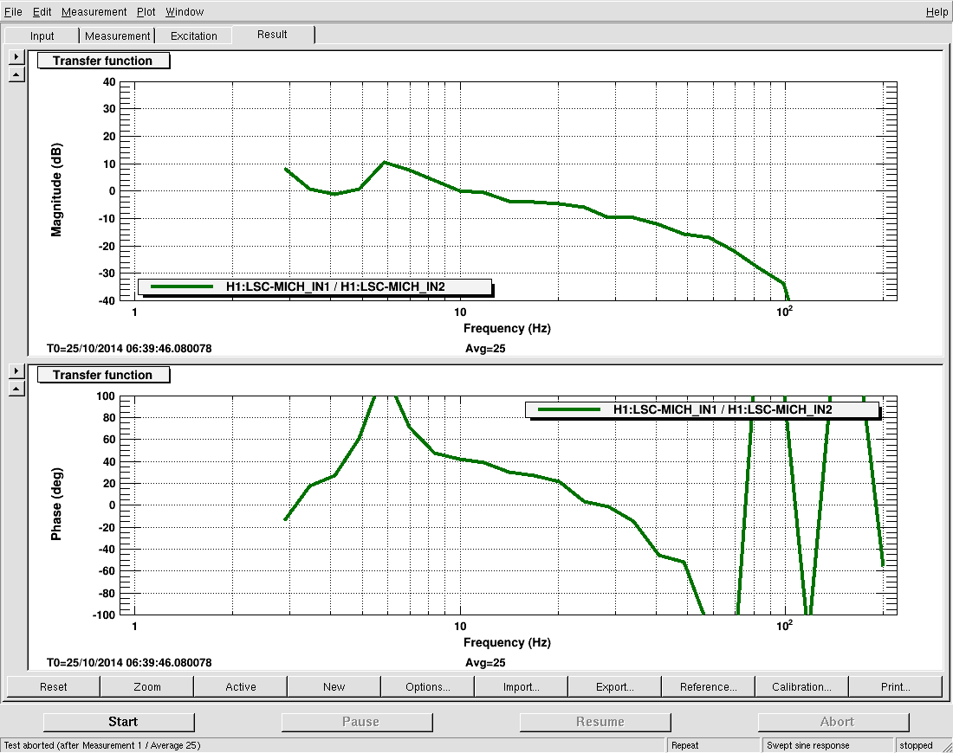
MICH Loop (as of 10/24/2014)

Slide 13
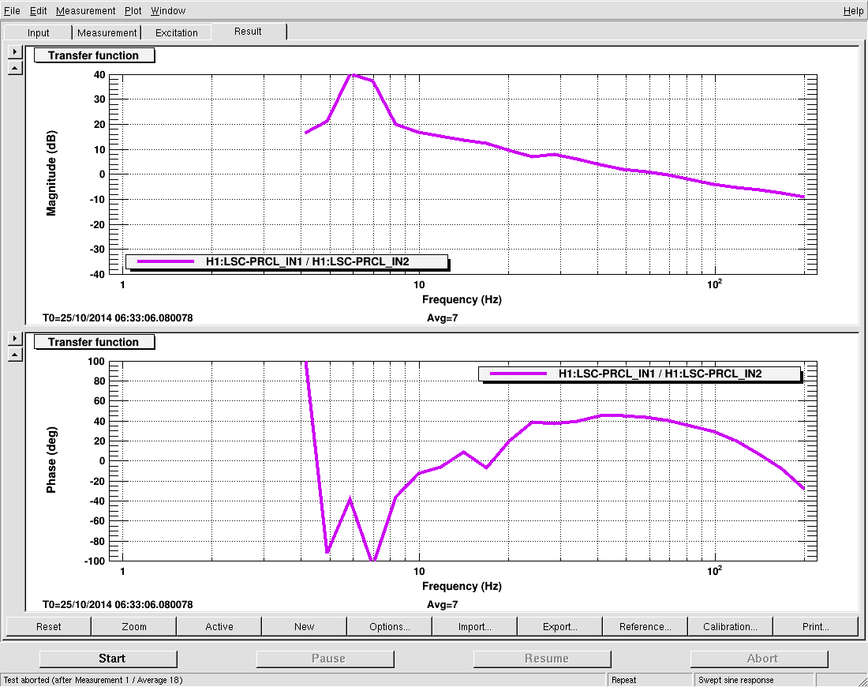
PRCL Loop (as of 10/24/2014)

Slide 14
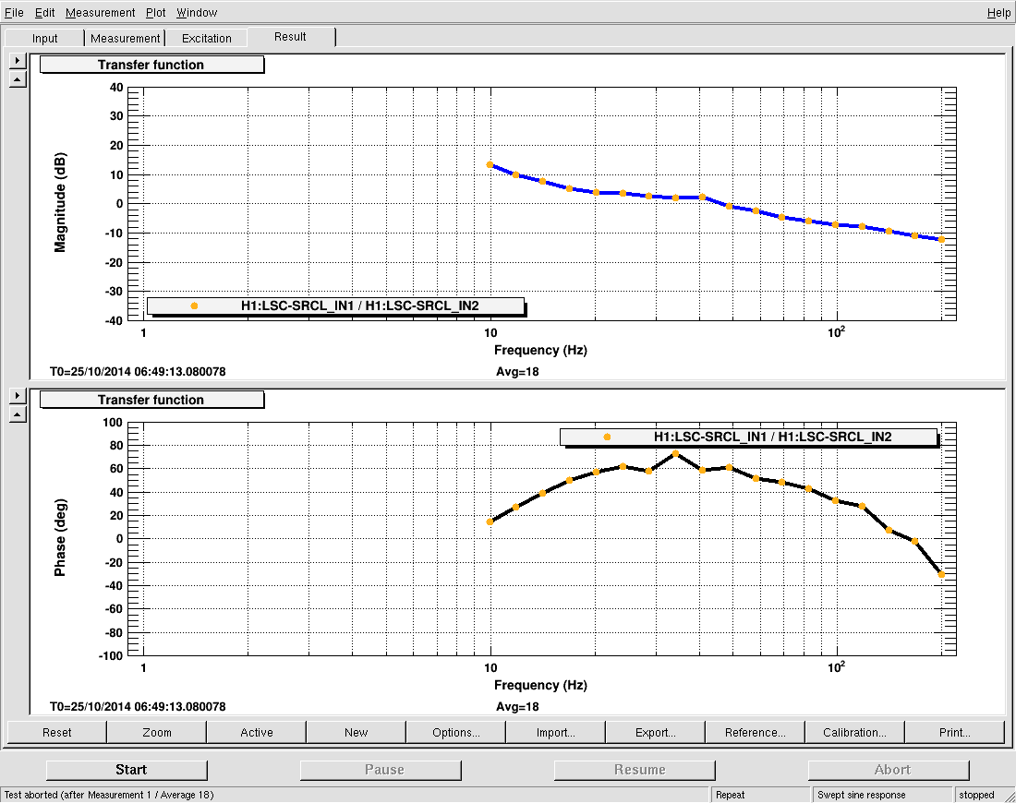
SRCL Loop (as of 10/14/2014)

Slide 15
DRMI Status (OLD)
In the process of stabilizing this loop.
At 10W, down time is approx 40 min. Once the cavity is locked we see mode hopping, which causes lock loss. Adjusting SCRL offset to -800 reduces the mode hopping (alog 14531).
At 1W, the down time is shorter and the mode hopping is less significant.

