Slide 1

Mirror suspensions at the AEI 10m-Prototype
Conor Mow-Lowry
For the AEI 10m team
Special credit: Johannes Lehmann, Sina Köhlenbeck, Gerald Bergmann

Slide 2
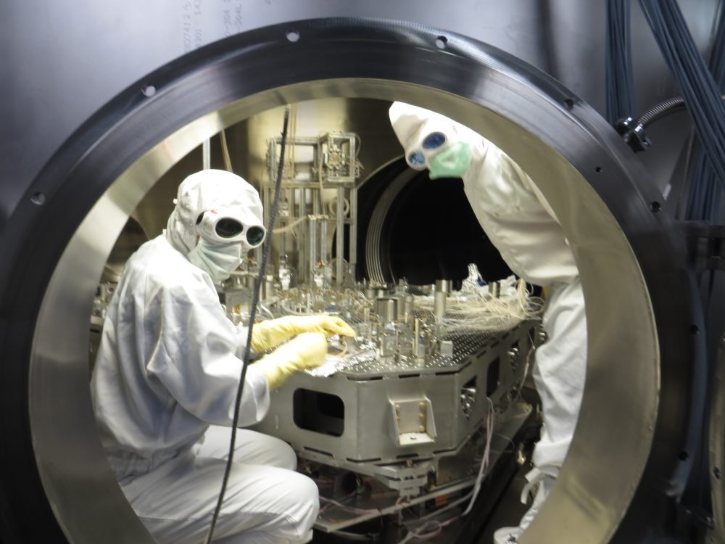
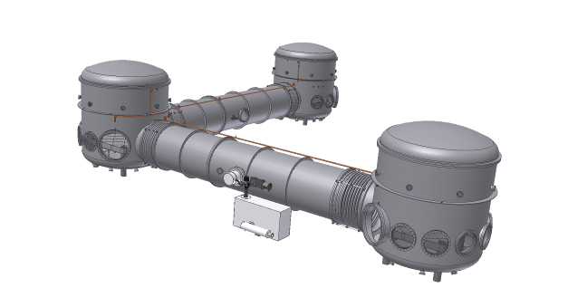
The 10m Prototype
Provides a test-bed facility with
  Low displacement noise at acoustic frequencies
  100m³ high-vacuum enclosure (10⁻⁷ mbar)
  Flexible configuration
An experimental platform
  Geodesy/LISA related experiments
  Novel techniques for future gravitational wave detectors
    Coating thermal noise reduction with
    materials or configurations
    Radiation pressure noise
    mitigation
    Parametric instabilities?
    Frequency dependent squeezing?
    Macroscopic quantum mechanics?

Slide 3
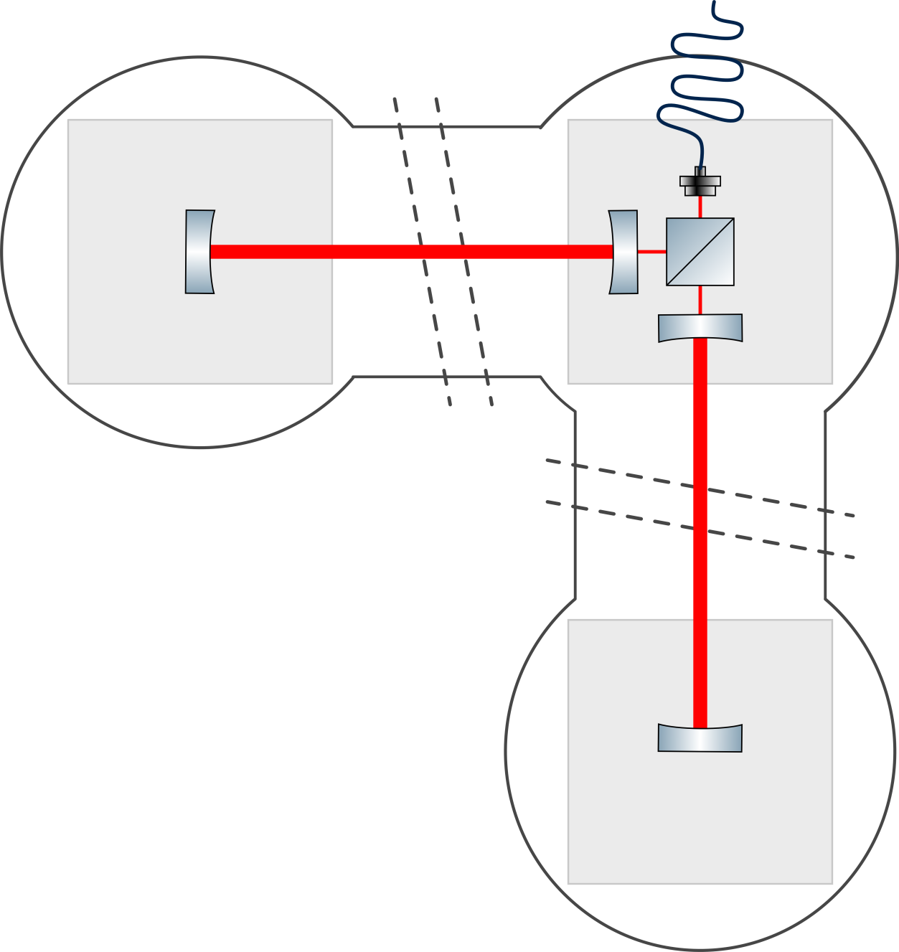
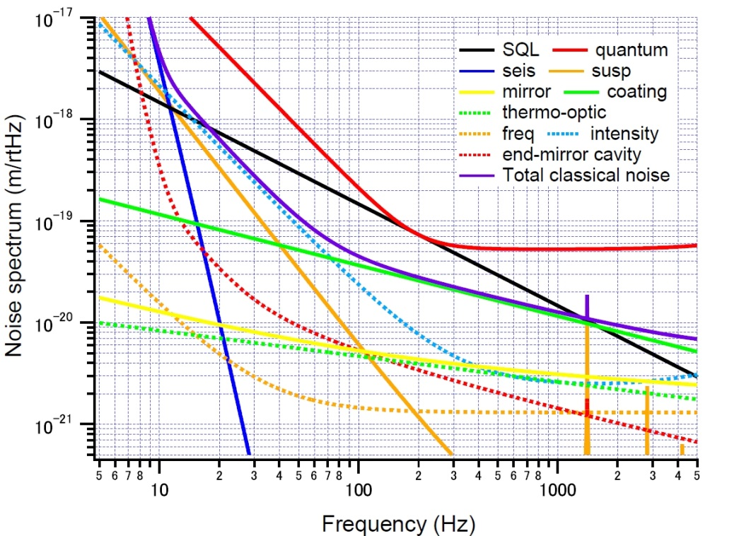
SQL interferometer
A Michelson interferometer with Fabry-Perot
arm-cavities

Slide 4
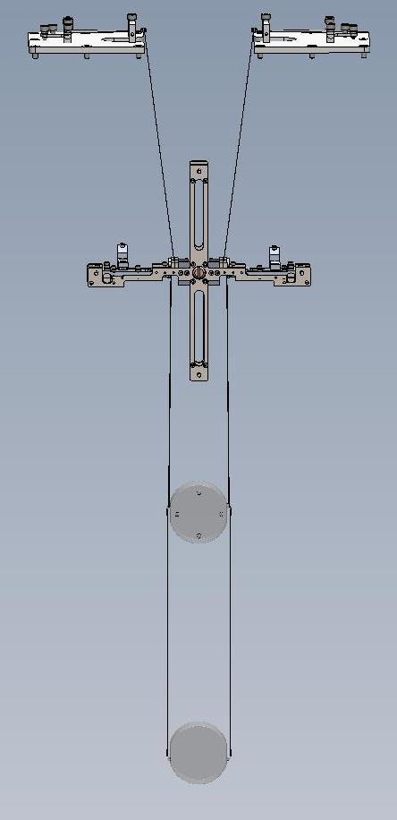
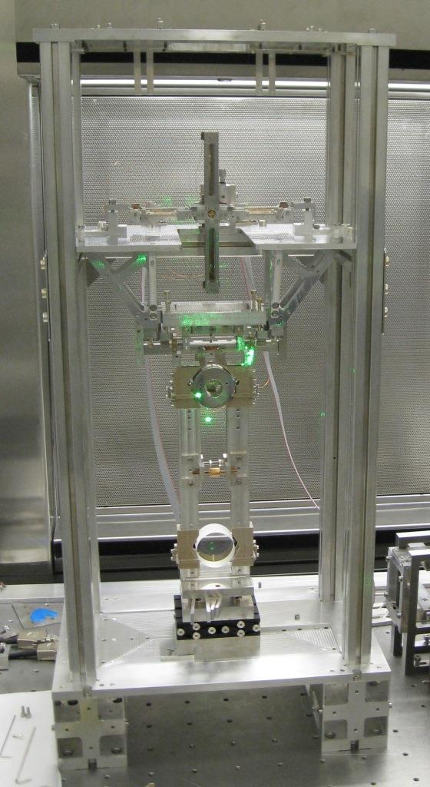
SQL interferometer triples
Designed by Glasgow group, including 10um glass fibre welding techniques
100g mirrors
3 horizontal, 2 maraging vertical stages
Monolithic final stage
Eddy-current damped
Novel ESD

Slide 5
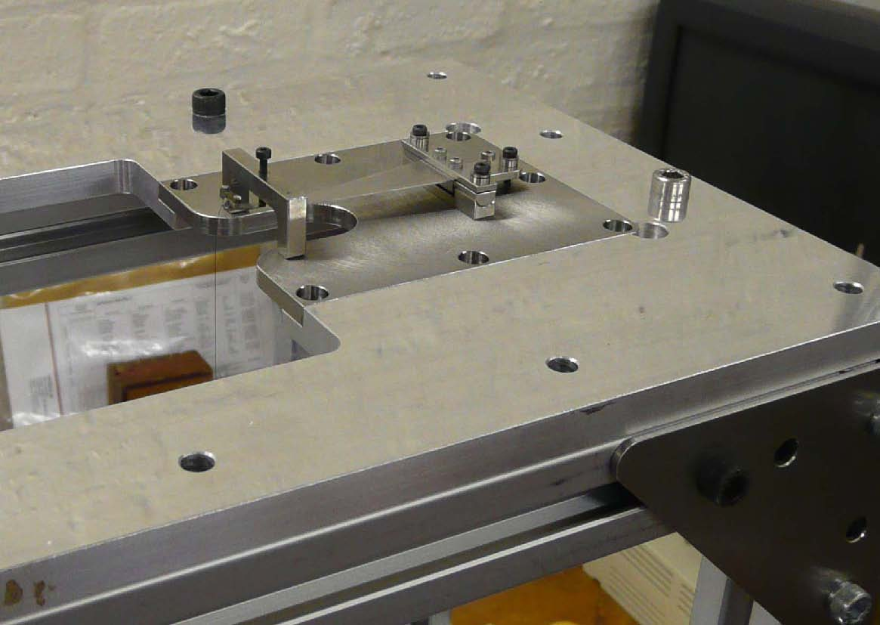
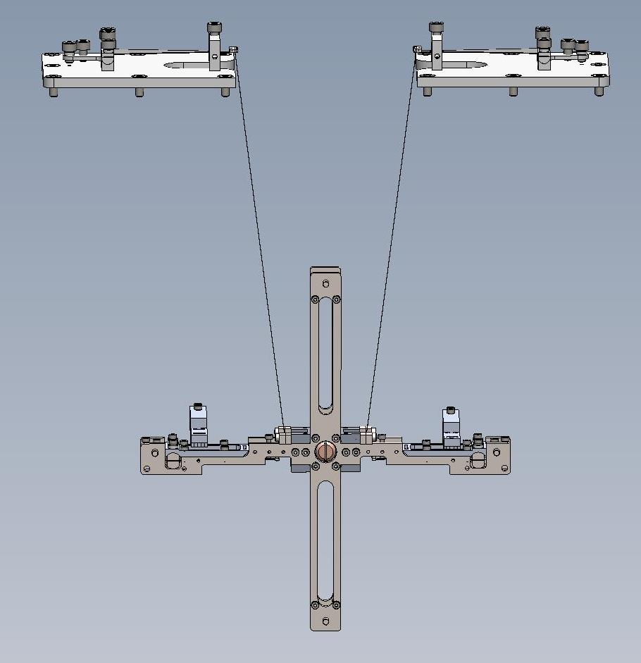
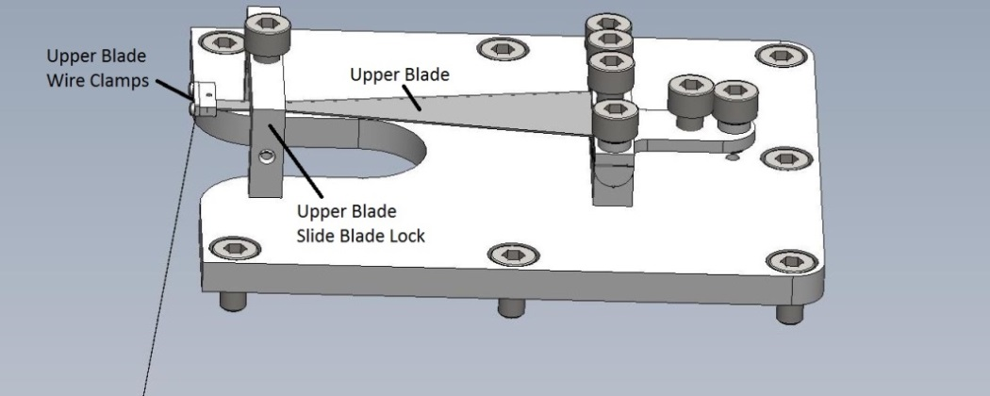
Top mass

Slide 6
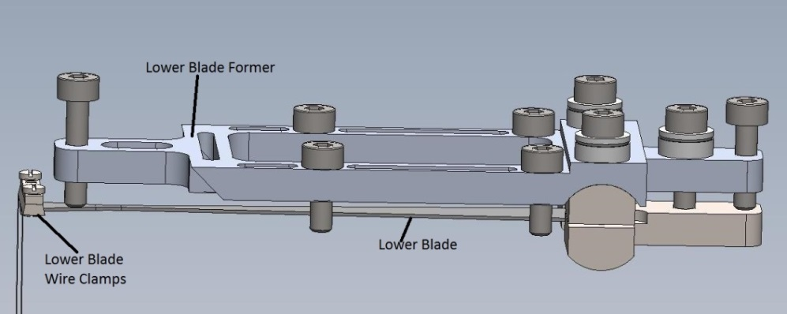
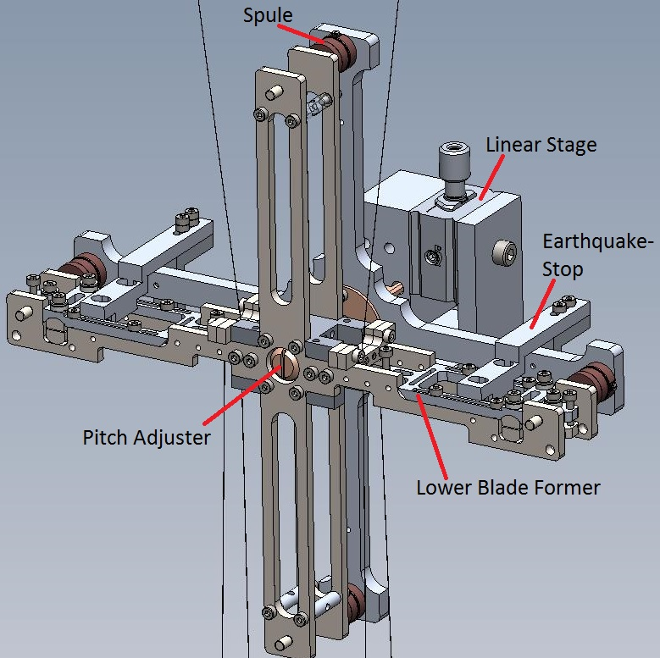
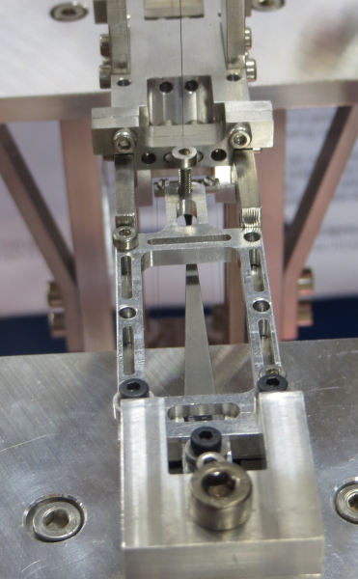
Top Mass
220 g, main balancing and steering
Eddy-current damped, 4 coils, 2 blades

Slide 7
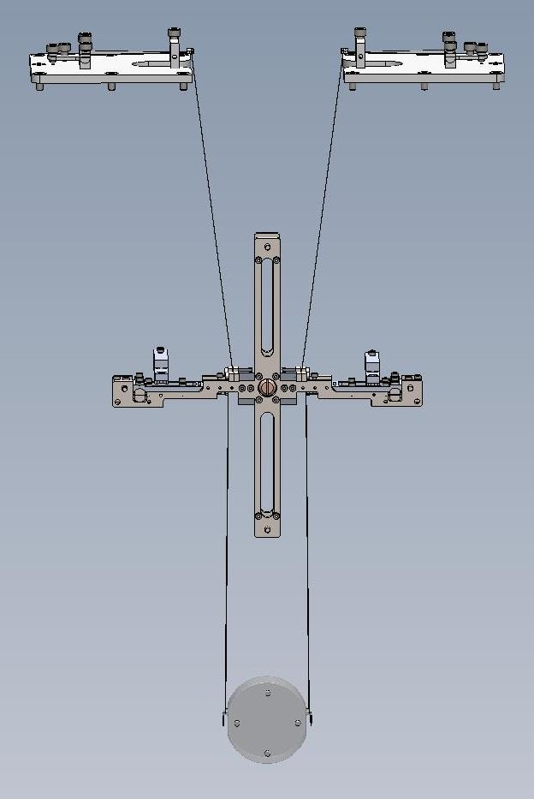
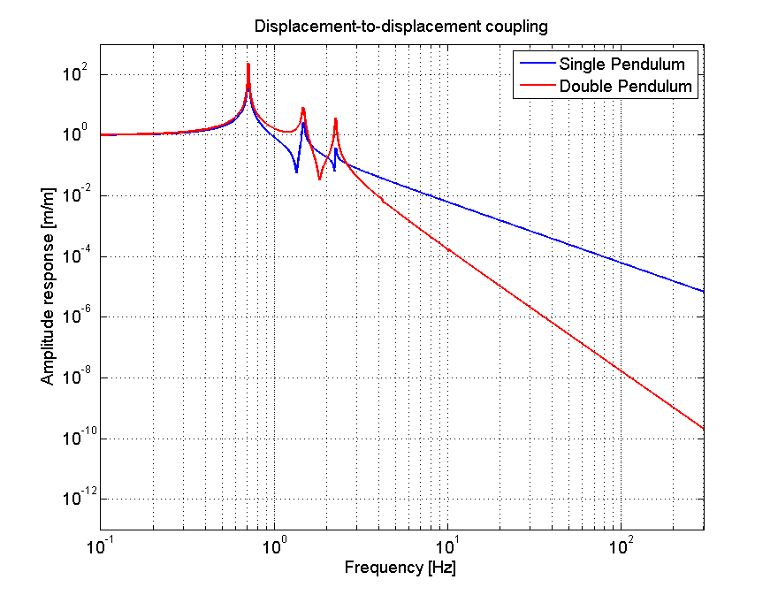
Penultimate mass

Slide 8
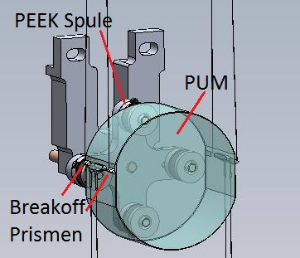
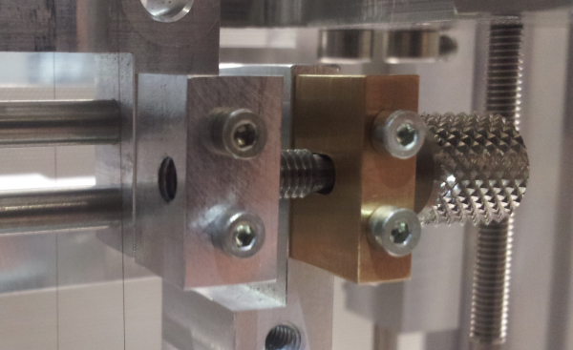
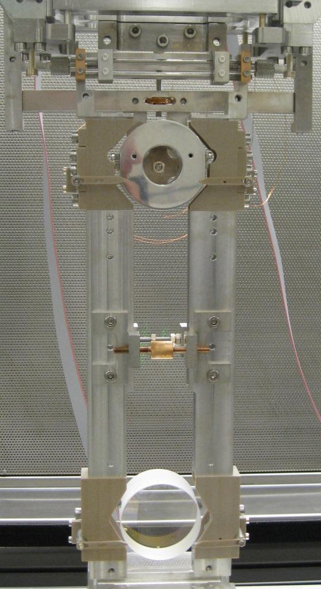
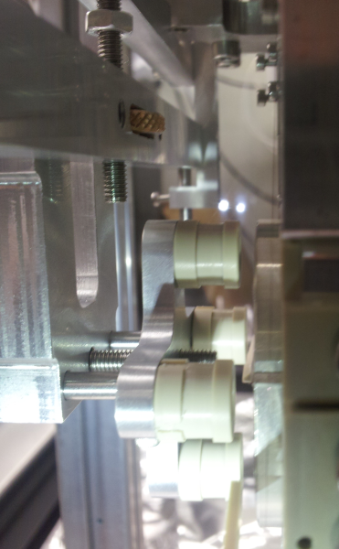
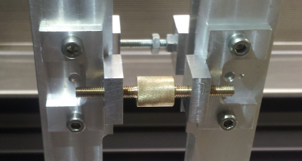
Penultimate Mass and fibre-guards

Slide 9
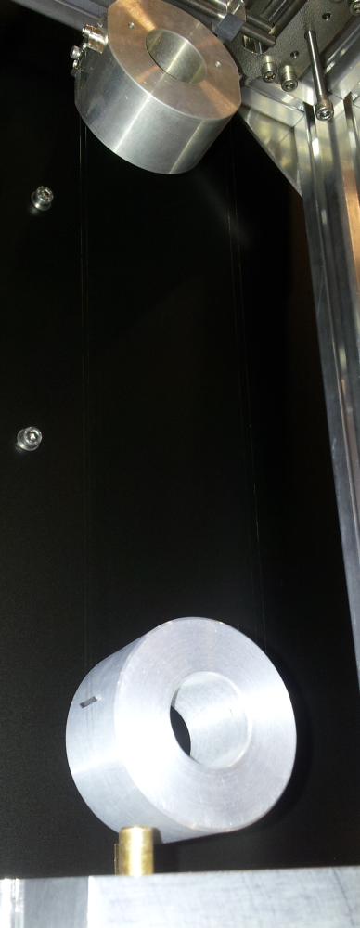
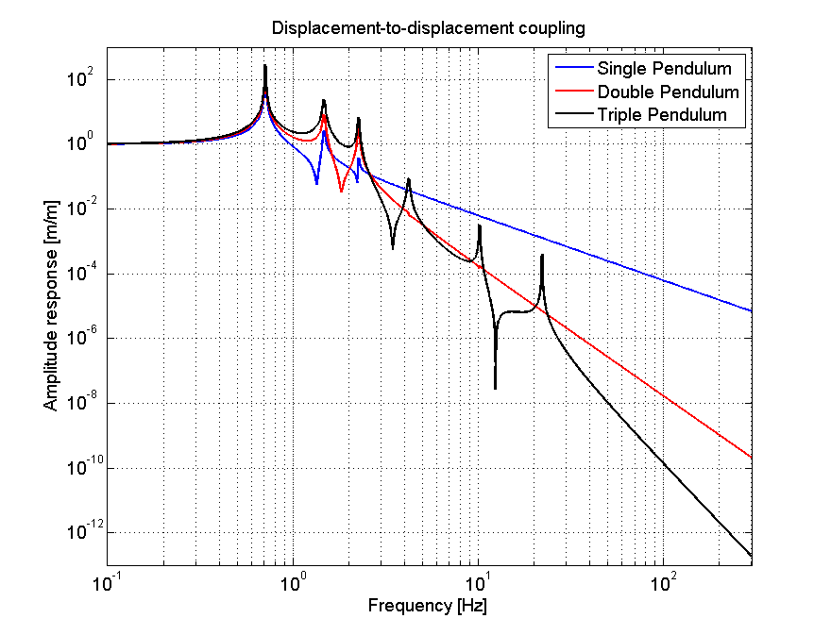
Test mass

Slide 10
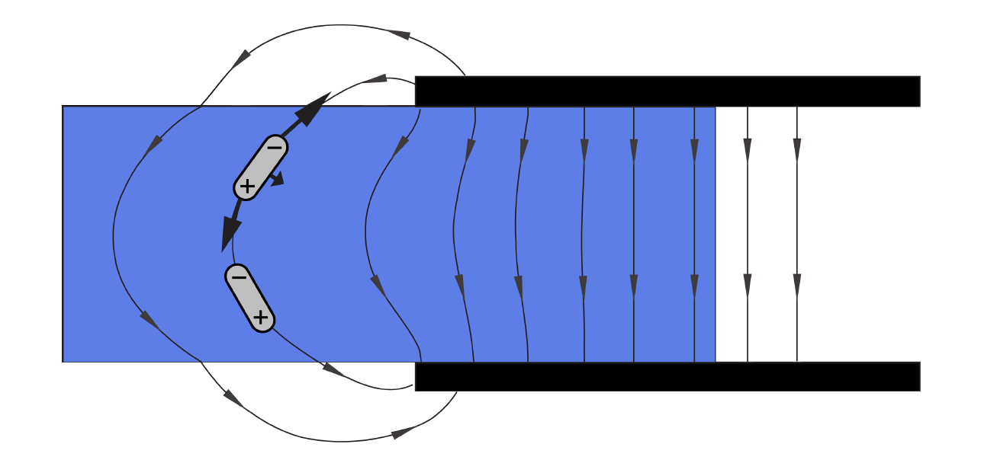
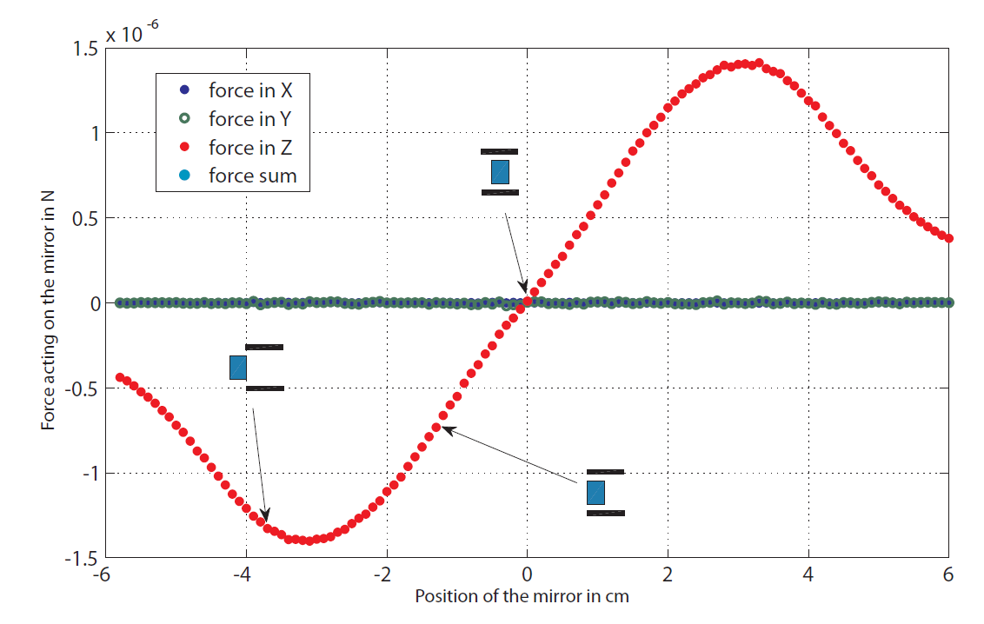
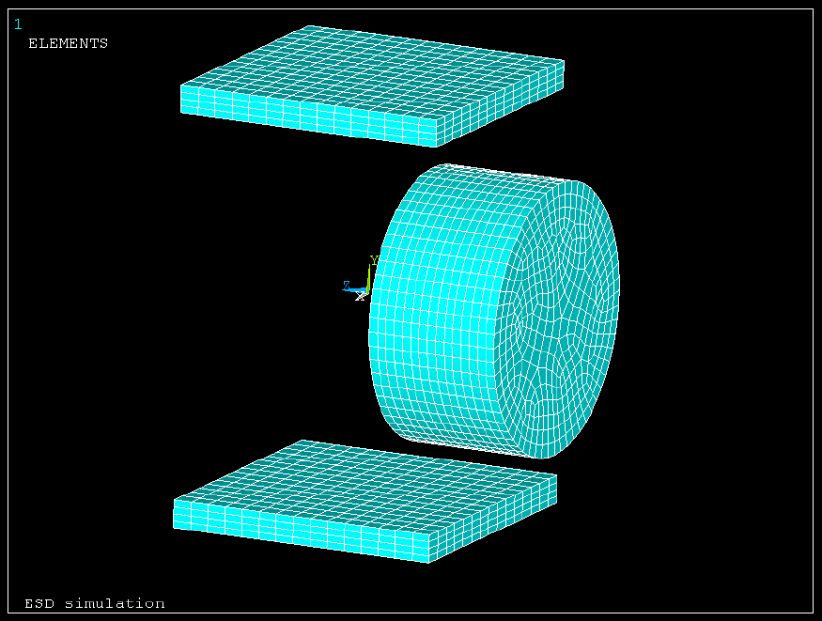
ESD concept

Slide 11
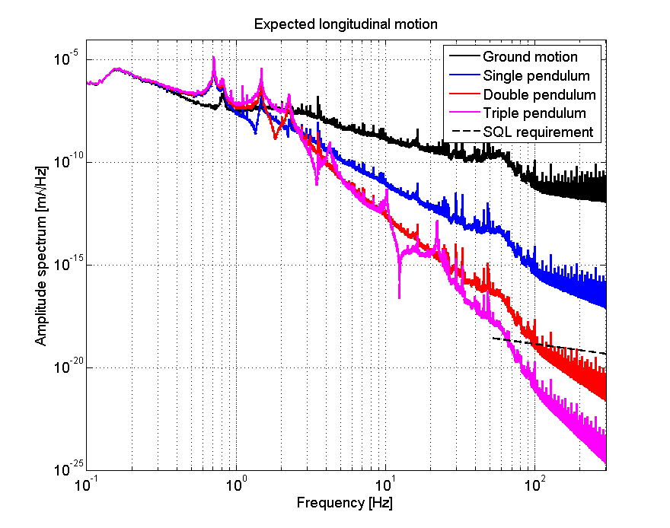
Expected longtiudinal motion

Slide 12
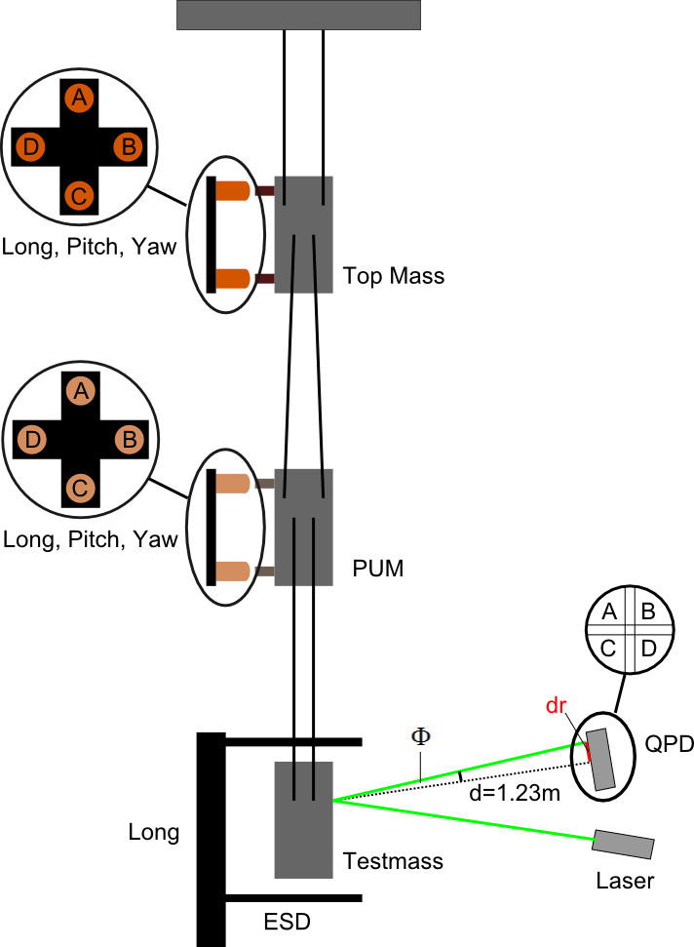
Transfer function testing
Test coils for Top and Penultimate masses
Confirm model
Inform control design
Pitch-balancing and de-bugging
(Measurements and analysis by Johannes Lehmann, bachelor project)

Slide 13
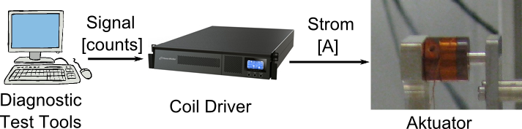
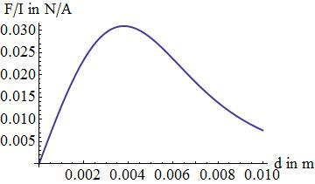
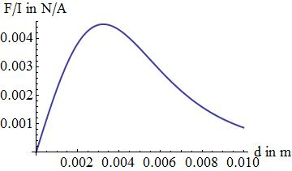
Actuator tests

Slide 14
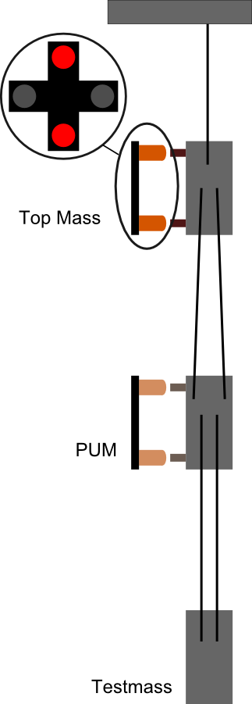
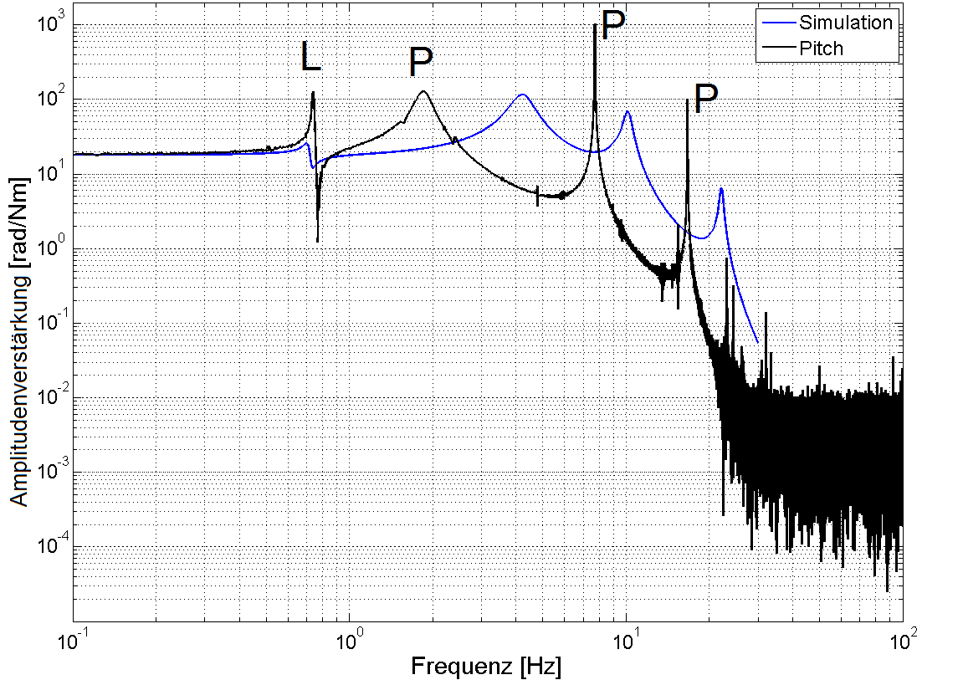
Top-Mass (Pitch)

Slide 15
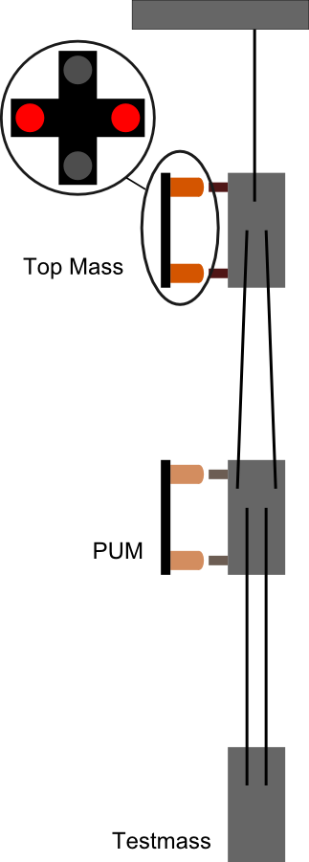
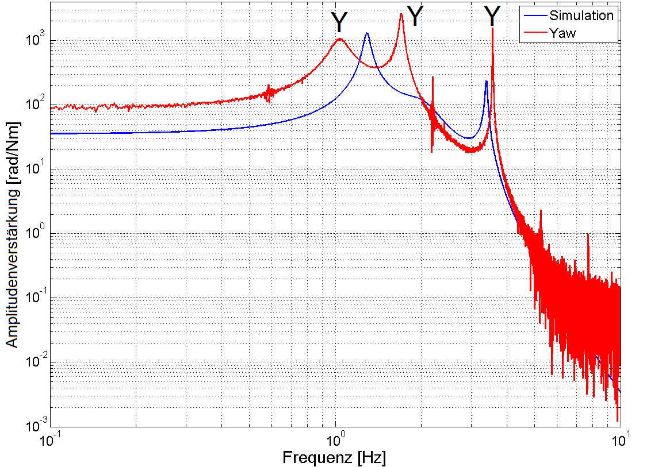
Top-Mass (Yaw)

Slide 16
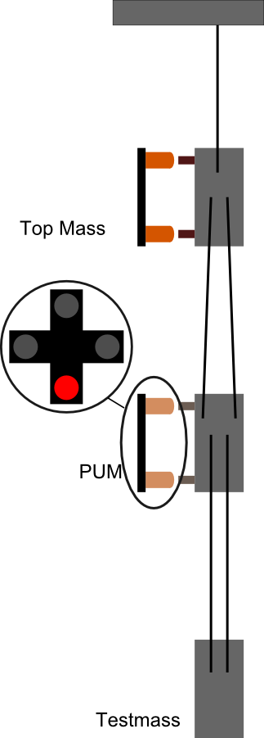
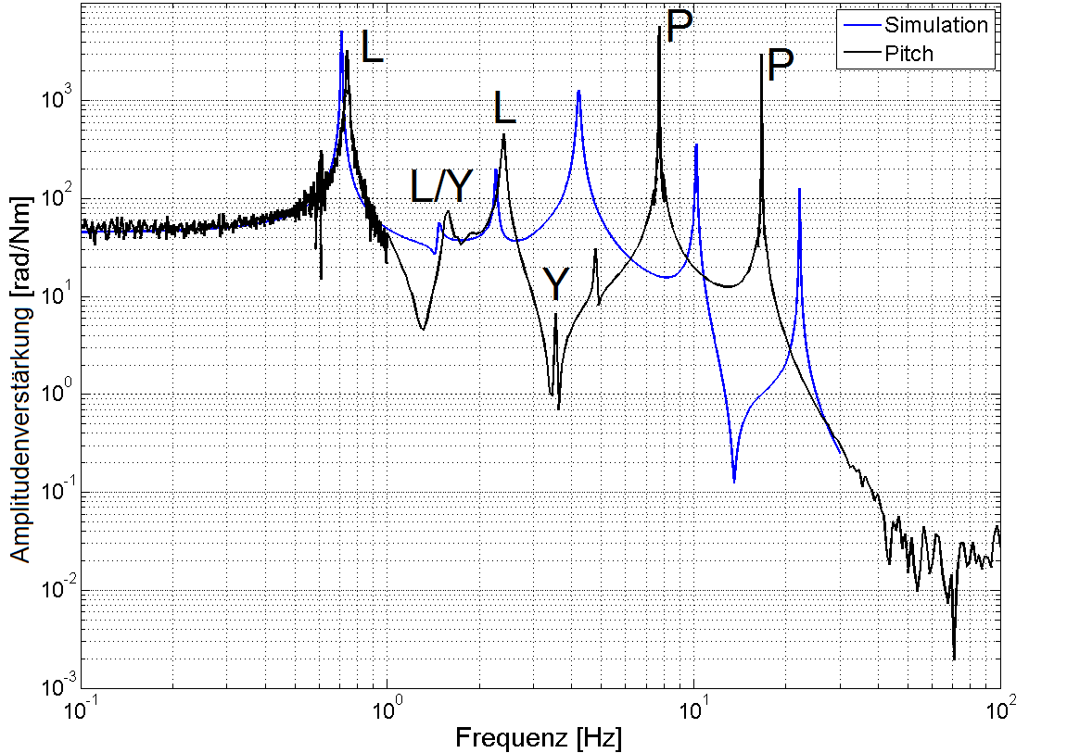
PUM (Pitch)

Slide 17
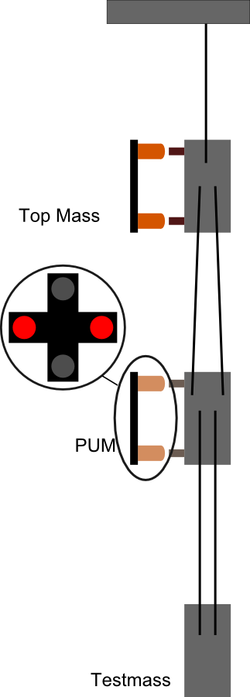
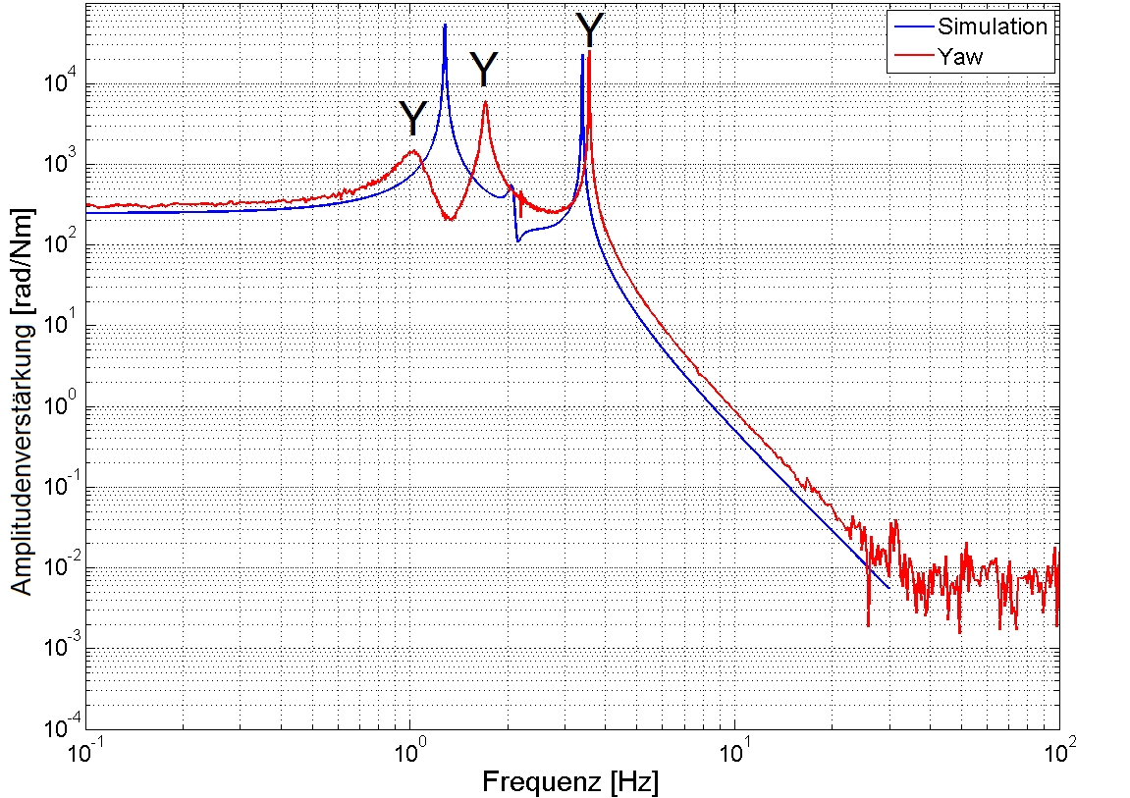
PUM (Yaw)

Slide 18
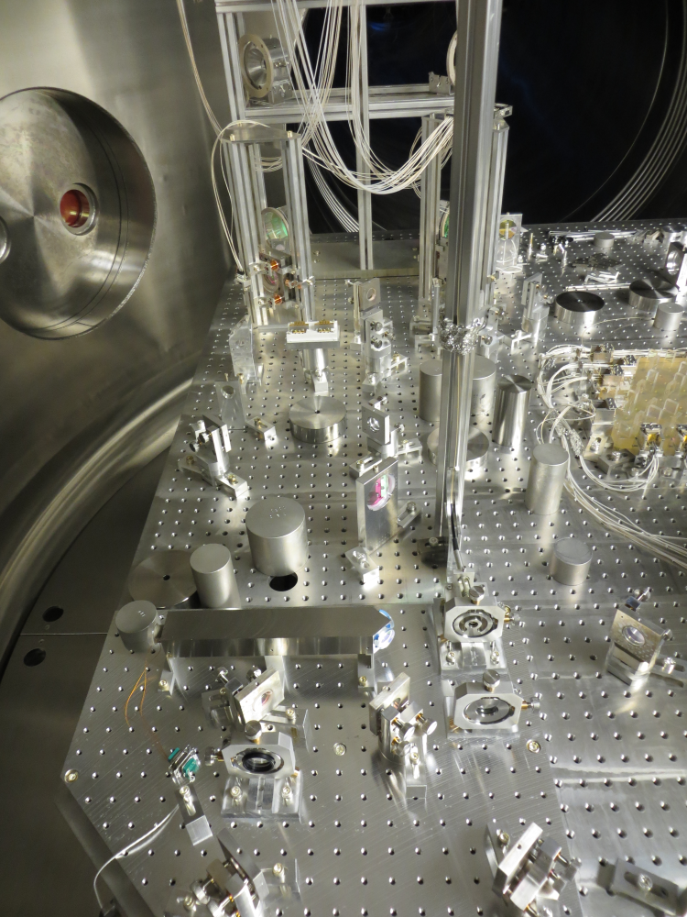
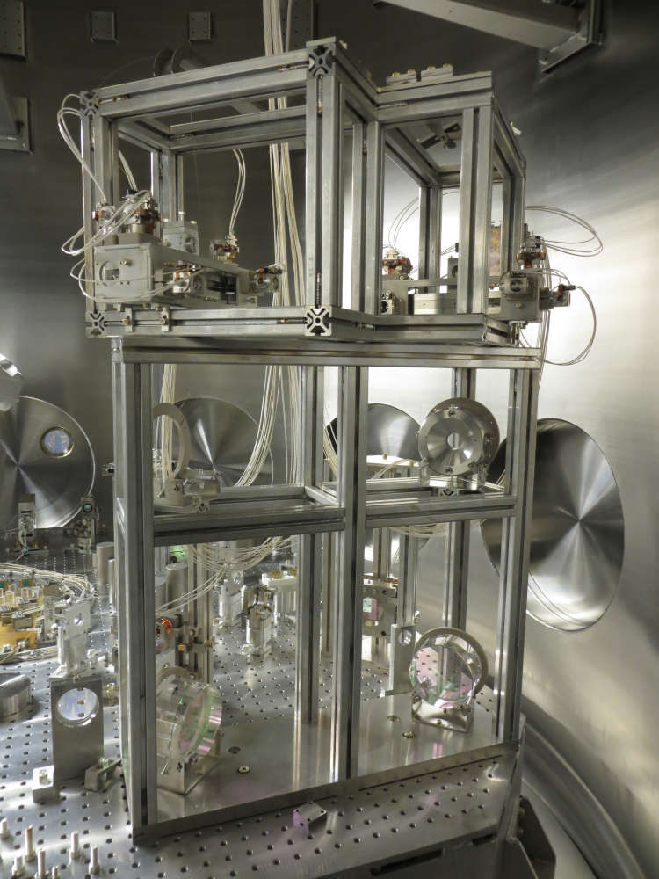
Reference cavity 1kg triples

Slide 19
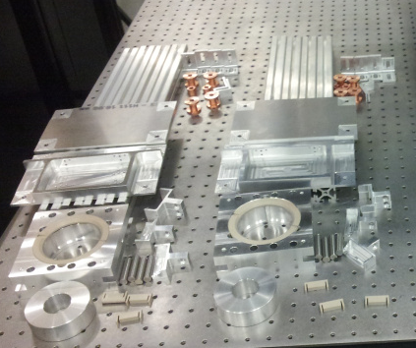
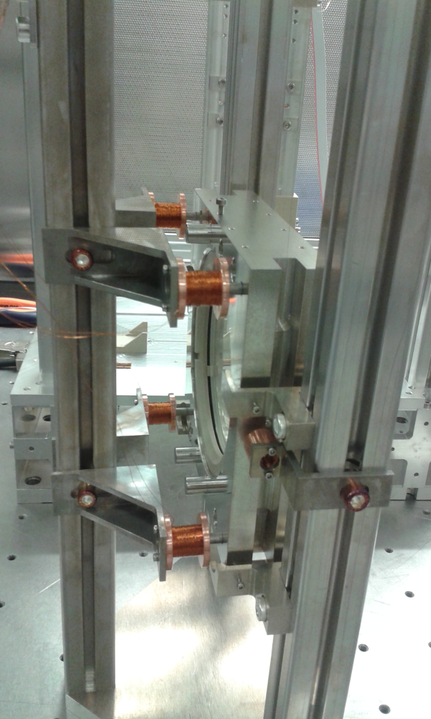
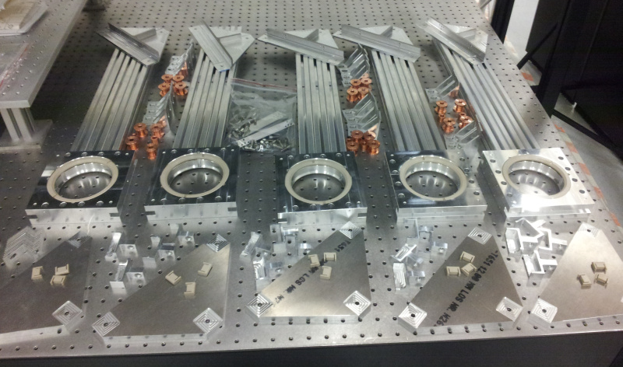
Steering mirror suspensions
Single loop, no springs
Eddy-current damped
3” normal-incidence
2” + 4” 45-degree

Slide 20
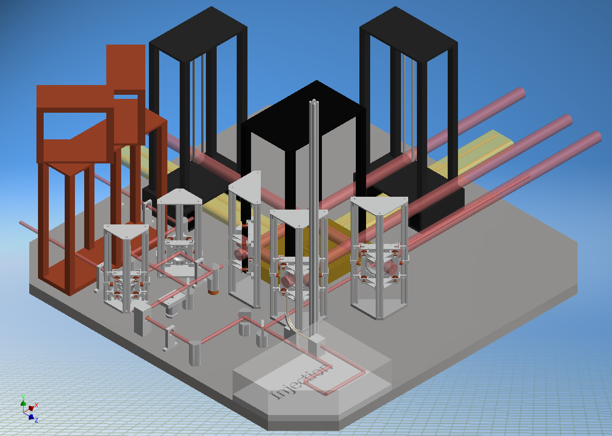
Physical layout

Slide 21
The team
Ken Strain: Scientific leader (Glasgow)
Harald Lück: Co-ordinator (Hannover)
  Tobin Fricke: Reference cavity, CDS, electronics
  Conor Mow-Lowry: Seismic isolation, suspensions, single-arm test
  Vaishali Adya: Interferometric sensing & control and simulations
  Gerald Bergmann: Isolation tables, ESD
  Manuela Hanke: Reference cavity
  Sina Köhlenbeck: Suspension Platform Interferometer, Single-arm test
  Tobias Westphal: Non-SQL suspensions, Thermal noise interferometer
  Aftab Baig: SQL and steering suspensions, Single-arm test
Liam Cunningham, Russell Jones, Alan Cumming, Giles Hammond: SQL IFO suspensions
Sean Leavey, Stefan Hild: Simulations and interferometric readout (Glasgow)
Gerrit Kühn: Real time control and data system
Andreas Weidner: Electronics and Electrical design
Benno Willke, Jan Hendrik Pöld, Patrick Oppermann: High power laser system
Kasem Mossavi: Vacuum system and pumps control
  Thimotheus Alig , Alessandro Bertolini, Michael Born, Yanbei Chen, Katrin Dahl, Stefan Danilishin, Stefan Goßler, Christian Gräf, Sabina Huttner, Fumiko Kawazoe, Kentaro Somiya, Bob Taylor, Alexander Wanner

