Slide 1
Advanced LIGO Seismic Isolation and Control
J. Kissel, B. Shapiro, A. Pele, S. Biscans,
for the LIGO SEI, SUS, ISC Teams

Slide 2
Part 1: Overview of aLIGO isolation systems
J. Kissel, B. Shapiro, A. Pele, S. Biscans,
for the LIGO SEI, SUS, ISC Teams

Slide 3
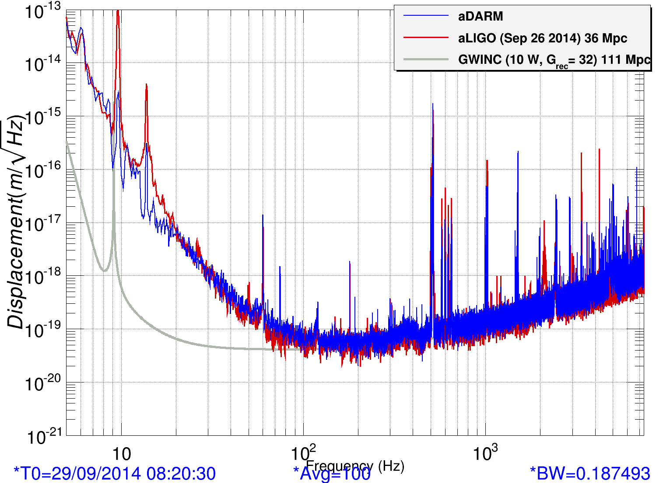
Recent Livingston Noise Floor
36 Mpc = 117 million light years
Sept 29, 2014. https://alog.ligo-la.caltech.edu/aLOG/uploads/4853_20140929051255_DARM_09_29.png

Slide 4
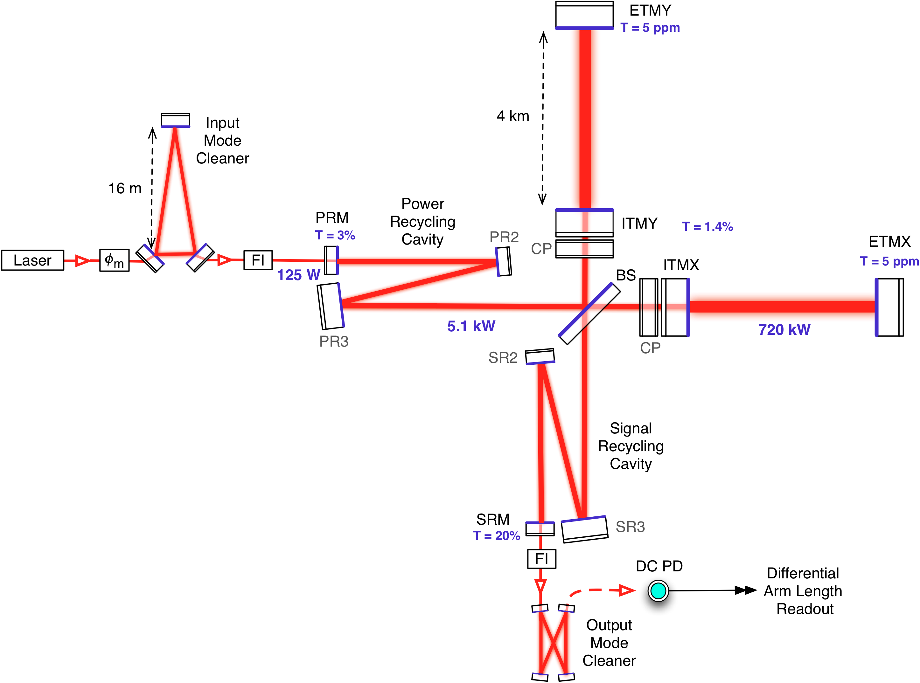
aLIGO (Simplified) Interferometer Layout

Slide 5
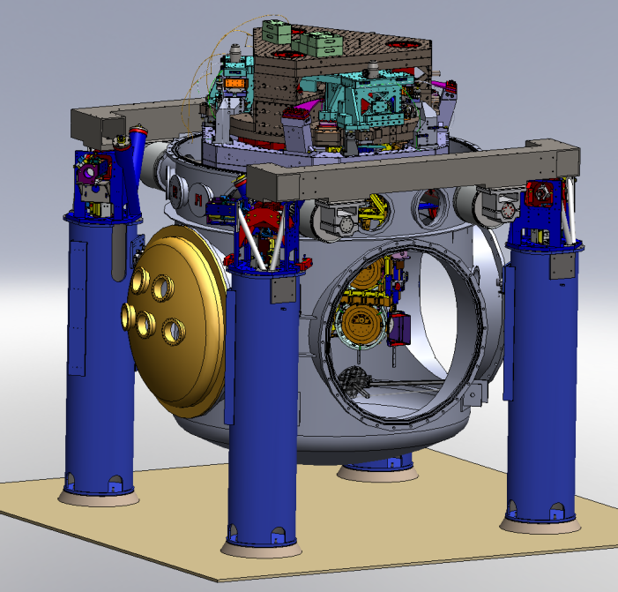
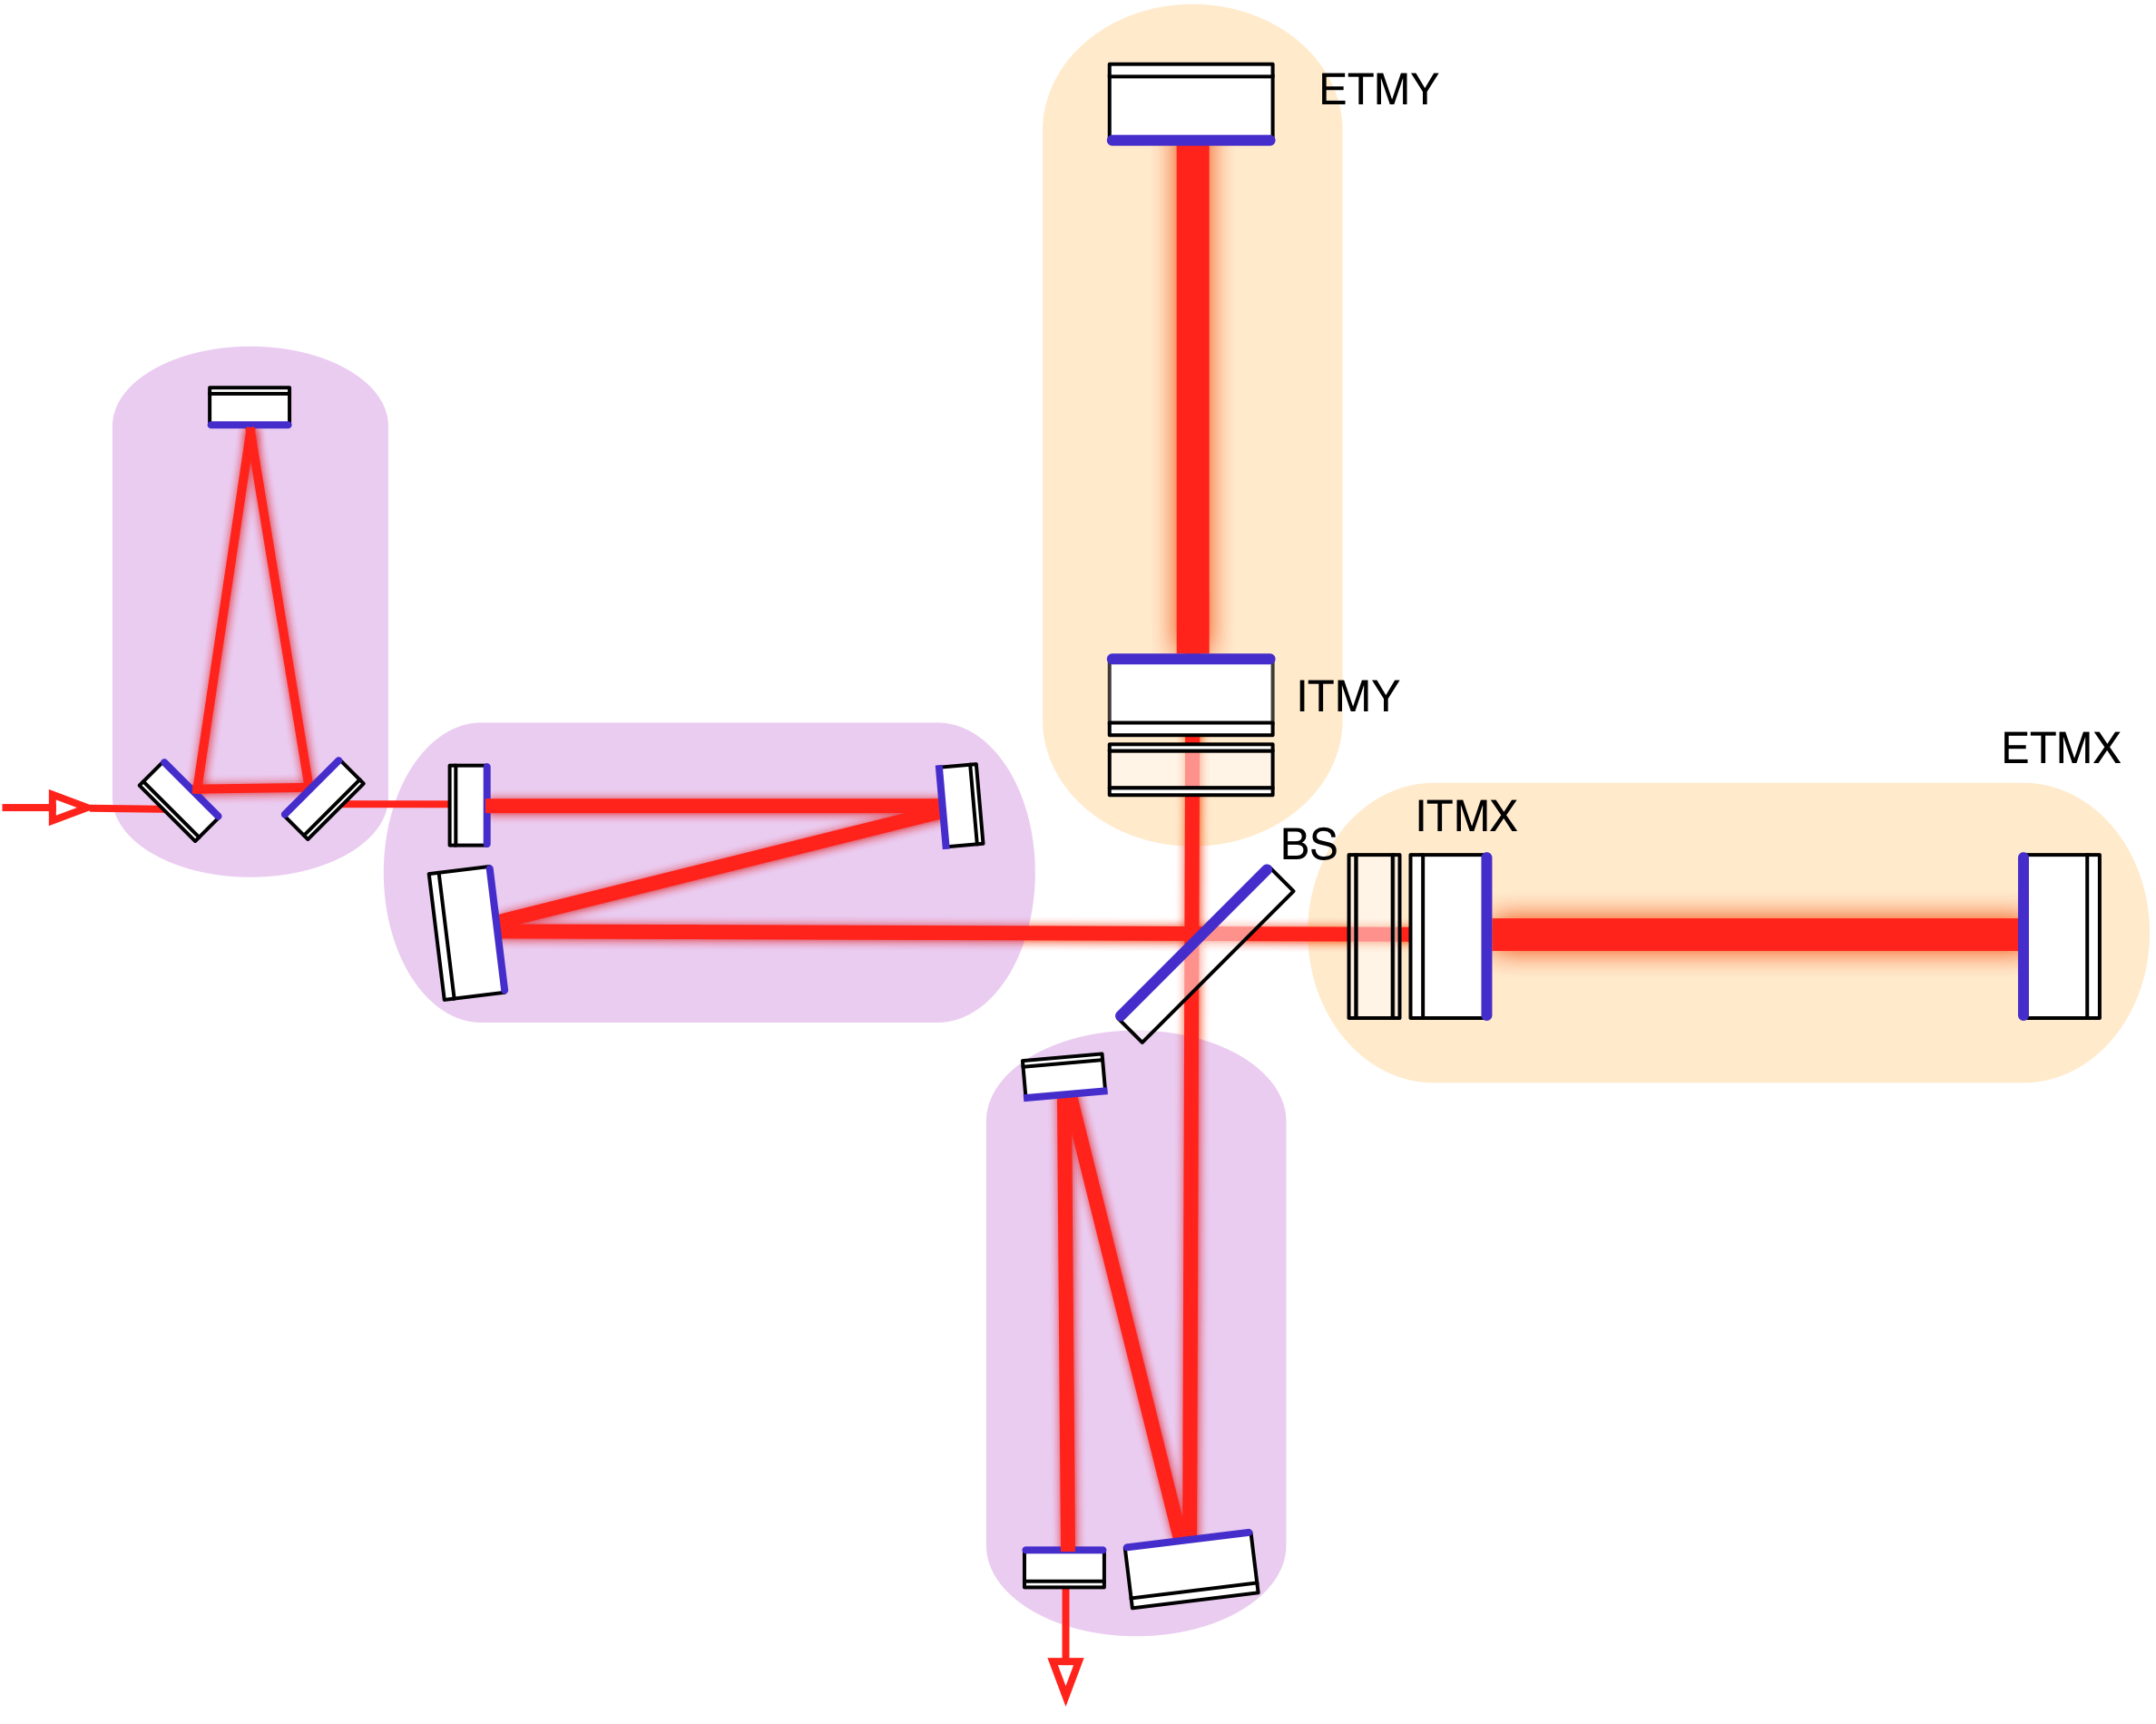
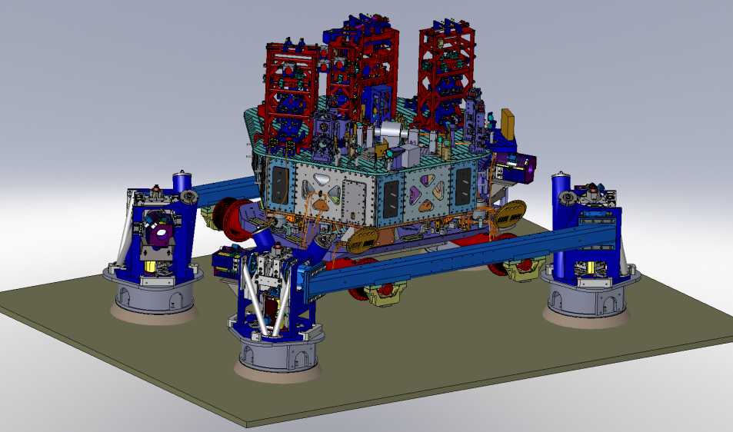
aLIGO Seismic Isolation
Core Optics
7 Stages
Active Isolation
1 external stage (BSC HEPI)
2 internal stages (BSC ISI)
Passive Isolation
4 stages
(Quadruple Pendulums)
Auxiliary Optics
(up to) 5 Stages
Active Isolation
1 external stage (HAM HEPI)
1 internal stage (HAM ISI)
Passive Isolation
3 stages
(Triple Pendulums)

Slide 6
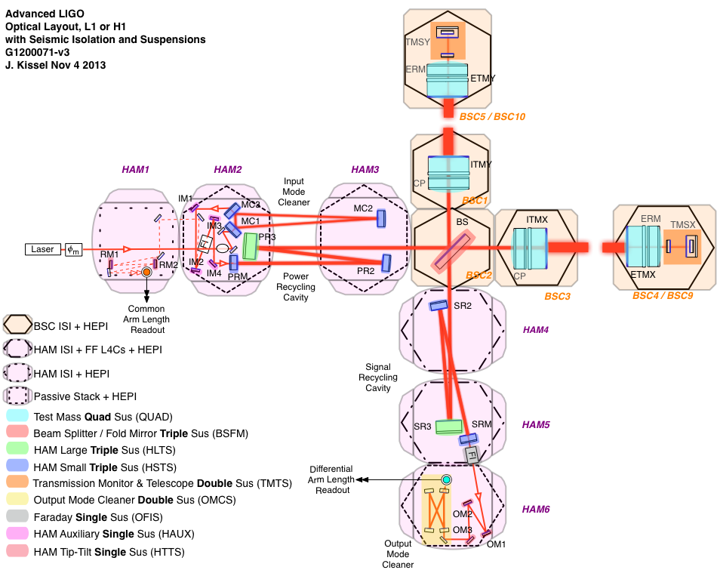

Slide 7
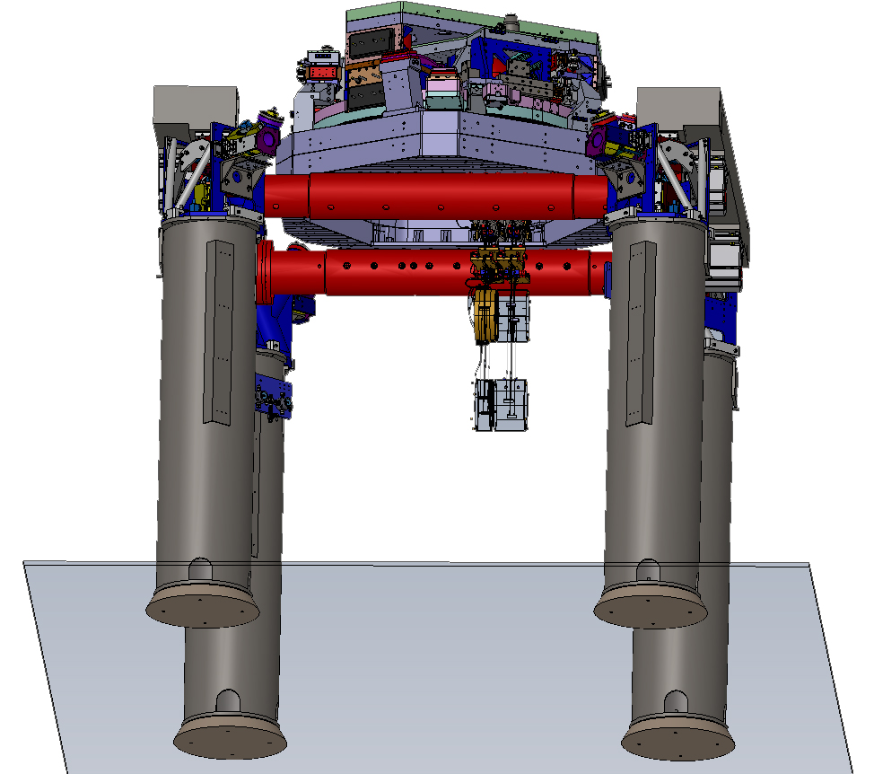
Hybrid Systems
Advanced LIGO - The Design
7 Stages of Isolation
  Hydraulic Preisolation
  Blade spring and wire flexures
  Monolithic Final Stage
6 DOF sensing on stages 1 – 4, 3 DOF on 5 – 6
  Inertial and displacement on stages 1-3
  Displacement only on stages 4 - 6
6 DOF DC - 1kHz actuation on Stages 1 – 4, 3 DOF on 5 - 7
(6+6+6+[3*6+4]) = 40 out of 42 Trans./Rot. resonant modes sensed and controlled
Many-control-loop system
  Sensor blending, Feed back, Feed forward, Sensor Correction, Heirarchical control
Versatile 800 kg payload
Stage 1 – 3 “Performance limited by sensor noise,” Stage 4 – 7 “Performance limited by direct transmission of platform motion”
2
3
1
4
4
5
5
6
6
7
7

Slide 8

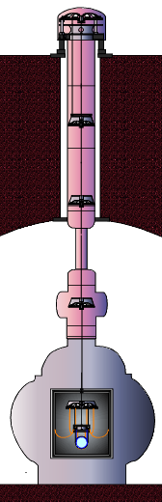
Hybrid Systems
The Comparison
All isolation systems are hybrid.
Not “Passive” vs. “Active”
Every isolation system uses a combination of “passive” pendula as well as “active” sensors and actuators for some degrees of freedom
Not “ISI” or “SA” vs. “Payload
Controls and mechanics don’t care how you’ve divided up assembly, all parts are connected and affect all dynamics
Not “Soft” vs. “Stiff”
Instead “Soft” vs. “Very Soft”
Every isolation system has some DOFs low frequency resonant modes and some with high frequency resonant modes. There *is* a difference between a 30 mHz system and a 400 mHz isolation system
Not “Cheap” vs. “Expensive”
Each system has a whole bunch of precision engineered metal, some fancy sensors, digital control system, man-hours … it’s all a wash in the end

Slide 9
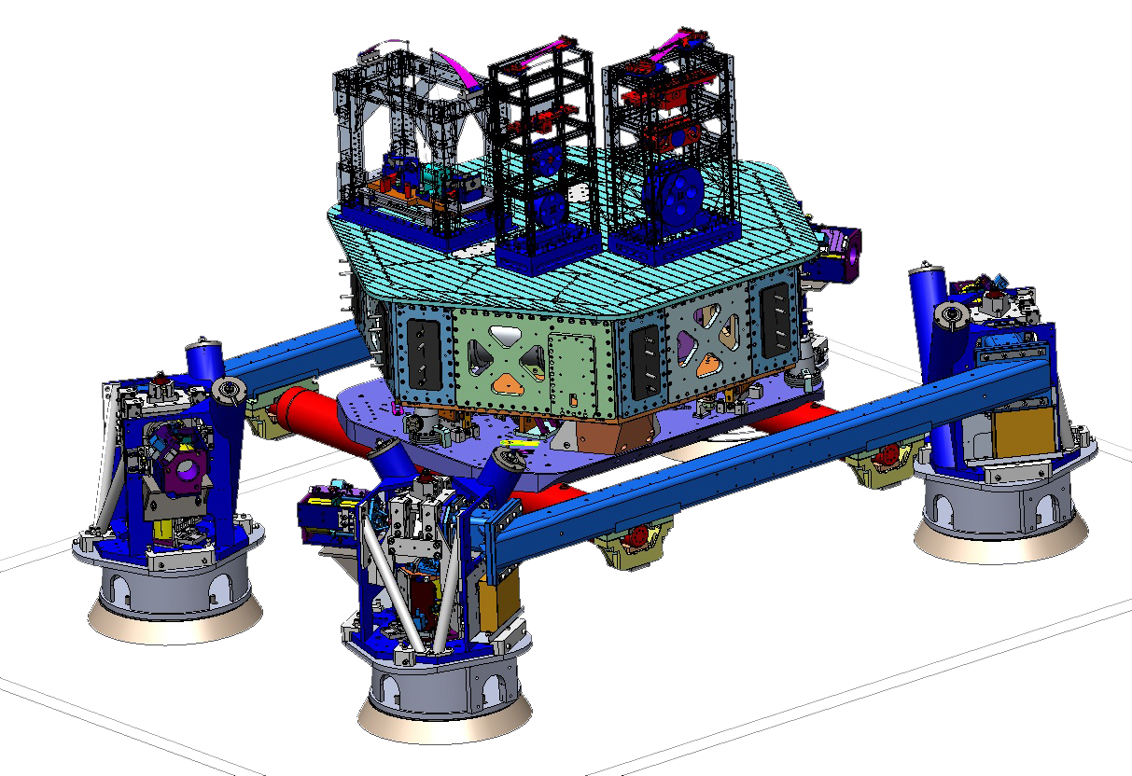
Advanced LIGO
A single output chamber is complicated!
HAM5
Signal Recycling
(Mirror) 3
Output Faraday
Single Suspension
Signal Recycling
Mirror
Small Triple Suspension
Hydraulic Pre-Isolation
Lots of practical stuff removed for demonstration
Vacuum chamber
SUS sensors
EQ stops, Lockers

Slide 10
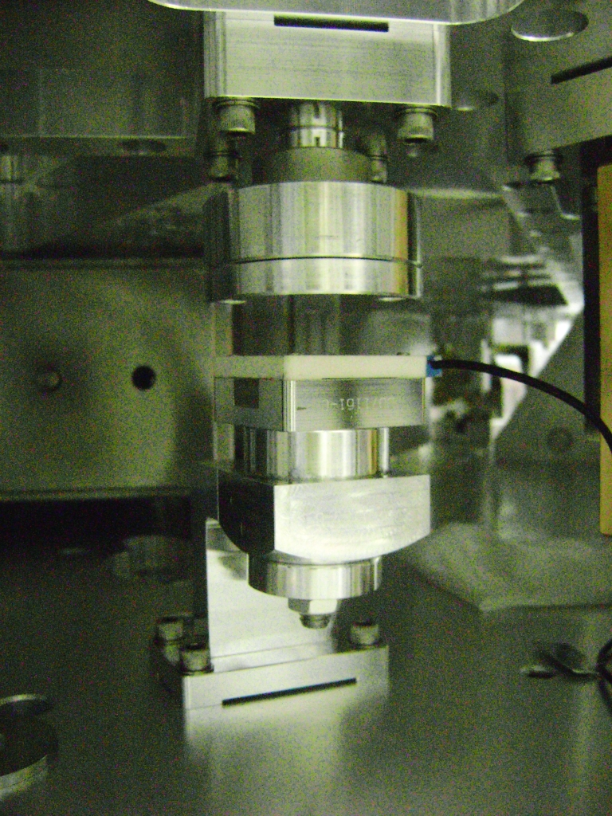
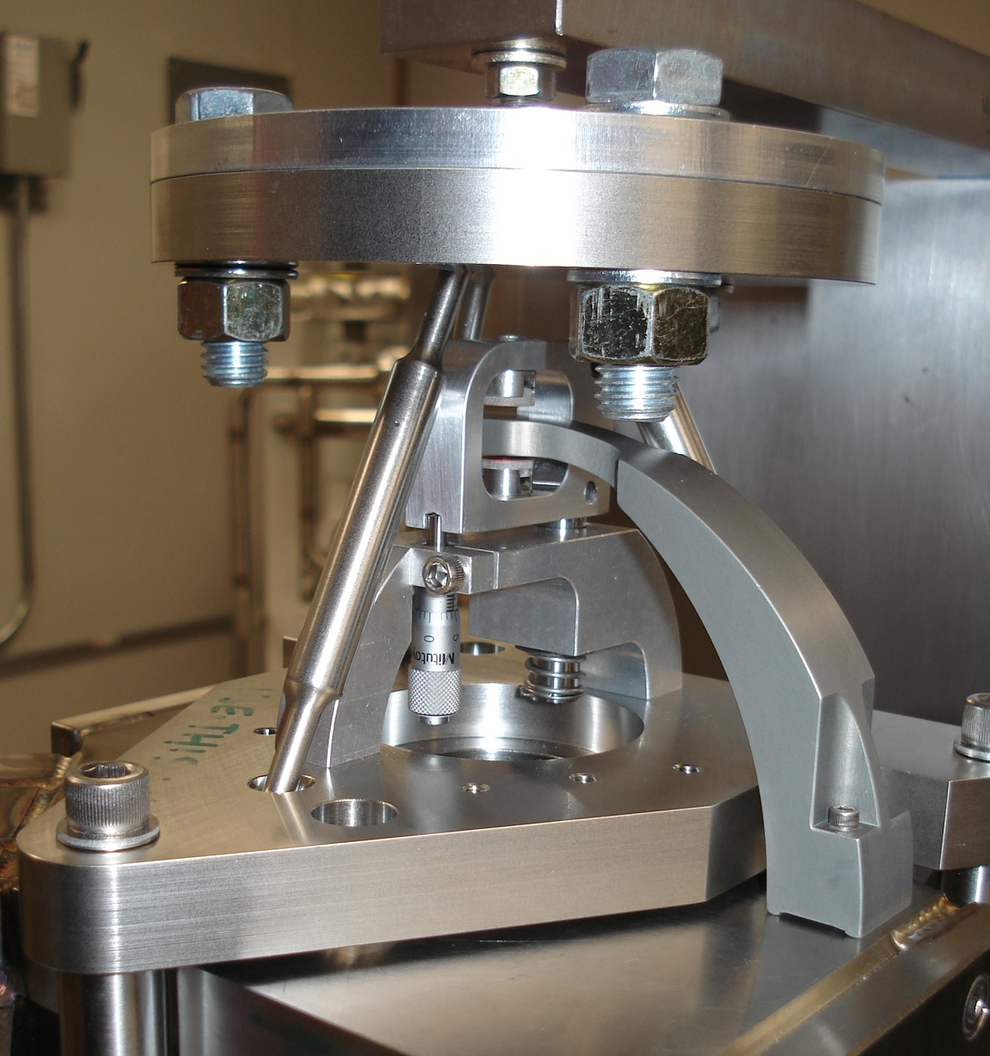
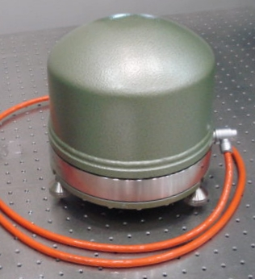
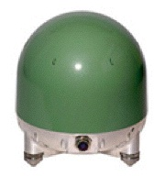
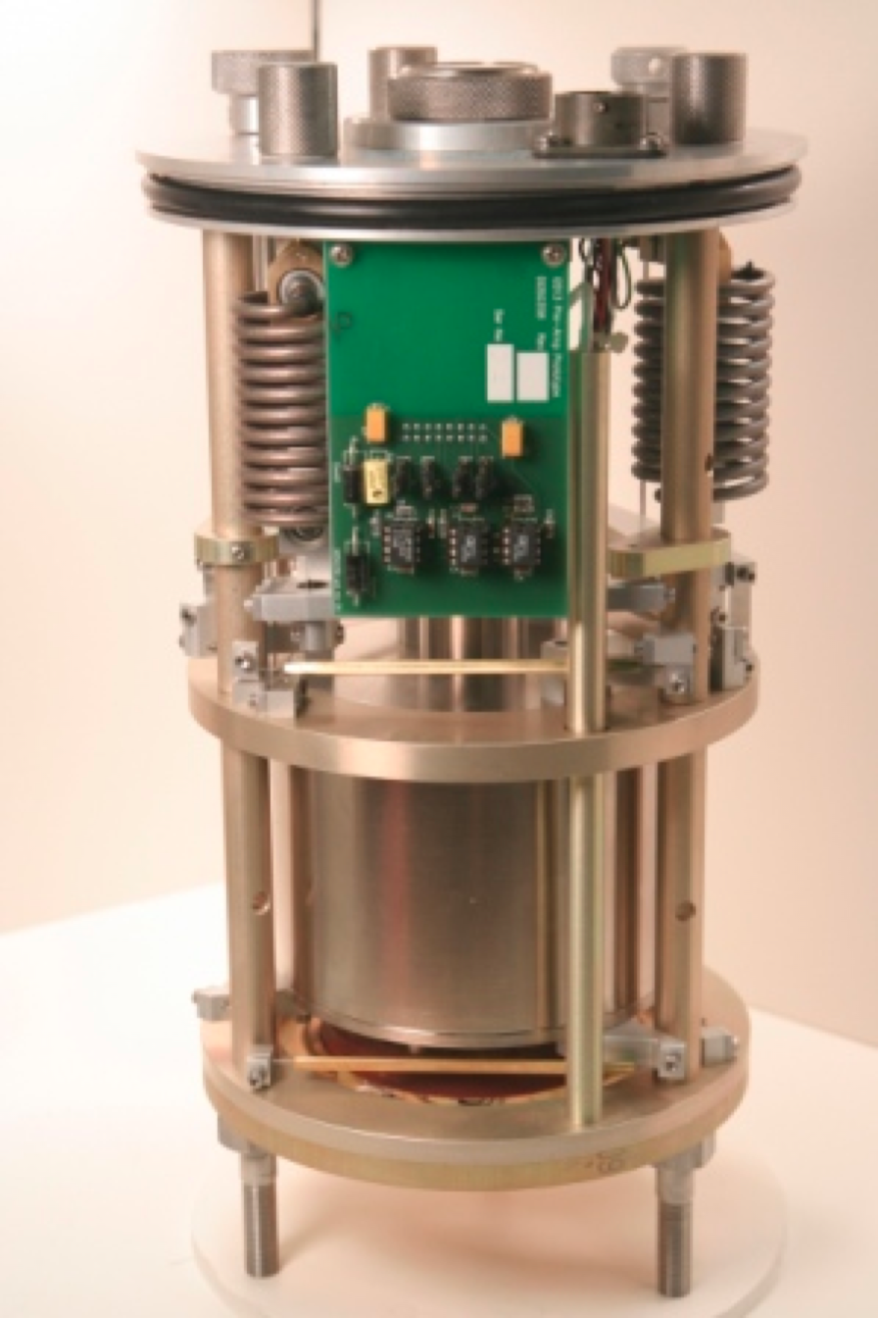
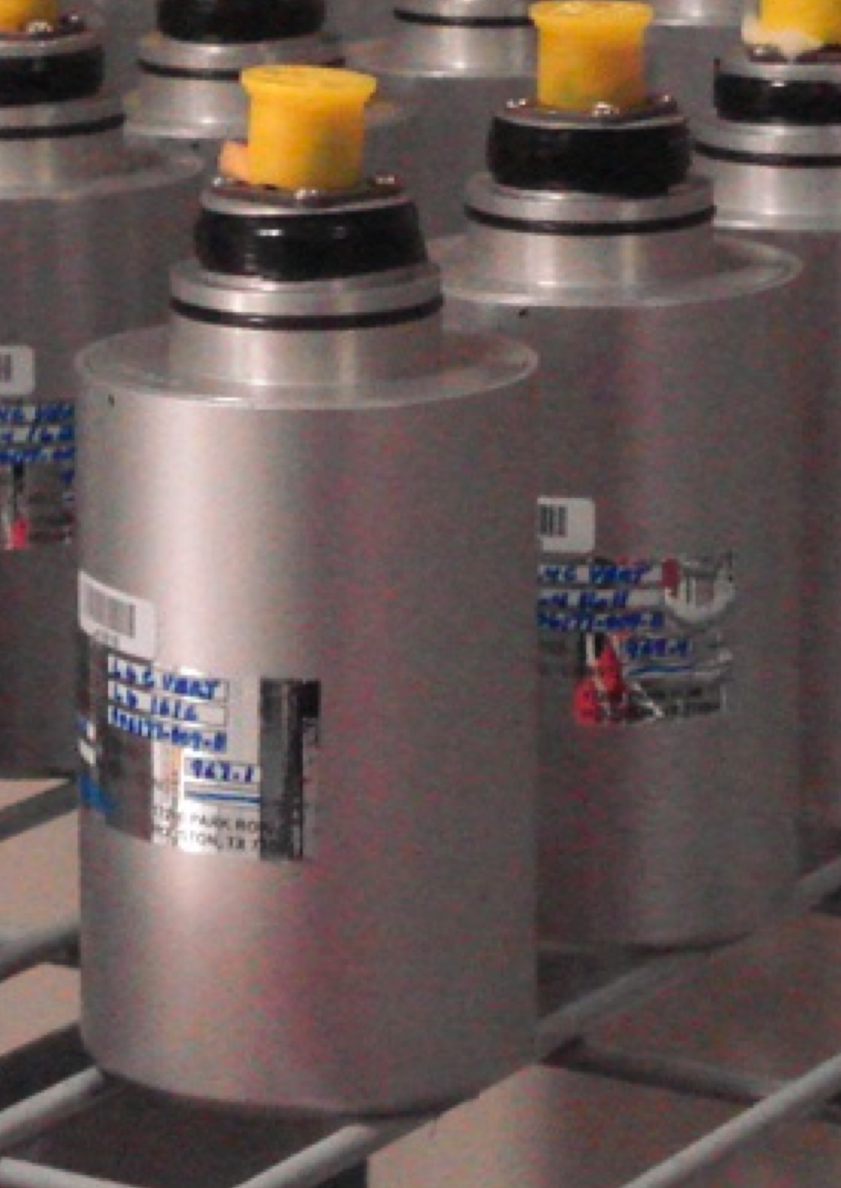
SEI Sensors and Their Noise
“Low” Frequency
IPS
Kaman’s Inductive Position Sensors
Used On: HEPIs
Used For: ≤ 0.5 Hz Control, Static Alignment
Used ‘cause: Reasonable Noise, Long Range
CPS
MicroSense’s Capacitive Displacement Sensors
Used On: HAM-ISIs and BSC-ISIs
Used For: ≤ 0.5 Hz Control, Static Alignment
Used ‘cause: Good Noise, UHV compatible
DC
10 mHz
STS2
Strekheisen’s STS-2
Used On: HEPIs
Used For: 0.01 ≤ f ≤ 1Hz Control
Used ‘cause: Best in the ‘Biz below 1 Hz, Triaxial
T240
Nanometric’s Trillium 240
Used On: BSC-ISIs
Used For: 0.01 ≤ f ≤ 1Hz Control
Used ‘cause: Like STS-2s, Triaxial, no locking mechasim -> podded
GS13
GeoTech’s GS-13
Used On: HAM-ISIs and BSC-ISIs
Used For: ≥ 0.5 Hz Control
Used ‘cause: awesome noise above 1Hz,
no locking mechanism -> podded
1 Hz
L4C
Sercel’s L4-C
Used On: All Systems
Used For: ≥ 0.5 Hz Control
Used ’cause: Good Noise, Cheap,
no locking mechanism -> podded
800 Hz
“High” Frequency

Slide 11
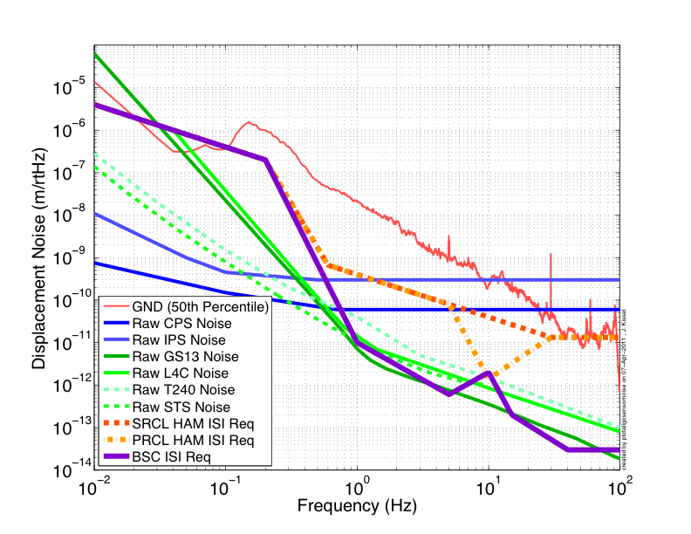
SEI Sensors and Their Noise

Slide 12
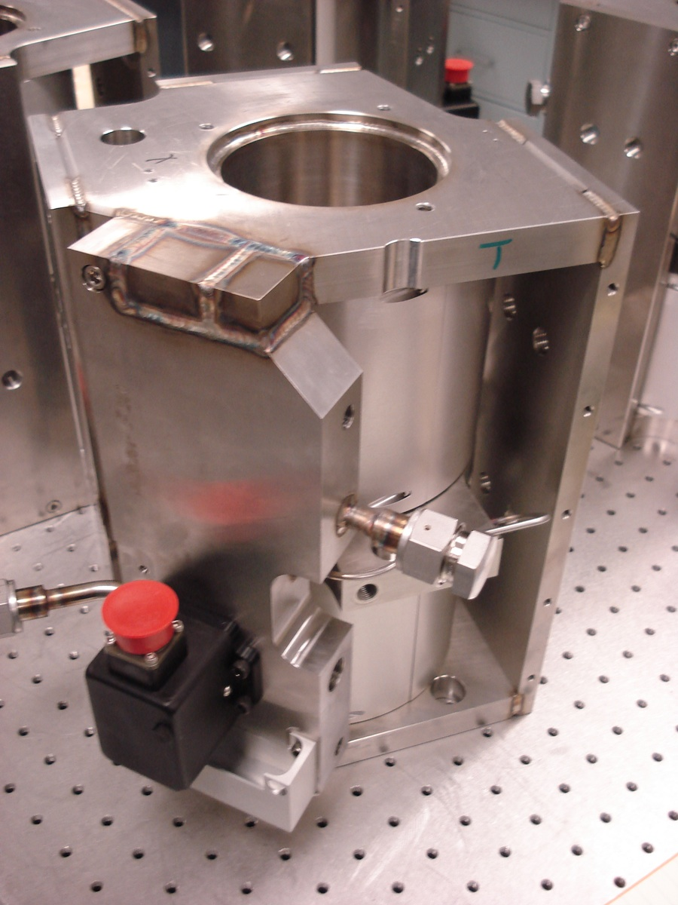
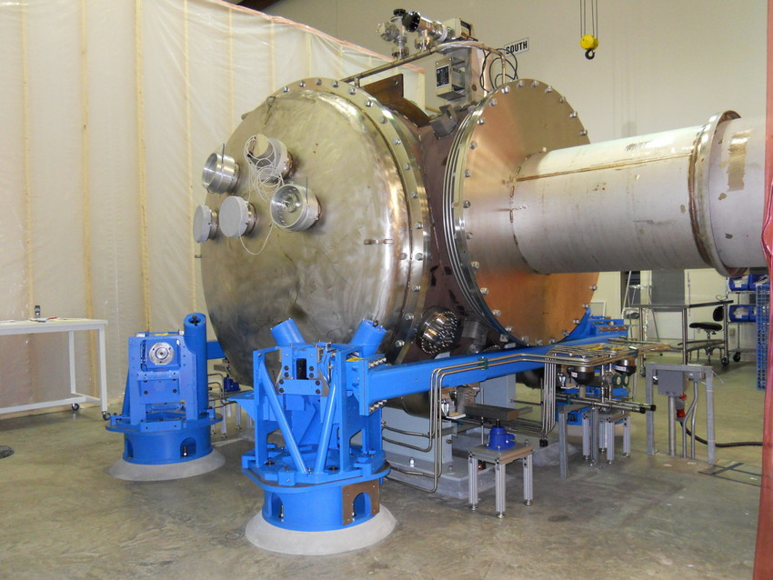
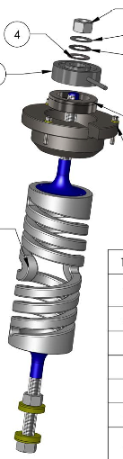
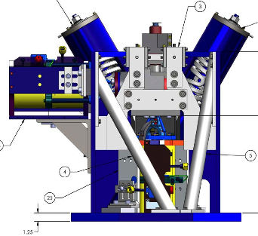
Where stuff is on HEPI
L4C
ACT
IPS
Position Sensor
f = ~1 Hz
Hydraulic
Actuators
Inertial
Sensor
Euler Springs

Slide 13
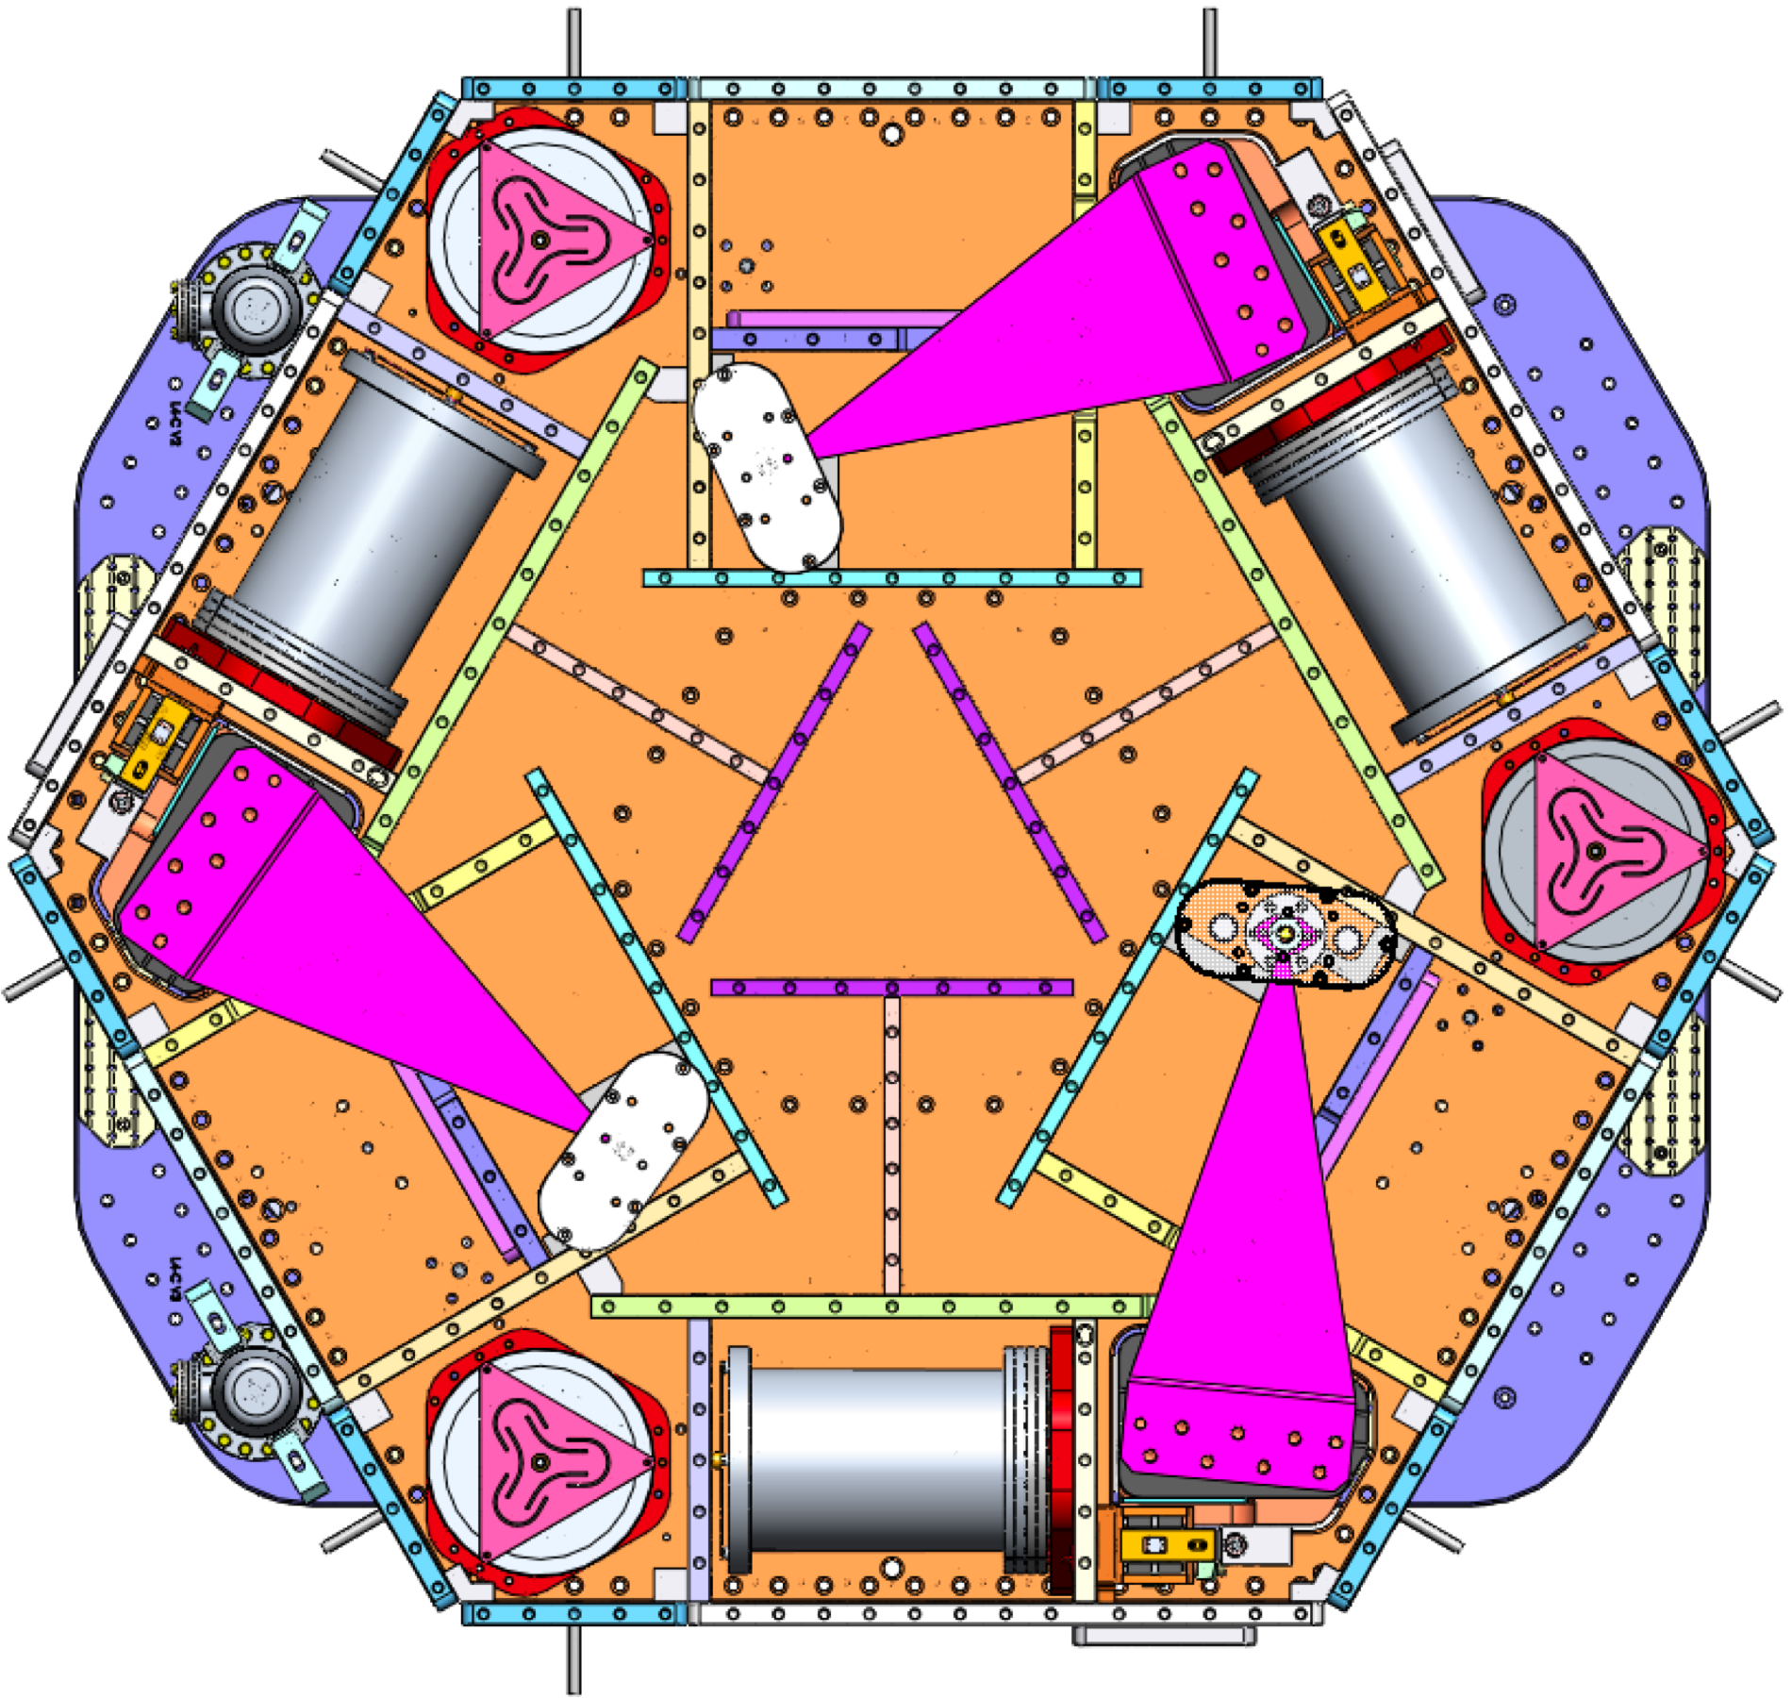
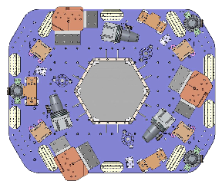
Where stuff is on a HAM-ISI
CPS
GS13
Displacement
f = ~1 Hz
Sensor
Inertial
Sensor
STAGE 1 (ST1)
SRCL HAM-ISIs will have “extra” L4Cs on the support stage (ST0) for feed-forward use around 10 Hz
L4C
f = ~1 Hz
STAGE 0 (ST0)

Slide 14
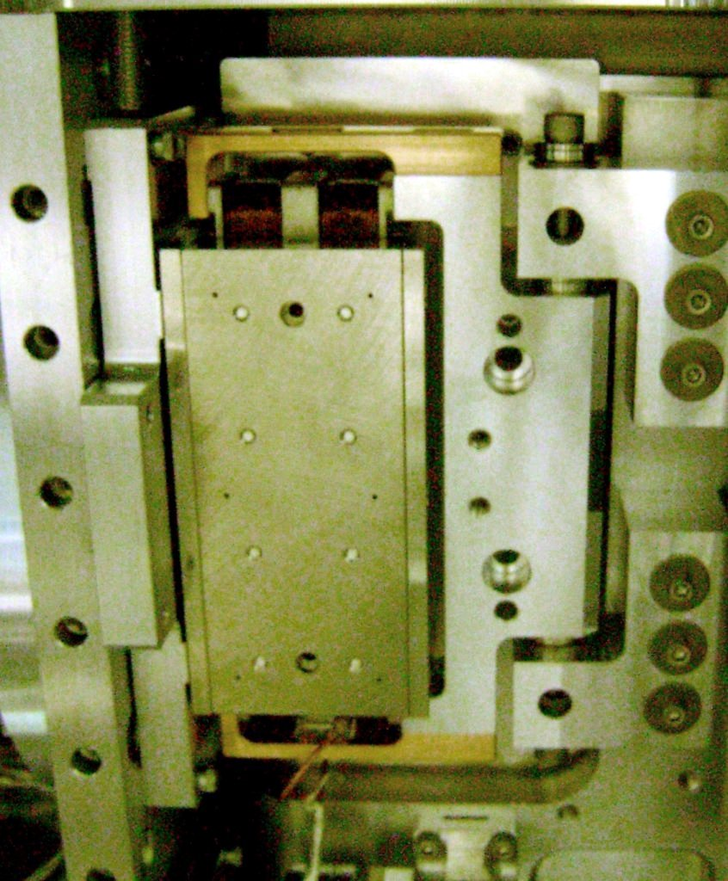
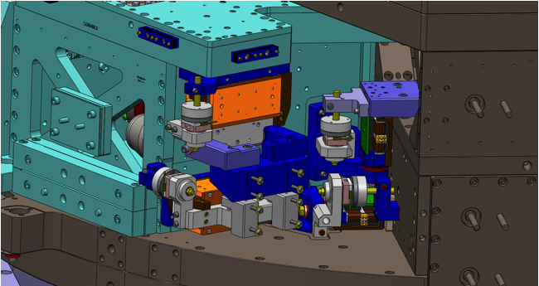
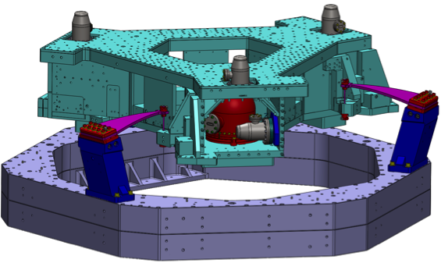
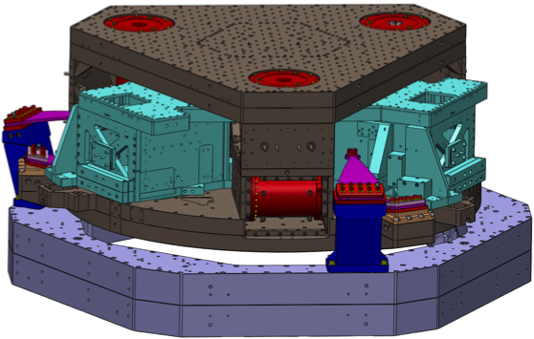
Where stuff is on a BSC-ISI
STAGE 2 (ST2)
STAGE 1 (ST1)
STAGE 0 (ST0)
L4C
T240
GS13
f = ~1 Hz
f = ~5 mHz
f = ~1 Hz
Inertial Sensors
Inertial Sensor
CPS
ACT
Displacement
One corner’s ST0-1 and ST1-2
position sensors and actuators
Electromagnetic
Sensor
Actuators

Slide 15
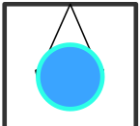
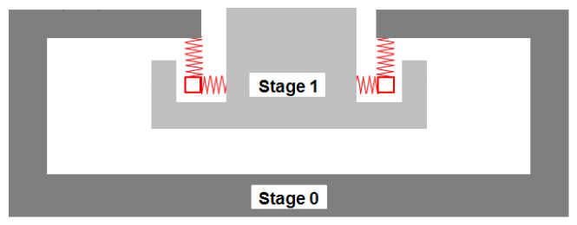
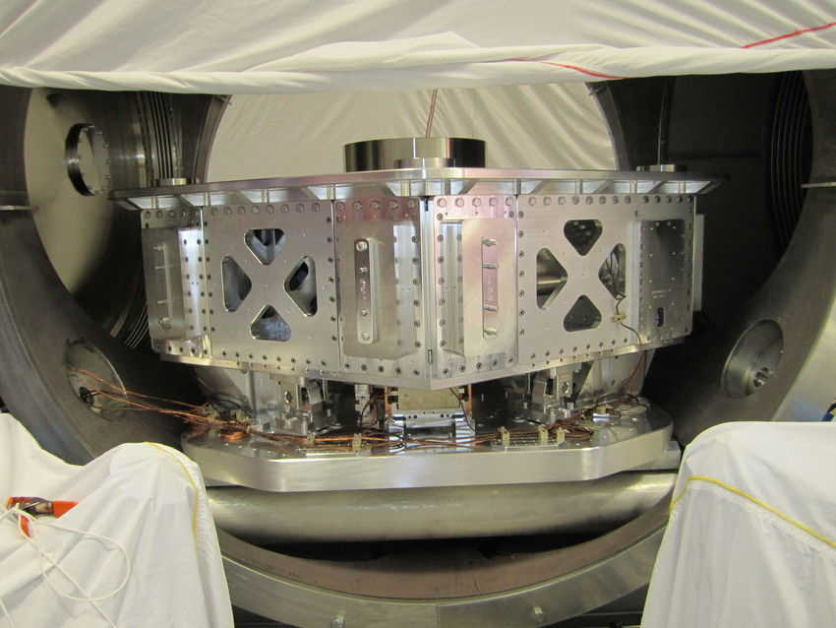
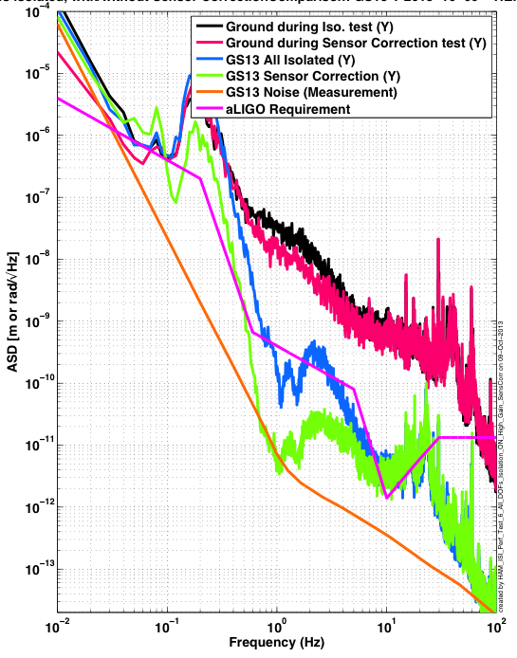
HAM chamber (auxiliary optics) configuration and performance
Crossbeam
Pier
Pier
Ground
Adapted from G1400965

Slide 16
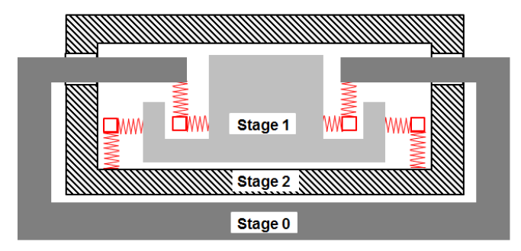
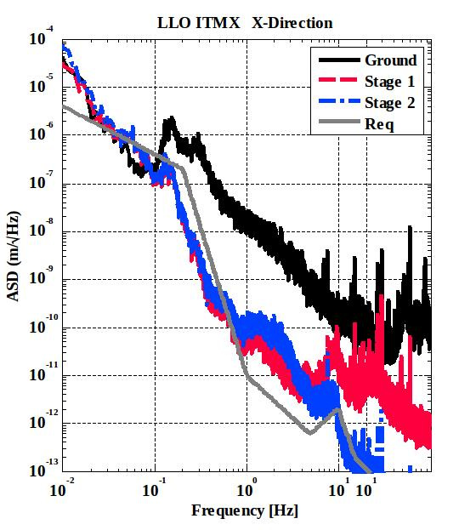

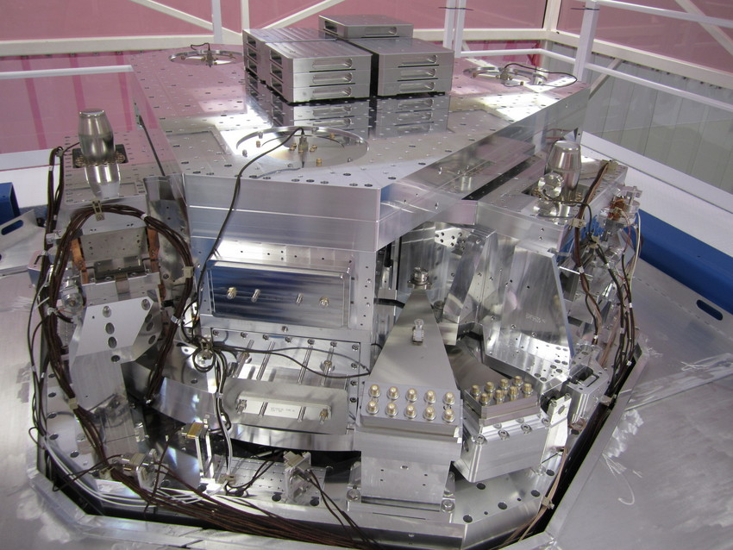
BSC chamber (core optics) configuration and performance
Pier
Pier
Ground
Adapted from G1400965

Slide 17
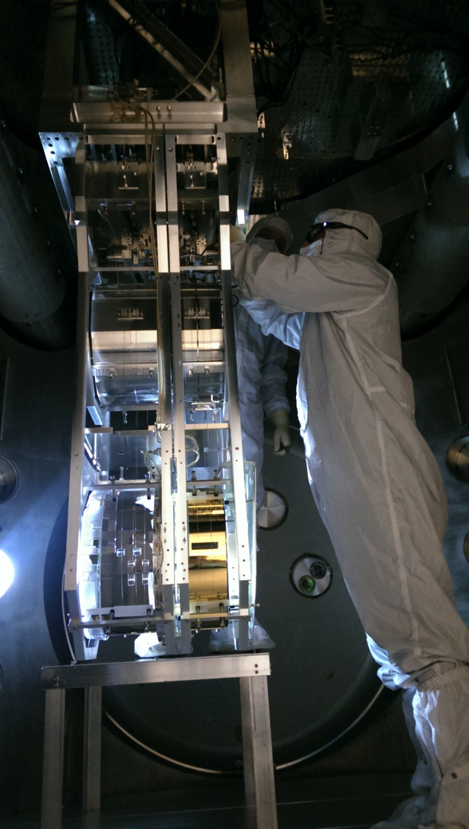
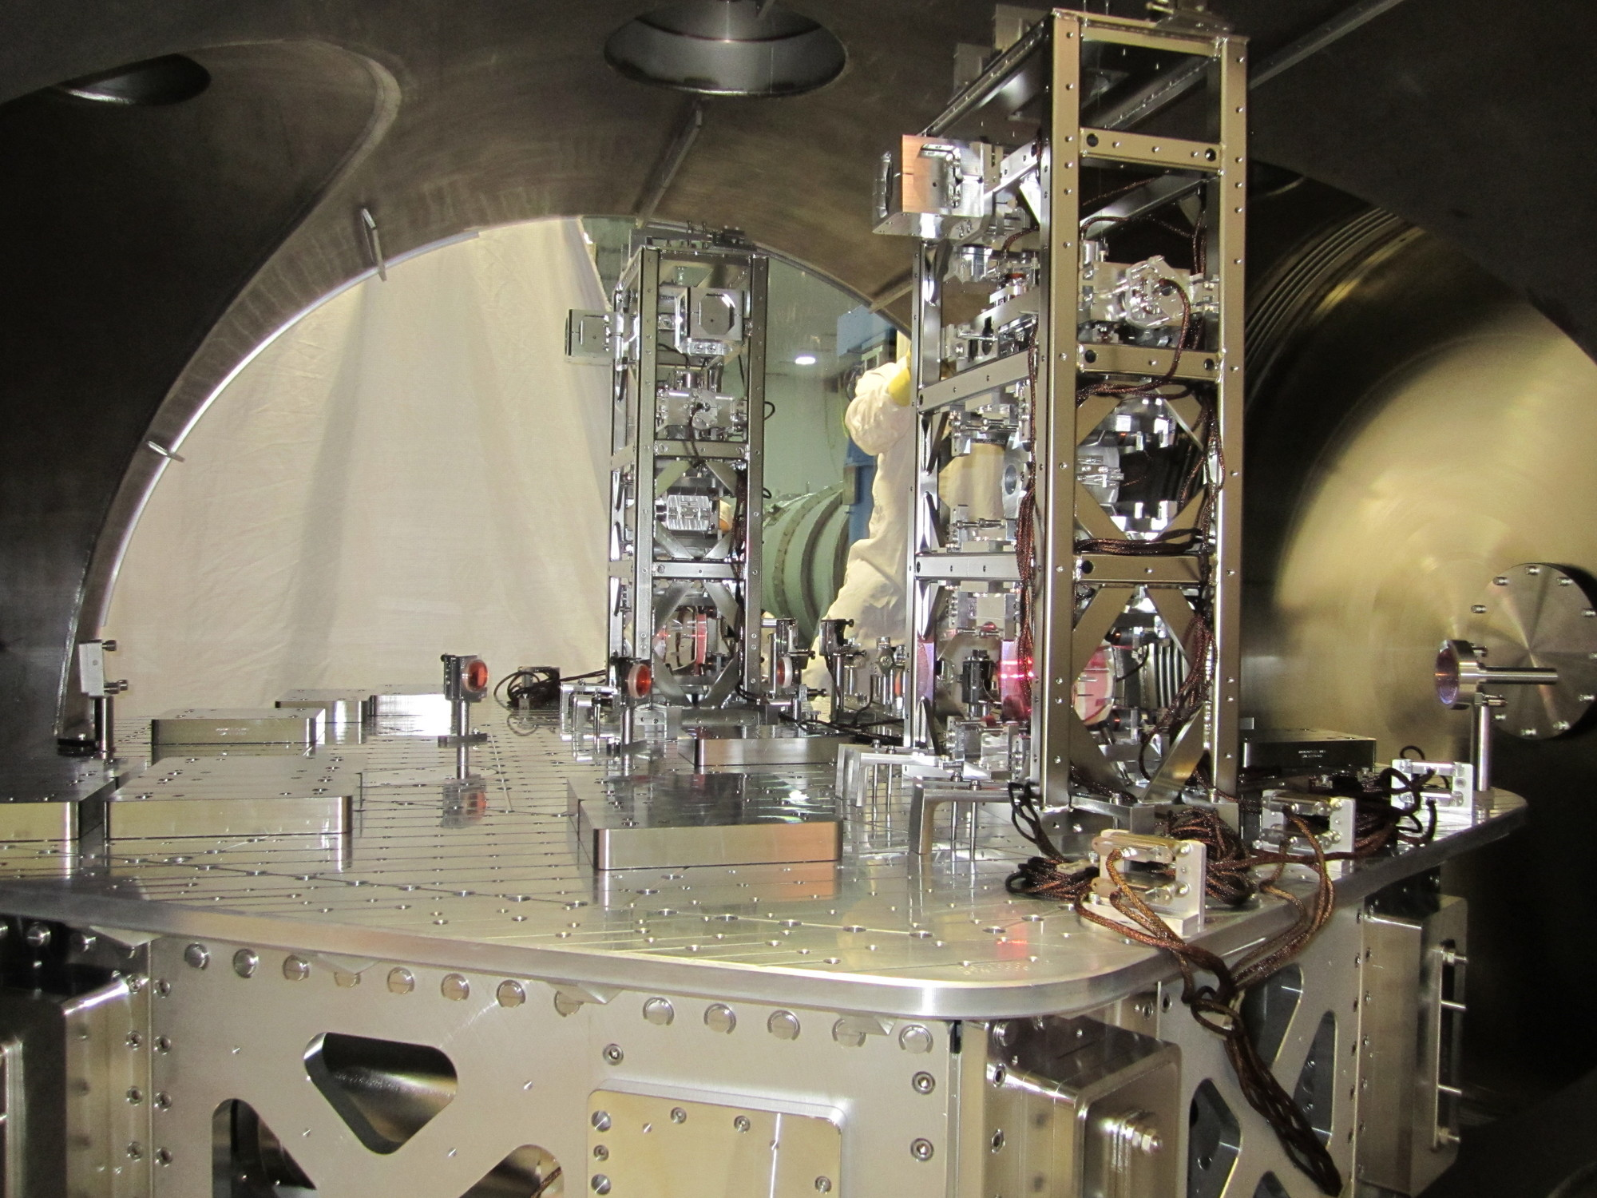
Test mass suspension on 2-stage in-vacuum isolation table
Auxiliary optics on 1-stage in-vacuum isolation table

Slide 18


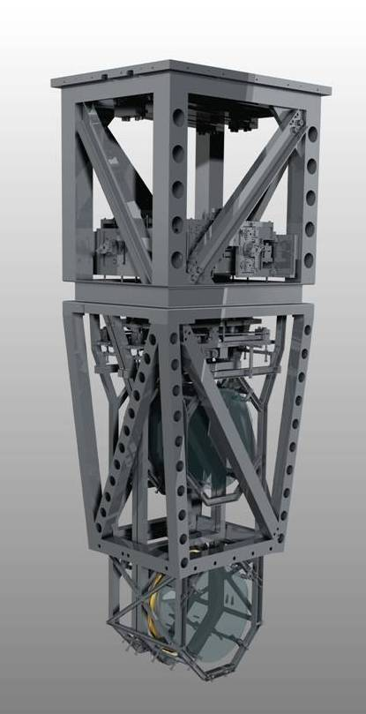
Quadruple Suspension (Quad)
Reaction Chain
Main (test) Chain
Purpose
Input Test Mass (ITM, TCP)
End Test Mass (ETM, ERM)
Location
End Test Masses, Input Test Masses
R0, M0
Control
Local – damping at M0, R0
Global – LSC & ASC at all 4
Sensors/Actuators
BOSEMs at M0, R0, L1
AOSEMs at L2
Optical levers and interf. sigs. at L3
Electrostatic drive (ESD) at L3
Documentation
Final design review - T1000286
Controls arrang. – E1000617
L1
L2
L3

Slide 19
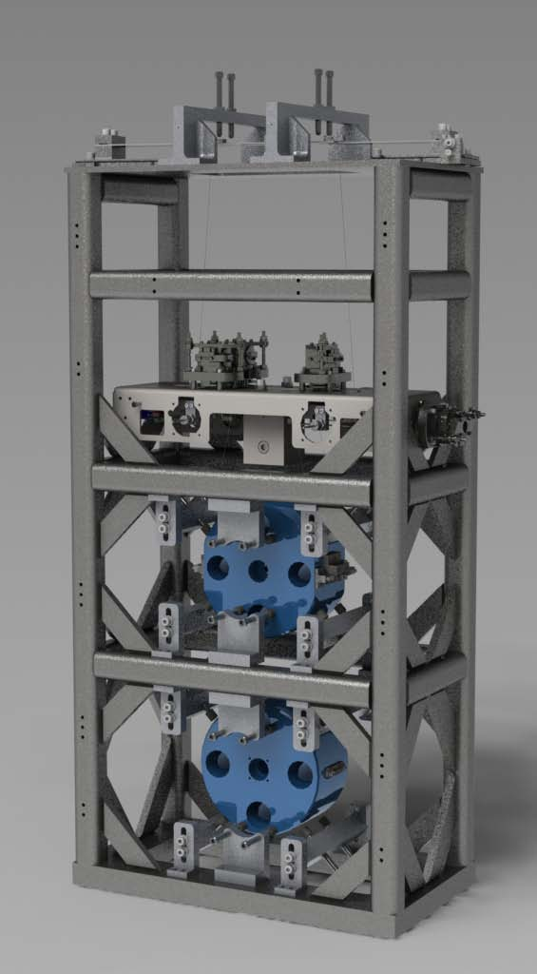

HAM Small Triple Suspension (HSTS)
Purpose
PRM, PR2, SRM, SR2
MC1, MC2, MC3
Location
Auxiliary Chambers
T1
T2
T3
SD
LF
M1
RT
Control
Local – damping at M1
Global – LSC & ASC at all 3
Sensors/Actuators
BOSEMs at M1
AOSEMs at M2 and M3
Optical levers and interferometric signals on M3
Naming: L1:SUS-PRM_M1…
Documentation
Final design review - T0900435
Controls arrangement – E1100109
UL
UR
M2
LL
LR
UL
UR
M3
LL
LR
V
T
L

Slide 20
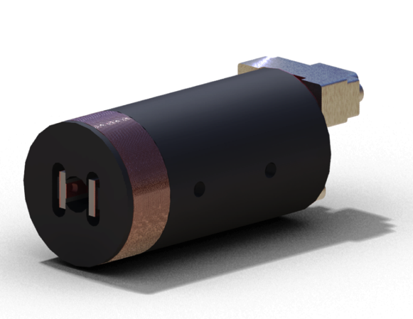
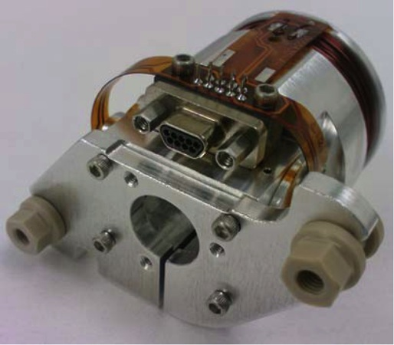
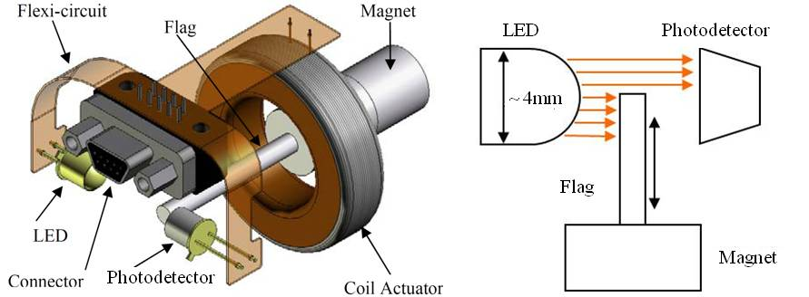
Optical Sensor ElectroMagnet (OSEM)
Birmingham OSEM (BOSEM)
Advanced LIGO OSEM (AOSEM)
- modified iLIGO OSEM
Magnet Types (M0900034)
BOSEM – 10 X 10 mm, NdFeB , SmCo
10 X 5 mm, NdFeB, SmCo
AOSEM – 2 X 3 mm, SmCo
    2 X 6 mm, SmCo
    2 X 0.5 mm, SmCo
BOSEM Schematic

Slide 21
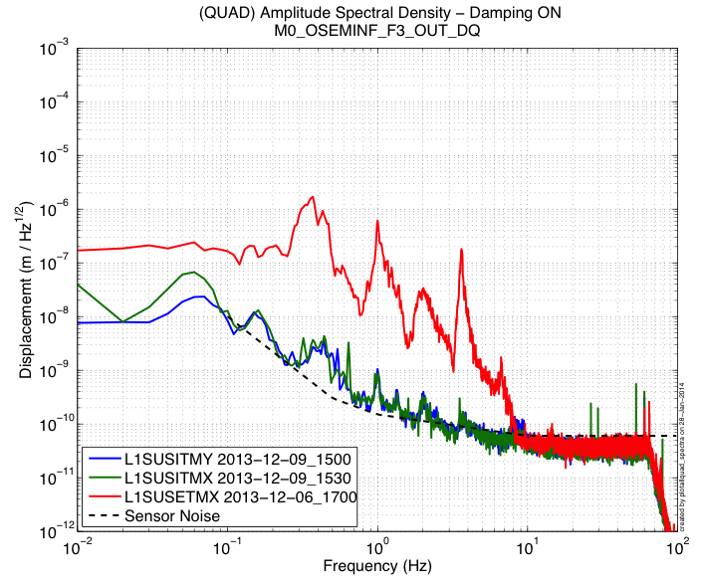
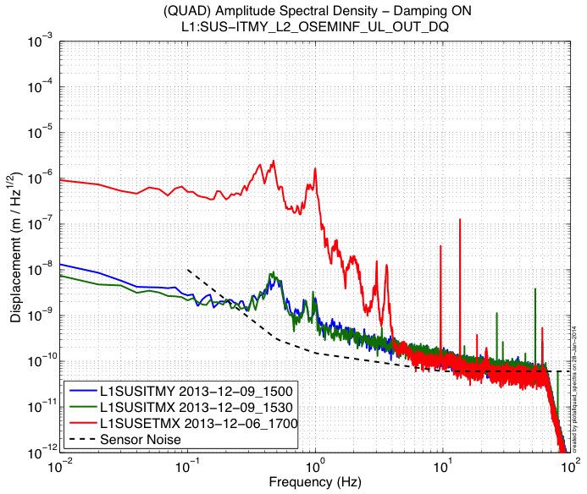
Optical Sensor ElectroMagnet (OSEM)
~5e-11 [m/rtHz] @ 10 [Hz]
~1e-10 [m/rtHz] @ 10 [Hz]

Slide 22
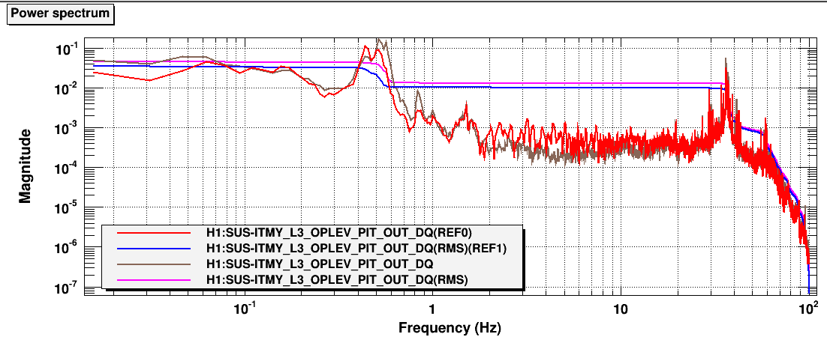
Optical Levers
Invaluable local sensor of the test masses
Main (test) Chain
Input Test Mass Pitch
Displacement [urad/rtHz]
~10 [m] lever arm
~ 1e-9 [nm/rtHz] sensitivity at from 0.1-10 [Hz]

Slide 23
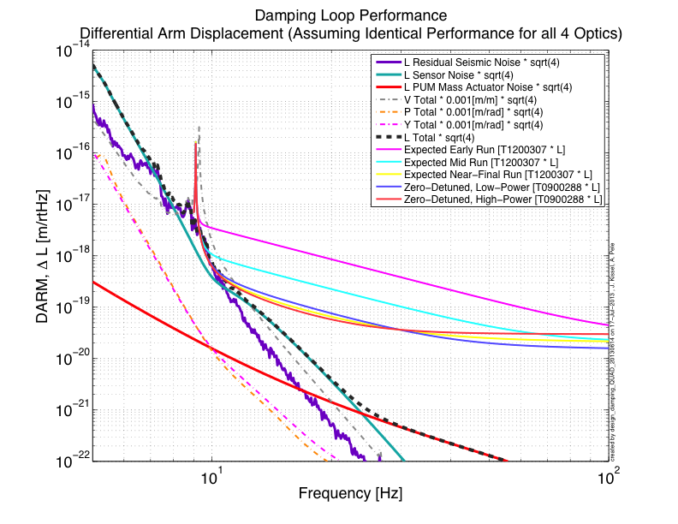
Predicted Performance
(Without Optical Lever Damping)
See G1300537 for details

Slide 24
Control of Seismic Isolation Systems

Slide 25
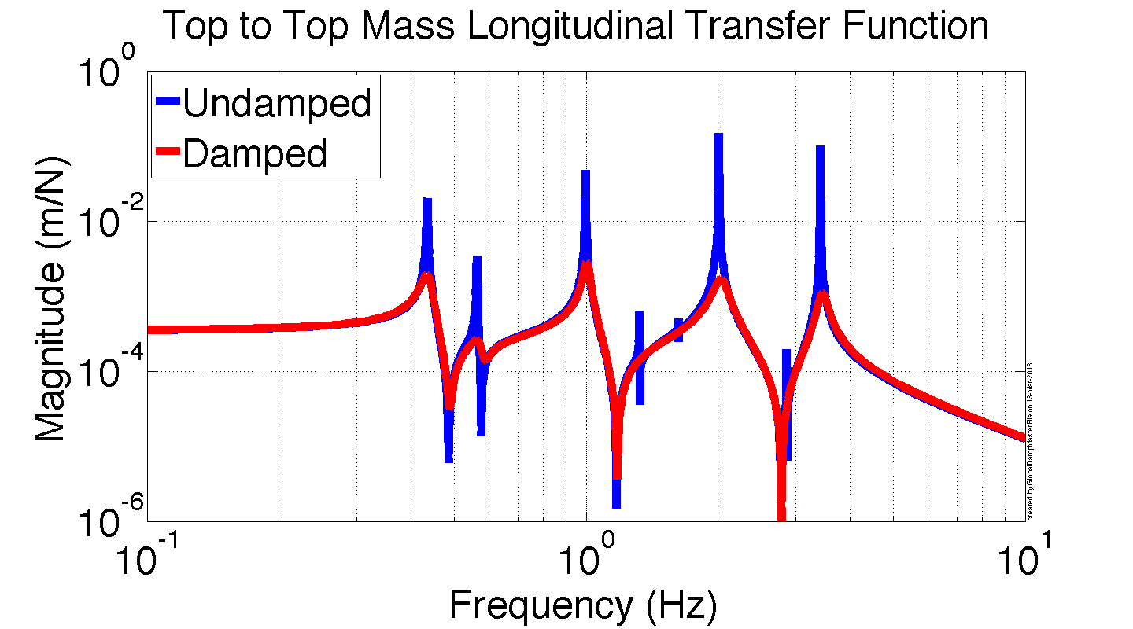
Suspension damping feedback
sensor noise
Simple, high-gain velocity damping with HF roll-off for lock acquisition
A little more complex design for low-noise operation
  see T1100232
[m]
Damping feedback filter
[N]
+

Slide 26
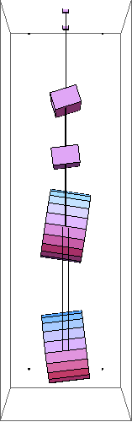
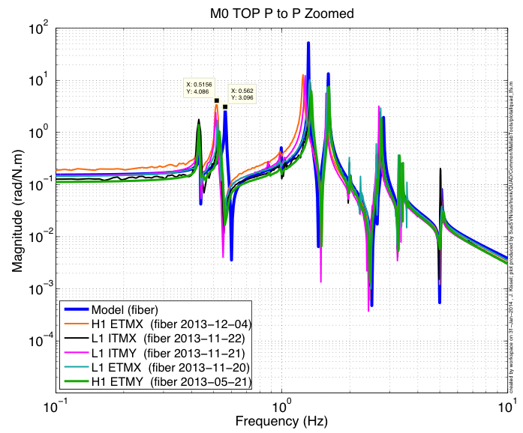
Suspension Damping Feedback

Slide 27
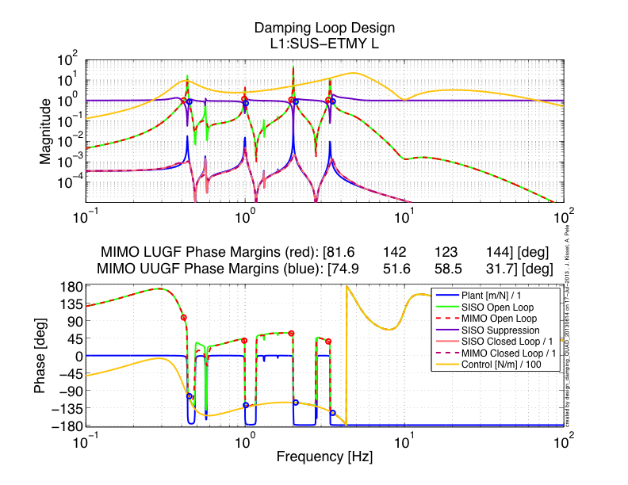
Suspension Damping Feedback

Slide 28
Suspension cavity control
Reaction Chain
Main (test) Chain
Drift control
Low frequency control
Medium frequency control
High frequency control
Cavity control filters

Slide 29
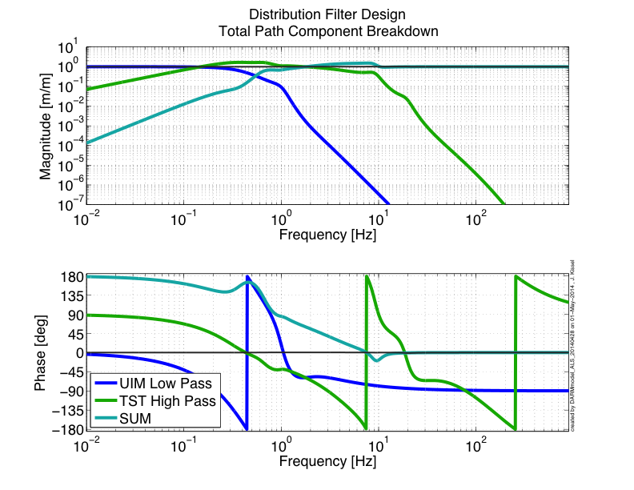
Suspension Cavity Control
Test Mass > 2 [Hz]
UIM Mass < 2 [Hz]
Top Mass < 0.2 [Hz]

Slide 30
Suspension angular control
Optical levers provide additional damping feedback for lock acquisition.
Wavefront sensors (WFS) provide low noise alignment feedback during observational runs.
Reaction Chain
Main (test) Chain
Optical levers or wavefront sensors
Alignment control filters

Slide 31
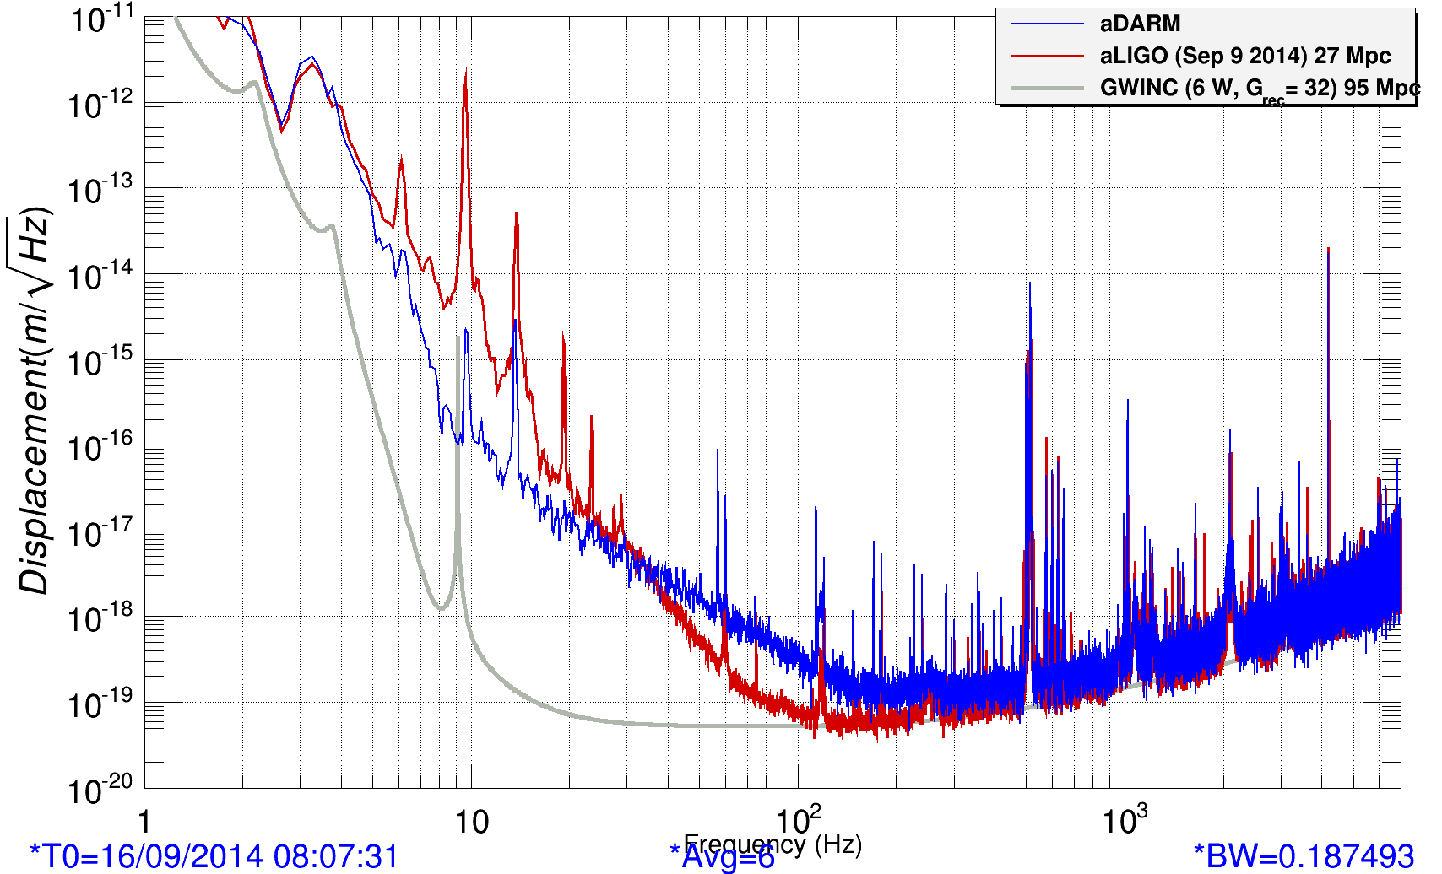
Suspension bounce and violin mode damping
Red: cavity error with undamped bounce (Hz) and roll (13 Hz) modes
Blue: cavity error with damping.
Reaction Chain
Main (test) Chain
https://alog.ligo-la.caltech.edu/aLOG/uploads/14605_20140916043743_DAMPING_BOUNCE_ROLL.png
Very high Q vertical bounce and roll modes between the lowest two stages. Top OSEMs cannot damp them.
Very high Q (~1 billion) silica fiber violin modes at 510 Hz and higher harmonics.
Damping filters

Slide 32
HEPI Control
Ground
Ground to HEPI / Stage 0
+
+
-
+
Local & Cal
Actuation to HEPI / Stage 0
L4Cs
IPS
GND STSs
Crossbeam twist correction
+
-
Cart & Cal
Cart & Cal
Cart & Cal
High pass
Isolation
+
+
Low pass
+
+
Sensor correction

Slide 33
Stage 1 of 1-stage of in-vacuum isolation table
(HAM-ISI)
Stage 0
Stage 0 to stage 1
+
+
-
+
Local & Cal
Actuation to stage 1
+
+
+
GS13
CPS
Cart & Cal
Cart & Cal
Stage 0 L4Cs
Damping
Cart & Cal
High pass
Feed-forward
Isolation
+
+
Low pass
Adapted from P1200010

Slide 34
Stage 1 of 2-stage of in-vacuum isolation table
(BSC-ISI)
Seismic noise
Stage 0 to Stage 1
+
+
-
+
Local & Cal
Actuation to stage 1
+
+
+
L4Cs
T240
IPS
Ground STS2s
Cart & Cal
Cart & Cal
Cart & Cal
Cart & Cal
Stage 0 L4Cs
Damping
Cart & Cal
High pass
Feed-forward
Isolation
+
+
+
Band pass
Low pass
+
+
Sensor correction
Adapted from P1200010

Slide 35
Stage 2 of 2-stage of in-vacuum isolation table
(BSC-ISI)
Stage 1
Stage 1 to stage 2
+
+
-
+
Local & Cal
Actuation to stage 2
+
+
+
GS13
CPS
Stage 1 T240s
Cart & Cal
Cart & Cal
Cart & Cal
Stage 1 L4Cs
Damping
Cart & Cal
High pass
Feed-forward
Isolation
+
+
Low pass
+
+
Sensor correction
Adapted from P1200010

Slide 36

Isolation Filter Loop Design

Slide 37


Sensor Blending and Blend Switching
Can't use inertial sensors at DC (tilt, magnetic coupling, etc.) → Use position sensors
Blend position and inertial sensors to create a “super sensor”
Several blend combinations are implemented and can easily be switched via real-time
blend switching
G1400965 and T1400284

Slide 38


Slide 39
BackUps

Slide 40
Conclusions
Open Questions
Is the temperature susceptibility of the lowest frequency modes of these hybrid systems a problem?
aLIGO’s low-stress, minimal force design claims less non-gaussian noise. Is it true?
aLIGO’s “sensors everywhere” policy is supposed to aid in identifying unknown unknowns. Will it help?
Can we read out our sensors / use our actuators [[CABLES]] without spoiling the mechanical isolation?
Can any of these hybrid systems – the *entire* system, not just the test masses – meet their claimed fundamental noise sources (ground transmission and/or sensor noise)
  Cables shorting isolation
  Heat links shorting isolation
  Reinjection of Sensor Noise
  Thermal Noise
  Magnetic Coupling Noise

Slide 41
Conclusions
Open Questions
Integration of large number of platforms together using inteferometric signals …
How to encorporate new / better sensors? e.g. ground rotation sensors
Can we use computers to “simulate” the mechanical dynamics in real-time?
Operations during sensor failure
How to create / encorporate a global array of sensors for Newtonian Noise Subraction?

Slide 42
List of Gotchas / Tricks
Capacitive position sensor clock signals beating against each other – causing ~0.3 [Hz] comb
QUAD Bounce/Roll Mode causing saturations
Violin Mode Damping
ISI modes seen in SUS TFs and vice-versa
Lock acquisition kicks influencing isolation of upper stages
HEPI mechanical tilt-horizontal ISI coupling (which first drove us to send sensor correction to the ISIs)
ESD Charging / Electronics Noise
HEPI Cross-beam Bending Modes
Magnetic fields from ISI Z actuators cause ISI RZ motion
Increase our SUS coil drive range for lock-acquisition

Slide 43
Resources on SUS control techniques
Damping
  Loop shaping and modal damping - P1200009 http://scitation.aip.org/content/aip/journal/rsi/83/4/10.1063/1.4704459?ver=pdfcov
  Modal damping - P1200057
  Global damping - P1400085, G1200774
Cavity control (aka hierarchical control)
  G1200632
  T1000242
  Using a blended actuator technique, using experience from the SEI group’s sensor blending: G1200692

Slide 44






Sensor Noise
Displacement Sensors
Inductive
aLIGO Pre-isolator Stage
Shadow Sensor
aLIGO SUS Top Stages
AEI 10m SUS Top Stages
Inductive
VIRGO / GEO / KAGRA SAS
Linear
Range
Shadow Sensor
aLIGO SUS Lower Stages
Capacitive
aLIGO Stage 1 ISIs
Interferometeric, U of Birmingham Prototype (As yet Non-UHV Comp.)
Capacitive
aLIGO Stage 2 ISIs

Slide 45



Sensor Noise
Inertial Sensors
aLIGO Stage 1 & 2 ISIs
aLIGO Pre-isolator Stage
aLIGO Stage 0 & 1 ISIs
AEI-SAS Vert. Witness
aLIGO Stage 1 ISIs
iVIRGO F0, F7
aLIGO Pre-isolator Stage
aVIRGO MultiSAS Horz. Witness
(Watt Linkage)
AEI-SAS Horz. Witness
(Watt Linkage)

Slide 46
SEI Sensors and Their Noise
“Low” Frequency
IPS
Kaman’s Inductive Position Sensors
Used On: HEPIs
Used For: ≤ 0.5 Hz Control, Static Alignment
Used ‘cause: Reasonable Noise, Long Range
CPS
MicroSense’s Capacitive Displacement Sensors
Used On: HAM-ISIs and BSC-ISIs
Used For: ≤ 0.5 Hz Control, Static Alignment
Used ‘cause: Good Noise, UHV compatible
DC
10 mHz
STS2
Strekheisen’s STS-2
Used On: HEPIs
Used For: 0.01 ≤ f ≤ 1Hz Control
Used ‘cause: Best in the ‘Biz below 1 Hz, Triaxial
T240
Nanometric’s Trillium 240
Used On: BSC-ISIs
Used For: 0.01 ≤ f ≤ 1Hz Control
Used ‘cause: Like STS-2s, Triaxial, no locking mechasim -> podded
GS13
GeoTech’s GS-13
Used On: HAM-ISIs and BSC-ISIs
Used For: ≥ 0.5 Hz Control
Used ‘cause: awesome noise above 1Hz,
no locking mechanism -> podded
1 Hz
L4C
Sercel’s L4-C
Used On: All Systems
Used For: ≥ 0.5 Hz Control
Used ’cause: Good Noise, Cheap,
no locking mechanism -> podded
800 Hz
“High” Frequency

Slide 47


BSCs – core optics
hydraulic external pre-isolator (HEPI) (one stage of isolation)
active isolation platform (2 stages of isolation)
quadruple pendulum (four stages of isolation) with monolithic silica final stage

Slide 48
An aLIGO HAM Chamber
z
x
y
HAM2 (Chamber hidden for clarity)

Slide 49

Predicted Advanced LIGO Sensitivity

Slide 50


Ground Variability

