Slide 1
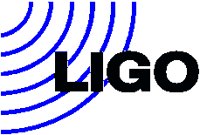
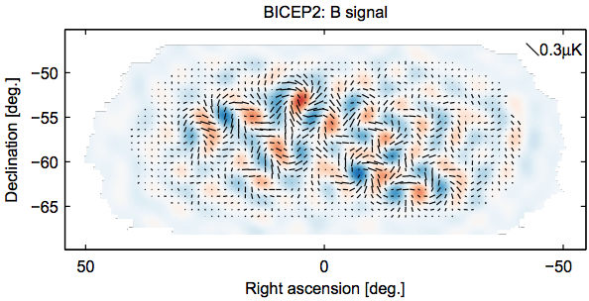
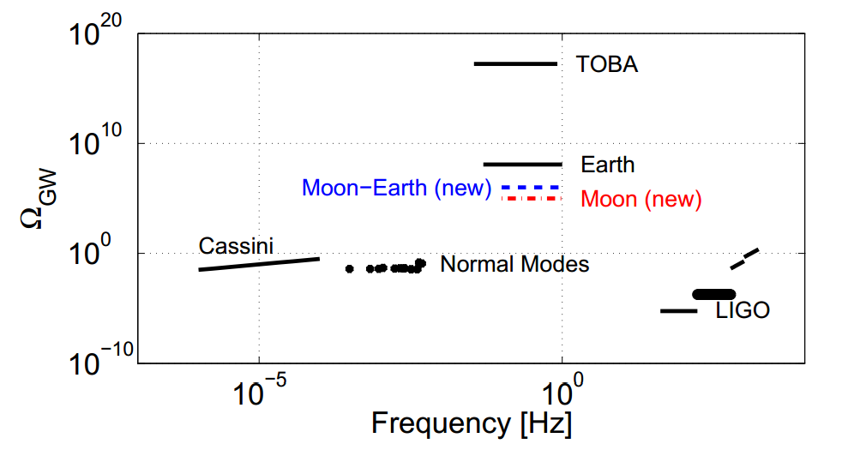
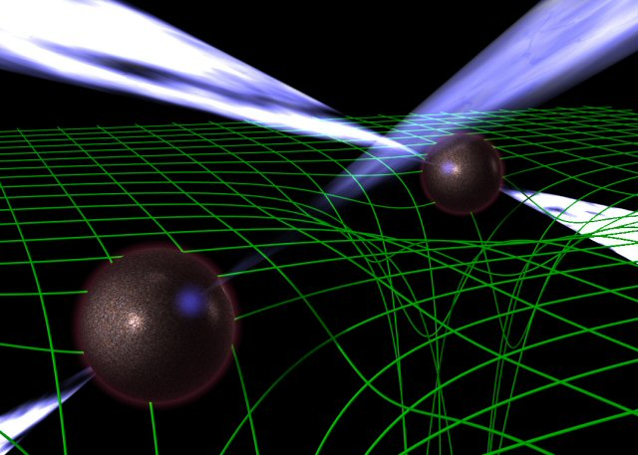
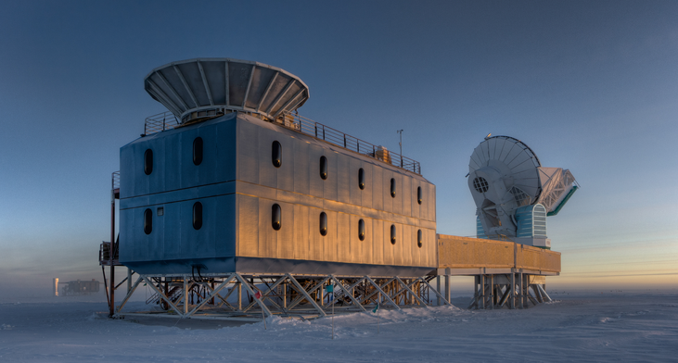
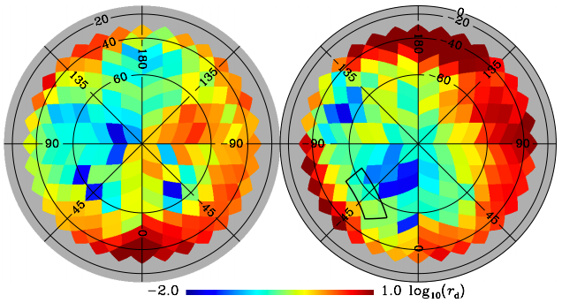
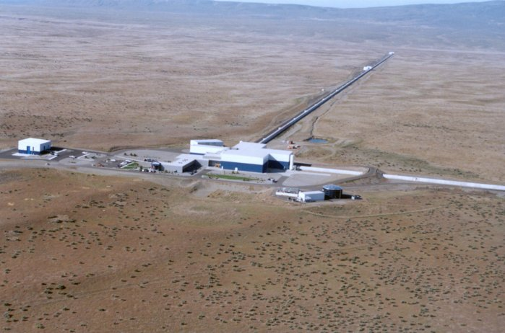
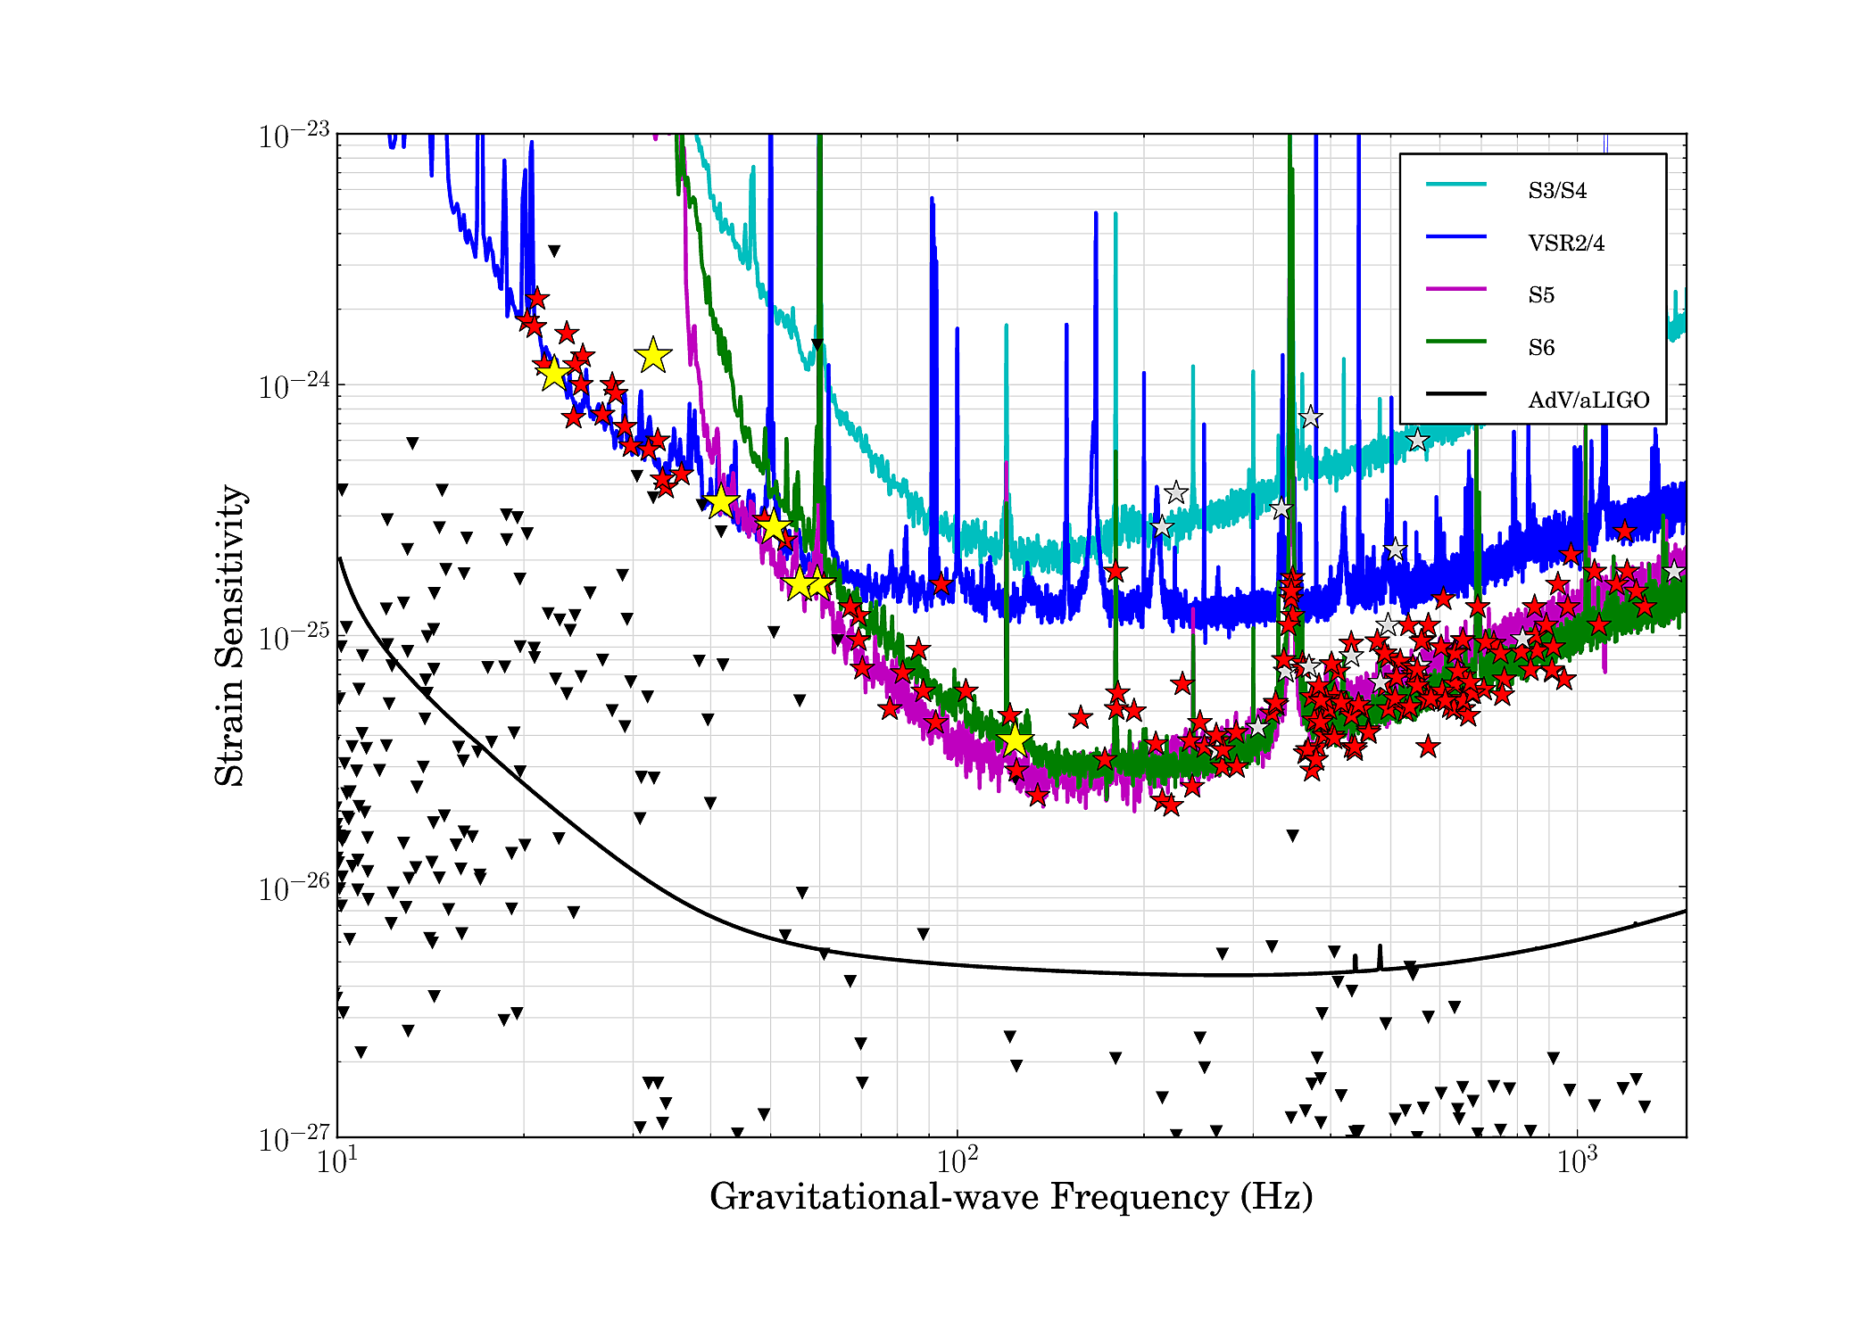
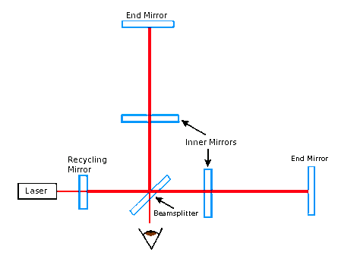
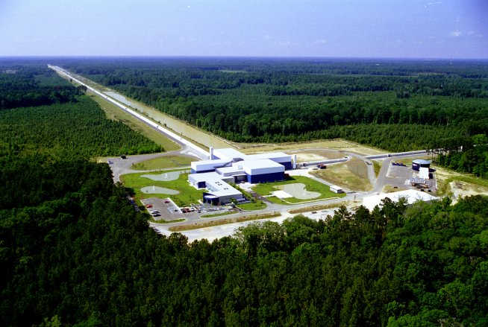
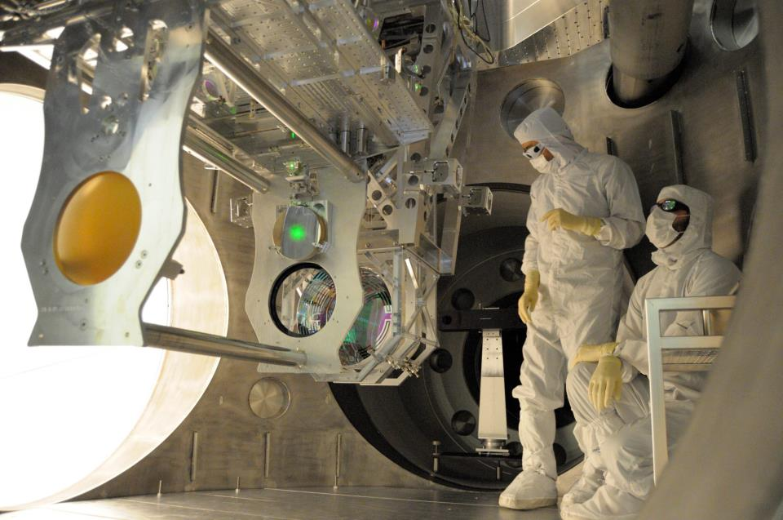
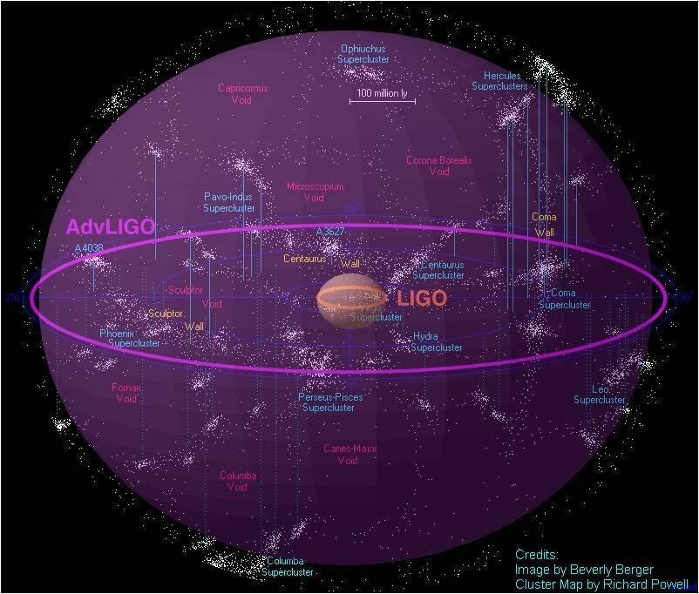
Gravitational Waves: On the Brink of a New Astronomy
Tiffany Summerscales, Dept. of Physics
What are gravitational waves?
Einstein’s theory of General Relativity predicts that mass curves the fabric of spacetime. John Wheeler summarized this prediction in the statement, “Mass tells spacetime how to curve and spacetime tells matter how to move.” Moving masses produce ripples in the fabric of spacetime that propagate outward at the speed of light. These ripples stretch and squeeze the space they pass through but are so weak by the time they reach earth that the largest ones would squeeze the planet by less than the diameter of a proton.
Gravitational waves in the news
In March the BICEP2 Collaboration announced that they had measured a certain type of twisting in the polarization of light from the Cosmic Microwave Background (CMB) [3]. This light was produced near the beginning of the universe. Gravitational waves from inflation, the rapid swelling of the early universe could have interacted with the CMB and caused the pattern measured. Inflation is important for explaining why the universe is so homogeneous but had not yet been supported by direct experimental evidence.
The Apollo lunar missions left seismometers on the surface of the moon to study
moonquakes. The data from these seismometers was studied for evidence of
passing gravitational waves. No evidence was found which places upper limits on the
strength of the gravitational wave background in the frequency range 0.1 – 1 Hz [6].
Gravitational waves at this frequency are outside of LIGO’s sensitivity range.
Above is an artist’s depiction of two pulsars orbiting around each other and producing gravitational waves. Pulsars are the remnants of dead stars whose powerful magnetic fields produce beams of radio waves that sweep around as the pulsar rotates. Such systems have been observed and seem to be loosing energy to gravitational waves [1]. Image from [2].
BICEP2 (left) and the South Pole Telescope (right). Image from [4]
The BICEP2 results (top) have been called into question by recent measurements of the
CMB by the Plank satellite [5]. Galactic dust (bottom) can also cause polarization twists
and it is uncertain how much, if not all of BICEP2’s measurement can be attributed to dust.
LIGO the Laser Interferometer Gravitational-wave Observatory
Gravitational waves stretch and squeeze the space they pass through, changing the distances between
objects. Therefore, we need a way to measure distance changes very accurately. The LIGO (Laser
Interferometer Gravitational-wave Observatory) detectors were built to do just that [7]. Laser light is
sent down perpendicular 4 km long arms, reflected from end mirrors and then allowed to recombine
and interfere. Changes in the amount of interference indicates changes in the length of the arms.
Initial LIGO results
Data from the LIGO detectors has been collected and analyzed, along with the
data from other gravitational wave detectors such as the Virgo detector in Italy,
GEO600 in Germany, and TAMA in Japan. None of the analyses completed thus far
has found a gravitational wave signal. However, even not detecting gravitational
waves has allowed LIGO scientists to make some important astrophysical
discoveries.
One example of astrophysics coming from LIGO observations involves measuring the
strength of pulsars’ outer crust. The stronger the crust, the more aspherical a pulsar
can be and the stronger the gravitational waves it can emit. The picture at right
shows the sensitivity of the LIGO and Virgo detectors during different data runs. Each
triangle is an upper limit on the amount of gravitational radiation produced by an
individual pulsar based on its slowing spin. The star at the same frequency is an
upper limit on the gravitational waves based on LIGO/Virgo data. For a couple of
pulsars, the star is lower than the triangle, meaning that LIGO and Virgo have set
the best limit on the gravitational waves and therefore give the most information
about the structure of the pulsars [9]
LIGO Hanford Observatory in Hanford, WA (above) and
LIGO Livingston Observatory in Livingston, LA (below)
Images from [8]
Advanced LIGO
The updates to the LIGO detectors include more powerful lasers, bigger mirrors, and more sophisticated suspension systems.
References
[1] Taylor, J. H. and Weisberg, J. M. “Further experimental tests of relativistic gravity using the binary pulsar PSR 1913 + 16”, Ap. J. 345, p434 (1989)
[2] http://www.jb.man.ac.uk/research/pulsar/doublepulsarcd/
[3] BICEP2 Collaboration “Detection of B-Mode Polarization at Degree Angular Scales by BICEP2”, Phys. Rev. Lett. 112, 241101 (2014) arXiv:1403.3985
[4] http://bicepkek.org/visuals.html
[5] Plank Collaboration “Planck intermediate results. XXX. The angular power spectrum of polarized dust emission at intermediate and high Galactic latitudes”, Submitted to A&A, arXiv:1409.573
[6] Coughlin, M. and Harms, J. “Constraining the gravitational wave energy density of the Universe in the range 0.1 Hz to 1 Hz using the Apollo Seismic Array”, Submitted to Phys. Rev. D arXiv: 1409.4680
[7] The LIGO Scientific Collaboration. “Detector Description and Performance for the First Coincidence Observations between LIGO and GEO”, Nucl. Instrum. Meth. A, 517 p 154 (2004) gr-qc/0308043
[8] http://www.ligo.caltech.edu/~beckett/LIGO_Images
[9] The LIGO and Virgo Collaborations. “Gravitational waves from known pulsars: results from the initial detector era”, Ap. J. 785 (2014) 119 arXiv:1309.4027
[10] DeRosa, R. “Major milestone: First full lock achieved!”, LIGO Magazine, Issue 5 (2014) http://www.ligo.org/magazine
[11] http://stuver.blogspot.com/2010/10/initial-ligo-is-dead-long-live-advanced.html
This poster has been given LIGO document number LIGO-G1401196
Sensitivity comparison between Initial LIGO (eLIGO) and the Advanced LIGO Livingston detector in July (aLIGO). The new detector is already more sensitive even though not all systems have been installed and tuned. Image from [10].
The above diagram shows the volume of space for which Initial LIGO
was able to measure gravitational waves produced by the inspiral of
two neutron stars. Once the detectors are upgraded, Advanced LIGO
will be able to see far enough to make frequent detections. Image
from [11].
Alignment of new mirrors at LIGO Livingston Observatory.
Background picture by Swinburne Astronomy Productions

