Slide 1
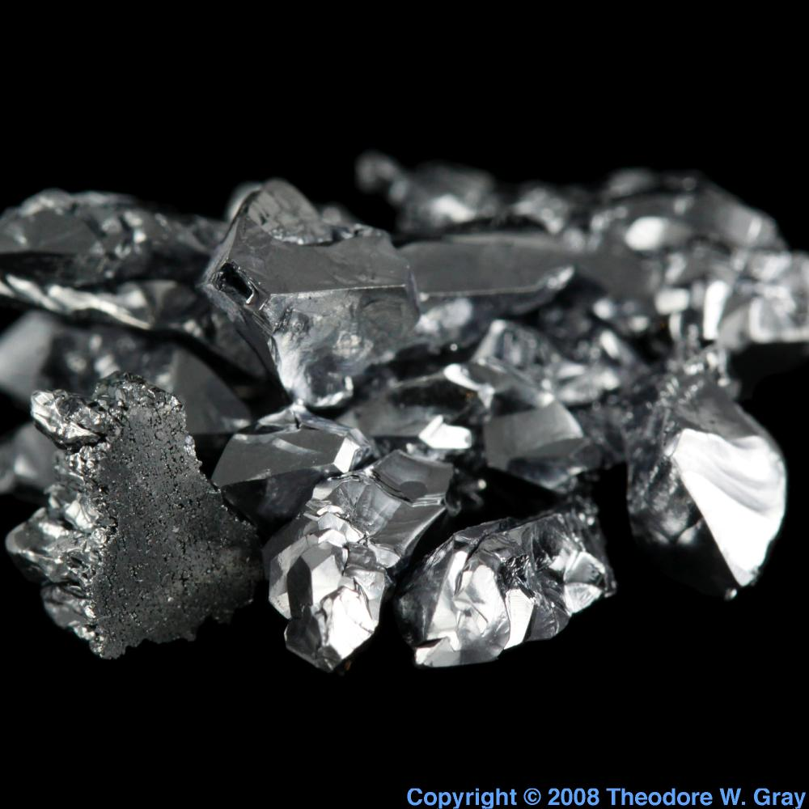
Mechanical Quality Factor of Cryogenic Silicon
Marie Lu
Mentor: Nicolas Smith

Slide 2
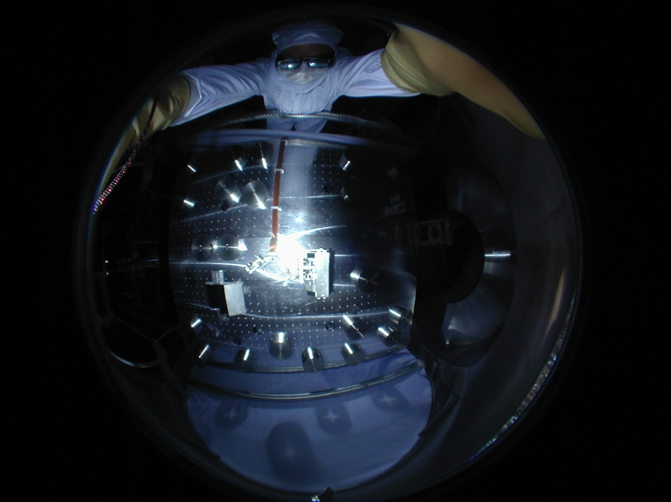
Overview
Background
Fluctuation-Dissipation Theorem and Applications
Making Measurements
Experimental Design
Theoretical Predictions
Results
Future plans

Slide 3
Background
Future LIGO detectors
Cryogenic silicon replace silica for test masses
Minimizes thermal elastic noise. Coefficient of the thermal expansion goes to 0 at 120K
Need to understand behavior of noise spectrum produced by silicon.
Difficult to detect tiny thermal fluctuations
Saved by the Fluctuation Dissipation Theorem!

Slide 4
Fluctuation-Dissipation Theorem
Relates noise spectrum + system’s linear responses to applied perturbations:
Power spectrum of noise

Slide 5
Applications
Note that our equation depends on one unknown, φ, the loss angle:
We will show that φ is related to the quality factor Q.
Q = dimensionless, a description of how under-damped an oscillator is.

Slide 6
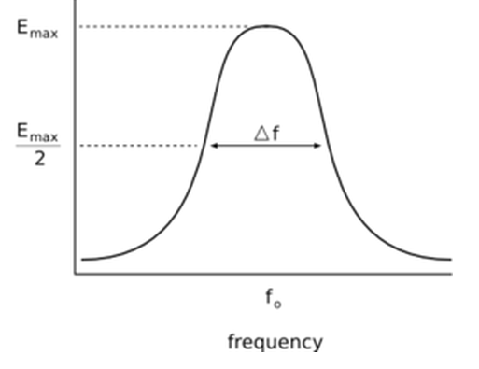
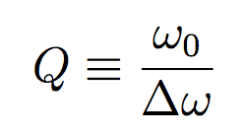
Q and φ
By definition,
If we derive from the equation of motion,
we find that
and

Slide 7
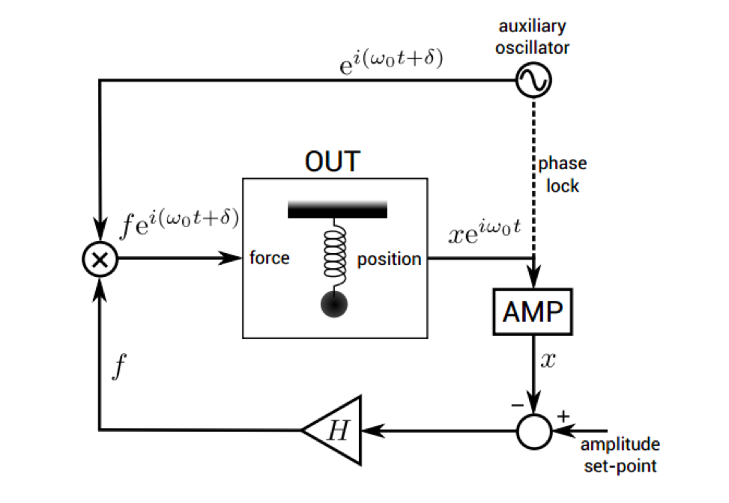
Measuring Q
Thus we have a relationship between Q and φ.
By measuring Q, we can find the power spectrum.
How?
Method 1: Ring down
Method 2: Transfer function
Method 3: Control loops (Future)
Phase locked loop
Amplitude locked loop

Slide 8
Reducing clamp loss
Important to reduce clamp loss in order to measure true loss of silicon
where R = strain energy ratio = E_{steel}/(E_{steel}+E_{Si})
φ ≈ φ _{Si} + Rφ _{Steel}

Slide 9
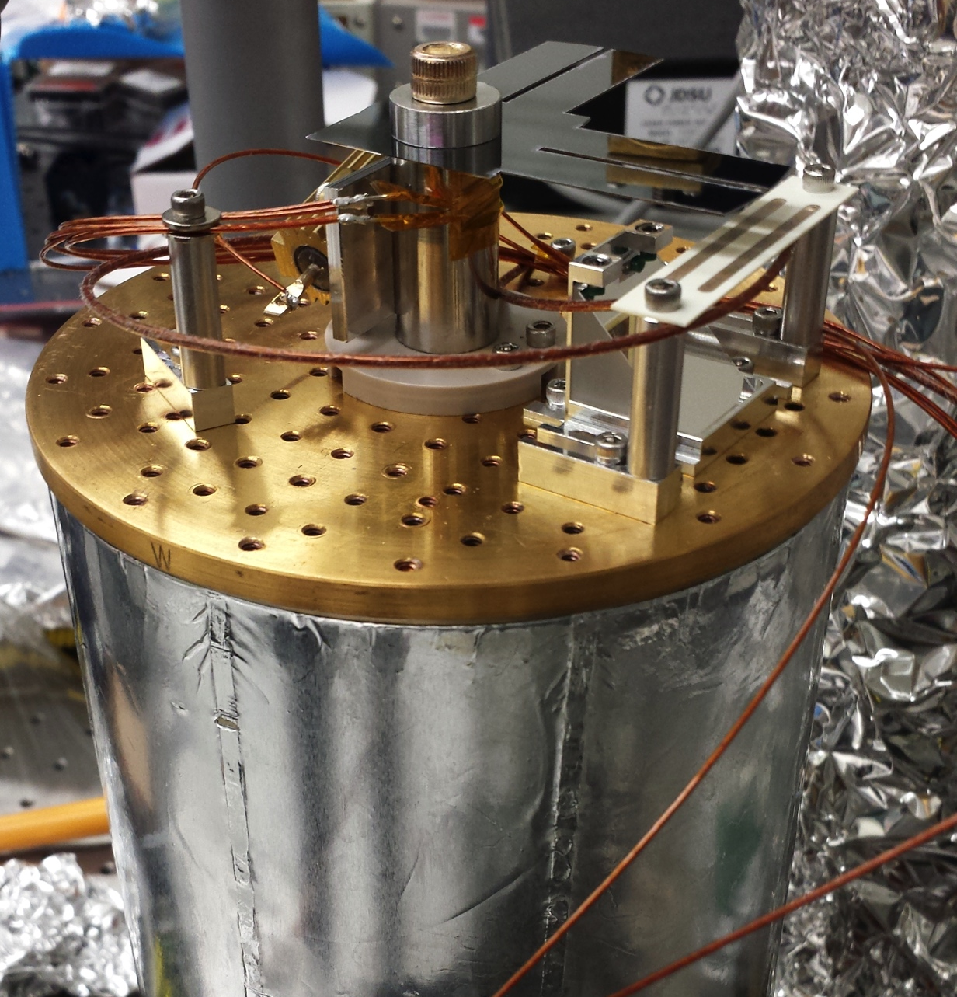
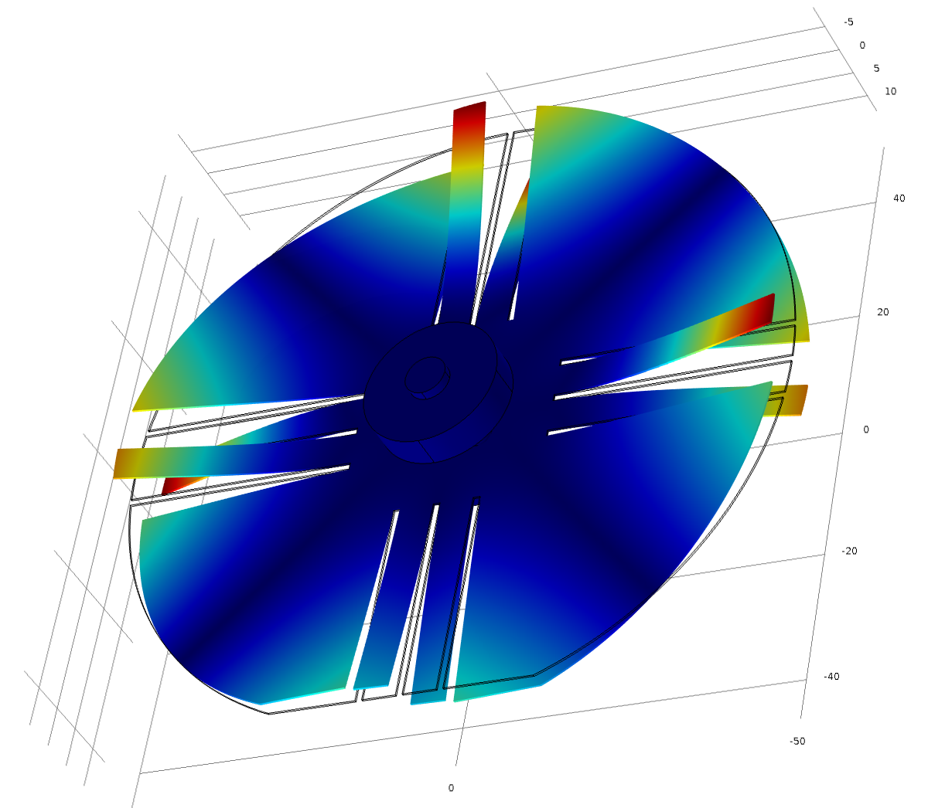
Clamp and Wafer Design

Slide 10
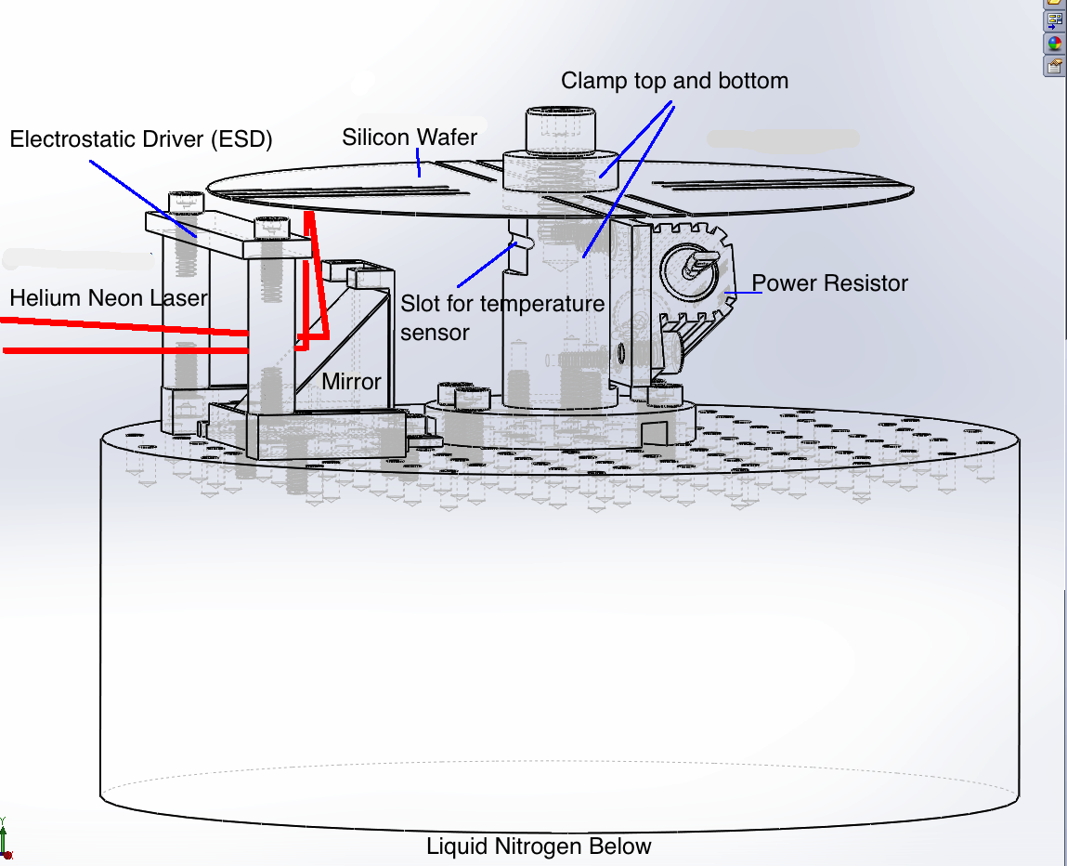
C R Y O S T A T
D
E
S
I
G
N

Slide 12
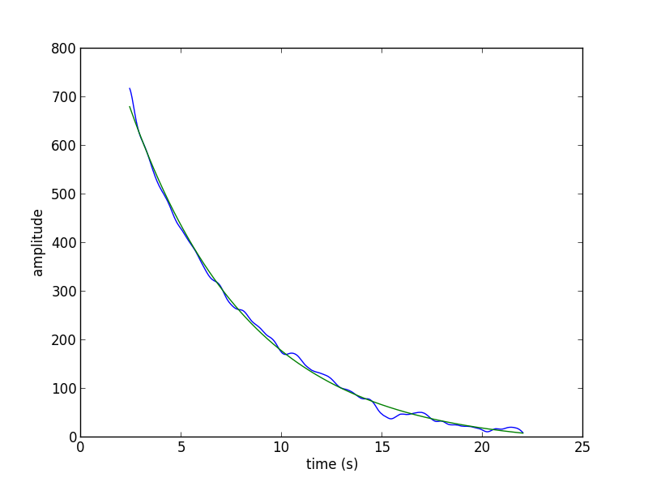
Obtaining φ

Slide 13
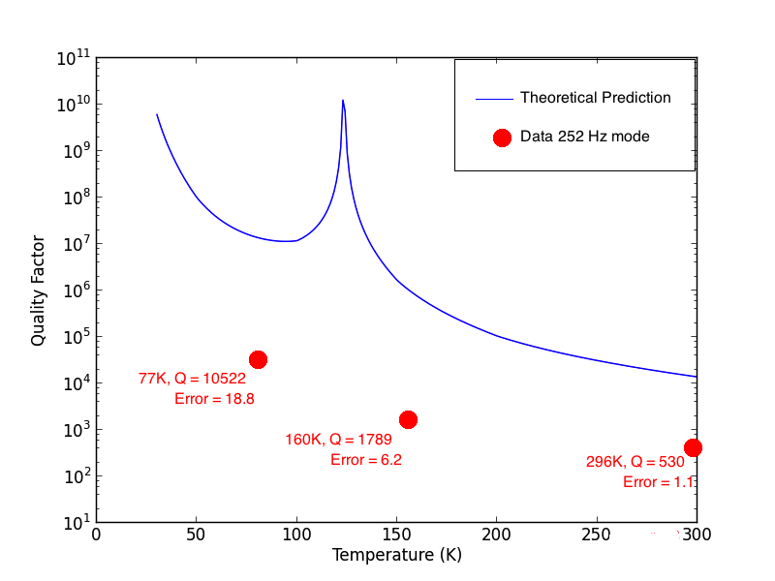
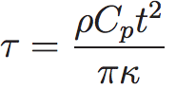
Results
241.5 Hz Mode: 296K, Q = 2784, Error = 6.2

Slide 14
Analysis
Results indicate that clamp loss is still dominant
To improve clamp, reduce strain energy lost in steel.
We focused on clamp shapes and dimensions before
Now we look into wafer design

Slide 15
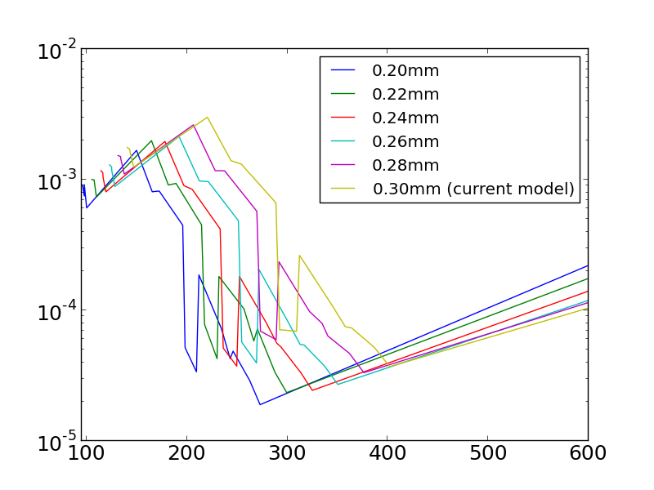
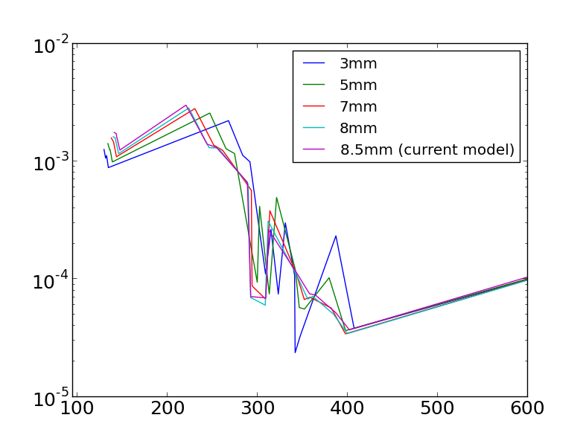
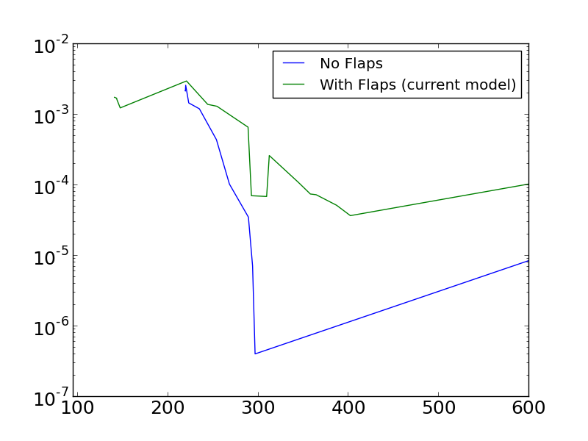
Strain Energy Ratio
Strain Energy Ratio
Frequency (Hz)
Frequency (Hz)
1) Reduce wafer thickness.
2) Decrease cantilever width
3) Simplify the geometry.
Geometry might be why the 241.5 Hz mode had less loss than the 242 Hz mode. Use higher order modes too?
Strain Energy Ratio
4) Study oscillation of the flaps rather than cantilevers
Frequency (Hz)

Slide 16
Future Work
Improve our current experimental design until we can measure a maximum Q ≈ 10⁸ or better.
Implement the control loops to continuously measure Q
Understand changes in Q with temperature and frequency
Then study the changes in Q of the silicon due to thin film deposition.
Films will be for controlling reflectivity of masses.
There could be deformations due to thin film deposition
Additional sources of loss between
How the curvature will affect laser reflectivity.

Slide 17
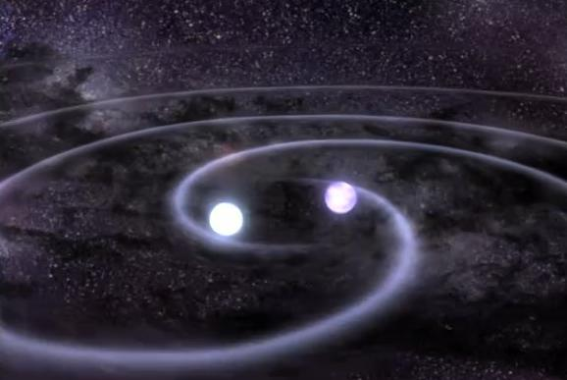
Acknowledgements
Thanks to my mentor Nic Smith
To Professor Rana Adhikari, Zach Korth, Professor Weinstein, NSF
Everyone in the subbasement lab for being so helpful
Fellow SURFs who made my summer so much fun!

Slide 18
Questions?

