Slide 1
Quantum noise in Gravitational Wave Detectors
LIGO-G1401147-v2
Koji Arai – LIGO Laboratory / Caltech

Slide 2
Introduction ~ Quantum noise?
m
SHOT NOISE:
Photon counting noise
RADIATION PRESSURE NOISE: Back-action noise caused by random motion of the mirrors
LASER
Photo-Detector
Measurement frequency
Slide courtesy of L. Barsotti
Notes:
h_shot, h_rad

Slide 3
“Standard Quantum Limit”
h_{SQL} doesn’t depend on the optical parameters
of the interferometer,
just on the quantum mechanics of a harmonic oscillator mass
Slide courtesy of L. Barsotti

Slide 4
Optical noises
Quantum noises
  Standard Quantum Limit (SQL)
- Trade-off Between Shot Noise and Radiation-Pressure Noise
- Uncertainty of the test mass position due to observation

Slide 5
Introduction ~ Quantum noise?
Quantum noise in Advanced LIGO
  Photon shot noise and radiation pressure noise
  will limit the detector sensitivity in the end
Radiation
Pressure
Noise
Shot noise

Slide 6
Introduction ~ Quantum noise?
Quantum noise reduction
  Make the interferometer longer
  => Needs new facility
  Heavier test masses & more optical power
  => Stored power of aLIGO will be 800kW
  Have to deal with thermal effects / instabilities
  More complex optical configuration to shape optical response
  Injection of squeezed states of vacuum

Slide 7
Introduction ~ Quantum noise?
What is “squeezing”?
Quantized Electromagnetic Fields
Quadrature Field Amplitudes
Classical Quantum
Coherent State
Heisenberg’s uncertainty principle

Slide 8
Introduction ~ Quantum noise?
Even when average amplitude is zero, the variance remains
=> Zero-point “vacuum” fluctuation
Vacuum fluctuations are everywhere
=> Comes into the interferometer
from the open optical port and
cause shot and radiation pressure noises

Slide 9
Squeezing
The noise can be redistributed while keeping the minimum uncertainty product ΔX1 ΔX2 =1
= Squeezed light
Squeezed light is characterized by
  Squeezing factor r
  How much the noise is squeezed
  Squeezing angle 𝜙_{sqz}
  Which quadrature is squeezed

Slide 10
Squeezing
Particularly useful two states
Amplitude squeezing
(Phase anti-squeezing)
Phase squeezing
(Amplitude anti-squeezing)

Slide 11
Squeezing
In practice, we inject squeezed “vacuum” from the dark port
  Squeezing angle needs to be fixed by a feedback control loop
  with regard to the field in the interferometer

Slide 12
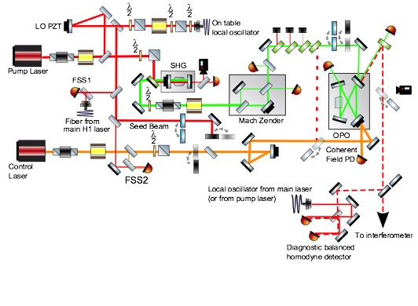
Squeezing in action
Actual squeezer (LIGO H1 squeezer)
  Many auxiliary phase lock loops
  are necessary to fix the squeezing
  angle
OPO is here!
Squeezed vacuum
is here!
Sheila Dwyer PhD Thesis (2013)

Slide 13
Squeezing in action
Shot noise reduction in GW detectors has already been realized since 2007
Squeezed light injection experiment at the LIGO 40m
K.Goda et al, Nature Physics 4, 472 - 476 (2008)

Slide 14
Squeezing in action
Squeezing in GEO600 and LIGO H1 to reduce shot noise
3.5 dB
(1/1.5)
2.1 dB
(1/1.27)
Slide courtesy of L. Barsotti
GEO data are courtesy of H. Grote
LSC, Nature Physics 7, 962 (2011)
LSC, Nature Photonics 7, 613–619 (2013)

Slide 15
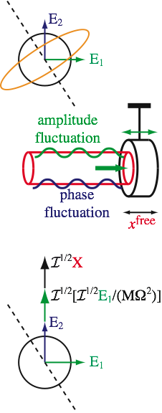
Quantum noise in an interferometer
Ponderomotive effect
  Vacuum fluctuations from the dark port produce
  amplitude and phase fluctuations in the arm cavities
  Radiation pressure
  The test mass mechanical system work as a converter
  from the amplitude fluctuation to the phase fluctuation

Slide 16

Quantum noise in an interferometer
Ponderomotive effect
  Radiation pressure:
  The test mass mechanical system work as a converter from the amplitude fluctuation to phase fluctuation
Output fluctuation
amplitude
phase
amplitude fluctuation in the arm
phase fluctuation
in the arm
radiation pressure
GW
signal

Slide 17
Quantum noise in an interferometer
Ponderomotive effect

Slide 18
Quantum noise in an interferometer
Homodyne detection
  In order to detect the signal (and noise) with a photodetector
  The output field needs to be mixed with a local oscillator field.
  cf. RF (or heterodyne) detection using RF sidebands
  Homodyne angle:
  Changes the projection of the GW signal field
  and output noise fields into the detection signal
  DC Readout
  A small (1~10pm) offset from the dark fringe is applied
  => Useful: The IFO beam itself becomes the LO field
  Φ_{H} is fixed at zero

Slide 19
Squeezed vacuum injection
Frequency dependent squeezing
  Rotate squeezing angle to optimize the output noise field
F.D. squeezing
S Danilishin, F Khalili, Living Rev. Relativity, 15, (2012), 5
http://www.livingreviews.org/lrr- 2012- 5

Slide 20
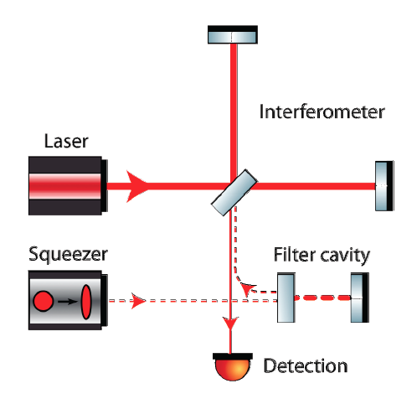
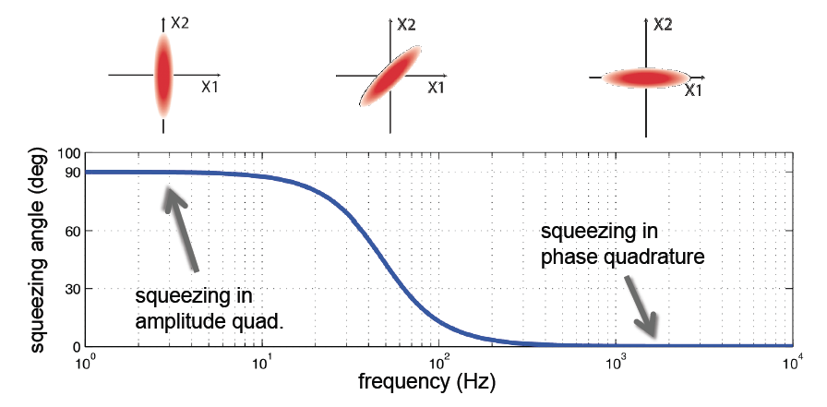
Squeezed vacuum injection
Slide courtesy of L. Barsotti
Frequency dependent squeezing
GW Signal
~30Hz
RADIATION PRESSURE
NOISE
~30Hz
Quantum Noise
SHOT NOISE
High finesse detuned “filter cavity” which rotates the squeezing angle as function of frequency

Slide 21
Squeezed vacuum injection: technical issues
The enemies of the squeezing
  Optical Loss
  Optical losses works as beamsplitters
  to introduce normal vacuum fluctuation
  Phase noise
  Wobbling of the squeezing angle causes
  leakage of the other quadrature into the
  squeezed quadrature

Slide 22
Optical loss & Squeezing phase noise
Slide courtesy of L. Barsotti
eLIGO
GEO
Target: -10dB
noise reduction
We need less
than 20% total
losses
aLIGO readout
now has ~30%
(w/o squeezing)
=> Need to reduce!
GW
Signal

Slide 23
Phase noise mitigation
Slide courtesy of L. Barsotti
Invac OPOfor aLIGO
Let’s move the OPO into the vacuum envelope on seismic isolated tables!
E. Oelker et al., Optics Express, Vol. 22, Issue 17, pp. 21106-21121 (2014) (P1400064)

Slide 24
Summary
Quantom noise in GW detectors
  Shot noise & Radiation pressure noise
Squeezed vacuum injection
  Shot noise reduction already demonstrated.
Radiation pressure
  Will eventually limit the sensitivity
  Frequency Dependent squeezed vacuum injection
  will mitigate the radiation pressure noise
Technical Issues: Optical loss & phase fluctuation
  R&D on going

