Slide 1
Control system in Gravitational Wave Detectors
LIGO-G1401146-v2
Koji Arai – LIGO Laboratory / Caltech

Slide 2
Introduction ~ Control?
Gravitational wave detection
Laser displacement sensor
Requires linear displacement detection
Control for measurement
Laser interferometer = nonlinear device
Feedback control => linearization

Slide 3
Introduction ~ Control?
What is the feedback control?
  A scheme to monitor and modify output(s) of a system by changing the input(s) depending on the output(s)
Examples
  Shower temperature
  Car driving
  Tight rope walking
Imagine what happens
  If the response is too slow?
  If the response is too fast?
  Air conditioning
  Bike riding
  Inverted bar on a hand

Slide 4
Introduction ~ Control?
Elements of a feedback loop
  Stabilized
  motion
  m or m/Hz^{1/2}
  m or m/Hz^{1/2}
  Disturbance
  Error
  signal
  Sensor
  V or V/Hz^{1/2}
  V/m
  Actuator
  Servo
  Filter
  m/V
  V/V
  Feedback
  signal
  V or V/Hz^{1/2}
  Transducer
  Filter

Slide 5
Introduction ~ Control?
Sensor:
Transducer for displacement-to-voltage conversion
If the sensor is completely linear
(and has or no frequency dependence)
We don’t need feedback control!

Slide 6
Introduction ~ Control?
In reality:
Sensors, laser interferometers in particular, are nonlinear!
Enclose the operating point in the linear region
=> The system recovers linearity
Was the displacement modified by the feedback?
=> Precise knowledge of the control system
for signal reconstruction

Slide 7
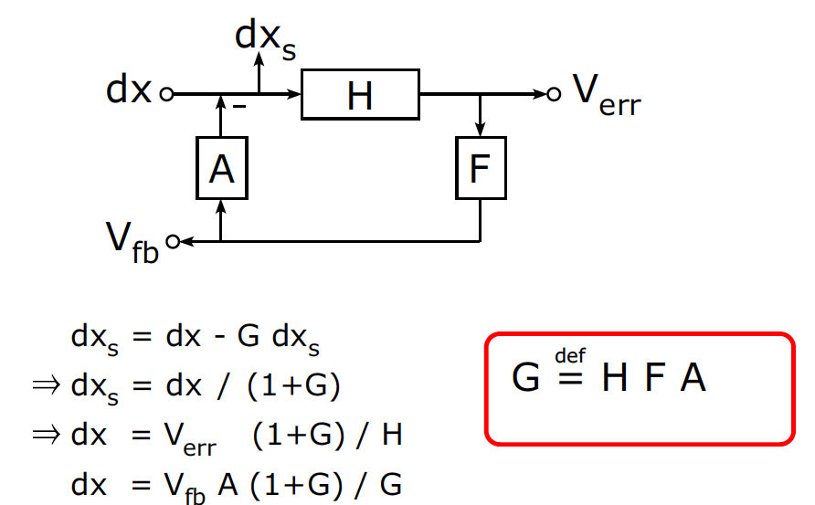
Introduction ~ Control?
Elements of a feedback loop
disturbance
stabilized disturbance
error signal
actuator
sensor
servo filter
feedback
signal
Open loop transfer function

Slide 8
Introduction ~ Control?
When G is small:
disturbance
stabilized disturbance
error signal
actuator
sensor
servo filter
feedback
signal
Open loop transfer function

Slide 9
Introduction ~ Control?
When G is big: e.g. G = 10, 100, or 1000
dx_{s}= dx/(1+G) = 0.09 dx, 0.01 dx, 0.001 dx
dx
V_{err}= dx H /(1+G)
Actuator range
Residual error
vs
Sensor linear range
0.91 dx,
0.99 dx,
0.999 dx
Filter frequency response / loop stability
V_{fb} = G/(1+G) /A dx
= 0.91 dx/A, 0.99 dx/A, 0.999 dx/A

Slide 10
Introduction ~ Control?
When the openloop gain G is >>1, the error signal gets suppressed
“Wow! our sensor signal became smaller!”
Is our system more sensitive now?
  No. We are just moving the actuator so that the error signal looks smaller.
  The signal and noise are equally suppressed in the error signal.
  Thus the SNR does not change.
OK... So can we still measure gravitational waves
even if the error signal is almost zero?
  Yes. We should be able to recover the original signal by compensating the effect of the control i.e. (1+G)
  And we can also use the feedback signal in order to reconstruct the original
  signal with appropriate compensation i.e. (1+G)/G

Slide 11
Introduction ~ Control?
Important difference between
  “Feedback control for stabilization”
  and “Feedback control for measurement”
  Feedback control changes the stabilized motion
  but reconstructed Disturbance is not modified by the loop*
  (*if everything is linear)
  Stabilized
  motion
  Disturbance
  Error
  signal
  Sensor
  Actuator
  Servo
  Filter
  Feedback
  signal

Slide 12
Linear systems and their stability

Slide 13
Linear systems and their stability
A deterministic and time-invariant system: H
The system H is LTI (linear & time-invariant) when
We can deal with such a system using Laplace transform
(or almost equivalently Fourier Transform)
H
  System Input
  x(t)
  System Output
  y(t)

Slide 14
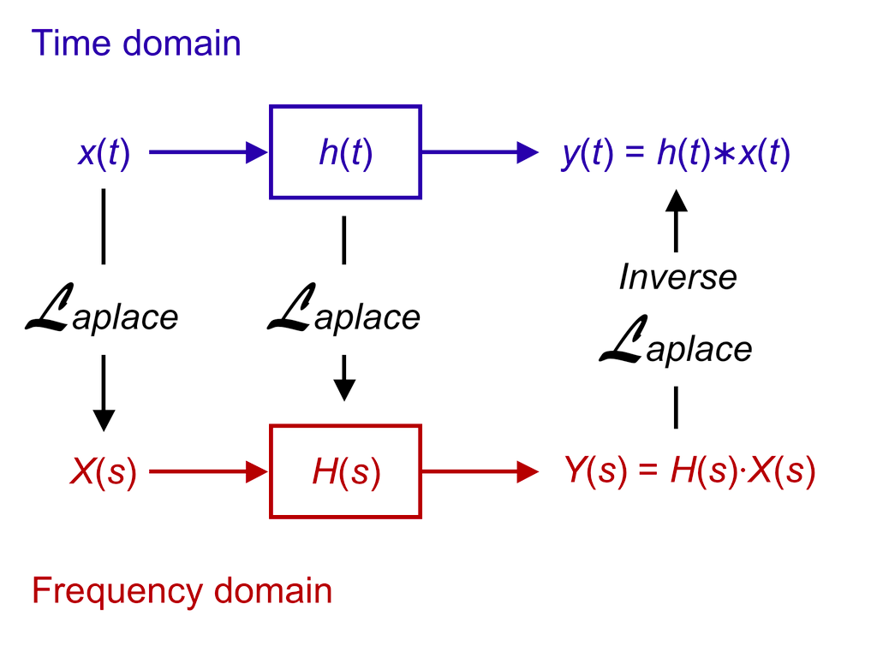
Linear systems and their stability
Time domain vs Laplace (or Fourier) frequency domain
Impulse response
transfer function
http://en.wikipedia.org/wiki/Linear_system
http://en.wikipedia.org/wiki/LTI_system_theory

Slide 15
Linear systems and their stability
It is easy to convert from an ordinary differential equation to a transfer function
e.g. Damped oscillator
  Laplace Transform
  Fourier Transform

Slide 16
Linear systems and their stability
e.g. Damped oscillator
  log-log
  log-lin
Bode diagram

Slide 17
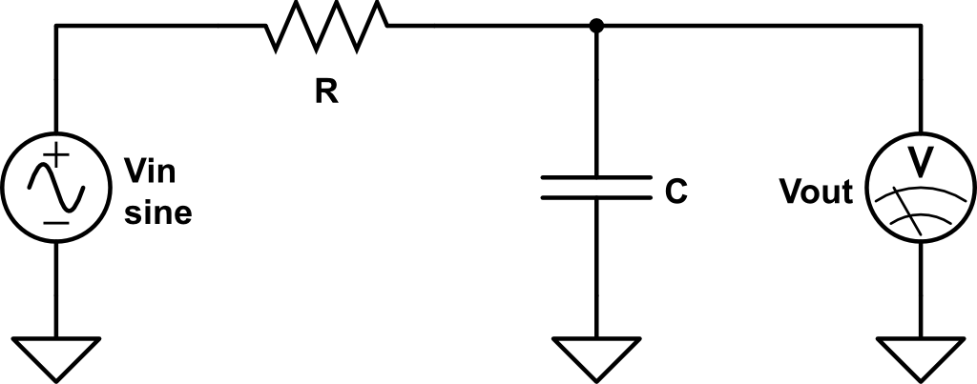
Linear systems and their stability
e.g. RC filter
cut-off freq
w = 1/(R*C)

Slide 18
Linear systems and their stability
In most cases, a system TF can be expressed as:
The roots of the numerator are called as “zeros”
and the roots of the denominator are called as “poles”
Zeros (s_{zi}) and poles (s_{pi}) are
real numbers (single zeros/poles)
or
pairs of complex conjugates (complex zeros/poles)

Slide 19
Linear systems and their stability
Poles rule the stability of the system!
H(s) can be rewritten as
Each term imposes exponential time impulse response
Therefore, if there is ANY pole with
the response of the system diverges

Slide 20
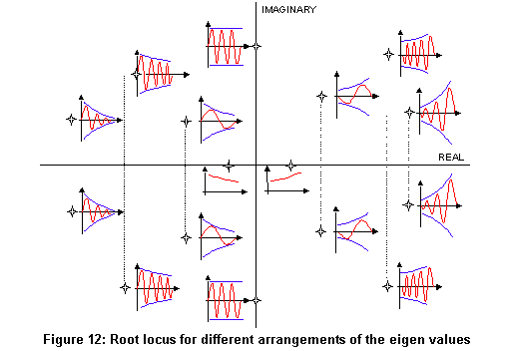
Linear systems and their stability
Poles rule the stability of the system!
  Im(s)
  Unstable
  response
  Re(s)
http://nupet.daelt.ct.utfpr.edu.br/_ontomos/paginas/AMESim4.2.0/demo/Misc/la/SecondOrder/SecondOrder.htm

Slide 21
Linear systems and their stability
Now we eventually came back to this diagram
  dx_{s} = dx/(1+G)
  Open loop TF:
  G = H F A
  Closed loop TF:
  G_{CL} = 1/(1+G)
  dx
Requirement:
All the roots for 1+G should be
in the left hand side of Laplace plane
  (!)

Slide 22
Linear systems and their stability
Remarks
Requirement:
All the roots for 1+G should be in the left hand side of Laplace plane
  This does not mean all H, F, A needs to be stable.
  e.g. Unstable mechanical system A can be stabilized by
  a control loop. (cf. An inverted Rod)
  We usually play with F to tune the result.
  It is awkward to evaluate the stability
  of 1/(1+G) every time.
  There is a way to tell the stability only from G
  Nyquist’s stability criterion
  Open loop TF:
  G = H F A
  Closed loop TF:
  G_{CL} = 1/(1+G)

Slide 23
Linear systems and their stability
Nyquist stability criterion
  Plot openloop gain G in a complex plane (i.e. Nyquist diagram)
  If the locus of G(f) from f=0 to ∞, goes to 0 looking at the point (-1 + 0 i)
  at the left side => Stable
  If the locus sees the point (-1+o i) at the right side => Unstable
  Unity gain frequency f_{UGF} : for |G(f_{UGF})| = 1
  Phase margin θ : θ = Arg(G(f_{UGF}))
  Gain margin g: g = 1/|G(f₀)| where Arg(G(f₀)) = -π

Slide 24
Linear systems and their stability
Phase Margin / Gain Margin in Bode diagram
  Most of the case, a bode diagram of G is enough to see the stability
  Nearly
  unstable
  Unity Gain Freq
  (176kHz)
  Gain Margin
  4.3dB@420kHz
  A rough standard of
  a stable servo loop:
  Phase Margin > 40deg
  Gain Margin > 10dB
  Phase Margin
  48deg
  -180deg

Slide 25
Linear systems and their stability
Building blocks (“zpk” representation)
  Single pole
  Single zero
  A pair of complex poles
  A pair of complex zeros
  Gain

Slide 26
Linear systems and their stability
Relationship between pole/zero locations and w0&Q
To be compared with

Slide 27
Linear systems and their stability

Slide 28
Linear systems and their stability
Summary
  Classical control theory
  Design locations of poles and zeros
  Stability: tuning of open loop transfer function is important

Slide 29
Control system components in GW detectors

Slide 30
Control systems
Elements of a feedback loop (again)
  Sensor
  Actuator
  Servo
  Filter

Slide 31
Interferometer control system
Local control vs global control

Slide 32
Local Sensors
Shadow sensor (relative displacement sensor)
  For suspension damping control, mirror attitude monitor
  Typical linear range ~1mm for 0-10V => dV/dx = 10 kV/m
  Typical noise level: ~ 100 pm/sqrtHz
  aLIGO: Birmingham Optical Sensor
  and Electro-Magnetic actuator (BOSEM)
L Carbone, Class. Quantum Grav. 29 (2012) 115005

Slide 33
Local Sensors
Shadow sensor (relative displacement sensor)
  Linear range (~0.7 mm) / displacement noise sensor locations
L Carbone, Class. Quantum Grav. 29 (2012) 115005

Slide 34
Local Sensors
Linear Variable Differential Transducer (relative disp. sensor)
  For low freq pendulum control (inverted pendulum), larger range
  VIRGO Super attenuator, KAGRA Seismic Attenuation System
  Typical linear range ~10mm for 0-10V => dV/dx = 1 kV/m
  Typical noise level: 10~100 nm/sqrtHz
  10 nm/sqrtHz
H. Tariq, Nuclear Instruments and Methods in Physics Research A 489 (2002) 570–576

Slide 35
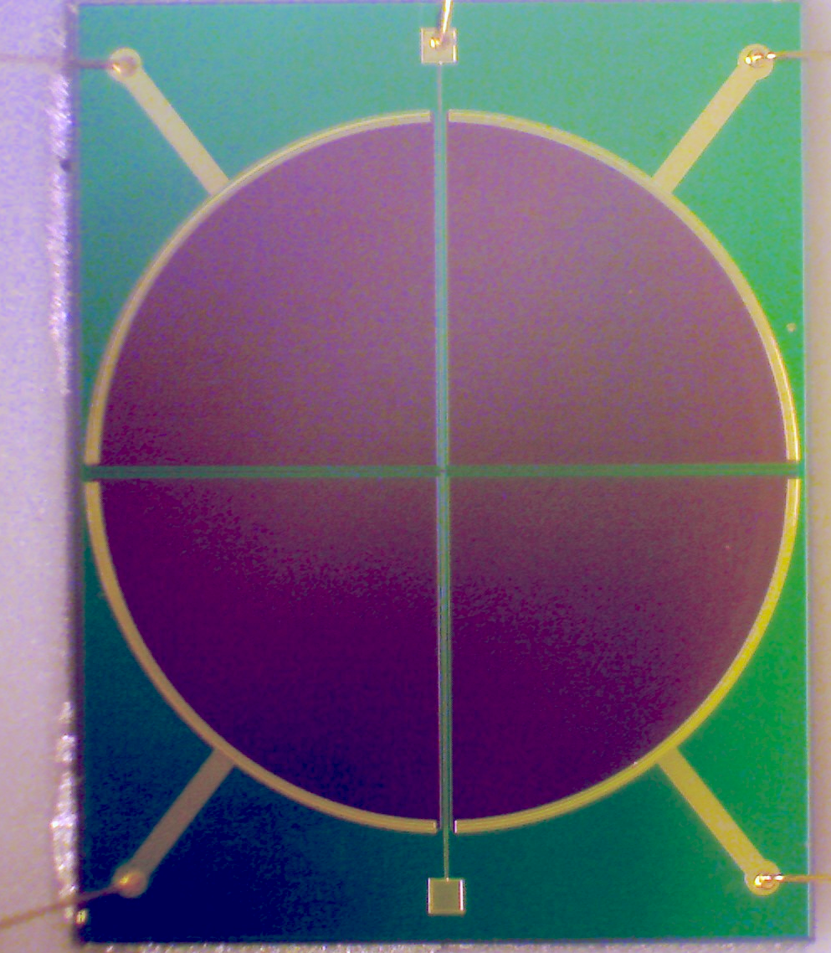
Local Sensors
Optical Lever (relative angular sensor)
  Angle local control
  Typical linear range ~beam side (0.1~1 mm) => dV/dθ = 1 ~10 kV/rad
  Typical noise level: 0.01~1 nrad/sqrtHz
  Optical Lever Calibration
  A B
  C D
  SUM = A+B+C+D
  X = A–B+C-D
  Y = A+B-C-D

Slide 36
Local Sensors
Piezo Accelerometer (Inertial sensor)
  Vibration measurement
  Typical linear range ~ 100~1000 m/s²
  Typical noise level: 0.5 ~ 50 (μm/s²)/sqrtHz

Slide 37
Local Sensors
Servo Accelerometer (Inertial sensor)
  Seismic platform control (f>0.1Hz), Vibration measurement
  Apply force to the suspended mass
  => Keep the distance from a reference
  When the control gain G>>1
  => a = F / m

Slide 38
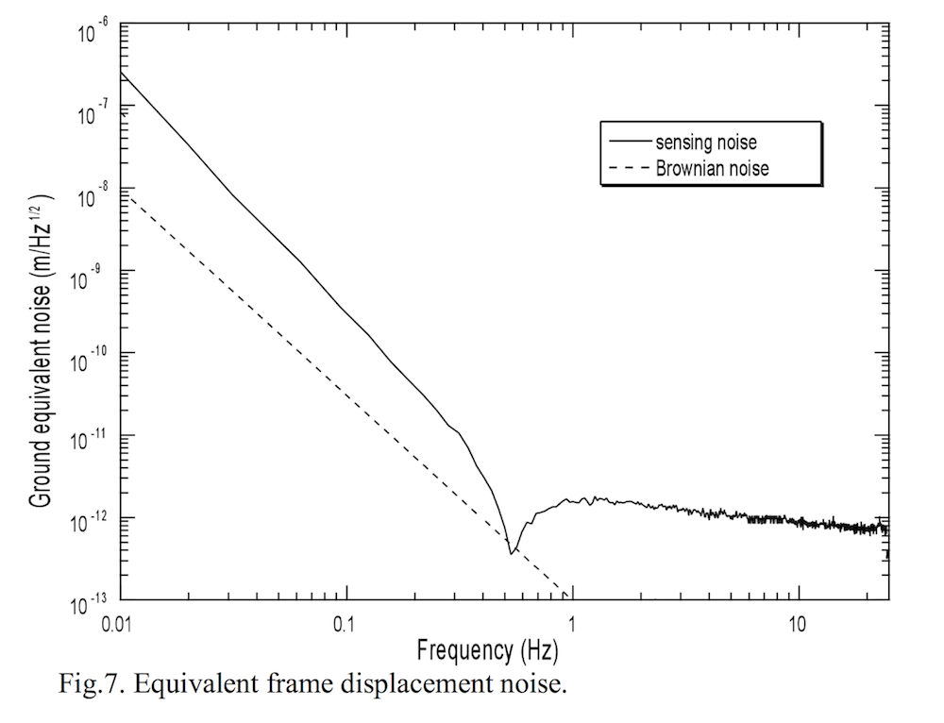
Local Sensors
Servo Accelerometer (Inertial sensor)
  Above the resonant freq: Limited by the sensor noise
  Below the resonant freq:
  Steep rise of the noise as the mass does not move
  in relative to the ground
  => Low resonant freq is beneficial
  1 pm/sqrtHz
  Negative
  spring
  Positive
  spring
A. Bertolini et al, Nuclear Instruments and Methods in Physics Research A 564 (2006) 579–586

Slide 39
Acutuators
Mechanical actuators
  Coil Magnet actuator
  Electro Static Driver (ESD)
  Piezo (PZT) actuator
Optical actuators
  Acousto-Optic Modulator
  Electro-Optic Modulator
  Laser Frequency

Slide 40
Acutuators (Mechanical)
Coil-magnet actuator
  Coil current induces force
  on a magnet attached to a mass
  Contactless
  aLIGO coil-magnet actuator
  is integrated in BOSEM
  Actuator response (coupling)
  has position dependence.
  Preferable to use it at its maximum
  in order to avoid vibration coupling
  1 gw = 9.8e-3 N

Slide 41
Acutuators (Mechanical)
Electro Static Driver (ESD)
  Apply potential close to the mirror
  => induces surface charge (or polarization) and attractive force
  In practice, comb patterns are used
  => strengthen the electric field, but less force range
  Can produce only attractive
  force. => Need DC Bias.
  Stray surface charging may
  cause problems.

Slide 42
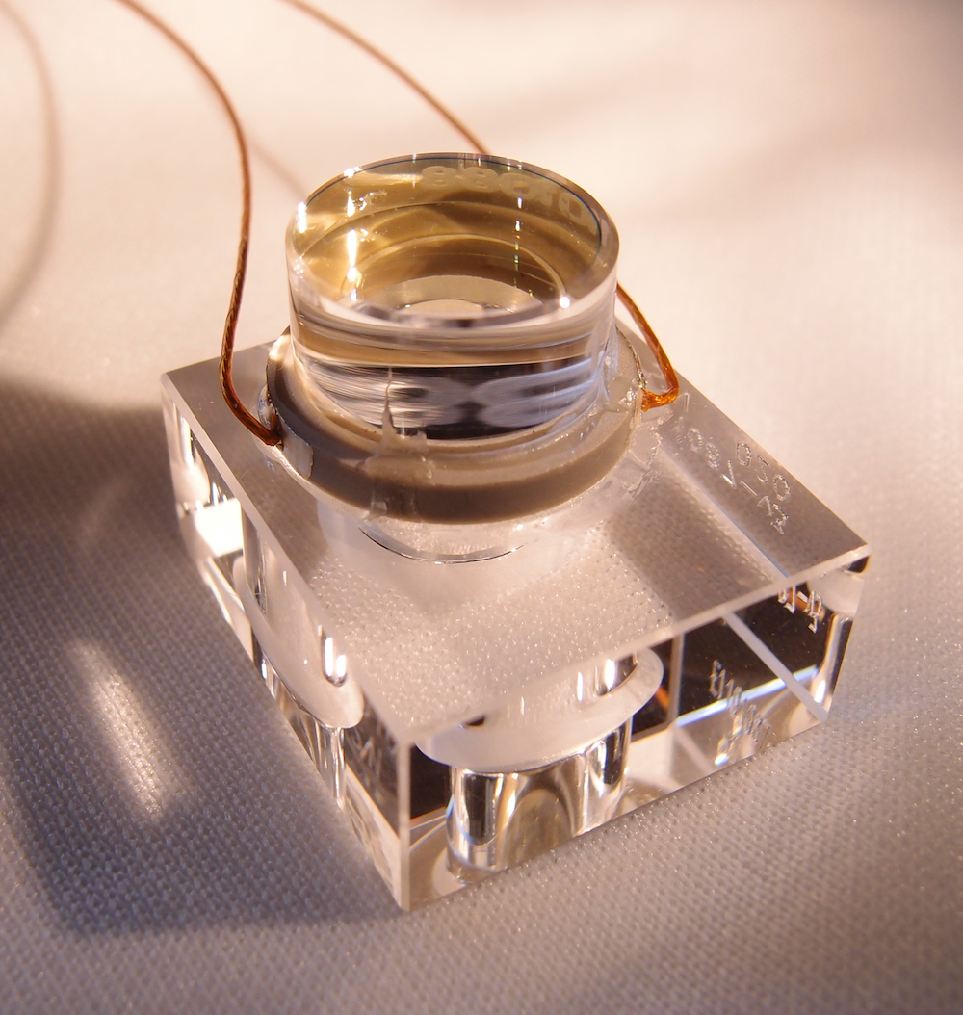
Acutuators (Mechanical)
Piezo (PZT) actuator
  Apply potential to a feroelectric material
  => cause internal polarization and induces strain
  To increase displacement, laminated piezo is often used
  => displacement 3~10 μm
  Requires a bias voltage and HV amplifier,
  but has wide applications
  OMC cavity mirror

Slide 43
Acutuators (Optical)
Acousto-Optic Modulator
  Phonon-Photon scattering (or bragg diffraction) in AOM crystal
  Effect: Beam deflection / Frequency shift
  Application: Laser frequency actuator, Laser intensity actuator
  Beam angle scanner

Slide 44
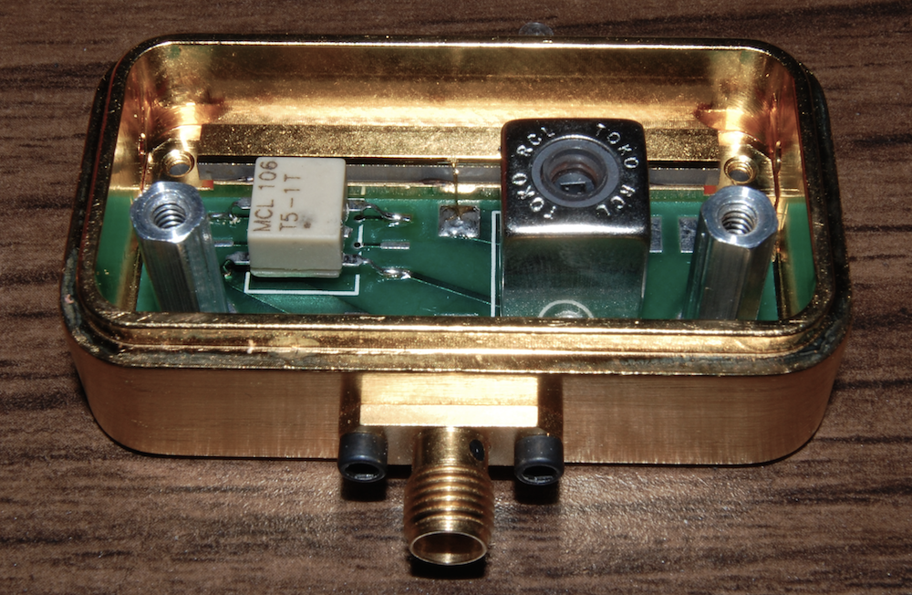
Acutuators (Optical)
Electro-Optic Modulator
  Pockels Cell effect:
  Refractive index changes linearly to the applied E-field
  Application:
  Laser phase modulation
  Phase actuation (= frequency actuation)
  LiNbO3 crystal

Slide 45
Acutuators (Optical)
Laser frequency actuation (YAG NPRO laser)
  We often control laser frequency with multiple actuators
  1) Thermal actuator
  Thermo-Electric Cooler attached to the laser crystal.
  Huge response (1GHz/K or 1GHz/V) but slow (f<0.1Hz)
  2) Fast piezo actuator
  A piezo attached on the laser crystal induces stress induced
  refractive index change.
  Response (~1MHz/V). Bandwidth 10~100kHz
  3) External EOM
  Response (~10 mrad/V), Bandwidth ~1MHz

Slide 46
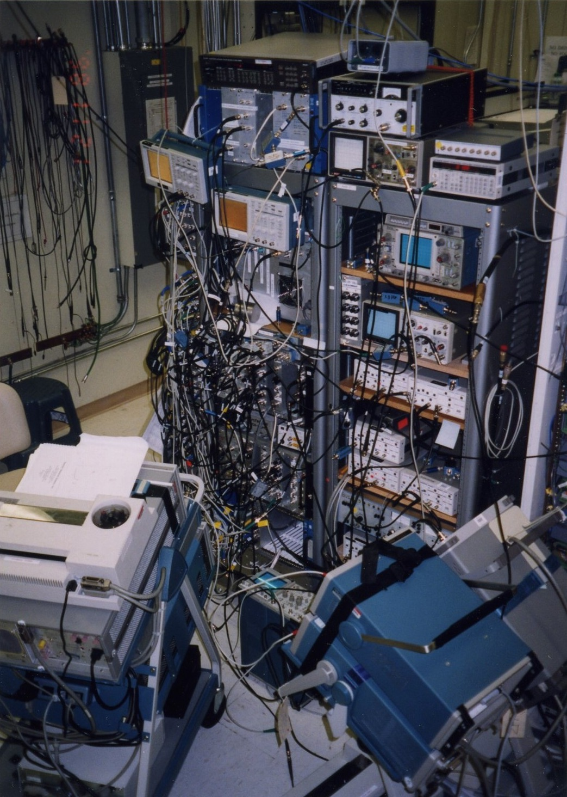
Servo Controller
Analog servo filters
  High dynamic range (~1nV/sqrtHz, +/-10V),
  High bandwidth
  Pole/zero placement
  with active op-amp filters
  Until the end of the 20th century,
  analog filters have been commonly used
  for servo filters in our field
  Analog servos are still in action for
  the feedback loops with bandwidth >1kHz.
  (cf. frequency stabilization,
  intensity stabilization)
  LIGO 40m
  prototype (1998)

Slide 47
Servo Controller
Digital servo filters
  Process digitized signals in a computer
  Large flexibility
  High compatibility with detector automation and management
  Limited dynamic range (~0.1mV/sqrtHz, +/-10V for 16bit)
  Limited bandwidth
    Each sample needs to be processed before the next sampled data comes
    Inevitable sampling delay
    Additional phase delays due to analog filters for analog-digital interface
    e.g. 16kHz sampling, control bandwidth ~200Hz

Slide 48
Analog/Digital interface
Restriction of signal digitization
  Voltage quantization: quantization noise
  => limited dynamic range
  => Requires whitening/dewhitening filters
  Temporally discrete sampling: aliasing problem
  => limited signal bandwidth
  => Requires anti-aliasing (AA) / anti-imaging (AI) filters
  Typical signal chain

Slide 49
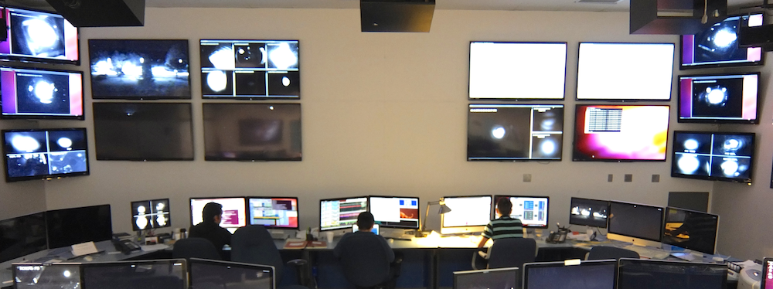
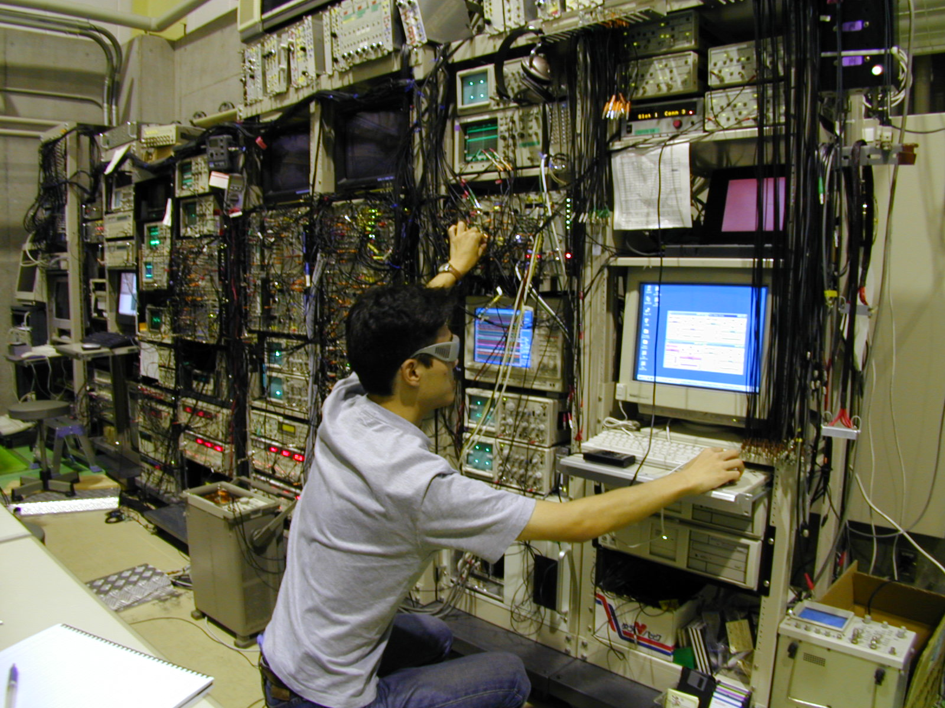
Control room
Comparison of the control room in the analog and digital eras
  aLIGO (2014)
  TAMA300 (2001)

