Slide 1
H1 and model by FFT+COC
Hiro Yamamoto LIGO/Caltech
Effects of ITM SPTWE
Simple Contrast Defect calculation
Beam size effect
PRMI vs PRFPM ⇔ SB vs CR

Slide 2
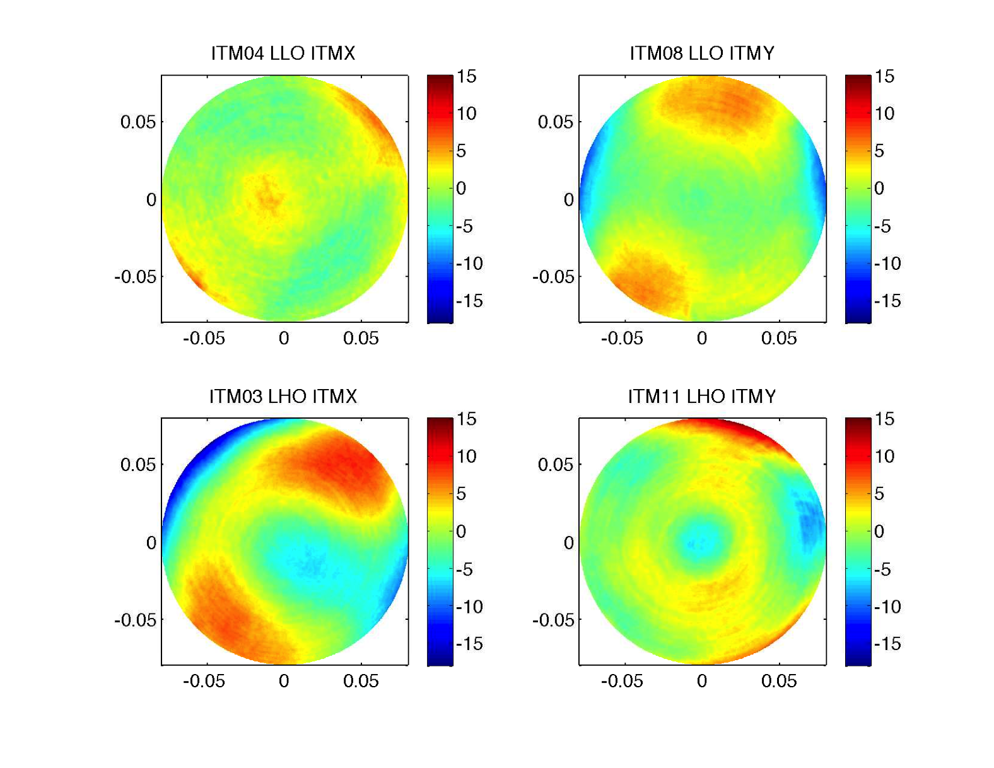
ITM SPTWE (tilt, power removed) and BS maps

Slide 3
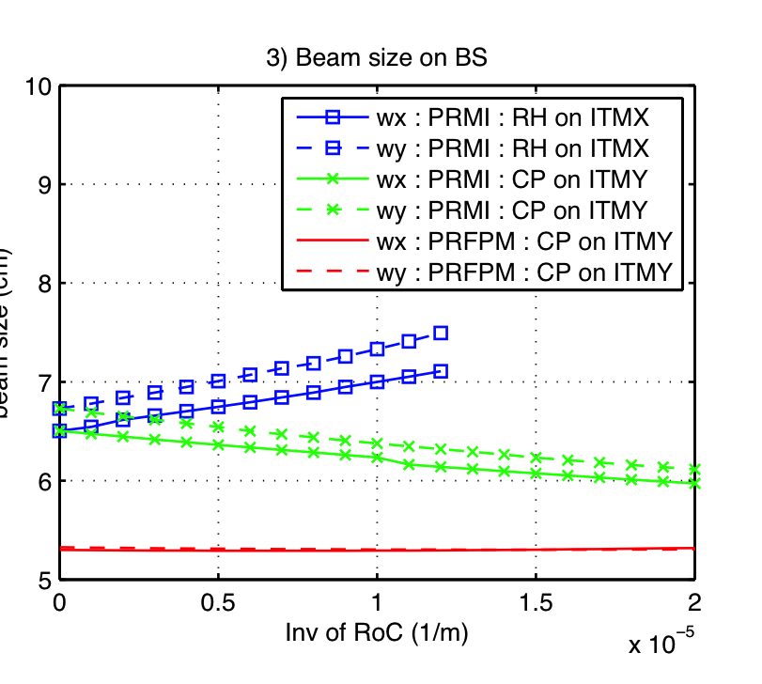
Contrast Defect estimation
LLO case

Slide 4
PRMI vs PRFPM ⇔ SB vs CR
When arms are attached, CR does not see none of these
  Arm modes determine the CR mode
  H1 : CD 190, PRG 40, w(ITM) = 5.3cm
  L1 : CD 280, PRG 40, w(ITM) = 5.3cm
The mode seen in PRMI without arm is the mode of BS with arm attached
When CP is used to compensate the large diverging lens, SB mode matches with CR mode and the beam size is optimal (5.3cm)
When RH is used to compensate the large diverging lens
  Modes of CR and SB mismatch
  SB beam on ITM becomes larger (5.7~6.6cm) and ITM non uniformity affects more

Slide 5
Mode coupling vs beam size
w | 5.3cm | 6.6cm
ITMX | 1.1% | 3.2%
ITMY | 0.2% | 1.0%

