Slide 1
Brief Introduction to Advanced LIGO Suspensions
Brett Shapiro
LAAC Session
24 August 2014

Slide 2
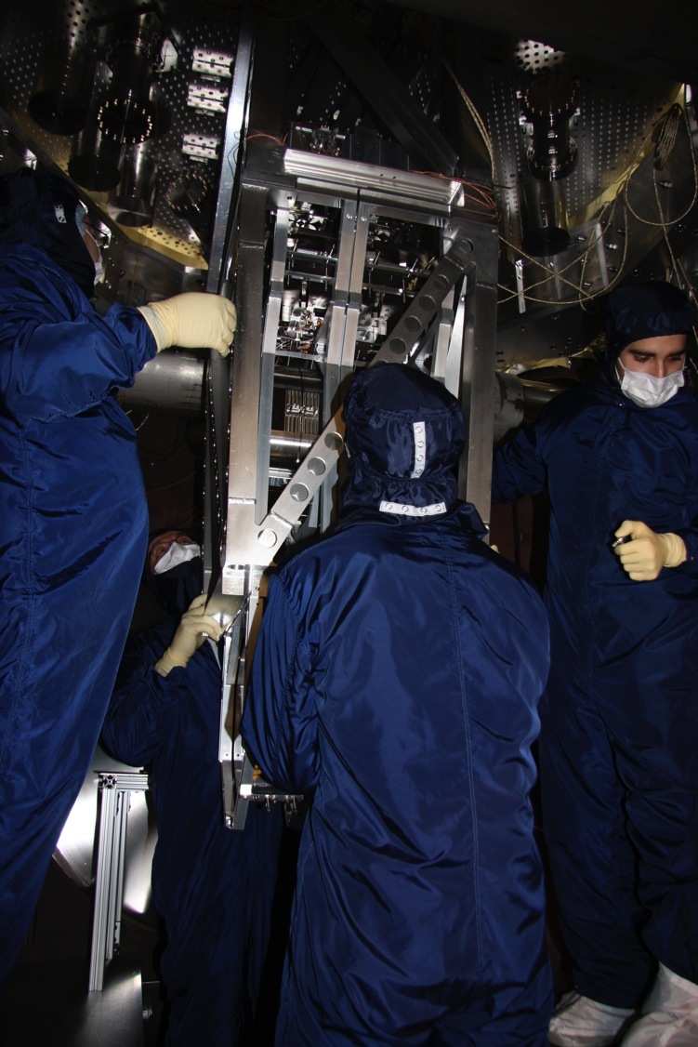
My experience
2001-2005 Undergrad: Penn State Engineering Science
2005-2012 PhD: MIT Mechanical Engineering
Worked on the controls, modeling, assembly, and testing of the prototype quadruple pendulums at the LASTI facility.
2012-now postdoc: Stanford University
Still some involvement in the suspensions group
Mostly working on cryogenic technologies for 3rd generation LIGO observatories
Installing the Quad Prototype at MIT
23 January 2009

Slide 3
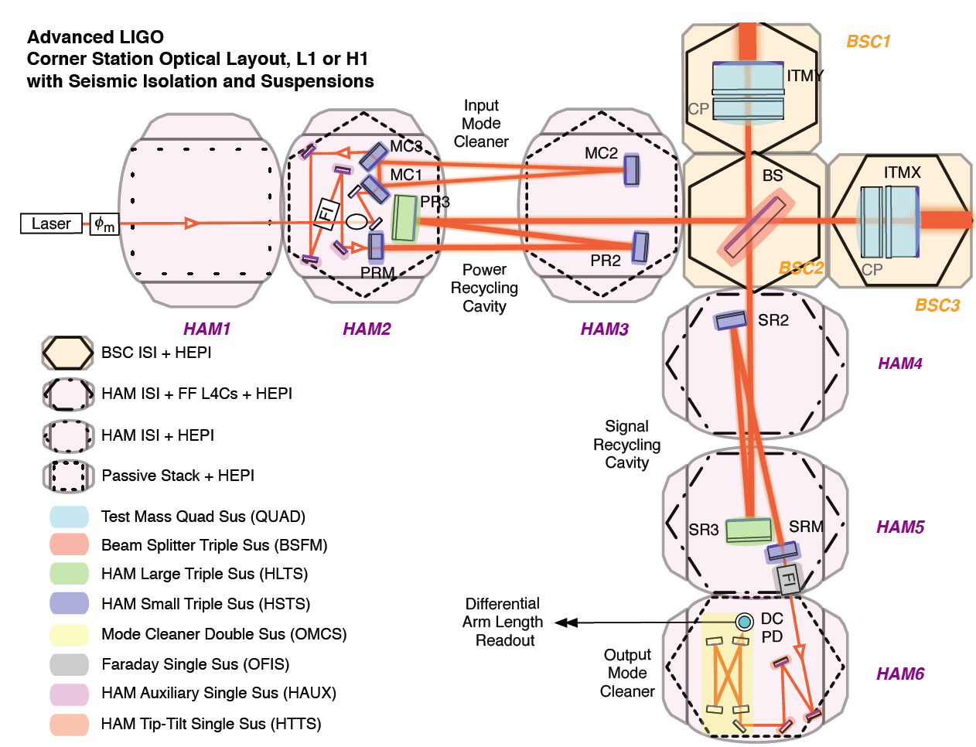
Courtesy of Jeff Kissel
SUS group
ITM, ETM
PR3, SR3
PRM, PR2, SRM, SR2, IMC
Other suspensions
+ TransMon

Slide 4
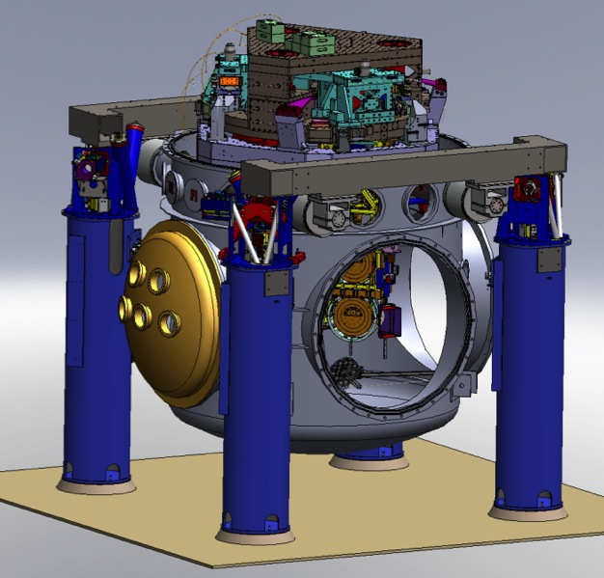
BSCs – core optics
hydraulic external pre-isolator (HEPI) (one stage of isolation)
active isolation platform (2 stages of isolation)
quadruple pendulum (four stages of isolation) with monolithic silica final stage

Slide 5
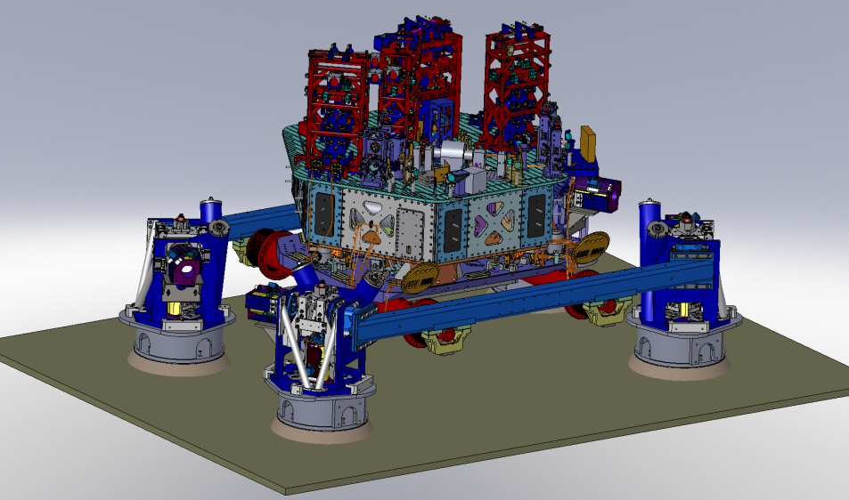
An aLIGO HAM Chamber
z
x
y
HAM2 (Chamber hidden for clarity)

Slide 6
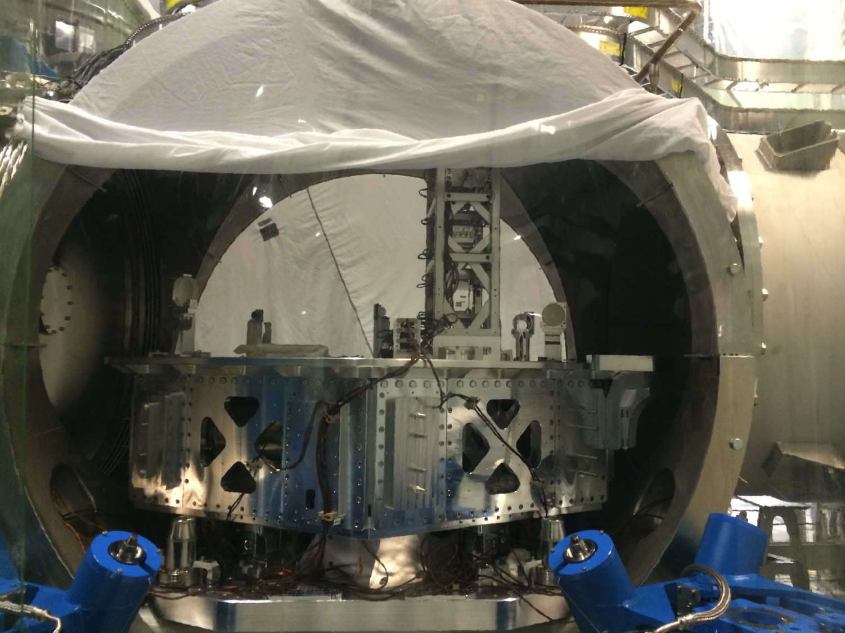
SR2, HAM4 – LHO 11 Feb 2014

Slide 7
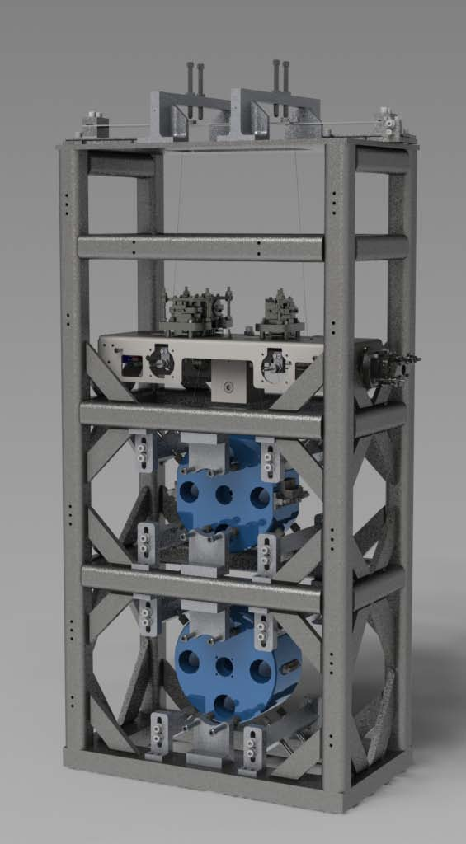
HAM Small Triple Suspension (HSTS)
Purpose
PRM, PR2, SRM, SR2
MC1, MC2, MC3
Location
HAM 2, 3, 4, 5, (8, 9, 10, 11)
T1
T2
T3
SD
LF
M1
RT
Control
Local – damping at M1
Global – LSC & ASC at all 3
Sensors/Actuators
BOSEMs at M1
AOSEMs at M2 and M3
Optical levers and interferometric signals on M3
Naming: L1:SUS-PRM_M1…
Documentation
Final design review - T0900435
Controls arrangement – E1100109
UL
UR
M2
LL
LR
UL
UR
M3
LL
LR
V
T
L

Slide 8
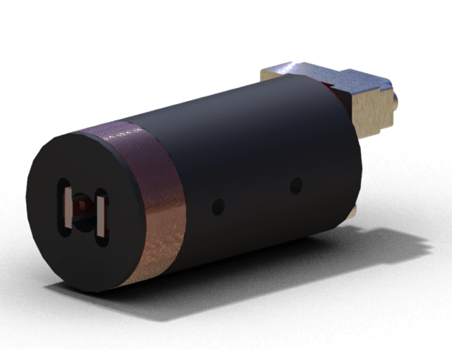
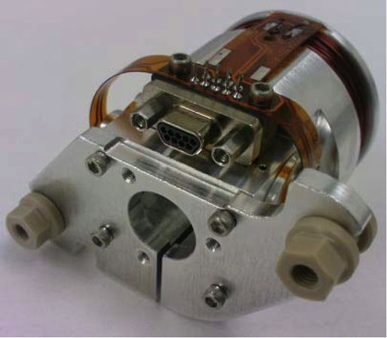
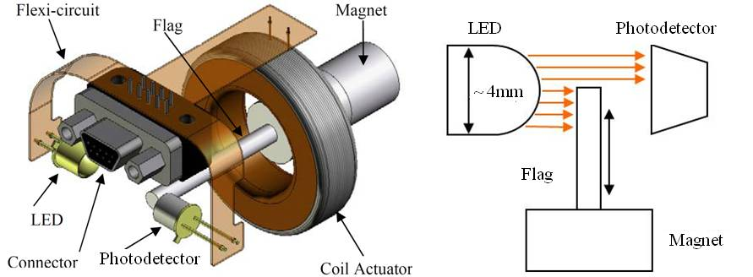
Optical Sensor ElectroMagnet (OSEM)
Birmingham OSEM (BOSEM)
Advanced LIGO OSEM (AOSEM)
- modified iLIGO OSEM
Magnet Types (M0900034)
BOSEM – 10 X 10 mm, NdFeB , SmCo
10 X 5 mm, NdFeB, SmCo
AOSEM – 2 X 3 mm, SmCo
2 X 6 mm, SmCo
2 X 0.5 mm, SmCo
BOSEM Schematic

Slide 9
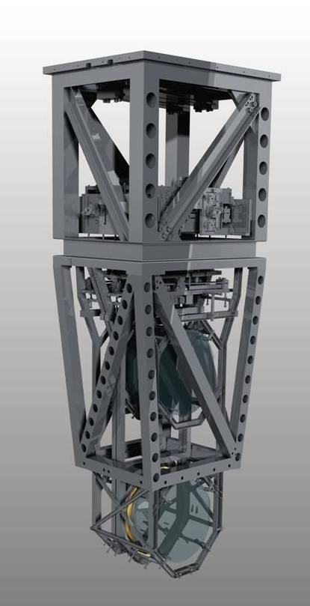
Quadruple Suspension (Quad)
Reaction Chain
Main (test) Chain
Purpose
Input Test Mass (ITM, TCP)
End Test Mass (ETM, ERM)
Location
H1 - BSC 1, 3, 9, 10
H2 - BSC 7, 8, 5, 6
L1 – BSC 1, 3, 4, 5
R0, M0
Control
Local – damping at M0, R0
Global – LSC & ASC at all 4
Sensors/Actuators
BOSEMs at M0, R0, L1
AOSEMs at L2
Opt. levs. and interf. sigs. at L3
Electrostatic drive (ESD) at L3
Documentation
Final design review - T1000286
Controls arrang. – E1000617
L1
L2
L3

Slide 10
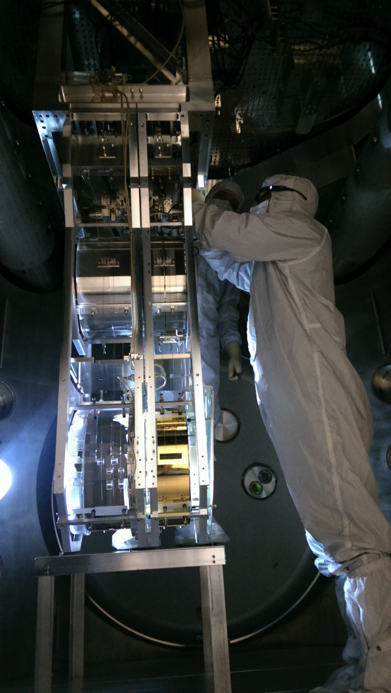
H1ITMX
LHO alog 12211
10 June 2014
De-install for silica fiber installation

Slide 11
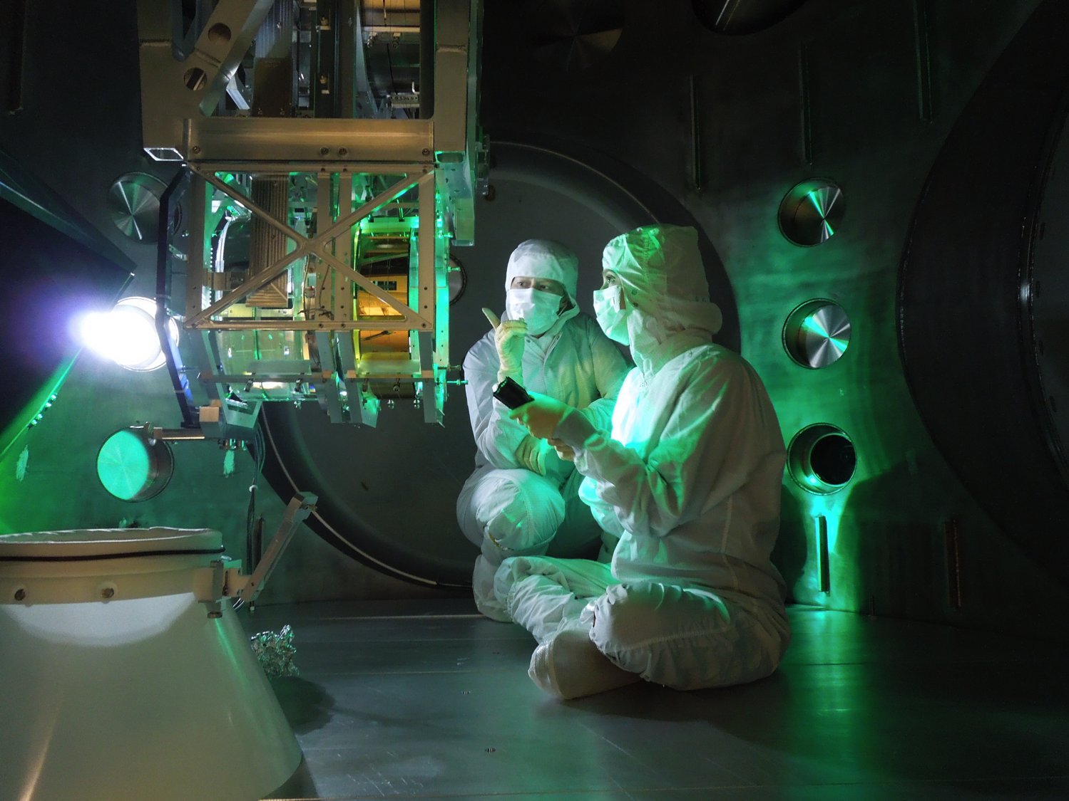
H1 ITMX – 30 July 2014 - LHO alog 13044

Slide 12
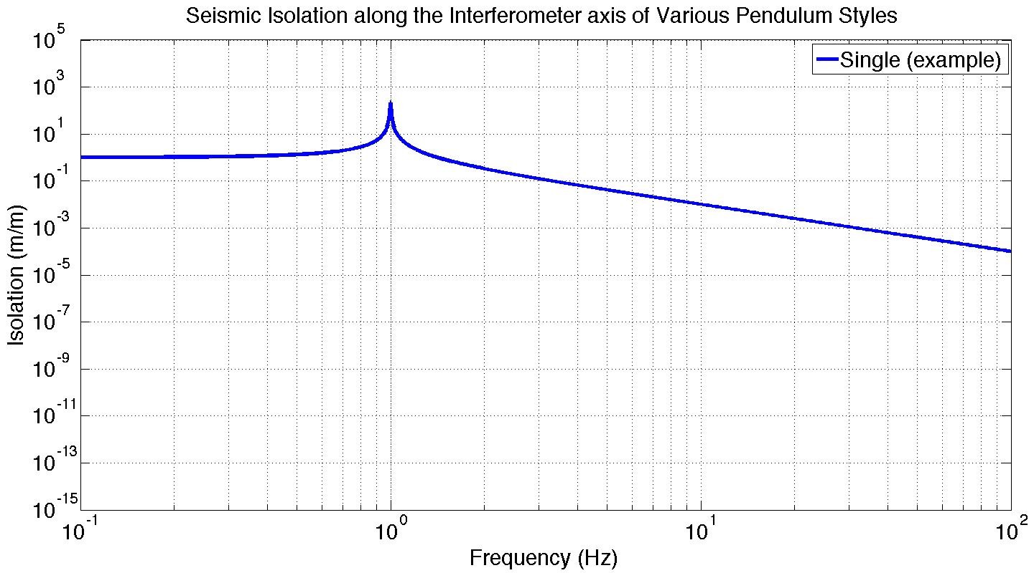
Suspension Isolation

Slide 13
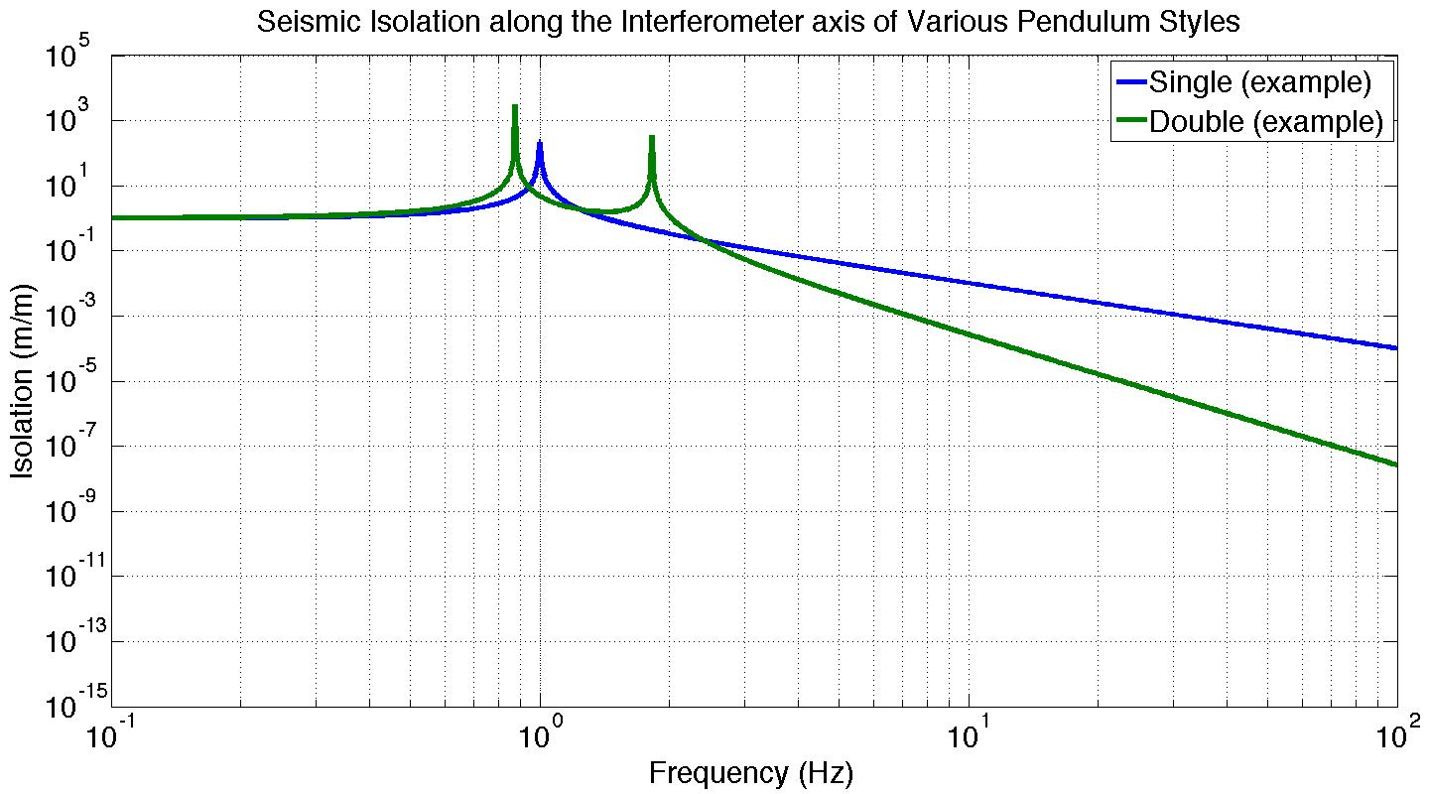
Suspension Isolation

Slide 14
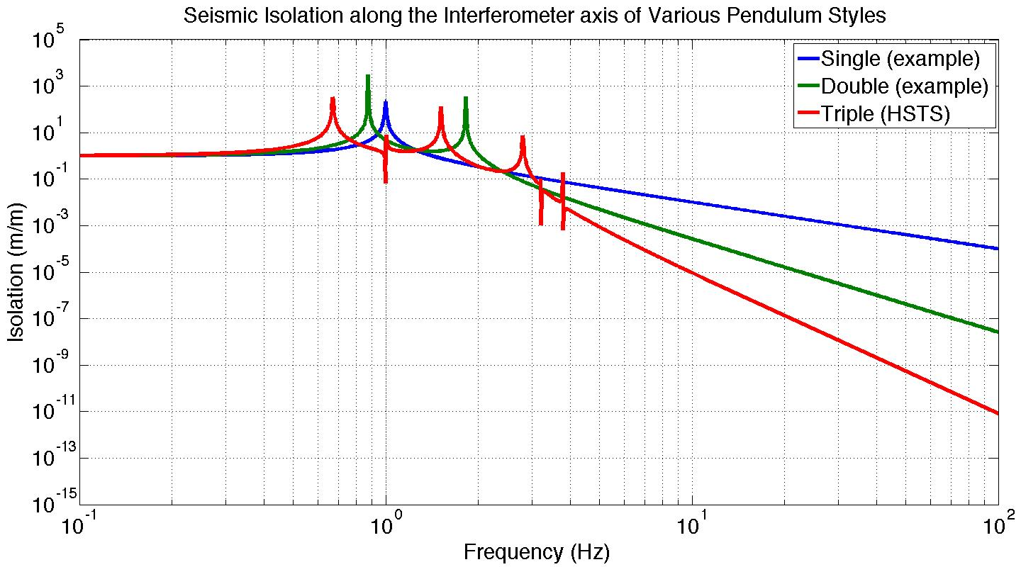
Suspension Isolation

Slide 15
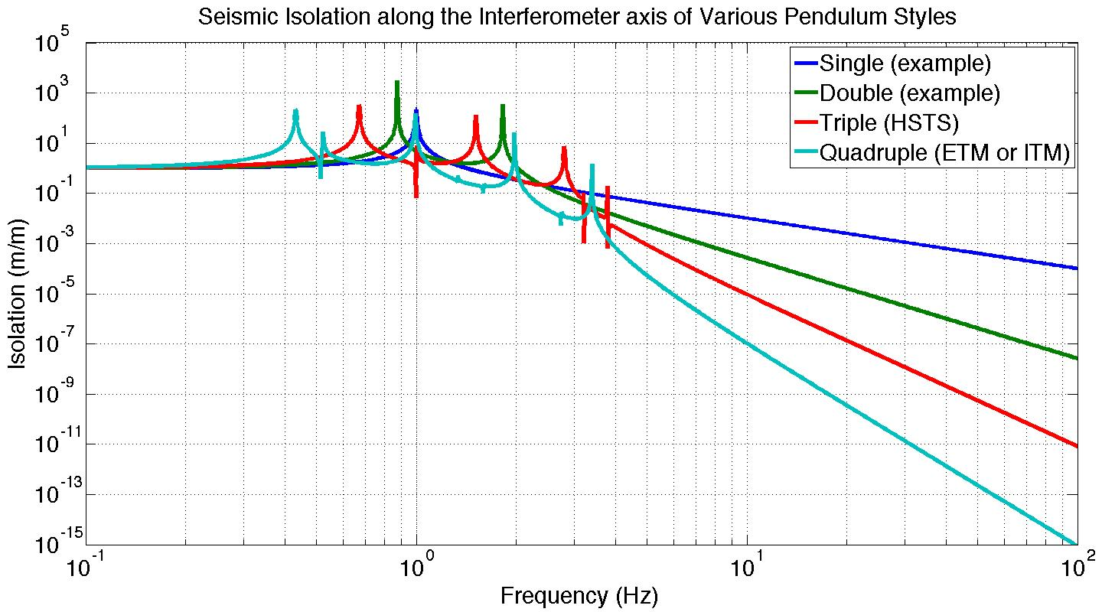
Suspension Isolation

Slide 16
Suspension Isolation
Each stage provides 1/f² isolation
GW band

Slide 17
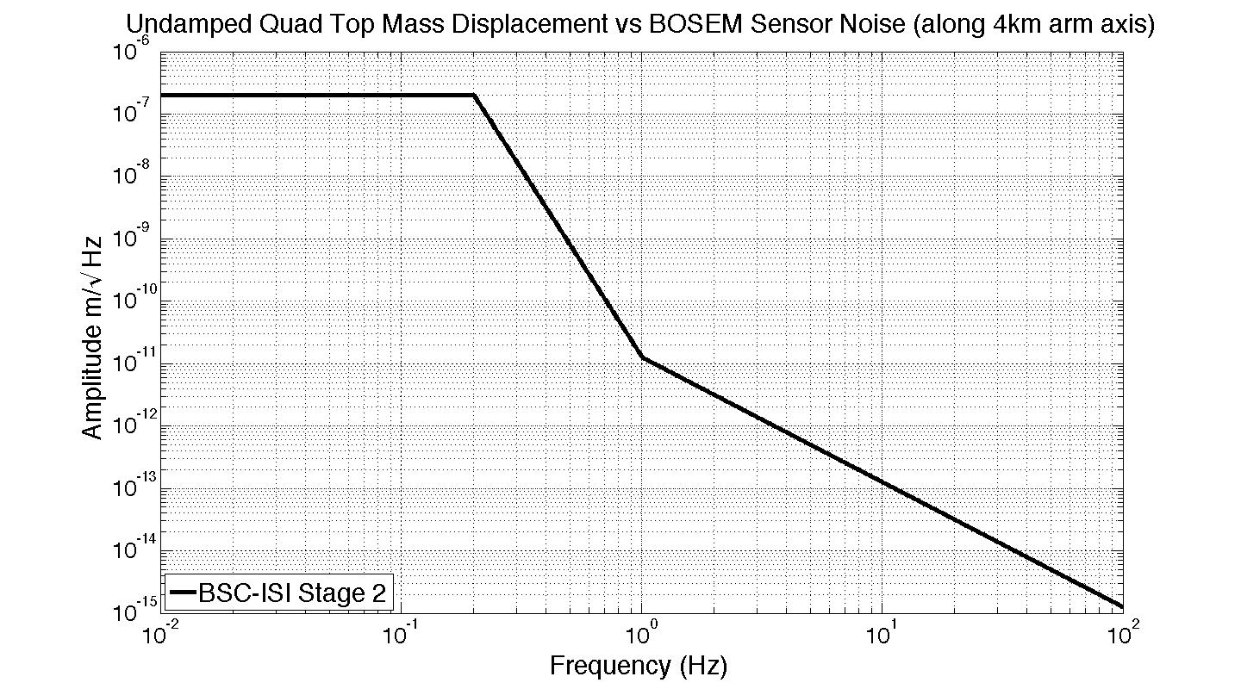
The damping challenge

Slide 18
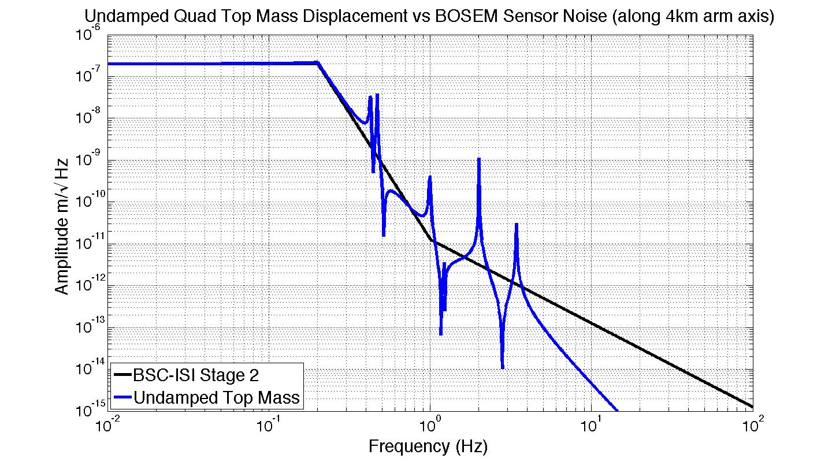
The damping challenge

Slide 19
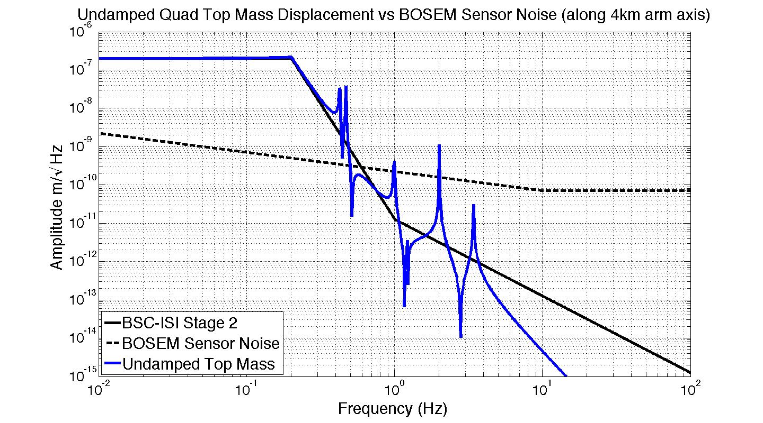
The damping challenge

Slide 20
The damping challenge
10000 times higher!

Slide 21
Damping feedback loop

Slide 22
Damping feedback loop
sensor noise
[m]
+

Slide 23
Damping feedback loop
sensor noise
[m]
Damping feedback filter
+

Slide 24
Damping feedback loop
sensor noise
[m]
Damping feedback filter
[N]
+

Slide 25
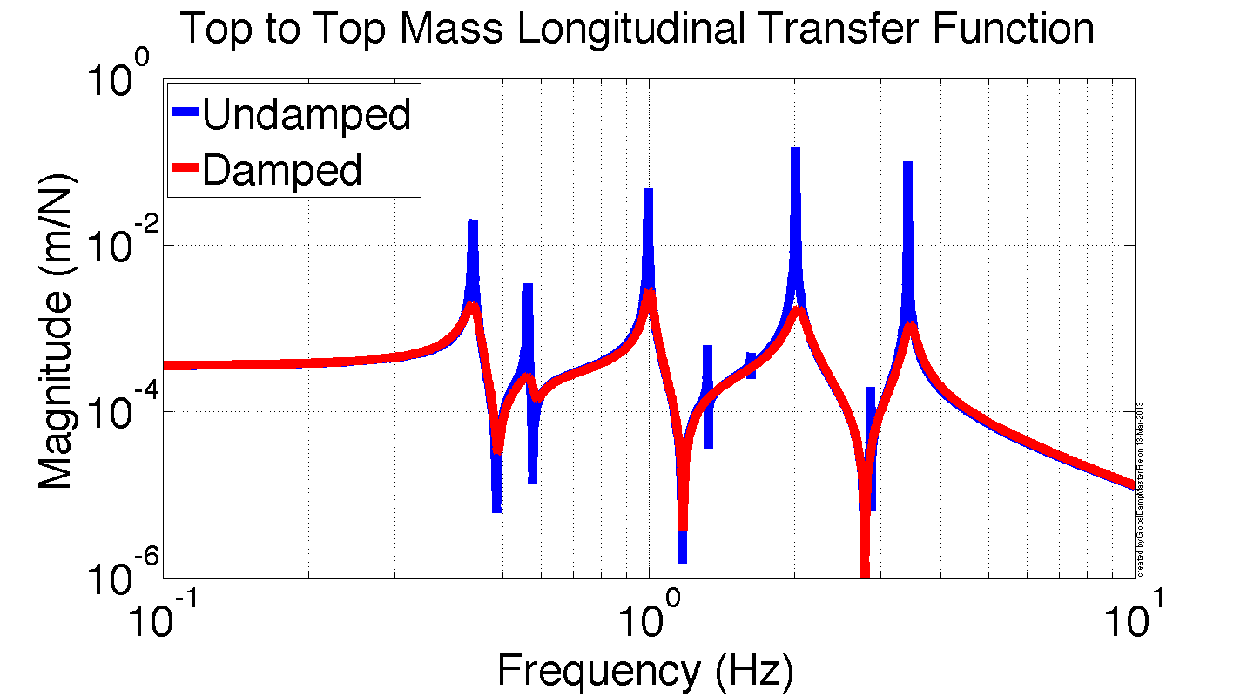
Damping feedback loop
sensor noise
[m]
Damping feedback filter
[N]
+

Slide 26
Damping feedback loop
sensor noise
[m]
Damping feedback filter
[N]
+
Ideal damping filter

Slide 27
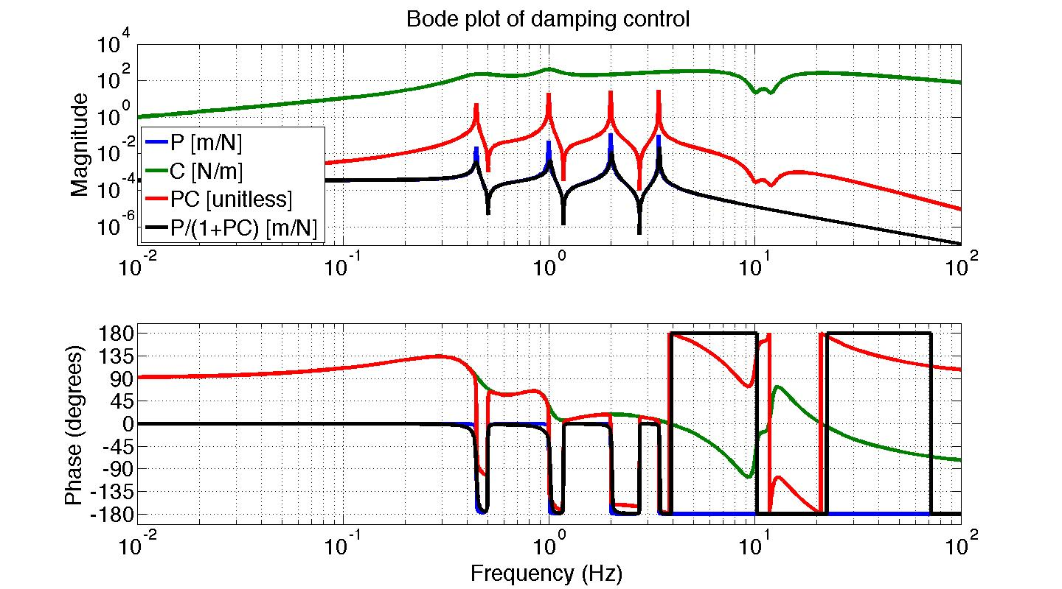
Damping filters in practice
Stable damping filter

Slide 28
Cavity control
Reaction Chain
Main (test) Chain
Drift control
Low frequency control
Medium frequency control
High frequency control
Cavity control filters

Slide 29
Resources on control techniques
Damping
Loop shaping and modal damping - P1200009 http://scitation.aip.org/content/aip/journal/rsi/83/4/10.1063/1.4704459?ver=pdfcov
Modal damping - P1200057
Global damping - P1400085, G1200774
Cavity control (aka hierarchical control)
G1200632
T1000242
Using a blended actuator technique, using experience from the SEI group’s sensor blending: G1200692

Slide 30
Back Ups

Slide 31
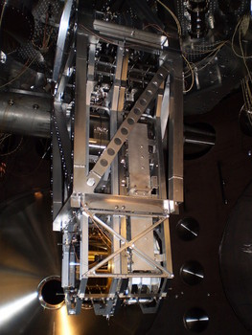
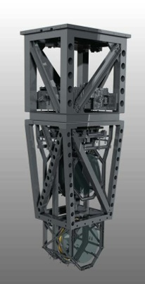
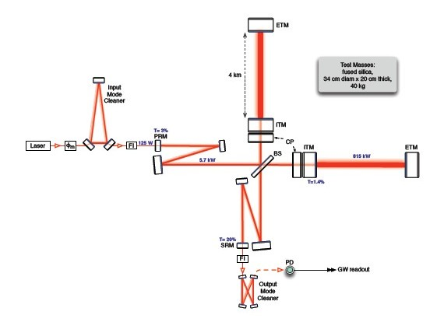
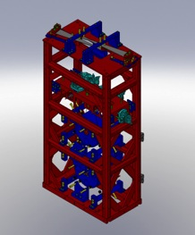
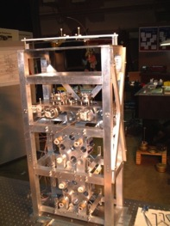
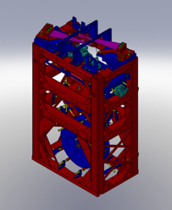
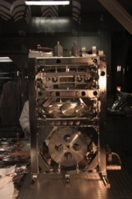
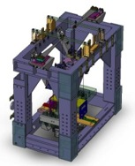
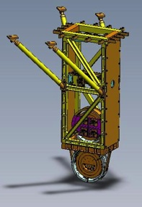
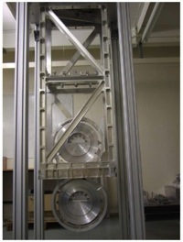
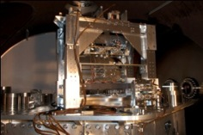
Five Suspension Designs
Ref: G1100434

Slide 32
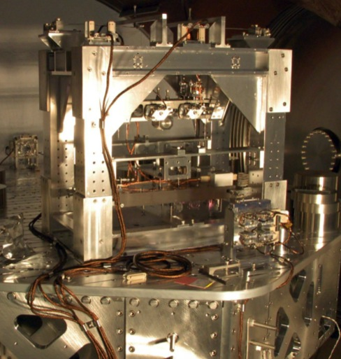
Output Mode Cleaner Double (OMCS)
Location
HAM 6, (12)
Control
Local – damping at M1
(true for all SUS’s)
Sensors/Actuators
BOSEMs at top mass
Top mass naming convention
L1:SUS-OMC_M1…
In use during S6
T3
T1
T2
SD
LF
M1
RT
M2
Optics
site subsystem unit stage
2
3
3,4
2
Documentation
Final design review - T0900060
HAM SUS controls arrangement – E1100109
V
Local coordinates
T
L

Slide 33
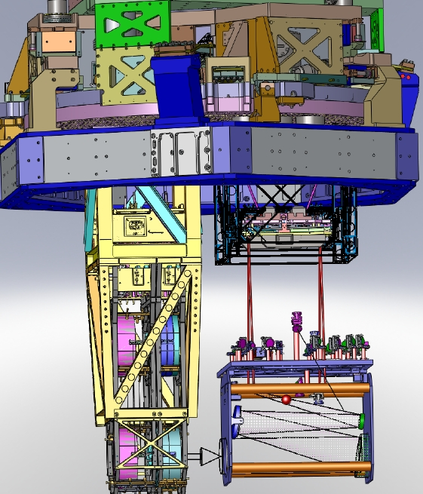
TransMon Double
Location
BSC 9, 10
Control
Local – damping at top mass
Sensors/Actuators
BOSEMs at top mass
Top mass naming convention
L1:SUS-TRMX_M1…
Ref: E1000040

Slide 34
HAM Large Triple Suspension (HLTS)
Purpose
PR3, SR3
Location
HAM 2, 5, (8, 11)
M1
Control
Local – damping at M1
Global – LSC & ASC at all 3
Sensors/Actuators
BOSEMs at M1
AOSEMs at M2 and M3
Optical levers and interferometric signals on M3
Naming: L1:SUS-SR3_M1…
Documentation
Final design review – T1000012
Controls arrangement – E1100109
UL
UR
M2
LL
LR
UL
UR
M3
LL
LR
V
T
L

Slide 35
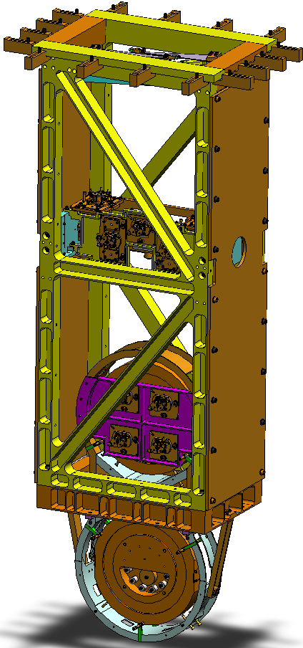
Beamsplitter/Folding Mirror (BSFM)
Purpose
BS, (FMX and FMY)
Location
Beamsplitter – BSC 2, (4)
(Fold Mirror – BSC 6, 8)
RT
LF
F1
SD
F2
F3
M1
Control
Local – damping at M1
Global – LSC & ASC at M2
Sensors/Actuators
BOSEMs at M1 and M2
Optical levers and interferometric signals on M3
Naming: L1:SUS-FMX_M1…
Documentation
Final design review - T080218
Controls arrangement – E1100108
UL
UR
M2
LL
LR
M3
V
T
L

Slide 36
Global Cavity Control (LSC)
C₄
C₃
Each stage has limited range, so the control is distributed up the chain with:
Increasing control force
Lower frequency control
C₂
Cavity Length
C₁
ITM
ETM

Slide 37
Parallel Control of Cavity Length
With parallel feedback, changing one loop requires changing the others to account for changes in gain and stability.
The stability of all stages are coupled
C₂
Cavity Length
C₁
ITM
ETM

Slide 38
Hierarchical Control of Cavity Length
If each stage’s input is the output of the previous stage, any feedback change is automatically registered by the rest of the loop.
The stability at each stage is independent from the others.
Detailed discussion in T1000242.
C₂’
Cavity Length
C₁
ITM
ETM

Slide 39
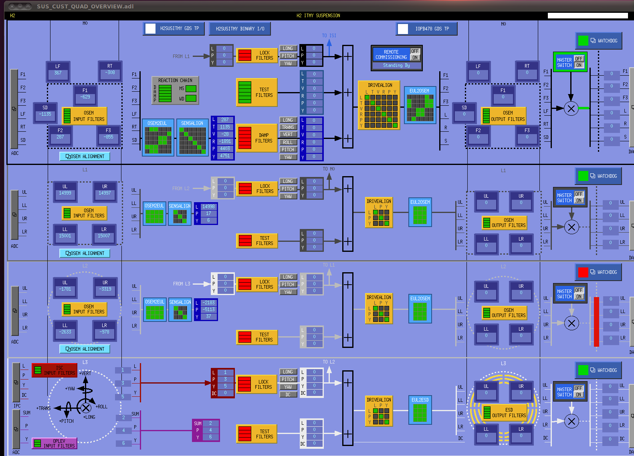
Quad MEDM Overview Screen

Slide 40
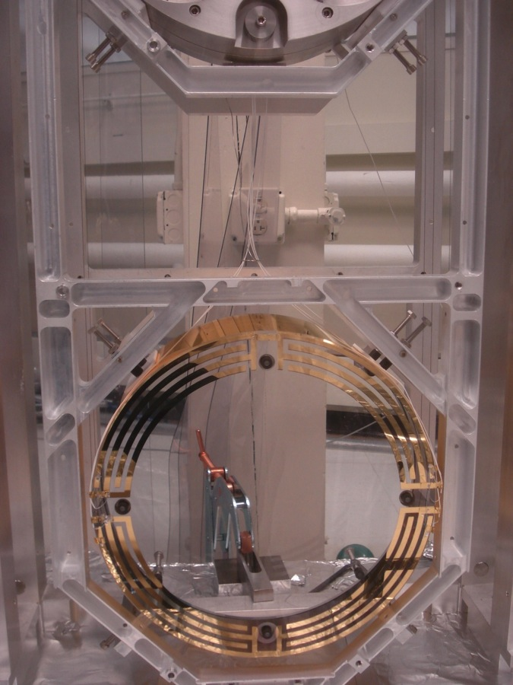
Quadruple Suspension ESD
Reaction Chain
Main (test) Chain
The electrostatic drive (ESD) acts directly on the test ITM and ETM test masses.
± 400 V (ΔV 800 V)
≈ 100 μN
Each quadrant has an independent control channel
Common bias channel over all quadrants
UR
UL
LR
LL

Slide 41
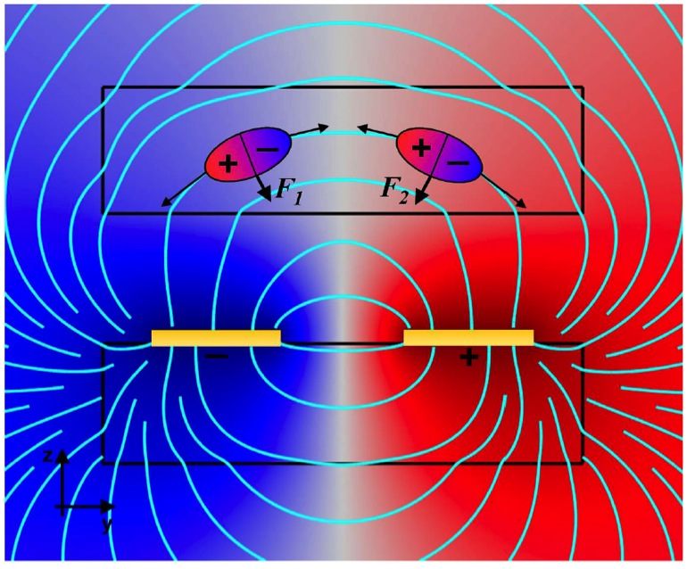
Quadruple Suspension ESD
F = αΔV²
α = coupling coefficient, depends on geometry
ΔV = differential voltage across traces
Test mass
5 mm
Reaction mass
Linearization occurs in the control!
Cartoon diagram illustrating the working principle of the ESD. The upper rectangle represents the test mass containing two polarized molecules; the lower rectangle represents the reaction mass bearing two electrodes. Surface plot shows electrical
potential with electric field lines shown in cyan (John Miller PhD thesis, P1000032).

Slide 42
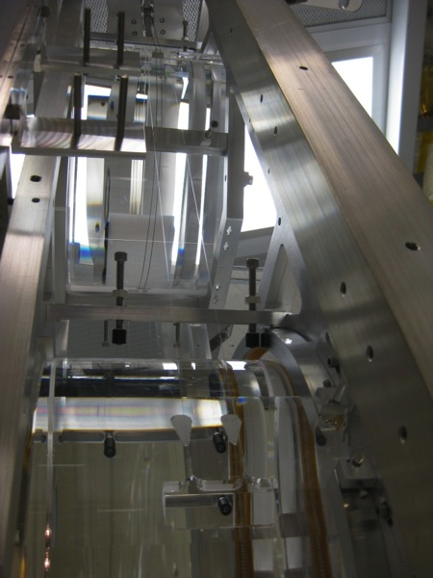
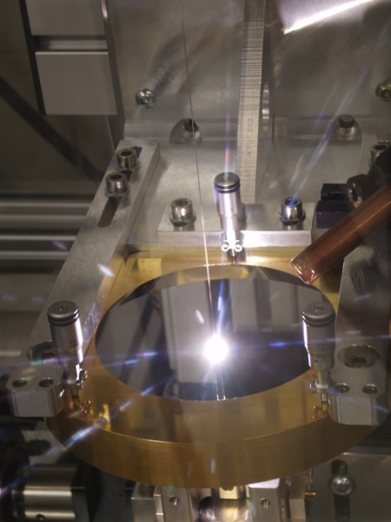
Quadruple Suspension (Quad)
Reaction Chain
Main (test) Chain
R0, M0
Fibers
L1
L2
Newly welded monolithic quad at MIT
11 May 2010
L3
Pulling a fiber at MIT
7 May 2010

Slide 43
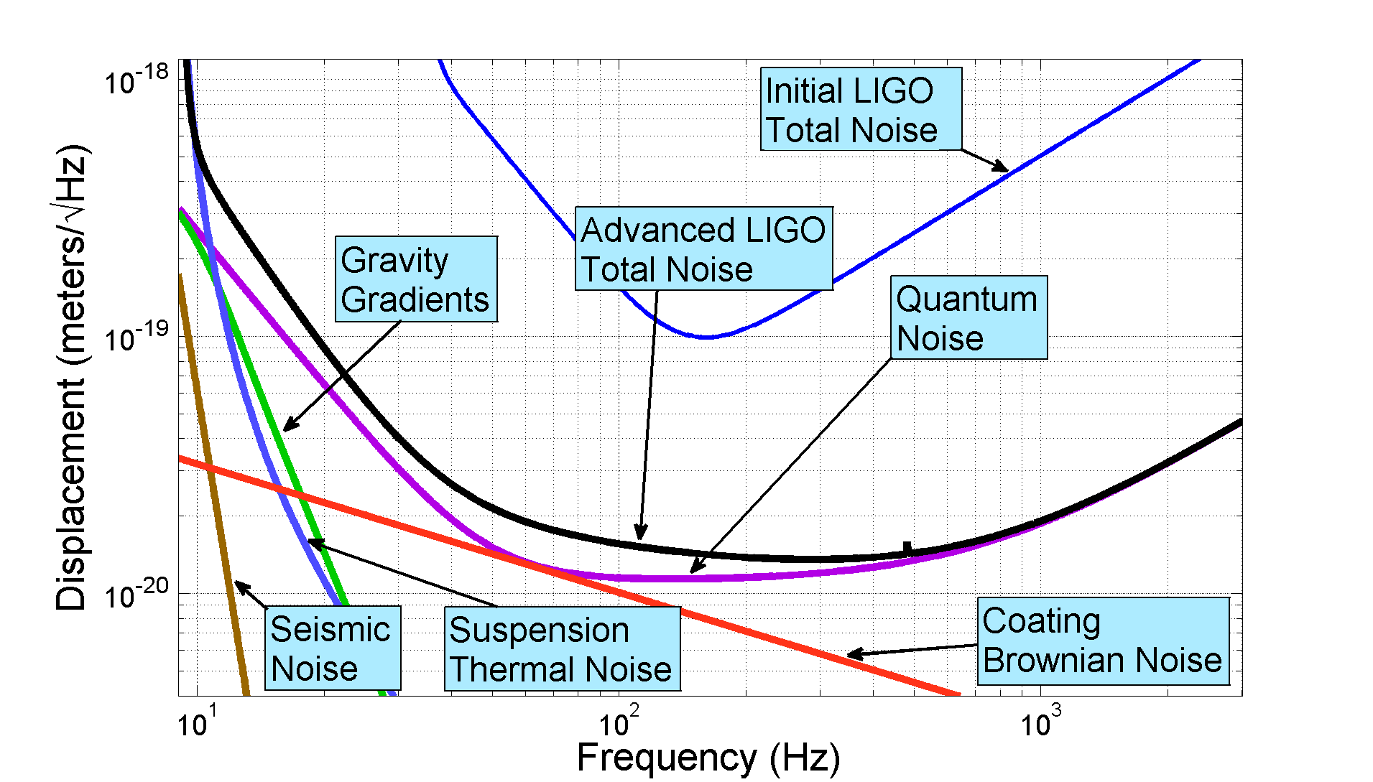
aLIGO Noise Budget

