Slide 1
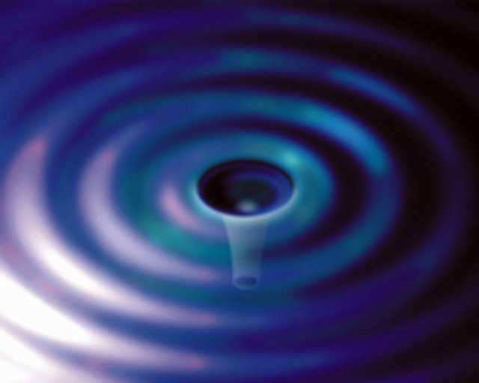
Optics Thermal Noise Work at American
Gregg Harry, Sam Hickey,
Jonathan Newport, Hannah Fair
American University
OWG Session, August 2014 LVC Meeting
G1400961

Slide 2
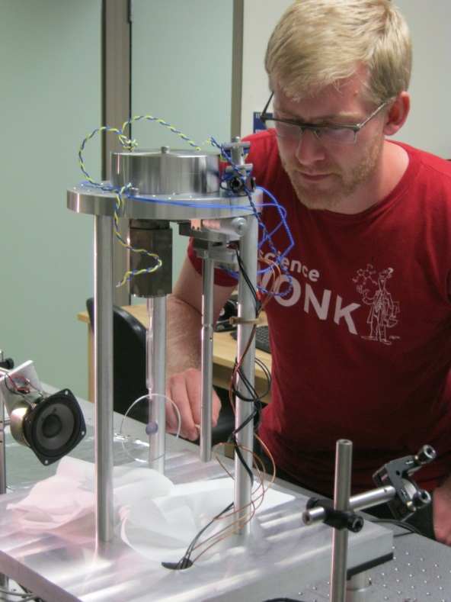
Overview of AU Lab
The AU Thermal Noise lab has two bell jars dedicated to studying thermal noise in gravitational wave detector optics
  Dedicated finite element modeling computer
PI Gregory Harry, Lab Specialist Jonathan Newport
  Typically two students, currently Hannah Fair and Sam Hickey

Slide 3
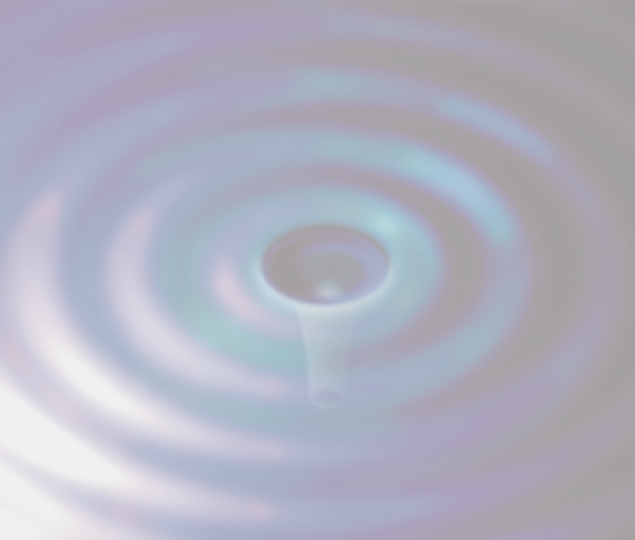
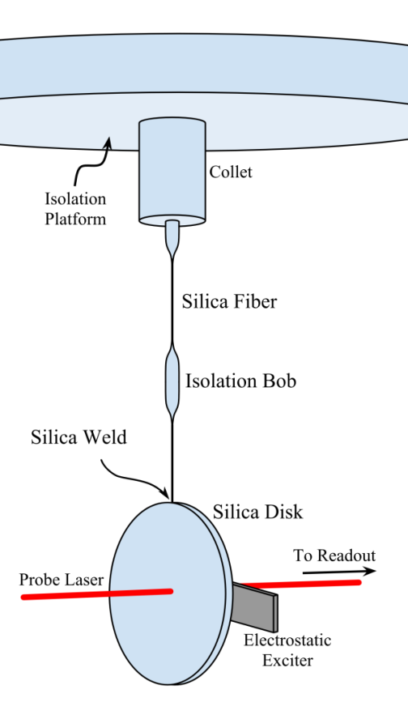
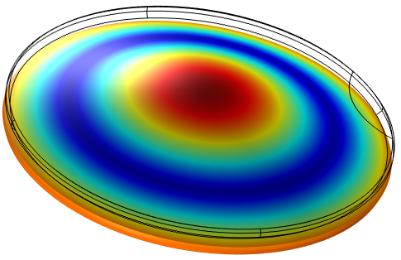

Technique
Q Measuring
Measure modal Q’s of sample optics
Finite Element Model
Energy distribution in sample by FEA
Determine modally (frequency), spatially, tensor elements
Determine mechanical loss from Q’s
In vacuum, silica fiber suspension, electrostatic excitation, birefringence laser readout

Slide 4
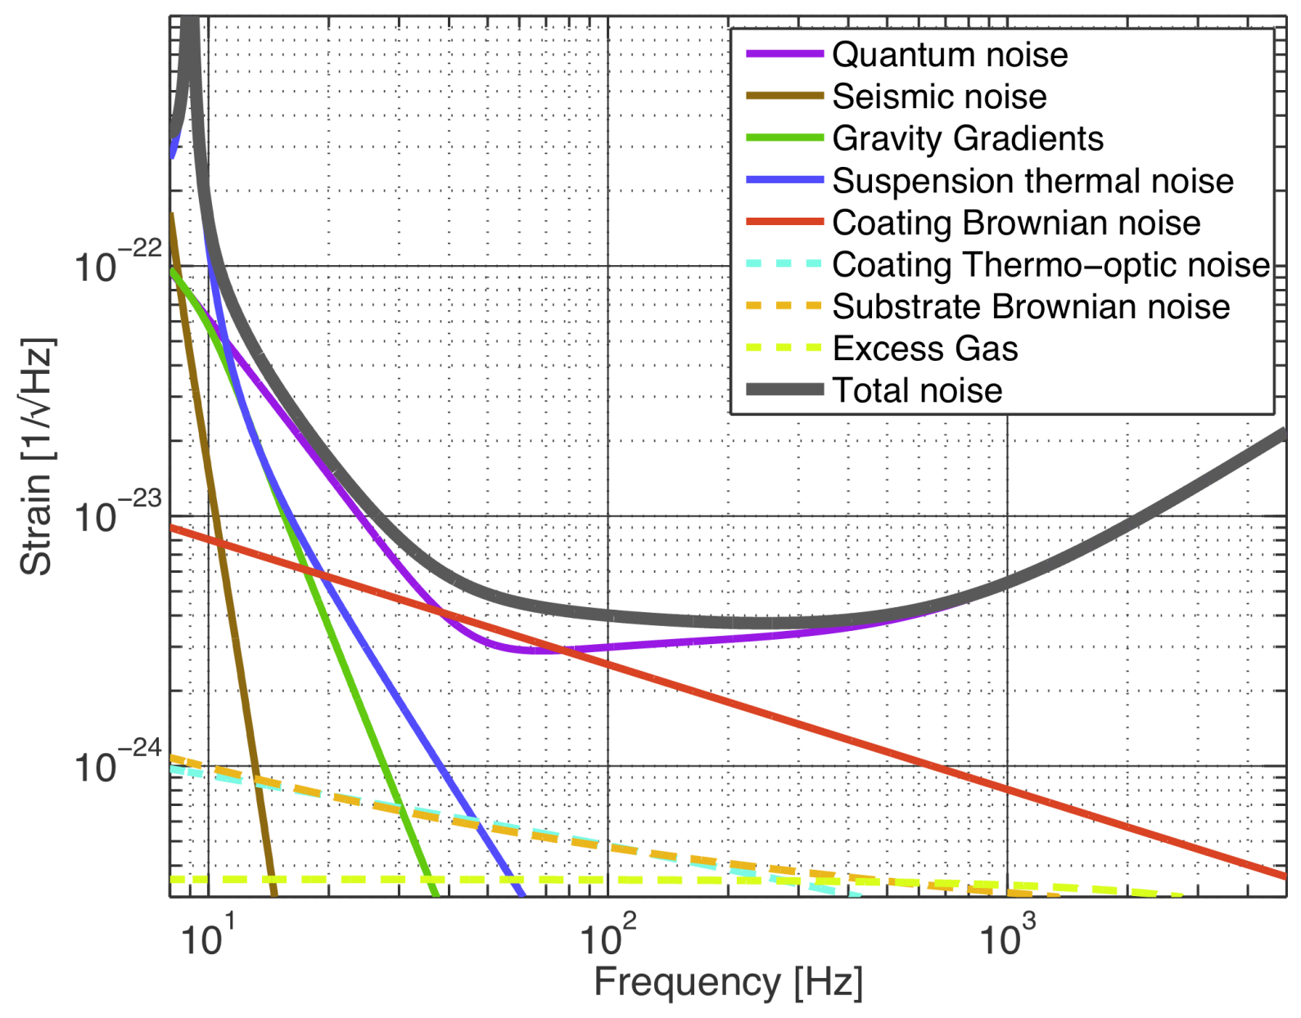
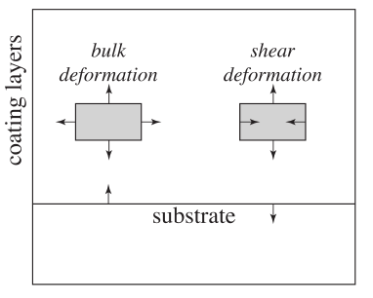
Coating Thermal Noise
Coating thermal noise caused by mechanical loss
Sensitivity limiting in aLIGO
  Titania doping, et al.
Continuing in 3rd generation
  Many approaches
Hong et al, Phys. Rev. D 87, 082001
Coating thermal noise depends on shear & bulk mechanical loss
  Hong et al estimate 37% uncertainty in thermal noise from ignorance of these values in aLIGO

Slide 5
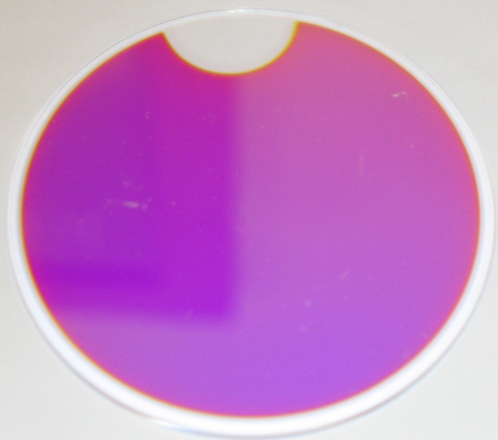
Ti-Ta Sample
Nominal thickness 0.5 μm
  Being measured at ERAU
Using standard values for
    Young’s Modulus 140 GPa
    Poisson ratio 0.23
    Density 2200 kg/m³
Jonathan Newport has been doing FEA work
Mode | Frequency | Q | δQ | E_{shear}/E_{tot} | E_{bulk}/E_{Tot}
BF | 2773 Hz | 1.14 X 10⁶ | 2.5 X 10³ | 9.93 X 10⁻³ | 6.58 X 10⁻⁴
DH | 4178 Hz | 8.70 X 10⁵ | 2.6 X 10⁴ | 6.85 X 10⁻³ | 4.79 X 10⁻³
Hex | 6307 Hz | 9.32 X 10⁵ | 3.2 X 10⁴ | 9.37 X 10⁻³ | 9.65 X 10⁻⁴
DDH | 9707 Hz | 9.16 X 10⁵ | 3.8 X 10³ | 7.68 X 10⁻³ | 3.62 X 10⁻³
Oct | 10943 Hz | 8.87 X 10⁵ | 1.6 X 10⁴ | 9.05 X 10⁻³ | 1.18 X 10⁻³

Slide 6
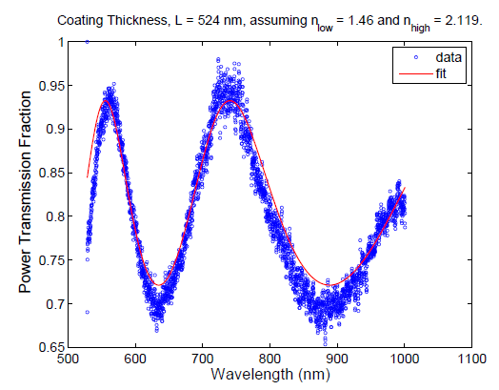
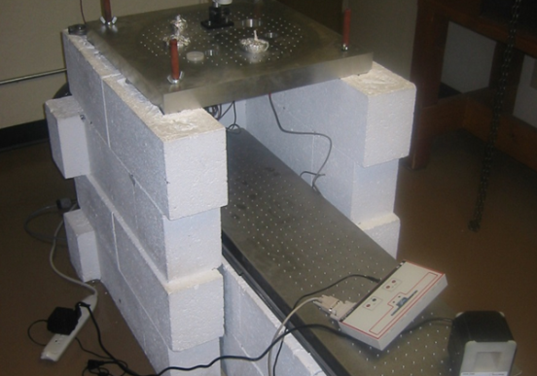
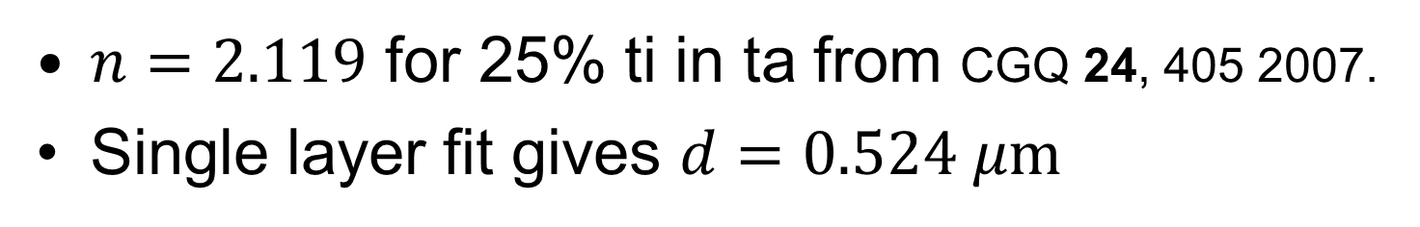
Coating Thickness
Transmission vs angle at ERAU by Andri Gretarsson
$n=2.119$ for 25% ti in ta from CGQ 24, 405 2007.
Single layer fit gives $d=0.524 μm$

Slide 7
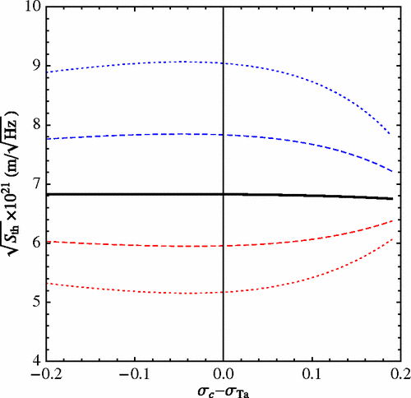
Poisson Ratio
Uncertainty in ti-ta Poisson ratio significant contributor to uncertainty in energy ratios
Hong et al estimate it accounts for ~10% uncertainty in thermal noise

Slide 8
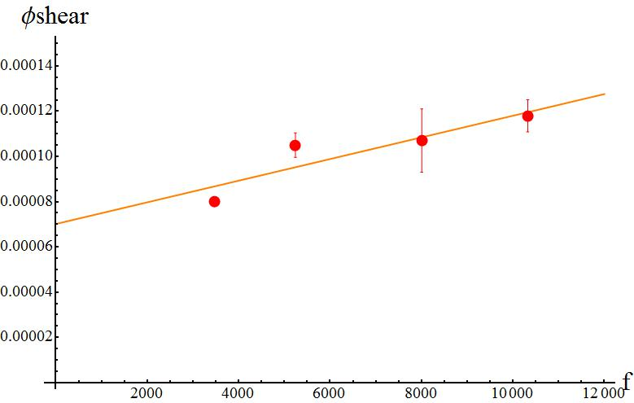
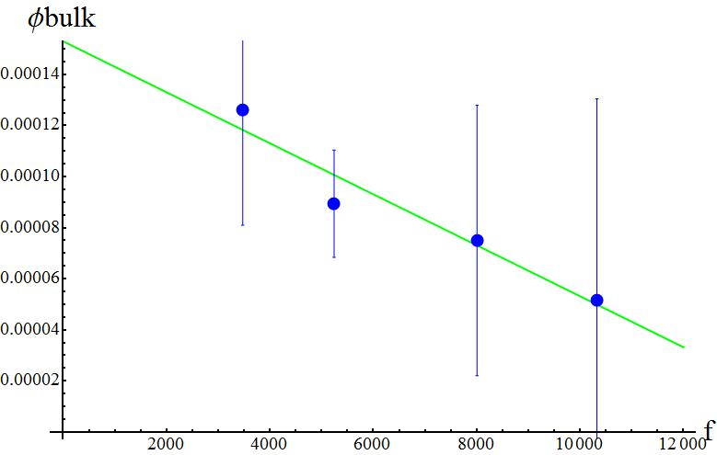
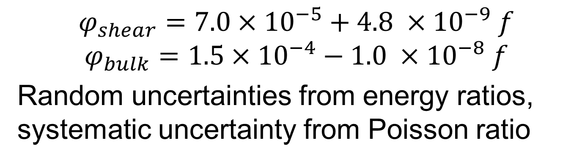
Results
Bulk and shear φ as functions of frequency
$$φ_{shear}=7.0×10^{−5}+4.8 ×10^{−9} f$$
$$φ_{bulk}=1.5×10^{−4}−1.0 ×10^{−8} f$$
Random uncertainties from energy ratios, systematic uncertainty from Poisson ratio

Slide 9
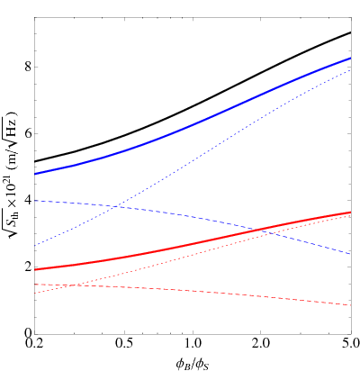
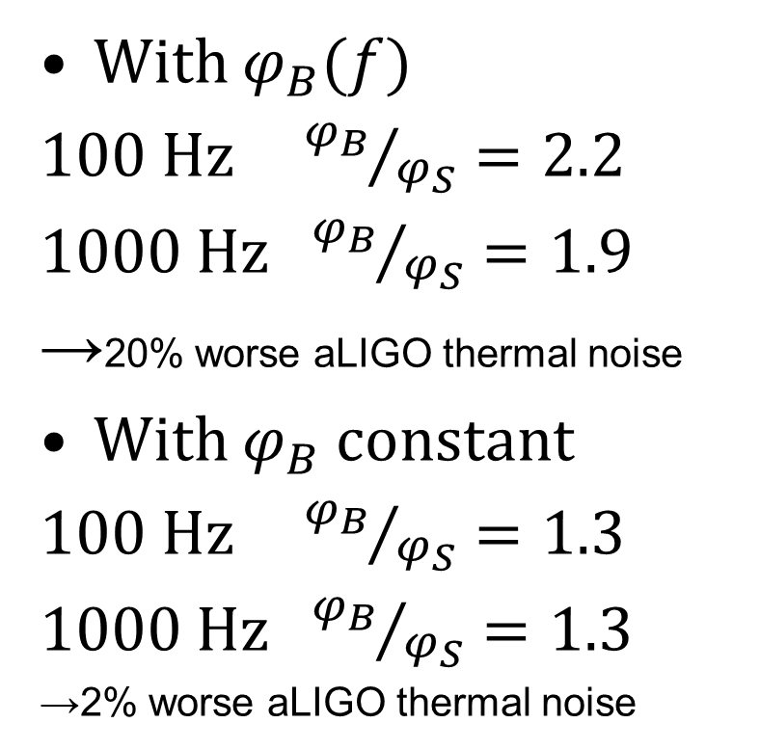
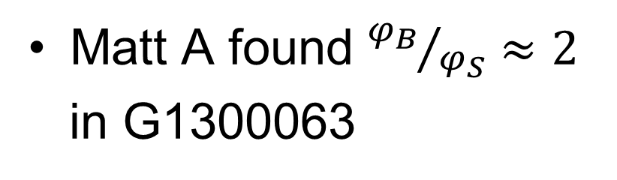
Thermal Noise
Noise prediction from Hong paper
With $φ_{B}(f)$
100 Hz ${φ_{B}}/{φ_{S}}=2.2$
1000 Hz ${φ_{B}}/{φ_{S}}=1.9$
→20% worse aLIGO thermal noise
With $φ_{B}$ constant
100 Hz ${φ_{B}}/{φ_{S}}=1.3$
1000 Hz ${φ_{B}}/{φ_{S}}=1.3$
→2% worse aLIGO thermal noise
Matt A found ${φ_{B}}/{φ_{S}}≈2$
in G1300063

Slide 10
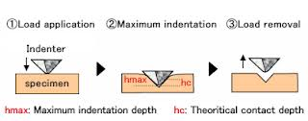
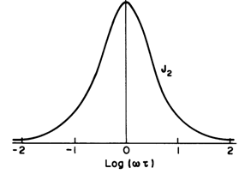
Outstanding Issues
Young’s modulus and Poisson ratio
  Nanoindenter
  Acoustic reflection
  Biggest source of uncertainty in aLIGO thermal noise
More precise FEA model
  Errors from energy ratios
Linear loss model
  Improve approximation
Thermal noise predictions
  Compare to prototypes

Slide 11
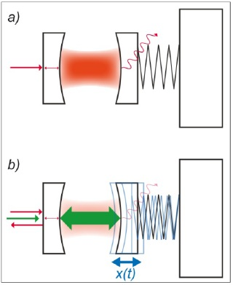
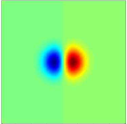
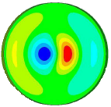
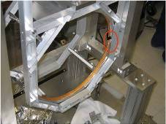
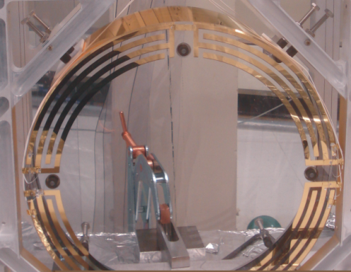
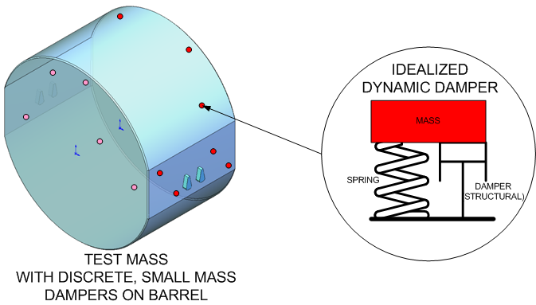
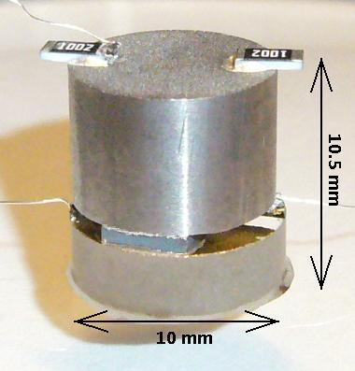
Parametric Instability
Optical
Possibly problem in aLIGO from exchange of energy between optical cavities and mirror acoustic modes
Mechanical
Possible solutions
Ring heaters to adjust mirror mode frequencies
Electrostatic drive to actuate on and damp acoustic modes
Acoustic mass dampers to passively damp acoustic modes
Optical mode active damping

Slide 12
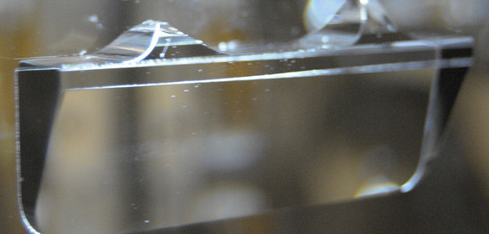
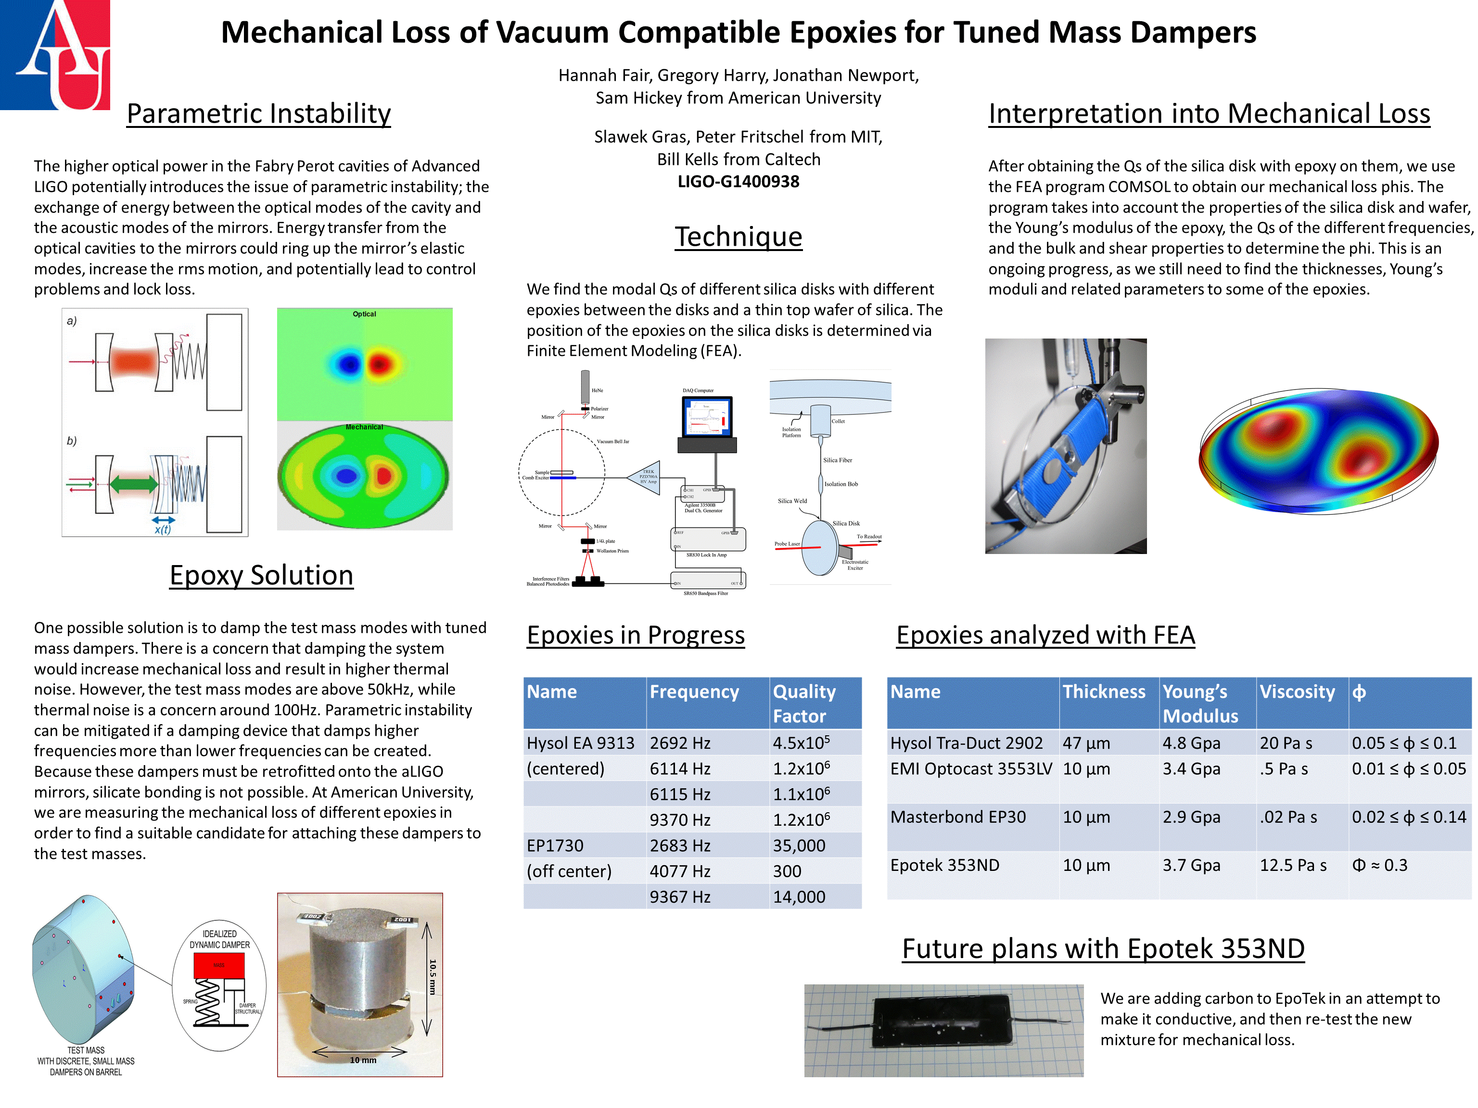
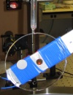
Epoxy Thermal Noise
Retrofit rules out silicate bonding, best solution
Use epoxy to connect dampers to mirrors
Predict thermal noise for dampers
Need mechanical loss of epoxies
  All bad, some more than others
Measure Q’s, do FE analysis
See H. Fair poster for details

Slide 13
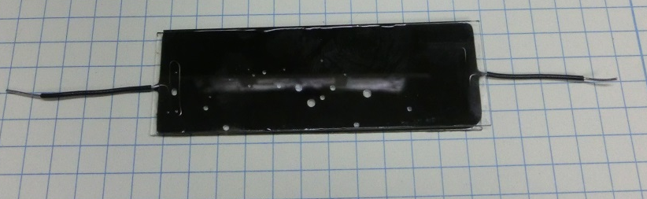
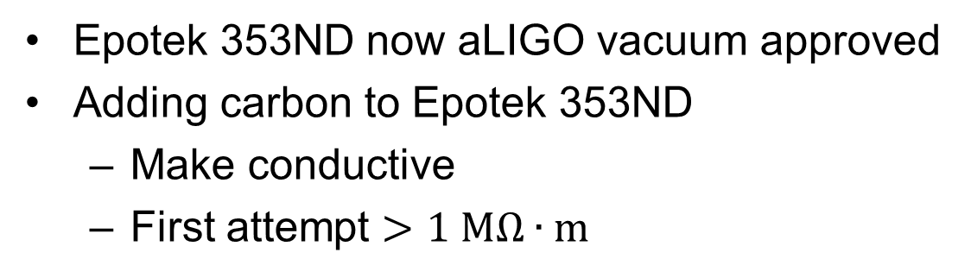
Epoxy Results
Green – Tra-Duct 2902, conducting
Red – Epotek 353ND, Nergis’ lab
Blue – Optocast 3553LV, aLIGO OMC
Cyan – EP 30, aLIGO standoffs
Also Hysol EA9313, EP1730, superglue
Epotek 353ND now aLIGO vacuum approved
Adding carbon to Epotek 353ND
  Make conductive
  First attempt $>1 \text{M}\text{Ω}∙\text{m}$

Slide 14
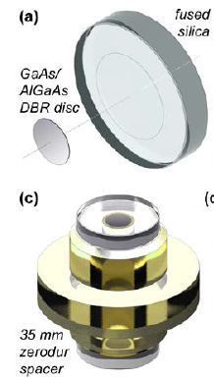
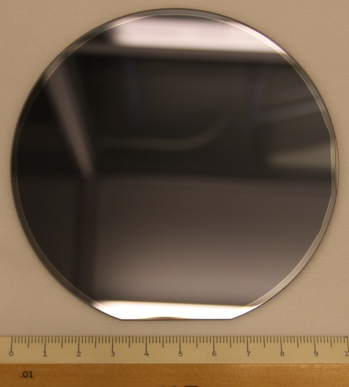
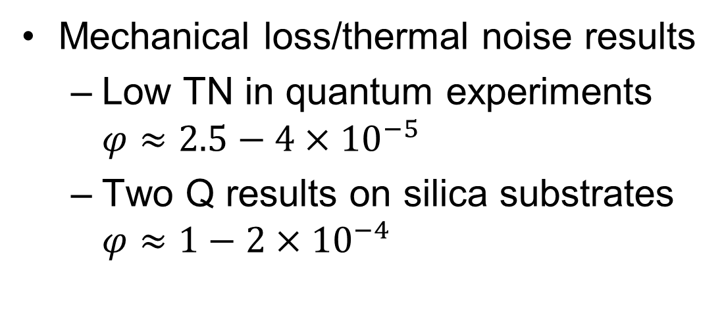
Aluminum Gallium Arsenide (AlGaAs)
Mechanical loss/thermal noise results
  Low TN in quantum experiments $φ≈2.5−4×10^{−5}$
  Two Q results on silica substrates $φ≈1−2×10^{−4}$
Crystalline Mirror Solutions recently able to make larger diameters, up to 10 cm
Improvement in bond strength
Flaw in AU/HWS sample due to scratch during transport/handling

