Slide 1
Optical Simulation vs Reality at LLO
Hiro Yamamoto LIGO lab/Caltech
Introduction
Arm loss
  Loss by COC data and modeling
  Measured loss to total loss
  Effect of LMA coating
Arm modes
  Effective RoC and locations of HOM peaks
Contrast Defect
  400ppm measurement vs 300ppm model
    Various sources of CD, what’s missing?
  ITMY lens and transmission maps, BS maps etc

Slide 2
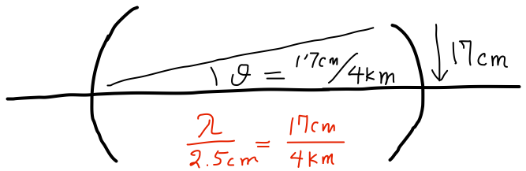
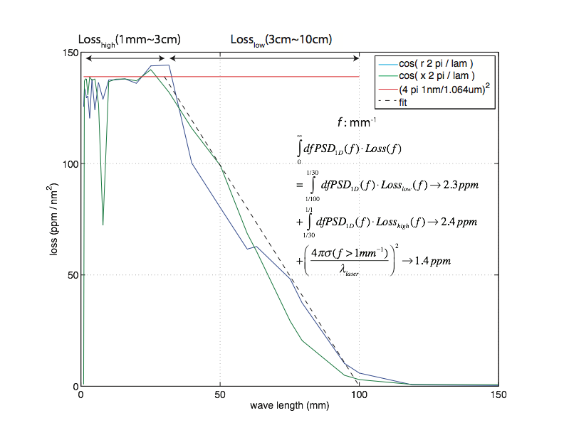
aLIGO optics scattering loss by wavelength
7.83mm
2

Slide 3
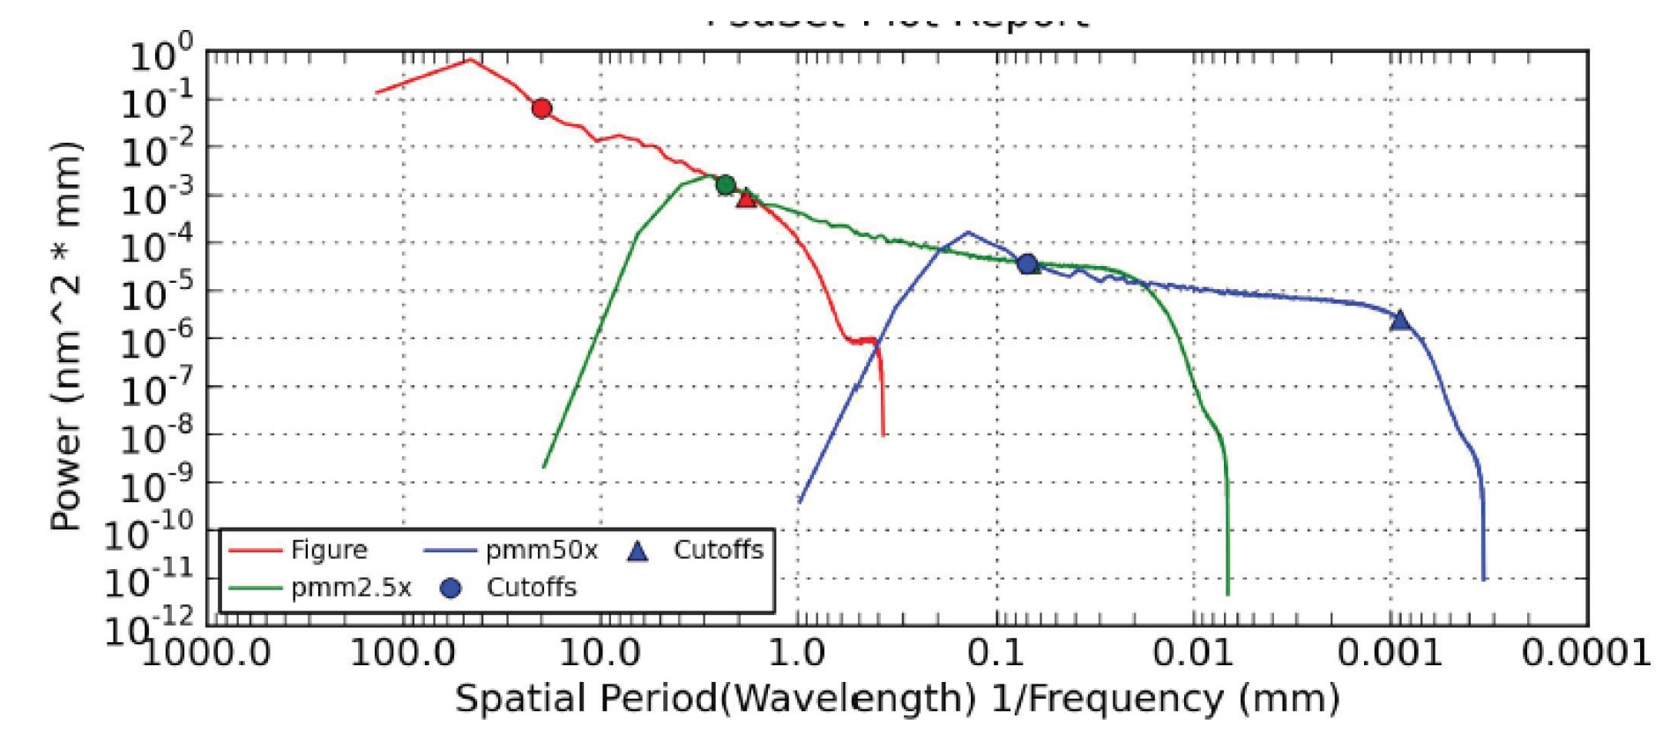
COC data and modeling
 | Spatial resolution | coverage | Main use
Phase map | > 1mm | < 2 x 10⁻⁴ rad, < 1m at 4km | Field in cavity and near the outer edge of mirror, cavity mode
PSD, RMS | 1μm ~ a few mm by PMM, + phase map | ~ large angle | Characterization of continuous structure, field scattered at large angle
Integrating sphere | fraction of mm | > 5 degree | Total scattering to all angle, effects of non contiguous structures captured. Hole at forward is covered by others.
COC data (characteristics of mirror) +
appr. Maxwell eq. with rigorous boundary cond.
⇒ IFO observable

Slide 4
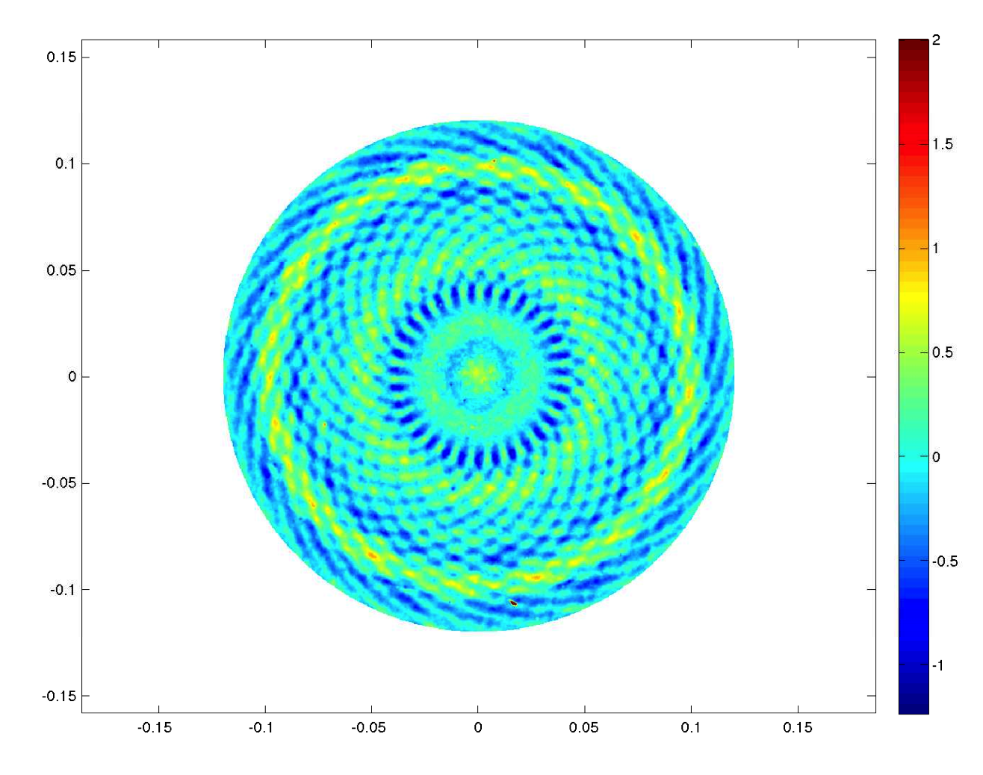
Details of ETM09 spiral effect
ETM09 map
Field going to ITM
50cm = 1.064μm / (8mm/4000m)
8mm
Spiral component
4
Real PD diameter is ¼ of

Slide 5
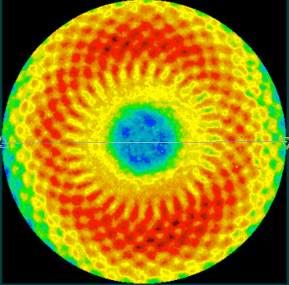
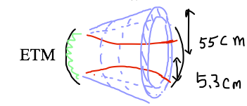
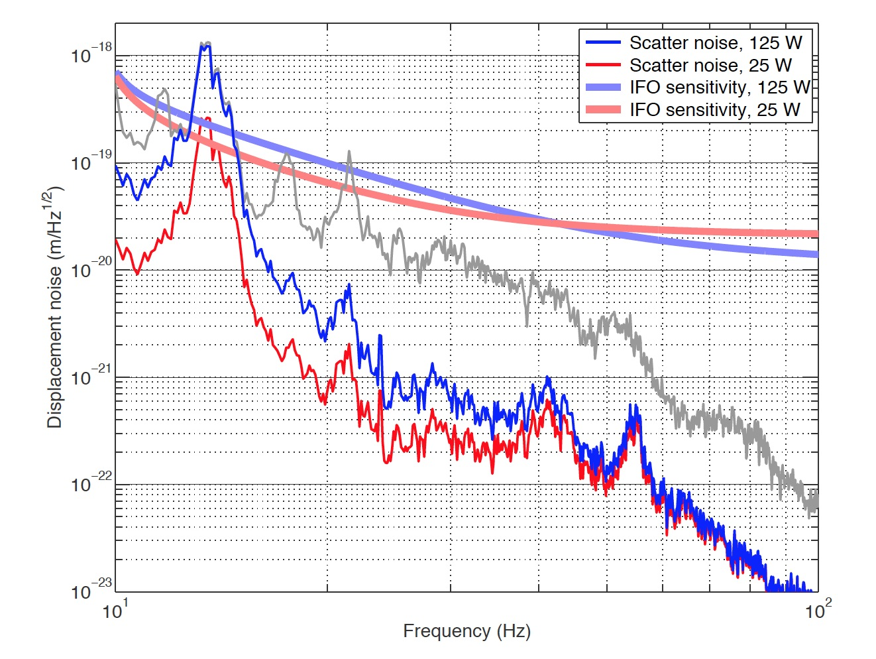
Noise injection by the spiral pattern on test mass coatings
Figure loss by two mirrors
~ 15-20ppm
ETM07 map
micro roughness, point scattering
~ 20 ppm
7.83mm
T1300354 by PF,HY
Phasemap resolution in simulation
main beam ⇒
ETM reflection ⇒
larger angle scattering into cone ⇒
reflected by beam tube baffles ⇒
back scattered into ETM ⇒
merged into the main beam

Slide 6
Loss : measurement vs model with COC data
Phasemap and Caltech/LMA scattering loss measurements
alog13414 ETMY scattering
  Total : 36ppm
  Point scattering : 18ppm
alog13769 Best round trip loss 85ppm
  Extra 30-40ppm, where???
COC data + Model
  Round trip loss error < 14ppm
  Integrated scattering
    7.5ppm by LMA
    9.3ppm by Caltech
  Zygo rms ⇒ loss(<1mm) < 1ppm
  PSD ⇒ loss(<5mm) < 1ppm

Slide 7
Analytic formula in the forward region
Huygen’s integral with Fresnel appr.
small aberration
Fresnel approx
Tiny source : dF ⇒ const BRDF ⇒ 2π dS / λ² x true scattering
PSD to dF :
Δ : 2D amplitude spectral density, ε~1/a few cm

Slide 8
Baffle PD capturing ETMY scatter phasemap resolution ~ 2mm ⇒ covers 1m
BRDF on ITMY baffle PD
Field going to ITM
 | PD1 | PD2 | PD3 | PD4
location (mm) | 200 | 438 | 435 | 217
data | 768 | 118 | 48 | 352
FOGP | 863 | 15 | 3 (5) | 625
PSD(f)=2500 f(m)⁻² nm² mm
⇒ BRDF = 20 (big error) at 45cm
by using Huygen+Fresnel
Real PD diameter is ¼ of

Slide 9
Details of ETM09 spiral effect
PD1,4 edge of central peak, PD 2,3 edge of 50cm ring
4.3ppm
10⁻⁵

Slide 10
Loss vs ITM tilt alog14171
Log(P) on ITM
Something is not understood
Log(P) on ETM

Slide 11
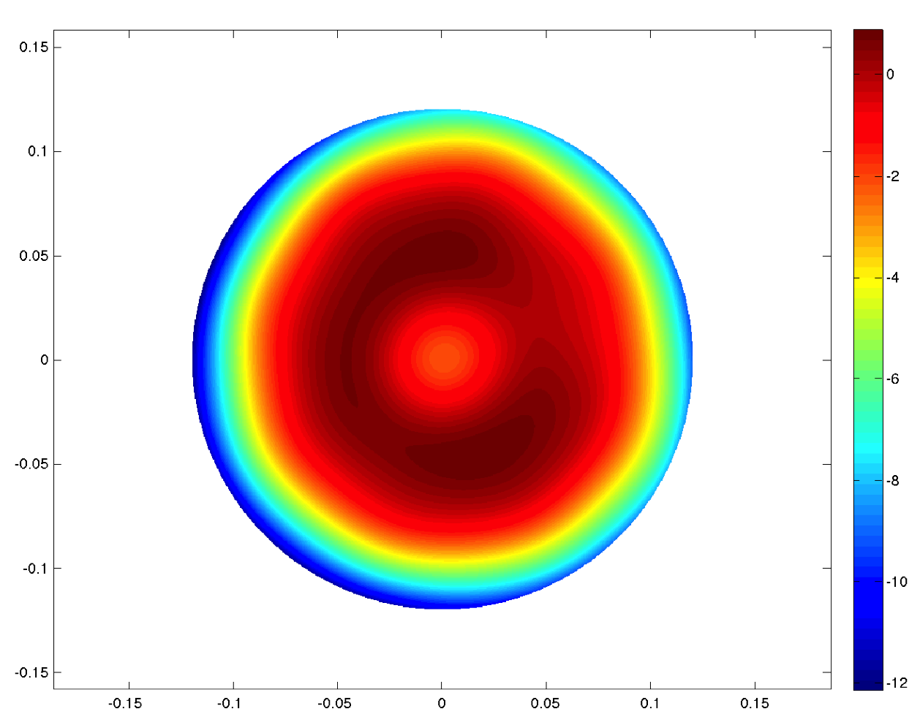
LMA coating and arm modes
ETM09 map
Arm loss = 80ppm
CD = 280
PRG = 40
Zernike(n+m≤17)

Slide 12
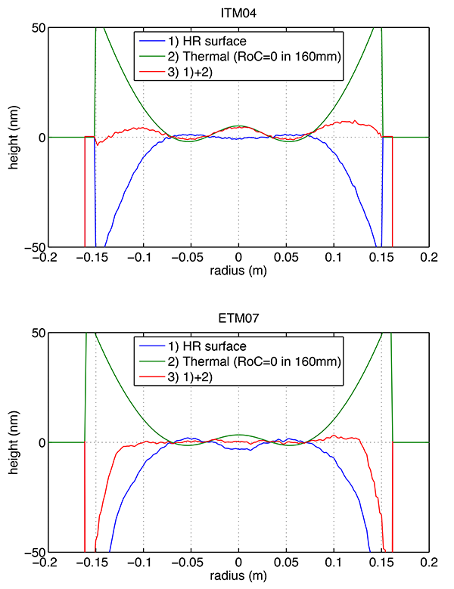
Effective RoC and modes

Slide 13
HOM peak and effective RoC

Slide 14
Arm scan : alog 14022
To do : calibrate the VCO linearity and refine (and add errors to) the data analysis. VCO sweep was not completely nice and linear.

Slide 15
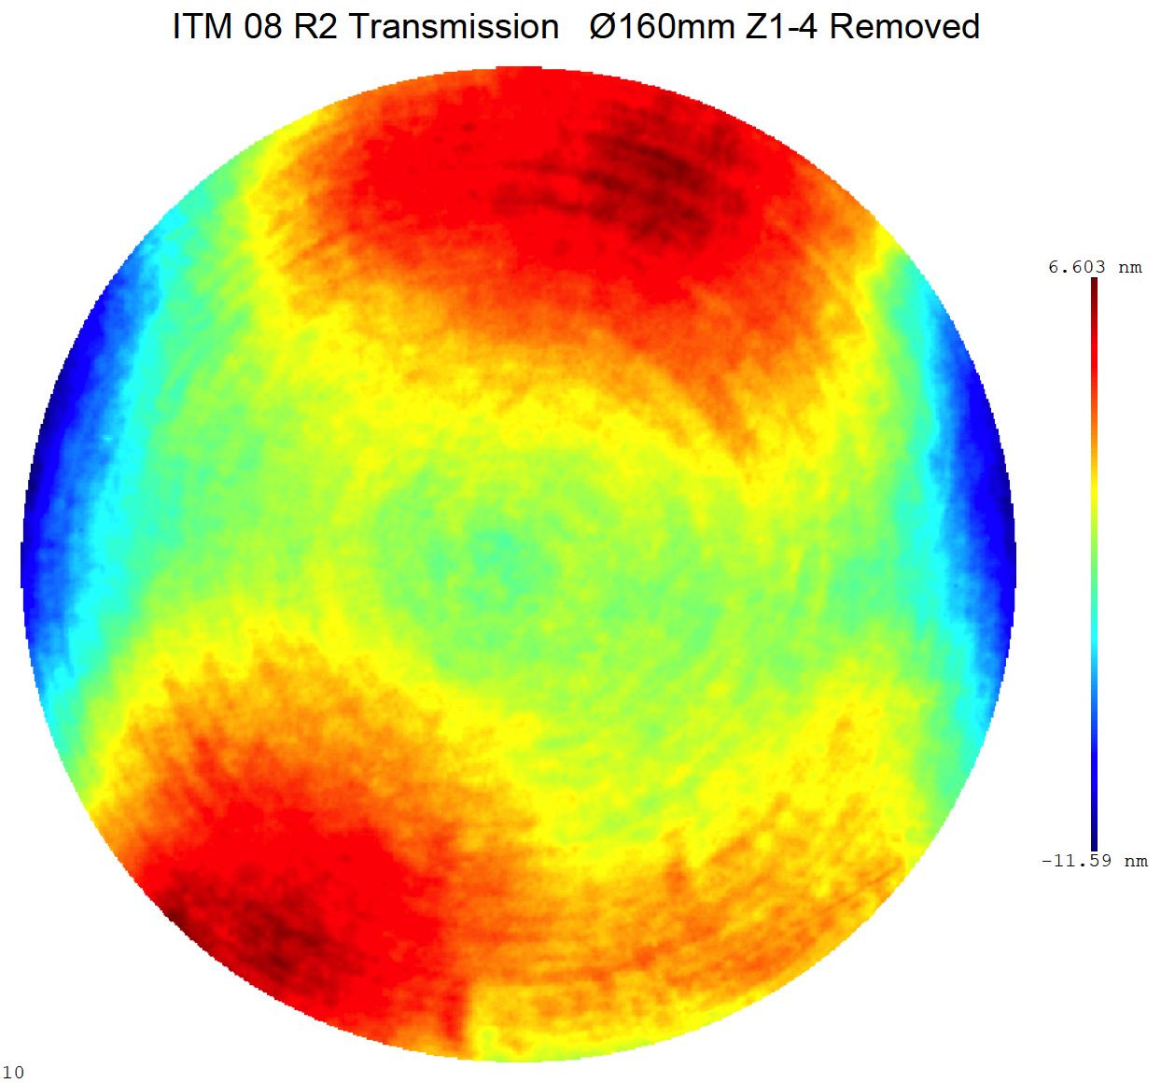
Contrast Defect
412ppm : alog13916
6.6nm
CR only CD, no TCS
 | No BS aperture | BS02 | BS05
no lens no abr | 44 | 200 | 82
lens abr | 165 | 280 | 300
lens no abr | 120 | 260 | 230
no lens abr | 60 | 200 | 100
-11.6nm
Beam center mismatch ⇒ (a / 2w)² = 100ppm for a=1mm

Slide 16
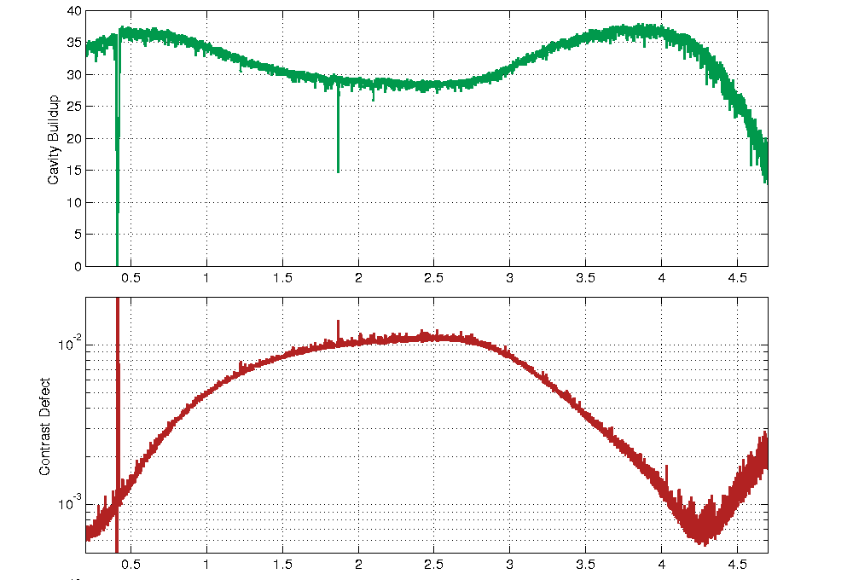
TCS corrections for LLO PRMI
RH optimal lens = n(SiO2) x 82km = 1/0.84 x10⁻⁵
CP optimal lens = 82km = 1/1.22 x10⁻⁵
log11140 CD~400ppm, PRG~45
log#9733 CD~600ppm, PRG~35

Slide 17
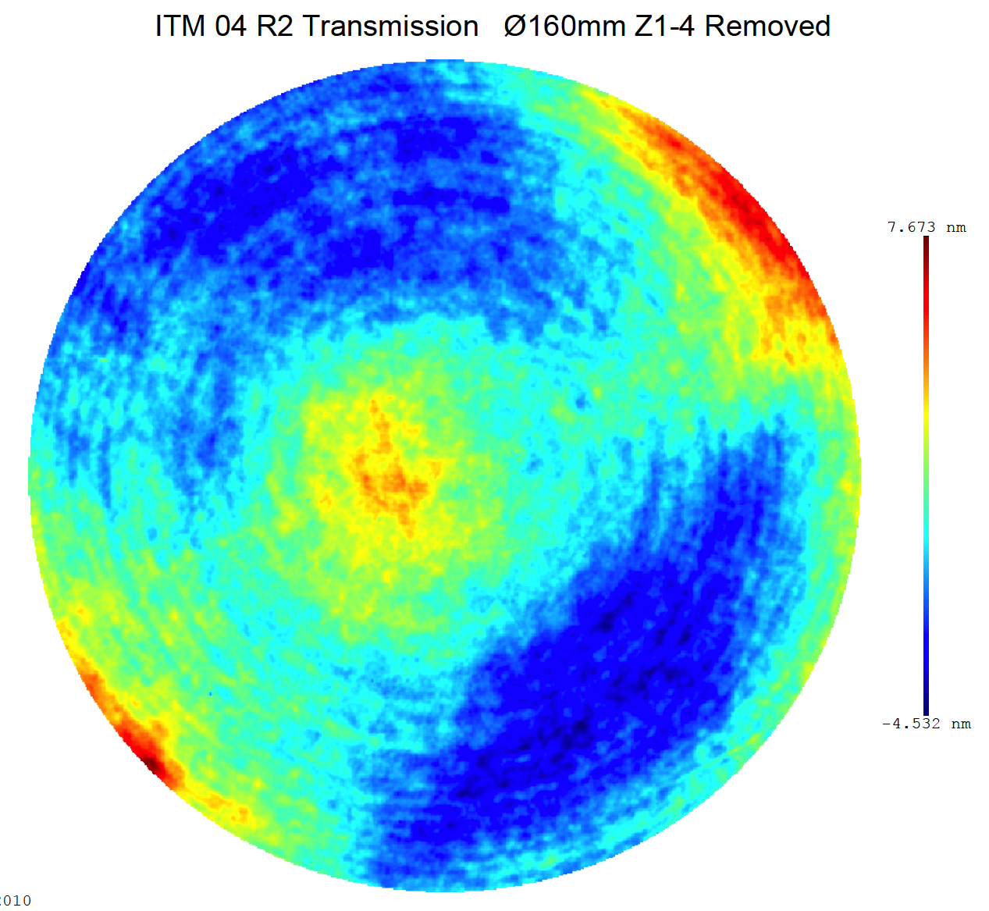
(In)Sensitivity on
ITM SPTWE + CP lens
ITM08 / ITMY
transmission map in 160mm w/o power
6.6nm
-11.6nm
ITM04 / ITMX
7.7nm
-4.5nm

Slide 18
Cavity mode
Recycling cavity mode is defined by RM HR reflection and ITM reflection, Ein to Eout, not Ein to Eref, just the same as length case
Optimal coupling is mode(Eref) = mode(Eleak), which makes mode(CR in RC) = mode(SB in RC)
When thermal lens changes, mode(CR in RC) does not change in the first order, but the mode(SB in RC) changes in the first order
But, CR suffers in the second order

