Slide 1

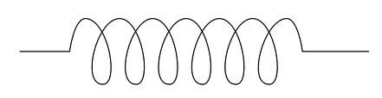


Transportation of Ultra-Stable Light via Optical Fiber
Emily Conant
Bard College, California Institute of Technology
Mentors: Evan Hall, Rana Adhikari, Tara Chalermsongsak

Slide 2
Outline
Background/Motivation
Thermal Noise
Fluctuation Dissipation Theorem
Pound-Drever-Hall Locking
Coating Thermal Noise Experiment
Work Completed
Conclusions/Future Work

Slide 3
Background/Motivation
LIGO is a signal and power recycling Michelson interferometer with Fabry-Pérot arms
Since the strain of a gravitational wave is weak, high precision is needed for detection
Some limiting sources of noise are: Thermal noise, seismic noise and shot noise

Slide 4
Thermal Noise
Brownian Noise: Mechanical displacement from thermal fluctuations in dielectric coatings
Thermo-optic Noise: Statistical fluctuations of the temperature of a system which are caused by random heat fluxes
Thermo-elastic Noise: Changes in the linear expansion coefficient cause surface displacement
Thermo-refractive Noise: Changes in refractive index from temperature fluctuations
R.Nawrodt,“Challengesinthermalnoisefor3rdgenerationofgravitationalwavedetectors,” Gen. Relativ. Gravit., 2011.
Notes:
http://download.springer.com/static/pdf/528/art%253A10.1007%252Fs10714-010-1066-5.pdf?auth66=1407688332_42e9c74735c7ea9eb0abfde57efccb45&ext=.pdf

Slide 5
Fluctuation Dissipation
Theorem
Callen and Welton’s FDT relies on the assumption that the response of a system in thermodynamic equilibrium to small forces being applied is analogous to the response of a system to random fluctuations
Mechanical admittance
Normal-Mode Decomposition
Direct Calculation
Compute and sum up
for each normal-mode
Yu. Levin, “Internal thermal noise in the LIGO test masses: A direct approach,” Phys. Rev. D 57, 659, 1998.
Notes:
-A consequence of the fluctuation–dissipation theorem is that any system in which energy is dissipated must exhibit fluctuations of its measurable (energy dependent) parameters
-Normal-Mode Decomposition: For a small laser beam diameter the sum over nor- mal modes converges very slowly, so one has to sum over many modes, which may be computationally expensive. By contrast, using the new method de- scribed in this paper, one can write down a simple analytic expression for the low-frequency noise in the case of a narrow laser beam.
-Direct approach: 1) Apply an oscillatory pressure to the face of the test mass, 2)work out the average power dissipated from this applied oscillatory pressure, 3) Directly calculate the PSD with the information found

Slide 6
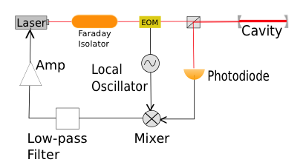
Pound-Drever-Hall
Locking
Frequency locking a laser to a Fabry-Perot cavity that is known to be stable
Adjust frequency of the laser to match the resonant mode of the cavity
EricD.Black,“AnIntroductiontoPound-Drever-HallLaserFrequencyStabilization,”Amer- ican Journal of Physics 69-79, 2001.

Slide 7
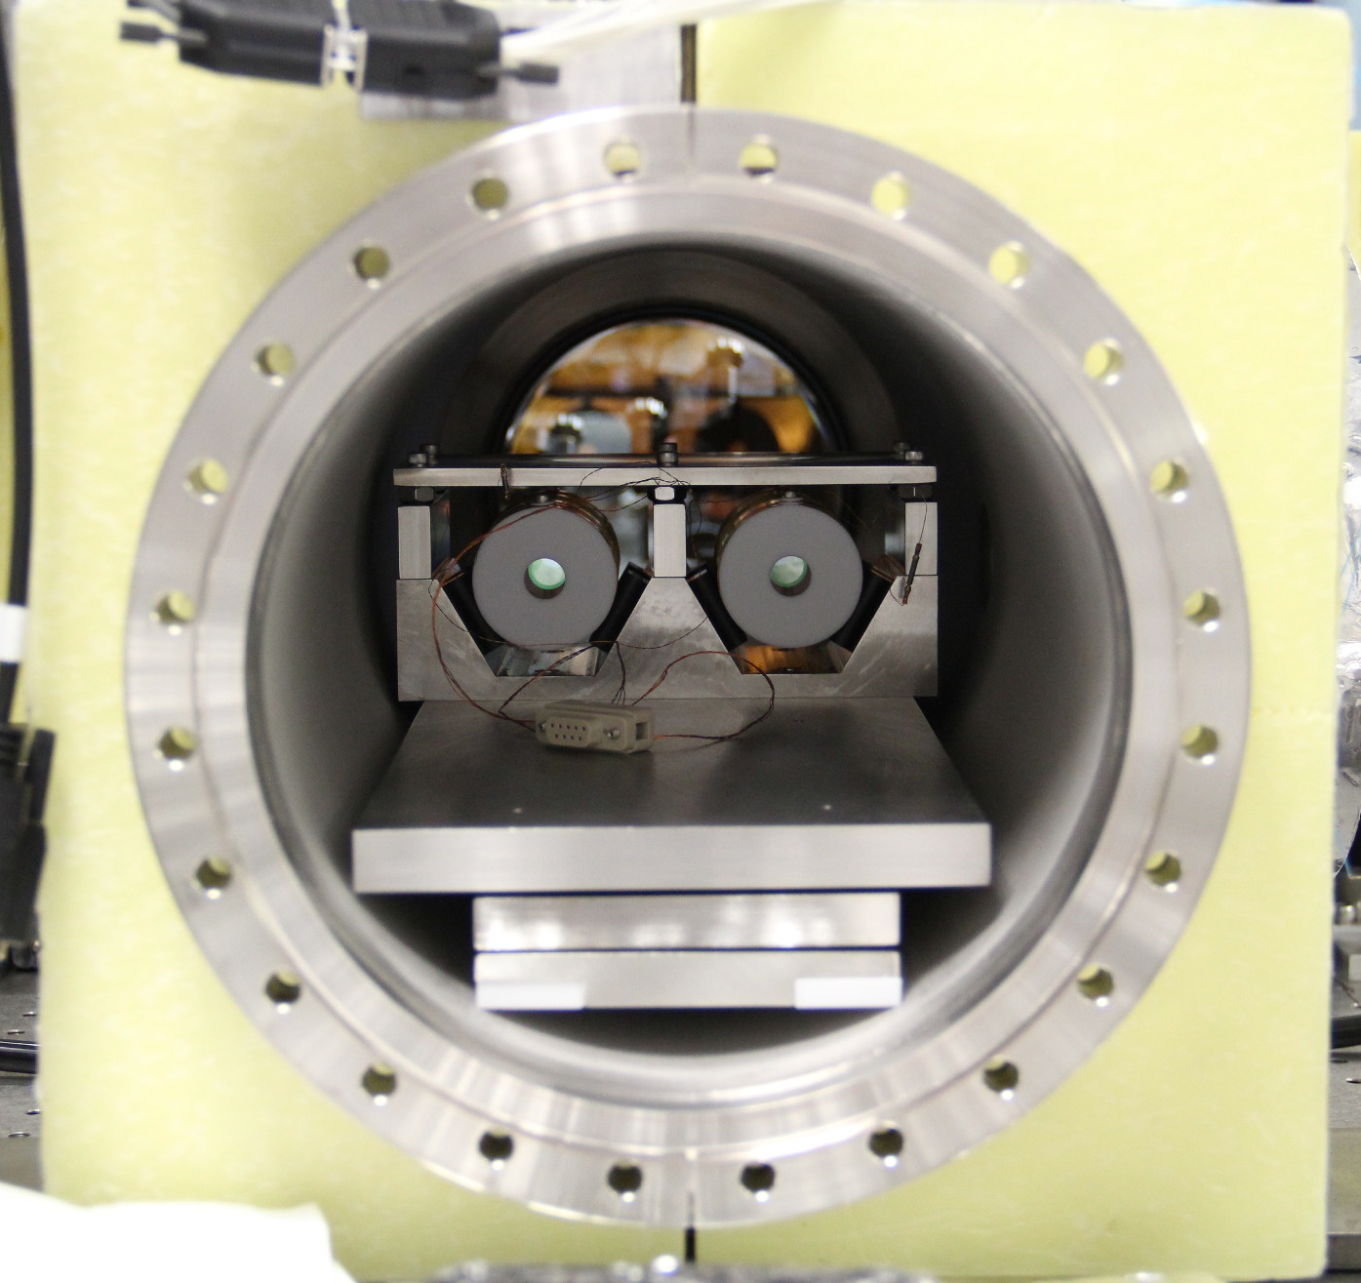
Coating Thermal Noise
Experiment
Two Fabry-Perot cavities with silica tantala mirror coatings are used
Each cavity has its own stabilized laser, which is locked to the cavities with the PDH technique
Cavities are kept in a temperature stabilized vacuum chamber
Pick off light to use as frequency reference

Slide 8
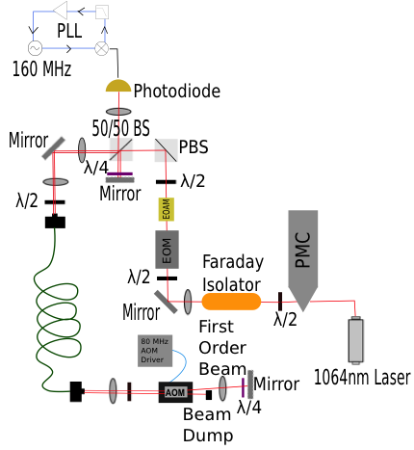
Initial Setup
Mode-Matched into the fiber
Double passed through AOM
Look at beat frequency
Measure PLL control signal

Slide 10
Noise Cancellation
Scheme 2
Scheme 1
Uses 2 AOMs
Has been demonstrated before
Inject negative first order beam
into fiber input, second AOM is
modulated such that the first order
beam emerges and is double passed
back through the fiber
Uses 1 AOM
Lock Optical Beat to Marconi to stabilize light
Long-Sheng Ma, Peter Jungner, Jun Ye, and John L. Hall, “Delivering the Same Optical Frequency at Two Places: Accurate Cancellation of Phase Noise Introduced by an Optical Fiber or Other Time-Varying Path,” Optics Letters, Vol. 19, No. 21, 1994.
Notes:
In the second scheme, the phase locked loop is used such that the correction frequency cancels the fiber phase noise

Slide 11
New Setup

Slide 12
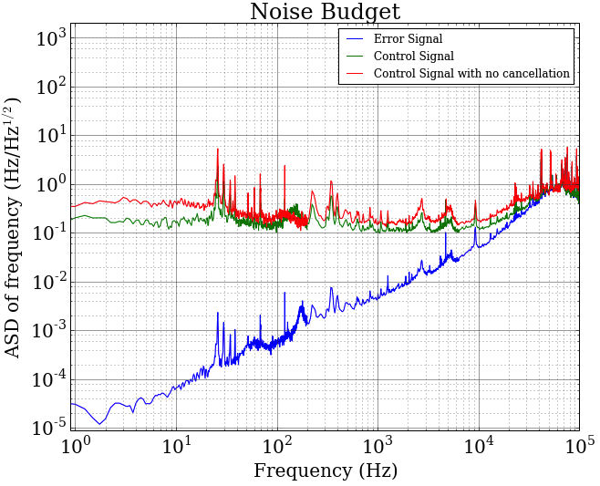
Results

Slide 13
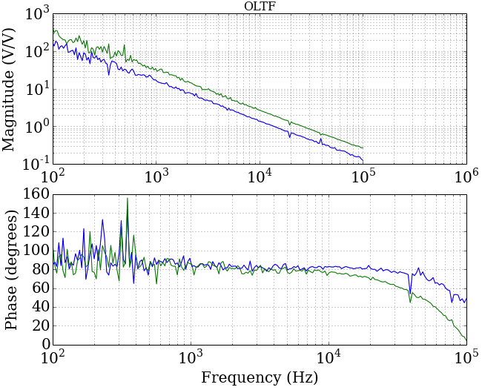
Results

Slide 14
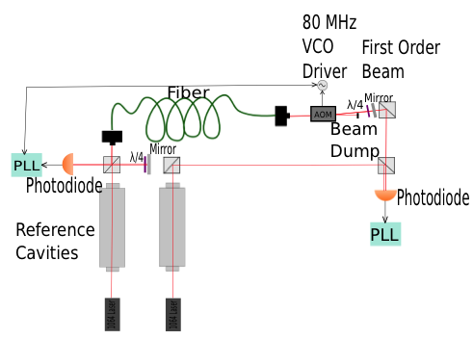
Conclusions/Future Work

Slide 15
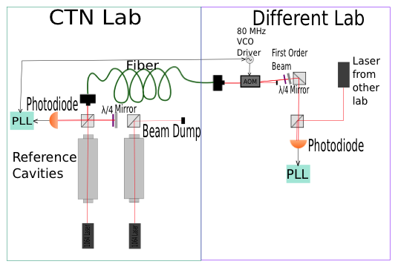
Conclusions/Future Work

Slide 16
Acknowledgments
My mentors: Evan Hall, Rana Adhikari, Tara Chalermsongsak
Alan Weinstein
LIGO labs
National Science Foundation (NSF)
Fellow SURF students
Thank you!!

