Slide 1
Cryogenic Test Mass Work at Stanford
Brett Shapiro
Stanford cryo people:
Brian Lantz, Tim MacDonald, Dakota Madden-Fong (summer ’13 and ‘14)

Slide 2
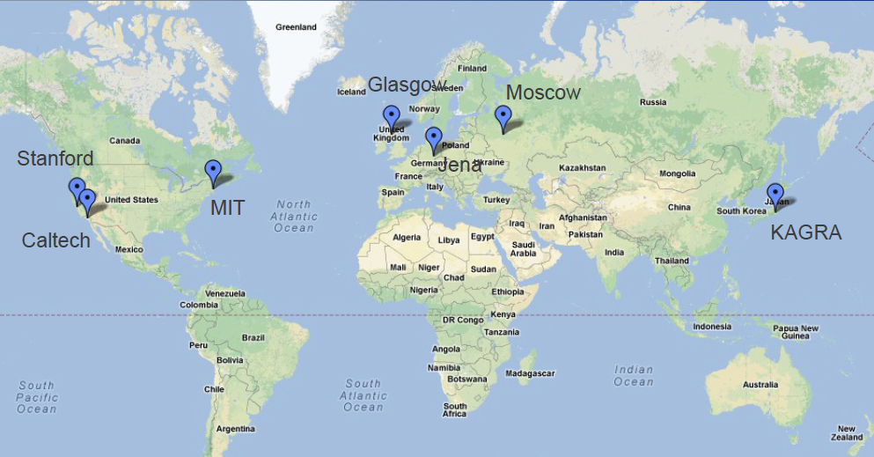
LIGO III cryo work distribution
Caltech - cryogenic reference cavities; direct thermal noise measurements
Jena/Glasgow/Moscow - mechanical loss
MIT – high emissivity coatings
KAGRA – 20 K sapphire suspensions
INPE Brazil – Cryogenic multi-nested pendulum
Stanford – optical coatings (Riccardo Bassiri’s talk); cryogenic technology
Adapted from Nicolas Smith-Lefebvre

Slide 3
LIGO III Cryosystem
chiller
Active Seismic Isolation Table
…
…
clamp
295 K
ISI stage 2
Vacuum flange
Flexible LN₂ tubing
or Cu cables
Not shown:
Test mass cold link for initial cool down
124 K
≤ 10 m
≈ 3 W absorption at 124 K
Heat shield at
80 K maintains 124 K through radiative coupling
1560 nm MW laser
≈140 kg Si test mass
See also G1200246-v1

Slide 4
Integrated Experiment Beginning
Maraging steel blade spring
Vacuum wall
Goal:
Show we can make a low vibration cryogenic environment
Cold link
motor
Cold link -
prototyped
and tested
Test mass –
6” prototype in lab
GN₂ feedthrough
Heat shield - preliminary design complete T1400553
LN₂ pipe around shield
LN₂ return
Stainless steel legs
LN₂ supply
LN₂ feedthrough
ISI Stage 2
ISI Stage 1
Chillers -
cryomech

Slide 5
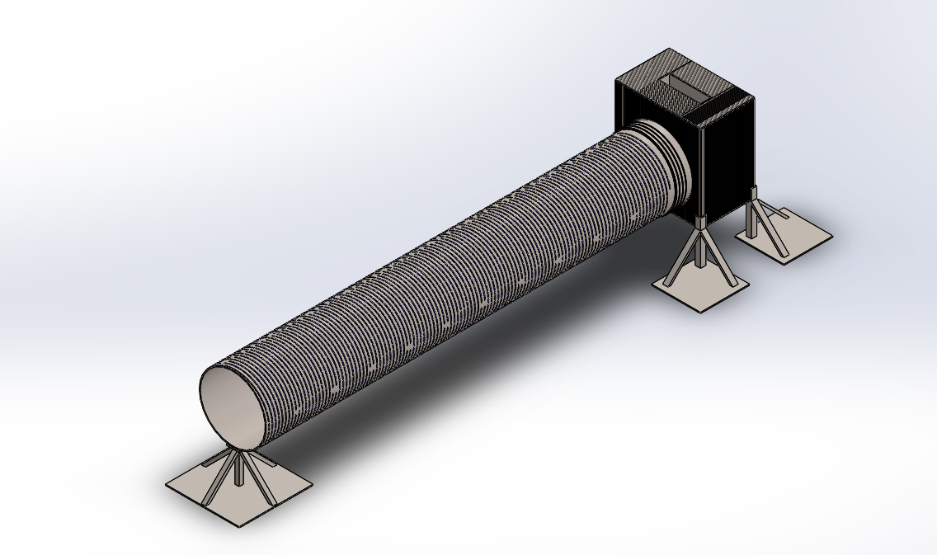
Stanford Heat Shield
6” test mass location
2 m
LN₂ pipes at 75 mm spacing
(shown w/ greater density here)
1 ft dia
Material: Stainless steel for weldability
Dakota Madden-Fong - T1400553

Slide 6
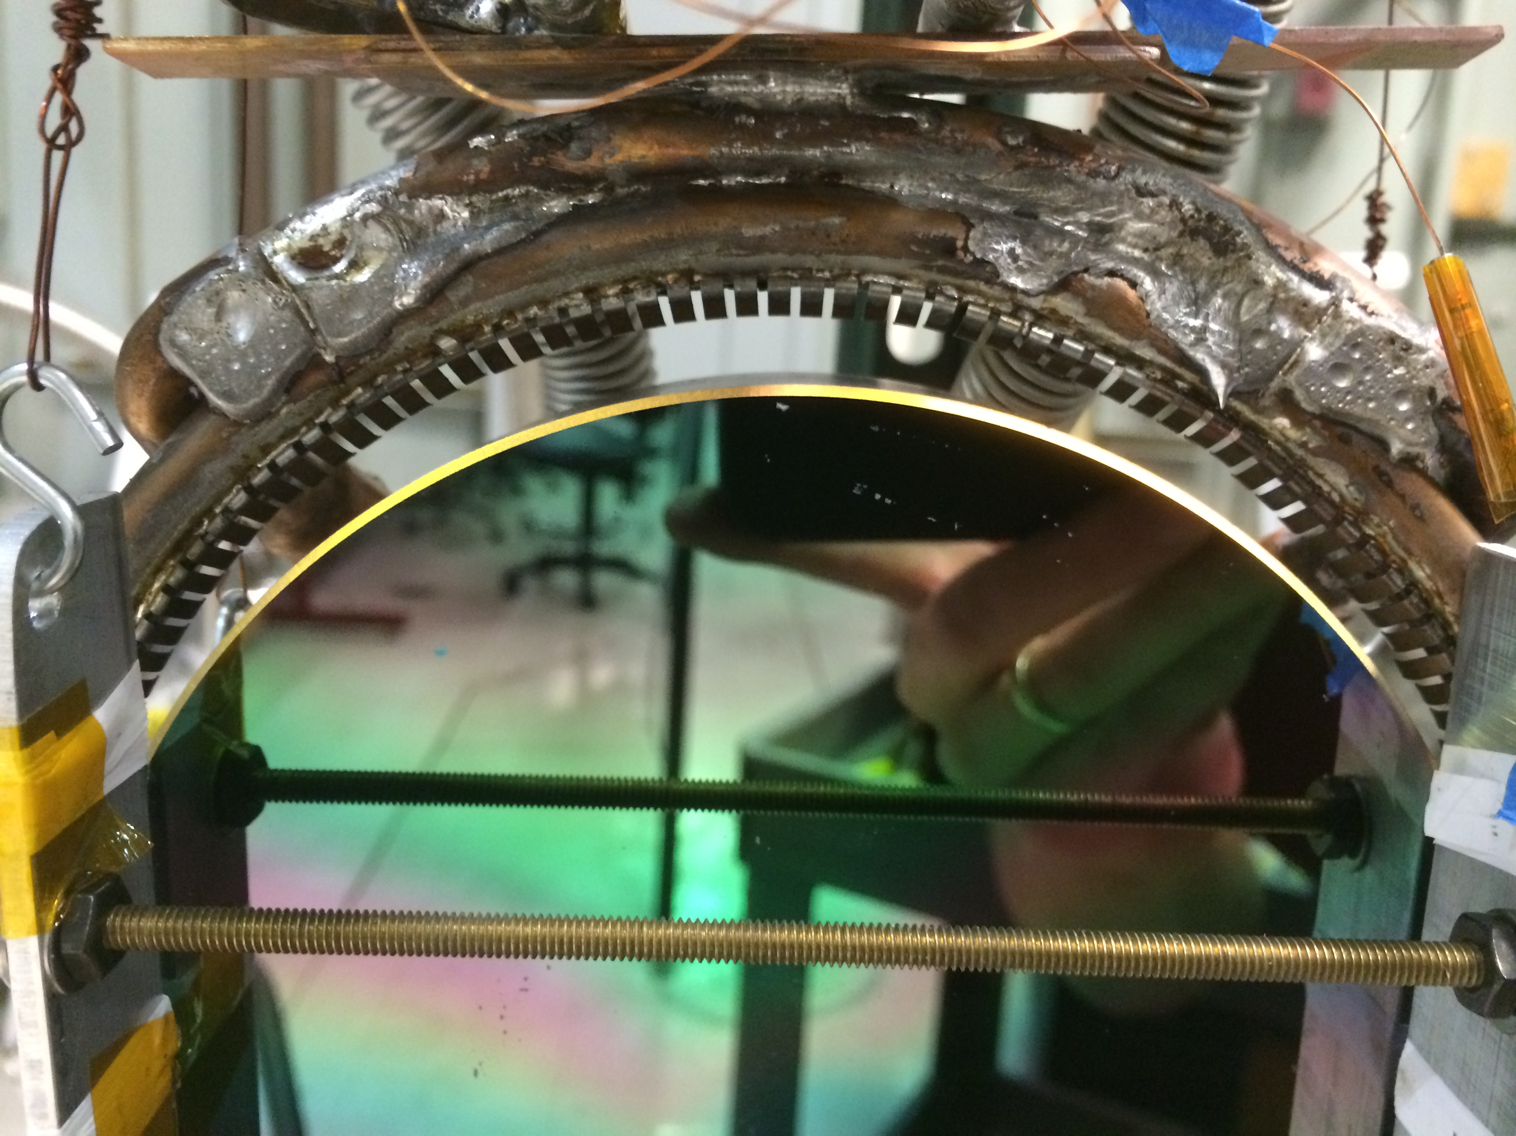
Initial Cool Down Cold Link – 2 Designs
Conductive cooling, low pressure N₂ gas
Stanford Prototype
liquid N₂ pipe flexures or Cu cables
Test mass
Operates in partial vacuum
Fine temperature control
Permits both conductive and convective cooling.
thermally conductive plate with variable gap

Slide 7
Pros and Cons of LN₂ pipe vs. Cu cable
Cu cable
Pros:
No fluid to make noise
No LN₂ pumping mechanism
No risk of N₂ leaks
Cons:
Low heat transfer
Cryo refrigerator must be placed near feedthrough
High bulk: stiffness, weight, etc
Q = K(A/L)ΔT
Big L means big A
Can reduce A by making cold end less than LN₂ (77 K). E.g. Cryomech’s PT407 can pull 25W at 55 K.
- Minimize stiffness by using lots of this wires, but wire dia must be > electron m.f.p.
Thermal conductivity decreases when wire dia becomes smaller than electron m.f.p.
Hysteresis
- Lots of small wires sliding past each other
High difficulty in minimizing seismic shorting
- Minimize using:
Lots of thin wires
Intermediate masses along length
LN₂ pipe
Pros:
High heat transfer
Low bulk
Moderate difficulty in minimizing seismic shorting
Length of pipe in vacuum not an issue for net heat transfer (longer pipes do require more pressure to push fluid)
Vibrating cryorefrigerator can be placed further from vacuum feedthrough.
Cons:
Complex LN₂ pumping mechanism
Requires its own seismic isolation stage.
Risk of leaking
Fluid flow could contribute noise
Minimize by:
Cooling the LN₂ so it doesn’t boil
Ensuring laminar flow

Slide 8
LN₂ pipes vs Cu cables trade-offs
 | Heat Transfer | Added weight | Seismic shorting | complexity of cryo system | Vacuum leaks
Copper cables
LN₂ pipes
?
Good
Risky
Fair
Show stopper

Slide 9
Cryogenic Cu Braids
Copper Braid Products Ltd. - http://www.copperbraid.co.uk/oxygen_free.php

Slide 10
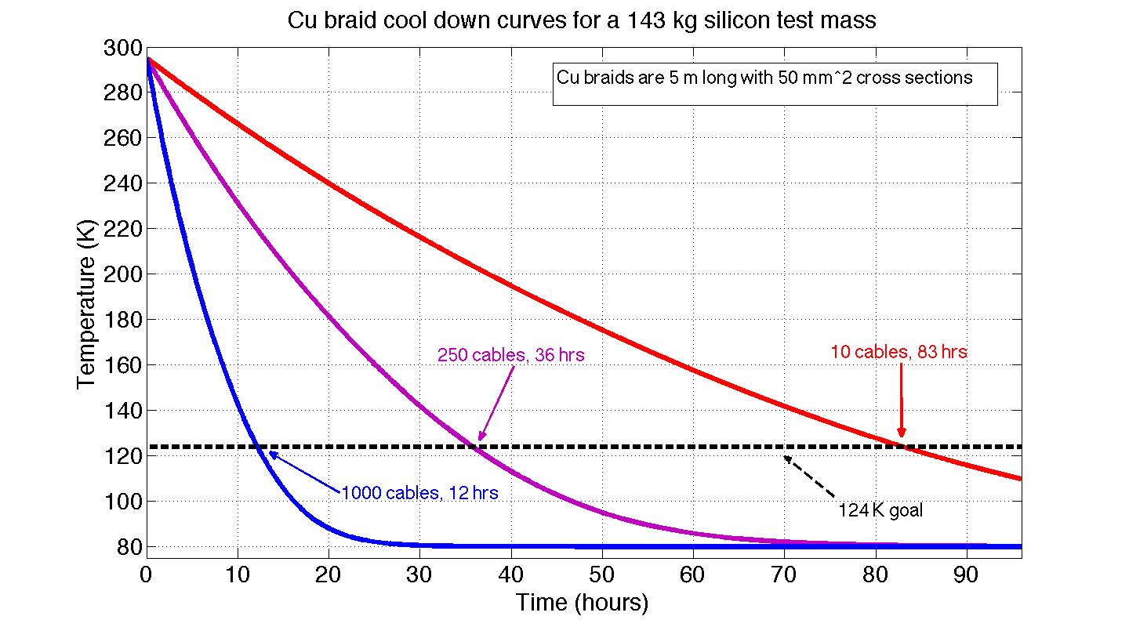
Test mass cool down
OFHC copper braids: http://www.copperbraid.co.uk/oxygen_free.php
== 1, 5” dia cable
== 1, 1” dia
cable
simulation
== 1, 10” dia cable

Slide 11
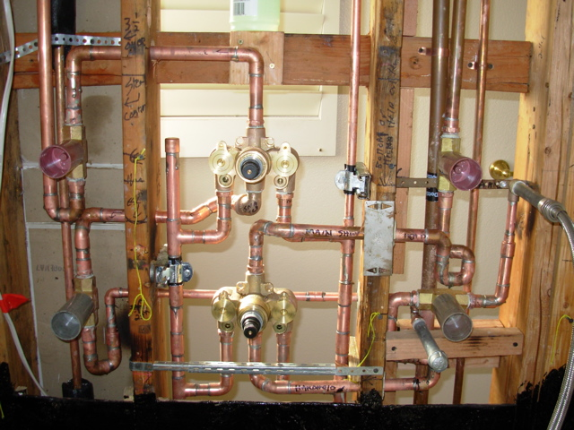
LN₂ Piping System
http://www.battlefieldplumbing.com

Slide 12
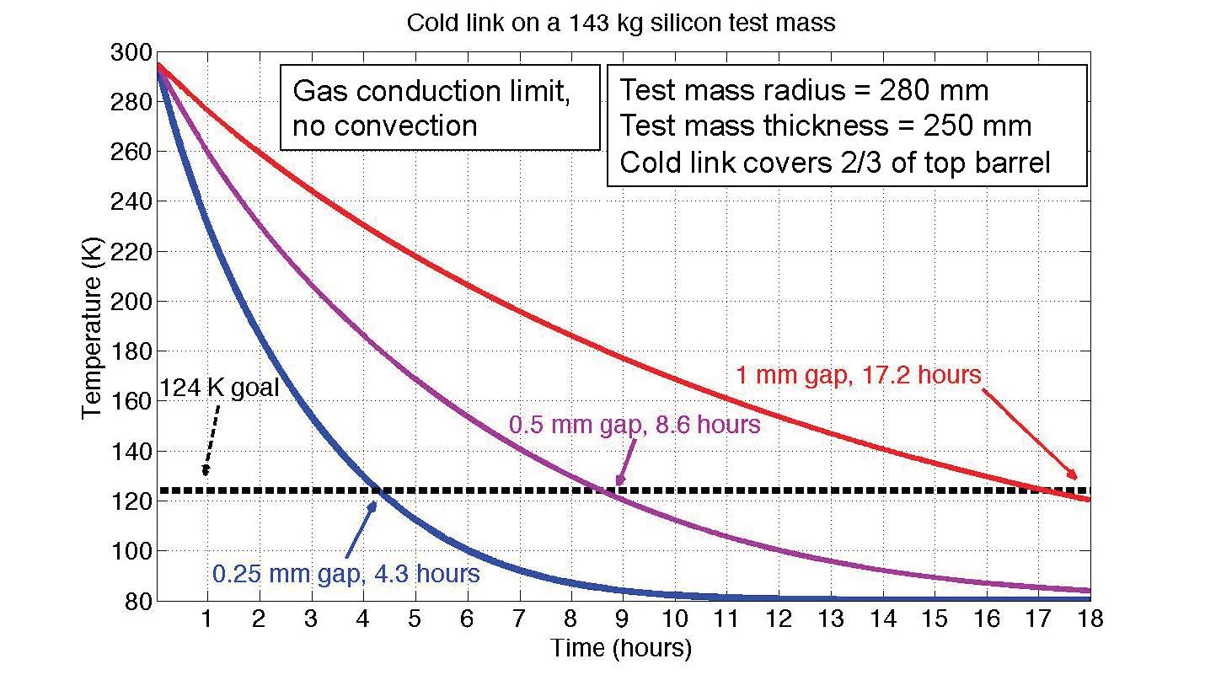
Test mass cool down
simulation

Slide 13
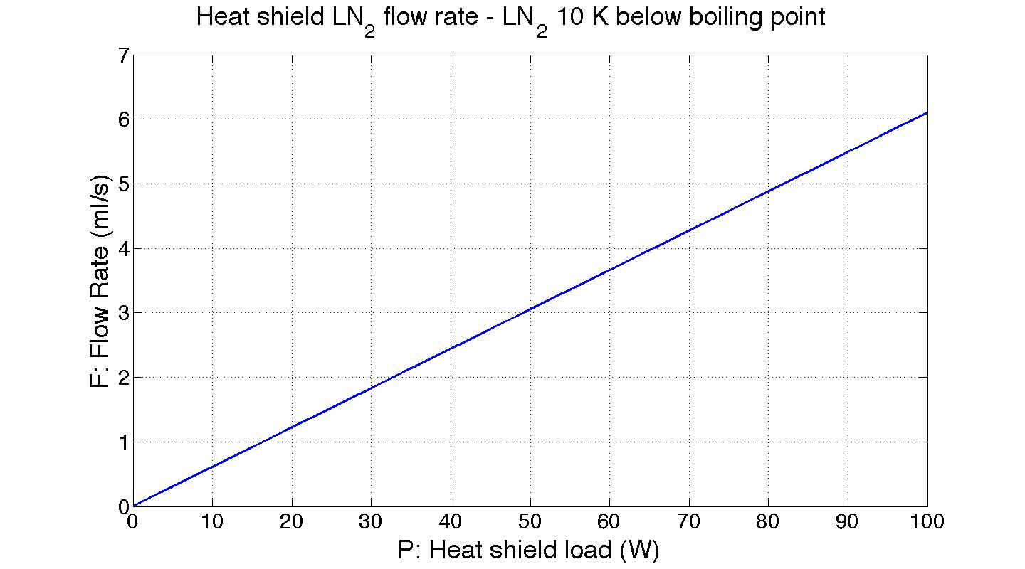
Steady state cooling with LN₂
P: Heat load
F: Flow rate
simulation

Slide 14
Steady state cooling with LN₂
P: Heat load
F: Flow rate
Test mass contribution
simulation

Slide 15
Steady state cooling with LN₂
P: Heat load
Possible scattered light contribution
F: Flow rate
Test mass contribution
simulation

Slide 16
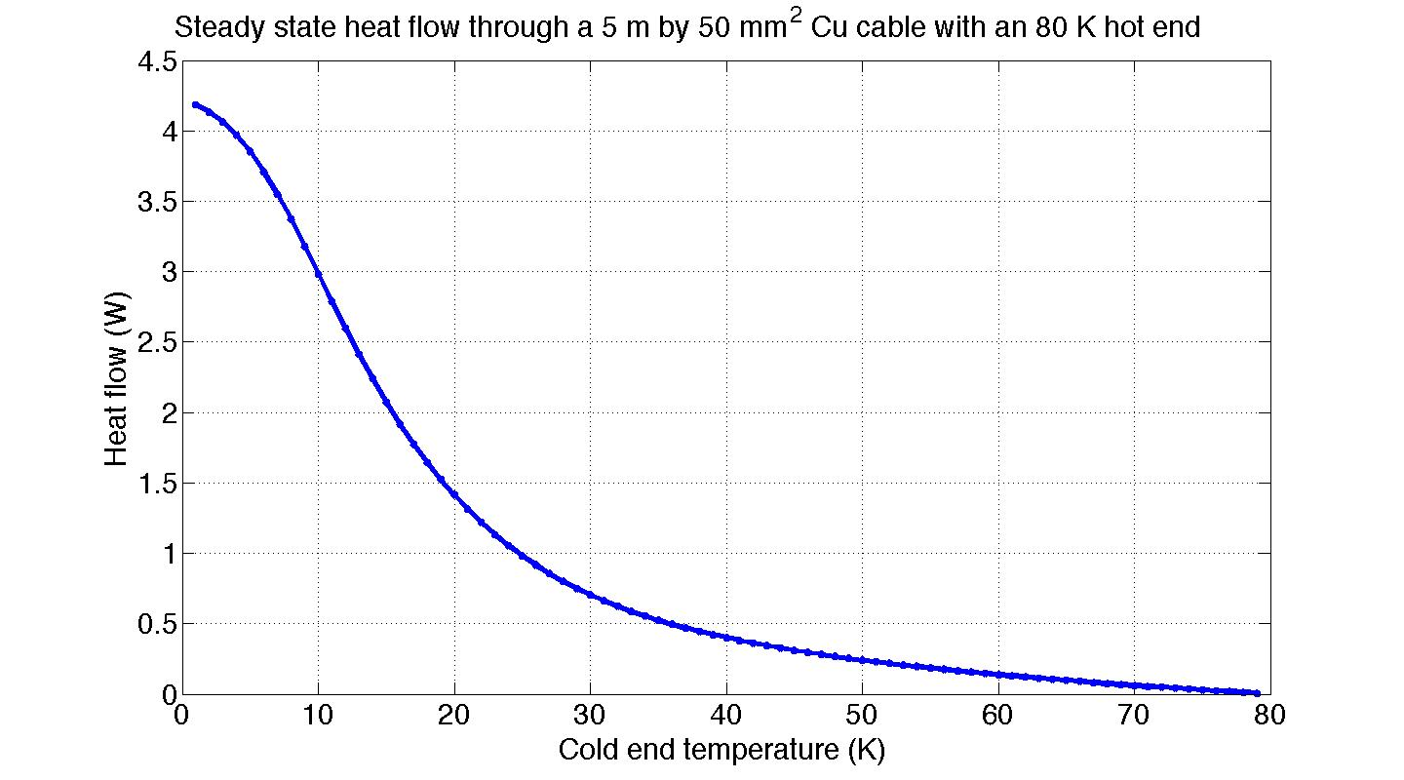
Steady state cooling with a Cu cable
Heat flow
Chiller Tcold
5 m Cu cable
50 mm²
Thot = 80 K
simulation

Slide 17
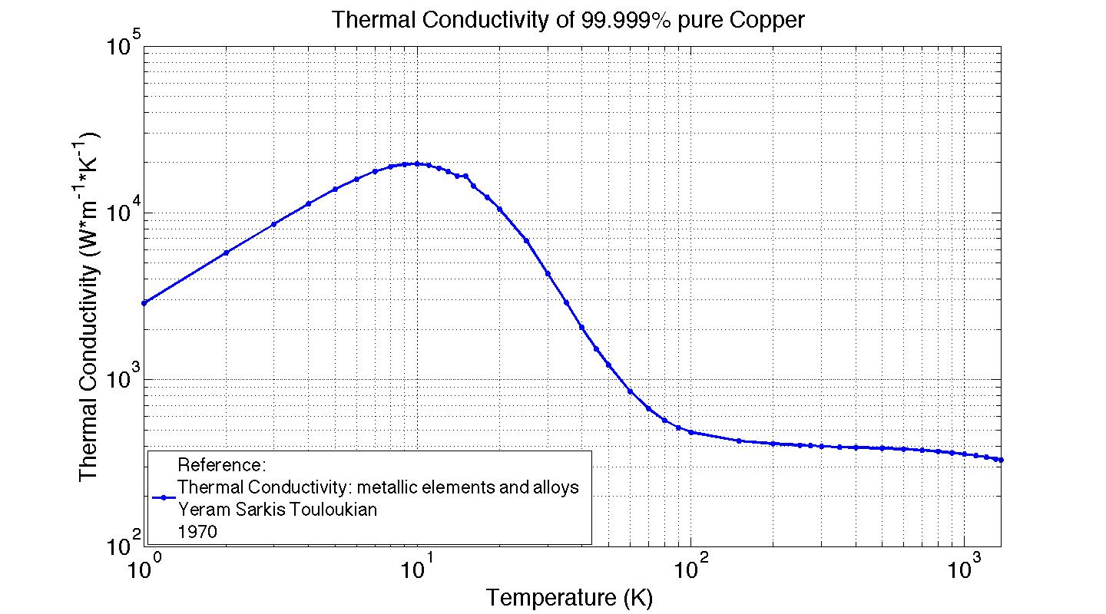
Copper thermal conductivity

Slide 18
Copper thermal conductivity
Depends on geometry:
Small dimensions bring this down.
Heat carriers scatter off boundaries.

Slide 19
Copper thermal conductivity
“In metals [the M.F.P. limit] is a relatively rare occurrence, to be considered only in the case of very small particles, very thin wires, or superconductors at extremely low temperatures.
Depends on geometry:
Small dimensions bring this down.
Heat carriers scatter off boundaries.

Slide 20
Copper thermal conductivity
Longer and skinny threads

Slide 21
Steady state heat through a Cu cable
simulation
Longer and skinner threads
More work needed to take this into account

Slide 22
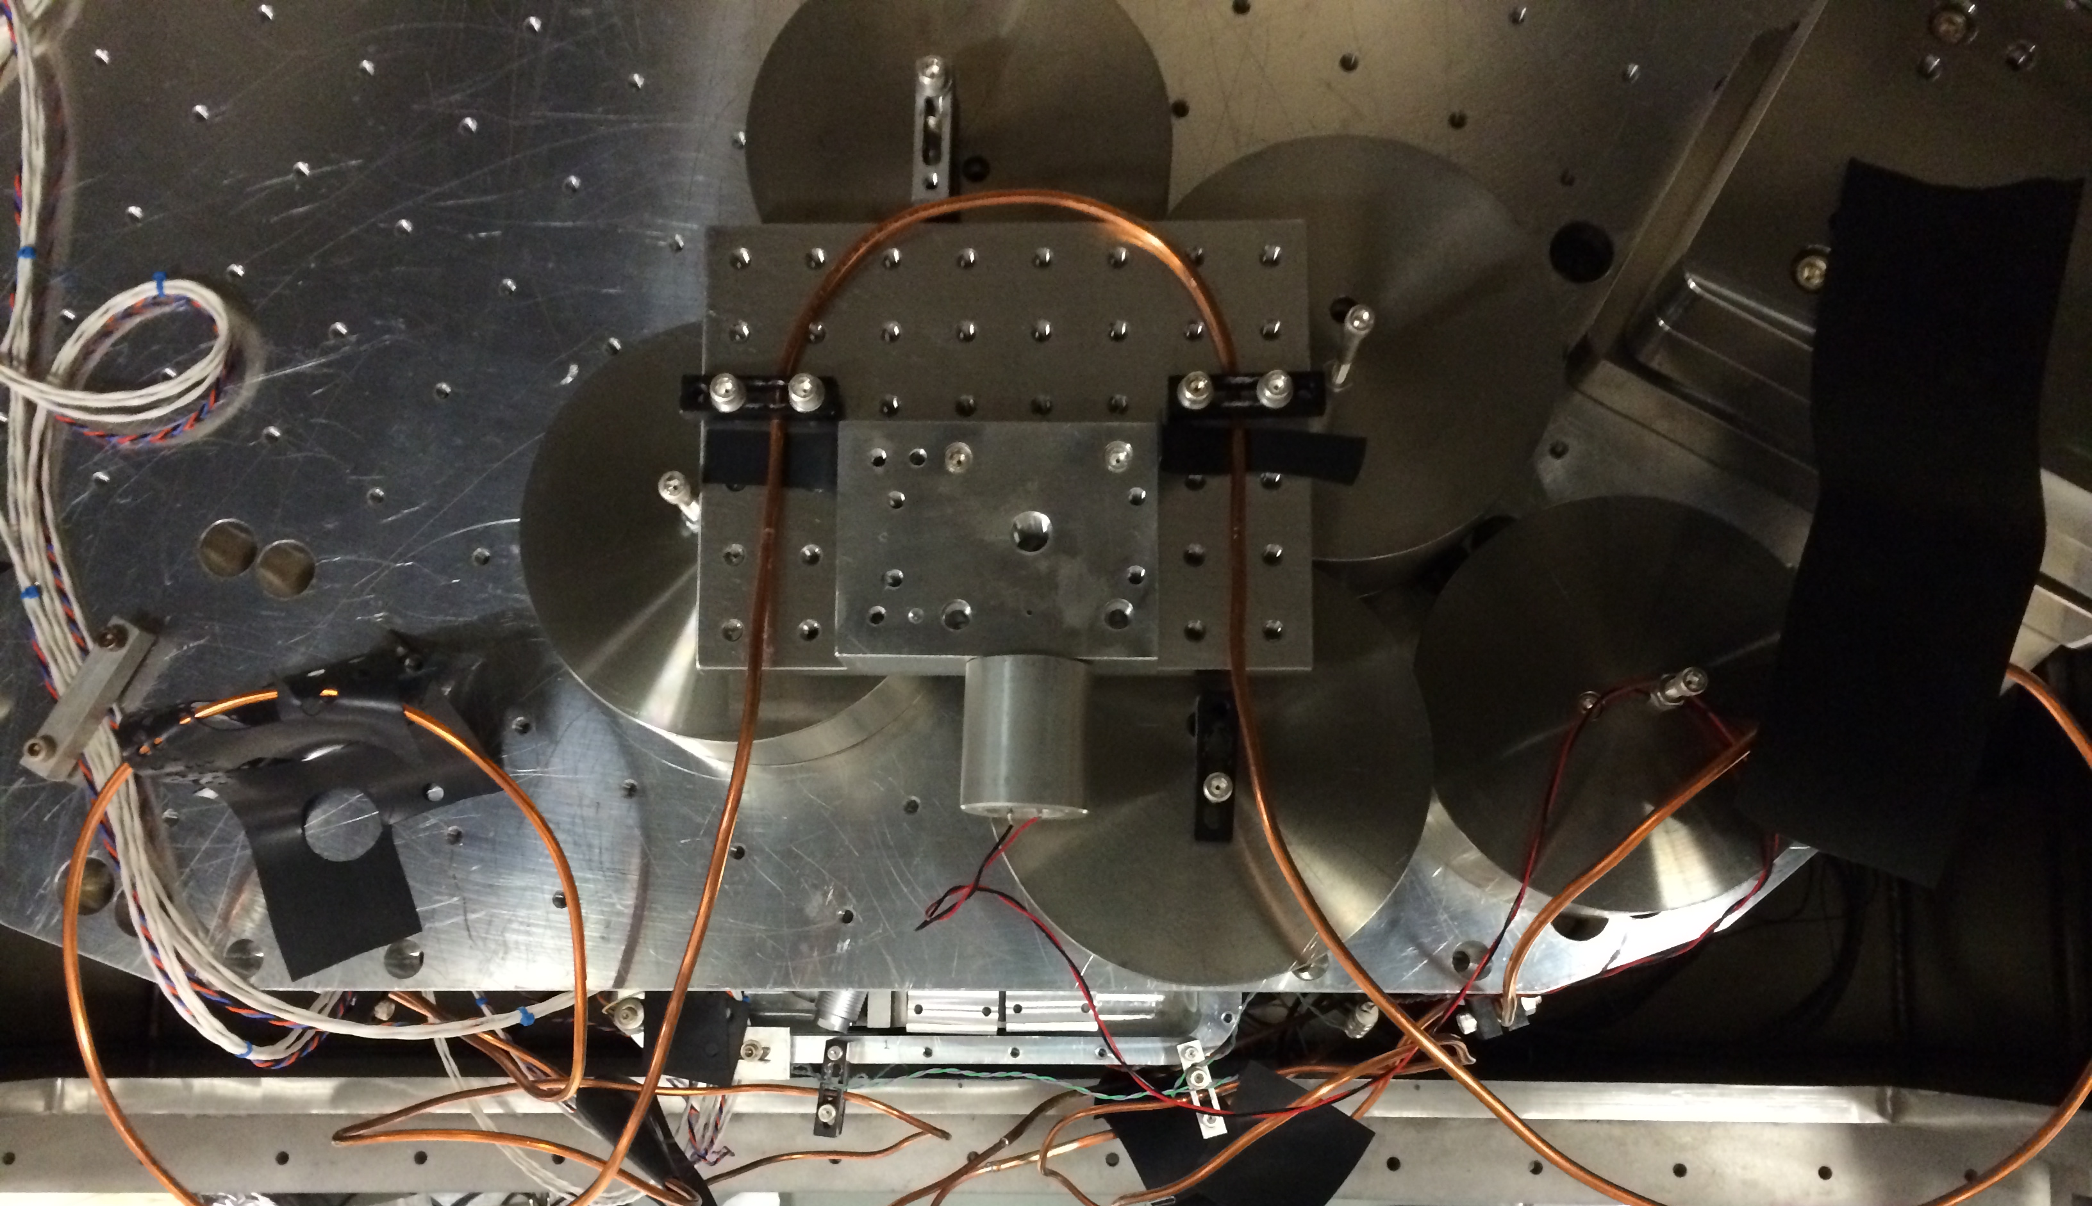
Flow-Induced Vibration Experiment
ISI Stage 2
3 kg test plate
Water pipe
Compliant pipe loop with viton damping
Earthquake stop
HS1 Geophone

Slide 23
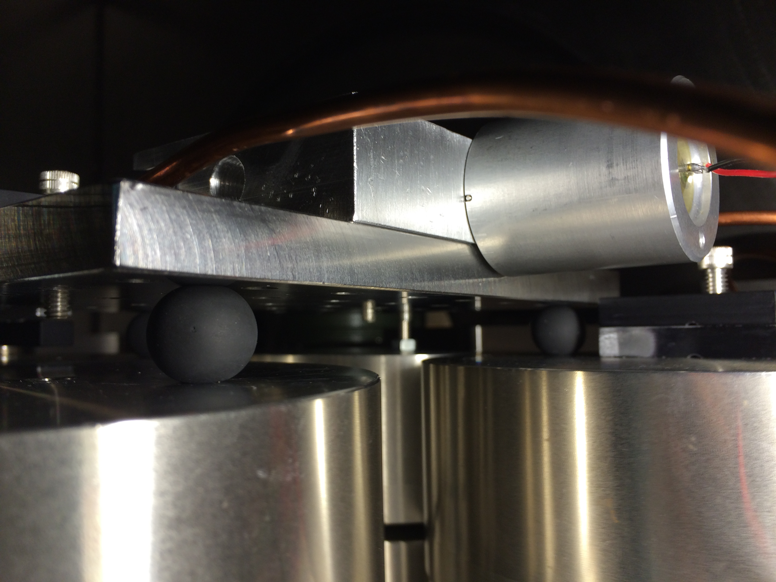
Water pipe
HS1 Geophone
3 kg test plate
Viton balls to for damping and horizontal isolation

Slide 24
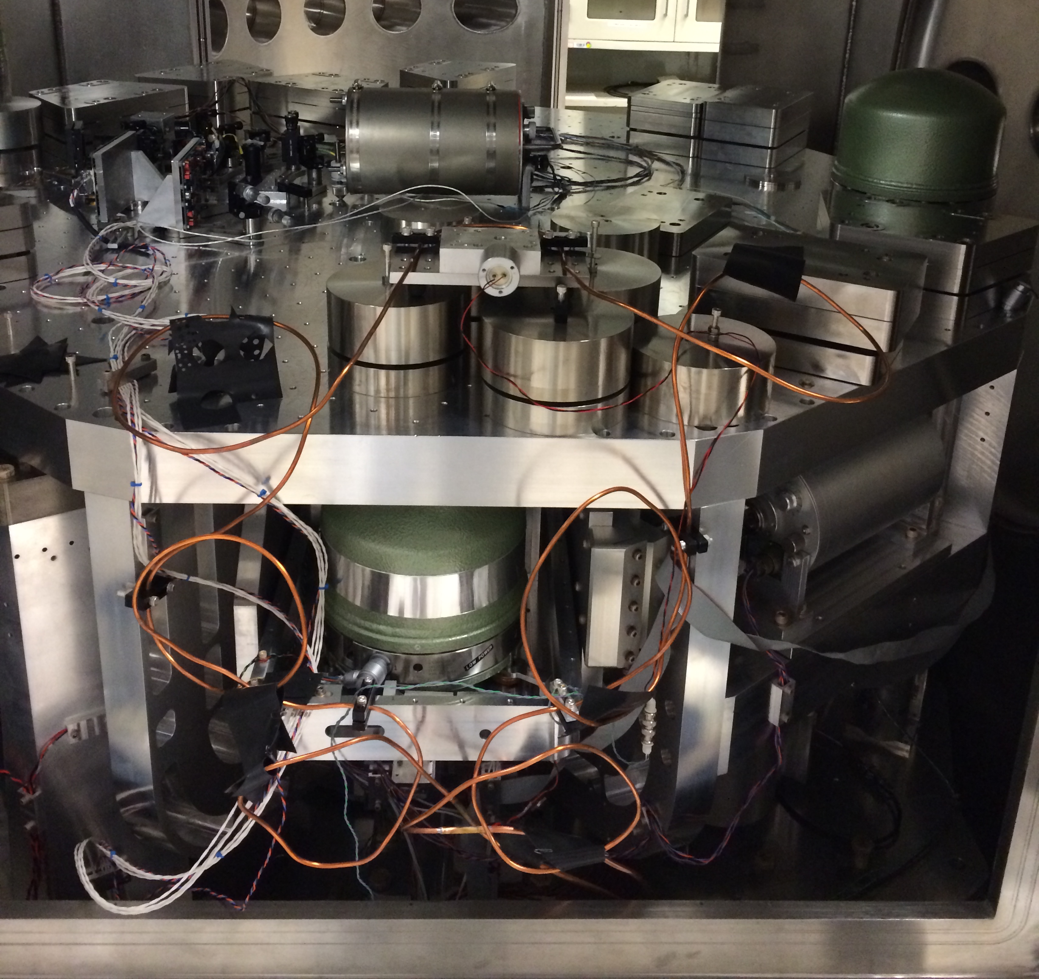
Flow-Induced Vibration Experiment

Slide 25
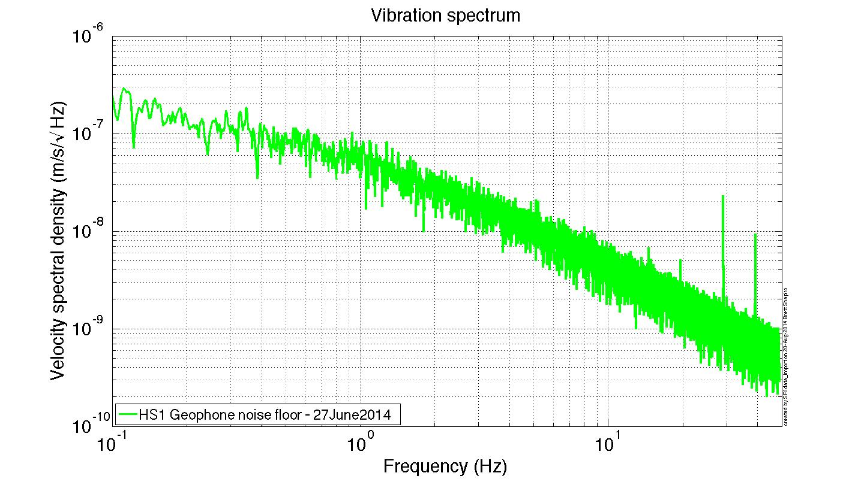
Flow-induced vibration measurement

Slide 26
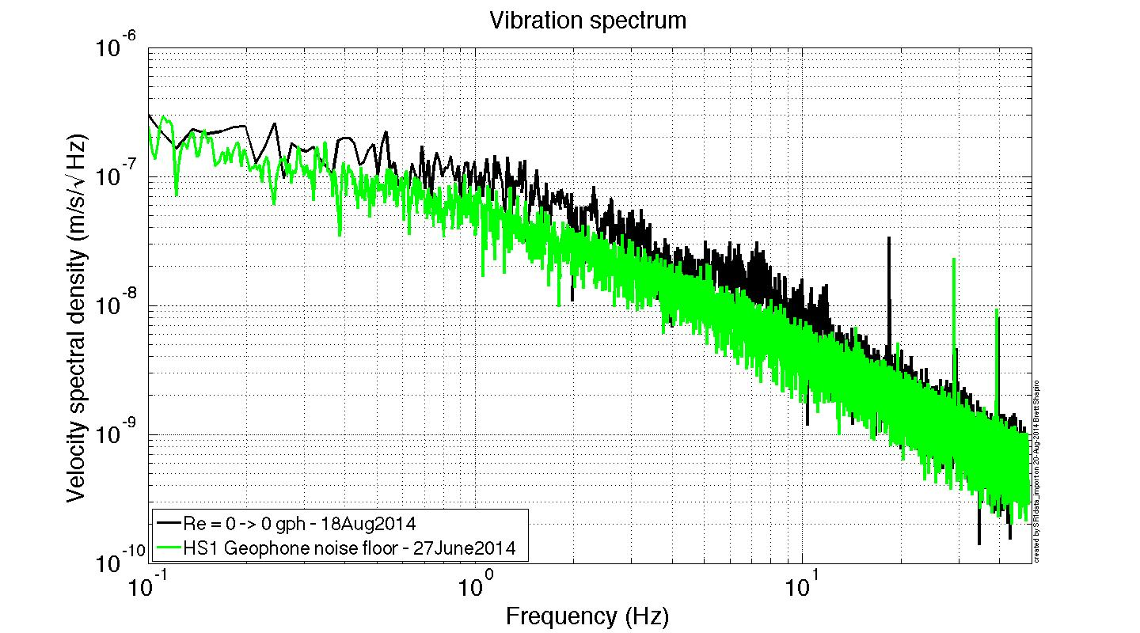
Flow-induced vibration measurement

Slide 27
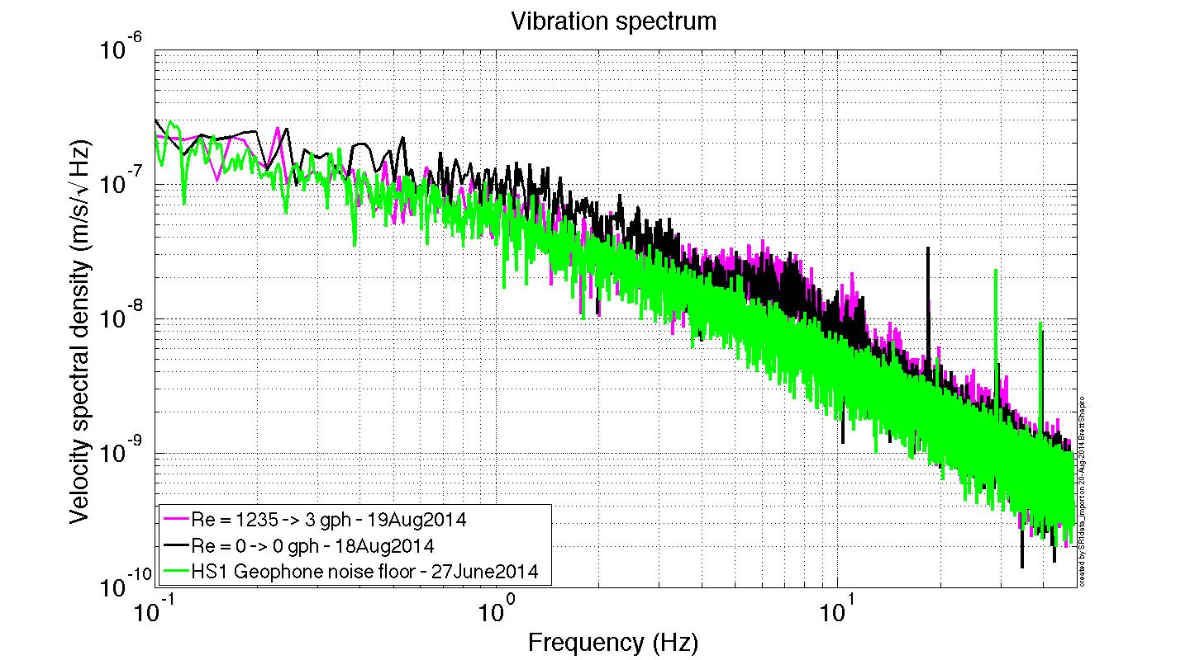
Flow-induced vibration measurement

Slide 28
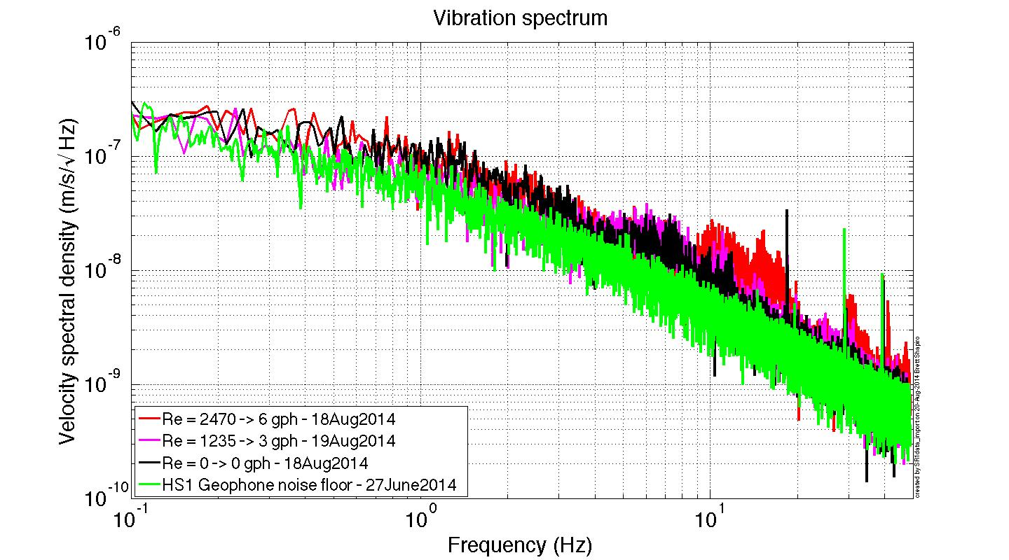
Flow-induced vibration measurement

Slide 29
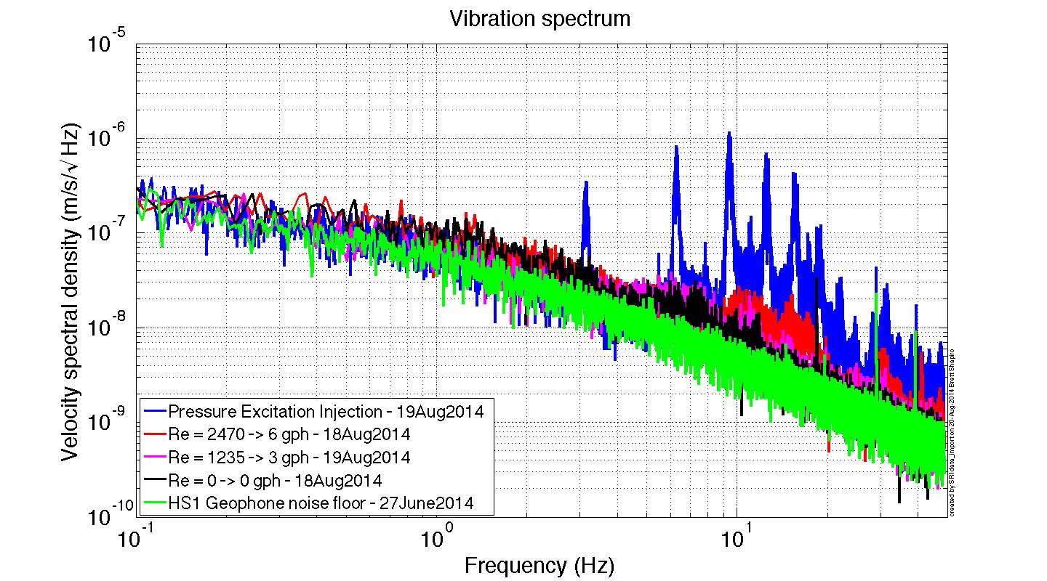
Flow-induced vibration measurement

Slide 30
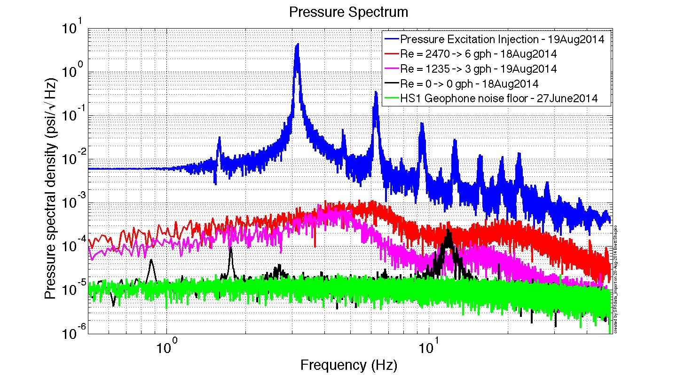
Flow-induced pressure measurement

Slide 31
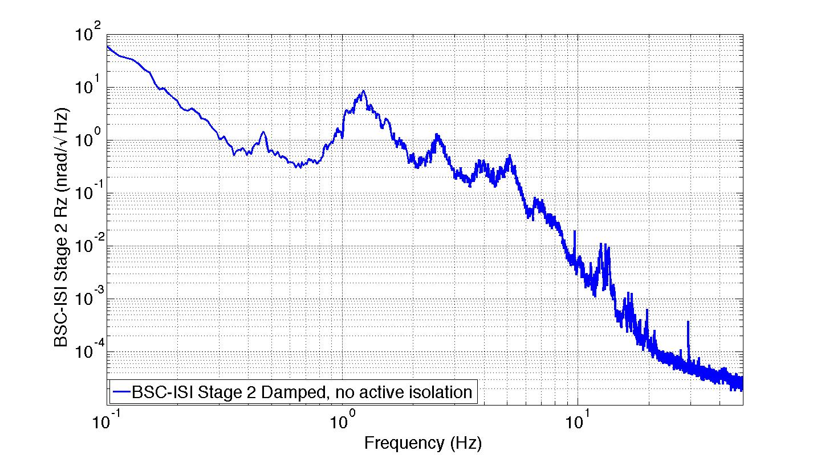
Seismic noise on BSC-ISI Stage 2 Rz

Slide 32
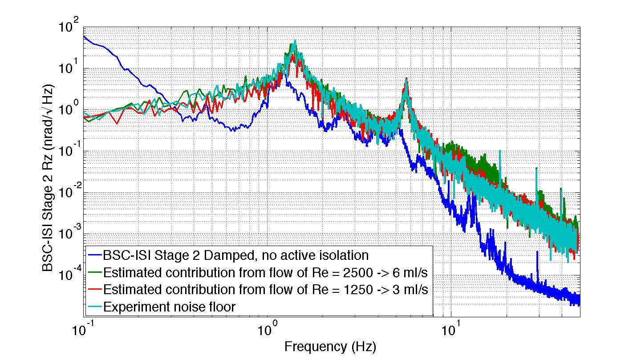
Noise projected on BSC-ISI Stage 2 Rz

Slide 33
LN₂ pipes vs cu cables trade-offs
 | Heat Transfer | Added weight | Seismic shorting | complexity of cryo system | Vacuum leaks
Copper cables
LN₂ pipes
?
Good
Risky
Fair
Show stopper

Slide 34
Future Work: Experiment Layout
Maraging steel blade spring
Vacuum wall
Goal:
Show we can make a low vibration cryogenic environment
Cold link
motor
Cold link -
prototyped
and tested
Test mass –
6” prototype in lab
GN₂ feedthrough
Heat shield - preliminary design complete T1400553
LN₂ pipe around shield
LN₂ return
Stainless steel legs
LN₂ supply
LN₂ feedthrough
ISI Stage 2
ISI Stage 1
Chillers -
cryomech

Slide 35
Backups

Slide 36
Future work
Next generation experiment using the Stanford ETF (experimental test facility)
More realistic LIGO setup
Measure temperature drifts on LIGO hardware, e.g. blade springs
Measure seismic noise of nitrogen delivery and/or copper cables
Test heat shield design
Black coatings
baffles
Test a variety of cooling techniques
System integration: how to make all this stuff work together
Implement in stages
Cables/hoses first – test seismic noise
Heat shield and suspended optic
Install cryogenic refrigerator
Cavity?
Anything we haven’t thought of yet

Slide 37
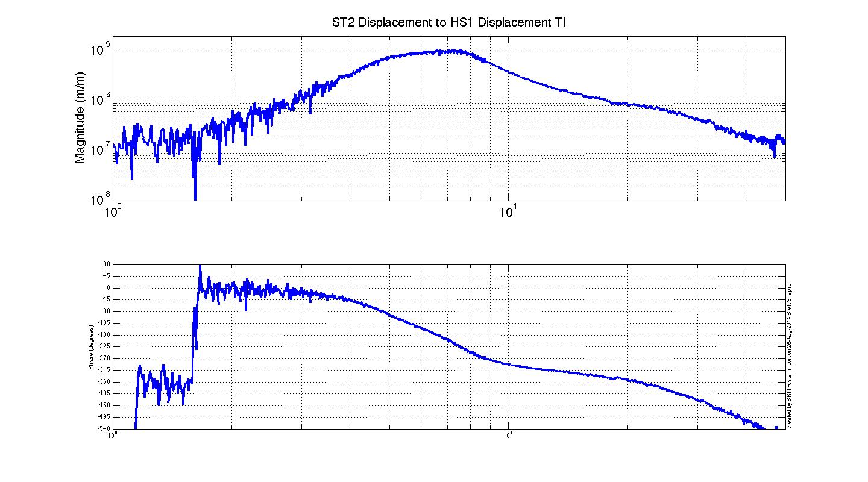
Stage 2 to Test Plate TF

Slide 38
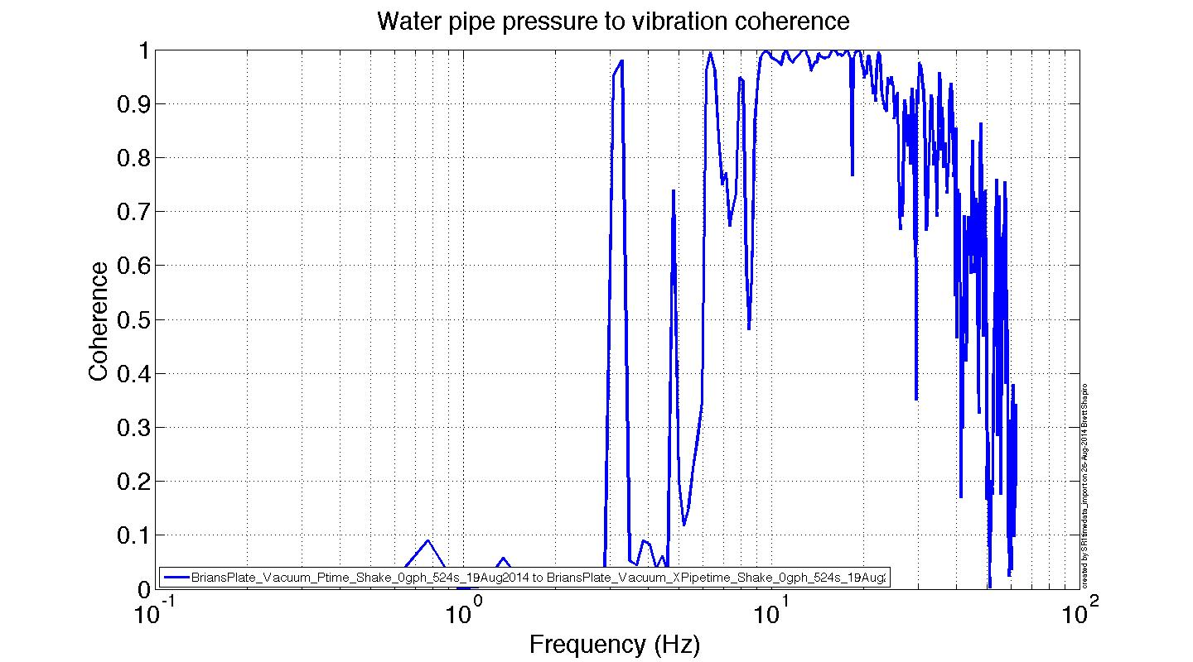

Slide 39
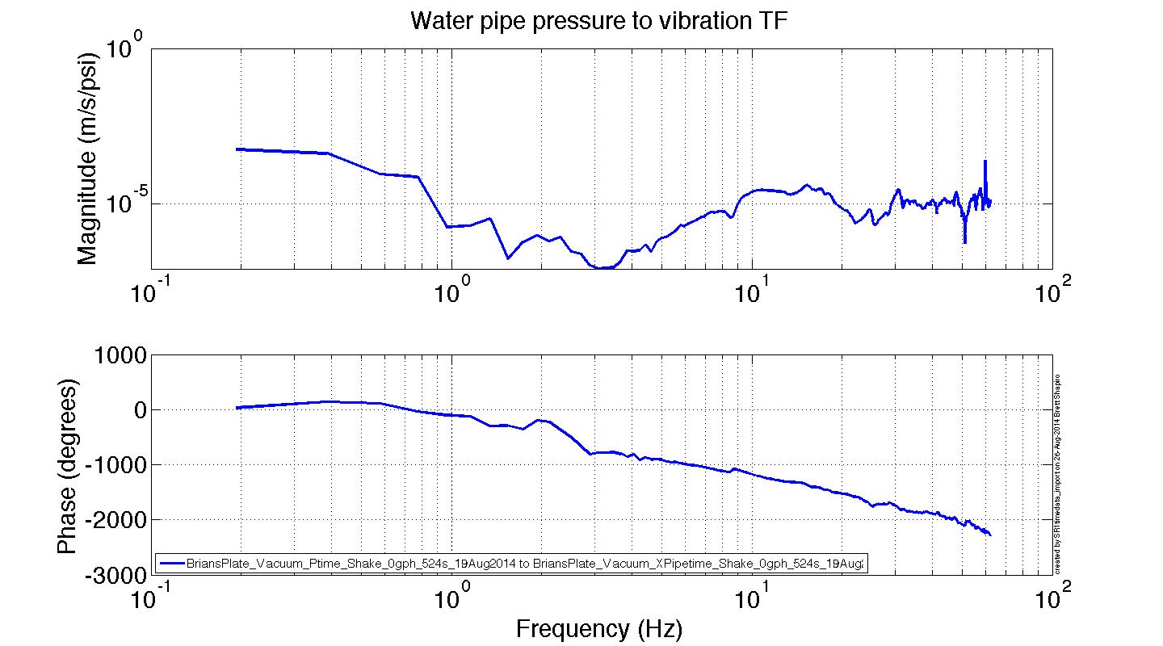

Slide 40
Other slides to add
Pressure to velocity TF
Maybe use this to get around noise floor
Summary slide?
Conclusions?
Update future work
Backups:

Slide 41
How to get a LN2 Hose to ST2
Vacuum flange
LN₂ hoses: Supply and return
Stage 0
Actuators
Stage A
Stage 1
Sensors
Stage 2
clamps
Extra stage, A, in parallel with stage 1 carries hose. Stage A is actuated to follow stage 2 so the hose has does not short seismic isolation. Stage A sensor noise is set by the stage 2 isolation requirement (so it follows stage 2 and not the sensor noise).

Slide 42
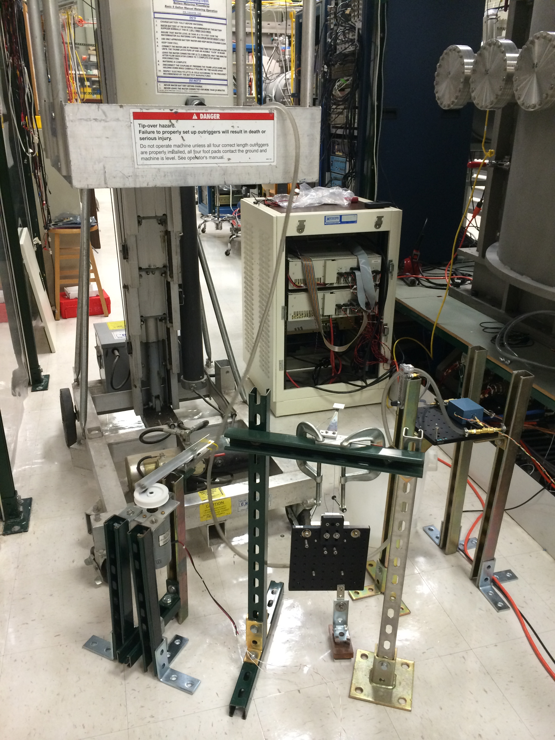
Water reservoir
Lift, for flow rate control
In vacuum vibration measurement (not visible)
Water hose
Suspension for
mechanical isolation of pipe shaking
Hose shaker
Eddy current damping for suspension

Slide 43
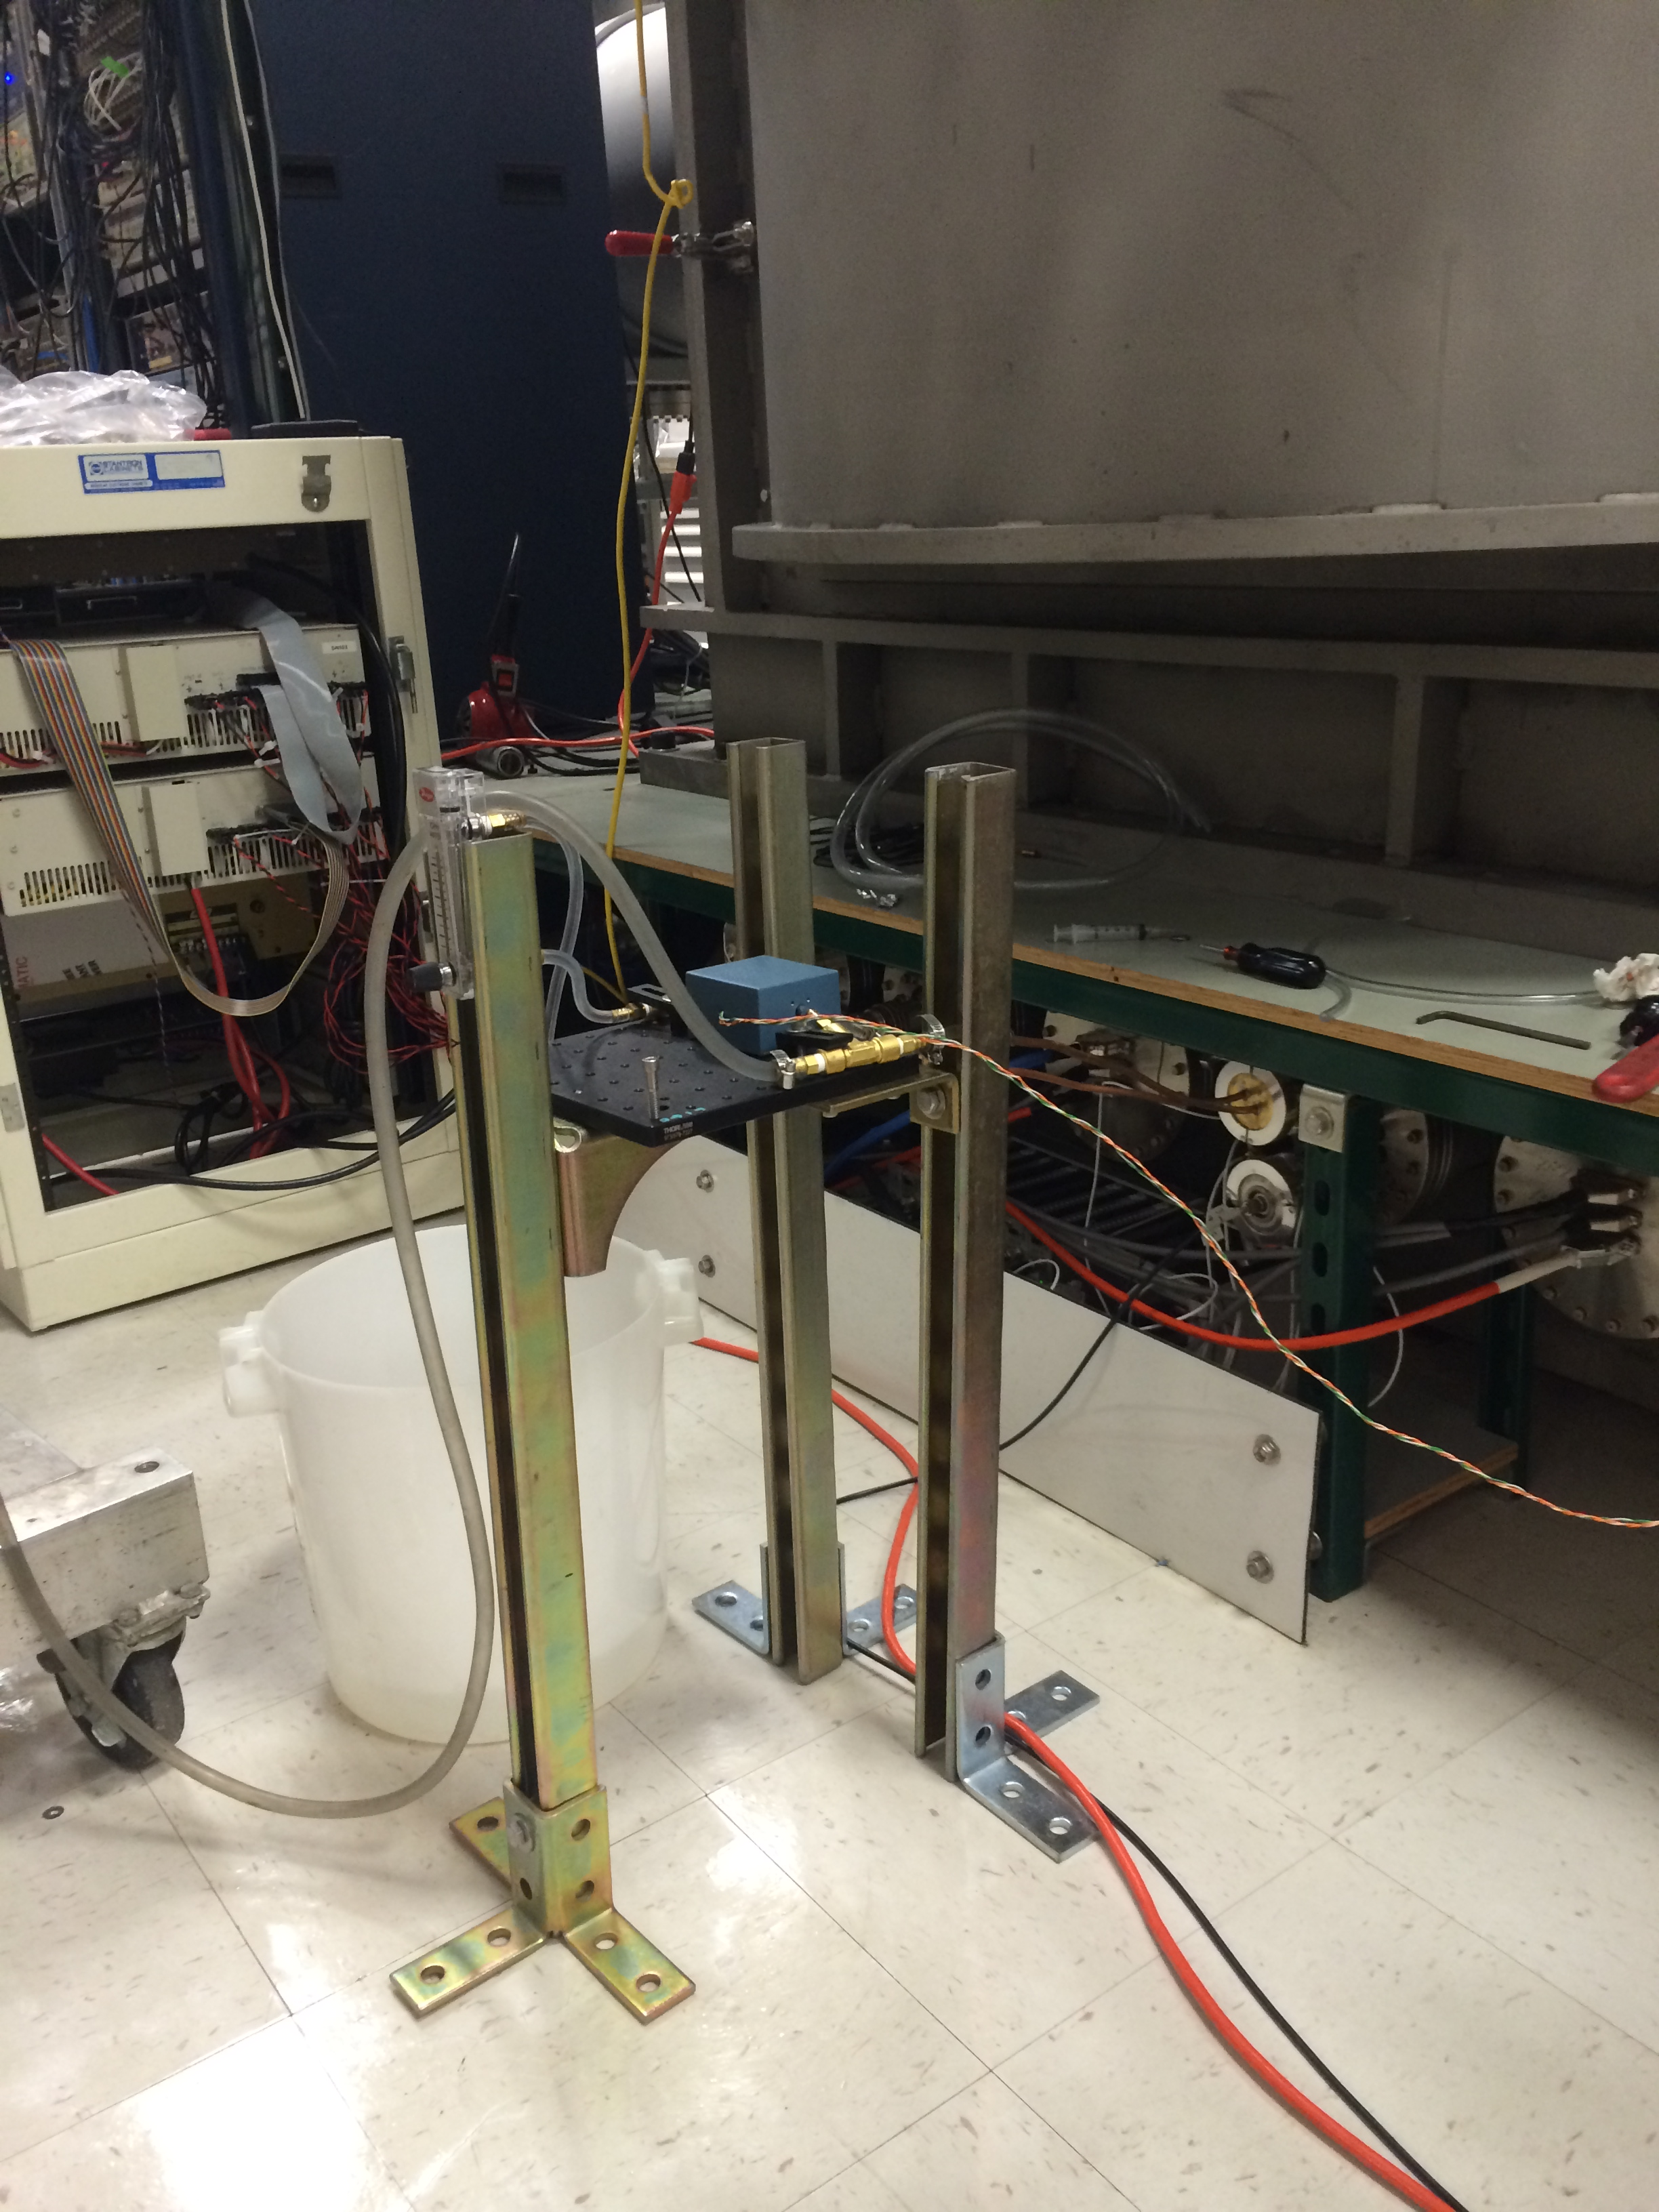

Slide 44
Other Problems To Solve
Flexibility of liquid N₂ hoses or Cu cables
Temperature/height control of blade springs
Test mass temperature control
Test mass temperature tolerance
How to measure temperature?
Measure acoustic modes – Young’s modulus is temp. dependent
Measure test mass diameter – combined with CTE data gives temperature
Infrared camera
Emissivity of optical coatings
Lossiness of emissive coatings
Good emissivity estimates/measurements of Si?
Power absorption in Si and Si coatings (ppm, W, etc)?
How noisy is flowing laminar liquid nitrogen: seismic, Newtonian?
Optical coating thermal noise at 124 K
How to actuate the test mass – is the ESD out?
Can we put viewports in the heat shield?

Slide 45
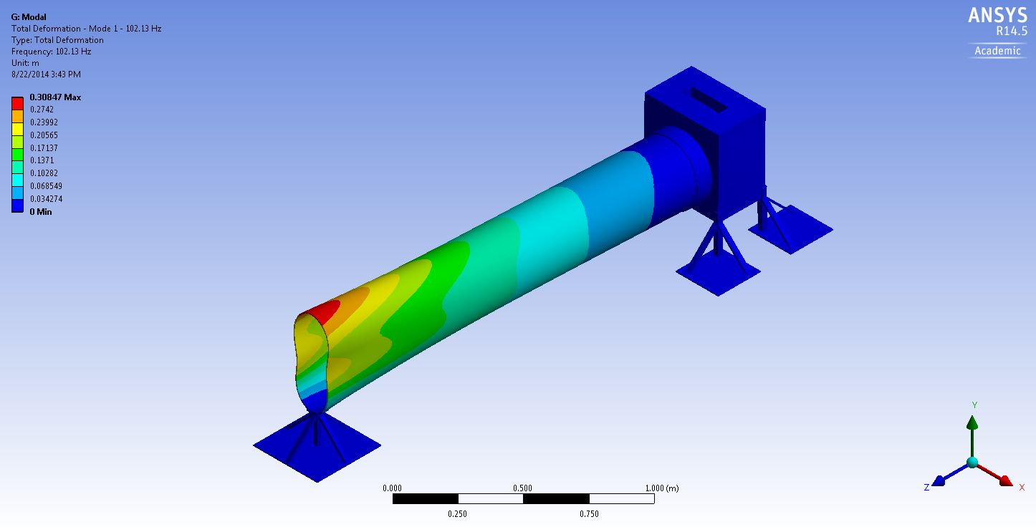
Heat shield mode 1 = 102 Hz
Can increase this frequency with a stiffening ring at the opening of the cylinder.

Slide 46
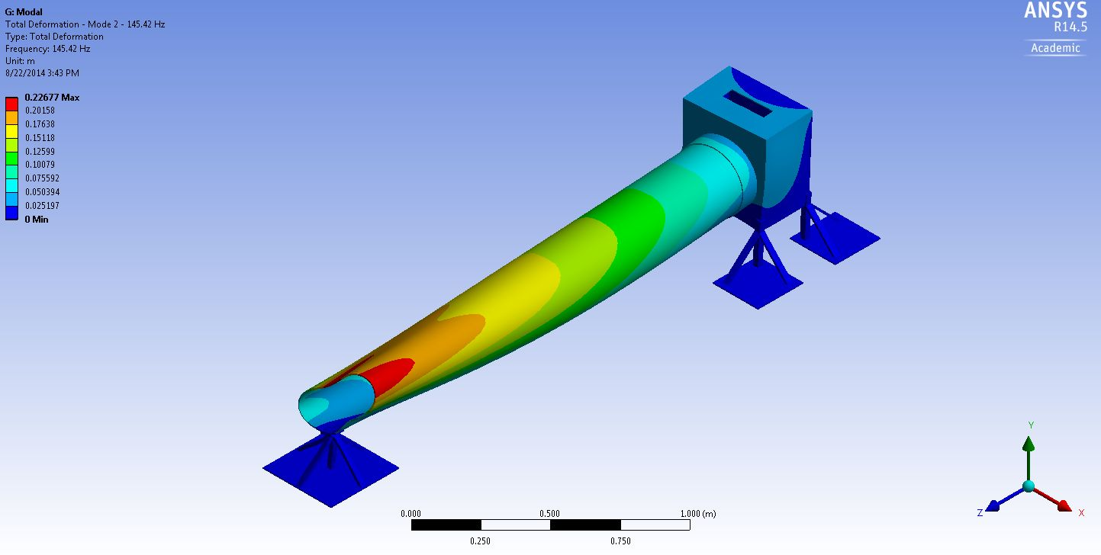
Heat shield mode 2 = 145 Hz
Can increase this frequency with a stiffening ring at the opening of the cylinder.

Slide 47
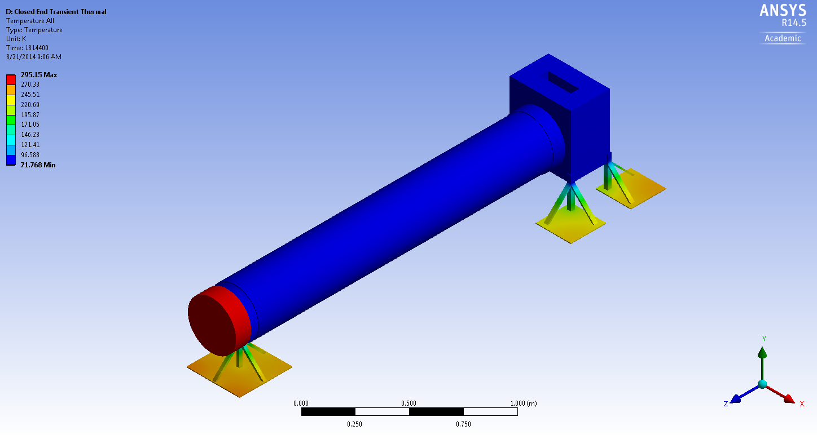
Steady state shield temperature

Slide 48
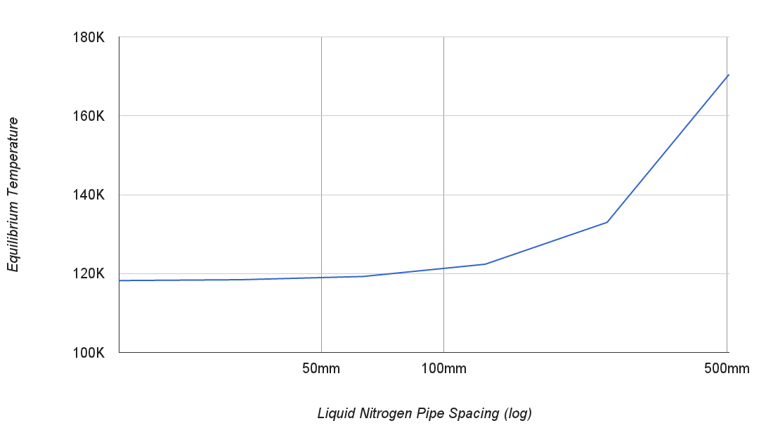
Influence of LN₂ pipe spacing
Dakota Madden-Fong - T1400553

Slide 49
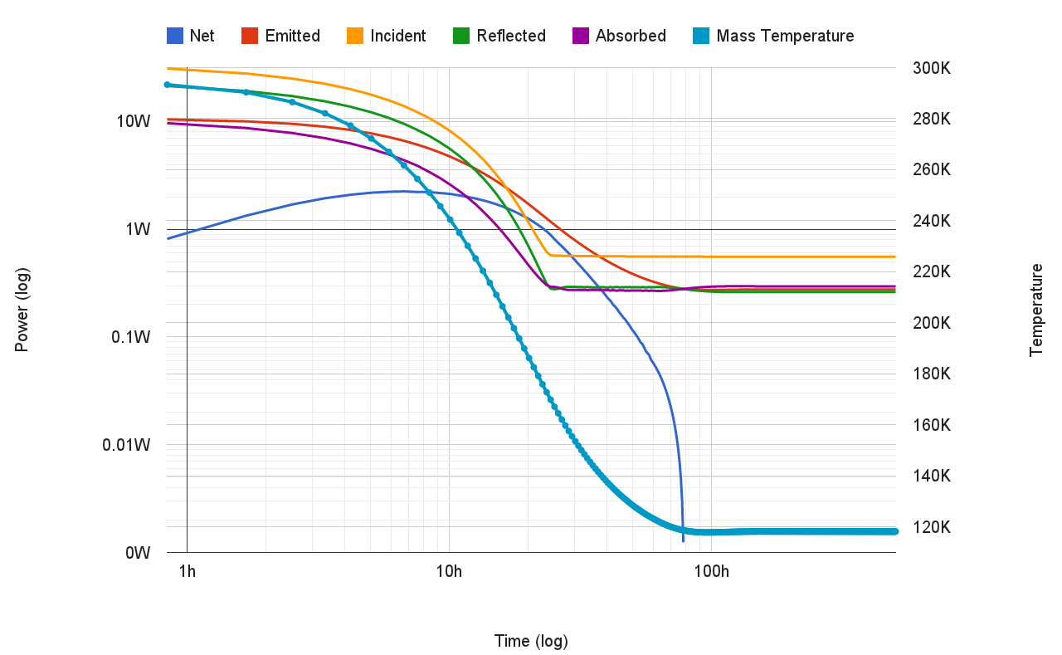
Radiation cool down with shield

Slide 50
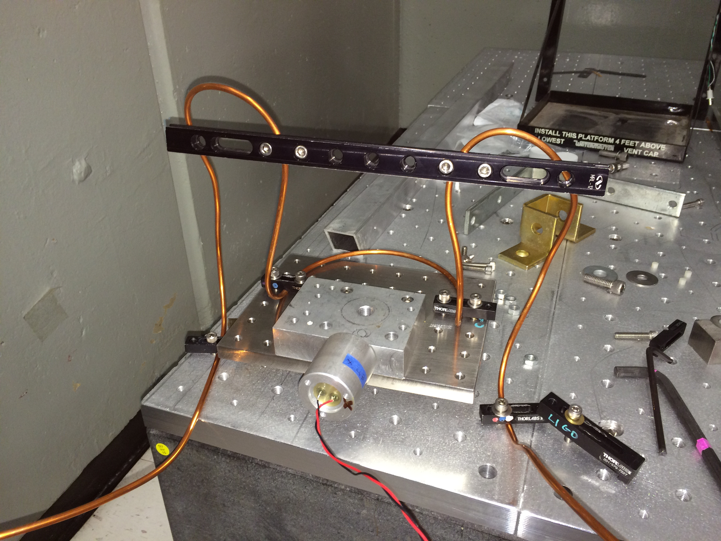
Concept for a lower natural frequency

