Slide 1

An Optical Setup for Crackle Noise Detection
Carell Hamil
Mentor: Gabriele Vajente

Slide 2

Crackle Noise and aLIGO
What is “Crackle Noise”?
Deformations in metals due to grain slippage or
similar microscopic; summed up by mechanical
upconversion
Crackle noise in aLIGO
In the suspension components and joint interfaces
the maraging steel blades, the clamps which hold
the suspension wires to the blades, the silica fibers which suspend
the test masses etc
Crackle Noise is vertical noise.
Crackle 1: measure vertical displacement noise using a Michelson Interferometer.
Use of maraging steel blades

Slide 3

Goals for the project
The goal of the project is to construct an optical setup which will produce the correct shape of a Gaussian Beam to go into the Michelson Interferometer of the Crackle Setup.
This will be done by:
Profiling the Gaussian beam
Design of a mode matching telescope
Construction of a mode matching telescope
Validation of the results

Slide 4
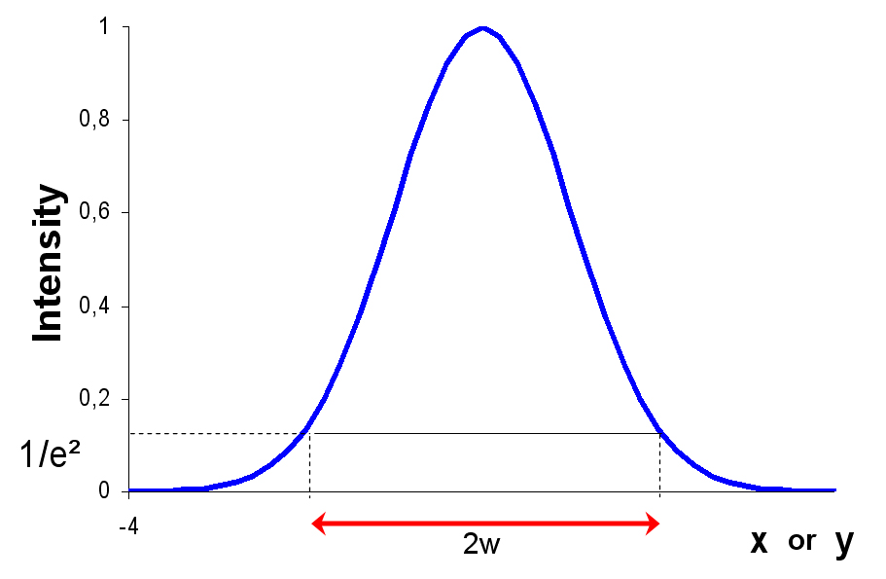
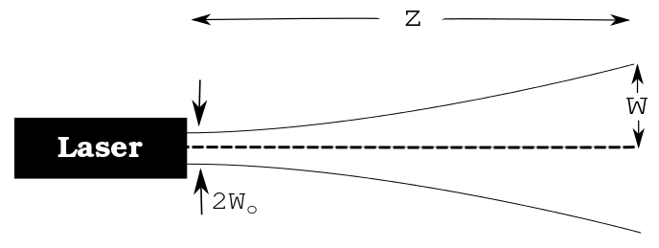
Gaussian Beams
What is a Gaussian Beam?
Electromagnetic radiation (light!)
Well approximated by
Gaussian functions.
Two parameters:
w(0) = The beam waist
z(0) = The position of the waist

Slide 5
Measurement Techniques
The “Knife Edge” Technique
The total power of the laser was measured (at first)
Then, power as a razor blade was translated across the beam using a calibrated translation stage was measured
Notes:
The measurements taken were then fitted to an error function and the beam parameters were determined from the fitted Gaussian distribution.
The Beam Parameters
- w(0) = 224 microns
- z(0) = 0.011m

Slide 6

Measurement Techniques
Measurements fitted to an error function
Beam parameters were determined from the fitted Gaussian distribution.

Slide 7
Measurement Techniques
The Beam Profiler Technique
An optical setup was constructed and the laser was shone into a beam profiling camera, and the full waist taken at 1/e^2 of the irradiance distribution was recorded for different values of z.

Slide 8
The Final Parameters
Beam Profiler:
-w(0) = 224 microns
-z(0) = 0.022mm
“Knife Edge”:
-w(0) = 224 microns
-z(0) = -0.013mm
Final Parameters:
-w(0) = 224 microns
-z(0) = 0.011mm

Slide 9
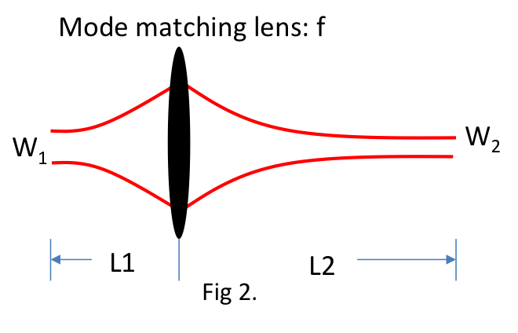
Mode Matching
Modification of the beam waist and position through the use of various lenses.
Notes:
Modification of the beam waist and position through the use of various lenses.

Slide 10
Mode Matching
ABCD matrix law is applied to an already aligned optical setup
relations between the sizes and positions of the beam waist
q parameter :
Free Space
Lens One
Free Space
Lens Two
Free Space
Notes:
Modification of the beam waist and position through the use of various lenses.

Slide 11
Mode Matching
An example of the mode matching done using the “Jammt” software.
Initial Waist
F = 120 mm
Final Waist
F = 50 mm

Slide 12
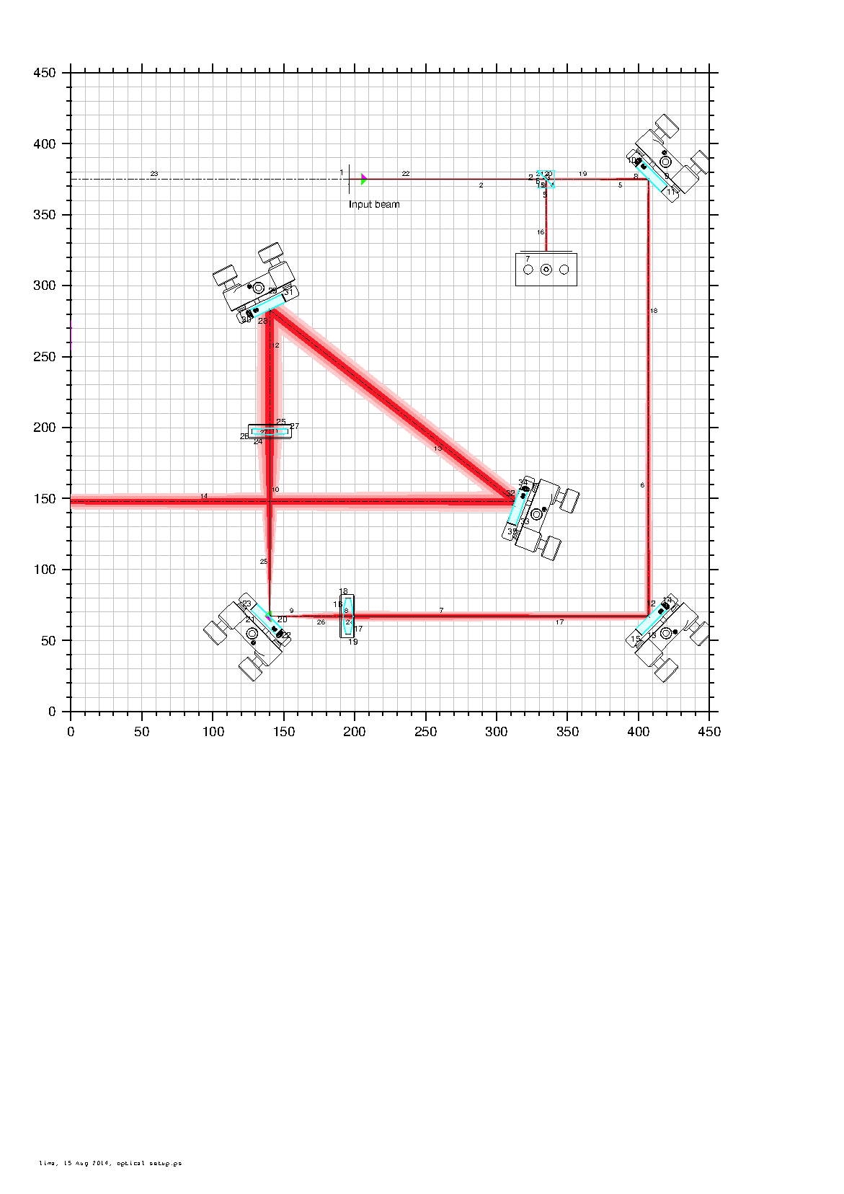
Design

Slide 13
A Mode Matching Telescope

Slide 14

The Final Parameters
The goal was to mode match our Gaussian Beam to the following parameters :
w(0) = 300 microns
z(0) = 3.253m
We mode matched our
Gaussian Beam to:
w(0) = 305 microns
z(0) = 3.243m

Slide 15

Future Work
Further alignment of the mode matching telescope to mode match the Gaussian Beam to within 1 micron and 0.5 mm.
Construction of a Michelson Interferometer; measurement of the laser frequency noise.

Slide 16
Acknowledgements
Gabriele Vajente
Alan Weinstein
LIGO
NSBP
NSF

