Slide 1
Studies of some properties of Hydroxide-Catalysis Bonds
LIGO-G1400857-v1
Valentina Mangano
on behalf of the Institute for Gravitational Research
LVC Meeting Stanford Aug 25th-28th 2014

Slide 2
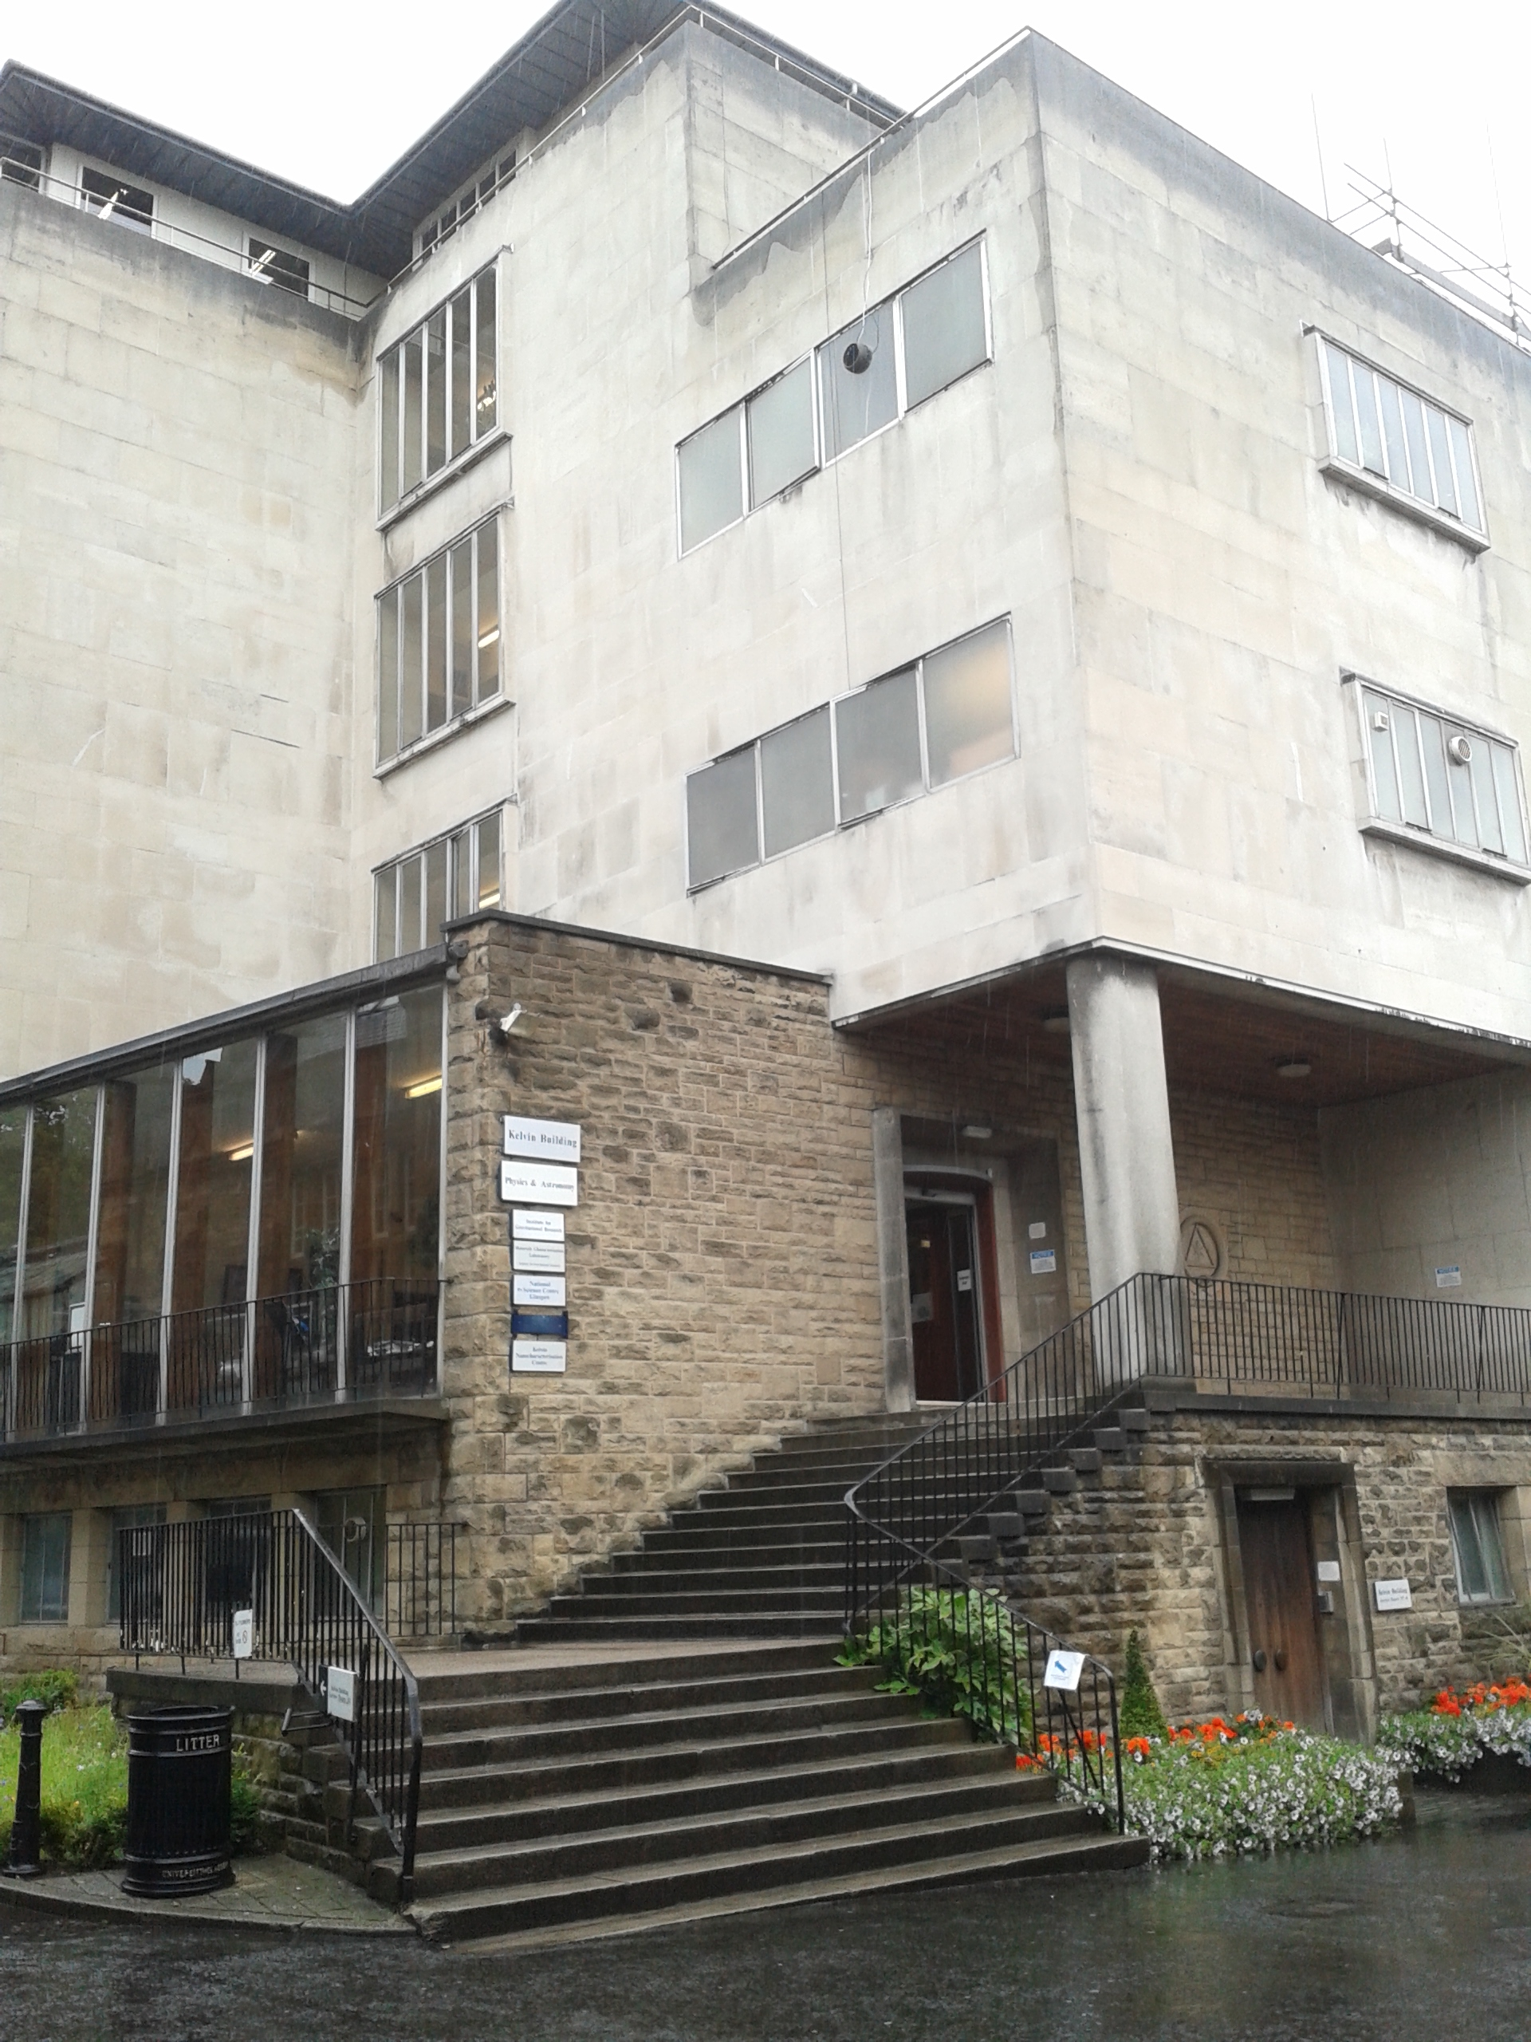
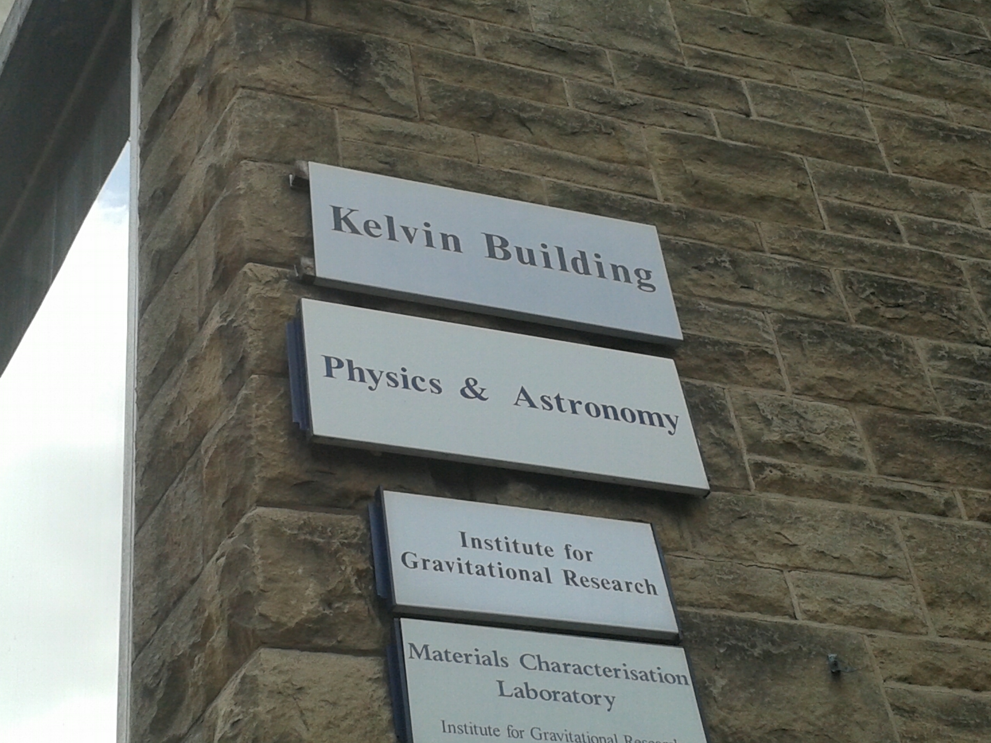
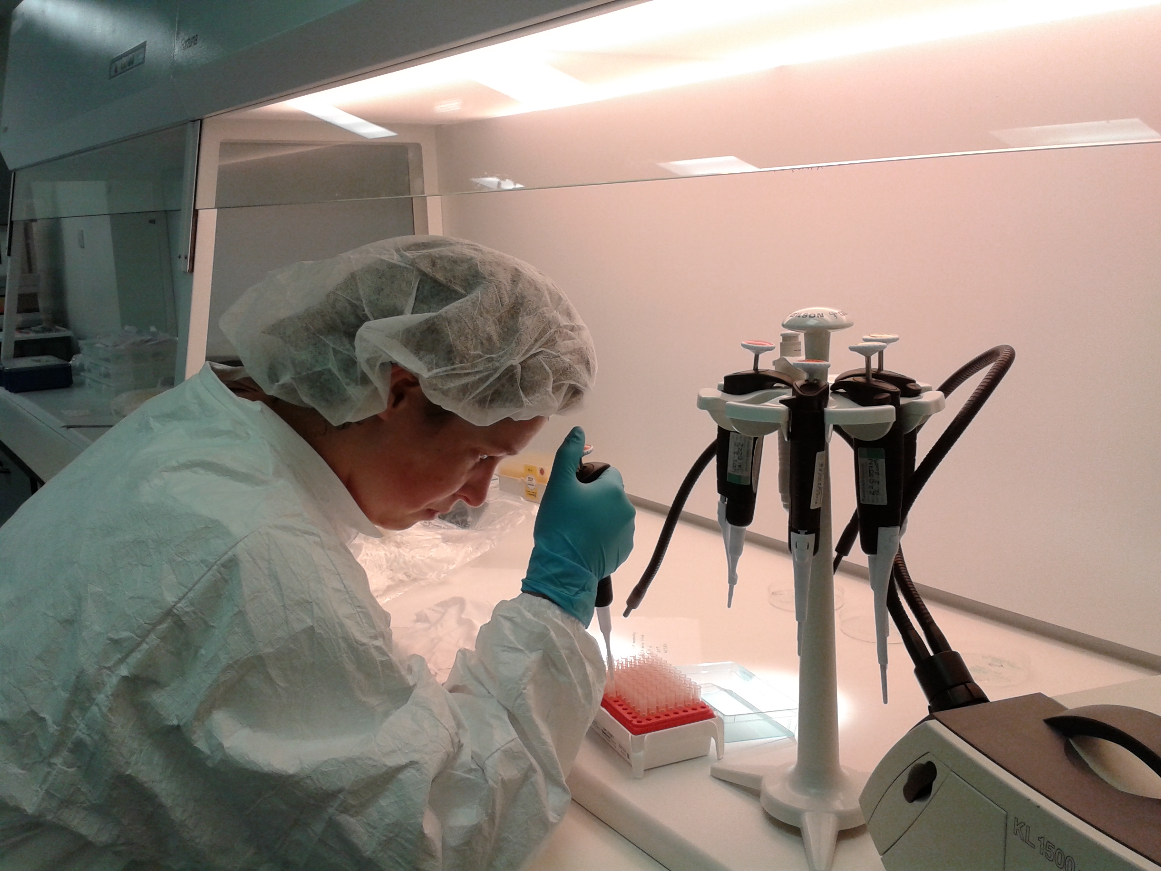
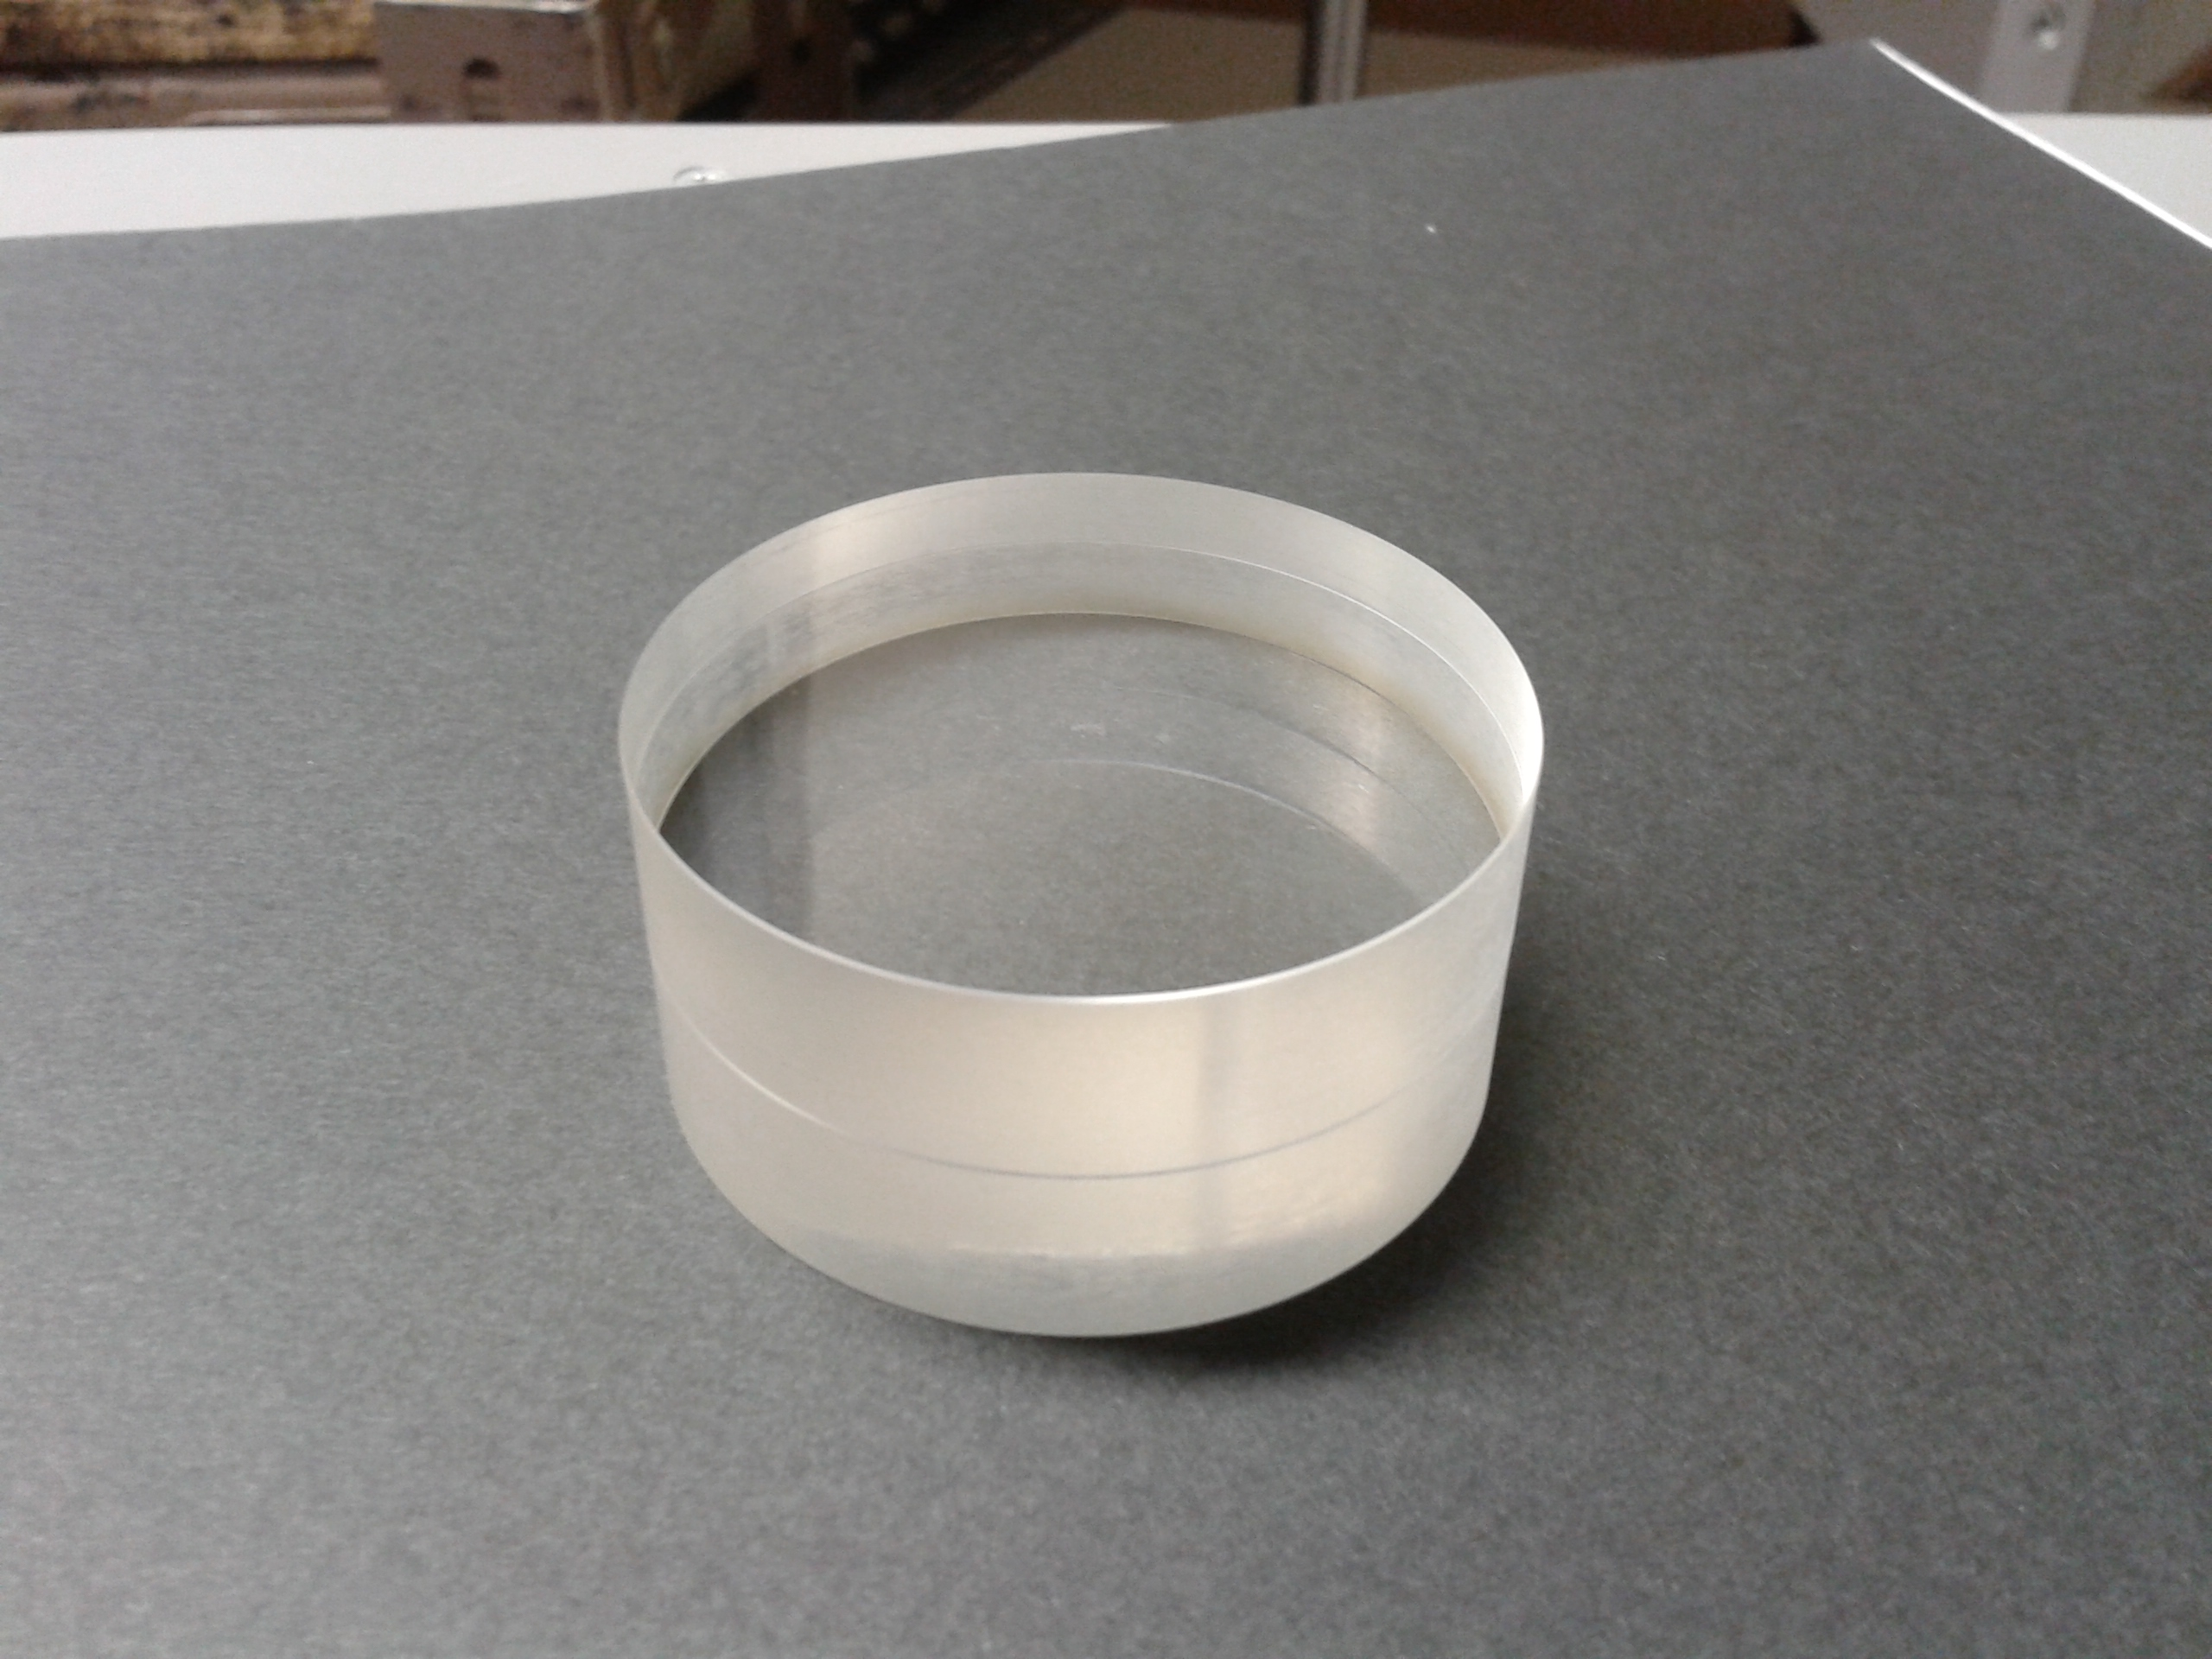
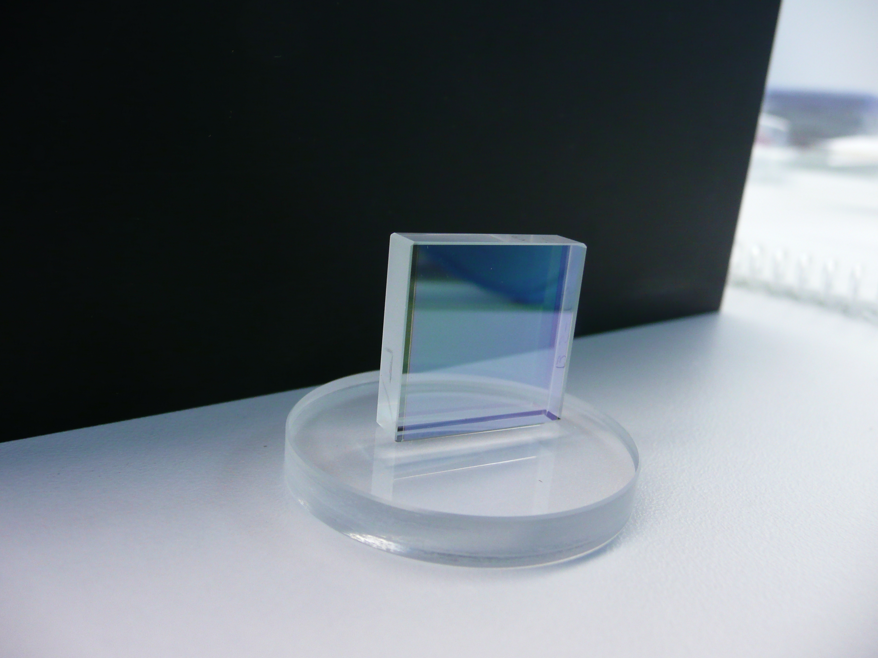
Outline
Introduction
Fabrication of bonds
Other applications
Experimental setup
Results and Analysis
Conclusions and Future work

Slide 3
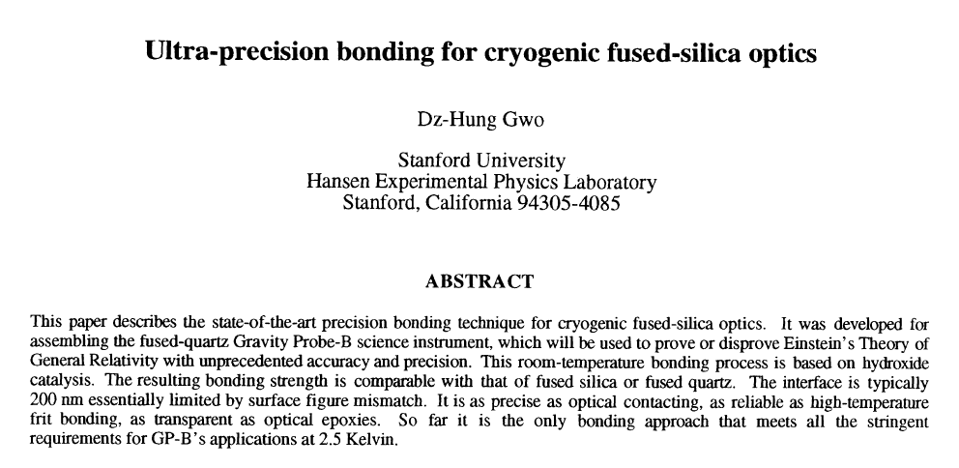
Introduction
Hydroxide-catalysis bonding is a jointing technique created at room temperature and characterized by:
very thin bonds which only introduce
low levels of mechanical loss
high strength
high precision alignment
Hydroxide-catalysis bonding was used in GEO600, and it is being used in the quasi-monolithic fused silica mirror suspensions for the advanced gravitational wave detectors (aLIGO and advanced Virgo).
To reduce the thermal noise further, cryogenic temperatures and crystalline materials, such as silicon and sapphire, are proposed for the next generations of detectors.
Is it possible to realize such a mirror suspension at cryogenic temperatures with these materials using the hydroxide-catalysis bonding?
July 1998

Slide 4
Fabrication of bonds
It is possible to combine any material, provided that a silicate-like network can be formed between them.
Example materials that can be bonded:
oxide materials: silica, fused silica, Zerodur, ultra low expansion glass, granite and sapphire
oxidisable materials: silicon and silicon carbide
The materials are bonded by means of an alkaline bonding solution:
potassium hydroxide KOH
sodium hydroxide NaOH
sodium silicate Na₂SiO₃
Want to develop techniques to characterize bond properties for different substrates and solutions to allow us to tailor bond properties to the various utilizations of interest.

Slide 5
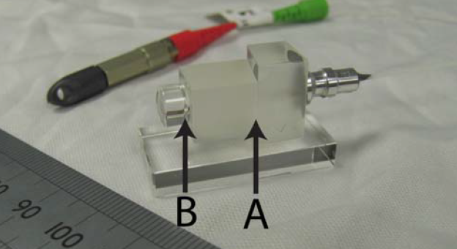
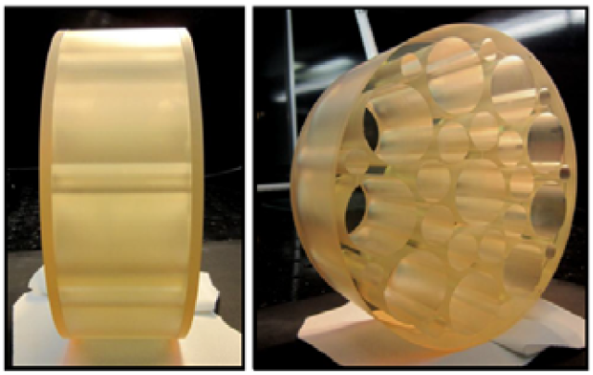
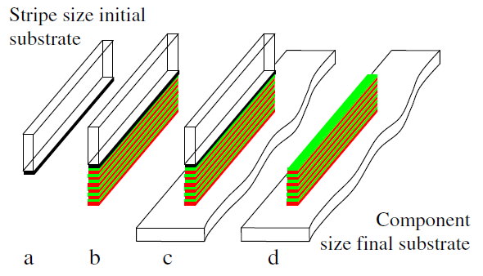
Other applications
Jointing optical components with low losses and high strength can also be employed in various applications, outside gravitational wave field.
(van Veggel, Killow - Adv. Opt. Techn. 2014; 3(3): 293–307)
connection of a fiber injector with a collimated lens through a fused silica spacer (Taylor et al. - ASP Conference Series, 467 (2012))
adaptive mirrors of the telescopes to bond actuators to substrates (Strachan et al. - Proc. SPIE 7736, 773664 and 773661 (2010))
lightweight composite mirrors (MacKay et al. - Proc. SPIE 8884, Optifab 2013, 88841N (2013))
construction of high power lasers (Sinha et al. - Opt. Express 15, 13003 (2007))
transfer of a multilayer coating from a substrate to another one (Duchêne et al. – Opt. Commun. 285, 128‐132 (2011))

Slide 6
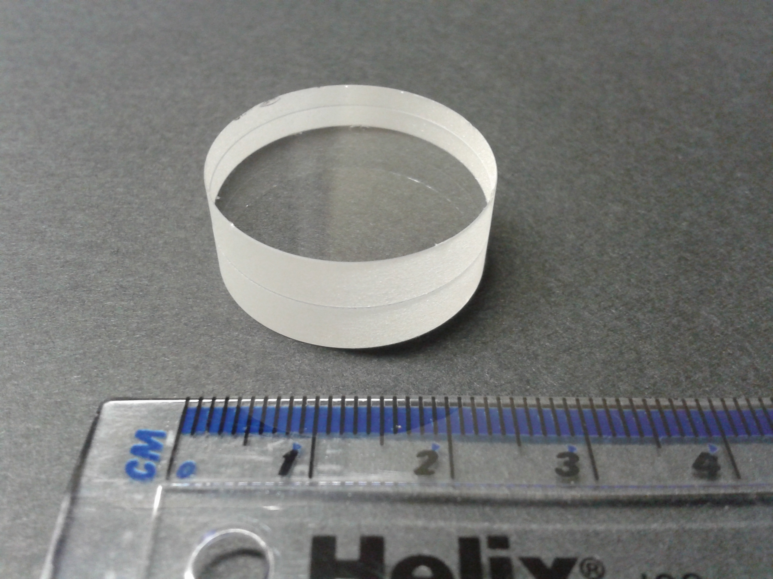
Experimental setup
Aim:
to measure the magnitude of the light reflected from bonded interfaces and use as a tool to determine bond thickness in a non-destructive manner.
For this purpose:
a pair of fused silica discs was bonded by means of sodium silicate solution;
a setup to measure the reflectances of both polarisation components of the incident light of a green laser diode module (λ=532nm) on the sample was realised.

Slide 7
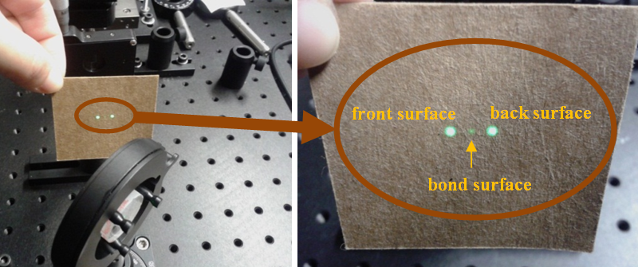
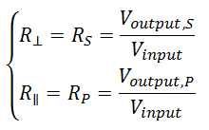
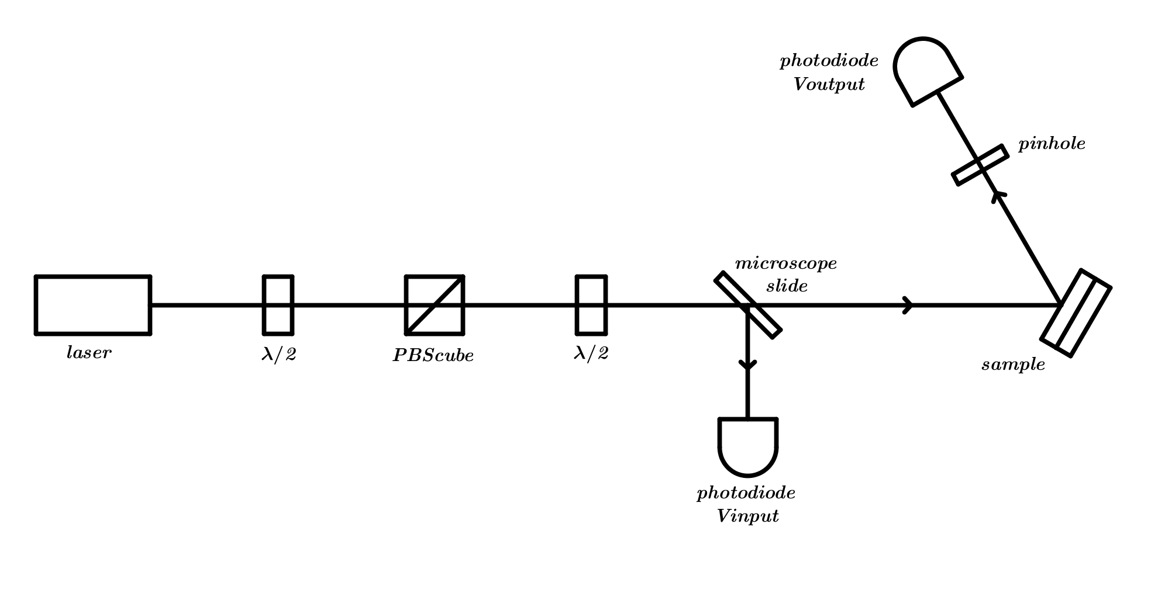
Experimental setup
For both the polarisations, the incident and reflected power of laser beam are measured as a function of angle of incidence, and the corresponding reflectances determined.

Slide 8
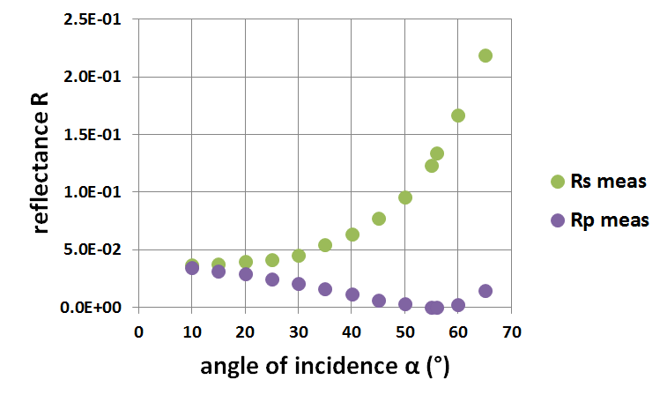
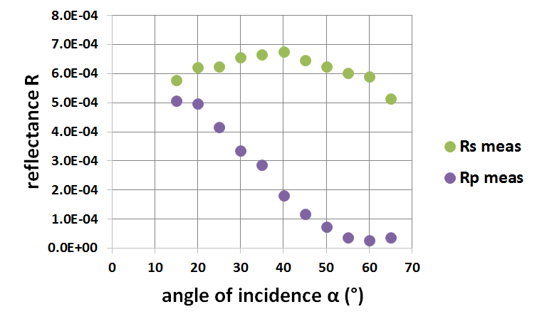
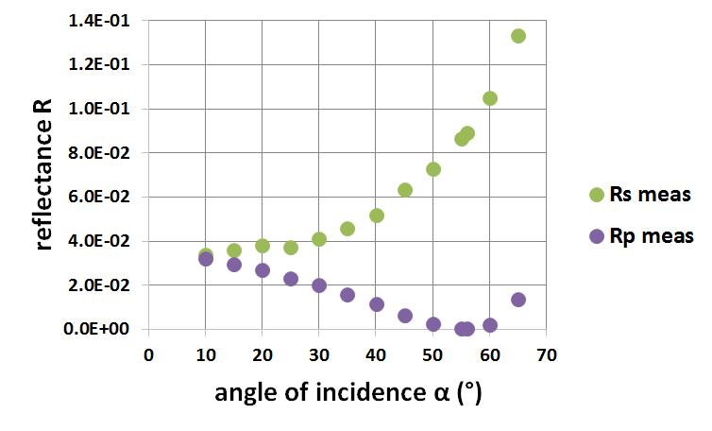
Results
front surface
bond surface
back surface

Slide 9
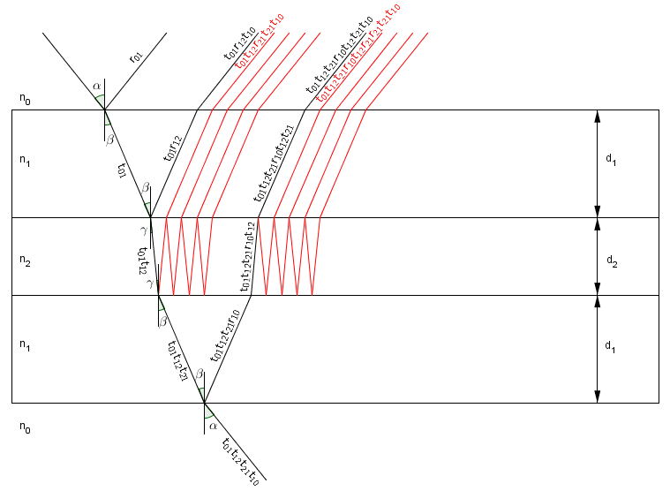
Analysis: sample
fused silica
sodium hydroxide solution
fused silica

Slide 10
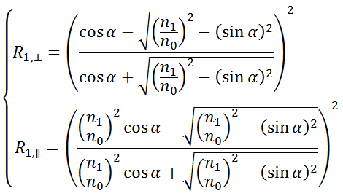
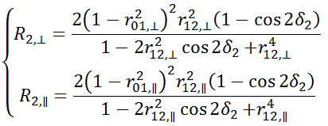
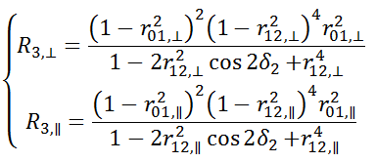
Analysis: formulae
front surface
bond surface
back surface

Slide 11
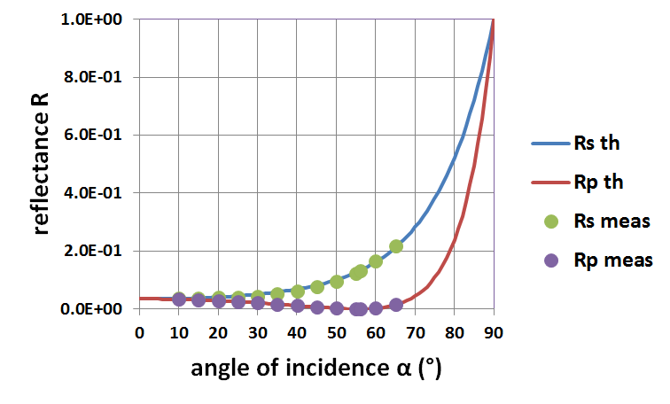
Analysis: front surface

Slide 12
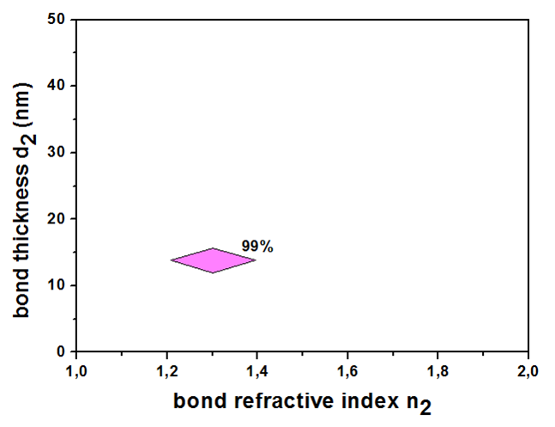
Analysis:
bond and back surface
The thickness of bond can be made less than tens of nm for precision applications.
(Gwo – US Patent 6284085B1 and 6548176B1).

Slide 13
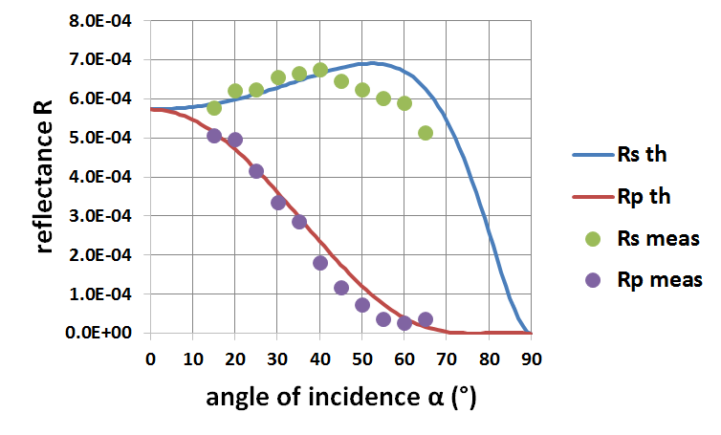
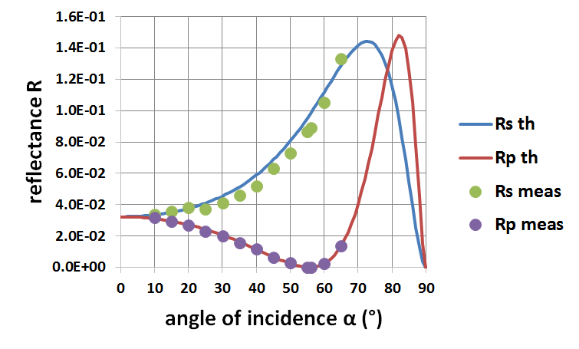
Preliminary
Analysis:
bond and back surface
bond surface
back surface
The reflectivity of bond is < 7.00·10⁻⁴.
(Sinha et al. - Opt. Exp. 15 (2007): < 7.08·10⁻⁴)

Slide 14
Conclusions
There is a reasonable agreement between measurements and model up to 65 degrees angle of incidence.
If the model is confirmed, it will be a powerful tool to:
measure the bond thickness in a non-destructive manner;
predict and measure how the reflectivity of a bond can be altered by the chemistry of a different bonding solution.
In this silica sample:
reflectivity of bond is < 0.1%;
bond refractive index is (1.3±0.1);
bond thickness is (14.0±1.9)nm.

Slide 15
Future work
→ new sample
(ø50.0×5.0)mm
For cross-check:
refractive index of the bond → refractive index matching liquids
sold by Cargille Laboratories
thickness of the bond → using SEM or AFM microscopy
techniques
Homogeneity across a bond and reproducibility
Three sapphire samples bonded with sodium aluminate, sodium hydroxide and sodium silicate solution → knowledge of how the reflectivity of the bond varies as a function of the chemistry of the bonding solution

Slide 16
Thank you for your attention!

Slide 17
Fabrication of bonds
The process of hydroxide-catalysis bonding can be summarized in the following steps:
hydration
etching
polymerisation
dehydration

Slide 18
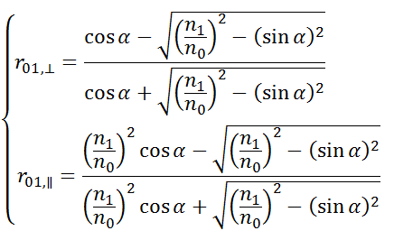
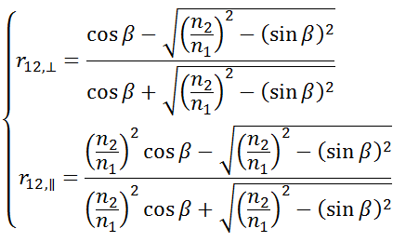
Analysis: formulae

Slide 19
How n₂ can be estimated
Refractive index of mixed solutions
sodium silicate solution:
Na₂O ~ 10.6% + SiO₂ ~ 26.5% + H₂O ~ 62.9%
bonding solution:
2 ml of sodium silicate solution + 12 ml of DI water

Slide 20
Measurements of d₂
M. van Veggel (IGR group meeting - 2012)

