Slide 1
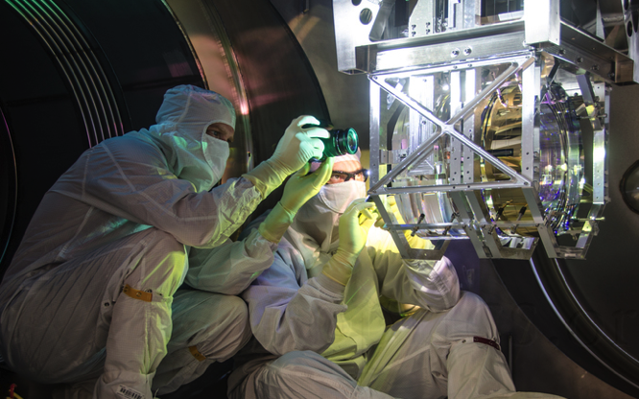
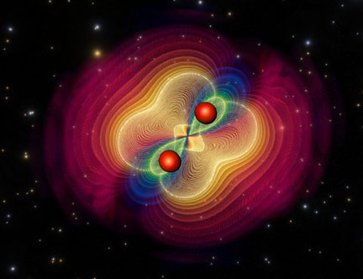


The road to Advanced LIGO’s first observations
Photo: Michael Fyffe
Jess McIver for the
LIGO Scientific Collaboration

Slide 2
Outline
Observing transient GW signals with Advanced LIGO
  The Advanced LIGO interferometers
  Projected commissioning timeline
  Likely observing scenarios
Detector characterization efforts
  Past strategies, challenges, and successes
  First glimpse of Livingston data quality

Slide 3
Outline
Observing transient GW signals with Advanced LIGO
  The Advanced LIGO interferometers
  Projected commissioning timeline
  Likely observing scenarios
Detector characterization efforts
  Past strategies, challenges, and successes
  First glimpse of Livingston data quality

Slide 4
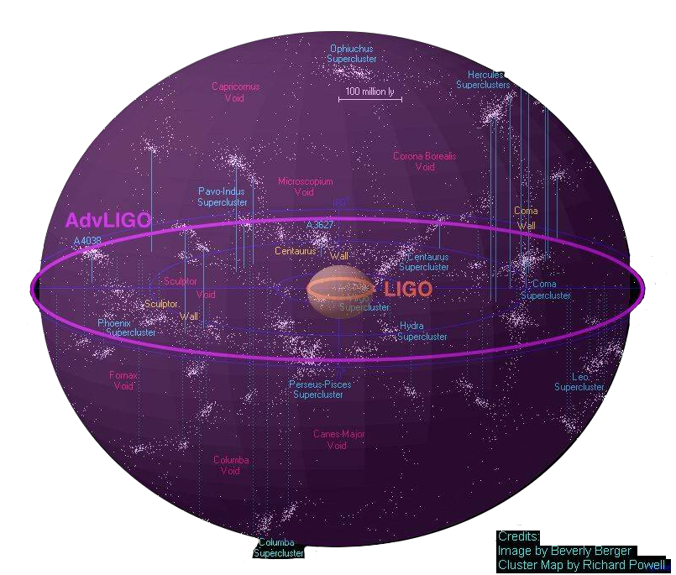
Advanced LIGO

Slide 5
Advanced LIGO
Advanced LIGO
Livingston is
currently here

Slide 6
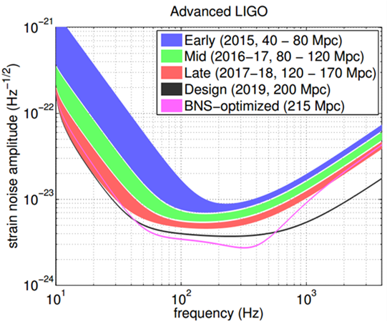
Likely aLIGO observing scenarios
Advanced LIGO expected BNS sensitivity
Aasi, et al. 2013
arxiv
1304.0670

Slide 7
How will we get there?

Slide 8
aLIGO instrumental improvements
Better
Seismic
Isolation
Reduced
Brownian
Noise
Increased
Laser Power
and Signal Recycling
Notes:
Three major frequency regimes improved by different technologies from initial to advanced LIGO
Low freq – introduction of active seismic isolation – actuating the platforms housing the optics to cancel the effects of ground motion – plus improved passive isolation suspensions
In our most sensitive frequency range on the order of hundreds of Hz we reduce the effects of thermal noise with improved optical coatings and the materials of our test mass suspensions
At higher frequency we are dominated by shot noise, which scales inversely with circulating power, so we combat this by increasing input power and further recycling it

Slide 9
aLIGO installation and testing
LIGO Hanford observatory
Each LIGO ifo has 4km arms

Slide 10
aLIGO installation and testing
Pre stabilized laser
Notes:
Test configurations of increasing complexity

Slide 11
aLIGO installation and testing
Input optics
Used for:
Input laser stabilization
Selecting for fundamental Gaussian beam mode

Slide 12
aLIGO installation and testing
Arm locking test
Arm Length Stabilization (ALS)
Tests:
Locking the interferometer arm cavities with green laser light
Notes:
Treat each arm as a distinct cavity and lock using GREEN laser light
Eventually this green light will be phase locked to the red light from the PSL and used to lock the arms to speed acquiring full ifo lock

Slide 13
aLIGO installation and testing
Power Recycled Michelson Interferometer (PRMI)
Vertex locking
Power Recycling Cavity:
Recycles the power that would exit via the power recycling mirror
Increases cycled power and reduces shot noise

Slide 14
aLIGO installation and testing
Vertex locking
Signal Recycling Cavity:
Tunable
Increases sensitivity in selected frequency band
Dual Recycled Michelson Interferometer (DRMI)

Slide 15
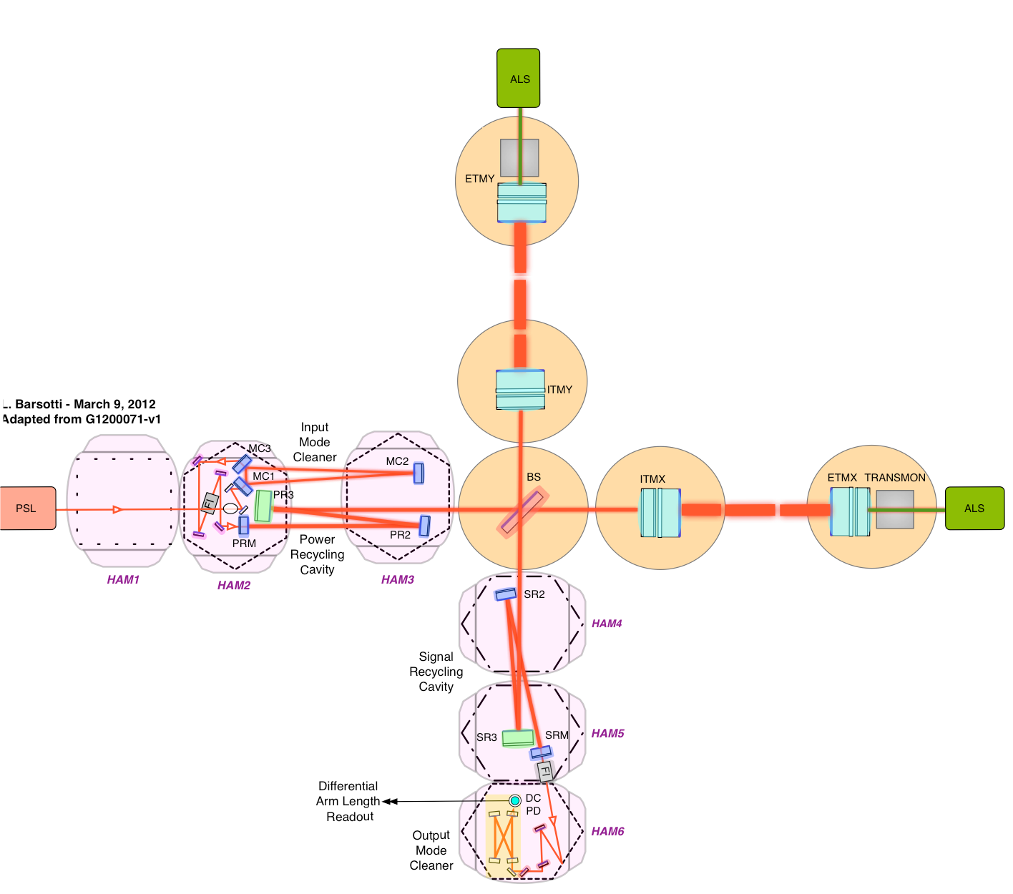
aLIGO installation and testing
Full interferometer!

Slide 16
Timeline: from eLIGO to aLIGO
2010
2011
2012
2013
2014
2015
2016
S6
Hanford aLIGO installation, testing, commissioning
aLIGO observing run
S6
Livingston aLIGO installation, testing, commissioning
aLIGO observing run

Slide 17
Timeline: from eLIGO to aLIGO
2010
2011
2012
2013
2014
2015
2016
S6
Hanford aLIGO installation, testing, commissioning
aLIGO observing run
Now
S6
Livingston aLIGO installation, testing, commissioning
aLIGO observing run

Slide 18
Timeline: installation and testing
2010
2011
2012
2013
2014
2015
2016
S6
Hanford aLIGO installation, testing, commissioning
aLIGO observing run
S6
Livingston aLIGO installation, testing, commissioning
aLIGO observing run
2010
2011
2012
2013
One arm
Input optics
Arms and vertex
Hanford Installation
Install
Input optics
Livingston Installation
Vertex
Arms
Full ifo

Slide 19
Timeline: the lead up to the first observing run
2010
2011
2012
2013
2014
2015
2016
S6
Hanford aLIGO installation, testing, commissioning
aLIGO observing run
S6
Livingston aLIGO installation, testing, commissioning
aLIGO observing run
2014
2015
Hanford Installation
Vertex
Arms
Full ifo
Acceptance and sens. improve.
O1
Now
Livingston Full interferometer
Acceptance and sensitivity improvement
O1

Slide 20
aLIGO project acceptance requires:
Subsystems meet their acceptance criteria
  Design and use documentation produced
  Meet individual performance requirements
Each interferometer locks for an extended time (2 hours)
  Locking: acquire and maintain interferometer resonance under automated control
Livingston has achieved this!

Slide 21
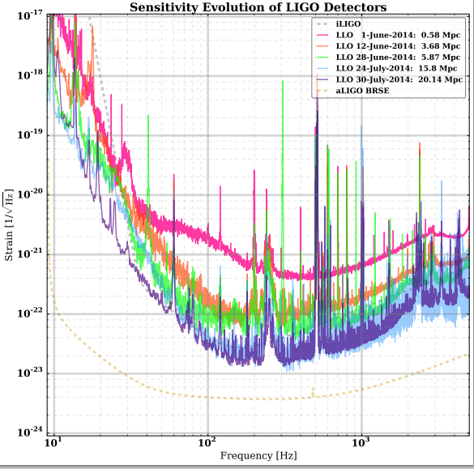
Commissioning at Livingston
Improving sensitivity
Increased laser power
Noise hunting
Transition to DC readout
Improved optic alignment and angular stability
+/- 25%
Notes:
Progression of LLO full ifo lock testing – point out iLIGO and aLIGO curves
Started in late May - Steady march throughout June and July
PASSED eLIGO on July 30th
Already doing ~1000x better at 10Hz, of interest to people looking for early inspirals
THIS IS DUE TO EXPECTED commissioning progression

Slide 22
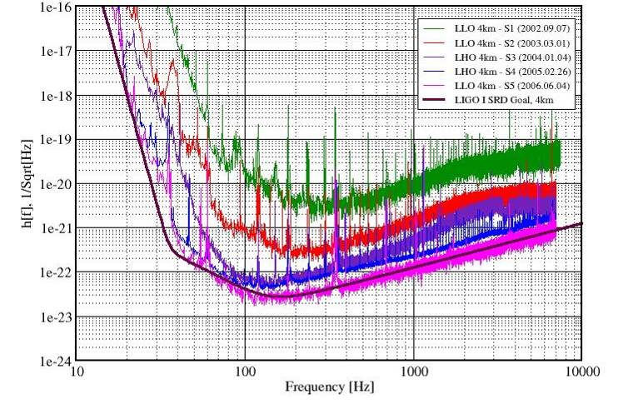
Prior commissioning progression
S2: Feb.- Apr. 2003
59 days BNS reach ~ 1Mpc
S3: Oct. ‘03 - Jan. ‘04
70 days BNS reach ~ 3Mpc
Science Requirement. document (1995)
S1: Aug. - Sep. 2002
17 days BNS reach ~100kpc
S4: Feb. - Mar. 2005
30 days BNS reach ~ 15Mpc
15 Mpc
S5: Nov 2005 – Oct 2007
L. Barsotti
Notes:
Slide for some perspective – understand how remarkably fast this is.
6 years to iLIGO sensitivity
3 MONTHS to the same sensitivity in aLIGO
S6 – same process/progression as now, but now MUCH FASTER (pick a freq and show how much faster in aLIGO)

Slide 23
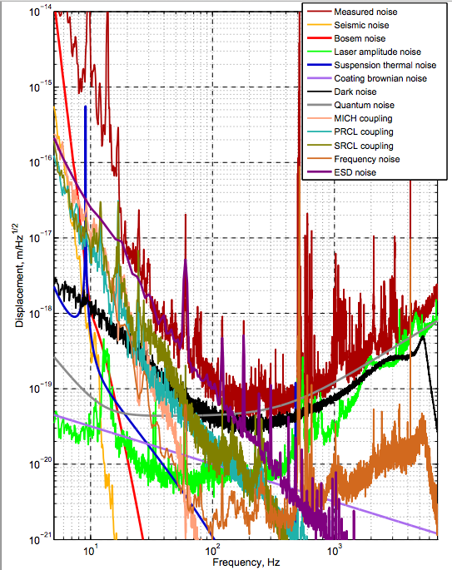
Noise budget
Livingston - August 16, 2014
July 28, 2014
Preliminary
Preliminary

Slide 24
The challenges of commissioning
Many effects cannot be tested prior to large scale implementation
Often noise sources stem from the interaction of different subsystems and cavities
Optic alignment
Laser power
Noise!
Seismic
Optic quality
Thermal effects
Scattering

Slide 25
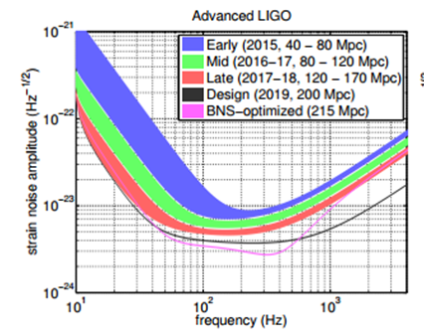
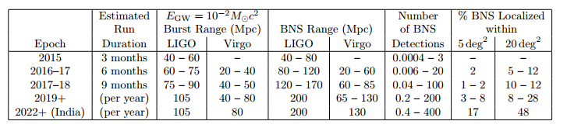
Planning observing runs
Number of detections =
Rate x Volume x Time

Slide 26
Planning observing runs
For Binary Neutron Stars:
Number of detections =
Rate x Volume x Time
arxiv 1003.2480
Notes:
Neutron Star Binaries:
Advanced LIGO:~200 Mpc, “Realistic*rate”*~*40/year*
Initial LIGO: ~15(Mpc, Rate ~1/50years)

Slide 27
Outline
Observing transient GW signals with Advanced LIGO
  The advanced detector network
  Projected commissioning timeline
  Likely observational scenarios
Detector characterization efforts
  Past strategies, challenges, and successes
  New approach to characterizing complex instrumentation
  First glimpse of Livingston data quality

Slide 28
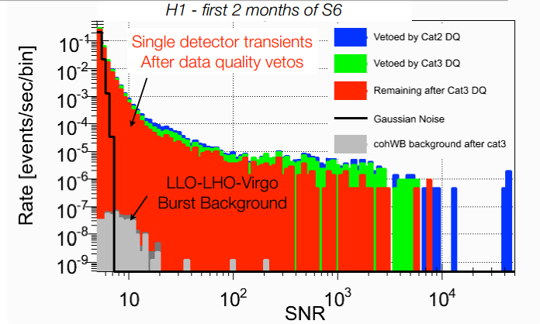
GW search pipelines are adversely affected by non-Gaussian data!
Long tails (outliers) in all-sky GW burst search background triggers greatly restrict achievable false alarm rate.
Non-Gaussian noise confuses parameter estimation for all transient searches.
  Slide: Josh Smith, 2014
Notes:
because of the loud tail, having a signal loud enough for detection is astrophysically unlikely.

Slide 29
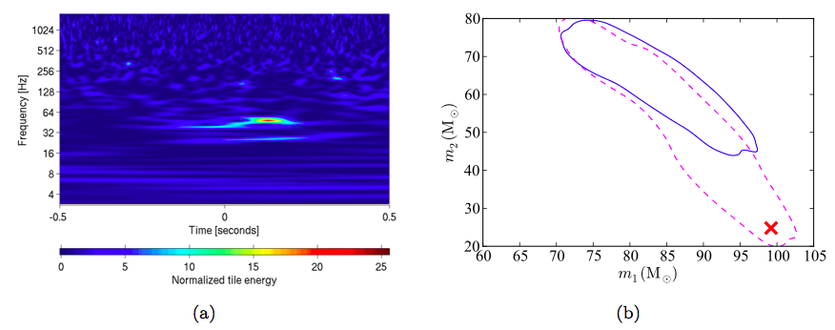
Example: NINJA2 search results
Actual injected masses
arvix 1401.0939
A normalized spectrogram of Hanford recolored noise only showing a transient event, or glitch, that happens to occur at the time of the injection.
Solid blue – the 95% credible region for mass estimation based on EOBNRv2 analysis using recolored noise.
Dashed pink – in Gaussian noise.
  Slide: Josh Smith, 2014
Notes:
NINJA2 notes

Slide 30
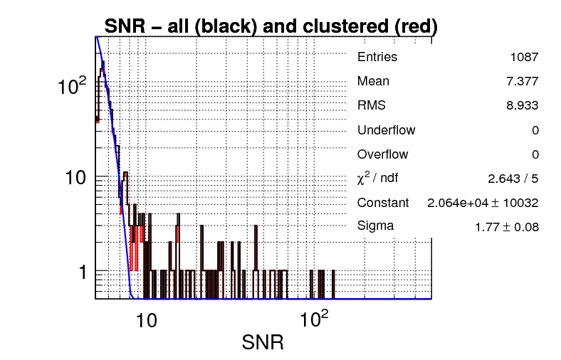
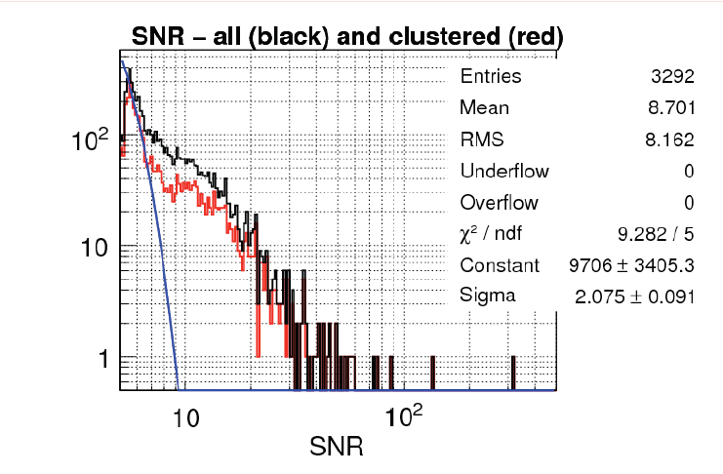
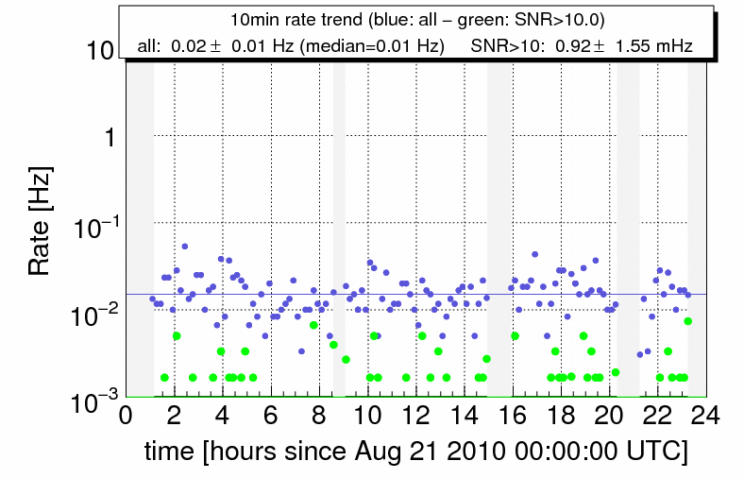
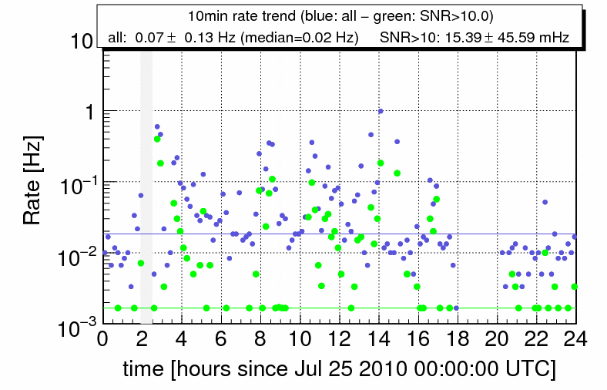
How glitchy were data in past runs?
A ‘good’ day in S6
A ‘bad’ day in S6
Number of events vs. loudness histogram
Number of events vs. loudness histogram
Gaussian noise prediction
Gaussian noise prediction
Notes:
S6 run in 2009-2010

Slide 31
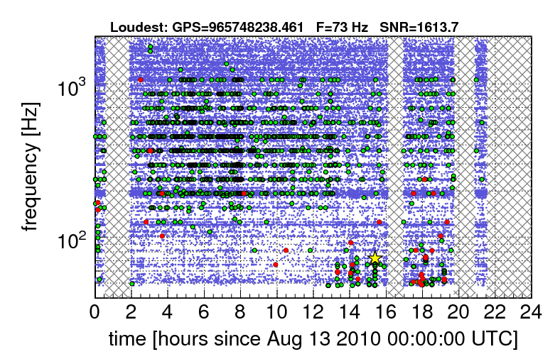
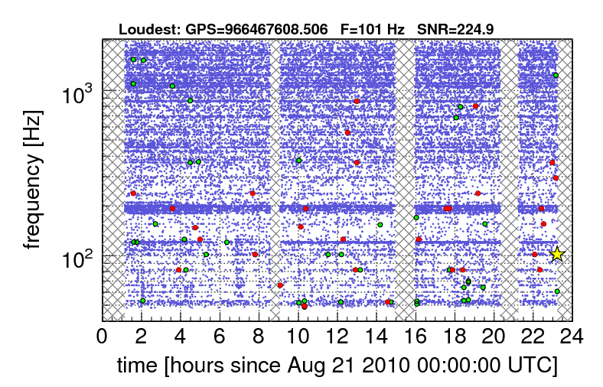
What kinds of glitches affect the transient GW searches?
The burst search, requiring coherence and time coincidence between ifos, is more affected by very frequent glitches
Example: ‘Grid’ Glitches
Detector characterization
Notes:
Explain glitchgrams – a time representation of bursts of noise in the detector, with color representing loudness, etc.

Slide 32
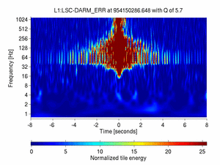
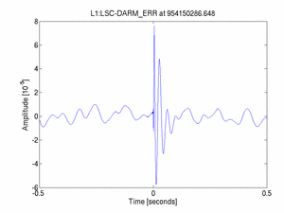
What kinds of glitches affect the
transient GW searches?
The CBC search is more affected by very loud glitches, which will convolve with many waveform templates in the template bank and pollute large chunks of data
Example: ‘Spike’ Glitches
Notes:
in a matched-filter search, a loud delta-function (like a spike glitch) will convolve with all the templates, across the entire duration of the template (as the template is 'slid' over the spike glitch). A loud glitch will ruin a large chunk of data for the CBC search, ~10s of sec long

Slide 33
First Glimpse
Advanced LIGO Livingston DQ

Slide 34
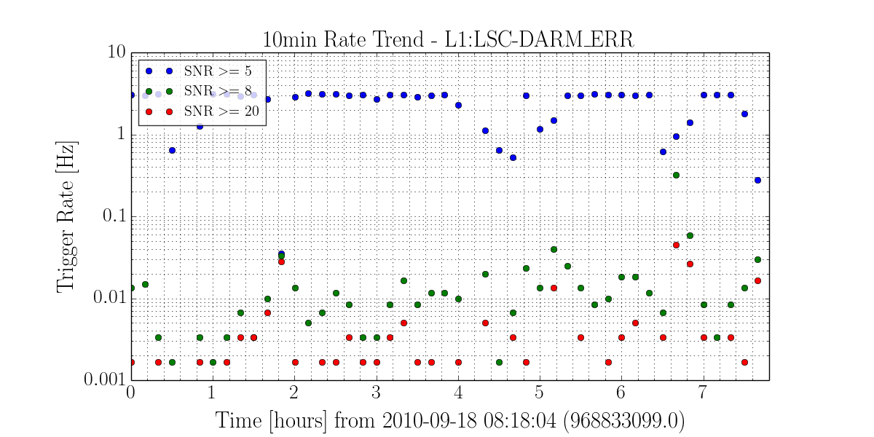
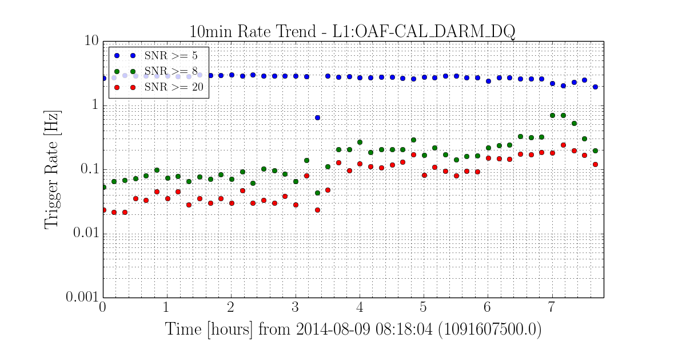
Livingston full interferometer glitching
Calibrated DARM (differential arm length) glitch rate comparison
September 2010 (S6)
August 2014
  Slide: Josh Smith, 2014

Slide 35
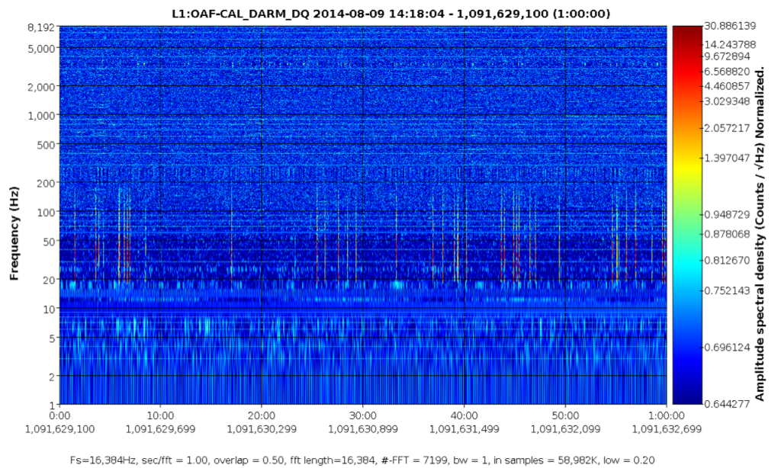
An early DQ issue diagnosis
Calibrated DARM - 1 hour on August 9th 2014
00:10
00:20
00:40
00:50
00:60
Time (minutes)
  Slide: Josh Smith, 2014

Slide 36
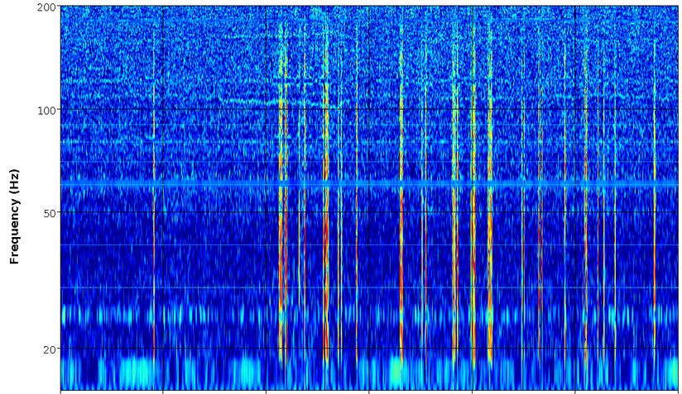
An early DQ issue diagnosis
Calibrated DARM - 1 hour on August 9th 2014
00:10
00:20
00:40
00:50
00:60
Time (minutes)
  Slide: Josh Smith, 2014

Slide 37
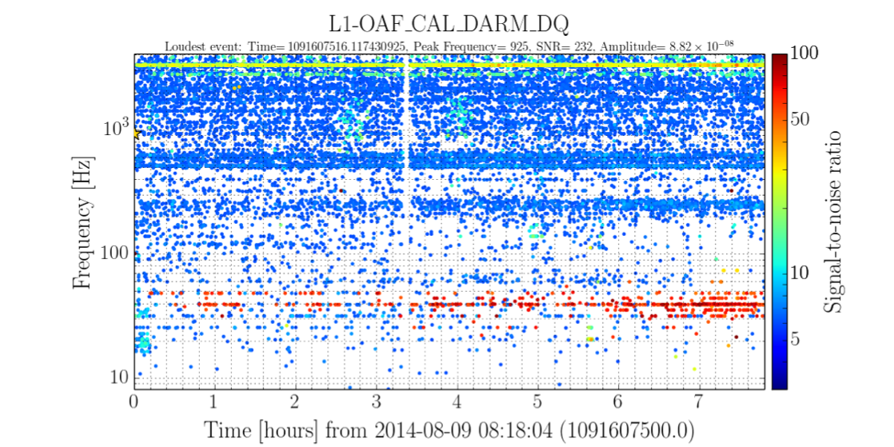
Through the lens of a single ifo burst GW pipeline
Calibrated DARM (differential arm length)
8 hours on August 9th 2014
  Slide: Josh Smith, 2014

Slide 38
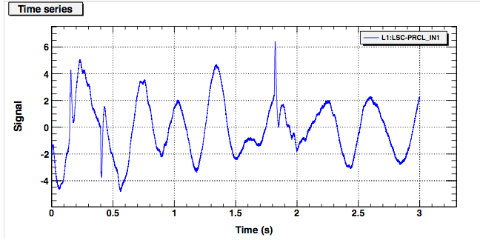
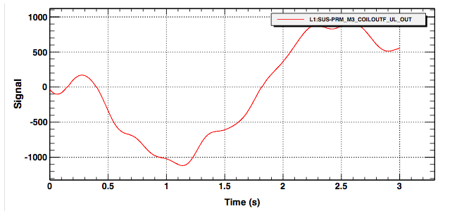
The mechanism : major carry transition DAC glitching
Power recycling cavity length
Power recycling mirror actuation
  Slide: Josh Smith, 2014
Notes:
LSC-PRCL_IN1_DQ is the power recycling cavity length error signal, so any misalignments in the PRC length will show up in this signal. Specifically this is the input to the control filters, so this signal is processed to make the PRC length control signal.

Slide 39
The mechanism : major carry transition DAC glitching
Power recycling cavity length
First dubbed “zero crossing” glitches – identified when vertex cavity actuation signals crossed zero.
Actually a subset of a broader known issue with these DACs.
Power recycling mirror actuation
  Slide: Josh Smith, 2014
Notes:
Think of it as an inversion of the majority of the switches. This is where glitch-ing is most common.
LLO commissioners reported Digital-to-Analog Converters (DACs) glitching on zero crossing (next slide) in ^{alog 13940}
This should occur for any other major carry transition (e.g.,+/- 2^16 for 18-bit DAC and +/- 2^14 for 16-bit DAC)

Slide 40
The mechanism : major carry transition DAC glitching
Major-carry transitions: single-code transitions that cause a most significant bit (to change because of the lower bits transitioning.
Examples:
Power recycling cavity length
0111
1000
Power recycling mirror actuation
G1400823
1000
0111
  Slide: Josh Smith, 2014
Notes:
Think of it as an inversion of the majority of the switches. This is where glitch-ing is most common.
LLO commissioners reported Digital-to-Analog Converters (DACs) glitching on zero crossing (next slide) in ^{alog 13940}
This should occur for any other major carry transition (e.g.,+/- 2^16 for 18-bit DAC and +/- 2^14 for 16-bit DAC)
R-2R precision DACs

Slide 41
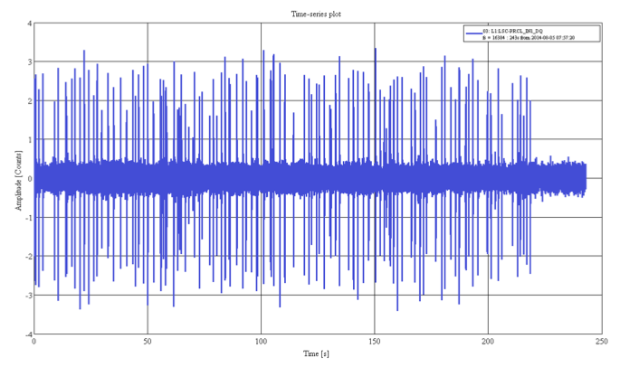
Offset applied to vertex cavity actuation
Time series of power recycling cavity length control signal
  Slide: Josh Smith, 2014

Slide 42
Offset applied to vertex cavity actuation
Time series of power recycling cavity length control signal
An offset is applied to the signal sent to the optic actuators in the vertex cavities
These signals no longer cross zero
The length signal glitching that couples to DARM is greatly reduced
  Slide: Josh Smith, 2014
Notes:
ZERO OR 2^16!!

Slide 43
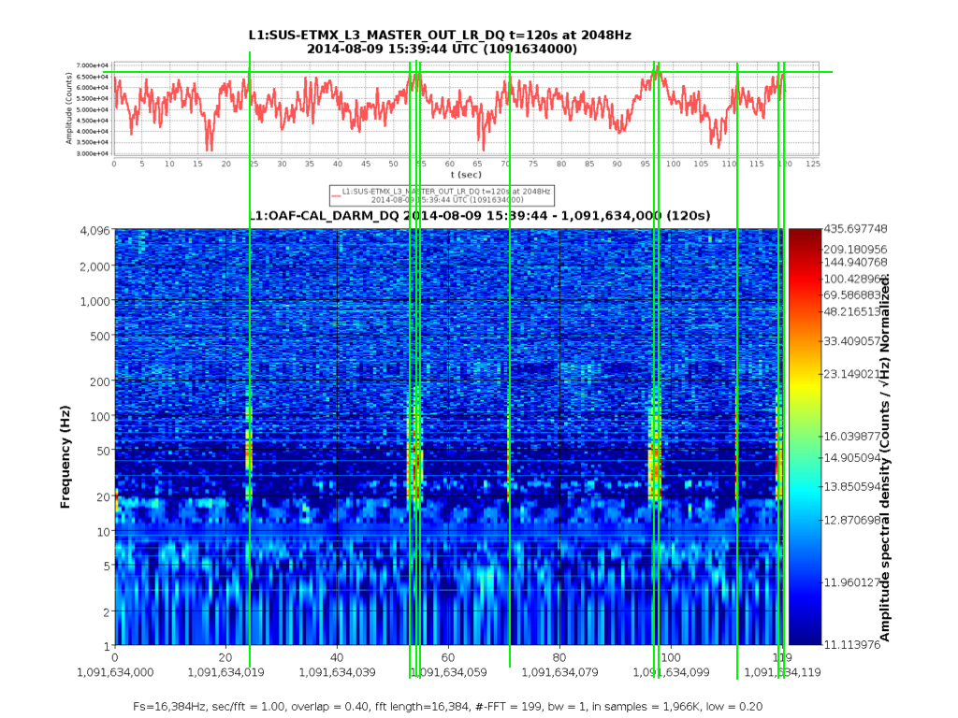
End station actuator glitches identified
End X optic suspension actuation signal
The Detector Characterization group also identified this behavior in one of the end stations at the 2^16 MCT
accounting for ~80% of loud glitches remaining after offset applied to vertex cavity actuators
Calibrated DARM
Time – 2 hours
  Slide: Josh Smith, 2014

Slide 44
Conclusions
With less than a year to go, making good progress toward commissioning and data analysis goals
  Commissioning following a rapid timeline, advances in sensitivity expected and well understood
  Detector characterization investment in instrumental expertise already fruitful in preparing to improve data quality for GW searches in O1
All indications are that we will be ready!

