Slide 1
LLO Laser Safety Overview
Index
Section 1: LLO Nominal Hazard Zones (NHZs)
Section 2: LLO Laser Hazard Lights
Section 3: LLO ESTOPs
Section 4: LLO Laser Safety Eyewear

Slide 2
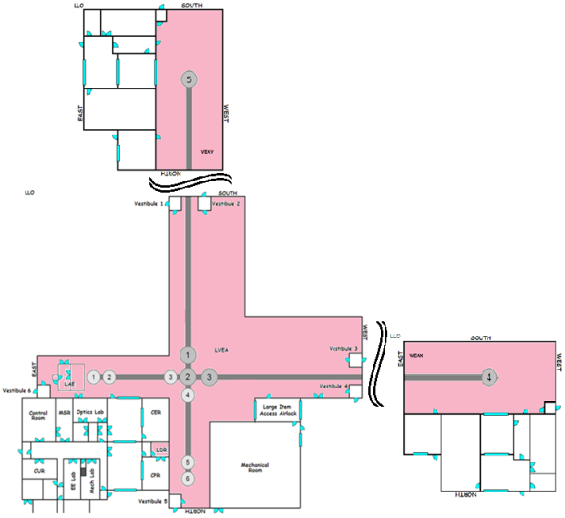
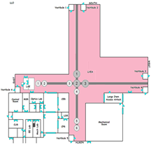
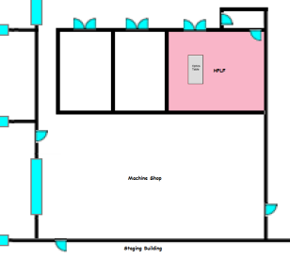
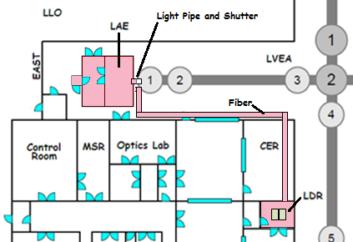
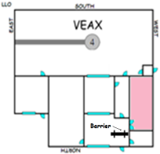
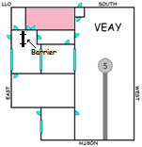
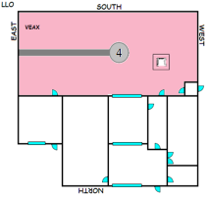
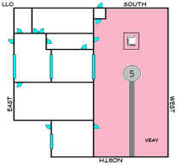
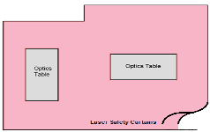
Section 1 - LLO Nominal Hazard Zones (NHZs)
<< Index
There are 9 Nominal Hazard Zones (NHZs) that are semi-permanent features of the LLO facility.
These include:
1. HPLF – The High Power Laser Facility run by the University of Florida
2. THE DETECTOR – The LVEA, VEAX, VEAY, LDR, and LAE (PSL)
3. LVEA – The Laser and Vacuum Equipment Area
4. LDR and LAE (PSL) – The Laser Diode Room and the Laser Area Enclosure
5. Optics Lab – Corner Station
6. Optics Lab – X-End Station
7. Optics Lab – Y-End Station
8. VEAX – The Vacuum Equipment Area at the X-End Station
9. VEAY – The Vacuum Equipment Area at the Y-End Station
3
2
1
4
5
6
7
9
8

Slide 3
LAE (PSL) and LDR Transition to Laser Safe
Both of the following conditions must be met.
1) The PSL laser must be off (M1100038).
2) NO OTHER LASER located in the NHZ may be ON.
NOTE: It is possible for this NHZ to be laser safe when the LVEA is laser hazard.

Slide 4
LVEA Transition to Laser Safe
ALL THREE (3) of the following conditions must be met.
1) The PSL INJECTION into the BEAM TUBE must be laser safe.
The PSL laser must be off (M1100038)
Or the light pipe between the PSL Enclosure and HAM1 must be locked closed (M1100038)
2) The LVEA TABLES must be laser safe.
TCSBT1R must be laser safe (M1300206)
(TCSY Laser locked OFF with key removed and in KEYBOX)
And TCSBT3L must be laser safe (M1300206)
(TCSX Laser locked OFF with key removed and in KEYBOX)
And TCSHT4R must be laser safe (M1300458)
(HARTMANN SLEDs locked OFF with key removed and in KEYBOX)
3) NO OTHER LASER located in the LVEA may be ON.
NOTE: ONLY when the LVEA is laser safe can VEAX or VEAY be transitioned to laser safe.
NOTE: It is possible for the LVEA to be laser safe while VEAX or VEAY or both are laser hazard.

Slide 5
VEAX Transition to Laser Safe
ALL THREE (3) of the following conditions must be met.
1) The LVEA must be laser safe.
2) The VEAX lasers must be laser safe.
Both PCALX (M1300574)
(PCALX Laser locked OFF with key removed and in KEYBOX)
And ISCBT4L (ISCTEX) (M1300551)
(ALS-X Laser locked OFF with key removed and in KEYBOX)
3) NO OTHER LASER located in the VEAX may be ON.
NOTE: It is possible for VEAX to be laser hazard when the LVEA is laser safe.

Slide 6
VEAY Transition to Laser Safe
ALL THREE (3) of the following conditions must be met.
The LVEA must be laser safe.
2) The VEAY lasers must be laser safe.
Both PCALY (M1300574)
(PCALY Laser locked OFF with key removed and in KEYBOX)
And ISCBT5R (ISCTEY) (M1300551)
(ALS-Y Laser locked OFF with key removed and in KEYBOX)
3) NO OTHER LASER located in the VEAY may be ON.
NOTE: It is possible for VEAX to be laser hazard when the LVEA is laser safe.

Slide 7
LAE (PSL) and LDR Transition to Laser Hazard
The following conditions must be met before laser light is introduced into the NHZ.
The LDR Entrance Door LASER HAZARD LIGHT must be switched to HAZARD.
Personnel in the LDR and the LAE (PSL) must be made aware of the transition and must be equipped with the appropriate eyewear.
NOTE: It is possible for the LAE (PSL) and LDR to be laser hazard when the LVEA is laser safe.

Slide 8
LVEA Transition to Laser Hazard
ALL Four (4) of the following conditions must be met before laser light is introduced into the beam tube.
The LVEA Entrance Door LASER HAZARD LIGHT must be switched to HAZARD.
The VEAX Entrance Door LASER HAZARD LIGHT must be switched to HAZARD.
The VEAY Entrance Door LASER HAZARD LIGHT must be switched to HAZARD.
Personnel in all of these NHZs must be made aware of the transition and must be equipped with the appropriate eyewear.
NOTE: Normally, the LVEA cannot be made HAZARD unless the VEAX and the VEAY are made HAZARD as well. There are possible exceptions that require a work permit and permission of the LSO.

Slide 9
VEAX Transition to Laser Hazard
The following conditions must be met before laser light is introduced into the NHZ.
The VEAX Entrance Door LASER HAZARD LIGHT must be switched to HAZARD.
Personnel in the VEAX must be made aware of the transition and must be equipped with the appropriate eyewear.
NOTE: The VEAX must be HAZARD before the LVEA is.
NOTE: It is possible for VEAX to be laser hazard when the LVEA is laser safe.
NOTE: ONLY the designated GREEN-LIGHT-SAFE eyewear is allowed in the VEAX.

Slide 10
VEAY Transition to Laser Hazard
The following conditions must be met before laser light is introduced into the NHZ.
The VEAY Entrance Door LASER HAZARD LIGHT must be switched to HAZARD.
Personnel in the VEAY must be made aware of the transition and must be equipped with the appropriate eyewear.
NOTE: The VEAY must be HAZARD before the LVEA is.
NOTE: It is possible for VEAY to be laser hazard when the LVEA is laser safe.
NOTE: ONLY the designated GREEN-LIGHT-SAFE eyewear is allowed in the VEAY.

Slide 11
LLO Laser SOPs (Most need reviewed)
LIGO-M960001: LIGO Laser Safety Program
LIGO-M080368: LLO NHZ Transition Procedures
LIGO-M1000236: LLO 8W TCS SOP
LIGO-M1000230: LLO 35W TCS SOP
LIGO-M1000233: LLO CrystaLaser SOP
LIGO-M1000232: LLO Photon Calibrator SOP
LIGO-M1000295: LLO 40mW Fermionics Diode Laser SOP
LIGO-M1000229: LLO 35W PSL SOP
LIGO-M1000235: LLO 200mW JDSU NPRO SOP
LIGO-M1100305: LLO Silica Fiber Welding Machine SOP
LIGO-M1100038: LLO 200 W PSL Installation SOP
LIGO-M1000231: LLO 100W HPLF SOP
LIGO-M1000234: LLO 700mW Lightwave NPRO SOP
LIGO-M1200103: LLO 50 W TCS Laser SOP for use in the HPLF
LIGO-G1101139: Wave Plate Lockout-Tagout
LIGO-G1100150: LLO Safety Document Emphasis
LIGO-M1200126: LLO TMS 130mW Alignment Laser SOP
LIGO-M1200327: LLO 5W Autocollimator SOP
LIGO-G1001060: aLIGO Laser Safety Eyewear Requirements
LIGO-M1200279: LLO Input Mode Cleaner Commissioning SOP
LIGO-M040112: LIGO Livingston Observatory Laser Safety Plan (Obsolete)
LIGO-M1300458: Standard Operating Procedure for aLIGO TCS HWS SLED
LIGO-M1300551: SOP for operating the Arm Length Stabilization at LLO
LIGO-M1300574: LLO PCAL SOP (Temporary)
LIGO-M1400006: LLO PRC Probe Laser SOP
LIGO-E1200231: Advanced LIGO TCS CO2 Laser Projection System Hazard Analysis
LIGO-M1200041: IO Laser Power Control - Standard Operating Procedure
LIGO-E1000205: aLIGO TCS HWS Hazard Analysis
LIGO-M1300206: Standard Operating Procedure for aLIGO TCS 50W CO2 Lasers

Slide 12
Section 2 - LLO Laser Hazard Lights
<< Index
Laser Hazard
Lights
TYPE 1: ENTRANCES:
LVEA Entrance
AIRLOCK Entrance
LDR Entrance
LAE Entrance
OPTICS LAB Entrance
VEAX Entrance
X-END OPTICS LAB Entrance
VEAY Entrance
Y-END OPTICS LAB Entrance
HPLF Entrance
TYPE 2: TABLES:
ISCHT1L (IMC)
IOHT2L
IOHT2R
ISCHT6R (OMC)
TCSHT4R (Hartmann)
TCSBT1R (TCS-Y)
TCSBT3L (TCS-X)
ISCBT5R (VEAY)
ISCBT4L (VEAX)
PCALX
PCALY

Slide 13
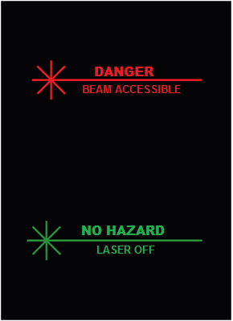
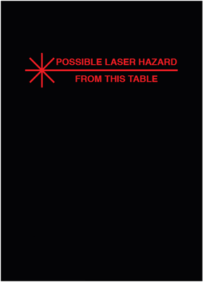
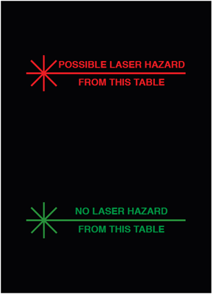
Types of Laser Hazard Lights
Entrances
Enclosures
Rockwell Laser Industries
7754 Camargo Rd
Cincinnati OH 45243
Rockwell Laser Industries
7754 Camargo Rd
Cincinnati OH 45243
Rockwell Laser Industries
7754 Camargo Rd
Cincinnati OH 45243

Slide 14
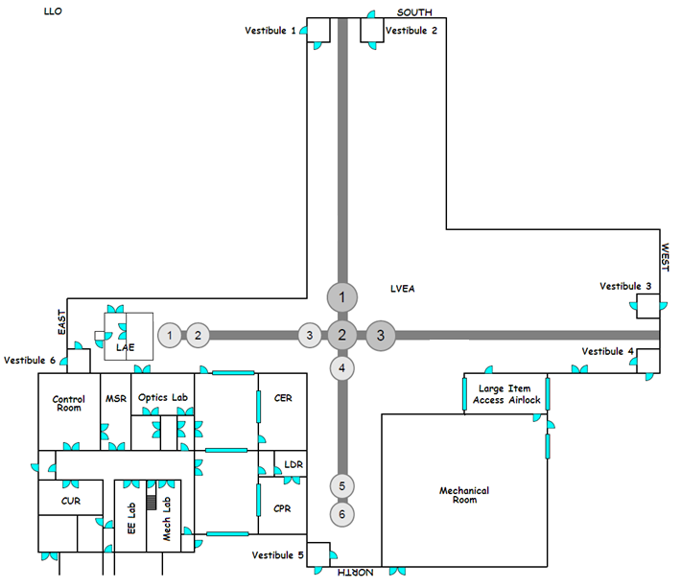
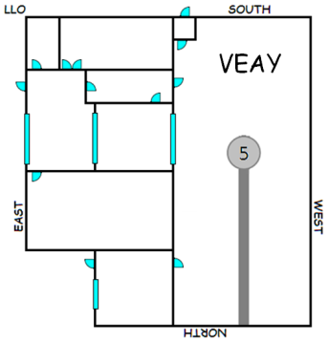
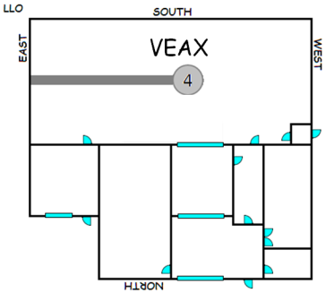
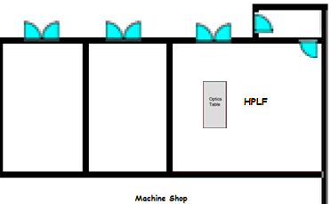
LVEA Laser Hazard Light at Entrances
<< Laser Hazard Lights
ENTRANCES:
LVEA Entrance
AIRLOCK Entrance
LDR Entrance
LAE Entrance
OPTICS LAB
VEAX Entrance
X-END OPTICS LAB
VEAY Entrance
Y-END OPTICS LAB
HPLF Entrance
Lights at ENTRANCES demark NOMINAL HAZARD ZONES (NHZ) where laser safety eyewear is required when the zone is in a HAZARD condition.

Slide 15
LVEA Laser Hazard Light on Tables
TABLES:
ISCHT1L (IMC)
IOHT2L
IOHT2R
ISCHT6R (OMC)
TCSHT4R (Hartmann)
TCSBT1R (TCS-Y)
TCSBT3L (TCS-X)
ISCBT5R (VEAY)
ISCBT4L (VEAX)
PCALX
PCALY
ISCBT5R
PCALY
Lights on a TABLE ENCLOSURE indicate the condition of the integrity of that table enclosure. If a table is closed, then that table cannot contribute any possible laser hazard. If a table is open, then that table might contribute a possible hazard.
TCSBT1R
ISCHT1L
IOHT2L
IOHT2R
TCSBT3L
TCSHT4R
PCALX
ISCBT4L
ISCHT6R

Slide 16
Section 3 - LLO Laser ESTOPs
<< Index
Suppose there is a problem that demands that all the lasers be shut off …
right now.

Slide 17
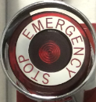
LLO Laser ESTOP Requirement
"Push one of these buttons and the lasers are off.“
- Joe Giaime
EMERGENCY
LASER ESTOP

Slide 18
LLO ESTOP Corner Building Locations
ESTOP buttons are RED mushroom buttons marked EMERGENCY STOP. They are located in a variety of places.
If any ESTOP is pressed, all detector lasers lose their interlocks and cease lasing. These lasers are the PSL, TCS-X CO2, TCS-Y CO2, and the Hartmann SLEDs.
In addition, when a Corner Station ESTOP is pressed, the LVEA entrance door, the LVEA AIRLOCK door, and the LDR door will be unsecured allowing them to be opened from the outside without using access cards.
LAE (PSL) Air Shower Entrance
ISCHT1L
TCSBT1R
IOHT2L
6
8
10
5
TCSBT3L
7
IOHT2R
12
2
11
4
TCSHT4R
Control Room
1
LDR Entrance Door
LVEA Entrance Door
LVEA AIRLOCK Door
3a
3b
9
ISCHT6R
Button Types
1. Table
2. Entrance

Slide 19
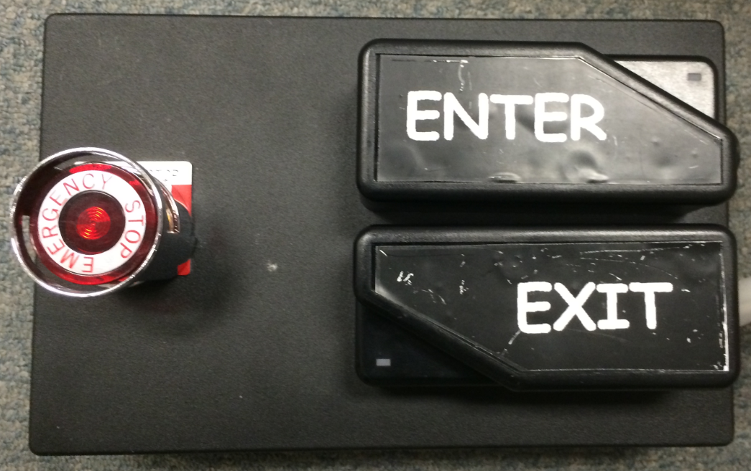
Table Button Type (Standard Access Box)
There is a Standard Access Boxes on each table enclosure, plus one at the entrance to the LAE (PSL) Air Shower.
An ESTOP Button is provided on each Standard Access Box.

Slide 20
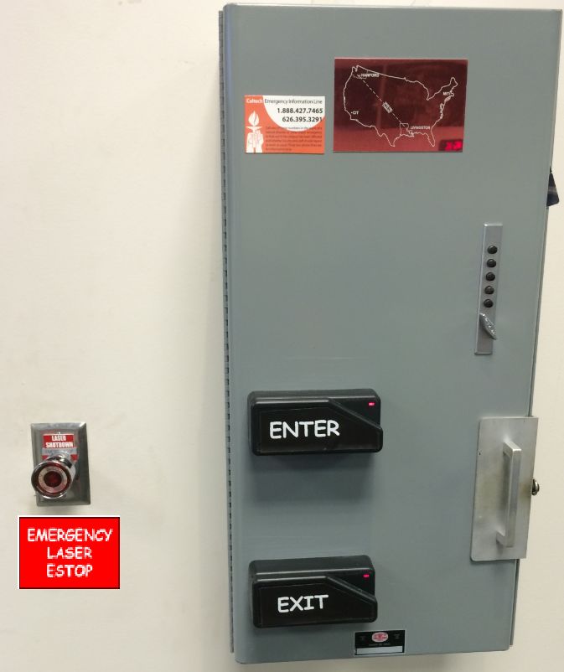
Entrance Button Type
There is an ESTOP Button in the control room beside the key box.

Slide 21
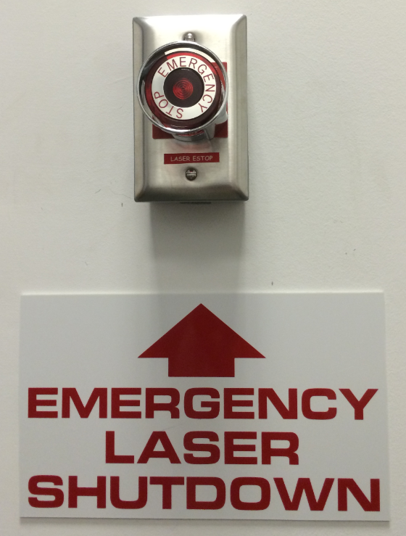
Entrance Button Type
There are also ESTOP Buttons strategically located at entrance doors.
There is an ESTOP Button at the LVEA entrance door.
There is an ESTOP Button at the LARGE AIRLOCK entrance door.
There is an ESTOP Button at the LDR entrance door.
There is an ESTOP Button inside the LDR.

Slide 22
What Happens If …
If an ESTOP is pressed:
The ESTOP that was pressed causes the latching circuit to unlatch, causing all of the interlocks to be disengaged, causing the various lasers to cease lasing. The ESTOP that was pressed must itself be reset before the ESTOP Control Box is capable of being reset.
An ESTOP Event must be thoroughly investigated by the LSO before any further work can proceed. It is a mandatory ‘STOP WORK’.
If there is a POWER FAILURE:
The ESTOP Control Box will lose power, causing the latching circuit to unlatch, causing all of the interlocks to be disengaged, causing the various lasers to cease lasing.
As part of the recovery from a power failure, the ESTOP Control Box must be reset before any laser can be recovered.

Slide 23
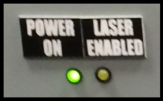
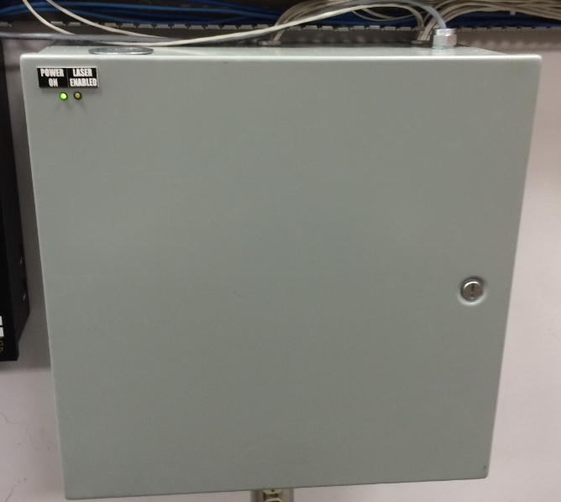
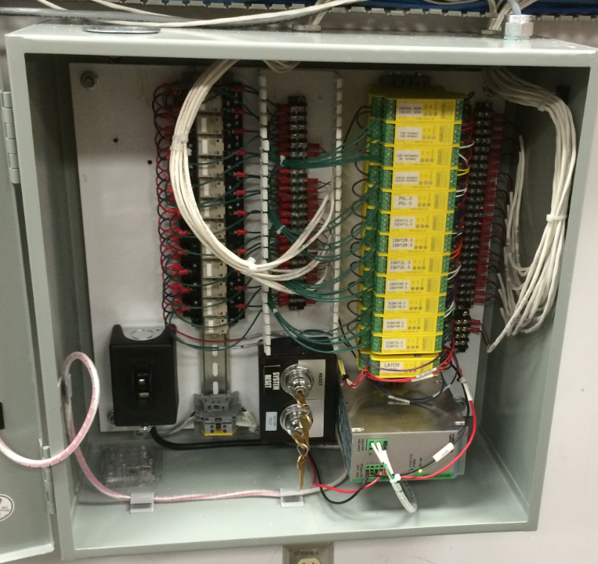
Corner Station ESTOP Control Box - OFF
The Corner Station ESTOP Control Box is located in the MSR.
When the Laser Enabled LED (Yellow) is OFF, lasers are prevented from lasing.

Slide 24
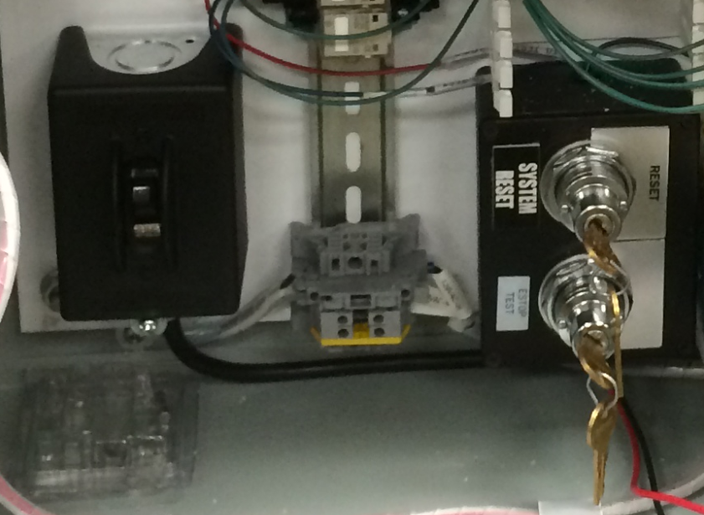
Corner Station ESTOP Control Box - Controls
To enable the lasers, the ESTOP Control Box must be reset.
RESET Switch
(Keyed)
(Momentary)
AC On/Off Switch
TEST Switch
(Keyed)
(Maintained)
AC 10A Fuse
Note: If the Power On LED (Green) is not lit, consider:
the On/Off Switch
the Fuse
The Circuit Breaker

Slide 25
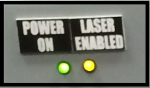
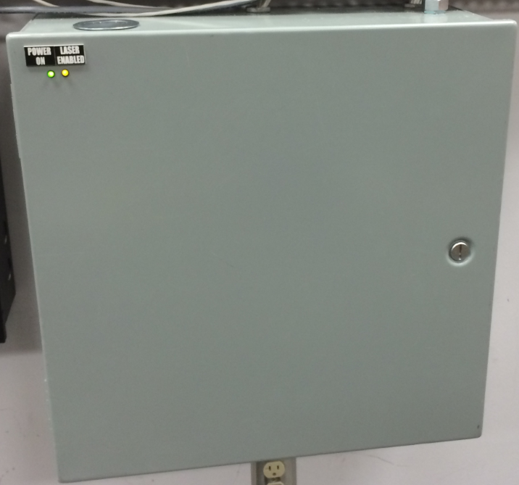
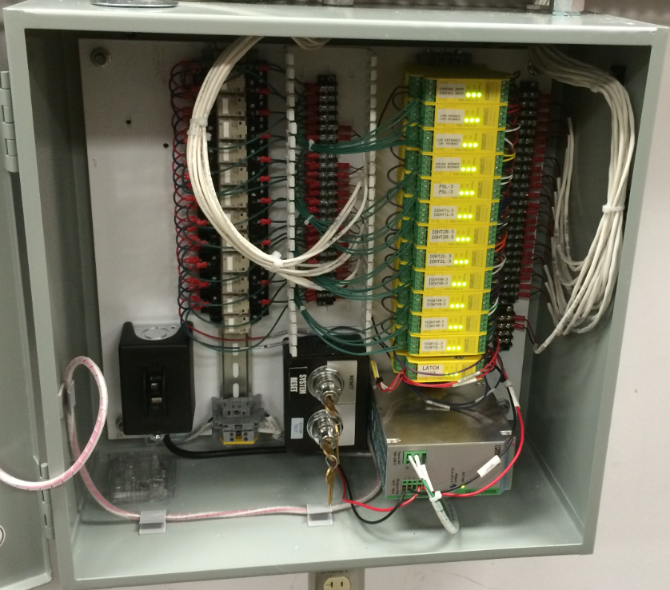
Corner Station ESTOP Control Box
When the Laser Enabled LED is ON, lasers are not prevented from lasing.
Note: This does NOT mean any laser is on.

Slide 26
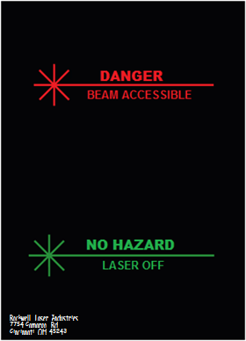
ESTOPs and Laser Hazard Lights
Laser Hazard Lights indicate the status of a Nominal Hazard Zone (NHZ). When an NHZ is HAZARD, laser safety eyewear is required.
The status of an NHZ is not based on the actual presence of a laser hazard. Instead, the status is defined by a transition and is signaled by the zone’s Laser Hazard Lights.
Although an ESTOP Event causes all controlled lasers to cease lasing, it will not change the status of the NHZ, that is, it will not change the state of any Laser Hazard Light.
During an ESTOP Event, one of the first things that must be decided is whether or not to transition the NHZ. This is a manual procedure precisely because there may be mitigating circumstances, and because other actions to insure a safe NHZ cannot be automated.

Slide 27
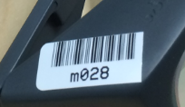
LLO Laser Safety Eyewear
<< Index
Laser Safety Eyewear is the Personal Protection Equipment required to be worn by any person who enters a Nominal Hazard Zone (NHZ) NHZ is HAZARD.
There are three categories of Laser Safety Eyewear that correspond to the hazardous frequencies that are present in various NHZs.
ALL Laser Safety Eyewear is marked according to Category.
Category J is for all frequencies in the LVEA.
Category K is for all frequencies in the PSL and LDR.
Category M is for all frequencies in the VEAX and VEAY.
Some helpful suggestions:
Be sure the eyewear you use is correct for the area you are entering.
Compare the OD written on the eyewear with the OD requirements on the laser hazard signs.
Clean the eyewear from time to time.
Inspect the eyewear for structural and optical integrity.
Return the eyewear to where you got it.

Slide 28
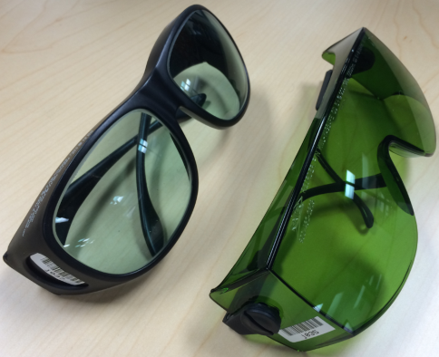
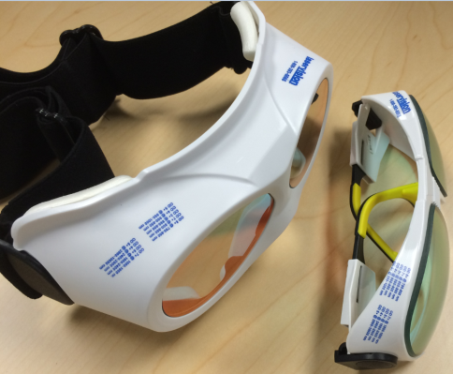
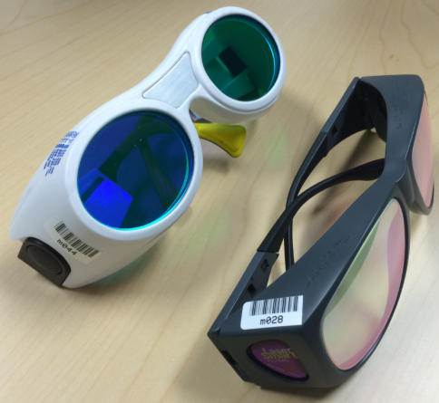
LLO Laser Safety Eyewear Categories
<< Laser Safety Eyewear
Category J is for all frequencies in the LVEA ONLY.
These are:
150 mW @ 900 nm (Hartman) (OD2.2) 150 mW @ 950 nm (Hartman) (OD2.1) 200 W @ 1064 nm (PSL) (OD5.1) 80 W @ 10,600 nm (TCS) (OD4.0)
Category K is for all frequencies in the PSL and LDR.
These are:
315 W @ 808 nm (PSL Pump Diodes) (OD5.7) 200 W @ 1064 nm (PSL) (OD5.1)
(NOTE: One must walk through the LVEA to get to the PSL, so
for convenience, Category K eyewear also cover the LVEA frequencies.)
Category M is for all frequencies in the VEAX and VEAY.
These are:
50 mW @ 532 nm (ALS) (OD2.2)
500 mW @ 1047 nm (Photon Calibrators) (OD2.5) 200 W @ 1064 nm (PSL, ALS is only 1.5 W) (OD5.1)
(NOTE: Category M will also cover ALL frequencies in ALL NHZs, but they are harder to see through.

