Slide 1
Joe Weber and the “original sin” of gravitational wave detection
Peter R. Saulson
Syracuse University

Slide 2
Outline
Who was Joe Weber?
Weber’s myriad original contributions
Weber’s observations of gravitational waves and how they were supported
Others replicate his observations without success
How were the conflicts resolved?
What lessons can we learn for the future?
What is the burden of “original sin”?

Slide 3
Joe Weber at Chapel Hill
Joe Weber, co-inventor of the maser, was a U Md professor, on sabbatical in 1956 -57 with John Wheeler at Princeton.
At the Chapel Hill conference in Jan 1957, they heard the key talk by Pirani that clarified that GW’s were real, because they could (in principle) be detected.

Slide 4
Joe Weber starts GW detection
Weber and Wheeler recapped Pirani’s argument in a paper written within weeks of the Chapel Hill conference.
Weber developed the experimental ideas in two Gravity Research Foundation essays (3rd prize 1958, 1st prize 1959), leading to his 1960 Phys. Rev. paper laying out the bar program.

Slide 5
Weber’s bar
Weber’s detector embodied Pirani’s gedankenexperiment.
It was a cylinder of aluminum, each end of which is like a test mass, while the center is like a spring. PZT’s around the midline absorb energy to send to an electrical amplifier.

Slide 6
Weber invented us from scratch
It was an act of genius (and/or madness) to transform a gendankenexperiment into a working apparatus and an observing program.
Along the way, Weber developed:
Sensitivity calculation and noise analysis
Thermal noise minimization by high Q
Seismic isolation
Coincidence for background rejection
Time slides for background estimation

Slide 7
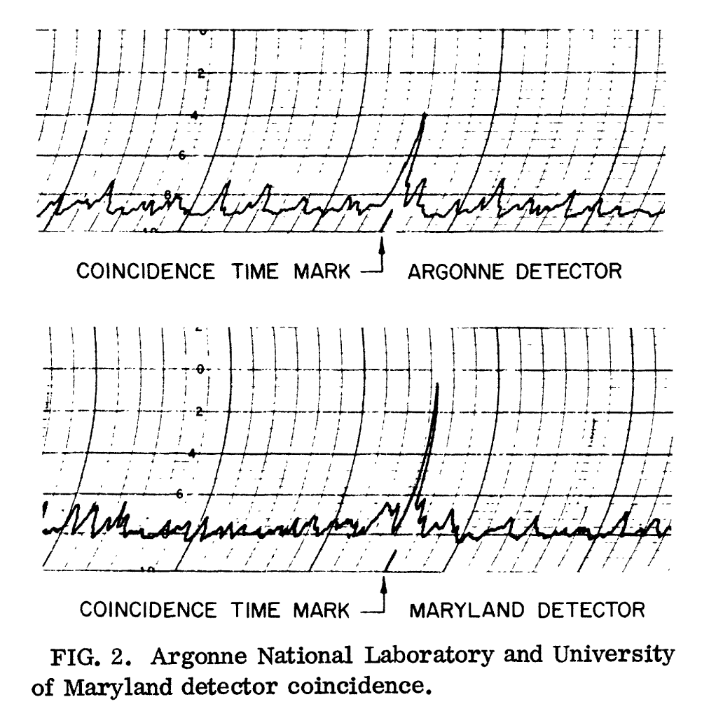
Weber started seeing things
In 1969, Weber made his first of many announcements that he was seeing coincident excitations of two detectors.

Slide 8
“Therefore it is quite certain that all of the coincidences cannot be accidental.”

Slide 9
Sidereal correlation points to the Galactic Center

Slide 10
True, or too good to be true?
Weber’s claims set the world on fire. It seemed that Weber had “opened a new window on the universe.”
Of course, if his observations were correct, the signals would have been shockingly large – the Galaxy should be blowing itself up in less than a Hubble time.
Many other groups started building resonant bars, including: Glasgow, Rome, Frascati, Munich, Bell Labs, and IBM (among others).

Slide 11
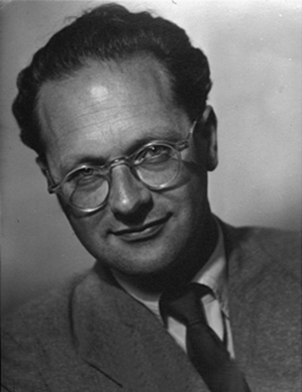
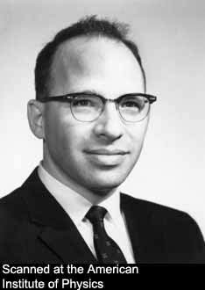
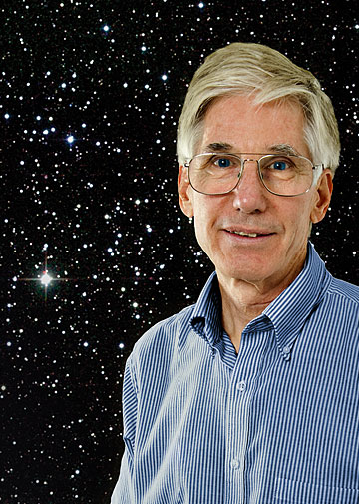
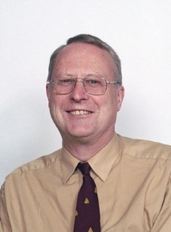
Joining the quest …
Edoardo Amaldi, Rome
Richard Garwin, IBM
Tony Tyson, Bell Labs
Ron Drever and Jim Hough, Glasgow

Slide 12
Billing and the bar at Munich

Slide 13
Sadly/inevitably, it became clear that Weber’s signals weren’t real
Starting in 1972, attempted replications by many groups all failed to see signals like Weber had claimed.
Weber had seen rather steady (and large) rates of GW pulses, so even one month of operation without detections was taken to contradict Weber’s results.

Slide 14
Doubts about Weber’s own procedures
In his early (1970 and earlier) analyses, Weber had found coincidences by eye while scanning paper recordings of instrument output. The possibilities for bias were apparent.
At others’ urging, Weber switched to computerized analysis. But at the CCR5 meeting in 1974, David Douglass (Rochester) announced that he had found a bug that produced numerous false coincidences.
Also at CCR5, Douglass revealed that Weber had mistaken the time stamp on Rochester data by 4 hours, but still had found significant coincidences at “zero” delay.

Slide 15
What went wrong?
Numerous technical mechanisms have been proposed for Weber’s false coincidences. None have stuck.
Weber never carried out a blind analysis. And, he often stated that he believed the main way to judge a search for gravitational waves was whether it produced signals.
Weber also made it difficult to learn details of his analysis.

Slide 16
What went right?
This is a textbook case of attempted replication of an important but controversial experimental claim.
It took only a few years for replications to be carried out and for a consensus to form that Weber must have been wrong.

Slide 17
The afterlife of the Weber affair
Weber lived a long and active life, until 2000. He never agreed that his results were wrong. He kept making observations and announcing detections. (He “saw” SN1987a, e.g.)
His continual presence reminded us that our field was born in controversy. Without any formal closure (in particular, any agreement on what had gone wrong), it was hard to leave that episode in the past; in effect, we replayed the Weber affair all the time.

Slide 18
Can we avoid the faults of Weber?
There is no second independent global network of interferometers to check a detection claim. (Is there one for pulsar timing?)
However, we can ensure that:
We carry out carefully documented blind analyses.
We make our data available and our procedures transparent to others.

Slide 19
The burden of history?
Are Weber’s sins our burden to carry and to atone for, or do Weber’s sins only burden those with memories as long as mine?
That is for our community to judge.

