Slide 1

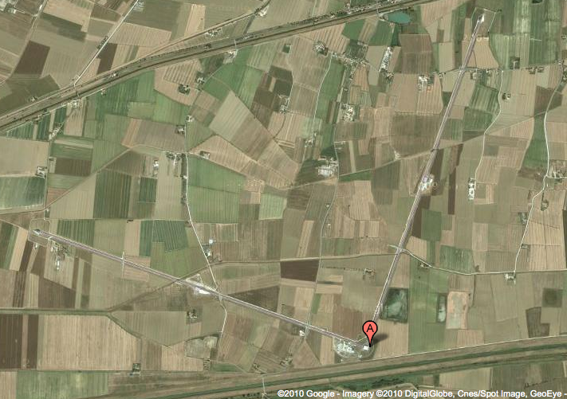
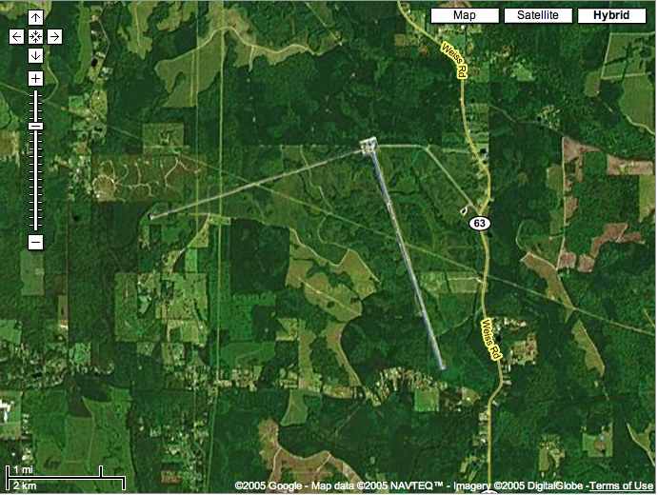
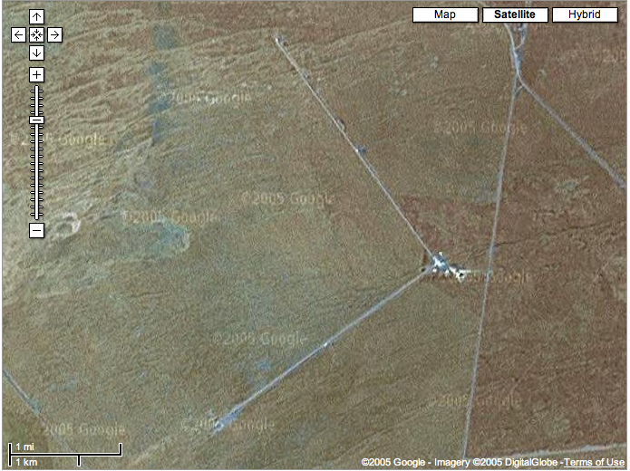
Opening the Gravitational Wave Window
Gabriela González
Louisiana State University
For the LIGO Scientific Collaboration and
the Virgo Collaboration
2014 CAP Congress - Sudbury, Ontario (Laurentian University)
June 18, 2014
Virgo detector, Cascina, Italy
LIGO Livingston Observatory,
Louisiana, USA
LIGO Hanford Observatory
Washington, USA

Slide 2
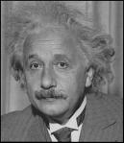
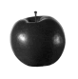
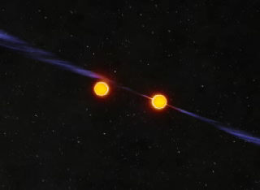


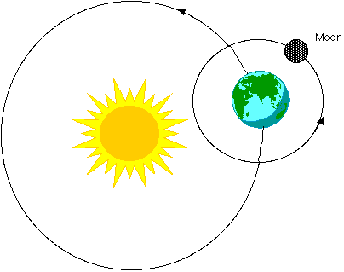
Einstein’s gravitation
When masses move, they wrinkle the space time fabric, making other masses move…
Explains just as well as Newtons’ why things fall and planetary motion…
.. but it also predicts
traveling away from moving masses!
gravitational waves

Slide 3
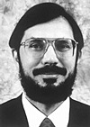
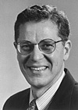
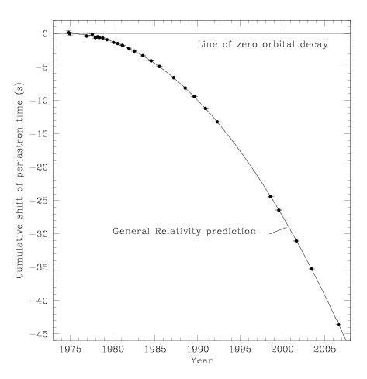
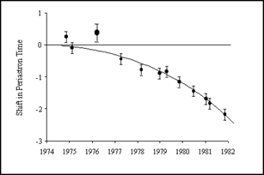
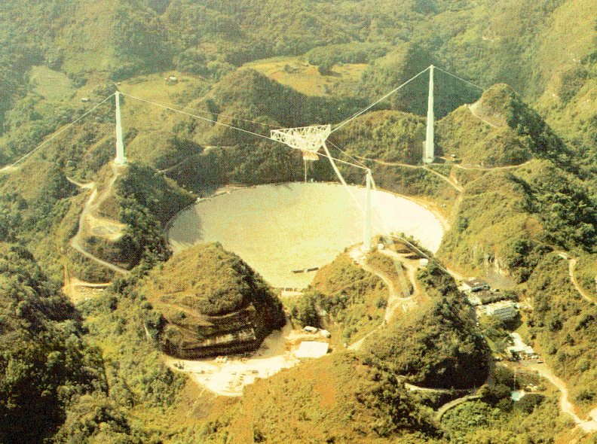
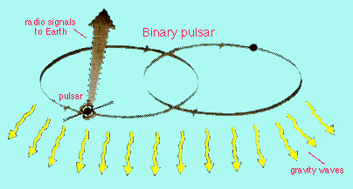
Gravitational Waves: they exist!
Hulse, Taylor
Nobel Prize 1993
Binary systems lose energy due to
gravitational radiation
(Hulse and Taylor, PSR 1913+16),
showing up in their orbital parameters.
Weisberg, Nice & Taylor, 2010
(Courtesy Joel Weisberg)

Slide 4




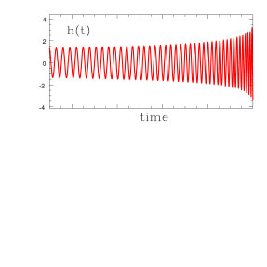
Gravitational waves
Gravitational waves are quadrupolar distortions of distances between freely falling masses. They are produced by time-varying mass quadrupoles.
A NS-NS coalescence in the Virgo cluster has h ~ 10⁻²¹ near Earth:
changes the distance between the Sun and the Earth by ~ one atomic diameter, and
changes 1km distance by ~10⁻¹⁸ m
Notes:
4
1AU x 1e-21 = 149 598 000 000 meters x 1e-21 = 1.5e11m x 1e-21 = 1.5 e-10 m = 3 Bohr radius
1 Bohr radius = 0.5 e-10 m
1km x 1e-21 = 1.5 e-10 m = 3 Bohr radius
1 Bohr radius = 0.5 e-10 m

Slide 5

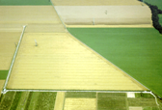



The GW Detector Network 2005-2010
LIGO Hanford
GEO600
Virgo
LIGO Livingston
5

Slide 6
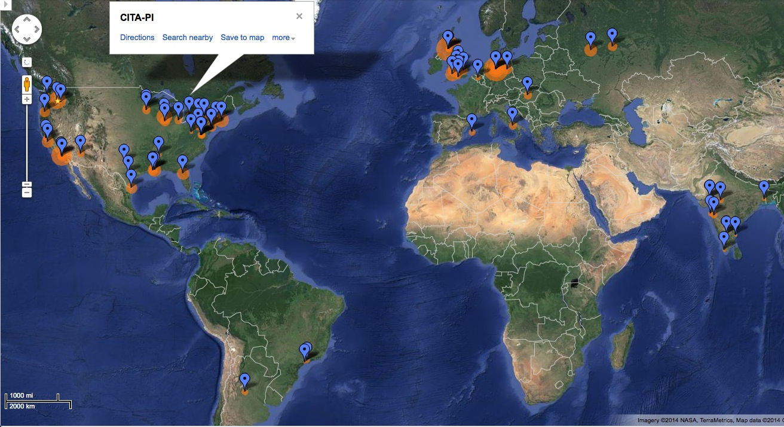
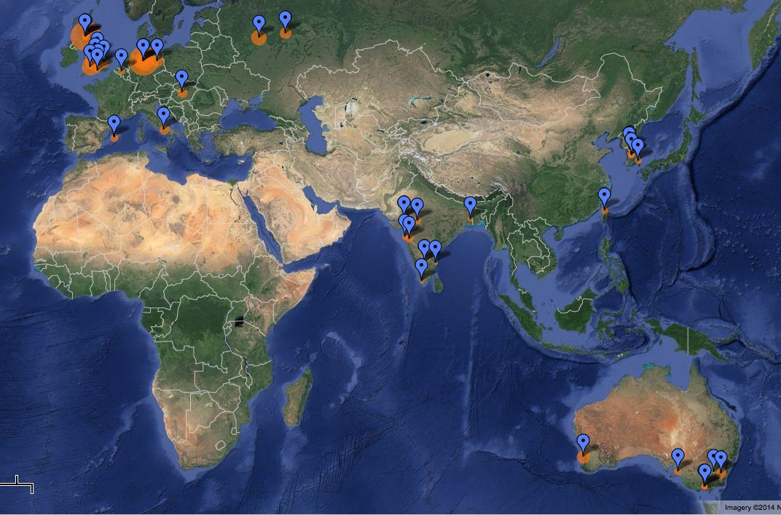
LIGO Scientific Collaboration
900+ members, 80+ institutions, 16 countries
www.ligo.org

Slide 7
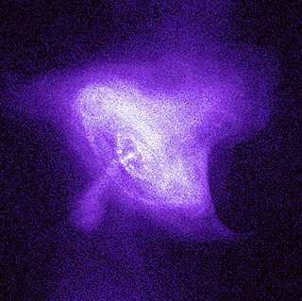
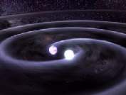
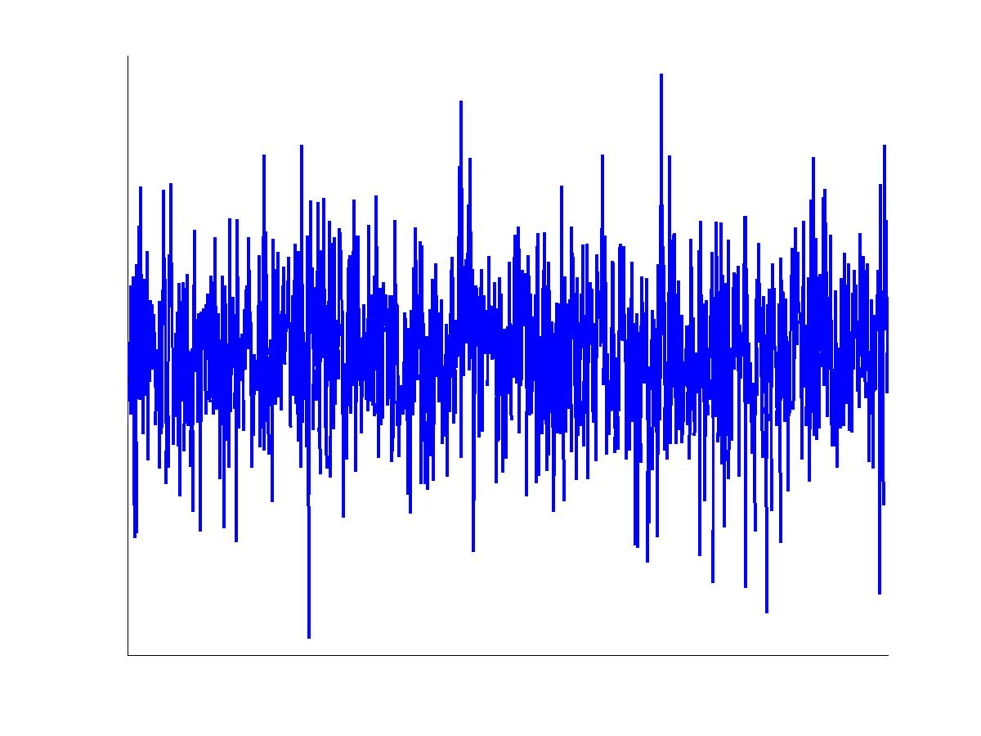
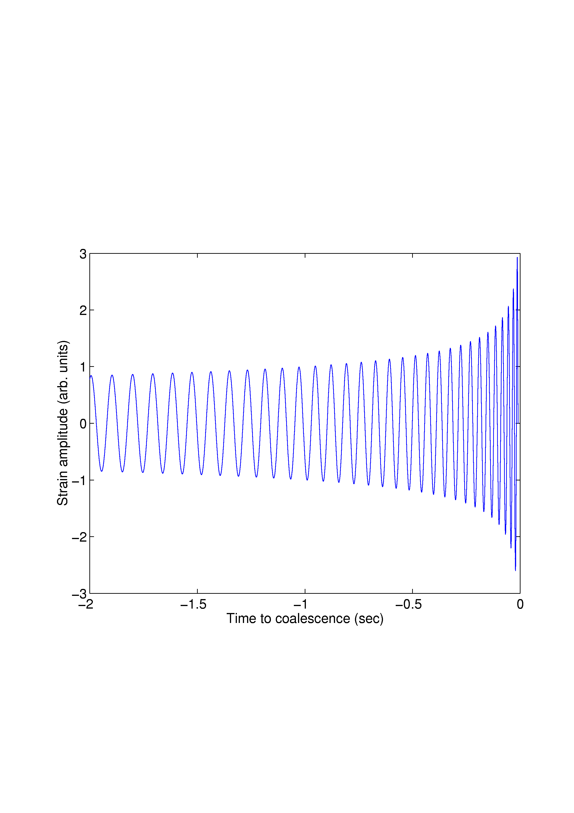
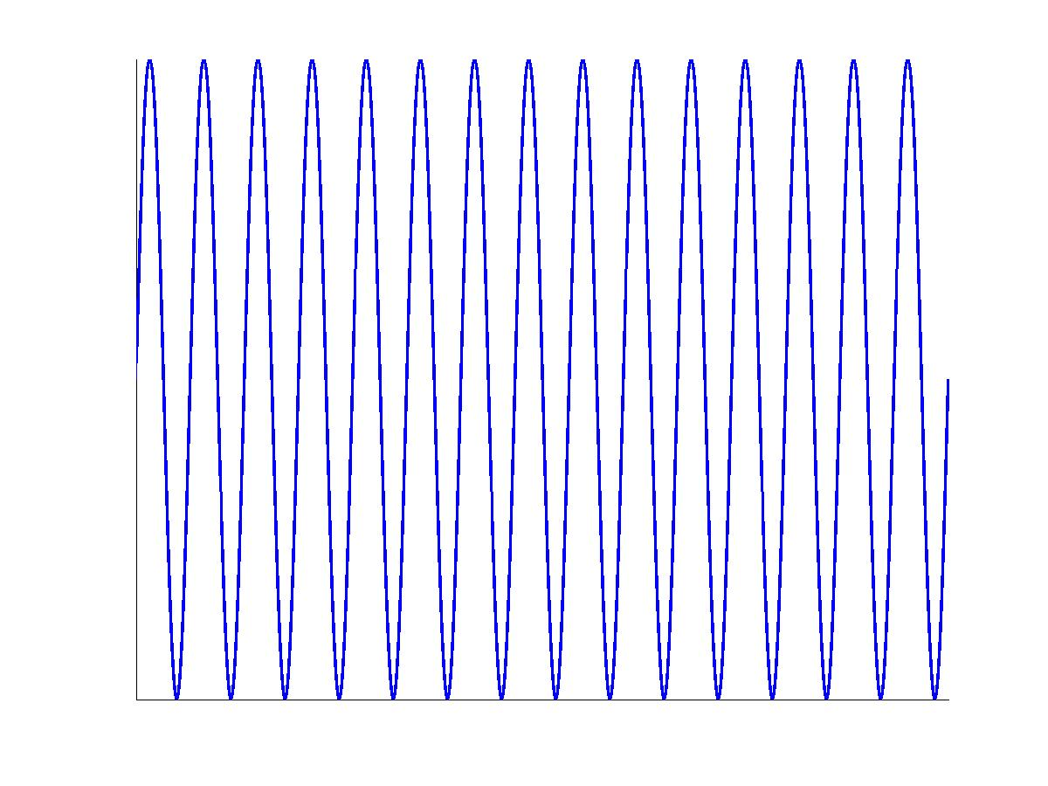
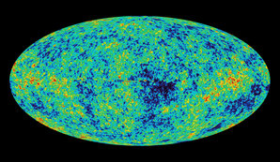
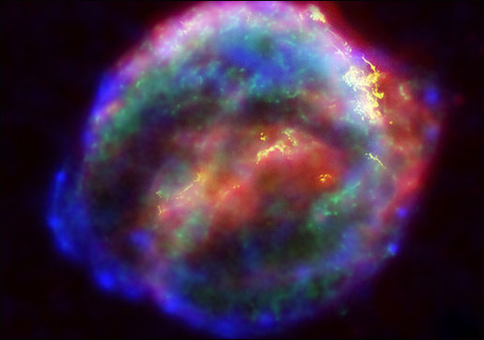
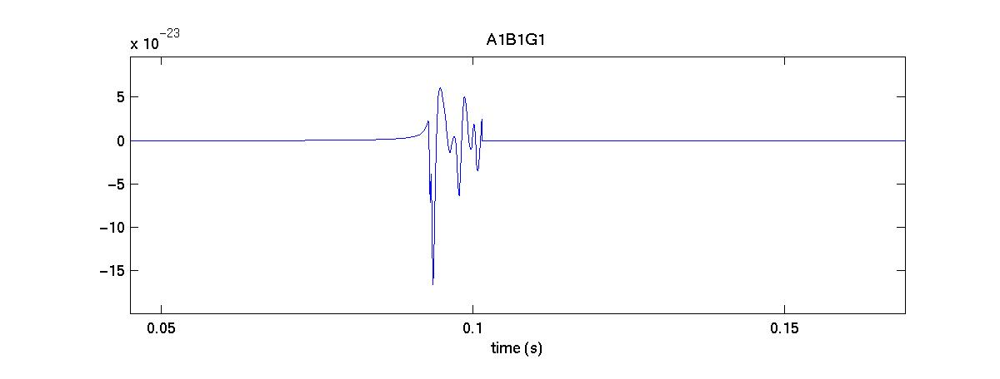
LIGO Detectors 2009-10
Crab pulsar (NASA, Chandra Observatory)
Strain (1/√Hz)
NASA, WMAP
?
Find all LSC results and publications in www.ligo.org - science tab

Slide 8
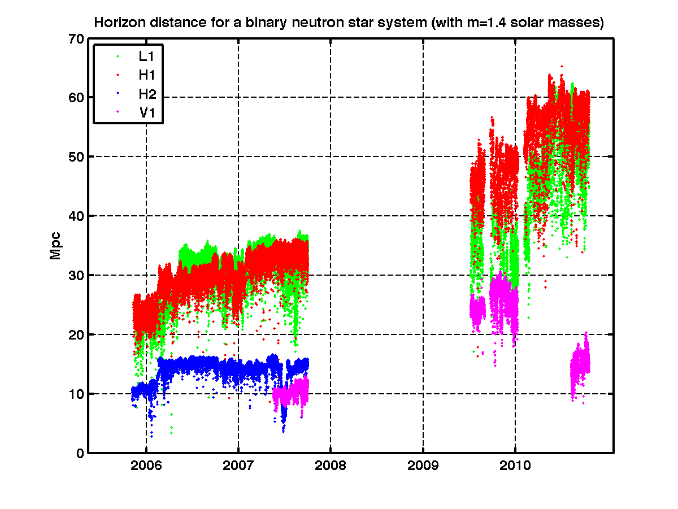
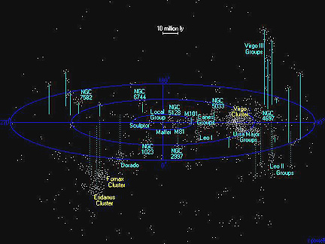
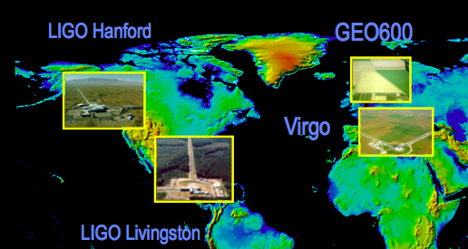
LIGO-Virgo detectors 2005-2010
atlasofthe universe.com

Slide 9
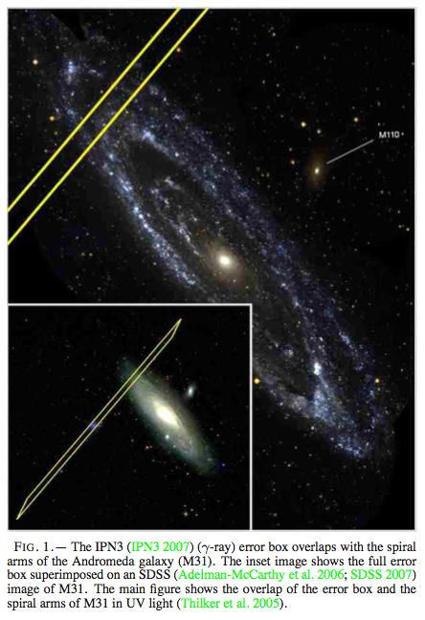
Some interesting results 2005-2011
Astrophys. J. 681 (2008) 1419
GRB070201
GW100916
Phys. Rev D85 (2012) 082002

Slide 10
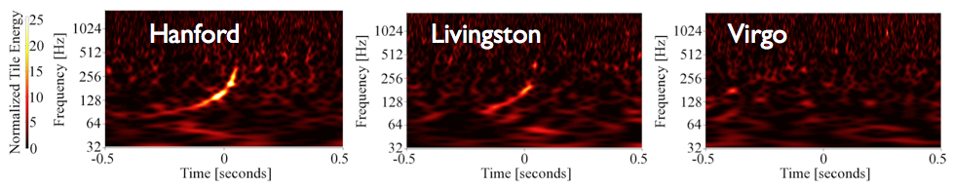
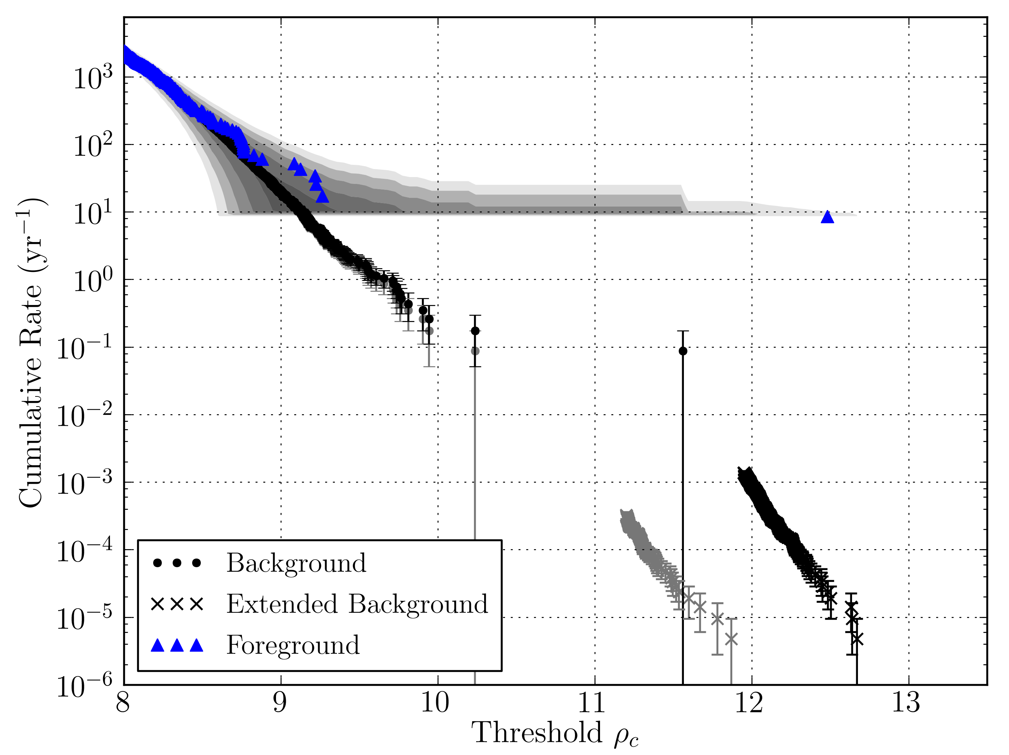
Sept 16, 2010: “Big Dog trigger”
False alarm rate ~1/7000 yrs!
Phys. Rev D85 (2012) 082002
You can get (and listen to!) the detector data and other details: http://ligo.org/science/GW100916/
http://ligo.org/news/blind-injection.php

Slide 11
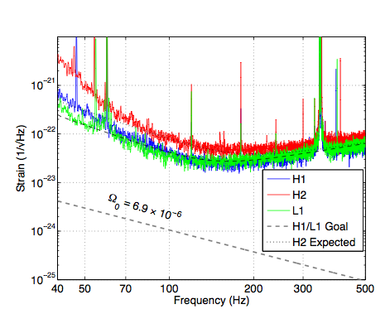
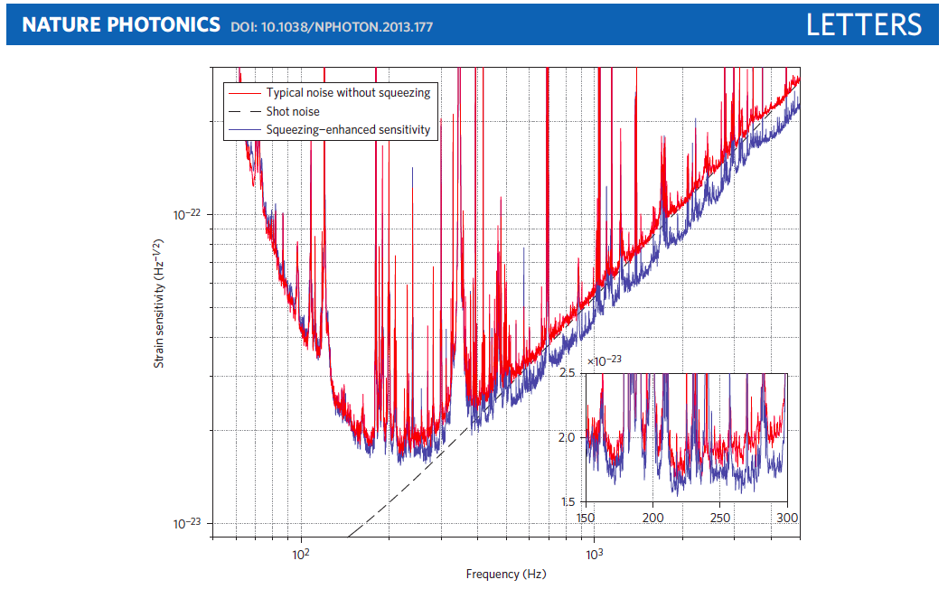
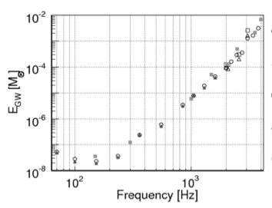
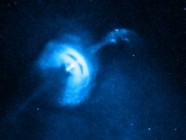
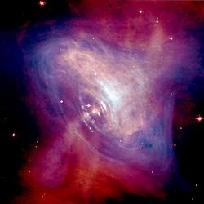
Some other LVC Results
Upper limit on GW stochastic background
Quantum-enhanced sensitivity!
Nature 460 (2009) 990
Upper limit on GW energy emitted
by generic sources at 10 kpc
Upper limits on GW emissions from
Crab and Vela pulsars
(X-ray: NASA/CXC/Univ of Toronto/M.Durant et al;
Optical: DSS/Davide De Martin)
Phys. Rev. D 81 (2010) 102001
NASA/CXC/ASU/J Hester et al. (Chandra);
NASA/HST/ASU/J Hester et al. (Hubble)
Astrophys. J. 737 (2011) 93
Astrophys. J. 722 (2010) 1504

Slide 12
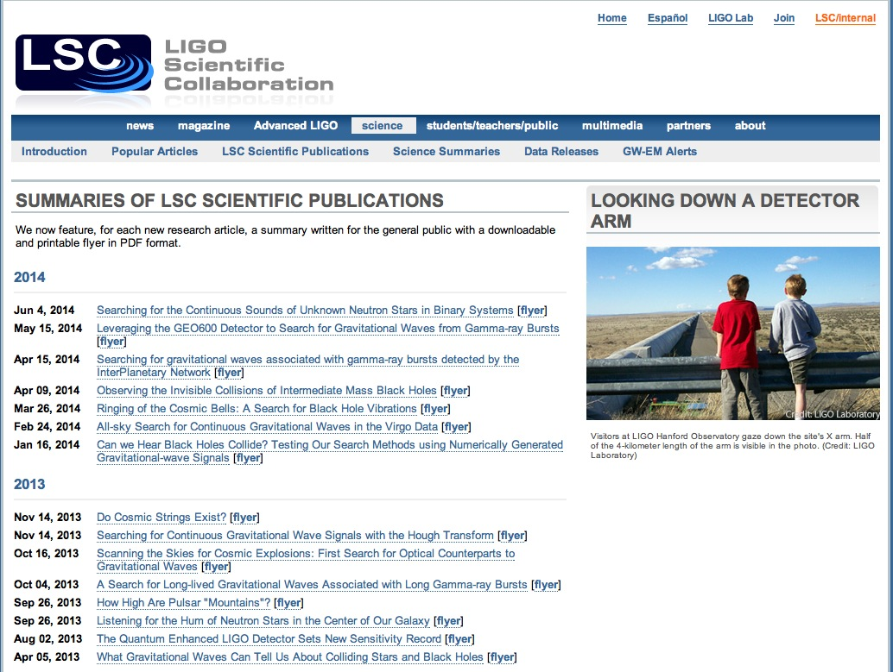
www.ligo.org/science

Slide 13

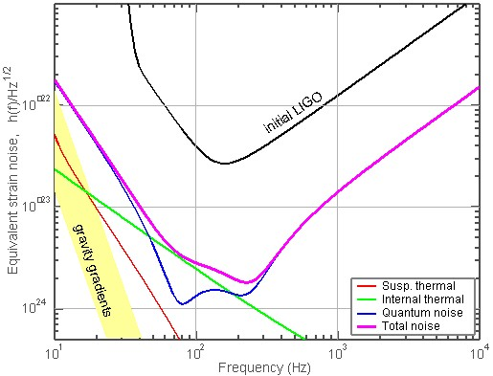

Now under construction: Advanced LIGO
Advanced LIGO
~10 times better than initial LIGO
Installation in progress, going very well, almost done !!
Coincident “lock” in ~2014 (already achieved at LLO!),
science runs starting in 2015
with increasing sensitivity to follow.

Slide 14
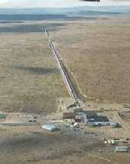
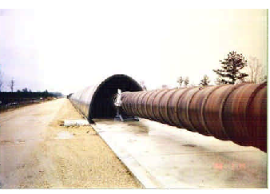
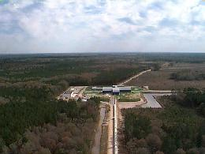

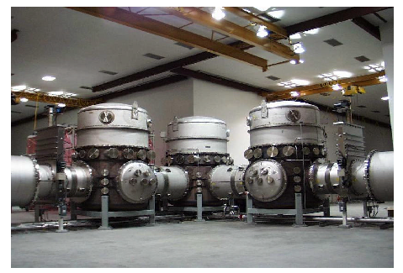
In progress: Advanced LIGO
Ten times better!
Vacuum system – same as initial LIGO
Advanced LIGO
US NSF funding for Advanced LIGO: 2008-2015.

Slide 15
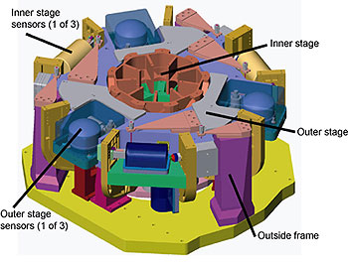
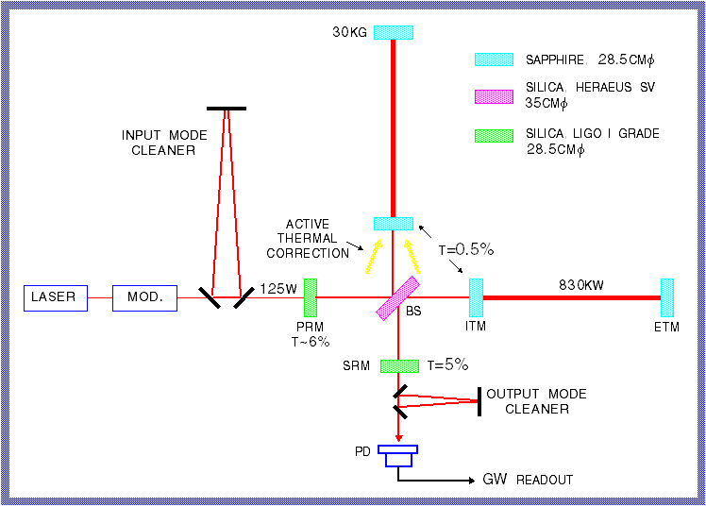
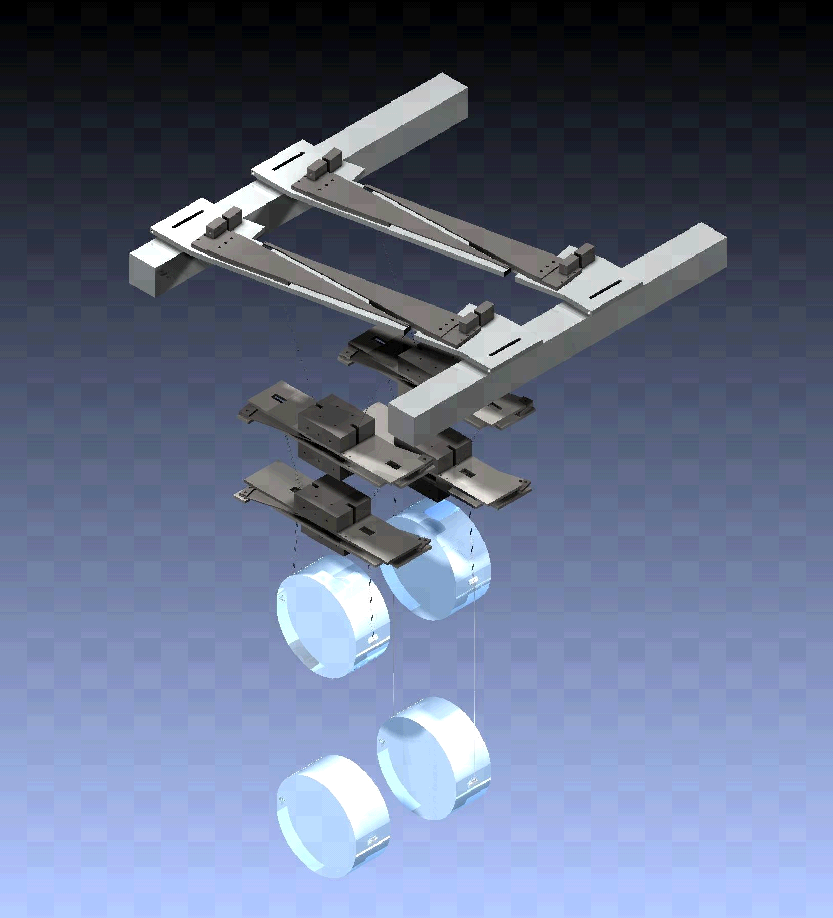
What’s advanced in Advanced LIGO?
Major technological differences between LIGO and Advanced LIGO
40kg
Advanced LIGO
Active vibration isolation systems
Quadruple pendulum:
Silica optics, welded to
silica suspension fibers
High power laser (180W)
More details on R&D for Advanced LIGO and for future detectors in Riccardo Bassiri’s talk this afternoon
Advanced interferometry
Signal recycling

Slide 16
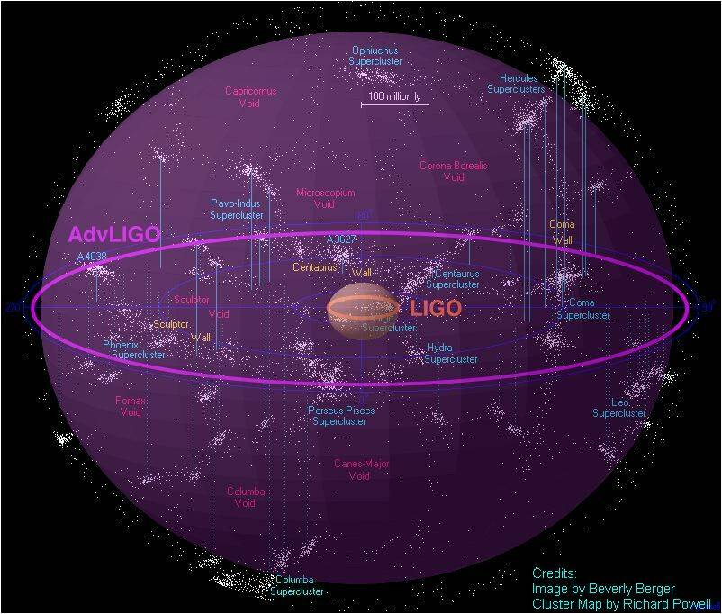
What will Advanced LIGO see ?
Advanced LIGO
Neutron Star Binaries:
  Initial LIGO:
  Average BNS reach ~15 Mpc → rate ~1/50yrs
  Advanced LIGO: ~ 200 Mpc
  “Realistic rate” ~ 40/year (but can be 0.4-400)
  Other binary systems:
  NS-BH: 0.004/yr → 10/yr
  BH-BH: 0.007/yr→ 20/yr
Class. Quant. Grav. 27, 173001 (2010)
Notes:
P0900125-v8

Slide 17
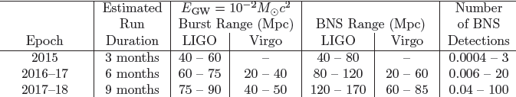
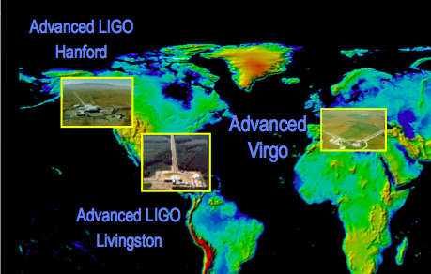
Coming soon near you:
Advanced GW Detectors running!
arXiv:1304.0670

Slide 18
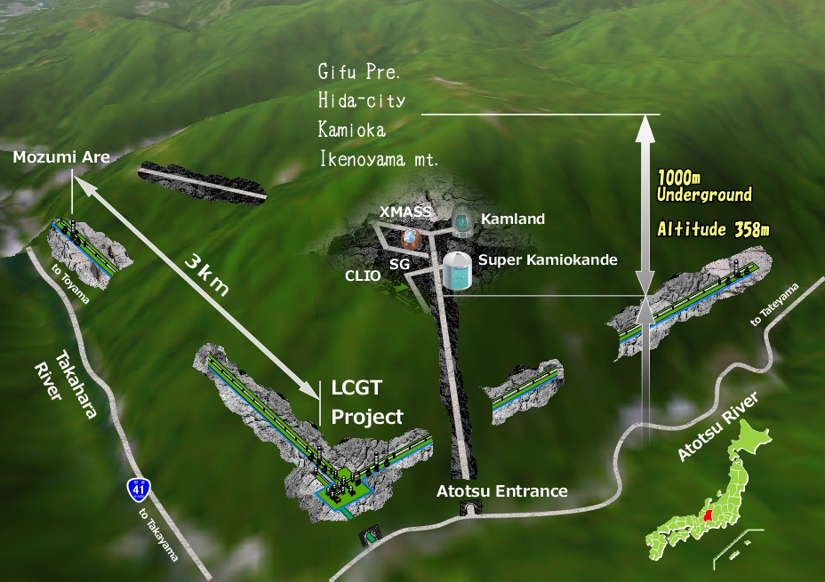
The GW Detector Network~2020
Advanced LIGO
Hanford
GEO600
Advanced
Virgo
KAGRA
Advanced LIGO
Livingston
LIGO-India
18

Slide 19
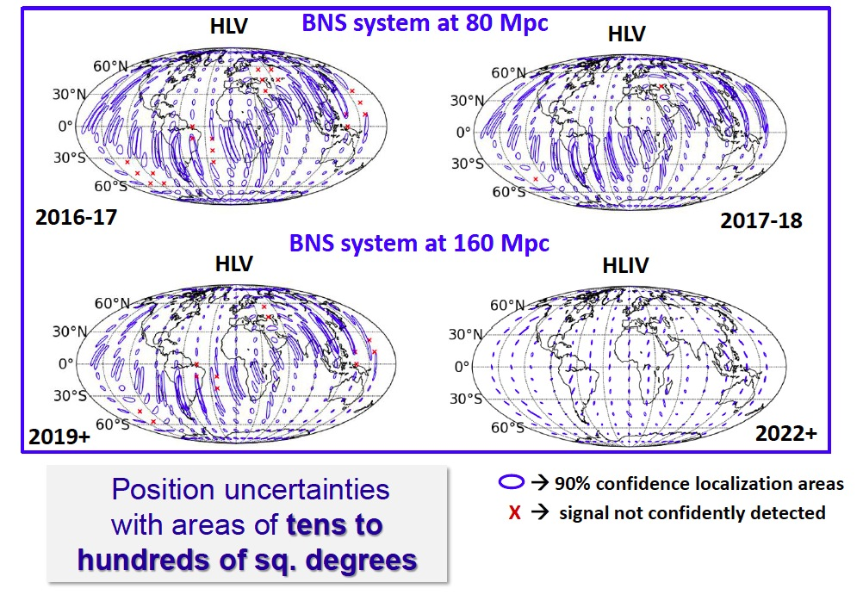
More detectors = better localization

Slide 20




Multi-messenger astronomy:
GW/EM observations
After detecting GW signals, we would like to …
Consider the signal in its astrophysical context
Give a precise sky localization, identify host galaxy
Get more insight into the physics of the progenitors (mass, spin, distance..) and their environment (temperature, density, redshift..)
We will obtain this picture combining gravitational-wave and electromagnetic information: Multi-messenger astronomy!
LSC and Virgo opened a call to sign agreements for the identification of EM counterparts to GW triggers in Advanced detectors starting in 2015.
We received more than 60 applications from 19 countries, with about 150 instruments covering the full spectrum, from radio to high-energy gamma-rays!
Shortly after a few detections, LSC/Virgo will publicly release GW triggers for follow up.
More details in Kipp Cannon’s talk on “The Exploding Sky” talk this afternoon

Slide 21


Gravitational waves are coming!
www.ligo.org

Slide 22


Initial vs Advanced LIGO
Lasers become more powerful: 10W ➔ 200 W
Advanced LIGO

Slide 23




Initial vs Advanced LIGO
Seismic isolation goes from passive to active.
Advanced LIGO

Slide 24




Initial vs Advanced LIGO
10 kg test masses on simple pendulums become 40 kg monolithic suspensions in quadruple pendulums, with better quality optics
Advanced LIGO
40 kg silica test mass
parallel reaction chain for control actuation

Slide 25

More on LIGO:
LIGO magazine in www.ligo.org

Slide 26

Multi-messenger astronomy
2010 (initial detectors)
Notes:
GEM for Swift (special requirements), LUMIN for everything else; cross checks
Sky coverage
Northern and southern hemispheres
Ideally, have at least one scope in each hemisphere in darkness at all times
Won’t be perfect because of weather, operational constraints, etc.
And events close to the Sun will never be observable (except by radio)
But pretty good coverage

Slide 27

Call for interest in EM counterparts to GW candidates
After the first four published GW events, LSC and Virgo will promptly release public triggers to be followed up.
To initiate the multi-messenger from the very beginning, LSC and Virgo opened a call to sign agreements for the identification of EM counterparts to GW triggers in Advanced detectors starting in 2015.
We received more than 60 applications from 19 countries, with about 150 instruments covergin the full spectrum,
from radio to high-energy gamma-rays!

Slide 28
The GW Detector Network~2016
Advanced LIGO
Hanford
GEO600
Advanced
Virgo
Advanced LIGO
Livingston
28

