Slide 1
System Integration Status and Challenges, Post Project Commissioning Plans to
Meet Science Goals
May 27, 2014
Daniel Sigg

Slide 2

What’s left to install
LIGO Livingston
LIGO Hanford
Complete

Slide 3
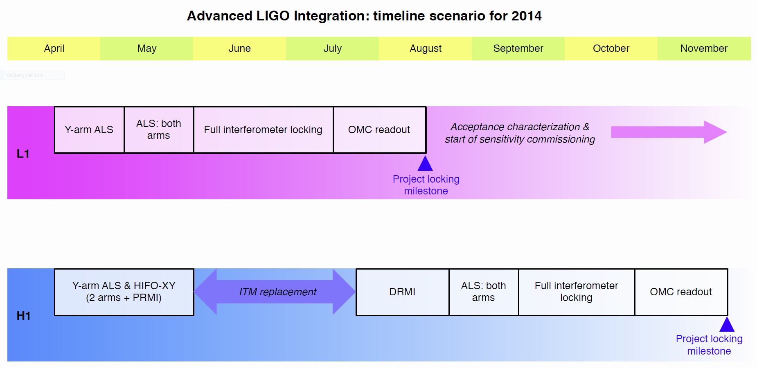
Current Timeline

Slide 4
Achievements
Pre-Stabilized Laser (PSL) was commissioned and works as designed at both at LHO and LLO
Input Mode Cleaner (IMC) has been fully commissioned
All seismic isolators (SEI) work as designed and are fully automated
All suspensions (SUS) work as designed and are fully automated
Dual Recycled Michelson (DRMI) has been fully commissioned at LLO
Arm Length Stabilization (ALS) has been commissioned at both LHO and LLO

Slide 5
Suspensions work as advertized

Slide 6
Past Commissioning Periods
One arm test (OAT)
  First arm cavity locked at LHO in summer 2012.
Input Mode Cleaner Test
  IMC locked at LLO in fall 2012, and spring 2013 at LHO.
HIFO-Y
  Commissioning the first ALS at LHO in summer 2013.
  Now also completed for H1 HIFO-X, L1 HIFO-X and HIFO-Y.
DRMI
  Locked at LLO in summer 2013.
  Also completed LHO PRMI (without AS port) in winter 2013.

Slide 7
Current Commissioning Period
HIFO-XY
  First look at arm cavity difference at both sites in spring 2014.
  Corner station ALS fully commissioned at both sites.
  Green coating issue resulted in schedule delay.
Interferometer locking
  Full lock attempt at LLO on-going.
  Common mode lock attempt at LHO on-going.

Slide 8
Top Level Summary
Initial integration testing has progressed quickly
  All major systems have performed as planned.
  No show-stoppers found.
  No true low noise test so far.
  The only significant delay was due to the green coating issue.
  Pace may not be sustainable.
Green coating issue
  Will not prevent the ALS from working.
  Additional resources had to be allocated.
  Robustness will suffer.
The locking procedure is close to being validated

Slide 9
Automation
Complexity has been a problem
  Too many variables
    Hard to know everything
    Too many steps to achieve simple tasks
    Too many things can go wrong
  Great strides are being made to improve automation
    Script approach (Guardian) and some ALS locking code (TwinCAT PLC)
    Still substantial work needed to recognize, diagnose and rectify problems, as well as user interfaces
  Keeping everything under configuration control is a problem
    How to make sure everything is in the right state?
Control room tools are not always well integrated
  Sometimes tedious and repetitive tasks are holding us back
  Need to make existing tools more useful and efficient
  Clear-text information/instructions for operators still only rudimentary

Slide 10
Arm Length Stabilization

Slide 11
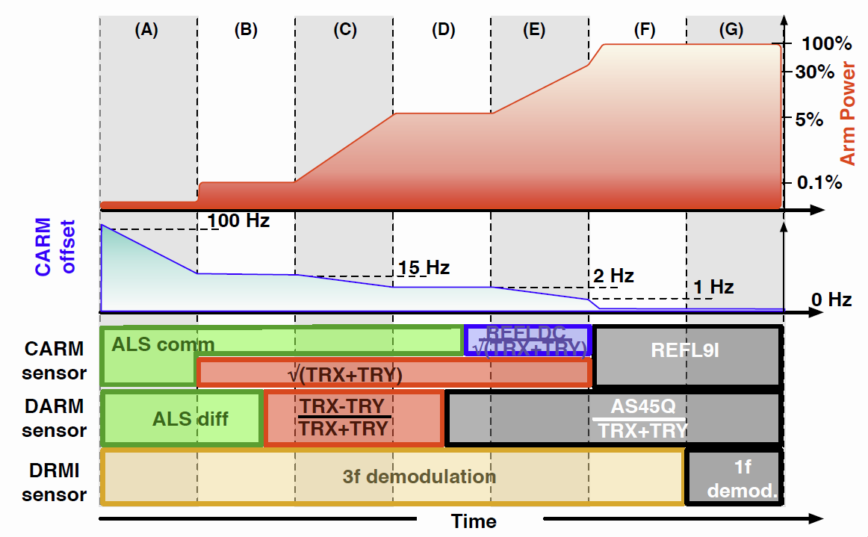
Locking Process

Slide 12
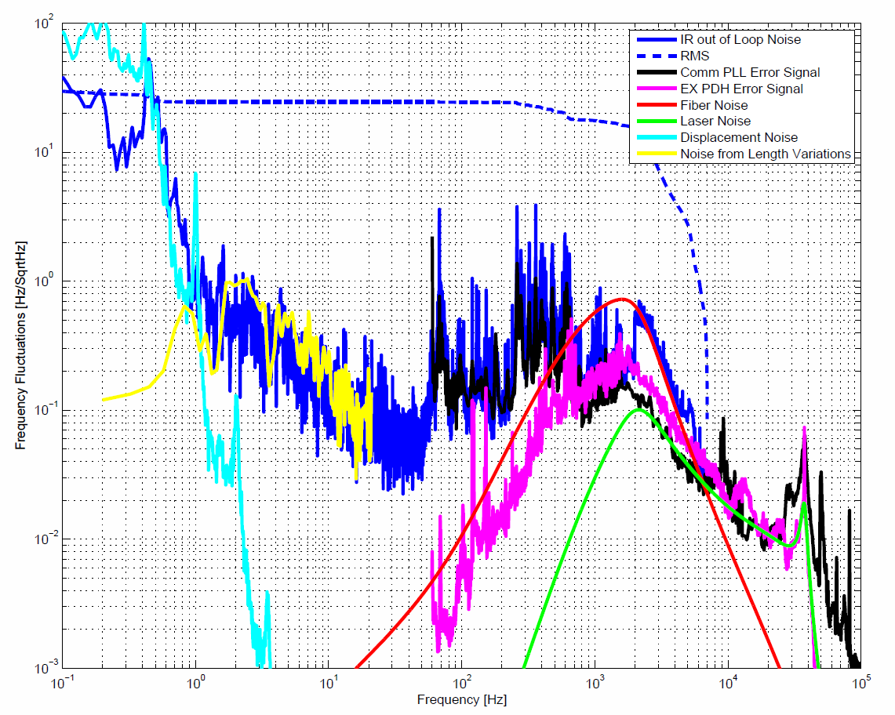
ALS Noise
Alignment
couplings
Acoustics
Cavity filtering

Slide 13
Differential Mode ALS
Suppressed
Commissioned and meets requirements

Slide 14
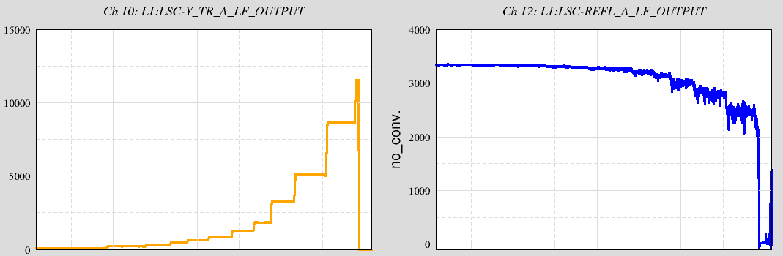
Current Effort
LLO succeeded in reducing the CARM offset to 30 pm.
(all five DOFs were locked by IR signals.)
Close to the fully locked interferometer
Arm power
Reflected power

Slide 15
Post Project Plans for Commissioning

Slide 16
Post Project Plans for Commissioning
Commissioning is the process of bringing each interferometer to its design sensitivity
  Noise characterization & noise hunting
  Achieving stable, low-noise operation
    Tuning of controls systems
    Gradual increase of injected laser power
    Robust operation
Implementation of new technologies and ideas to continually improve detector performance
Commissioning is interleaved with engineering & science data collection runs

Slide 17
The challenge of commissioning
Everything is operating near fundamental limits, and many effects cannot be tested on small scale setups
Requirements are often set as a compromise between feasibility and design margin: some may turn out to be inadequate
Many noise mechanisms arise from the interplay among several subsystems or interferometer characteristics
High power
Alignment
Optics quality
Stray light
Noise
Thermal effects
Output mode cleaner

Slide 18
Starting Point:
Advanced LIGO Project Acceptance
Subsystems meet their acceptance criteria
  Design documentation
  Test results and requirements verification
  User’s manuals, procedures, parts lists, etc.
Each interferometer locks for an extended time
(2 hours)
  Locking: acquire and maintain interferometer resonance under automated control
  Functional prerequisite for sensitivity studies and improvements
  Locking tests basic functional requirements; commissioning tests deeper performance requirements

Slide 19
Advanced LIGO: anticipated timeline
Full sensitivity (200 Mpc): end-2018
end-2017
mid-2016
Initial LIGO:
Overall, 4-5 years from locking to design sensitivity
2015: ~1+ yr after acceptance

Slide 20
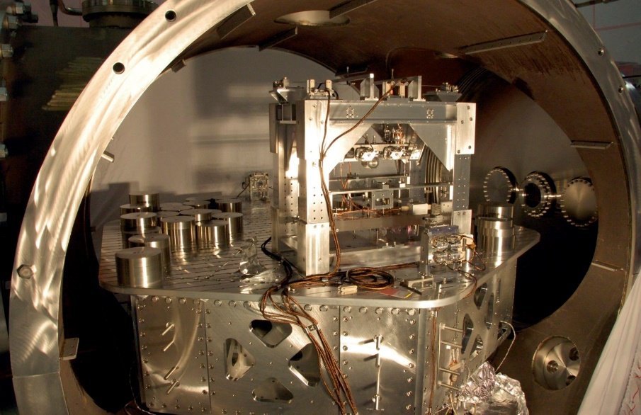
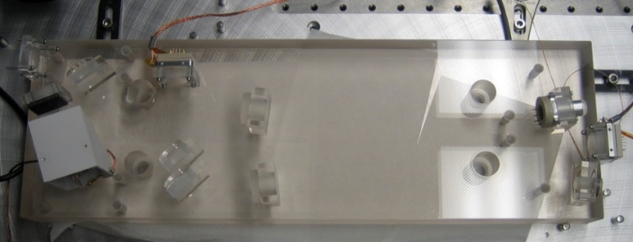
How we expect to speed commissioning effort in aLIGO
There is much more upfront subsystem testing in aLIGO, including …
Enhanced LIGO, a full scale test bed for several aLIGO technologies.
Output Mode Cleaner
HAM ISI
Commissioning advances:
  Alignment of the output mode cleaner
  Diagnosis and mitigation of beam jitter noise

Slide 21
Much greater seismic isolation in the control band
Motion input to the test mass suspensions
iLIGO
1000x
aLIGO so far
aLIGO target

Slide 22
Speedier commissioning
Lock acquisition strategy designed in from the start, including a new Arm Length Stabilization system
  Long arm cavities are controlled independently using a different wavelength laser
4 km arm
Better teams on hand
  More people and with more experience
  Observatory staff, including operators, involved from the beginning
Better support structure in place
  Software tools in place
  Online web tools in place
Having been there before helps a lot!

Slide 23
On the other hand:
Principal Technical Risks
High power operations
  Absorption & thermal compensation; parametric instability potential
Required displacement noise levels not verified directly
  Essentially impossible to test in subscale setups
  Thermal noises (suspension and mirror coating): rely on design calculations; material parameter measurements; scaled noise tests
  Technical noises (magnetic field coupling, e.g.!): design calculations & best practices
Increased complexity
  Number of control loops an order of magnitude larger than in iLIGO
  Mechanical systems have many more degrees-of-freedom; e.g., Test Mass Quad suspension has 48 DOF, vs. 6 in iLIGO
  Reliable and robust controls of interferometer

Slide 24
Challenges
Operational and logistical aspects must be addressed from the beginning; greater complexity of aLIGO demands more investment in:
  Configuration control
  Operator training
  Maintainability
  Simplification of operations
Must anticipate that some components may need to be re-designed or upgraded with new features
  Nature of a new and complex scientific instrument that not all requirements are adequately known beforehand
  A number of such examples from initial LIGO enforce the lessons:
    Initiate & maintain R&D in supporting technologies
    Identify deficiencies early and commit resources to dealing with them

Slide 25
Commissioning strategy for early discovery
Frequency range of 25-250 Hz is the most important for NS-NS inspiral range
Laser power
  Operation at full laser power will take significant commissioning time, but is not necessary to achieve very good inspiral range
  We’ve targeted 25 W as the input power level for the first stages of operation (approximately the level achieved in Enhanced LIGO)
Technical noise sources
  For many noise contributors, ultimate performance at 10 Hz can be deferred, with ~20 Hz as an intermediate goal, with no effect on NS-NS inspiral range

Slide 26
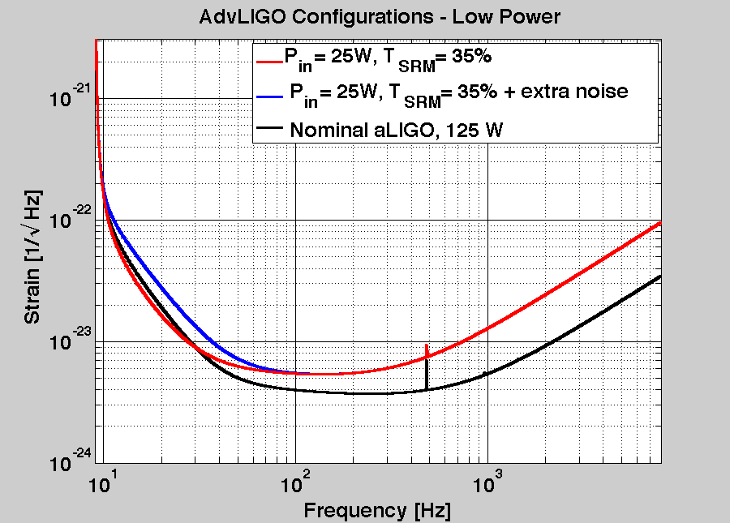
Design for performance at lower power
Recycling cavities designed so that little or no compensation of thermal lensing will be needed
  Implementation/optimization of thermal compensation was a big time sink in iLIGO/eLIGO
Signal recycling optimized for lower power
BH-BH Range (Gpc)
35%
SRM
transmission

Slide 27
Steps to get to
Low-Noise Operation
There are many steps in getting to a functional GW detector – these are split into 3 phases
Acquisition
  All steps to bring an uncontrolled interferometer to its operating point
  All cavities on resonance; alignment close to optimal
Locked
  All steps between acquisition mode and low-noise mode
Low-noise or Science mode
  Science data is collected

Slide 28
Locked Phase Steps
Transition to low-noise sensors for global control
  Initial locking achieved with more robust, but lower SNR sensors
  aLIGO innovation: all low-noise sensors are located in vacuum, on isolated platforms
Increase laser power
  Initial locking done at low power, one-to-several Watts
  Typically increased in multiple steps
Full implementation of alignment control system
  Initial acquisition mode, with a simple sensing matrix but relatively poor performance
  Science mode, with more complex sensing, tuned control bandwidths and noise cut-off filters

Slide 29
Locked phase steps, cont’d
Global length controls optimization
  Tuning of the GW channel loop for stable, low-noise performance
  Reducing noise contribution from auxiliary loops via bandwidth tuning; filter design; on-line correction paths
Low-noise mode for suspension and seismic systems
  Optimization of suspension local damping filters
  Engagement of low-noise mode for suspension actuator drivers
Thermal compensation activation
  First level of compensation achieved with the ITM ring heaters
  Greater levels of compensation using the CO2 laser projector beams
Preceding steps aren’t entirely sequential
Establishing and optimizing the Locked Phase sequence is one of the two main tasks of commissioning

Slide 30
Potential Component Upgrades
Why are we talking about upgrades at this stage?
Non-essential design element may not have been ready for baseline
  Example: input beam mode-matching control
New analysis may indicate less margin in the design, or uncertainty in the original design margin
  Example: squeezed-film damping in the End Reaction Masses
  Example: improved suspensions for output beam steering optics
New developments since the design was frozen
  Example: output beam mode-matching control
Paper design might not cut it, and we need to be prepared to rectify it

Slide 31
Resources
Increased observing
Commissioning teams comprised of observatory-based personnel, plus students, post-docs, scientists and engineers from the MIT and Caltech groups
Equipment budget of $8M over five years
  Covers modifications required to the basic aLIGO design
  Engineering estimate using aLIGO design/procurement data, and comparison with analogous iLIGO activities
Requested budgeted is at the low end of this range

Slide 32
Summary
Commissioning Advanced LIGO is the biggest challenge for the Lab
We have a well defined plan for where we want to be and how to get there
Improvements in technology, test plans, and overall experience and personnel should result in faster commissioning
Faster to get close to design sensitivity:
Within a factor of 2 of the design goal in 2 years of commissioning

Slide 33
Squeezer Effort
First upgrade to aLIGO
  Goal 10dB, minimum 6dB
  Proposal: TBD
R&D effort at MIT/ANU
  Filter cavity experiment (with H1 squeezer)
  In-vacuum OPO: Prototype at ANU
  Fiber-coupling: UHV feedthroughs, drift, noise, etc.
Other efforts
  Syracuse: adaptive mode matching at AS port
  Florida: Low loss Faraday

