Slide 1


Gravitational Wave Follow-up: Expectations, Tools, and Choices
Roy Williams (Caltech)
for the LIGO Scientific Collaboration
and Virgo Collaboration
Time Domain Forum, Caltech
May 9, 2014
LIGO-G1400497

Slide 2
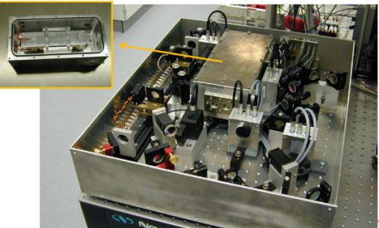


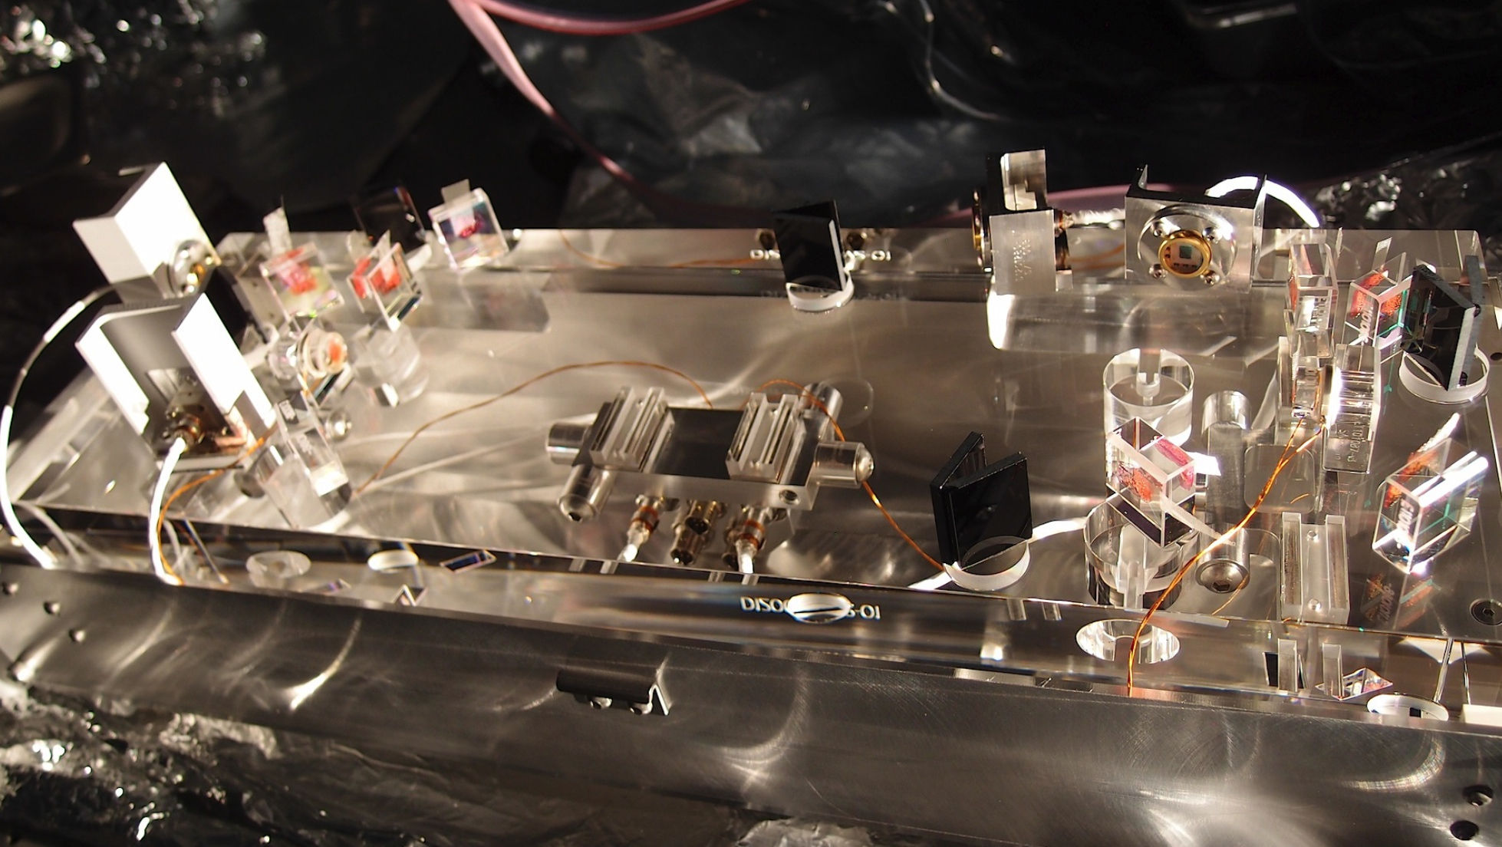
Advanced Gravitational Wave Detectors
Long-planned upgrades of initial GW detectors: Advanced LIGO (shown) and Advanced Virgo
  Factor 10 in strain means factor 1000 in volume.
courtesy P. Shawhan
LIGO-G1400497

Slide 3
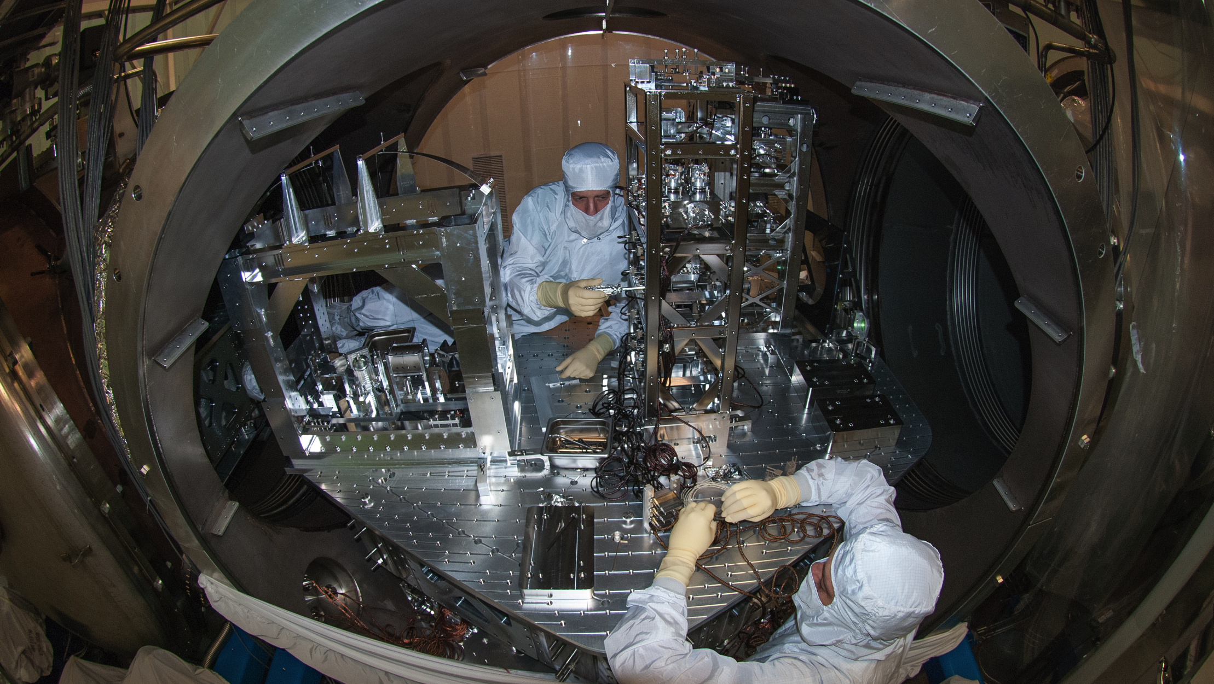
Now Being Installed and Tested !
Hoping for Science Run in 2015
courtesy P. Shawhan
LIGO-G1400497

Slide 4


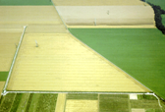





Advanced Detector Network – Under Construction
GEO-HF
Advanced LIGO
4 km
600 m
3 km
3 km
4 km
4 km
Advanced LIGO
(pending)
Advanced VIRGO
courtesy P. Shawhan
LIGO-G1400497

Slide 5

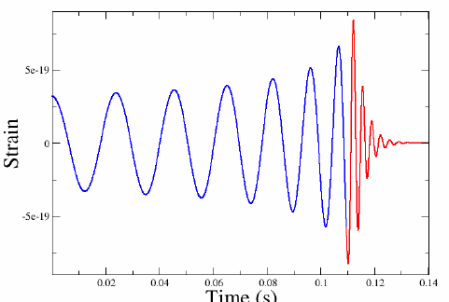
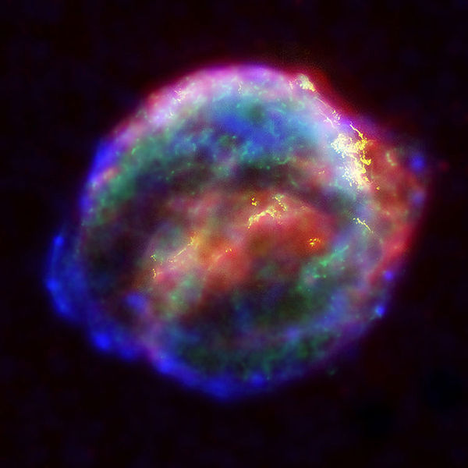
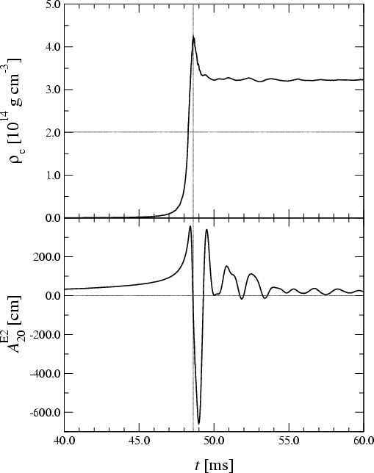
Searches for GW Transient Sources
GW data streams are analyzed jointly
  Initially LIGO Hanford+Livingston and Virgo; later others too
Two main types of transient searches:
Compact Binary Coalescence (CBC)
Known waveform ➔ Matched filtering
Templates for a range of component masses
(spin affects waveforms too, but not so important for initial detection)
Unmodelled GW Burst (< ~1 sec duration)
e.g. from stellar core collapse
Arbitrary waveform ➔ Excess power
Require coherent signals in detectors,
using direction-dependent antenna response
Credit: AEI, CCT, LSU
Credit: Chandra X-ray Observatory
courtesy P. Shawhan
LIGO-G1400497

Slide 6
Projecting Advanced LIGO Sensitivity Progression 2015-2018
From “Prospects for Localization of Gravitational Wave Transients by the Advanced LIGO and Advanced Virgo Observatories”
arXiv:1304.0670
2017-18: ~ 9 month run,
120 - 170 Mpc
Multiple Detections
2016-17: ~ 6 month run,
80 - 120 Mpc
Likely Detection
2015: ~ 3 month run,
40 - 80 Mpc
Possible Detection
2010: Initial LIGO, 15 Mpc
z=0.05
LIGO-G1400497

Slide 7
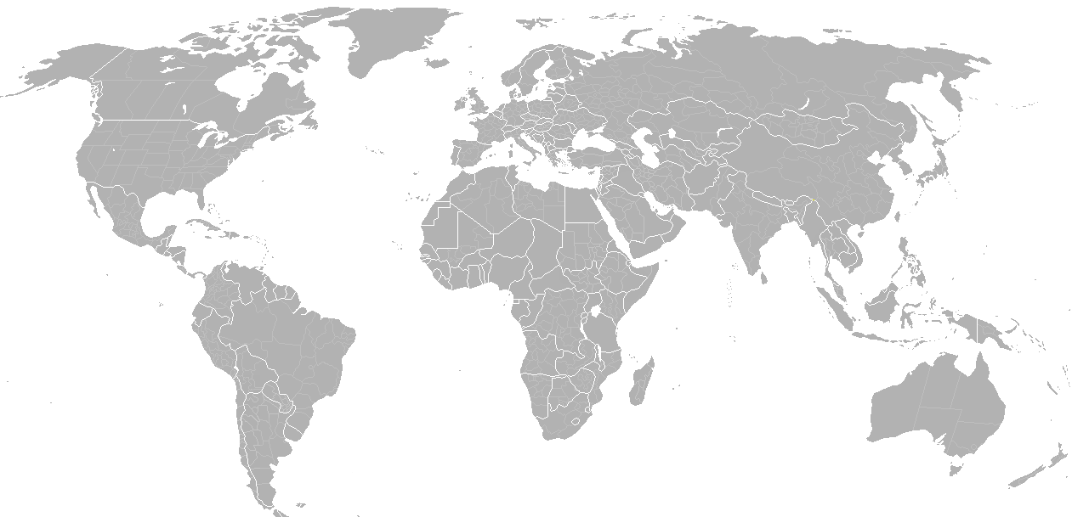
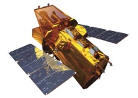
Low-latency GW Event Candidates
LIGO Hanford
GEO 600
KAGRA
Virgo
LIGO Livingston
LIGO-India
Transfer data
Send info
to observers
Swift: NASA E/PO, Sonoma State U., Aurore Simonnet
Analyze data, identify triggers,
infer sky position
Trigger database
Validate
GW data
Select event candidates
Estimate background
Multiple analysis pipelines running as data is collected
Generate triggers from apparent transients in the data
  Estimate significance by comparing with background distribution from
  time-shifted analysis
courtesy P. Shawhan
LIGO-G1400497
Notes:
Can lower threshold for GW triggers, to seek confirmation of weaker triggers
In addition to exttrig

Slide 8
Alert Latency and Notes
Typical latency to generate triggers with sky position info:
3 to 6 minutes
  Additional time needed for validation: not yet known, but maybe ~20 min
We might provide multiple skymaps with different assumptions about the source
  CBC orbit inclination: unconstrained, or face-on
  GW burst polarization: unconstrained, linear, or elliptical
We may send updated information about an event
after the initial alert
  e.g. refined skymap (PE analysis) or significance estimate
  Will send a VOEvent referencing the first one, incrementing the version number in the IVORN
LIGO-G1400497

Slide 9
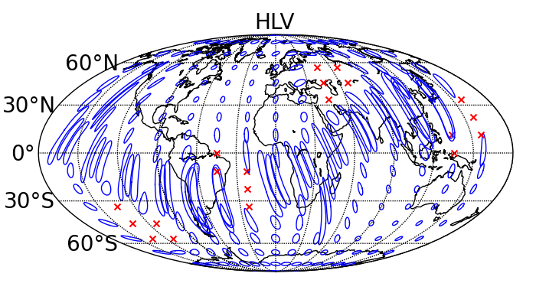
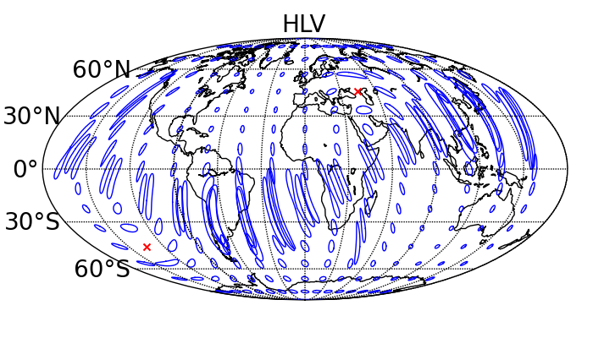
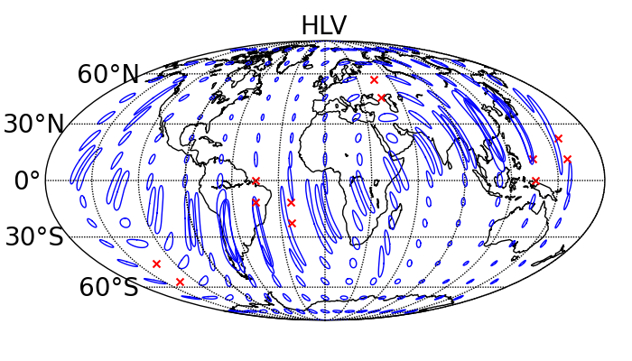
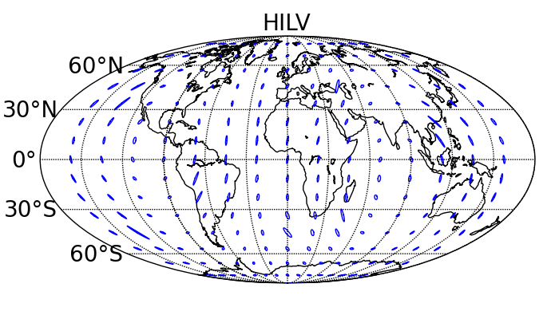
Position Reconstruction Accuracy vs. Time http://arxiv.org/abs/1304.0670
Face-on BNS 80 Mpc HLV 2016-17
~8 % contained in 20 deg²
Face-on BNS 80 Mpc HLV 2017-18
~10 % contained in 20 deg²
Face-on BNS 160 Mpc HLV 2019+
~30 % contained in 20 deg²
Face-on BNS 160 Mpc HILV 2022+
~50 % contained in 20 deg²
LIGO-G1400497

Slide 10
Follow-up Scenario
Expect to distribute GW alerts as Notices/VOEvents over (initially) private GCN/TAN
Responses by Notices and Circulars
With private wiki, bulletin board, email for MOU partners
Interactions between LVC and EM partners will start soon
LIGO-G1400497

Slide 11
What's in the Alert?
Time of the GW candidate
  At Earth, with precision of order ~10 ms (direction-dependent)
Significance of the candidate
  Expressed as an effective false alarm rate (FAR)
Sky position probability map
  HEALPix grid in FITS file
Maximum Distance
  Although the source could be much closer
Programs (eg Healpy/Healpix)
Astro viz apps (eg DS9 or Aladin)
Derived data like Skymap.json
Specialist viz like Skymap Viewer
LIGO-G1400497

Slide 12
Follow-up Observer wants:
(1) Automatic neglect of what I cannot observe
too close to sun or moon
too close to galactic plane
wrong hemisphere
(2) If good, let me look carefully
when can I observe it?
which survey fields are relevant?
which galaxies could it be?
what are my partners doing?
Skymap.json
Time UTC and MJD
Which detectors were involved
Declination histogram
Decile contour areas
Decile contours as polylines
Sun and Moon
Skymap Viewer
Sky atlas with contour map
Local horizon
Catalogs of galaxies etc

Slide 13
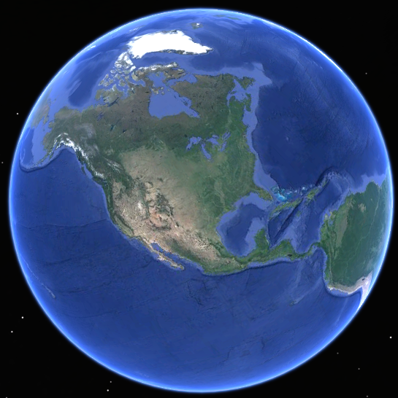
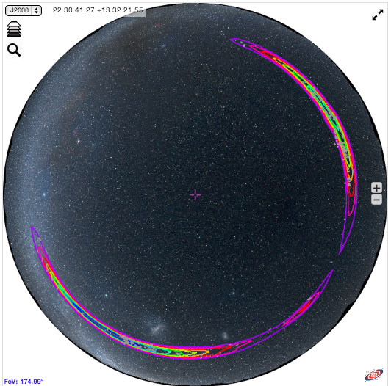
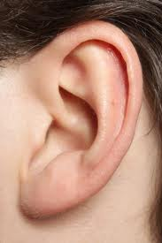
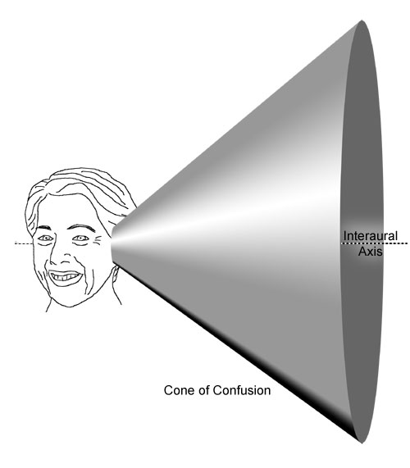
Ring-shaped Skymaps
Hanford
Livingston
http://www.ligo.caltech.edu/~rwilliam/skymapViewer
LIGO-G1400497

Slide 14
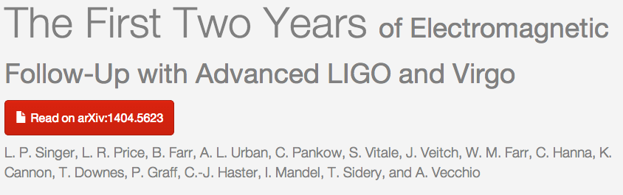
Simulated skymaps
Posterior probability skymaps are obtained from coherent analysis
  Fast coherent position reconst. (~min)
  Full parameter estimation can be done, but currently is slow (~days), effort underway to reduce to ~hour)
Examples of simulated skymaps
  L. Singer+ http://arxiv.org/abs/1404.5623
  Data release: http://www.ligo.org/science/first2years/
LIGO-G1400497

Slide 15
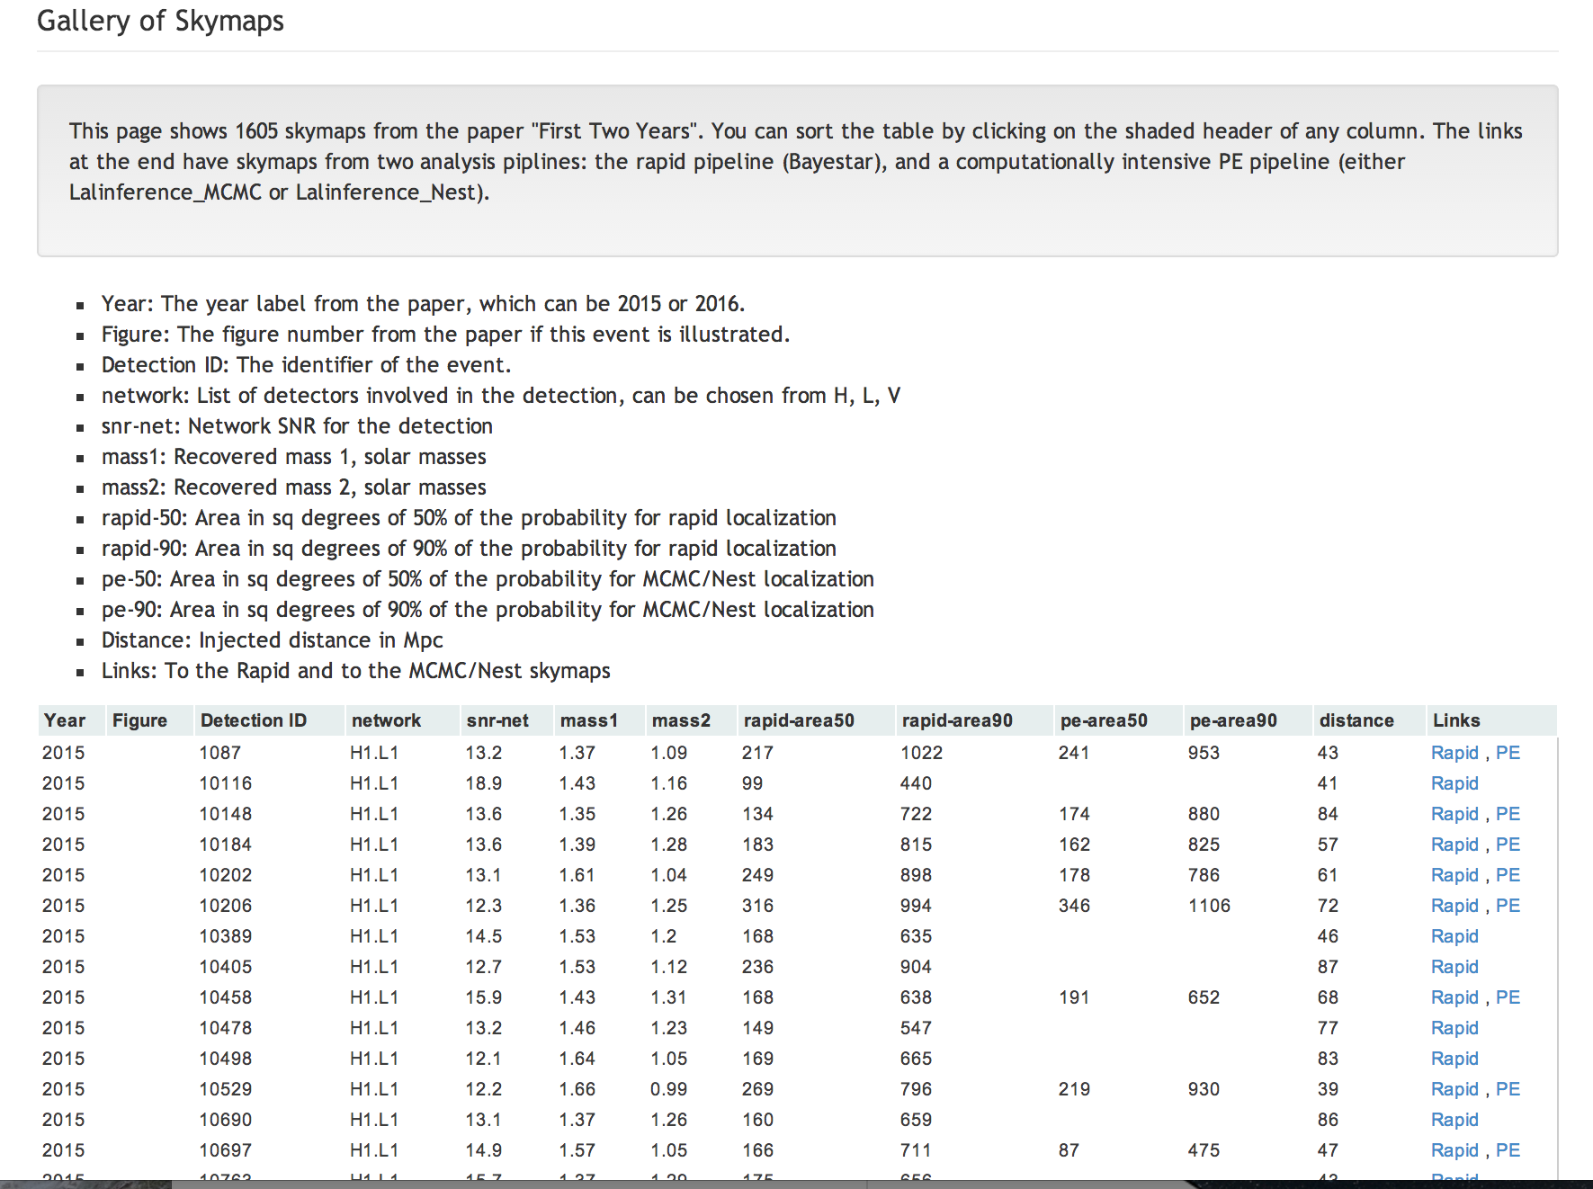
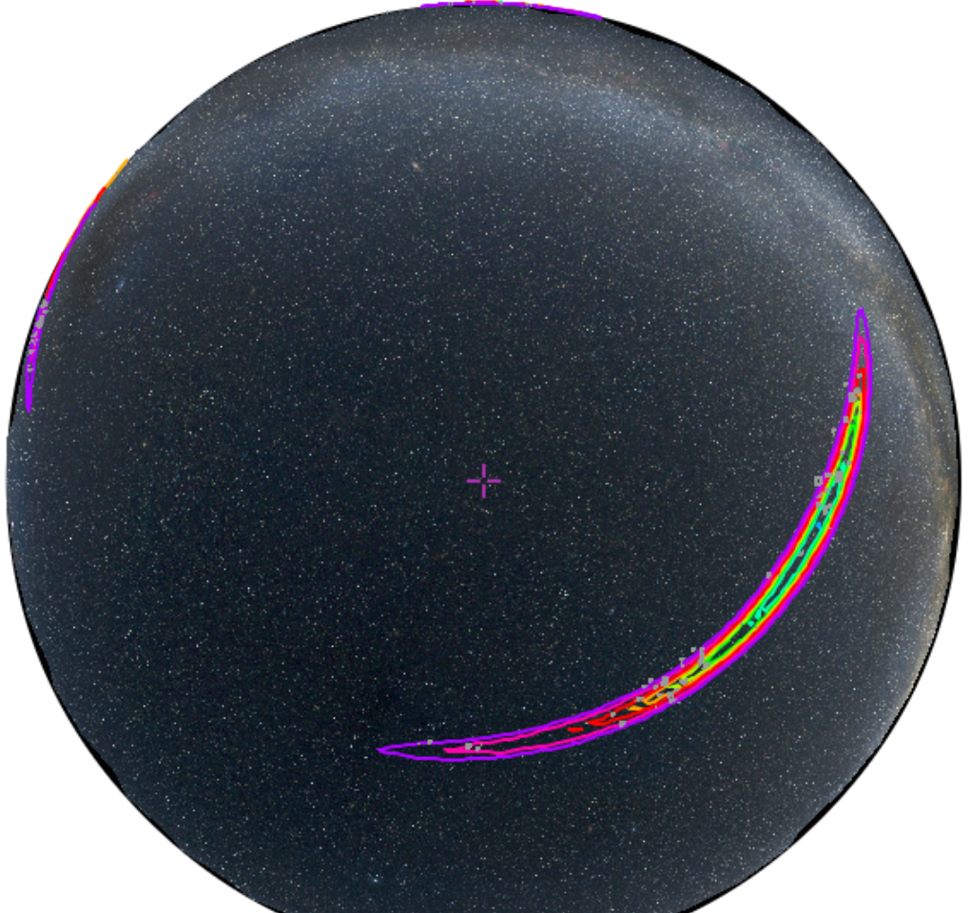
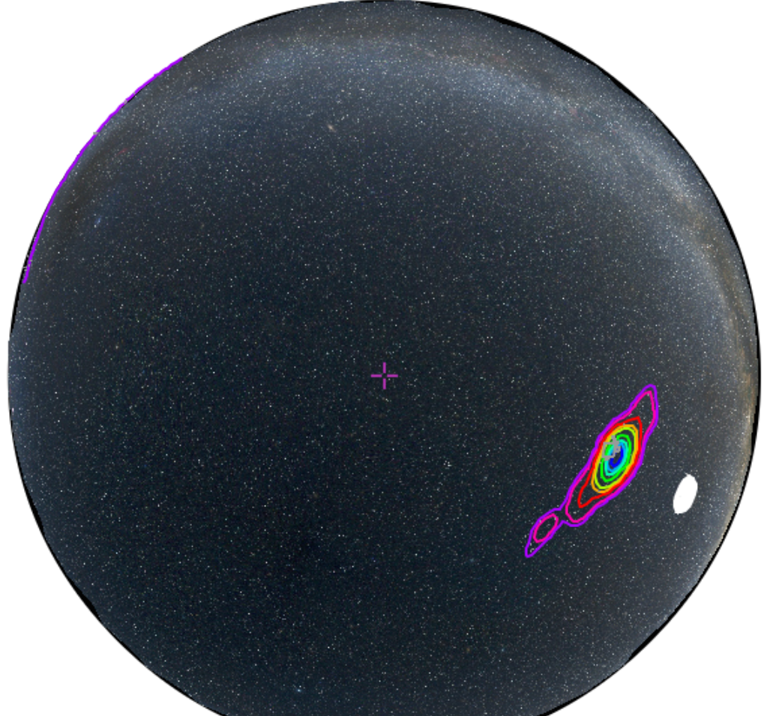
Skymap Gallery from First2Years
Click to Sort
Rapid is ~Minute
PE is ~Hours
Can make a big difference

Slide 16
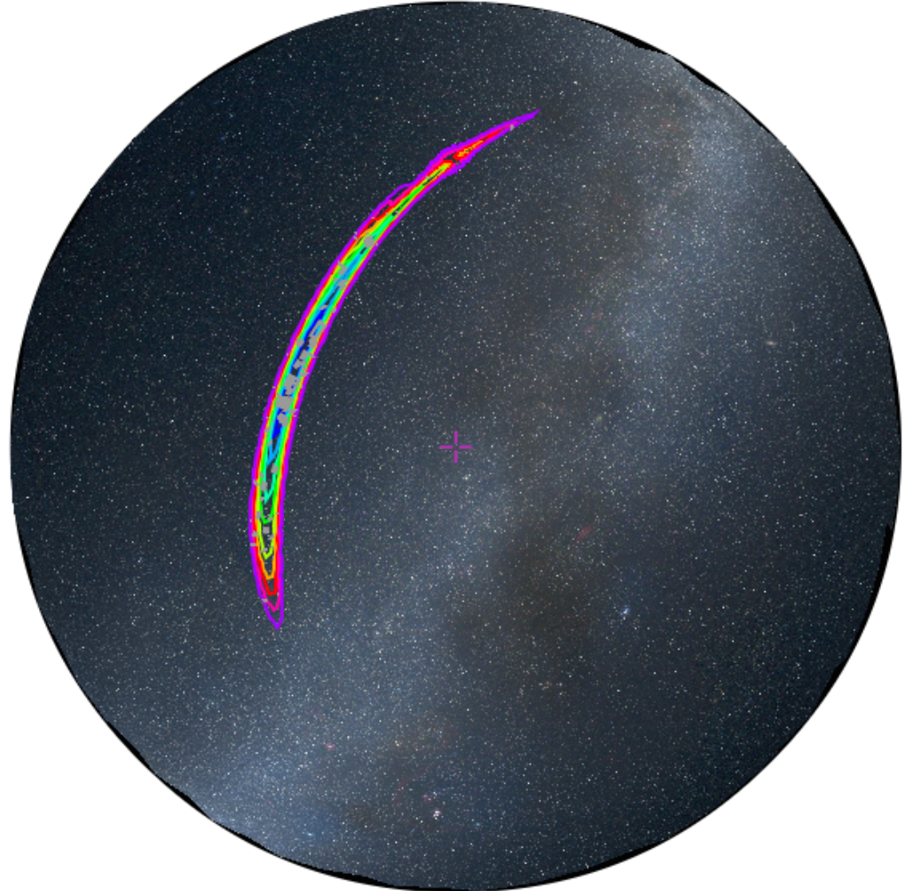
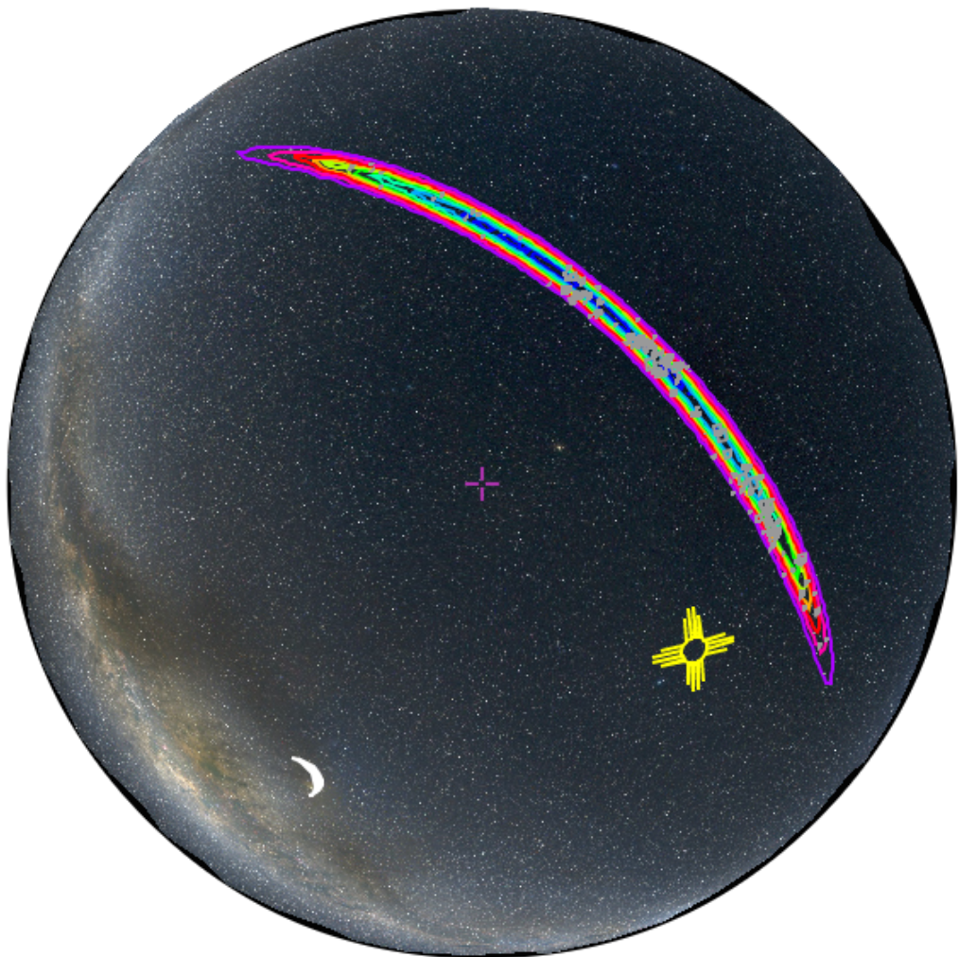
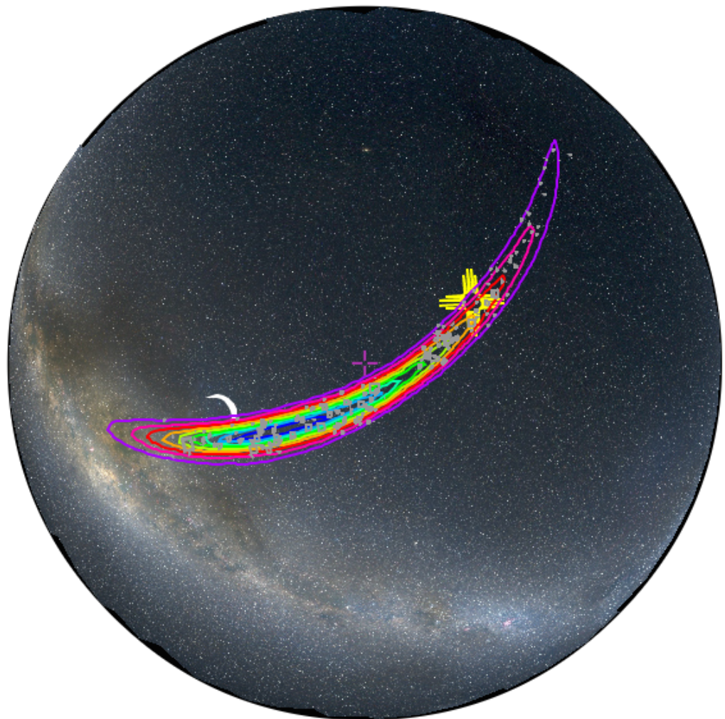
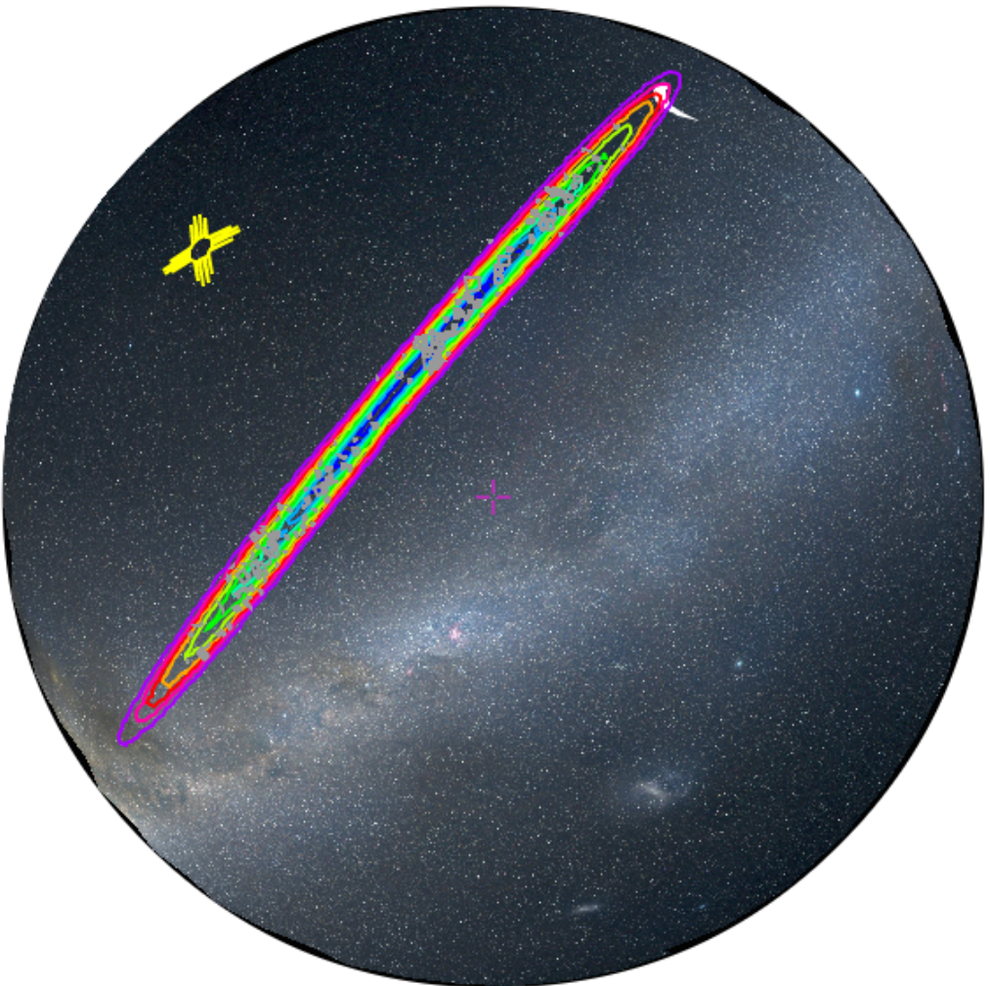
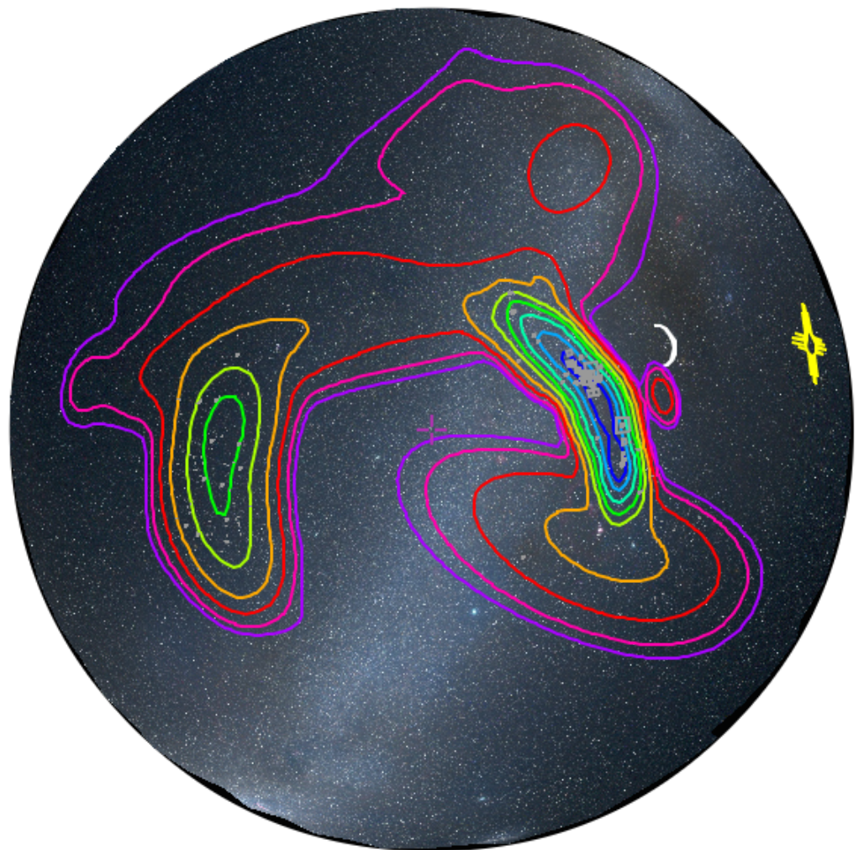
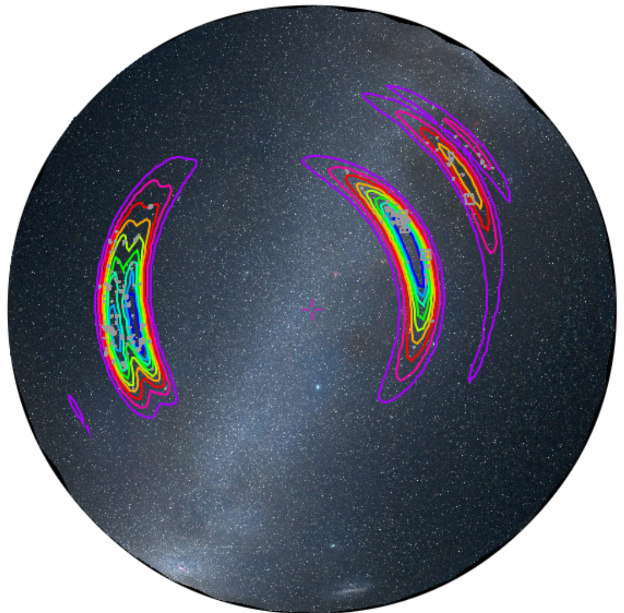
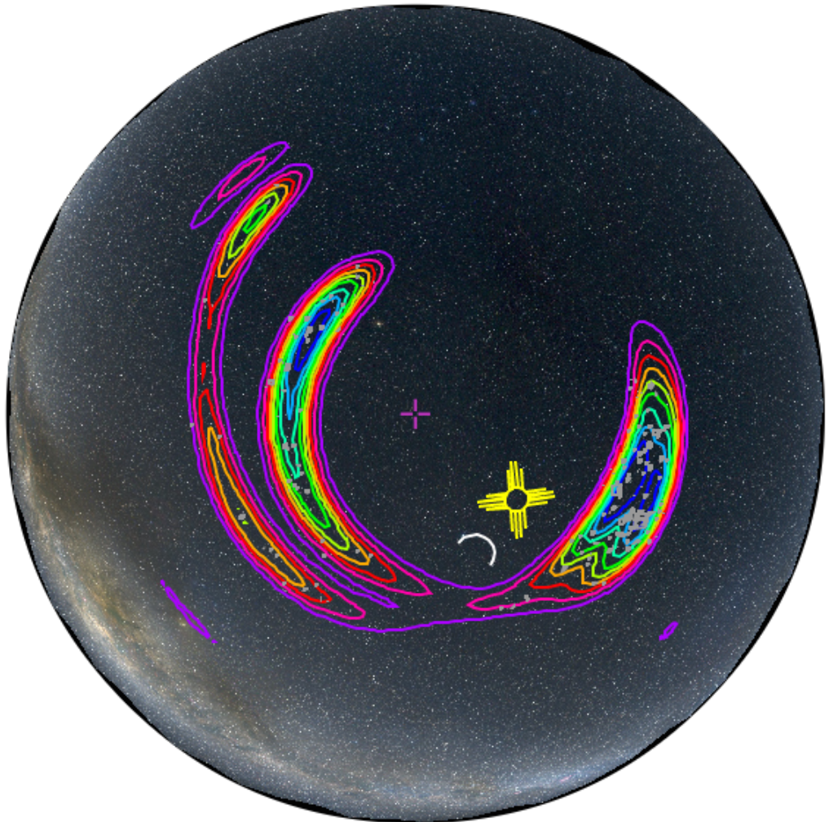
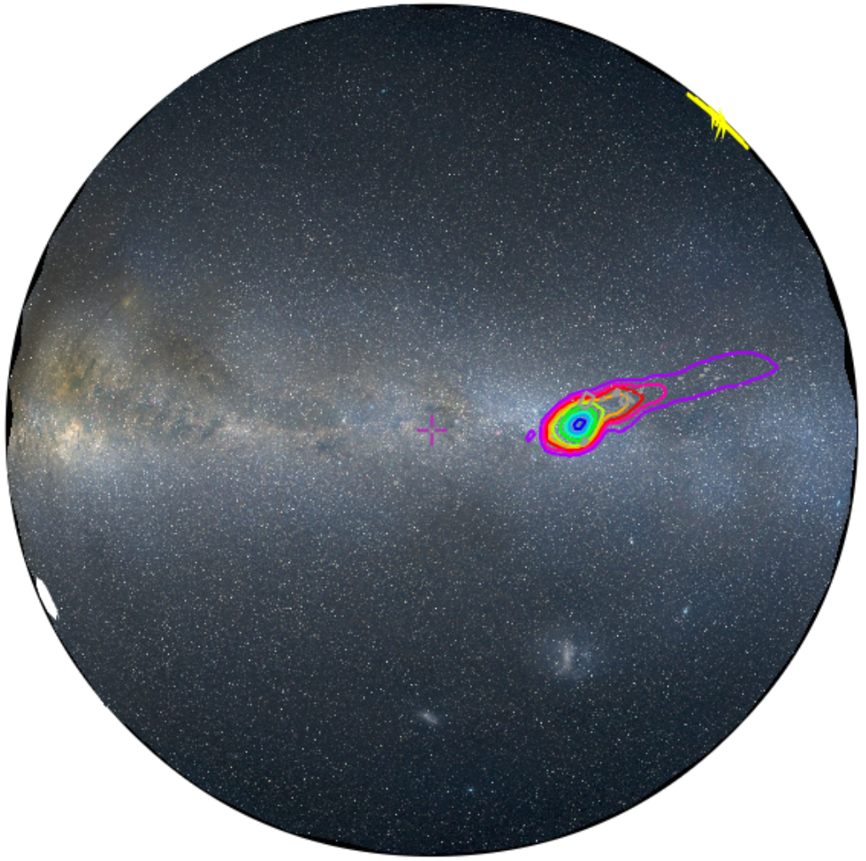
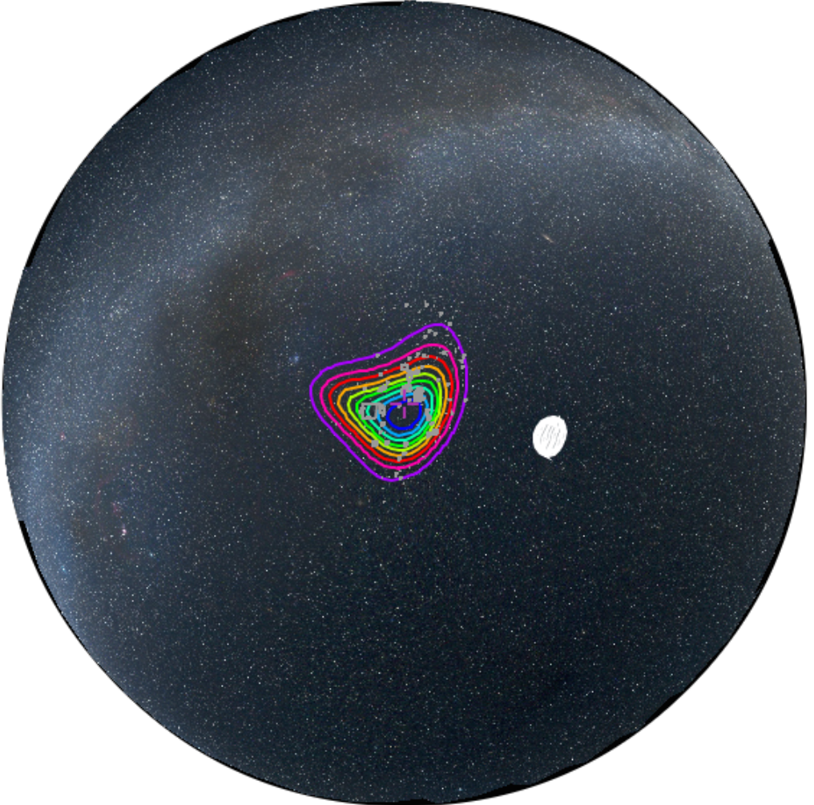
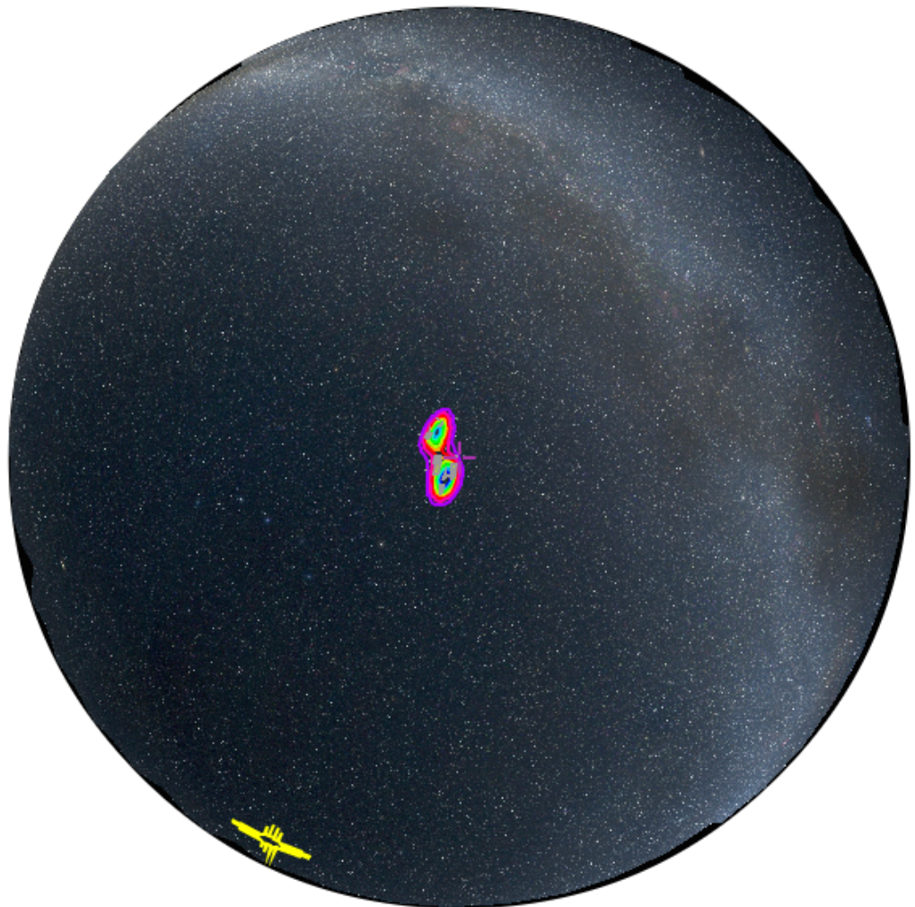
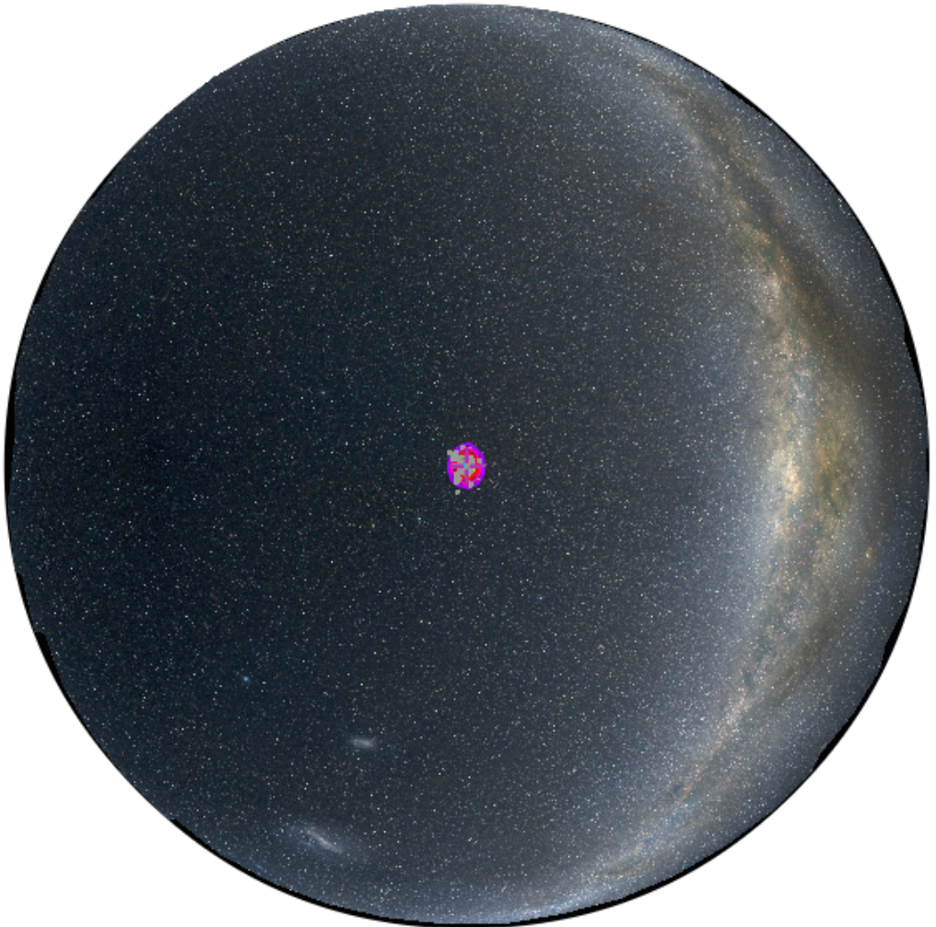
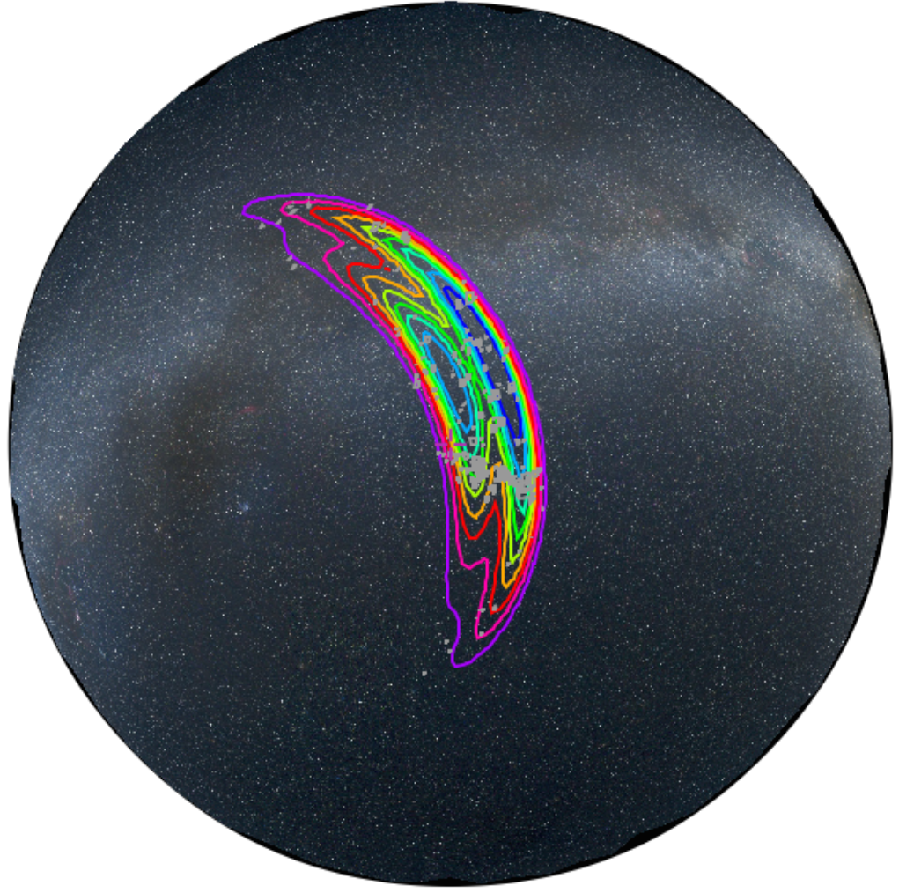
Simulated Skymaps
Warning: My Contours are Too Fat!
Error region geometry can be non-trivial
  Banana shape and/or
  disconnected islands – especially for narrowband GW burst candidates
fringes
(HV and LV)
2-detector arc 2015
3-detector spot 2016
LIGO-G1400497
http://www.ligo.caltech.edu/~rwilliam/skymapViewer

Slide 17
Skymap Viewer
LIGO Caltech (US) + CDS Strasbourg (FR)
http://www.ligo.caltech.edu/~rwilliam/skymapViewer
★ Skymap as decile contours
100's of simulations 2015/2016
★ Multi-scale
allsky to arcsecond
★ Multi-wavelength
DSS, Fermi, XMM, SDSS etc
★ Observing (Sun/moon/horizon)
horizon for given long + lat + UTC
sun and moon
★ Catalogs of galaxies/clusters
or any catalog from Vizier
your suggestions welcome!
★ Browser only
nothing to install
LIGO-G1400497

Slide 18
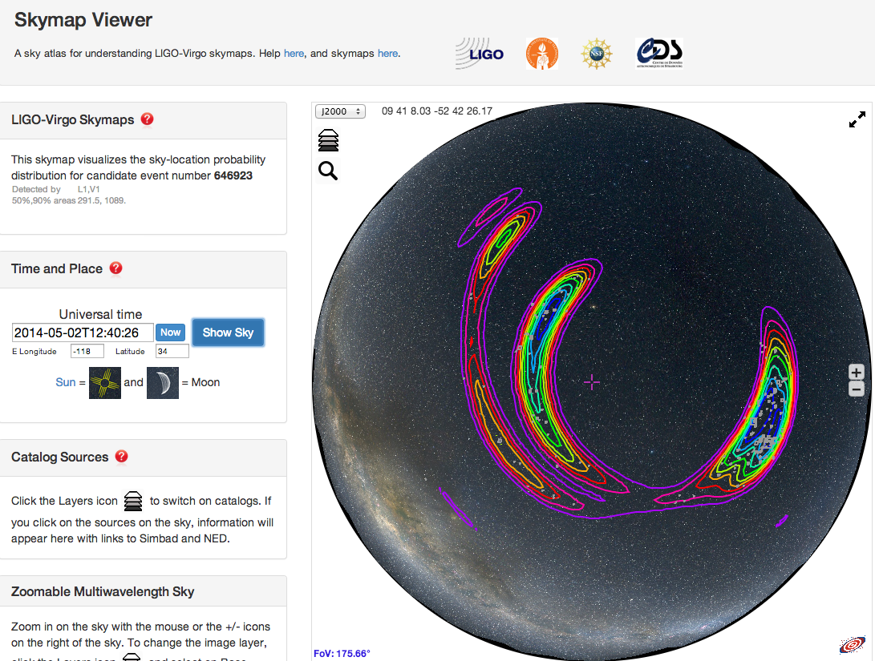
Choose image & catalogs
About the skymap
Time and place
Watch this space
LIGO-G1400497

Slide 19
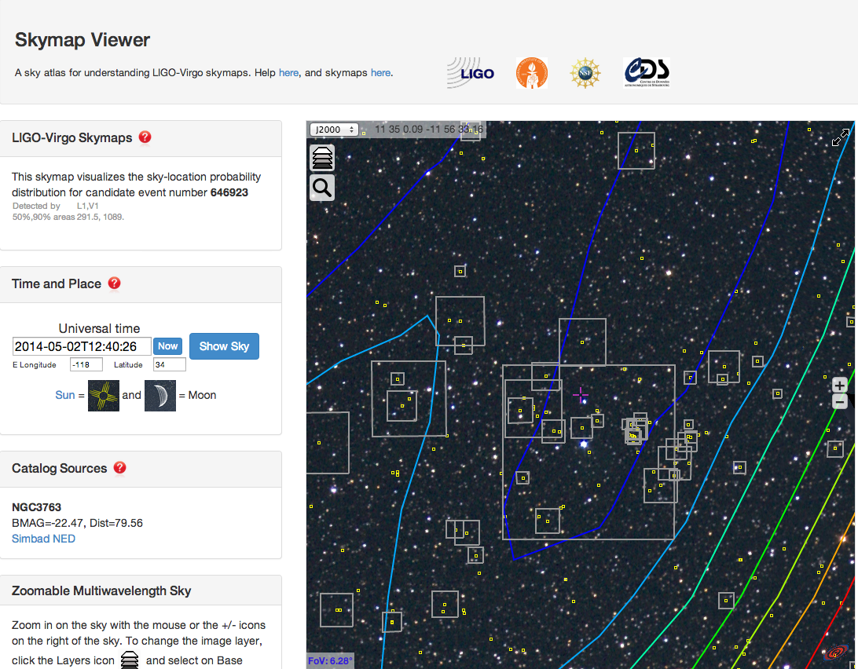
GWGC galaxy position x and abs mag M
→ size = skymap(x).10^{-2BMAG/5}
Click catalog source
http://www.ligo.caltech.edu/~rwilliam/skymapViewer

Slide 20
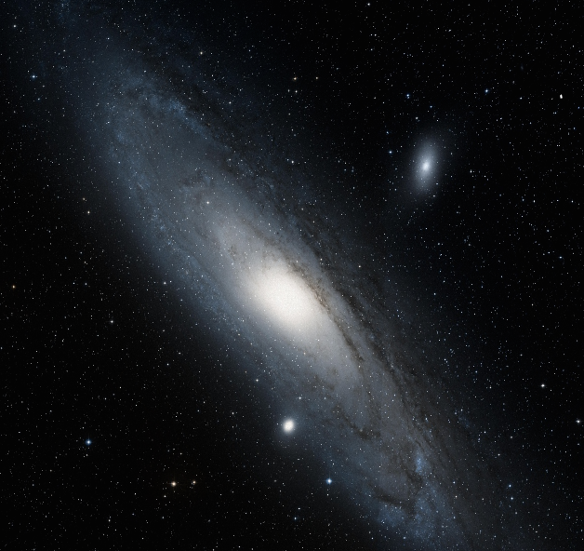
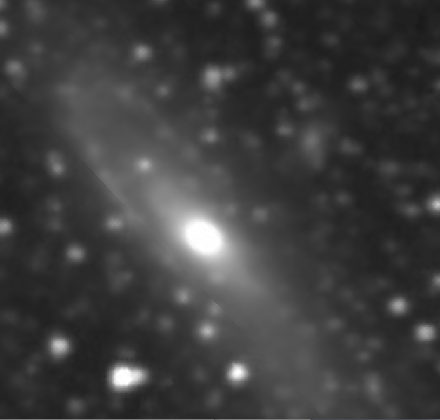
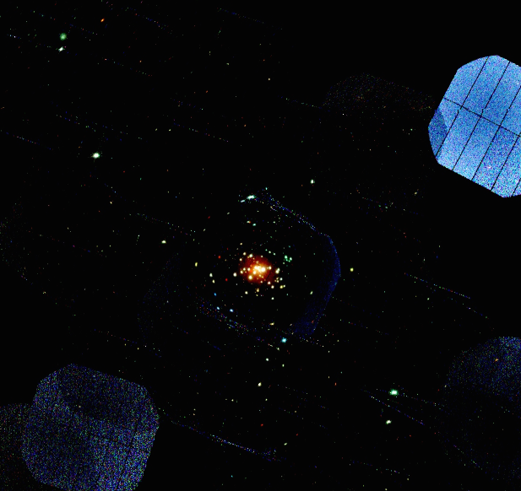
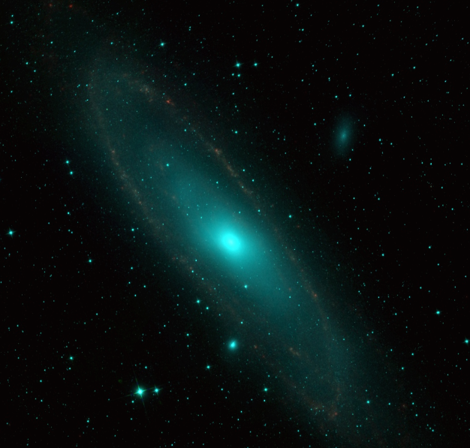
Multi-wavelength: M31 in Skymap Viewer
Optical (DSS)
H-alpha (VTSS)
X-ray (XMM)
Infrared (Allwise)
LIGO-G1400497

Slide 21
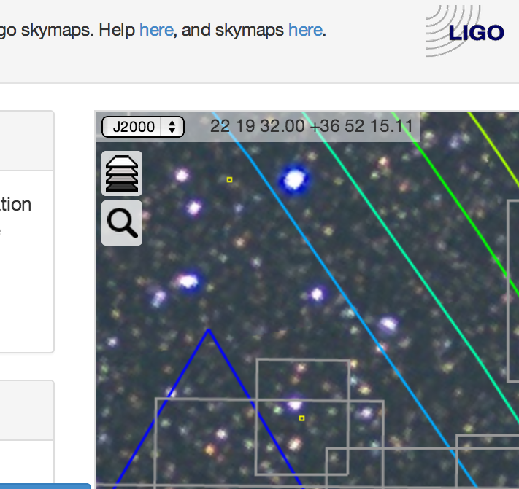
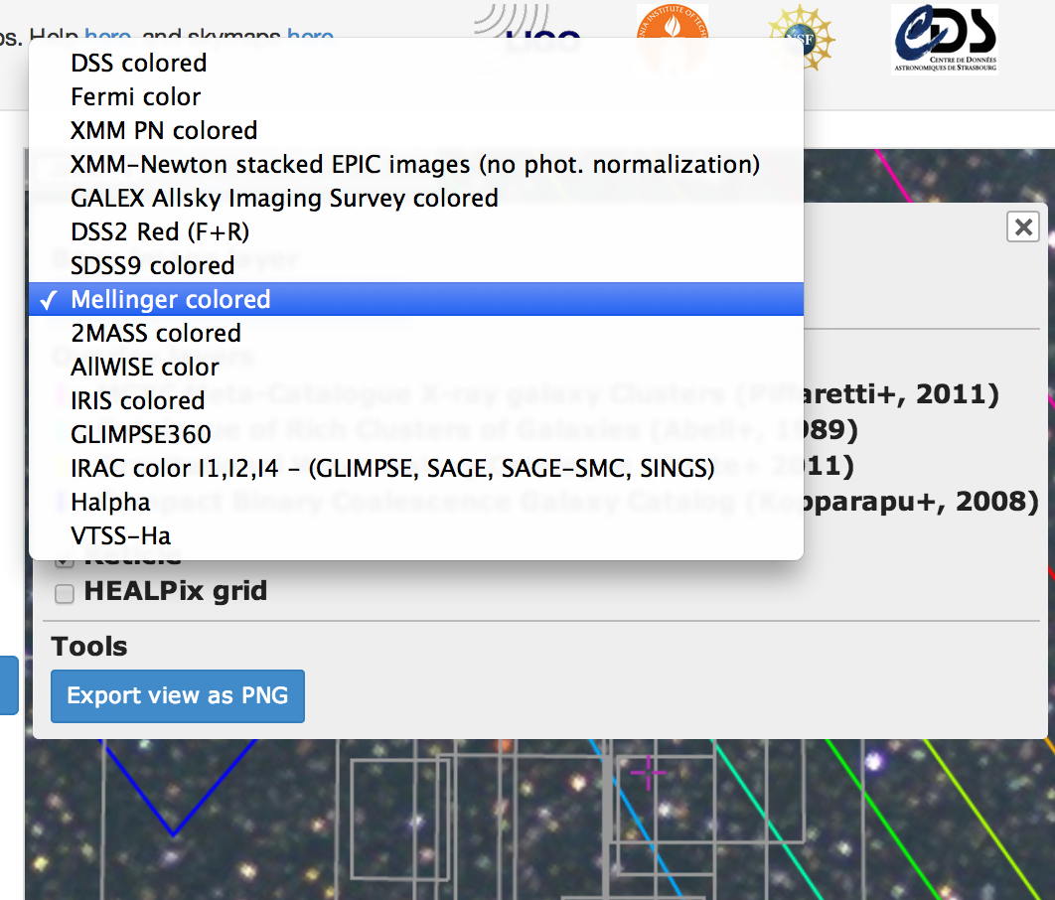
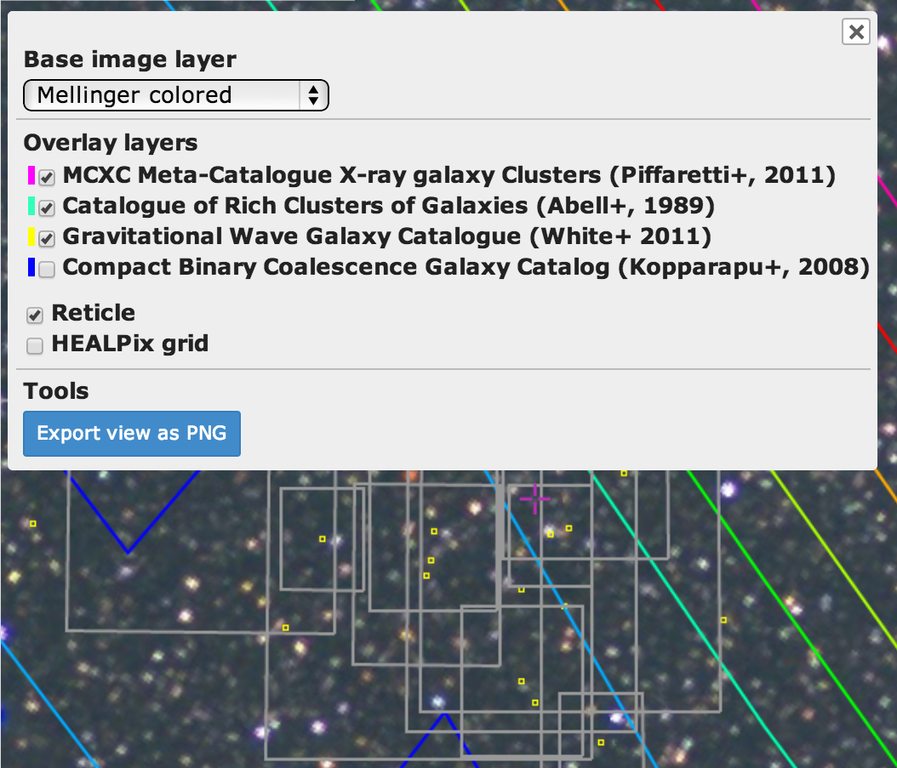
Catalogs and Imagery
http://www.ligo.caltech.edu/~rwilliam/skymapViewer
LIGO-G1400497

Slide 22
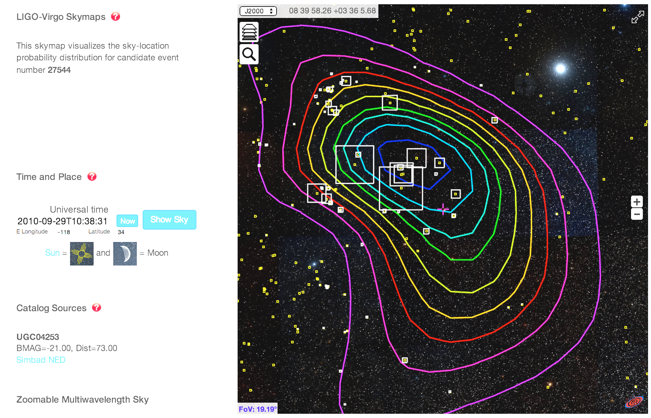
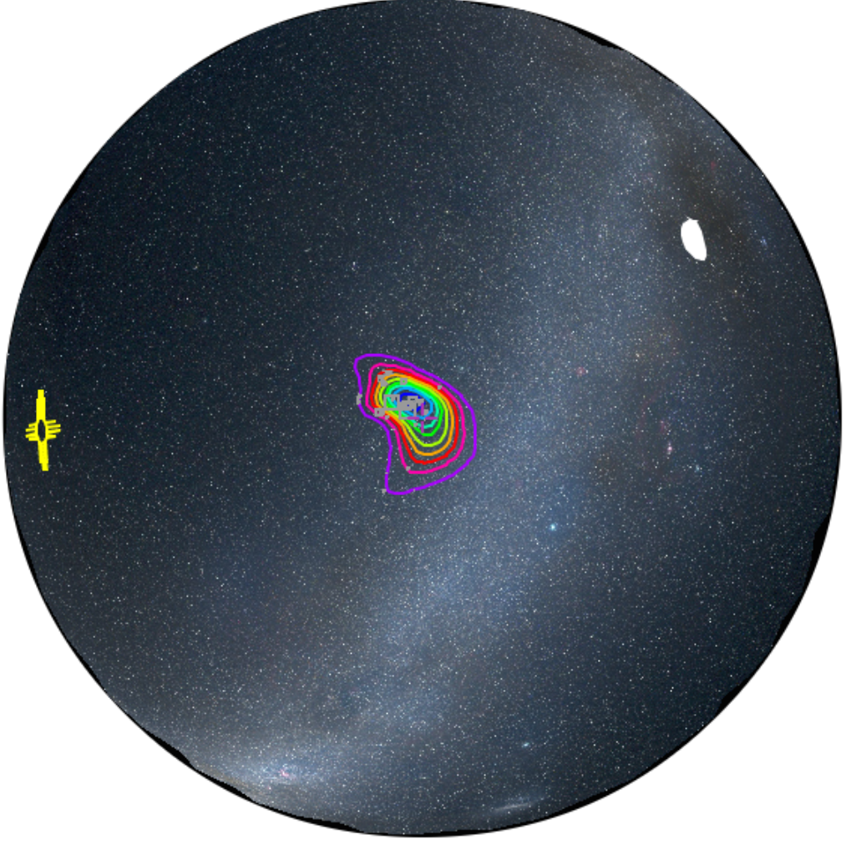
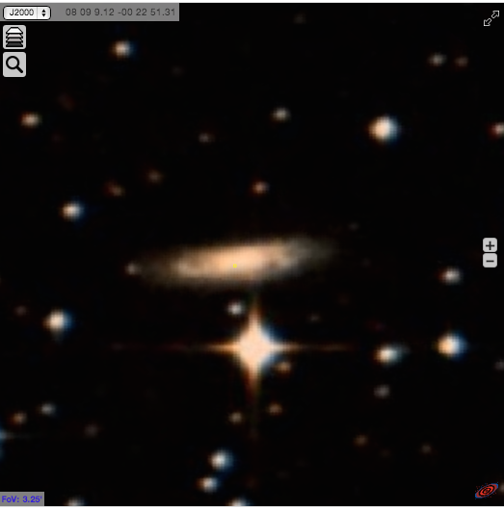
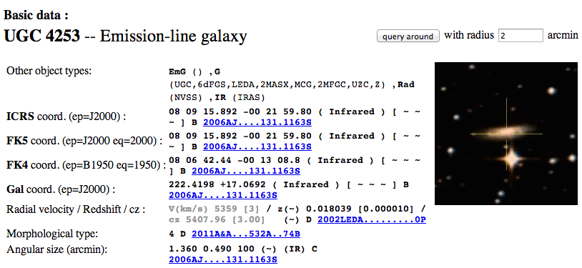
zoom
zoom
click
click
Simbad page:
galaxy at 79 Mpc
http://www.ligo.caltech.edu/~rwilliam/skymapViewer
LIGO-G1400497

Slide 23
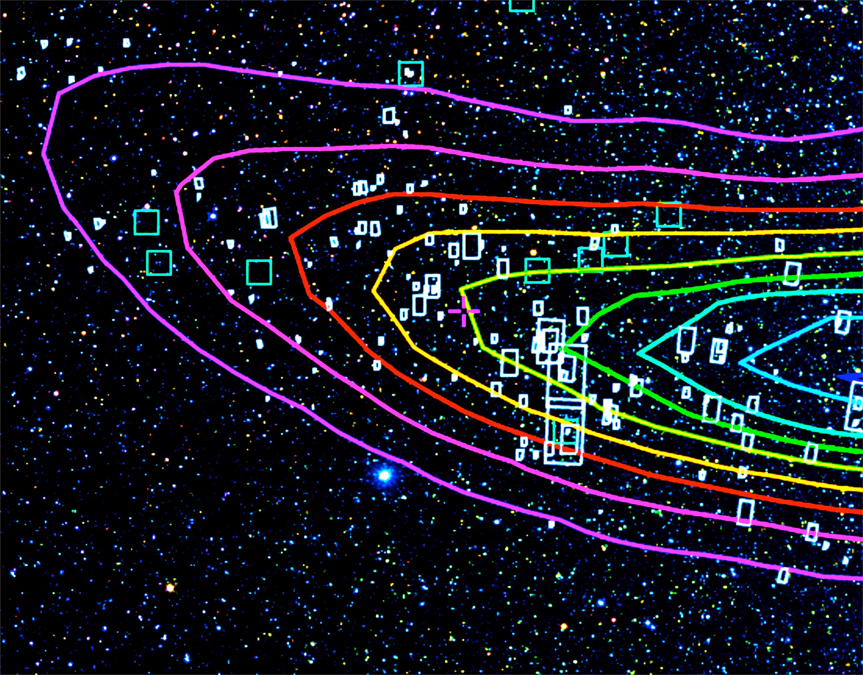
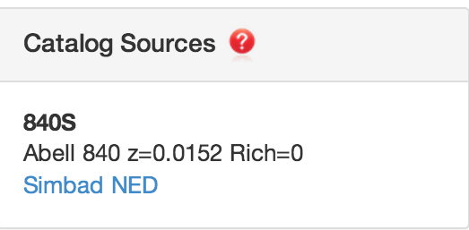
Abell Galaxy Cluster catalog
click
cluster Abell 840S is at 67 Mpc
http://www.ligo.caltech.edu/~rwilliam/skymapViewer
LIGO-G1400497

Slide 24
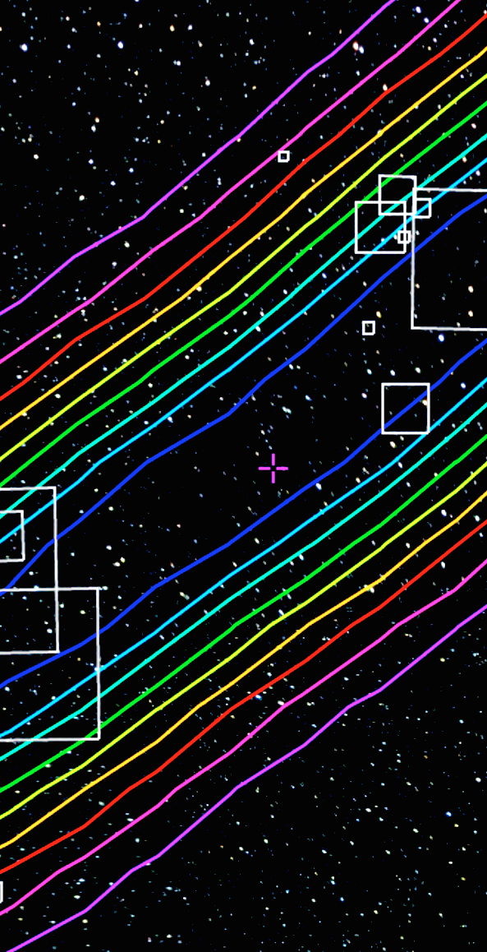
Bulletin Board?
I observed here
Transients found as catalog
Candidates, each with comment stream
Footprints of images acquired
Locating Notices and Circulars in the sky
Do follow-up observers want to communicate this way?
Its not red enough

Slide 25
Summary
Gravitational wave detectors operate as a global network
  Data combined and analyzed coherently
  Japan and/or India critical for good localization
Advanced LIGO and Virgo upgrades are well underway
  First science run is only about 1 year away. Livingston in lock 2014 May
  Sensitivity and position reconstruction accuracy will improve over time
EM follow-ups are exciting
  Building tools to help the EMfollow groups
  Sensitivity and position reconstruction accuracy will improve over time
LIGO-G1400497

Slide 26
Questions for Discussion
Would observers use the Bulletin Board if provided?
What other catalogs can go in Skymap Viewer
both candidates and false positives?
Is it useful to have last ~week of GRBs shown on skymap?
How can Notices and Circulars be enhanced?

