Slide 1
ALS HIFO-X Noise Budget and Model Status Report
By Alexa Staley
Contributors: S. Dwyer, D. Sigg, J. Kissel, C. Wipf

Slide 2
Outline of Talk
What is ALS?
The Simulink model
What does it consist of?
Validating the model.
Noise budget using the model
Comparison to HIFO-Y
Future Plans

Slide 3
Outline of Talk
What is ALS?
The Simulink model
What does it consist of?
Validating the model.
Noise budget using the model
Comparison to HIFO-Y
Future Plans

Slide 4
Arm Length Stabilization
ALS is an independent locking scheme; allows us to decouple the arm cavities from the interferometer.
The ALS holds the arm cavities off resonance from the PSL beam for easy locking of the recycling cavities.
Once the recycling cavities are locked, ALS brings the arm cavity into resonance with the PSL beam.
Notes:
-ALS is an independent arm locking scheme. It provides a means of holding the arm cavities off resonance from the PSL beam in order to facilitate lock acquisition in the cavities in the corner station. Once the other cavities are locked, the ALS brings the arm cavity into resonance with the PSL beam.

Slide 5
How do we do this?
Using an auxiliary laser at the end station that has both IR and green light, we …
Lock the IR auxiliary beam to the PSL frequency.
Lock the green auxiliary beam to the arm cavity.
Compare the green frequency to the PSL doubled frequency; and eventually bring the PSL light resonant in arm.

Slide 6
ALS Schematic
3.
1.
2.

Slide 7
Outline of Talk
What is ALS?
The Simulink model
What does it consist of?
Validating the model.
Noise budget using the model
Comparison to HIFO-Y
Future Plans

Slide 8
Simulink Model
Notes:
Simulink is a tool to model systems…

Slide 9
Simulink Model
Consists of function blocks that are defined in a control script. The control scripts defines the properties (zpk’s) of all the servo parts in the ALS.
Uses LiveParts for the filters.
Besides the control script, there is a second script in place to validate the model.
A third script to produce the noise budget.

Slide 10
Servo Loops in Model
End-X Phase locking loop (PLL)
End-X Pound-Drever-Hall Loop (PDH)
Corner Station COMM PLL beatnote
Corner Station Input Mode Cleaner Loop (IMC)
MC2 Suspension stage
COMM handoff path for CARM feedback

Slide 11
End-X PLL Loop
Uses a phase locked loop to lock the IR auxiliary laser to the frequency transmitted fiber light of the PSL.
Consists of
PLL Common Mode Board Servo
Phase Frequency Discriminator (PFD)
PZT response
Tuned VCO and PFD used for error signal

Slide 12
ALS Schematic

Slide 13
End-X PLL Loop Validation
Notes:
UGF: 22kHz with phase margin of 50 deg (nominally run with boost off)

Slide 14
End-X PDH Loop
With the EX PLL locked, we employ a PDH locking scheme to lock the green auxiliary laser from the end station to the arm cavity.
Consists of:
PDH Common Mode Servo Board
Voltage Controlled Oscillator (VCO)
Cavity pole (1.46kHz * different from HIFOY).
Optical gain of cavity ~1kHz/V
Notes:
We use a VCO, as an actuator on the laser frequency, and the frequency of green light tells us about the length of the arm cavity.
PDH is the error signal.
Important thing to note: as everyone keeps bringing up, the ETMX was coated incorrectly. This makes a difference in the arm cavity locking. In particular the cavity pole is now much greater. This makes us more sensitive in terms of alignment (which Ill talk about later).

Slide 15
ALS Schematic

Slide 16
Validating End-X PDH Loop
Notes:
UGF: ~3kHz with phase margin of 80 deg

Slide 17
IMC Loop
This loop consists of the mode cleaner lock with a feedback to the MC2 suspension.
Consists of:
IMC cavity pole: ~8kHz
VCO
MC Common Mode Board
Optical gain: 3kHz/V
Notes:
MC2 is one of the mode cleaner optics

Slide 18
ALS Schematic

Slide 19
IMC Loop Validation
Notes:
UGF: 53kHz with phase margin of 45 deg.

Slide 20
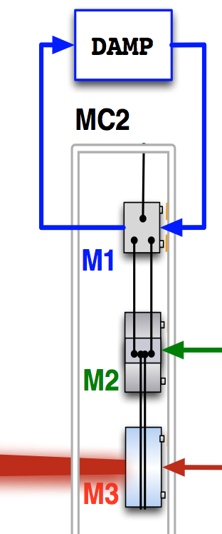
MC2 Loop
The test mass hangs from a triple suspension; we can actuate on any of three.
Model a simplified version of the loop
Use un-damped HSTS model
Assumes coil driver and coil output exactly cancels
Mystery gain of 1/4
Notes:
-We have triple suspension, and we can actuate on any of the three, so we have a servo loop.

Slide 21
MC2 Loop Validation
Notes:
-M1/M2 crossover: 0.125Hz, 36deg
-M2/M3 crossover: 7Hz, 38deg
-MCL/MCF crossover: 14.5Hz, 39deg
Below the crossover frequency the M1 stage is the main actuator and after the crossover the M2 stage is the main actuator.

Slide 22
COMM PLL Beatnote
PLL lock of the green transmitted light through the arm with a frequency doubled light from the PSL.
Locks the green beatnote controlling the common mode to the corner VCOs
Consists of:
PFD
VCO
PLL Board
Notes:
Tells us the difference between the green frequency and the PSL frequency; i.e. how far the red is from resonating in the arm

Slide 23
ALS Schematic

Slide 24
COMM PLL Loop Validation
Notes:
UGF: 30kHz with phase margin of 40 deg

Slide 25
COMM Handoff
In preparation for locking the IR to the arm (i.e. handing-off from green to IR), we run the COMM handoff.
This feedbacks the COMM beatnote frequency to the IMC and the MC2 suspension.
The slow path is feedback to the MC2 suspensions, while the fast path is feedback to the IMC
Crossover between fast and slow: 13Hz
Notes:
Feedback the comm pll error signal to the laser frequency
The controls the difference btwn the IR being off resonance to the arm cavity

Slide 26
COMM Handoff Validation
Notes:
Common UGF: 27kHz, phase margin of 55deg
Crossover: 13Hz, 33 deg phase margin

Slide 27
Outline of Talk
What is ALS?
The Simulink model
What does it consist of?
Validating the model.
Noise budget using the model
Comparison to HIFO-Y
Future Plans

Slide 28
End X PLL Noise Budget in Loop
Notes:
PLL noise was measured out of IMON of the PFD. The represents the loop suppressed noise at the error point of the PLL loop.
Shot noise was measured out of the preamplifier with the laser light blocked at the PD, and leaving fiber
BBPD dark noise was measured by blocking all the light
PFD noise was estimated from the test report of the board and assumed to be flat
Fiber and laser noise are estimated from previous measurements and are in loop suppressed.

Slide 29
End X PLL Noise Budget Out of Loop
Notes:
This is the out of loop noise
The laser frequency noise is loop suppressed
The sensor noises are multiplied by G/1+G, so that at high frequencies the noises are suppressed, but a low frequencies it gets imposed on laser freq
The fiber is also multiplied by G/1+G since this noise only enters the cavity through the PLL loop; i.e. this noise is only seen by the PDH up until the UGF of the PLL
The sum of the noises will be used as I propagate the noise to the corner station…

Slide 30
End X PDH Noise Budget
Notes:
The PDH noise was measured at IMON of the demodulator. Again this spectrum is loop suppressed.
The shot noise was measured while ITMX was misaligned and placing a mirror at the bottom of the periscope on ISCTEX. Notably, this noise is not purely shot noise.
The dark noise was measured by blocking the REFL A photodiode on ISCTEX.
The VCO noise was measured by Kiwamu during HIFOY. I assumed the same noise here.
The sum of the noises from the PLL loop are imposed onto the PDH loop.

Slide 31
COMM PLL Noise Budget
Notes:
This plot shows the EX noises propagated to the COMM PLL loop
The COMM PLL error signal was measured from IMON of the PFD without the handoff engaged. This noise is loop suppressed.
PFD was the usual noise; assuming a flat 500nVrms/sqrtHz noise
The shot noise was estimated from first principles using the power incident on the COMM BBPD
Below 100 Hz the COMM PLL error signal is limited by sensor noise; otherwise we would expect the PDH error signal to match the COMM PLL signal.
From 100Hz to 10kHz, the PDH error signal is about a factor of 10 larger than the COMM PLL error signal and im not sure why.
Above 10kHz, we see an extra peak in the COMM PLL error signal at 37kHz due to a repeated cavity pole another FSR away (which is not emulated in my model).

Slide 32
IR Noise Budget
Notes:
The “money plot”
All the noise souces have been propagated to the out of loop IR noise
The solid blue line is the IR noise measured with REFL_DC_BIAS
Red and black are error signals measured out of IMON of the COMM PLL loop w/ and w/o handoff respectively. At around 100Hz this noise is limited and diverges from IR noise; from 100Hz to 1kHz the COMM PLL noise is the same as the IR noise; above which we are off by a factor of 10 and we see the PDH error signal matches the IR noise.
Big problem comes below 100Hz. Nothing in the model matches the noise measurement
The RMS depicted here is 40Hz; we have achieved better with the WFS on (I use this measurement because it’s the only one we took with high data pts).

Slide 33
Outline of Talk
What is ALS?
The Simulink model
What does it consist of?
Validating the model.
Noise budget using the model
Comparison to HIFO-Y
Future Plans

Slide 34
In Comparison to HIFOY
Notes:
HIFOY RMS was ~6Hz (below the 8Hz requirement line)
High frequency noise came from the laser, we saw acoustic noise in the middle, and then were dominated by ADC at low frequency. In HIFOX this ADC noise gets suppressed by the common compensation in the common servo board. Additionally, we did not have the fast path turned on in the handoff.
Laser noise is worse in HIFOX because of the ETMX
Acoustic noise is about the same
Due to ETMX coating, we are more sensitive to alignment; which is why things like ISI are so important

Slide 35
In Comparison to HIFOY
Notes:
At high frequencies where we are sensitive to laser noise, our noise in HIFOX is worse because of the ETMX coating. And we also see the effect of the ETMX at low frequencies, where we are limited by alignment.
Then the acoustic noise is about the same (maybe slightly worse), when we actually expected it to be better with changes we made on ISCT1.
We thought we mitigated the ADC noise, but somehow still have this 1/f noise and its unexplained.
But overall we have made some great accomplishments: 1) a model that works, 2) a noise budget that is mostly understood, and 3) brought rms from 100 to 10hz rms. Something we can lock with.

Slide 36
Outline of Talk
What is ALS?
The Simulink model
What does it consist of?
Validating the model.
Noise budget using the model
Comparison to HIFO-Y
Future Plans

Slide 37
Future Plans
Continue to search for the 1/f noise in HIFOX (and reduce RMS)
Repeat HIFOY with new configuration
Develop a version of the model to be used in Chris’s full IFO noise budget.

Slide 38
THE END

Slide 39
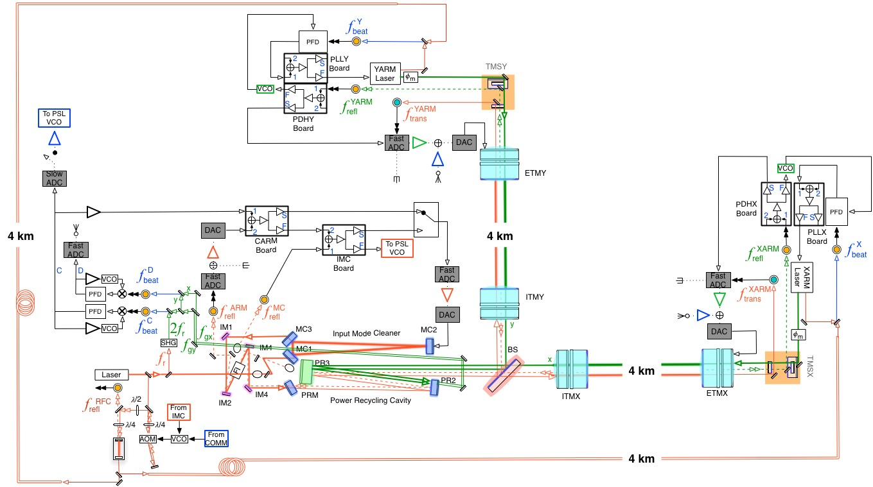

Slide 40
COMM Handoff Basic Block Diagram
COMM PLL
COMMON PATH
IMC LOOP
FAST PATH
MC2 LOOP
SLOW PATH

