Slide 1

Advanced LIGO Seismic Isolation and Control
LIGO
Brett Shapiro
30th Pacific Coast Gravity Meeting
UC San Diego – 29 March 2014

Slide 2
Summary
LIGO
Advanced LIGO
Seismic Isolation Systems
Control design Ex: quadruple pendulum damping
How control design influences astrophysical sensitivity

Slide 3




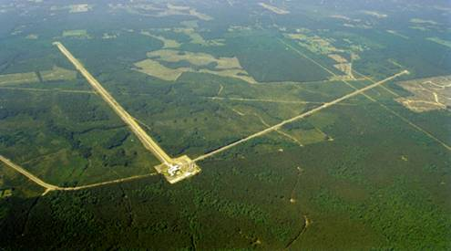
The Laser Interferometer
Gravitational-wave Observatory (LIGO)
Funded by
ETM
Test Masses
:
fused silica
4 km
34
cm diam x
,
20
cm thick
Input
Mode
Cleaner
40
kg
,
T = 3%
ITM
PRM
CP
Laser
Φ
m
FI
ITM
ETM
125 W
BS
815 kW
5.7 kW
Not to scale
Hanford, WA
Advanced LIGO configuration
1st observational run ≈2015
Upgrade to Initial LIGO
SRM
FI
PD
GW readout
Output
Mode
Cleaner
2, 4 km interferometers at 2 sites in the US
Michelson interferometers with Fabry-Pérot arms
Optical path enclosed in vacuum
Sensitive to strains around 10⁻²² -> 10⁻¹⁹m_{rms}
LIGO Budget ≈ $60 Million per year from NSF.
Operated by MIT and Caltech.
Livingston, LA

Slide 4
4/17

Slide 5
Projected Sensitivity for Adv. LIGO
GWs

Slide 6

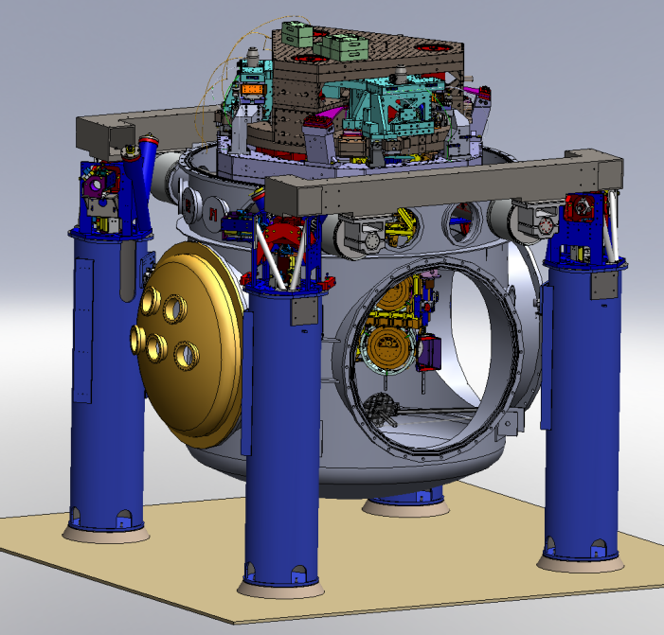
Suspensions and Seismic Isolation
Advanced LIGO test mass isolation
Ref: LIGO-G1000469-v1; Kissel PhD thesis

Slide 7
Suspensions and Seismic Isolation
Advanced LIGO test mass isolation
quadruple pendulum (four stages of isolation) with monolithic silica final stage
Ref: LIGO-G1000469-v1; Kissel PhD thesis

Slide 8
Suspensions and Seismic Isolation
Advanced LIGO test mass isolation
active isolation platform (2 stages of isolation)
quadruple pendulum (four stages of isolation) with monolithic silica final stage
Ref: LIGO-G1000469-v1; Kissel PhD thesis

Slide 9
Suspensions and Seismic Isolation
Advanced LIGO test mass isolation
active isolation platform (2 stages of isolation)
hydraulic external pre-isolator (HEPI) (one stage of isolation)
quadruple pendulum (four stages of isolation) with monolithic silica final stage
Ref: LIGO-G1000469-v1; Kissel PhD thesis

Slide 10
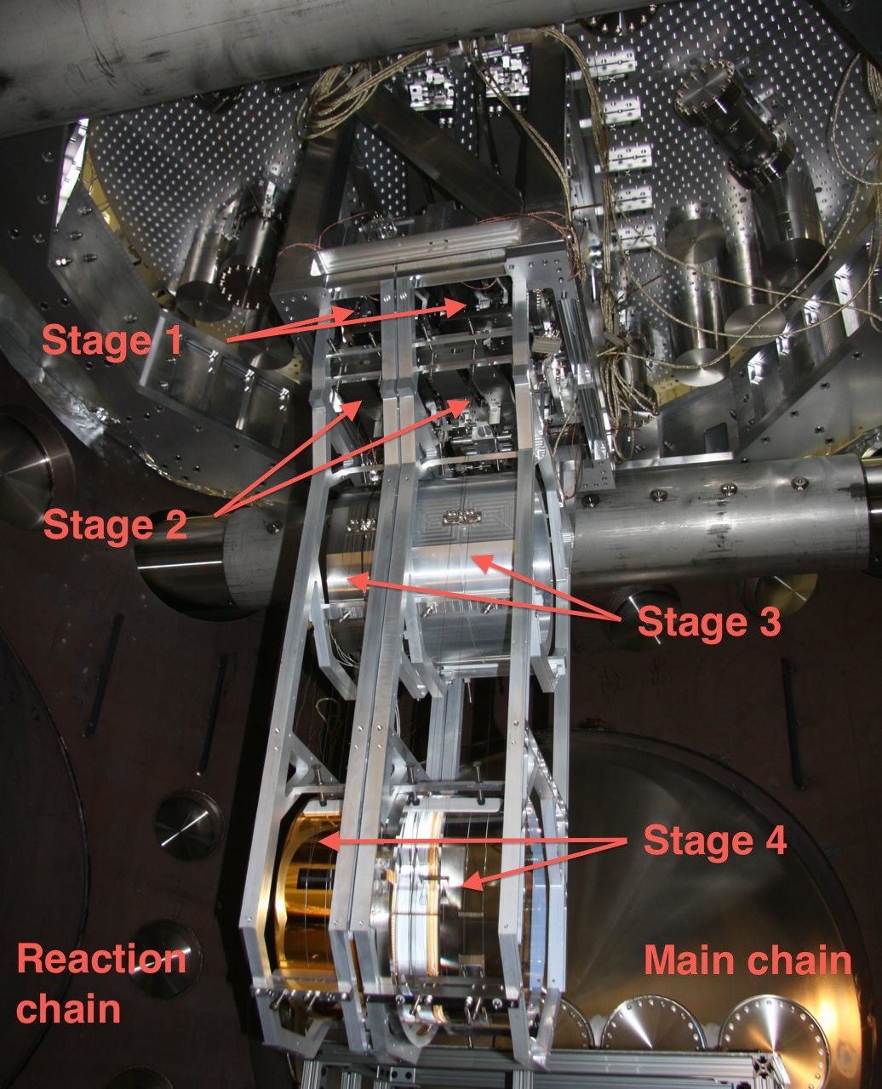
prototype quad pendulum installation
Jan 2009 at MIT

Slide 11
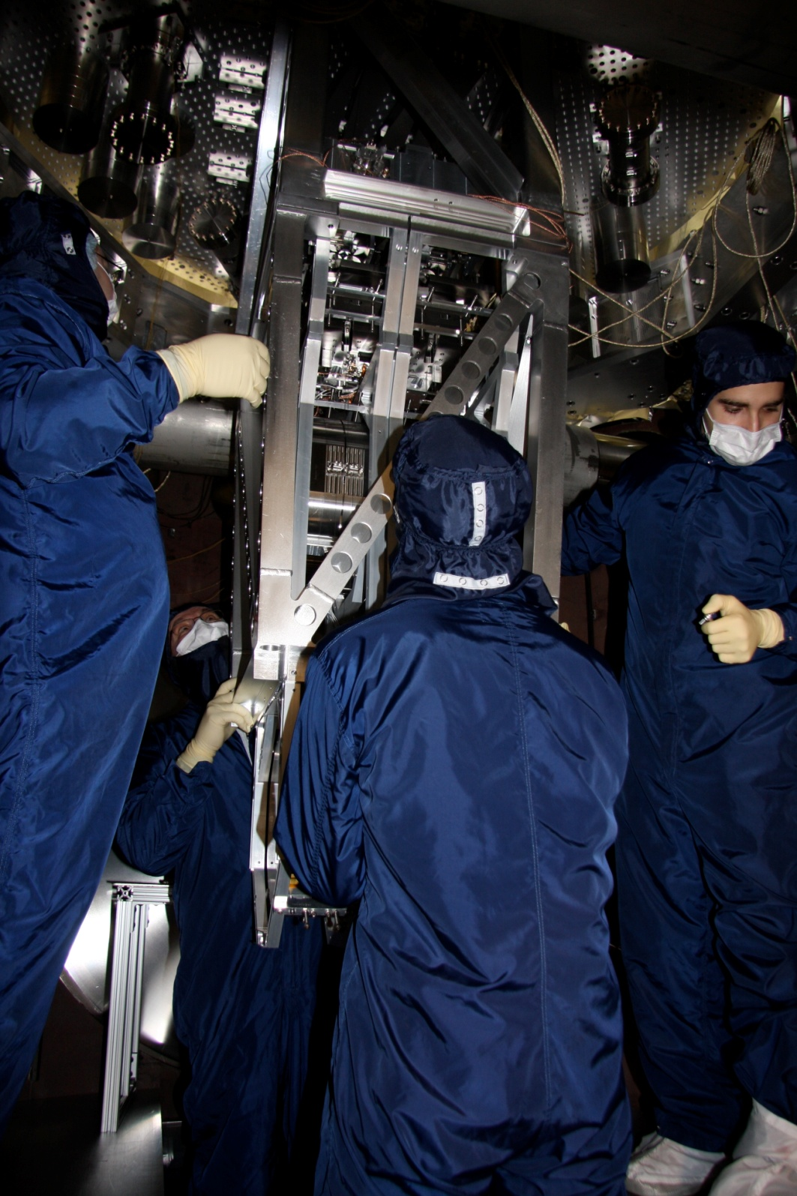
active isolation platform (2 stages of isolation)
quadruple pendulum (four stages of isolation)
prototype quad pendulum installation
Jan 2009 at MIT

Slide 12
Pendulum Control Layout
Schematic view of one of LIGO’s 4 km Fabry-Perot cavity arms
Pendulum 2
Pendulum 1
4 km ± ΔL

Slide 13
Pendulum Control Layout
Schematic view of one of LIGO’s 4 km Fabry-Perot cavity arms
Pendulum 2
Pendulum 1
2.85 kW
Incident beam
4 km ± ΔL
Laser
Reflected beam
Cavity Resonant beam
125 W
1064 nm
≈ 800 kW
Photodiode
Error Signal:

Slide 14
Pendulum Control Layout
Schematic view of one of LIGO’s 4 km Fabry-Perot cavity arms
Pendulum 2
Pendulum 1
Cavity length control
Goal:
2.85 kW
Incident beam
4 km ± ΔL
Laser
Reflected beam
Cavity Resonant beam
125 W
1064 nm
≈ 800 kW
Photodiode
Error Signal:

Slide 15
Pendulum Control Layout
Schematic view of one of LIGO’s 4 km Fabry-Perot cavity arms
Pendulum 2
Pendulum 1
Local damping
Local damping
Cavity length control
Goal:
2.85 kW
Incident beam
4 km ± ΔL
Laser
Reflected beam
Cavity Resonant beam
125 W
1064 nm
≈ 800 kW
Photodiode
Error Signal:

Slide 16
Pendulum Control Layout
Schematic view of one of LIGO’s 4 km Fabry-Perot cavity arms
Pendulum 2
Pendulum 1
u₁
Local damping
Local damping
u₂
u₃
Cavity length control
Goal:
2.85 kW
Incident beam
4 km ± ΔL
u₄
Laser
Reflected beam
Cavity Resonant beam
125 W
1064 nm
≈ 800 kW
Photodiode
Error Signal:
Control Law
Actuation

Slide 17
Pendulum Control Layout
Schematic view of one of LIGO’s 4 km Fabry-Perot cavity arms
Pendulum 2
Pendulum 1
u₁
Local damping
Local damping
u₂
Alignment control
u₃
Cavity length control
Goal:
2.85 kW
Incident beam
4 km ± ΔL
u₄
Laser
Reflected beam
Cavity Resonant beam
125 W
1064 nm
≈ 800 kW
Photodiode
Error Signal:
Control Law
Actuation

Slide 18
Pendulum Control Layout
Schematic view of one of LIGO’s 4 km Fabry-Perot cavity arms
Pendulum 2
Pendulum 1
u₁
Local damping
Local damping
u₂
Alignment control
u₃
Cavity length control
Goal:
2.85 kW
Incident beam
4 km ± ΔL
u₄
Laser
Reflected beam
Cavity Resonant beam
125 W
1064 nm
≈ 800 kW
Photodiode
Error Signal:
Control Law
Actuation

Slide 19
Damping loop block diagram
- Frequency domain signals, i.e. Laplace or Fourier Transform
d: seismic disturbance
-C
Actuator force
P
+
y: pendulum displacement,
make this as small as possible
digital damping controller
Pendulum
+
n: sensor noise
Sensor signal

Slide 20
Damping loop block diagram
- Frequency domain signals, i.e. Laplace or Fourier Transform
d: seismic disturbance
-C
Actuator force
P
+
y: pendulum displacement,
make this as small as possible
digital damping controller
Pendulum
+
n: sensor noise
Sensor signal
Seismic contribution:
Want PC big to reduce resonant amplitude
Sensor noise contribution:
Want PC small to minimize transmission

Slide 21
Damping loop block diagram
- Frequency domain signals, i.e. Laplace or Fourier Transform
d: seismic disturbance
-C
Actuator force
P
+
y: pendulum displacement,
make this as small as possible
digital damping controller
Pendulum
+
n: sensor noise
Sensor signal
For a stable response
Seismic contribution:
Want PC big to reduce resonant amplitude
Sensor noise contribution:
Want PC small to minimize transmission

Slide 22
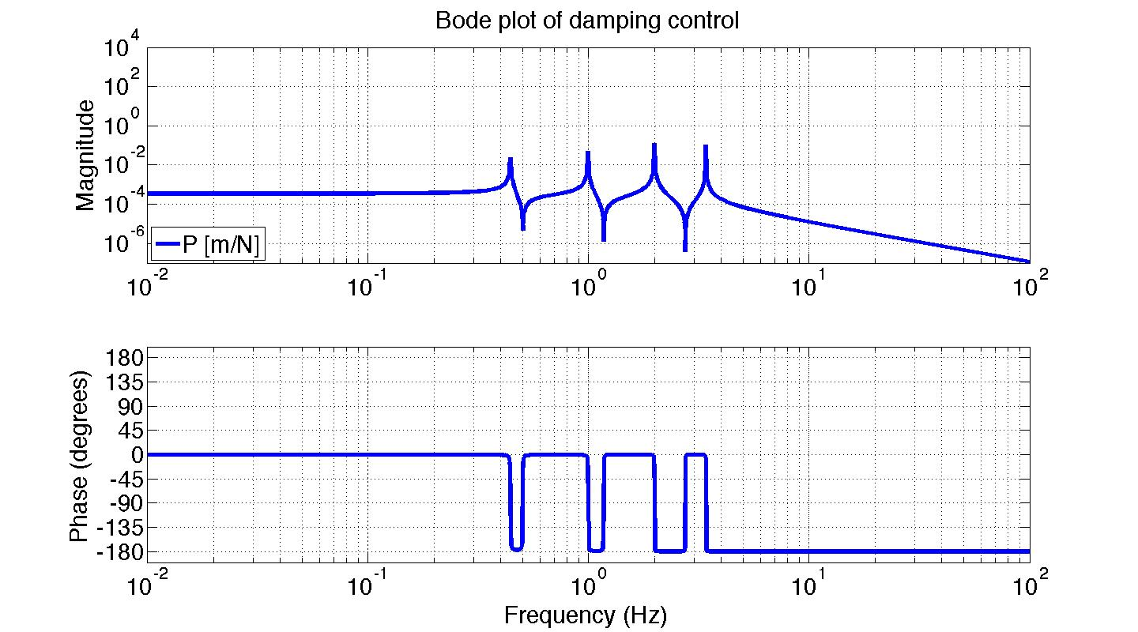
Top Mass Velocity Damping

Slide 23
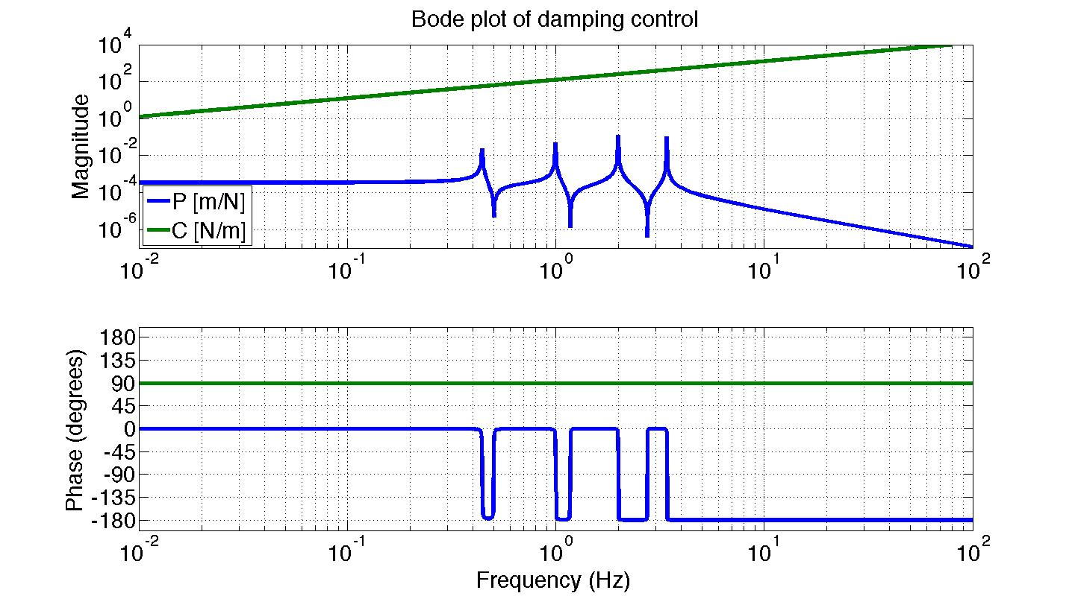
Top Mass Velocity Damping

Slide 24
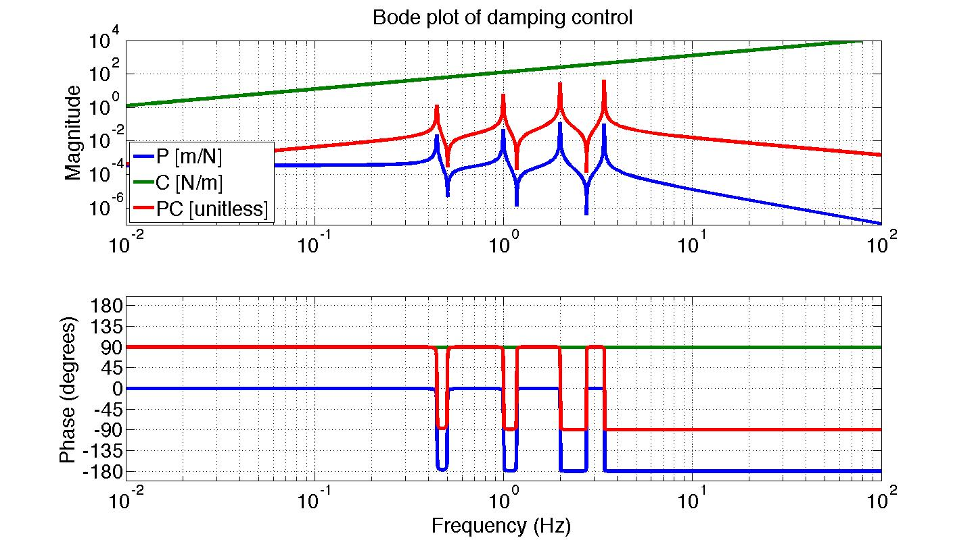
Top Mass Velocity Damping

Slide 25
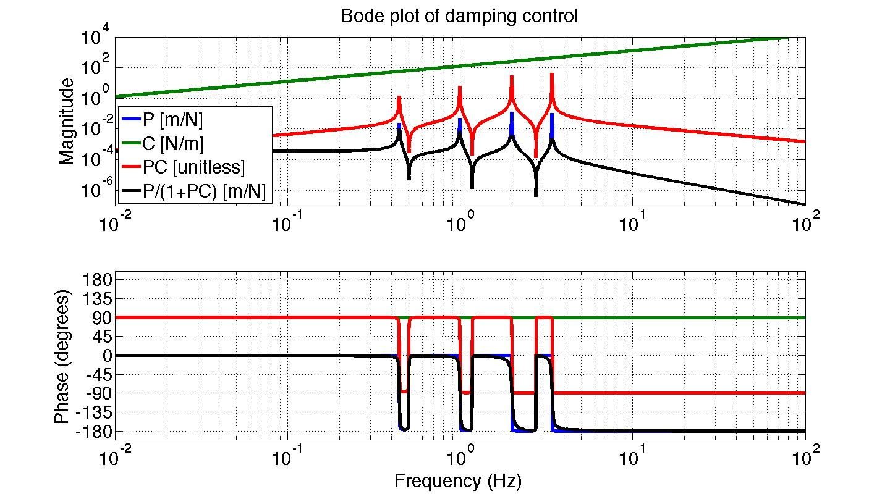
Top Mass Velocity Damping

Slide 26
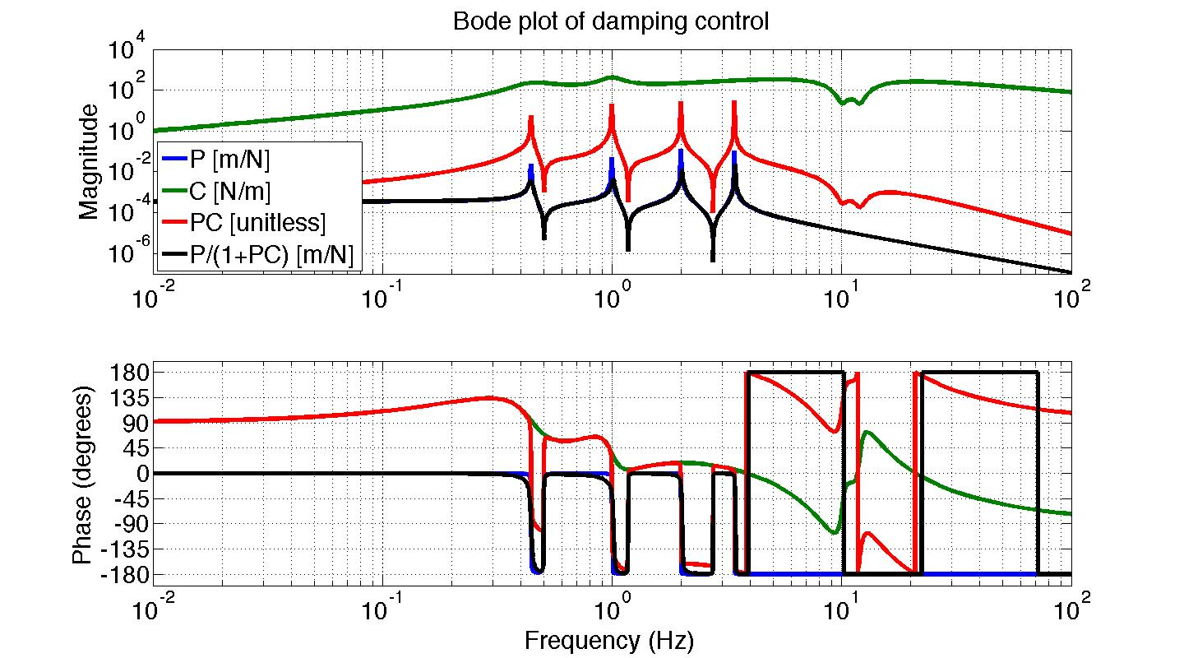
Tuned Top Mass Damping

Slide 27
Tuned Top Mass Damping
Cost parameters:
Amount of damping
Sensor noise amp.
Automated Algorithms:
Linear Quadratic Regulator (LQR)
State Estimation
Modal Decoupling
Control design

Slide 28
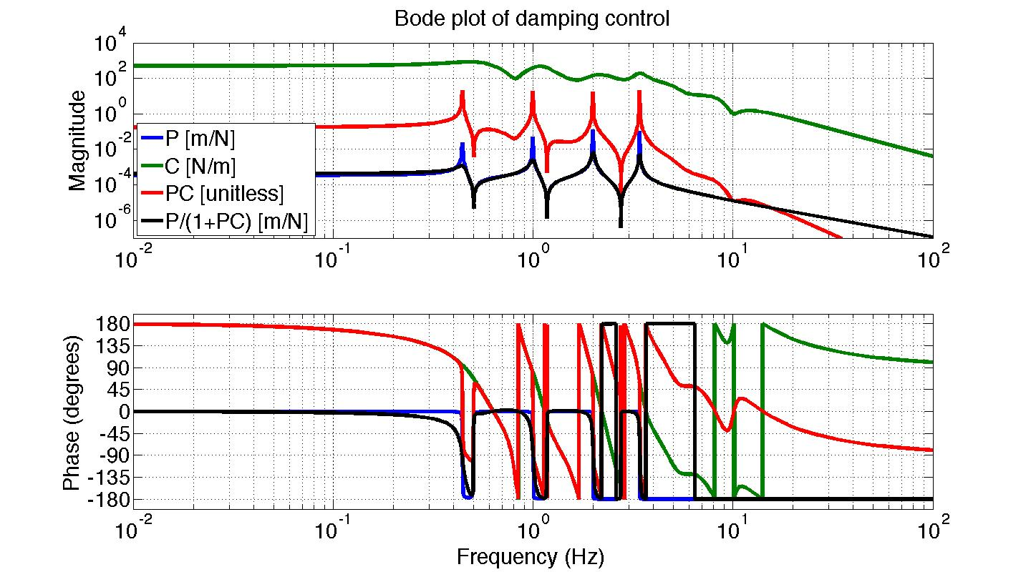
Optimized Top Mass Damping
Cost parameters:
Amount of damping
Sensor noise amp.
Automated Algorithms:
Linear Quadratic Regulator (LQR)
State Estimation
Modal Decoupling
Control design
Ref: “Adaptive Modal Damping for Advanced LIGO Suspensions.” Brett Shapiro, PhD Thesis, MIT Mechanical Engineering, 2012

Slide 29
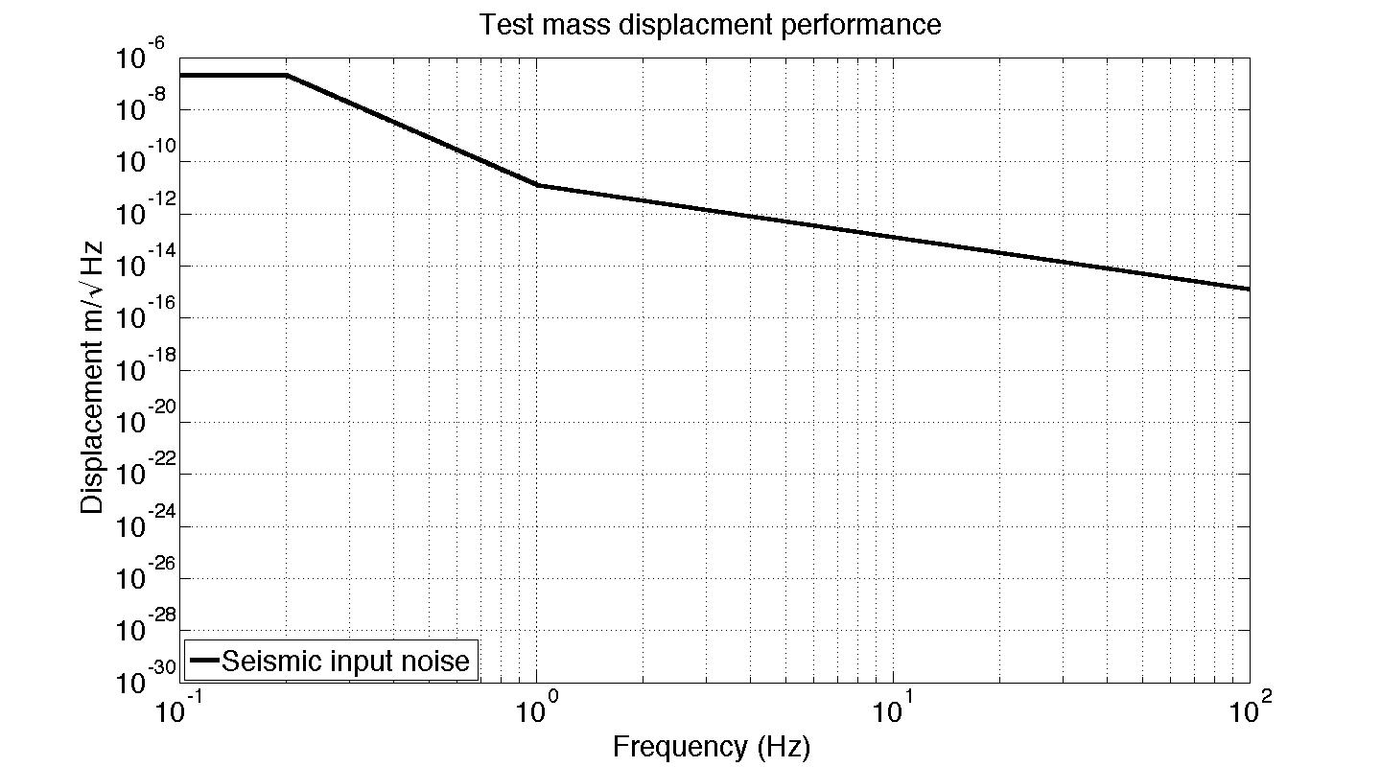
Test Mass Noise Performance

Slide 30
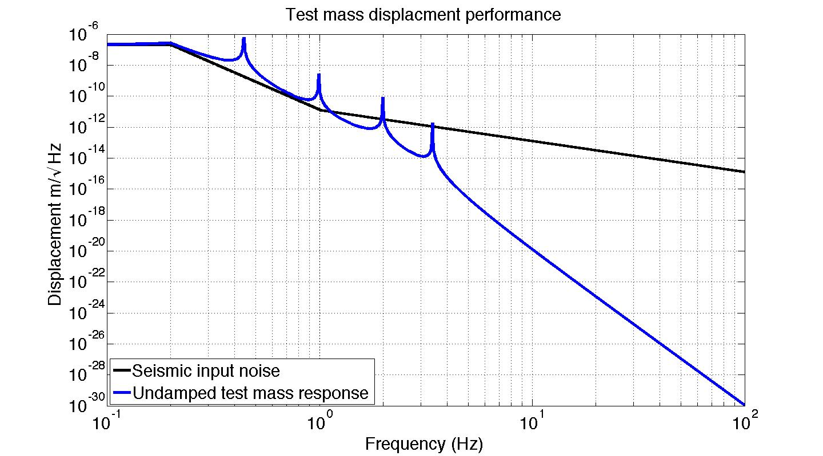
Test Mass Noise Performance

Slide 31
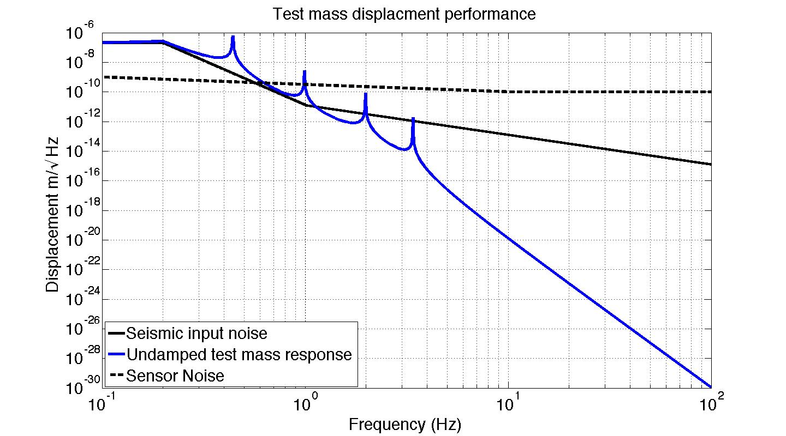
Test Mass Noise Performance

Slide 32
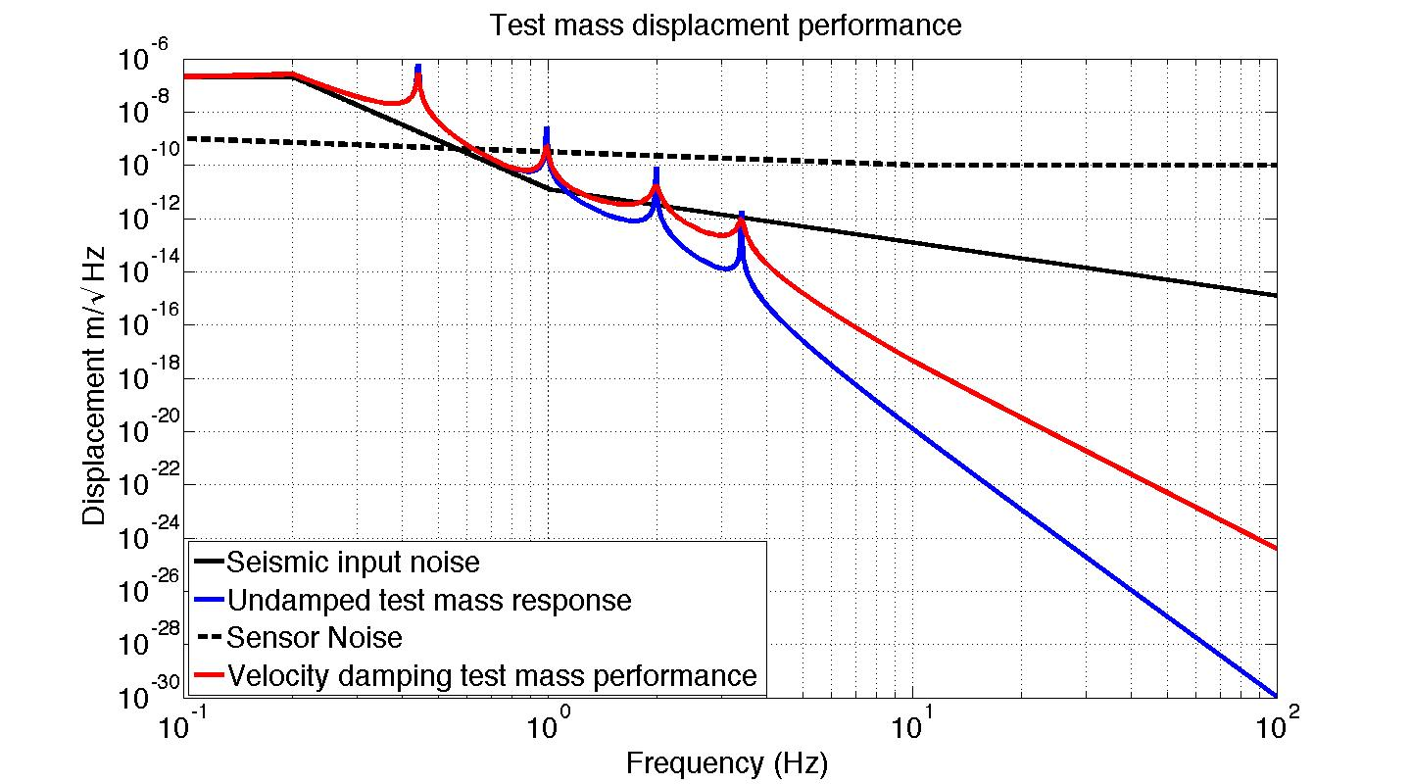
Test Mass Noise Performance

Slide 33
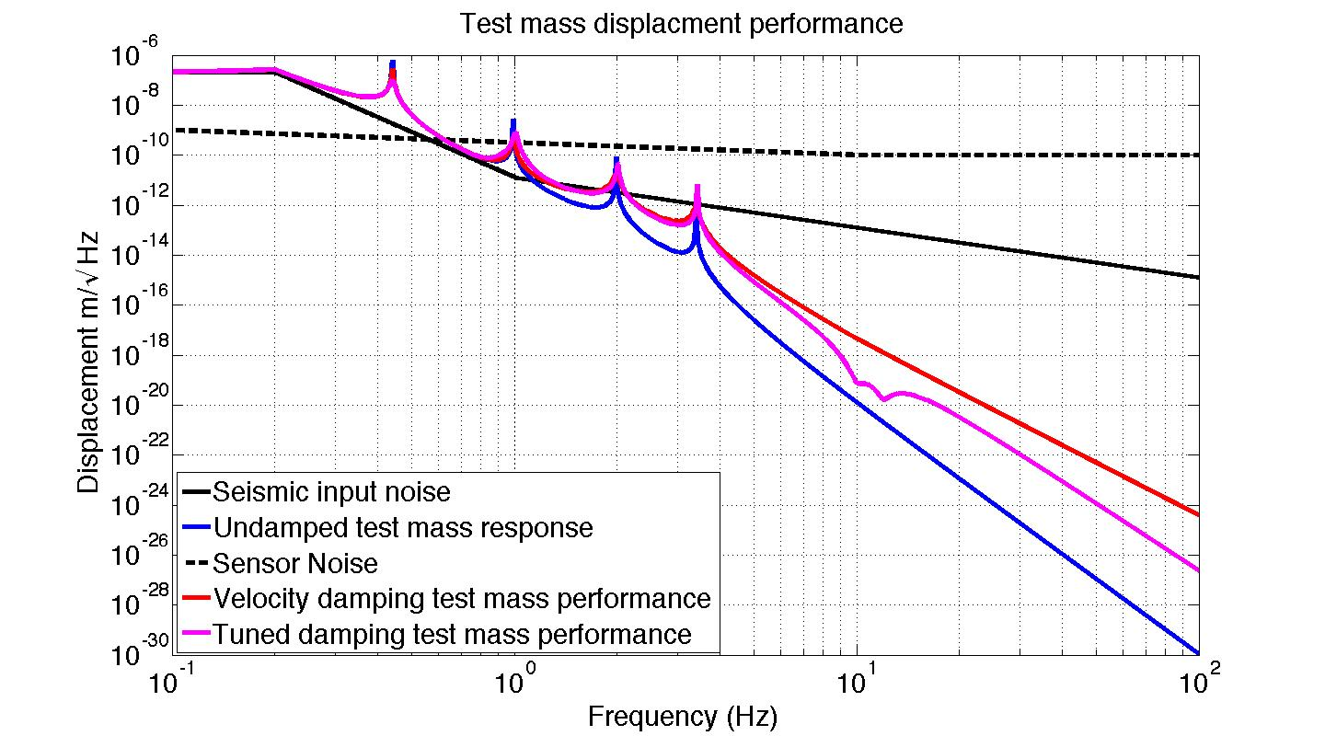
Test Mass Noise Performance

Slide 34
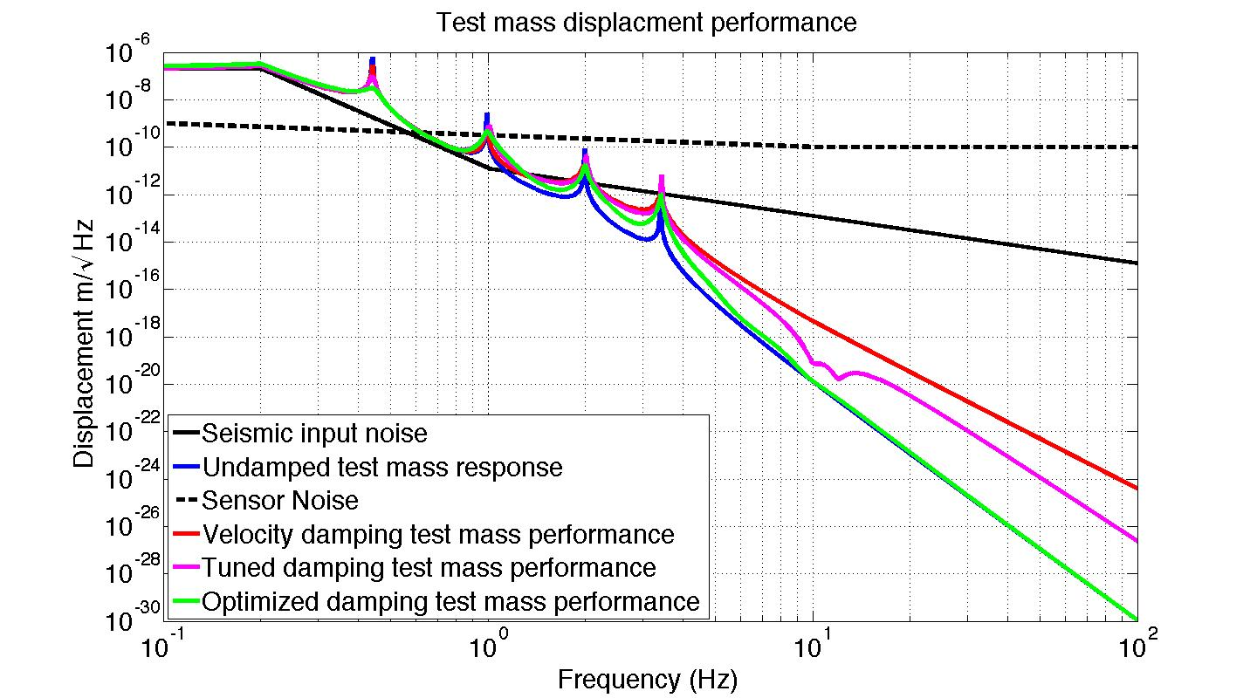
Test Mass Noise Performance

Slide 35
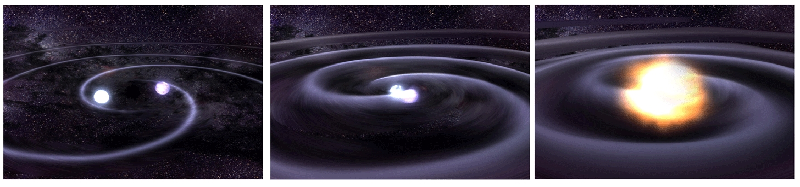
Binary Inspiral Sensitivity
Ref: LIGO doc T030276 - https://dcc.ligo.org/LIGO-T030276/public

Slide 36
Binary Inspiral Sensitivity
Ref: LIGO doc T030276 - https://dcc.ligo.org/LIGO-T030276/public

Slide 37
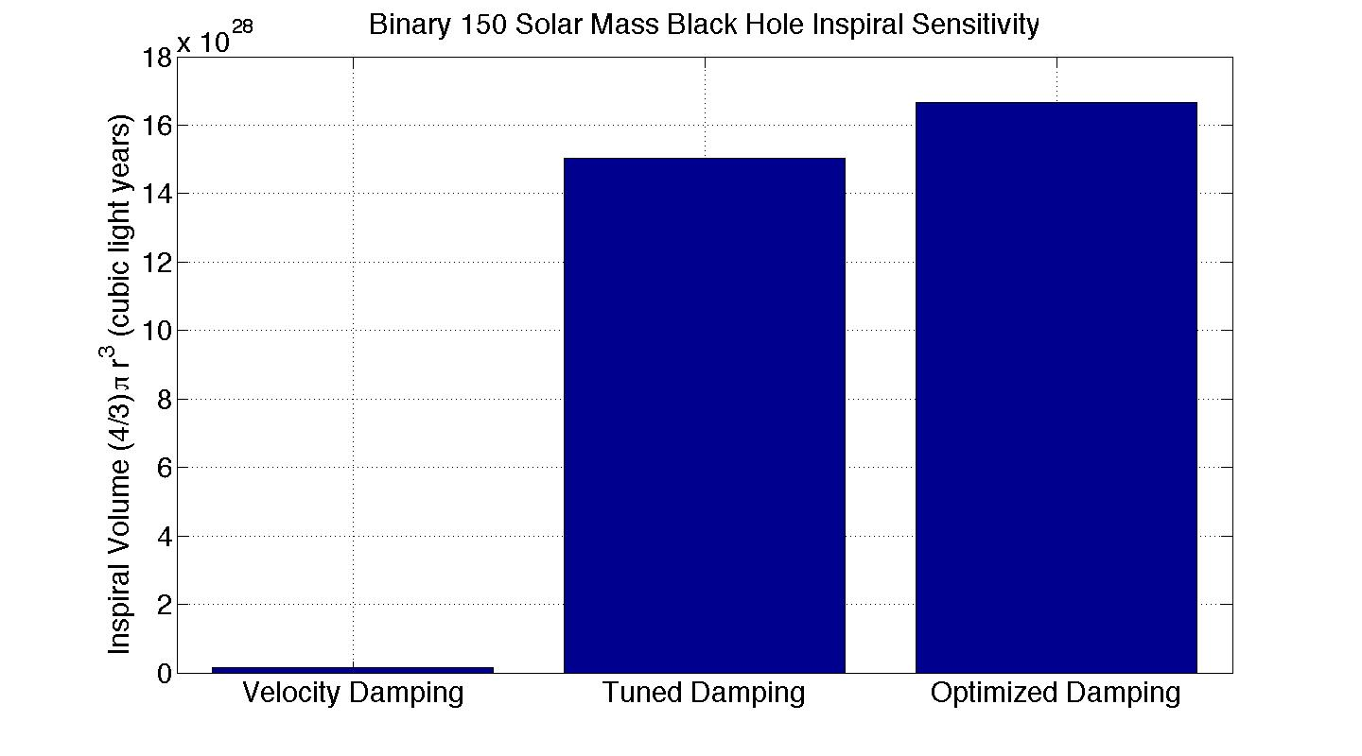
Observable Range to Binary Inspirals

Slide 38
Conclusions
Many control systems are needed to operate the interferometer
Good controls are needed for good science

Slide 39
Questions?

Slide 40
Backups

Slide 41
Optimized Top Mass Damping
Ref: “Adaptive Modal Damping for Advanced LIGO Suspensions.” Brett Shapiro, PhD Thesis, MIT Mechanical Engineering, 2012

Slide 42
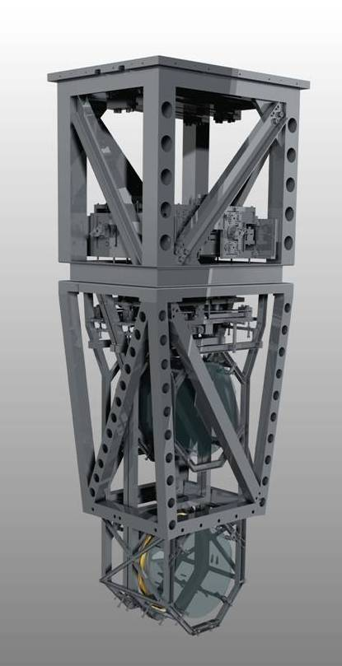
Quadruple Pendulum
Reaction Chain
Main (test) Chain
Purpose
Test mass (stage 4) isolation.
the test mass consists of a 40 kg high reflective mirror
Stage 1
Control
Damping - stage 1
Cavity length - all stages
Sensors/Actuators
BOSEMs at stage 1 & 2
AOSEMs at stage 3
Opt. levs. and interf. sigs. at stage 2
Electrostatic drive (ESD) at stage 4
Stage 2
Stage 3
Stage 4

Slide 43
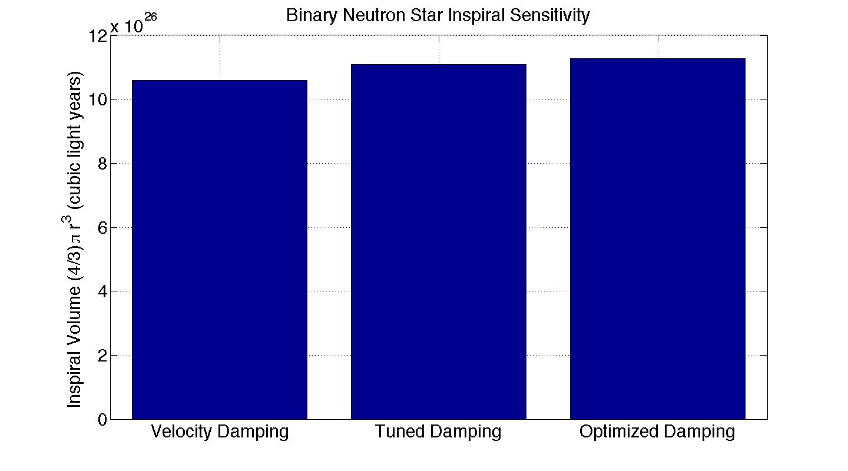
Observable Range to Binary Inspirals

Slide 44

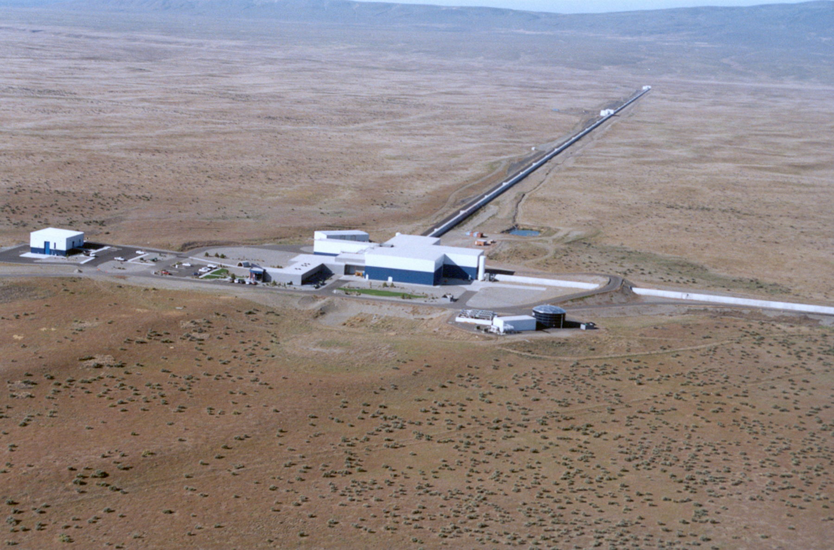
Advanced LIGO Timeline
Livingston, LA
Hanford, WA
Full lock testing
1st science run
GW
astronomy
Build LIGO III
Last core optics
March 2014
Aug-Sept 2014
Sept-Dec 2015
Soon after
Far after

Slide 45
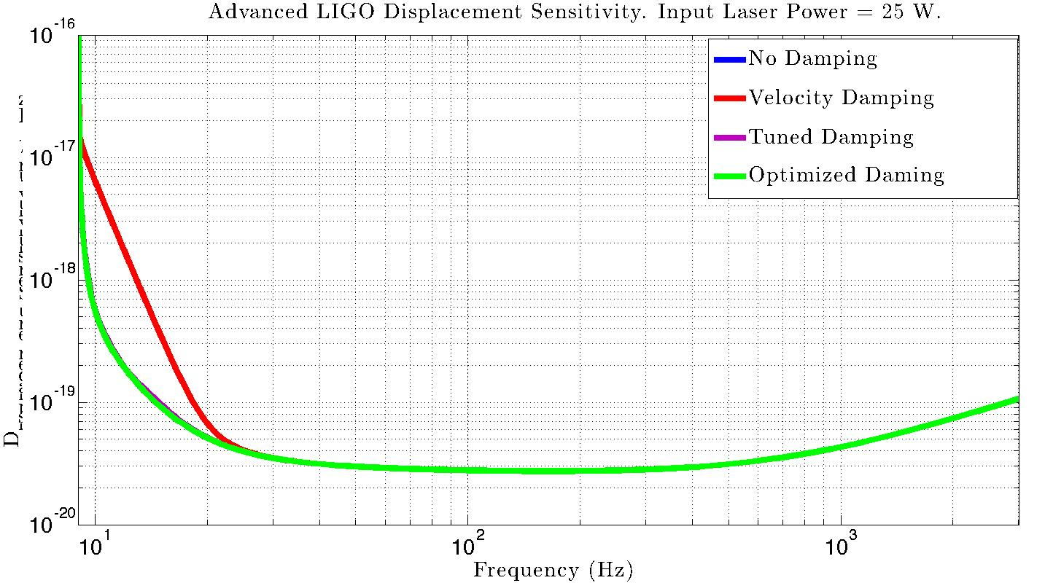
GW sensitivity with various damping

Slide 46
Observable Range to Binary Inspirals
25 W input laser power
Damping type | Binary neutron star range (Mpc) | Binary 150 solar mass black hole range (Mpc)
Velocity damping | 143 | 229
Tuned damping | 153 | 1331
Optimized damping | 154 | 1396
125 W input laser power
Damping type | Binary neutron star range (Mpc) | Binary 150 solar mass black hole range (Mpc)
Velocity damping | 194 | 225
Tuned damping | 197 | 1012
Optimized damping | 198 | 1047

Slide 47















































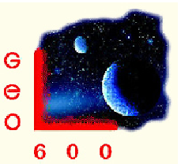

























LIGO Scientific Collaboration
3/12/14

Slide 48
Problem 3: Cavity Signal
“Linear region”
PDH signal
The PDH signal for a 4 km aLIGO Fabry-Perot cavity with mirror power transmissions of 1.4% and 7.5 ppm. The cavity finesse is 445. The linear region between the dashed lines is 1 nm wide.
F = cavity finesse = 445
λ = laser wavelength = 1064 nm
C = arbitrary electronic scaling

Slide 49
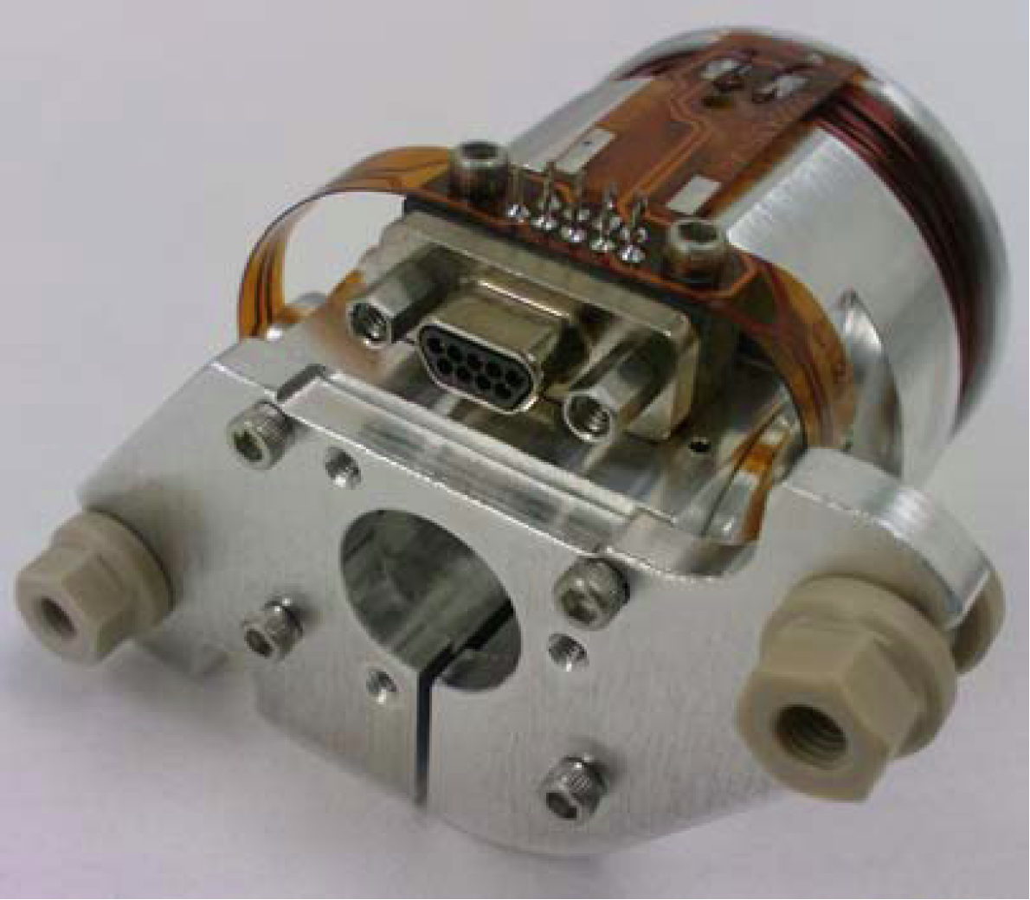
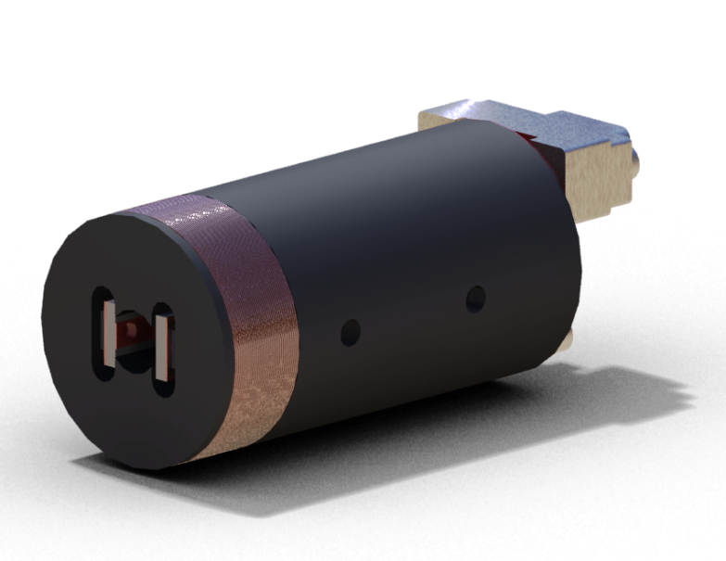
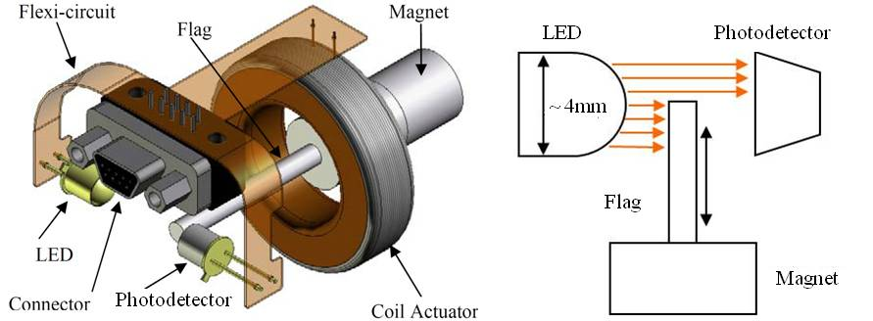
Backups: Optical Sensor ElectroMagnet (OSEM)
Birmingham OSEM (BOSEM)
Advanced LIGO OSEM (AOSEM)
- modified iLIGO OSEM
Magnet Types (M0900034)
BOSEM – 10 X 10 mm, NdFeB , SmCo
10 X 5 mm, NdFeB, SmCo
AOSEM – 2 X 3 mm, SmCo
    2 X 6 mm, SmCo
    2 X 0.5 mm, SmCo
BOSEM Schematic

Slide 50
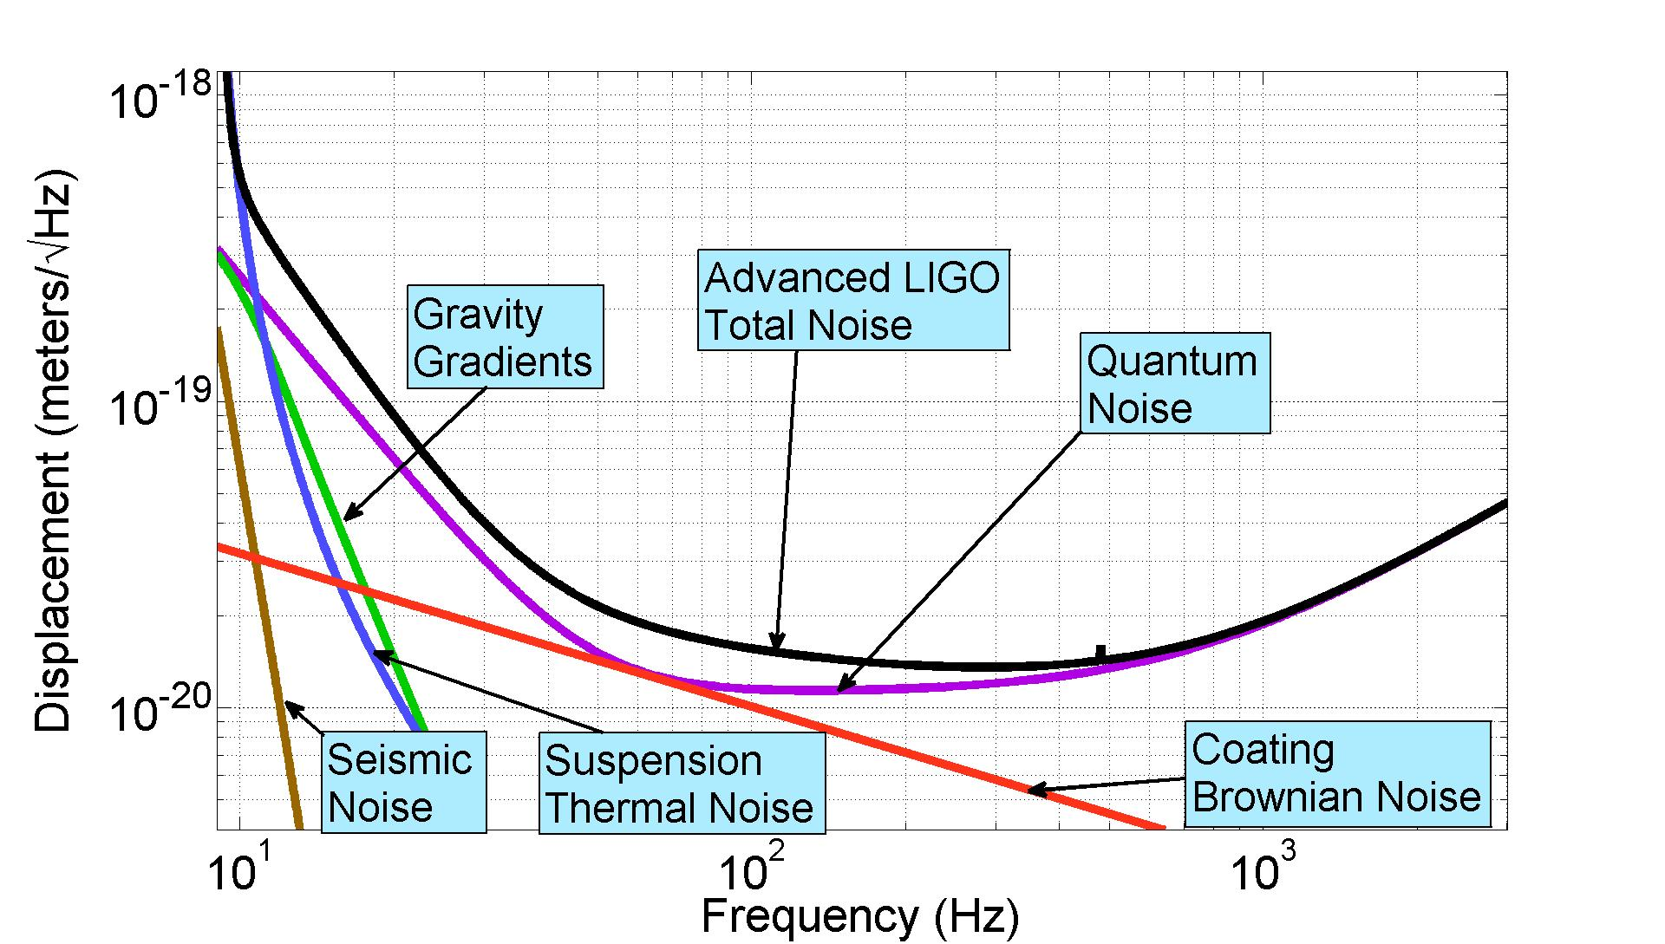
Predicted Advanced LIGO Sensitivity

Slide 51
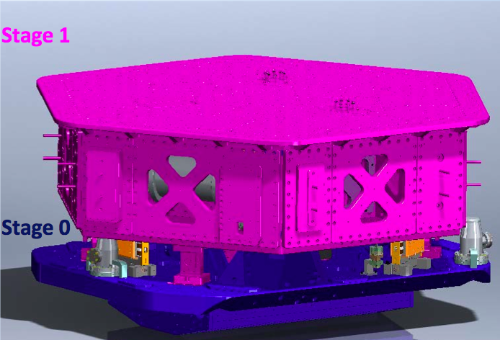
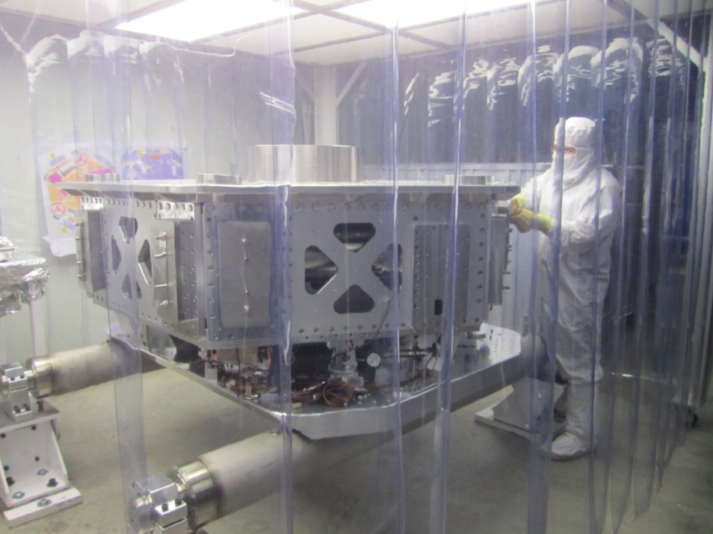
Assembly, Installation & Performance
HAM-ISI:
  Single Stage
  Passive Isolation above Natural frequency: 1.8 Hz
  Active Isolation ~ .1 Hz - 35 Hz
Installed:
  LHO: 5/5
  LLO: 5/5
Courtesy of
C. Ramet
Notes:
HAM: Horizontal Access Module
ISI: Internal Seismic Isolation

Slide 52
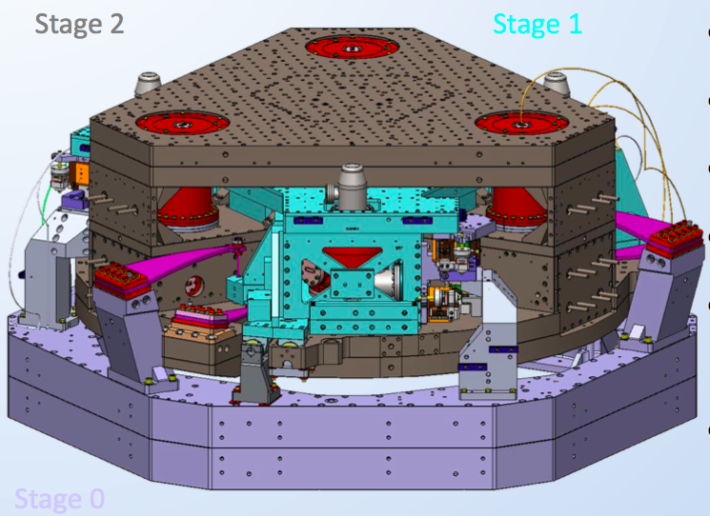
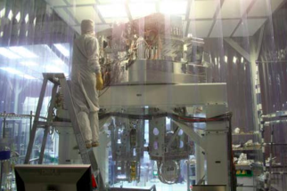
Assembly, Installation & Performance
BSC-ISI:
  Two Stages
  Passive isolation above Natural Frequencies:
  1 Hz - 7 Hz
  Active Isolation
  ~.1 Hz – 40 Hz
Installed:
  LHO: 5/5
  LLO: 5/5
Courtesy of
C. Ramet
Notes:
BSC: Beam Splitter Chamber
ISI: Internal Seismic Isolation

Slide 53
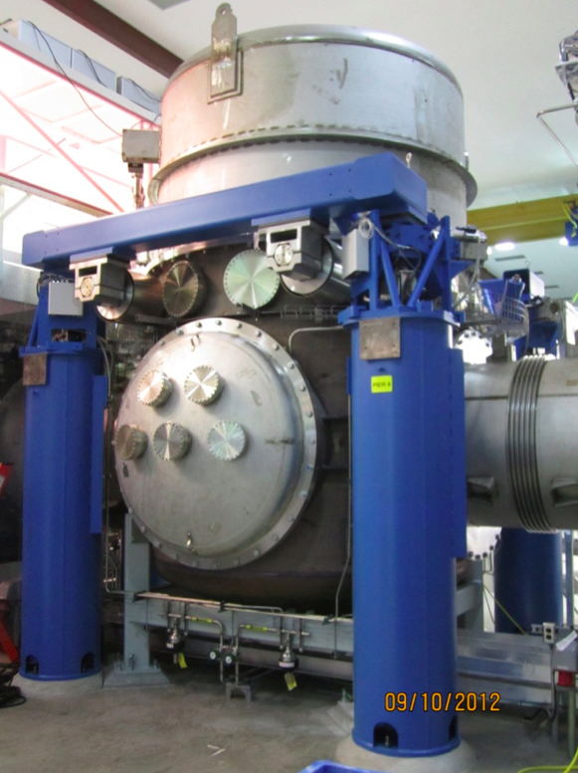
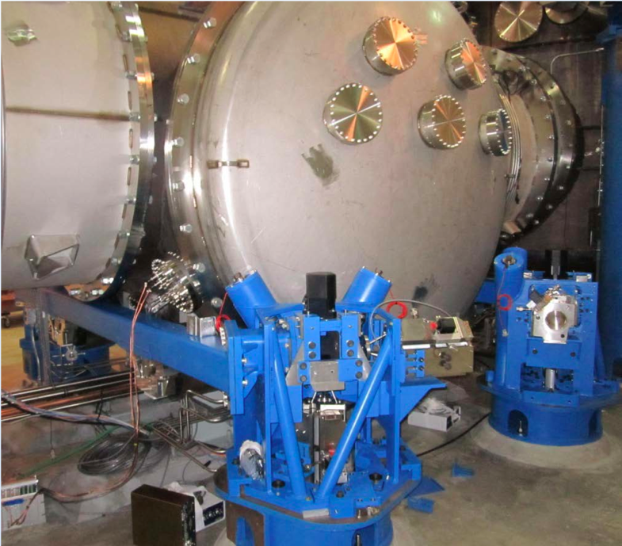
Assembly, Installation & Performance
HEPI:
  Single Stage
  Hydraulic actuation
  Isolation bandwidth 0.1 Hz - 10 Hz
Installed:
  LHO: 11/11*
  LLO: 11/11
*: A few HEPI still need to be wired up
Courtesy of
C. Ramet
Notes:
HEPI: Hydraulic External Pre-Isolator

