Slide 1
Characterization of Second Harmonic Generators for Advanced LIGO Squeezing by Andres Medina
Mentors: Sheila Dwyer and Daniel Sigg

Slide 2
Gravitational Wave Detectors
At high frequencies shot noise (quantum noise) limited the sensitivity of the detector above a few hundred Hertz.
Shot noise is the result of detected photons obeying the Poisson distribution, which has an uncertainty of
The best solution that does not involve increasing the power of the laser is to use squeezed light

Slide 3
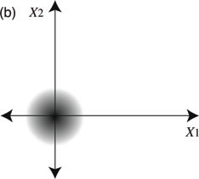
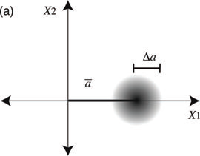
Squeezed light
Vacuum State
Coherent State
Squeezed State

Slide 4
Overview of Squeezed Light
SHG
OPO

Slide 5
Second Harmonic Generator
R @ 1064, 99.85%, HR @ 532
R @ 1064 90% AR @ 532

Slide 6
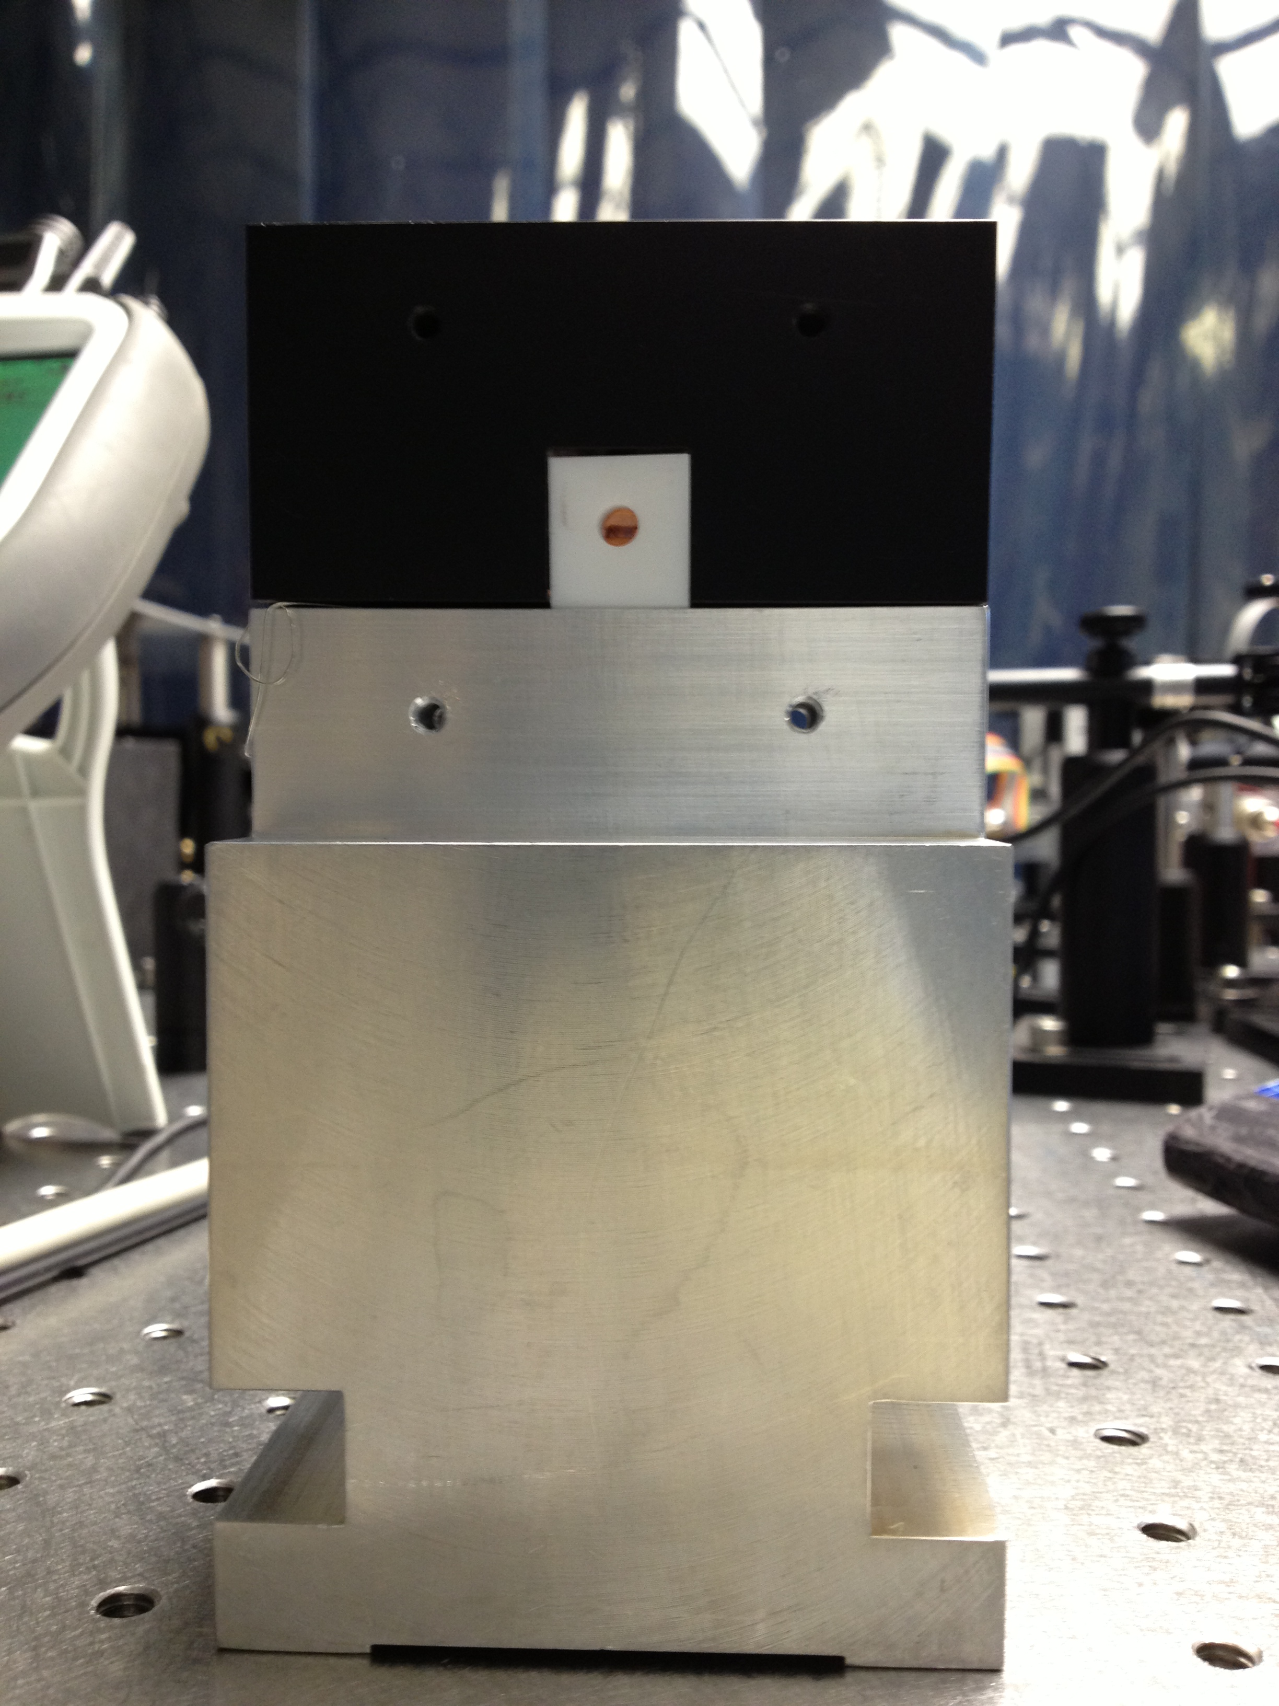
Second Harmonic Generator

Slide 8
Beam Profiler
Waist X = 64.48 μm
Waist Y= 69.21 μm
Effective Waist to Mode Match= 68.81 μm
Expected Waist Size= 70.41 μm

Slide 9
Cavity Modes
Hermite Gauss (r)

Slide 11
Transmission Scan
Mode Mismatch = 10.58%

Slide 12
Feedback Control System

Slide 13
Pound-Drever-Hall Technique

Slide 14
Pound-Drever-Hall Signal

Slide 15
Phase Match

Slide 16
Predicted Phase Matching Curve

Slide 17
`

Slide 18
Phase Matching Curve
Incident infrared power = 15.33mW

Slide 19
Conversion Efficiency of SHG
Using an Incidence beam of 100 mW
We found the Efficiency conversion from Infrared to green light is 27%.

Slide 20
Prediction of Conversion Efficiency
Green Power @ 500 mW = 225 mW

Slide 21
References
McClelland, D.E., Mavalvala, N., Chen, Y., Schnabel, R., Advance Interferometry, Quantum Optics and Optomechanics in Gravitational Wave Detectors, Laser & Photonics Reviews 5.5 (2011): 677-696.
Henry, Richard W., and Sharon C. Glotzer. "A squeezed-state primer." Am. J. Phys 56.4 (1988): 318-328.
Walls, Daniel F. "Squeezed states of light." nature 306 (1983): 141-146.

Slide 22
Intra-cavity losses
IntraCavityLoss = 6.25%
Front Mirror = 10.65%
Back Mirror = 0.31%

