Slide 1
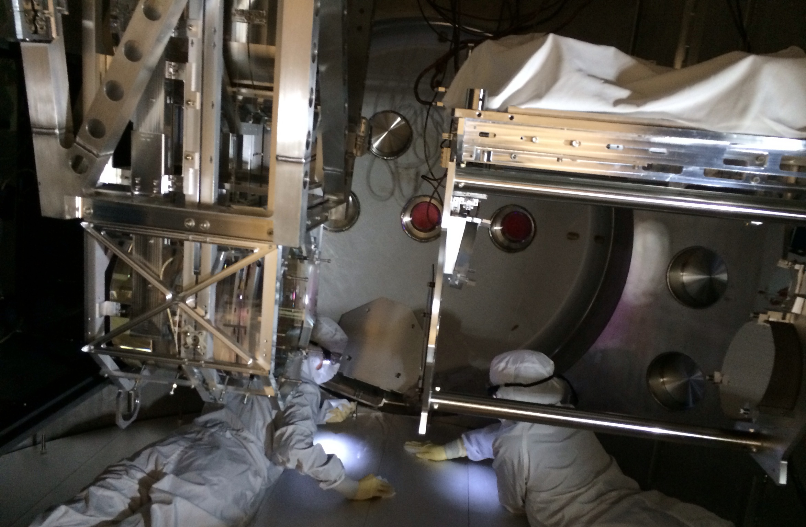
Hanford Contamination Control Update 2 Back to Basics
LIGO G1400378-v2 Contamination Control Working Group March 21, 2014

Slide 2
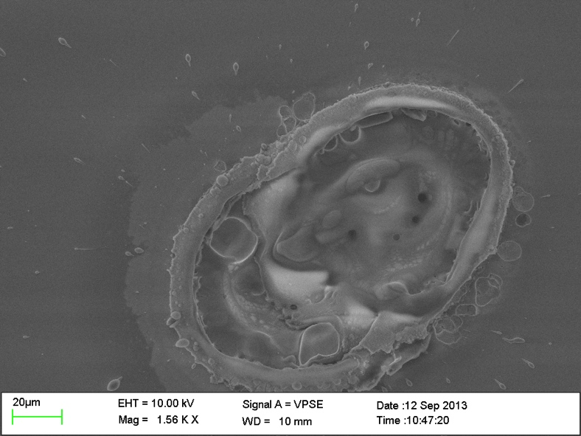
Why do we care?
Sensitivity loss
Absorption
Scatter
Damage
Contamination will limit performance.
Notes:
aLIGO optics are vulnerable to particulate contamination. Surface particles absorb and scatter power from the interferometer mode. Such losses limit recycling and signal cavity finesse, degrading shot-noise limited strain sensitivity.
ven low-level contaminants can result in laser damage to optics during the operation the interferometers, and/or the unacceptable reduction of overall detector sensitivity.

Slide 3
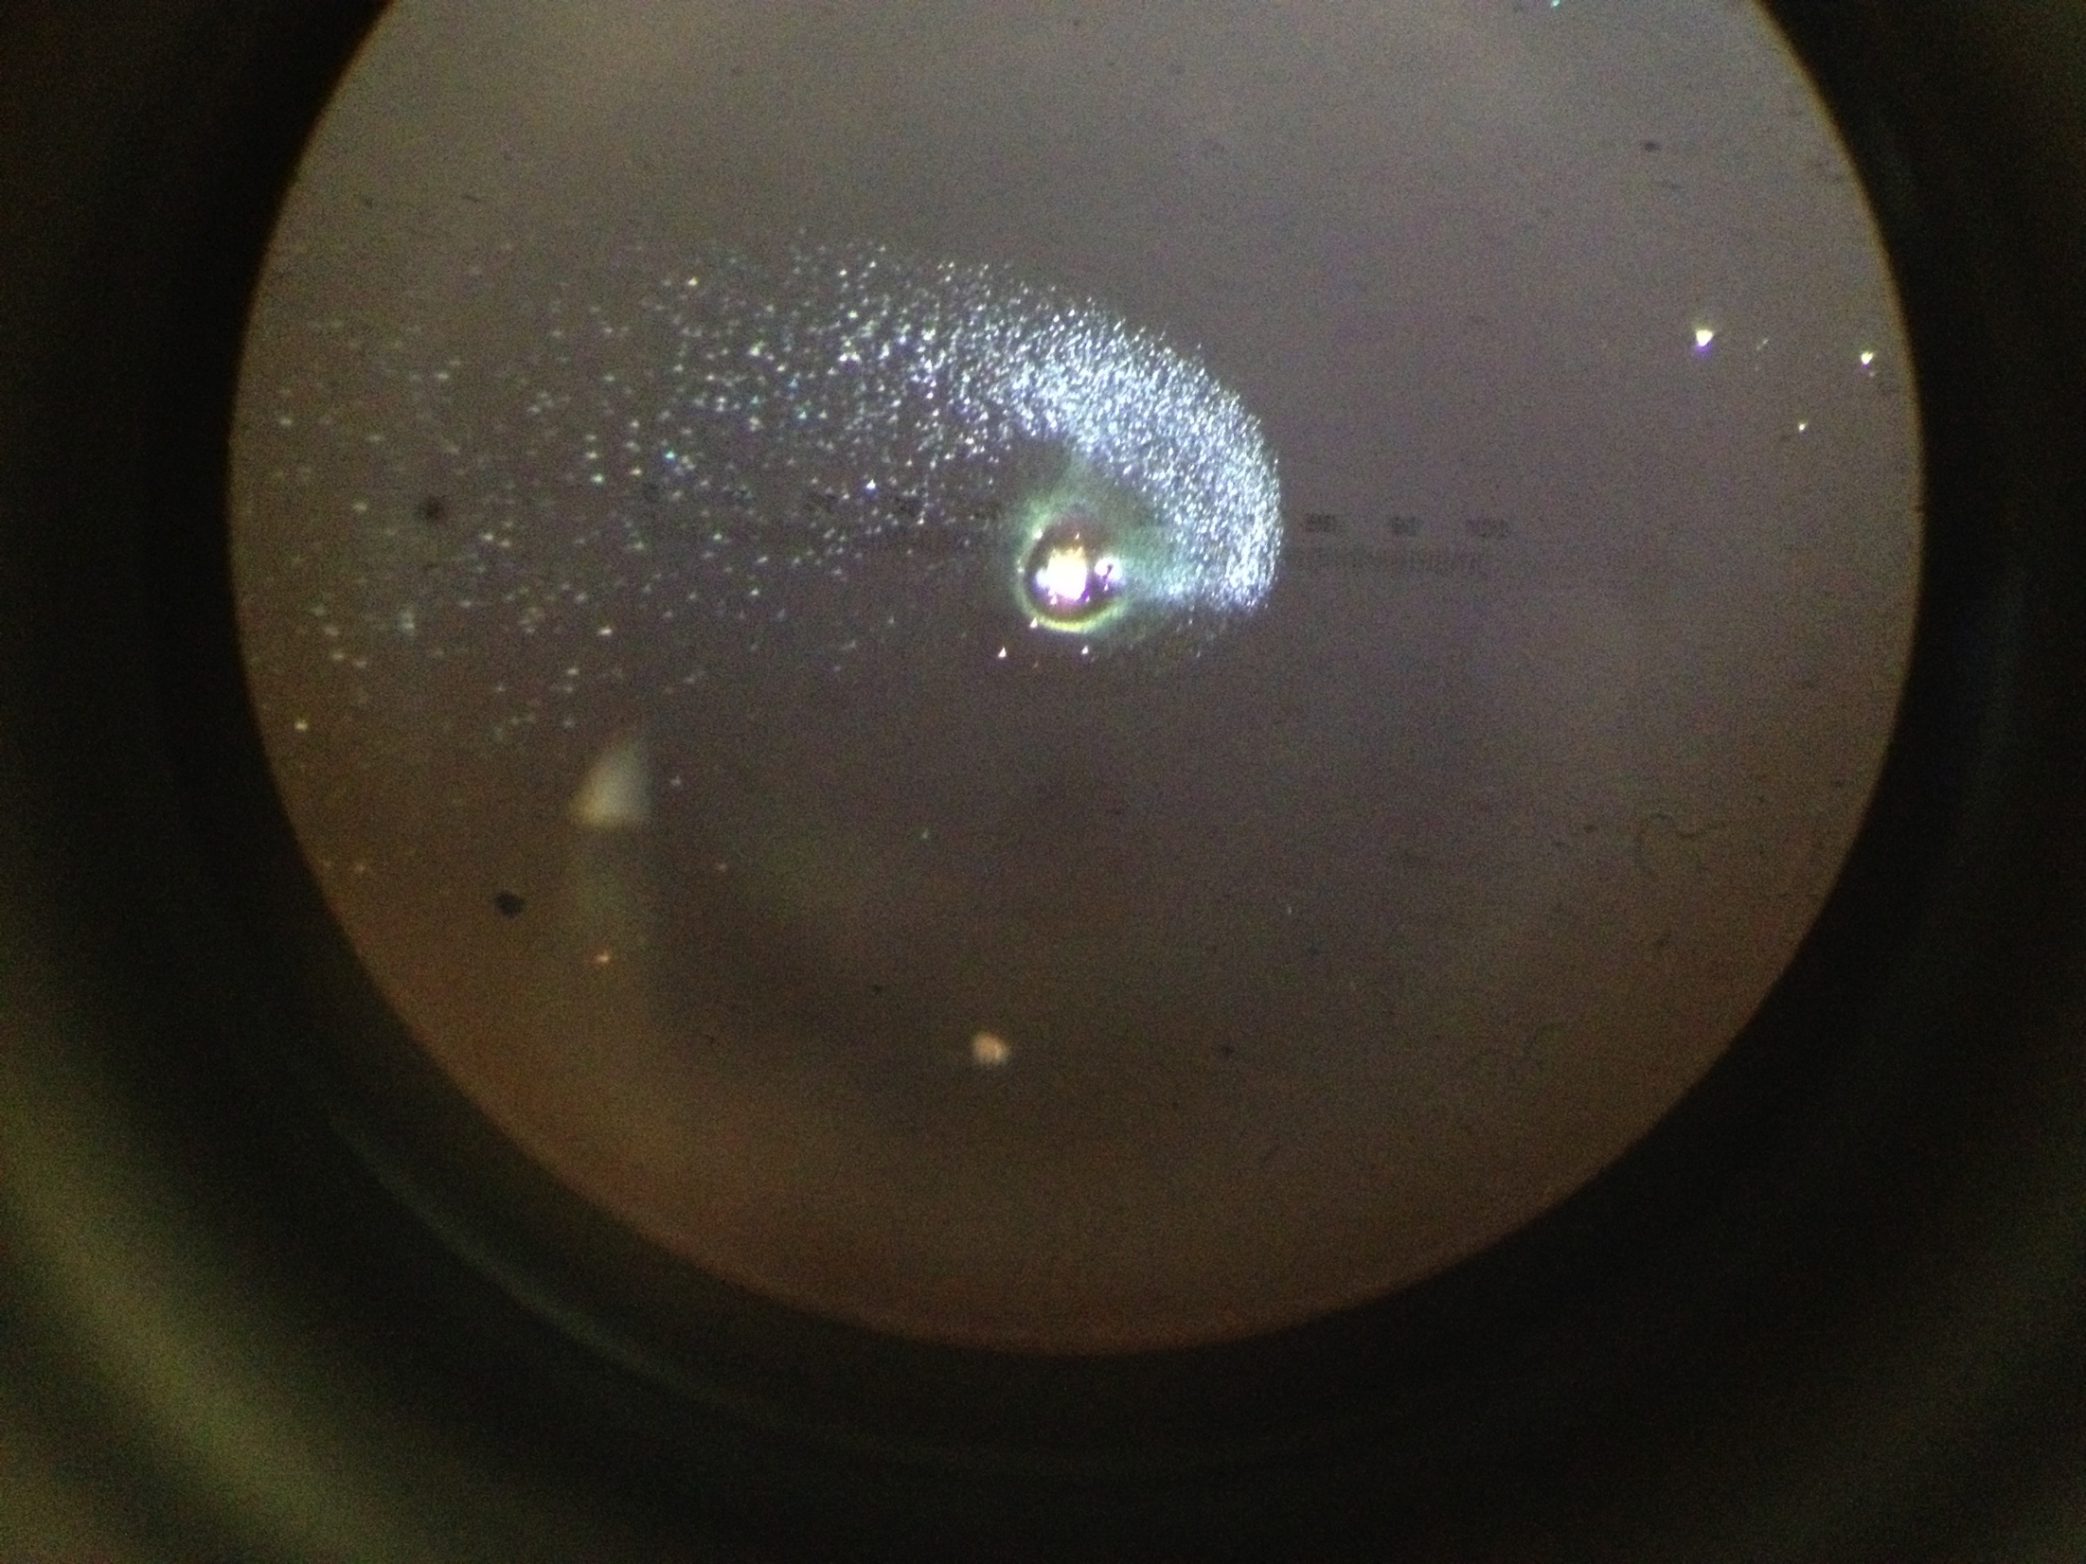
Laser Induced Damage due to Particulate Contamination
Billingsley, Gushwa, Phelps, Torrie, Zhang
LVC meeting March 2014
LIGO-G1400209

Slide 4
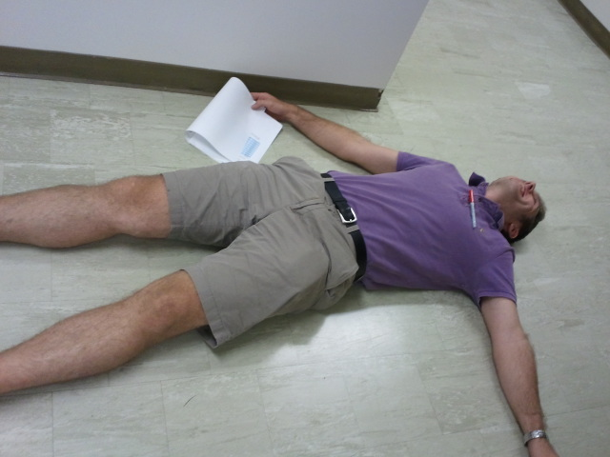
Contamination Control Working Group:
Analyze and mitigate contamination

Slide 5
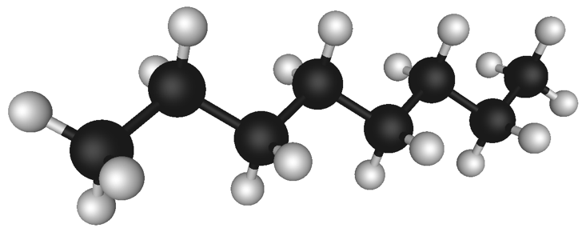
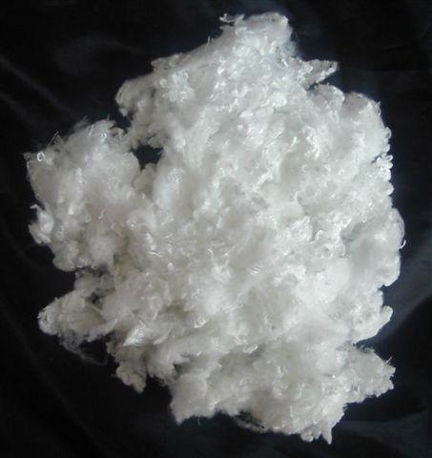
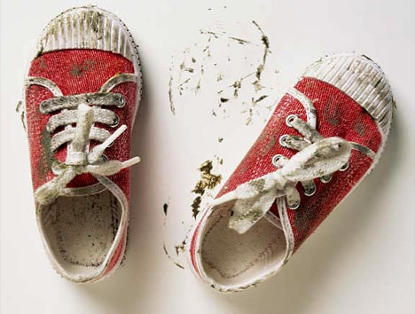
Contamination
Contamination comes from us and everything we do.
Metals
Complex mix of hydrocarbons
Fibers
Biological
Mixed silicates (soil)

Slide 6
Understanding PCLs
log vs. log² graph
Scan area = 4.2 cm²
Total particles = 10,229
Goal for vertical surfaces
Goal for horizontal surfaces
424
Notes:
Sample T1300454

Slide 7
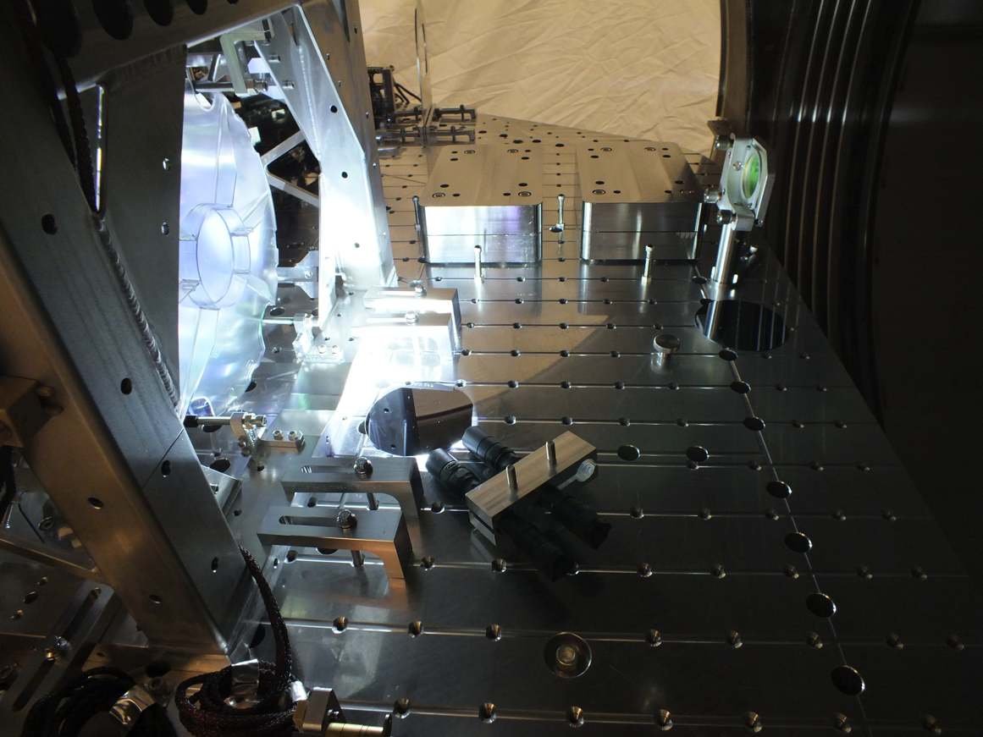
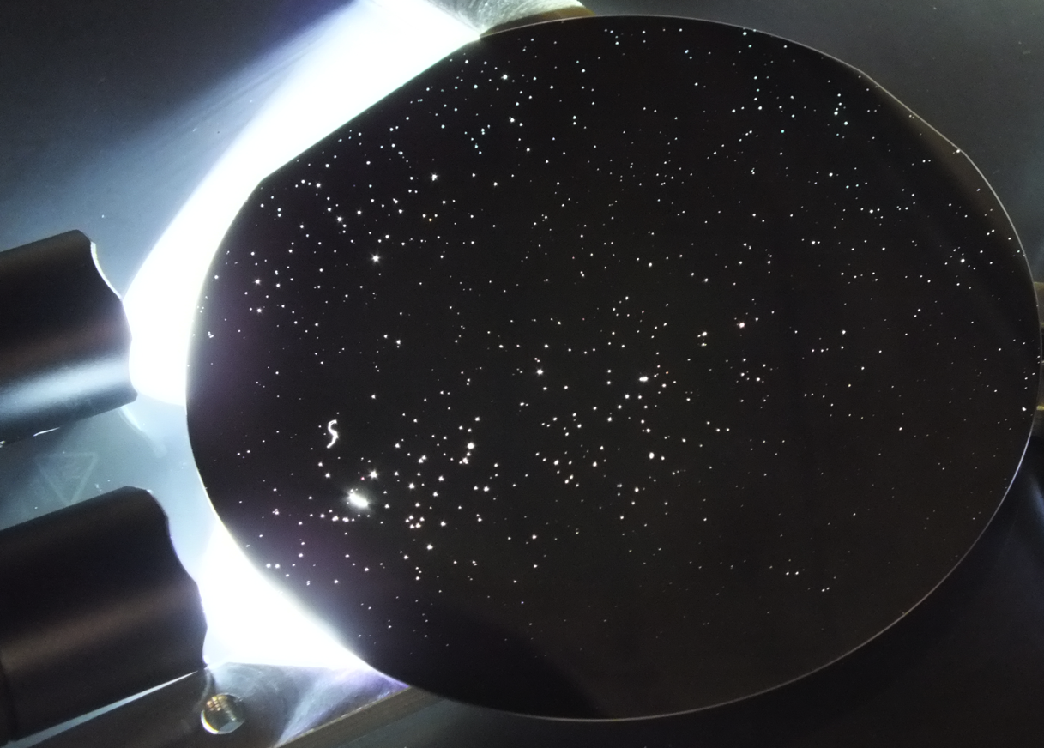
Telling a story…

Slide 8
LLO HAM2 History
Big clean – Wiped horizontal & vertical surfaces, inside of ISI, underneath support tubes, etc.
1-1.5 hrs per chamber
First clean – Basic wipe down.
~ 1 hour total
Pump down #1
(doors close)
Vent (doors open)
Big clean – Multiple wipe downs over 2 week period.
Pump down #4
Vent
Pump down #2
Vent
Pump down #3
Vent
1 cycle
Medium work
(PRM, ISS PD array, PR3 gluing)
Medium work
(PRM, ISS PD array, PR3 gluing)
1 cycle
Minimal work
1 cycle
Light work
(PR2/PR3 baffles)

Slide 9
LLO HAM2 Story
In front of PR3
In front of PR3
Cleaning as you go works!
In front of PR3
In front of PR3
Near PR3, N door (Vertical)
NW corner of table
N side of table (Vertical)
192
105
218
218
280
268
817

Slide 10
LHO BSC Stories
Feb – Oct 2013
1 cycle
Work in adjacent chambers
April – Oct 2013
1 cycle
Heavy work over wafer
Oct – Nov 2013
1 cycle
No work?
Need more samples to determine trends.
WBSC1 – Floor below ITMY
WBSC2 – Floor below baffle
WBSC3 – Floor below ITMX
230
316
598

Slide 11
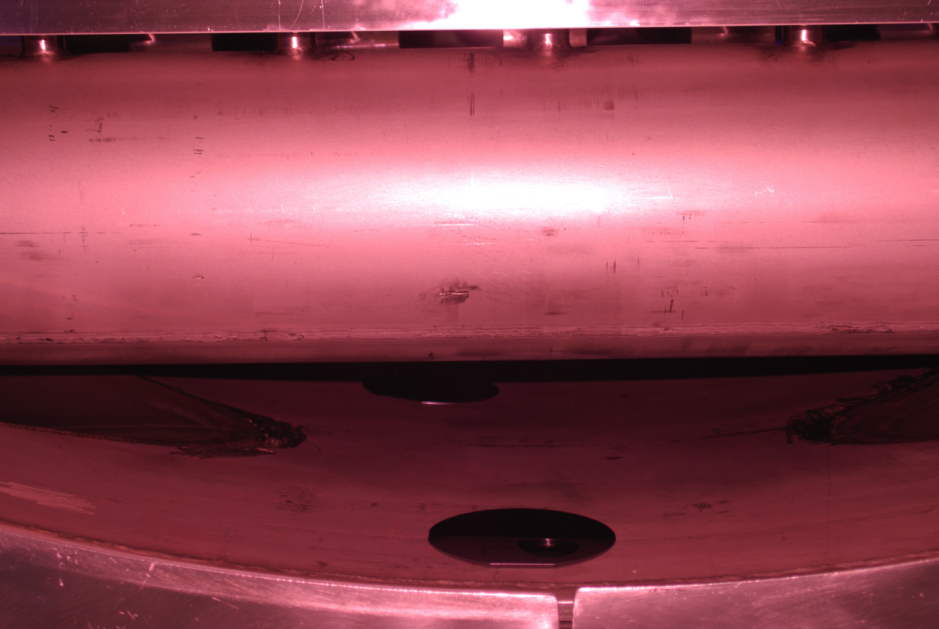
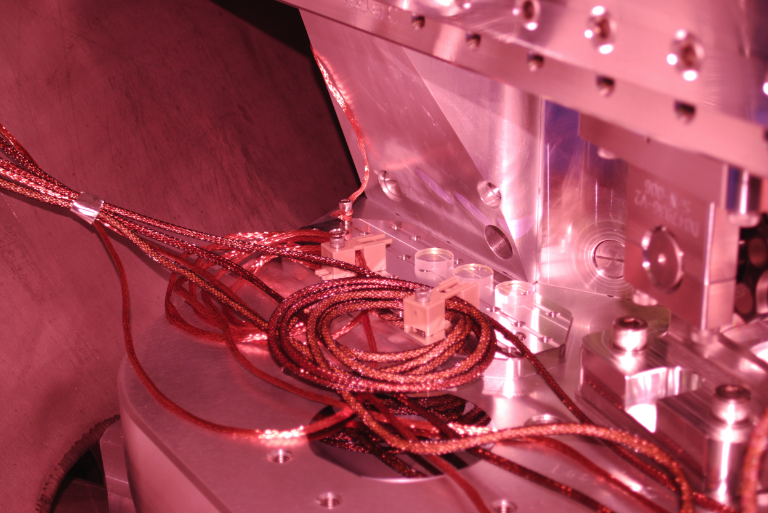
Total Wafers Collected
Need more samples from Hanford.
LIGO-T1300014: Aligo, BSC Flooring + HAM ISI, Witness Sample Placement Requirements

Slide 12
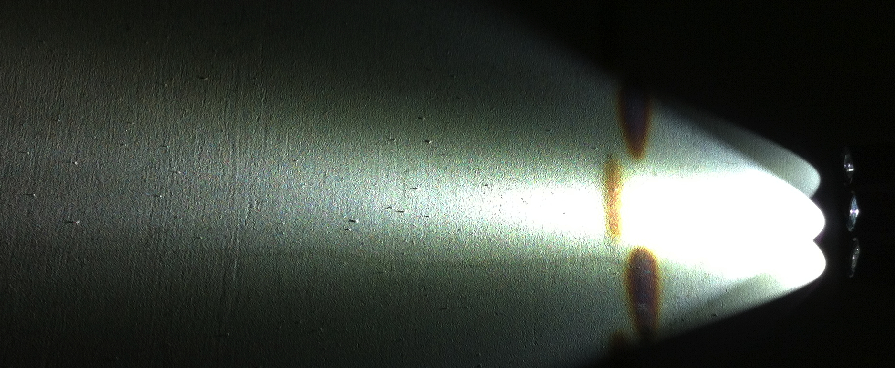
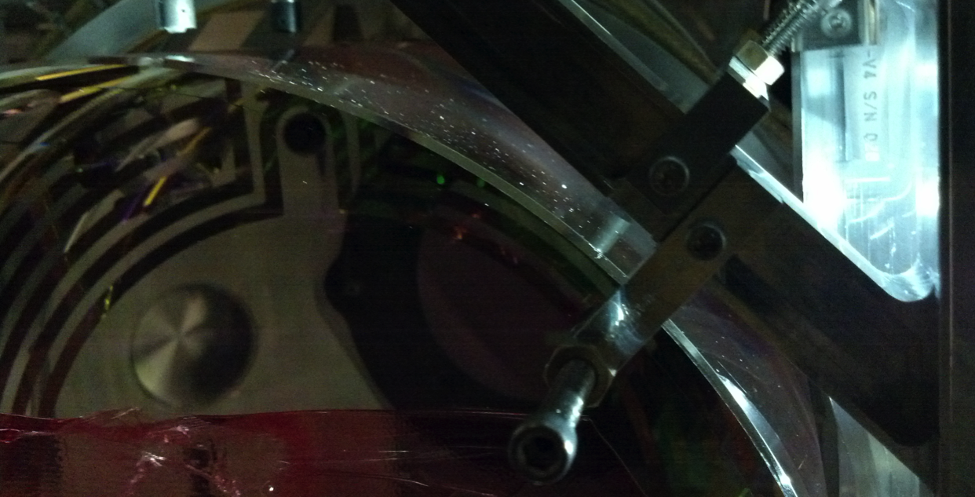
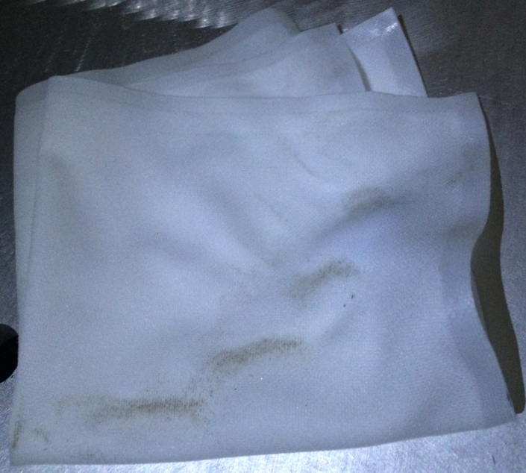
WBSC10 – March 2014

Slide 13
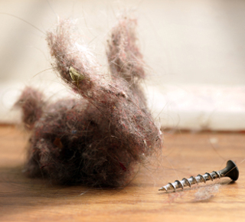
Contamination Control 101

Slide 14
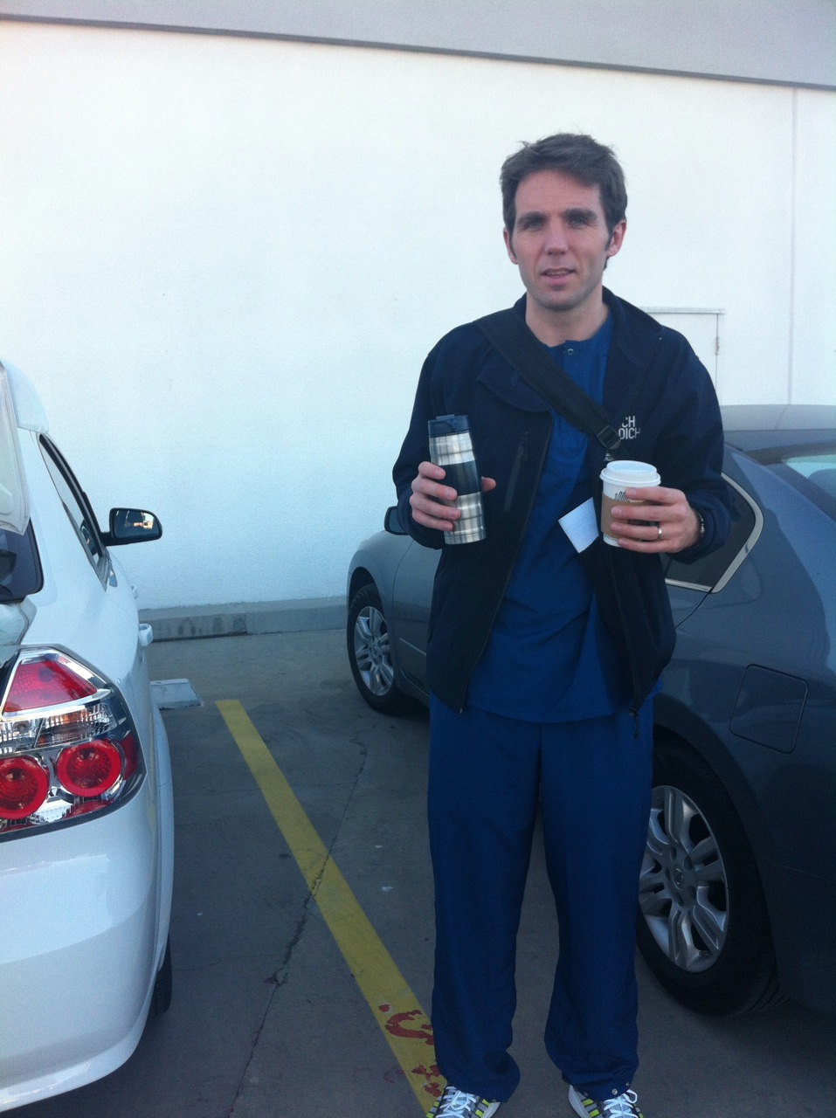
Scrubs
Why:
At least ½ class improvement
How:
Wear instead of street clothes
No special laundering requirements
Tailor if needed
When:
Required for all cleanroom work
Strongly encouraged for VEA work
* NOT a magical barrier against contamination! Refer to LIGO-E0900047 aLIGO Contamination Control Plan

Slide 15
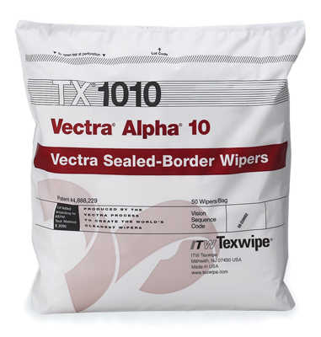
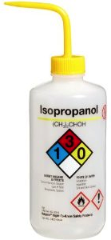
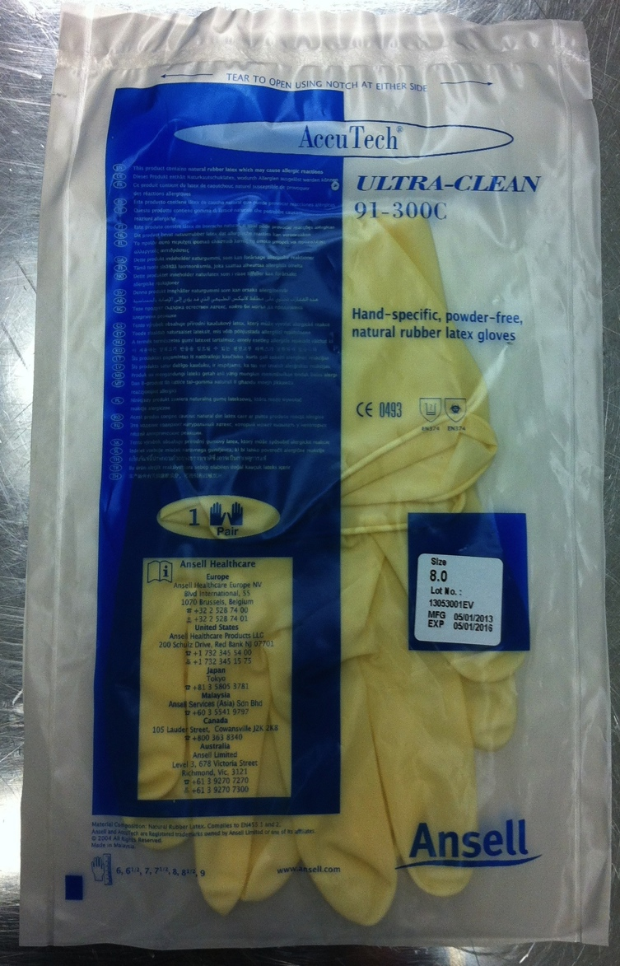
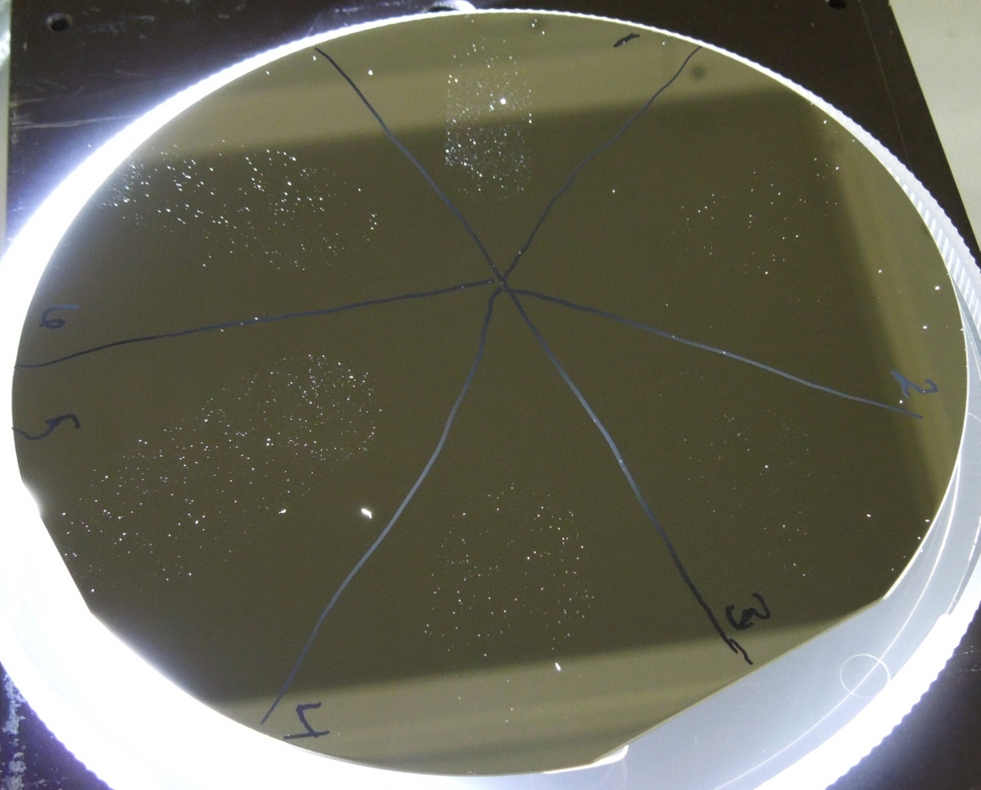
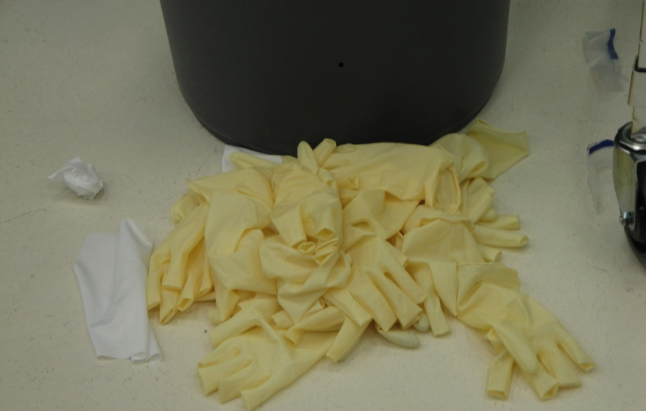
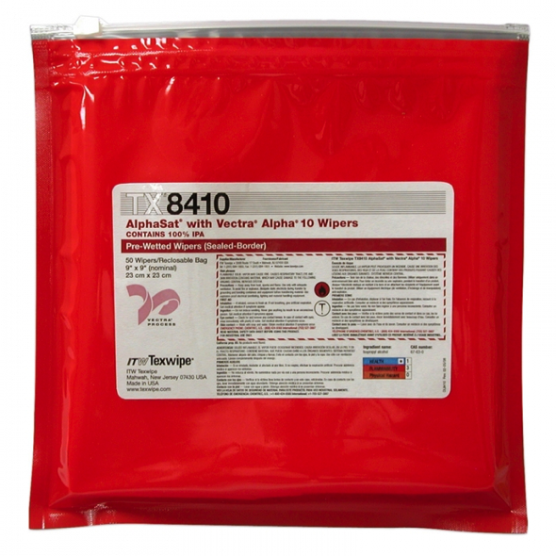
Glove Washing
Why:
Covered in particulates
How:
High purity IPA + wipe
Think peanut butter hands
When*:
After donning
If dirty
* Change if ripped or excessively dirty
OR

Slide 16
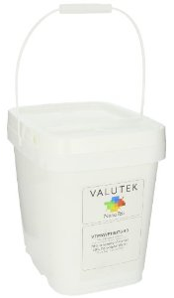
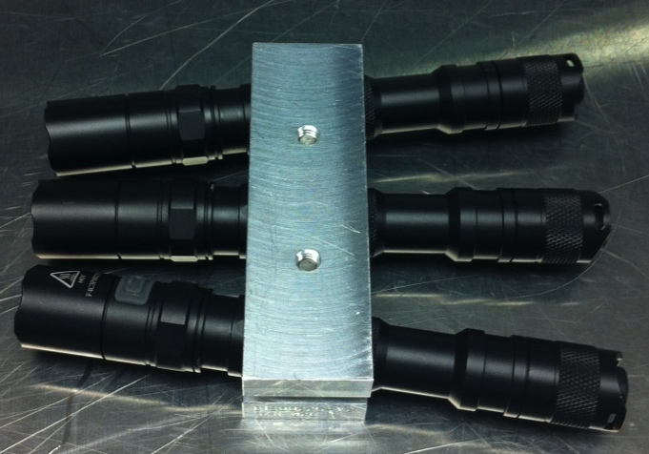
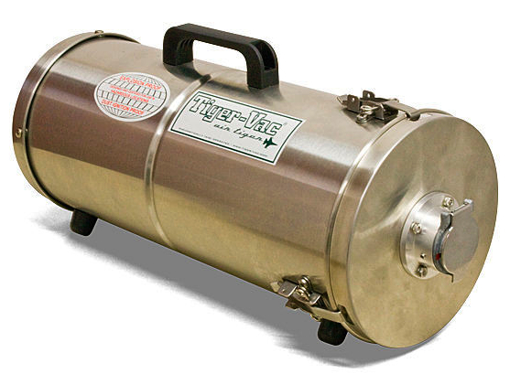
Clean as you go policy
Why:
Everyone contributes to problem
Everyone MUST contribute to solution
How (basic):
Inspect
Wipe
Vacuum
When:
GROSS
End of Work
Assembly
End of Assembly
Pre-Install
Post-Install
Pre-Chamber Close
CHAMBER

Slide 17
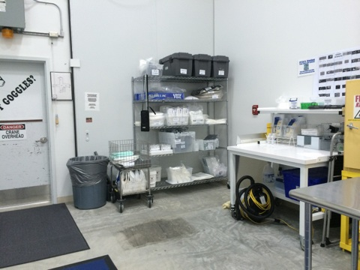
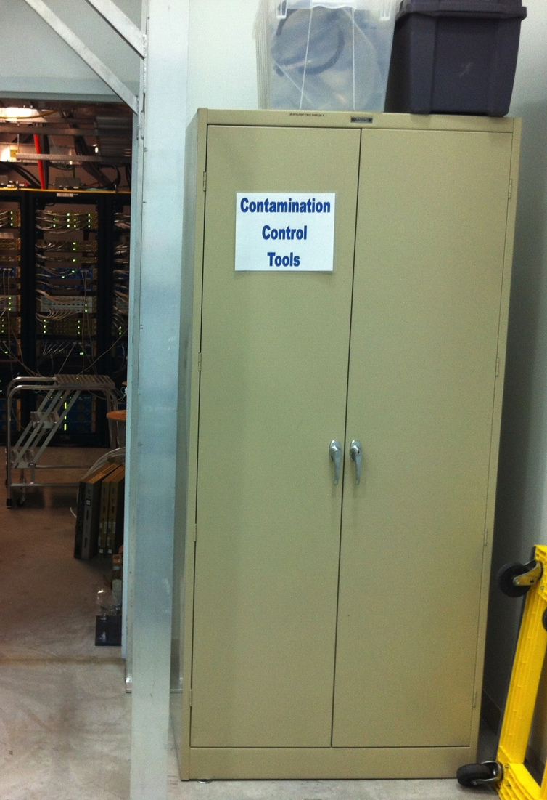
Contamination Control Supplies

Slide 18
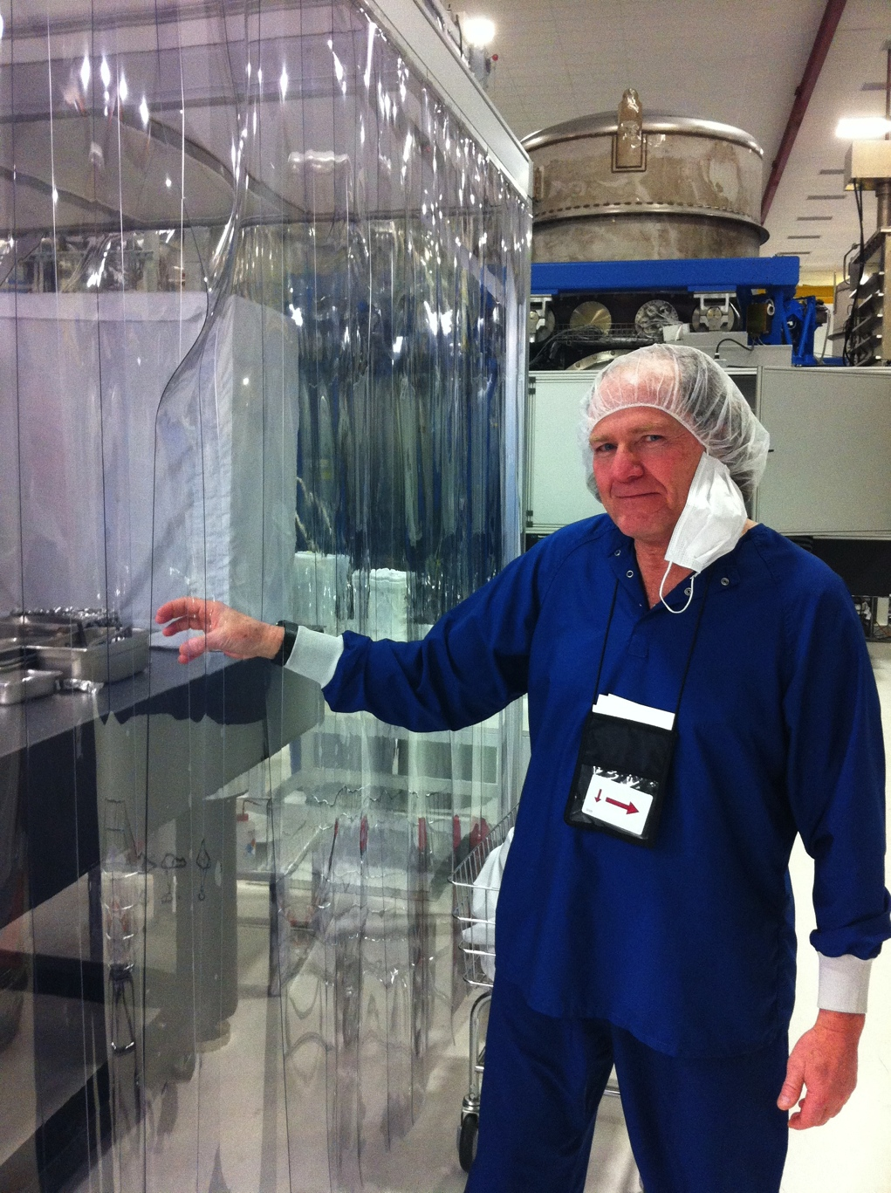
Common mistakes
What’s wrong with these pictures…

Slide 19
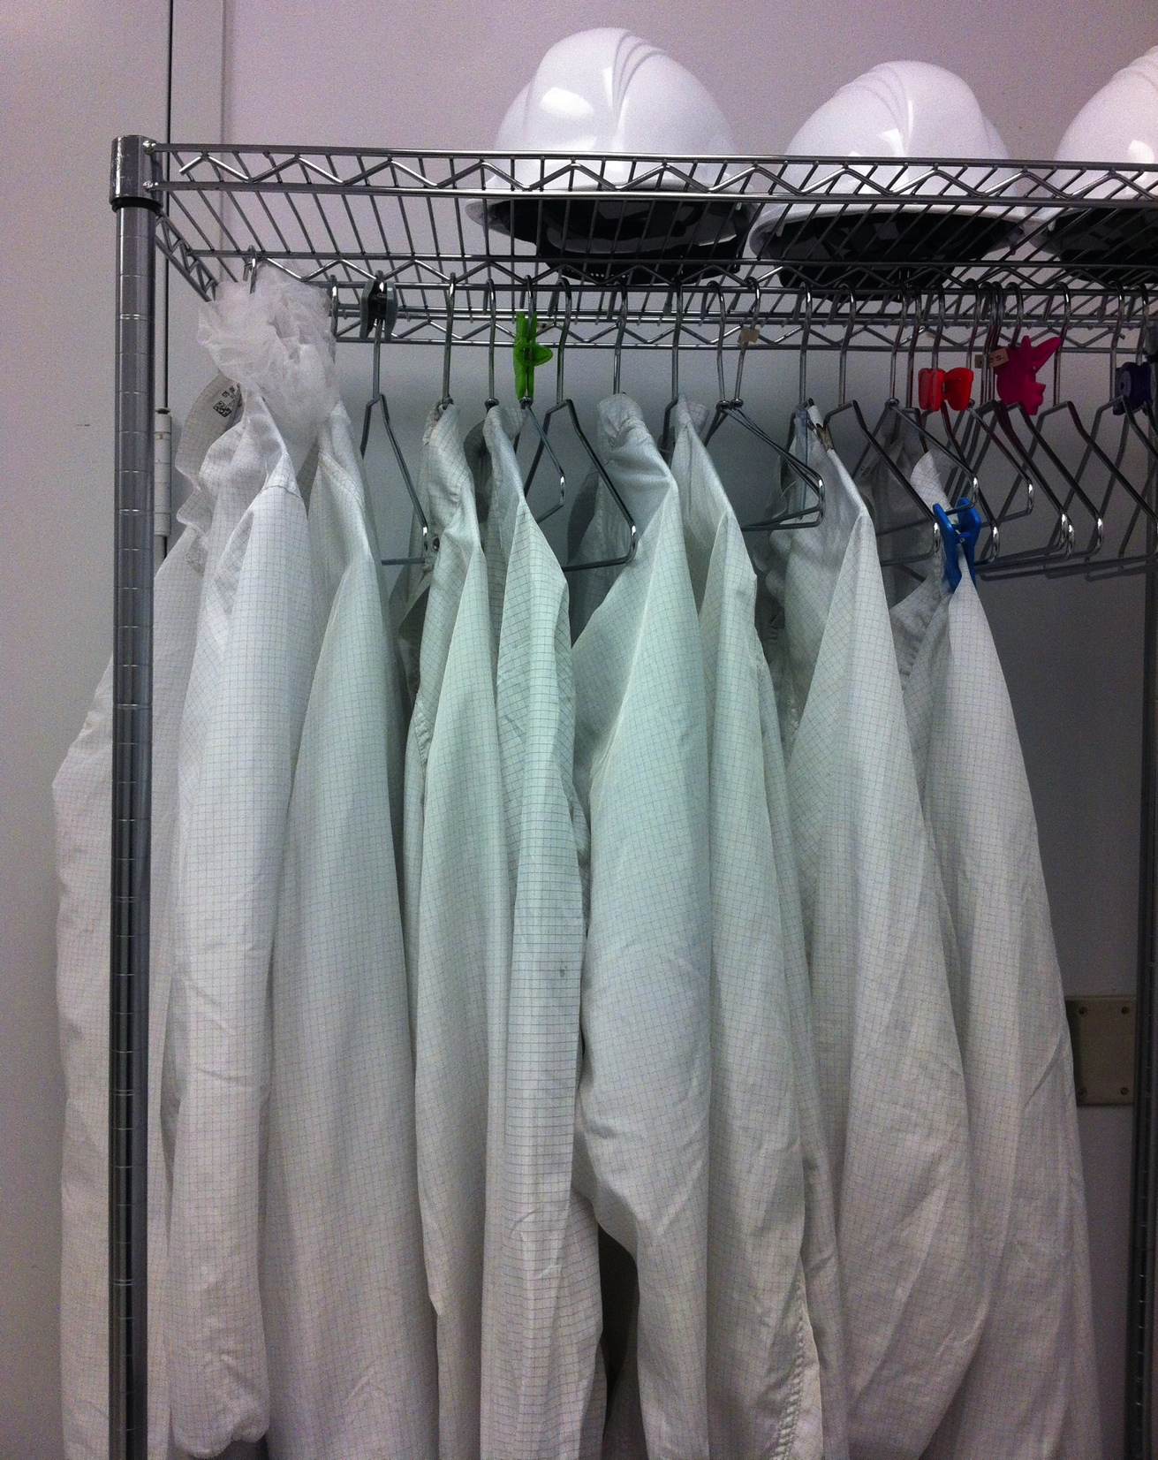

Slide 20
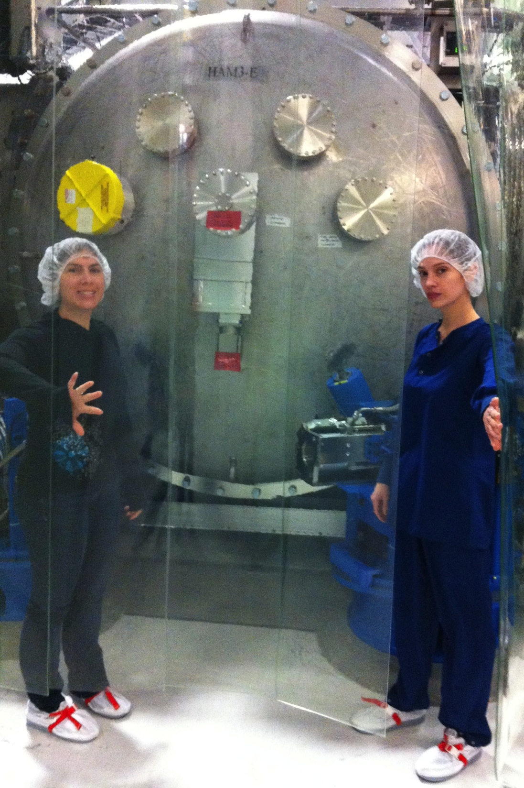
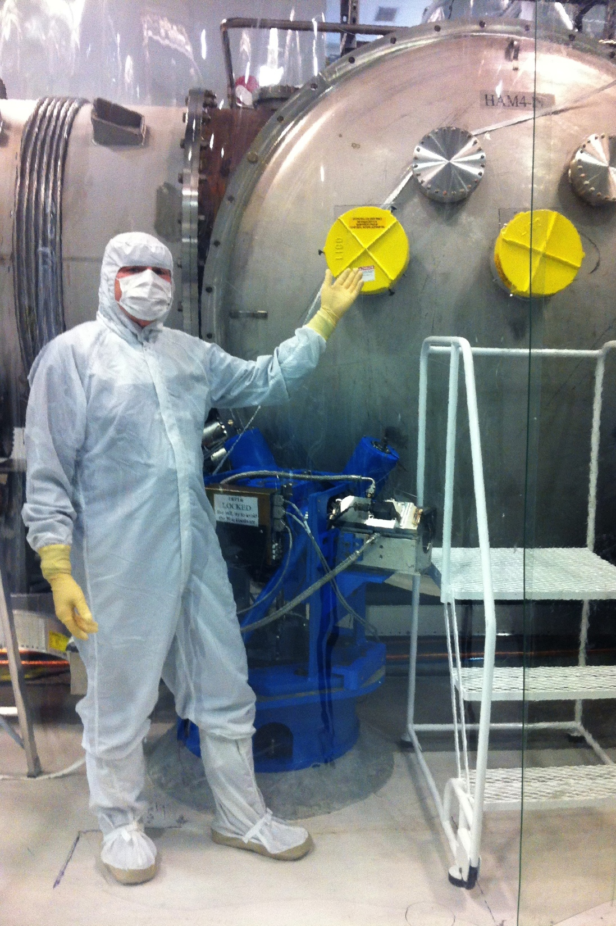
As shown ready for door removal.
If in to e.g. "clean" or other then skinny bunny okay but only when door or door cover is on.

Slide 21
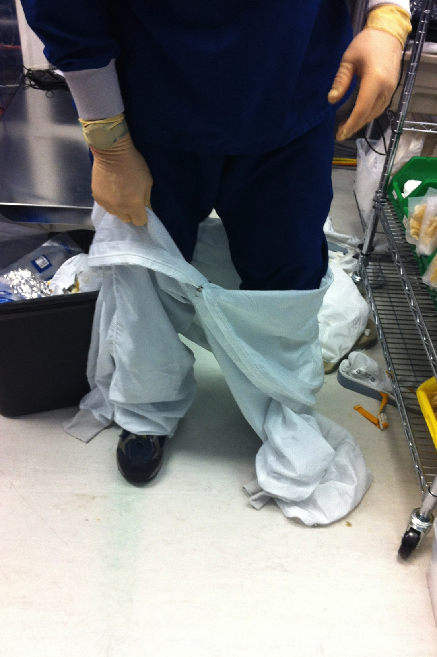
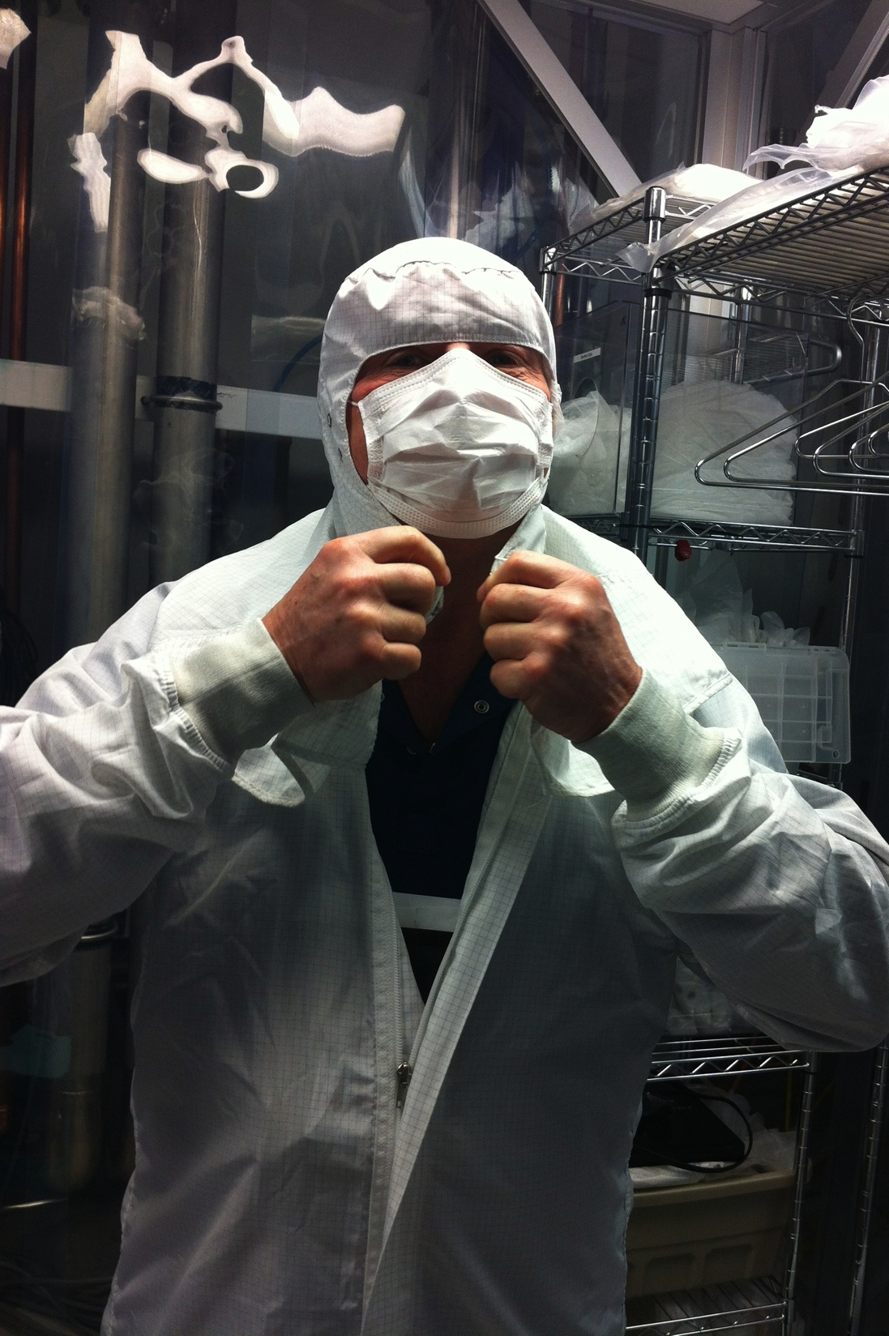

Slide 22
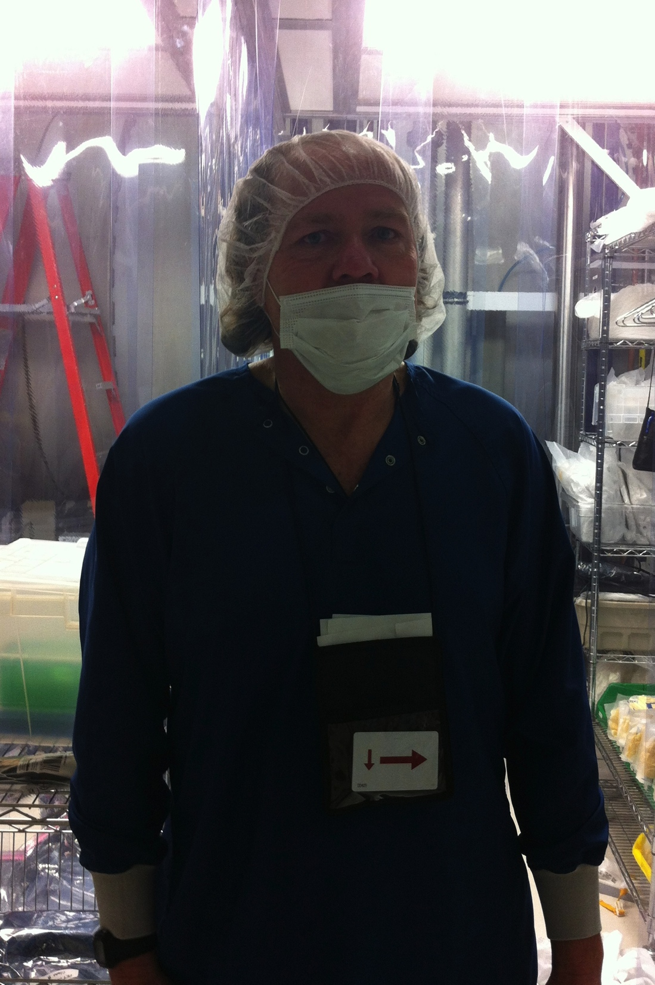
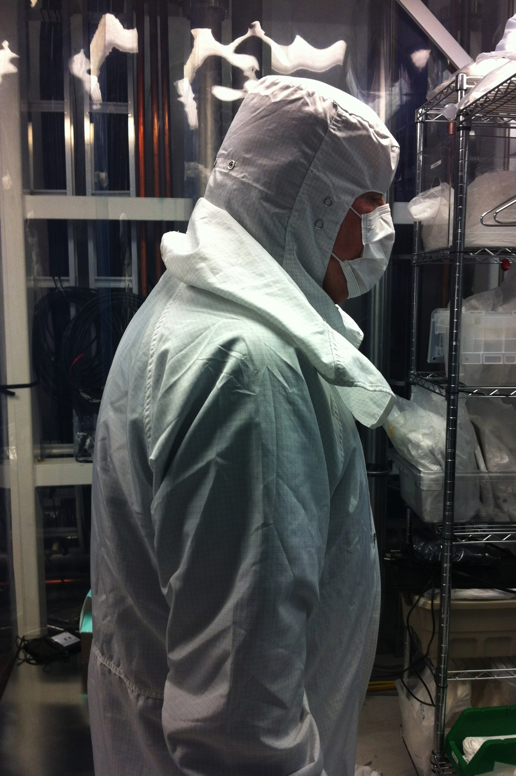

Slide 23
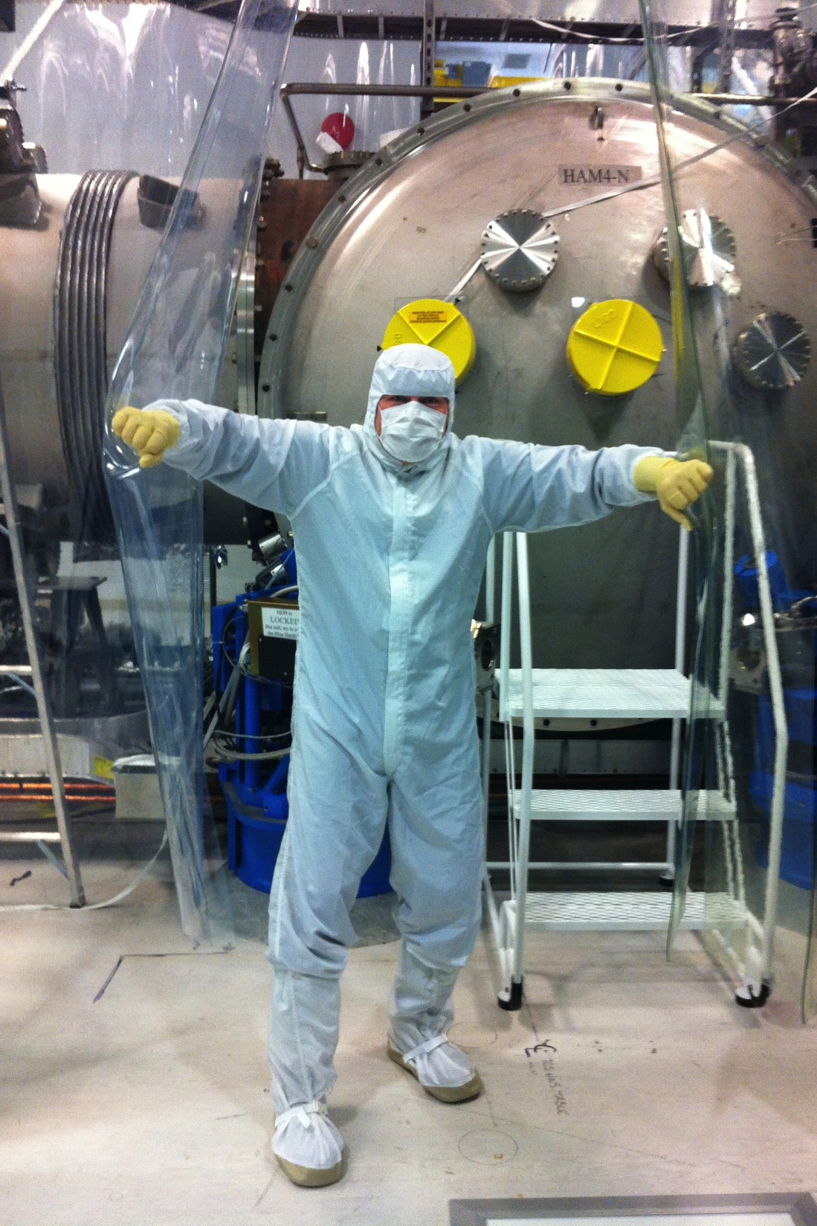
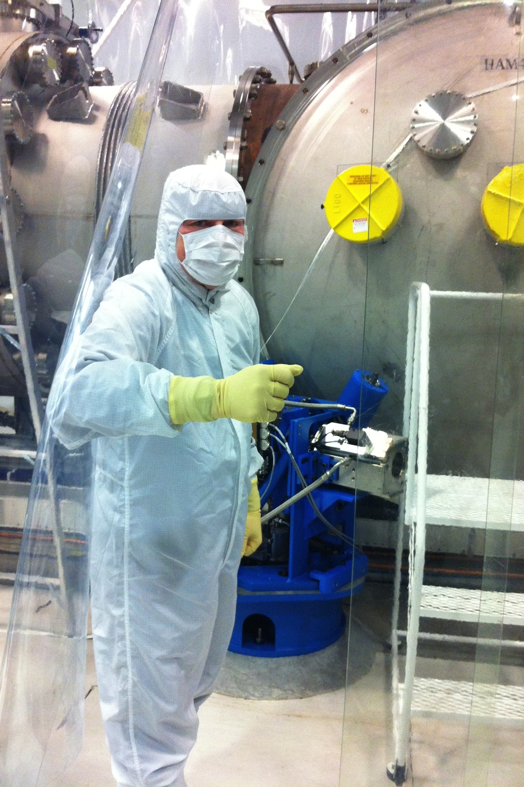

Slide 24
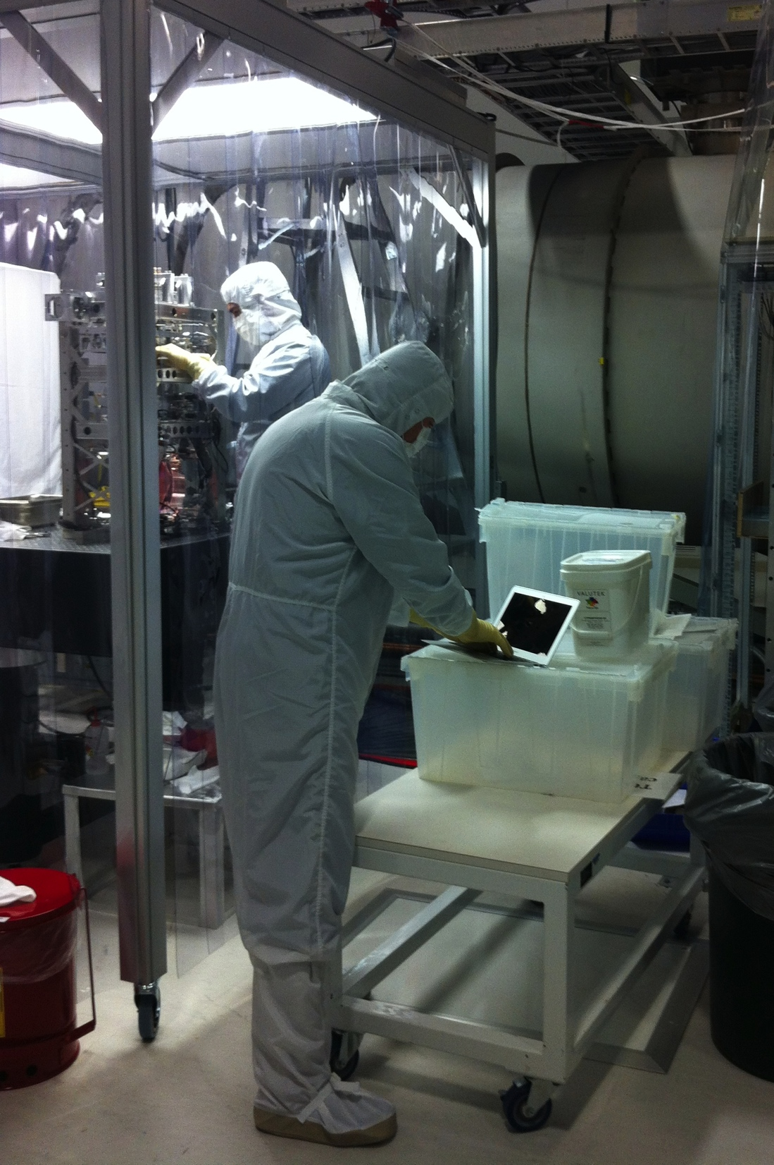

Slide 25
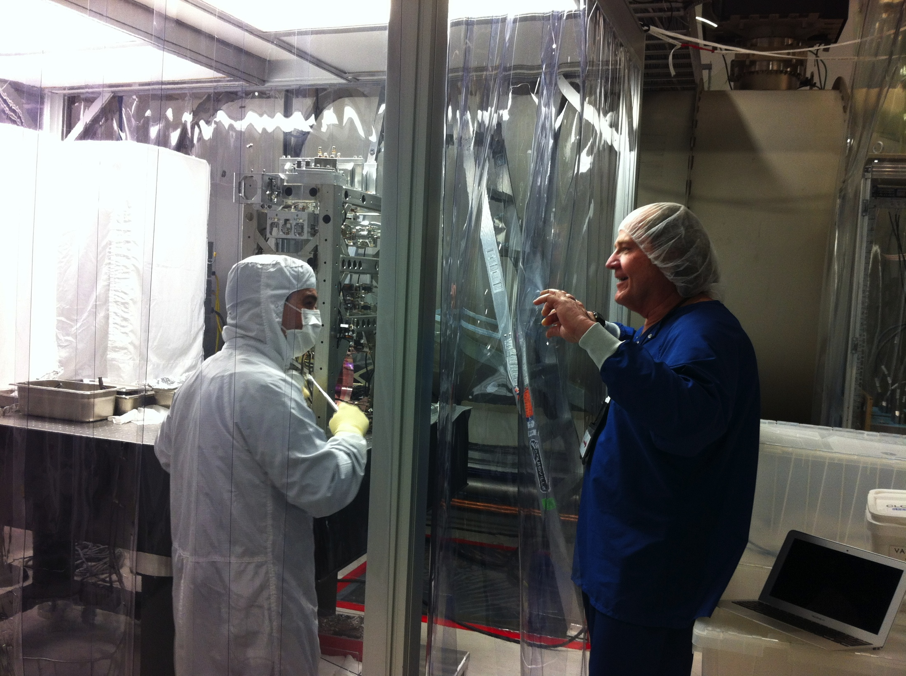

Slide 26
Questions or Concerns?
Local CC Czar:
Jeff Bartlett
Caltech:
Calum Torrie
Kate Gushwa

Slide 27
References
Contamination Control on the DCC and Wiki
LIGO-E1300953 aLIGO, Particulate Contamination
https://dcc.ligo.org/wiki/index.php/Engineering_for_LIGO/ContaminationControlWorkingGroup
Requirements
LIGO-T1300511 Some thoughts regarding Particulate Contamination Requirements
Talks
LIGO-G1301249 Hanford and Livingston Contamination Control Update Dec 2013-Jan2014
LIGO-G1400142: Summary of 4" Wafer Data
LIGO-G1300777 Contamination Control Requirements – Gloves, Cleaning on the Go and The Plan
Key Documents
LIGO-E0900047 aLIGO Contamination Control Plan
LIGO-E1201035 aLIGO Chamber Entry & Exit Procedures.
LIGO-E1201096 Contamination Sample Handling – How to receive, use, send, buy and store samples.
LIGO-T1300014: Aligo, BSC Flooring + HAM ISI, Witness Sample Placement Requirements
LIGO-L1300086 Contamination Control Guidance on Cleanroom Scrubs

Slide 28
Backup slides

Slide 29
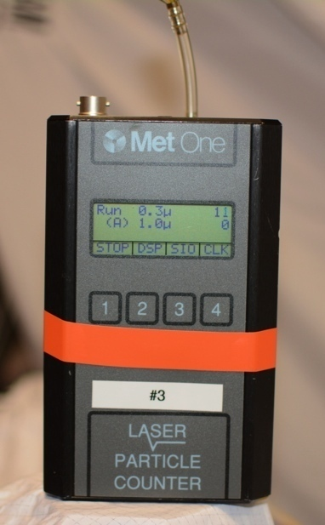
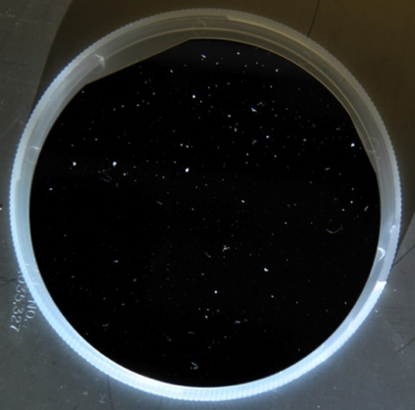
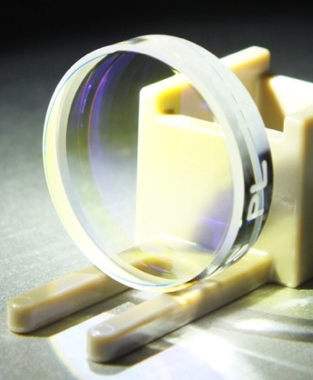
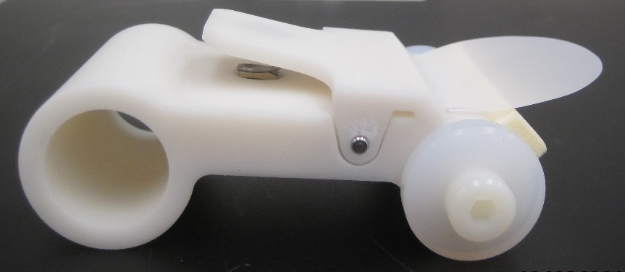
Defining Clean
Particles per:
Requirement:
Tool:
Cleanroom Class
Volume of air
ISO 5 (Class 100)
Particulate Cleanliness Level (PCL)
Area of surface
Level 65 (optics at full power)
Level 100 (chambers)
Notes:
Cleanroom Class:
What we have been using all along to determine cleanliness.
Surface Cleanliness Level:
What we should have been looking at (in addition to Cleanroom Class).
ONE of the tools, but not the only one.

