Slide 1
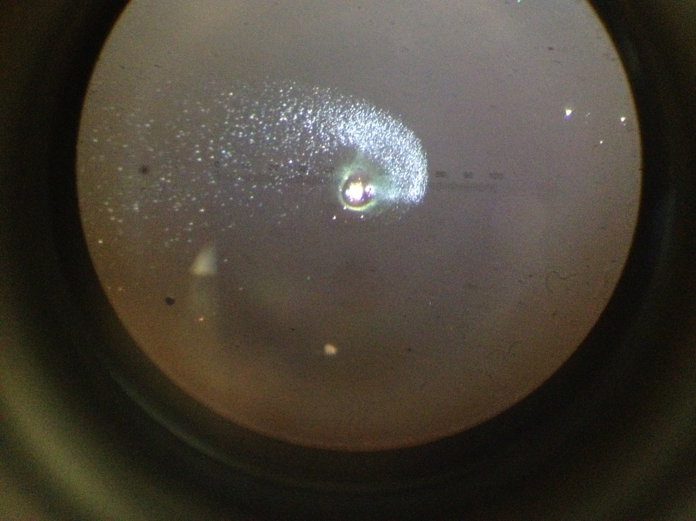
Laser Induced Damage due to Particulate Contamination
Billingsley, Gushwa, Phelps, Torrie, Zhang
LVC meeting March 2014

Slide 2
How clean should the LIGO optics be? At what power level will we see damage?
-Damage Testing-
1064 nm beam with a 50 µm waist is raster scanned over a 1 cm square area with 100% coverage in air
Samples: IBS coated, super polished, 1” fused silica

Slide 3
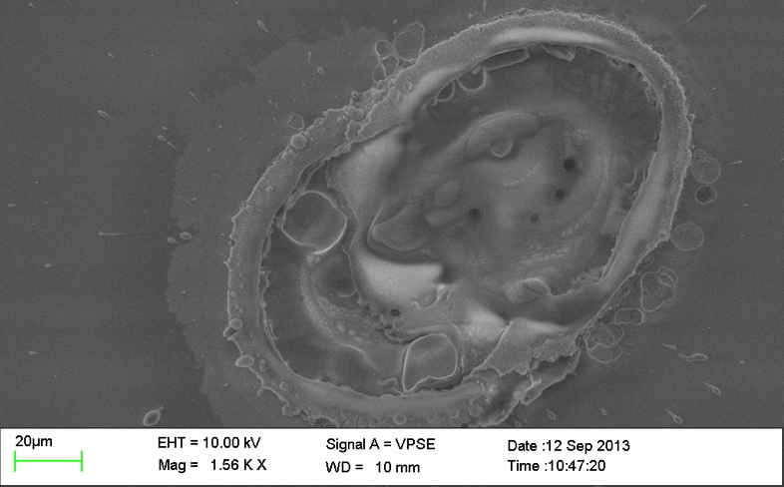
The Pits
Contamination (dust) melts the coating.
Onset of this effect at Average ~ 92 W/mm²
Average power density at full operating power:
Density at the ITM is 96 W/mm²
Density in the mode cleaner is 2 KW/mm²
https://services.ligo-wa.caltech.edu/integrationissues/show_bug.cgi?id=198

Slide 4
Observations
iLIGO – 2 mode cleaner optics have been examined
Pits with center defect surrounded by melted glass dots were found on 1 mode cleaner optic from LLO eLIGO.
The other mode cleaner optic showed a high density of small defects at the center, but no dots surrounded the defects.
“Safe” level ~ 40 W/mm²
Large particles and high power yield bigger pits
Clean room lab dust, blown with ion gun:
~ 240 W/mm2 produces ~100 µm pits
~ 100 W/mm2 produces ~ 2-20 µm pits

Slide 5
Observations 2
“Burnt” particles leave a residue that is not always removed by first contact (Plated metals?)
Not all burnt particles cause damage to the optic, some are completely removed by first contact cleaning.
Ionizing air gun does not remove all particles > 10 µm in size.
Great care must be taken to have a clean air gun system find ion gun reference LIGO-T1300687

Slide 6
A sampling of likely materials
Laser Induced Damage Test (LIDT)
• LIGO-T1300584: LIDT Optic: CIT Lab Dust and Top Gun
• LIGO-T1400162: LIDT Optic: Lab Dust and 160Weq
• LIGO-T1400163: LIDT Optic: FC Clean and Combination Dust
• LIGO-T1400164: LIDT Optic: 5um Al Dust
• LIGO-T1400165: LIDT Optic: 30um Al Dust
• LIGO-T1400166: LIDT Optic: Al Part Dust
• LIGO-T1400167: LIDT Optic: Cu Part Dust
• LIGO-T1400168: LIDT Optic: Ag Part Dust
• LIGO-T1400169: LIDT Optic: SSTL Part Dust
• LIGO-T1400170: LIDT Optic: C3 and cleanroom wipe fibers
• LIGO-T1400171: LIDT Optic: Cleanroom Glove
• LIGO-T1400174: LIDT Optic: Lab Dust and Top Gun
• LIGO-T1400175: LIDT Optic: Top Gun Debris

Slide 7
1 of 30 images at T1300933

Slide 8
A start on Theory
10 µm particles and larger are likely to cause damage according to a currently un-archived calculation by E. Gustafson. The damage calculation depends on assumptions of radiative or conductive heat transfer
T1300933 – particle zoo ~ irradiated at 88 W/mm²
A rich resource for someone interested in modeling this process!

Slide 9
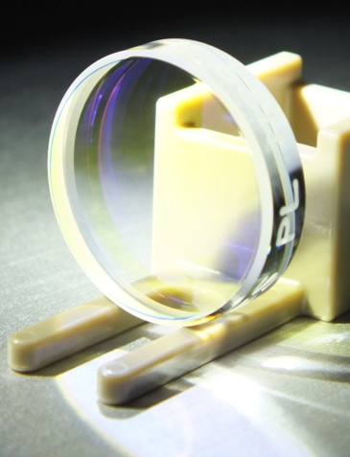
Data base of 1” optics placed in LIGO vacuum chambers
Statistics: LIGO-T1300987
Initial scan
Irradiation at 400 W/mm²
Post irradiation scan
First Contact cleaning
Final Scan
S A M P L E SE R I A L N U M B E R
S A M P L E SE R I A L N U M B E R
S A M P L E SE R I A L N U M B E R

Slide 10
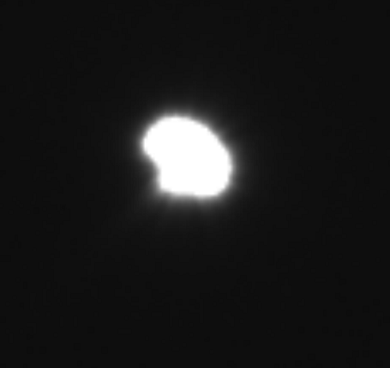
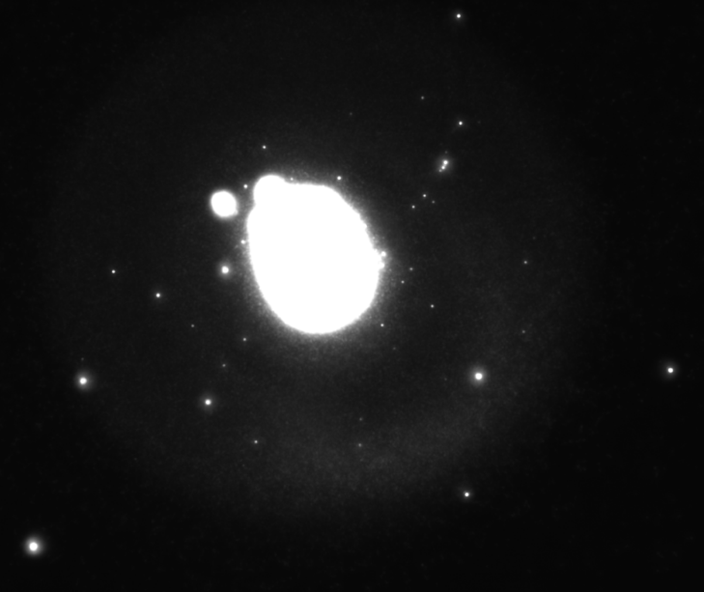
Damage on 1” Optic
Placed vertically near PR3 at LLO
Saw 1 cycle + work
Irradiated 5 mm x 5 mm area at ~400 W/mm²
Only 3 particles in 20 – 25 μm dia. range in image scan area (12.8 mm x 12.9 mm)
Makeup of particle – probably SSTL based on size and shape. Refer to LIGO-E1300147-v12
Refer to LIGO-T1300851-v2 and LIGO-T1300987-v5
Before
25 μm dia.
After
 | Initial Scan | Post Irradiation
Min Diameter (µm) | 1.0 | 1.0
Max Diameter (µm) | 32.0 | 41.4
Total Particles | 140 | 179
PCL | 207 | 244
Total Particle Area (µm²) | 4,069 | 6,060
Percent Area Coverage | 0.002% | 0.004%
Parts per Million | 25 | 37
40 μm dia.

Slide 11
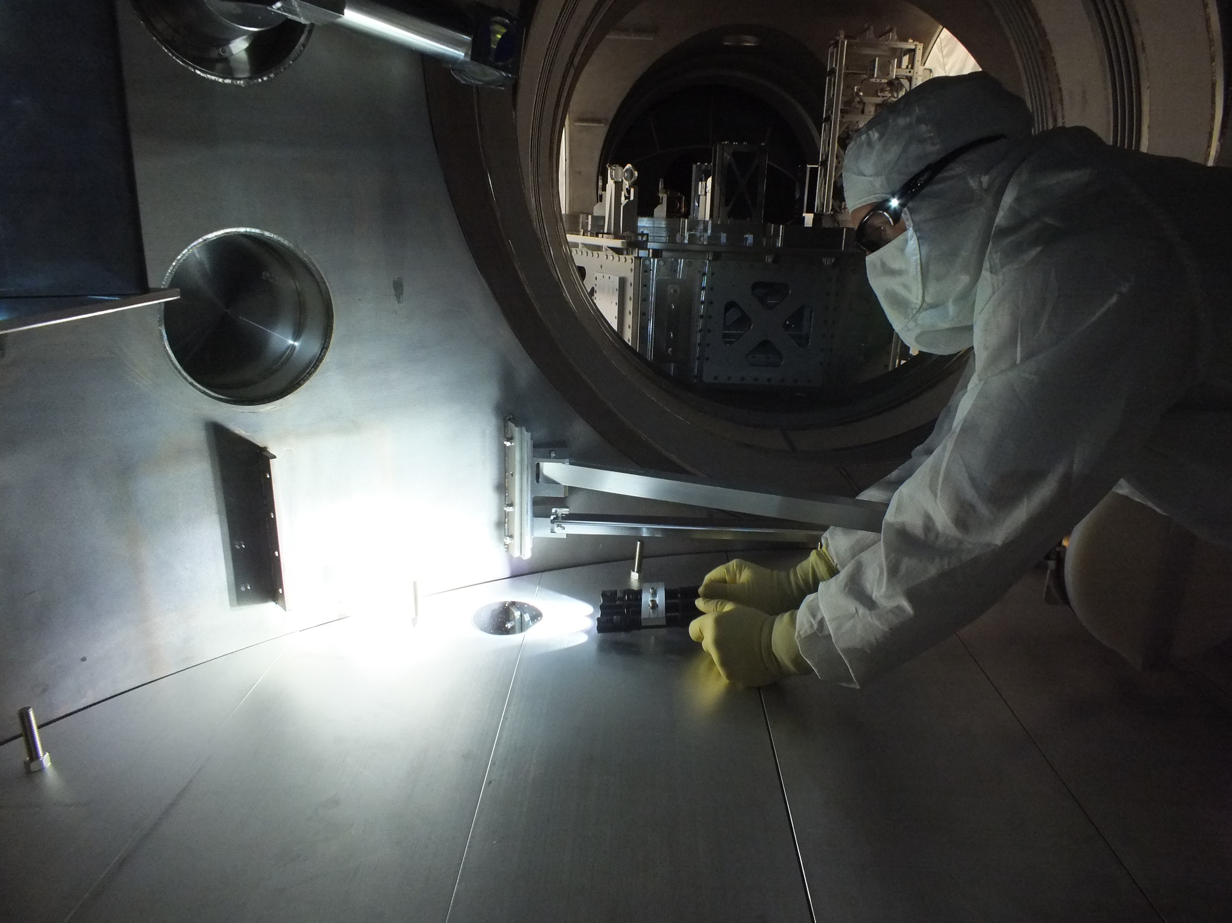
In Chamber Mitigation
LIGO-G1301249 Contamination Control – Clean as you go!
Tools for testing and reducing the particulate count in vacuum chambers

Slide 12
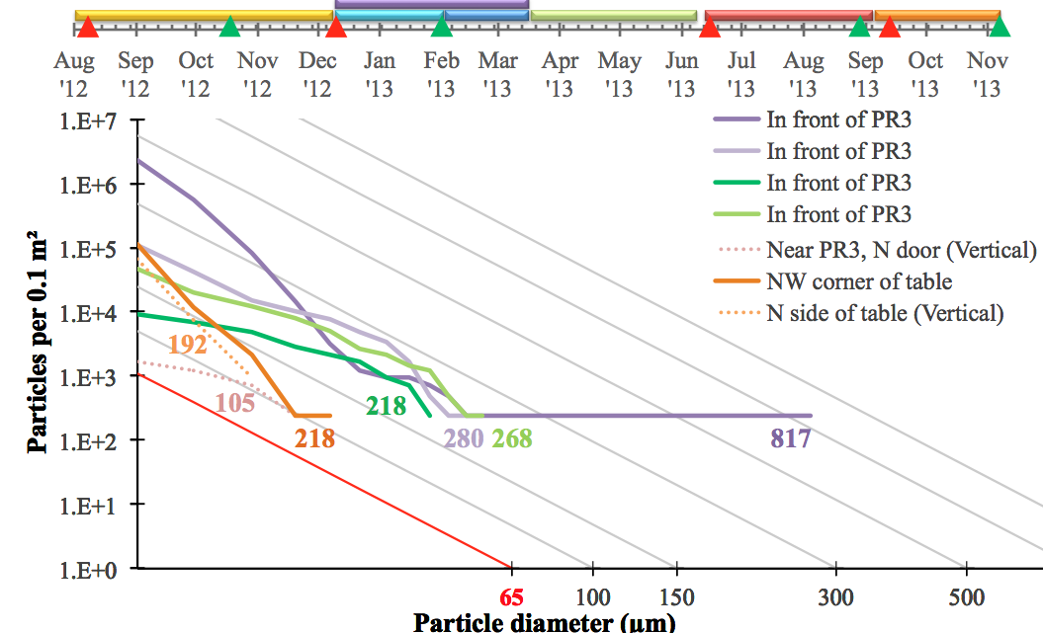
Progress is quantifiable
LIGO-G1400142

